Slide 1
Wekiva Basin Working Group Meeting
December 16, 2011

Slide 2
Brief review of previous meeting information

Slide 3
Wekiva Basin Nitrate & TP TMDLs
  Targets (“assimilative capacity”)
  Nitrate Target = 0.286 mg/L
  TP Target = 0.065 mg/L

Slide 4
Wekiva Basin % Reductions
Waterbody | Nitrate | TP
Wekiwa Spring | 79% | 64%
Upper Wekiva River | 68% | 61%
Lower Wekiva River | 47% | 57%
Rock Spring | 81% | 23%
Rock Spring Run | 63% | 58%
Blackwater Creek | 52% | 36%
Little Wekiva River | 59% | 78%
*Little Wekiva Canal requires a total nitrogen reduction of 45%
* TMDL also identifies load reductions for the Yankee Lake WRF, Wekiva Hunt Club WWTF, and Altamonte Springs WRF.

Slide 5
Phased BMAP Approach
Schedule: The TMDL reductions will be achieved over a 15-year period.
The first iteration of the BMAP will cover a 5-year period.
This iterative approach allows for project implementation to achieve reductions while monitoring occurs to better understand the springshed/watershed.

Slide 6
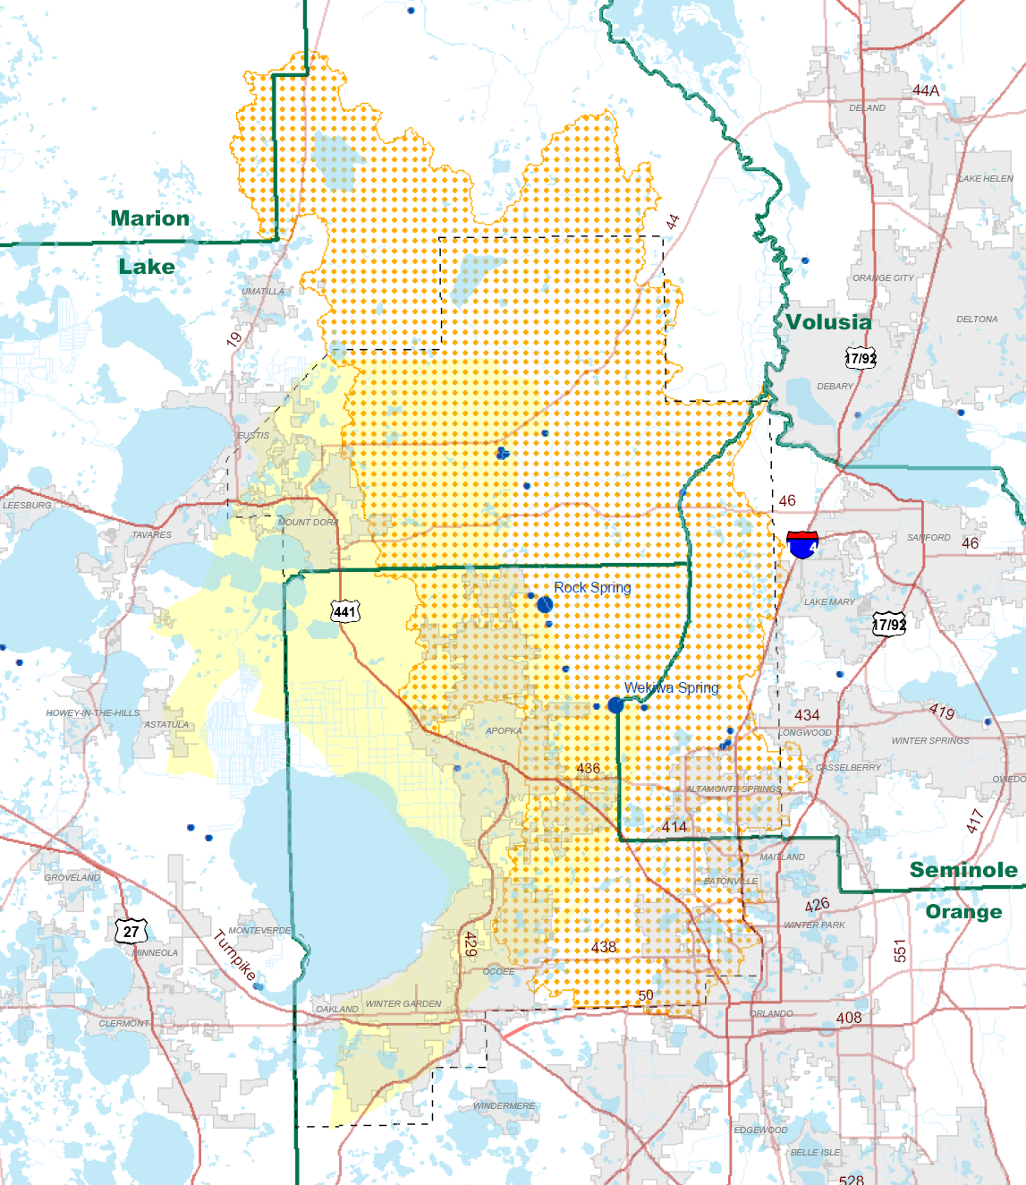

Slide 7
BMAP Stakeholders
Astatula
Eustis
Expressway Authority
Mount Dora
Oakland
Tavares
Winter Garden
Altamonte Springs
Apopka
Eatonville
FDACS
FDOT
Florida Turnpike
Lake County
Maitland
Marion County
Ocoee
Orange County
Orlando
Seminole County

Slide 8
Sources of Nitrate Loadings to the Wekiva Basin
Fertilizer (Residential, Agriculture, Gold Courses)
OSTDS
WWTFs
Livestock
Atmospheric
Natural or unattributed
-Wekiva River Basin Nitrate Sourcing Study, MACTEC 2010

Slide 9
WWTF Changes: Wekiva Parkway and Protection Act
Primary Protection Zone
  No new RIB Systems or restricted access sprayfields
  New reclaimed water limit:
    Existing RIBs – 3 mg/L Total Nitrogen
    Reuse Irrigation Systems – 10 mg/L Total Nitrogen
    Package Plants – 10 mg/L Total Nitrogen or connect
  No residuals land application sites
- Rule 62-600.550, FAC

Slide 10
WWTF Changes: Wekiva Parkway and Protection Act (cont’d)
Secondary Protection Zone
  New RIB systems are allowed
  New reclaimed water limits:
    Existing RIBs – 6 mg/L Total Nitrogen
    Reuse irrigation systems – 10 mg/L Total Nitrogen (including RIBS as back-up to reuse)
    Package Plants – 10 mg/L Total Nitrogen or connect
- Rule 62-600.550, FAC

Slide 11
WWTF Changes: Wekiva Parkway and Protection Act (cont’d)
Tertiary Protection Zone
  Meet existing regulations
- Rule 62-600.550, FAC

Slide 12
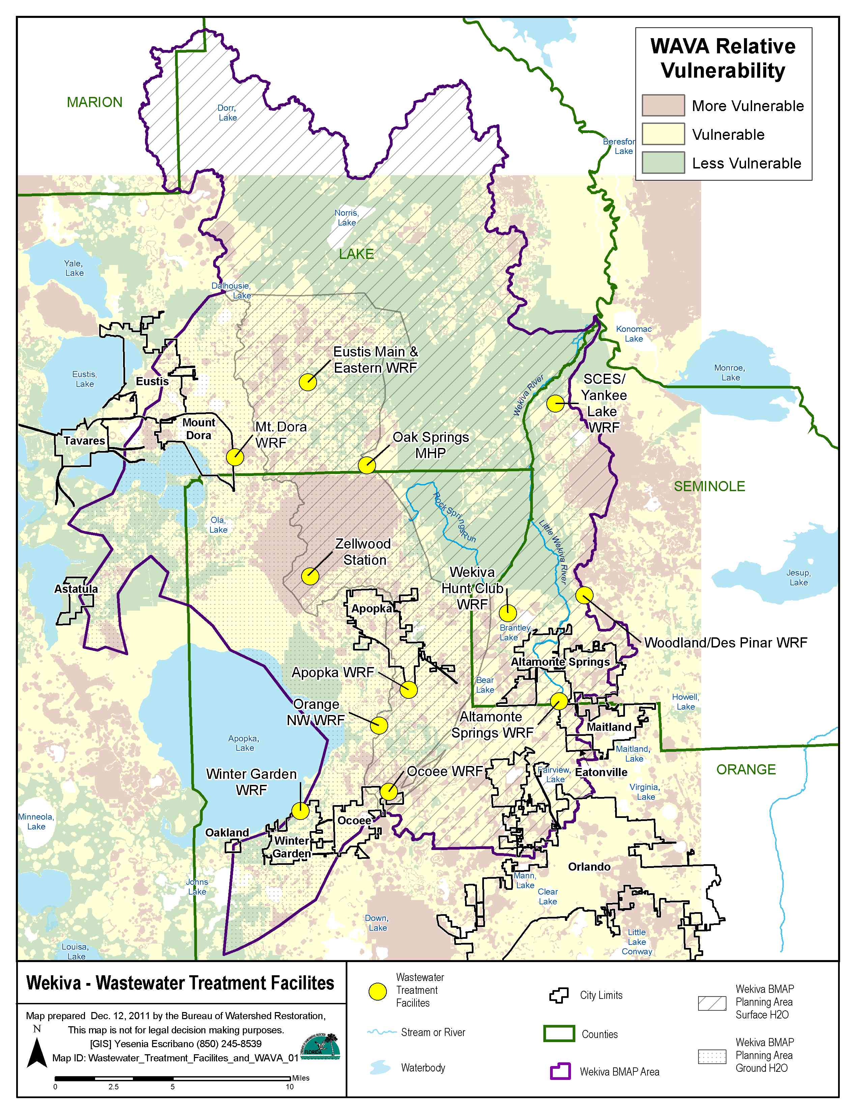

Slide 13
Previous meeting information, presentations, handouts, meeting summaries, and reference documents can be found on the FDEP’s ftp site:
http://publicfiles.dep.state.fl.us/DEAR/BMAP/Wekiva/

Slide 14
Non-WWTF Project Submittals

Slide 15
Types of Projects Accepted to Demonstrate Sufficiency of Effort
Retention BMPs (such as basins and exfiltration trenches);
Wet detention ponds;
Treatment trains;
Dry detention;
Baffle box (1st generation);
Nutrient baffle box (2nd generation);
Catch basin inserts/inlet filters;
Grass swales – both with and without swale blocks or raised culverts; and
Alum injection
Stormceptor units;
Continuous deflective separation (CDS) units (phosphorus reductions only);
Public education and outreach efforts; and
Street sweeping

Slide 16
Quantitative detailed allocation is not appropriate due to 3 primary factors:
1) With impaired springs, consideration of activities in the springshed is necessary
2) Quantification of denitrification in soil and groundwater is not possible at the scale necessary for entity-specific allocations
3) A portion of the Wekiva/Rock springshed extends beneath surface watersheds that drain to other basins

Slide 17
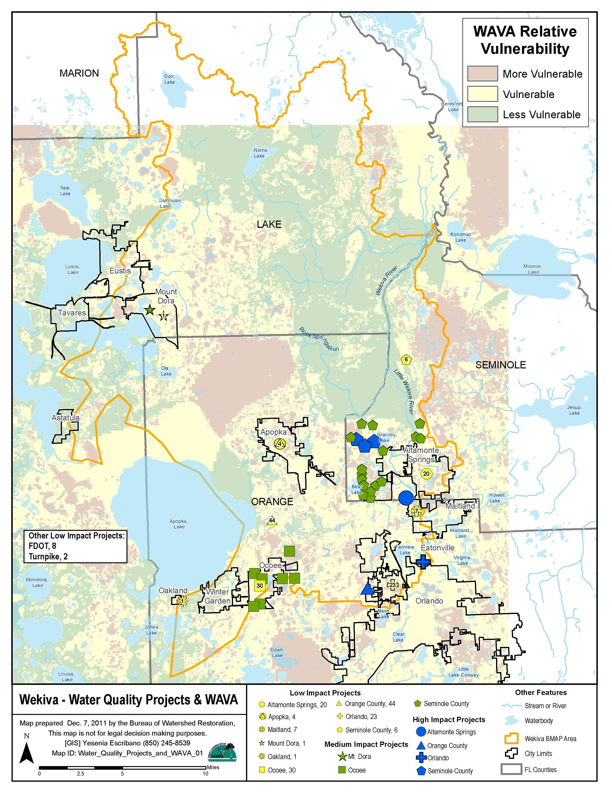

Slide 19
Additional Stakeholder Projects due on January 6, 2012
Additional projects required from:
  City of Apopka
  City of Eatonville
  City of Eustis
  City of Maitland
  City of Winter Garden
  Lake County
  Expressway Authority
  Clarification for submitted projects:
    Altamonte Springs, Maitland, and FDOT

Slide 20
Questions?

Slide 21
BMAP Monitoring Plan

Slide 22
Nine Elements of a BMAP
Identification of Pollutant Sources & Causes of Impairment
Estimation of load reductions from management measures
Description of management measures to achieve load reductions and critical locations
…
Monitoring component to evaluate effectiveness of the implementation efforts over time as measured against the established criteria

Slide 23
Purpose of the BMAP Monitoring Plan
The main purpose of the BMAP monitoring plan is to track trends in water quality to show progress towards achieving the TMDLs.
Other objectives can be identified and addressed through the BMAP monitoring plan.

Slide 24
Existing Monitoring in the Basin
The first step in developing the monitoring plan is to identify current monitoring in the basin.
The existing monitoring locations will be compiled into maps for discussions on which stations are key for the BMAP monitoring network and to identify where there are gaps in the network.
A spreadsheet has been provided to submit monitoring station information.

Slide 25
Existing Monitoring, continued
Review of the monitoring spreadsheet:
      Sampling Entity
      Station Number
      Station Name
      Station Location Description
    Station Type (surface water flow, surface water quality, spring discharge, MS4 discharge, groundwater, or other)
      Lat/Long

Slide 26
Existing Monitoring, continued
Review the monitoring collection sheet:
  Begin Date/End Date
  Sample Type [water quality (grab, storm event, or continuous), biological, or other]
  Sampling Frequency
  Sampling Parameters
Information on existing monitoring stations is due by January 6, 2012.

Slide 27
Monitoring Plan Objectives
The second step in developing the monitoring plan is to determine the objectives of the plan.
Draft primary and secondary objectives have been prepared for discussion.
Primary objectives are necessary to evaluate success of the BMAP.
Secondary objectives contribute to this evaluation, can help interpret data collected, and provide information for potential future refinements of the TMDL and/or BMAP.

Slide 28
Draft Monitoring Plan Objectives
The following objectives were drafted for discussion:
Primary Objective: Long Term Trend Analysis
    Track inputs and concentration trends in TN and TP loads through groundwater , surface water, and MS4 sampling.
Secondary Objective: Source Assessment
    Identify areas within the springshed/watershed with high loadings of nutrients to surface water and groundwater to better focus management efforts

Slide 29
Presentation materials and forms can be found:
http://publicfiles.dep.state.fl.us/DEAR/BMAP/Wekiva

