Slide 1
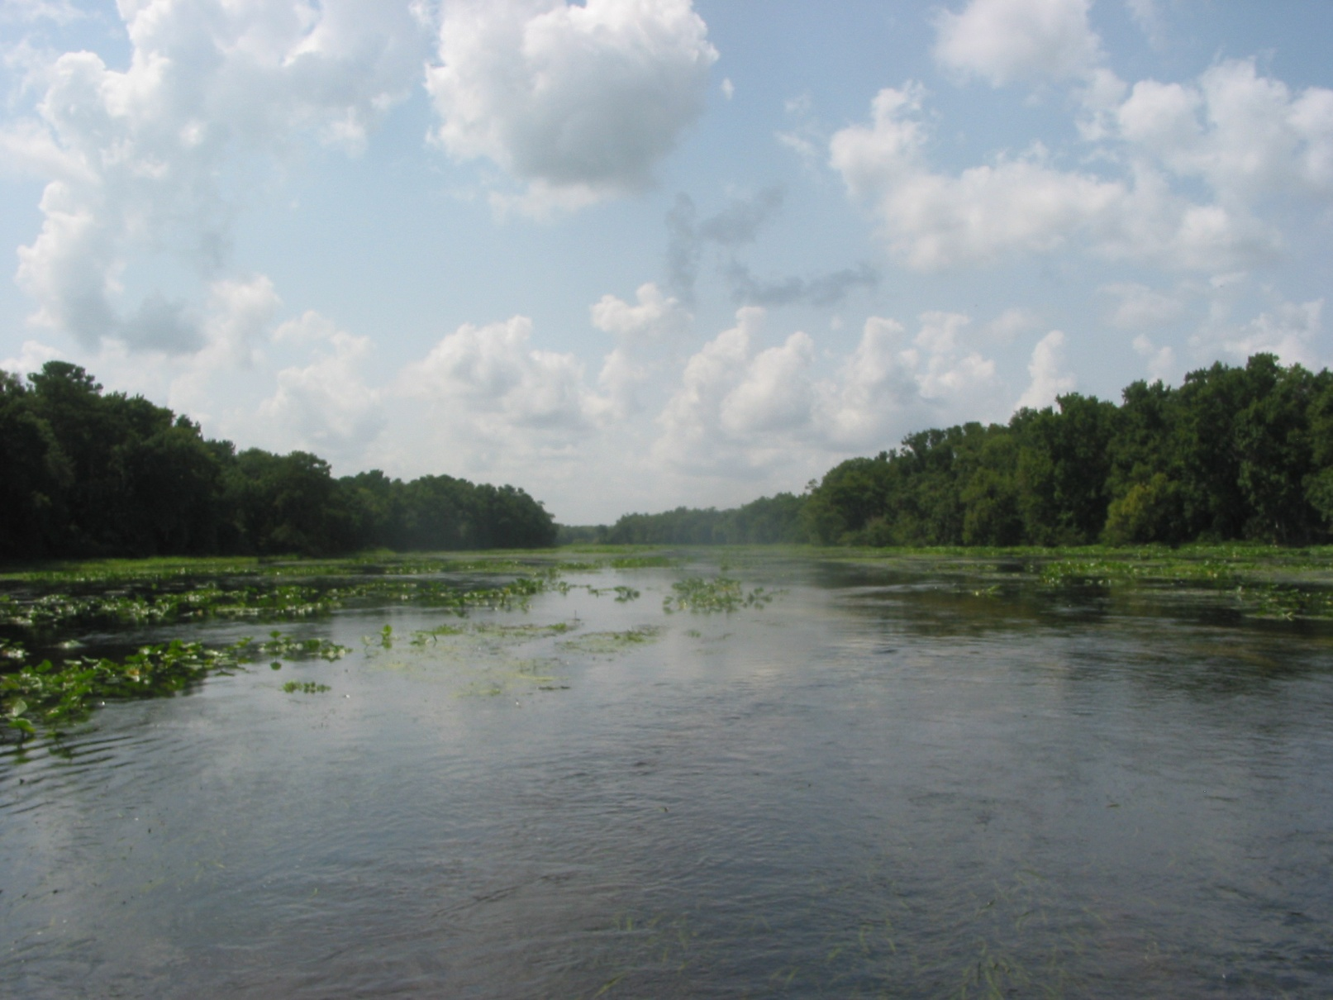
Water Quality in the Wekiva River System
Current Status and Selected Trends
Wekiva BMAP Basin Working Group 17 February 2012
Robert A. Mattson, CEP, CSE Bureau of Environmental Sciences

Slide 2
Water Quality Monitoring* in the Wekiva River System
SJRWMD – SWIM related and ambient for FDEP; groundwater
Seminole County (ambient surfacewater)
Orange County (surface and groundwater)
FDEP Florida Geological Survey – Springs
FDEP Central District – ambient/SCI monitoring; 5-yr assessments of NPDES permits
USGS (historical)
* - “regional”, ambient monitoring

Slide 3
TMDL Targets and Reduction
Nitrate-Nitrite | Rock Springs | Rock Springs Run | Wekiwa Springs | Upper Wekiva River | Lower Wekiva River
Existing Mean (highest nitrate monthly mean - mg/L) | 1.50 | 0.77 | 1.34 | 0.88 | 0.54
Target Nitrate Concentration (mg/L) | 0.286 | 0.286 | 0.286 | 0.286 | 0.286
Percent Reduction | 81% | 63% | 79% | 68% | 47%
Total Phosphorus | Rock Springs | Rock Springs Run | Wekiwa Springs | Upper Wekiva River | Lower Wekiva River
Existing (highest TP monthly mean – mg/L) | 0.084 | 0.153 | 0.181 | 0.168 | 0.150
Target TP Concentration (mg/L) | 0.065 | 0.065 | 0.065 | 0.065 | 0.065
Percent reduction | 23% | 58% | 64% | 61% | 57%

Slide 4
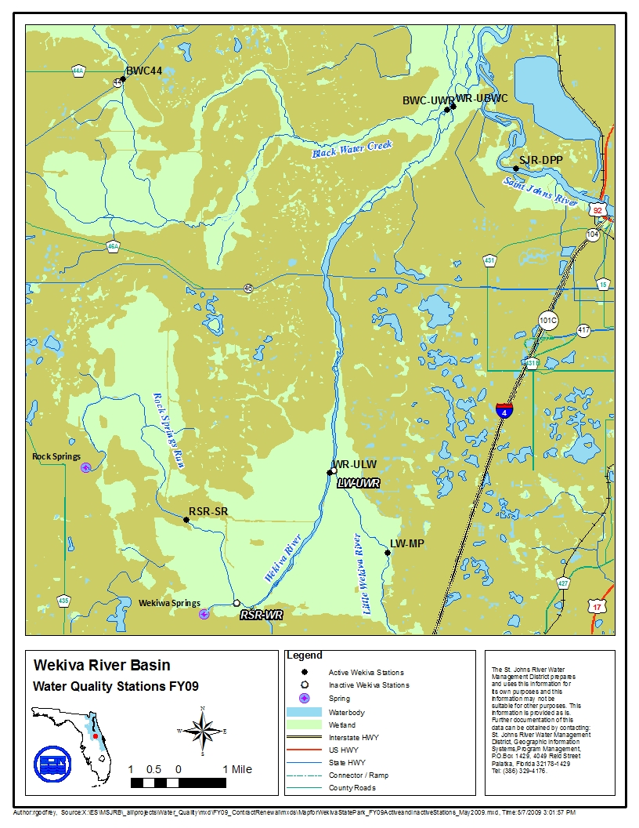
BWKL
WR-SR46
BWB

Slide 5
Water Quality Analytes Measured (SJRWMD)
Field Parameters (On-site Measurements) | Water Quality (Laboratory Analysis) | Water Quality (Laboratory Analysis)
pH | Alkalinity | Si-T (Silicon-T)
Dissolved Oxygen (DO) | Ca-T (Calcium-T) | Sulfate
Conductivity | Cl (Chloride) | Total Dissolved Solids
Secchi Depth | Color | Dissolved Kjeldahl Nitrogen
Depth of Collection | Dissolved Organic Carbon | Total Kjeldahl Nitrogen
Depth of Water | Fe-T (Iron-T) | Total Organic Carbon
Air Temperature | Hardness, Calc | Dissolved Phosphorus (TP-D)
Weather | Mg-T (Magnesium-T) | Total Phosphorus (TP-T)
Cloud Cover | Dissolved Ammonia | Total Suspended Solids
Wind Speed | Total Ammonia | Turbidity
Wind Direction | Total Nitrate/Nitrite (NOx-T)
Water Temperature | Dissolved Orthophosphate
 | Total Orthophosphate

Slide 6
Water Quality Analytes Presented
Conductivity – basic water chemistry
Dissolved O₂ – aquatic life support
Turbidity – water clarity
NOx and TP – nutrient status

Slide 7
Spring Water Quality
Wekiwa Springs
Rock Springs
SJRWMD, USGS, and FDEP/FGS data combined

Slide 8
Conductivity
Conductivity – measure of the dissolved ionic content

Slide 9
Nitrate
Remember this ‘spike’ !

Slide 10
Total Phosphorus
Odum, 1953
Notes:
10

Slide 11
5-year Average (Range)
 | Wekiwa Spring | Rock Spring
Conductivity (µmhos/cm) | 352.0 (191-390) | 247.8 (143-284)
NOx-N (mg N/L) | 0.95 (0.34-2.00) | 1.33 (0.67-2.50)
TP (mg P/L) | 0.11 (0.01-0.13) | 0.08 (0.05-0.10)

Slide 12
Stream Water Quality
Wekiva River¹ (ULW and SR-46)
Wekiva River² (BWB and BWKL)
Rock Springs Run (BWKP² and SR¹)
SJRWMD¹ and OCEPD² data

Slide 13
Wekiva River Conductivity

Slide 14
Conductivity Profile – Wekiva River
WR-SR46
SJRWMD Annual Veg. Surveys

Slide 15
Rock Springs Run Conductivity

Slide 16
Conductivity Profile - RSR
BWKP
RSR-SR
SJRWMD Annual Veg. Surveys

Slide 17
Wekiva River DO

Slide 18
Rock Springs Run DO

Slide 19
Wekiva River Turbidity
Turbidity – measure of amount of suspended material in water

Slide 20
Rock Springs Run Turbidity

Slide 21
Wekiva River Nitrate

Slide 22
Rock Springs Run Nitrate

Slide 23
Wekiva River Total Phosphorus

Slide 24
Rock Springs Run Total Phosphorus

Slide 25
5-year Average (Range)
OCEPD | BWB | BWKL | BWKP
Conductivity (µmhos/cm) | 323.8 (304-361) | 909.6 (658-1072) | 268.7 (262-273)
Dissolved O₂ (mg/L) | 5.01 (2.30-6.10) | 5.11 (2.00-8.70) | 2.68 (1.90-3.60)
Turbidity (NTU) | 0.97 (0.10-2.30) | 0.99 (0.40-2.40) | 0.29 (0.10-0.90)
NOx-N (mg N/L) | 0.85 (0.33-1.87) | 0.26 (0.02-0.49) | 1.22 (0.99-1.52)
TP (mg P/L) | 0.11 (0.08-0.18) | 0.11 (0.08-0.24) | 0.08 (0.07-0.09)
SJRWMD | WR-ULW | WR-SR46 | RSR-SR
Conductivity (µmhos/cm) | 344.9 (300.8-600) | 387 (296-482) | 295.2 (251.9-514)
Dissolved O₂ (mg/L) | 4.90 (1.64-7.29) | 5.06 (0.69-9.85) | 6.89 (2.11-8.70)
Turbidity (NTU) | 1.48 (0.01-9.30) | 1.08 (0.35-2.60) | 1.42 (0.33-8.70)
NOx-N (mg N/L) | 0.58 (0.26-0.86) | 0.34 (<0.01-0.73) | 0.84 (0.06-1.10)
TP (mg P/L) | 0.11 (0.07-0.18) | 0.11 (0.06-0.31) | 0.09 (0.06-0.17)

Slide 26
What’s a Trend ?
Spatial – differences among different springs/spring runs; changes down the length of a spring run stream
Temporal – change over time

Slide 27
Long-Term Temporal Trends
What did the springs used to be ?
What has been happening over time ?
What are the springs now ?

Slide 28
Long-term nitrate trends
1900
2000

Slide 29
Long-term phosphorus trends
1900
2000

Slide 30
Long-term [ionic] trends
Copeland et al.:
Changing rainfall patterns (climate change?)
Increased GW pumping last 50 yrs
1900
2000
Copeland, R., et al. 2009. Regional and Statewide Trends in Florida’s Spring and Well Groundwater Quality (1991-2003). Fla. Geol. Survey Bulletin No. 69. (Updated 2011)

Slide 31
Summary
[NOx] in the headsprings drives (in part) what’s in the streams
[NOx & TP] at this time are usually above the established TMDL targets (springs & streams)
NOx in both springs appears to be associated with “younger” water; reflecting loading from current land uses

Slide 32
Summary
TP in both springs appears to, in part, also come from landscape loading (human origin); P also derived from watershed loading downstream
DO levels in Wekiva River frequently fall below WQ standard (mostly due to natural events)
Conductivity in Wekiwa Springs indicates more of its flow consists of “older” water from deeper w/in the Floridan Aquifer

Slide 33
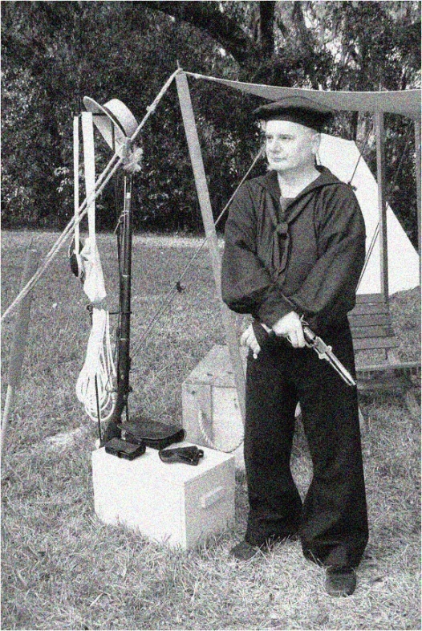
Contact
Rob Mattson
Environmental Scientist V
St. Johns River Water Management District
(386) 329-4582
rmattson@sjrwmd.com
R. Mattson Nov. 1862

Slide 35
Vegetation Survey Work
Wekiva River
Rock Springs Run
Alexander Springs Creek
Juniper Creek
Silver Glen Run
Blue Spring Run

Slide 36
Spring Run SAV Cover
(SAV acres/Total bottom acres)
Map data from various studies SJRWMD Report in prep.

Slide 37
Submerged Aquatic Vegetation Survey
N = no vis 2009 * = no vis 2010

Slide 38
Algal Cover
(macroalgae and epiphytes)

Slide 39
Algal Cover
(macroalgae and epiphytes)

