Slide 1
Wekiva BMAP Monitoring Discussion
February 17, 2012

Slide 2
Existing Monitoring
Existing water quality monitoring is conducted by:
  City of Altamonte Springs;
  City of Apopka;
  City of Maitland;
  City of Orlando;
  City of Winter Garden;
  Lake County;
  Orange County;
  Seminole County; and
  SJRWMD

Slide 3
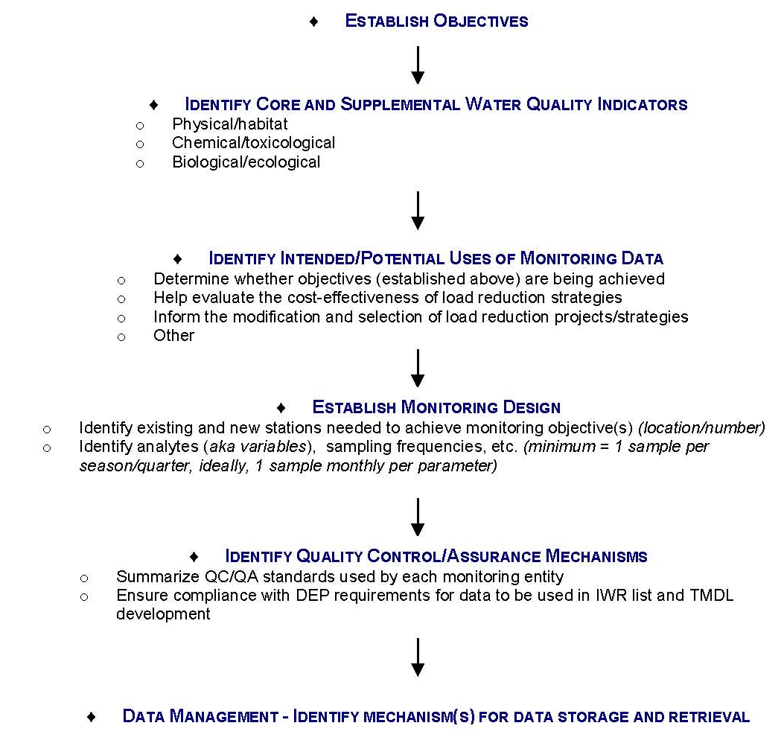
Monitoring Plan Development

Slide 4
Review Monitoring Plan Objectives
Primary Objective: Long Term Trend Analysis
    Track inputs and concentration trends in TN and TP loads through groundwater , surface water, and MS4 sampling.
Secondary Objective: Source Assessment
    Identify areas within the springshed/watershed with high loadings of nutrients to surface water and groundwater to better focus management efforts

Slide 5
Water Quality Parameters
Recommended parameters for discussion:
Core Parameters | Supplemental Parameters
Total phosphorus (as P) | Total suspended solids (TSS)
Orthophosphate as P | Biochemical oxygen demand (BOD)
Nitrate/nitrite as N
Total Kjeldahl nitrogen (TKN)
Chlorophyll-a
Dissolved oxygen (DO)
Temperature
Specific conductance
pH - field

Slide 6
Sampling Frequency
Current sampling frequencies for surface water:
  Quarterly – Altamonte Springs, Apopka, Orlando, Lake County, Orange County, Seminole County
  Bimonthly – SJRWMD
  Monthly – Altamonte Springs, Maitland, Lake County, SJRWMD, Seminole County
  Semi-Annually – Orlando
  Annually – Lake County, Seminole County
What frequency is needed to achieve the monitoring plan objectives?

Slide 7
Sampling Frequency (continued)
Current sampling frequencies for groundwater:
  Quarterly – SJRWMD (springs & wells), Apopka, Winter Garden, Orange County, Seminole County,
  3-times per year – Orange County
  Semi-Annually – Lake County (springs), SJRWMD
  Annually - SJRWMD
What frequency is needed to achieve the monitoring plan objectives?

Slide 8
QA/QC and Data Storage
Water quality data collection will be conducted in a manner consistent with the Florida Department of Environmental Protection’s (FDEP) standard operating procedures (SOPs) for quality assurance/quality control (QA/QC).
The SOPs can be found at: http://www.dep.state.fl.us/labs/library/lab_sops.htm.
The Florida STORET database will serve as the primary resource for storing ambient data.
Stakeholders will regularly upload their BMAP data to STORET.

Slide 9
QA/QC, continued
These QA/QC requirements are important to ensure that FDEP can use the data in future water quality assessments.
Data must be in STORET for FDEP to use the information in the assessments.
STORET uploads are only appropriate for data that represent ambient conditions.
  Other data (biological, storm event, continuous flow), if collected, will be maintained by the entity that collected the samples.

Slide 10
Monitoring Network
Determine the monitoring network:
  Identify existing stations that are necessary to achieve the monitoring objective.
  Identify gaps in the monitoring:
    Determine if existing stations can be moved to fill a gap; or
    Determine if a stakeholder is able to add a new station to fill a gap.
Review the monitoring maps and identify the monitoring network for the NRP.

Slide 11
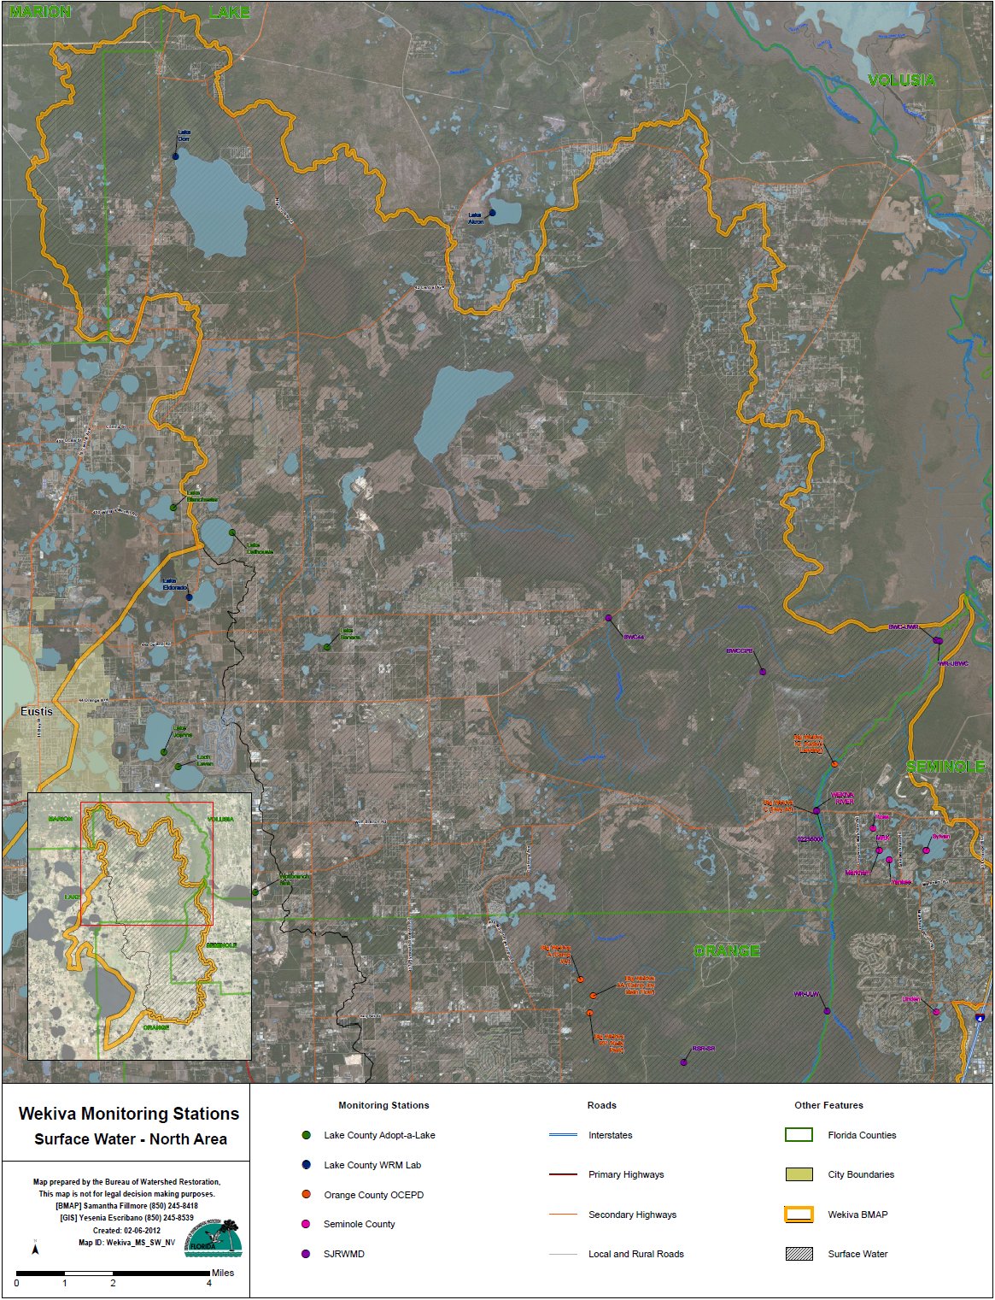

Slide 12
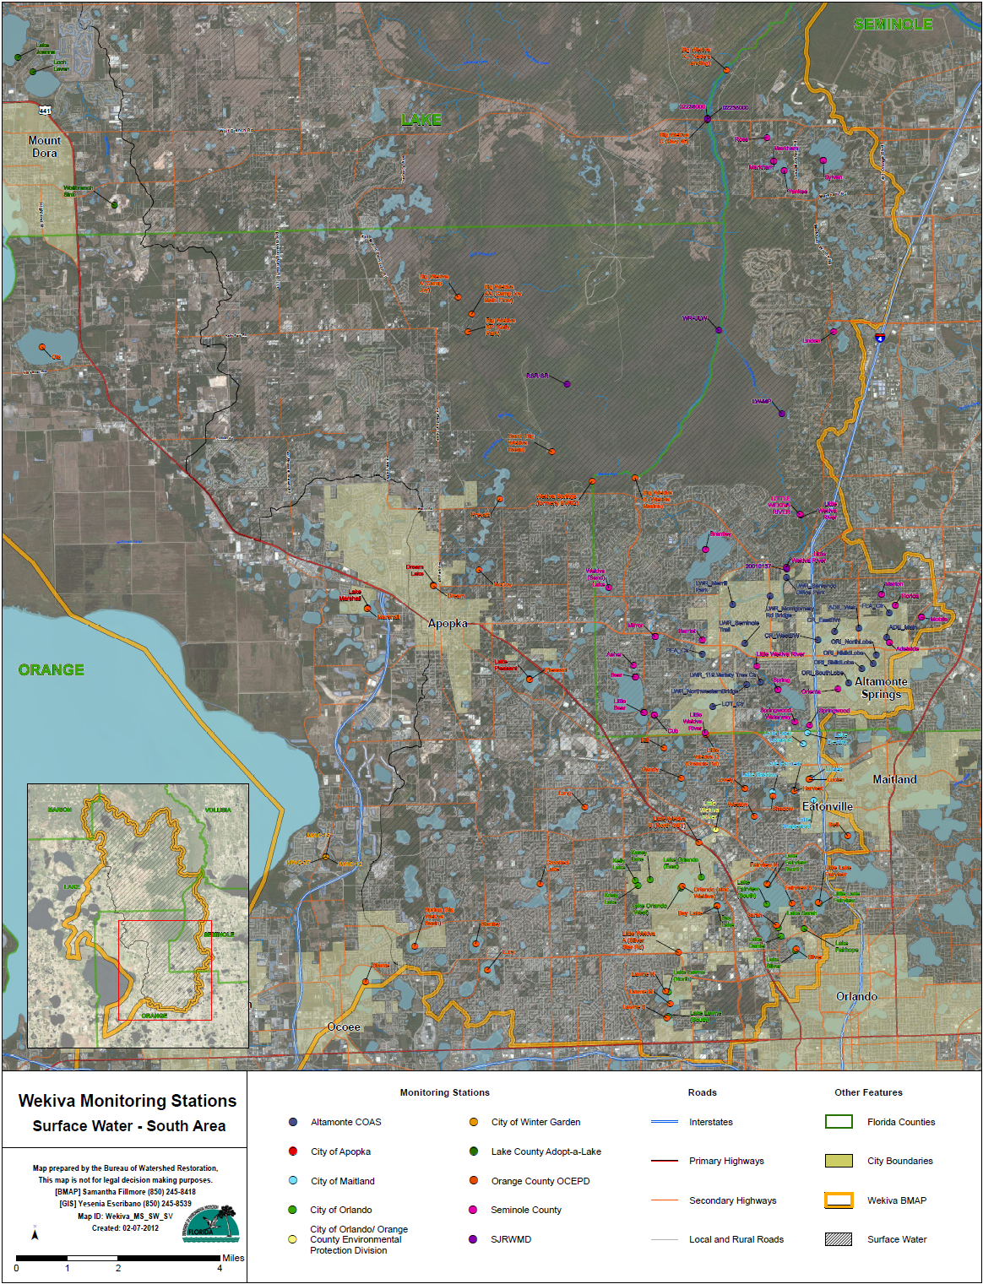

Slide 13
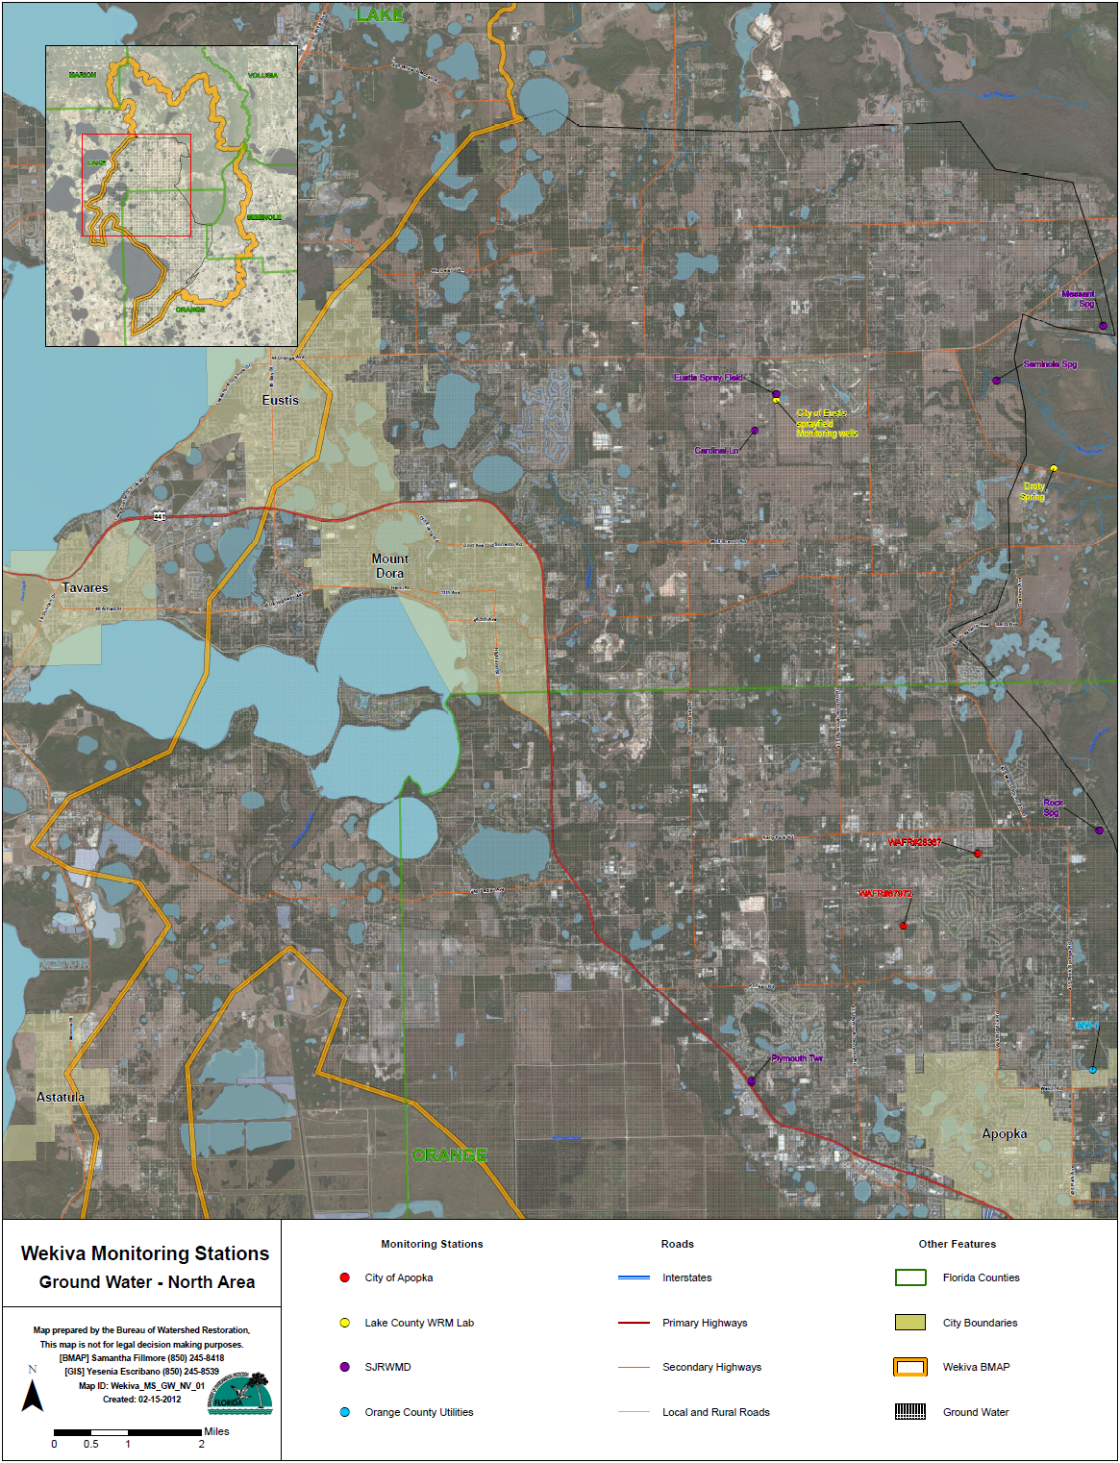

Slide 14
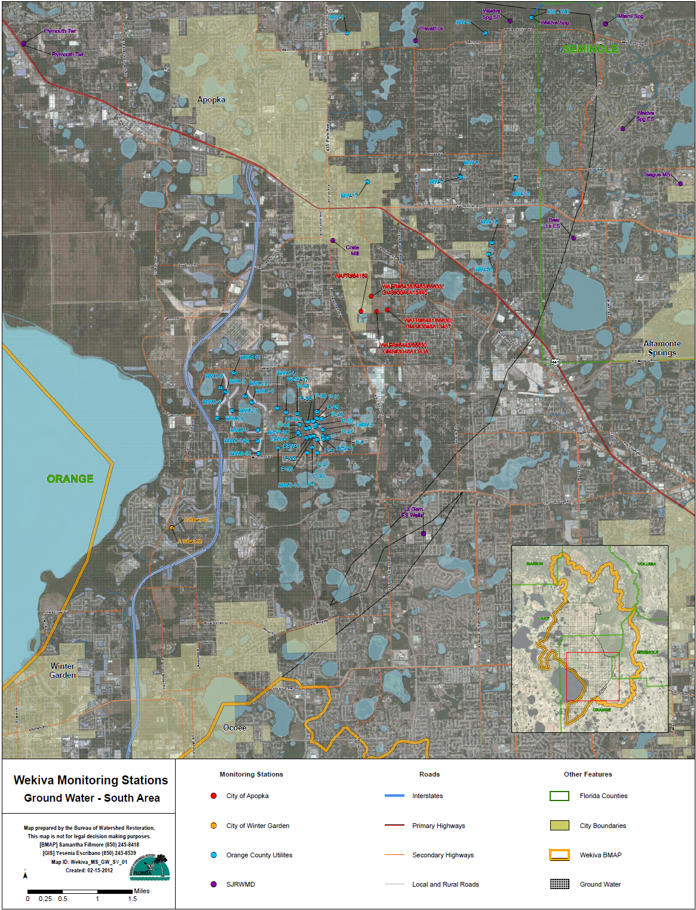

Slide 15
Presentation materials and forms can be found:
http://publicfiles.dep.state.fl.us/DEAR/BMAP/Wekiva

