Slide 1
Wekiva Basin Working Group Meeting
February 17, 2012

Slide 2
Project Collection Update
FDEP has received Public Education and/or Street Sweeping information from:
    City of Altamonte Springs
    City of Apopka
    City of Eustis
    City of Maitland
    City of Mt. Dora
    City of Oakland
    City of Ocoee
    City of Orlando
    FDOT District 5
    Lake County
    Orange County
    Seminole County
    SJRWMD

Slide 3
Project Collection Update
Since the last meeting, FDEP has received additional (or updated) Collection System and/or Non-WWTF projects from:
    City of Apopka
    City of Mt. Dora
    City of Orlando
    City of Winter Garden
    FDOT District 5
    Lake County
    Orange County
    Seminole County

Slide 4
Stakeholder | # Low Impact Projects | # Medium Impact Projects | # High Impact Projects | # Studies | Stakeholder Jurisdiction Impact
City of Altamonte Springs | TBD | - | 1 | 1 | Little Wekiva River/Little Wekiva Canal Watershed
City of Apopka | 3 plus additional TBD | - | - | - | Springshed and Rock Springs Run/ Wekiva River Surface Watershed
Town of Astatula | - | - | - | - | Very small amount of town in springshed
Town of Eatonville | - | - | - | - | Little Wekiva River/Little Wekiva Canal Watershed
City of Eustis | - | - | - | - | Partially within springshed
City of Maitland | - | - | - | - | Partially within Little Wekiva Canal Watershed
City of Mt Dora | 14 | 5 | - | - | Springshed
City of Oakland | - | 1 | - | - | Very small amount within Springshed
City of Ocoee | 3 | 26 | - | - | Springshed/Wekiva River Watershed
City of Orlando | 17 | 9 | 2 | 1 | Partially within Little Wekiva Canal Watershed
City of Tavares | - | - | - | - | Very small amount within springshed
City of Winter Garden | 1 | 2 | - | - | Springshed
FDOT District 5 | 1 | 23 | - | - | Various springshed & surface watershed
Florida Expressway | - | - | - | - | Various springshed & surface watershed
Florida Turnpike | - | 2 | - | - | Transects small portion of springshed
Lake County | - | 1 | - | 1 | Springshed/Blackwater Creek, Rock Springs Run, and Wekiva River Watershed
Orange County | 13 | 5 | 2 | - | Springshed/Rock Springs Run, Wekiva River, and Little Wekiva Canal Watershed
Seminole County | 9 | 14 | 3 | - | Wekiva River and Little Wekiva River Watershed
Marion County (DeMinimus) | - | - | - | - | Blackwater Creek (DeMinimus - Area Mostly Forest, Wetlands, Barren Land, and some Agriculture)

Slide 5
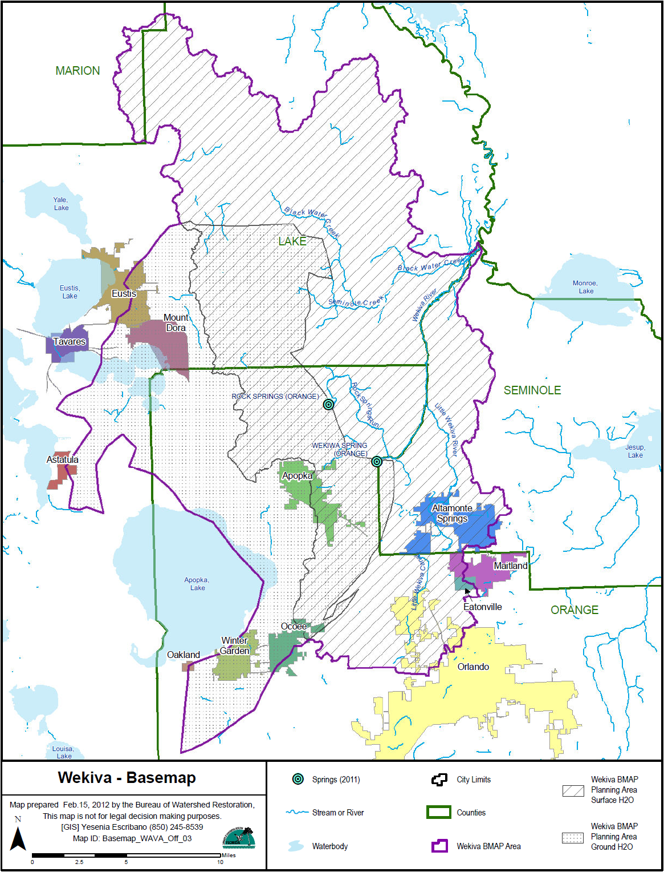

Slide 6
Stakeholder | FYN Program | Landscaping Ordinance | Irrigation Ordinance | Fertilizer Ordinance | Pet Waste Management | PSAs, Websites, Pamphlets, etc | Street Sweeping | Stakeholder Jurisdiction Impact
City of Altamonte Springs | Yes | Yes | Yes | - | Yes | Yes | Yes | Little Wekiva River/Little Wekiva Canal Watershed
City of Apopka | - | Yes | Yes | Yes | - | Yes | Yes | Springshed and Rock Springs Run/ Wekiva River Surface Watershed
Town of Astatula | - | - | - | - | - | - | - | Very small amount of town in springshed
Town of Eatonville | - | - | - | - | - | - | - | Little Wekiva River/Little Wekiva Canal Watershed
City of Eustis | - | Yes | Yes | - | - | Yes | - | Partially within springshed
City of Maitland | - | Yes | Yes | Yes | Yes | Yes | Yes | Partially within Little Wekiva Canal Watershed
City of Mt Dora | - | - | Yes | - | Yes | Yes | Yes | Springshed
City of Oakland | - | Yes | Yes | - | - | Yes | - | Very small amount within Springshed
City of Ocoee | - | - | - | - | - | Yes | - | Springshed/Wekiva River Watershed
City of Orlando | Yes | Yes | - | Yes | Yes | Yes | Yes | Partially within Little Wekiva Canal Watershed
City of Tavares | - | - | - | - | - | - | - | Very small amount within springshed
City of Winter Garden | - | - | - | - | - | - | - | Springshed
FDOT District 5 | n/a | n/a | n/a | n/a | n/a | Yes | Yes | Various springshed & surface watershed
Florida Expressway | n/a | n/a | n/a | n/a | n/a | - | - | Various springshed & surface watershed
Florida Turnpike | n/a | n/a | n/a | n/a | n/a | - | - | Transects small portion of springshed
Lake County | - | Yes | - | - | - | Yes | - | Springshed/Blackwater Creek, Rock Springs Run, and Wekiva River Watershed
Orange County | Yes | Yes | Yes | Yes | Yes | Yes | Yes | Springshed/Rock Springs Run, Wekiva River, and Little Wekiva Canal Watershed
Seminole County | Yes | Yes | Yes | - | Yes | Yes | - | Wekiva River and Little Wekiva River Watershed
Marion County (DeMinimus) | n/a | n/a | n/a | n/a | n/a | n/a | n/a | Blackwater Creek (DeMinimus - Area Mostly Forest, Wetlands, Barren Land, and some Agriculture)

Slide 7
Project Impact Category Review

Slide 8
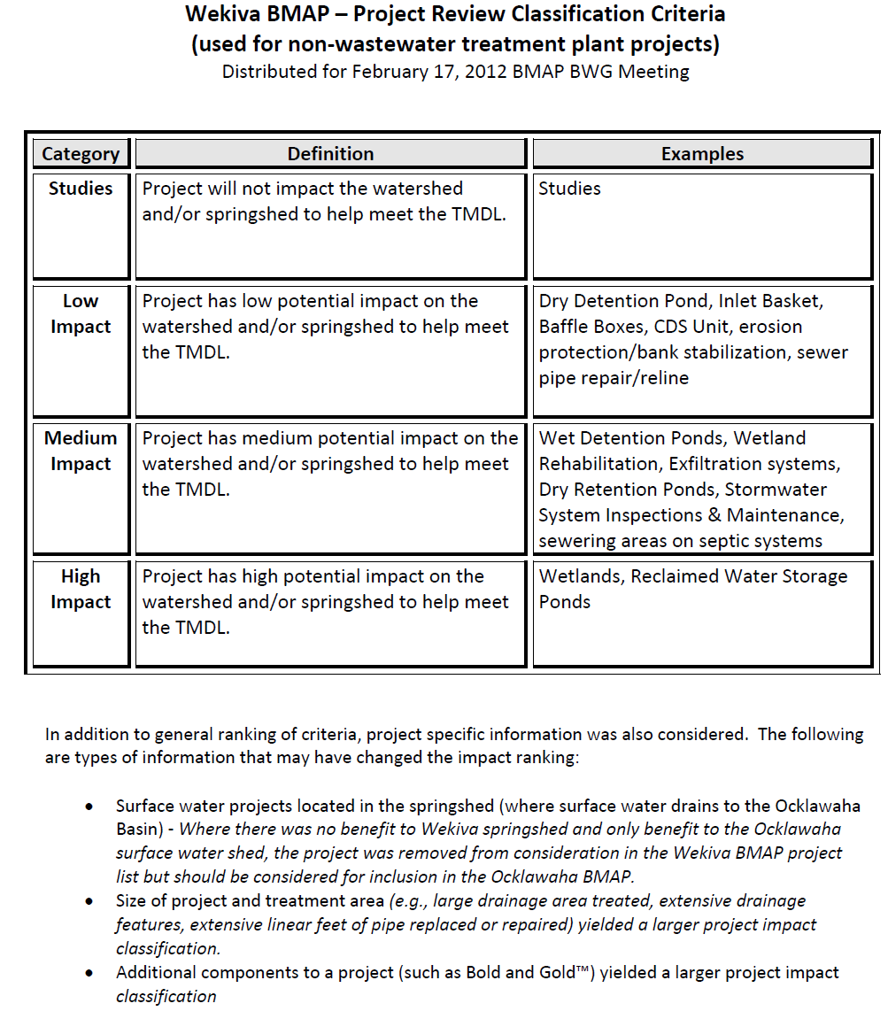

Slide 9
Examples of Low Impact Projects
City of Orlando
  “2 inlet baskets around Lake Daniel”
  Project treats 3.7 acres
City of Mt. Dora
  “Gravity Sewer Line Replacement”
  Project replaces 602 feet of 8-inch gravity sewer pipe and two manholes

Slide 10
Examples of Medium Impact Projects
City of Orlando
  “Compliance Inspections of Private Stormwater Systems”
  The city inspects all commercial, single and multi family stormwater systems in the basin (totaling 233) on an annual basis to ensure ponds are maintained at design criteria.

Slide 11
Examples of Medium Impact Projects (continued)
Seminole County
  Bear Lake Road Reconstruction
  Project provides water quality treatment to an existing roadway and subdivision with wet detention pond
  Project treats 32 acres

Slide 12
Examples of High Impact Projects
Seminole County
  “Sweetwater Cove Dredging and Drainage Improvements and Sweetwater Tributary Erosion Project”
  Project will increase water quality treatment resonance time through pond expansion; construction of an online sediment basin; and erosion control measures along Sweetwater Creek
  Project treats 2,181 acres

Slide 13
Examples of High Impact Projects (continued)
Altamonte Springs
  “Keller Rd WWTF Reclaimed Water Storage Pond”
  Pond will provide 7.8 MG reclaimed water storage
Notes:
DEP has done some monitoring and it appears that these storage ponds significantly reduce the level of nitrates.

Slide 14
Questions?

