Slide 1
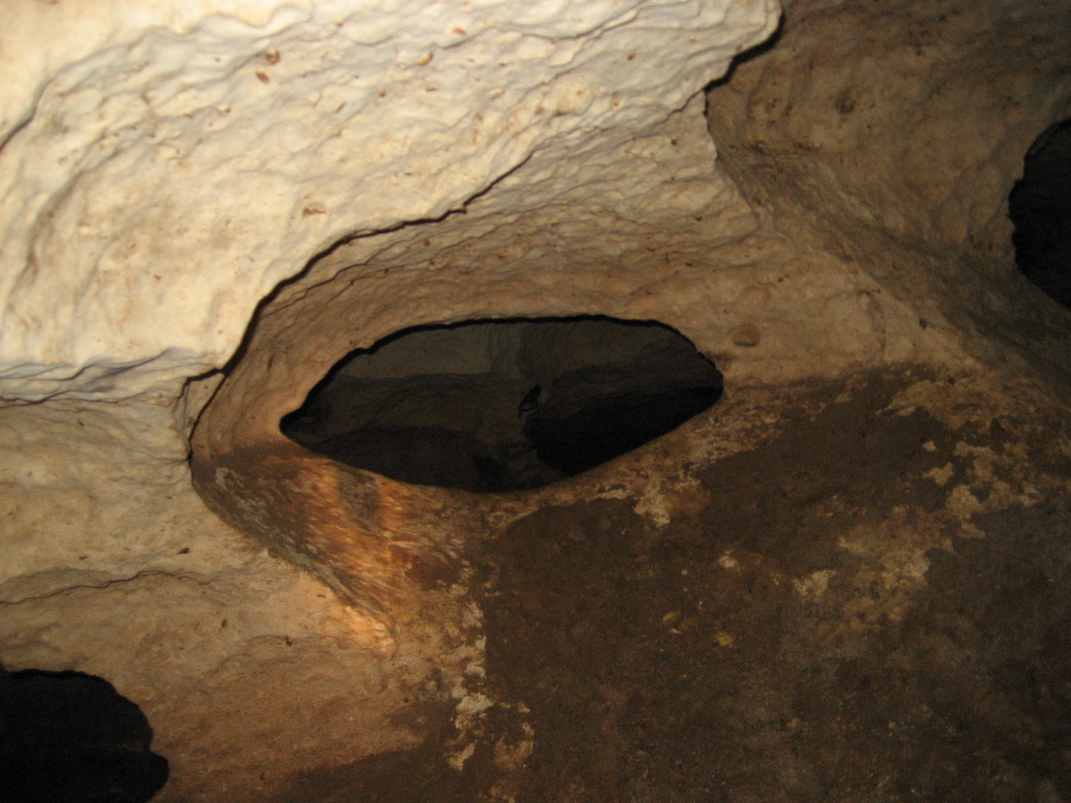
HYDROGEOLOGY OF MARION COUNTY, ORANGE LAKE SUBSURFACE, AND DYE TRACING
ORANGE CREEK BASIN INTERAGENCY WORKING GROUP
HYDROGEOLOGY WORKSHOP 11/05/2015
Jeffrey B. Davis, P.G
St. Johns River Water Management District
jdavis@sjrwmd.com

Slide 2

TOPICS
MARION COUNTY HYDROGEOLOGY
ORANGE LAKE SUBSURFACE
SILVER SPRINGS NUTRIENT PATHWAY DYE TRACE STUDY

Slide 3
MARION COUNTY HYDROGEOLOGY

Slide 4
HYDROSTRATIGRAPHIC UNITS
A Hydrostratigraphic Unit is a body of rock (or sediment) distinguished and
characterized by its porosity and permeability. *
Unit is laterally extensive enough to be mapped.
Unit can be sufficiently permeable to produce water and allow flow.
Unit can have low permeability and retard flow or provide confinement.
Unit does not have to conform to lithostratigraphic boundaries.
Unit has to be recognizable.
It’s all about the connectivity of
water in the rocks
* Modified from The Geology of North America, Vol. O-2 Hydrogeology, The Geological Society of North America, 1988

Slide 5
HYDROSTRATIGRAPHIC UNIT - LITHOSTRATIGRAPHIC UNIT
COMPARISON
LITHOSTRATIGRAPHIC UNIT
Undifferentiated sand, silt, clay, and shell
Cypresshead Formation
Hawthorn Group, Coosawhatchie Formation
Hawthorn Group, Undifferentiated
Ocala Limestone
Avon Park Formation
Oldsmar Formation
HYDROSTRATIGRAPHIC UNIT
SURFICIAL AQUIFER SYSTEM (SAS)
INTERMEDIATE CONFINING UNIT (ICU)
UPPER FLORIDAN AQUIFER (UFA)
MIDDLE CONFINING UNIT I OR II
(MCU I OR MCU II)
FLORIDAN AQUIFER SYSTEM
LOWER FLORIDAN AQUIFER (LFA)

Slide 6
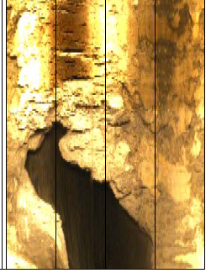
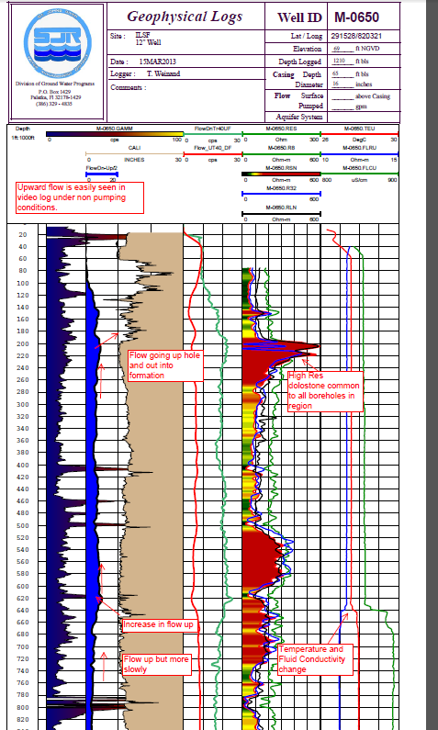
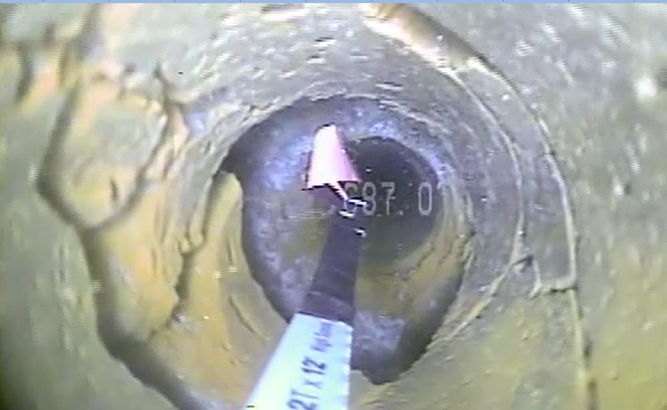
SUBSURFACE EXPLORATION
GEOPHYSICAL LOGS
RUN IN BOREHOLES
TO SEE WHAT IS
UNDERGROUND

Slide 7
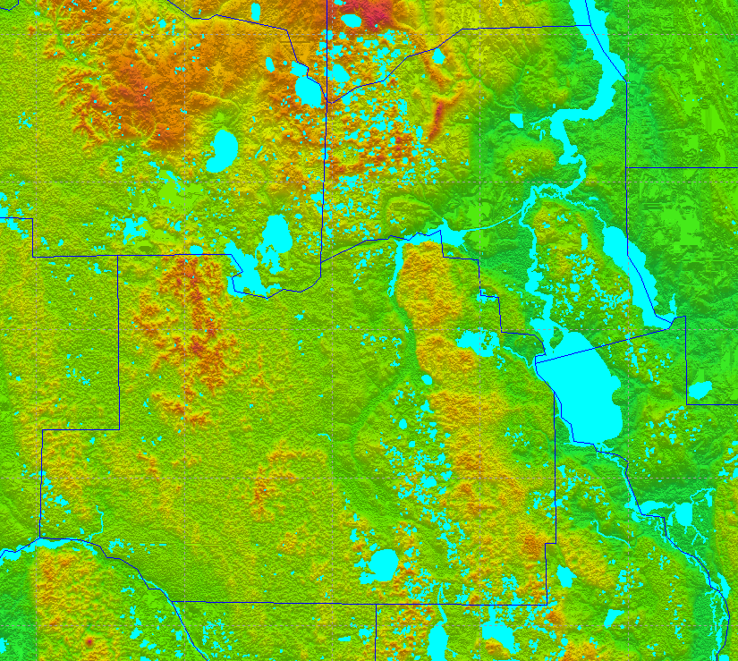
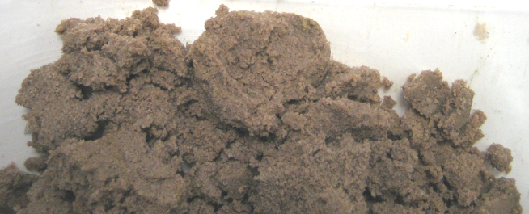

LAND SURFACE ELEVATION
(aka TOP OF SURFICIAL AQUIFER (SAS))
GENERALLY NOT USED EXTENSIVELY FOR PRODUCTION.
MOST VULNERABLE TO CONTAMINATION AND FLUCTUATING WATER LEVEL BASED ON RAINFALL.

Slide 8
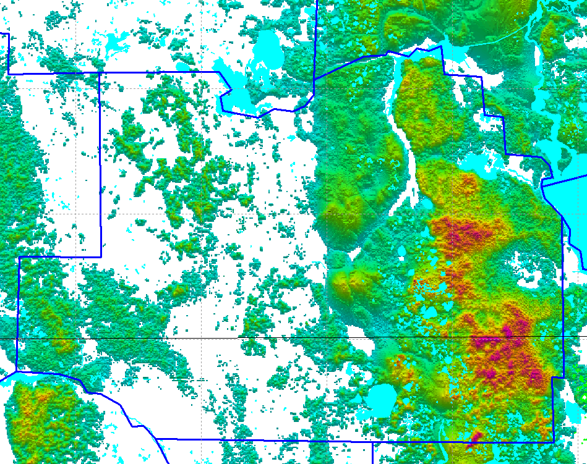
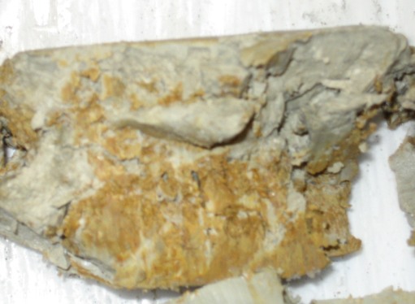

SURFICIAL AQUIFER THICKNESS ( WHITE AREAS LESS THAN 20’ THICK)
SAS IS THIN OR ABSENT IN MUCH OF MARION COUNTY.
WHERE SAS IS PRESENT IT MAY CONTAIN SIGNIFICANT AMOUNTS OF CLAY.

Slide 9
INTERMEDIATE CONFINING UNIT
Comprised of multiple intervals of varying hydraulic properties.
Some intervals may produce water and others are very confining.
The entire “package” of ICU rocks and sediments acts as a confining unit to
the Floridan aquifer system (FAS).
Some intervals may produce water and others are very confining.
Hydraulic properties of individual intervals are not laterally continuous.
Erosion has removed or thinned the ICU in many areas. These areas can
provide pathways for direct recharge to the FAS.

Slide 10
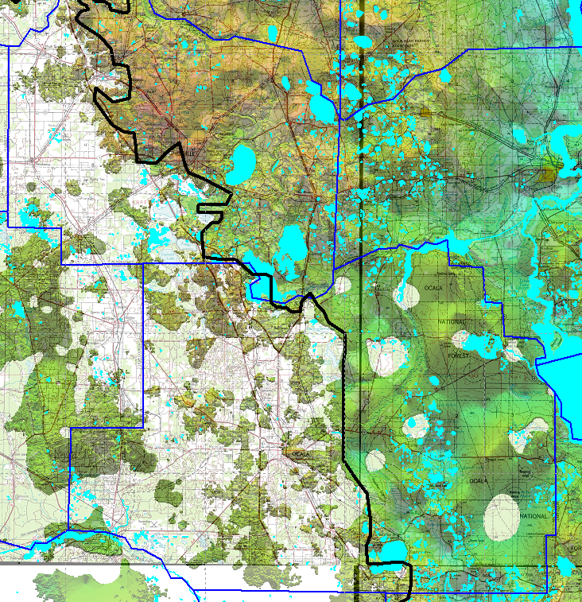

ELEVATION OF INTERMEDIATE CONFINING UNIT (ICU)
SURFACE IS CLIPPED WHERE
THICKNESS OF ICU IS LESS THAN 20’
NOTE THERE ARE MORE WATER BODIES
PRESENT WHERE THE ICU IS PRESENT.
THERE ARE SIGNIFICANTLY MORE CAVES
AND SINKHOLES IN THE WESTERN AREA.
DIRECT RECHARGE TO THE FAS IN THE WEST.
ELEVATION RANGES FROM -70’ TO 173’

Slide 11
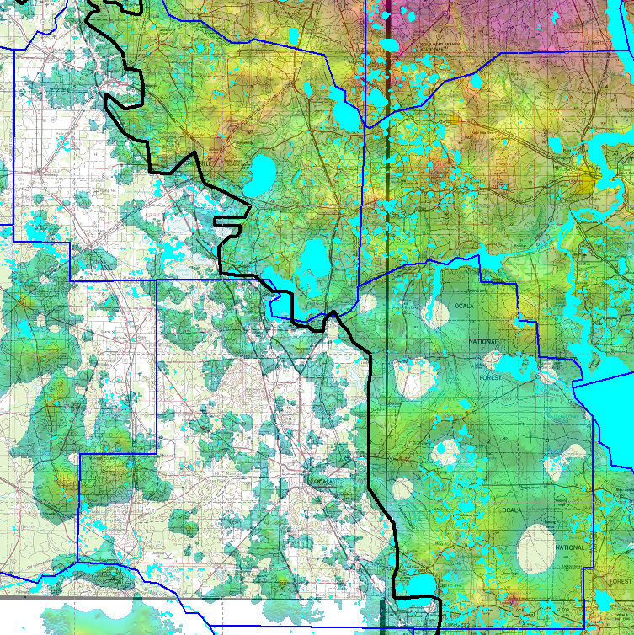

THICKNESS OF THE ICU (clipped to >20’ thick)
Thin or absent in western
Marion County. (Ocala Platform)
Thickens to the northeast and south.
Patches of ICU in the west provide
localized confinement but considered
as unconfined regionally.
Generalized boundary where
the Floridan Aquifer is unconfined
based on where ICU is less than 20’
thick.

Slide 12
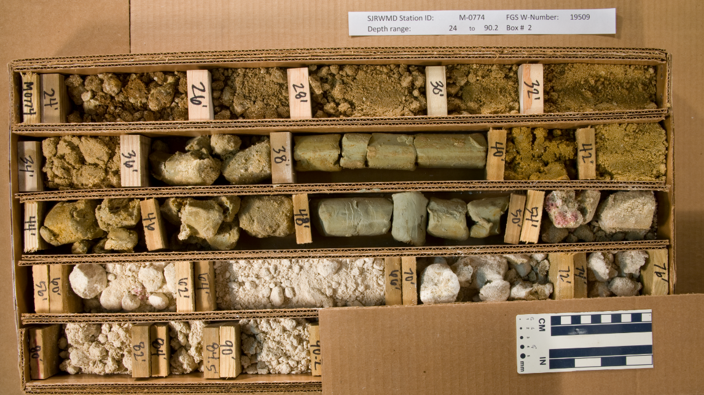
EXAMPLE WHERE NO ICU IS PRESENT. SOME CLAY ZONES IN THE SAS
MAY PROVIDE SOME MINIMAL CONFINEMENT TO THE FLORIDAN.

Slide 13
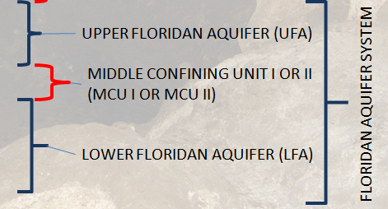
FLORIDAN AQUIFER SYSTEM (FAS)
Predominately limestone and dolostone
but may contain beds of peat, lignite,
sands, clay, chert, and gypsum.
Primary porosity up to 30-40%. Secondary
porosity up to 100% (caves).
Secondary porosity from dissolution and fracturing
can greatly affect permeability (caves, conduits).
Individual intervals can have very low porosity and permeability
forming confining units within the system.
The cumulative effect of multiple low permeable intervals
divides the system into the Upper and Lower Floridan aquifers
with distinct hydraulic properties.

Slide 14
FLORIDAN AQUIFER SYSTEM (FAS)
Covers an area of over 100,00 square miles in Florida, Georgia, Alabama, South Carolina and extends offshore.
Maximum age of the water has been dated to 26,000 years.
One of the most productive aquifers in the world.
May be thousands of feet thick however not all is productive.

Slide 15
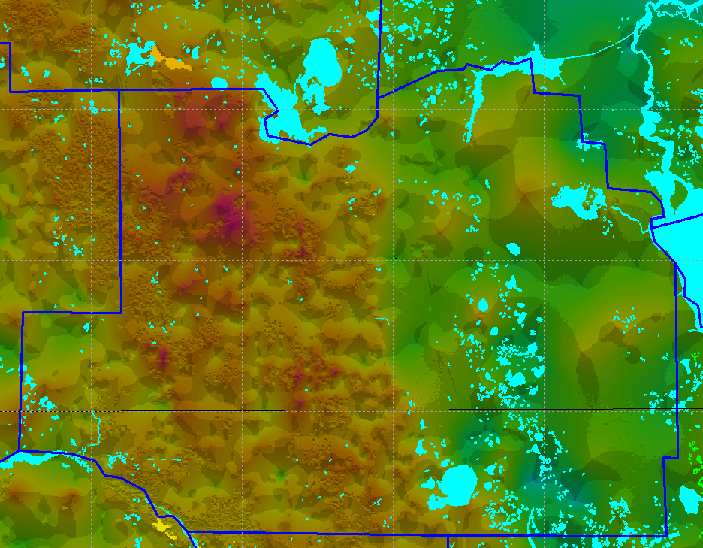

ELEVATION OF THE UPPER FLORIDAN AQUIFER (UFA)
Elevation increases to the west.
Elevation ranges from a low of
about -200 to a high of about 150
In this area.
Karst features greatly influence
the hydrologic characteristics.

Slide 16
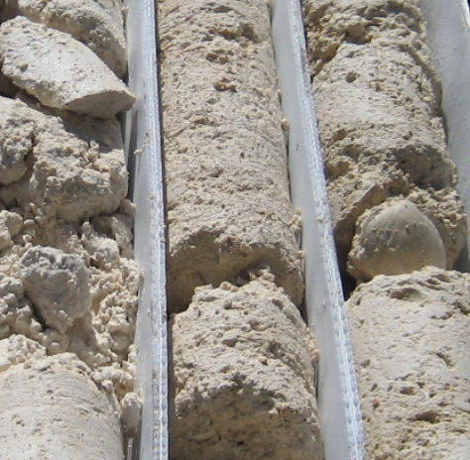
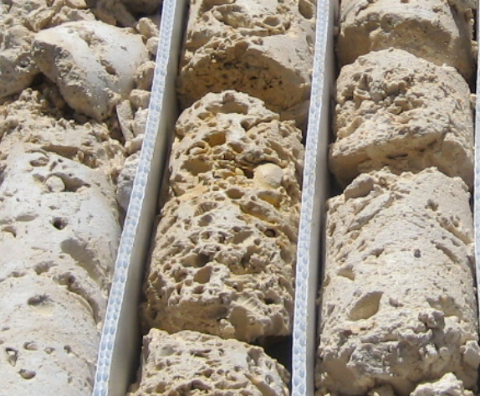
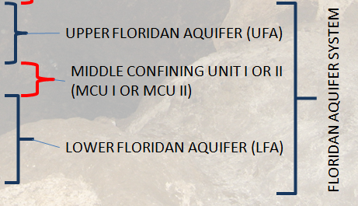
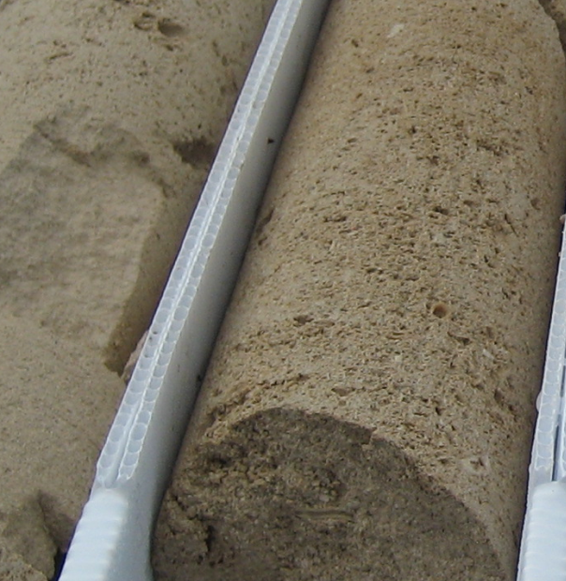
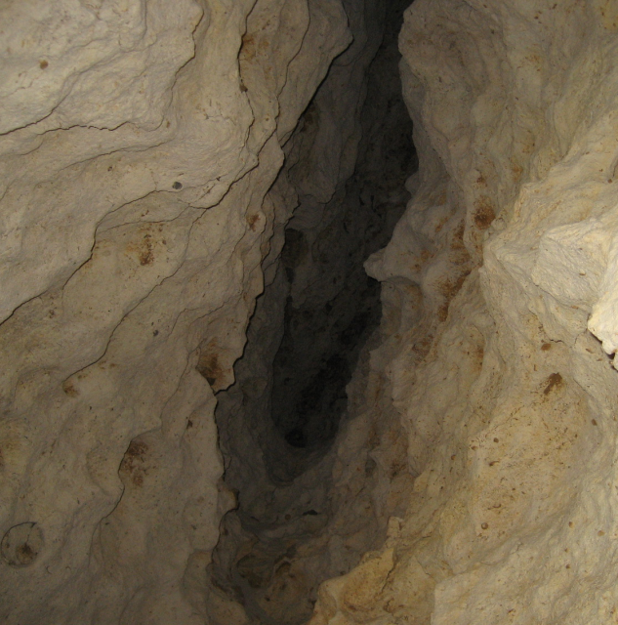
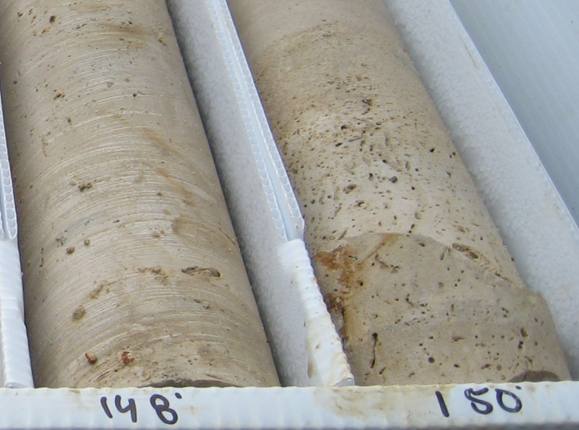
UPPER FLORIDAN AQUIFER
HIGHLY VARIABLE BUT GENERALLY MORE
PERMEABLE THAN UNDERLYING UNITS
High Permeability
High Porosity
Medium Permeability
Low Permeability
Dissolution Fractures

Slide 17
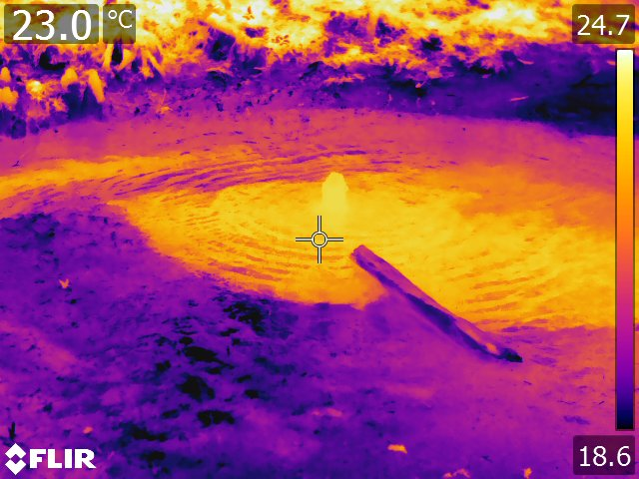
UPPER FLORIDAN AQUIFER
WATER IN THE UPPER FLORIDAN MAY BE UNDER ARTESIAN CONDITIONS
AND CAN FLOW AT LAND SURFACE.
MAY BE EXPOSED AT LAND SURFACE
OR COVERED BY HUNDREDS OF FEET OF
SEDIMENT.
CAVES, DISSOLUTION ENLARGED FRACTURES,
AND HIGH POROSITY AND PERMEABILITY ARE
COMMON FEATURES.
INTERVALS WHERE PERMEABILITY IS VERY HIGH OR LOW CAN BE MAPPED
REGIONALLY.

Slide 18
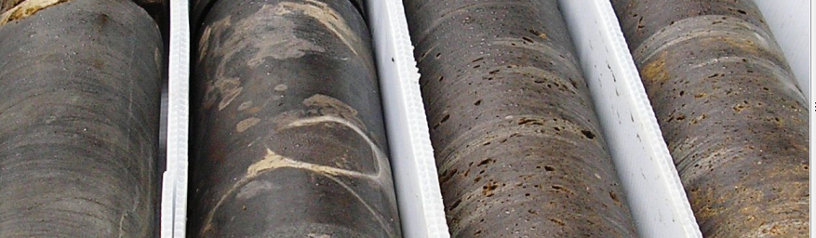
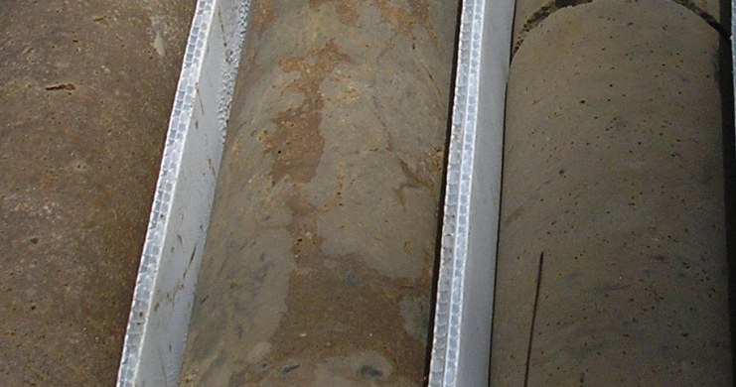
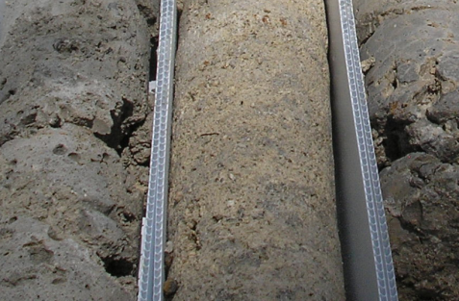
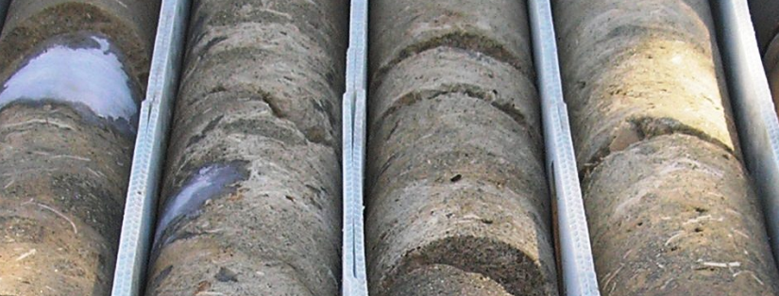
MIDDLE CONFINING UNITS
EXTREMELY LOW VERTICAL
CONDUCTIVITY (Kh)
MULTIPLE LAYERS,
EACH WITH
DIFFERENT Kh
BUT THE CUMULATIVE
EFFECTS OF ALL LIMIT
CONNECTION BETWEEN
THE UPPER FLORIDAN
AND
LOWER FLORIDAN
AQUIFERS
LOW VERTICAL
CONDUCTIVITY (Kh)
HIGH VERTICAL
CONDUCTIVITY (Kh)
EXTREMELY LOW VERTICAL
CONDUCTIVITY (Kh)

Slide 19
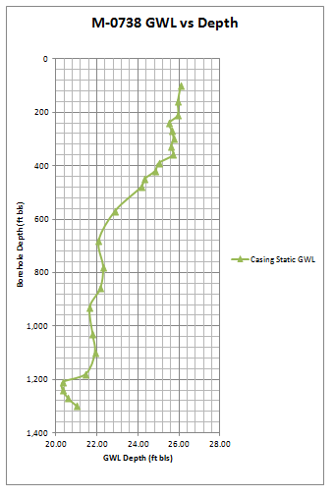
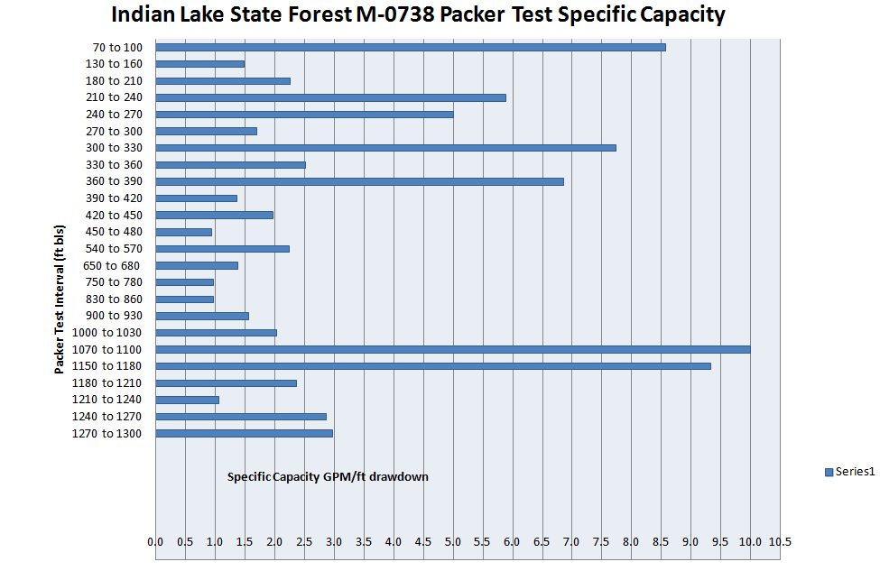
MIDDLE CONFINING UNITS
SEPARATES THE UFA FROM THE LFA.
BOUNDARIES CAN BE DIFFICULT TO IDENTIFY.
GEOPHYSICAL LOGS, CORES, PACKER TESTS, AND WATER LEVEL CHANGES DURING DRILLING AND TESTING.
ROCK TYPE CAN BE A GOOD INDICATOR BUT FRACTURES OR OTHER SECONDARY FEATURES CAN PROVIDE HYDRAULIC CONNECTION WITH THE UFA.
THIN, ABSENT, OR DIFFICULT
TO RECOGNIZE TO THE WEST. NEED
MORE DRILLING TO REFINE.

Slide 20
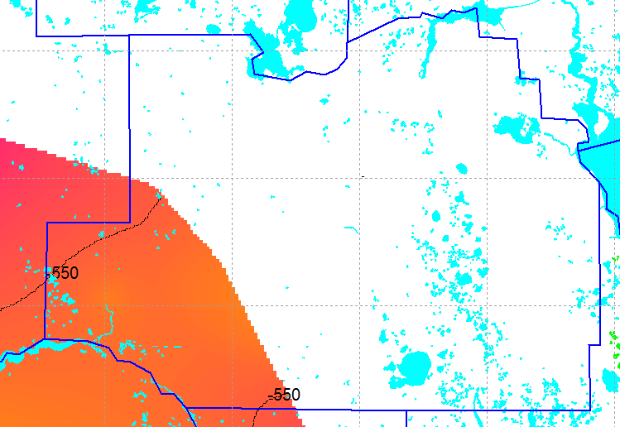
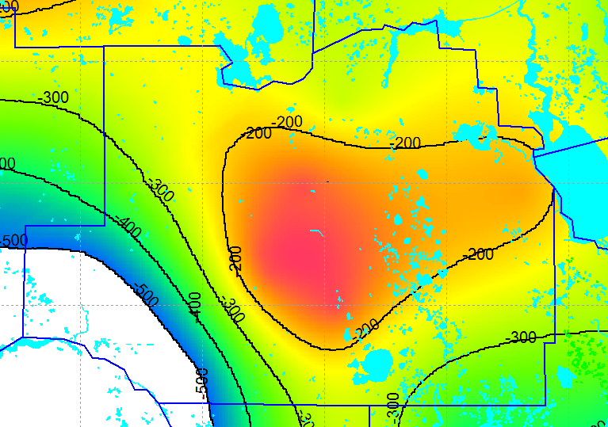
ELEVATION AND EXTENT OF MCU I AND MCU II MARION COUNTY
MCU II EXTENT
MCU I EXTENT
Note – efforts are underway to update these surfaces with additional data from other
WMDs so there may be refinements in the near future.

Slide 21
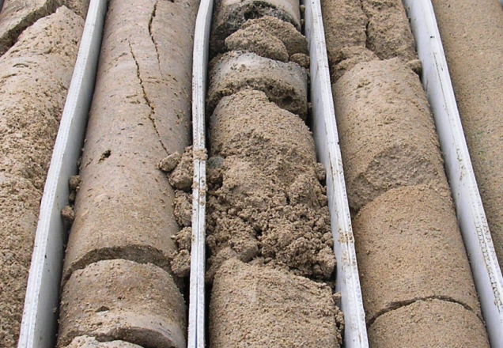
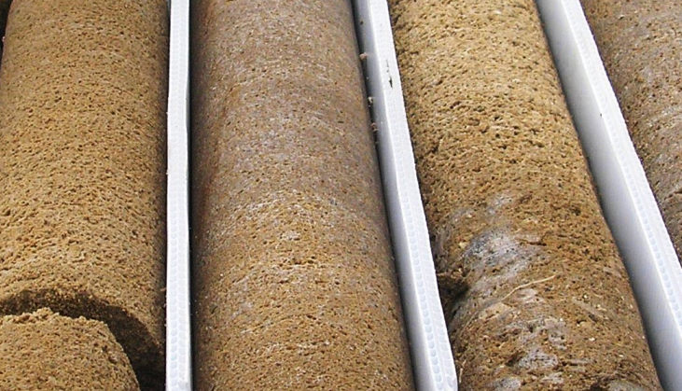
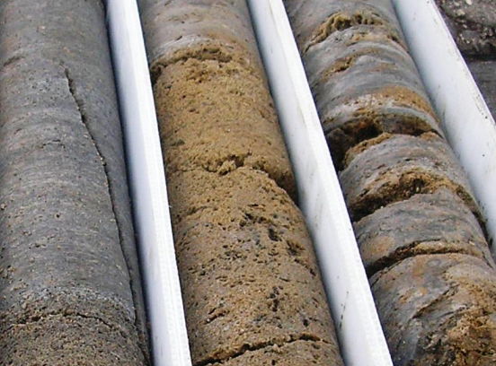
LOWER FLORIDAN AQUIFER
SJRWMD maps this as the first regionally extensive
permeable zone below the middle confining units.
May be recognized by changes in water level, packer
tests during drilling, geophysical log response, and
rock type.
Not always well defined or sharp boundary.

Slide 22
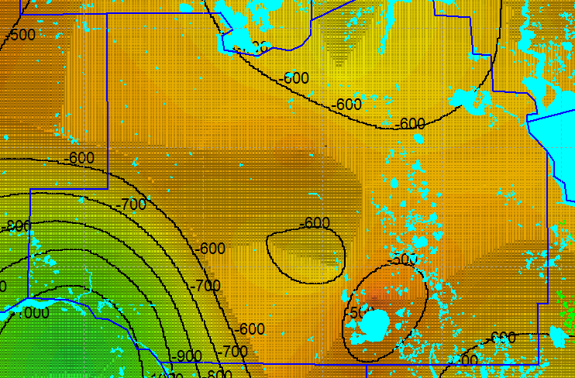
GENERALIZED TOP ESTIMATION OF THE LOWER FLORIDAN AQUIFER
IN MARION COUNTY
Elevation in feet NAVD88,

Slide 23
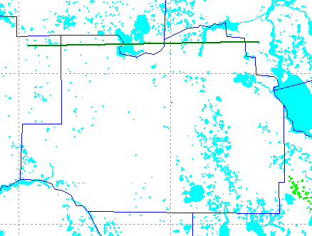
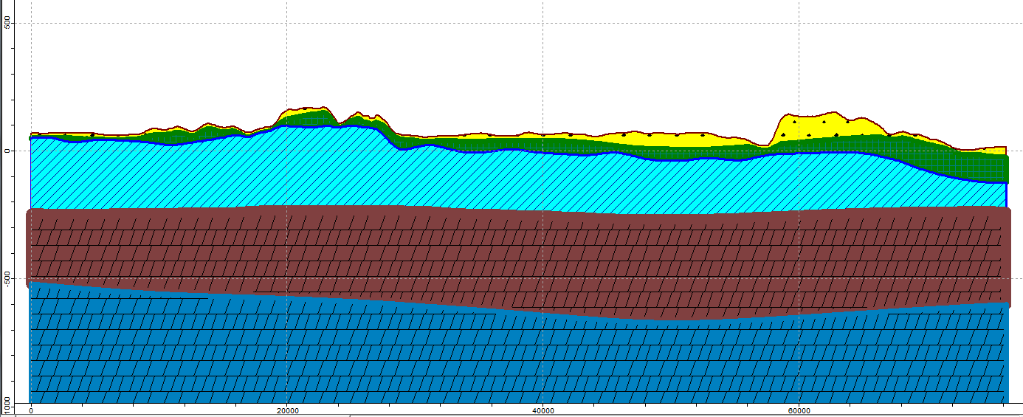

A
A’
WEST TO EAST HYDROGEOLOGIC CROSS SECTION A-A’
A
Orange
Lake
A’

Slide 24
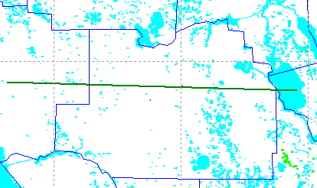
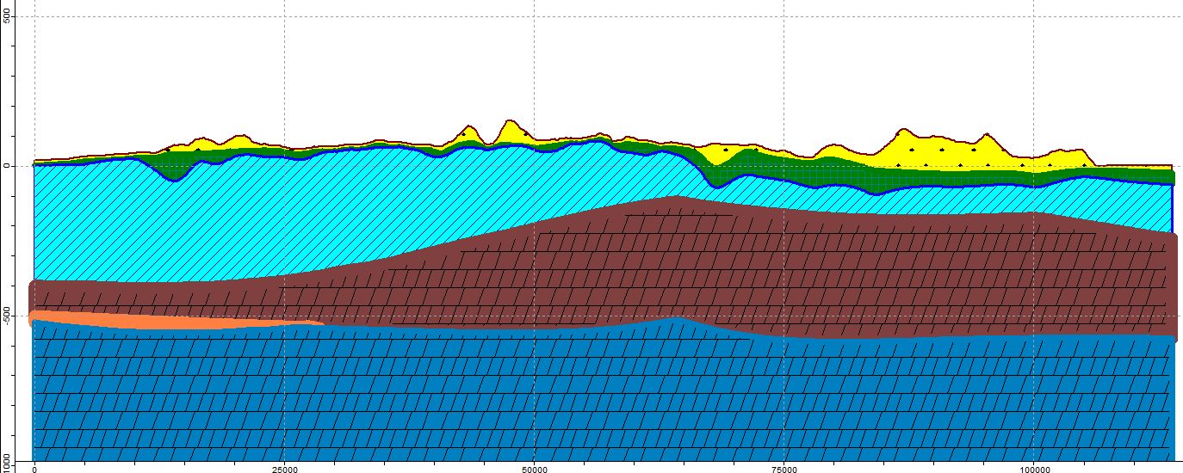

WEST TO EAST HYDROGEOLOGIC CROSS SECTION B-B’
B
Note – MCUI thins to west and MCUII present
B’
B
Ocala Platform
Lake George
B’

Slide 25
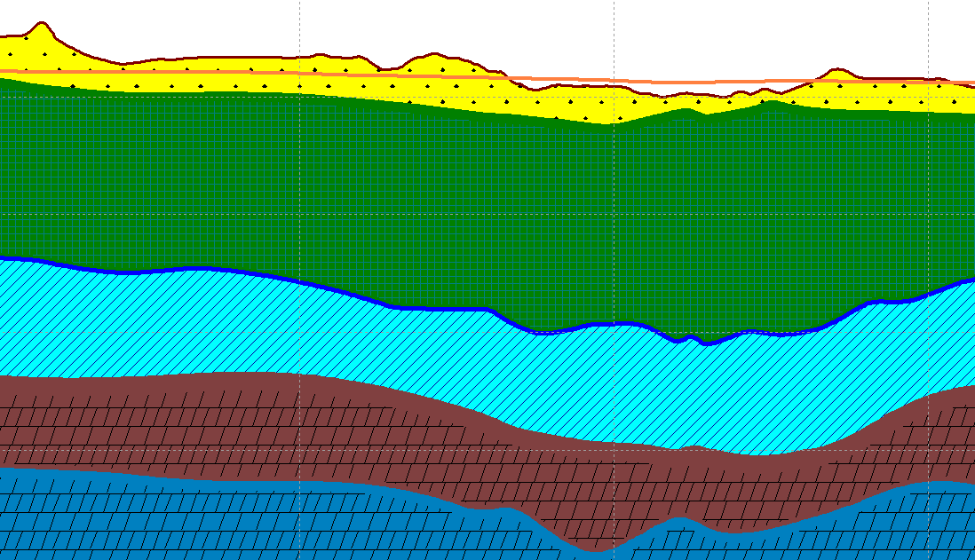
POTENTIOMETRIC SURFACE – THE LEVEL TO WHICH WATER WILL RISE IN A
TIGHTLY CASED WELL
UFA WELL FLOWS
AT LAND SURFACE
LFA LEVEL CAN BE
DIFFERENT THAN
UFA WELL
UFA WELL LEVEL
BELOW GROUND
CASED INTERVAL
OPEN HOLE INTERVAL

Slide 26
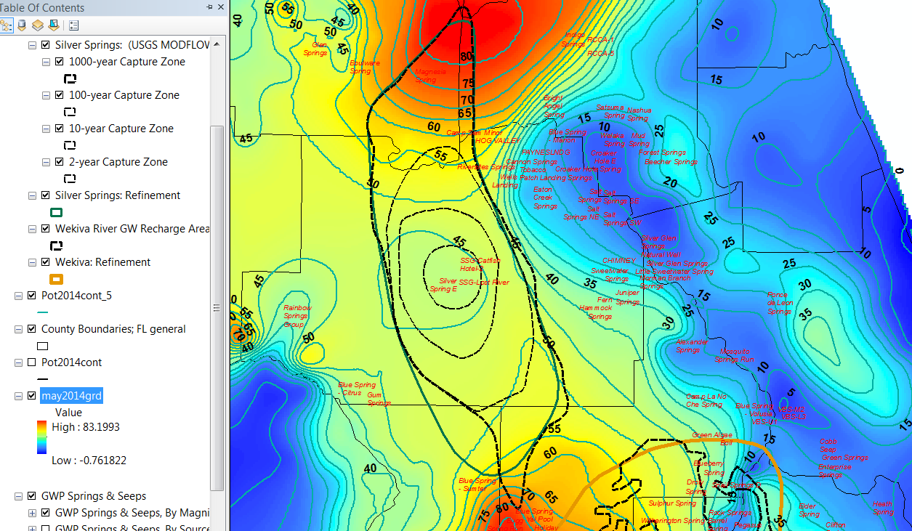
EXAMPLE POTENTIOMETRIC SURFACE MAP OF UPPER FLORIDAN AQUIFER
Recharge
Silver Springs Group discharge
Low relief or poorly defined gradient
Springshed boundary and 2, 10, 100, 1000 year capture zones
(USGS MODFLOW)

Slide 27
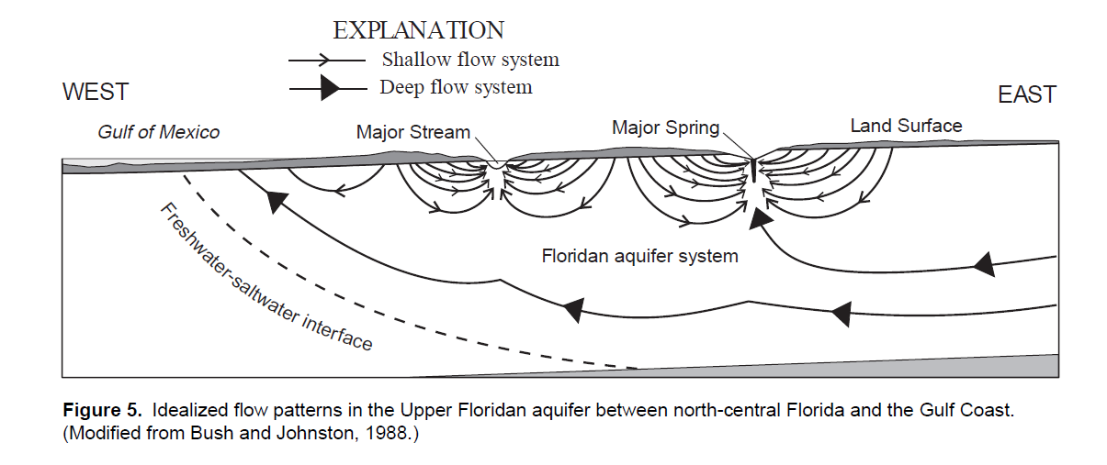
The Lower Floridan Aquifer has it’s own potentiometric surface that can be above, below, or equal to the Upper Floridan Aquifer potentiometric surface.
From : Geochemical and Isotopic Composition of Ground Water with Emphasis On Sources of Sulfate in the Upper Floridan Aquifer in Parts of Marion, Sumter, and Citrus Counties, Florida. Laura A. Sacks, USGS Water-Re sources Investigation Report 95-4251

Slide 28
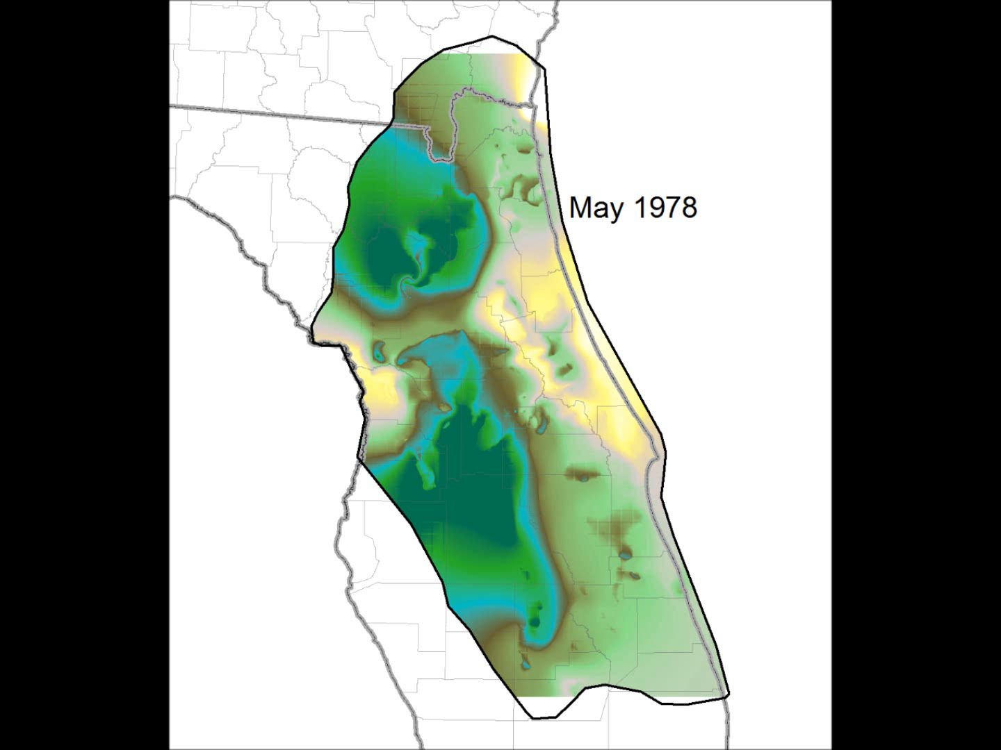
ANIMATION OF UPPER FLORIDAN POTENTIOMETRIC SURFACE
MAY 1978- SEPTEMBER 2010
(CLICK IMAGE TO START ANIMATION – movie file needs to be in directory of presentation
and will not work if viewing this as a pdf)
Test animation made by Jill Stokes, GIS analyst, SJRWMD

Slide 29
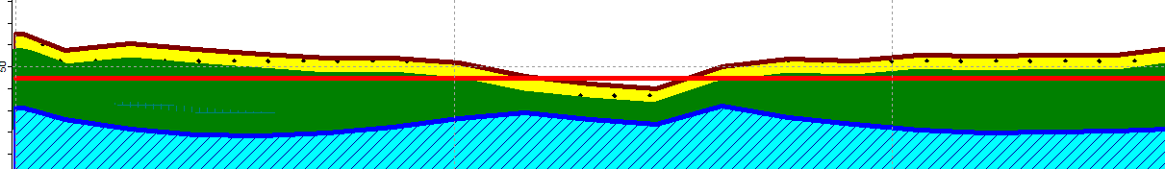
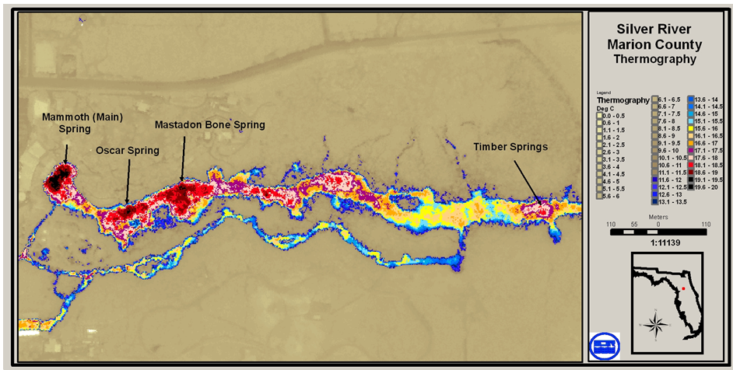
SILVER SPRINGS FLOWS BECAUSE THE POTENTIOMETRIC SURFACE
IS HIGHER THAN LAND SURFACE AND THERE ARE PATHWAYS
THROUGH THE CONFINING UNIT
1995 UFA potentiometric surface (red line)
Thermal imagery showing discharge locations
SOME DISCHARGE FROM UFA AND SOME FROM LFA

Slide 30
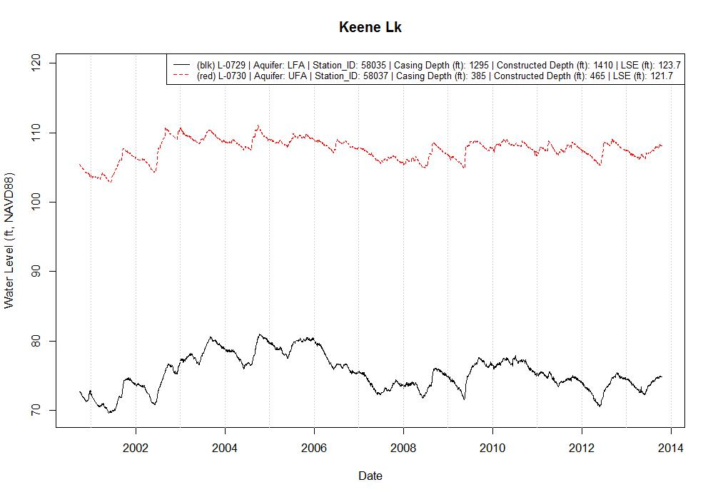
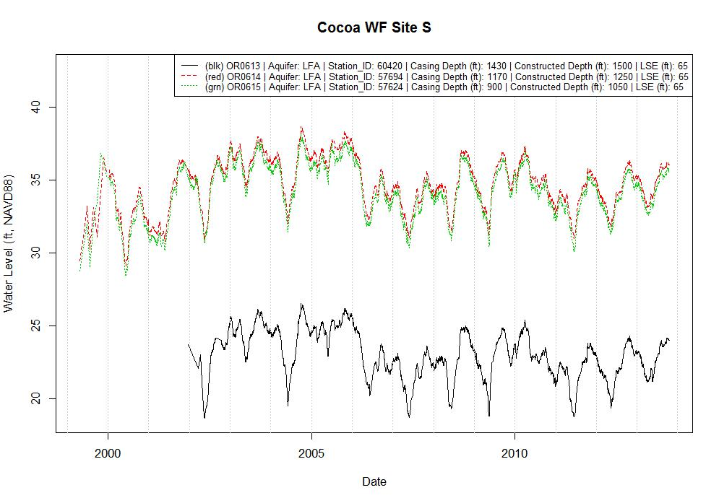
HYDROGRAPHS ARE MADE FROM MEASURING WATER LEVEL IN WELLS FOR A TIME INTERVAL
A HYDROGRAPH CAN SHOW THE GRADIENT BETWEEN UPPER FLORIDAN AND LOWER FLORIDAN
POTENTIOMETRIC SURFACE.
AT THIS SITE THERE IS OVER 35’ DIFFERENCE
IN WATER LEVEL ELEVATION BETWEEN THE
TWO AQUIFERS SO WATER WOULD FLOW
DOWN FROM UFA TO LFA IF A PATHWAY WAS
PRESENT.
Red – UFA water level
Black – LFA water level
HYDROGRAPHS CAN ALSO SHOW WATER LEVEL CHANGES FROM DIFFERENT ZONES AT THE SAME SITE IN THE UPPER OR LOWER FLORIDAN.

Slide 31
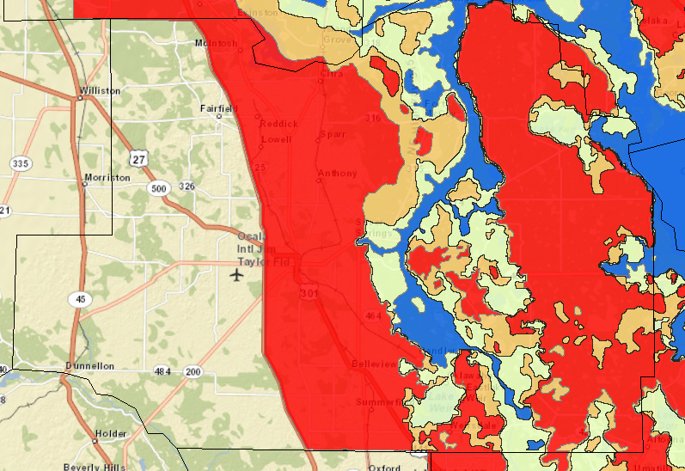
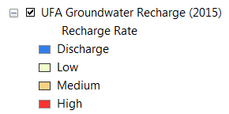
RECHARGE AND DISCHARGE IN THE SJRWMD

Slide 32
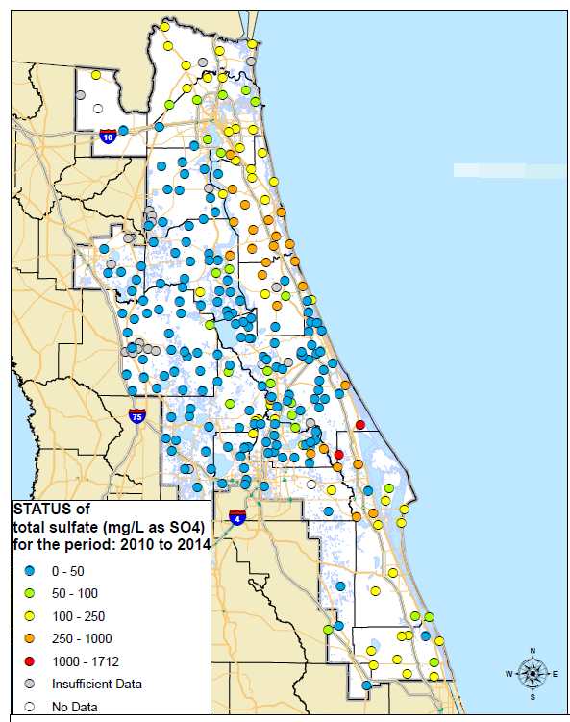
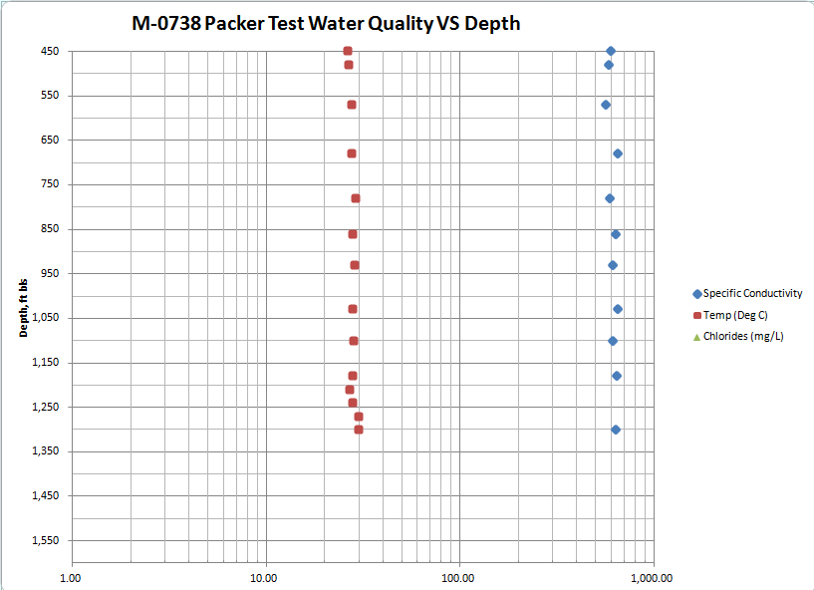
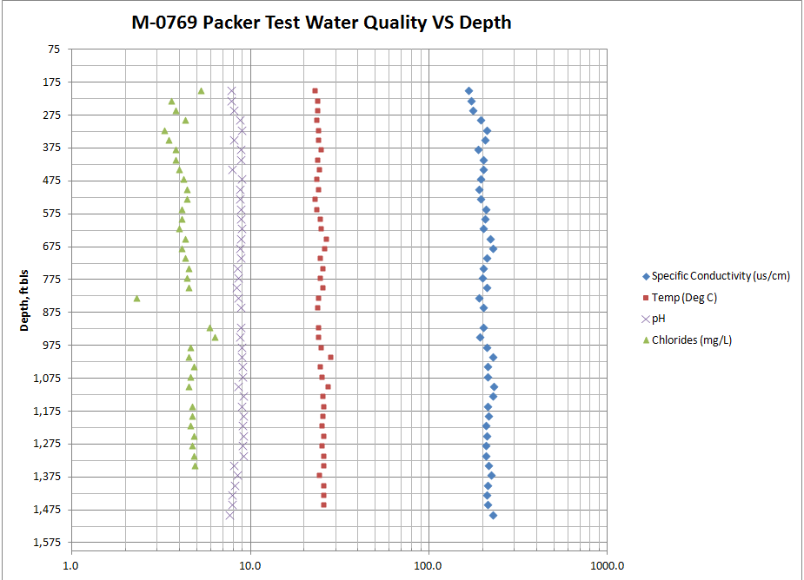
WATER QUALITY FAIRLY CONSISTENT WITH DEPTH
Sulfates generally
under 50 mg/l

Slide 33
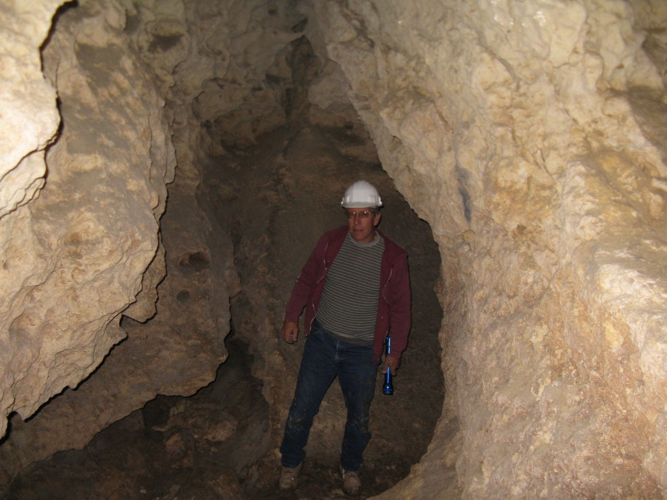
LET’S LOOK BELOW ORANGE LAKE

Slide 34
GEOPHYSICAL INVESTIGATIONS OF THE
ORANGE LAKE AREA SUBSURFACE
HIGH RESOLUTION SINGLE CHANNEL
SEISMIC REFLECTION.
MAGNETOMETER.
GROUND PENETRATING RADAR.

Slide 35

MAGNETIC FIELD INTENSITY AT THE HEAGY-BURY PARK, MARION COUNTY
ANOMALIES IN THE MAGNETIC FIELD INTENSITY INDICATE WHERE
VEHICLES AND OTHER DEBRIS WERE PLACED IN 1964
From: Davis, J. B. 1996, Geological and Karstic Features That May Impact the Surface Water to Ground Water Interactions at Orange Lake, Alachua County, Florida. Masters Thesis, University of Florida, Gainesville, Florida, 125p.

Slide 36


GROUND PENETRATING RADAR EXAMPLE (OLD STYLE ANALOG) AT THE
HEAGY-BURRY PARK BOAT RAMP
FILL
BURIED JUNK (CAR?
FUEL TANK? BUS?)
From: Davis, J. B. 1996, Geological and Karstic Features That May Impact the Surface Water to Ground Water Interactions at Orange Lake, Alachua County, Florida. Masters Thesis, University of Florida, Gainesville, Florida, 125p.

Slide 37


HIGH RESOLUTION SINGLE CHANNEL SEISMIC REFLECTION (HRSP)
Track lines limited by aquatic vegetation
Example of a subsidence feature that does
not breach the confining unit over the Floridan.
From: Kindinger, J. L., Davis, J. B., and Flocks, J. G. 1994, High-Resolution Single-Channel Seismic Reflection Surveys of Orange Lake and Other Selected Sites of Northern Florida: U S Geological Survey Open-File Report 94-616, 48 p

Slide 38

HIGH RESOLUTION SINGLE CHANNEL SEISMIC REFLECTION
AT THE HEAGY-BURRY PARK
Example of a collapse sinkhole with blocks
Slumping into the sink.
From: Kindinger, J. L., Davis, J. B., and Flocks, J. G. 1994, High-Resolution Single-Channel Seismic Reflection Surveys of Orange Lake and Other Selected Sites of Northern Florida: U S Geological Survey Open-File Report 94-616, 48 p

Slide 39

HIGH RESOLUTION SINGLE CHANNEL SEISMIC REFLECTION
AT THE HEAGY-BURRY PARK
Cavity
From: Kindinger, J. L., Davis, J. B., and Flocks, J. G. 1994, High-Resolution Single-Channel Seismic Reflection Surveys of Orange Lake and Other Selected Sites of Northern Florida: U S Geological Survey Open-File Report 94-616, 48 p

Slide 40


HIGH RESOLUTION SINGLE CHANNEL SEISMIC REFLECTION
SOUTHERN ORANGE LAKE
MUCK ON THE BOTTOM
CAUSES PROBLEMS BUT
CERTAIN FEATURES CAN
STILL BE DISCERNED
From: Davis, J. B. 1996, Geological and Karstic Features That May Impact the Surface Water to Ground Water Interactions at Orange Lake, Alachua County, Florida. Masters Thesis, University of Florida, Gainesville, Florida, 125p.

Slide 41

HIGH RESOLUTION SINGLE CHANNEL SEISMIC REFLECTION
NEAR SAMSONS POINT
Vertical discontinuity
through confining unit
From: Davis, J. B. 1996, Geological and Karstic Features That May Impact the Surface Water to Ground Water Interactions at Orange Lake, Alachua County, Florida. Masters Thesis, University of Florida, Gainesville, Florida, 125p.

Slide 42

LOCATION OF SUBSIDENCE AND COLLAPSED FEATURES IDENTIFIED
BY SEISMIC PROFILING
North and Central – Isolated, solitary
features with breaches through the ICU.
Multiple features around Samsons Point.
Poor data quality in the central area
Southwest – Mostly covered with
vegetation. Active sinks identified.
Southeast – gently sloping bowl shaped
features with evidence of differential
subsidence rates and infilling. Coalesced
sinks.
From: Davis, J. B. 1996, Geological and Karstic Features That May Impact the Surface Water to Ground Water Interactions at Orange Lake, Alachua County, Florida. Masters Thesis, University of Florida, Gainesville, Florida, 125p.

Slide 43


DYE TRACING TO IDENTIFY FLOW DIRECTION AND
ESTIMATE GROUNDWATER VELOCITY
Silver Springs Nutrient Pathway Characterization Project
FROM: Mcgurk, B.E., Davis, J. B., Stokes, J. A., Toth, D.J., Colona, W., Butt, Pete, 2011, Silver Springs Nutrient Pathway Characterization Project
Final Report Prepared for the Florida Department of Environmental Protection, St. Johns River Water Management District Special Publication SJ2012-SP2
http://floridaswater.com/technicalreports/spubs1.html Go to SJ2012-SP2 for download

Slide 44




Funded by the American Reinvestment
And Recovery Act of 2009

Slide 45
DYE TRACE CONCEPT
DYE INJECTED
AT POINT “A”
SAMPLING LOCATIONS BASED ON
ESTIMATED PATH AND AVAILABILITY
OF SUITABLE SITES.
A
WHEN DYE ARRIVES AT “B”
THE STRAIGHT LINE DISTANCE
AND TRAVEL CAN BE USED TO
CALCULATE MINIMUM
GROUNDWATER VELOCITY.
B
ACCURACY IS LIMITED BY SAMPLE FREQUENCY SO IF SAMPLES ARE WEEKLY
THEN THE ARRIVAL TIME COULD BE ON DAY 1 OR DAY 7 OF THE WEEK

Slide 46
KEY ELEMENTS OF A SUCCESFUL DYE INJECTION
Injection and sampling sites need to be located to maximize the chance of reaching the target site. This can be difficult to predict.
  Up-gradient based on potentiometric surface. Remember
  the low gradient areas in the potentiometric surface slide? Not good for dye trace.
  Natural features present (sinkhole, cave, lineaments) that would suggest site is part of a flow path.
Site has sufficient water flow to insure dye gets into the system (water filled sinkhole, drainage well, retention pond, manual injection). Rainfall is good!!
Sufficient sampling frequency to insure the event is captured.
Baseline sampling to insure no interference.

Slide 47



CAVE LOCATIONS
NATURAL FEATURES SUCH
AS CAVES MAY INDICATE
A PREFERRED GROUNDWATER
FLOW PATHWAY

Slide 48

Types of Tracer Dyes
Fluorescein (Uranine, Fluorescent yellow)
Rhodamine WT (“red fluorescent dye”)
Eosine (D&C red 22)
Sulforhodamine B (Pontacyl Brilliant Pink B)
Pyranine (Solvent Green 7)
All are usually in powder form,
except Rhodamine WT is liquid.

Slide 49

SAMPLING
SAMPLES COLLECTED ON ACTIVATED
CHARCOAL PACKETS STRATEGICALLY
PLACED.
SAMPLES ARE TAKEN FREQUENTLY
AT FIRST THEN LESS FREQUENTLY
AS TIME GOES ON
SAMPLES SENT TO A
LAB THAT SPECILAIZES IN
DYE TEST ANALYSIS.
ANALYSIS SHOWS FLURESENCE
MAGNITUDE AND WAVELENGHT
SO THE TYPE OF DYE CAN BE IDENTIFIED. EACH DYE HAS A UNIQUE SIGNATURE SO MULTIPLE DYES CAN BE INJECTED AT DIFFERENT SITES.

Slide 50

COMPARISON OF RESPONSE FROM DIFFERENT DYES

Slide 51

INJECTION SITES AND DISTANCE TO TARGET (SILVER SPRINGS)
Orange Lake 17.5 miles
Tuscawilla DRA 5.1 miles
Pontiac Pit 6.3 miles
Ocala Civic Center 1.5 miles

Slide 52



EXAMPLE RESULTS FROM A FLUORESCEIN DETECTION SITE

Slide 53


WELL SAMPLING
Avoid exposure to chlorination.
Don’t compromise water system or sanitation.
Well sampling sites set up so when pump turned on, water trickled through the charcoal sampler.

Slide 54




DYE RELEASE;
APRIL 23, 2010
SOMETIMES THE DYE
NEEDS SOME HELP TO
GET INTO THE SYSTEM.

Slide 55

ORANGE LAKE HEAGY-BURRY PARK DYE RELEASE
WATER IS ACTIVELY DRAINING INTO THE SINKHOLE IN ORANGE LAKE

Slide 56




ORANGE LAKE HEAGY-BURRY PARK INJECTION SITE TO AS FAR AS IT WAS RECORDED
NO DETECTION IN
THESE WELLS

Slide 57


TUSCAWILLA PARK DRAINAGE WELL INJECTION SITE TO SILVER SPRINGS GROUP

Slide 58





OCALA CIVIC THEATRE DRA INJECTION SITE TO SILVER SPRINGS GROUP

Slide 59




PONTIAC PIT INJECTION SITE TO AS FAR AS IT WAS RECORDED

Slide 60

TIME, DISTANCE, AND MEAN VELOCITY OF DYE

Slide 61
DISCUSSION
PATHWAYS AND TRAVEL TIMES WERE SUCCESSFULLY IDENTIFIED
BETWEEN INJECTION SITES AND SILVER RIVER OR INTERMEDIATE
SAMPLING LOCATIONS.
TRAVEL TIMES ARE SIGNIFICANTLY FASTER THAN PREVIOUSLY SUSPECTED.
NO DYE DETECTED AT SILVER RIVER FROM THE ORANGE LAKE INJECTION SITE.
EITHER SAMPLING WAS STOPPED TO EARLY, VELOCITY SLOWED DOWN POSSIBLY
BECAUSE OF MATRIX INSTEAD OF CONDUIT FLOW, OR DYE PATHWAY MISSED
THE SAMPLING SITES. SAME FOR PONTIAC PIT SITE.
DYE DID NOT REACH ALL VENTS AT SILVER RIVER SUGGESTING MULTIPLE PATHWAYS.
NO DYE DETECTED AT RAINBOW SPRINGS.
ADDITIONAL TEST MAY BE ABLE TO COMPLETE THE PATH.

Slide 62
THANK YOU FOR PARTICIPATING!

