Slide 1
Water Quality Status and Trends in Newnans, Lochloosa, and Orange Lakes
Jian Di & Erich Marzolf
jdi@sjrwmd.com
emarzolf@sjrwmd.com

Slide 2
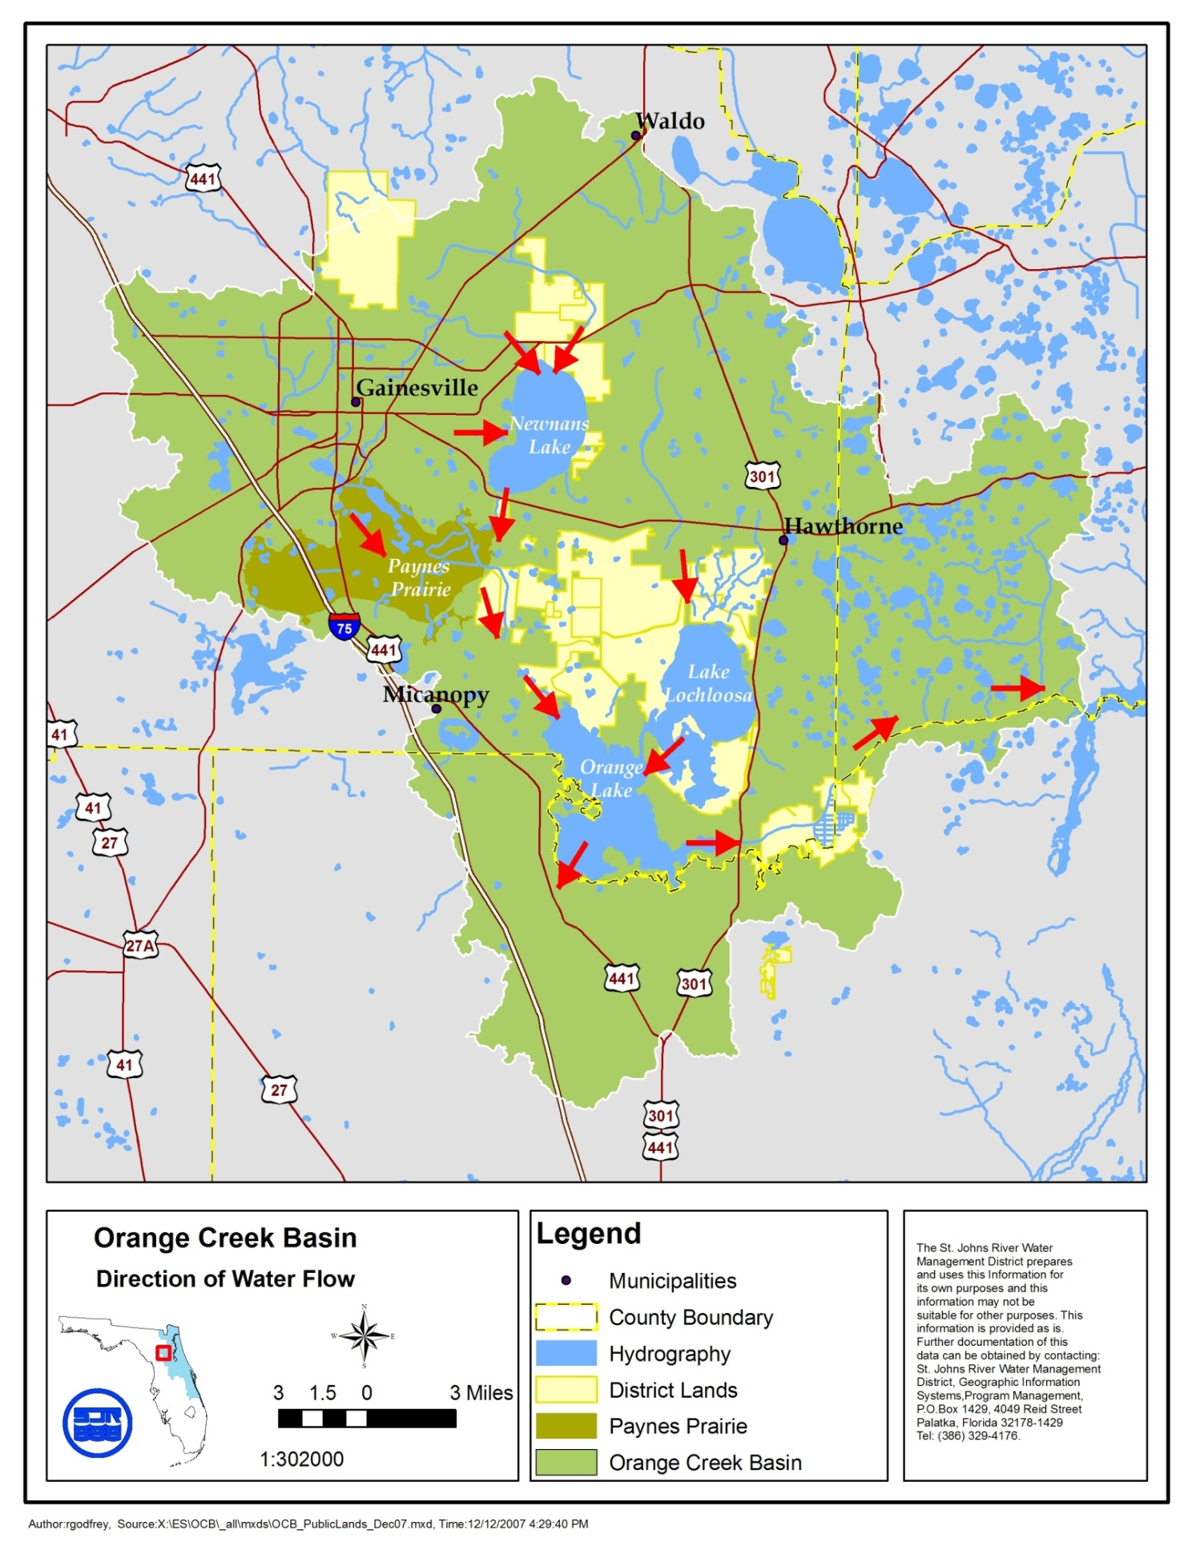
Orange Creek Basin

Slide 3
Water Quality Status
Evaluated based on recent five years (March 2004- March 2009)
Total Phosphorus (TP)
Total Nitrogen (TN)
Algal Abundance (Chl-a)
Trophic State Index (TSI)

Slide 4
Water Quality Status
Trophic State Index (TSI) scores are used to describe the water quality status:
TSI > 70 Water quality is POOR.
TSI between 60 -70 Water quality is FAIR.
TSI <60 Water quality is GOOD.

Slide 5
Water Quality Trends
Evaluated using 15 years data (1994 to 2009) of TP, TN, Chl-a and TSI in the lakes
Lake stage variation is considered for the analysis

Slide 6
Newnans Lake Water Quality Status

Slide 7
Newnans Lake Water Quality Status

Slide 8
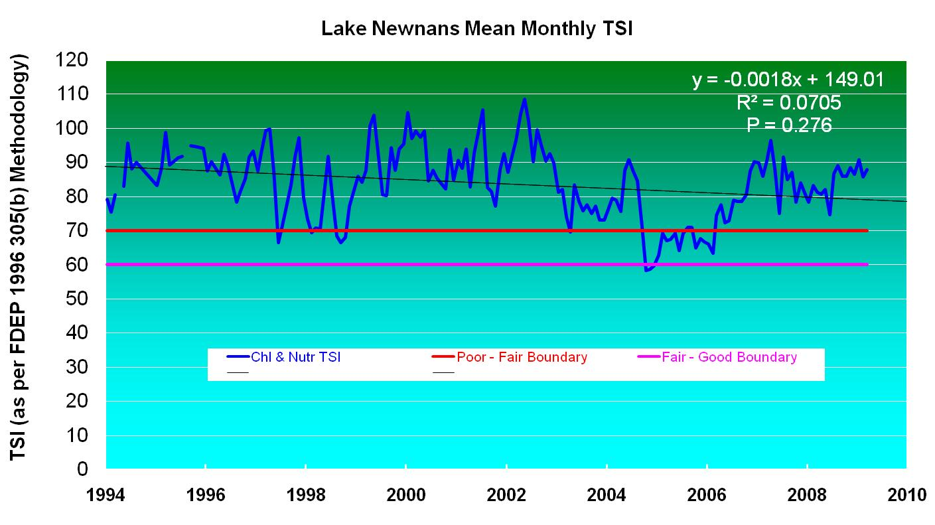
Newnans Lake Water Quality Trends

Slide 9
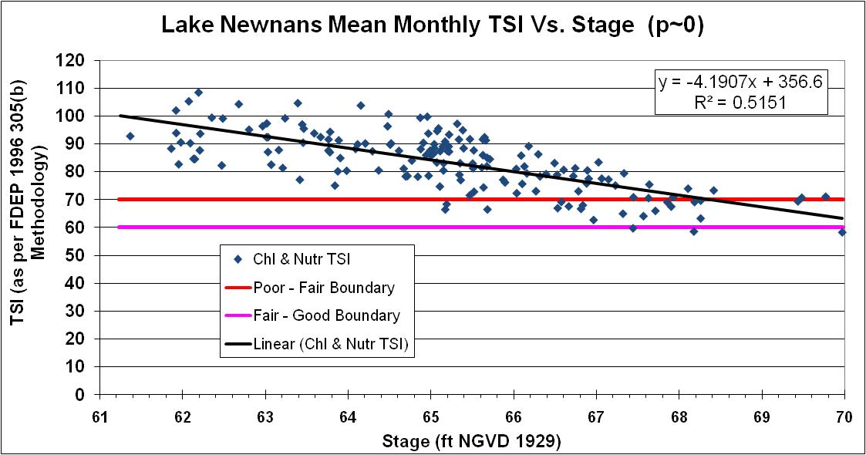

Slide 10
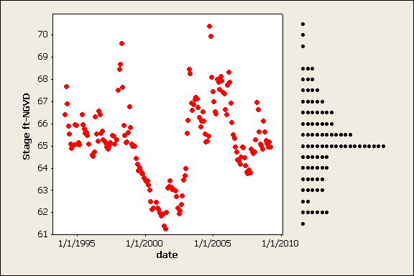
Monthly median stages and distribution in Newnans Lake 1994 -2009
Median = 65.15 ft NGVD
Data range for trend analysis 64.65 ft – 65.65 ft

Slide 14
Newnans Lake
Water quality is generally poor and varies strongly with lake stage.
The decline in TSI, TN and Chl-a over the past 15 years might indicate that Newnans Lake water quality is improving.
However, TP trends with and without a lake stage correction suggest the TP concentration is increasing.

Slide 15
Lochloosa Lake Water Quality Status

Slide 16
Lochloosa Lake Water Quality Status

Slide 17
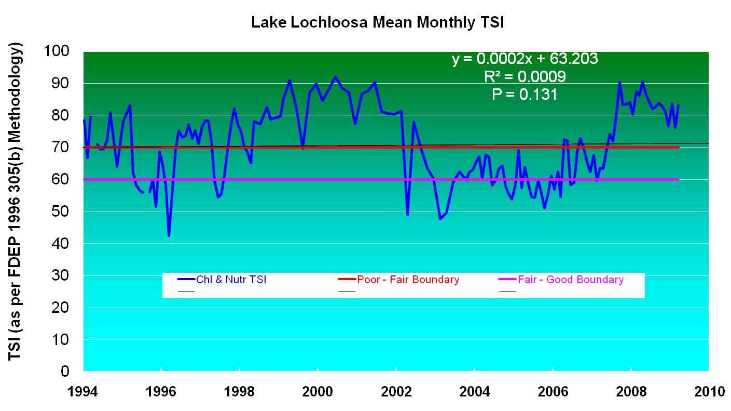
Lochloosa Lake Water Quality Trends

Slide 18
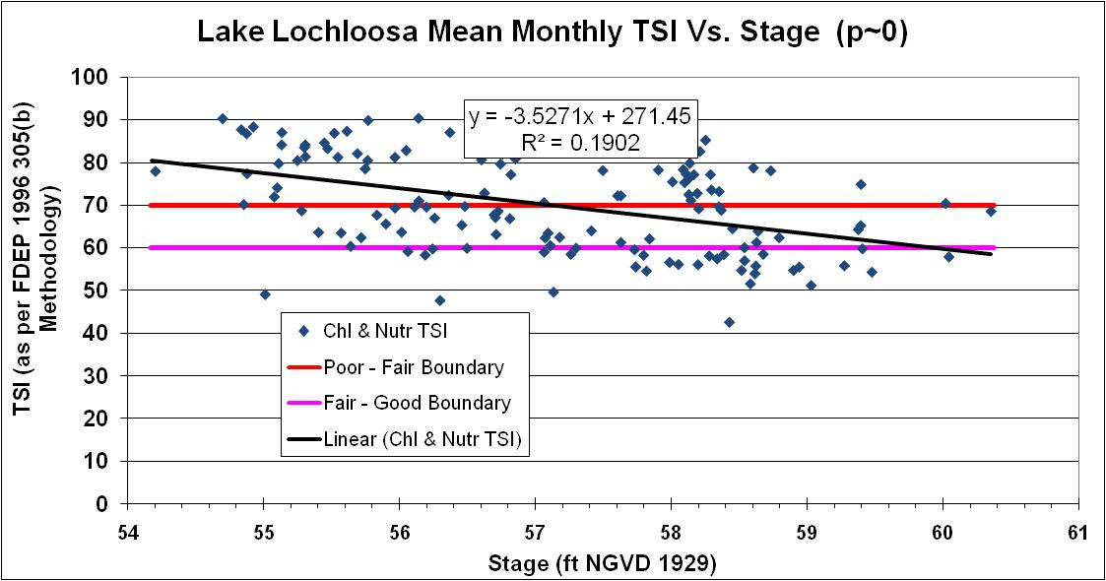

Slide 21
Lake Lochloosa
Water quality is fair, but varies from good to poor.
Less stage driven variability than in Newnans.
Very weak to no trends in TP, TN, Chl-a and TSI.

Slide 22
Orange Lake Water Quality Status

Slide 23
Orange Lake Water Quality Status

Slide 24
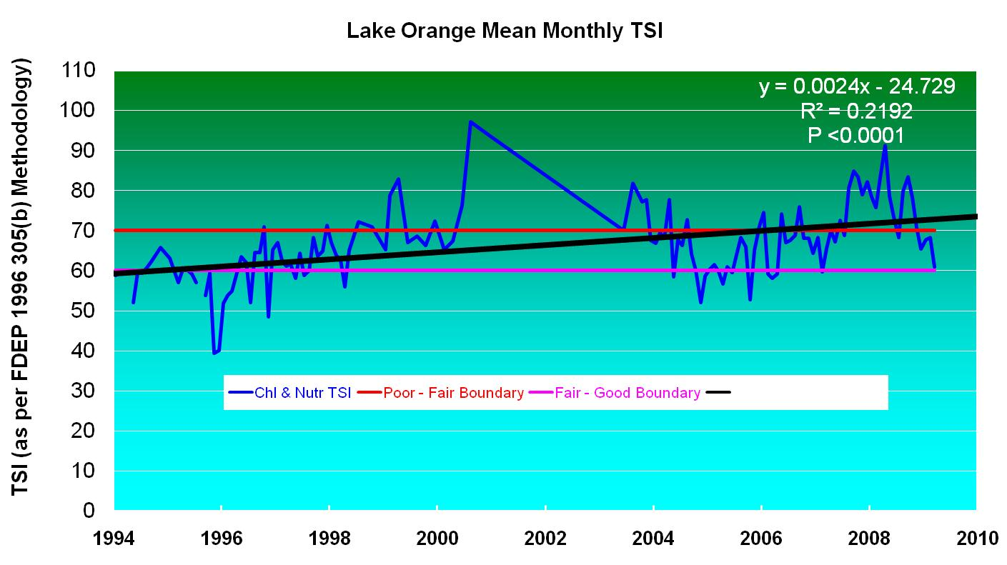
Orange Lake Water Quality Trends

Slide 25
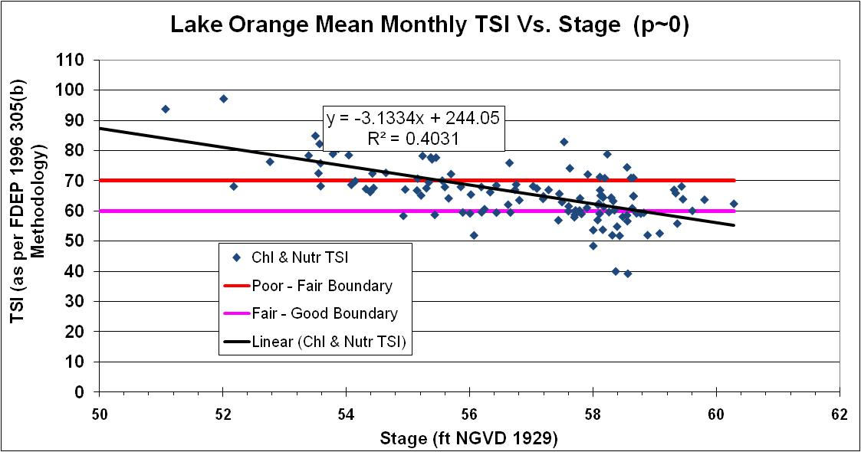

Slide 28
Orange Lake
Water quality is fair, but varies from good to fair.
Water quality varies strongly with stage, but not as strongly as Newnans.
TP, Chl-a, and TSI show significant increasing trends over the past 15 years.

Slide 29
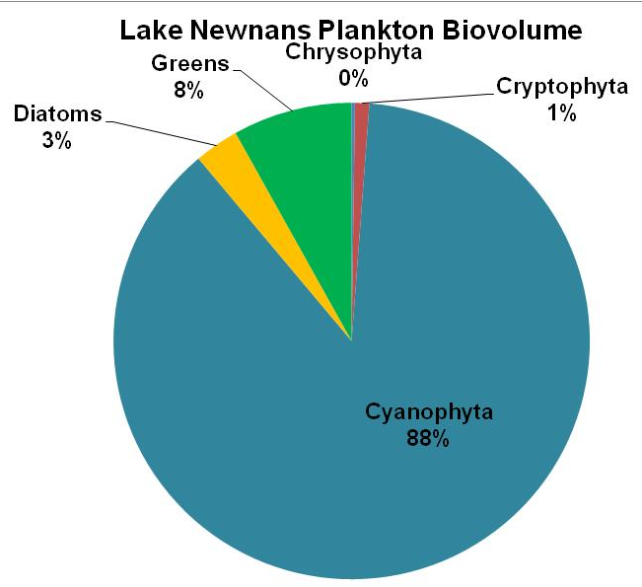
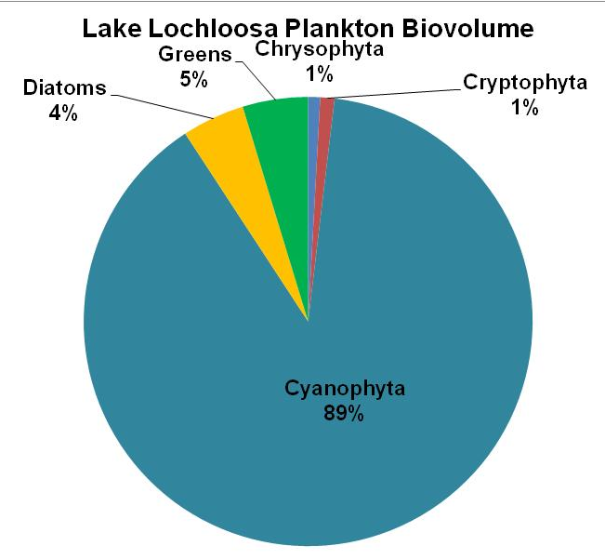
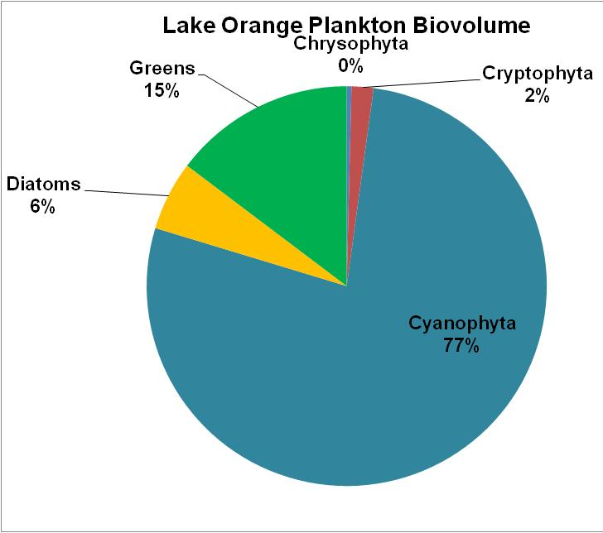
Algal Biomass Diversity
Cyanophyta dominated by N-fixing species

Slide 30
Summary
Water Quality Status:
Newnans Lake --- Poor.
Orange & Lochloosa Lakes --- Fair.
Water Quality Trends:
Newnans Lake
No significant trends in the past 15 years.
Phosphorus concentration appears to be increasing.

Slide 31
Summary
Water Quality Trends:
Lochloosa Lake
No significant trend in the past 15 years.
Water quality varies from good to poor.
Orange Lake
Significant water quality deterioration trend in the past 15 years.

Slide 32
Summary
Phytoplankton Community
All three lakes dominated by Cyanophyta (blue-greens), capable of fixing nitrogen.
Therefore, need to focus on phosphorus load reductions, especially in Newnans Lake.

Slide 33
Questions and Comments

Slide 34
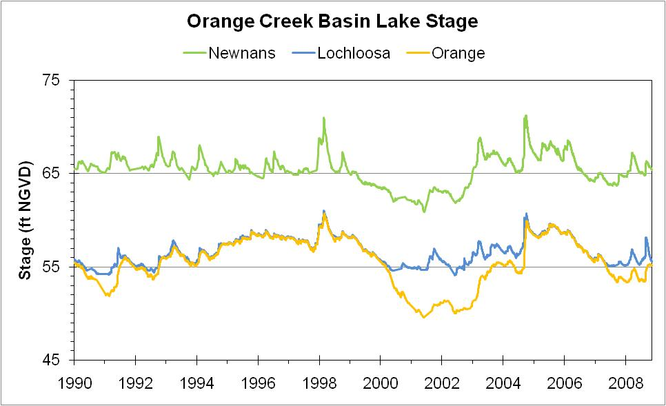
Lake Stages

Slide 35
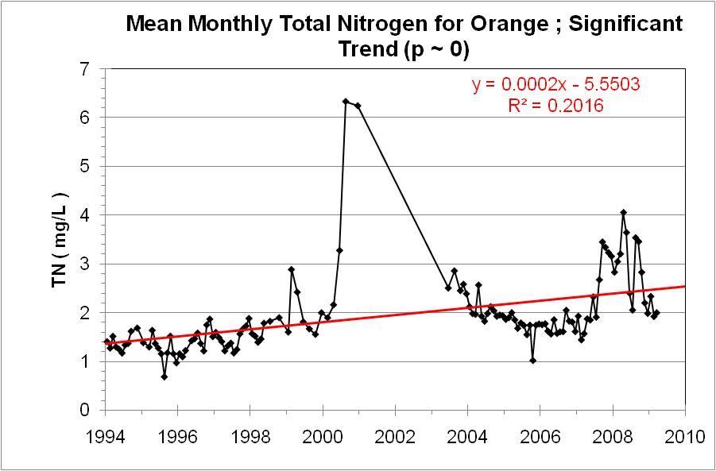
End

Slide 36
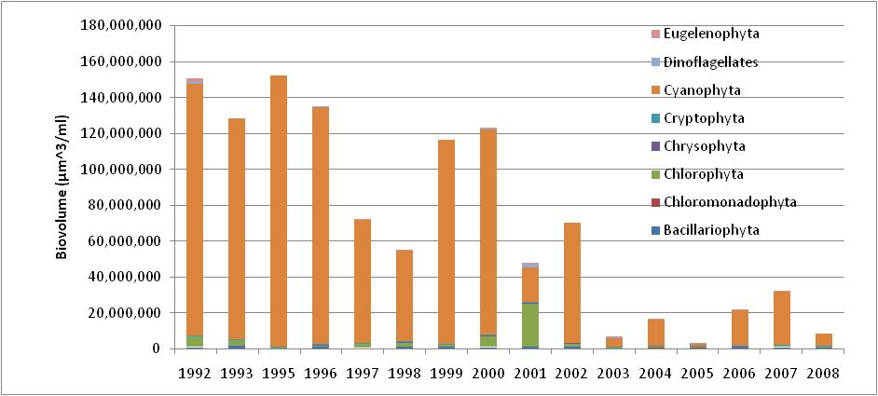
Annual average phytoplankton biovolume in Newnans Lake

Slide 37
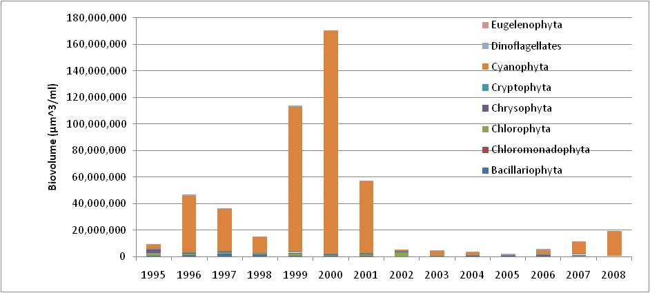
Annual average phytoplankton biovolume in Lochloosa Lake

Slide 38
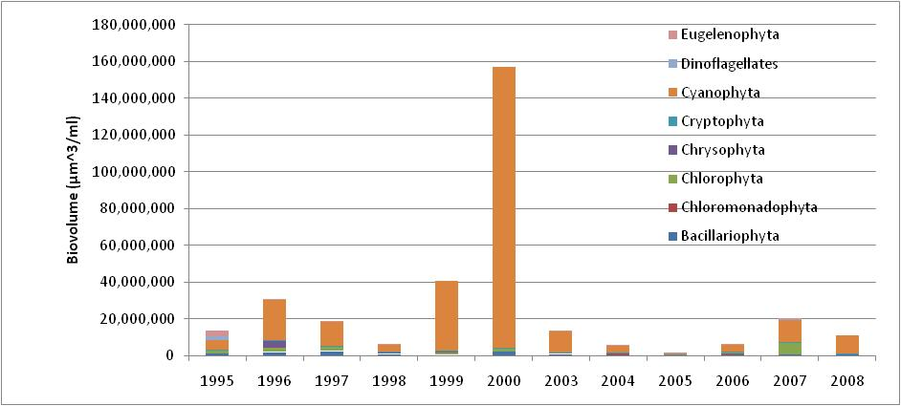
Annual average phytoplankton biovolume in Orange Lake

Slide 39
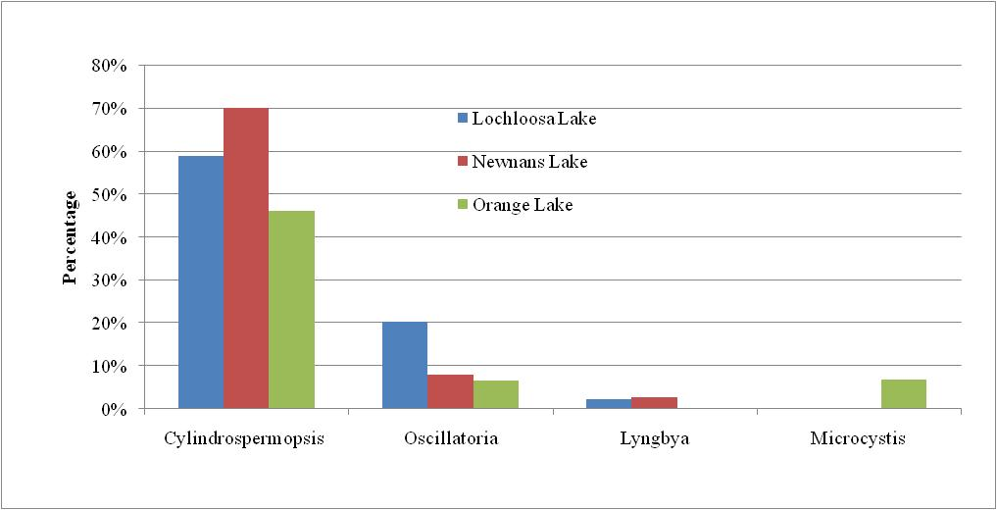
Top three dominant phytoplankton genera
In the three lakes

Slide 40
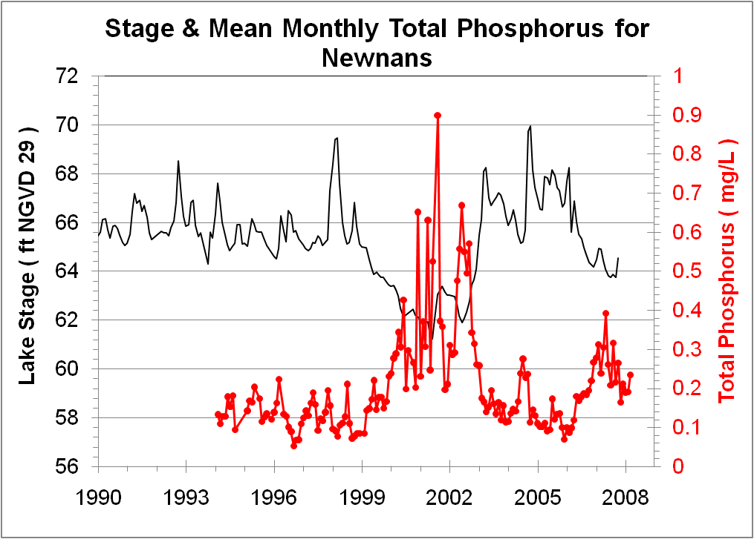

Slide 41
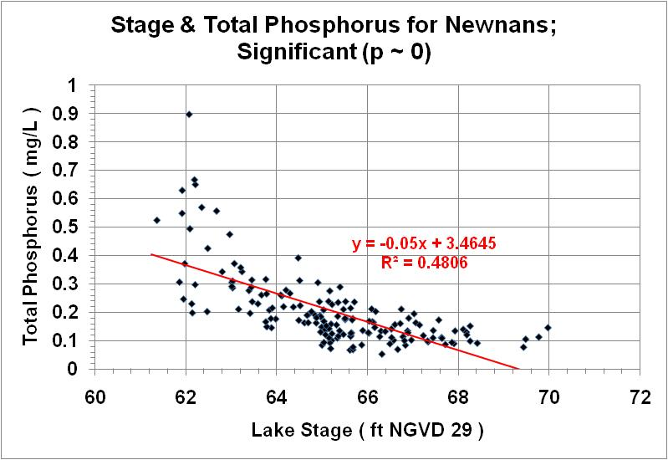
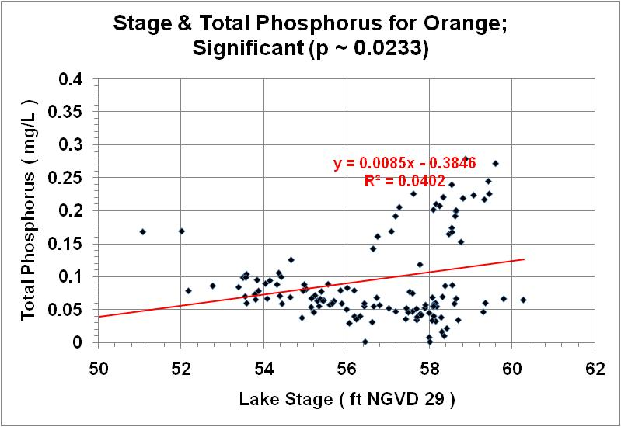

Slide 42
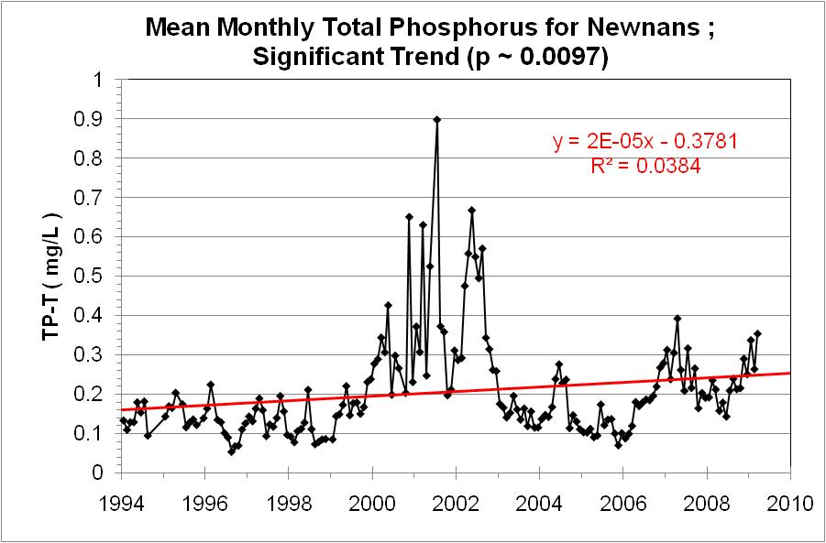
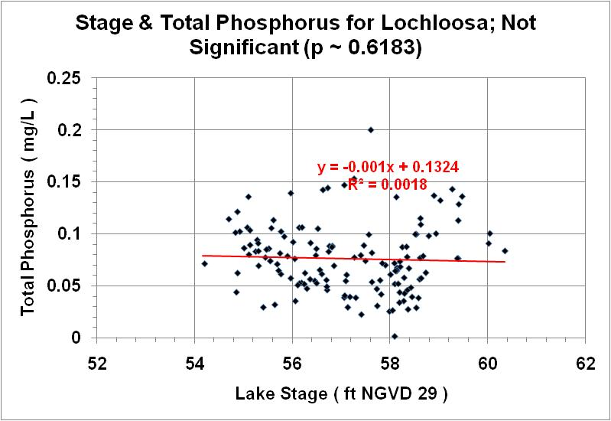

Slide 43
Summary
(Water Quality Status)
Newnans Lake has consistently poor water quality, which is strongly affected by lake stage.
Orange & Lochloosa Lakes vary from good to poor condition.
Hydrilla and its management are an additional factor complicating nutrient patterns in Orange Lake.

Slide 44
Summary
Phosphorus appears to be increasing in Newnans & Orange Lakes.
Orange Lake shows a significant water quality deterioration in TSI over the past 15 years.
All three lakes dominated by Cyanophyta (blue-greens), capable of fixing nitrogen.
Therefore, need to focus on phosphorus load reductions, especially in Newnans Lake.

