Slide 1
Fixed Crest Weir at Hwy 301
FWC Engineer’s Report – March 2012

Slide 2
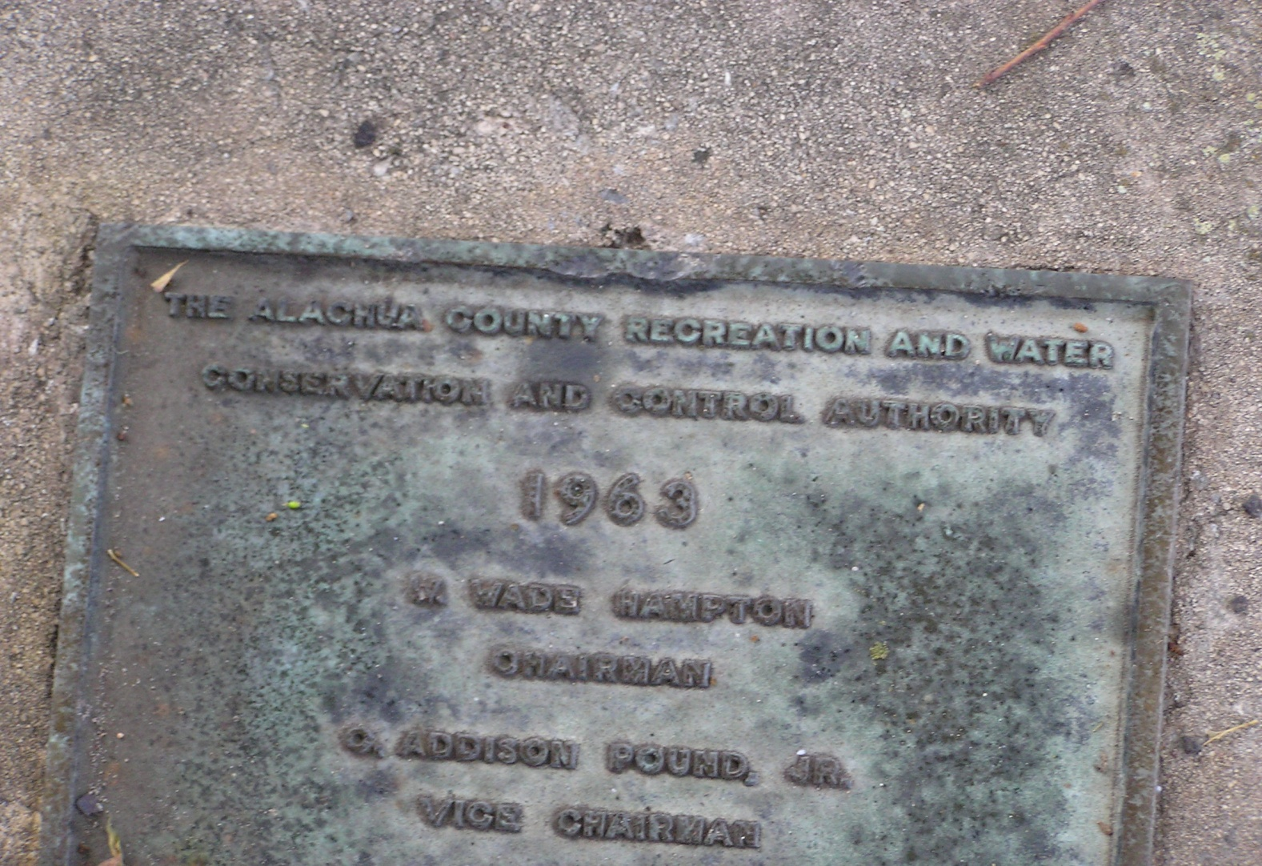
Alachua County Recreation and Water Conservation and Control Authority
Notes:
This agency has never been decommissioned.

Slide 3
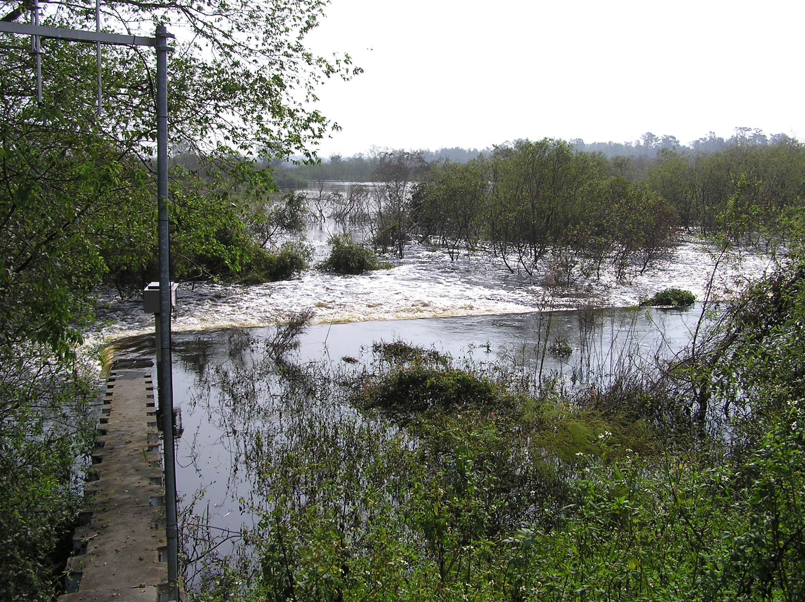
October 2004 – 1.5 Foot Head Over Notch in Weir

Slide 4
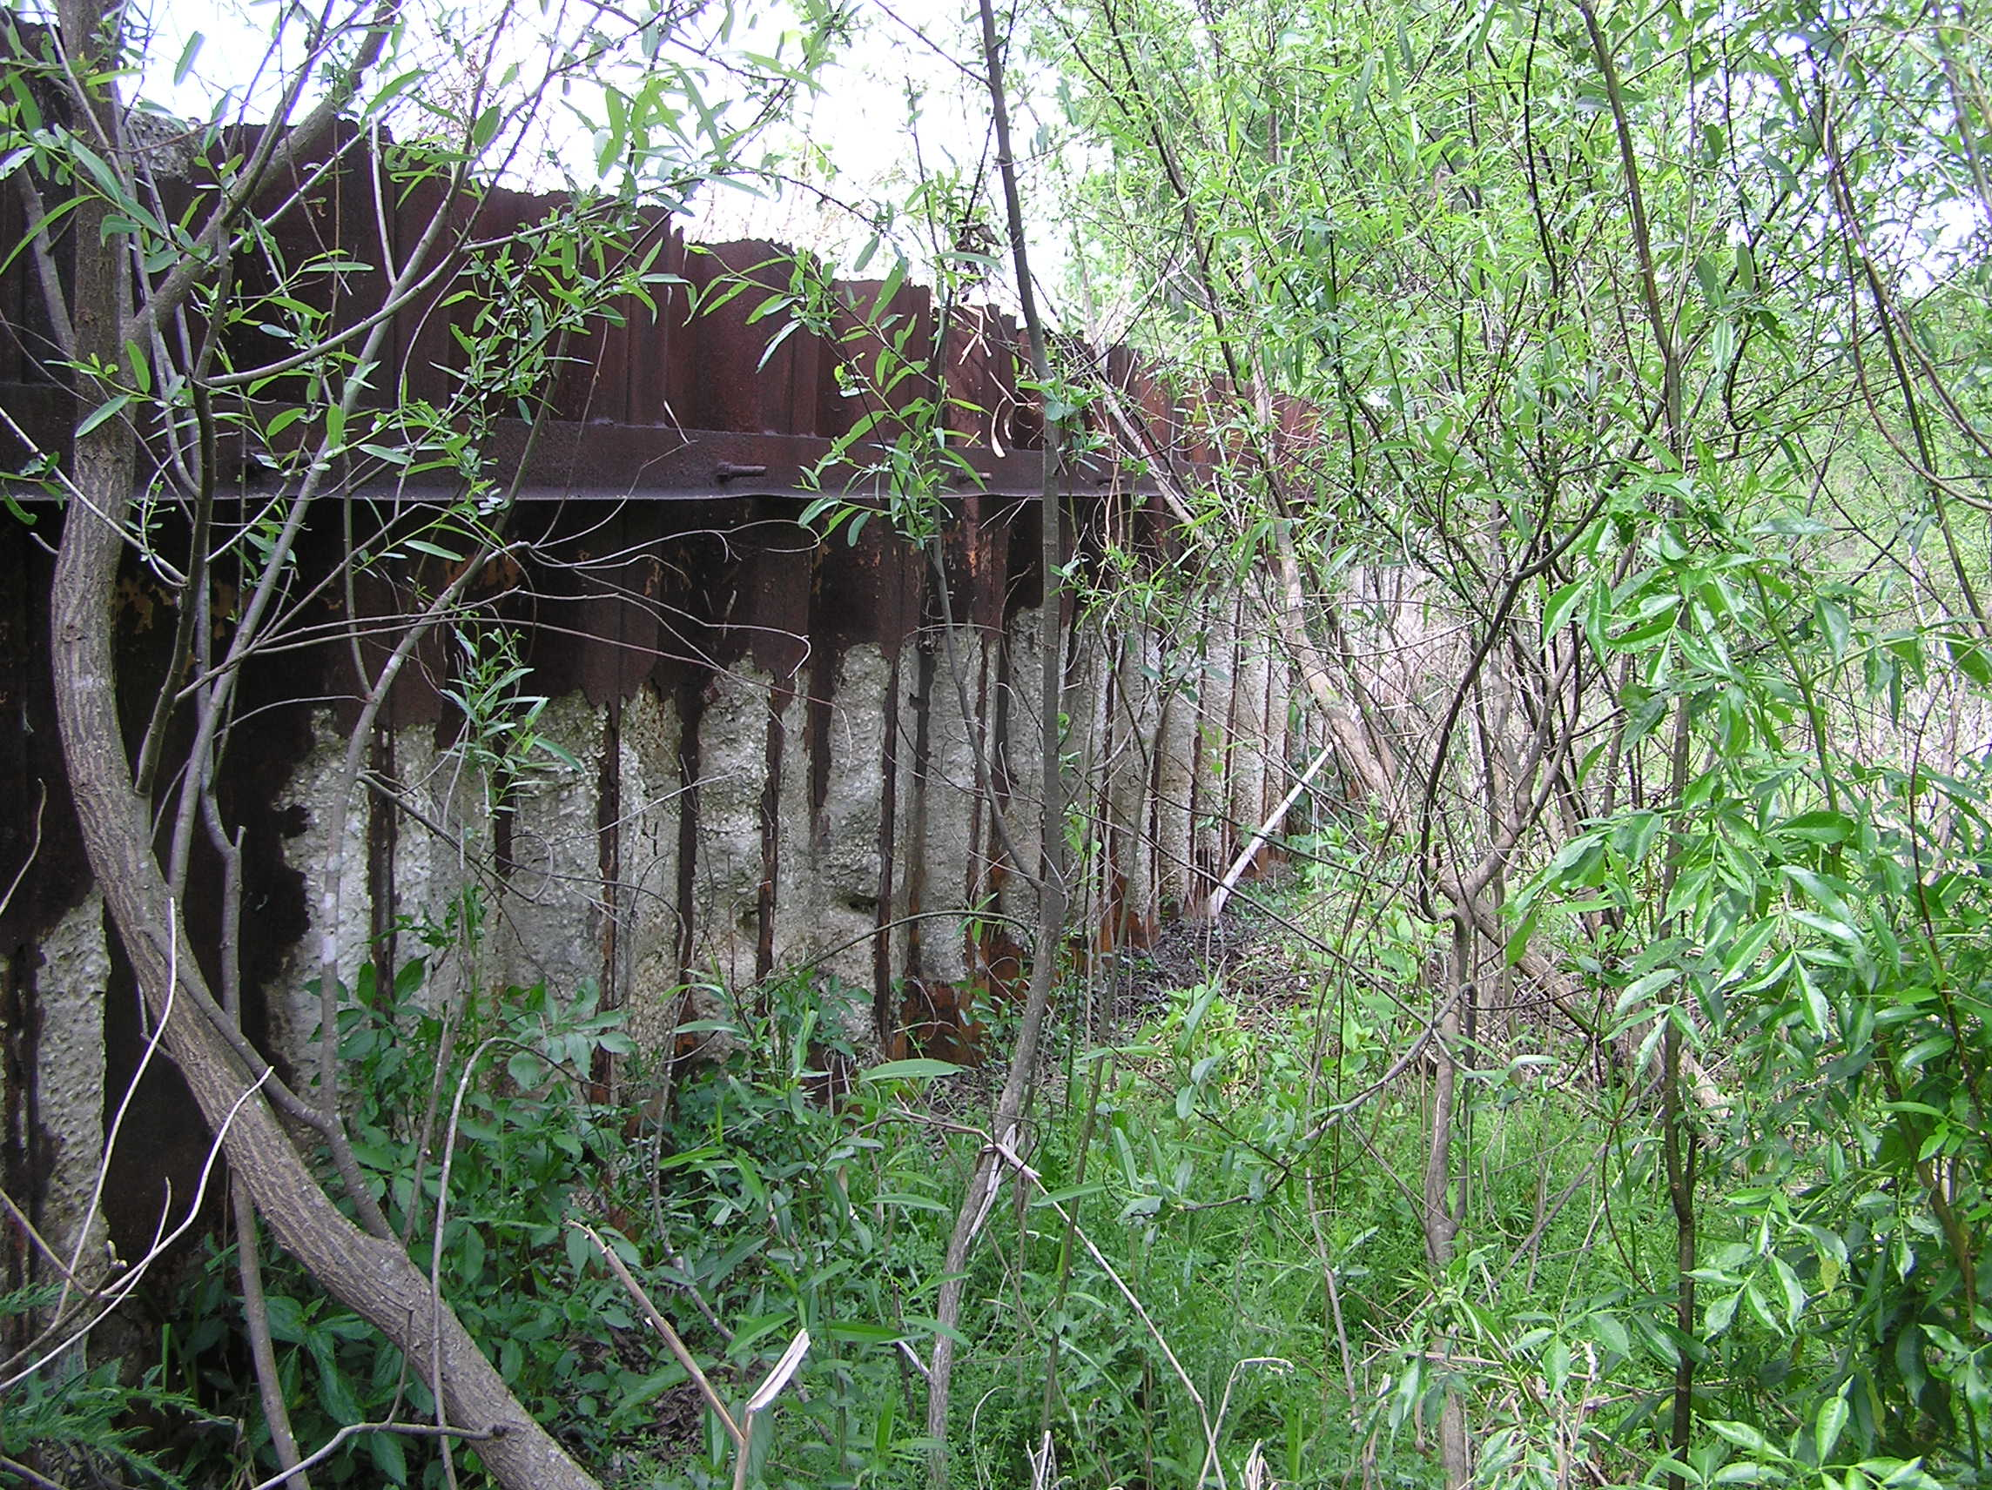
Reinforcing Sheet Pile Completely Eroded Away

Slide 5
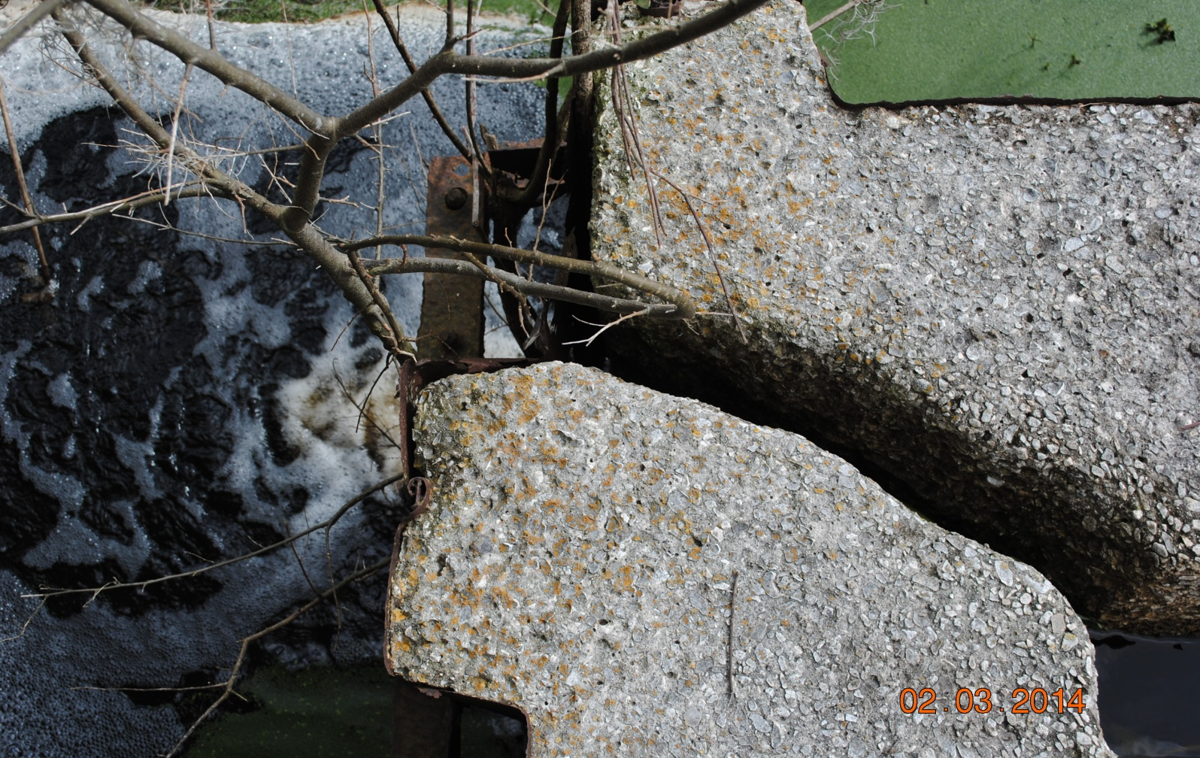
Corners Separating – Never Reinforced With Rebar During Construction

Slide 6
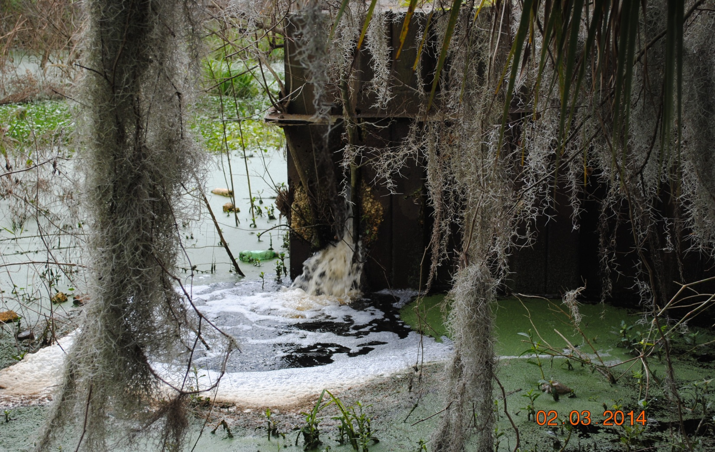
Repair or Temporary Stabilization of Structure not Feasible
Notes:
Notice water leaking from corner of structure.

Slide 7
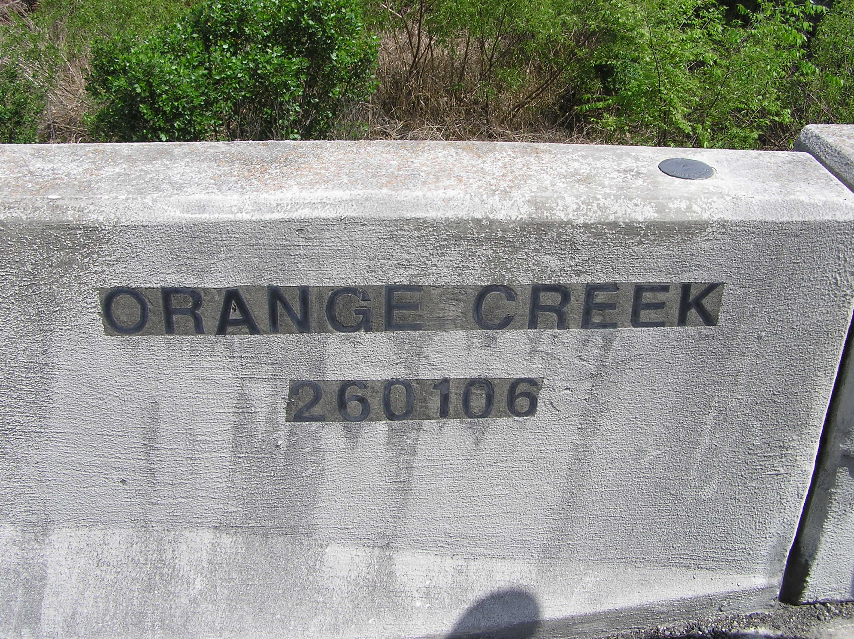
Engineer Conclusion – Imminent Failure of Structure Likely

Slide 8
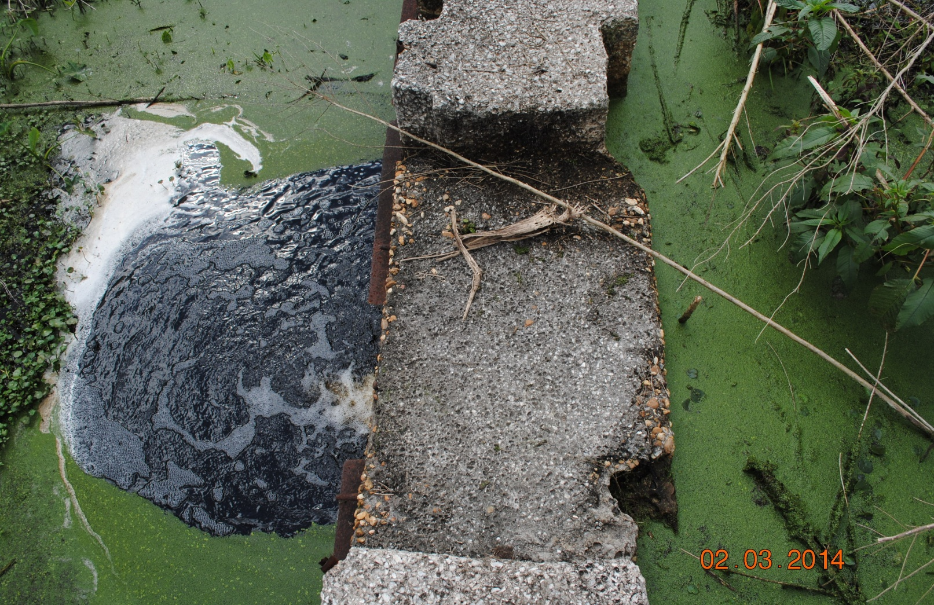
Water Three Inches From Notch In Weir – February 3, 2014
Notes:
Orange Creek Restoration Area water level only ~ 1.5 feet lower than Orange L (1-31-14).

Slide 9
DOT Concerns With Structure?
Scour Study Contracted out in 2012 – some risk to integrity of bridge with high volume water flows
DOT Engineer has not Reviewed Report to Date (February 2014)

