Slide 1
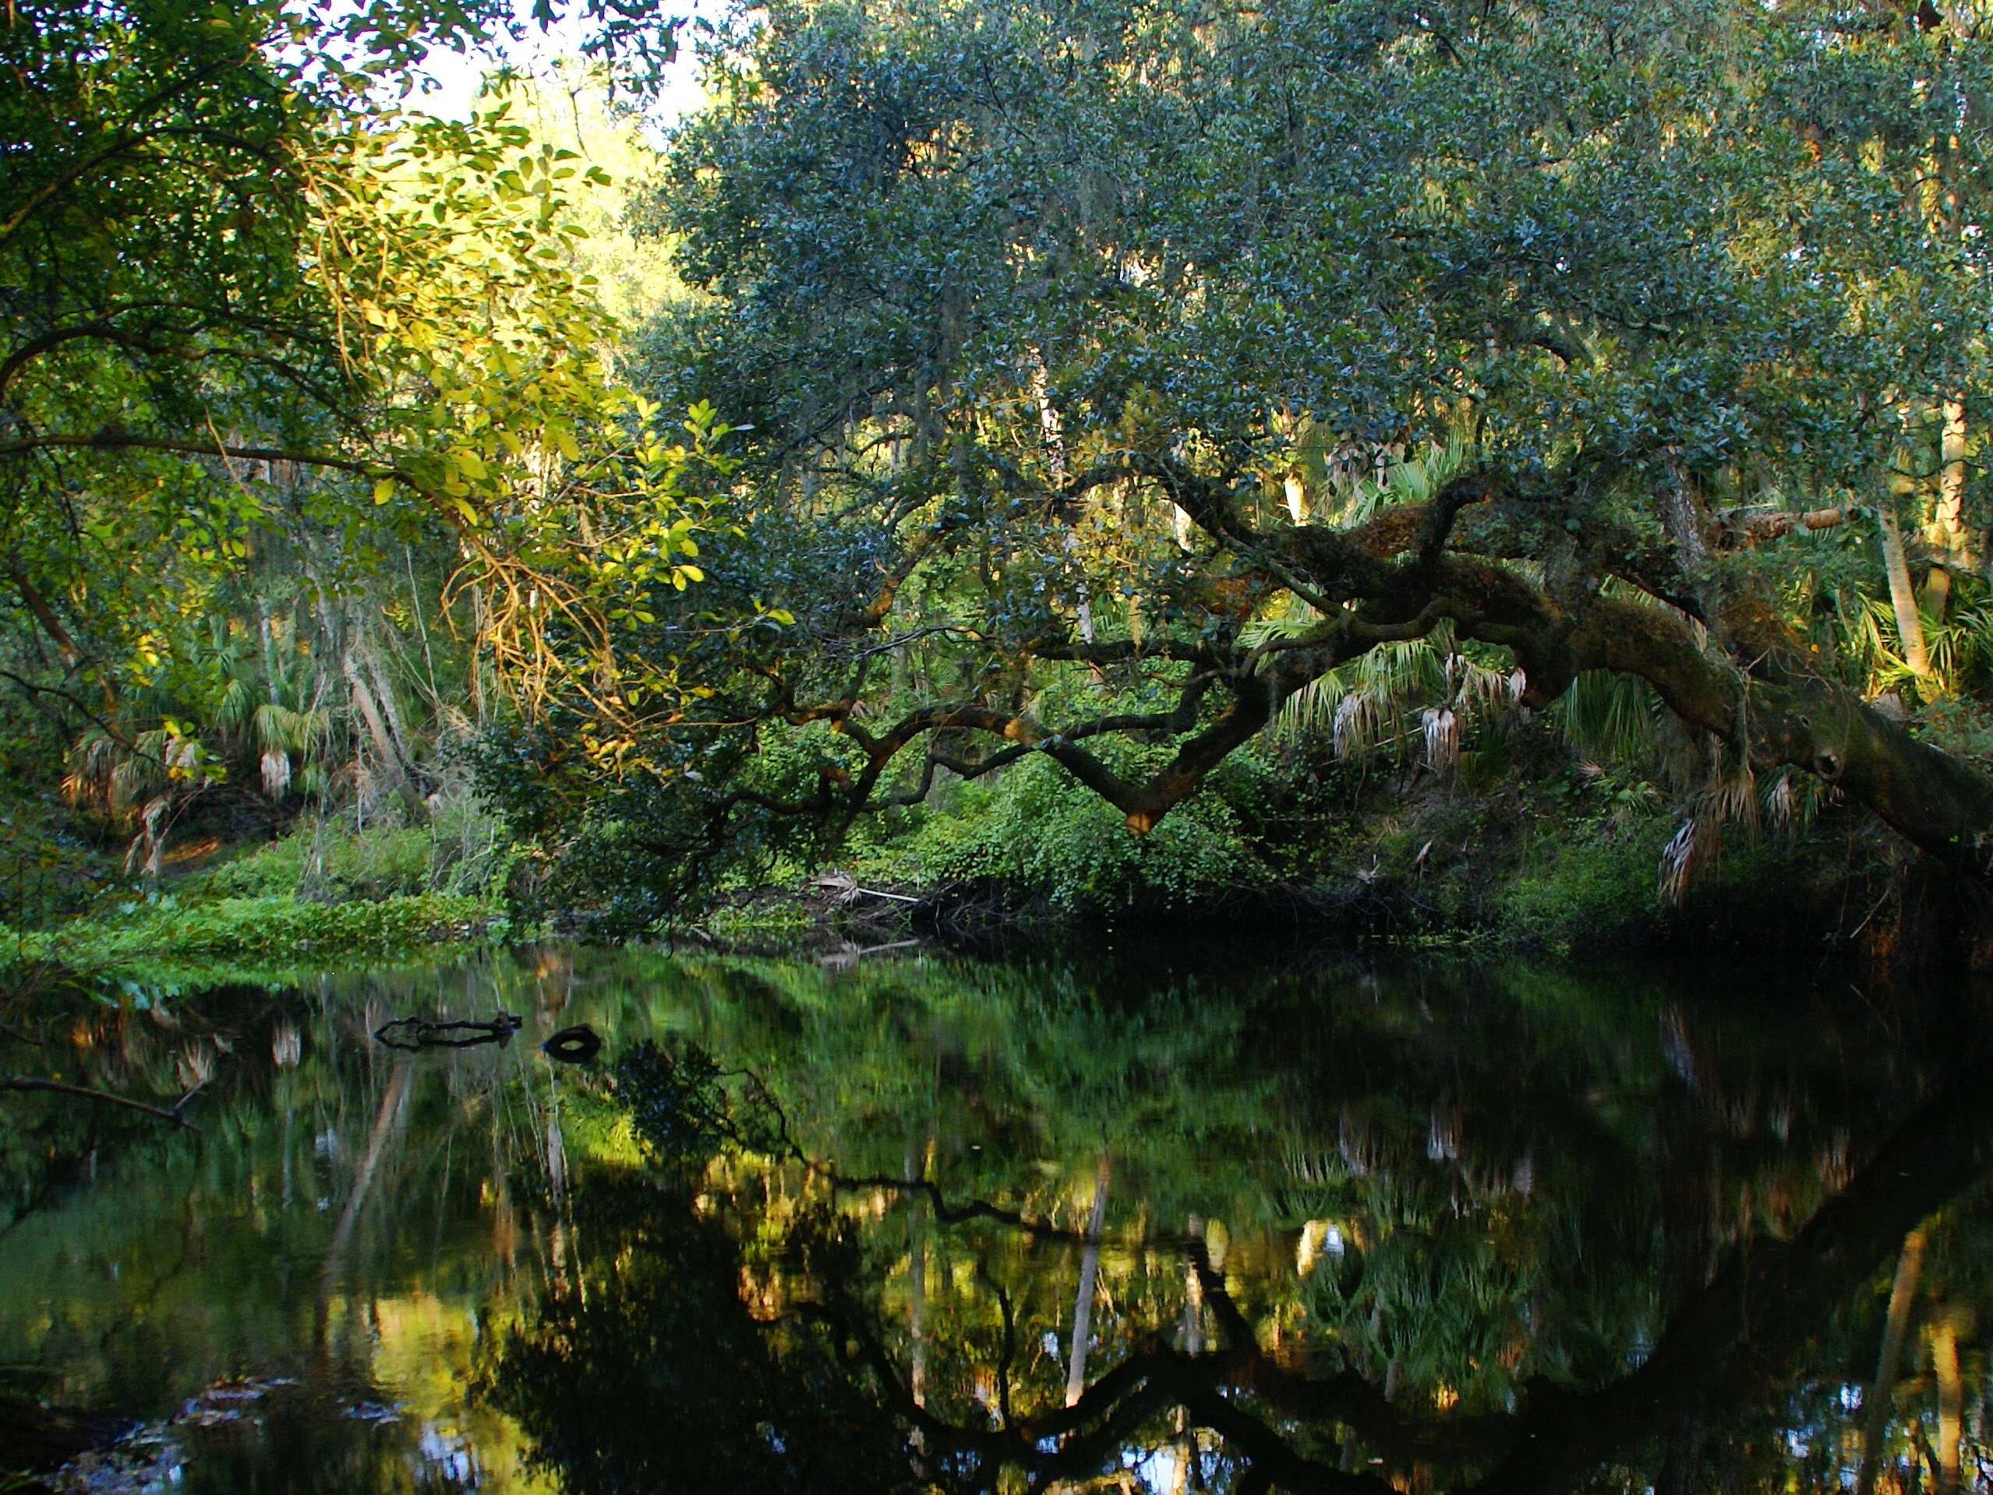

Orange Creek Basin Management Action Plan (BMAP) Annual Meeting
Jessica Fetgatter
Division of Environmental Assessment and Restoration
Florida Department of Environmental Protection
GoTo Webinar| June 27,2023

Slide 2
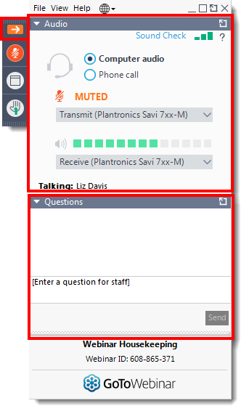
Webinar Housekeeping
Attendee Participation
Open your control panel.
Join audio:
Choose Computer Audio or
Choose Phone Call and dial using the information provided with your registration
Attendee audio will automatically be muted.
Submit questions and comments via the Questions panel.
If viewing this webinar as a group, please provide a list of attendees via the Questions panel.
Note: Today’s presentation is being recorded and will be provided on the file transfer protocol (FTP) site after the webinar.
(Example Only)

Slide 3
Annual Meeting Agenda
Welcome
St. Johns River Water Management District (SJRWMD) Updates
BMAP Background and Updates
Florida Department of Agriculture and Consumer Services (FDACS) Updates
Unenrolled Agricultural Producer Enforcement
Funding Opportunities
Notes:
In todays meeting we are going to cover: Water Quality by Tiffany Trent with St. Johns River Water Management District
a brief history of the Upper Ocklawaha Basin Management Action Plan followed by Updates
Agricultural Enrollment by Cori Hermle with the Florida Department of Agriculture and Consumer Services
Unenrolled Agricultural Enforcement by David Frady with DEP
and Funding Opportunities by Michael Barr also with DEP

Slide 4
BMAP PROGRAM STAFF UPDATE
https://floridadep.gov/dear/water-quality-restoration/content/basin-management-action-plans-bmaps
Moira Homann
Program Administrator
Lauren Campbell
Environmental Administrator
Diana Turner
Environmental Administrator
Chandler Keenan
BMAP Coordinator
Sam Hankinson
BMAP Coordinator
Jessica Fetgatter
BMAP Coordinator
Stacy Cecil
BMAP Coordinator
Nicole Morgan
BMAP Coordinator
Evelyn Becerra
BMAP Coordinator
Anita Stine
BMAP Coordinator
Jared Searcy
FSESCI Coordinator
Vacant
BMAP Coordinator
DeLeon Spring
Gemini Springs
Long Branch
Lower St. Johns River Main Stem
Upper Wakulla River and Wakulla Springs
Volusia Blue Spring
Wekiwa and Rock Springs
Wekiva River, Rock Springs Run, and Little Wekiva Canal
Lake Okeechobee
Suwannee
Santa Fe
Homosassa & Chassahowitzka
Weeki Wachee
Crystal River/Kings Bay
Jackson Blue
Wacissa River and Wacissa Springs Group
Silver Springs and Rainbow Spring
Upper Ocklawaha
Orange Creek
Alafia River
Bayou Chico
Hillsborough River
Lower St. Johns River Tributaries
Manatee River
Banana River Lagoon
North Indian River Lagoon
Central Indian River Lagoon
Caloosahatchee River and Estuary
St. Lucie River and Estuary
Everglades West Coast
Lakes Harney, Monroe, Middle St. Johns River and Smith Canal
Lake Jesup
Florida Stormwater, Erosion, and Sedimentation Control Inspector (FSESCI) Program
Notes:
To start we have a couple of quick updates. There have been several changes in the program so we wanted to provide a reference for current contacts. Also, the vacant position has been posted.

Slide 5
The Florida Stormwater, Erosion, and Sedimentation Control Inspector (FSESCI) Program
To become qualified to conduct National Pollutant Discharge Elimination System (NPDES) Construction Generic Permit (CGP) Stormwater Inspections, take this class to learn:
  Construction Best Management Practices – Common Techniques and Technologies
  Proper compliance with the NPDES CGP
  Creating and reviewing a Stormwater Pollution Prevention Plan (SWPPP)
  Florida specific stormwater regulation
  How to conduct stormwater inspections
For more information and a list of public classes, visit:
  www.fsesci.com, or
  www.FDEPstormwaterclass.com.
Become an FSESCI Instructor for your organization:
  www.fsesci.com/newinstructor/
DEP Statewide Training Coordinator:
Jared Searcy
Jared.Searcy@floridadep.gov
850-245-8445
Notes:
We wanted to talk a little bit about Jared Searcy’s Florida Stormwater, Erosion, and Sedimentation Control Inspector Program (FSESCI)
Jared is our statewide training coordinator and is knowledgeable about all things construction.
Jared Searcy is our statewide training coordinator for the Florida Stormwater, Erosion, and Sedimentation Control Inspector Program (FSESCI). He is super knowledgeable about all things construction BMP wise. He puts together all the materials, teaches, and pretty much runs this program single handedly. On the screen are a couple of websites you can visit if you are interested in becoming a certified inspector or an instructor. The more instructors we have across the state, the more inspectors we can have, which is great with all of the construction always going on in Florida.

Slide 6
Orange Creek Water Quality Monitoring Update
Tiffany Trent, St Johns River Water Management District

Slide 7
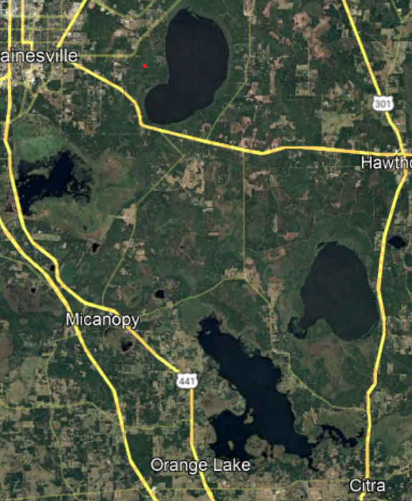
Water Quality Update
NEW
Focusing on 3 analytes: TN, TP, and Chl-a
Newnans Lake, Lochloosa Lake, Orange Lake
Water quality data obtained from St Johns River Water Management database.
Each lake had samples in every quarter, so arithmetic means were used.
Harmful Algal Bloom Data provided by DEP HAB website.
LOL
OLC

Slide 8
Lake TMDL Summaries
Lake | TN TMDL Target (mg/L) | 2022 Average | TP TMDL Target (mg/L) | 2022 Average | Chl-a TMDL Target (mg/L) | 2022 Average
Newnans | 0.97 | 1.71 | 0.062 | 0.15 | 57.6 | 80.15
Lochloosa | 1.15 | 1.66 | 0.055 | 0.07 | 38 | 58.3
Orange | N/A | 1.42 | 0.031 | 0.06 | 29.2 | 51.51
Notes:
Unfortunately, none of the TMDL concentration targets were met for the 3 major lakes in the OCB in 2022. In 2021, Lochloosa met its TP and Chl-a TMDLs, and came very close to meeting Chl-a TMDL in Newnans Lake.

Slide 9
Annual Load Allocations
Lake | Total Nitrogen (kg/year) | Total Phosphorus (kg/year)
Newnans | 38,769 | 4,956
Lochloosa | 78,163 | 4,505
Orange | N/A | 15,262
Total nutrient loading will be calculated for next year’s OCB BMAP meeting.

Slide 10
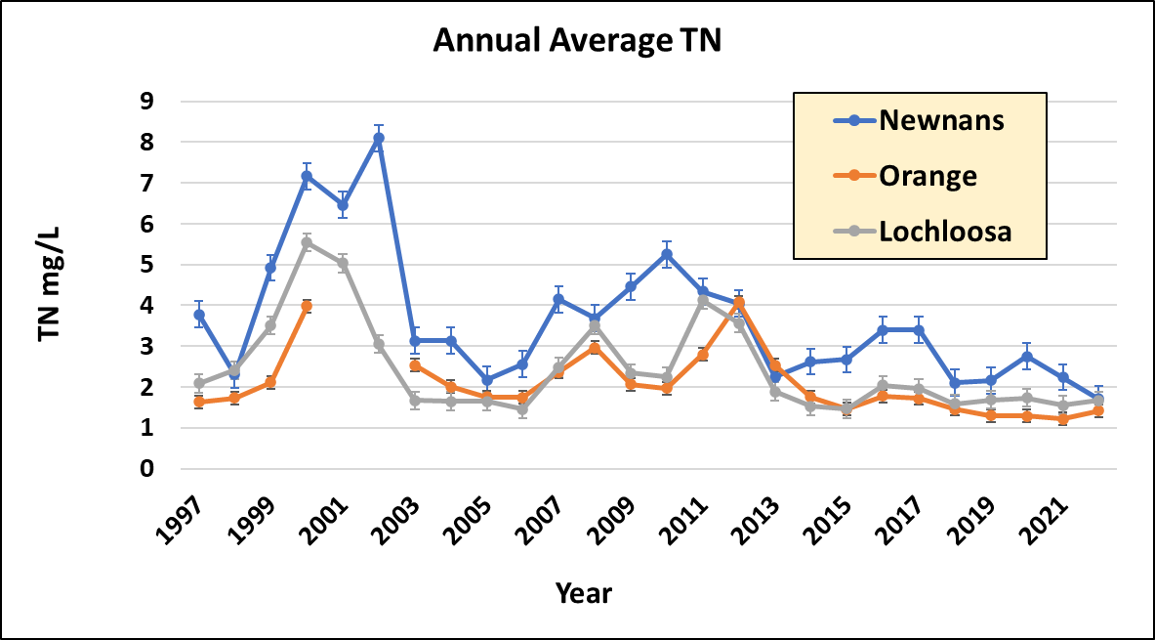
Total Nitrogen
Dotted lines represent TMDL with respective lakes by color
Notes:
OLC does not have a TMDL for TN. Nitrogen did decrease for Newnan’s lake in 2022. Someone asked me last year someone asked me about these spikes around 2002. I looked back in some tributary data around that time, and didn’t see any spikes in Hatchet creek, one of the main tributaries to the north. I did see some significant spikes in both TP and TN in mid 2003 that didn’t really seem to translate to a spike in the middle of Lake in the later months.

Slide 11
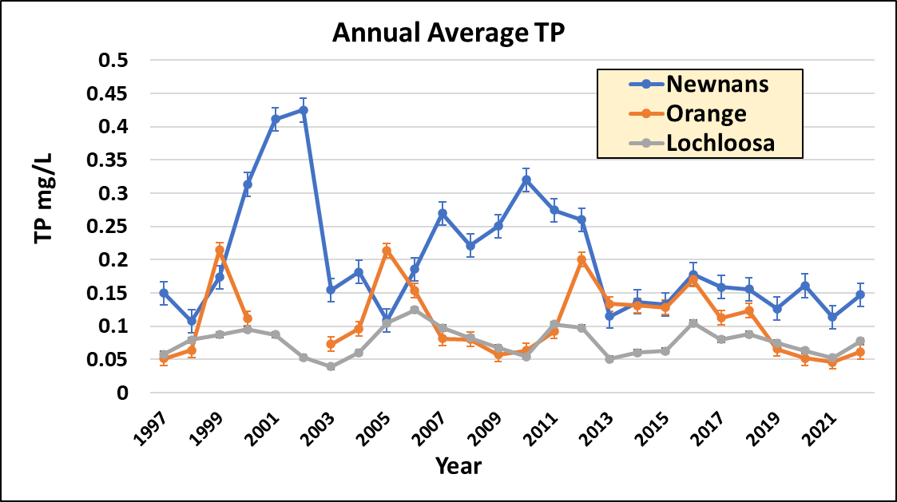
Total Phosphorus
Dotted lines represent TMDL with respective lakes by color

Slide 12
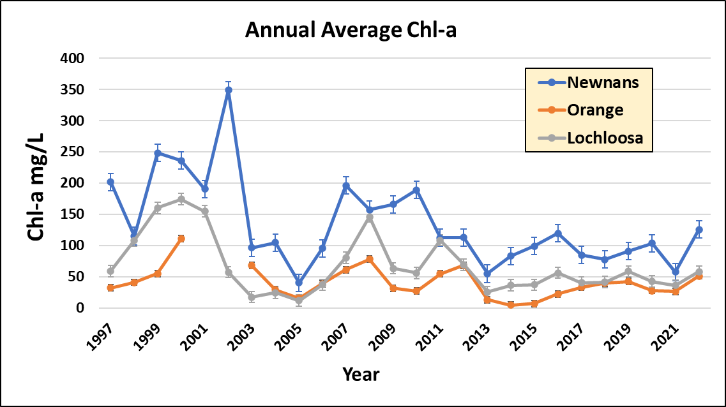
Chlorophyll-a
Dotted lines represent TMDL with respective lakes by color

Slide 13
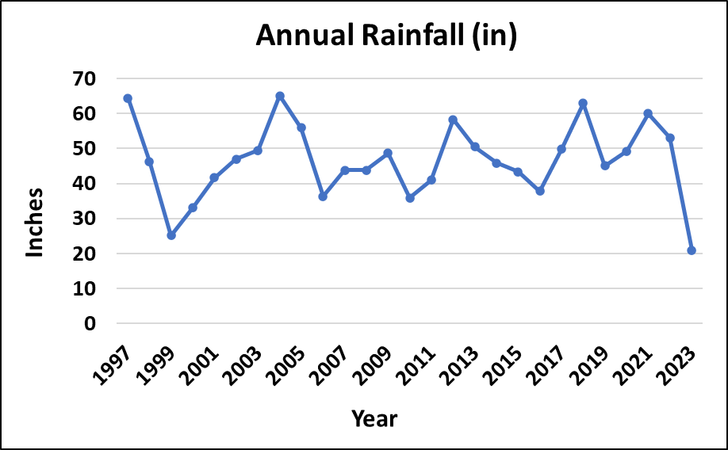
Spikes in Nutrients and Low Rainfall
53.4 in
Annual average TP across OCB lakes.
Average annual rainfall at Orange Lake at Boardman.
Notes:
Nutrients and Chl-a can significantly increase in drought conditions. While the highest spikes in nutrients in 2001/2002 didn’t coincide with a major drought (1999), rainfall was still below the annual average of 53.4 inches (weather and climate.com). 2007 and 2010 also saw spikes in nutrients and Chl-a and were also below normal average rainfall levels.

Slide 14
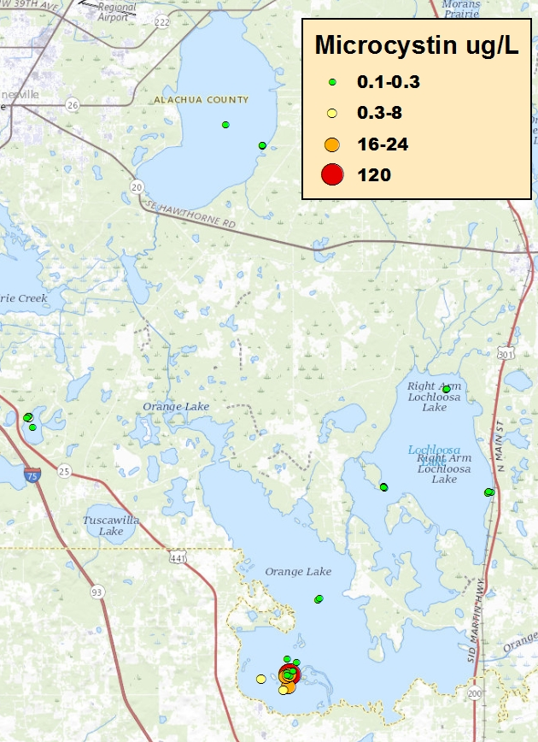
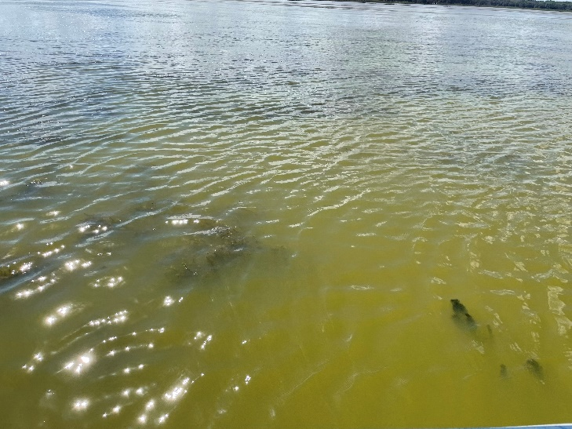
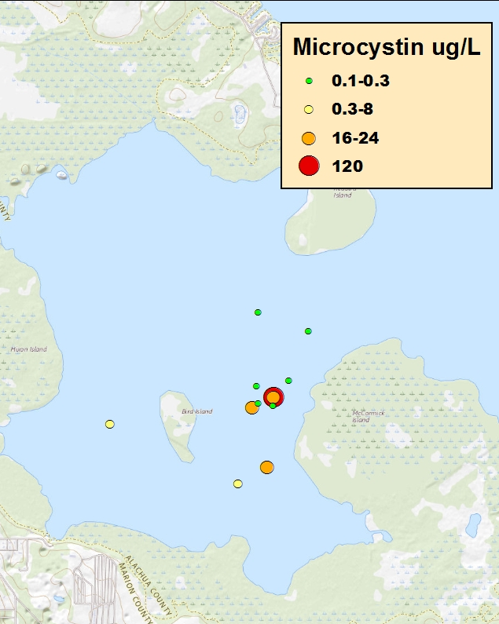
Harmful Algal Blooms
All MCY data
McIntosh Bay 3/1/22
MCY McIntosh Bay
Instances of toxicity detection in 2022
Lake | MCY below 15 µg/L | MCY above 15 µg/L
Newnans | 4 | 0
Lochloosa | 10 | 0
Orange | 10 | 4
Wauburg | 6 | 0
EPA limit for MCY is 15 ug/L

Slide 15
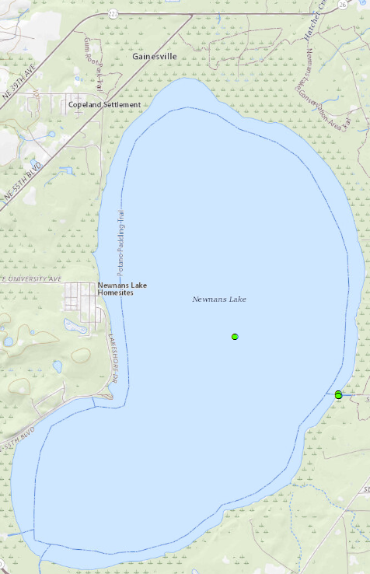
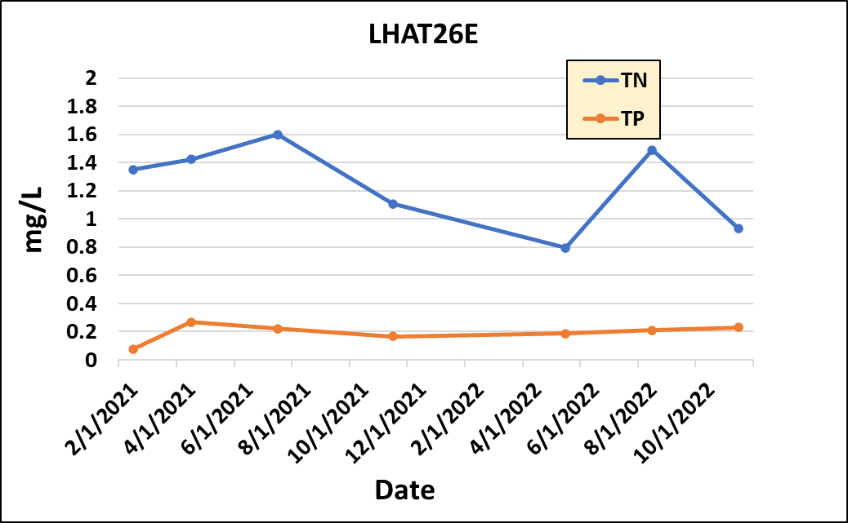
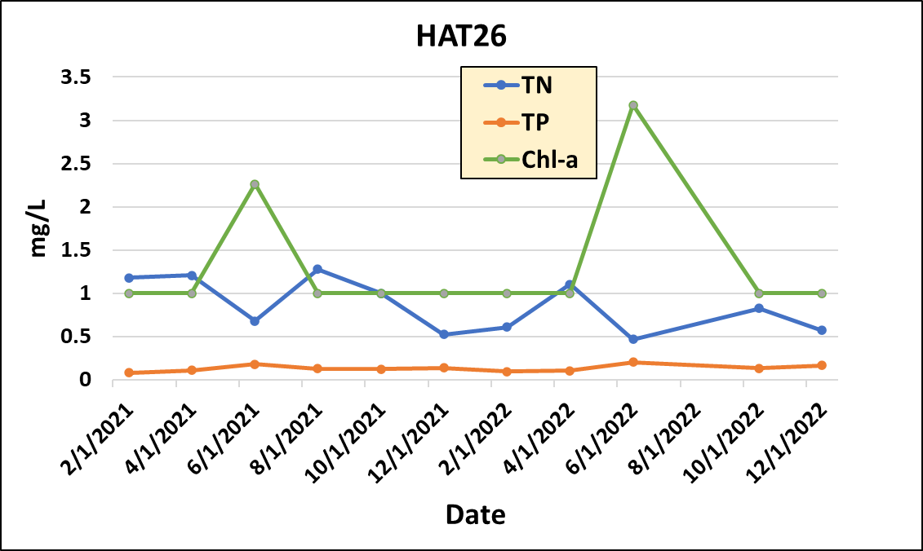

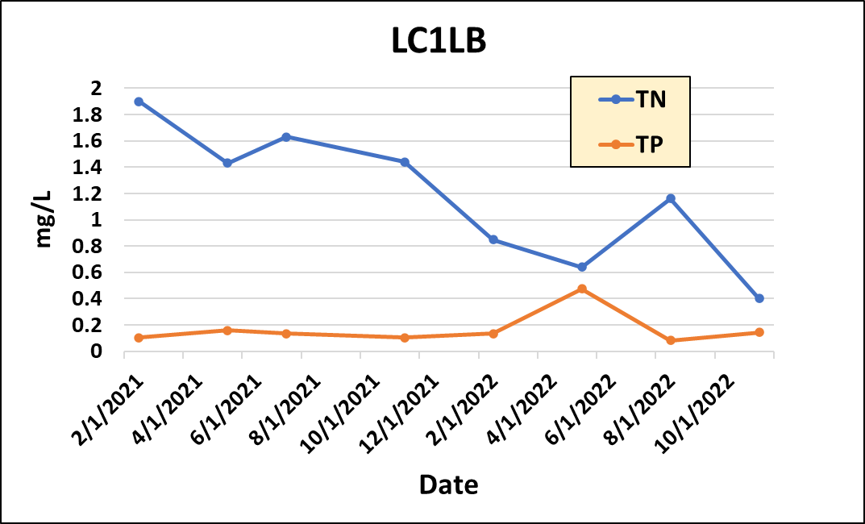
Harmful Algal Blooms
No algal toxin samples collected in 2021 in lakes Newnan, Lochloosa, and Orange had any detectable levels of microcystin, cylindrospermopsin anatoxin, or nodularin. So, what happened in 2022?
LHT26E
MCY µg/L
HAT26
3
LHAT26
2
MCY µg/L
3
1
2
0
1
0
MCY µg/L
3
2
1
= Algal bloom event
0
Dominant: Microcystis and Dolichospermum
Notes:
District data collected bi-monthly and Alachua county data collected quarterly. Hat26 is collected by District, other 2 by Alachua county. Chl-a data not collected with Alachua county.

Slide 16
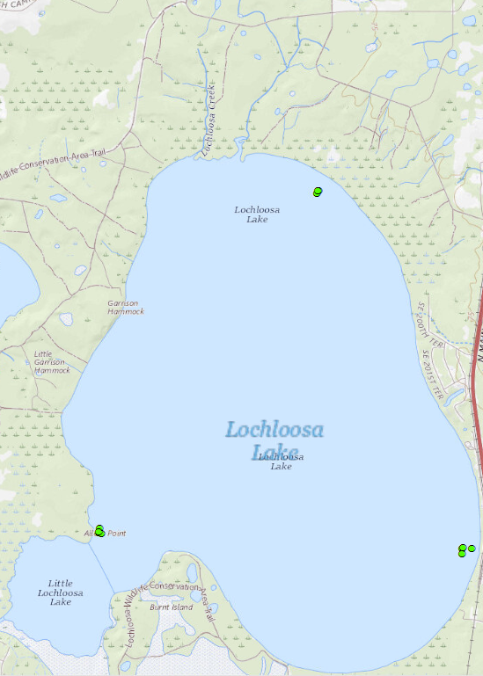
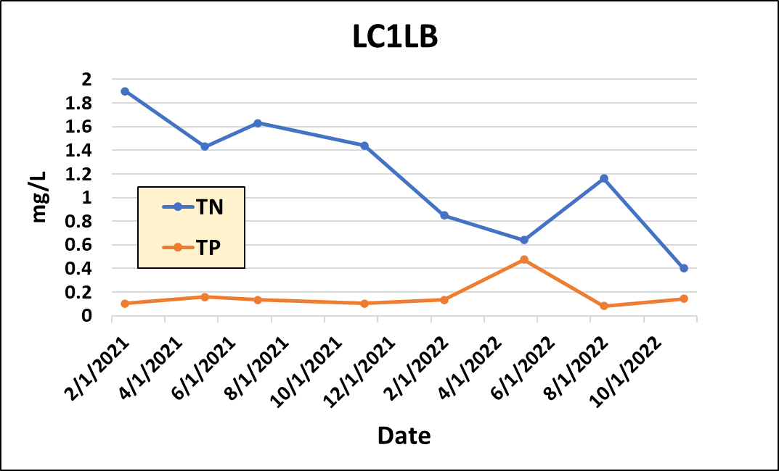
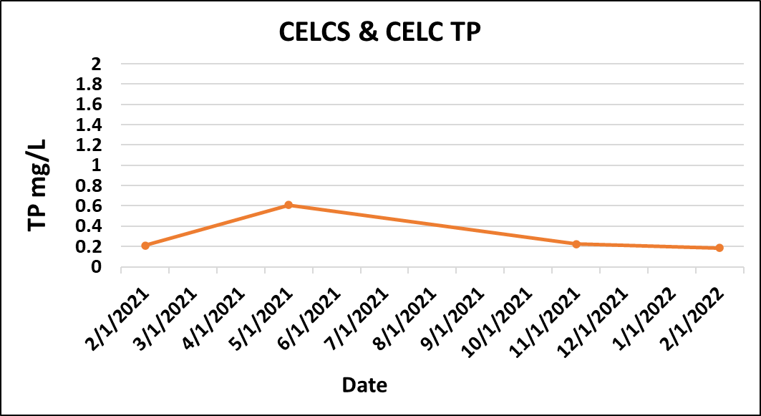
Harmful Algal Blooms
LC1LB
CELC
MCY µg/L
3
CELCS
2
1
0
CELCS
CELCS
CELC
CELC
Dominant: Microcystis
Notes:
Alachua county data. Data was less extensive for Lochloosa tributaries, especially CELCS and CELC. Only 1 data point was collected in 2022.

Slide 17
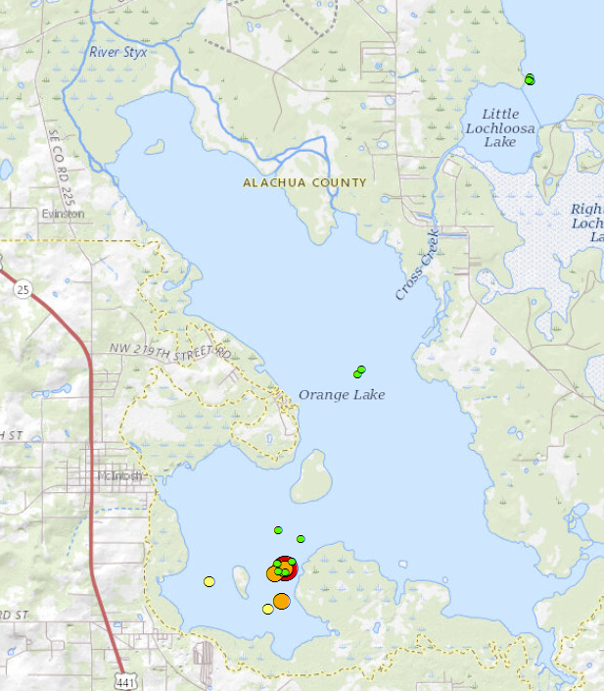
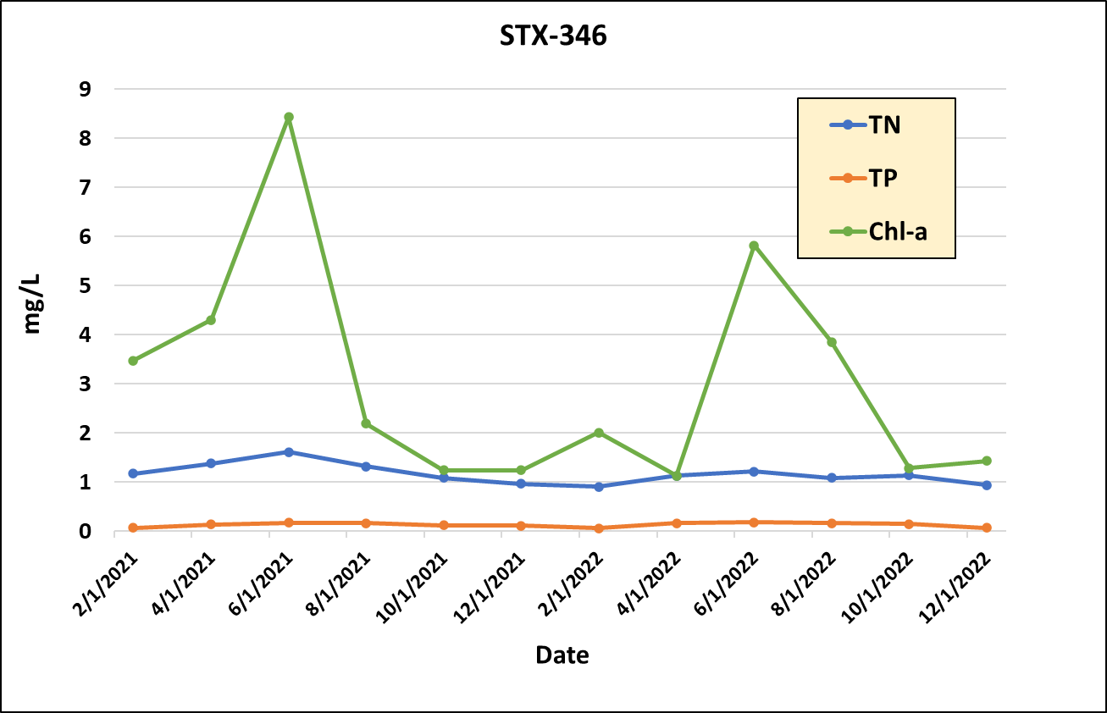
Harmful Algal Blooms
STX-346
MCY µg/L
100
10
0
N:P ratios from tributaries drop before algal bloom events; particularly in Newnans and Lochloosa lakes.
Dominant: Microcystis
Notes:
District data; included Chl-a

Slide 18
Summary
None of the 3 lakes met their target TMDLs for 2022.
While most nutrients rose from 2021-2022, TN did drop a bit in Newnans lake, bringing it closer to the TMDL target.
Multiple HABs were recorded in the lakes; most were under the EPA target limit of 15 mg/L. The 4 that exceeded this number were all in McIntosh Bay, Orange lake.
N:P ratios declined in tributaries prior to algal blooms.
Additional possible explanations for the HABs could include non-point source runoff, internal loading, rainfall. McIntosh Bay may be in a more vulnerable location for HABs.

Slide 19
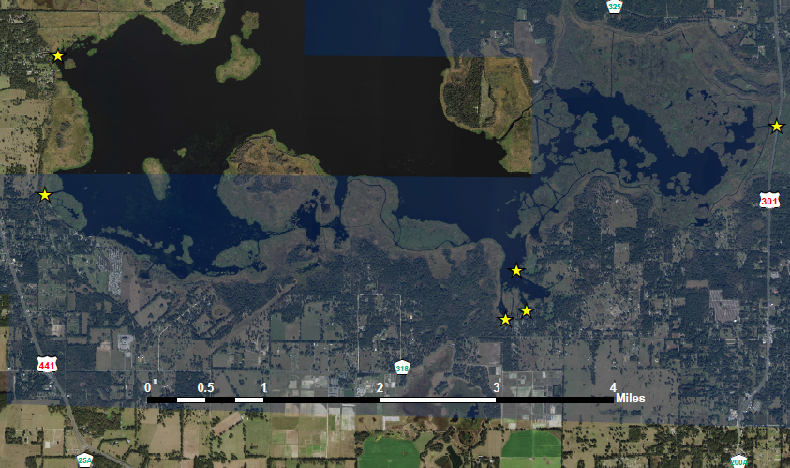
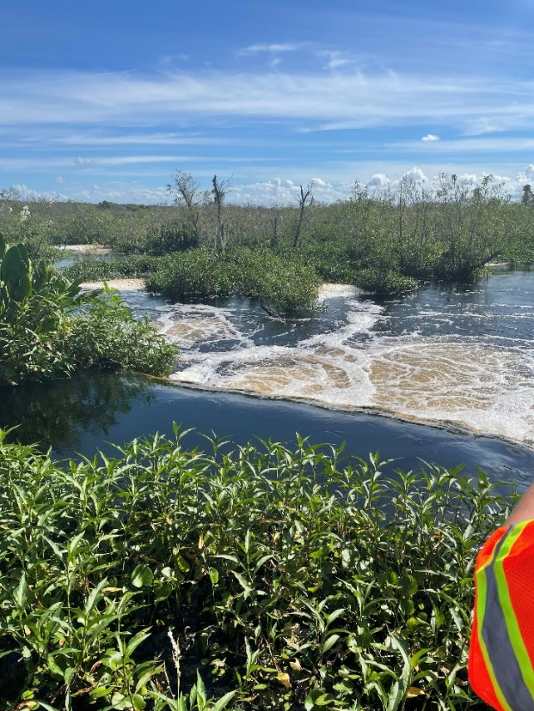
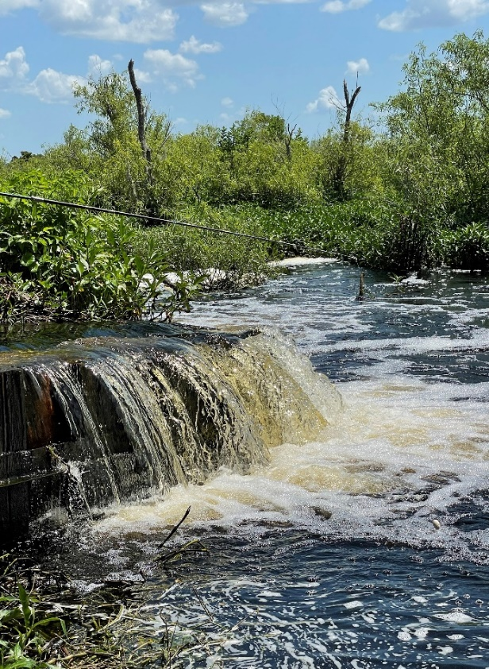
Orange Lake Weir at 301
Weir
Sinkhole
Areas of concern for flooding if an additional foot was added to the current weir.
Photos taken by SJRWMD, 2022
Joy Kokjohn produced a document last year that summarized some history and current condition of the weir. Included some photos and suggestions for repairing or replacing the weir.
It was concluded that DEP and FDOT share ownership of the weir.
We do have DEP representatives who will be present at the next interagency meeting to help figure out a future for the weir.
Notes:
There’s not a lot of updates for the Weir 301, but I did want to mention that it is on the agenda for the Interagency meeting this week, and we do have DEP representatives who will be joining us to help figure out a plan of action.

Slide 20
Questions?

Slide 21
Annual Meeting Agenda
Welcome
St. Johns River Water Management District (SJRWMD) Updates
BMAP Background and Updates
Florida Department of Agriculture and Consumer Services (FDACS) Updates
Unenrolled Agricultural Producer Enforcement
Funding Opportunities
Notes:
In todays meeting we are going to cover: Water Quality by Tiffany Trent with St. Johns River Water Management District
a brief history of the Upper Ocklawaha Basin Management Action Plan followed by Updates
Agricultural Enrollment by Cori Hermle with the Florida Department of Agriculture and Consumer Services
Unenrolled Agricultural Enforcement by David Frady with DEP
and Funding Opportunities by Michael Barr also with DEP

Slide 22
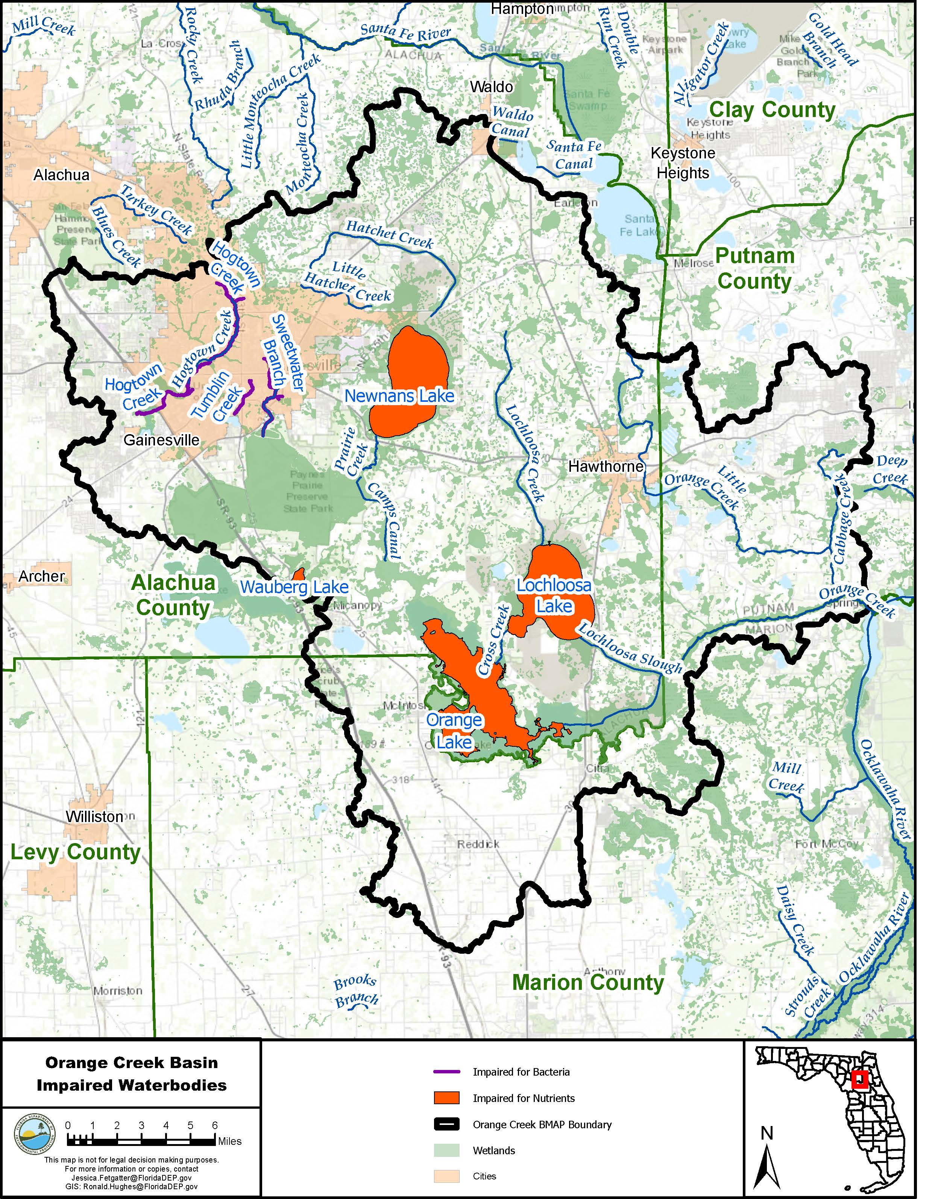
Orange Creek Background
2008: Initial adoption
2014: Phase 2
2019: Amendment adoption
Notes:
2008: to address nutrient or fecal coliform impairments in 7 waterbodies.
watersheds: Newnans Lake, Orange Lake, Lake Wauberg, Alachua Sink, Hogtown Creek, Tumblin Creek, and Sweetwater Branch.
2014: focused on several lakes that required additional management strategies to reach their TMDLs and a strategy to address high bacterial levels in urban streams.
2019: added a new TMDL (Lochloosa Lake) and allocated loading reduction responsibilities to local jurisdictions for Newnans Lake, Orange Lake, and Lochloosa Lake.

Slide 23
Stakeholders
Local Governments
Alachua County
Marion County
Gainesville
Hawthorne
Gainesville Regional Utilities
McIntosh
Micanopy
Waldo
Regional & State Agencies
St. Johns River Water Management District
Florida Fish and Wildlife Conservation Commission
Florida Department of Agriculture and Consumer Services
Florida Department of Transportation, District 2
Florida Department of Transportation, District 5 Florida Department of Environmental Protection – Northeast District & Tallahassee
Florida Department of Health in Alachua County
University of Florida
Notes:
Stakeholders include local governments as well as regional and state agencies.

Slide 24
STAR
Statewide Annual Report
What is it and where can you find it?
New interactive web application
Notes:
Now that you have some background, how to you find out what activities are going on currently? One place you can look is the Statewide Annual Report. So what is the STAR and where can you find it?

Slide 25


STAR
STATEWIDE ANNUAL REPORT
What’s in the STAR?
  Summarizes accomplishments in the BMAPs statewide.
  Reports on restoration projects and management strategies.
STAR got a digital makeover!
  Moving to visual-driven experience.
  Data download available.
Report is submitted by July 1, 2023
https://floridadep.gov/STAR
Notes:
A requirement under Section 403.0675 Florida Statutes (F.S.) to provide an annual update to the Governor and Legislature, the STAR summarizes accomplishments in the BMAPs across the state, reporting on restoration projects and management strategies. And it is submitted by July 1 each year.
Next slide

Slide 26
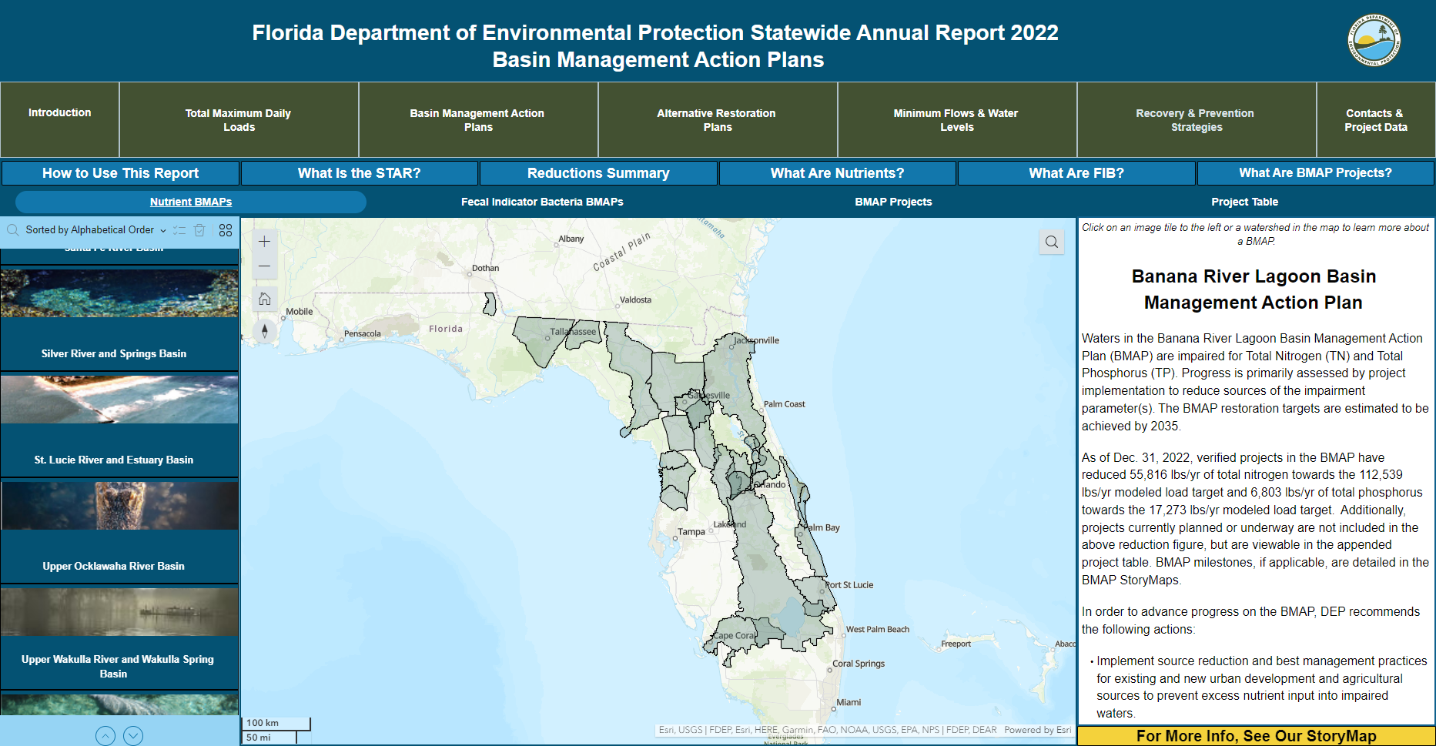
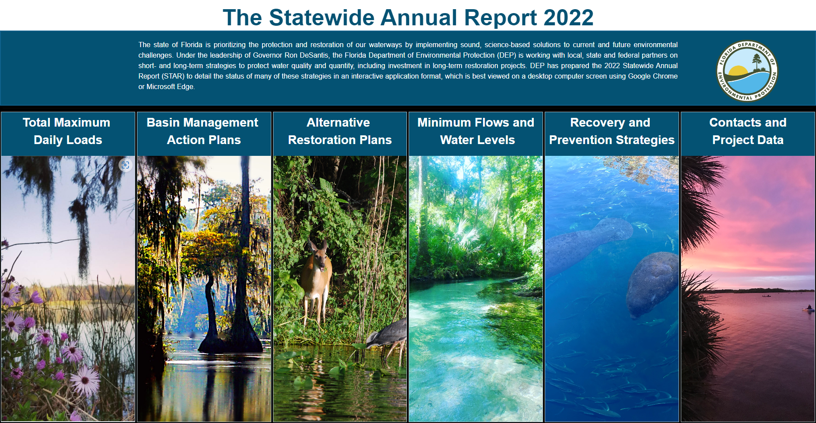
STAR 2022
Notes:
This year the STAR got a digital makeover. It has moved to a more visually driven experience. A data download will be available as before.

Slide 27
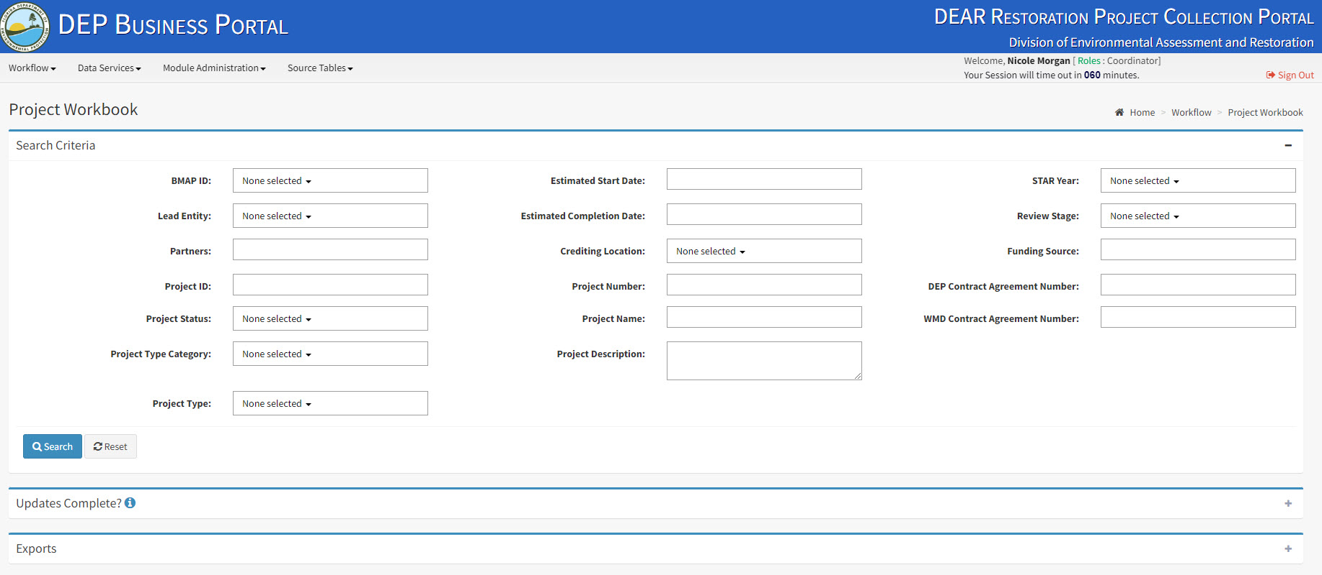
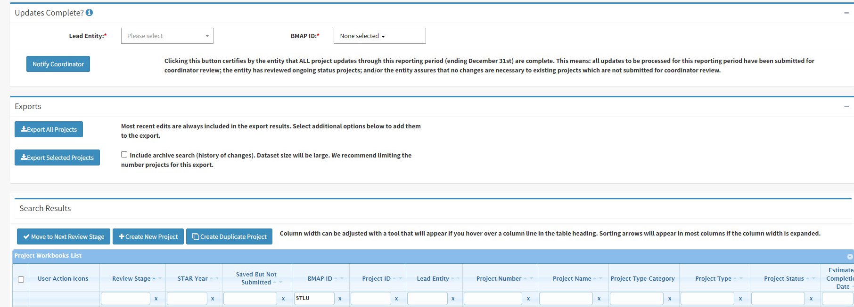
STAR
BMAP PORTAL IMPLEMENTATION
Notes:
How we collect the data?
This was the first year that all of our entities submitted their updates via our online project collection portal. We thank everyone for their participation…next slide

Slide 28
Status of Projects
Through December 31, 2022
Lead Entity | Canceled | Completed | Ongoing | Planned | Underway | Total
Alachua County | 5 | 75 | 19 | 2 | 4 | 105
City of Gainesville | 8 | 32 | 24 | 1 | 1 | 66
City of Hawthorne |  |  | 1 | 1 |  | 2
City of Waldo |  |  | 1 |  |  | 1
DEP |  | 4 |  |  |  | 4
FDACS |  | 6 | 7 |  |  | 13
FDOT District 2 |  | 9 | 7 |  |  | 16
FDOT District 5 |  | 2 | 1 |  |  | 3
FFS |  |  | 1 |  |  | 1
FWC |  | 25 | 3 |  | 2 | 30
GRU | 4 | 13 | 6 | 1 |  | 24
Marion County |  | 2 | 3 |  |  | 5
Orange Creek Basin Partnership |  | 1 |  |  |  | 1
SJRWMD | 3 | 21 |  | 1 | 2 | 27
Town of McIntosh |  |  | 1 |  |  | 1
Town of Micanopy |  |  | 1 |  |  | 1
Town of Reddick |  |  | 1 |  |  | 1
Total | 20 | 190 | 76 | 6 | 9 | 301
Total Phosphorous: 17,947 pounds per year (lbs/yr)
Total Nitrogen (Newnans, Lochloosa, Wauberg, Alachua Sink, Orange Creek, Hogtown Creek): 143,067 lbs/yr
Notes:
What can be done with the information the STAR provides?
You can check the status of projects. In this table you see a count of all of the projects in the BMAP and what stage they are in. 6 projects were completed this year. The currently completed and ongoing projects have resulted in an estimated seventeen thousand nine hundred forty seven pounds per year of reduced total phosphorous. And a total of one hundred forty three thousand sixty seven pounds of total nitrogen.

Slide 29
Estimated Reductions Achieved
Through December 31, 2022
Waterbodies | TN Reductions Achieved (lbs/yr) | TP Reductions Achieved (lbs/yr)
Lake Wauburg | 167 | 34
Lochloosa Lake | 8,321 | 1,615
Newnans Lake | 7,218 | 1,805
Orange Lake | NA | 4,062
Alachua Sink | 75,616 | NA
Orange Creek | 46,962 | 7900
Hogtown Creek | 4,783 | 2535
Notes:
Another way you can use the data is to look at estimated reductions by crediting area, in this case by waterbody. Here I have the areas that make up nutrient portions of the Orange Creek BMAP and the estimated reductions achieved in those areas.

Slide 30
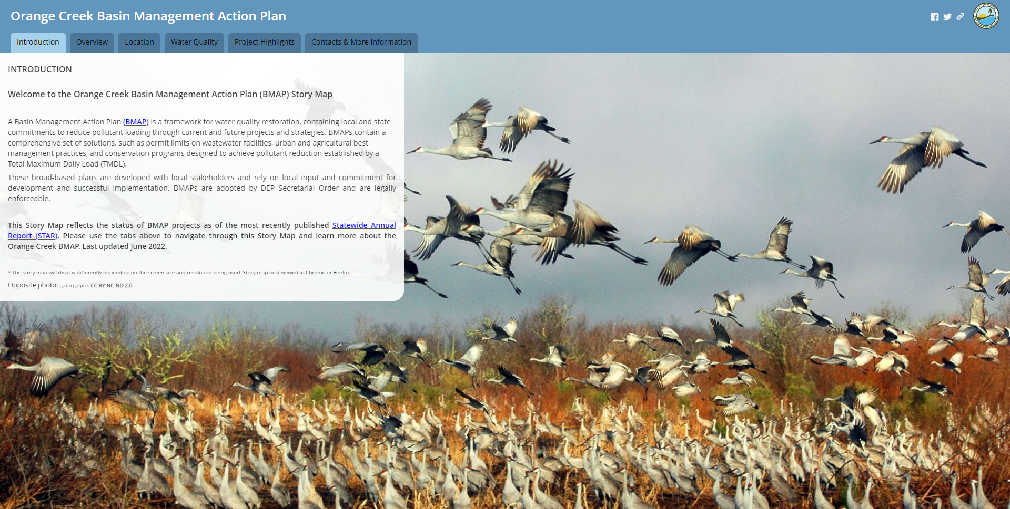
Story Map
Upper Ocklawaha BMAP
The Orange Creek Story Map will also be updated.
More details can be seen in the BMAP Story Map.
Orange Creek Basin Management Action Plan (arcgis.com)
Notes:
For more information you can visit the Upper Ocklawaha Story Map. You will find overview information. You can explore more about project types and where they are located. New this year is a water quality section where you can see monitoring efforts and water quality analysis. Please note these analyses are not used for Impaired Waters Rule (IWR) assessments.
Annual Geometric Averages- which are important for data that have large fluctuations and are not independent of each other (i.e. seasonal variability and spatial distributions).

Slide 31
Coming Up
New St. Johns River Modeling Efforts
Trend/Hotspot Analysis
SB 712 (2020): Clean Waterways Act Requirements
HB 1379 (2023): Environmental Protection
Subscribe for GovDelivery Notifications
Notes:
New St. Johns River Modeling Efforts have begun. The bidding process has been completed. Contractor selected- Janicki. That is all the information available at this time but I recommend signing up for GovDelivery notices to be notified when any of our public meetings come up.
Senate Bill 712
House Bill 1379

Slide 32
Targeted Restoration Analysis
First Steps
Methodology is being developed.
  Started with process in South Florida BMAPs.
  Tailored to fit individual BMAPs.
Goal: Find areas for project prioritization and opportunities to monitor progress.
  Identify areas for regional projects and greatest impacts.
  Prioritize funding.
Trend/hotspot analysis.
Concentration 5-yr Average
Compare to BMAP Target Concentration(s)*
Priority 1: Greater than twice the benchmark.
Priority 2: Greater than the benchmark but less than twice benchmark value.
Priority 3: Equal to or less than the benchmark
*Can use the Numeric Nutrient Criteria if a target concentration is not defined for the waterbody.
Notes:
The methodology is still being developed but we started with a process used in South Florida BMAPs as guidance. And are tailoring the methodology to fit the individual BMAPs.
The goal for this analysis is to find key areas for project prioritization and opportunities to monitor progress.
Areas for regional projects?
Areas where a project could have greater impact?
Assist in prioritizing funding?
The first step is to compare 5-yr average concentration from each station (with enough data) to the BMAP target conc.‘s (when available) or Numeric Nutrient Criteria (NNC). Then give a priority rank: 1 when the 5yr average is greater than twice the target. 2 if the average is greater than the target but by less than 2x. 3 when the 5yr average is equal to or less than the target.
Also planning to do some trend/ hot spot analysis to identify areas to further focus resources.

Slide 33
Clean Waterways Act (SB 712)
Wastewater Treatment Plans and Onsite Sewage Treatment and Disposal System Remediation Plans
Written explanation of potential exemption must be submitted by
  July 12, 2023.
Draft plans must be submitted to the department by
  February 1, 2024.
Final plans must be submitted to the department by
  August 1, 2024.
These plans must be incorporated into the BMAPs by
  July 1, 2025.
Clean Waterways Act Requirements for Wastewater & Onsite Sewage Treatment and Disposal Systems Plans in Nutrient BMAPs | Florida Department of Environmental Protection
Notes:
Passed in 2020. The Clean Waterways Act had a few different requirements for the BMAP group. One includes that local governments (counties and municipalities) within a basin management action plan (BMAP) must develop a wastewater treatment plan and/or an onsite sewage treatment and disposal system (OSTDS) remediation plan containing certain information (please see below), if the Florida Department of Environmental Protection identifies domestic wastewater treatment facilities or onsite sewage treatment and disposal systems (OSTDS) as contributors of 20% of point source or nonpoint source nutrient pollution or if the department determines remediation is necessary to achieve the total maximum daily load (TMDL).
Important dates:
A written explanation of potential exemption must be submitted by July 12, 2023.
Draft plans must be submitted to the department by February 1, 2024.
Final plans must be submitted by August 1, 2024.
We must incorporate these plans into the BMAPs by July 1, 2025.
Local governments received a notification the week of June 12th concerning the requirements of SB712 and we had another webinar just yesterday. We have now had a couple webinars addressing SB 712
A webpage has been created with further guidance, you can find the link at the bottom of the slide.

Slide 34
Wastewater Treatment Plans
Summary of expected elements of the Wastewater Treatment Plans:
Inventory of WWTFs within jurisdiction of local governments.
Summary of each facility’s current status, which may include:
  Permitted capacity.
  Average discharge.
  Permitted nutrient limits.
  Average nutrient concentration.
  Estimated average nutrient load.
Summary of capacity analysis for each facility.
  Including plans for future growth.
Ranking or list of facility upgrades needed to meet requirements.
Timelines/milestones for all projects.
Funding estimates for all projects.
Notes:
Summary of wastewater treatment plan expectations:
An inventory of WWTF’s within the jurisdiction of the local governments.
A summary of each facility’s current status and capacity.
A list of facility upgrades needed to meet requirements.
Along with timelines and funding estimates for all projects.
Possible Qs w As
Surface water calcs: Did not include attenuation. Could also not include all facilities (outside BMAP but services/discharges inside the BMAP).
Does it include sewer system areas or just facilities? All

Slide 35
OSTDS Remediation Plans
Summary of expected elements of the OSTDS Remediation Plans:
Inventory of OSTDS within jurisdiction of local governments.
Plan to address OSTDS in the future:
  Areas for sewering and/or enhancements & prioritization of those areas.
  Summary of capacity analysis for wastewater facilities that would accept newly sewered areas.
  Timelines/milestones for projects.
  Funding estimates for all projects.
  Future growth considerations.
Notes:
Summary of OSTDS remediation plan expectations: Similar to WWTF
An inventory of OSTDS within the jurisdiction of local governments.
And a plan to address OSTDS in the future.

Slide 36
HB 1379: Environmental Protection
Enhances Water Quality Protection in the Indian River Lagoon.
Strengthens Water Quality Protections and Basin Management Action Plans (BMAPs).
Improves Local Government Long-Term Comprehensive Planning.
Expands Funding Opportunities to Address Water Quality Impairments.
Notes:
Finally we have House Bill 1379. This bill makes significant strides to protect Florida’s water resources. We’ve started working on an implementation plan with our partners within and outside of DEP. DEAR has many of the responsibilities, and we will be working with each program through the implementation. This is a summary slide of the main items our Division will be working on.

Slide 37
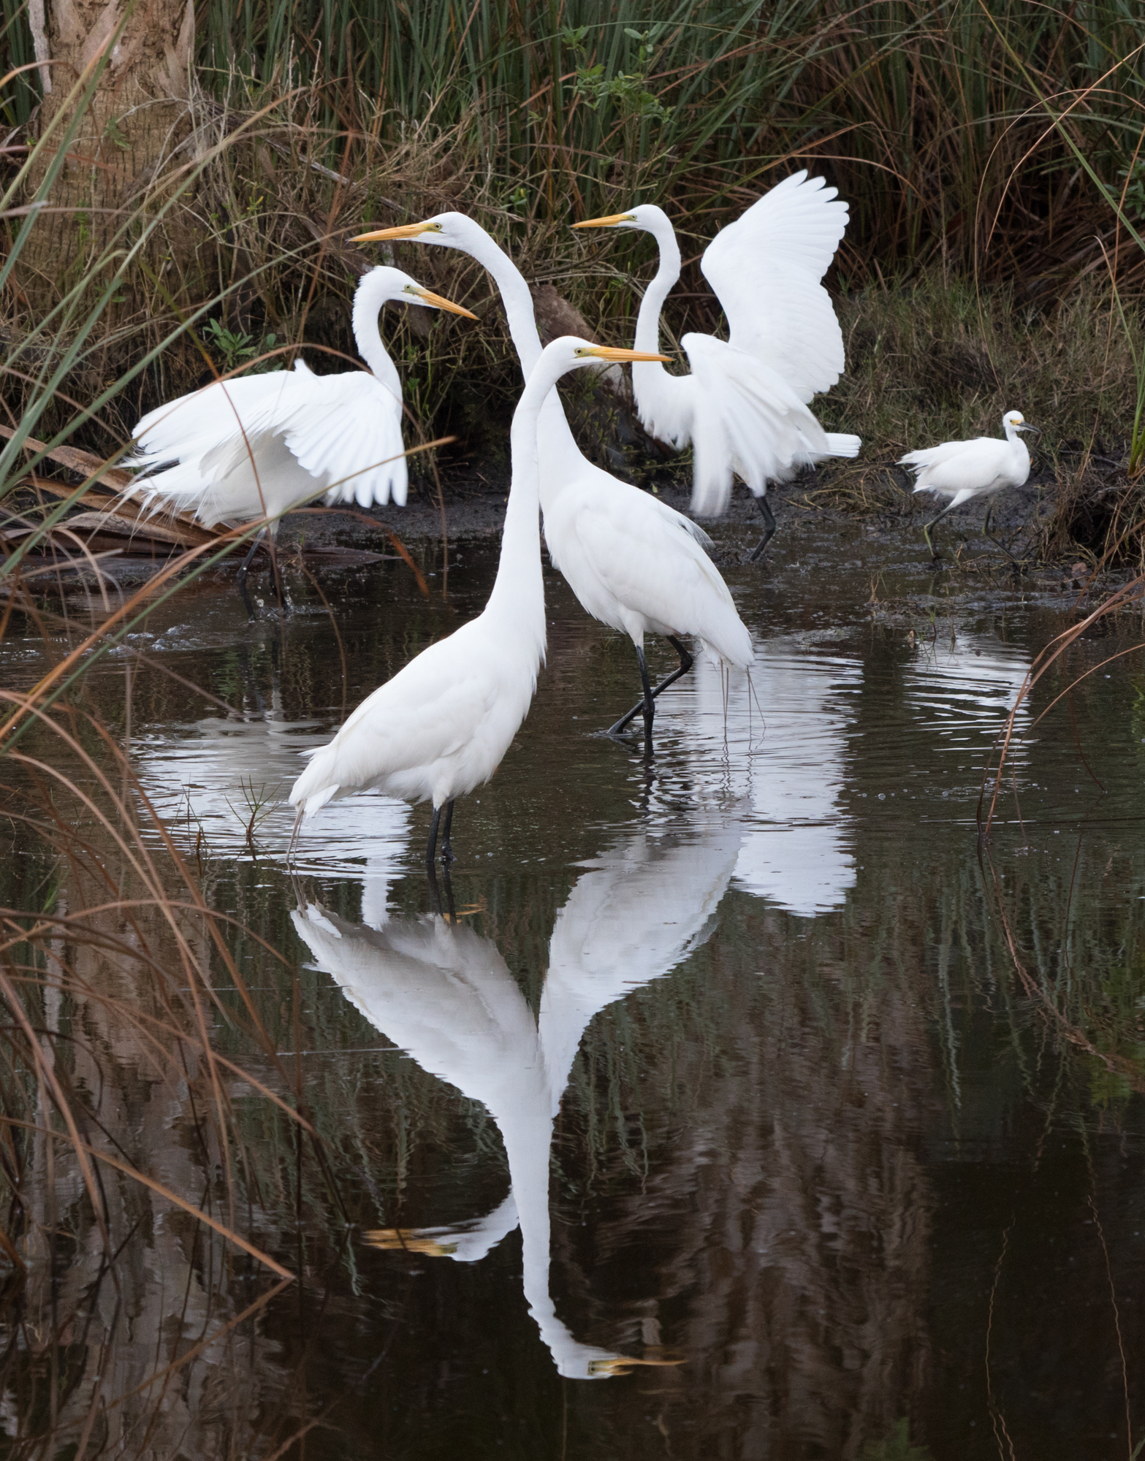

Improving Comprehensive Planning
BMAP Projects:
Requires local governments to include BMAP projects in their comprehensive plans so that these projects can be prioritized to achieve restoration benefits.
Sanitary Sewer:
Except for rural areas of opportunity (RAO), requires local governments to assess the feasibility of providing sanitary sewer for developments of 50 lots or more, on a 10-year planning horizon.
  Deadline for updates with new sanitary sewer requirements is July 1, 2024.
Wastewater Facility Upgrades:
Requires prioritization of advanced wastewater treatment (AWT) in comprehensive plans.
Notes:
We will start with improving comprehensive planning:
Requires local governments to include BMAP projects in their comprehensive plans so they can be prioritized to achieve the goals of the TMDL.
In addition to projects that will reduce nutrient loading all local municipalities are required to look at any developments of 50 parcels or more and assess how they can provide sanitary sewer to those developments. This must be provided by July 1, 2024.
Requires prioritization of advanced wastewater treatment (AWT) which will become the standard as we move forward for all surface water discharges in BMAPs.

Slide 38
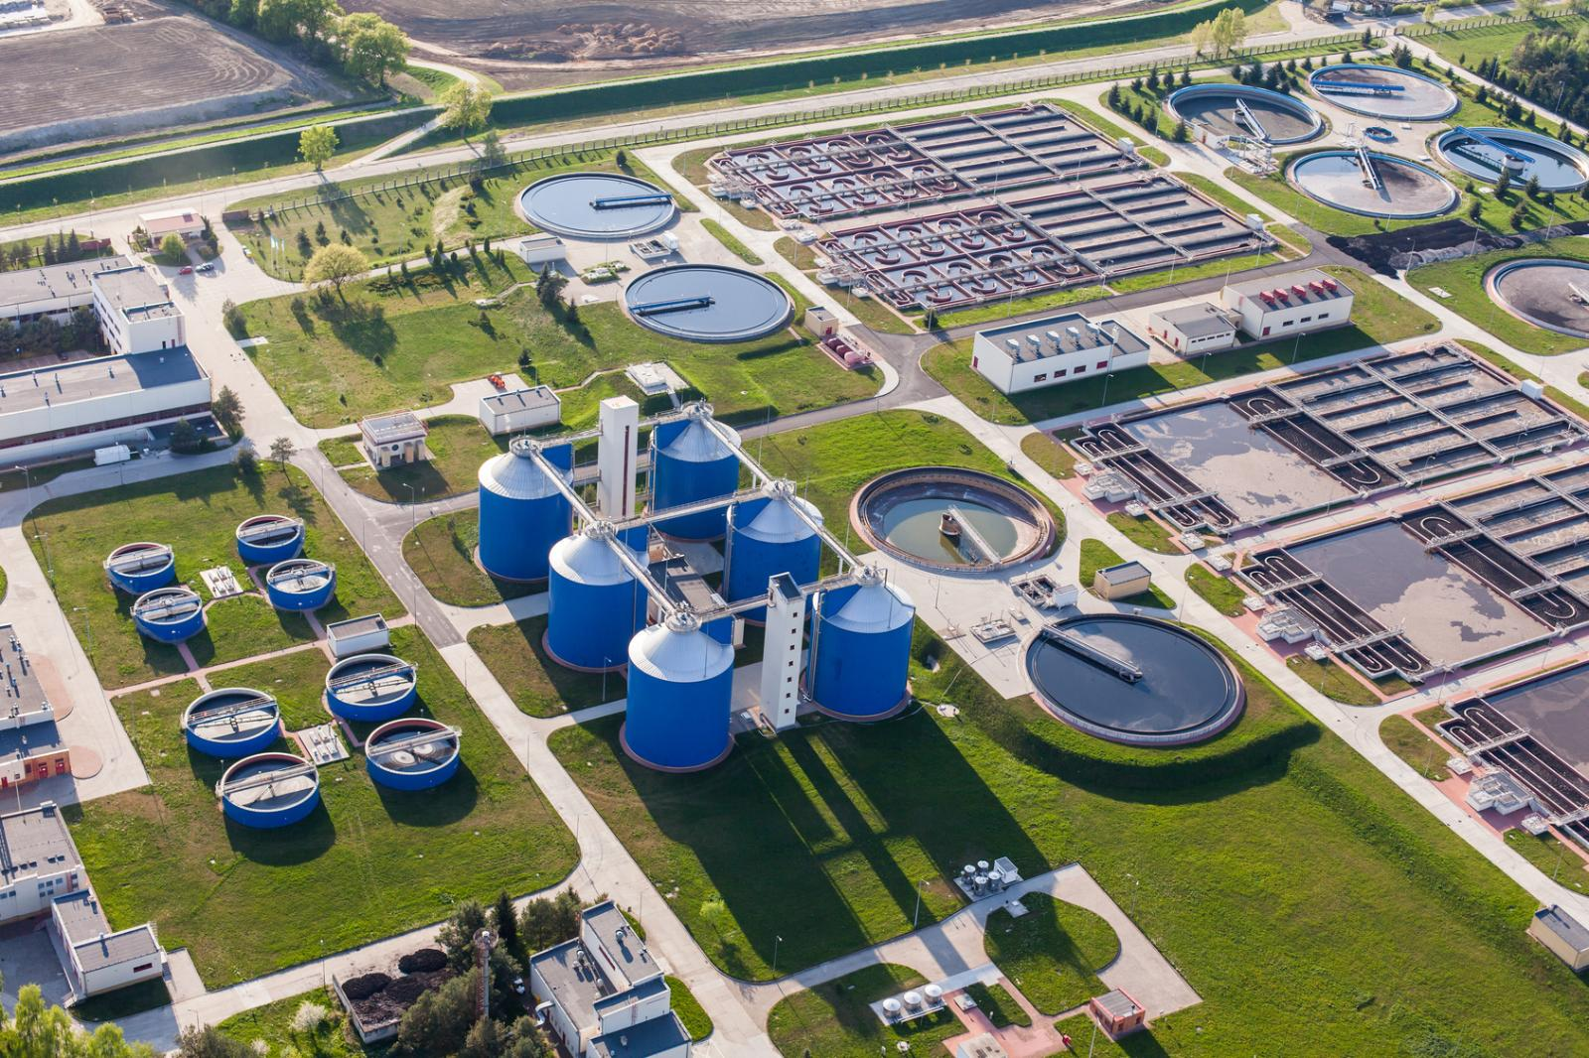
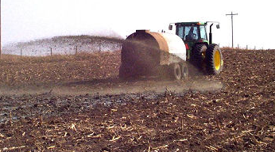
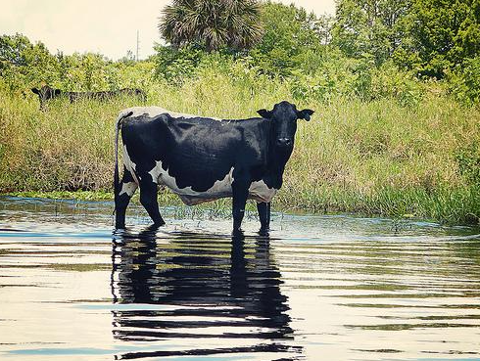
Strengthening BMAPs
List of Identified Projects:
Requires a list of projects and strategies that will achieve the 5-year implementation milestones to meet total maximum daily loads (TMDLs).
Requires each identified project to include an estimated amount of nutrient reduction, a planning-level cost estimate and an estimated date of completion.
Requires DEP to increase coordination with local governments, water management districts and other stakeholders to identify projects.
Agricultural Nonpoint Sources:
Where agricultural nonpoint sources contribute at least 20 percent of nonpoint source nutrient discharges, requires a list of cooperative agricultural regional water quality improvement element(s) submitted by the Department of Agriculture and Consumer Services which, in combination with the best management practices, additional measures, and other management strategies will achieve the needed pollutant load reductions established for agricultural nonpoint sources.
Notes:
Strengthening BMAPS
Requires a list of projects/strategies including estimated amounts of nutrient reduction, cost estimate, and estimated date of completion, that will achieve milestones to meet the TMDLs. We have about 5 years left until the 20 year milestone for this BMAP.
Any BMAP where Ag is at least 20% of the nonpoint source loading, cooperative agricultural regional water quality improvement elements can automatically be incorporated. We will be looking at every BMAP where this applies.
cooperative agricultural regional water quality improvement elements- streamline Process to identify projects that will reduce nutrient loading for Ag. FDACS will be in charge of this.

Slide 39
Improving Domestic Wastewater
Wastewater Facility Upgrades:
By 2033 – requires all wastewater facilities discharging to an impaired water to upgrade to Advanced Wastewater Treatment (AWT).
After July 1, 2023 – requires any facility discharging to a waterbody impaired for nutrients or subject to a BMAP or reasonable assurance plan (RAP) area to upgrade to AWT within 10 years.
More Stringent Wastewater Treatment Standards:
Authorizes DEP to require a more stringent treatment standard (greater than AWT) if required to meet the total maximum daily load (TMDL) within a BMAP.
Onsite Sewage Treatment Disposal Systems (OSTDS):
Requires new OSTDS on lots 1 acre or less within a BMAP to connect to central sewer if available, or if unavailable, to upgrade to an enhanced nutrient-reducing system or other wastewater system that achieves 65 percent reduction.
Notes:
Improving Wastewater
By 2033, all domestic wastewater facilities discharging to an impaired water must meet AWT.
After July 1, 2023 any facility discharging to a nutrient impaired waterbody or subject to a BMAP or reasonable assurance plan must upgrade to AWT within 10 years.
DEP can require more stringent treatment standards if it is required to meet the TMDL. Each BMAP will be evaluated.
New OSTDS on lots of 1 acre or less within a BMAP are required to connect to sewer if available, or if unavailable, to upgrade to an enhanced nutrient reducing system or other wastewater system that achieves 65% reduction.
(existing systems are not required to do this until it is time to replace- tank or drainfield)-unless otherwise stated by a BMAP?
NSF 245 is where the 65% standard comes from.
50% in tank, 15% in drainfield.

Slide 40
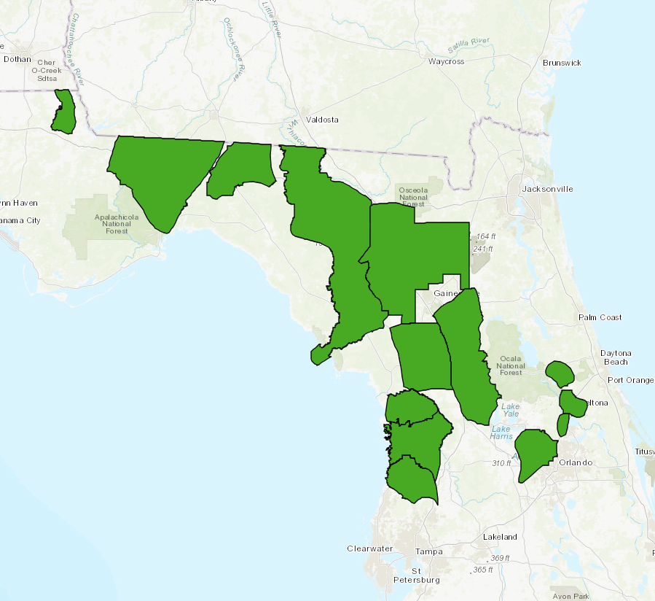
Enhanced Protections For
Outstanding Florida Springs
Expanding current prohibitions in priority focus areas to entire Outstanding Florida Spring (OFS) BMAP areas:
New conventional OSTDS on lots one acre or less - Where connection to a sewer system is not available, all new OSTDS on lots one acre or less must be enhanced nutrient-reducing systems (at least 65% nitrogen reduction).
New domestic wastewater disposal facilities with permitted capacities of 100,000 gallons per day or more unless they meet AWT standards.
New HAZMAT disposal facilities.
Land application of Class A or B biosolids not in accordance with a DEP-approved nutrient management plan.
New agricultural operations not implementing best management practices (BMPs).
Notes:
Not going into detail about this but since ORCR has overlapping areas with OFS BMAPs SILV and Santa Fe.
All restrictions previously contained within a priority focus area (PFA) are now in effect for the entire BMAP.

Slide 41
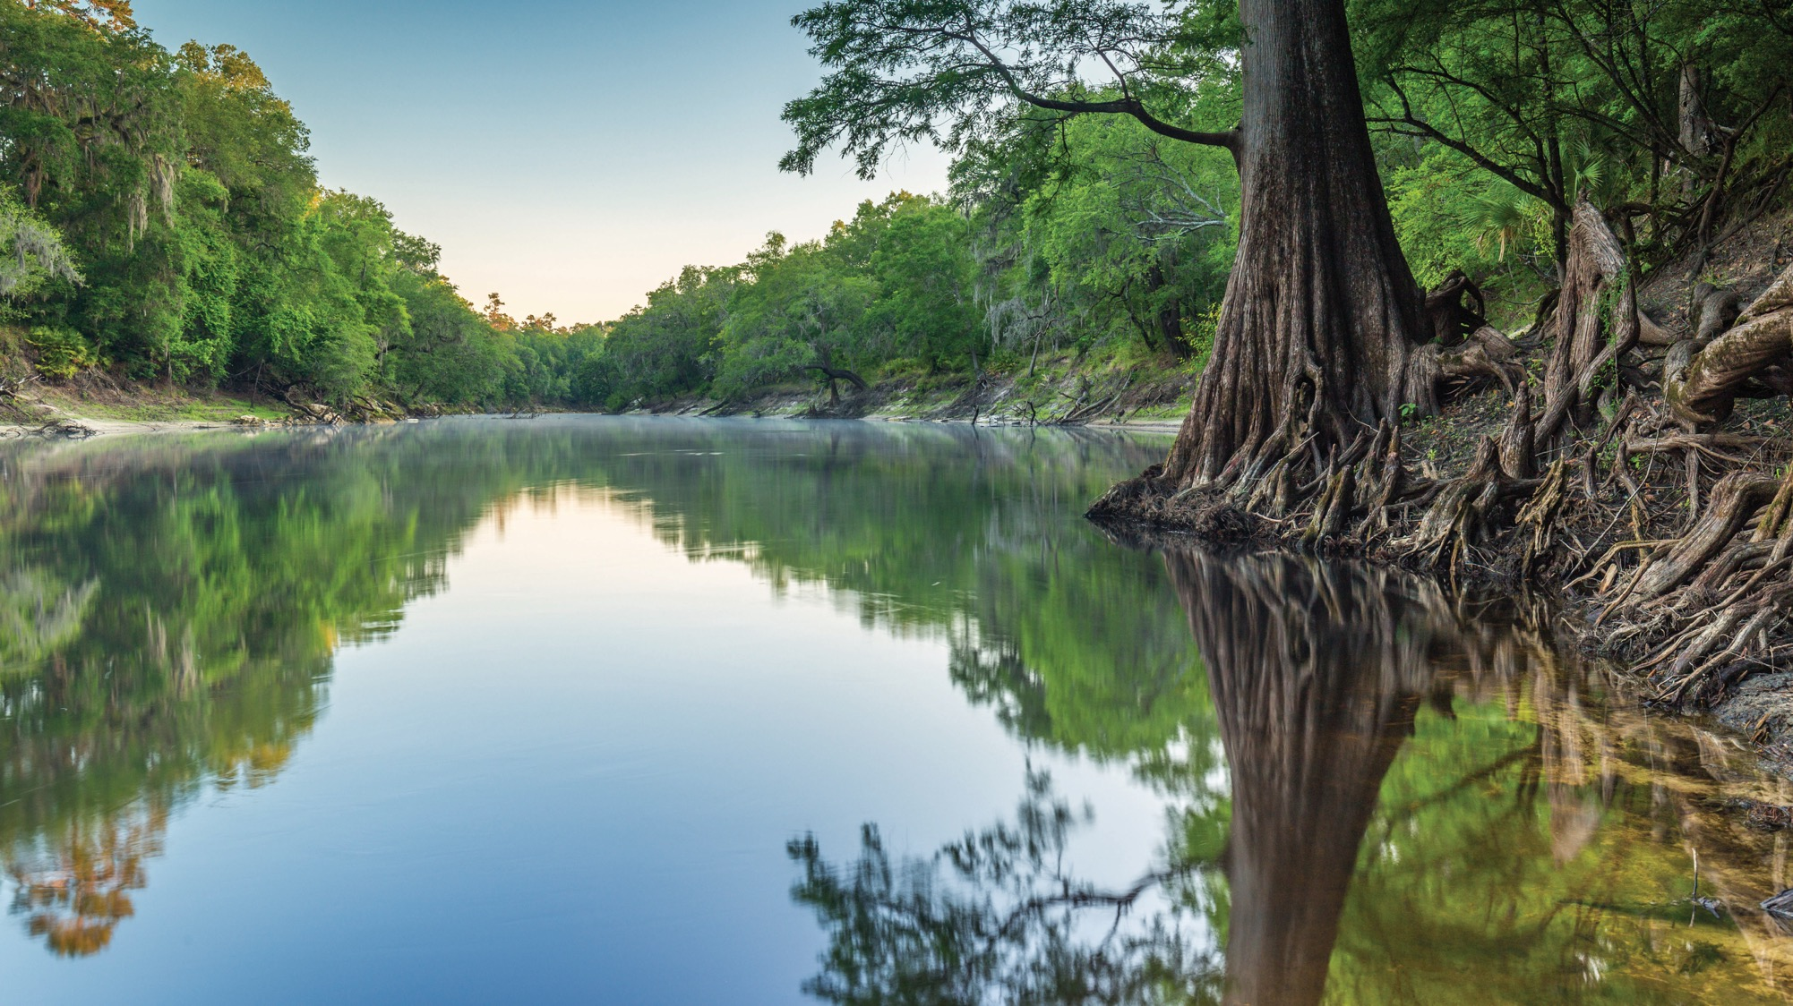
THANK YOU
Jessica Fetgatter
Florida Department of Environmental Protection
Division of Environmental Assessment and Restoration
Upper Ocklawaha BMAP Coordinator
Contact Information:
850-245-8107
Jessica.Fetgatter@FloridaDEP.gov

Slide 42

Orange Creek BMAP
Annual Meeting
June 27, 2023
Cori Hermle
Florida Department of Agriculture and Consumer Services
Office of Agricultural Water Policy

Slide 43
Overview
Agricultural Best Management Practices (BMP)
FDACS Role in BMP Implementation
Enrollments within the Orange Creek Basin
  Unenrolled Agricultural Lands Classification
BMP Implementation Verification (IVs)
Producer Outreach
Legislative Report

Slide 44
Office of Agricultural Water Policy (OAWP) Staff Update
N. West Gregory; Director West.Gregory@fdacs.gov
Bret Prater; Asst. Director Bret.Prater@fdacs.gov
Angela Chelette; Chief of Policy Planning and Coordination (PPC) Section Angela.Chelette@fdacs.gov
Yesenia Escribano; Environmental Administrator-BMAPs Yesenia.Escribano@fdacs.gov
Cori Hermle; Environmental Consultant, SJRWMD liaison Cori.Hermle@fdacs.gov

Slide 45
Agricultural Best Management Practices
Management strategies, tools and practices that improve water quality, conserve water, enhance soil health and protect water resources
Based on the best available science and technology
  Work closely with FDEP staff
Must balance production and water resource protection

Slide 46
Benefits of Agricultural Best Management Practices
Increase efficiencies in nutrient, irrigation and water management
Conservation and protection of water and environmental resources
Improve soil health
Promote groundwater recharge
Enhance wildlife habitat

Slide 47
FDACS Role in BMP Implementation
Develop BMPs in Manuals and adopt BMPs by Rule
Assist Producers with BMP Enrollment
Identify and support targeted cost-share of select BMPs
Fund research to develop new, innovative BMPs that improve nutrient and irrigation use efficiencies
Verify proper implementation through site visits and record review

Slide 48








Adopted BMP Manuals

Slide 49
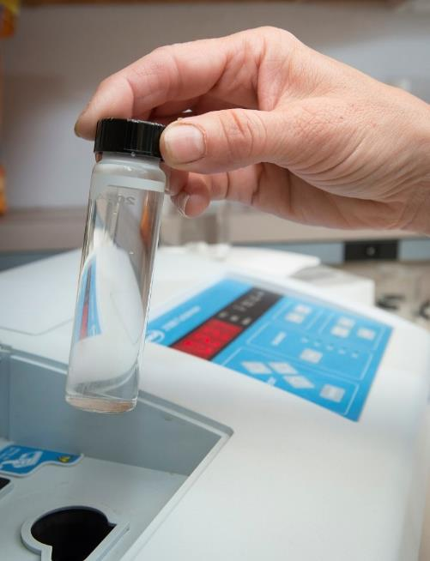
Producer Options in BMAP Areas
Sign a Notice of Intent (NOI) and properly implement applicable BMPs for presumption of compliance, OR
Follow an FDEP or WMD-prescribed water quality monitoring plan at a Producer’s expense

Slide 50

Enrollments within the Orange Creek BMAP
39% of all agricultural acres are enrolled in the BMP program
  Total Ag Acres = 68,515
  Enrolled Ag Acres = 26,514
69% of all irrigated agricultural acres are enrolled in the BMP program
  Total Irrigated Ag Acres = 3,418
  Enrolled Irrigated Ag Acres = 2,343
Majority of enrollments are Cow/Calf and Multiple Commodities
BMP enrollment as of Dec 2022 and the 9th Florida Statewide Agricultural Irrigation Demand (FSAID) Geodatabase

Slide 51
Agricultural Acres Enrolled within Orange Creek BMAP
BMP Manual | Acres
Cow/Calf | 14,922
Dairy | 114
Equine | 2,660
Fruit & Nut | 883
Multiple Commodities | 4,615
Nursery | 47
Row/Field Crop | 3,209
Sod | 64
Total | 26,514

Slide 52
Agricultural Lands within Orange Creek BMAP
Non-Agricultural Acres | Agricultural Acres | Enrolled Agricultural Acres | Remaining Agricultural Acres | Unlikely Enrollable Acres | Potentially Enrollable Acres
316,754 | 68,515 | 26,514 | 41,983 | 13,388 | 25,973

Slide 53
Unlikely Enrollable Agricultural Lands within Orange Creek BMAP
Category | Acres
State Lands | 2,644
Timberland and Aquaculture * | 4,867*
Not Agriculture [e.g., DOR Use Code 70-99 (industrial or institutional use, acreage not zoned agricultural), Non-Ag Entity] | 6,364
Not Enrollable [e.g., Missing Parcel Information, Slivers, Tribal Lands] | 2,157
Unlikely Enrollable Acres: 13,388
* May be eligible to be enrolled under the FDACS Florida Forest Service’s Silviculture BMP Manual
or the FDACS Division of Aquaculture’s Aquaculture BMP manual.

Slide 54
Potentially Enrollable Agricultural Lands within Orange Creek BMAP
Ag Acres within Parcel | Parcel Count | Total Ag Acres
< 1 | 29 | 19
1 - < 25 | 999 | 9,519
25 - < 50 | 132 | 4,518
50 - < 250 | 82 | 7,419
≥ 250 | 13 | 4,498
Potentially Enrollable Acres: 25,973

Slide 55
BMP Implementation Verification (IV)
Process to verify the status of implementation of BMPs
Clean Waterways Act - SB 712 (July 2020)
  Requires IV site visits every 2 years
    91% completed
  Requires collection, review, and retention of N and P fertilizer records
    Nutrient Application Record Form (NARF)
  FDACS reports total N and P applications to FDEP for utilization in BMAP assessments
** IVs completed as of Dec 31, 2022

Slide 56
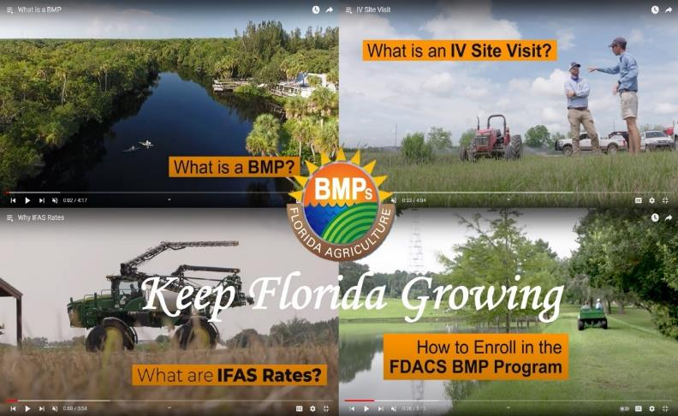
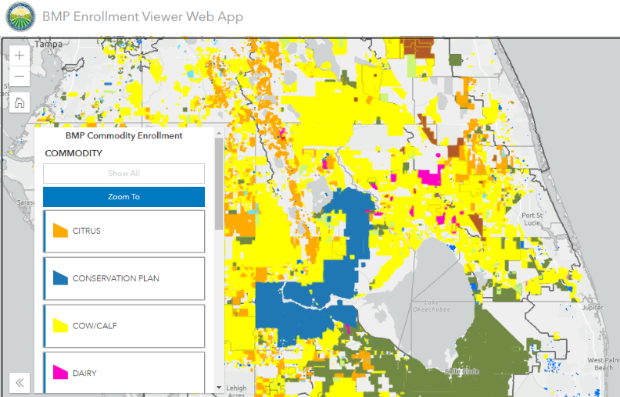
Producer Outreach: Coming Soon….
BMP Program Videos
Agricultural Water Policy - About BMPs – YouTube
New Online Features
  Are you in a BMAP?
  BMP Enrollment Viewer Web App
Agricultural Best Management Practices / Water / Agriculture Industry / Home - Florida Department of Agriculture & Consumer Services (fdacs.gov)

Slide 57
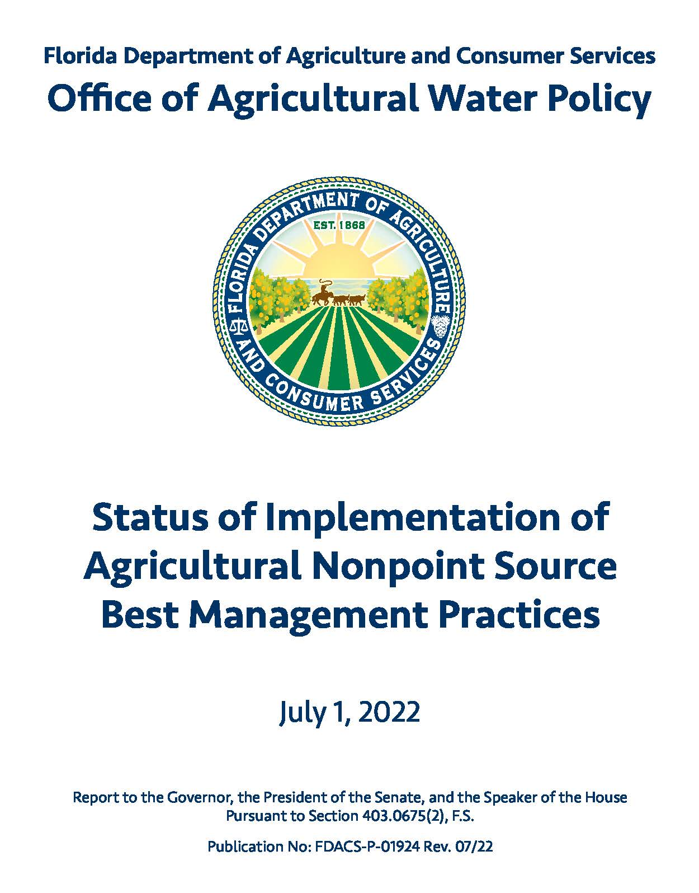
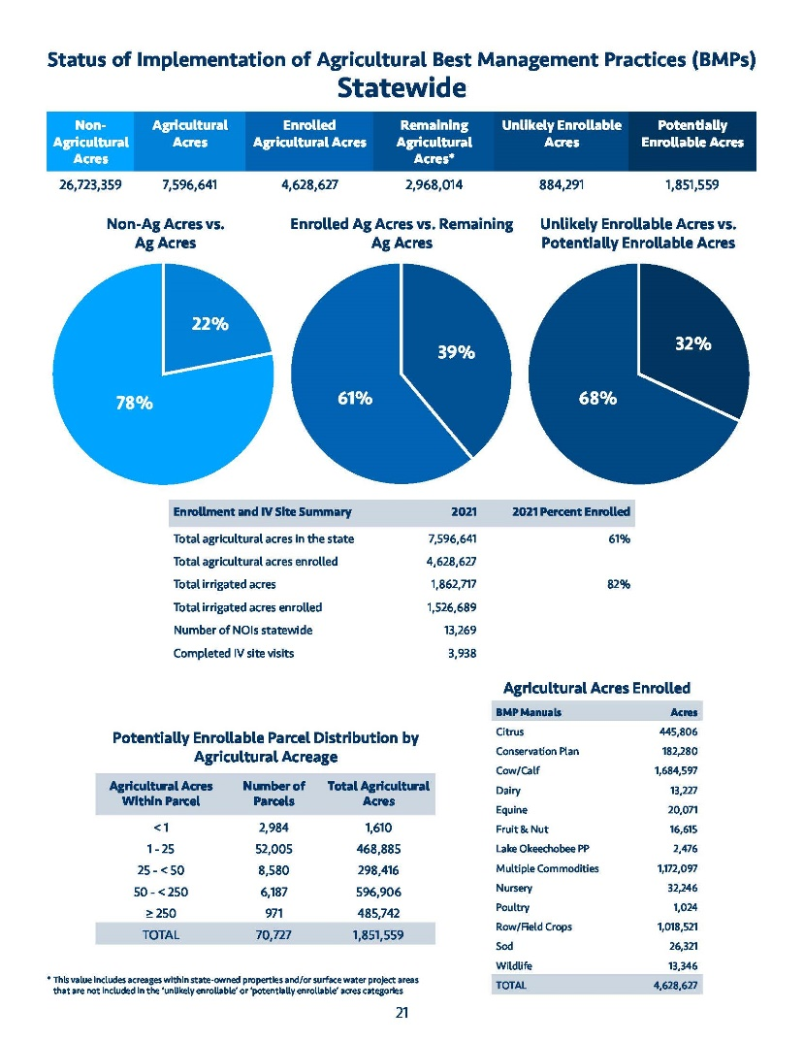
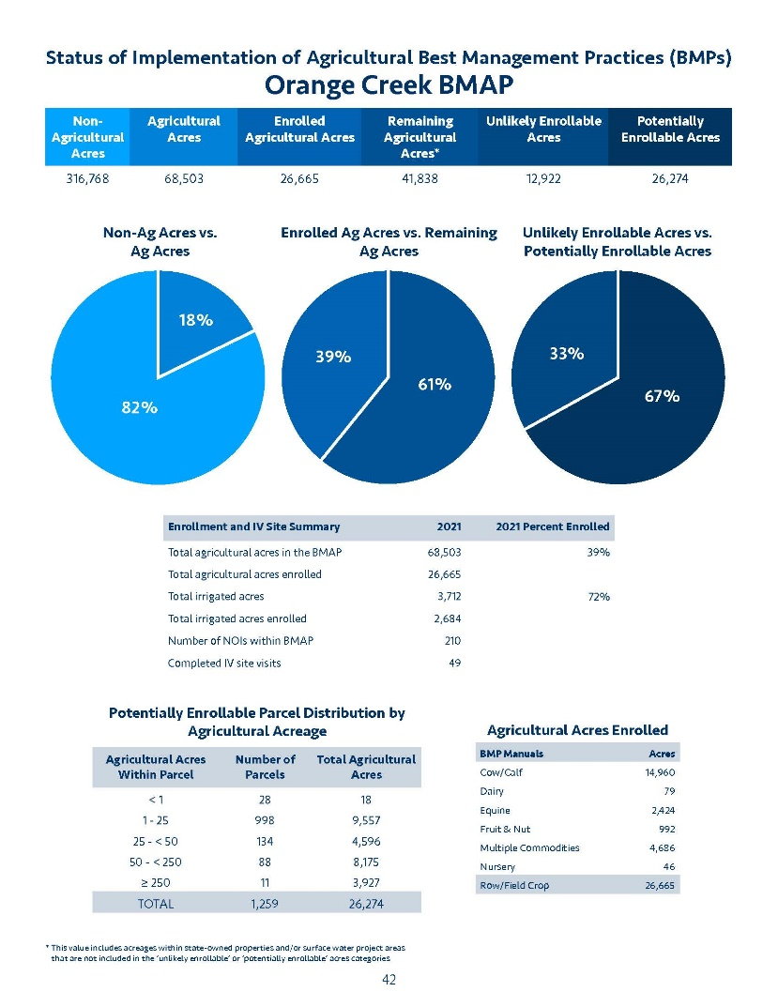
2023 FDACS Legislative Report
https://www.fdacs.gov/Divisions-Offices/Agricultural-Water-Policy

Slide 58

Thank You!
http://www.fdacs.gov/Divisions-Offices/Agricultural-Water-Policy
Cori Hermle, Environmental Consultant
Corinne.Hermle@fdacs.gov (850) 688-6156

Slide 59
Unenrolled Agricultural Producer Enforcement
David Frady, Ph.D.
Program Administrator
Division of Environmental Assessment and Restoration
Florida Department of Environmental Protection

Slide 60
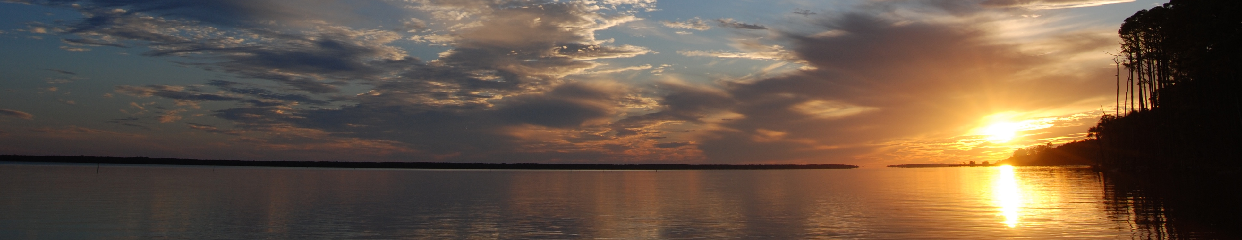

Clean Waterways Act
The Clean Waterways Act (SB 712) was signed into law by Governor DeSantis in 2020
  The law requires a wide range of water quality protection provisions aimed at minimizing impacts from known nutrient pollution sources
  Agricultural landowners and producers within a Basin management Action Plan (BMAP) must enroll in one of two programs:
    FDACS’ Best Management Practices (BMP) program
    Water Quality Monitoring approved by DEP
  The law also requires FDACS to:
    conduct on-site implementation verification (IV) site visits on properties enrolled in the BMP program every two years
    Collect fertilizer data via the Nutrient Application Record Form (NARF)
    identify agricultural parcels within a BMAP that are out of compliance and refer them to DEP for enforcement

Slide 61
Unenrolled Agricultural Producer Enforcement
The Florida Department of Agriculture and Consumer Services (FDACS) uses various database to identify parcels within a BMAP that may be agricultural operations
FDEP conducts outreach and engagement to bring producers into compliance
It saves taxpayers money and is better for the environment to bring producers into compliance quickly through education and outreach efforts prior to taking formal enforcement action against small farmers
FDEP Initiates enforcement action
If an agricultural producer fails to come into compliance, DEP initiates a civil suit to compel them to come into compliance
FDACS refers non-compliant producers to FDEP for enforcement
FDACS Identifies non-compliant producers
After confirming agricultural activity and attempting to enroll the producer in the BMP program, FDACS refers non-compliant producers to FDEP for enforcement
FDEP is prioritizing enforcement actions based on parcel size and impact to the environment

Slide 62
Outreach and Engagement Has Been Successful
DEP takes immediate action when a producer is referred for enforcement
  More than 96% of the unenrolled agricultural parcels identified by FDACS and referred to FDEP have been brought into compliance
There are no parcels greater than 100 acres out of compliance and the majority are smaller than 10 acres
FDEP is engaged in an ongoing campaign to educate landowners of their requirements and bring them into compliance quickly through additional outreach and on-site visits
Notes:
1

Slide 63
THE FLORIDA DEPARTMENT OF ENVIRONMENTAL PROTECTION
THANK YOU
David Frady
Division of Environmental Assessment and Restoration
Florida Department of Environmental Protection
CONTACT INFORMATION:
850-245-8559
David.Frady@FloridaDEP.gov

Slide 64
Water Restoration Assistance Grant Funding
Nathan Jagoda
Division of Water Restoration Assistance /
Springs and Watershed Restoration Program
Florida Department of Environmental Protection
Orange Creek BMAP Annual Meeting | 6.27.2023

Slide 65
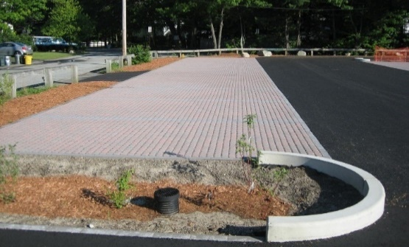
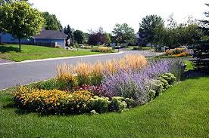
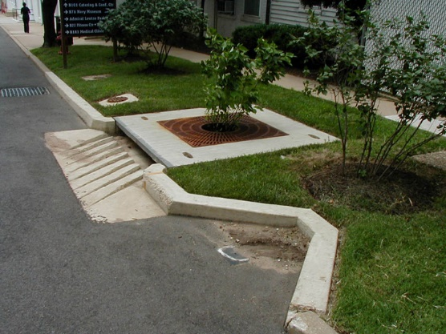
NONPOINT SOURCE MANAGEMENT:
EPA 319(H) NONPOINT SOURCE GRANT
Federal Grant through the U.S. EPA
Construction, education and monitoring.
40% match requirement, may use state grant/loans towards match.
Monitoring requirement.
Planning and design may be eligible for match.
May take two years to receive grant award.
Eligibility
Green stormwater infrastructure
Water quality improvement/restoration
Groundwater protection
Stormwater BMPs
Agricultural BMPs
Nonpoint source education
Septic to sewer connections
Notes:
First, I will cover our Federal 319 funding which comes from the US EPA.
We are very excited and eager to fund Green Stormwater Infrastructure and Low Impact Development projects
Construction, education and monitoring are eligible for grant funding
There is a 40% Match Requirement, and Grantees may use state grant/loans towards match
The 319 grant funds can take a bit more time to receive the award when compared to our state funded projects
Other types of projects eligible for funding include:

Slide 66
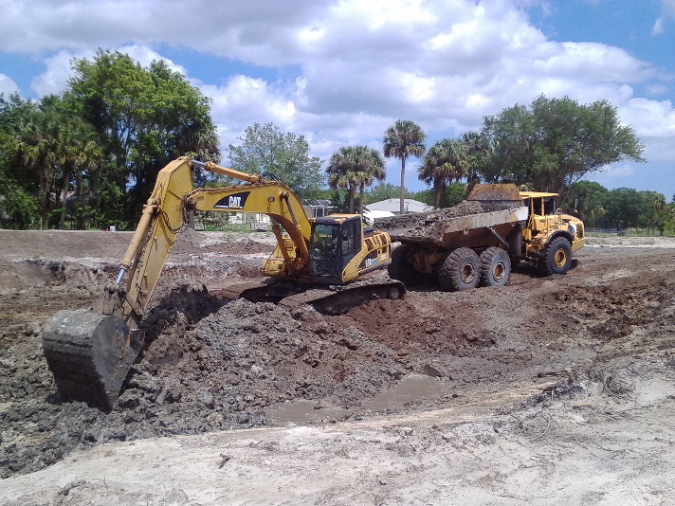
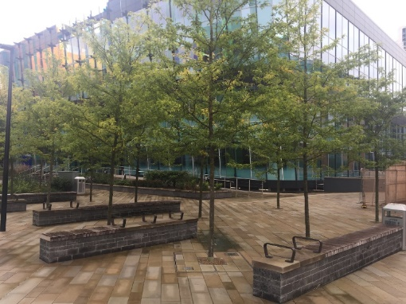
NONPOINT SOURCE MANAGEMENT:
STATE WATER QUALITY ASSISTANCE GRANT (SWAG)
  State grant for projects that reduce stormwater pollutant loadings in impaired waterbodies.
  Shovel-ready construction projects.
  No required match.
  No required water quality monitoring.
  Fast application to grant award date.
  Eligibility:
  Green stormwater infrastructure
  Water quality improvement
  Groundwater protection
  Water quality restoration
  Best management practices
  Reuse water
Notes:
Next I will cover our state funded SWAG projects.
We typically like to fund shovel ready construction projects with our state funding.
Match is not required for these projects but can help during the grant award selection process.
Similarly, monitoring is not required for these projects but can help during the grant award selection process.
Types of projects eligible for funding include:

Slide 67
NONPOINT SOURCE MANAGEMENT: HOW TO SUBMIT A PROPOSAL?
Grant proposals for 319 and SWAG grants are accepted throughout the year:
Contact Nonpoint Source Program grant coordinator for a copy of the latest grant proposal form.
Department review and evaluation periods are expected to occur in fall and spring of each year.
If funding is available, grant awards may be awarded out of cycle.
Questions:
If you are considering a grant application, contact the Nonpoint Source Program grant coordinator to discuss eligible grant components, funding available, match requirements, etc.
Notes:
In order to apply Grantees must be local governments, special districts, or Public universities
We use one proposal form for both grants. You can apply for both at once, or leverage the state funding as the federal match
You can use the protecting Florida together portal to view available grants and apply.
You can also contact Connie Becker, the NPSM Grants Coordinator, at the email listed here. She can help you determine eligible grant components, funding available, match requirements, and help with other questions.
We review proposals twice per year, but occasionally award grants out of cycle if funding is available.

Slide 68
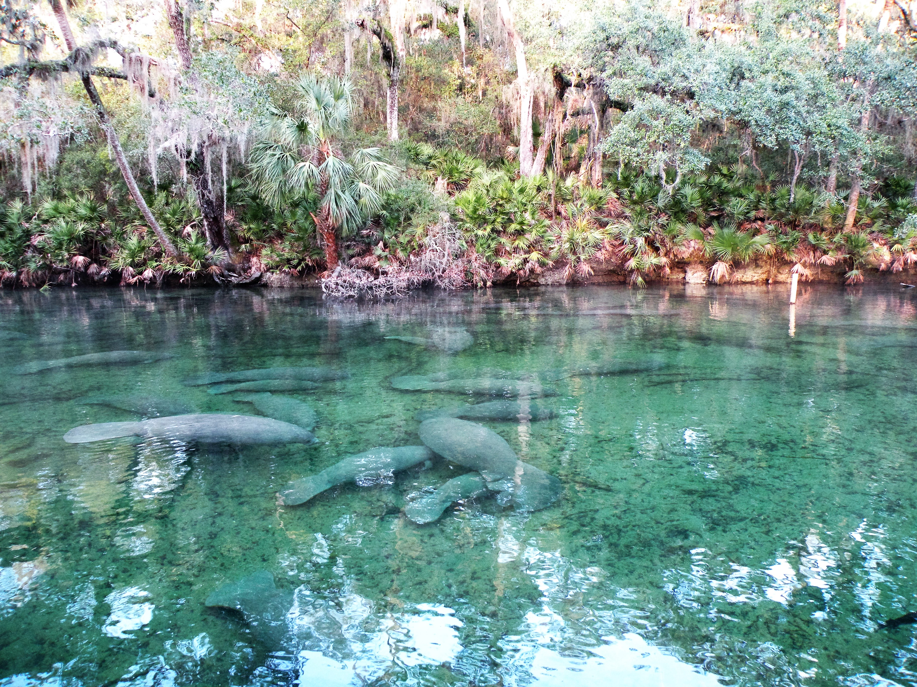
FLORIDA DEPARTMENT OF ENVIRONMENTAL PROTECTION
About The Springs Grant
Annual state appropriation. Typically $50m
Eligible projects are land acquisition and capital projects that protect the quality and/or quantity of water from springs:
  Agricultural Best Management Practices
  Wastewater
  Water Conservation
  Hydrologic Restoration
  Stormwater
  Other types of Water Quality and Quantity

Slide 69
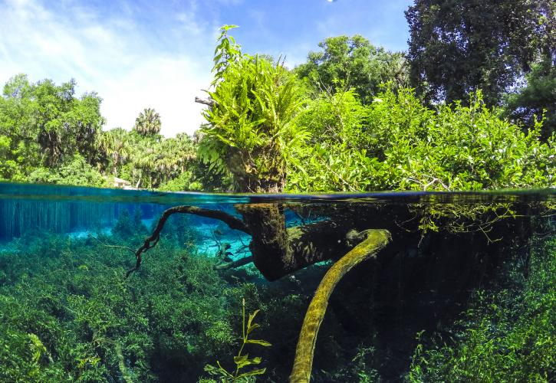
FLORIDA DEPARTMENT OF ENVIRONMENTAL PROTECTION
Springs Grant Evaluation
DEP consolidates list of proposed projects and posts for public comment
DEP will review and make recommendations
Factors considered in evaluating projects:
  Nutrient reductions
  Water savings
  Cost sharing
  Readiness to proceed
  Whether project is in BMAP area
  Whether project impacts spring that has an MFL
Springs awards were announced in early December 2022

Slide 70
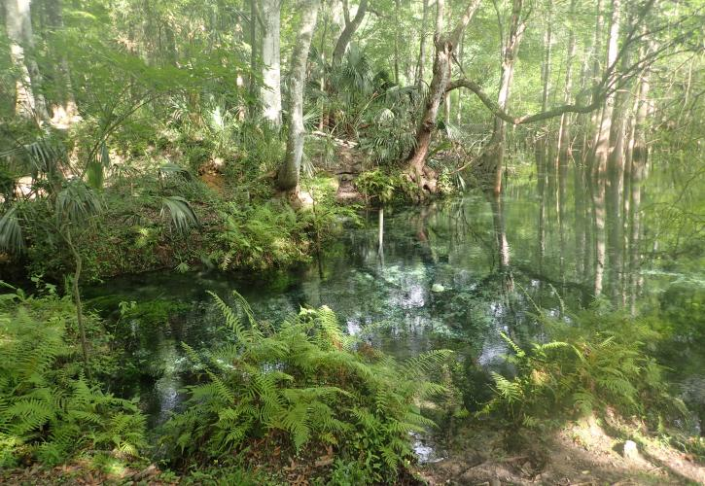
FLORIDA DEPARTMENT OF ENVIRONMENTAL PROTECTION
Water Quality Improvement Grant
Will be established under 403.0673, F.S. (Formerly the Wastewater Grant)
To be eligible for funding, a project must improve the quality of waters that:
  Are not attaining nutrient or nutrient-related standards;
  Have an established total maximum daily load; or,
  Are located within a BMAP or a reasonable assurance plan area adopted by final order, an accepted alternative restoration plan area, or located within a rural area of opportunity.
Project proposals may be submitted through the Protecting Florida Together portal (opening this summer)

Slide 71
Water Quality Improvement Grant
Eligible projects include:
Septic to sewer projects
Wastewater treatment facility improvements that result in improvements to surface water or groundwater quality
Stormwater treatment projects
Projects that qualify as a cooperative agricultural regional water quality improvement element as part of a basin management action
Where central sewerage is not available, retrofitting OSTDS to upgrade such systems to enhanced nutrient-reducing onsite sewage treatment and disposal systems or other equivalent wastewater system that achieves 65% reduction in total nitrogen
BMAP projects

Slide 72
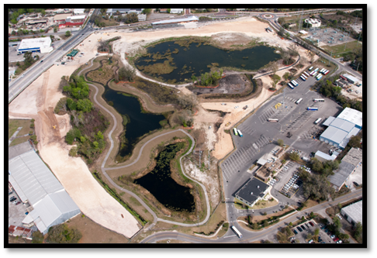
STATE REVOLVING FUND (SRF)
Florida’s largest financial assistance program for water infrastructure, capitalized by federal grants through EPA.
  Low-interest loans to local governments to plan, design, and build or upgrade water, wastewater and stormwater facilities.
  Interest rates on loans are below market rates and vary based on the economic wherewithal of the community.
  Discounted assistance (e.g., very low interest rates, grants, etc.) for small communities is available.
  Federal requirements for fair wages, American Iron and Steel, asset management plans.
  Eligible as match to the 319(h) and SWAG grants.

Slide 73
THANK YOU
Nathan Jagoda
Division of Water Restoration Assistance
Springs and Watershed Restoration Program
Contact Information:
850-245-2946
Nathan.Jagoda@FloridaDEP.gov
Protecting Florida Together
https://protectingfloridatogether.gov/state-action/grants-submissions
Division of Water Restoration Assistance
https://floridadep.gov/wra
Notes:
Protecting Florida Together is where you can sign up to receive grant updates and get more information for various grants including the Resilient Florida Grant.
DWRA website is where you can find more information on the funding opportunities, including the Springs and Nonpoint Grants, and SRF.

Slide 74

MENTIMETER SURVEY
To participate in the opening survey, please go to menti.com and use code
4444 4646
Notes:
Have to hit present (upper right corner).
Question 3: Let them know that answers are anonymous.

Slide 75
THANK YOU
Jessica Fetgatter
Division of Environmental Assessment and Restoration
Florida Department of Environmental Protection
Contact Information:
850-245-8107
Jessica.Fetgatter@FloridaDEP.gov

