Slide 1
LEXINGTON TERRACE
STORMWATER RETROFIT
EFFECTIVENESS REPORT
Escambia County
Department of Natural Resource Management
Water Quality Land Management Division
Brent Wipf and Dana Morton
Bayou Chico 2015 Annual Meeting

Slide 2
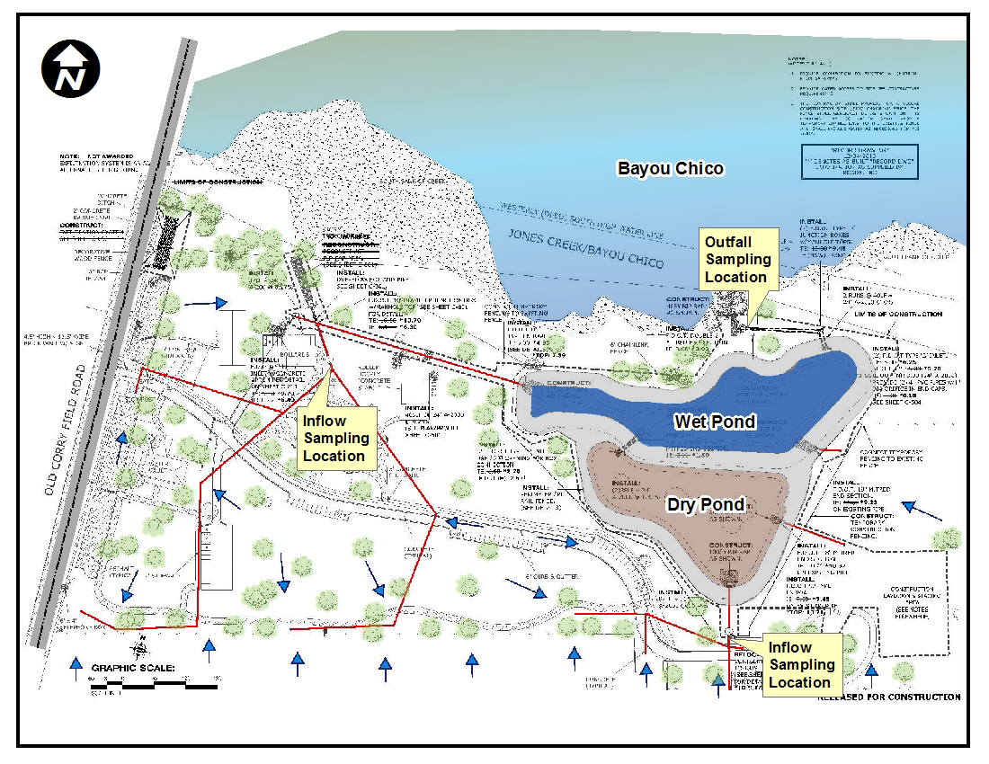
Lexington Terrace Stormwater Retrofit
+/- 53 acre basin

Slide 3
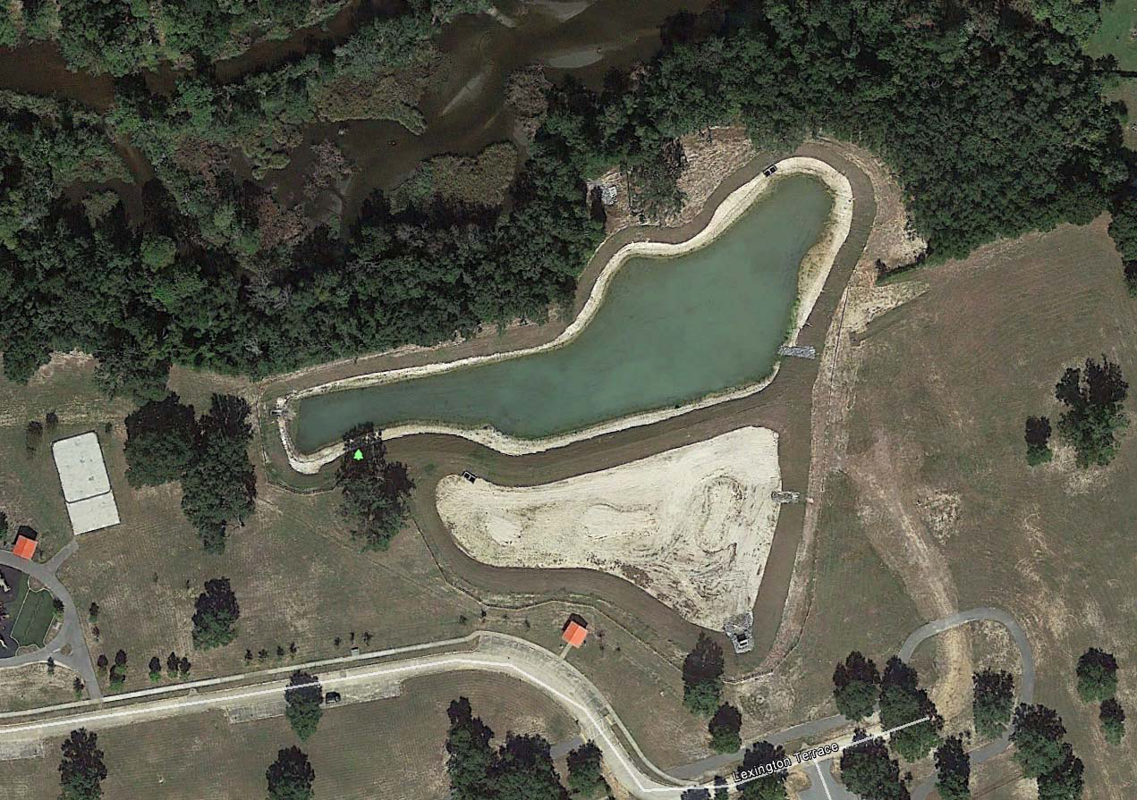
After Project Completion

Slide 4
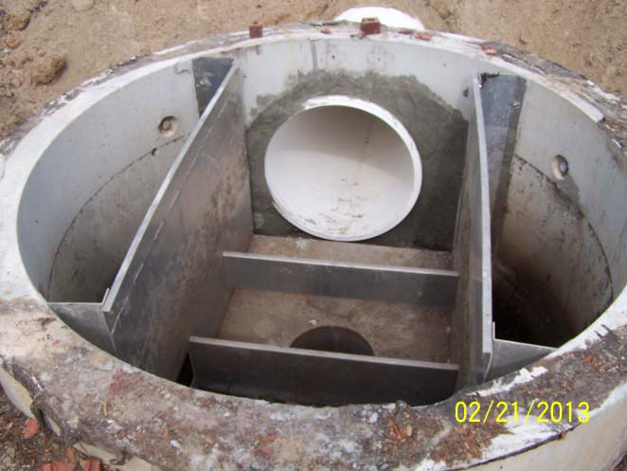
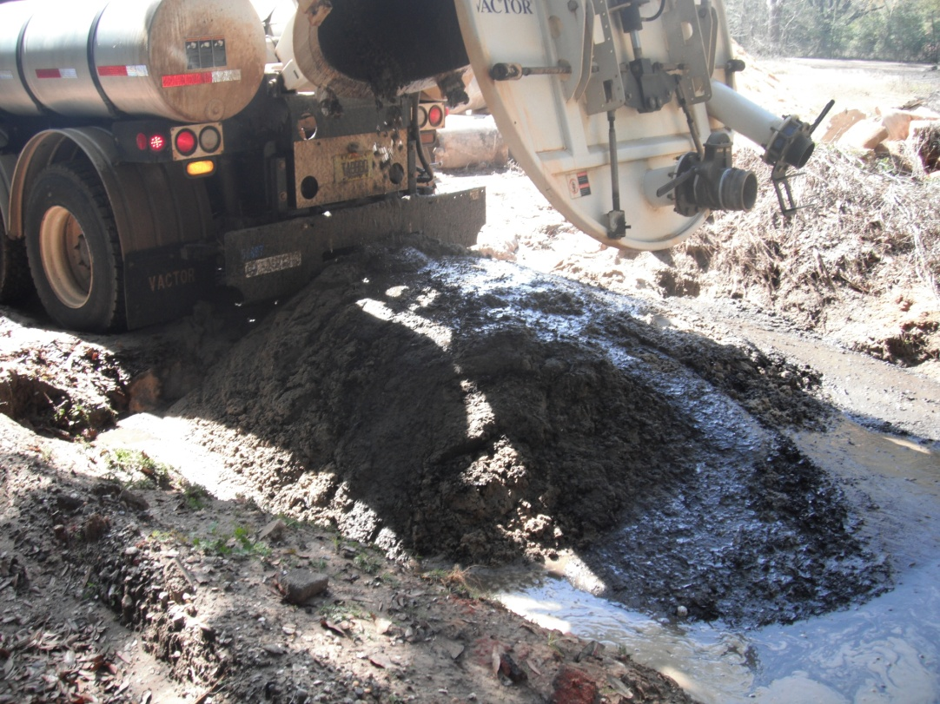
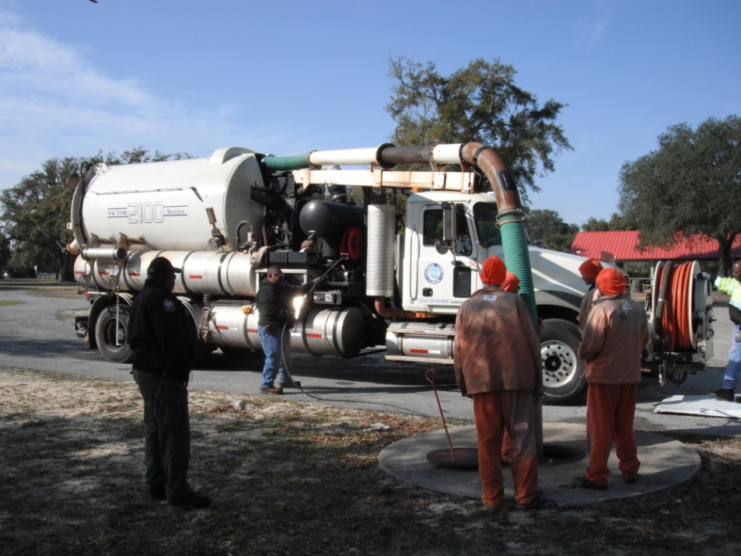
Employs “Treatment Train” concept
  (2)VortSentry hydrodynamic separators

Slide 5
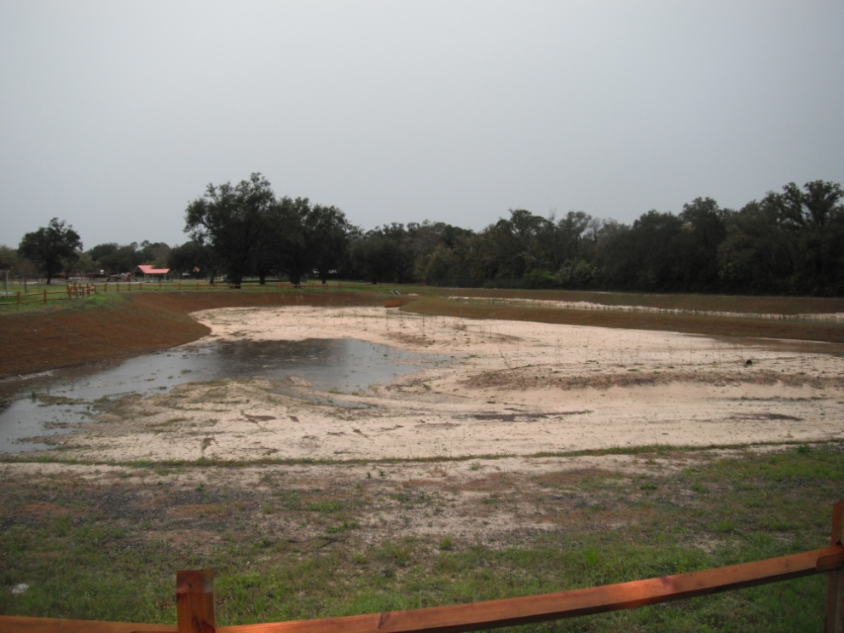
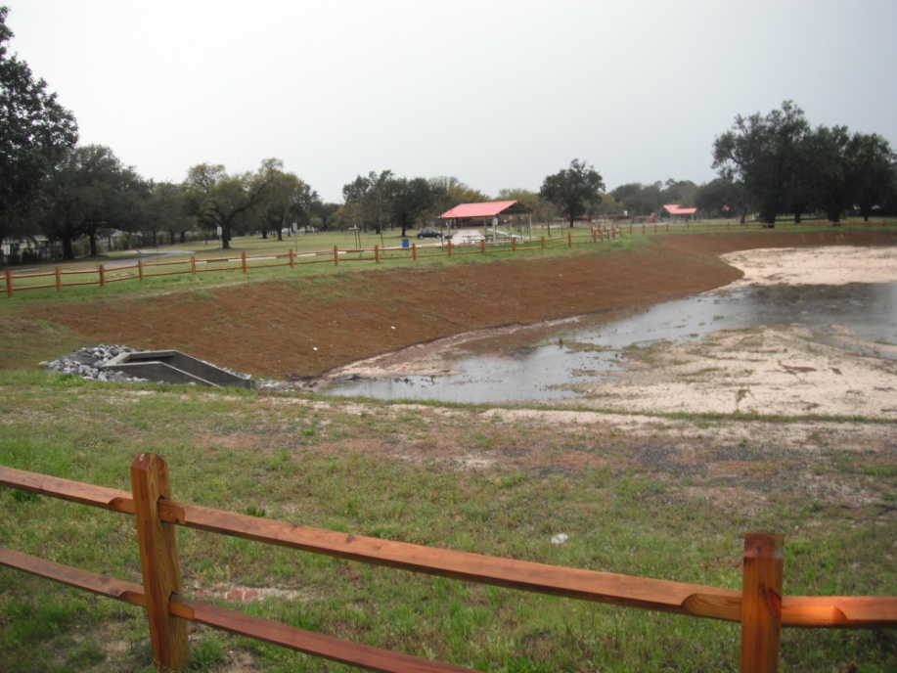
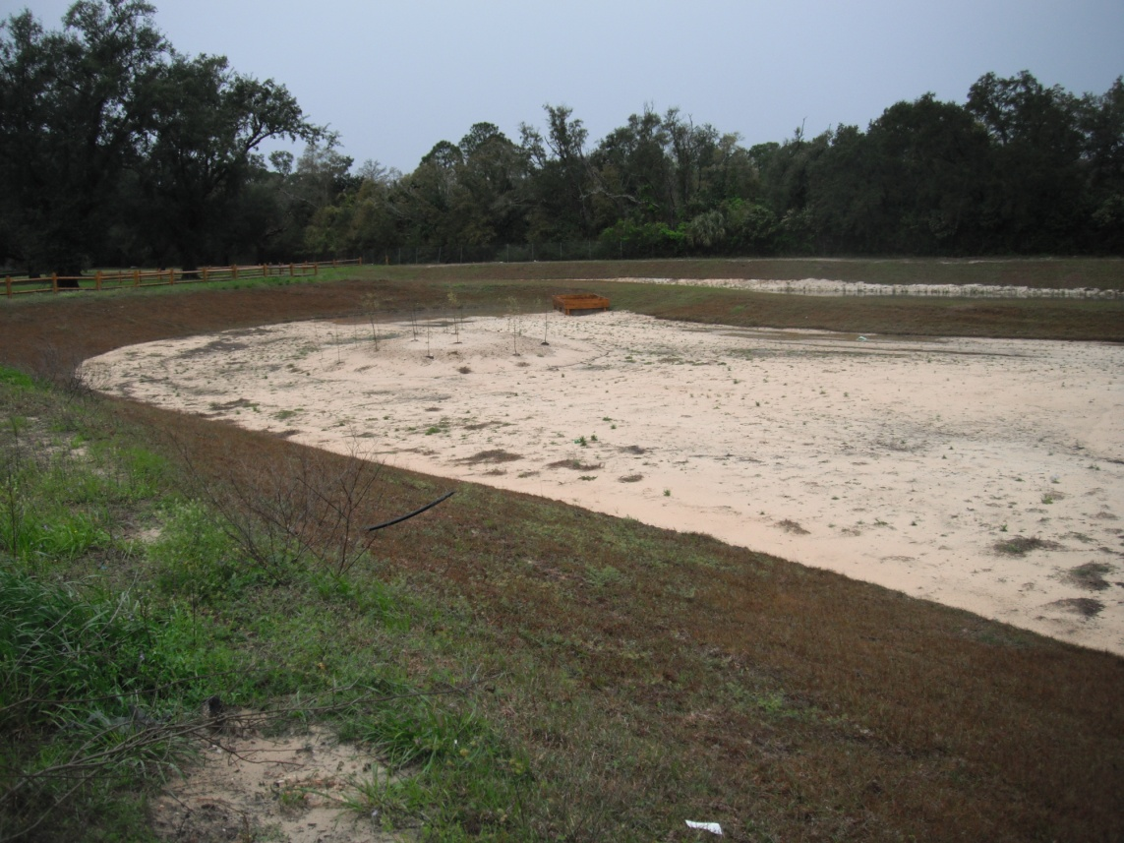
Employs “Treatment Train” concept
  2) Dry pond
March 28 2014
After 4 “ rain

Slide 6
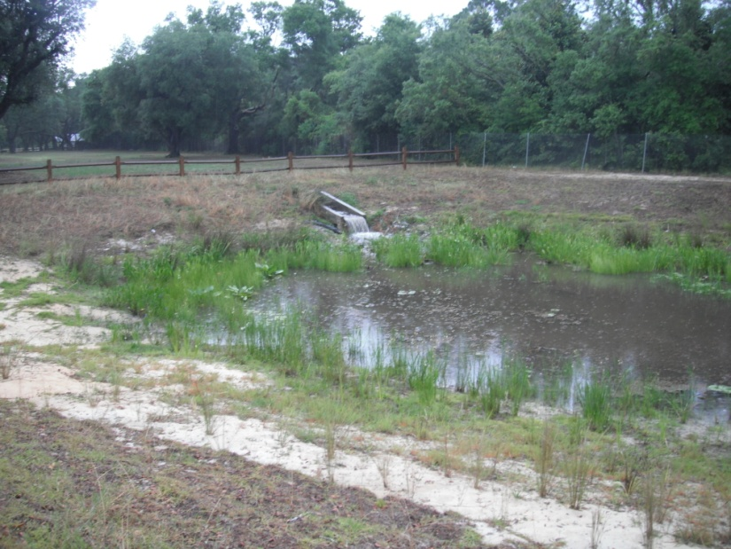
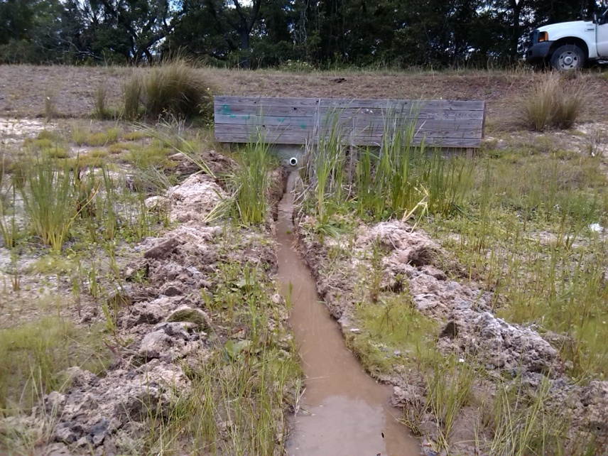
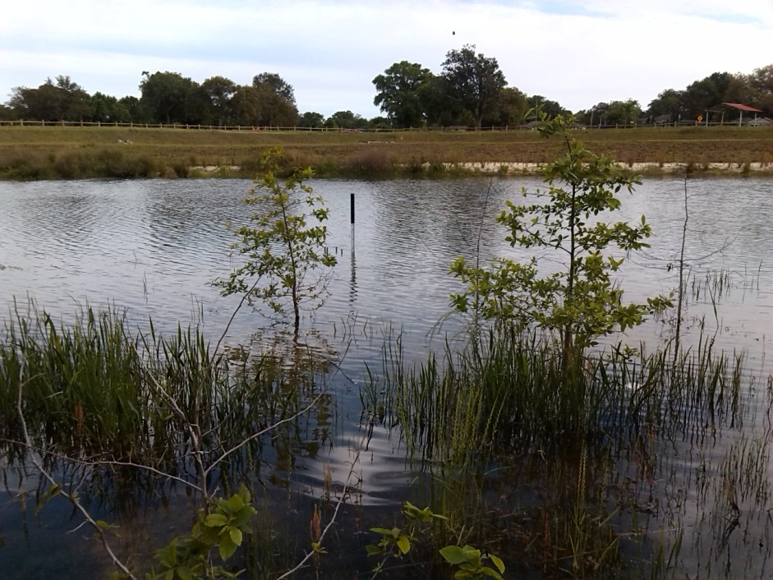
Employs “Treatment Train” concept
  3) Wet stormwater detention pond

Slide 7
BMP Effectiveness Study
February – June 2015
Minimum of seven qualifying rain events (evaluated ten)
0.2 – 1.5” is a qualifying event
Flow weighted composite samples
Avalanche automatic sampling equipment
Two inlet structures and one outlet structure
Anaylytes:
  Metals (Cd, Cr, Cu and Zn)
  Nutrients
  Bacteria
  Oil and grease

Slide 8
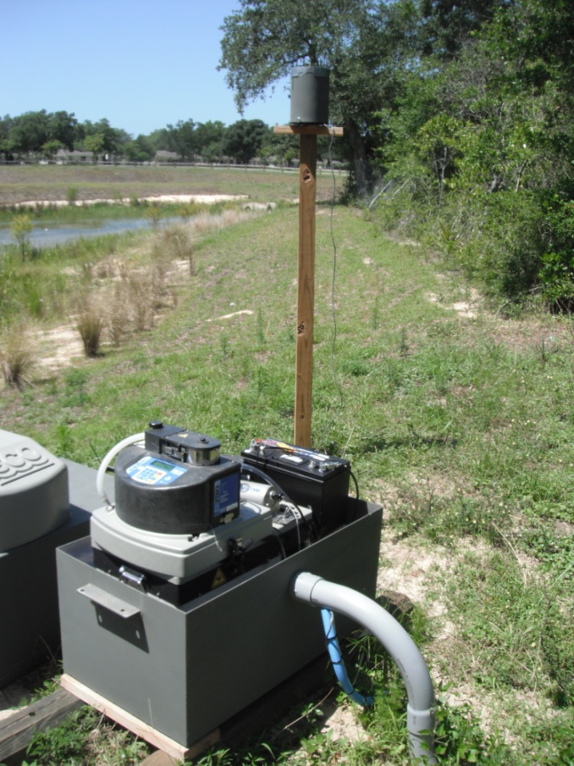
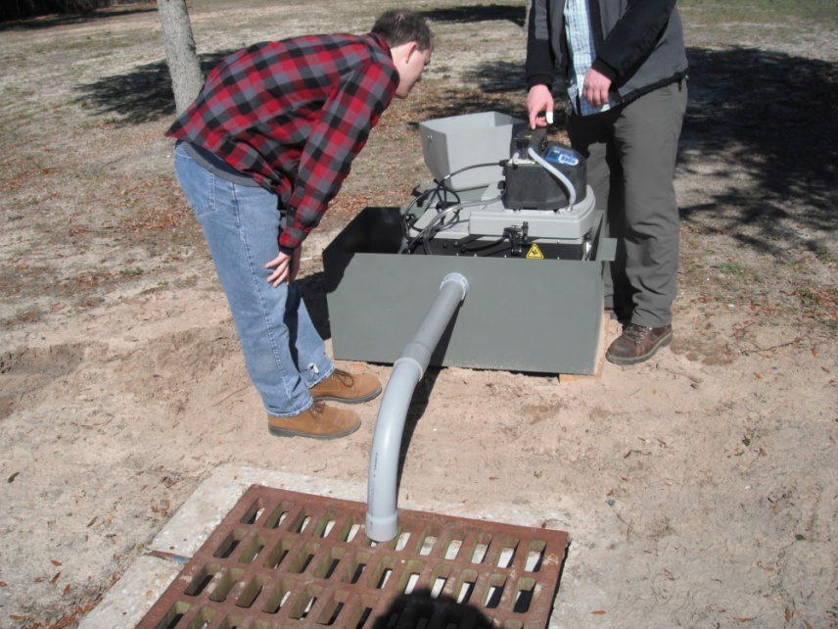
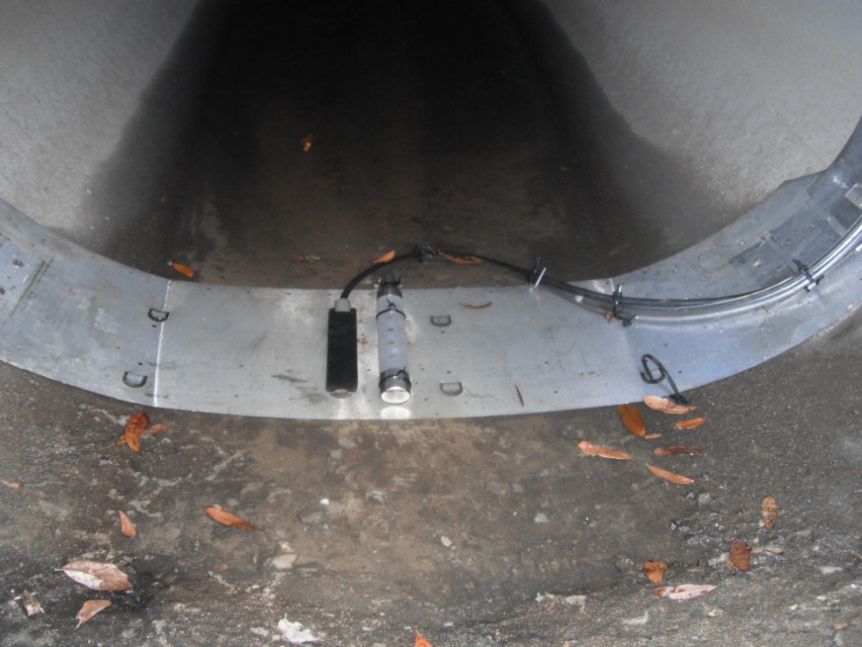
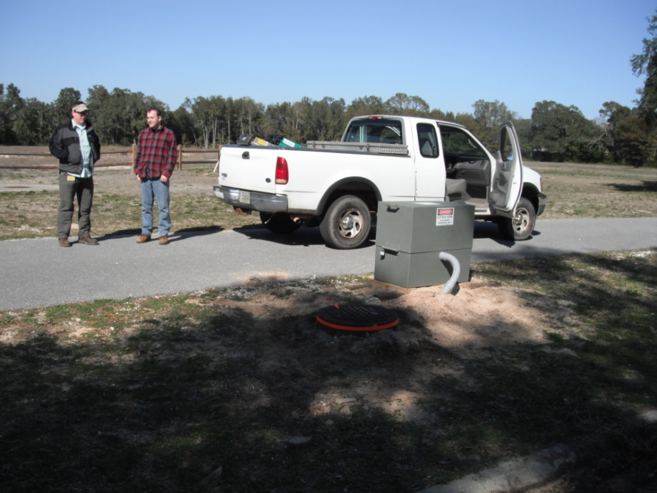
Equipment Installation

Slide 9
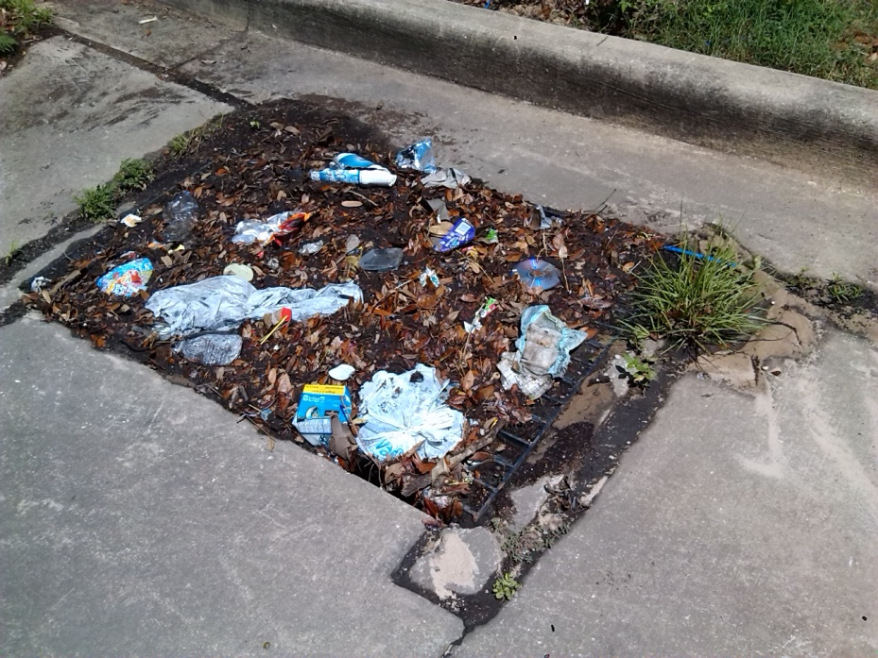
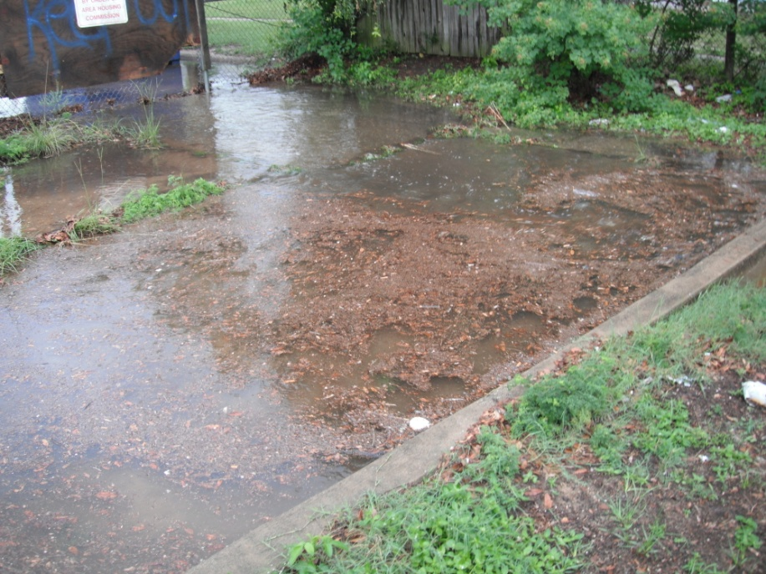
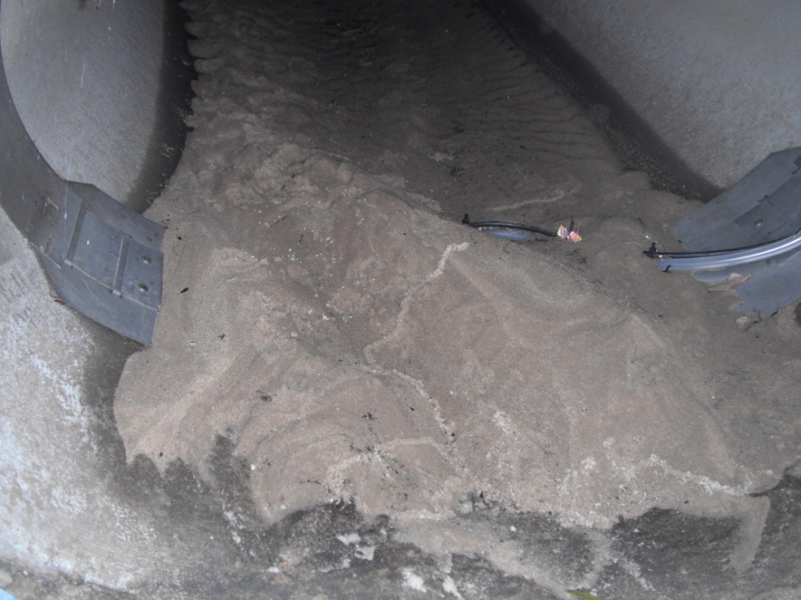
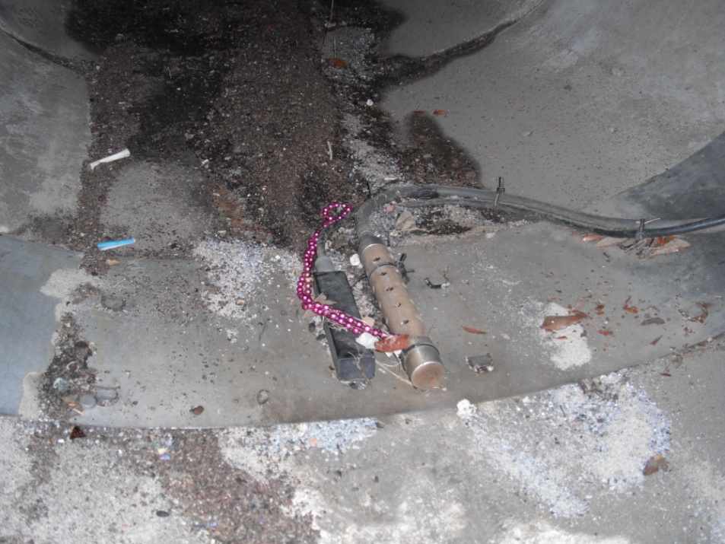
Project Realities

Slide 10
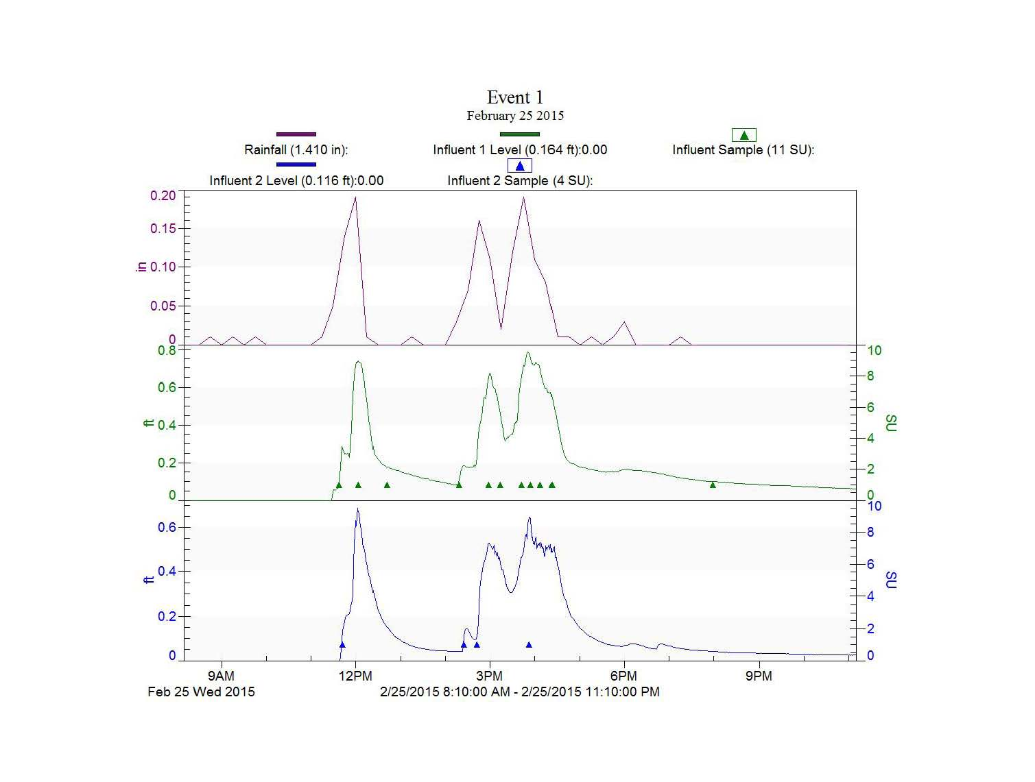
Typical Rain Event Hydrograph

Slide 11
RESULTS: Total Event Loading
100 % Removal Efficiency
Event | TN (lbs) | TP(lbs) | ZN(lbs) | CU(lbs) | CD(lbs) | CR(lbs) | TSS(lbs) | O/G(lbs) | FC (MPN)
1 | 6.548 | 0.950 | 0.209 | 0.053 | 0.004 | 0.015 | 358.707 | 7.746 | 195,829,853,915
2 | 8.634 | 1.253 | 0.276 | 0.070 | 0.005 | 0.020 | 473.032 | 10.214 | 258,244,080,857
3 | 0.552 | 0.080 | 0.018 | 0.004 | 0.000 | 0.001 | 30.268 | 0.654 | 16,524,492,984
4 | 17.358 | 2.520 | 0.554 | 0.141 | 0.010 | 0.040 | 950.961 | 20.534 | 519,161,164,555
5 | 1.683 | 0.244 | 0.054 | 0.014 | 0.001 | 0.004 | 92.214 | 1.991 | 50,342,703,267
6 | 4.491 | 0.652 | 0.143 | 0.036 | 0.003 | 0.010 | 246.032 | 5.313 | 134,317,143,202
7 | 1.976 | 0.287 | 0.063 | 0.016 | 0.001 | 0.005 | 108.250 | 2.337 | 59,097,260,853
8 | 3.326 | 0.483 | 0.106 | 0.027 | 0.002 | 0.008 | 182.197 | 3.934 | 99,467,620,032
9 | 5.254 | 0.763 | 0.168 | 0.043 | 0.003 | 0.012 | 287.851 | 6.216 | 157,147,270,439
10 | 7.939 | 1.152 | 0.254 | 0.064 | 0.005 | 0.018 | 434.939 | 9.392 | 237,447,503,642

