Slide 1
Division of Environmental Assessment and Restoration
Bayou Chico
Basin Management Action Plan (BMAP)
Annual Meeting
January 12, 2017

Slide 2
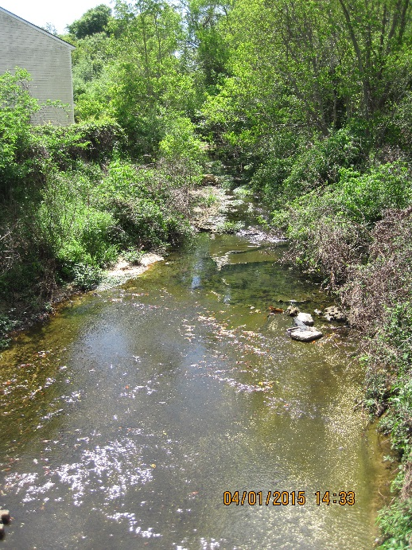
Meeting Agenda
Welcome and Introductions.
BMAP Background.
Progress Towards Restoration.
Review of Year Five Projects.
Next Steps.
Public Comments and Wrap Up.

Slide 3
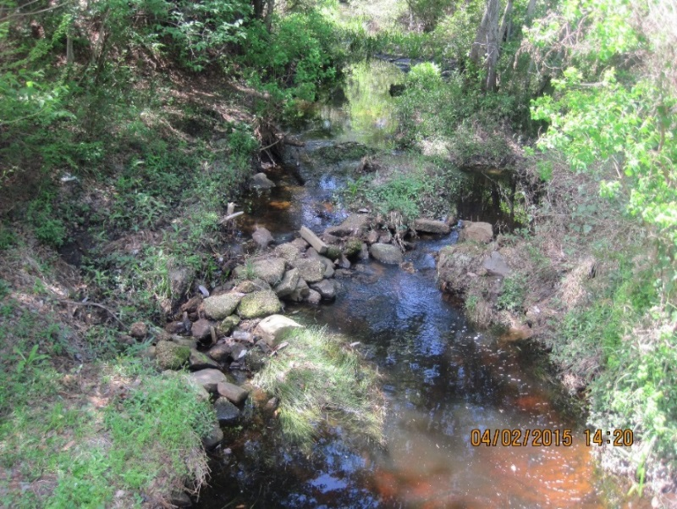
BMAP Background
Adopted October 2011.
End of first 5-year iteration October 2016.
The waterbodies addressed by BMAP:
  Bayou Chico Drain (Maggie’s Ditch).
  Jones Creek.
  Jackson Creek.
  Bayou Chico.
  Bayou Chico Beach.
  Sanders Beach.

Slide 4
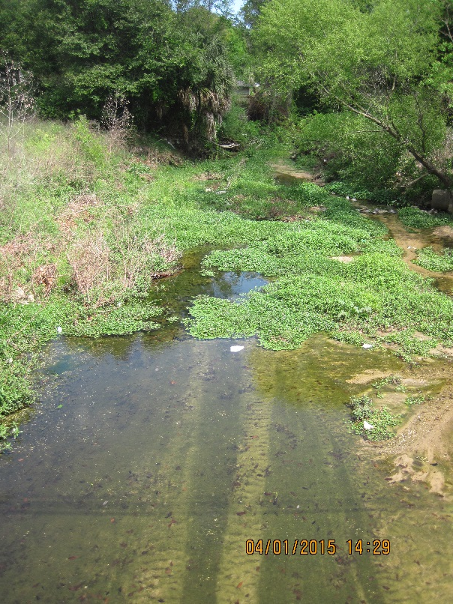
Progress Towards Restoration
Assessments to Date.
Data Plot Review.
New Criteria Review.

Slide 5
Projects
  Southwest Greenway 3rd Extension.
  Beach Haven Stormwater Improvement.
  Jones Creek Floodplain Restoration.
  BMP effectiveness studies at Lexington Terrace Stormwater Retrofit.
  Jones Swamp Floodplain & Sewer Lift Station Relocation .
  Secured funding ($30 million) for 9 structural stormwater projects.
  R Street Stormwater.
  Bill Gregory Park Stormwater.
  Jackson Creek Restoration.
  Dredge around Old Train Trestles.
  Bayou Chico Restoration grant proposal drafting.
  Bayou Chico Trash Round-up.
  Studies about the feasibility of uses of the Clark Sand Pits.

Slide 6
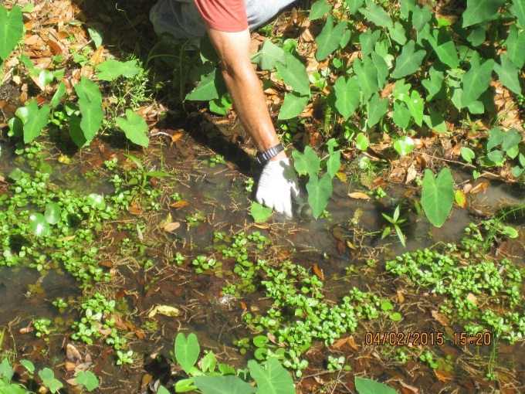
Next Steps
Source Identification 2016 Results.
  Sucralose (artificial sweetener).
  Acetaminophen (pain medicine).
  Bacteria DNA analysis: quantitative polymerase chain reaction (qPCR).
    Human Waste.
    Gull and Wading Bird Waste.
  Develop programs based on source types identified.

Slide 7
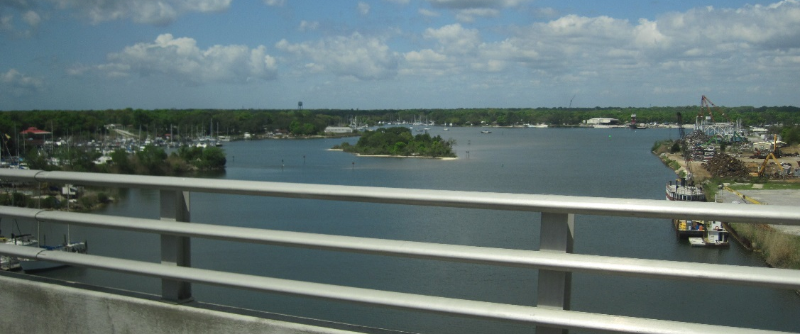
Wrap Up
Deadline for Comments is February 28, 2017.
PowerPoint Presentation is posted to:
  http://publicfiles.dep.state.fl.us/DEAR/BMAP/PensacolaBasin/BayouChico/
For questions contact Anita Nash:
  Anita.Nash@dep.state.fl.us
  850-245-8545

Slide 8
Contacts
Tom Frick, Director, Division of Environmental Assessment and Restoration, Thomas.Frick@dep.state.fl.us
Kevin Coyne, Administrator, Watershed Planning and Coordination Section, Kevin.Coyne@dep.state.fl.us
Anita Nash, Basin Coordinator, Watershed Planning and Coordination Section, Anita.Nash@dep.state.fl.us
David Glassner, Basin Coordinator, Watershed Planning and Coordination Section, David.Glassner@dep.state.fl.us
Heather York, Consultant, HYork@wildwoodconsulting.net
31

