Slide 1
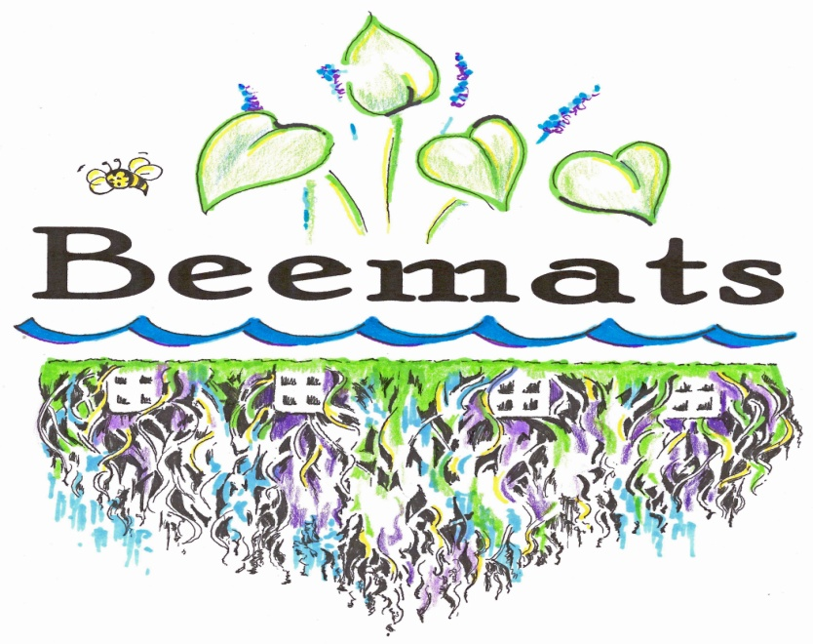
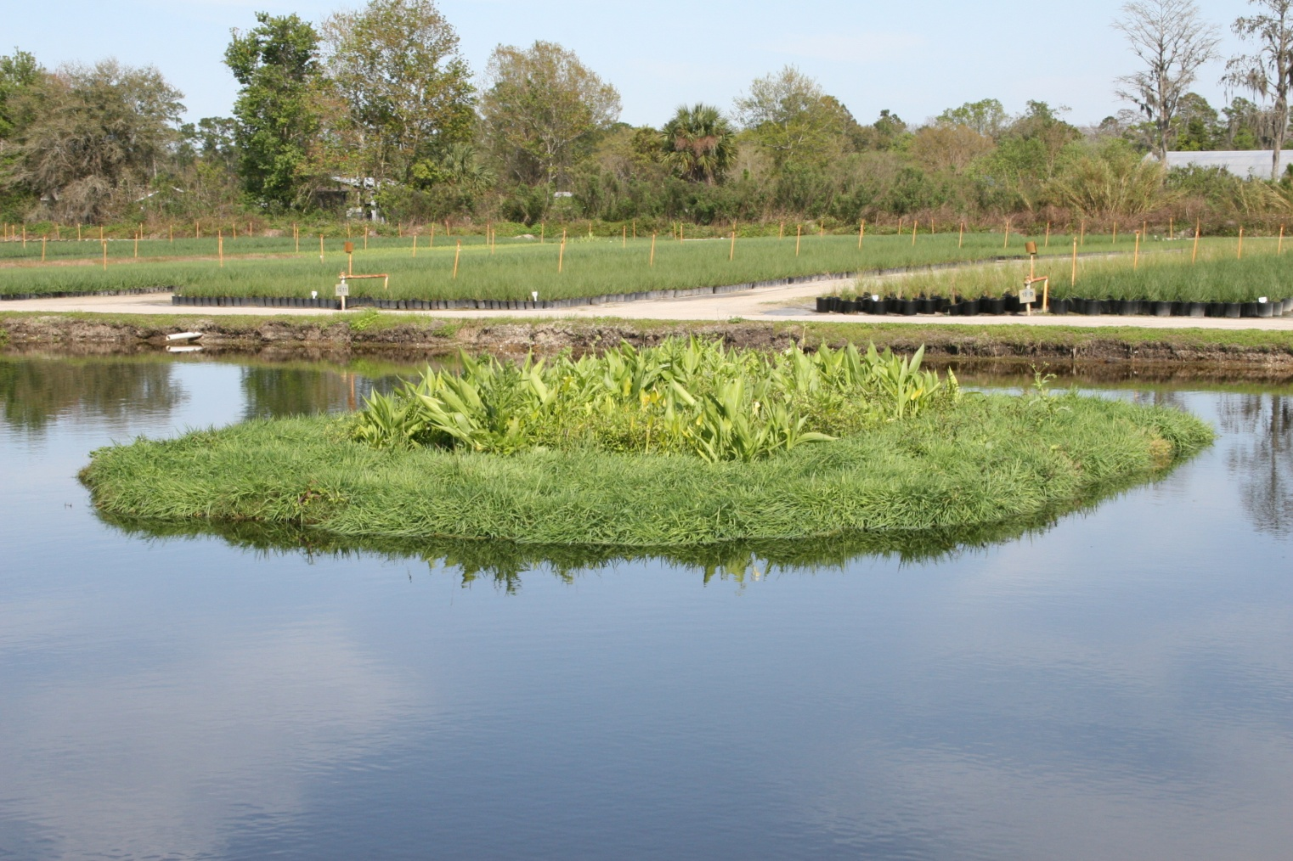
What are Beemats?

Slide 2
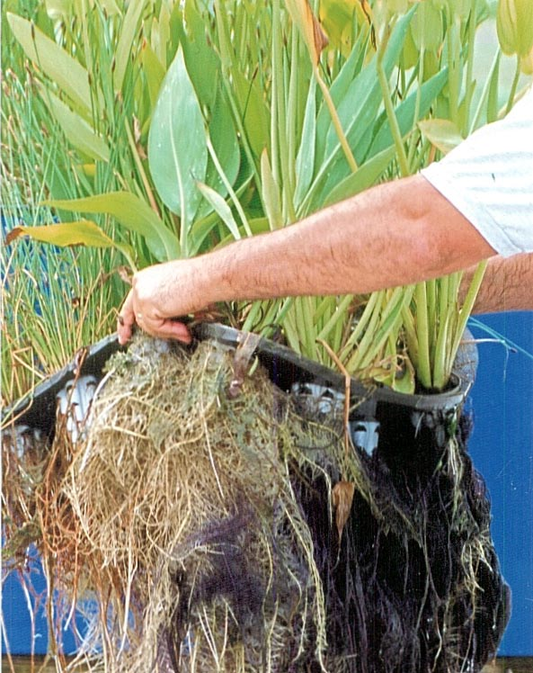
Beemats are active biological systems that utilize macrophytes to remove nutrient pollution from stormwater

Slide 3
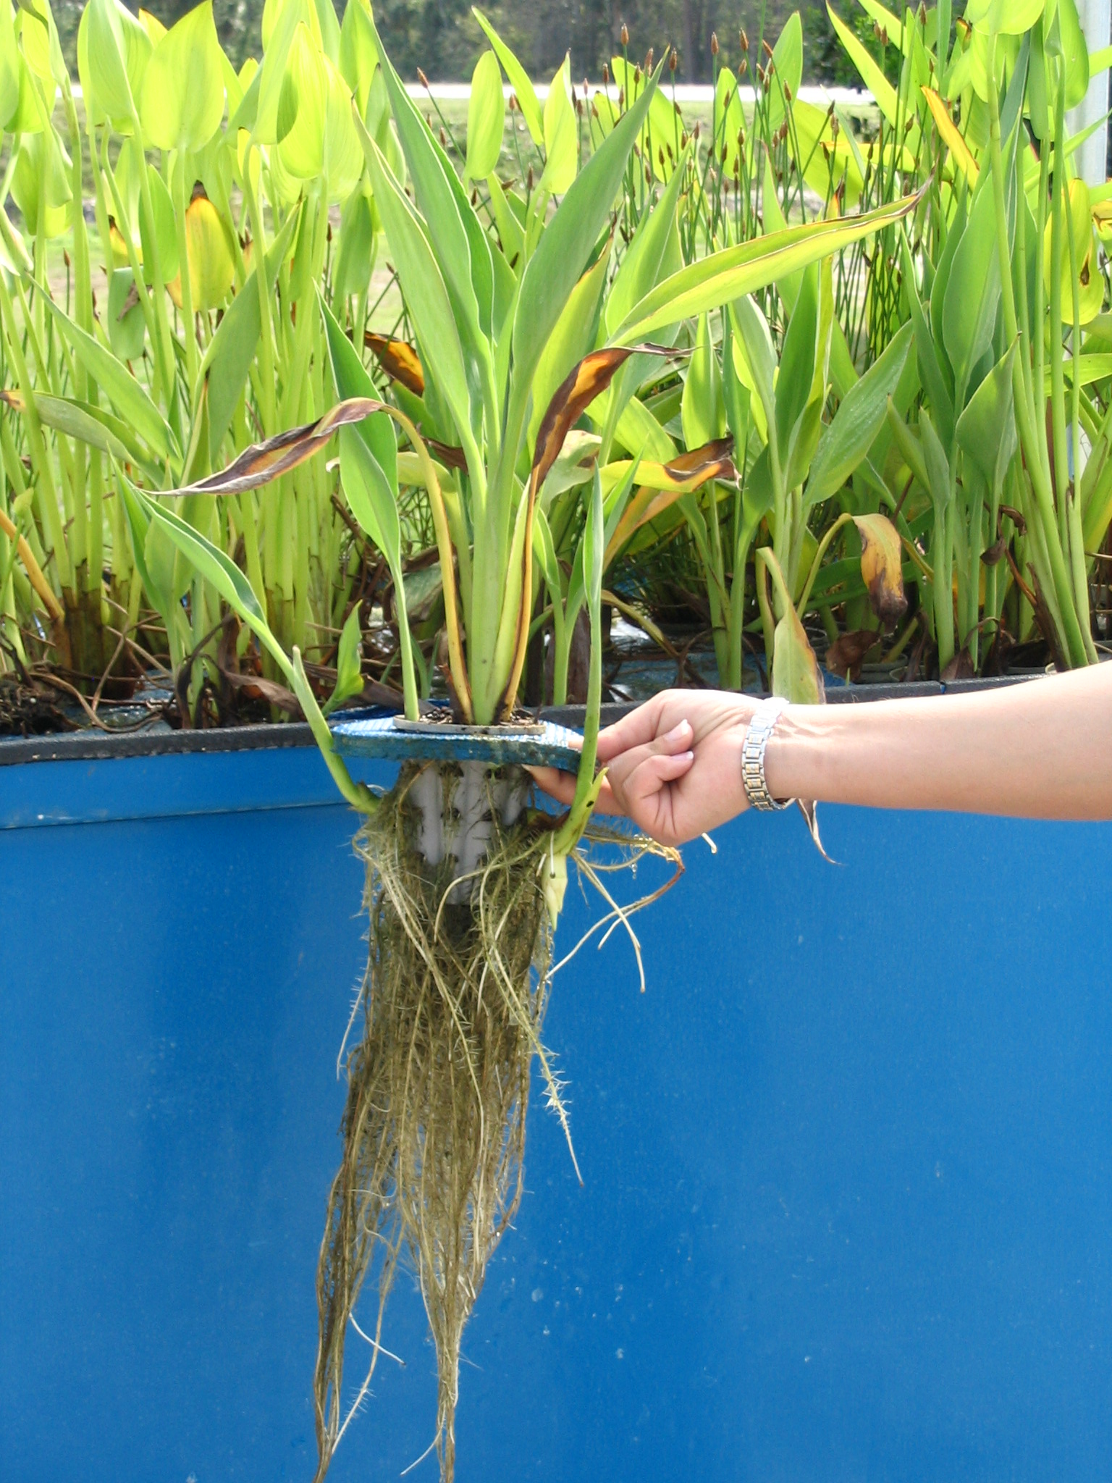
The roots and attached biofilm are suspended in the water below the mats where they accumulate and store soluble nutrients

Slide 4
Phosphorus is one of the primary nutrient pollutants in stormwater. Orthophosphorus (also referred to as soluble reactive phosphorus - SRP) is the inorganic, ionic form of phosphorus that is available for direct plant uptake. SRP may comprise 20% or more of the total phosphorus in water. Macrophyte plants are effective at taking SRP from solution and storing it as increased biomass. If there are no macrophytes available, other plants like algae, duckweed and hydrilla can fill that niche and rapidly grow to nuisance proportions. When the plants die, the phosphorus is recycled back into the aquatic ecosystem.
Nitrogen, in its organic form, is not bioavailable and not a threat to the aquatic environment. Organic nitrogen may be changed to ammonia through enzymatic activity or changes in pH, light, temperature or redox potential. As ammonia, nitrogen is of concern as a pollutant since it contributes to eutrophication and can be toxic to aquatic animals in warm water with high pH levels. Nitrate and nitrite are formed by the oxidation of ammonia through the process of nitrification. Nitrates can also enter the water directly as components of nitrate fertilizers, used in agriculture and in ornamental plant cultivation. Both ammonia nitrogen and nitrate-nitrite nitrogen may be removed from the water column by direct plant uptake. As with phosphorus, if no macrophytes are available, other opportunistic types of vegetation like duckweed and algae can experience population explosions through the luxury uptake of bioavailable nitrogen.

Slide 5
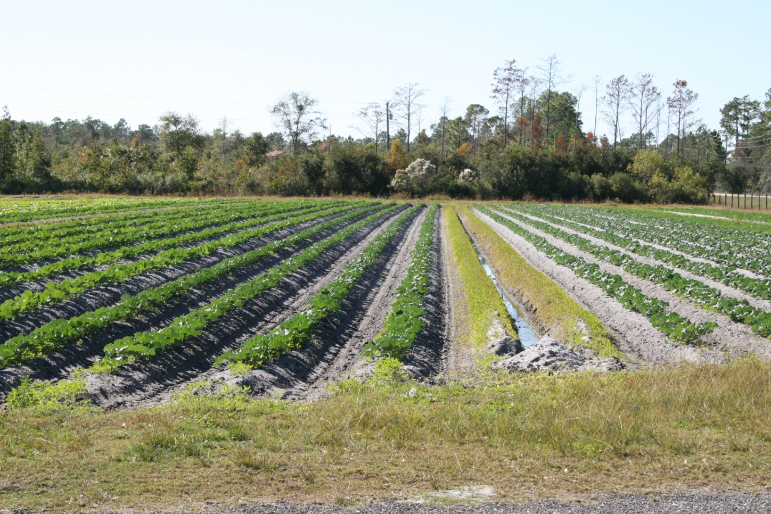
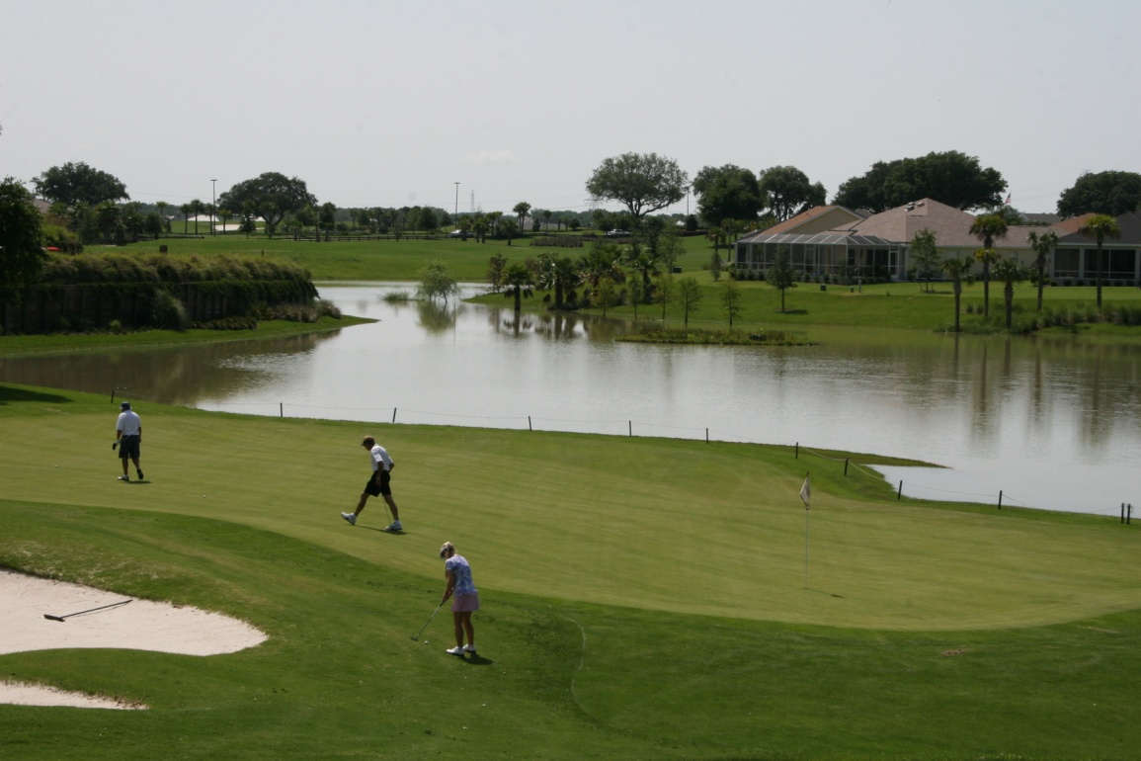
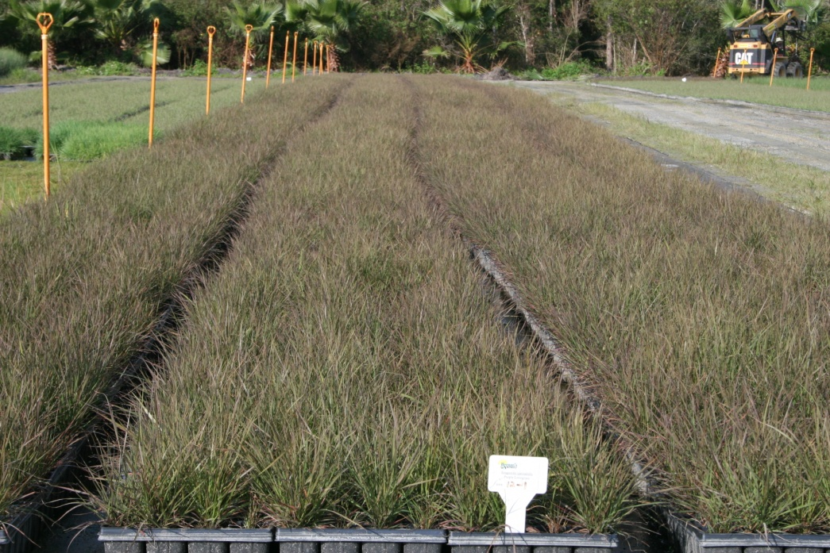
Agriculture, Floriculture, Golf Courses, and Residential Development are all sources of Nutrient Pollution

Slide 6
A recent South Carolina study found that many stormwater detention ponds produce toxic algae

Slide 7
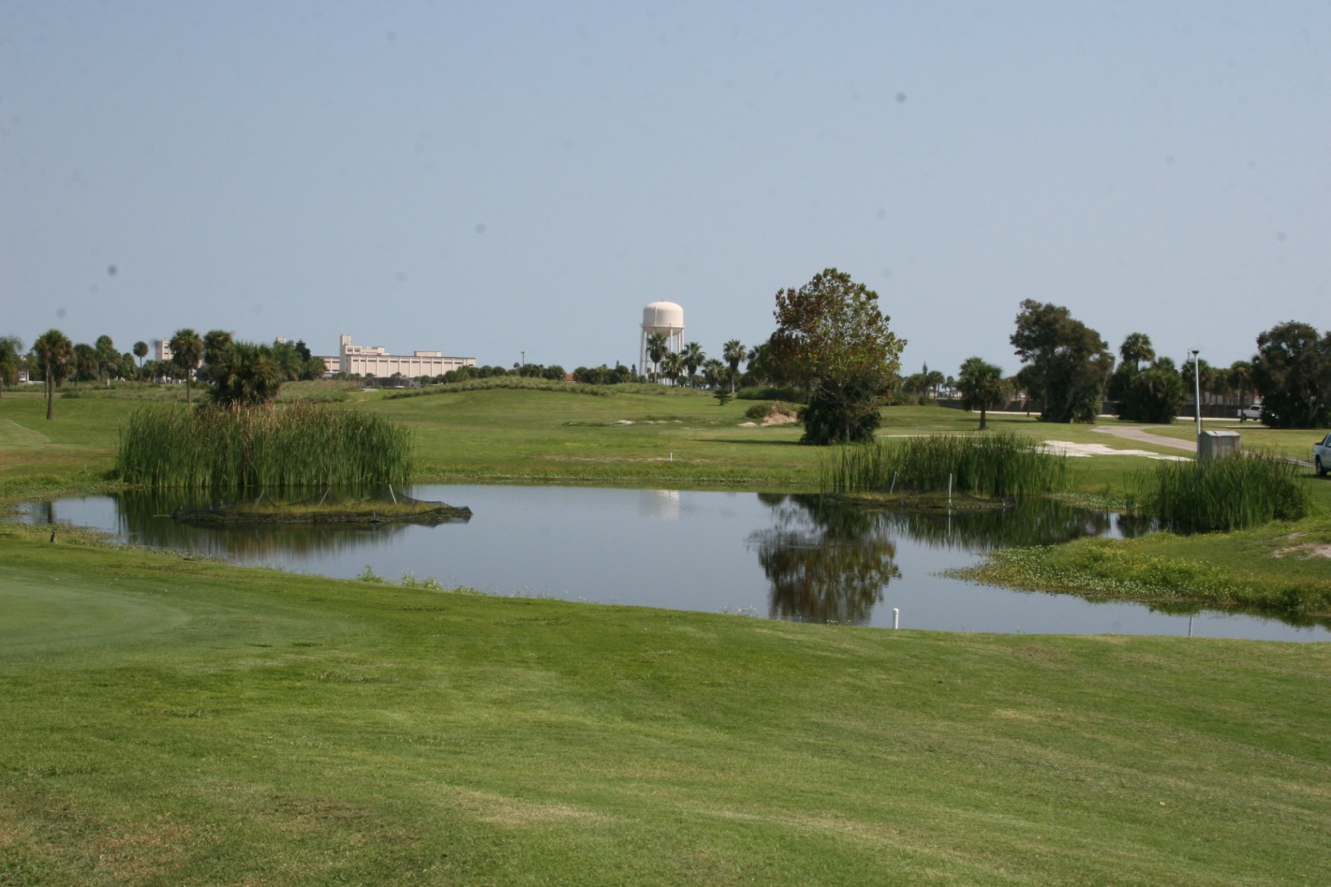
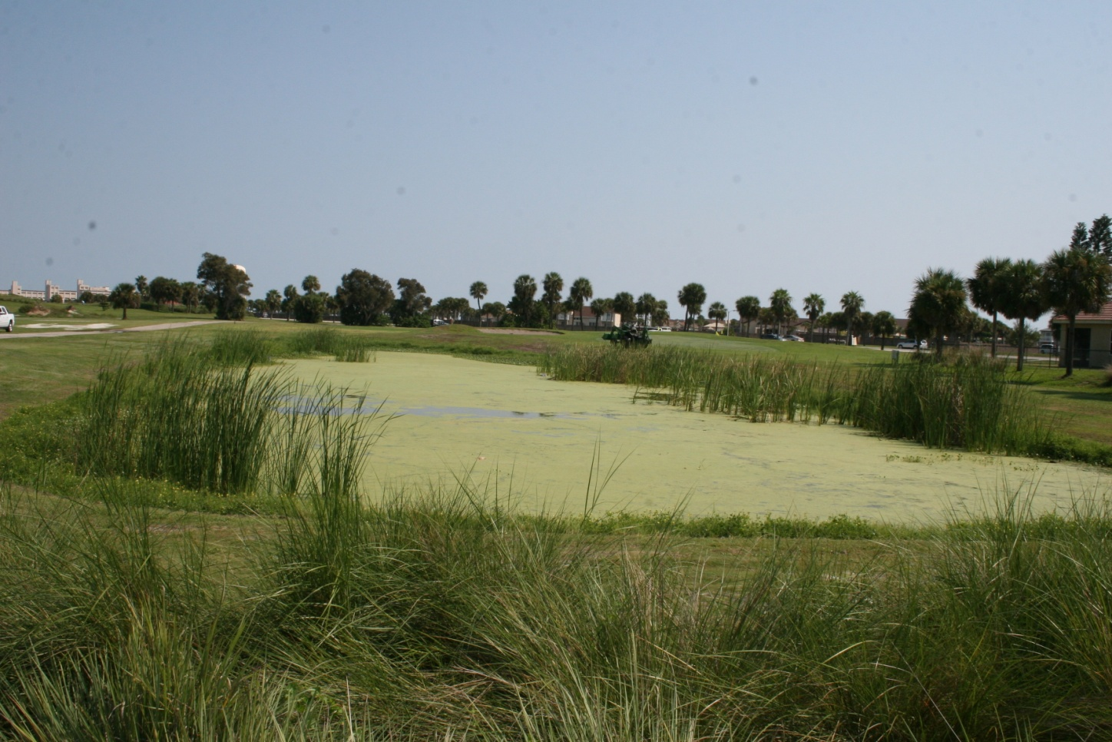
Patrick Air Force Base
These two ponds are connected. The one at the top has Beemats, the one on the bottom doesn’t.

Slide 8
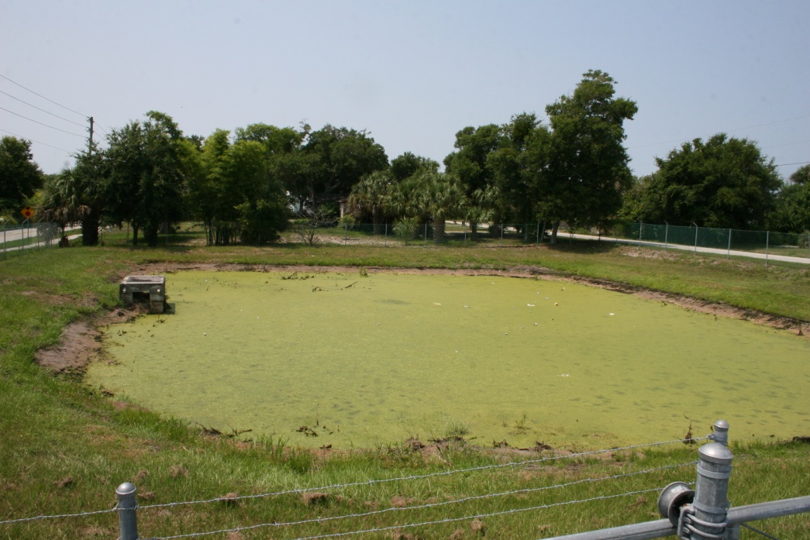
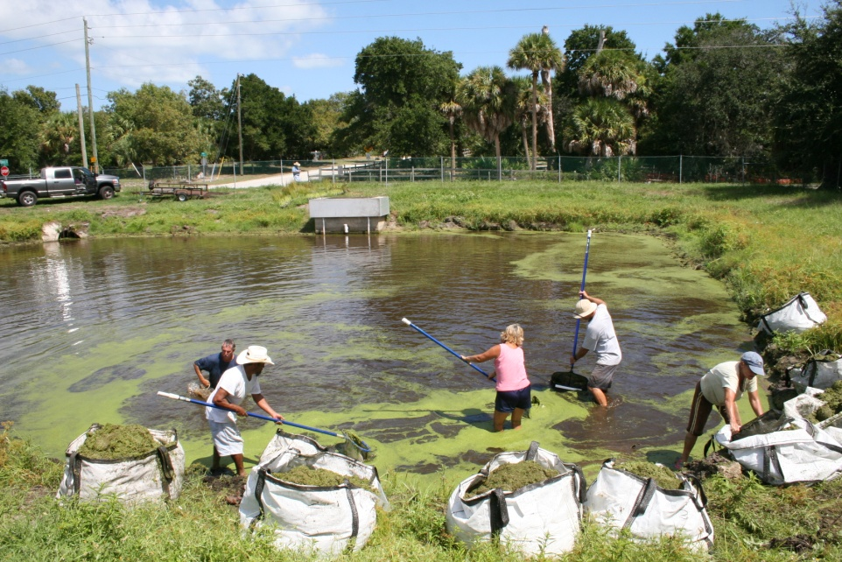
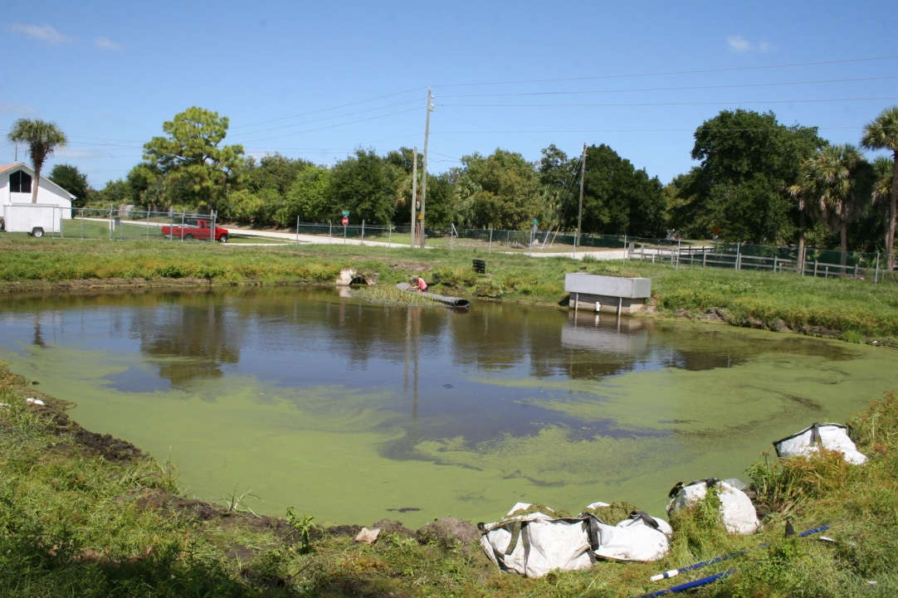
Church St. Pond – Micco, Fl.
Sept.2010

Slide 9
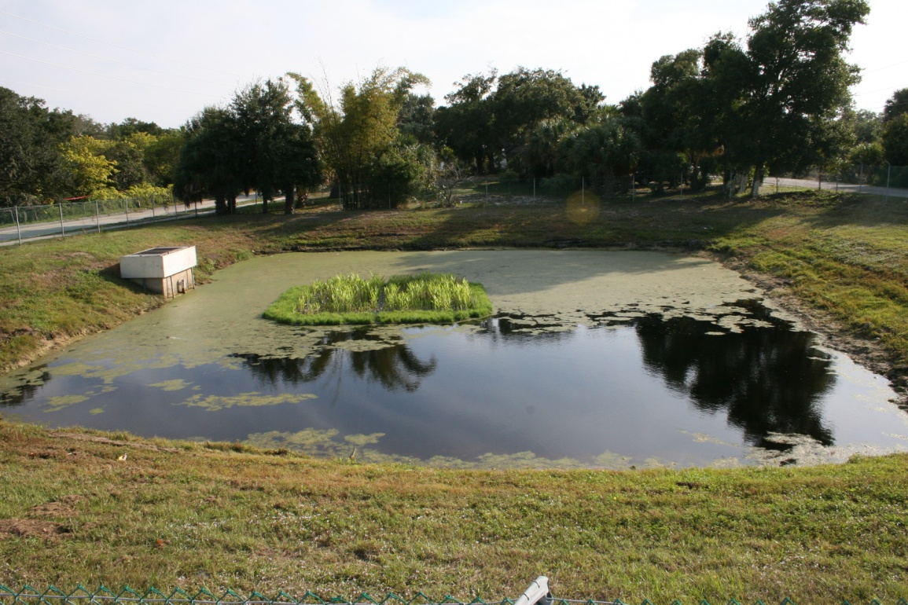
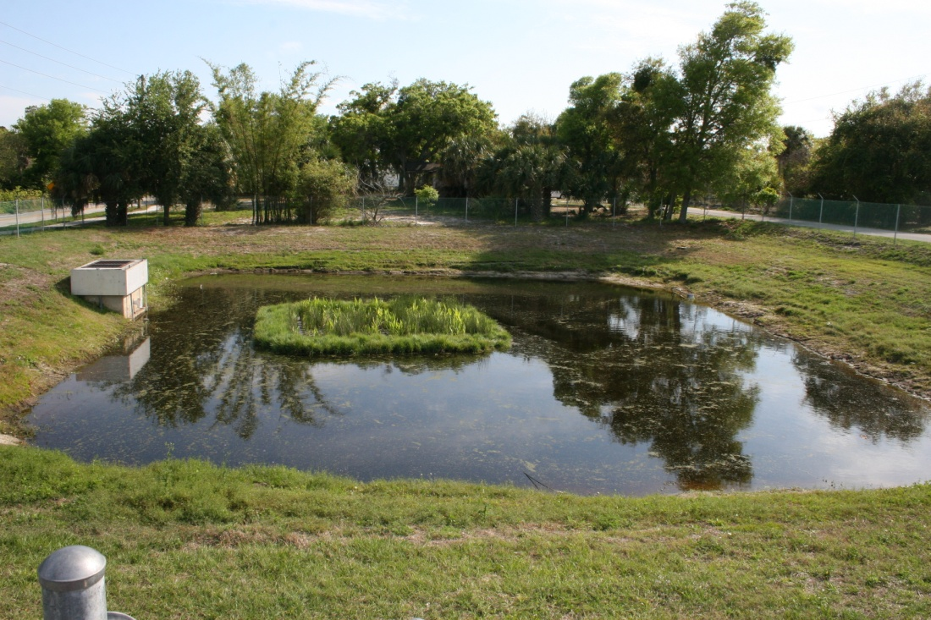
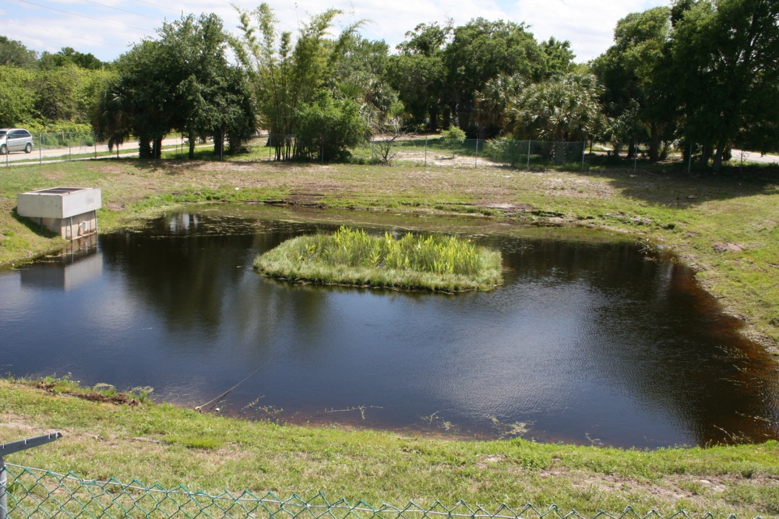
Nov. 2010
Jan. 2011
Apr. 2011

Slide 10
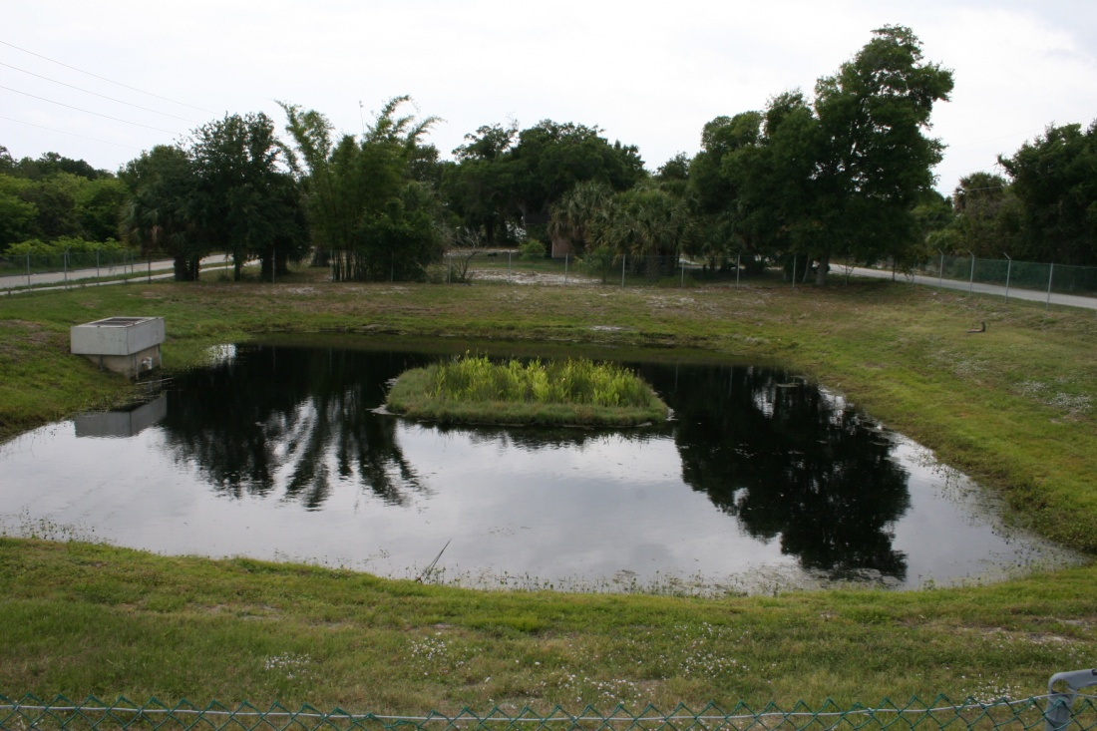
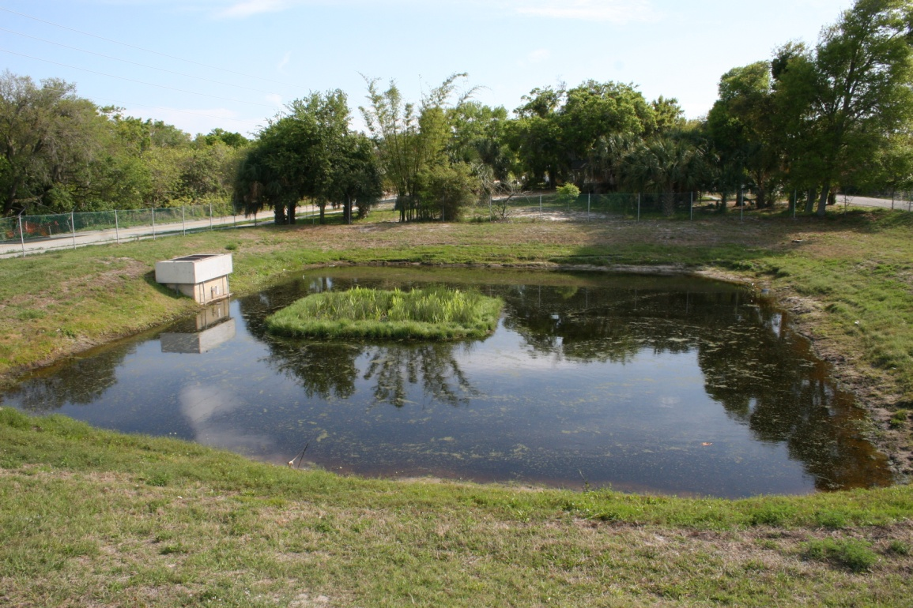
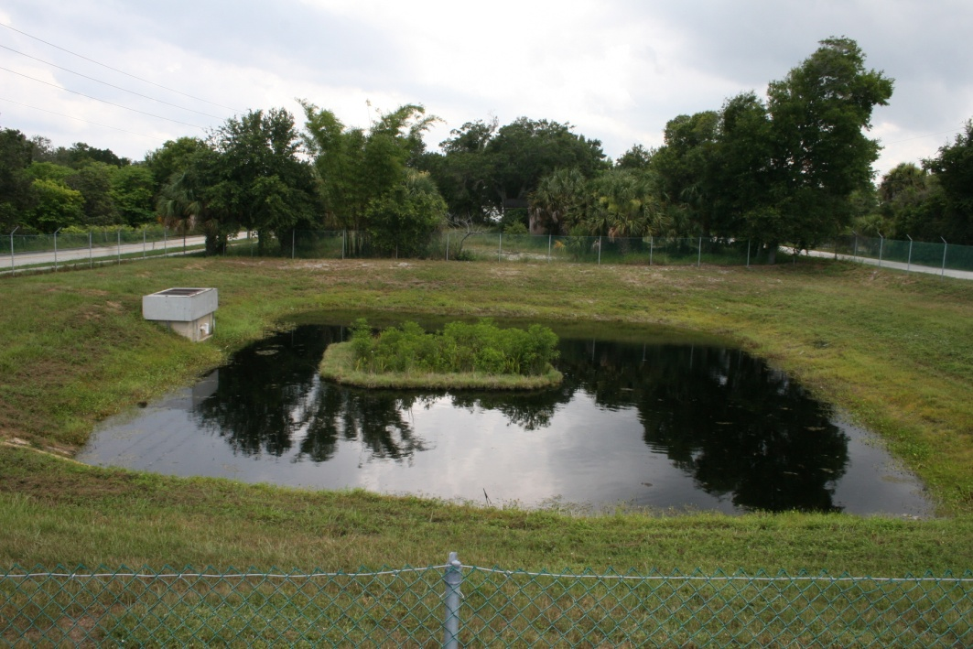
May 2011
July 2011
Aug. 2011

Slide 11
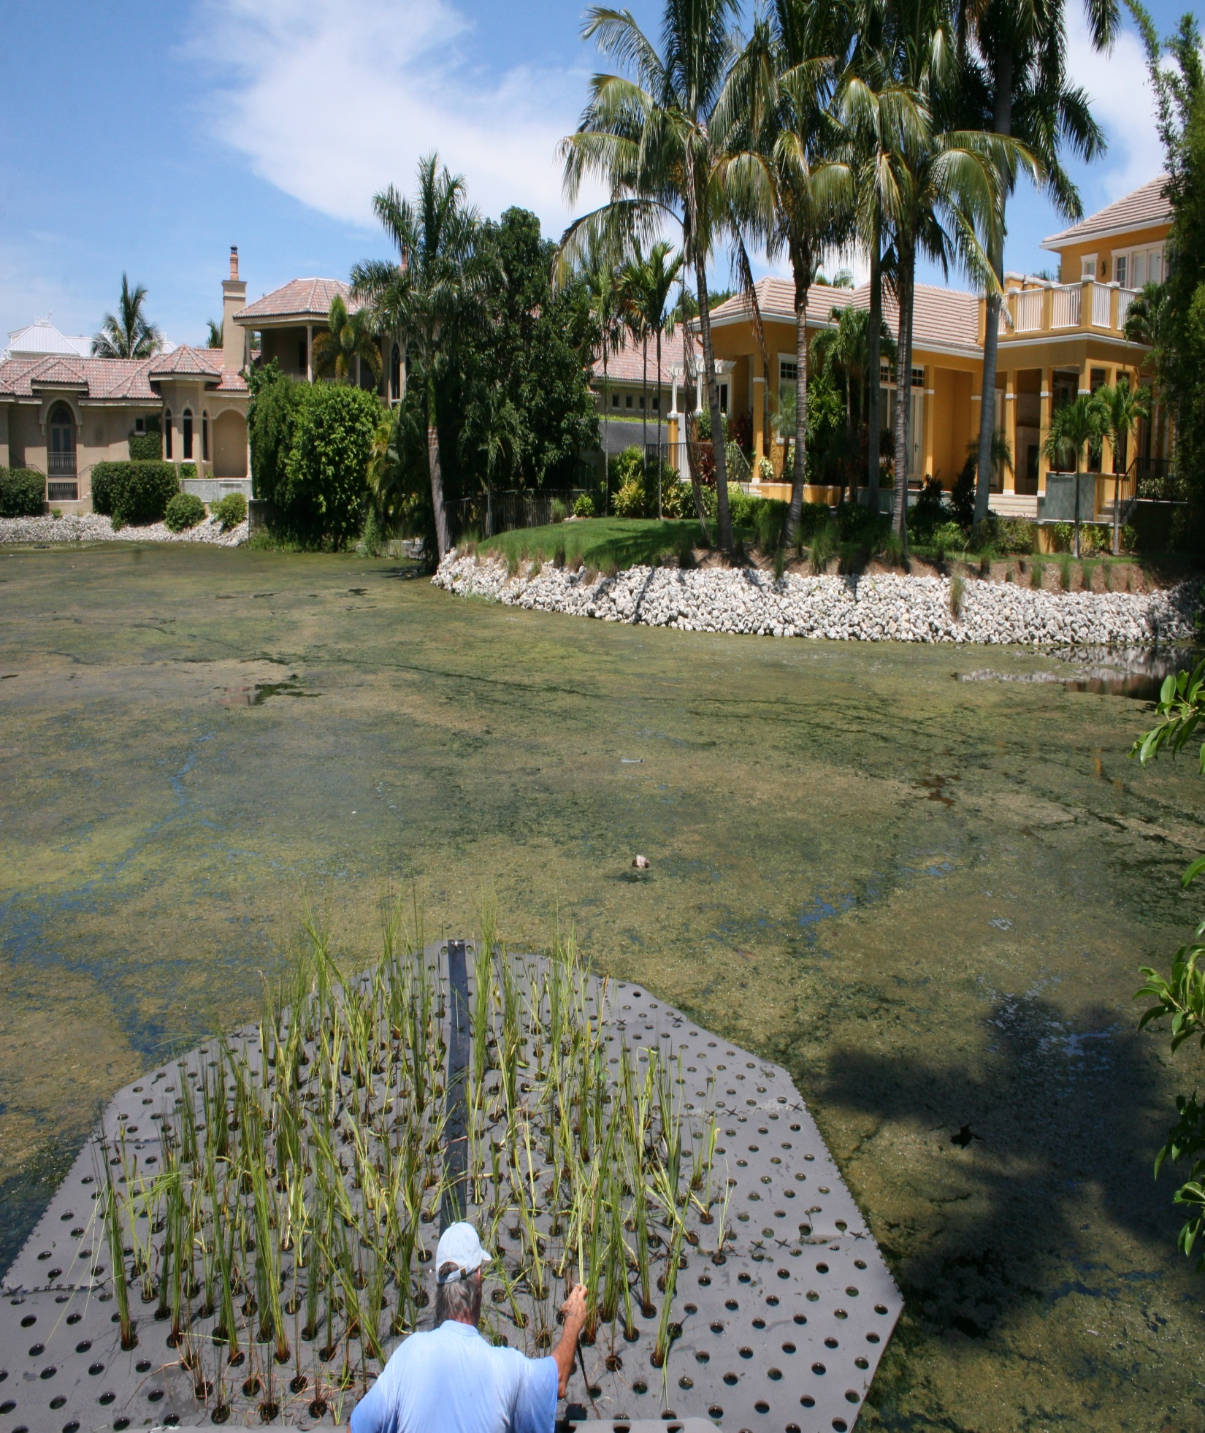
City Of Naples
This is an email send by :
Michael R. Bauer, Ph.D.
Natural Resources Manager
City of Naples
239 213-1031
Please take a look at these remarkable photos. A few weeks ago, we put floating islands into a small lake at 17th Avenue South and Gordon Drive that was completely covered in algae. The residents took advantage of our “no copper sulfate and we’ll give you aerators and floating islands policy.” The results are nothing short of amazing. The algae has disappeared, the residents are thrilled, and one resident is actually asking if we can put another island in because he likes to look at them. Another resident has mentioned how they’re attracting all kinds of wading birds.
Aug 5th

Slide 12
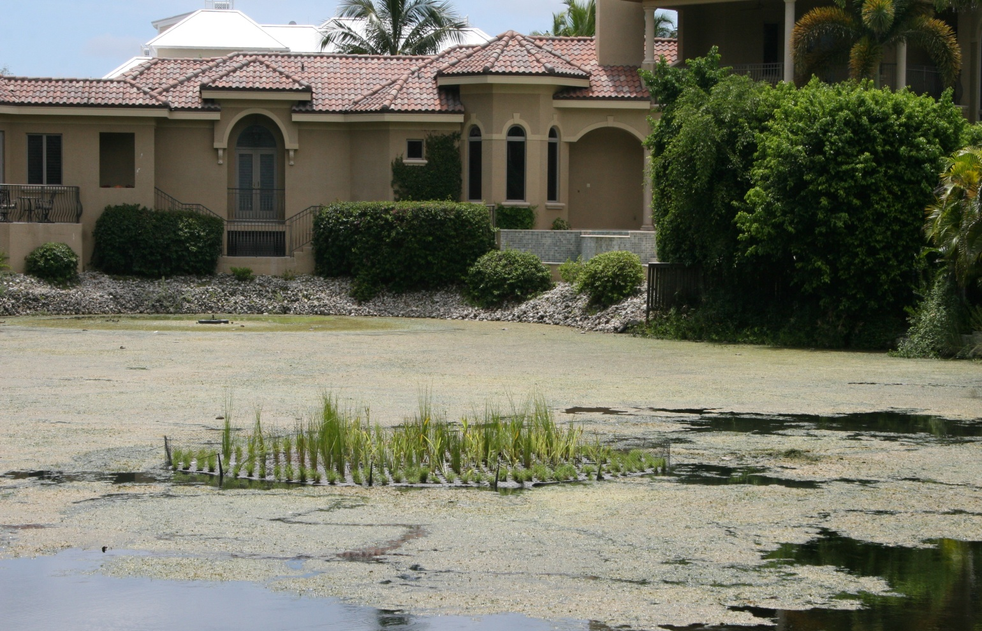
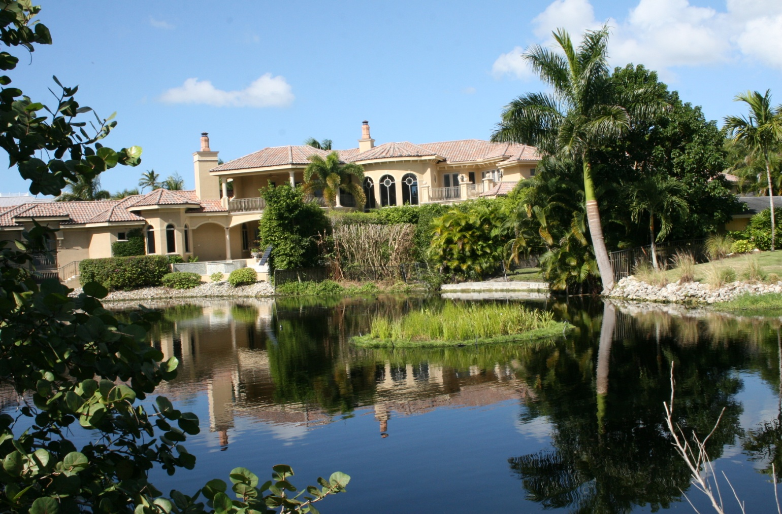
August 5, 2011
October 10, 2011

Slide 13
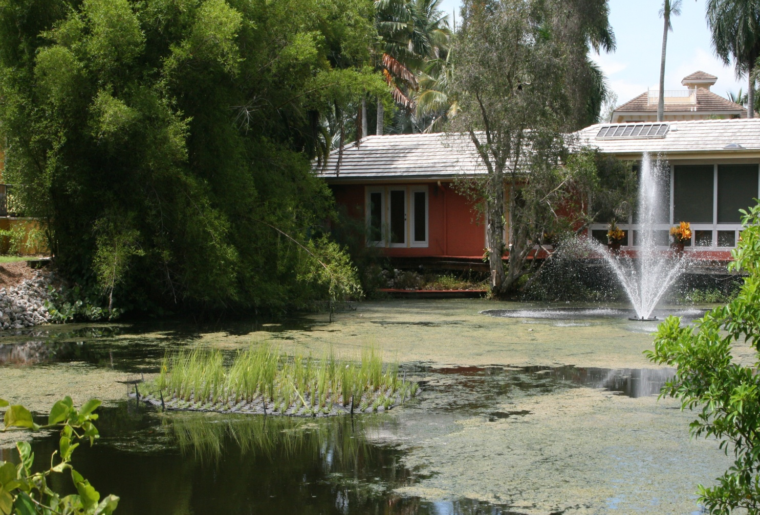
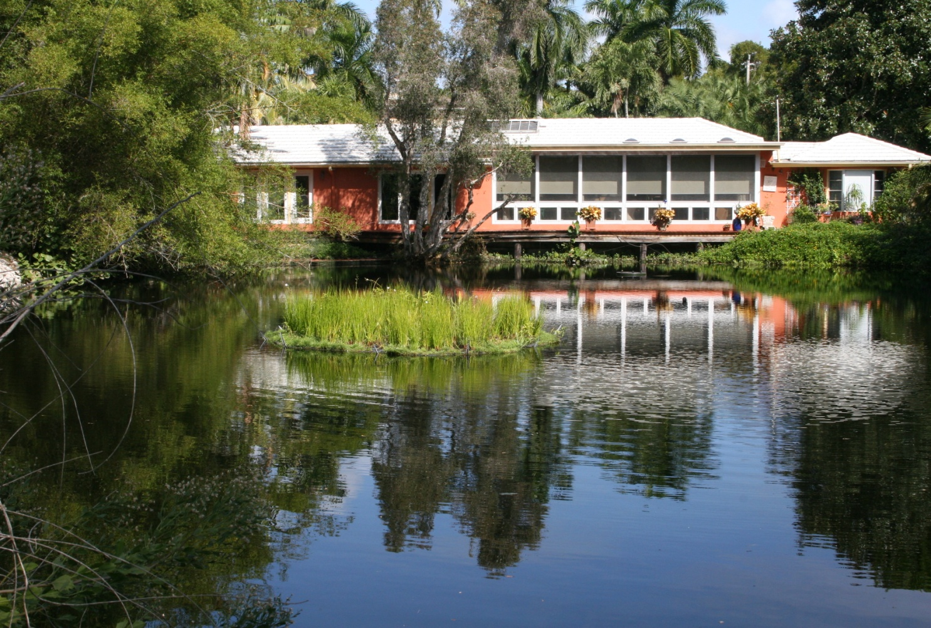
August 5, 2011
October 10, 2011

Slide 14

OTHER EXAMPLES

Slide 15
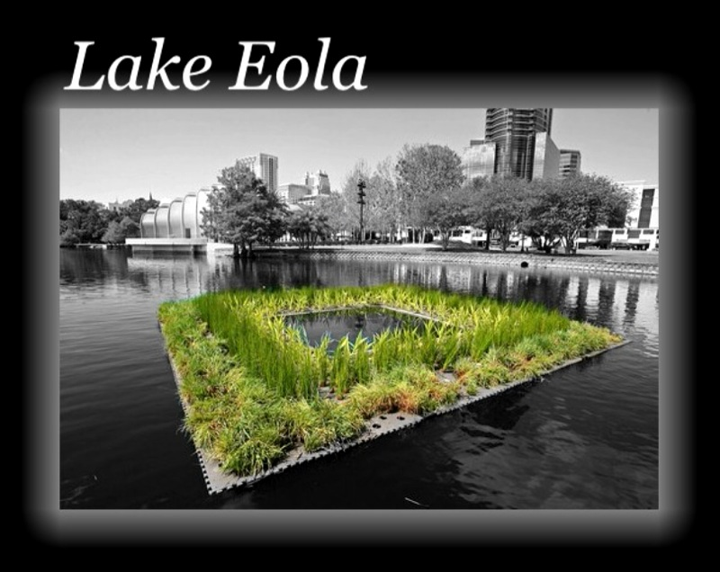
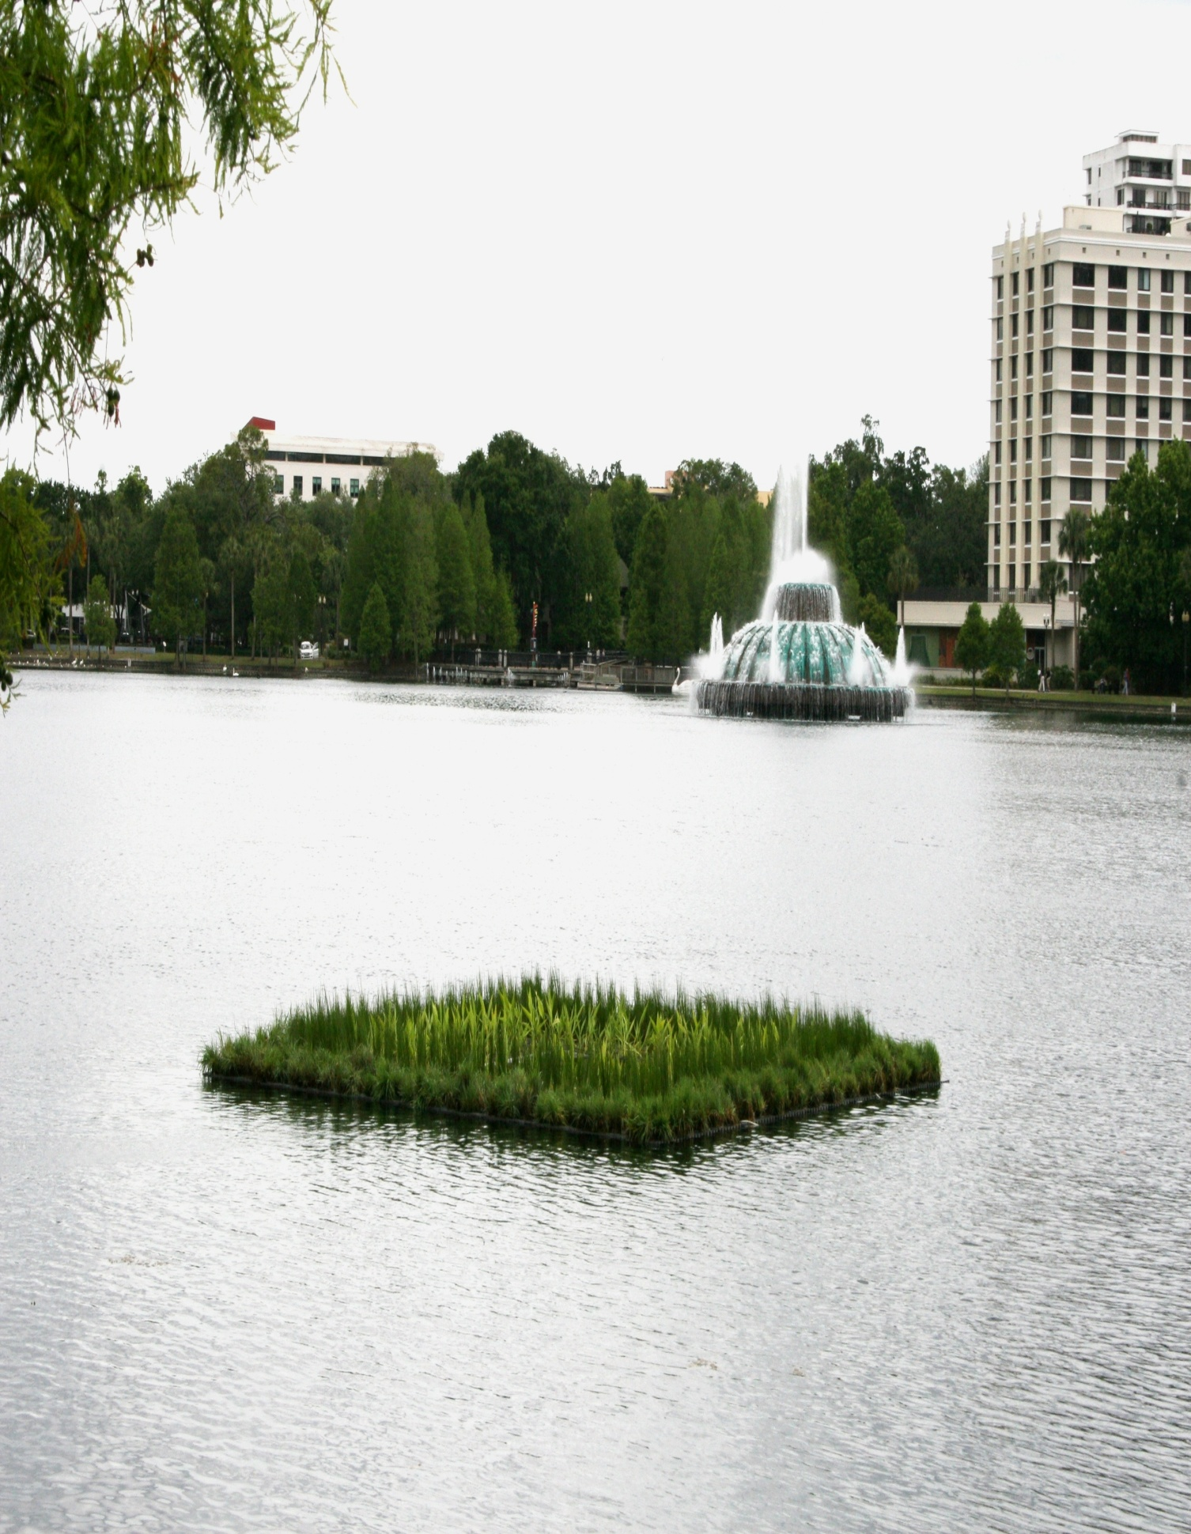

Slide 16
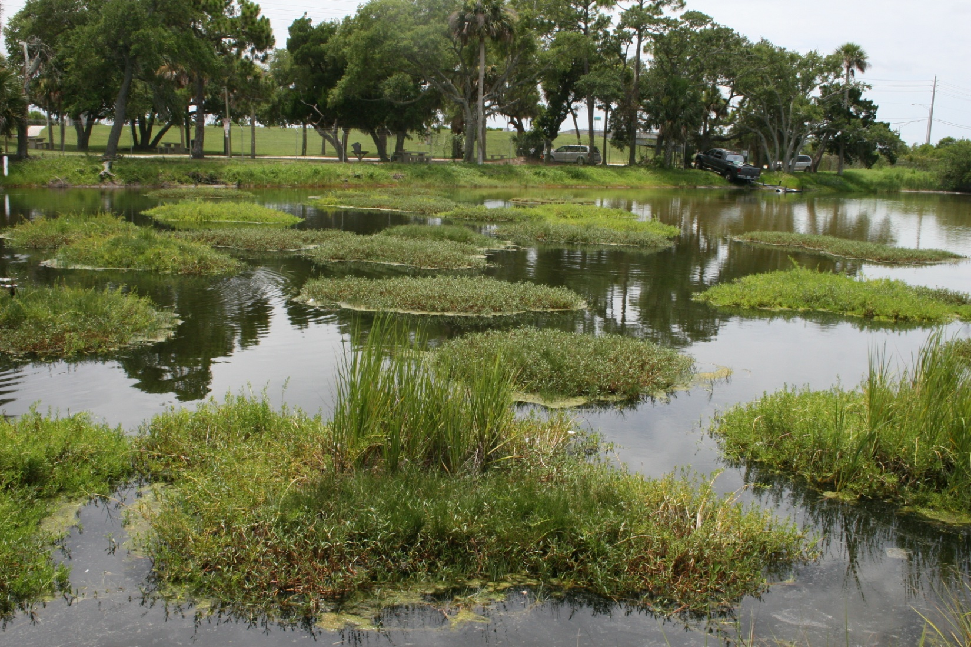
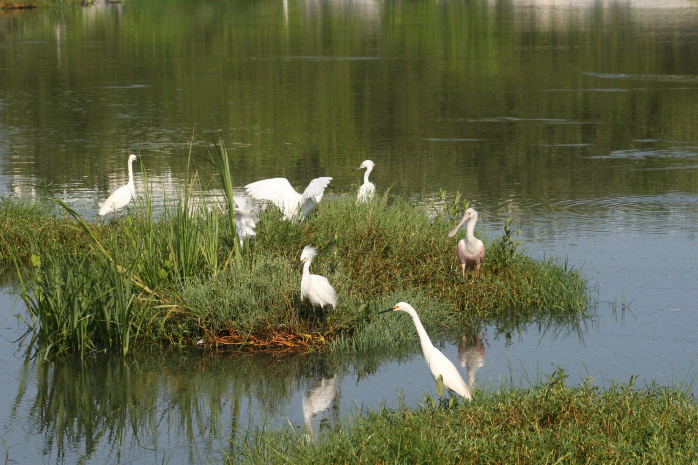
Brackish Water System – D.O.T. Retention Pond

Slide 17
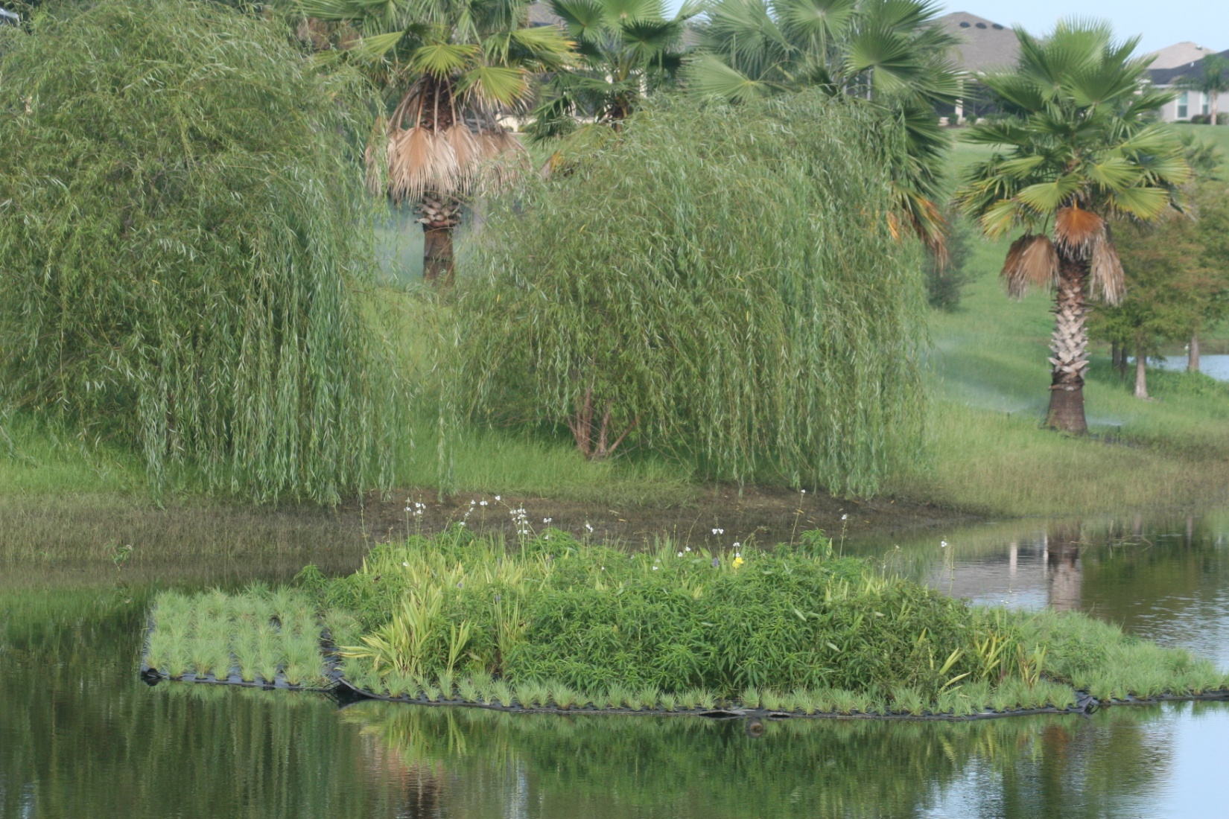
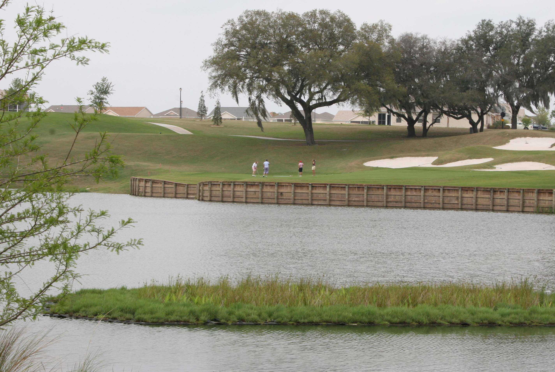
The Villages

Slide 18
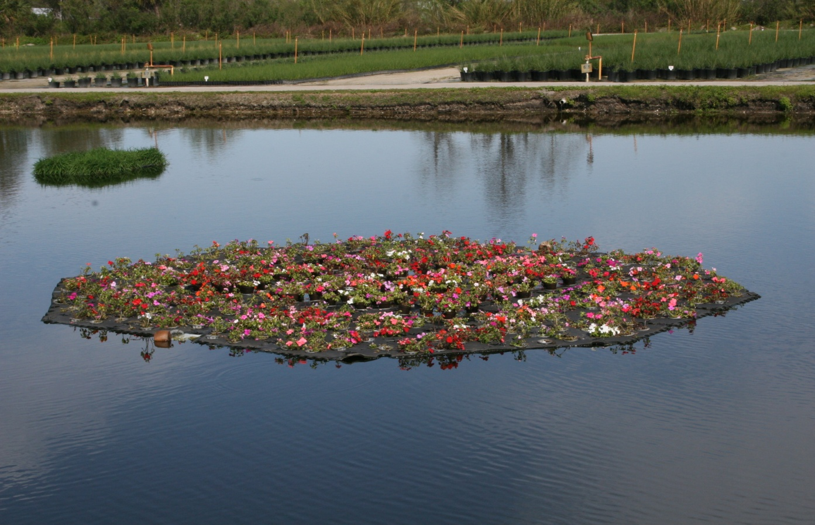
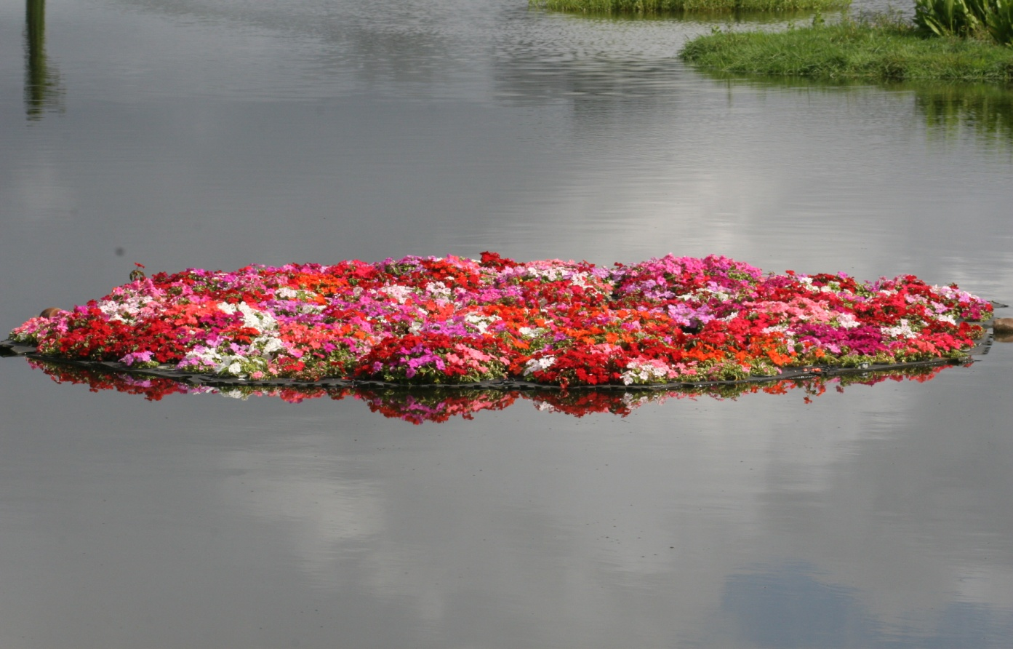
Impatiens

Slide 19
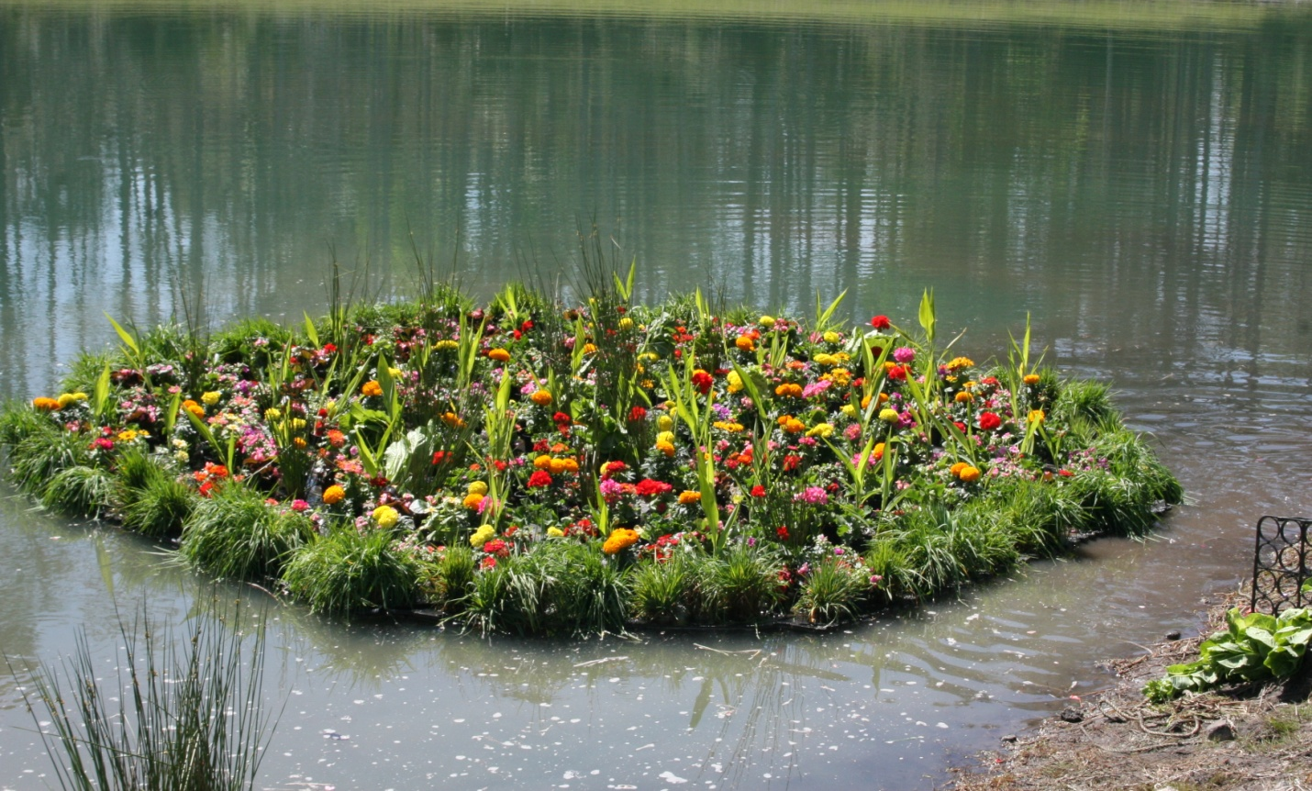
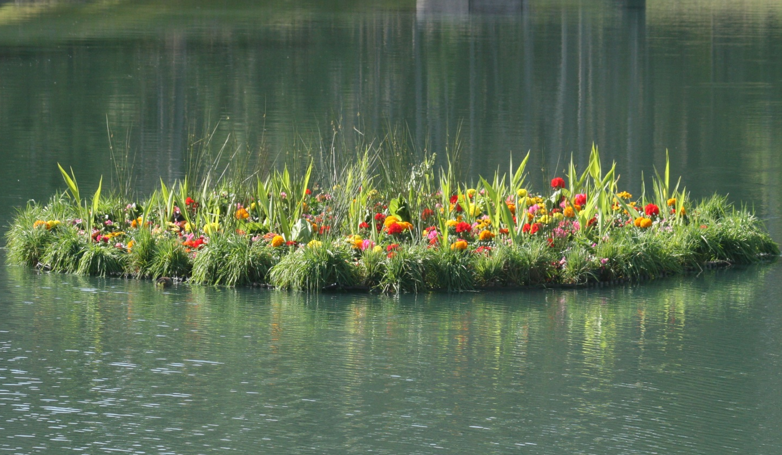
Floating Flower Garden

Slide 20
RESEARCH

Slide 21
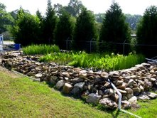
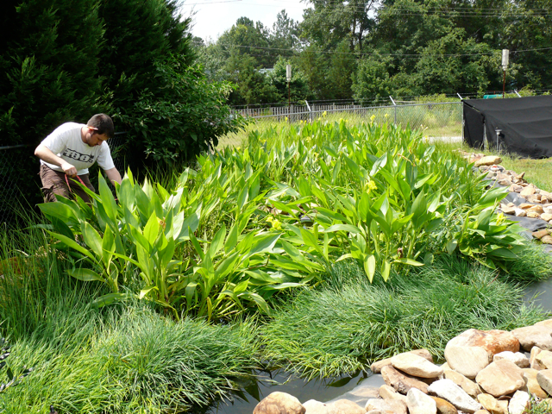
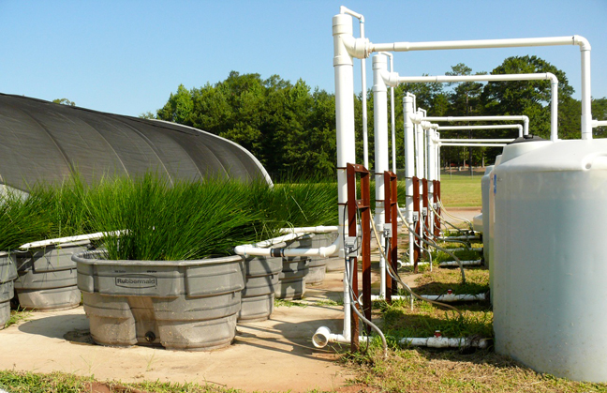
Clemson University – Beemats Studies

Slide 22
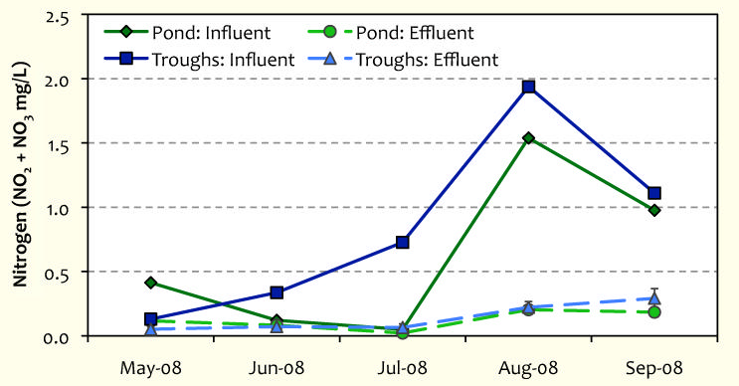
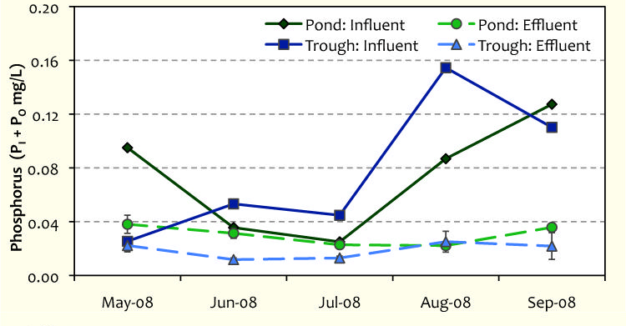
Clemson Study - 2008
Dr. Sarah White conducted laboratory and field studies with Beemats over the past four years. In the 2008 experiments, the input concentrations were very low.
Load Reduction – 14.7g/m²/yr
Load Reduction – 0.94 g/m²/yr

Slide 23
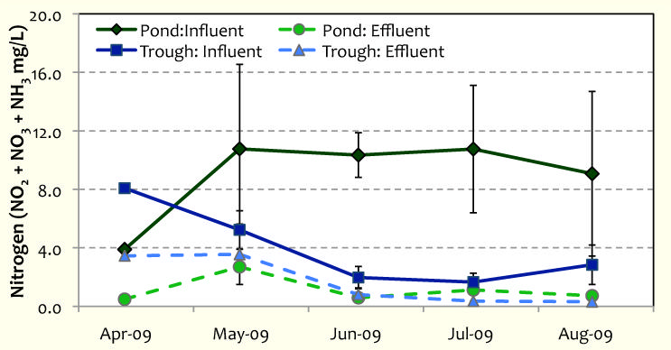
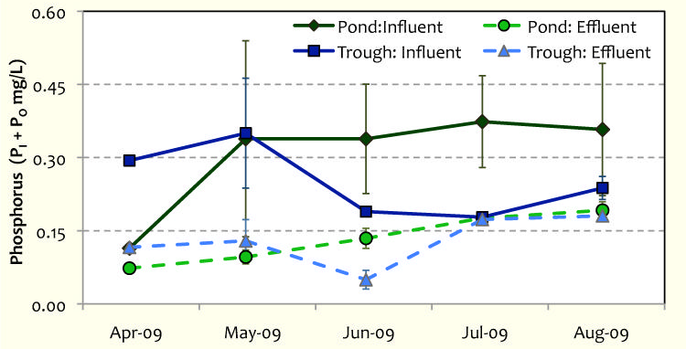
Clemson Study - 2009
In 2009, the nutrient input levels were increased significantly, elevating the nitrogen and phosphorus uptake rates.
Load Reduction – 52.2 g/m²/yr
Load Reduction – 4.5 g/m²/yr

Slide 24
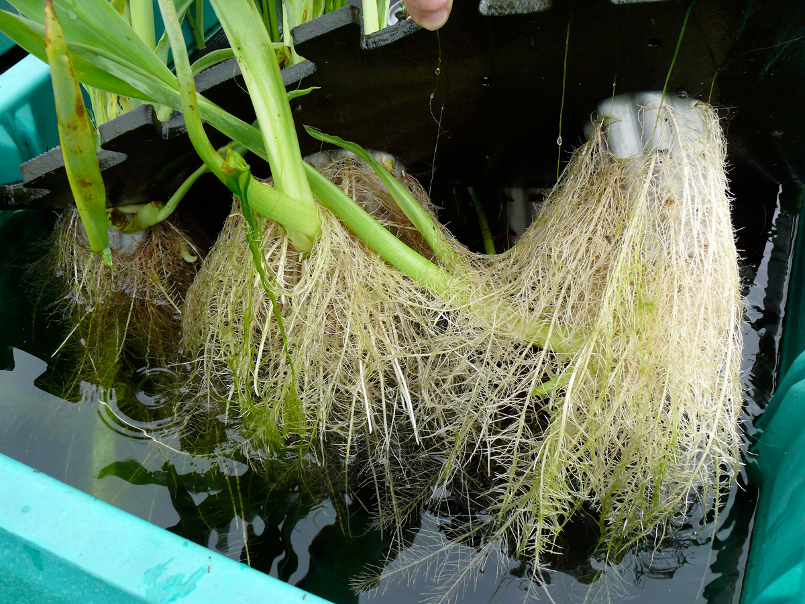

Slide 25
Effects of Aeration on Uptake

Slide 26
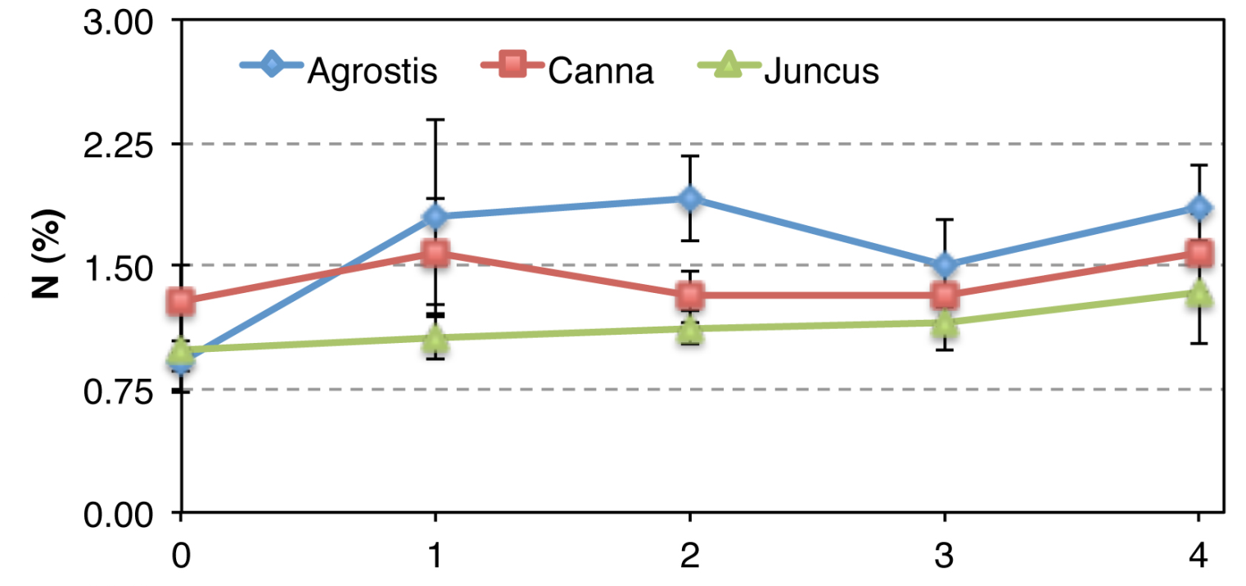

Slide 27
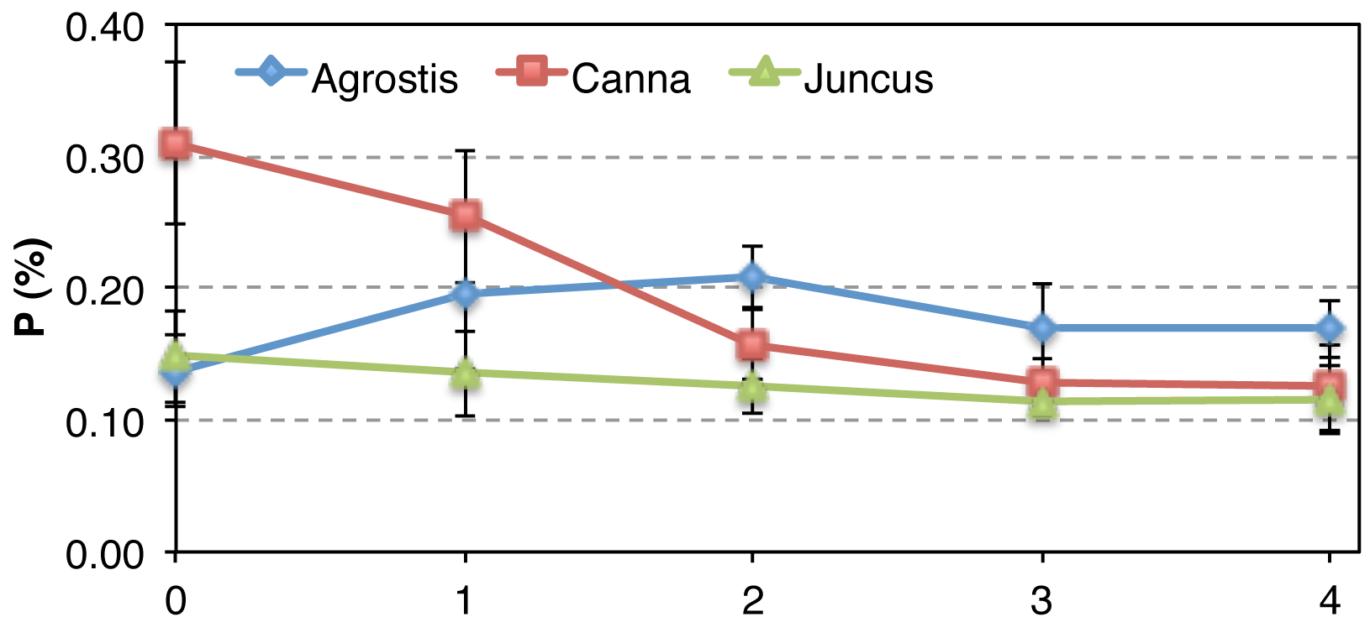

Slide 28
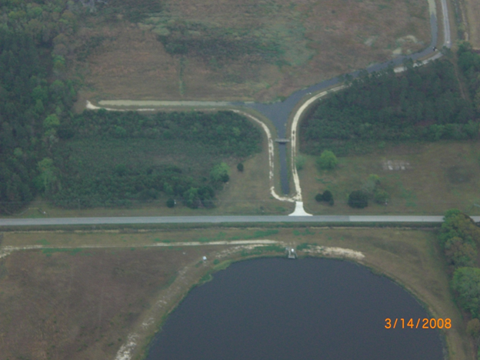
Deep Creek S.T.A.
We conducted a 16 month study, in cooperation with the St. Johns River Water Management District, to evaluate the effectiveness of using Beemats to reduce nutrient loading from agricultural runnoff. Five mats were placed in the header ditch connecting the holding pond to the treatment marsh. Individual mats were sequentially harvested and representative plants were analyzed for nitrogen and phosphorus concentrations. Uptake rates were calculated by comparing the weights and nutrient content of the harvested plants with the initial values at the time of planting.

Slide 29
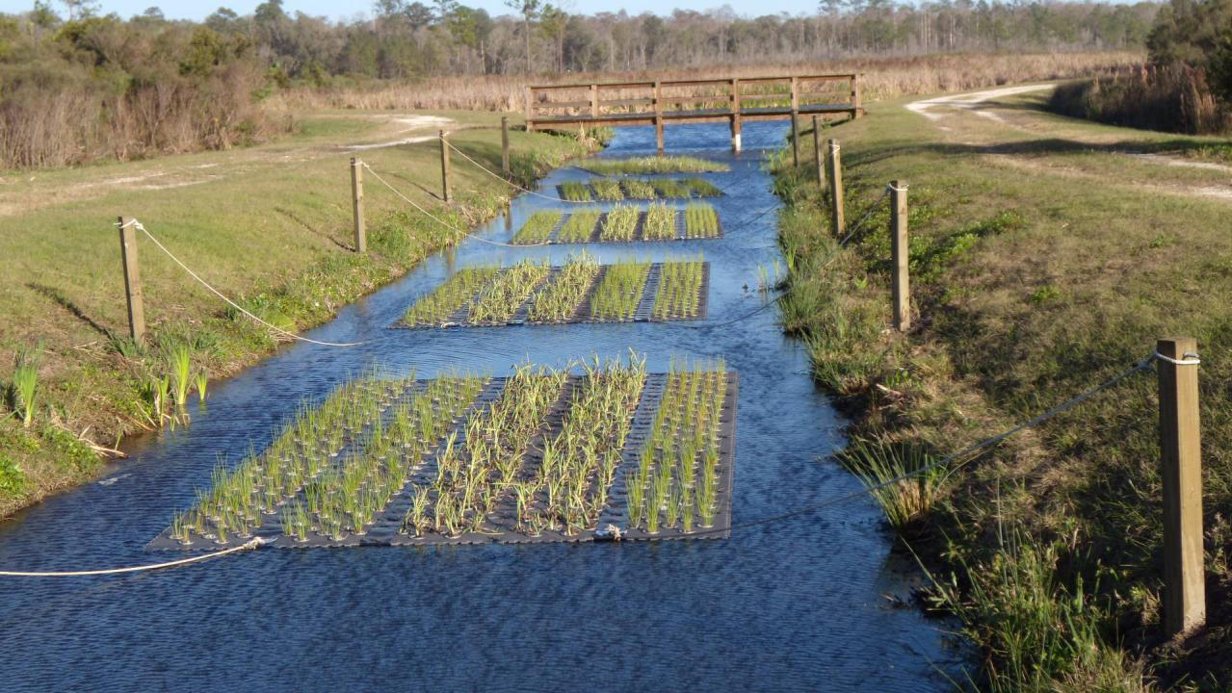
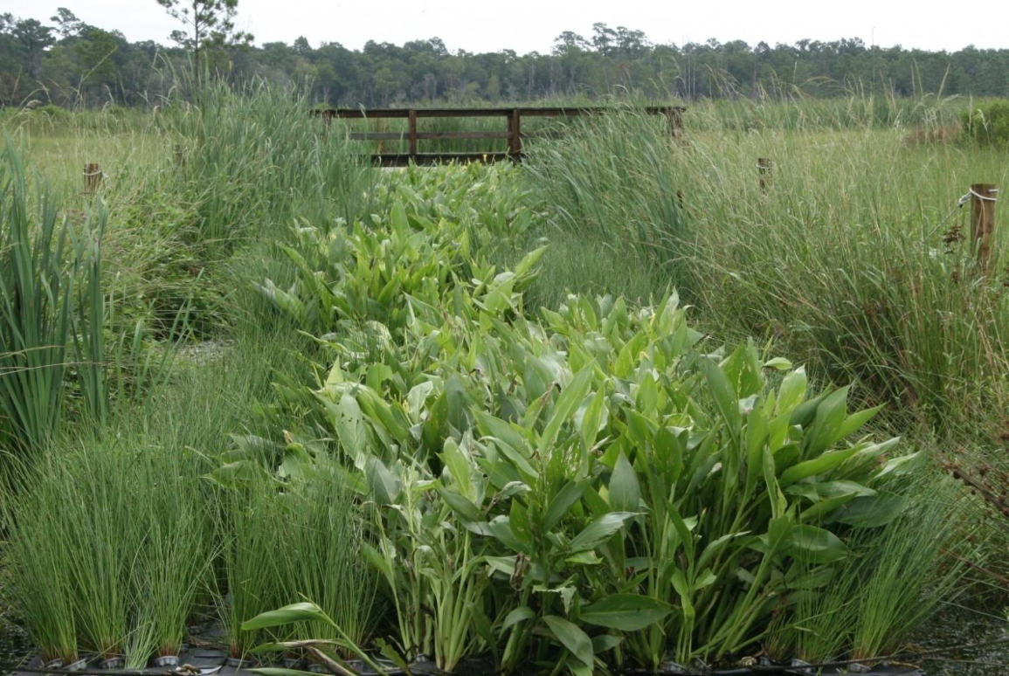
Deep Creek
Stormwater Treatment Area
Initial Planting – January 2009
July 2009

Slide 30
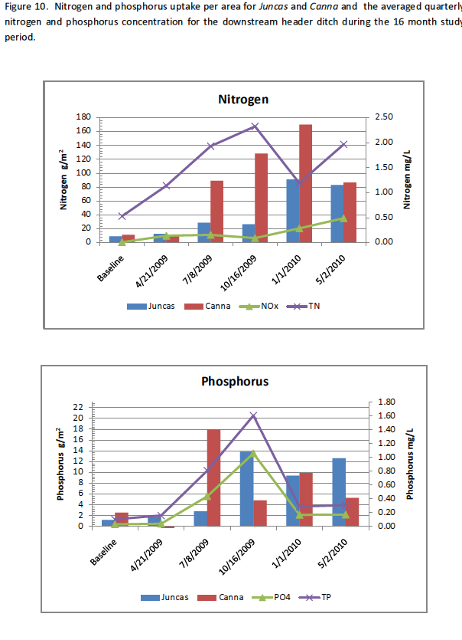

Slide 31
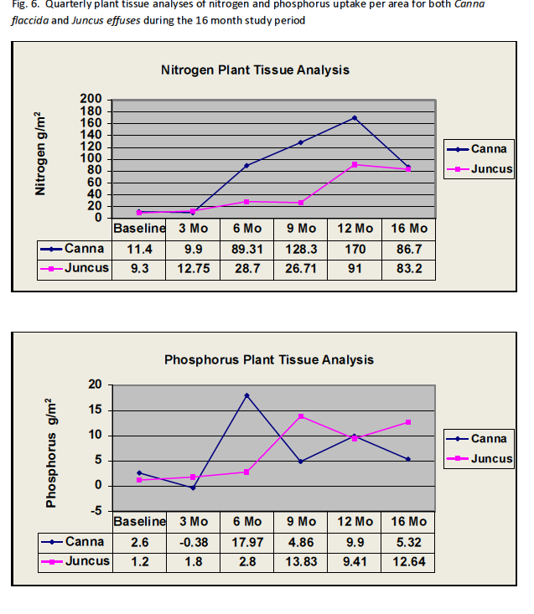

Slide 32
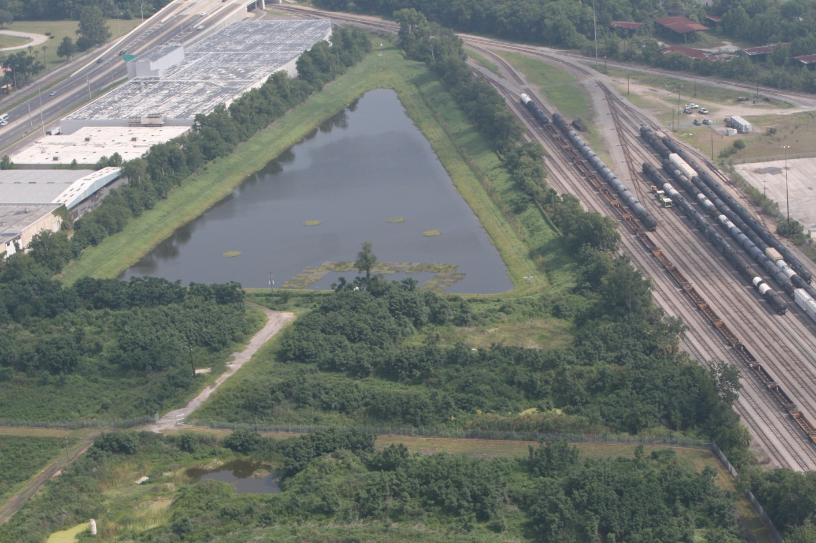
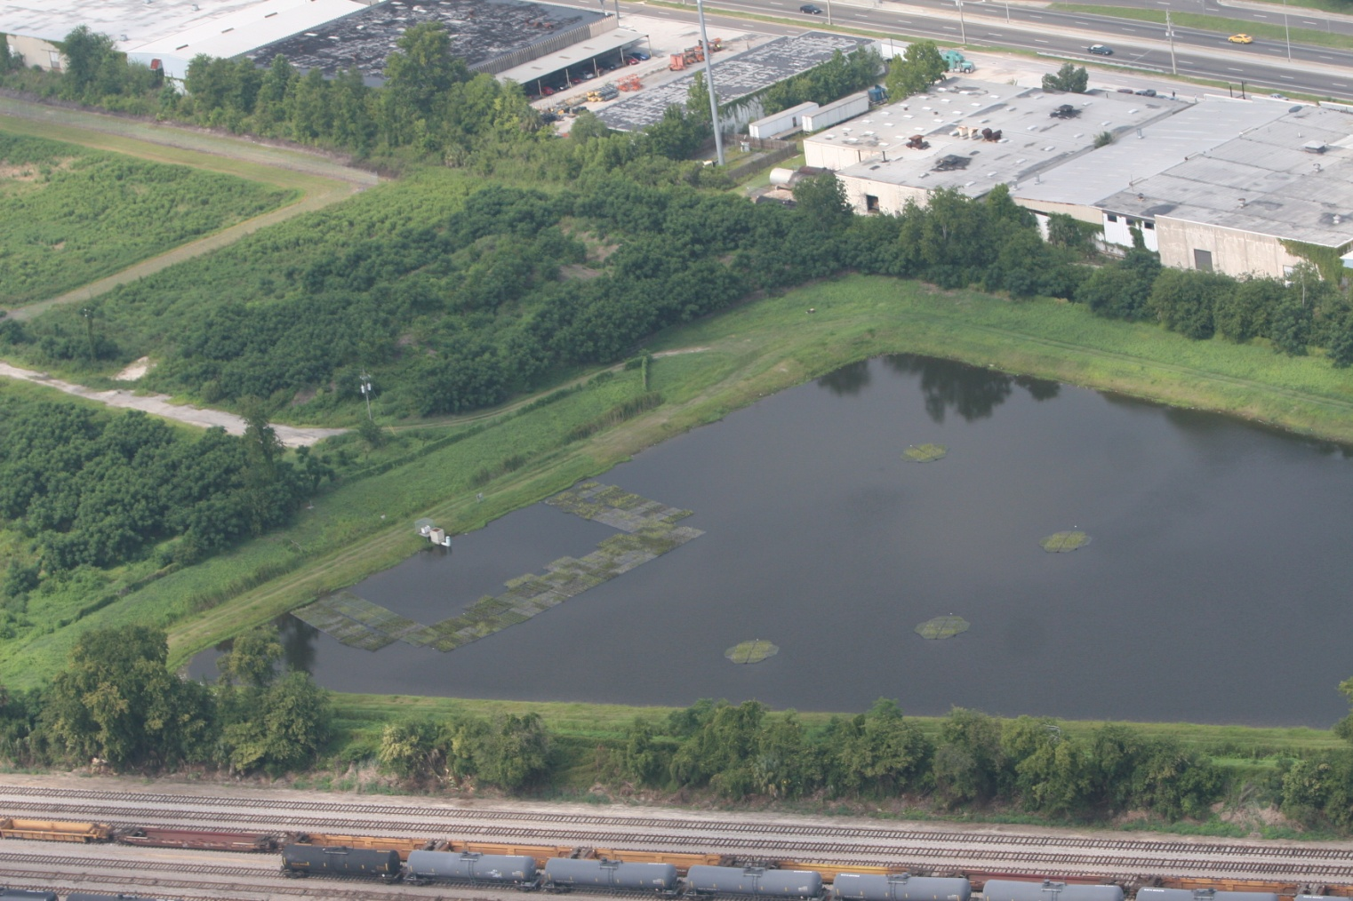
Upper Deer Creek - Jacksonville

Slide 33



Slide 34



Slide 35



Slide 36




Vegetables in Beemats
Since nutrient pollution in agricultural run off is an issue of national concern, we decided to investigate the possibility of using vegetables in Beemats to remove nitrogen and phosphorus from discharge water. Many varieties of produce are grown hydroponically anyway, so why not use the excess nutrients from agricultural fields to grow secondary crops and clean up the water in the process?
Dr. Sarah White at Clemson University ran some initial tests during her other Beemats studies during the summer of 2011. She grew several varieties of lettuce and basil.

Slide 37

We also conducted tests in our experimental pond to compare biomass growth and uptake rates of two types of lettuce and a variety of kale to the native aquatic plants that we typically use in Beemats.
Although the kale did not grow well in our experiments, the lettuce exceeded our expectations. We used a variety of romaine lettuce, called “Coastal Star” and a selection of butterhead lettuce called “Ermosa”. In both cases, nitrogen and phosphorus sequestration surpassed the native aquatic plants by orders of magnitude. By comparison to the uptake rates observed at the Deep Creek project, the butterhead variety stored three times as much nitrogen and four times as much phosphorus per unit area over time. The romaine selection took up four times as much nitrogen and five times as much phosphorus.

Slide 38


Butterhead Lettuce

Slide 39


Romaine Lettuce

Slide 40

Beemats as Agricultural B M P’s

