Slide 1
Northern Everglades and Estuaries Basin Management Action Plans
September 6, 2018
Drew Bartlett, Deputy Secretary
Office of Ecosystem Restoration

Slide 2
Evolution of the Northern Everglades and Estuaries Protection Program (NEEPP)
2000
Lake Okeechobee Protection Act
2004
Lake Okeechobee Watershed Protection Plan
2009
TMDLs and River Watershed Protection Plans for the Estuaries
2016
NEEPP amended to define roles and responsibilities for the Coordinating Agencies
1972
2018
2012 – 2014
Basin Management Action Plans (BMAPs) for Lake Okeechobee, and the Caloosahatchee and St. Lucie River Watersheds
2007
Northern Everglades and Estuaries Protection Program (NEEPP)
2001
Lake Okeechobee TMDL (Water Quality)
1972
Clean Water Act
Notes:
It’s probably best to start with a Timeline of legislation and milestones; the evolution of the Northern Everglades and Estuaries Protection Program.
The program really began back in 1972 with at the Federal level with the EPA’s Clean Water Act and progressed through the plans and actions you see here, and delegation of actions and implementation to the state of Florida, bringing us to today’s most recent amended Northern Everglades and Estuaries Protection Program that we are implementing today.
In between the 1972 CWA and the 2016 NEEP, TMDLs for the Lake and Estuaries were established, which required water quality targets to be met. How we get to those targets is really by way of DEP’s Basin Management Actions Plans and Watershed Protection Plans which tell us what work needs to be completed and by when TMDL targets need to be met.

Slide 3
Kissimmee-Okeechobee-Everglades Ecosystem
Region | Strategy
Lake Okeechobee | BMAP/NEEPP/CERP
St. Lucie/ Caloosahatchee Estuaries | BMAP/NEEPP/CERP
Everglades Agricultural Area | Restoration Strategies/ CERP (SB10)
Everglades Protection Area | Restoration Strategies/ CERP
Florida Bay | Reasonable Assurance Plan
Notes:
The 2016 NEEP legislation purpose is to protect and restore surface water resources by improving hydrology and water quality for the Northern Everglades ecosystem.
Each of the watersheds has specific nutrients for which its is impaired and storage goals for which projects are intentionally developed.
No two watersheds are alike and therefore STATE projects have to be planned with these goals as their marching orders.

Slide 4
Water Quality Assessment and Implementation Framework
Collect data
Analyze and verify
List “impaired” waters
REPEAT
Set water quality standards
Monitor water quality
Determine pollution problems
Develop and implement restoration plans (BMAPs)
Establish restoration goals (TMDLs)
Measure success and adapt
Work with community leaders
Monitor and report progress annually
Adapt and change
Excessive nutrients
Bacteria
Mercury
Allocate responsibilities
Identify projects
  Infrastructure
  BMPs
Establish schedules
Identify success criteria
Gather additional data
Model water quality
Adopt pollutant reduction targets
Notes:
This graphic is a generalization of the process DEP uses to evaluate water bodies in Florida. Each “slice of the pie” is further divided into separate, complex processes.
Step 1: Preliminary evaluation of water quality
Step 2: Strategic monitoring and assessment to verify water quality impairments
Step 3: Development and adoption of TMDLs for waters verified as impaired
Step 4: Development of Basin Management Action Plan (BMAP) to achieve the TMDL
Step 5: Implementation of the BMAP and monitoring of results
This process is a continuous cycle, rather than a linear path.

Slide 5
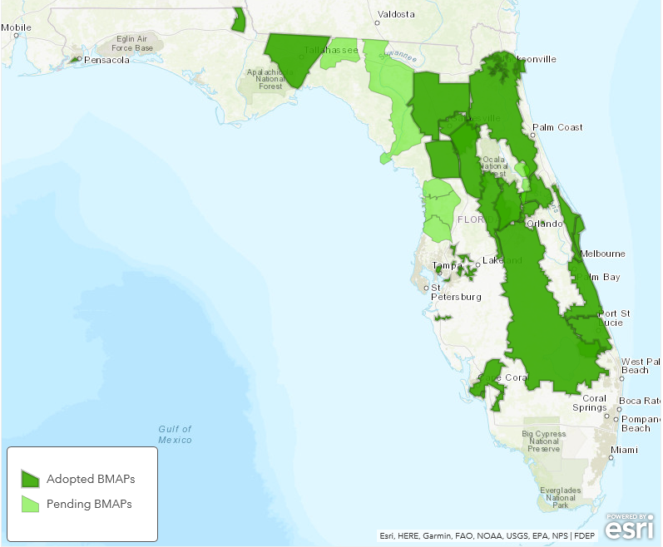
Basin Management Action Plans (BMAPs)
One of DEP’s methods for restoring water quality in an impaired water body
BMAPs are:
  Developed with stakeholder input
  Adopted by DEP Secretarial Order
  Enforceable
  Implemented through a phased approach
  Reviewed annually
403.067, F.S. (7) Development of Basin Management Plans and Implementation of Total Maximum Daily Loads.
5
Notes:
403.067, F.S. (7) Development of Basin Management Plans and Implementation of Total Maximum Daily Loads.
(a) Basin management action plans.—
1. In developing and implementing the total maximum daily load for a water body, the department, or the department in conjunction with a water management district, may develop a basin management action plan that addresses some or all of the watersheds and basins tributary to the water body.
Agricultural producers within a BMAP:
Enroll in Florida Department of Agriculture and Consumer Services (FDACS) Best Management Practices (BMPs);
or
Monitor Water Quality
Urban stormwater projects include:
BMPs such as stormwater ponds, baffle boxes that remove debris, swales, and street sweeping
projects that reduce nutrient sources such as local ordinances, public education, and Florida-friendly landscaping practices

Slide 6
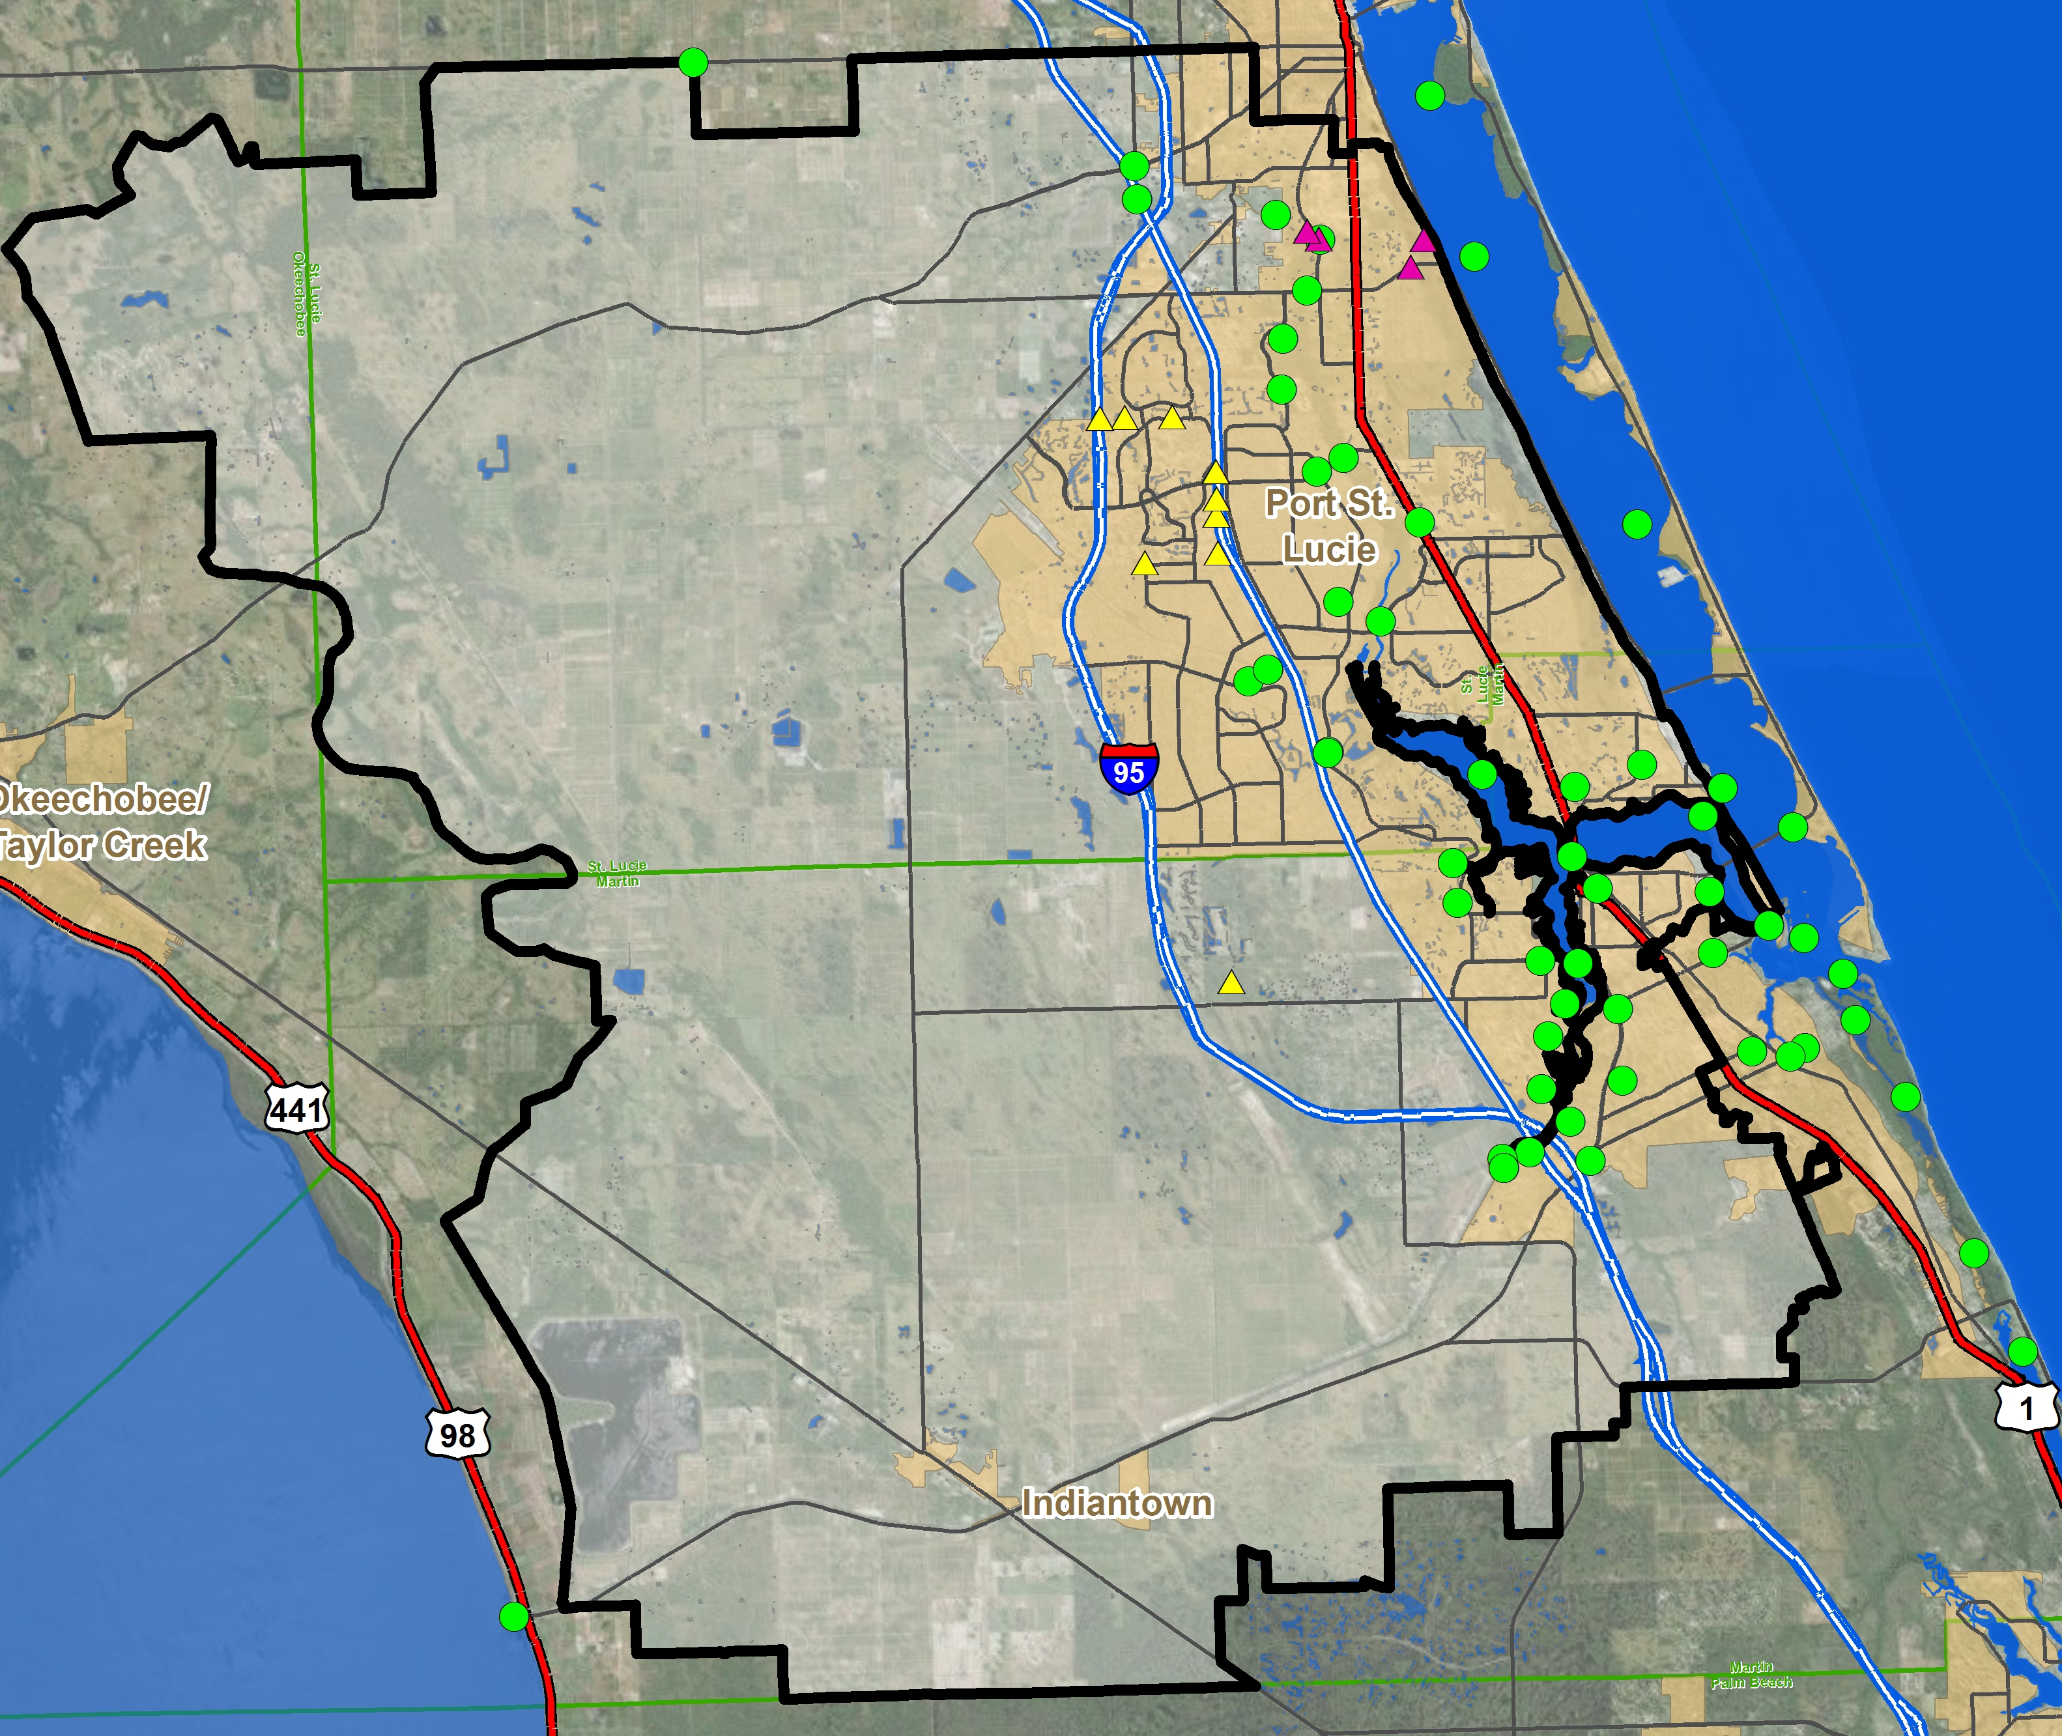
Tracking BMAP Progress
BMAP Monitoring Plans
  Provide the information needed to evaluate implementation success.
  Identify parameters, frequency, and network of stations.
Adaptive management
  Mechanism for making adjustments in the BMAP when circumstances change or feedback indicates the need for a more effective strategy.
Notes:
BMAPs aim to attain TMDL targets through a phased approach and reviewed annually, so that new information can be incorporated into the plans.

Slide 7
Coordinating Agencies Roles
SFWMD
DEP
FDACS
Watershed Protection Plans
St. Lucie BMAP
Caloosahatchee BMAP
Lake Okeechobee BMAP
Agricultural
BMP Program
Construction Project/Plan
Research and Water Quality Monitoring Program
Notes:
NEEPP
Provide project information, data, and text for reports
Assist with water quality evaluations
Review and comment on reports
Updates on BMP implementation (FDACS)
Information on cost-share and other projects (FDACS)
Lake Okeechobee Specific Tasks
Input on Interagency Agreement tasks
Identify LOWCP modifications and provide text for 5-Year Review (SFWMD)
Watershed Protection Plan Components:
Construction Project/Plan which is a list of management measures designed to help achieve water quality and quantity goals, and
Research and Water Quality Monitoring Program, which supplies information/data needed for assessment of potential management measures and evaluation of implemented projects and programs.

Slide 8
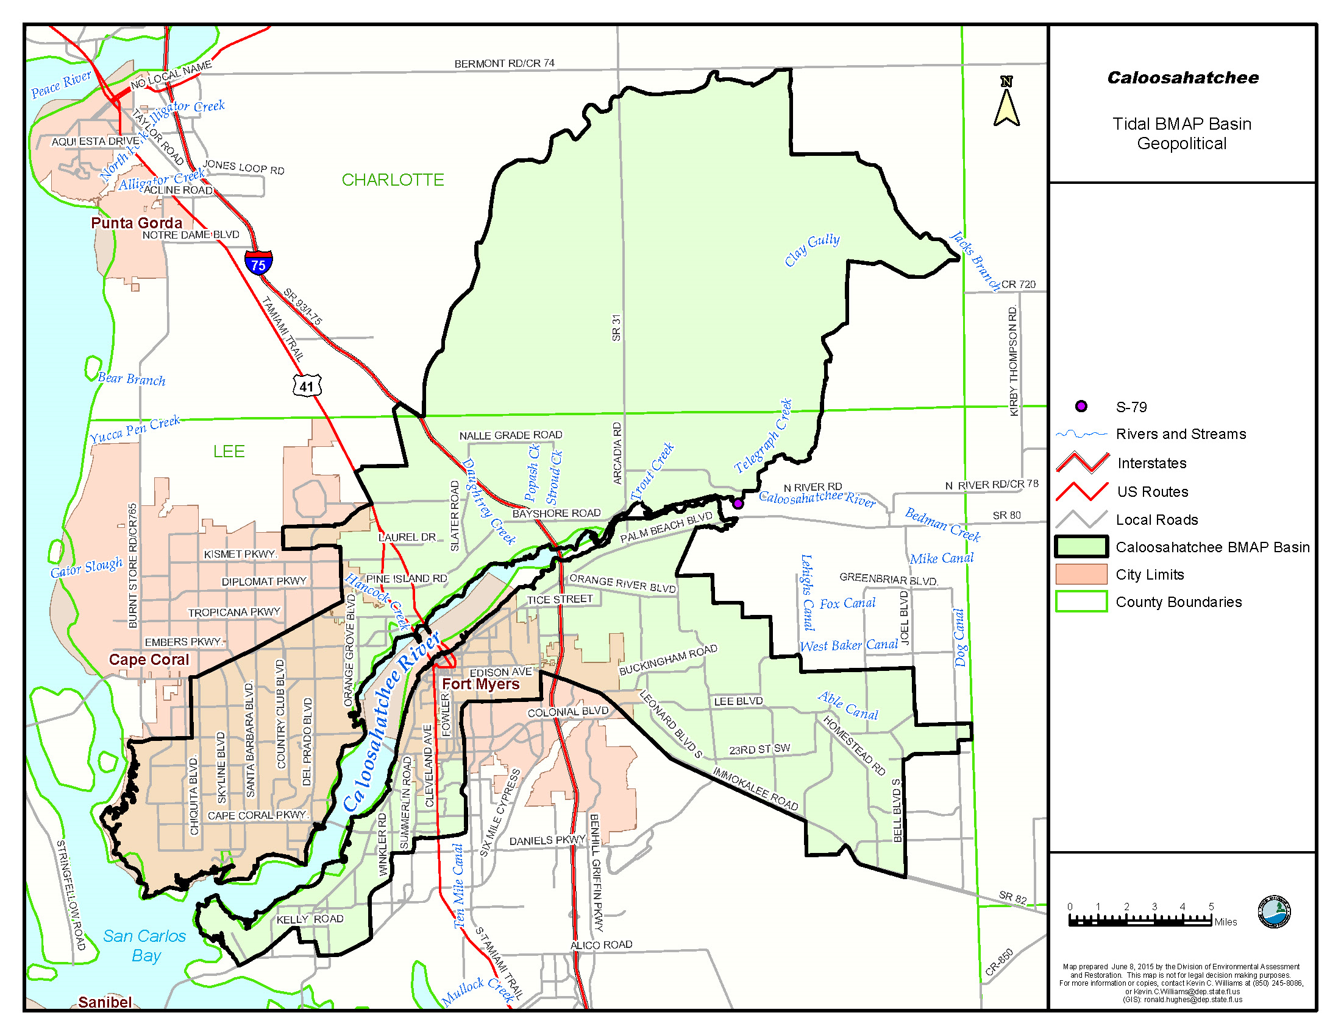
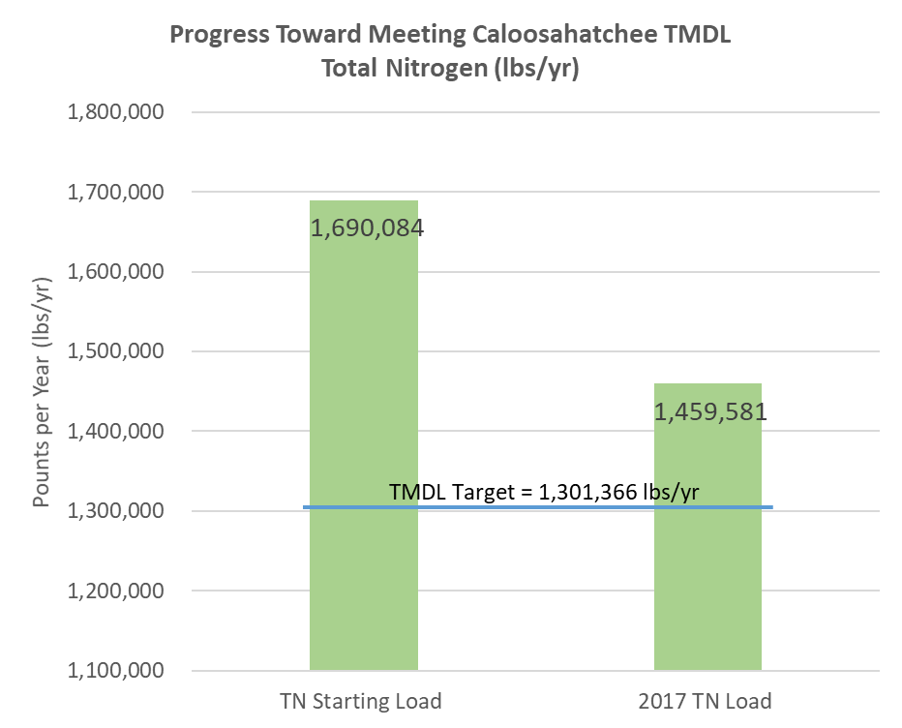
Caloosahatchee Estuary Basin
Impaired for DO and nutrients
  Freshwater input from S-79, tributaries and canal systems
TMDL adopted in 2009
  Requires 23% reduction in TN
BMAP adopted in 2012
  Total required reductions: 388,718 lbs/yr
*
*Loads are modeled long-term loads

Slide 9
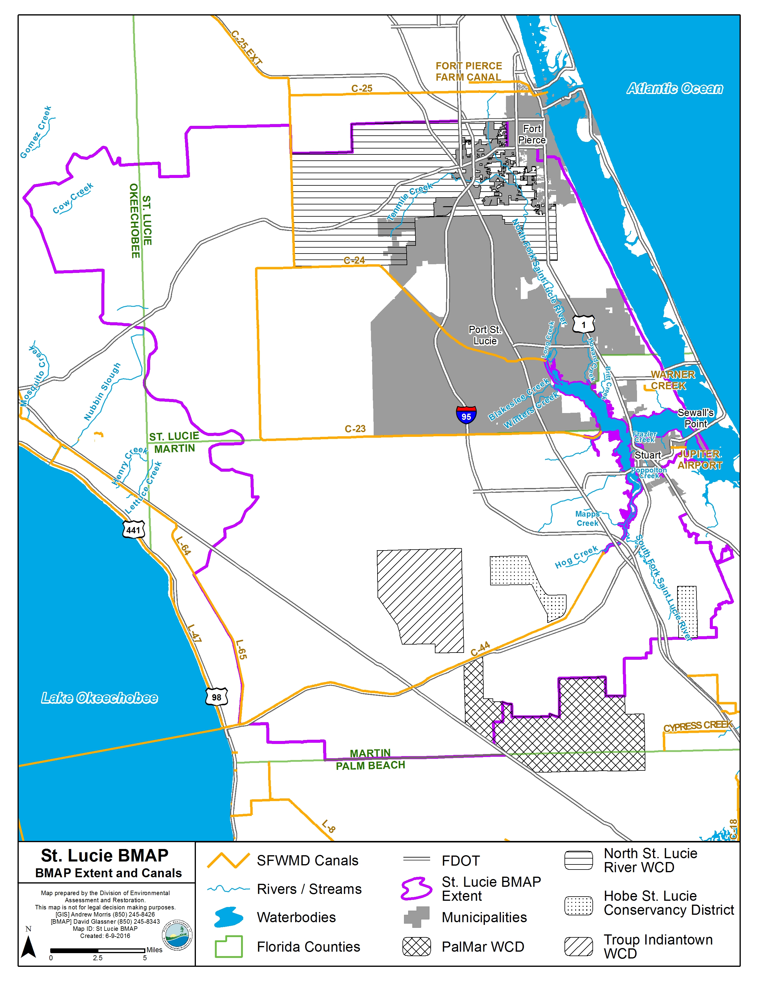
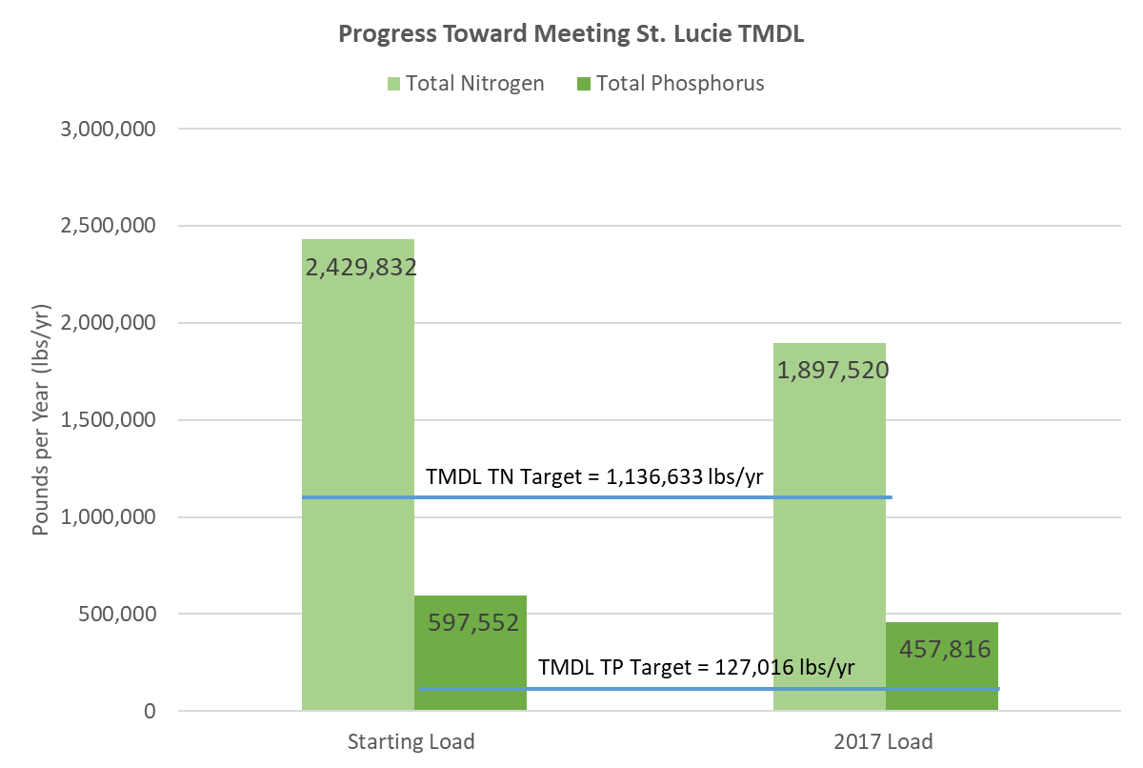
St. Lucie River & Estuary Basin
Impaired for DO and nutrients
TMDL adopted in 2009
  TP, TN, BOD
  Designates SE03 as compliance point for target concentrations
BMAP adopted in June 2013
  Focused on achieving TP and TN reductions
*
*Loads are modeled long-term loads

Slide 10
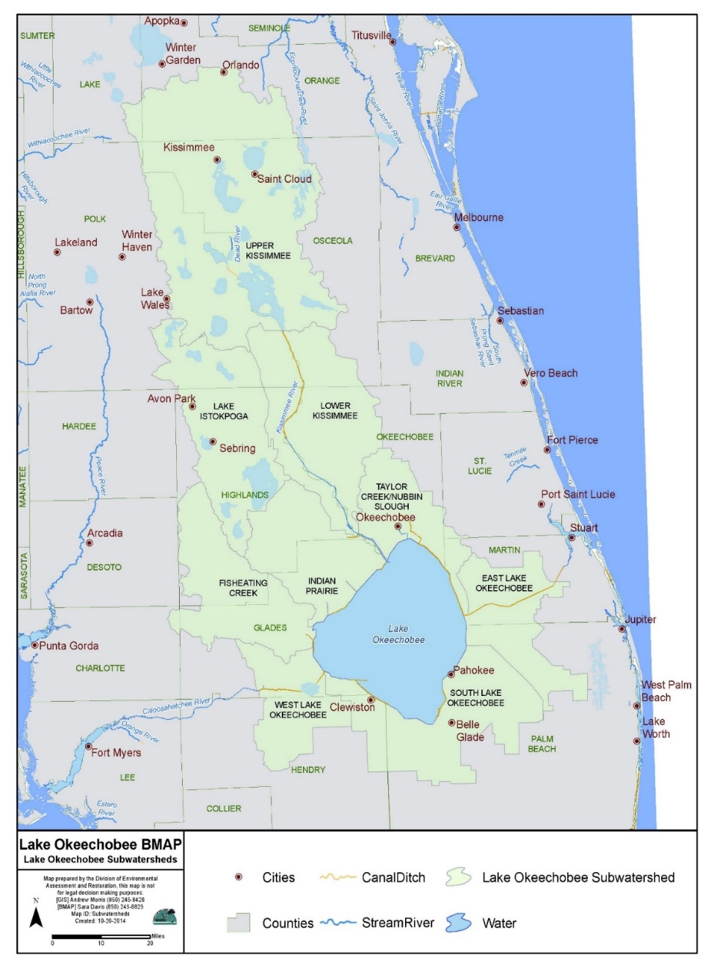
Lake Okeechobee TMDL
TMDL for TP adopted in 2001
TMDL is a total annual TP load of 140 metric tons per year (mt/yr):
  35 mt/yr fall directly on the lake through atmospheric deposition
  Remaining 105 mt/yr allocated to the entire Lake Okeechobee Watershed (LOW)
TMDL attainment calculated using a 5-year rolling average of the monthly loads calculated from measured flow and concentration values

Slide 11
Lake Okeechobee BMAP
BMAP adopted in December 2014
Focus is on project implementation in the six sub-watersheds north of Lake Okeechobee
Project reductions spread over a ten-year time frame:
  Allows Coordinating Agencies to include long-term projects and develop additional projects to meet the TMDL
166 projects completed through December 2017
  Additional 54 projects underway or planned
*
TMDL Target = 105 mt/yr
*Loads are modeled long-term loads
Notes:
Through December 31, 2017:
Estimated TP reductions of 79,733 kilograms per year (kg/yr)
23.2 % of reductions needed to meet the TMDL

Slide 12
Key Lake Okeechobee Initiatives
Agricultural Cost Share Program
  $70 Million across watersheds executed incrementally and annually
Dispersed Water Management
  Greater than 20 contracts executed and funded annually
  Larger scale projects like Brighton Valley and Latt Maxcy/El Maximo
Stormwater Treatment Areas/Flow Equalization Basins
  Lakeside Ranch Phase II (Construction)
  Istapoga Marsh (Design & Construction)
  West Waterhole Marsh (Completed)
Dairy Projects
  Inactive Dairies – Lagoon Remediation (Completed)
  Legislative Cost-Share Appropriation Program – projects submitted annually (~$4 million, 8 approved projects)
Rolling Meadows Phase II Wetland Restoration (Awaiting funding)
Kissimmee River Restoration (Construction)
Lake Okeechobee Watershed CERP Project
Notes:
Status:
Lakeside Ranch – STA completion expected in 2018; Pump Station completion expected in 2021
Brighton Valley - Upon receipt of permits and completed design, construction may begin.
Latt Maxcy/El Maximo – Construction begins in 2018, completion expected in 2019.
PL566 – NRCS lead. SOW under review, contract under development.
Rolling Meadows - Once funded, project completion is anticipated in 2 to 3 yrs.
KRR – Estimated completion 2020
West Waterhole – Only remaining FRESP contract, nutrient reduction project with design storage capacity of ~4,800 ac-ft, TP reduction of 4,166 kg/yr.

Slide 13
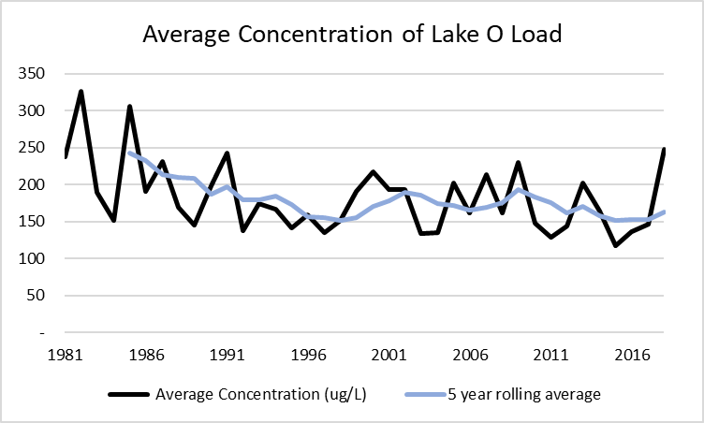
Lake Okeechobee Loads
 | TP Load to Lake (mt) | Total Flow to Lake (ac-ft)
WY2016 | 508 | 3,012,129
WY2018 | 1046 | 3,423,597

Slide 14
Lake Okeechobee Loads

Slide 15
NEEPP 5-Year Reviews
Chapter 373.4595, F.S.
NEEPP BMAPs require a review to legislature and Governor, to include:
  5-year milestones towards meeting TMDLs 20 years after adoption
    Assessment of progress towards meeting the milestones
  Determination of whether TMDLs can be met in 20 years
    If not, explanation of why
  Identification of recommended revisions to the BMAP
    modeling, allocations, monitoring network, etc.
BMAP | Adoption Date | 5-Year Review Date
Caloosahatchee | November 2012 | November 2017
St. Lucie | June 2013 | June 2018
Lake Okeechobee | December 2014 | December 2019

Slide 16
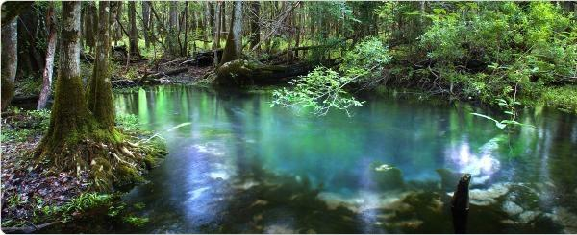
Contact
Drew Bartlett, Deputy Secretary
Office of Ecosystem Restoration
Drew.Bartlett@dep.state.fl.us, 850.245.2030
Notes:
Developing Lake Okeechobee 5YR (Includes WQ analysis)
Annual Public Meetings in November/December
Update SLE BMAP with recommended changes
Update Caloosa BMAP with recommended changes

