Slide 1
Santa Fe River
Basin Management Action Plan (BMAP)
Terry Hansen P.G., Basin Coordinator
850-245-8561
terry.hansen@dep.state.fl.us

Slide 2
Water Quality Framework
Collect data
Analyze and verify
List “impaired” waters
REPEAT
Monitor and report progress annually
Adapt and change – new statewide annual report
Set water quality standards
Monitor water quality
Determine pollution problems
Develop and implement restoration plans (BMAPs)
Establish restoration goals (TMDLs)
Measure success and adapt
Work with community leaders
Excessive nutrients
Bacteria, Metals, and Other Impairments
Allocate responsibilities
Identify projects
  Infrastructure
  Best Management Practices (BMPs)
Establish schedules
Identify success criteria
Gather additional data
Evaluate water quality
Adopt pollutant reduction targets

Slide 4
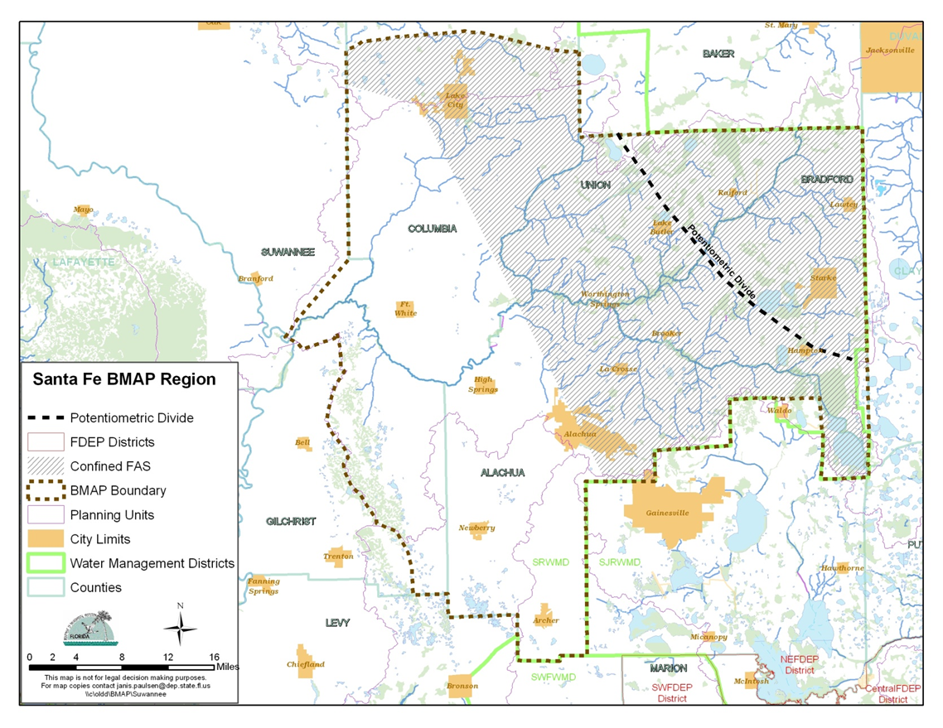
Santa Fe BMAP Area
BMAP planning area, nearly 1.1 million acres
Outstand Florida Springs (OFS) included
Ichetucknee
Devils Complex
Hornsby
Poe
Treehouse
Columbia
Both agricultural and urban BMPs are being implemented.

Slide 5
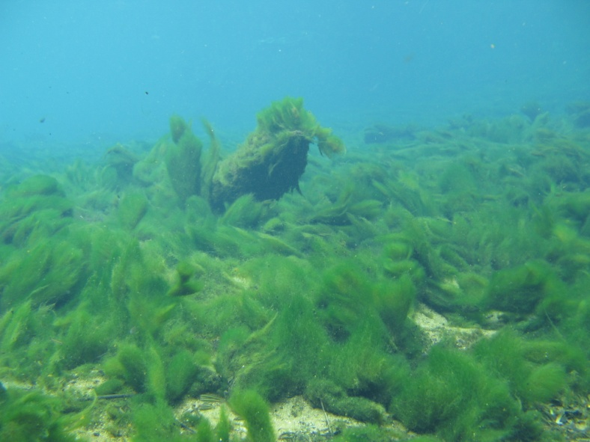
Santa Fe River
Basin Total Maximum Daily Loads (TMDLs)
TMDL Data Period of Record:
  June 1, 2000 through June 30, 2007
TMDL Study Results:
  Nitrate shown to be primary factor in causing algal blooms
TMDL:
  0.35 milligrams per liter (mg/L) nitrate monthly average
  concentration (or lower) will not
  cause an imbalance in the flora
  or fauna

Slide 6


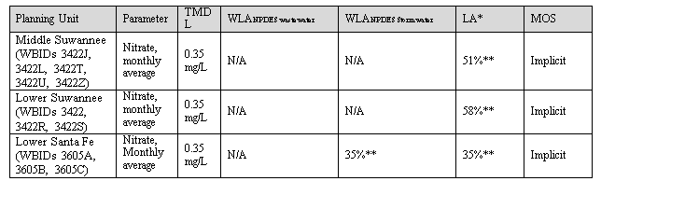
Santa Fe River Nitrate
Total Maximum Daily Loads (TMDLs)
WBID: Waterbody identification area.

Slide 7
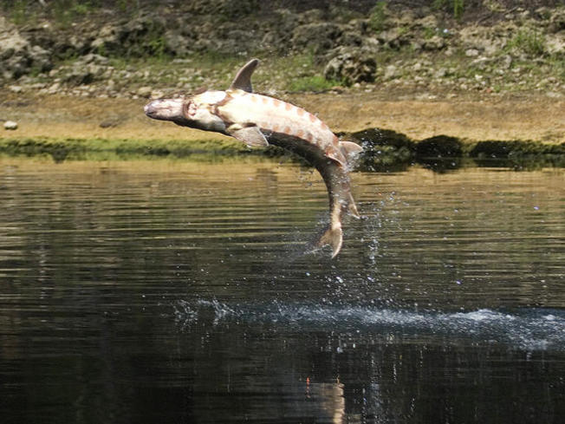
Regulatory Framework
The process for preparing BMAPs is found in:
  Section 403.067, Florida Statutes (F.S.), known as the “Florida Watershed Restoration Act”
  The 2016 Florida Springs and Aquifer Protection Act lists requirements for BMAPs for OFS
  Requirement is to achieve TMDL in 20 years
    Plan is to achieve:
      30 % reduction in 5 years
      80 % in 10 years
      100 % in 15 years

Slide 8
2016-1 Requirements
  INCLUDE:
  Priority Focus Area (PFA) delineation
    Area(s) of basin where Floridan Aquifer is generally most vulnerable
  Identification of point source or category of nonpoint sources with the estimated allocation of the load for each.
    Nitrogen Source Inventory Loading Tool (NSILT)
Notes:
Definition: area or areas of a basin where the Floridan Aquifer is generally most vulnerable to pollutant inputs where there is a known connectivity between ground water pathways and an Outstanding Florida Spring (OFS), as determined by the department in consultation with the appropriate water management districts, and delineated in a BMAP.
Using the best data available from the water management districts and other credible sources, the department, in coordination with the water management districts, shall delineate priority focus areas for each OFS or group of springs that contains one or more OFS and is identified as impaired in accordance with s. 373.807.
PFA and is effective upon incorporation in a basin management action plan.
For ease of implementation delineation Shall use understood and identifiable boundaries such as:
Roads.
Political jurisdictions

Slide 9
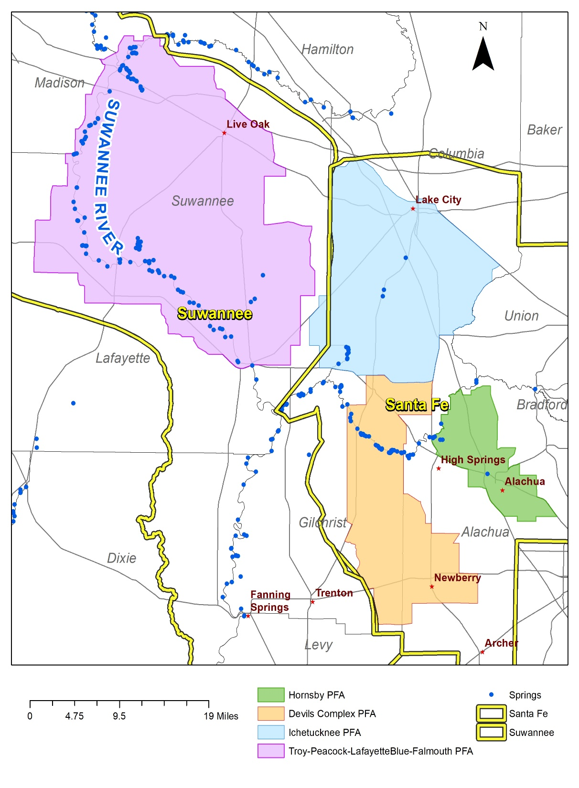
PFA/NSILT
Priority Focus Area (PFA) – developed for OFS(s) and used to focus restoration efforts
Nitrogen Source Inventory Loading Tool (NSILT) – developed for OFS springsheds to estimate sources of nitrogen to groundwater
  Used to determine if >20% load is from OSTDS

Slide 10
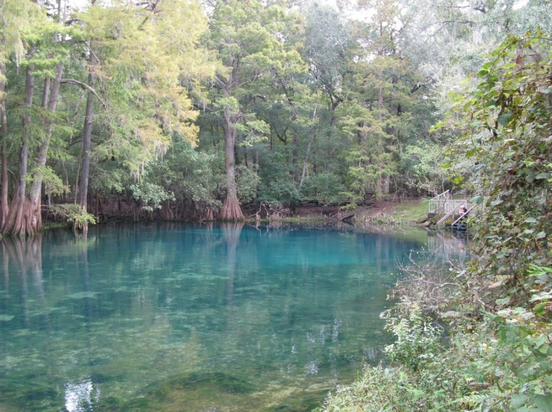
Santa Fe River Basin
PFAs and NSILTs
  PFAs and NSILTs completed for the following impaired OFS:
    Devil’s Spring System
    Hornsby Spring
    Ichetucknee Spring
Notes:
Definition: area or areas of a basin where the Floridan Aquifer is generally most vulnerable to pollutant inputs where there is a known connectivity between ground water pathways and an Outstanding Florida Spring (OFS), as determined by the department in consultation with the appropriate water management districts, and delineated in a BMAP.
Using the best data available from the water management districts and other credible sources, the department, in coordination with the water management districts, shall delineate priority focus areas for each OFS or group of springs that contains one or more OFS and is identified as impaired in accordance with s. 373.807.
PFA and is effective upon incorporation in a basin management action plan.
For ease of implementation delineation Shall use understood and identifiable boundaries such as:
Roads.
Political jurisdictions

Slide 11

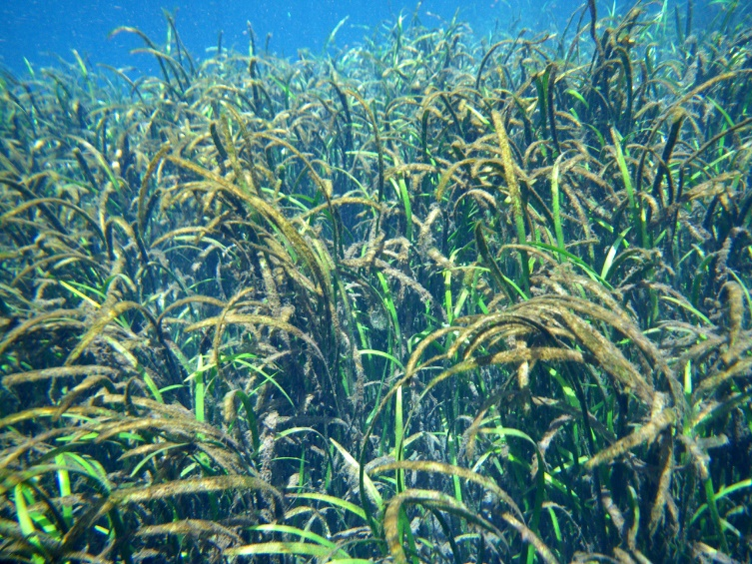
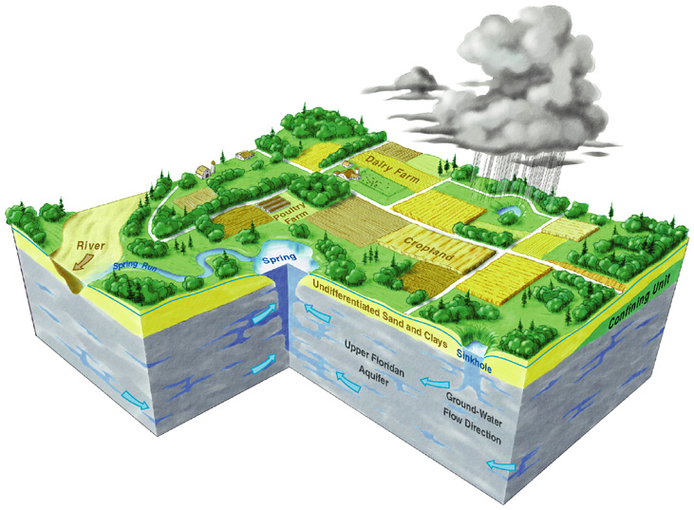
Nitrate-Impaired Spring Waters
The water quality in several Outstanding Florida Springs in the Suwannee River Basin is impaired due to elevated nitrate concentrations
Many sources contribute nitrogen in each springshed:
  atmospheric deposition
  fertilizers (farm and non-farm)
  septic tanks
  land application of wastewater
  livestock manure

Slide 12
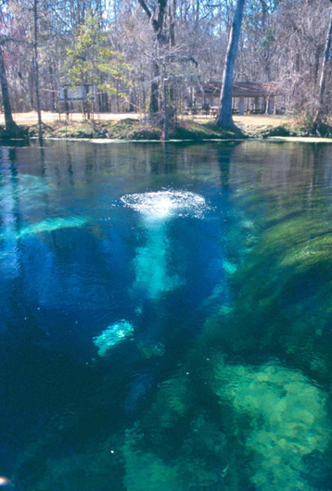
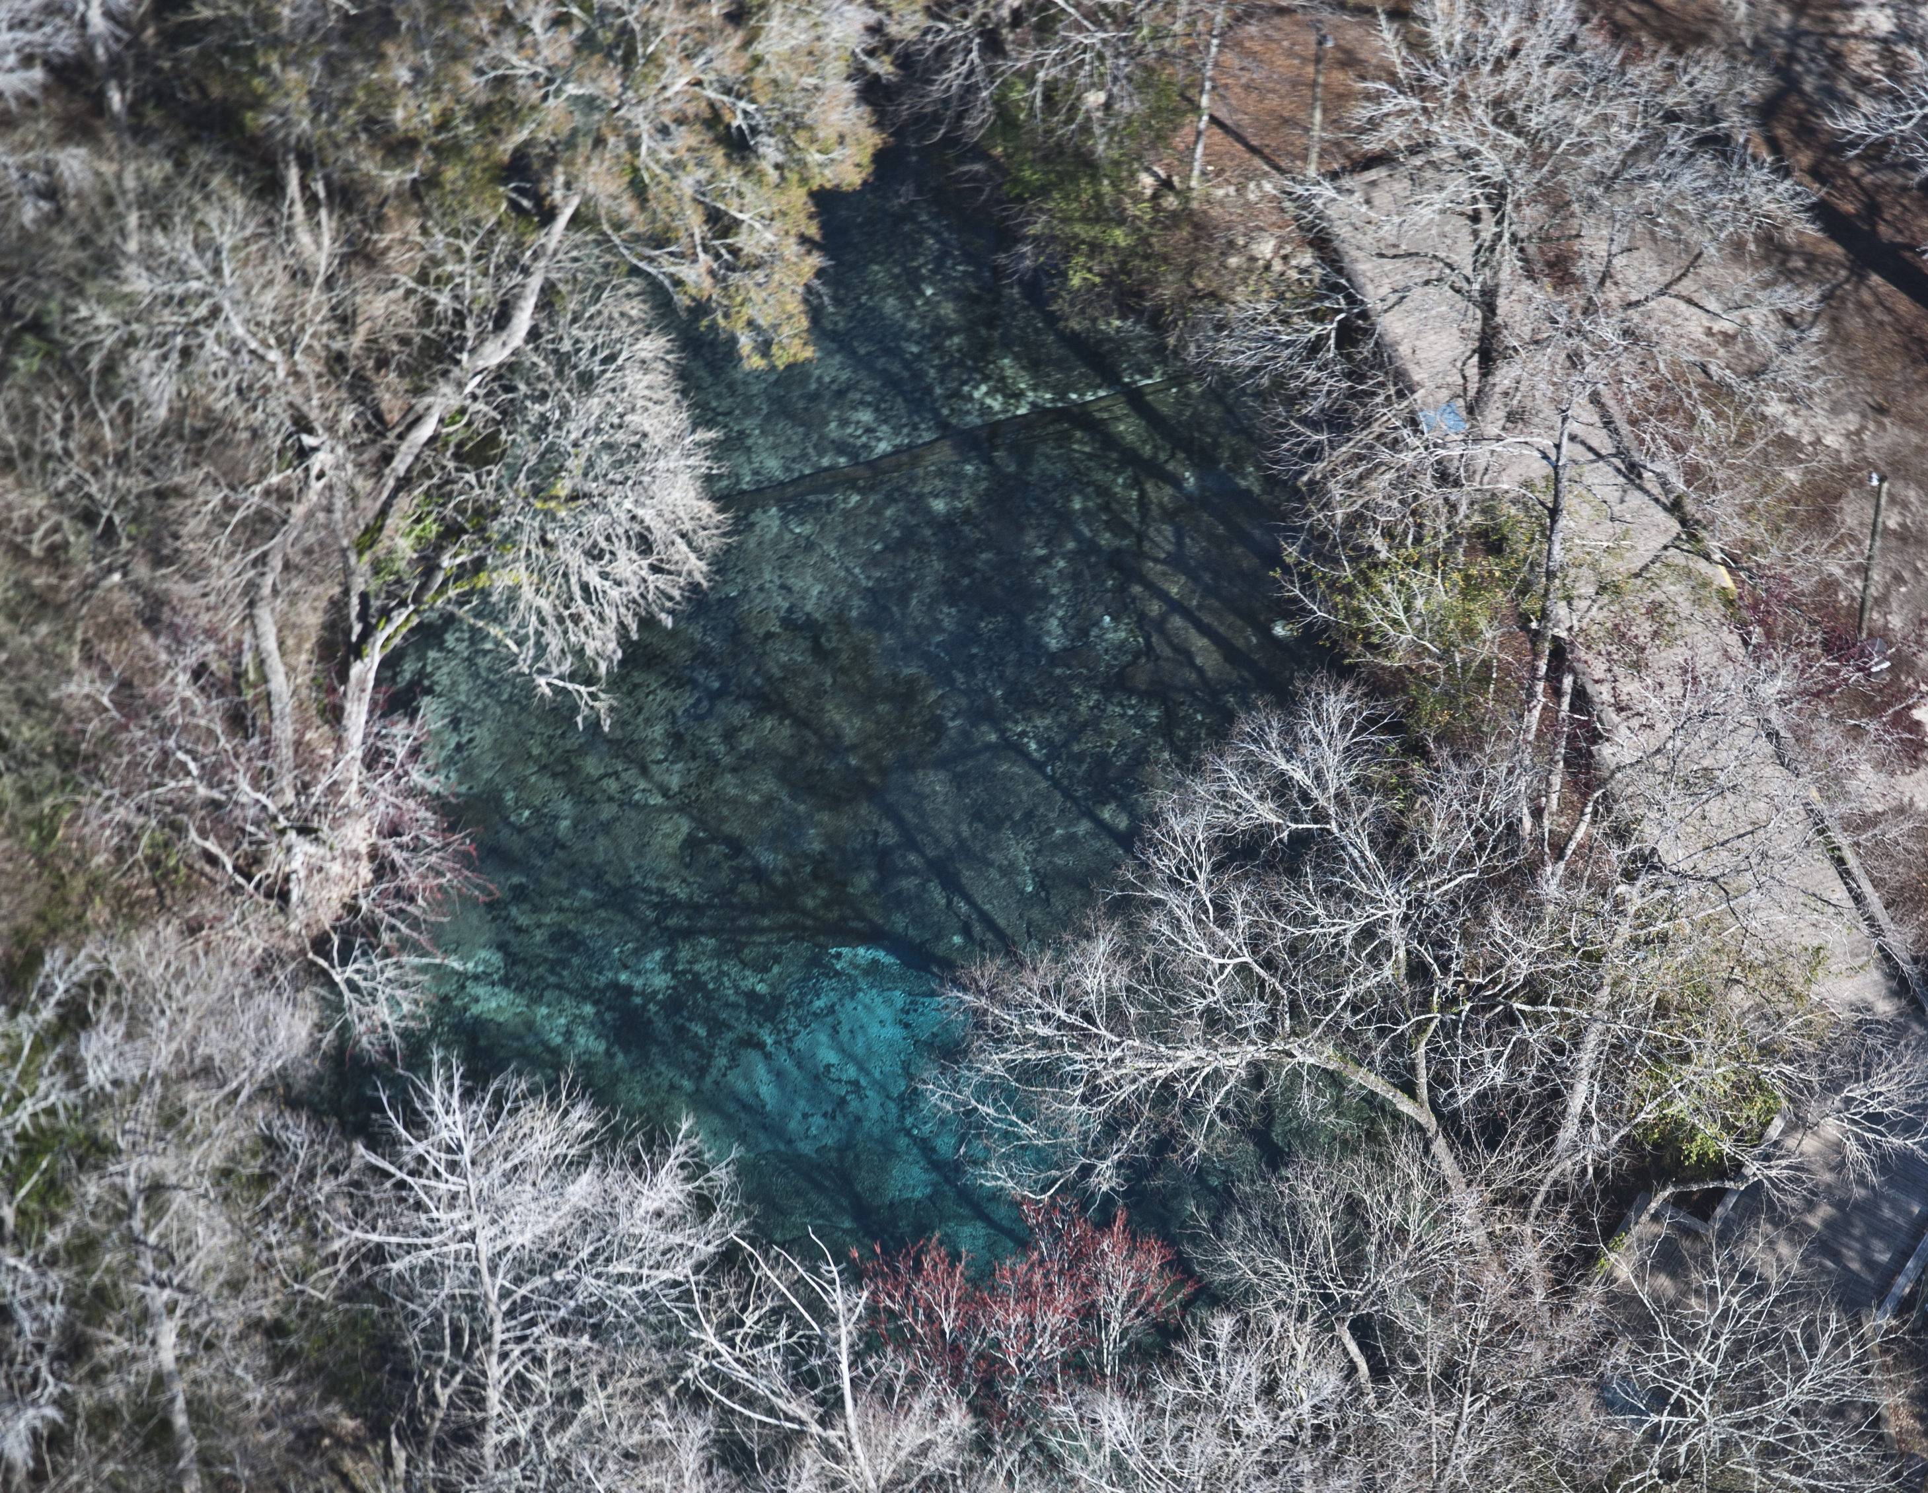
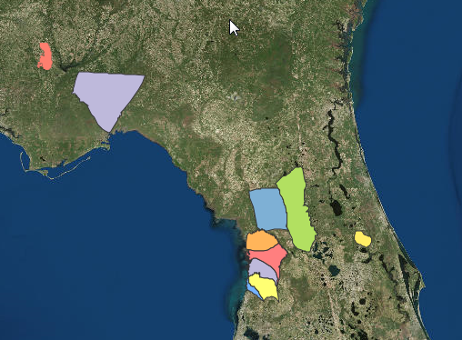
Nitrogen Source Inventory and Loading Tool
Quantifies nitrogen sources and loading to ground water, and highlights source categories where reductions in N loading could help achieve restoration of impaired waters
Customized inventory for each spring basin or BMAP area to account for hydrogeologic and land use differences
Inventories have been completed for impaired Outstanding Florida Springs

Slide 13

Outstanding Florida Springs
Impaired Outstanding Florida Springs (OFS) in this BMAP area were aggregated into three general springshed areas to more efficiently organize information and implement restoration actions:
Ichetucknee Spring Group (and associated springs of Ichetucknee River)
Devil’s Complex combined springshed
Hornsby-Treehouse (not impaired) combined Springshed
Additional not impaired OFS in BMAP
Columbia
Poe

Slide 14
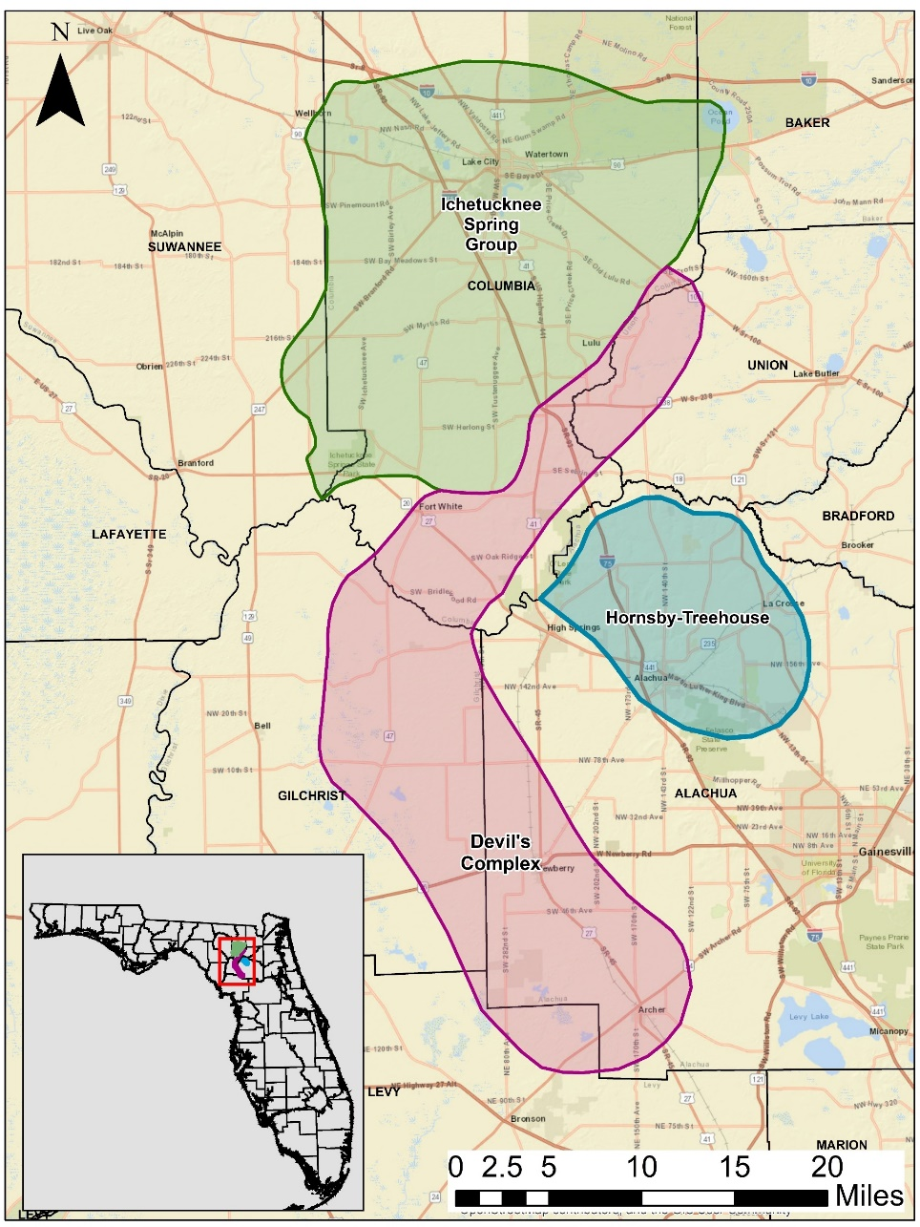
Inventories Conducted for 3 Springshed Areas
Springshed Area | County | Acres
Devil’s Complex | Gilchrist | 78,922
Devil’s Complex | Alachua | 72,982
Devil’s Complex | Union | 21,126
Devil’s Complex | Columbia | 43,853
Devil’s Complex | Levy | 11,781
Ichetucknee | Baker | 3,817
Ichetucknee | Suwannee | 13,621
Ichetucknee | Union | 48
Ichetucknee | Columbia | 227,927
Hornsby | Alachua | 77,520
Hornsby | Columbia | 31
Evaluation included portions of 7 counties

Slide 15
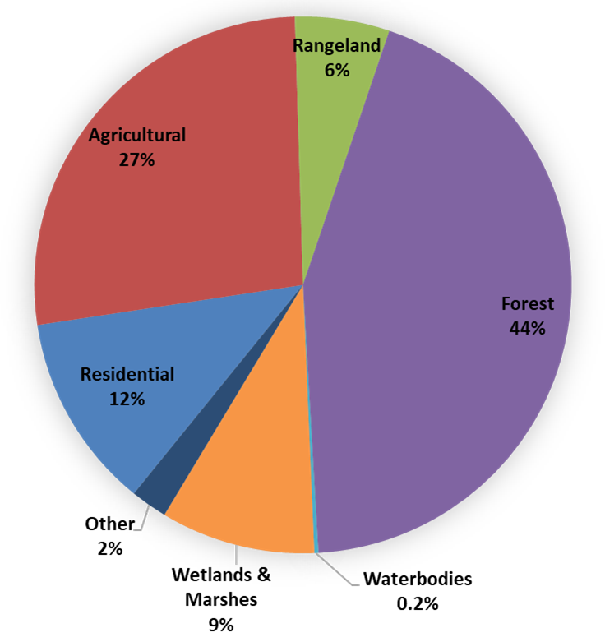
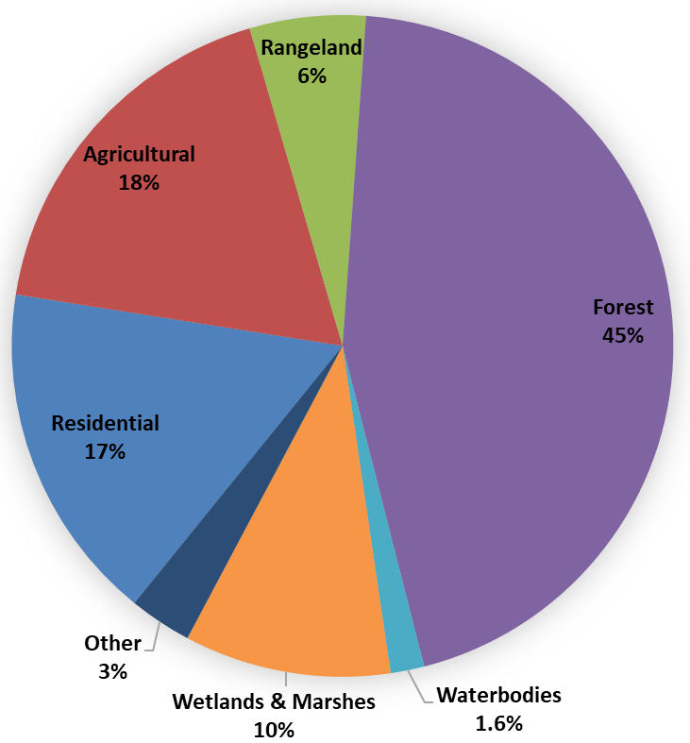
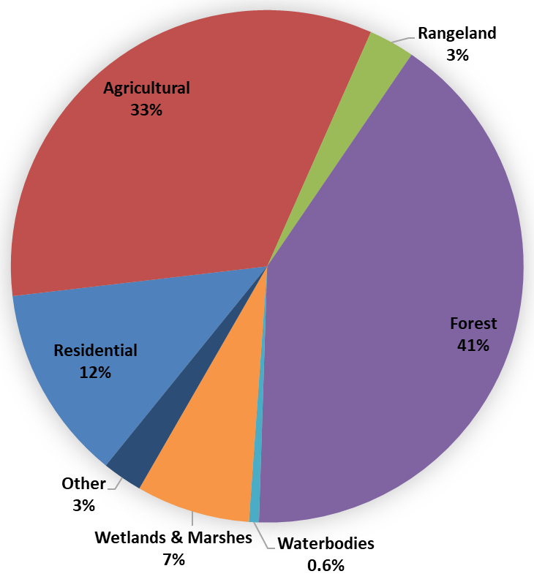
Land Use
Devil’s Complex
Ichetucknee
Hornsby
Notes:
This chart illustrates the various land uses within the springshed. The majority of nitrogen sources will enter the environment within an urban or agricultural landscape, which make up approximately 40% of the lands in each springshed

Slide 16

Source Categories
Land Use evaluation provides potential groundwater sources of nitrate
  Farm Fertilizer (FF)
  Livestock Waste (LW)
  Dairies
  Urban Turfgrass Fertilizer (UTF)
  Sports Turfgrass Fertilizer (STF)
  Atmospheric Deposition (AD)
  Wastewater Treatment Facilities (WWTP)
  Onsite Treatment and Disposal Systems (OSTDS)
Notes:
For atmospheric deposition, we rely on a nationwide model developed by EPA called the TDEP. This approach relies on data from monitoring stations as well as other atmospheric models. At the recommendation of the developers, the model results used included data from 2011 to 2013.

Slide 17
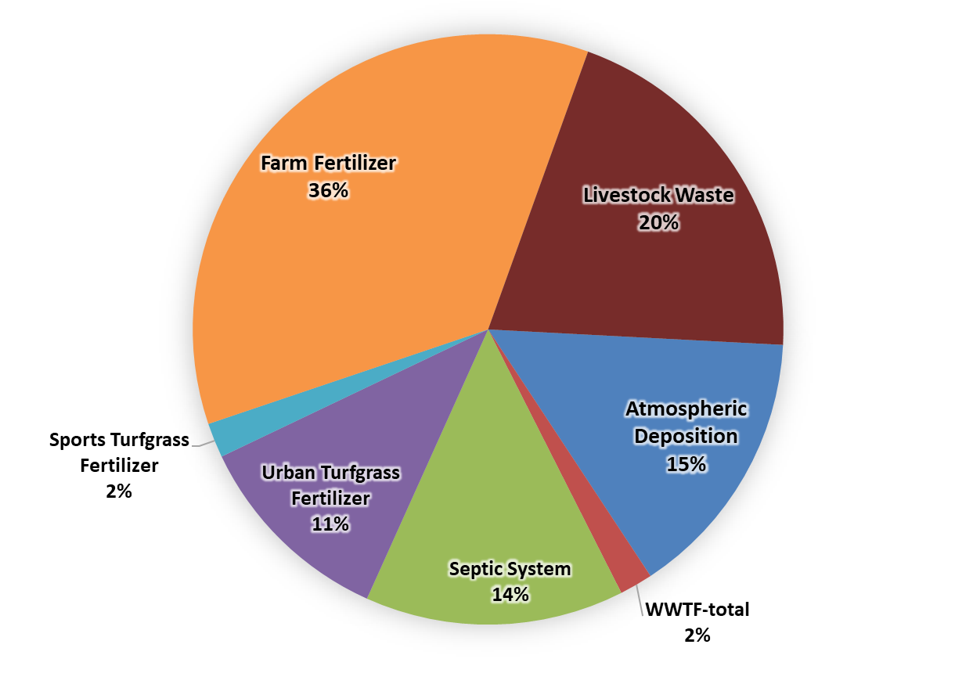
Ichetucknee- Nitrogen Load to Groundwater

Slide 18
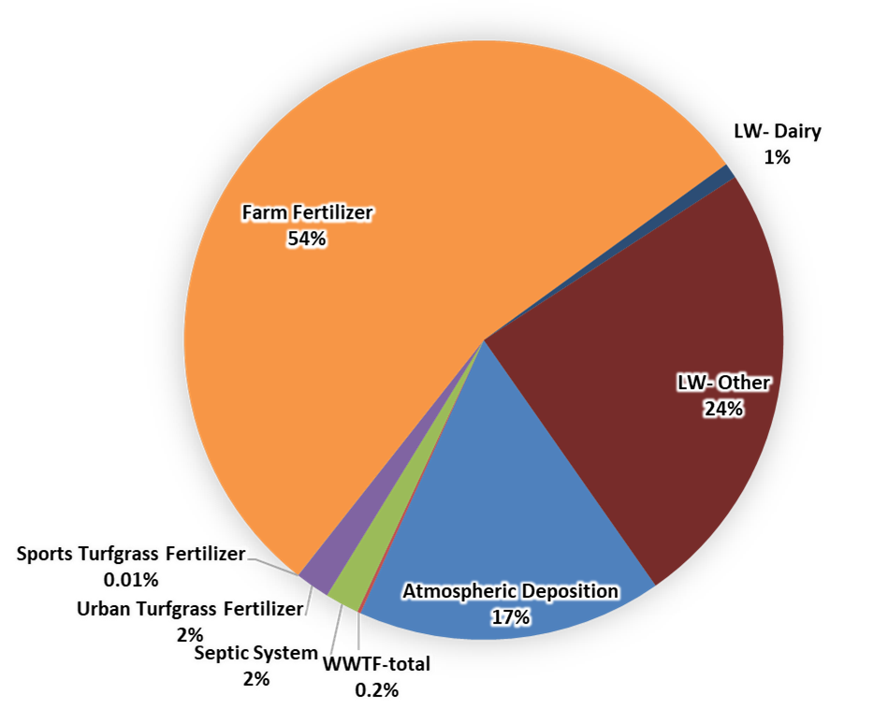
Devil’s Complex- Nitrogen Load to Groundwater

Slide 19
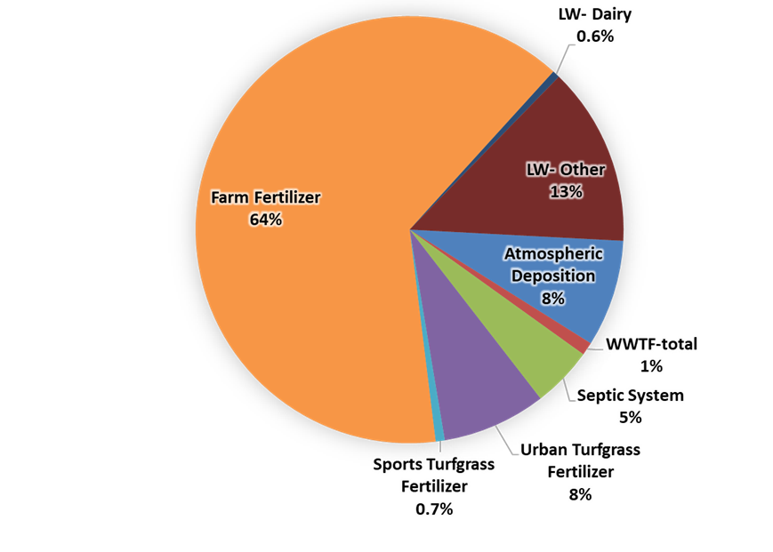
Hornsby-Treehouse- Nitrogen Load to Groundwater

Slide 20
Source Categories
Load to Groundwater evaluation provides comparison of potential groundwater sources of nitrate
  Farm Fertilizer (FF)
  Livestock Waste (LW)
  Dairies
  Urban Turfgrass Fertilizer (UTF)
  Sports Turfgrass Fertilizer (STF)
  Atmospheric Deposition (AD)
  Wastewater Treatment Facilities (WWTP)
  Onsite Treatment and Disposal Systems (OSTDS)
Notes:
For atmospheric deposition, we rely on a nationwide model developed by EPA called the TDEP. This approach relies on data from monitoring stations as well as other atmospheric models. At the recommendation of the developers, the model results used included data from 2011 to 2013.

Slide 21
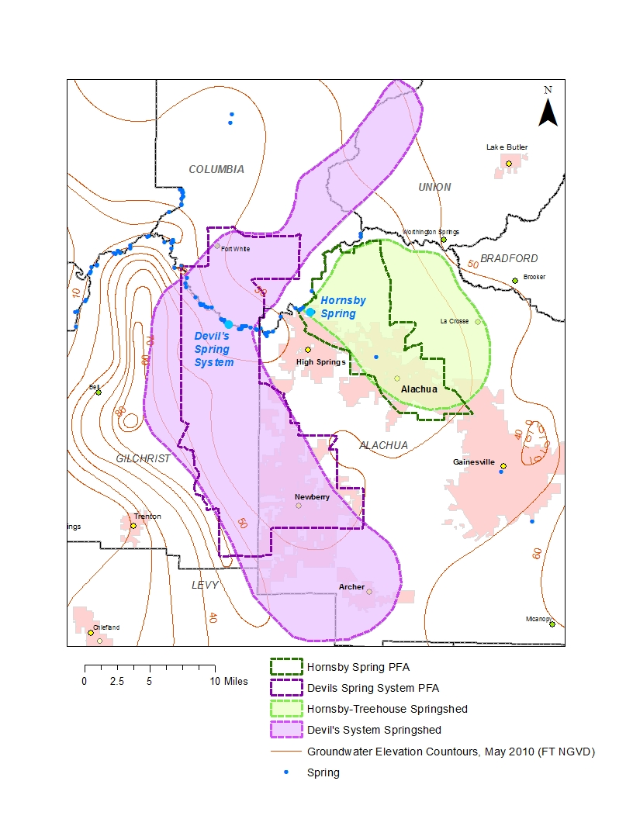
PFA – Boundaries

Slide 22
PFA Delineation
  Sub-Section 373.802, F.S.:
    Definition: Area or areas of a basin where the Floridan Aquifer is generally most vulnerable to pollutant inputs where there is a known connectivity between groundwater pathways and an OFS
  Sub-Section 373.803, F.S.:
    Delineation considers factors that may lead to degradation of an OFS, such as:
        Groundwater travel time to the spring
        Hydrogeology
        Nutrient load, etc.
Notes:
Definition: area or areas of a basin where the Floridan Aquifer is generally most vulnerable to pollutant inputs where there is a known connectivity between ground water pathways and an Outstanding Florida Spring (OFS), as determined by the department in consultation with the appropriate water management districts, and delineated in a BMAP.
Using the best data available from the water management districts and other credible sources, the department, in coordination with the water management districts, shall delineate priority focus areas for each OFS or group of springs that contains one or more OFS and is identified as impaired in accordance with s. 373.807.
PFA and is effective upon incorporation in a basin management action plan.
For ease of implementation delineation Shall use understood and identifiable boundaries such as:
Roads.
Political jurisdictions

Slide 23
PFA Requirements
  Prohibitions
    Wastewater treatment facilities greater than 100,000 gallons per day (GPD), UNLESS advanced wastewater treatment (AWT) is used.
    New conventional OSTDS on less than one-acre lots.
    Ban on land application of Class A or B biosolids w/o approved NMP.
    New Hazardous waste facilities.
  Additional Requirements for Biosolids and Septage Application Practices
    Requirements for newly permitted sites or at renewal
    Verified BMPs for agricultural operations
    Effective nutrient management practices
    Groundwater monitoring requirements

Slide 24
PFA Delineation
  Evaluate
    Aquifer Recharge
    Aquifer Vulnerability
    Soil Leaching Potential
    Land Elevation
    Land Use
    Conservation Lands
    WWTP and OSTDS

Slide 25
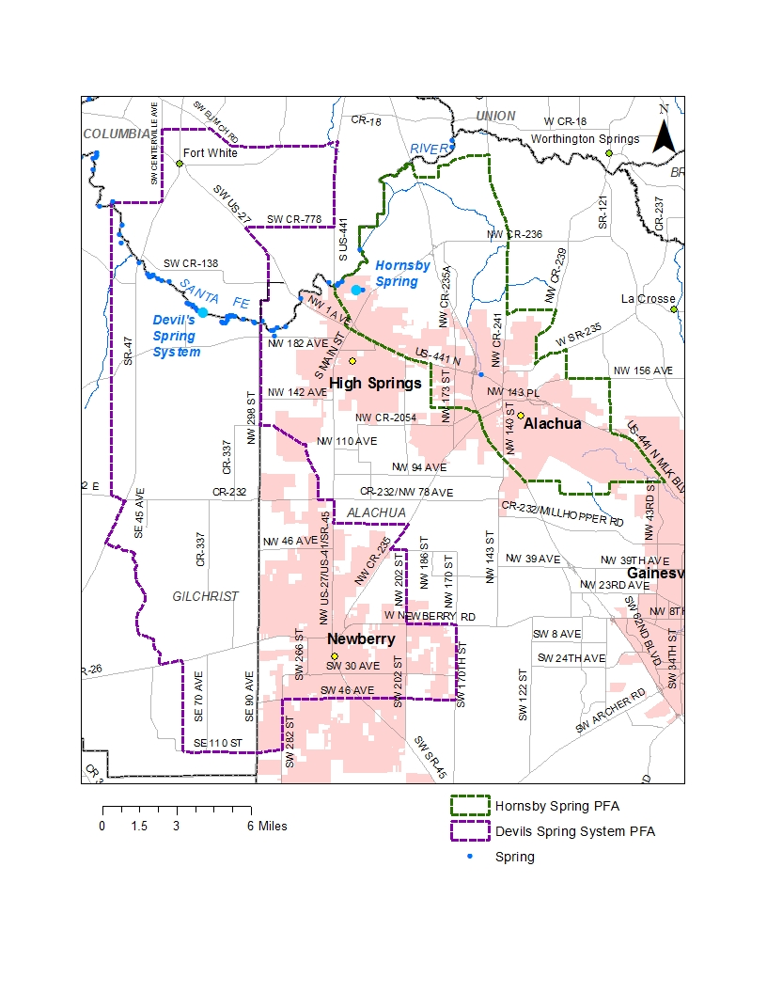
PFA – Boundaries

Slide 26
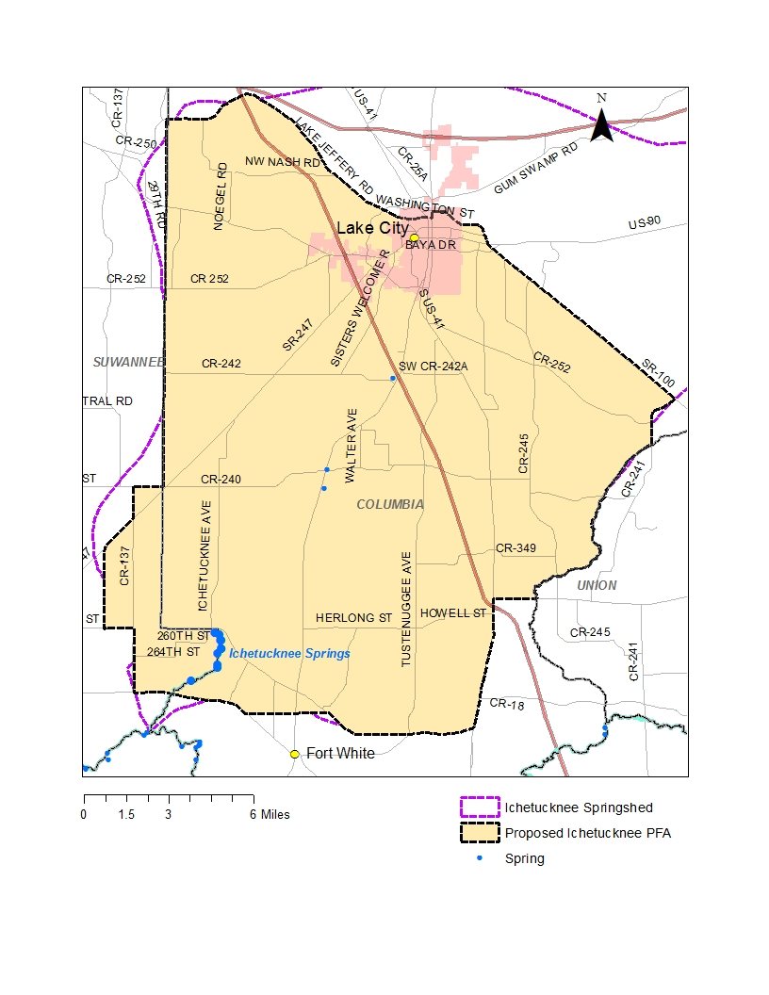
Ichetucknee PFA

Slide 27
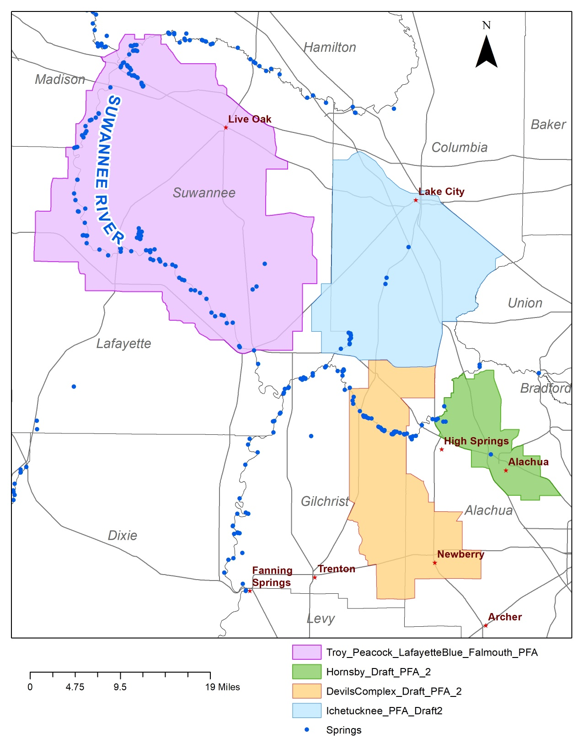
PFAs

Slide 28
Ichetucknee- Nitrogen Load to Groundwater

Slide 29
Devil’s Complex- Nitrogen Load to Groundwater

Slide 30
Hornsby-Treehouse- Nitrogen Load to Groundwater

Slide 31
Project Credit Analysis
Nitrogen Source | Credits to Load to Groundwater (lb-N/yr) | Description
Onsite Sewage Treatment and Disposal Systems (OSTDS) | 12,000 | Credits identified for stakeholder OSTDS projects (onsite enhancement or sewer)
Urban Turfgrass Fertilizer (UTF) | 19,000 | DEP approved credits (up to 6 %) for public education activities as well as credits identified for stakeholder stormwater projects
Atmospheric Deposition (AD) | - | No reduction
Farm Fertilizer Reductions | 330,400 | 15 % BMP credit on FF load to groundwater, assuming 100 % owner-implemented verified BMPs on all fertilized lands (includes 98,000 from projects)
Sports Turfgrass Fertilizer (STF) | 2,300 | 6 % BMP credit for sports fields and 10 % BMP credit for golf courses (where applicable) on STF load to groundwater, assuming 100 % BMP implementation on golf courses and sports fields
Permitted Dairy | 7,400 | 15 % BMP credit on permitted dairy load to groundwater, assuming 100% owner-implemented verified BMPs at permitted dairies.(includes 200 from projects)
Livestock Waste | 51,500 | 10 % BMP credit on load to groundwater, assuming 100 % owner-implemented verified BMPs at all livestock facilities
Wastewater Treatment Facilities (WWTF) | 21,500 | Achieved by BMAP WWTF policy if BMAP-wide (achieving 3 or 6 mg/L total nitrogen concentration at discharge)
Total Credits | 444,000

Slide 32
Total Santa Fe River BMAP Nitrogen Reductions
Total Reduction Required to Meet the TMDLs
 | Total Load at Spring Vents (lb-N/yr) | TMDL Load (lb-N/yr) | Required Reduction to Meet TMDL (lb-N/yr)
In Springsheds
Ichetucknee | 308,107 | 107,867 | 200,269
Devils Complex | 1,899,233 | 664,731 | 1,234,501
Hornsby | 435,385 | 152,385 | 152,385
Subtotal |  |  | 1,717,771
Outside Springsheds and in BMAP Area
West |  |  | 62,454
East |  |  | 73,148
Subtotal |  |  | 135,602
Total |  |  | 1,853,372
Project Credits |  |  | 444,000
Remaining Load |  |  | 1,410,000
Notes:
9.48M total

Slide 33
Additional Potential Reductions
Existing OSTDS in PFAs (lb-N/yr)
 | High Recharge Area |  | Med. Recharge Area
 | Tanks | Credit | Tanks | Credit
Parcels <1 ac | 5,162 | 27,000 lbs. | 718 | 2,100 lbs.
Parcels >1ac | 13,353 | 71,000 lbs. | 2,712 | 7,900 lbs.

Slide 34
Additional Potential Reductions
Additional Ag Practices Estimated Reduction Credit (lb-N/yr)
Action | High Recharge Area (100%) | Med. Recharge Area (100%)
Precision Irrigation | 25,530 | 13,072
Precision Fertilization | 184,751 | 102,640
Soil Moisture Probes | 278,046 | 154,470
Controlled Release Fert. | 47,714 | 26,508
Cover Crops | 410,508 | 228,060
Banders | 371,974 | 206,652
Additional Potential Reductions
 | 50% reduction in FF | 10% Reduction in FF
100% Acreage (104,757 ac) | 774,244 lbs | 154,849 lbs

Slide 35
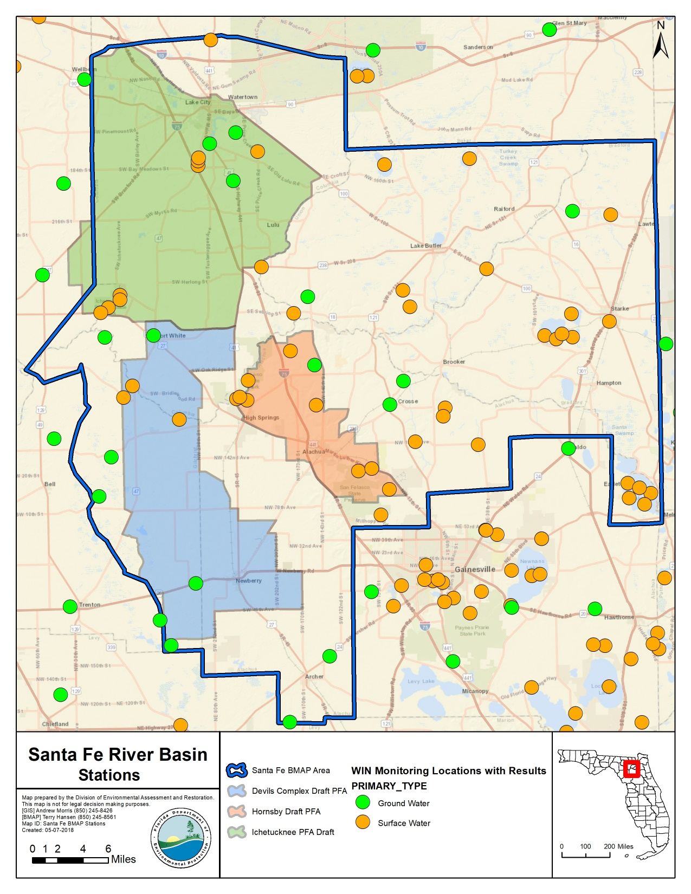
Monitoring

Slide 36
Statewide TMDL, BMAP, Minimum Flows and Levels (MFLs) Annual Report
403.0675(1), F.S. – requires a report that will include status of MFLs, TMDLs, and BMAPs
Replacement of individual BMAP annual progress reports
Annual meetings will continue
Calendar year reporting
Report will contain project information: funding, proposed priority ranking for implementation
Progress made towards restoration goals
Information will be requested in late November, due by the end of January
Info. needed will include: entity activities, compliance, project information, and milestones
Report is due to the Governor and Florida Legislature July 1, 2018 and every year thereafter

Slide 37
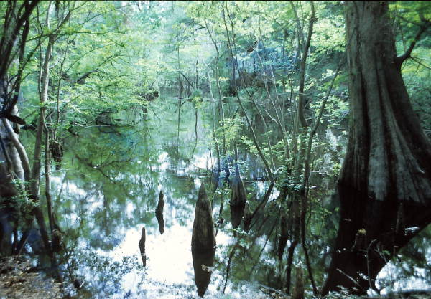
Questions?

Slide 38
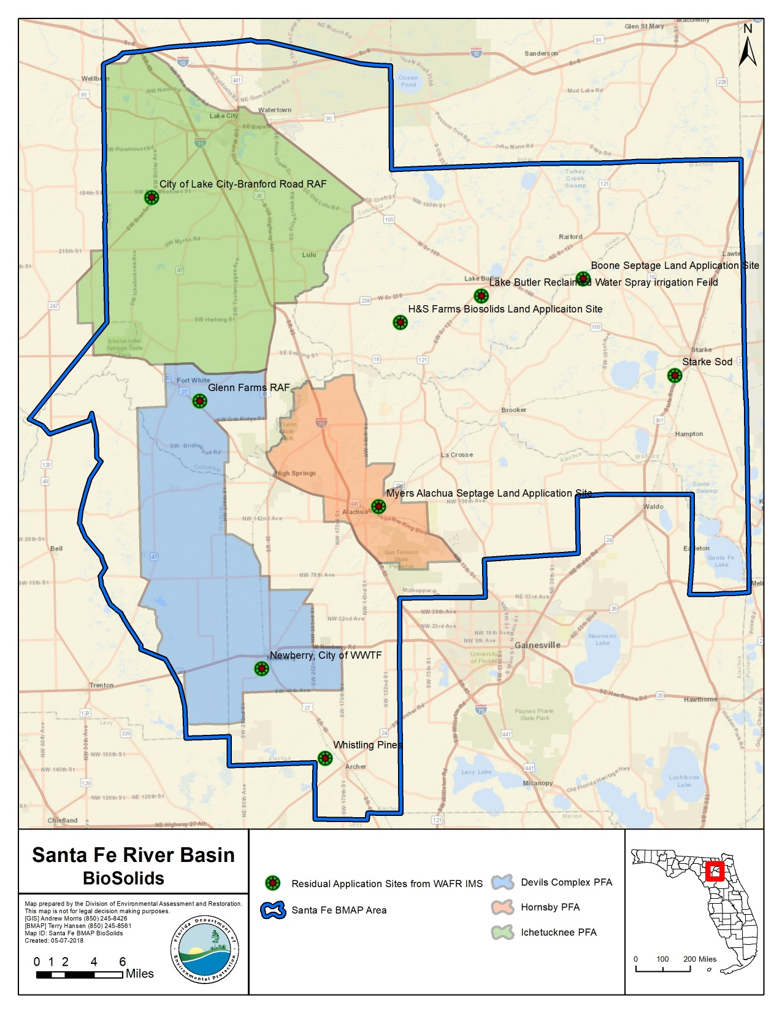
Biosolids

