Slide 1
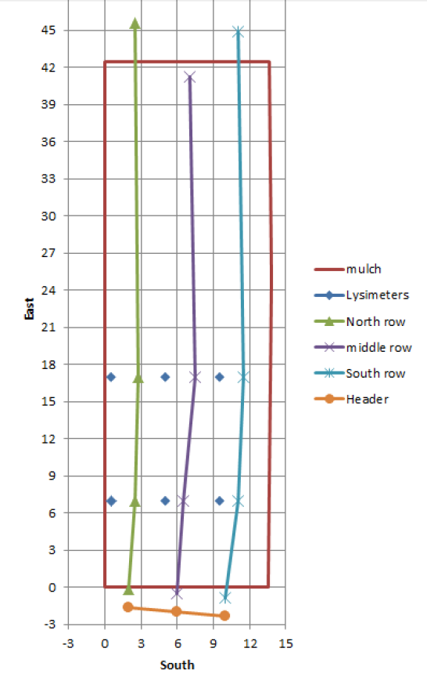
North
W2
L2-D
L4-D
L6-D
L2-S
L4-S
L6-S
W1
Shallow lysimeter
Deep lysimeter
P1
Monitoring well
Piezometer
L1-D
L3-D
L5-D
Lysimeter replaced
L1-S
L3-S
L5-S
West

