Slide 1
Update on
Wekiva Septic Tank Study
April 20, 2017

Slide 2
Study Objectives
The results of study helps us better understand:
  Attenuation and leaching of nitrogen from existing septic systems into the soil and ground water
  Other sources of nitrogen in residential areas
  Conditions that may influence nitrogen attenuation local to this area

Slide 3
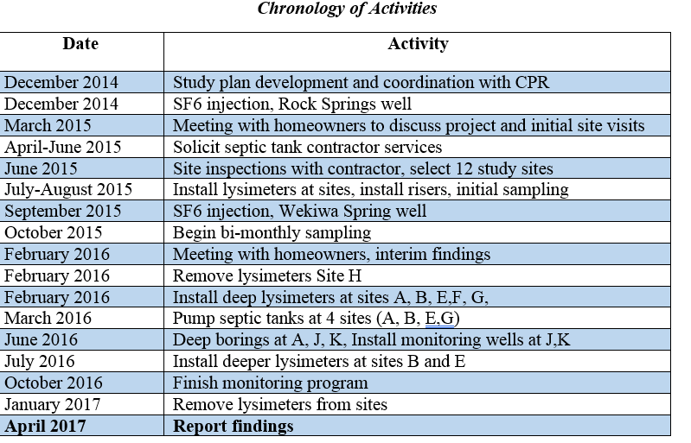
Chronology

Slide 4
Information on Study Sites
Site ID | City | No. residents | Drainfield repair/replacement history | Maintenance info | Fertilizer use | Soil
A | Sorrento | 2 | infiltrators (original) | pumped regularly | yes, self applied | Candler fine sand
B | Apopka | 3 | infiltrators (2009) | pumped in 2013 | yes, self applied | Candler fine sand
C | Apopka | 3 | infiltrators (2010) | septic tank pumped in 2013 | yes, self applied | Candler fine sand
D | Apopka | 2 | pipe in gravel (original) | not pumped out lately | yes, commercial service | Candler fine sand
E | Apopka | 2 | pipe in gravel (1989) | not pumped | yard mostly mulched beds | Candler fine sand
F | Apopka | 4 | infiltrators (2010) | pumped in 2014 | not lately | Candler fine sand
G | Apopka | 3 | pipe in gravel (original) | pumped in 2014 | yard mostly mulched beds | Candler fine sand
H | Apopka | 2 | pipe in gravel (original) | not pumped | yes, commercial service | Candler fine sand
I | Longwood | 1-2 | infiltrators (1989) | pumped in 2015 | yes, commercial service | Urban land
J | Longwood | 2 | mounded pipe in gravel bed | pumped regularly | yes, commercial service | Urban land
K | Apopka | 2 | pipe in gravel (original) | pumped in 2015 | yard mostly mulched beds | Candler fine sand

Slide 5
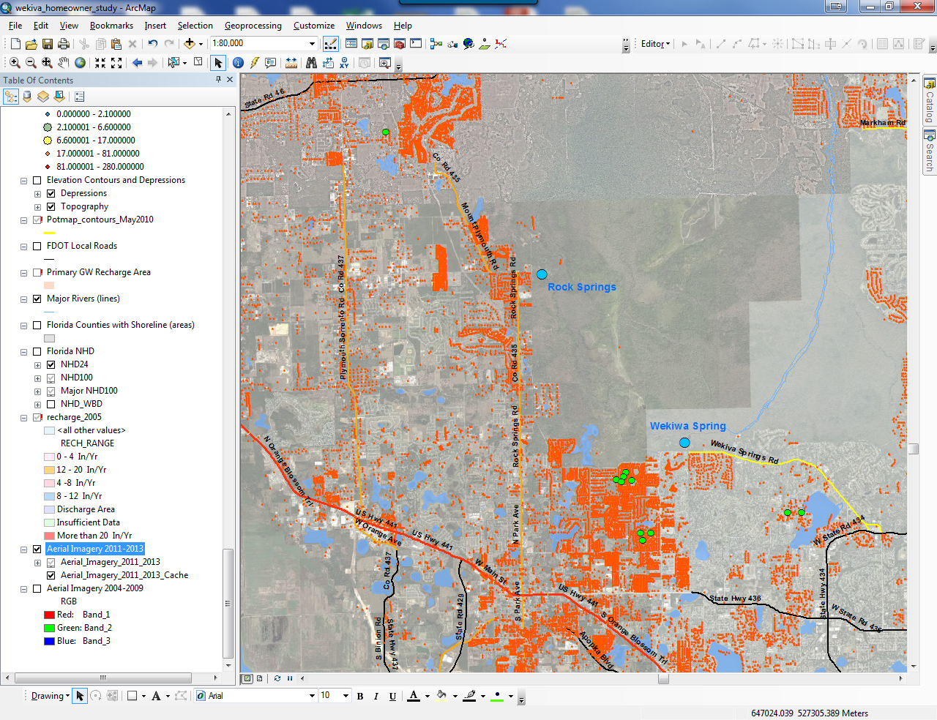
11 Study Site Locations

Slide 6
Scope
Lysimeters to monitor soil pore water below drainfields and at background locations
Riser installation and effluent monitoring
Monitoring wells at some locations
Collect data on water use to estimate loading

Slide 7
Other Activities
Evaluate changes in septic tank treatment after pumping.
  By selectively sampling septic tank effluent, pre and post pumping we hope to help provide some actual data on the potential benefit of tank pumping.
Conduct alternative nitrogen reducing drainfield study.
  Bold and Gold or other similar reactive media
  Passive low-cost construction
  Wekiwa Springs State Park location
  Orchard Drive location
Use data for modeling purposes, “STUMOD”

Slide 8
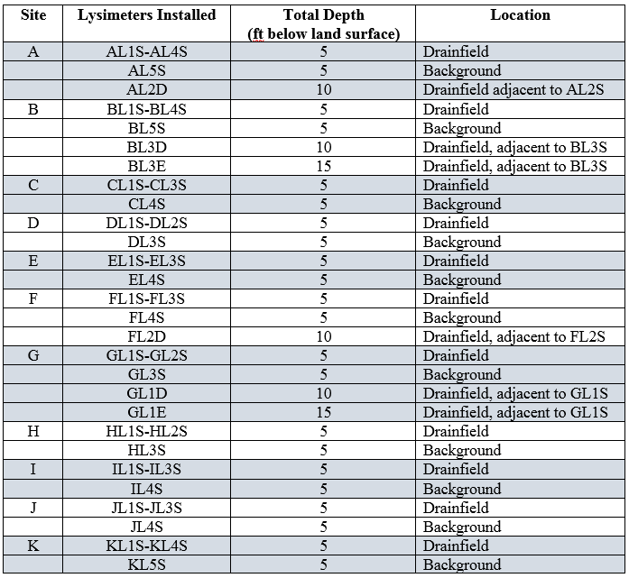
Nutrient Levels in Soil Pore Water

Slide 9
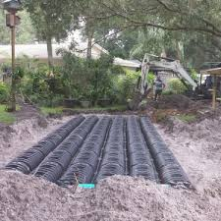
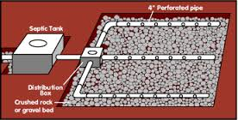
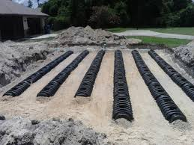
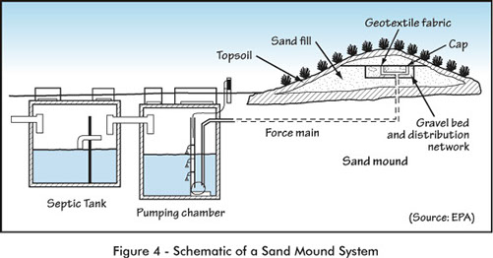
Types of drainfields in study

Slide 10
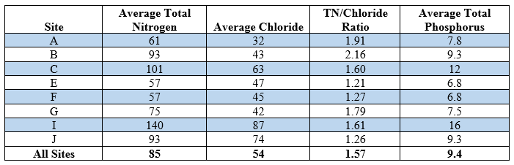
Septic Tank Effluent Sampling
Septic tank effluent samples collected bimonthly at 8 sites

Slide 11
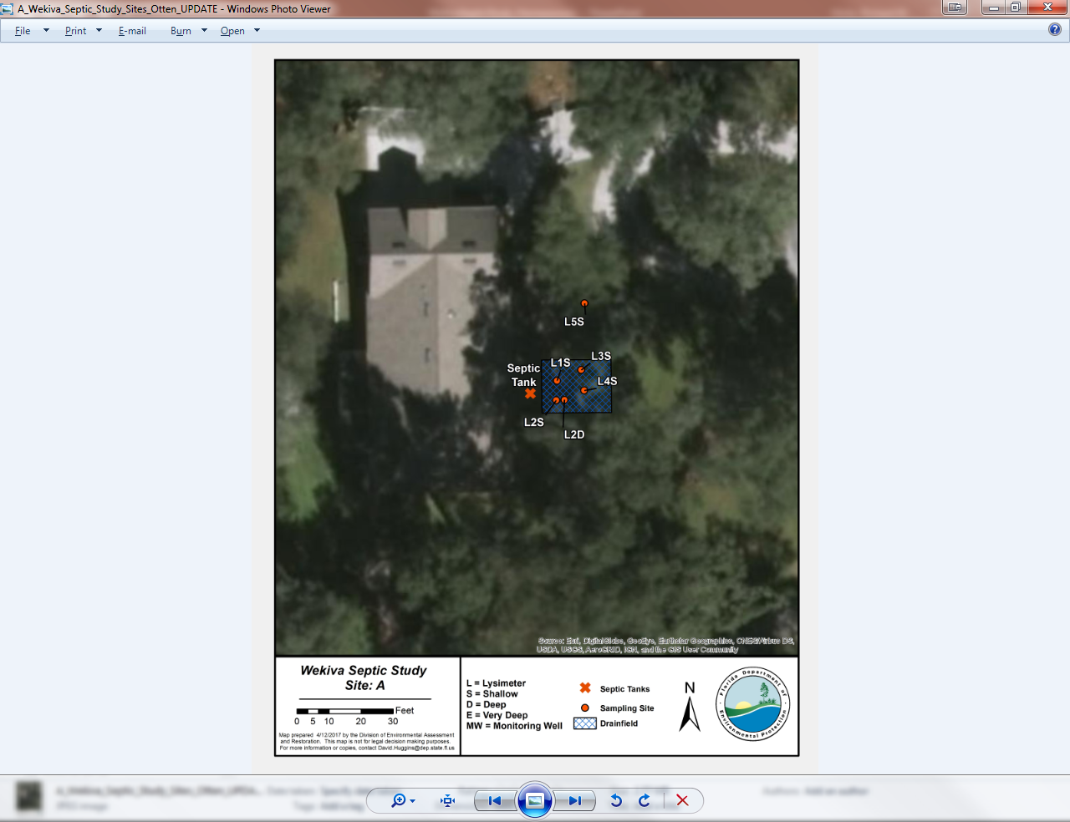

Slide 12
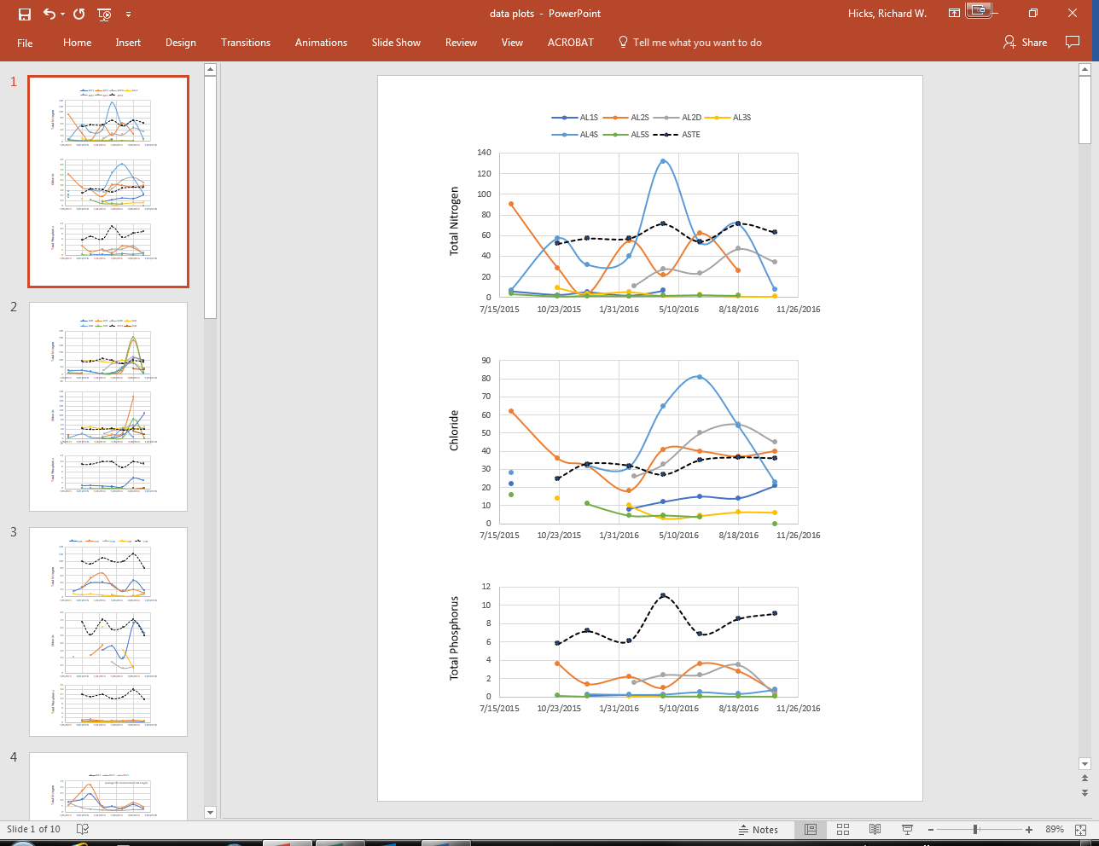

Slide 13
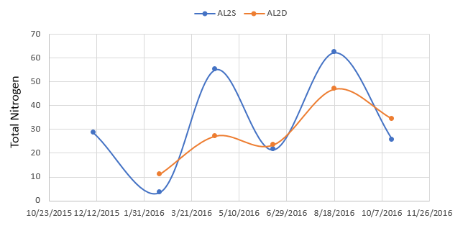

Slide 14
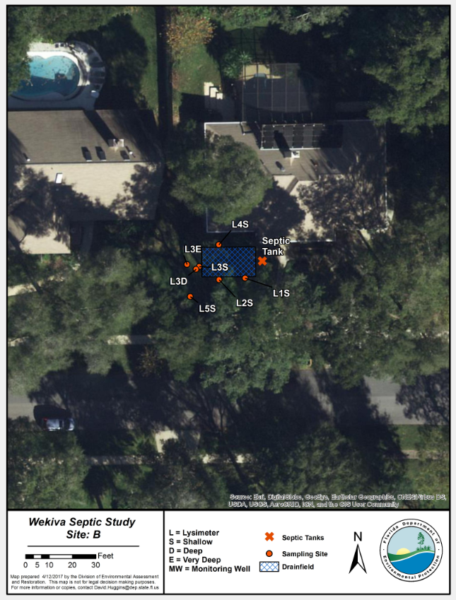

Slide 15
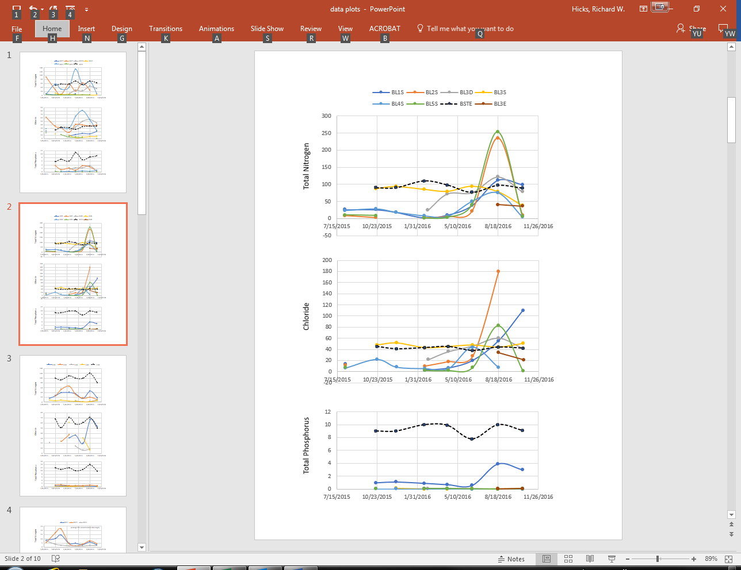

Slide 16
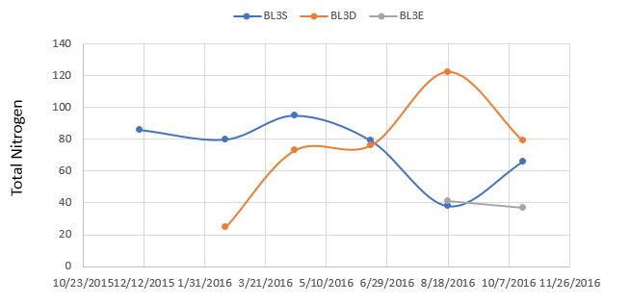

Slide 17
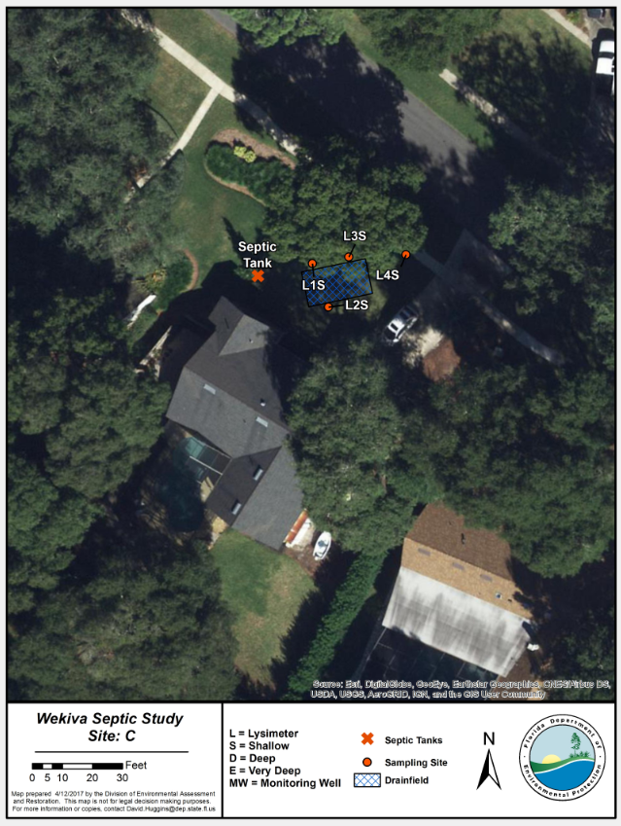

Slide 18
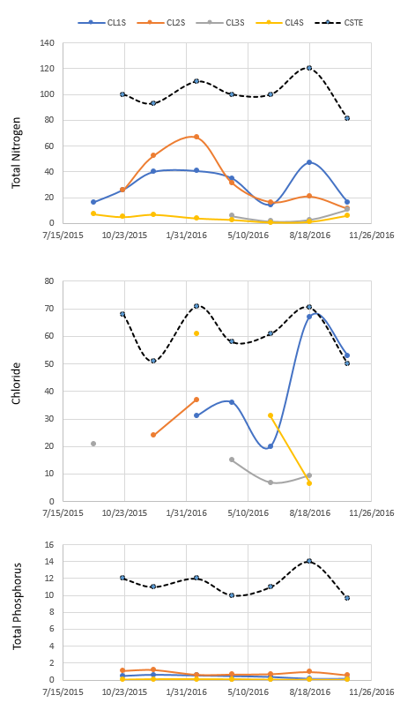

Slide 19
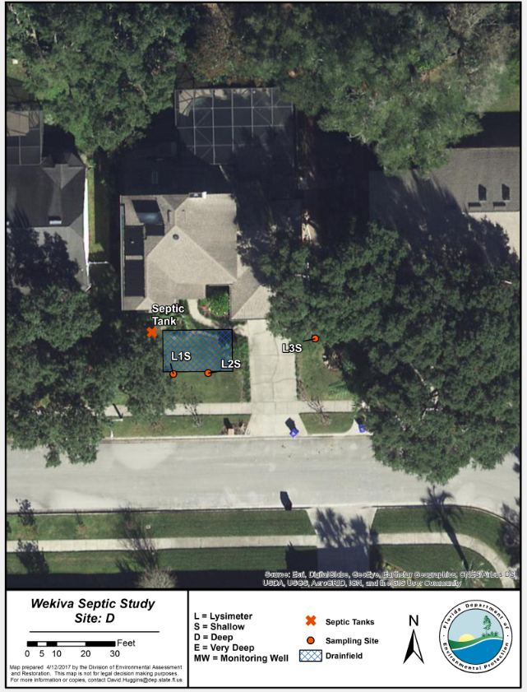

Slide 20
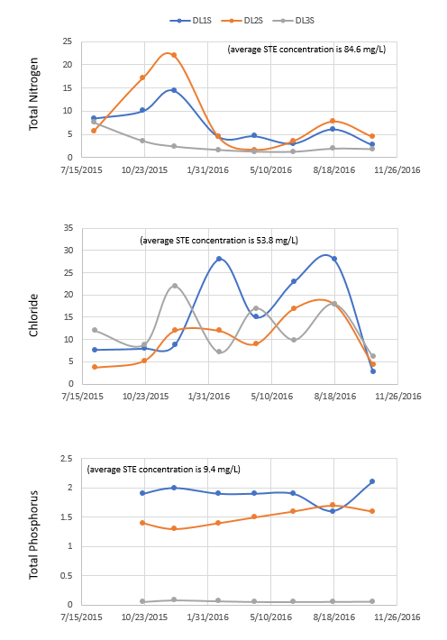

Slide 21
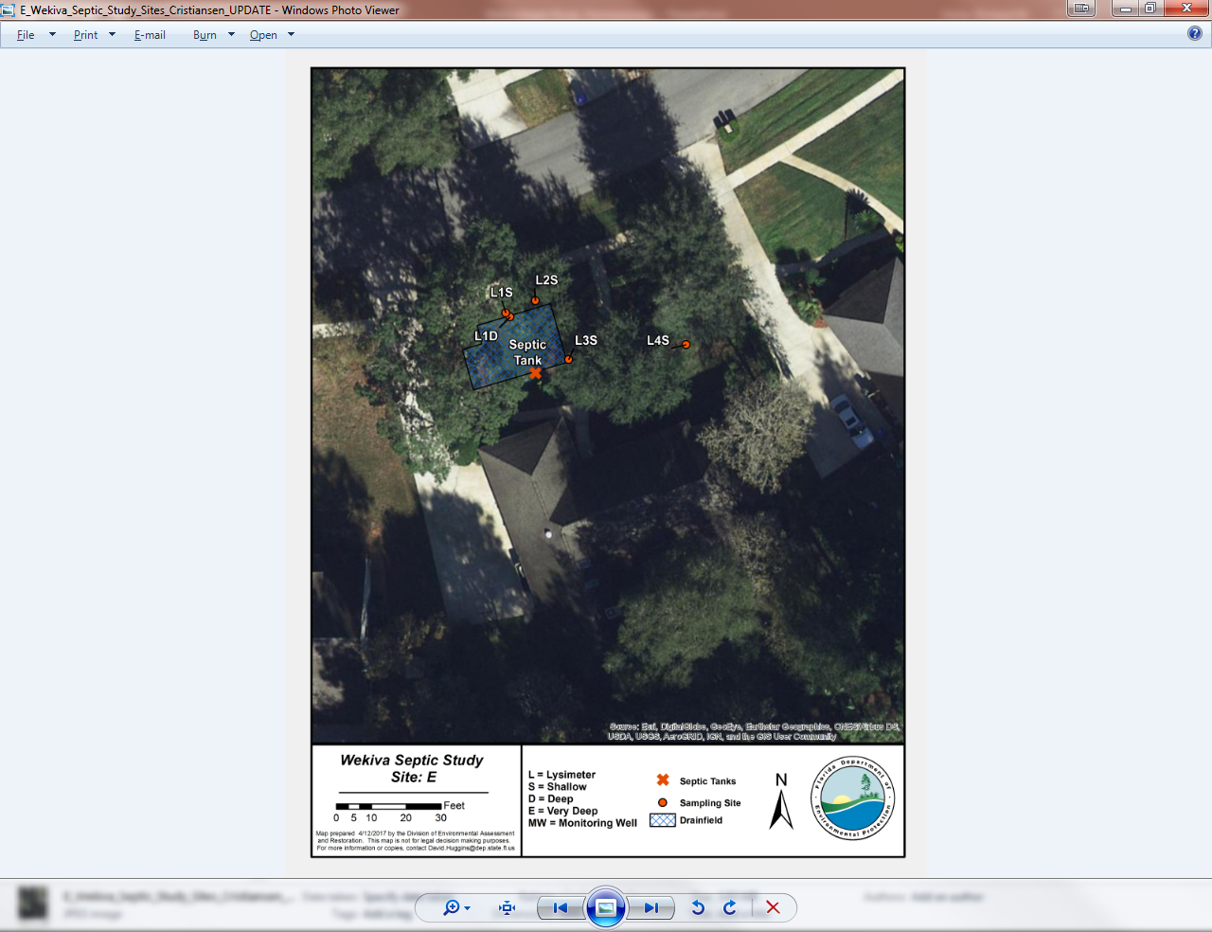

Slide 22
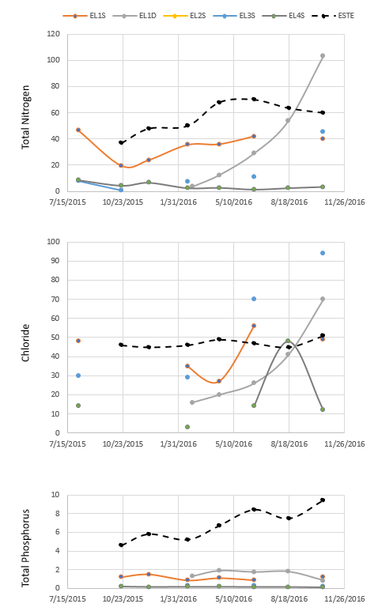

Slide 23
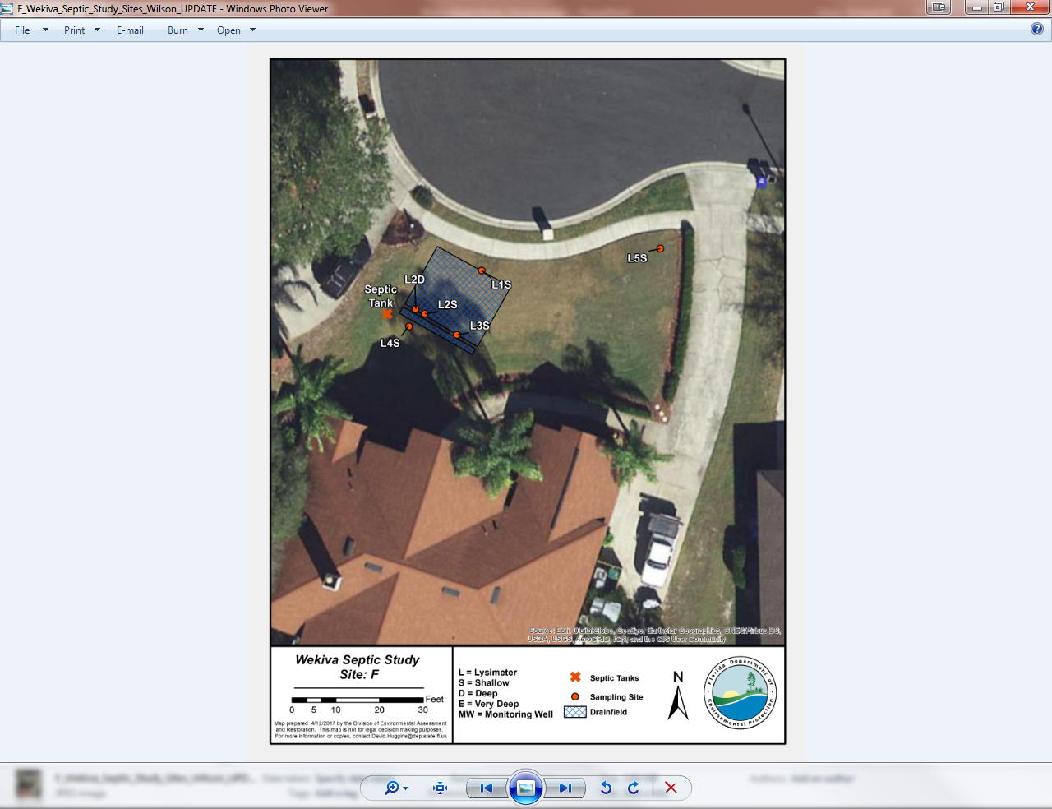

Slide 24
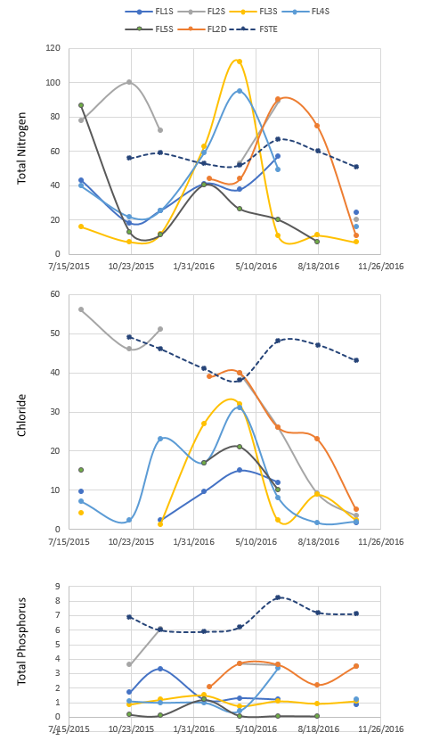

Slide 25
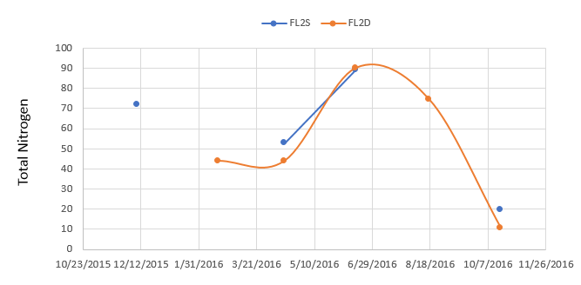

Slide 26
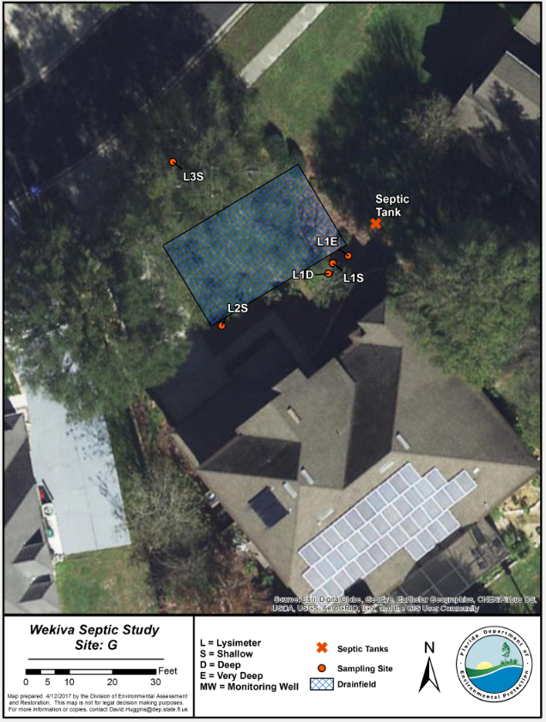

Slide 27
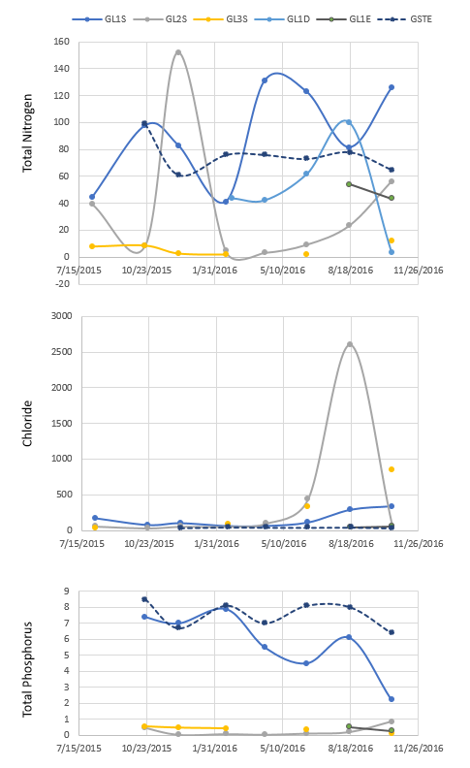

Slide 28
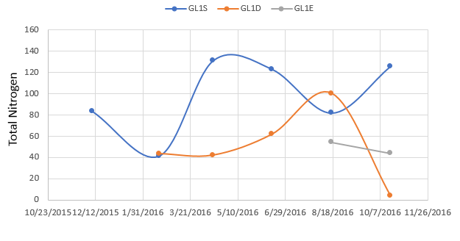

Slide 29
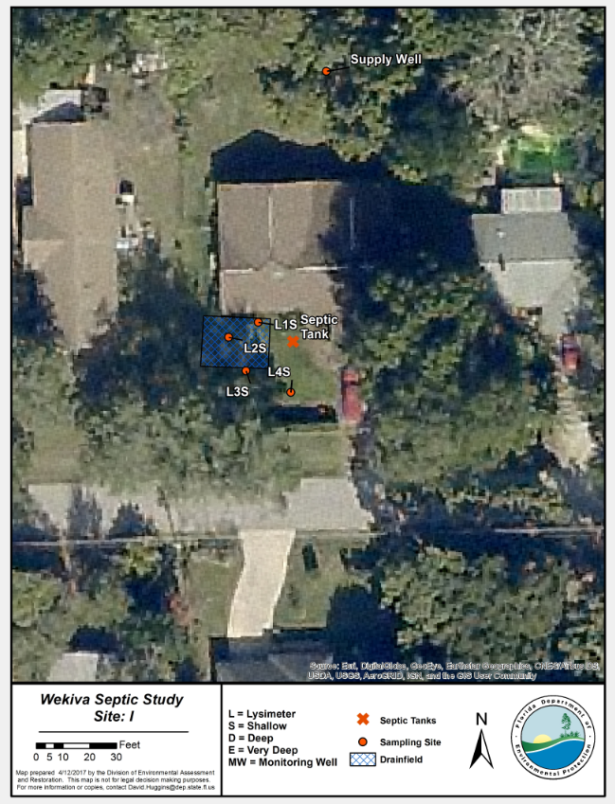

Slide 30
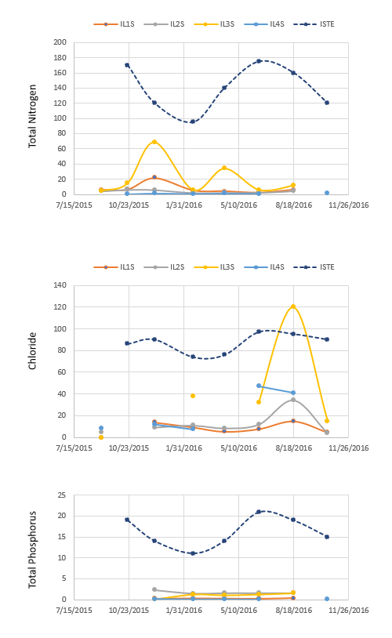

Slide 31
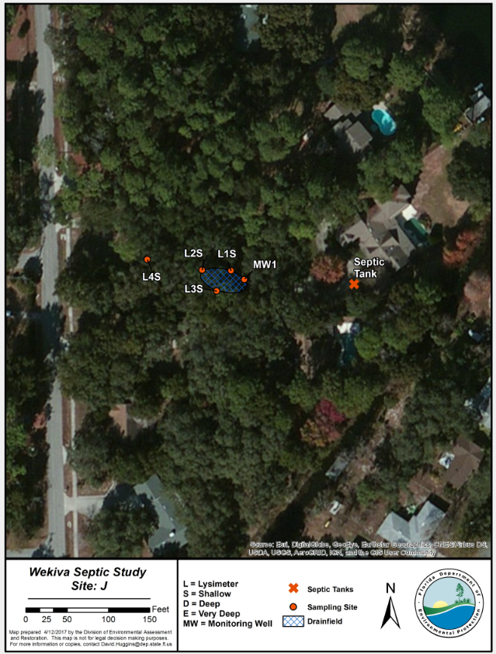

Slide 32
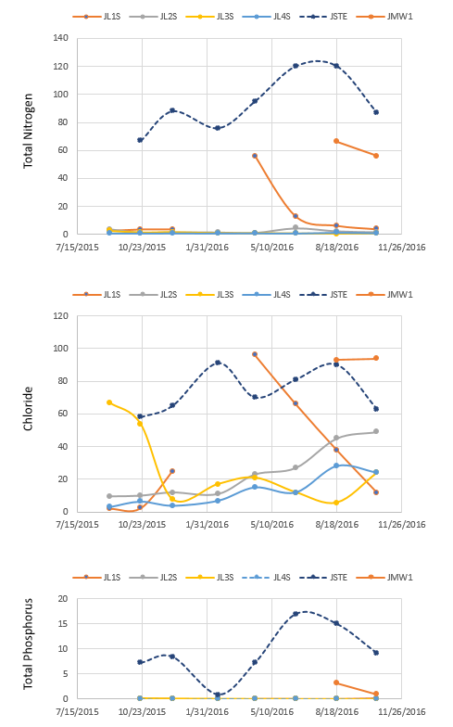

Slide 33
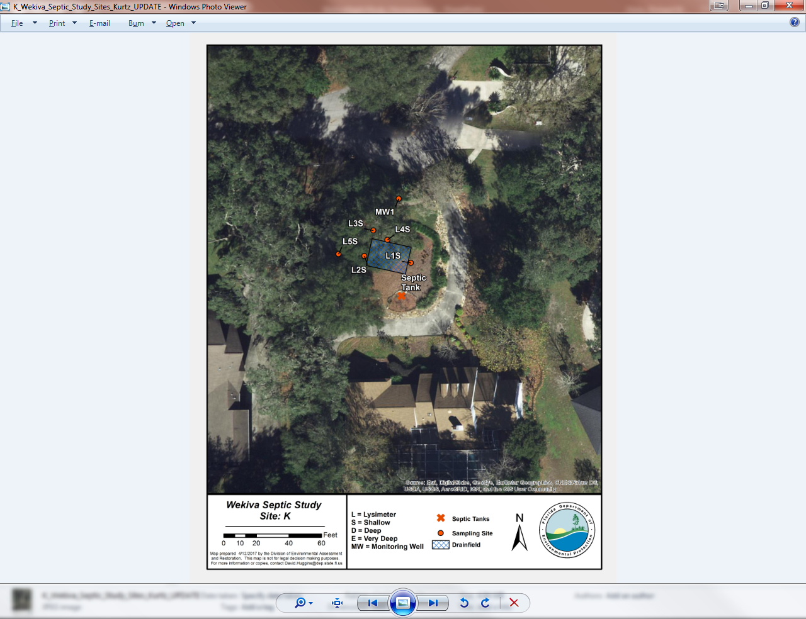

Slide 34
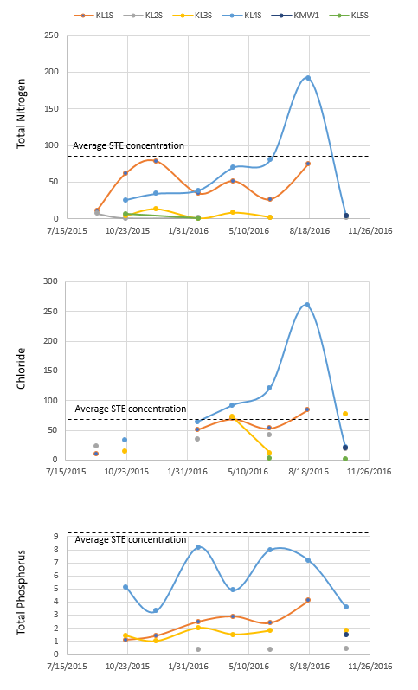

Slide 35
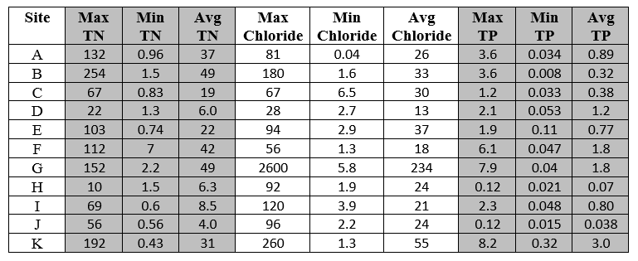
Summary Findings for Lysimeter Samples

Slide 36
Information about drainfield-related N attenuation
Information on attenuation to be used in soil attenuation modeling. Results from some of the sites where TN was mostly from drainfields are summarized below.
At Site E, 39 % of nitrogen was reduced with 10% due to dilution.
At Site G, 42 to 46 % of nitrogen was reduced in shallow and deep lysimeters with no dilution.
At Site J where there is a shallow water table, 35 % of the nitrogen was reduced in a shallow well with no dilution.
At Site K, 44 % of nitrogen was reduced with no dilution.
Overall attenuation of N by means other than dilution 35-46%

Slide 37
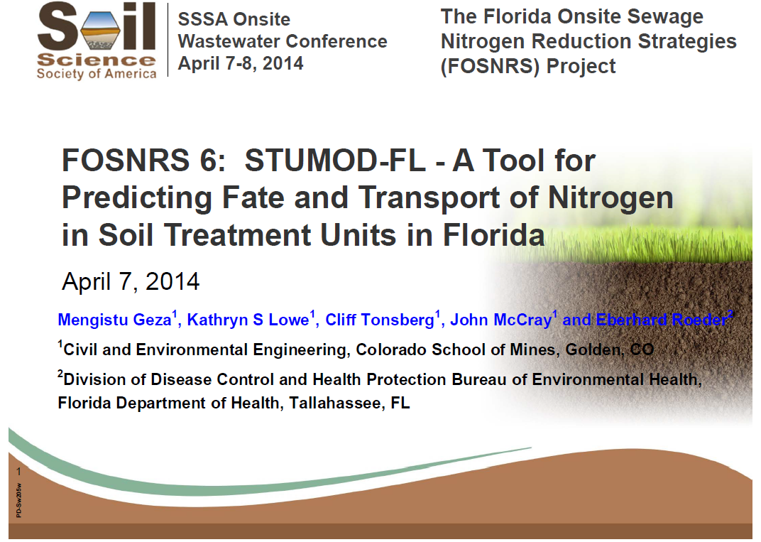
Soil Attenuation Modeling

Slide 38
Septic Tank Effluent and Influence of Pumping
Midway through the study, 4 septic tanks were pumped. Others left as control.
Septic tanks at sites A, B, E and G were pumped in March 2016, between February and April monitoring events

Slide 39
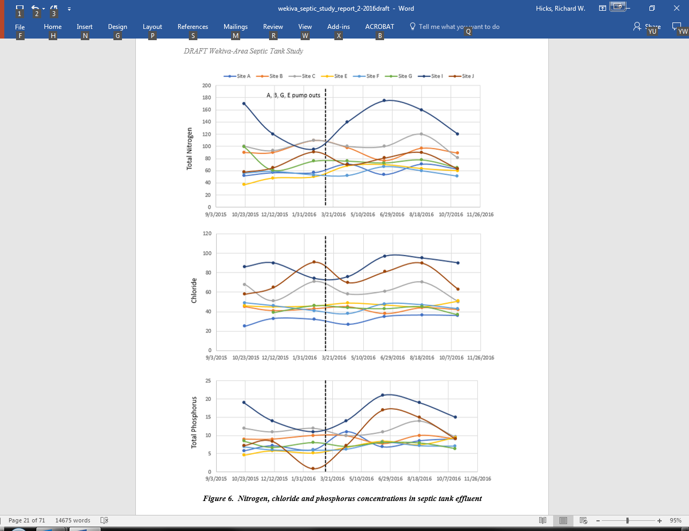

Slide 40
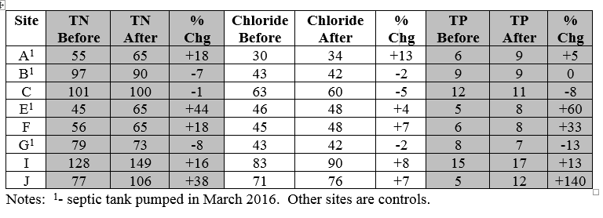
Statistics for all sites

Slide 41
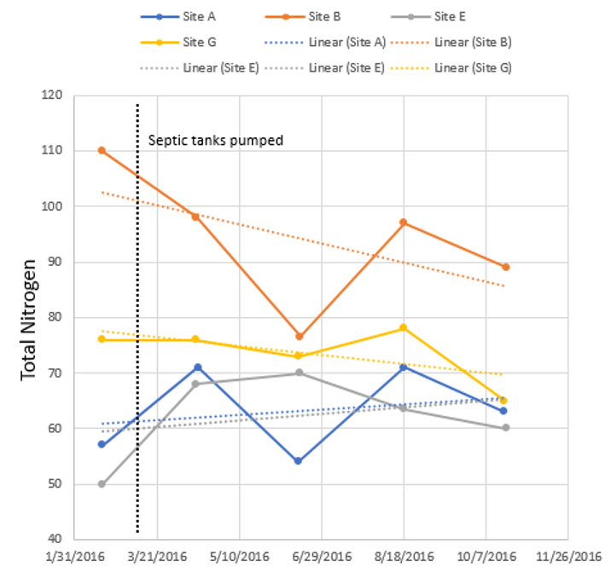
TN Trends after pumping

Slide 42

Alternative Drainfield Research

Slide 43
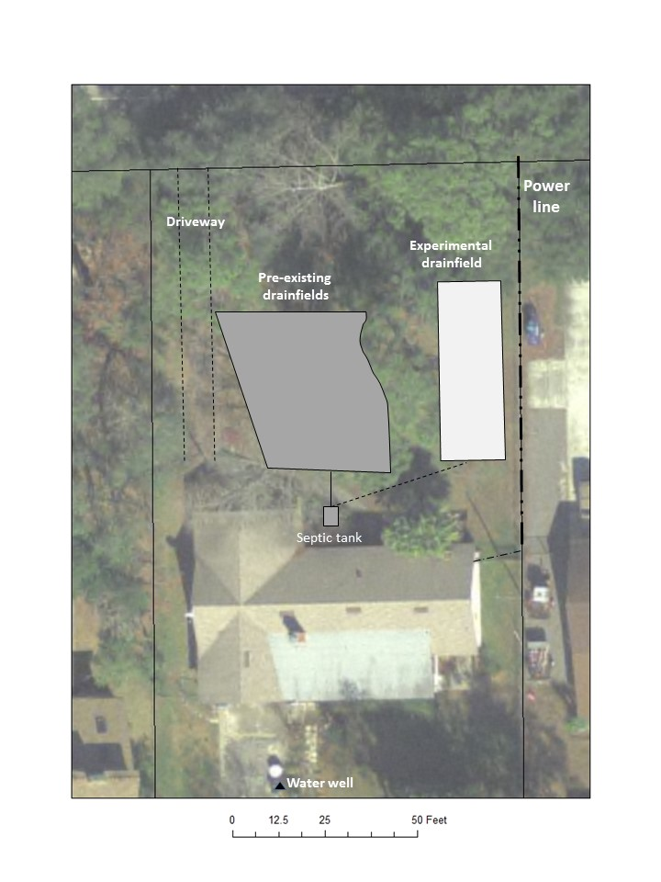

Slide 44
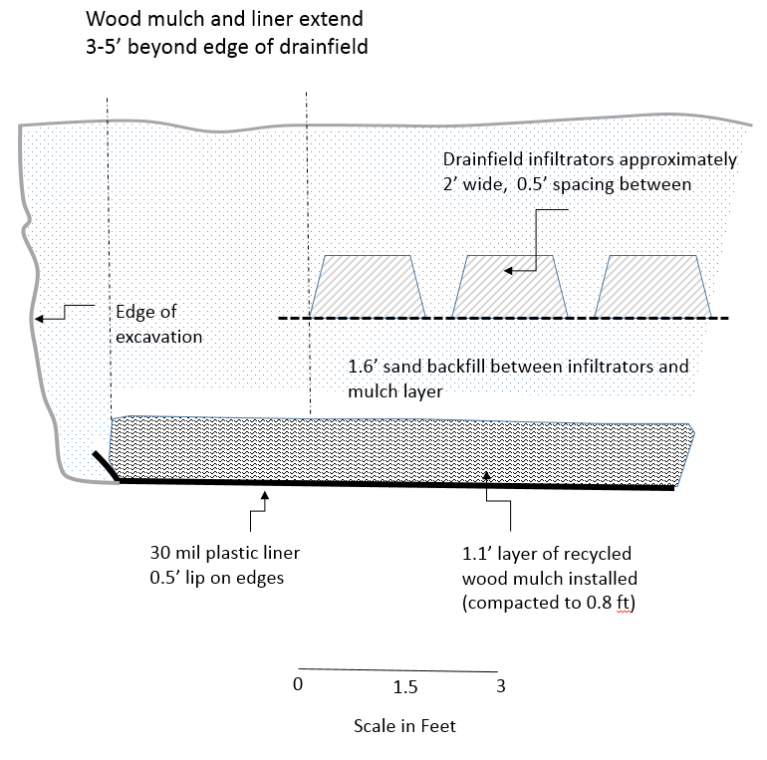

Slide 45
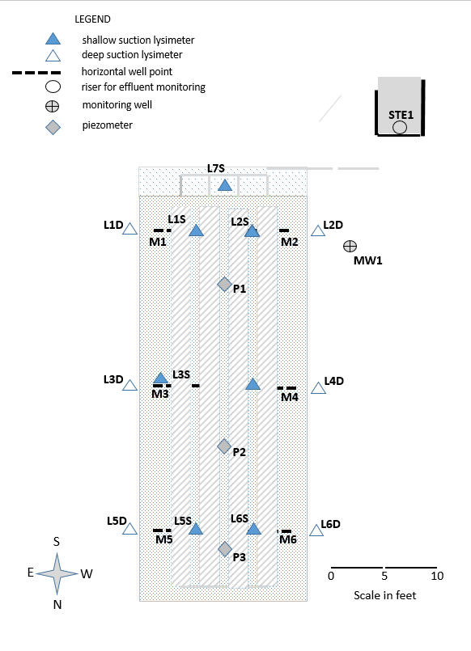

Slide 46
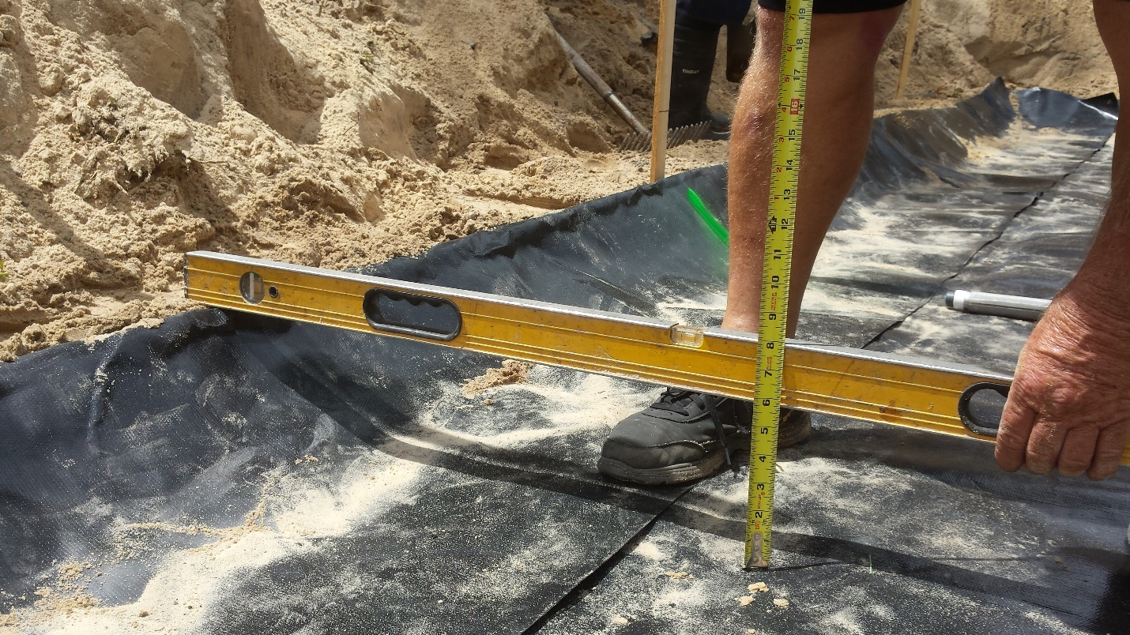

Slide 47
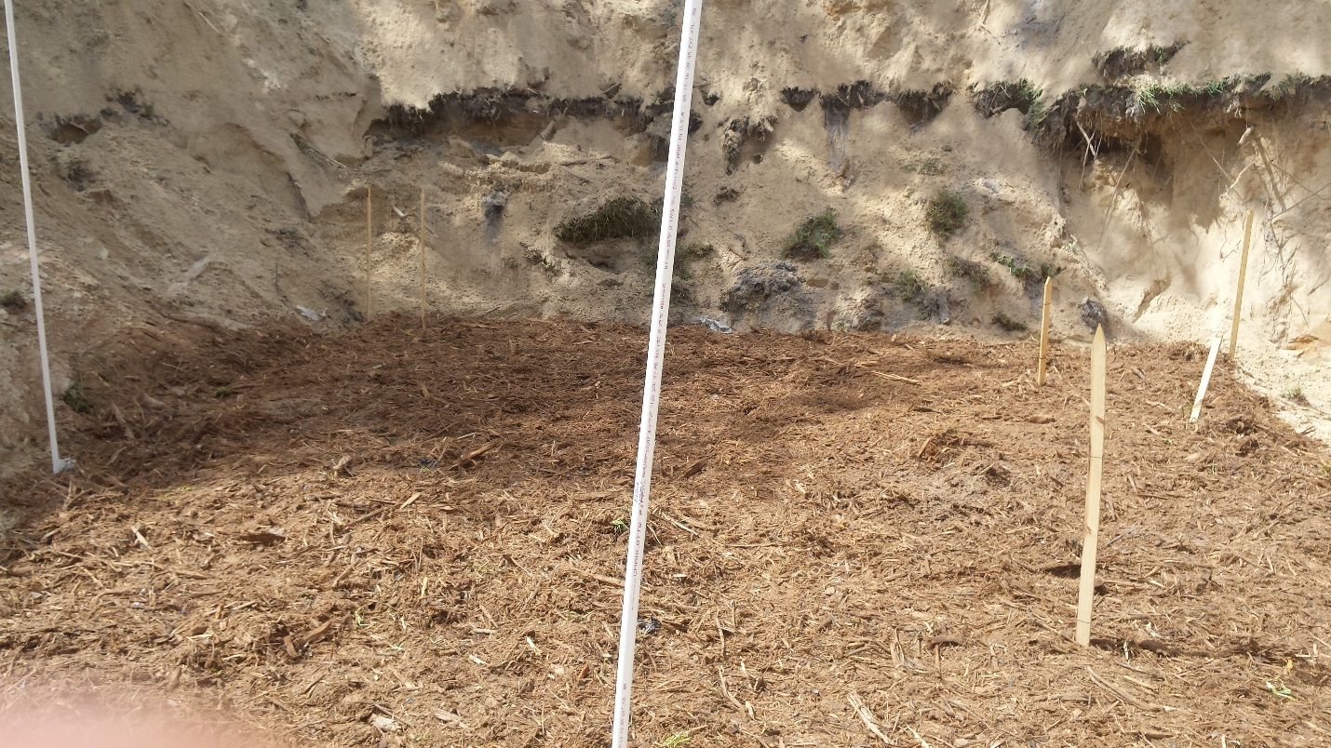

Slide 48
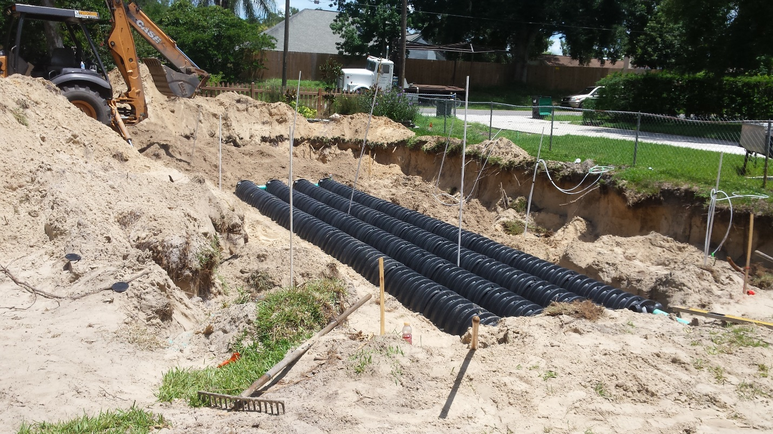

Slide 49
TN results through February
Average 70-80% reduction

Slide 50
Next Steps
Complete modeling of soil attenuation (May 2017)
Produce draft report (May 2017)
Finalize report (June 2017)
Continue monitoring at experimental site

