Slide 1
Silver Springs and Rainbow Springs BMAP Meeting
March 30, 2016

Slide 2
Florida Springs and Aquifer Protection Act
Chapter 2016-1 Laws of Florida.
  Signed on January 21, 2016.
Florida Springs and Aquifer Protection Act (Act).
  Sub-Sections 373.801– 373.813, Florida Statutes (F.S.).
  Outstanding Florida Springs.

Slide 3
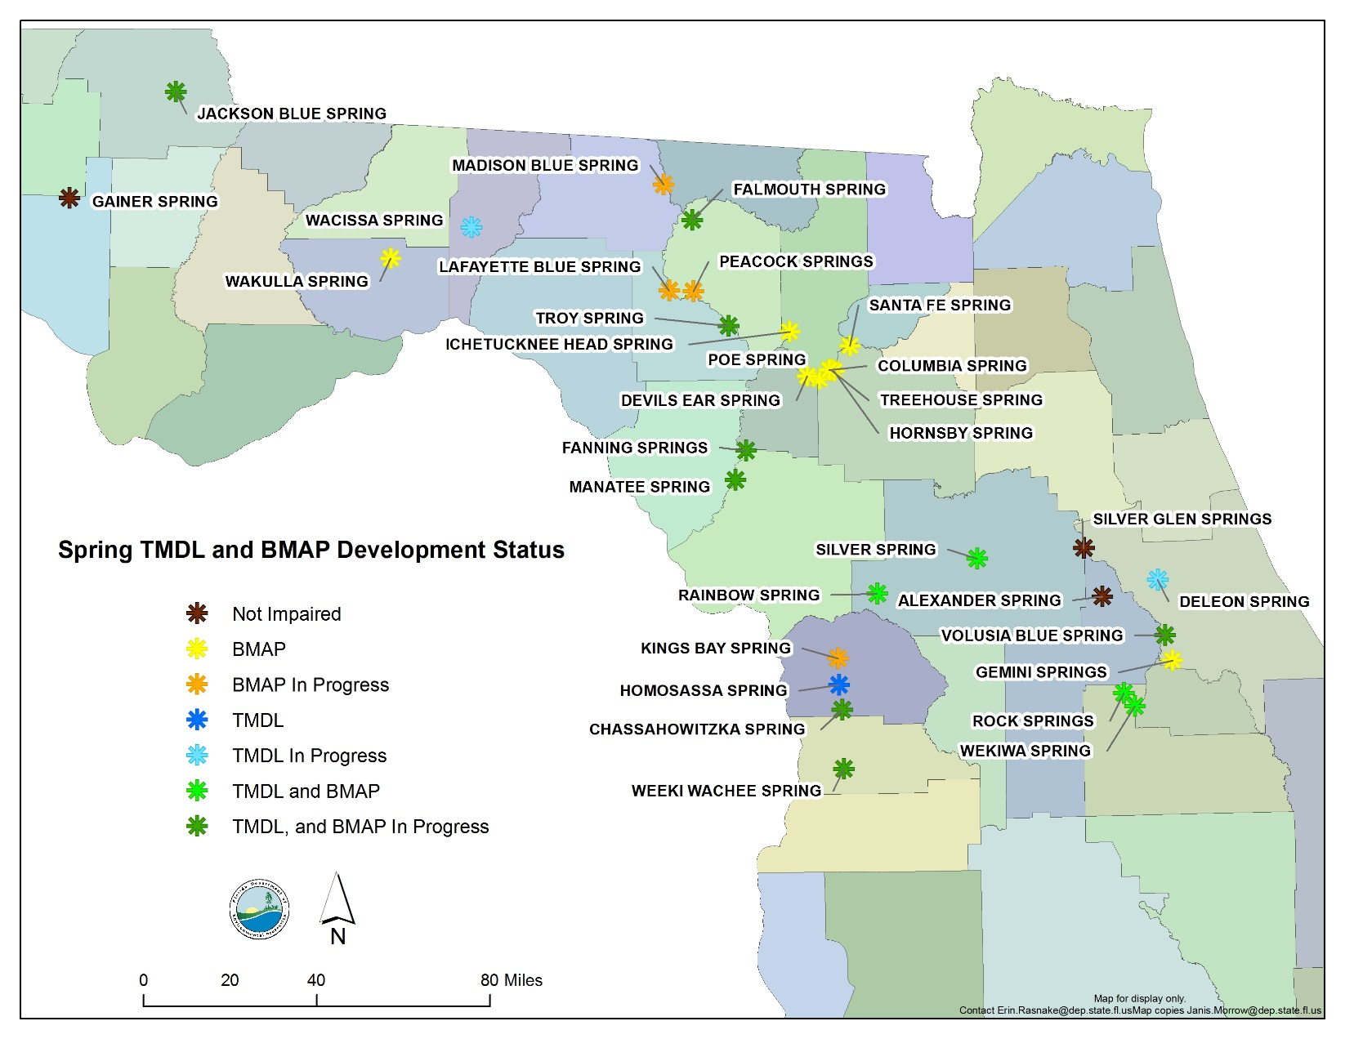
Outstanding Florida Springs

Slide 4
Elements of Act
Local governments within spring BMAP area must have fertilizer ordinance!
  Deadline is July 2017.
  Department has model ordinance available.
  Meets Section 403.9337, F.S.
Onsite Sewage Treatment and Disposal System (OSTDS) remediation plan.

Slide 5
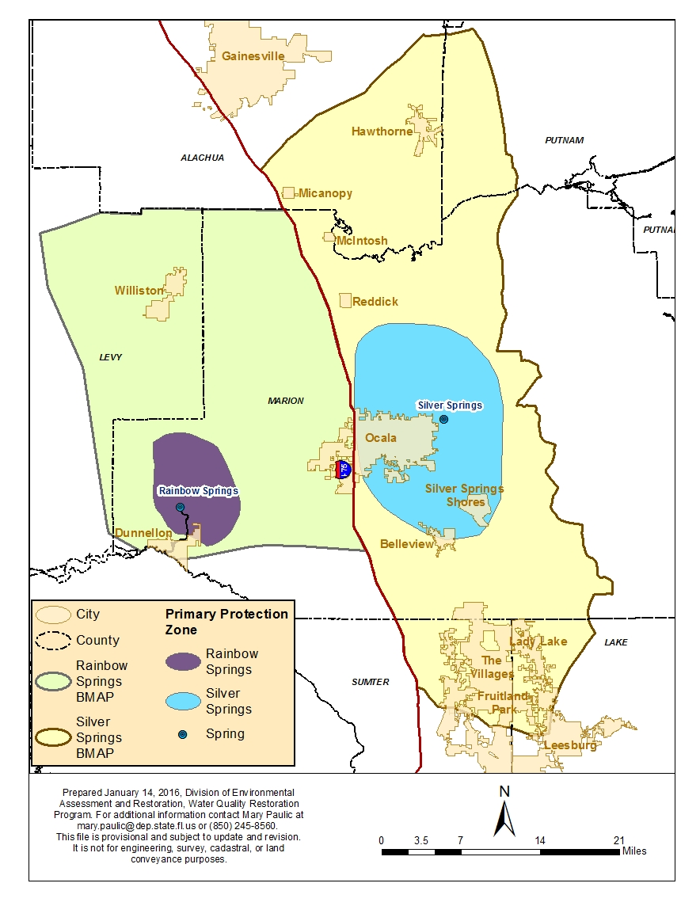
Primary Focus
Area
Defined in Marion County Springs Protection Ordinance.
Approximates 10 year time of travel.
Includes known conduit flow for Silver.

Slide 6
Elements
Notification to local governments of 10-2 (Environmental Resource Permit) General Permit.
  Applies within Priority Focus Area (PFA).
Proposed restrictions within PFAs.
  Directed to new development.
  Prohibition on some activities:
    Domestic wastewater disposal facilities unless they meet treatment requirements.
      Applies to >100,000 gallons per day unless it meets standard of 3 mg/L on an annual basis or better, if needed.
      BMAP effluent standards apply in these basins.

Slide 7
Elements (cont.)
  New hazardous waste disposal facility.
  Land application of residual unless there is approved nutrient management plan.
  New OSTDS on lots smaller than 1 acre.
    IF the specific systems conflicts with an OSTDS remediation plan in a BMAP.
  New agriculture operations that do not implement best management practices or do approved monitoring.

Slide 8
BMAP Requirements
Additional reporting requirements for BMAPs.
  5 year incremental milestones.
  Detailed project and financial information.
OSTDS remediation plan incorporated into BMAP.

Slide 9
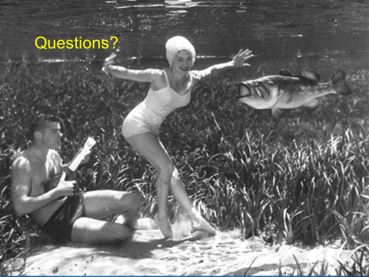

Slide 10
Silver Springs and Rainbow Springs Wastewater OSTDS Plan

Slide 11
Wastewater/OSTDS Plan
Charge to the department.
  Develop an OSTDS remediation plan to achieve TMDL reduction for this source within 20 years.
  Wastewater/OSTDS Management Plan.
  Basis for charge:
    Adopted BMAP language.
    Requirements of Act.
Effort is limited to OSTDS and wastewater components of Nitrogen Source Inventory Loading Tool (NSILT) sources.

Slide 12
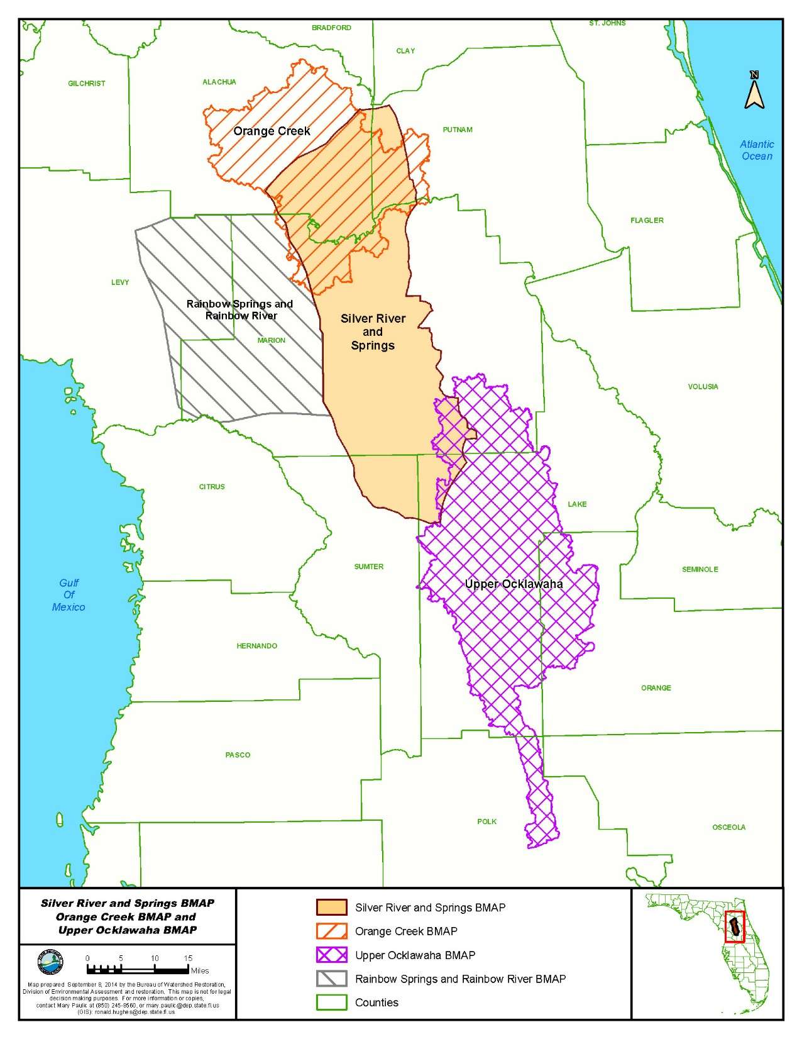
Merges Rainbow Springs and Silver Springs BMAP areas.

Slide 13
Area Covered
Covers Marion County and additionally portions of Levy, Lake, Sumter, Putnam, and Alachua counties.
Private Utilities (limited number).
Cities and community development districts:
Name | Name | Name
Ocala | Williston | The Villages
Belleview | Fruitland Park | On Top of the World
Dunnellon | Lady Lake | Reddick
Hawthorne | McIntosh | Micanopy
Bronson

Slide 14
Deadlines
BMAP stated deadline.
  Initiate plan development within 3 months of adoption of BMAP.
      January 21, 2016 initiation of project. Complete.
  Completion within 30 months from initiation.
Law specifies deadline of July 1, 2018.
We have a lot of work in a short time frame!

Slide 15
Draft General Schedule
 | 2016
OSTDS Strategy Development | Q1 | Q2 | Q3 | Q4
Introductory Meeting (January 2016) | X
Organizational Meeting (March 2016) | X
First Advisory Committee Meeting |  | X
Organizational meeting |  | *
Current BMAP Overview |  | *
Sunshine Law
Complete Committee Selection | * | *
Full Committee Meeting |  |  | X | X
DEP-DOH Coordination | X | X | X | X
Technical Group(s) Formed |  | X
Technical Discussions |  | X | X | X
Technical Group Reports |  | * | * | *
Committee Comments |  |  | * | *
BMAP Revision
Local Government Briefings |  |  |  | X
Public Meetings
Notes:
DO we include DEP-DOH coordination

Slide 16
Draft Schedule 2017
 | 2017
OSTDS Strategy Development | Q1 | Q2 | Q3 | Q4
Introductory Meeting (January 2016)
Organizational Meeting (March 2016)
First Advisory Committee Meeting
Organizational meeting
Current BMAP Overview
Sunshine Law
Complete Committee Selection
Full Committee Meeting | X | X | X | X
DEP-DOH Coordination | X | X | X | X
Technical Group(s) Formed
Technical Discussions | X | X | X | X
Technical Group Reports | * | * | * | *
Committee Comments | * | * | * | *
BMAP Revision |  |  |  | X
Local Government Briefings |  |  | X
Public Meetings | X |  | X

Slide 17
Draft Schedule 2018
 | 2018
OSTDS Strategy Development | Q1 | Q2 | Q3 | Q4
Introductory Meeting (January 2016)
Organizational Meeting (March 2016)
First Advisory Committee Meeting
Organizational meeting
Current BMAP Overview
Sunshine Law
Complete Committee Selection
Full Committee Meeting | X | X | X
DEP-DOH Coordination | X | X | X
Technical Group(s) Formed
Technical Discussions | X | X | X
Technical Group Reports | * | *
Committee Comments | * | *
BMAP Revision | X | X | X
Local Government Briefings |  | X
Public Meetings | X

Slide 18
Advisory Committee
Responsibilities and Duties
Provide discussion topics/ideas to DEP.
Advise/provide DEP with opinions or direction on Wastewater/OSTDS Management Plan.
Assist with specialized technical discussions and topics to be researched.
Provide information back to community leaders, decision makers, and homeowners.
Not a commitment to provide specific funding amount.

Slide 19
DRAFT Advisory Committee Makeup
Represents | Nominee
DOH * | County level staff
Marion County * | Marion County Commissioner
Belleview * | Bruce Phillips, Public Works Director
Ocala * | Jeff Halcomb, Water Resource Director
Dunnellon * | ?
On Top of the World * | Bryan Schmalz
Environmental Interest Rainbow Springs | Burt Eno, Rainbow River Coalition
Environmental Interest Silver Springs | Russ Melling, Oklawaha Valley Audubon
Florida Home Builders | Robert Himschoot
HOAs, property owners (1) | ?
* Required by law

Slide 20
Advisory Committee Meeting Topics
Draft first meeting proposed topics:
  Sunshine Law.
  Operating procedures.
  Schedules and timelines.
  Overview of BMAPs.
Draft second meeting proposed topics:
  Status of implementation of new effluent standards.
  What we know about wastewater and OSTDS management in these basins.

Slide 21

Technical
Technical Discussions
Scientific Information and Technical Review
Management Strategies
and Projects
Public Education Plan

Slide 22
Technical Discussions
Objective 1: Data Collection.
  Identify, collect, and evaluate existing and any additional data about nutrient impact of wastewater.
Objective 2: Analysis and Prioritization.
  Wastewater management plan that includes identification and development of strategies (projects).
  Joint planning and coordination efforts between BMAPs have already been developed.
Objective 3: Public Education and Outreach Plan.
  Provide residents with understandable information about the impacts of nitrogen loading and proper and effective wastewater management.

Slide 23
Public Participation
Public (nonmember) involvement.
  Attend Advisory Committee and technical meetings and provide comment.
  Review draft plan and submit comments.
Second opportunity at public meetings.
Word of caution about the Sunshine Laws and blogs, editorials, etc.

Slide 24
Deliverables
Management Plan/Strategy.
  Priority project list.
  Implementation schedule.
  Reductions to be achieved.
  Data needs.
Education Efforts and Needs.
Scientific Studies (as needed).
  Report results
Schedule to implement.

Slide 25
To Do List
Finalize membership of Advisory Committee.
Preparations for first meeting and second meetings.
Start technical discussions.
  Late April or early May.
  Prepare background material for first Advisory Committee meetings.
Draft operating procedures for Advisory Committee.

Slide 26
In Summary
Develop a wastewater/OSTDS Management Plan to achieve TMDL reduction for this source within 20 years.
Limit effort to OSTDS and Wastewater components of NSILT sources.
  Combined Silver Springs and Rainbow Springs effort.
First full Advisory Committee meeting late May – early June.
First Technical discussion late April – early May.

Slide 27
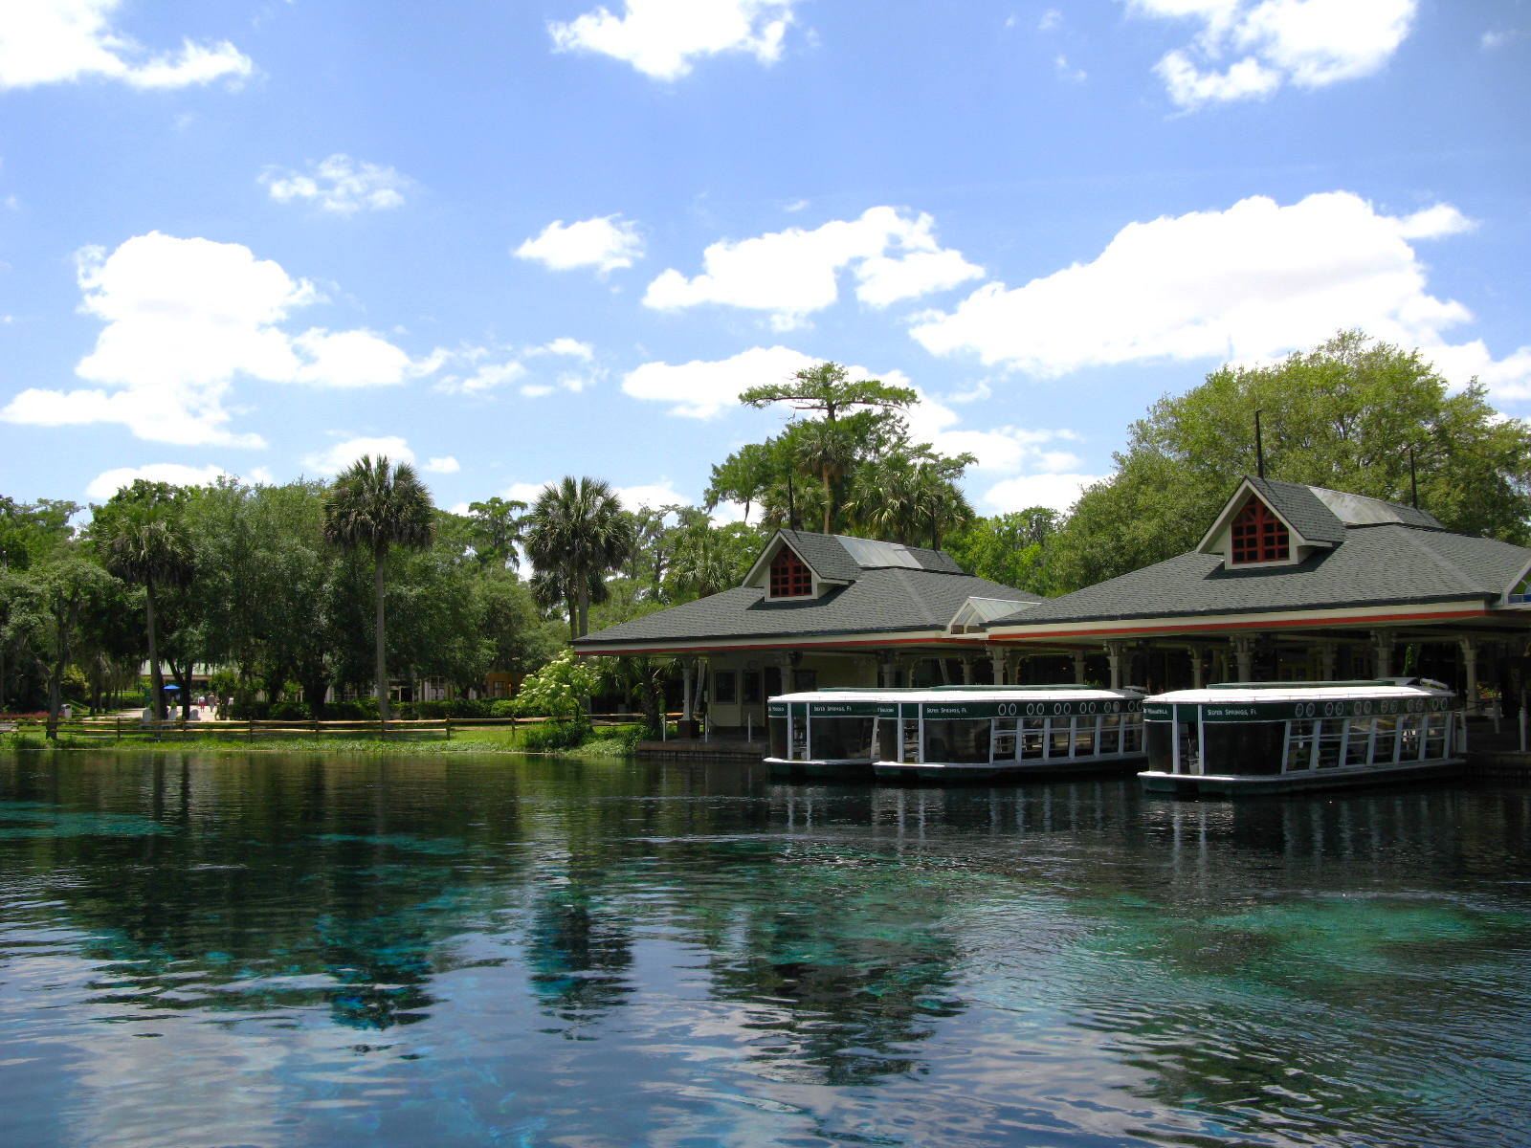
We have a lot of work in a short time frame!

Slide 28

Questions?

Slide 29
Contacts
Tom Frick, Director Division of Environmental Assessment and Restoration, thomas.frick@dep.state.fl.us.
Kevin Coyne, Administrator Watershed Planning and Coordination Section, kevin.coyne@dep.state.fl.us.
Mary Paulic, Silver Springs Basin Coordinator, mary.Paulic@dep.state.fl.us.
Terry Hansen, Rainbow Springs Basin Coordinator, terry.Hansen@dep.state.fl.us.
Kenny Hayman, Senior Attorney, kenneth.Hayman@dep.state.fl.us.
Shane Williams, Facilitator, evan.williams@marioncountyfl.org.

