Slide 1
Silver and Rainbow Springs BMAP
Department of Health Onsite Sewage Efforts
March 30, 2016
Elke Ursin, PMP, CPM
Environmental Manager
Onsite Sewage Research and Engineering
Division of Disease Control and Health Protection
To protect, promote and improve the health of all people in Florida through integrated state, county, and community efforts.
Notes:
The committee is to:
Provide discussion topics/ideas to DEP
Advise/provide DEP with opinions or direction on the plan
Assist with specialized topic-based technical meetings
Provide information back to the represented interest groups
The deliverables that the committee will develop are:
Priority project list
Implementation schedule
Reductions to be achieved
List of data needs
Education efforts and list of needs
List of existing scientific studies and report results
This presentation goes into how our current research efforts fit into this, specifically relating to the list of existing scientific studies and report results.

Slide 2
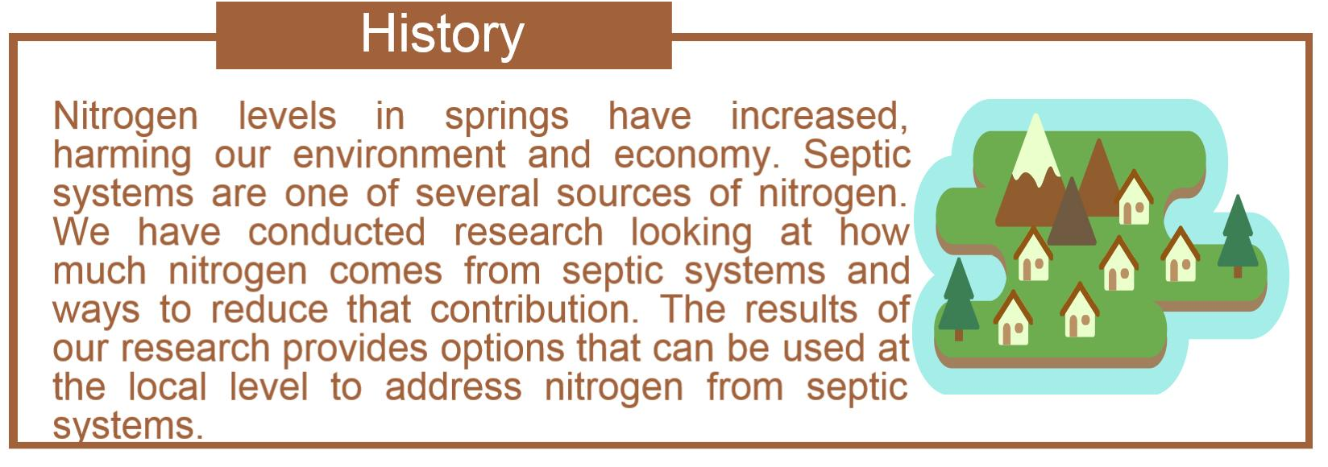
Nitrogen Reduction Options
for Septic Systems
Notes:
Background
In 2008, the Florida Legislature directed the Department of Health to develop cost-effective nitrogen reduction strategies for onsite sewage treatment and disposal systems (OSTDS). In January 2009, the Department awarded a 6-year, $5 million contract to a project team made up of nationally recognized experts led by Hazen and Sawyer, P.C. The Department and its Research Review and Advisory Committee (RRAC) oversee the project, with input from the Department of Environmental Protection. The contractual portion of the project is complete, with a total contract spending of approximately $4.7-million

Slide 3
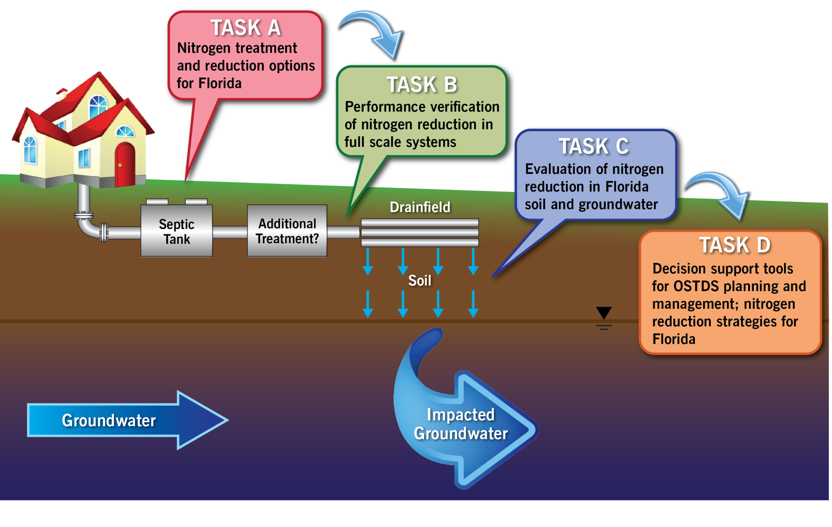
Image Credit: Hazen and Sawyer
Primary Study Areas
Notes:
Objectives
Develop cost-effective, passive strategies for nitrogen reduction from onsite sewage
Characterize nitrogen removal in the soil and shallow groundwater
Develop simple models on fate and transport of nitrogen in soil and groundwater
Task A - Prioritize technologies for testing at existing home sites and perform controlled tests at a test facility to develop design criteria for new passive nitrogen reduction systems.
Task B - Install top-priority nitrogen reduction technologies at existing homes, with documentation of performance and cost.
Task C - Perform field evaluations of nitrogen reduction in Florida soils and shallow groundwater, and provide data for calibration of a simple planning model (see Task D).
Task D - Develop a simple fate and transport model of nitrogen from OSTDS for use in assessment, planning, and system siting.

Slide 4
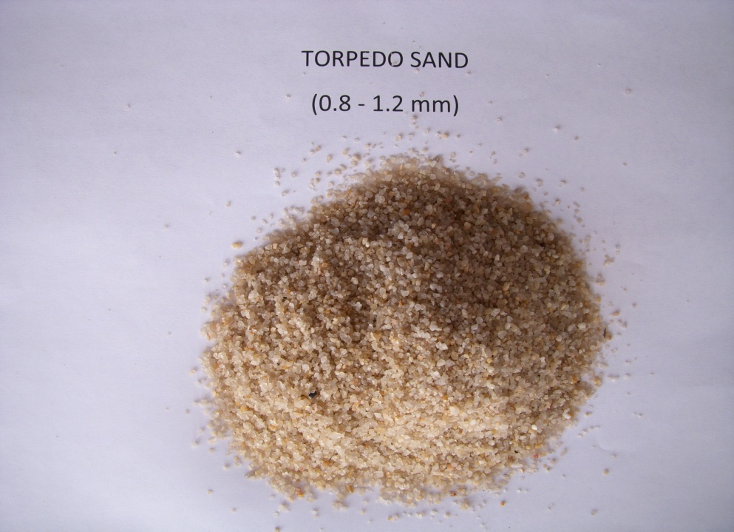
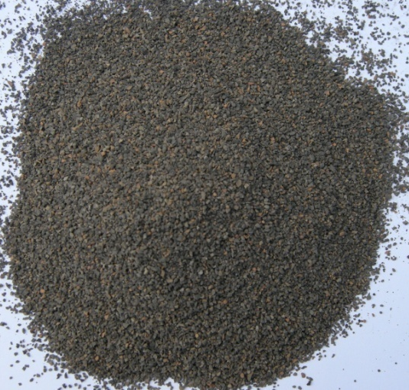
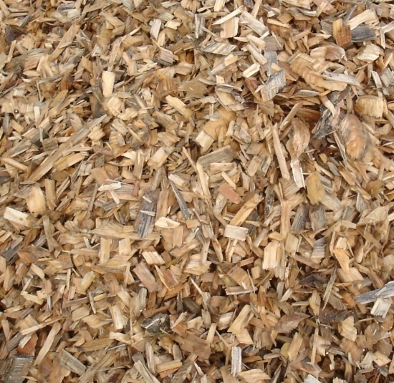
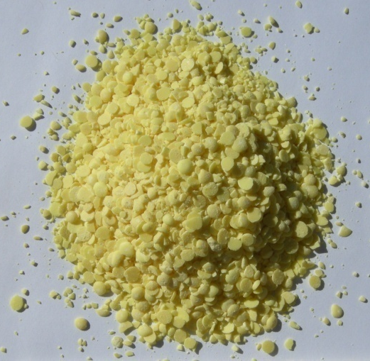
“Passive” Nitrogen Reduction Systems
Reduce effluent N using reactive media for denitrification and a single liquid pump, if necessary.
Wastewater from home
Dispersal
  Stage 1
  (nitrification)
  Stage 2
  (denitrification)
nitrification media:
sand & expanded clay
denitrification media:
lignocellulosics & elemental sulfur

Slide 5
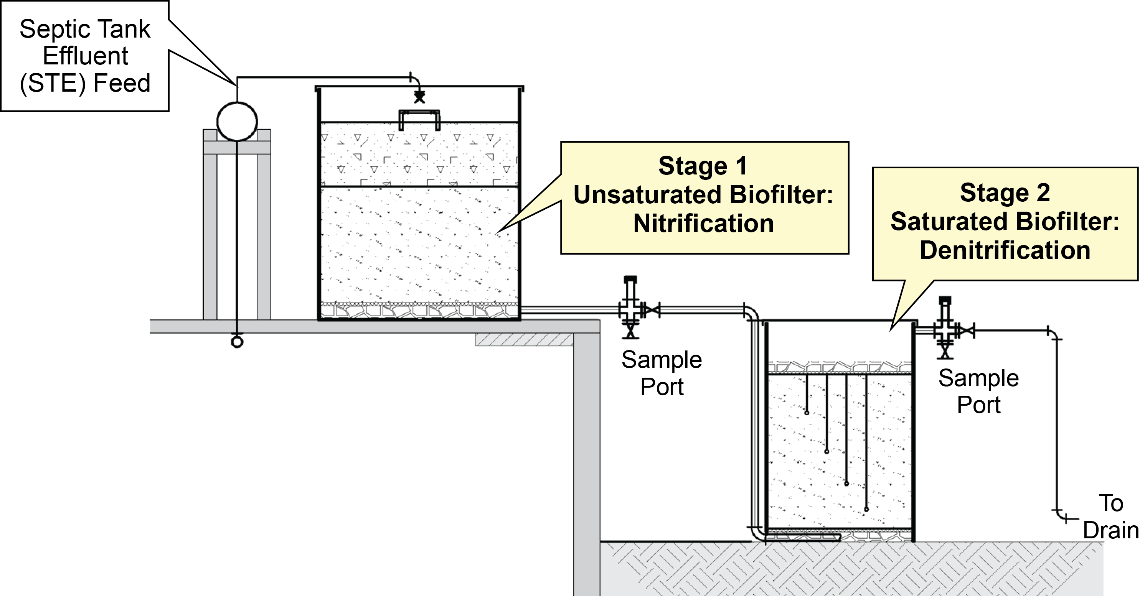
Image Credit: Hazen and Sawyer
Test Facility
Notes:
Accomplishments:
Facility constructed at the University of Florida Gulf Coast Research and Education Center in Wimauma, to evaluate pilot-scale configurations for full-scale systems, resulting in options that consistently reduced nitrogen by 95% or more.

Slide 6
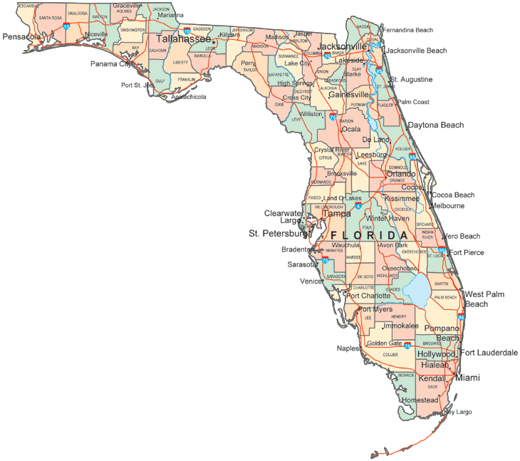

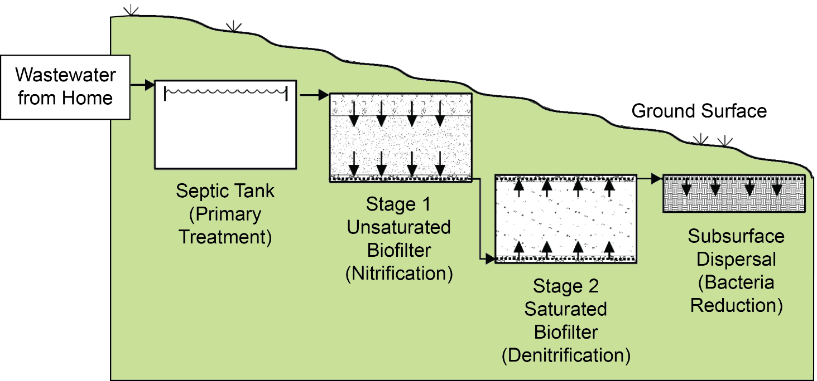
Nitrogen Reduction at Field Sites
Full Scale Concepts Complement Existing Septic Systems
Notes:
Accomplishments:
Seven full-scale systems installed at existing homes throughout the state with multiple configurations; sampling completed for two systems with the remaining systems to complete in February 2015; preliminary results indicate about 90-95% nitrogen reduction prior to the drainfield.

Slide 7
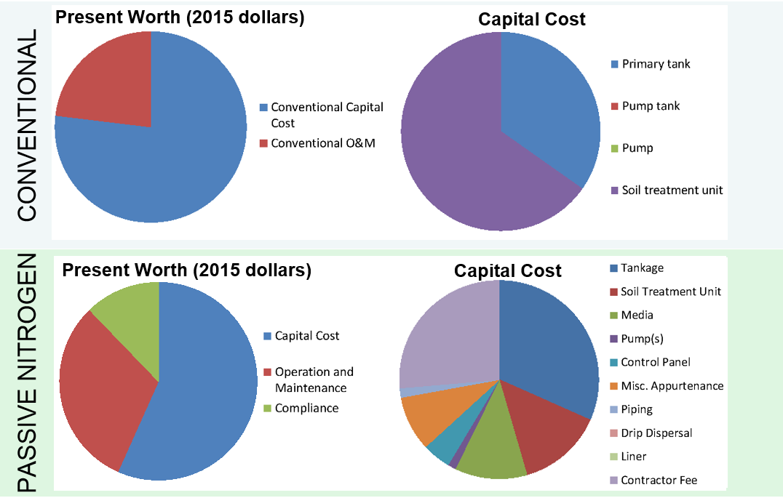
Life Cycle Costs
7
Notes:
System cost estimates and cost comparisons to existing approved systems
Shows how much the system costs AND how much it costs over lifetime
Present worth=current worth of a future sum of money or stream of cash flows given a specified rate of return
Capital Cost= total cost needed to bring a project to a commercially operable status

Slide 8
Image Credit: Hazen and Sawyer
Case Study: Groundwater Monitoring
Notes:
Four detailed soil and groundwater assessments were completed at existing home sites throughout Florida to evaluate existing septic systems over a 12-month period. One of these sites coincided with the test site for one of the experimental treatment systems. At this home site a marked improvement in groundwater nitrogen concentrations occurred after installing the passive system. In Figure 5, sampling point B08 (red dashed circle) showed a Total Nitrogen concentration of over 35 mg/L before installation of a passive nitrogen reduction system and at background levels (0-5 mg/L) within a few months after installation. The nitrogen plume under the drainfield disappeared.

Slide 9
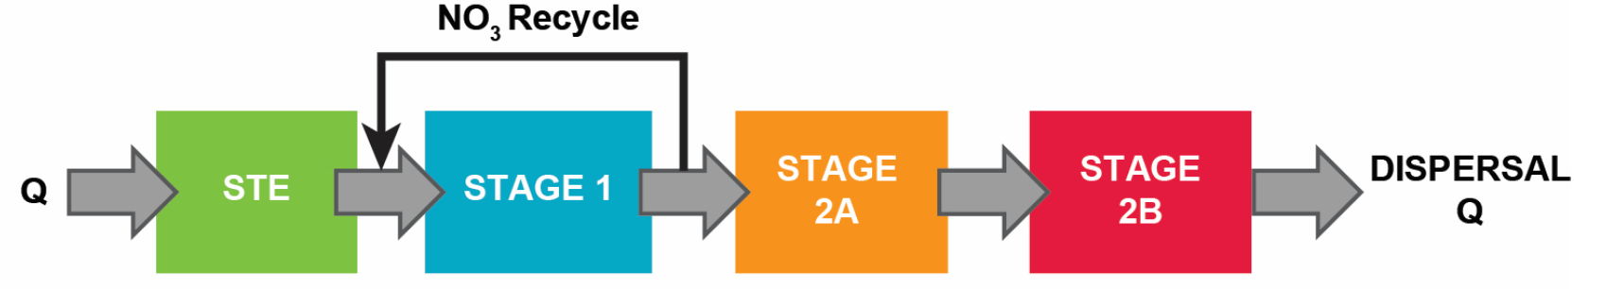
In-Tank Passive Nitrogen System
In-tank two stage biofilter with recirculation stage 1, dual media stage 2 lignocellulosic (2a) followed by elemental sulfur (2b)
Media longevity: | 10-149 years
System performance: | 85-95% reduction of nitrogen
Energy costs: | $3 monthly / $36 annually
Standardized costs*: | $13,000 new / $15,500 retrofit existing
* 300 gallon per day system with $4,000 estimated conventional system cost (tank and drainfield)
Notes:
Wastewater flows through the septic tank (STE) to a tank filled with an unsaturated layer of expanded clay (Stage 1) (Figure 15). Then the wastewater goes to a pump tank (NO₃ Recycle) which recycles a portion back to the top of Stage 1 and pumps a portion to a tank with two sections: a section filled with a saturated layer of wood-chip material (Stage 2A) and a second section filled with a saturated mixture of sulfur and oyster shells (Stage 2B). The wastewater then flows by gravity to the existing STU (Dispersal).

Slide 10
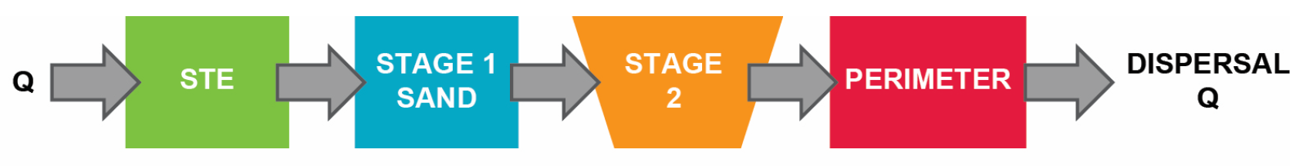
In-Ground Passive Nitrogen System
In-ground stacked biofilter, single pass stage 1 over stage 2 lignocellulosic
Media longevity: | 10-135 years
System performance: | 40-70% reduction of nitrogen
Energy costs: | $0.75 monthly / $9 annually
Standardized costs*: | $8,700 new / $12,000 retrofit existing
* 300 gallon per day system with $2,250 estimated conventional tank cost
** Performance may have been significantly improved with design and construction revisions based on lessons learned in this study.
Notes:
Wastewater flows through the septic tank (STE) to a pump tank which pressure doses a lined drainfield to spread the sewage throughout the STU (Figure 17). Under the STU, within the liner, are two layers: an unsaturated layer of regular STU sand (Stage 1 Sand) above a saturated layer of wood-chip material (Stage 2). The treated wastewater flows over the rim of the liner (Perimeter) into the soil (Dispersal).

Slide 11
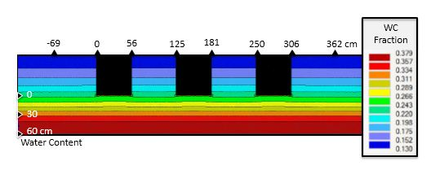
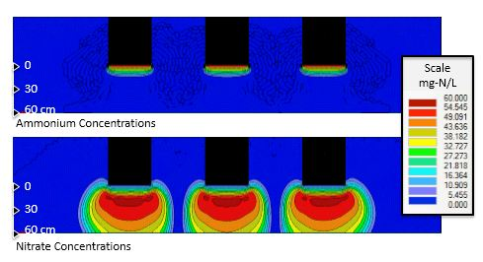
Image Credit: Colorado School of Mines
Vadose Zone Model Example
Notes:
Vadose Zone Model Example Showing Ammonium and Nitrate Concentrations under an Equally Loaded Trench Configuration with a Groundwater Elevation of 60 cm (2 ft) under the Bottom of the Soil Treatment Unit

Slide 12
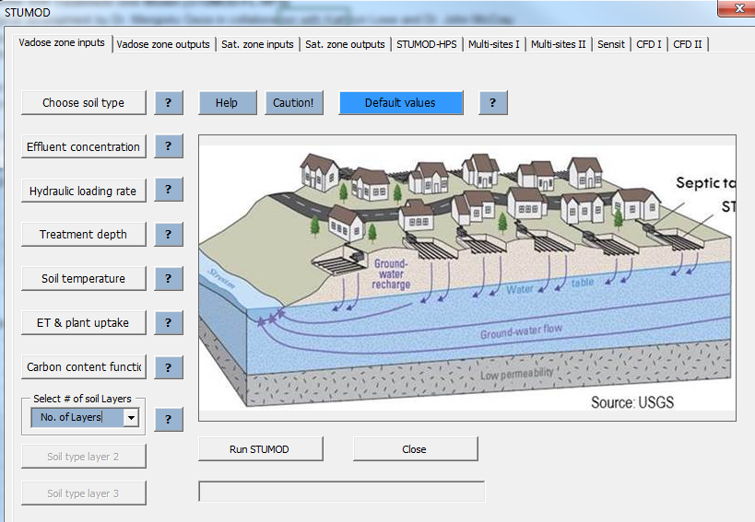
Image Credit: Colorado School of Mines
Nitrogen Model

Slide 13

floridahealth.gov/FLWMI
GOAL:
Map the drinking water source and wastewater treatment method for every built property in Florida
Notes:
To help facilitate the wastewater infrastructure management paradigm, we need to first understand where the wastewater goes.
The data is fragmented between state agencies and public and private utilities. Florida DOH decided to create a centralized tool, using a data map, linking each built property in the state to information about the corresponding drinking water source (Public Water or Private Well) and the wastewater treatment method (Central Sewer or Onsite Septic).
Visit the project website to learn more about what we are doing and where we are with this project.

Slide 14
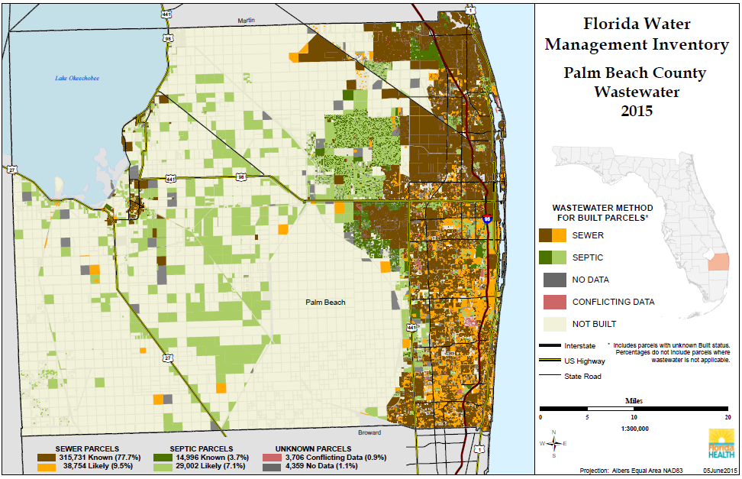
Notes:
Palm Beach inventory results: sewer heavy
Sewer: 87.2%
Septic: 10.8%
Unknown: 2%

Slide 15
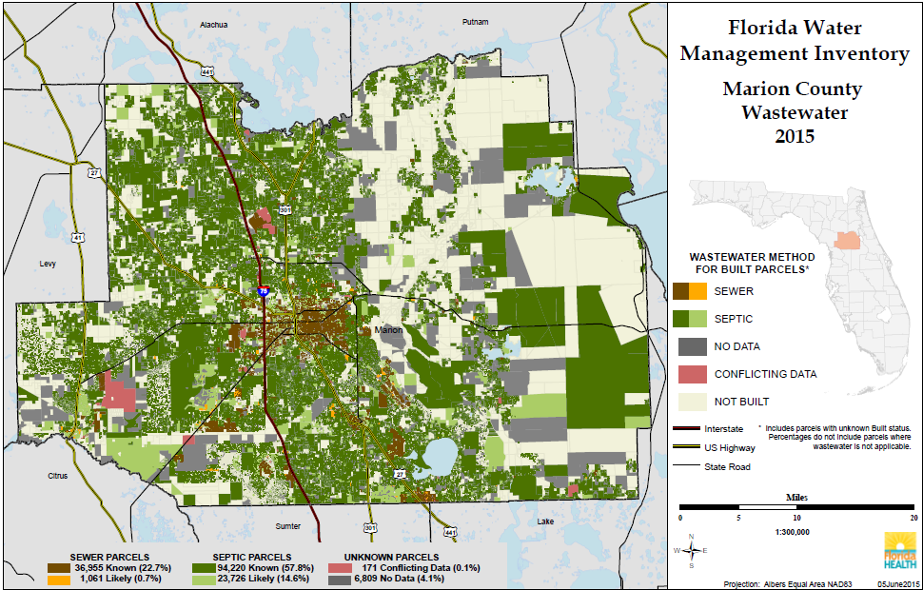
Notes:
Marion inventory results: septic heavy
Sewer: 23.4%
Septic: 72.4%
Unknown: 4.2%

Slide 16
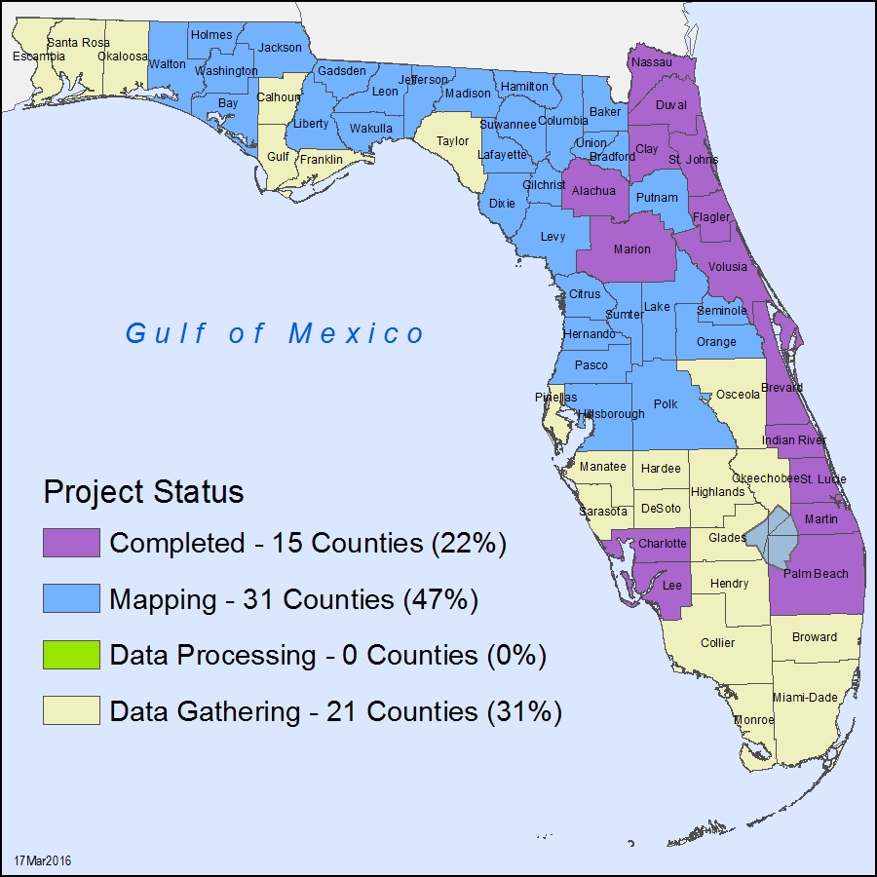
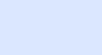
16
Florida Water Management Inventory
Status | # Counties
Completed | 15
Mapping | 31
Data Processing | 0
Data Gathering | 21

Slide 17
Implementation Plan:
Goal: Make tools available to reduce nitrogen contributions from septic systems

Slide 18
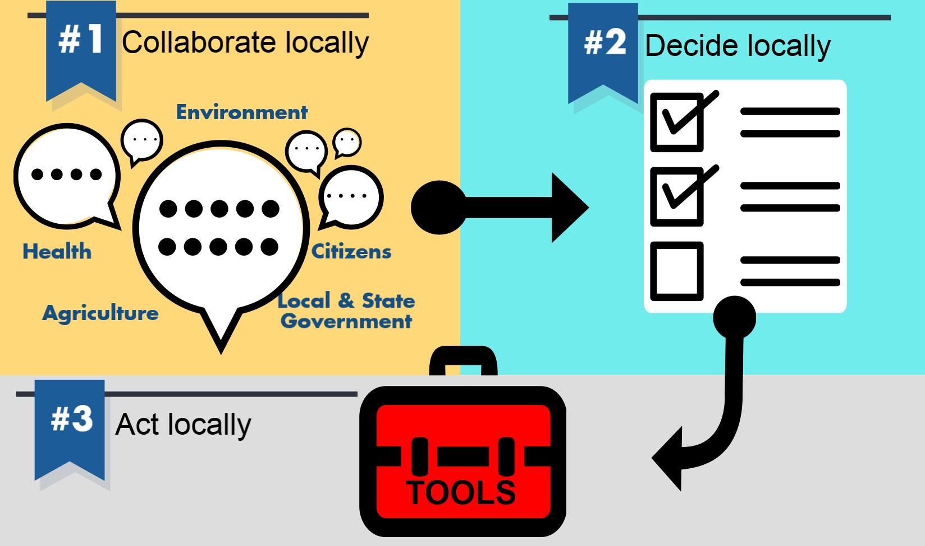

Slide 19

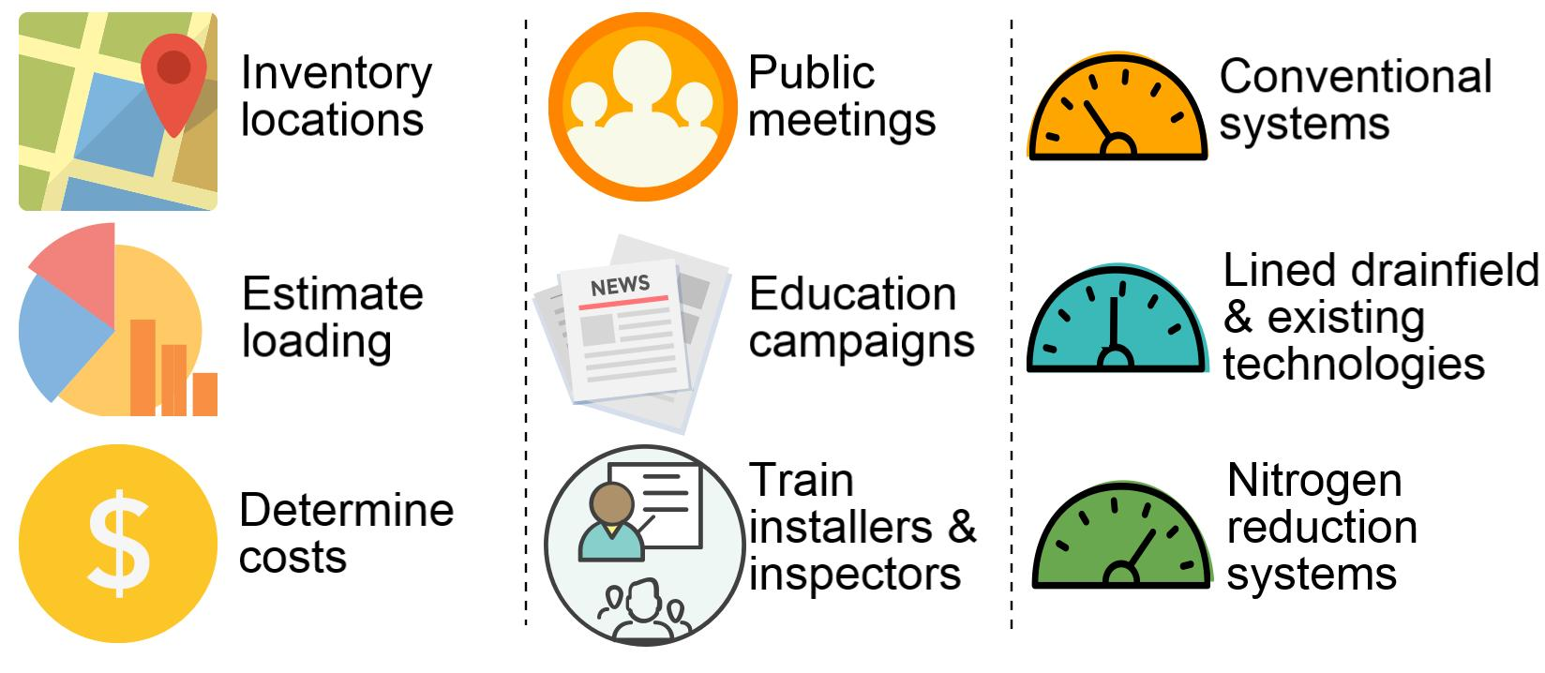

Slide 20
1
Implementation
Plan
Approve baseline conventional septic system enhanced for nitrogen reduction (in-ground system)
Requires rule change.
Status: Tabled by Technical Review and Advisory Panel on October 22, 2015 for more details
Notes:
Description: Engineer-designed nitrogen-reducing liner beneath a conventional drainfield.
Benefit: Low-cost alternative to other performance-based nitrogen-reduction systems. Requires no operating permit or maintenance contract.

Slide 21
2
Implementation
Plan
Incorporate nitrogen study systems as approved performance-based systems
Requires development of system specifications
Status: Being developed

Slide 22
3
Implementation
Plan
Develop new nitrogen reducing systems section in Chapter 64 E-6 Florida Administrative Code
Requires rule and possibly statute changes
Status: Requires multiple public meetings

Slide 23
4
Implementation
Plan
Provide public education and training on nitrogen reduction strategies
Requires training development and message standardization
Status: Ongoing

Slide 24
5
Implementation
Plan
Share planning-level tools to assess nitrogen reducing strategies (inventory, model)
Requires coordination with local stakeholders
Status: Ongoing

Slide 25
6
Implementation
Plan
Determine funding solutions for nitrogen reduction efforts
Requires coordination with Department of Environmental Protection and local stakeholders
Status: Pending

Slide 26
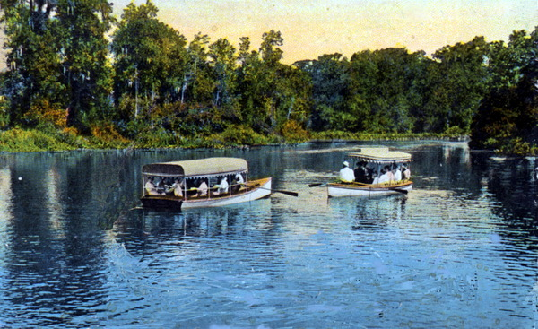
Seeing Silver Springs in glass bottom boats
Photo Credit: State Archives of Florida, Florida Memory, http://floridamemory.com/items/show/161202
Results Benefit Floridians
  Field-tested designs
  Cost estimates
  Nitrogen model
  Options
Notes:
Results Will Benefit Floridians by Providing…
Field tested designs for “passive” systems effective at removing nitrogen and user-friendly
System cost estimates and cost comparisons to existing approved systems
Nitrogen fate and transport model for estimating nitrogen contribution from onsite systems
Options for nitrogen reduction onsite systems in sensitive watersheds where sewers are not feasible
Looking for people to help with development of recommendations for science-based nitrogen reduction options for onsite wastewater systems. Having a public online meeting at the end of the month to start discussing the results and conclusions of this project and begin work on a final report to the legislature.

Slide 27
Elke Ursin, PMP, CPM
Elke.Ursin@flhealth.gov
850-245-4070 x 2708
Environmental Manager
Onsite Sewage Research and Engineering
Florida Department of Health
Division of Disease Control and Health Protection
Bureau of Environmental Health

