Slide 1
Homosassa and Chassahowitzka
Basin Management Action Plan (BMAP)
January 17, 2018
Terry Hansen P.G., Basin Coordinator
850-245-8561
terry.hansen@dep.state.fl.us

Slide 2
Water Quality Framework
Collect data
Analyze and verify
List “impaired” waters
REPEAT
Monitor and report progress annually
Adapt and change – new statewide annual report
Set water quality standards
Monitor water quality
Determine pollution problems
Develop and implement restoration plans (BMAPs)
Establish restoration goals (TMDLs)
Measure success and adapt
Work with community leaders
Excessive nutrients
Bacteria, Metals, and Other Impairments
Allocate responsibilities
Identify projects
  Infrastructure
  Best Management Practices (BMPs)
Establish schedules
Identify success criteria
Gather additional data
Evaluate water quality
Adopt pollutant reduction targets

Slide 3
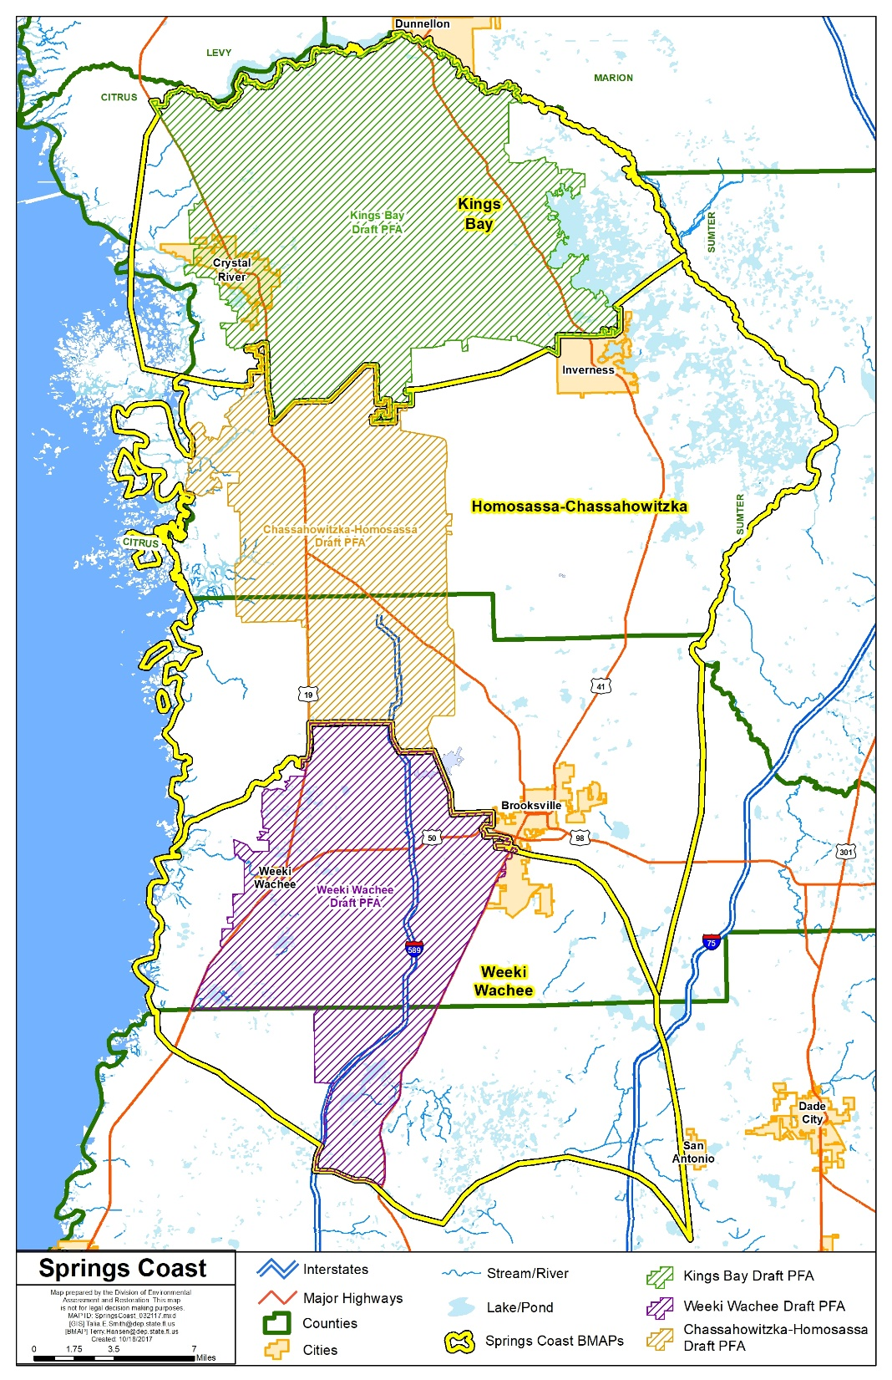
Springs Coast
BMAP Study Areas and Priority Focus Areas (PFAs)

Slide 4
Homosassa Spring Group Nitrate Total Maximum Daily Loads (TMDLs)
Waterbody or Spring Name | Waterbody Identification (WBID) Number | Parameter | TMDL (mg/L)
Homosassa #1 Spring | 1345G | Nitrate, annual average | 0.23
Homosassa #2 Spring | 1345G | Nitrate, annual average | 0.23
Homosassa #3 Spring | 1345G | Nitrate, annual average | 0.23
Pumphouse Springs | 1345G | Nitrate, annual average | 0.23
Trotter Springs | 1345G | Nitrate, annual average | 0.23
Bluebird Springs | 1348A | Nitrate, annual average | 0.23
Hidden River Main Spring | 1348E | Nitrate, annual average | 0.23
Hidden River #2 Spring | 1348E | Nitrate, annual average | 0.23

Slide 5
Chassahowitzka Spring Group and River Nitrate and TN TMDLs
Waterbody or Spring Name | WBID Number | Parameter | TMDL (mg/L)
Chassahowitzka Spring Group
Chassahowitzka Main Spring | 1348Z | Nitrate, annual average | 0.23
Chassahowitzka #1 Spring | 1348Z | Nitrate, annual average | 0.23
Crab Creek Spring | 1348Z | Nitrate, annual average | 0.23
Baird #1 Spring | 1348D | Nitrate, annual average | 0.23
Ruth Spring | 1348D | Nitrate, annual average | 0.23
Beteejay Spring | 1361B | Nitrate, annual average | 0.23
Chassahowitzka River
Chassahowitzka River-Baird Creek | 1348D | TN, annual average | 0.25

Slide 6
Regulatory Framework
The process for preparing BMAPs is found in:
  Section 403.067, Florida Statutes (F.S.), known as the “Florida Watershed Restoration Act”
  The 2016 Florida Springs and Aquifer Protection Act lists requirements for BMAPs for Outstanding Florida Springs (OFS)
  PFA Report and Nitrogen Source Inventory Loading Tool (NSILT) developed by the Florida Department of Environmental Protection (DEP) for the Homosassa and Chassahowitzka Springs Groups

Slide 7
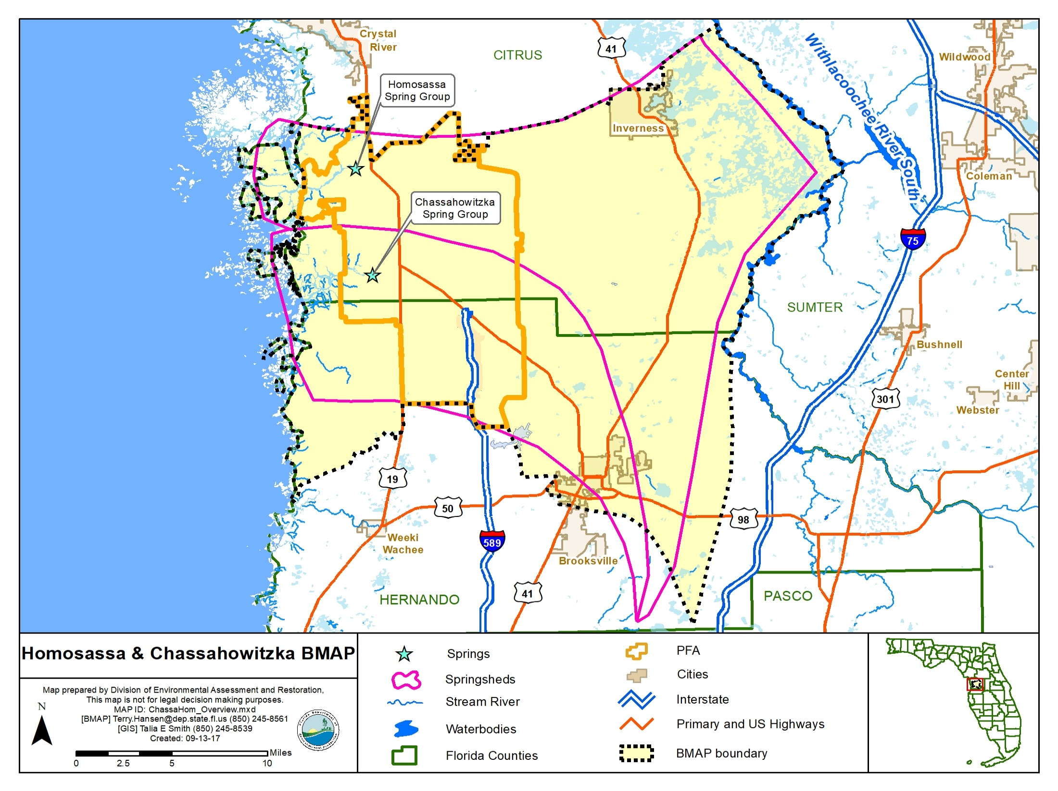

Slide 8
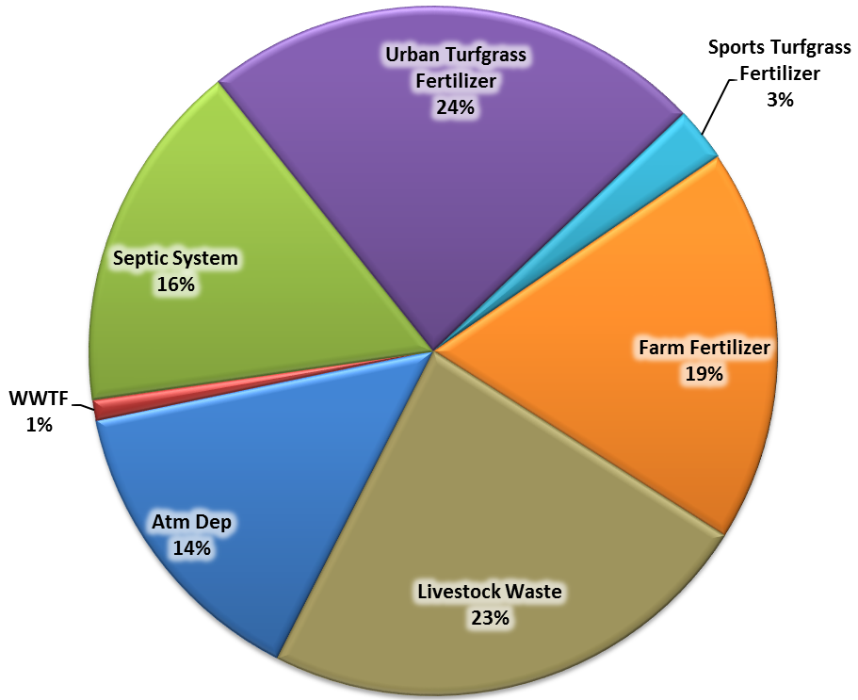
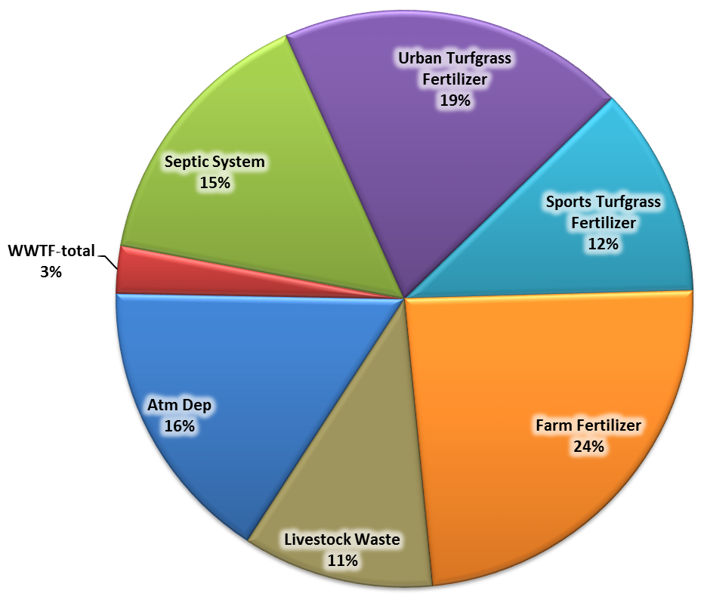
Estimated Annual Average Loading to Groundwater in Springsheds
Homosassa
Chassahowitzka
582,077 pounds of nitrogen per year (lb-N/yr)
380,463 lb-N/yr
Notes:
Here are the current results illustrating the relative contribution of nitrogen from various nitrogen sources within each contributing area. These results represent an estimation of the nitrogen currently entering the aquifer within the Chass and Homosassa boundaries and not an estimation of the concentrations exiting the springs. The spring discharge is a mixture of water which has entered the aquifer over a varied amount of time.

Slide 9
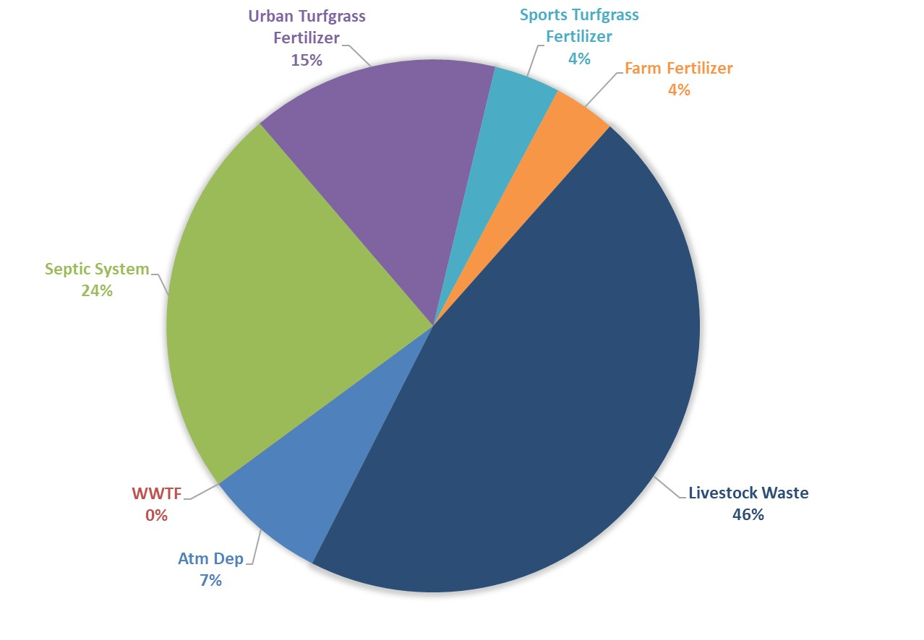
Homosassa Nitrogen Loading
to Groundwater in PFA
201,774 lb-N/yr

Slide 10
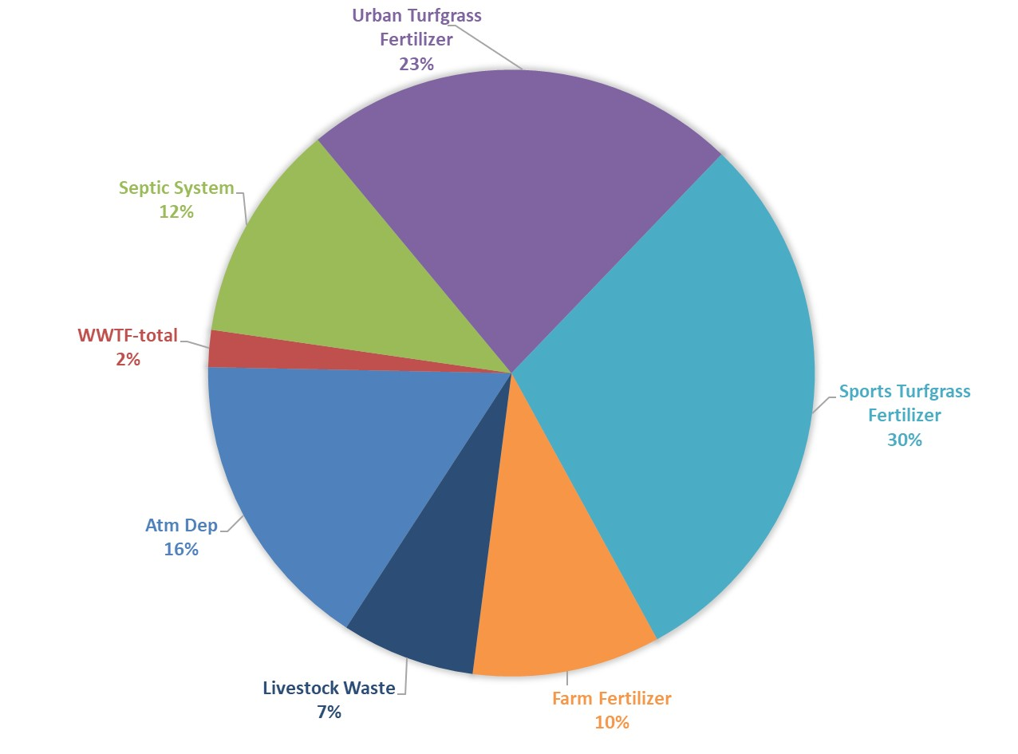
Chassahowitzka Nitrogen Loading
to Groundwater in PFA
112,133 lb-N/yr

Slide 11
Onsite Sewage Treatment and Disposal System (OSTDS) Remediation Plan
The Florida Springs and Aquifer Protection Act mandates that a BMAP with OSTDS contributing at least 20 % of nonpoint source load within a PFA include an OSTDS Remediation Plan (24 % in Homosassa; 12 % in Chassahowitzka)
Homosassa is required to have an OSTDS Remediation Plan
Chassahowitzka will have an OSTDS Remediation Plan
Both plans will include:
  Public education plan
  Scientific information on effect of nutrients on springs
  Projects designed to reduce nutrient impacts from OSTDS
The OSTDS Remediation Plan is included as an appendix in the BMAP

Slide 12
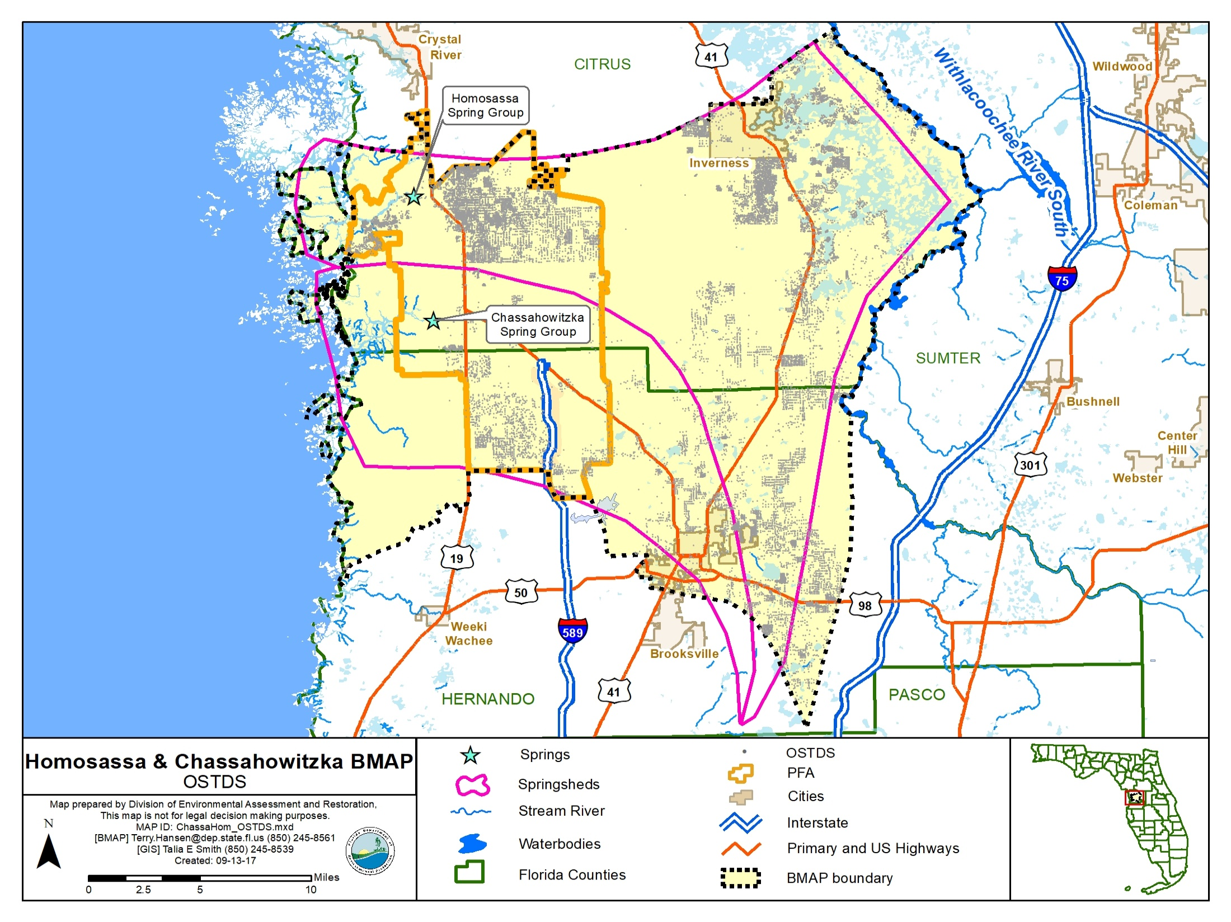

Slide 13
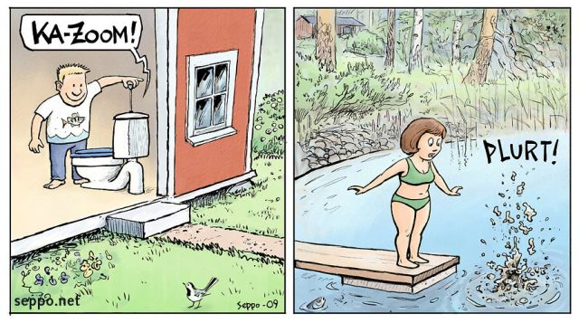
BMAP Policies – OSTDS
New OSTDS
No
Inside of PFA?
Yes
Either:
Conventional System
Enhanced System
No
Sewer
Yes*
Enhanced system
Either:
Conventional System
Enhanced System
*Must connect to sewer when available

Slide 14

TMDLs / BMAP
To achieve the TMDLs, BMAP implementation will be a 20-year process
Plan will define nitrogen reduction milestones:
  30% reduction within 5 years
  50% reduction within 10 years
  20% reduction within 15 years
  Use last 5 years to finish up and see results
Notes:
The overall load reduction targets are 30 % of the total within five years; 80 % of the total within ten years; and 100 % of the total within 15 years
The goals are aggressive for the first ten years; these aggressive goals are to ensure that the overall load reduction occurs within 20 years.
The load reduction progress will be tracked yearly and adjustments made as needed. At the five-year milestone, progress will be assessed and load reductions adjusted as necessary.

Slide 15
Nitrogen Load to Groundwater (NSILT) in Springsheds
Nitrogen Source | Estimated Total Nitrogen Load to Groundwater (lb-N/yr) Hom. / Chaz | Percent Contribution H / C
OSTDS | 96K / 58K | 17 / 15
Urban Turfgrass Fertilizer | 138K / 74K | 24 / 20
Atmospheric Deposition | 83K / 61K | 14 / 16
Farm Fertilizer | 108K / 91K | 19 / 24
Sports Turfgrass Fertilizer | 15K / 45K | 3 / 12
Livestock Waste | 137K / 41K | 24 / 11
Wastewater Treatment Facilities | 6K / 10K | 1 / 3
Total | 582K / 380K | 100%
Notes:
95% Avg GW conc. is 0.482 mg/L

Slide 16
Nitrogen Load to Groundwater (NSILT) in Springsheds
Nitrogen Source | Estimated Total Nitrogen Load to Groundwater (lb-N/yr) | Percent Contribution
OSTDS | 154,473 | 16%
Urban Turfgrass Fertilizer | 211,837 | 22%
Atmospheric Deposition | 144,498 | 15%
Farm Fertilizer | 198,685 | 21%
Sports Turfgrass Fertilizer | 59,583 | 6%
Livestock Waste | 177,691 | 18%
Wastewater Treatment Facilities | 15,773 | 2%
Total | 962,540 | 100%
Notes:
95% Avg GW conc. is 0.482 mg/L

Slide 17
Reduction to Meet the TMDLs
H/C Required Reduction to Meet the TMDL
Description | Nitrogen Loads (lb-N/yr) | Notes Regarding Data Used
Total Load at Spring Vents | 245K/197K | 95th% data and flow data from 2012 to 2015 & 2012 to 2017 (195/164 cfs)
TMDL Load | 88K/82K | TMDL target is 0.23 mg/L and using the same flow data
Required Reduction | 157K/115K
cfs = cubic feet per second
mg/L = milligrams per liter

Slide 18
Homosassa Chassahowitzka
Gap Analysis
Nitrogen Source | Credits Based on Project Tables (lb-N/yr) H/C | Description
OSTDS | 10,929 / 0 | Credits identified for stakeholder OSTDS projects (enhancement or sewer)
Urban Turf Fertilizer | 7,246 / 992 | DEP approved credits (up to 6%) for public education activities as well as credits identified for stakeholder stormwater projects
Atmospheric Deposition | − | No reduction
Farm Fertilizer (FF) | 16,177 /13,626 | 15% BMP credit on FF load to groundwater, assuming 100% owner-implemented BMPs on all fertilized lands
Sports Turf Fertilizer (STF) | 1,431 / 4,708 | 6% BMP credit for sports fields and 10% BMP credit for golf courses on STF load to groundwater, assuming 100% BMP implementation on golf courses and sports fields
Livestock | 13,688 / 4,081 | 10% BMP credit on load to groundwater, assuming 100% owner-implemented BMPs at all livestock facilities
Wastewater Treatment Facility | 1,176 /6,574 | Achieved by BMAP WWTF policy (achieving 3 or 6 mg/L)
Total Credits | 50,647 / 29,981
Required Reduction | 157K / 115K | 106,485 / 85,720 Load Remaining:

Slide 19
Options to Reduce Remaining Load
Estimated Reduction Credits for Additional OSTDS Enhancement OR Sewer
Recharge Area | BMAP Policy: OSTDS Parcels Less Than One Acre in PFAs | Credit for Enhancement (lb-N/yr) | Credit for Sewer (lb-N/yr) | OSTDS Parcels One Acre and Greater in PFAs | Credit for Enhancement (lb-N/yr)) | Credit for Sewer (lb-N/yr)
High | 3,942 | 20,755 | 30,334 | 3,310 | 17,427 | 25,740
Medium | 617 | 1,805 | 2,638 | 143 | 418 | 611
Low | 156 | 91 | 133 | 80 | 47 | 68
Total | 4,715 | 22,651 | 33,105 | 3,533 | 17,982 | 26,150

Slide 20
Options to Reduce Remaining Load
Potential WWTF Projects that Could Result in Additional Reductions
Project # | Name/Location | Estimated Reduction (lb-N/yr)
CC-02 | Southwest Regional Water Reclamation Facility (SWRWRF)/ Homosassa | 13,700
CC-04 | Chassahowitzka to SWRWRF Force Main/ Chassahowitzka | 9,280
CC-05 | Sugarmill Woods Residential Reclaimed Water/ Chassahowitzka | 19,852
 |  | 42,832

Slide 21
Closing the OSTDS Gap
BMAP will contain an OSTDS remediation plan.
DEP & FDOH will work together to implement it.
To be most successful, local funding needs to be available to homeowners:
  For example: grant programs for assisting homeowners, with costs administered by county.
  Best if administered at the local level.
  State funding for such grant programs is available.

Slide 22
OSTDS Options
OSTDS enhancement (defined as 65+ % nitrogen reduction).
FDOH approved options in Florida:
  Aerobic Treatment Units (ATU) meeting the NSF 245 standard.
  Passive nitrogen-reducing, in-tank systems tested by FDOH study:
  Florida Onsite Sewage Passive Nitrogen Reduction Strategies Study
FDOH innovative system testing process is evaluating more options, such as:
  Performance based treatment systems (PBTS).
  Media filter systems
  http://www.floridahealth.gov/environmental-health/onsite-sewage/products/_documents/pbts-components.pdf
OSTDS sewering.
  BMAP has new wastewater disposal requirements for nitrogen.

Slide 23
OSTDS Remediation Plan
Which systems must be enhanced or sewered?
What is the deadline for enhancing or sewering?
  Upon needing a permit for new, modified, or repaired OSTDS.
  Unless sewer is available or described as becoming available in a BMAP project.
  Backstop: In areas where enhancement or sewer is required, all OSTDS loads must be reduced no later than 20 years after BMAP adoption.
When does this start?
  As soon as the BMAP is adopted.
  By law, BMAP must be adopted before July 1, 2018.

Slide 24
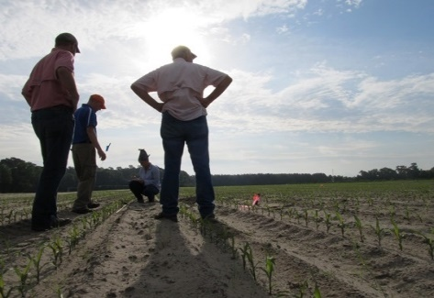
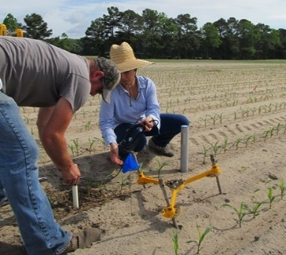
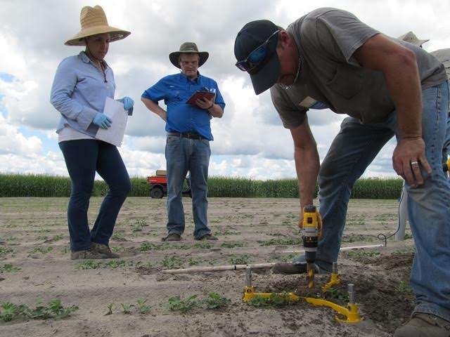
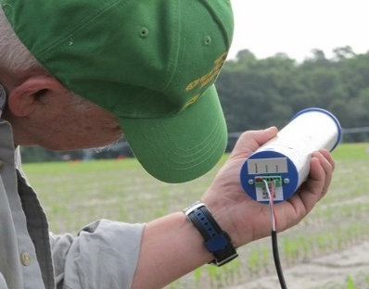
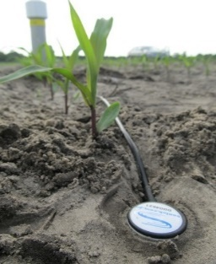
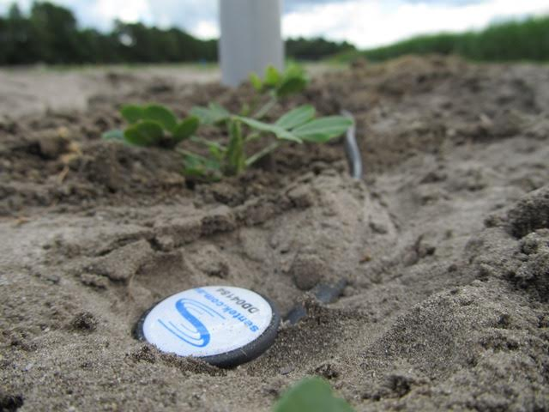
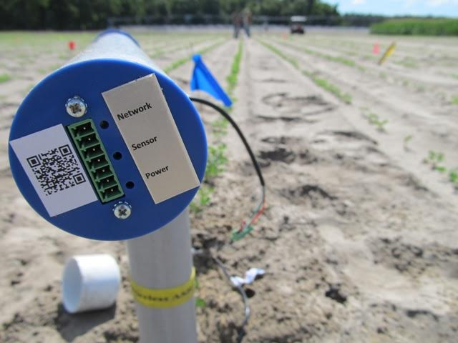
Ag Options to Reduce Remaining Load
Estimated Reduction Credits for Advanced Agricultural Practices
Action | Estimated Reduction Credit (lb-N/yr) High Recharge | Estimated Reduction Credit (lb-N/yr) Medium Recharge
Precision Irrigation | 673 | 374
Soil Moisture Probes | 1,328 | 4,772
Controlled Release Fertilizer | 700 | 389
Precision Fertilization | 7,701 | 4,278
Total | 10,402 | 9,813

Slide 25
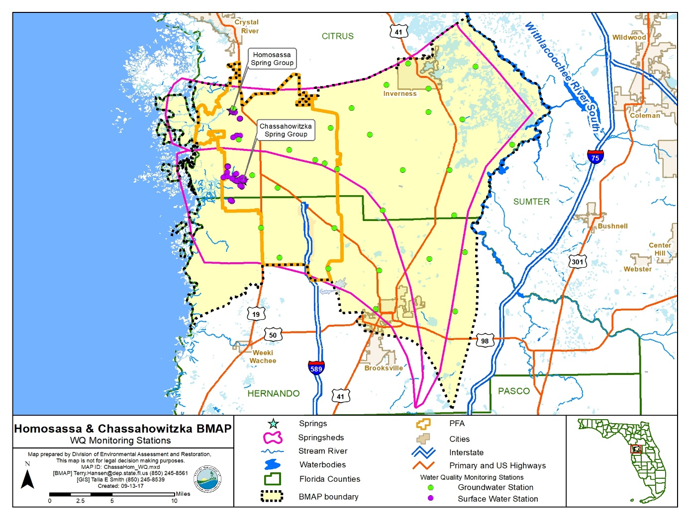
Next Steps
Public meeting - January 30, 2018
BMAP adoption - February 2018

Slide 26
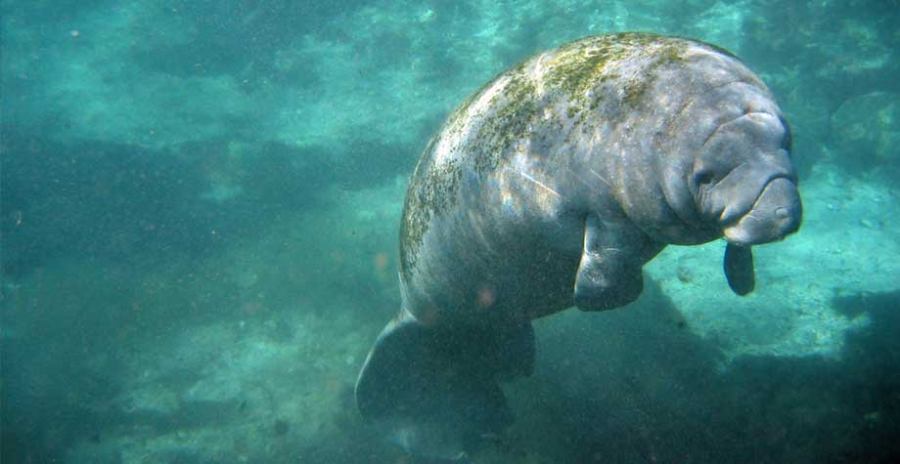
QUESTIONS??
Photo: SWFWMD

Slide 27

Basin Management Action Plan
Contact: Terry Hansen, P.G.
terry.hansen@dep.state.fl.us
http://www.dep.state.fl.us/water/
http://publicfiles.dep.state.fl.us/DEAR/BMAP/Springs%20Coast/CHAZ%20HOM/

Slide 28
Groundwater Loading
Surface Inputs
Attenuation & Recharge
NSILT estimate
Load to Aquifer Surface
AQUIFER
Effect of Aquifer properties
Unknown
Spring Vent

Slide 29
OSTDS Options Costs
For ATUs that meet the NSF 245 Standard, PBTS, and media filter systems, the estimated construction cost is about $13,000. The life cycle (30 years) operation and maintenance cost is about $12,000, with about $1,500 for permit and compliance.
For passive nitrogen-reducing in-tank systems, the estimated construction cost is about $19,000. The life cycle (30 years) operation and maintenance cost is about $9,000, with about $4,000 for permit and compliance.
From DOH 19DEC17

