Slide 1


BASIN MANAGEMENT ACTION PLAN UPDATES
Chandler Keenan, Environmental Consultant
Water Quality Restoration Program
Florida Department of Environmental Protection
Southwest Florida Water Management District- Management Meeting | July 10, 2024

Slide 2
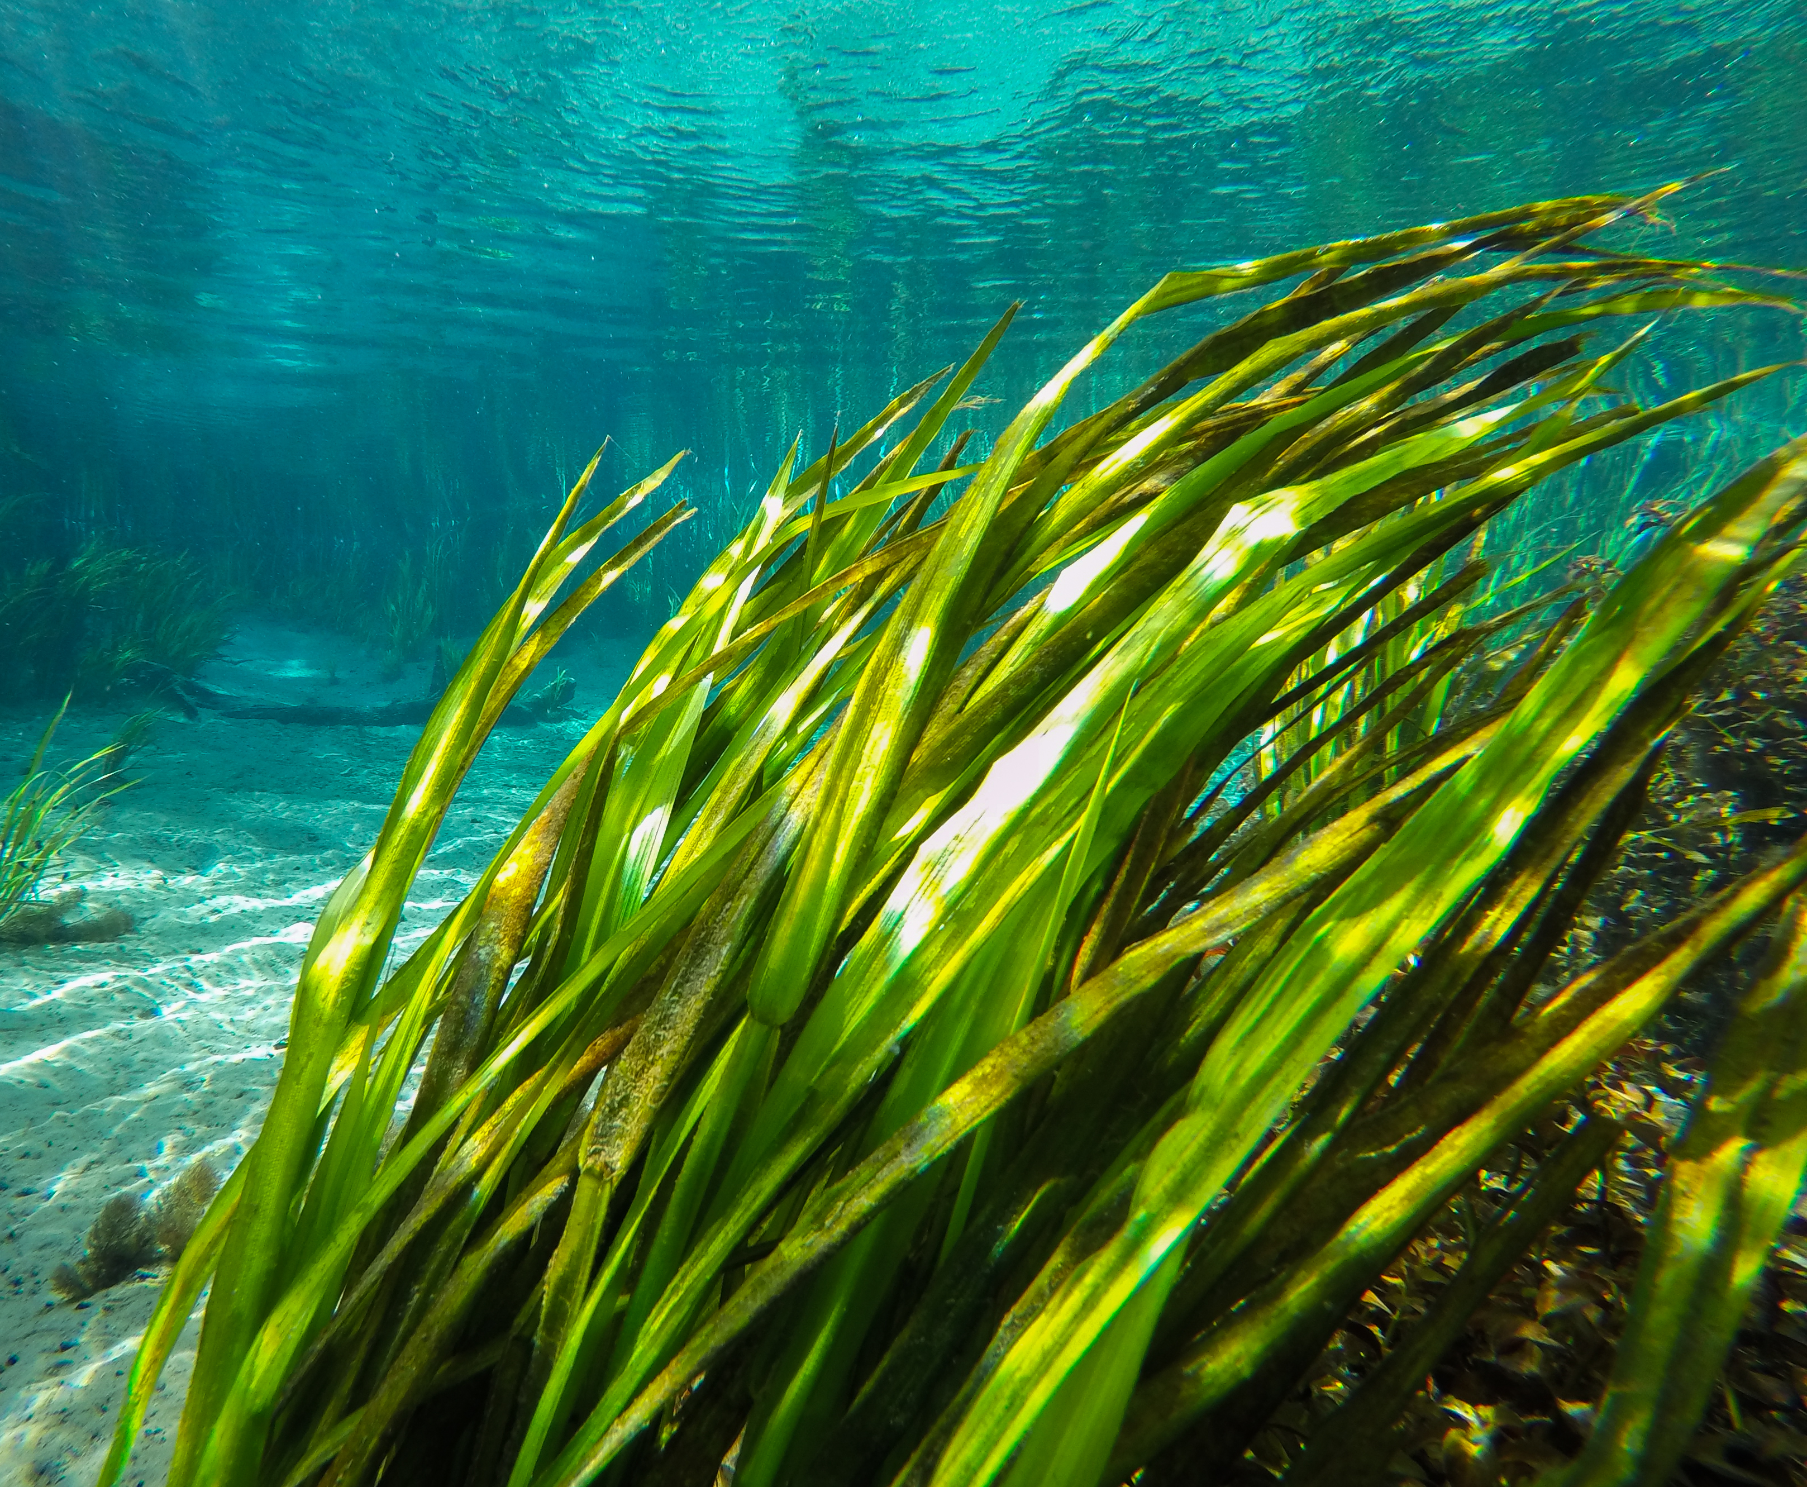
AGENDA
Basin Management Action Plan (BMAP) Overview:
  Project Highlights.
  Spring Vent Water Quality.
Basin Analyses:
  Nitrogen Source Inventory Loading Tool (NSILT) Draft Results.
  Spring Vent Load Analysis.
Next Steps for BMAP Updates:
  Project Prioritization.
  Timeline.

Slide 3
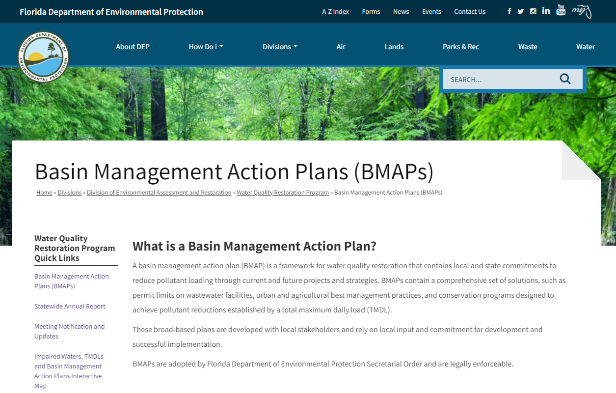
BMAPs
BMAPs are:
  Developed with stakeholder input.
  Adopted by The Florida Department of Environmental Protection’s (DEP) Secretarial Order.
  Enforceable.
  Implemented through a phased approach.
  Reported on annually.
  Updated regularly.
Attain water quality standards.
Restoration
Coordination
Community leaders.
Partner agencies.
Research.
Restoration plans
Address pollution sources in the basin.
Identify priorities and funding.
Measure success and adapt.
Regular updates
Statewide Annual Report (STAR).
One of DEP’s methods for restoring water quality in an impaired waterbody.
Notes:
DEAR is charged with monitoring and assessing Florida's surface water and groundwater quality; identifying, verifying and prioritizing pollution problems; developing strategies to resolve the problems; and implementing those strategies through comprehensive restoration actions in partnership with local stakeholders. BMAP and restoration are steps within the larger cycle of evaluation and assessment of water quality standards where the ultimate goal is to achieve water quality. DEP may develop a basin management action plan for some of the waterbodies that have TMDL.
TMDL is a restoration target. It represents how much of a pollutant can be introduced into a waterbody without causing exceedances in the water quality standards
When developing a BMAP, numerous meetings are held with the public and local stakeholders to come to agreement on the best approach for restoration in the watershed. Coming to consensus during BMAP development allows for better success during implementation.
Once agreement is reached, the BMAP is presented to the DEP Secretary to be signed and adopted, which makes BMAP legally enforceable
Legal requirements can be enforced through National Pollutant Discharge Elimination System (NPDES) wastewater treatment facility (WWTF) permits, NPDES municipal separate storm sewer system (MS4) permits, or through the authority of the adopted BMAP itself
The FWRA (Florida Watershed Restoration Act) directs us to integrate appropriate management strategies (aka projects) and establish a schedule to implement the strategies.
BMAPs are implemented with a phased approach and using adaptive management, so that new information can be incorporated as needed.
Reviewed annually.
Work with community leaders.
Develop and implement restoration plans.
Measure success and adapt.
Restoration – attain water quality standards.

Slide 4
KEY BMAP COMPONENTS
Total maximum daily loads (TMDLs) being addressed.
Area addressed by the restoration plan.
Identify sources.
Phased implementation approach.
Milestones.
Projects and management strategies.
Future growth impacts.
Projects to meet the TMDL:
Implementation timeline.
Commitment to projects.
Expected water quality improvement from projects and management strategies.
Process to assess progress toward achieving the TMDL:
Monitoring plan.
Project reporting.
Periodic follow-up meetings.
Water quality analyses.
Notes:
Regardless of the type of BMAP, the plans all contain some similar elements. They discuss the geographic area and specific TMDLs that are being addressed. All BMAPs feature some sort of analysis or mechanism to address future growth and other impacts.
The main component of the BMAPs consists of two parts: the projects identified to achieve pollutant reductions, and the process that will be followed to monitor and assess progress.

Slide 5
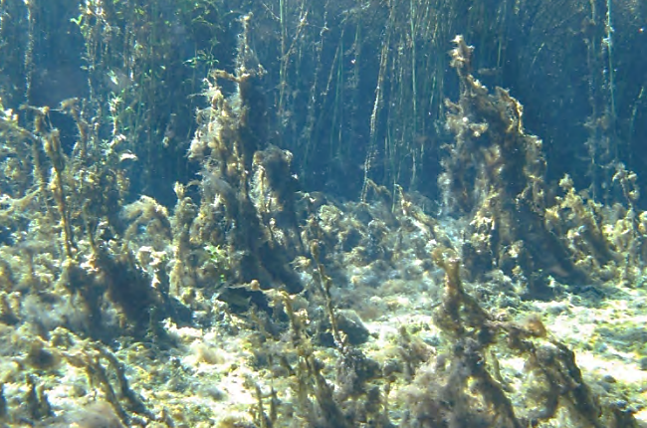
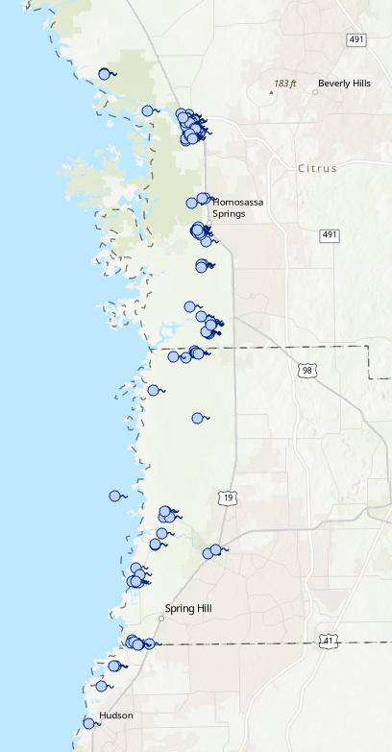
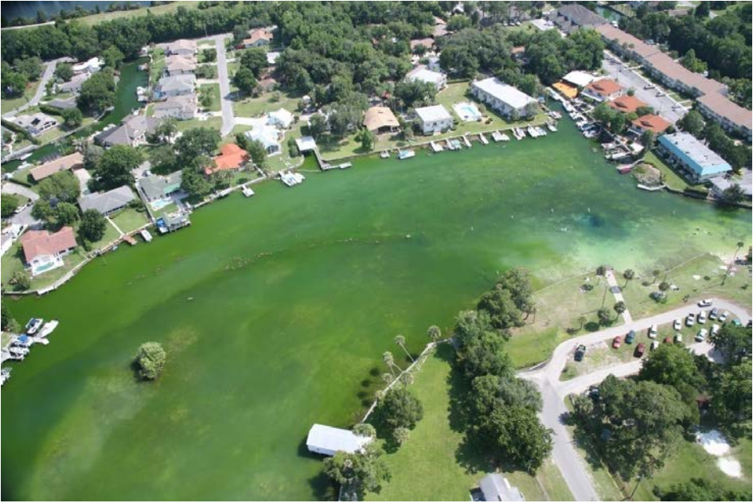
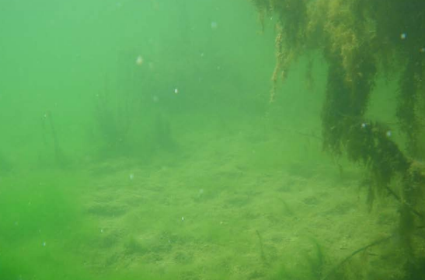
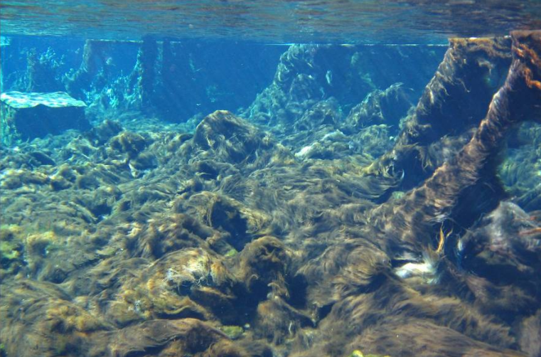
BMAPs
SPRINGS COAST OVERVIEW
Rainbow Final TMDL Report
Background
  Early 2000s - Many of Florida’s freshwater springs determined to be impaired for nutrients.
  2014 - DEP adopted TMDLs for many waterbodies in Springs Coast basin.
  2016 - Florida Legislature designated 30 Outstanding Florida Springs (OFS) to require additional protections.
  2018 - BMAPs adopted as restoration framework to meet TMDLs.
  Today - Working on updates to the Springs BMAPs to be adopted by 2025.
2009
Kings Bay Final TMDL Report
2010
Homosassa Final TMDL Report
2010
Weeki Wachee Final TMDL Report
2006

Slide 6
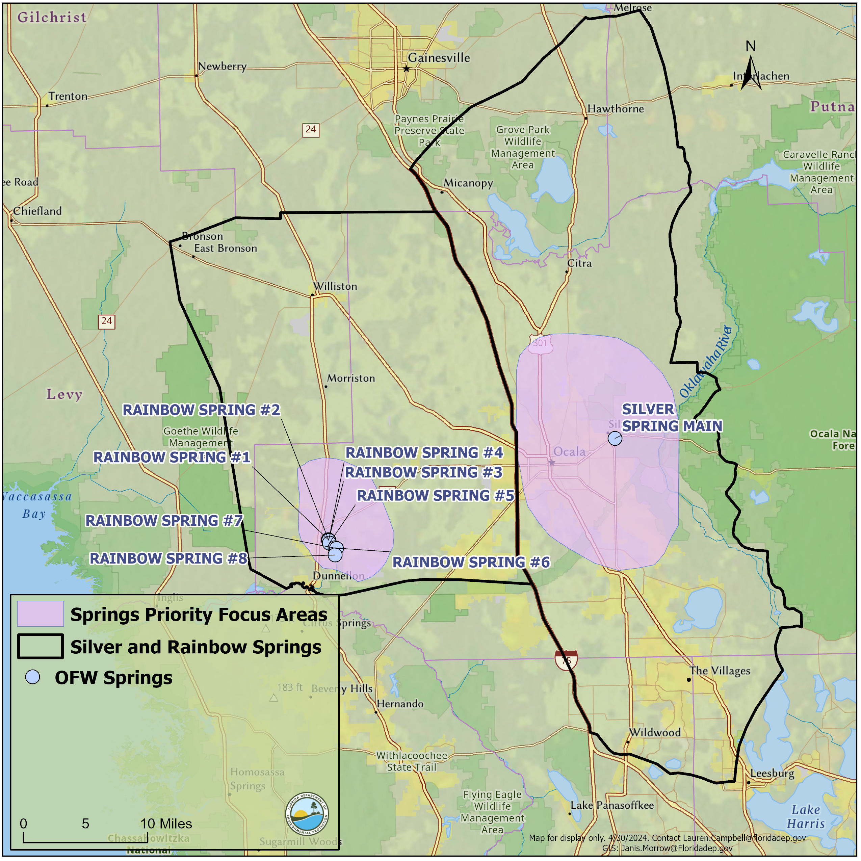
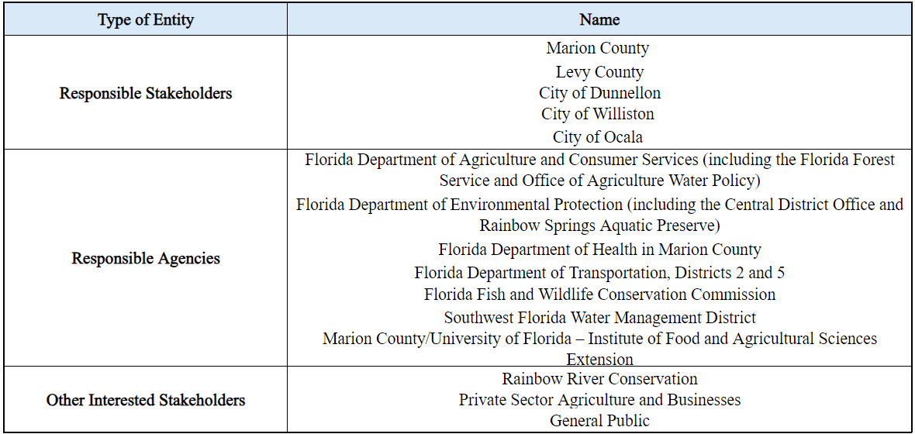
RAINBOW SPRINGS AND RIVER BMAP AREA
The Rainbow Spring Group and Rainbow River BMAP area is approximately 679 square miles.
Impaired for the nitrate form of nitrogen.
TMDL is 0.35 mg/L of nitrate, as monthly arithmetic mean target.
Notes:
identified as an Outstanding Florida Spring (OFS) by the 2016 Florida Springs and Aquifer Protection Act (Chapter 373, Florida Statutes [F.S.]). The Silver Springs and Upper Silver River BMAP area (989 square miles [mi²]) includes Silver Springs, Silver Springs Group, and the Upper Silver River along with the groundwater contributing area for the springs. For our purposes, the waterbodies delineated as Silver Springs and Silver Springs Group are collectively referred to as Silver Springs and together include at least 30 named springs that contribute flow to the Upper Silver River.
The decision to merge the two adopted BMAPs was based on the following considerations:
• The two spring systems have a zone of interaction that influences the movement and direction of groundwater flow. There is no clear delineation between the two systems' groundwater contributing areas (Section 1.4.2).
• Management policies implemented to address pollutant sources are largely the same for both spring systems. Two plans are not needed to implement most of these policies.
• Marion County has the largest land area within both BMAP areas—60 % of Silver Springs and 65 % of the Rainbow Spring Group. The City of Ocala spans both BMAP areas. Upgrades to Ocala Utilities wastewater treatment facilities (WWTFs) allow the transfer of wastewater between portions of Ocala east and west of Interstate 75 (I-75). A single BMAP provides greater consistency in local jurisdiction planning and policy making.
• Two distinct BMAP areas are maintained for the calculation of loadings and identification of sources. They are separated by I-75, because the interstate separates the area overseen by the St. Johns River Water Management District (SJRWMD) from that of the Southwest Florida Water Management District (SWFWMD). One BMAP provides an opportunity for increased coordination and consistency in the programs and policies implemented by the two water management districts (WMDs).

Slide 7
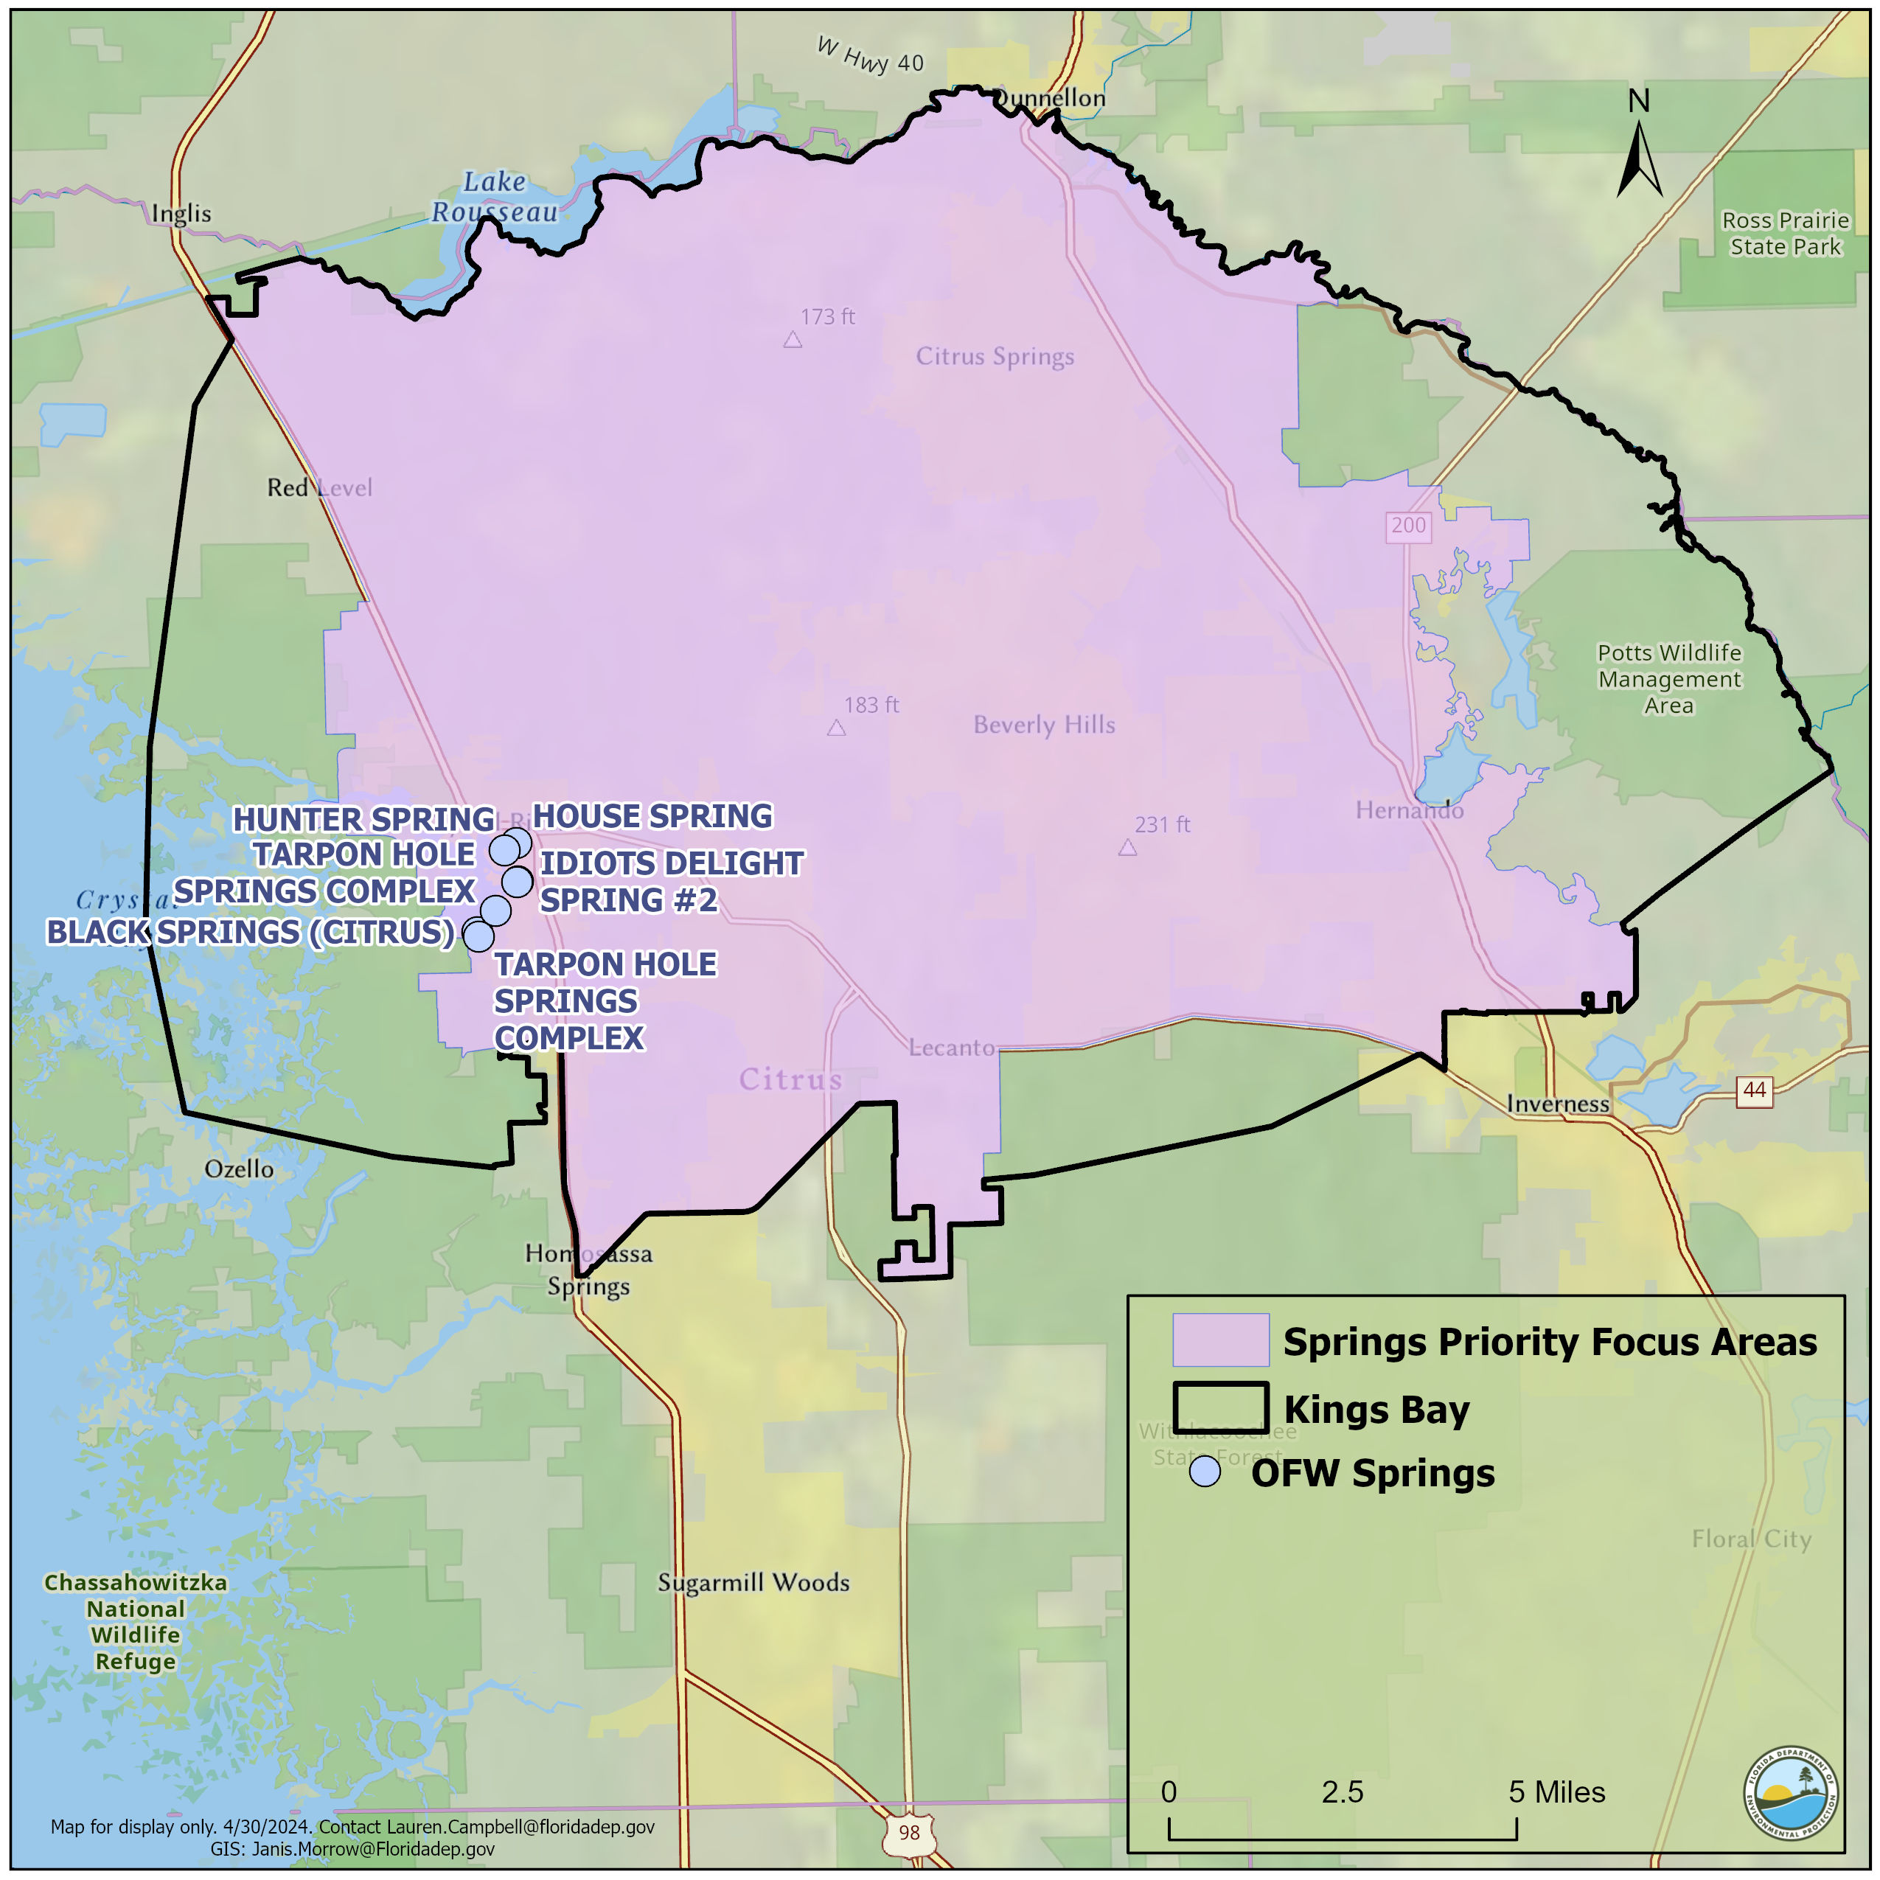
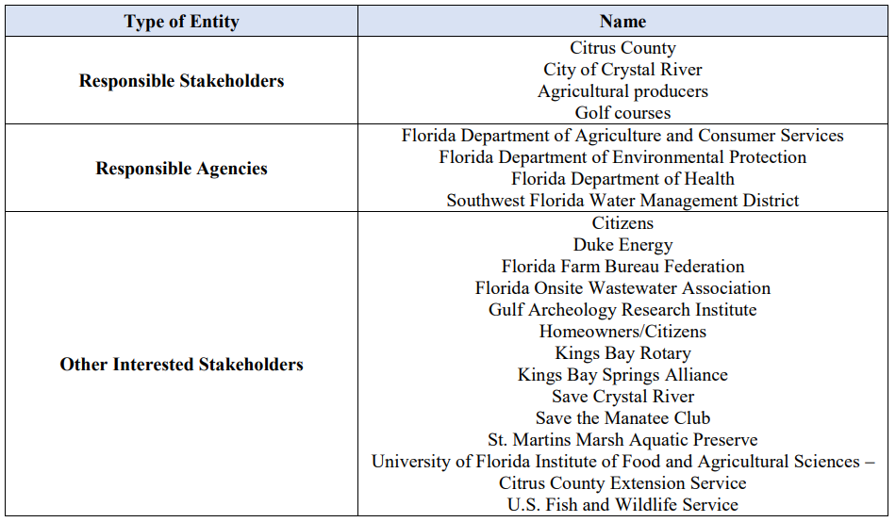
CRYSTAL RIVER/KINGS BAY BMAP
BMAP area is approximately 178,753 acres and includes OFS including Kings Bay Group (Hunter, House, Black, Idiot’s Delight and Tarpon Hole Springs).
Impaired for the nitrate form of nitrogen and orthophosphate.
TMDLs:
  Springs 0.23 mg/L nitrate as an annual average.
  Kings Bay 0.28 mg/L nitrate as an annual average.
  Springs 0.028 mg/L orthophosphate as an annual average.
  Kings Bay 0.032 mg/L orthophosphate as an annual average.

Slide 8
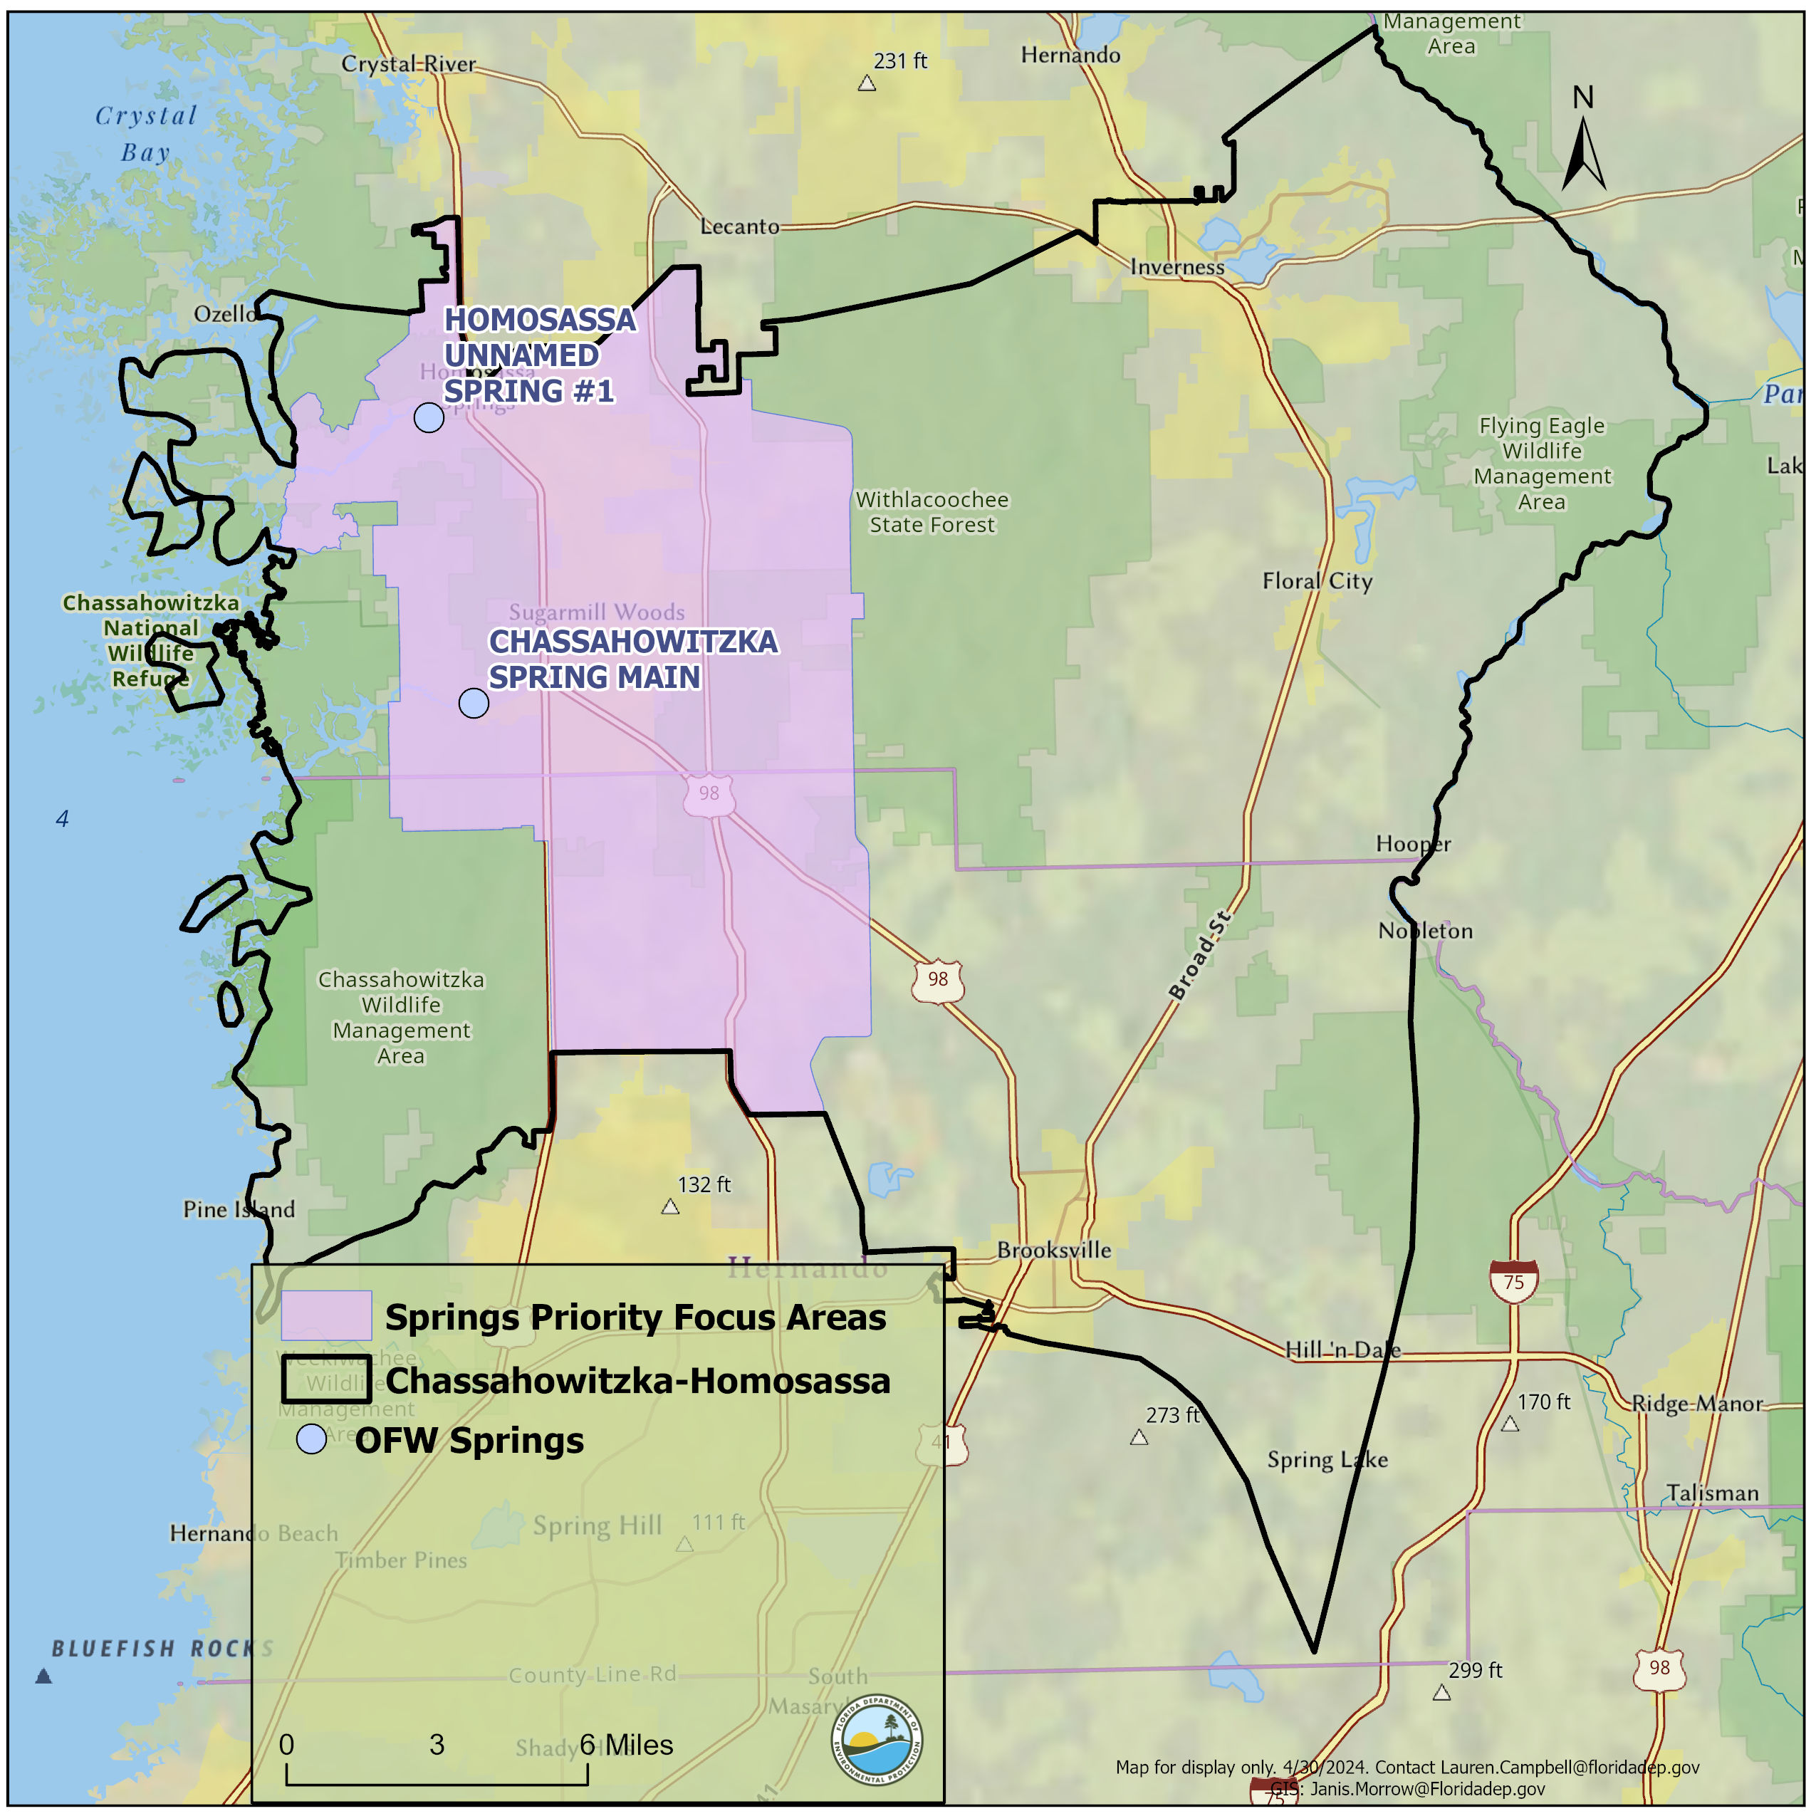
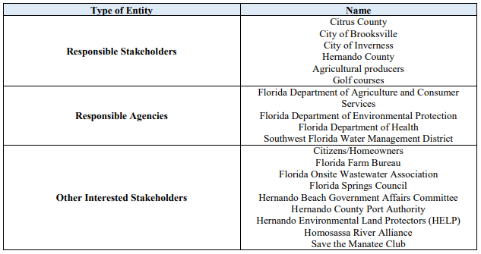
HOMOSASSA/CHASSAHOWITZKA SPRINGS BMAP
BMAP area is approximately 340,609 acres and include OFS Homosassa and Chassahowitzka Springs Groups.
Impaired for the nitrate form of nitrogen.
TMDLs are nitrate annual averages of 0.23 mg/L for the springs and 0.25 mg/L for the rivers.

Slide 9
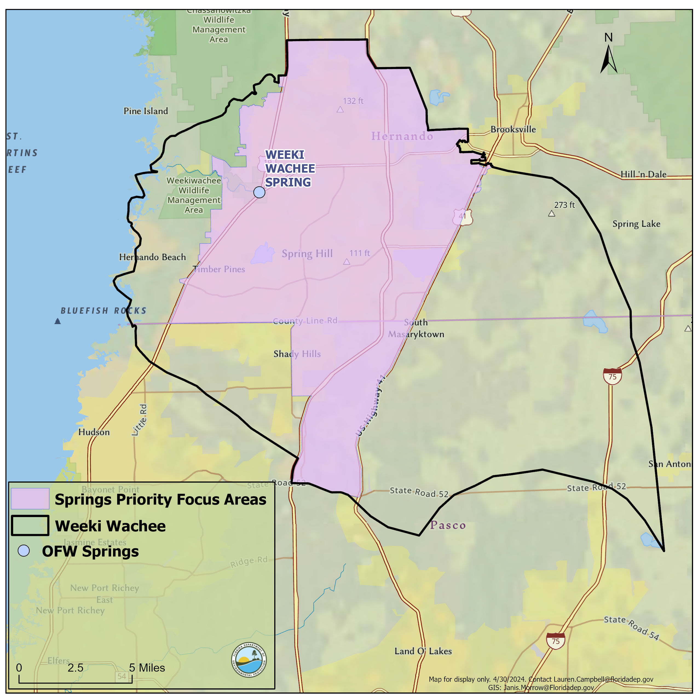
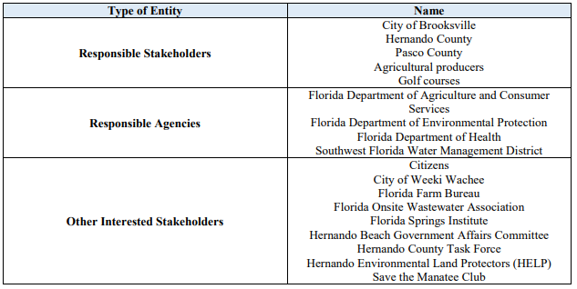
WEEKI WACHEE BMAP
BMAP area is approximately 200,474 acres and includes the Weeki Wachee OFS.
Impaired for the nitrate form of nitrogen.
TMDLs are nitrate annual averages of 0.28 mg/L for Weeki Wachee Spring, 0.23 mg/L for the Magnolia-Apripeka Spring Groups and 0.20 mg/L for the Weeki Wachee River.

Slide 10
BILLS AND LEGISLATION
Florida Watershed Protection Act, Section 403.067, Florida Statutes (F.S.).
Florida Springs and Aquifer Protection Act, Part VIII of Chapter 373, F.S.
Senate Bill (SB) 712 Clean Waterways Act.
House Bill (HB) 1379 Environmental Protection.
HB1557.
Summary of latest updates:
Wastewater and Onsite Sewage Treatment and Disposal System (OSTDS) remediation plans from local governments.
List of identified project to meet five-year milestones.
Agricultural Cooperative Regional Elements.
Prohibitions expanded from priority focus area (PFA) to entire BMAP.
Advanced waste treatment (AWT) required for more treatment effluent, including reclaimed water.

Slide 11
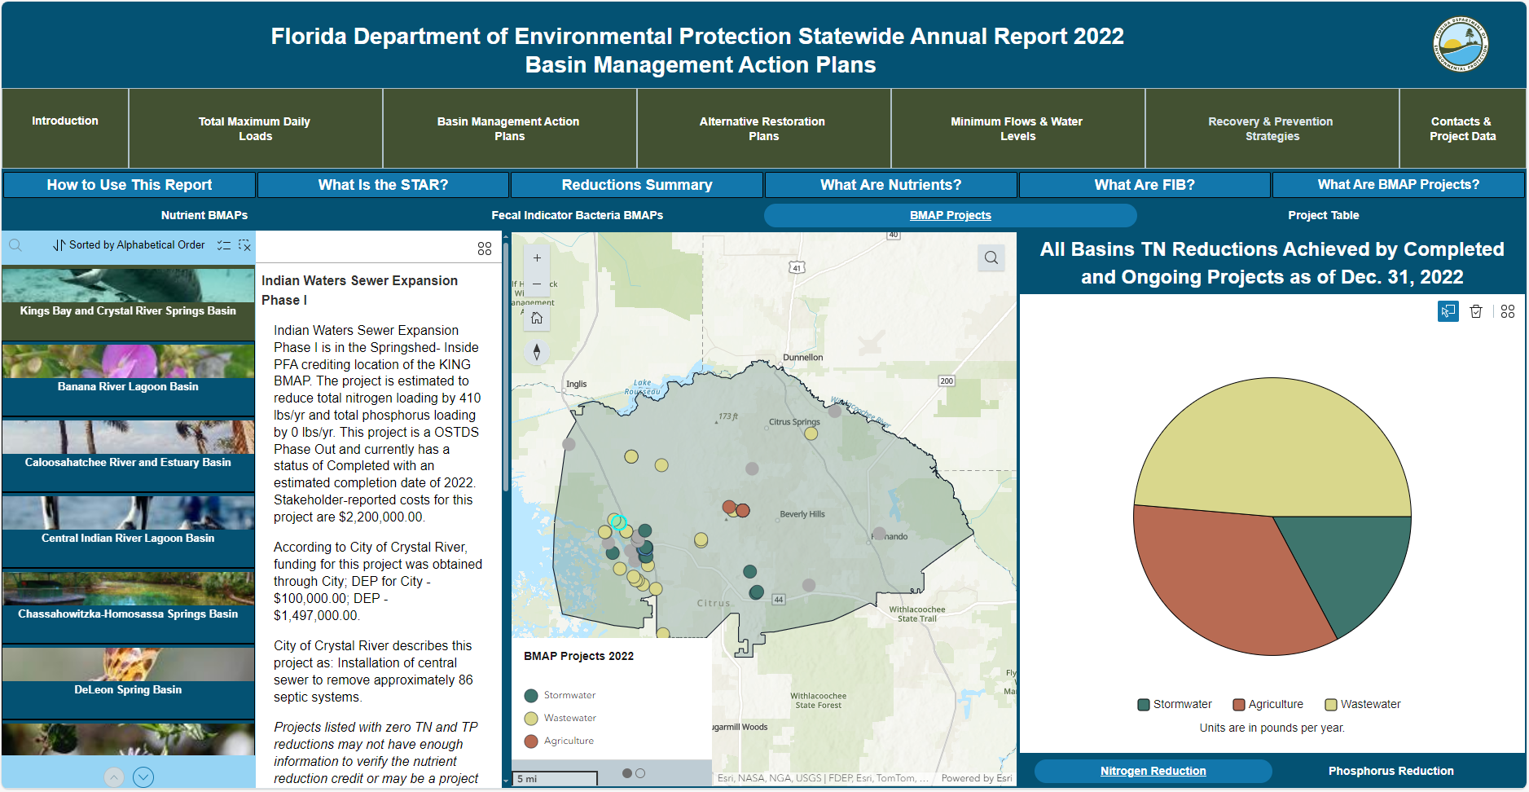


STAR
PROJECT REPORTING
What is the STAR?
Summarizes accomplishments in the BMAPs statewide.
Reports on restoration projects and management strategies.
Published July 1 of each year.
Notes:
Under Section 403.0675 Florida Statutes (F.S.) we are required to provide an annual update to the Governor and Legislature - STAR
Reports on TMDLs, BMAPs, Minimum flows or minimum water levels, and recovery or prevention strategies
BMAPs: Reports on restoration projects and management strategies that are designed for nitrogen and phosphorus removal.
Reminder about making sure entity has access to the portal and is uploading projects that have recieved grant funding.

Slide 12
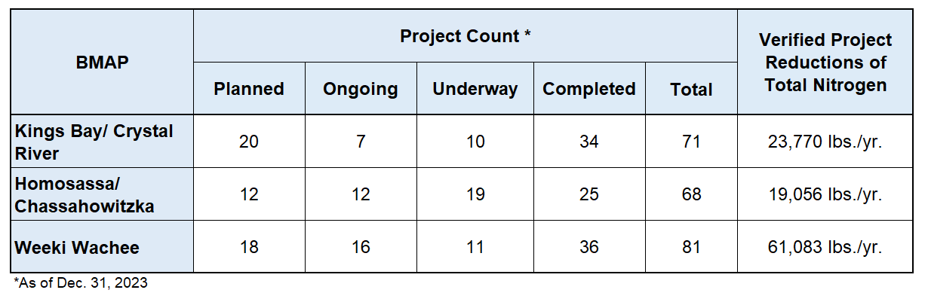
STAR RESULTS FOR 2023
Rainbow
21
20
29
90
160
42,519 lbs./yr.
Notes:
Preliminary numbers

Slide 13
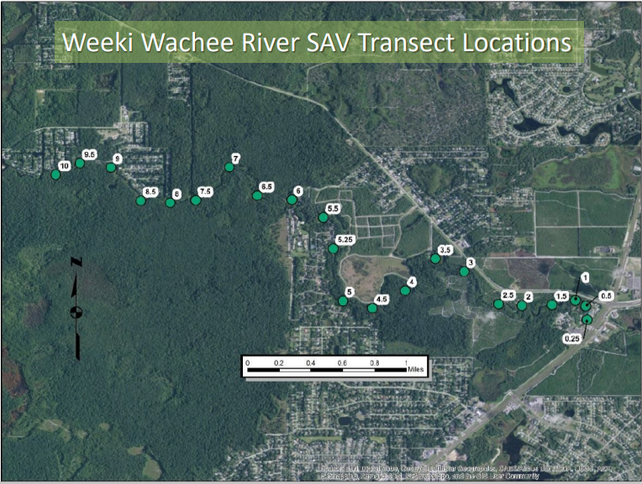
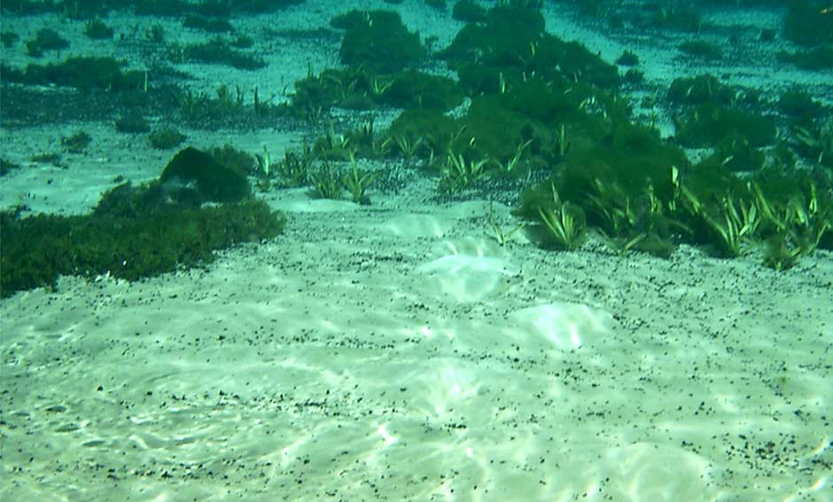
PROJECT HIGHLIGHTS
Studies and Monitoring:
Rainbow Spring algae growth and vegetation mapping.
Weeki Wachee vegetation mapping.
Recently published work on three different ecological zones within the spring-fed Chassahowitzka River.
In Water:
Muck removal.
Wetland restoration.
Source: Southwest Florida Water Management District (SWFWMD)
Notes:
Preliminary numbers

Slide 14
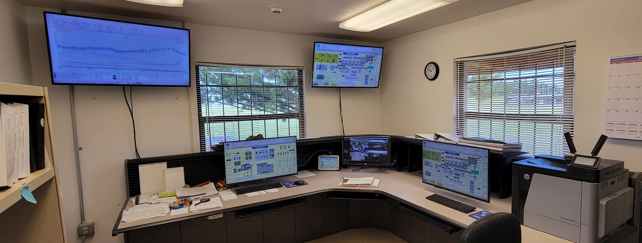
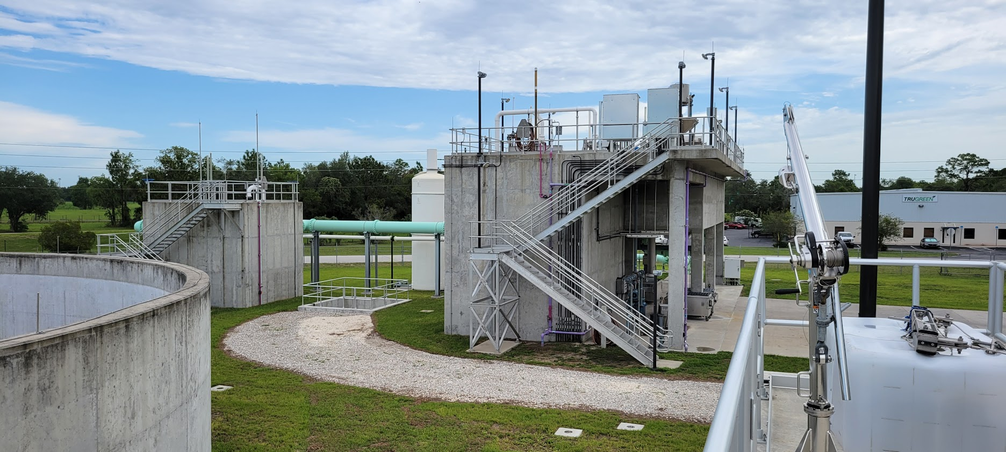
PROJECT HIGHLIGHTS
Wastewater Improvements:
Hernando County – Upgrade and consolidation of Wastewater Treatment Facilities (WWTFs), septic to sewer phase conversion.
Citrus County - Upgrading Meadowcrest WWTF, sewer line expansion north, south and east of the bay.
OSTDS Enhancements:
Hernando and Citrus utilizing Septic Upgrade Incentive Program grant funds to switch out conventional to Enhanced Nutrient Reducing OSTDS (ENR-OSTDS) where sewer isn't available.
DEP Employee photographs
Notes:
Springs shoreline stabilization and SAVplantings
Fanning Springs
Manatee Springs
Gilchrist Blue
Troy Spring
Ichetucknee Springs
Volusia Blue
Lafayette Blue

Slide 15
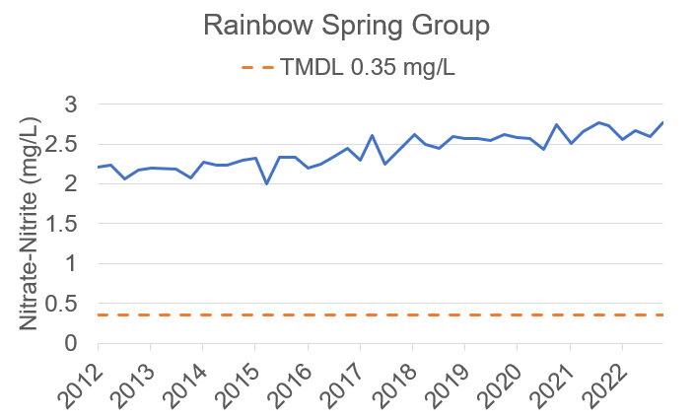
WATER QUALITY DATA
RAINBOW NITRATE DATA
Notes:
Along with visiting the STAR website for information on projects and progress you can also visit the BMAP storymaps for more information on the BMAP and water quality monitoring.
Stations Used: Silver- Mammoth
Rainbow- RR1

Slide 16
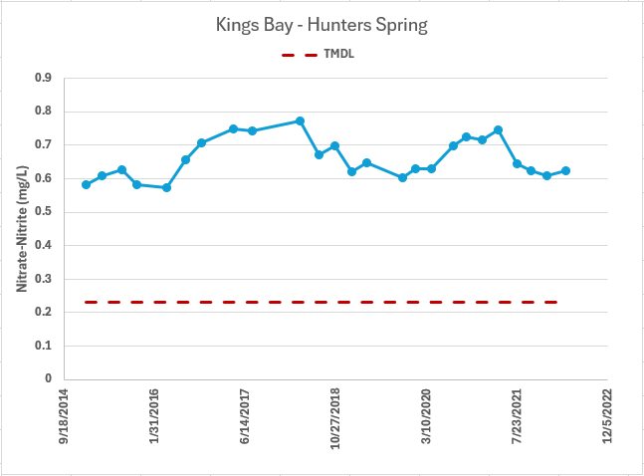
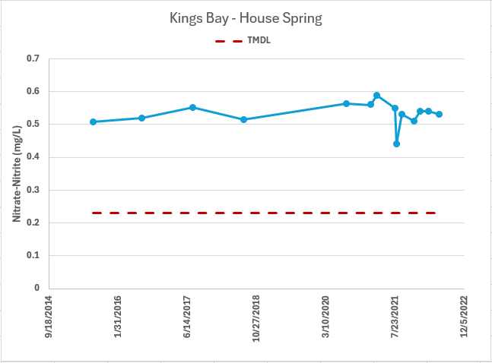
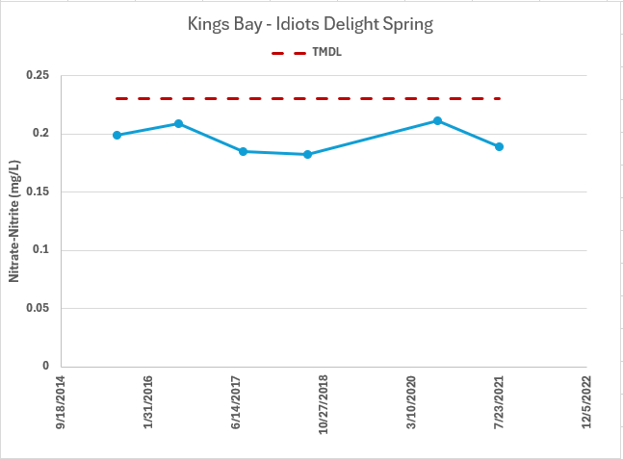
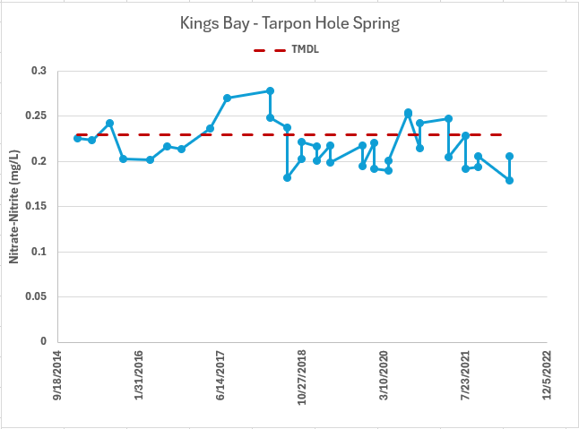
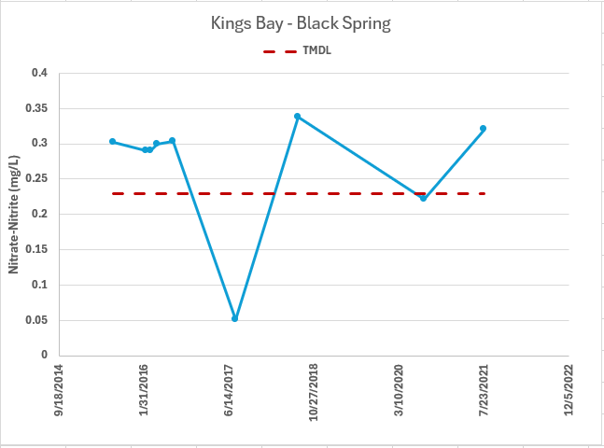
WATER QUALITY DATA
KINGS BAY NITRATE DATA
Notes:
Along with visiting the STAR website for information on projects and progress you can also visit the BMAP storymaps for more information on the BMAP and water quality monitoring.

Slide 17
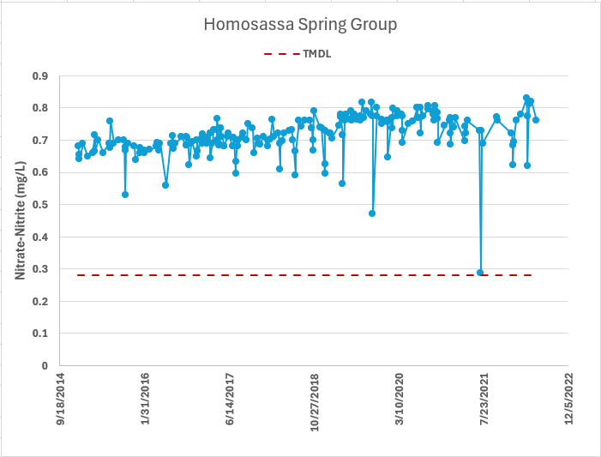
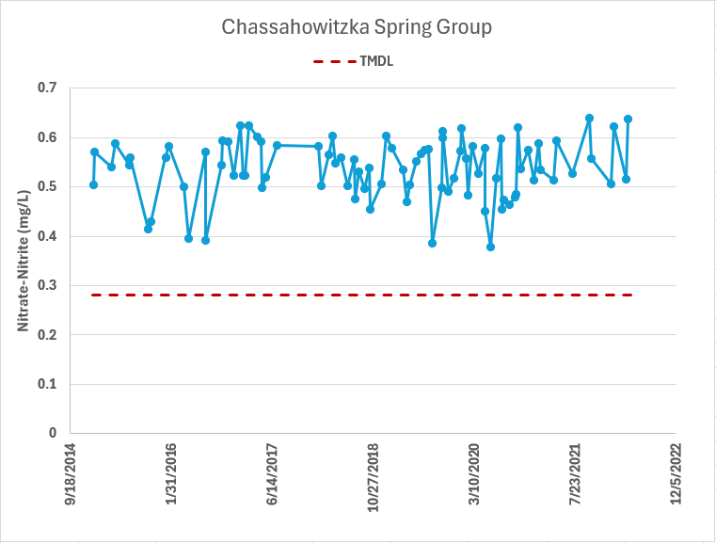
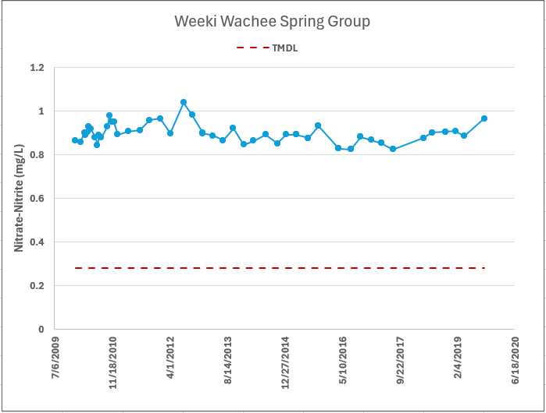
WATER QUALITY DATA
HOMOSASSA/CHASSAHOWITZKA AND WEEKI WACHEE DATA
Notes:
The presenter may want to note that the TMDL expressions are on a different time scale than the TMDL limit expression. It is still a usual data presentation, just need to be caveat any conclusions. This is especially true where the waterbody is close to meeting the TMDL limit.

Slide 18
SPRINGS BIOASSESSMENT WORKGROUP
Working group members:
Tasks:
Challenges:
Provide recommendations for the use of bioassessment tools to support springs BMAP objectives.
Identify and track biological responses in spring systems to assist in determining if water quality restoration strategies implemented to reduce nitrate loading to groundwater are effective in restoring healthy biological conditions.
Need consistent bioassessment monitoring tools to assess condition and changes in plant and algal communities.
Identify most appropriate tool or modification to assess unique conditions associated with spring systems.
DEP’s Division of Environmental Assessment and Restoration.
St. Johns River Water Management District (SJRWMD).
Southwest Florida Water Management District (SWFWMD).
TASKS
Four pilot study springs were identified: Wakulla Springs, Wacissa Springs, Ichetucknee Springs and Wekiwa Springs.

Slide 19
DATA UPLOAD
Watershed Information Network (WIN)
Through both the WIN and Florida STORET (STOrage and RETrieval) data repositories, DEP implements Florida statutory requirements, DEP rule requirements and U.S. Environmental Protection Agency (EPA) funding requirements for management of environmental (non-regulatory) data for the state.
Data from WIN are used by DEP for standards development, Impaired Waters Rule assessments, TMDL development, reasonable assurance plans, alternative restoration plans, BMAP development and assessment and for providing data as required to EPA and to the public.
Data providers to WIN and STORET include DEP entities, water management districts (WMDs), cities, counties, other state agencies, universities, private and volunteer organizations.
For any assistance, contact WIN Coordinator Jason.Storrs@FloridaDEP.gov.
Notes:
Subsection 373.026(2), F.S.
Chapter 62-40.540(3), Florida Administrative Code (F.A.C.)
Chapter 62-303, F.A.C., Identification of Impaired Surface Waters

Slide 20
BMAP UPDATES​
ADOPTED BY JULY 1, 2025
NSILT updates.
Spring vent load analyses.
Entity allocation development.
Future growth.
  Establish five-year milestones for project implementation.
  Incorporate additional projects.
Incorporate Clean Waterways Act (SB 712) requirements.
Incorporate HB 1379 requirements.
  Incorporate regional projects.
Water quality data evaluation:
  Evaluation of the monitoring network (spring vent and groundwater).
  Water quality trend analyses.
Evaluate additional OSTDS provisions.
Evaluate AWT or other more stringent effluent limits.
Update the BMAP documents.

Slide 21
NSILT GENERAL PROCESS SUMMARY
Estimate loading to land surface for each source category.
Apply a source specific, literature derived biochemical attenuation factor to surface loading estimate.
Apply a location specific recharge factor to surface loading estimate.
LOADING TO GROUNDWATER.

Slide 22
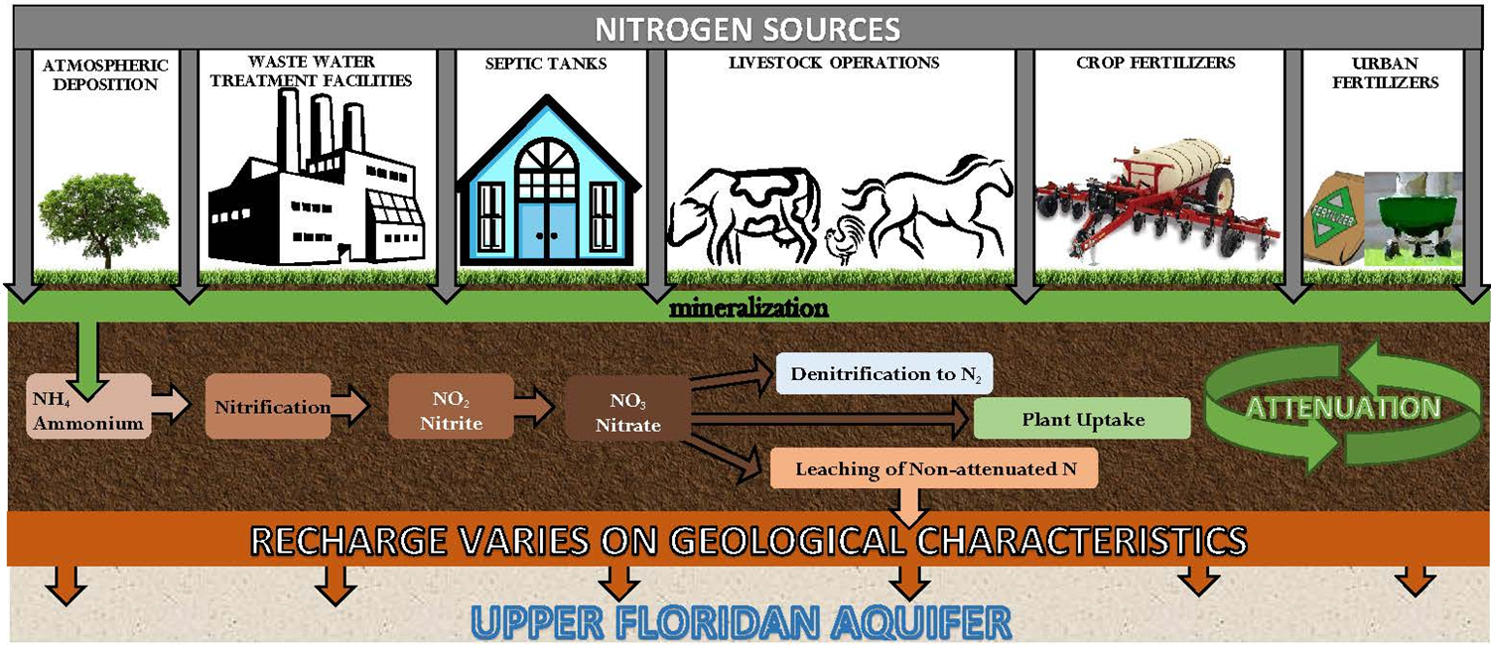
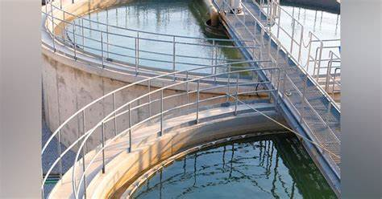

NITROGEN CYCLE AND ATTENUATION
Notes:
This is a diagram that shows the general processes evaluated by the NSILT. We first attempt to estimate loading to land surface from various sources. In addition to the above listed sources, we also included biosolids as a source loading category evaluated in this tool. To provide additional detail we have broken some of the sources into subcategories such as dairies for livestock waste, but this is a general overview of the sources evaluated by the tool. Once we have estimated loading to the ground surface, we evaluate the impact of the processes that control the transformation in soils and the subsurface. The processes listed in the brown bar describe the attenuation or how the environment is able to process and take up nitrogen. For NSILT estimates, we are interested in the bar labeled “Leaching of Non-attenuated N”. This is the nitrogen which is not utilized by the environment and has the potential to reach ground water. Hyrdogeological factors impact the amount of non-attenuated N that ultimately reach the Upper Floridan Aquifer, so a location specific recharge factor is also applied to estimate total loading to groundwater.

Slide 23
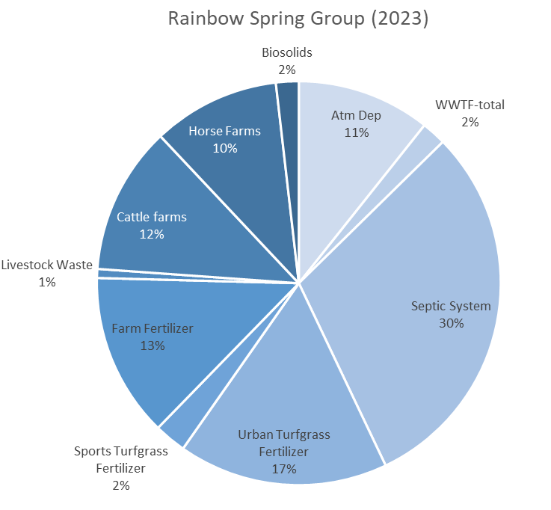
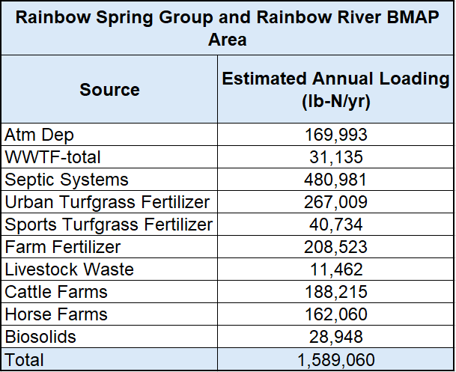
DRAFT NSILT LOADING
RAINBOW SPRINGS BMAP
Notes:
2018 NSILT load was 1,541,216 lbs-N/yr

Slide 24
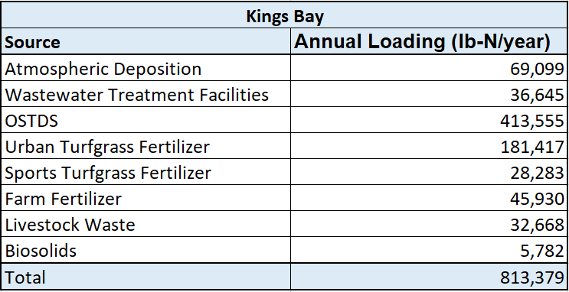
DRAFT NSILT LOADING RESULTS
KINGS BAY/CRYSTAL RIVER
Notes:
2018 NSILT load was 572,646 lbs-N/yr

Slide 25
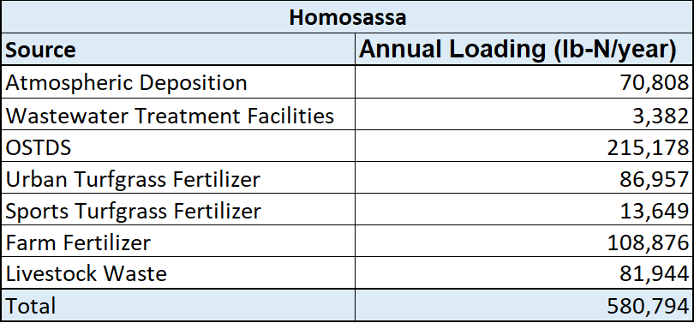
DRAFT NSILT LOADING RESULTS
HOMOSASSA/CHASSAHOWITZKA
Notes:
2018 NSILT load was 572,646 lbs-N/yr

Slide 26
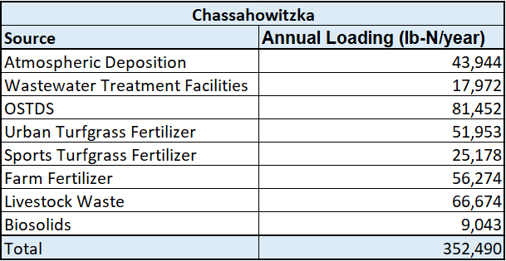
DRAFT NSILT LOADING RESULTS
HOMOSASSA/CHASSAHOWITZKA
Notes:
2018 NSILT load was 572,646 lbs-N/yr

Slide 27
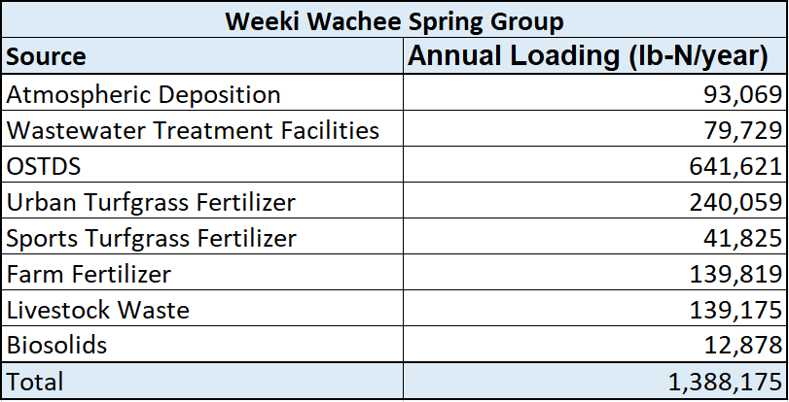
DRAFT NSILT LOADING RESULTS
WEEKI WACHEE
Notes:
2018 NSILT load was 572,646 lbs-N/yr

Slide 28
BMAP UPDATES
SPRING VENT LOAD ANALYSIS
Calculated the current loading using the most recent 10 years of nitrate and discharge data.
Calculated the percent reduction using the TMDL and current loading.
Applied the spring vent percent reduction to the updated NSILT loading.
Estimate the total reduction needed to meet the TMDL.
Notes:
The 95% Upper Confidence Interval was used for current load calculations.

Slide 29
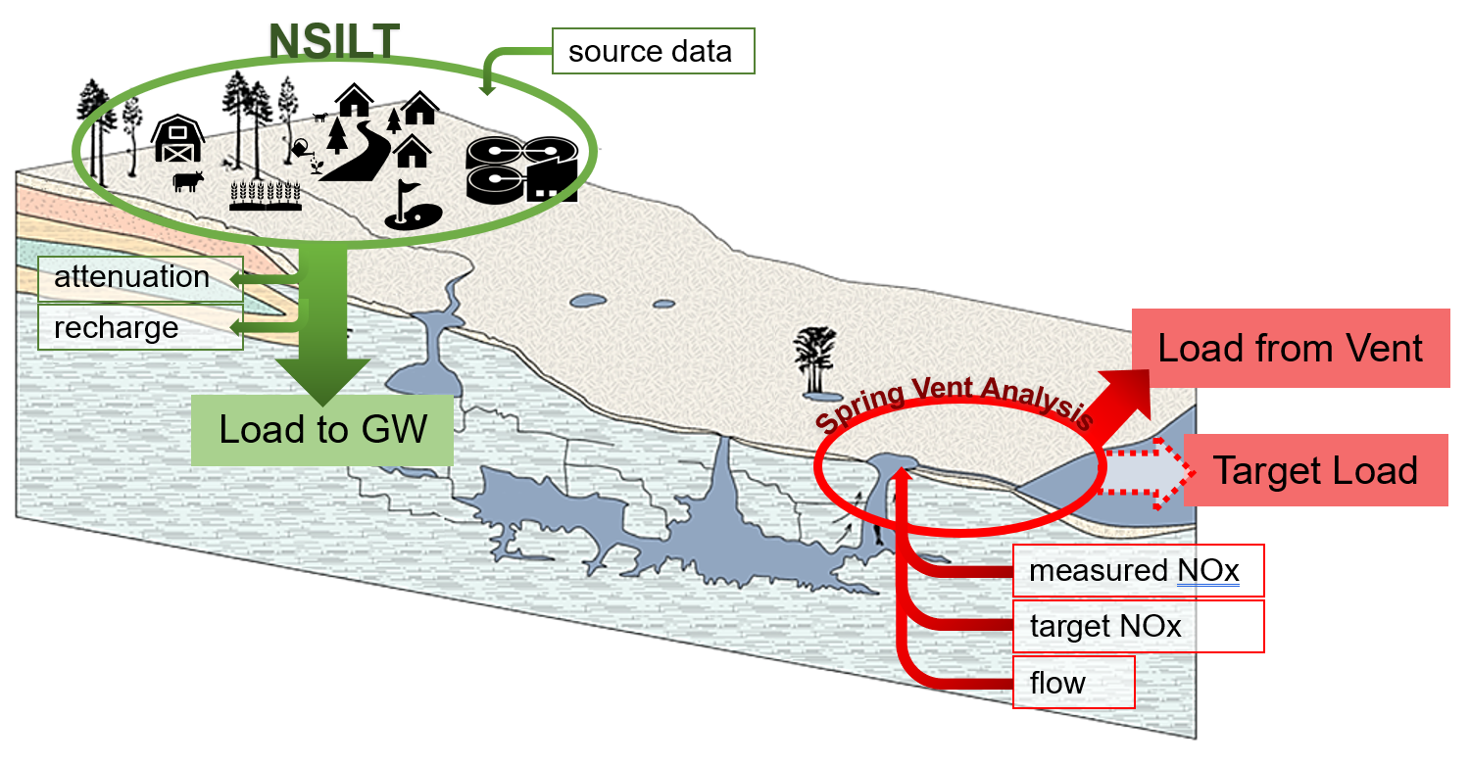
BMAP UPDATES
SPRING VENT LOAD ANALYSIS
Load from Vent – Target Load = Reduction Goal
(at vent)
% Reduction at vent x Load to GW = Required Reductions
(from sources)
Source: Suwannee River WMD What is a Spring?

Slide 30
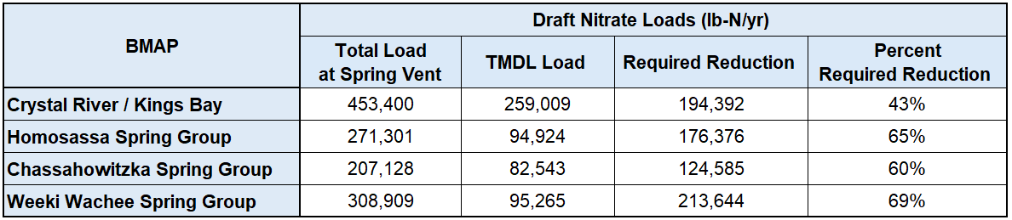
BMAP UPDATES
Spring Vent Load Analysis
¹
1,461,175
420,139
1,041,036
Rainbow
¹
71%
²
²
²
²
³
Upper 95% confidence interval - nitrate data from 2012 to 2022. ¹ TMDL target is 0.35 mg/L
²TMDL target is 0.23 mg/L ³ TMDL target is 0.28 mg/L
Notes:
Verbal discussion of flow data because different methodology for KING, data gaps for Chass
These are all estimates.
The total load is based on the upper 95% confidence interval for the

Slide 31
BMAP UPDATES
Allocation And reduction Approach
The percent reduction calculated from the spring vent analysis is applied to the estimated NSILT load to determine the overall required reduction needed in the basin.
Each source will be evaluated for a reduction strategy.
Responsible entities will receive an allocation based on the combined necessary reductions estimated by source for their area based on the NSILT loading.

Slide 32
BMAP UPDATES
Future Growth
Domestic Wastewater Projections:
  Use wastewater to estimate future growth projections.
  Start with population growth for each county from Bureau of Economic and Business Research:
    2040 Medium Growth Projections.
  Proportion growth for each entity based on land area.
  Distinguish the future population expected to be served by sewer versus those with OSTDS based on the most recent Florida Water Management Inventory for each BMAP county.
  Use per person calculations to estimate future loads from WWTF and OSTDS.
Agriculture Projections:
  Exploring different tools to estimate future changes in agricultural acreage in the BMAPs to estimate changes in agricultural loading.

Slide 33
BMAP UPDATES
5-, 10- AND 15-YEAR MILESTONES/REDUCTION SCHEDULE
5-year Milestone
2028
30%
End of BMAP
YEAR
2028
2033
2038
PROGRESS
MILESTONE
30%
80%
100%
Notes:
It's fine to keep this slide as is, but as you are presenting I would mention that we may revise these percentages.

Slide 34
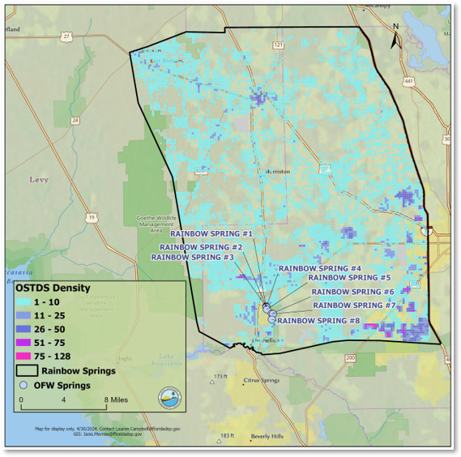
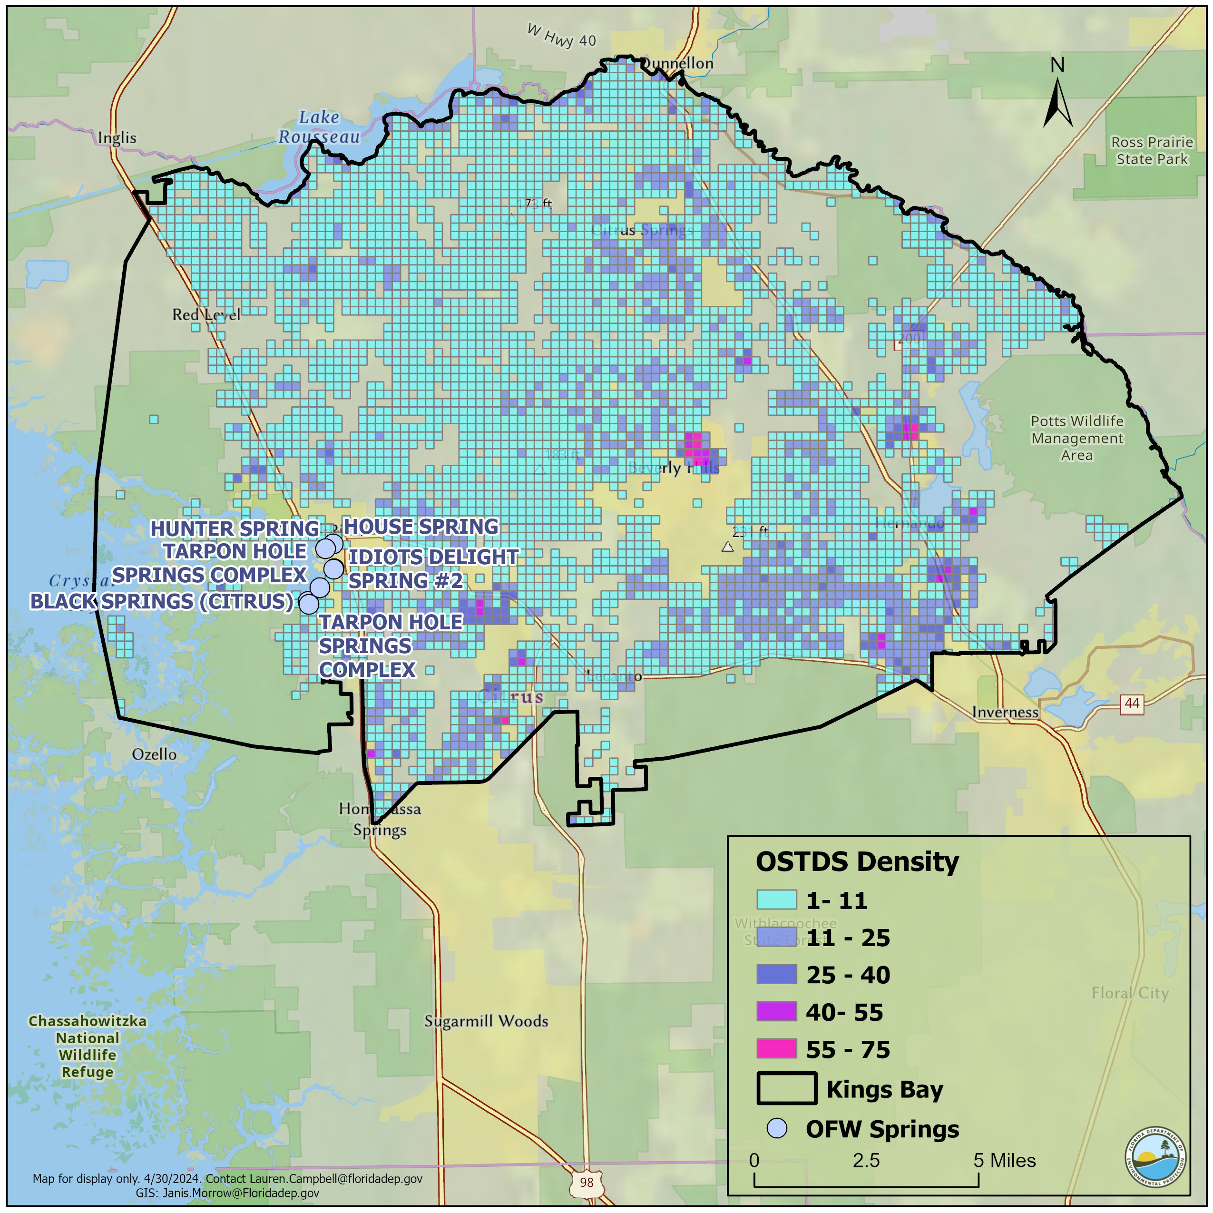
OSTDS
PROJECT IMPORTANCE
Rainbow Springs BMAP
Kings Bay/Crystal River BMAP
*Density is per 300-meter by 300-meter grid cell.
Notes:
Estimated loading has been updated to 10 lb-N/year from 9.012 lb-N/year. No longer adjust for time away from home as this is captured in the estimated loading rate.

Slide 35
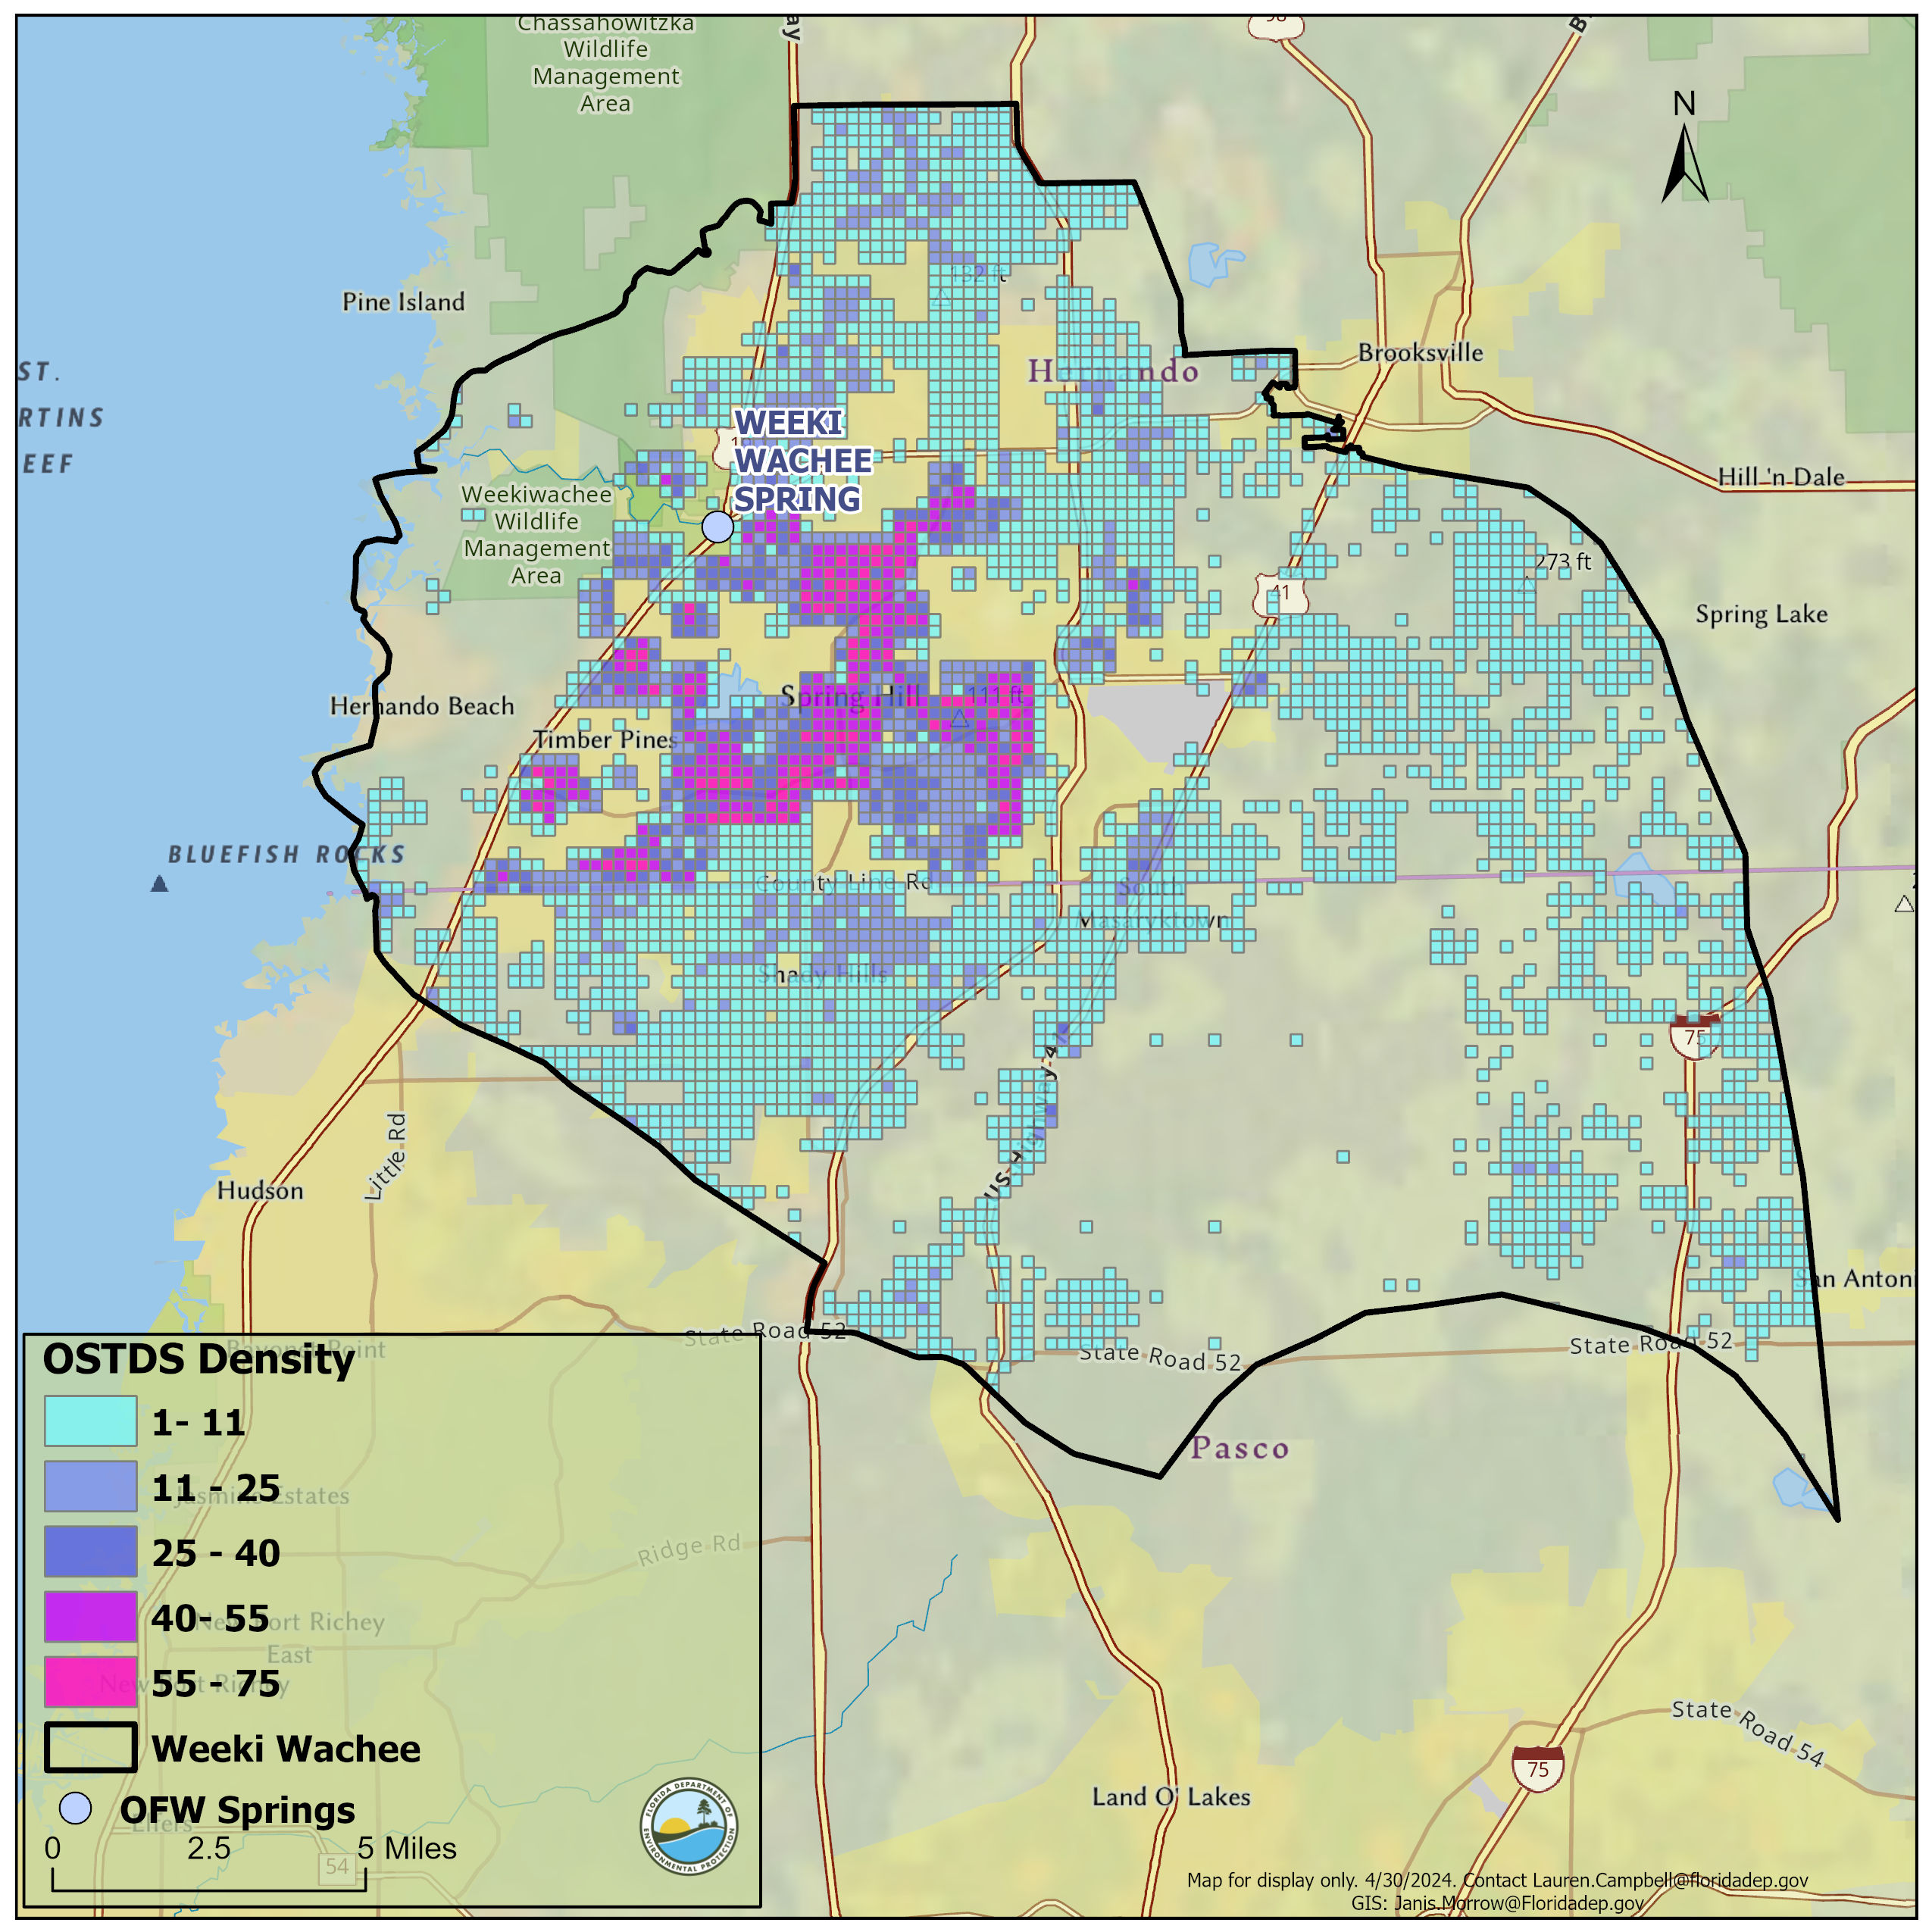
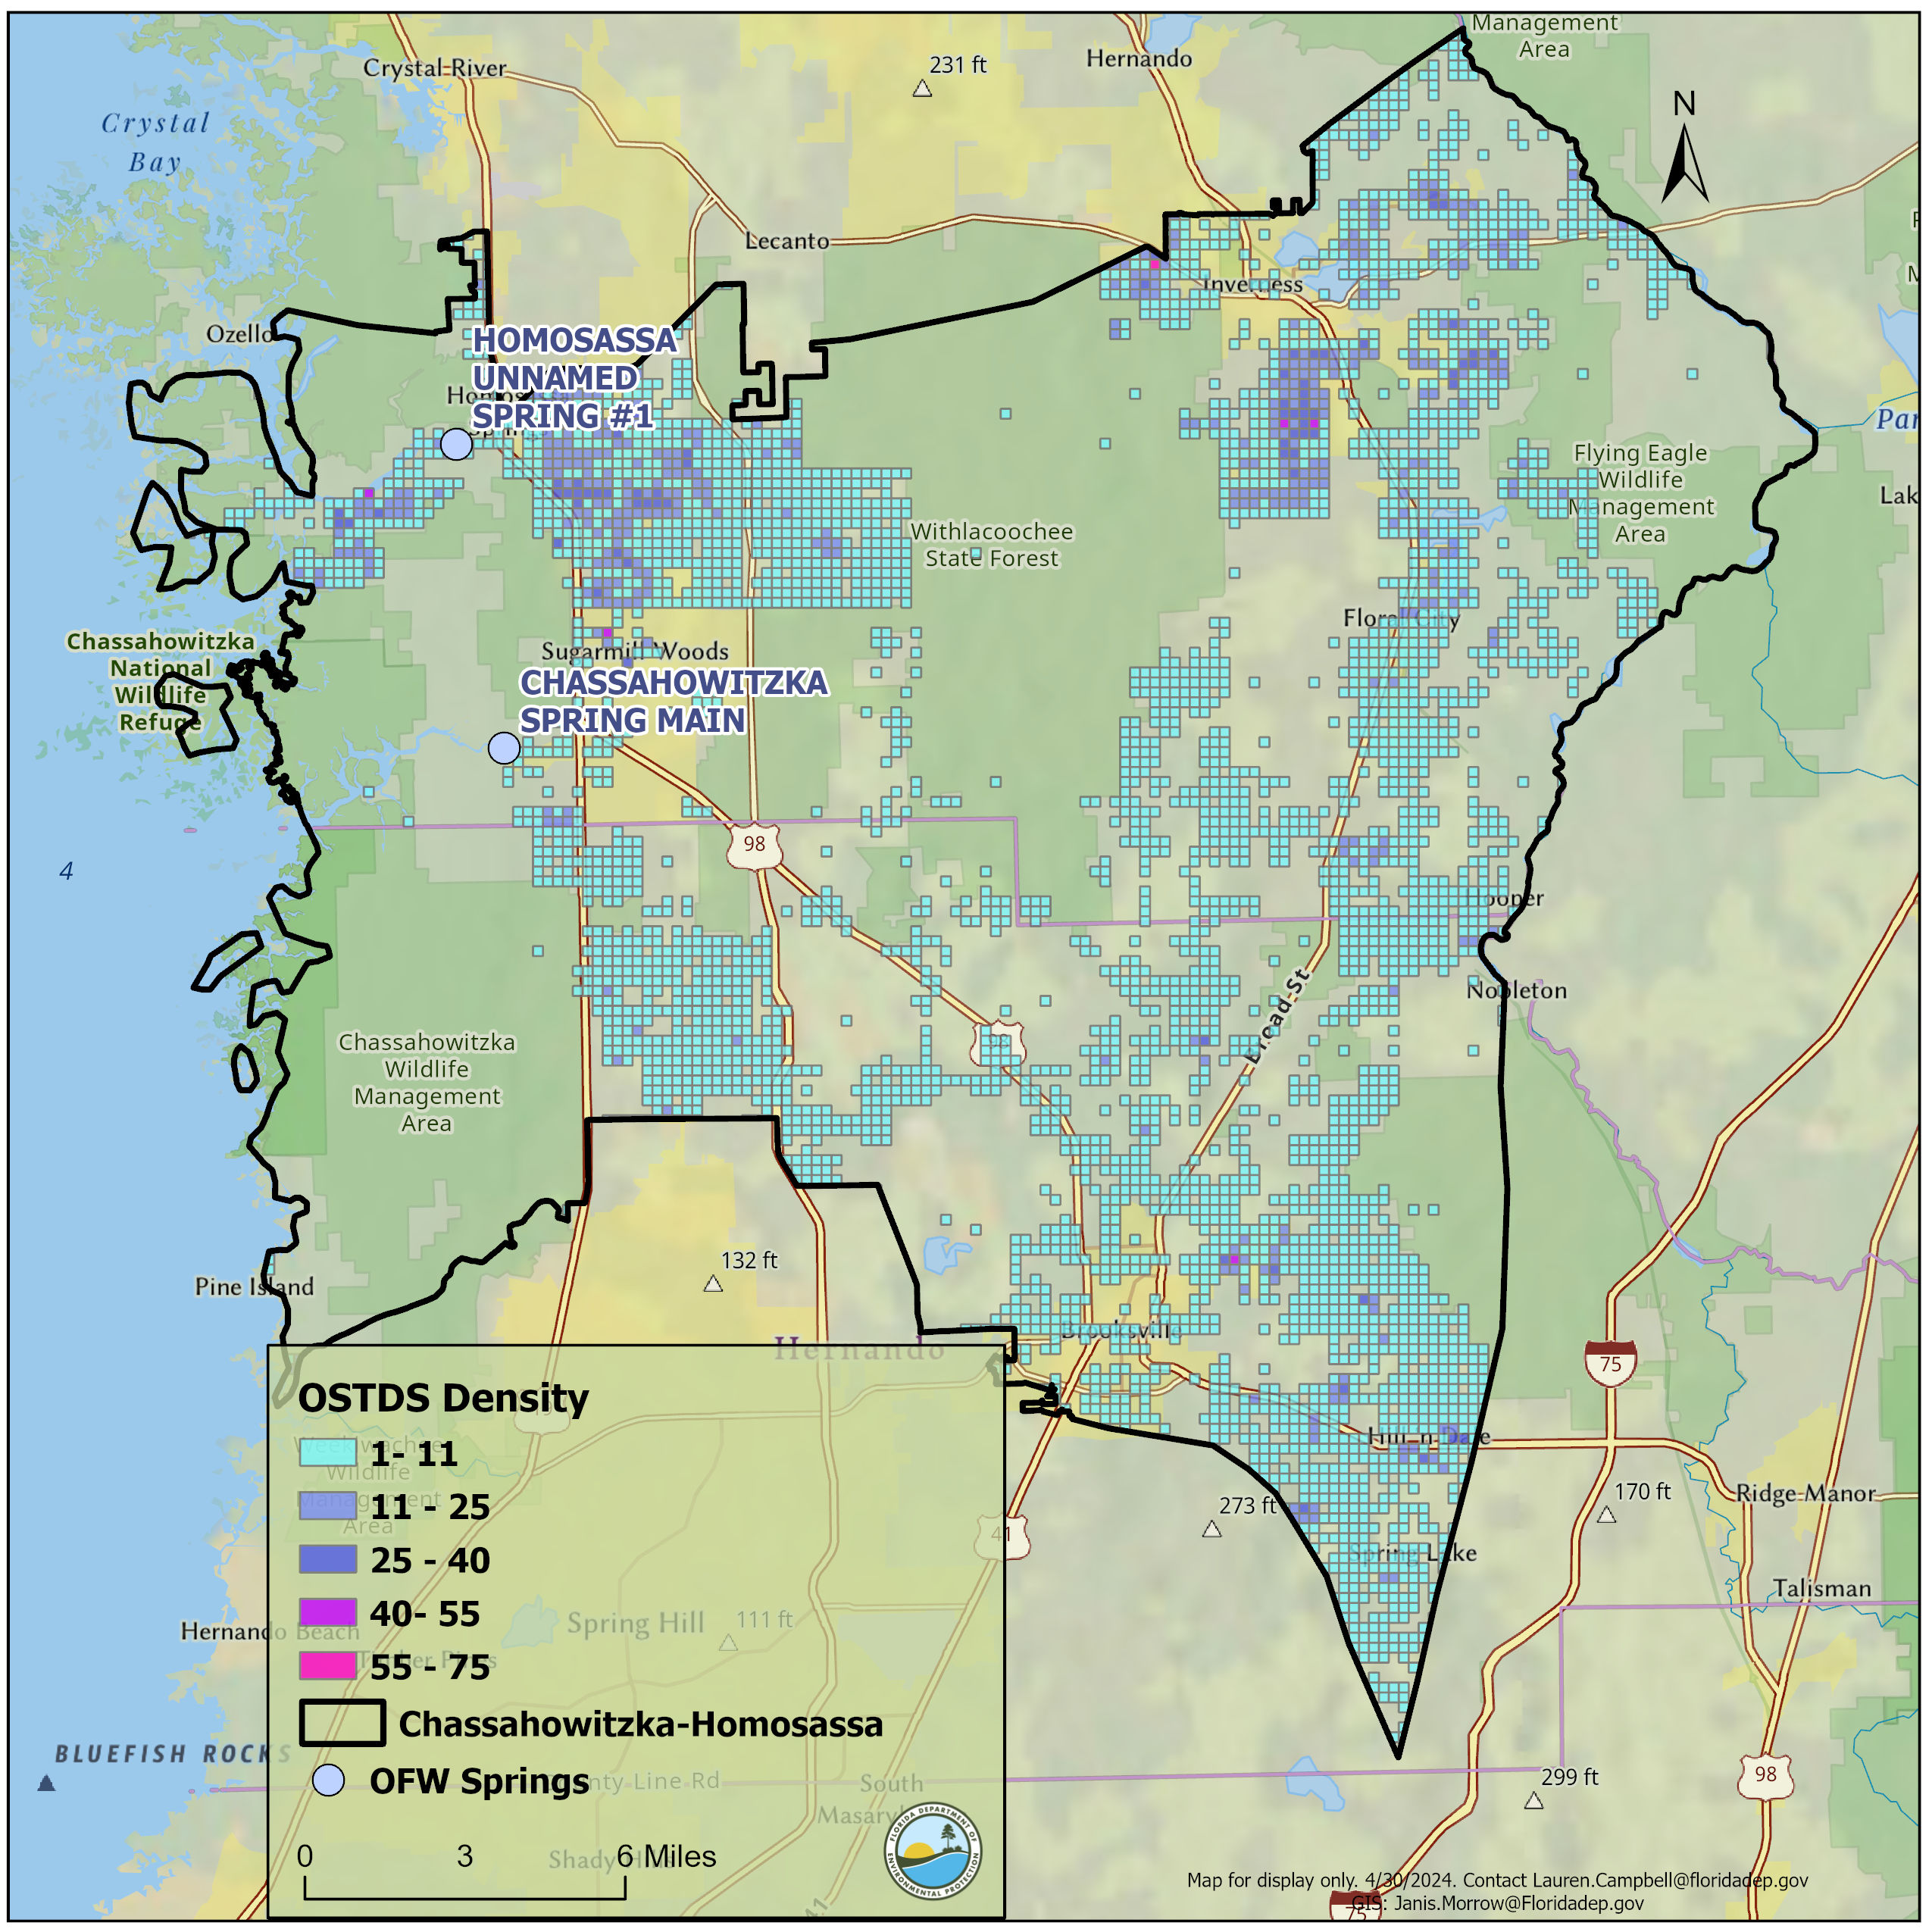
OSTDS
PROJECT IMPORTANCE
Homosassa/Chassahowitzka Springs BMAP
Weeki Wachee BMAP
*Density is per 300-meter by 300-meter grid cell.
Notes:
Estimated loading has been updated to 10 lb-N/year from 9.012 lb-N/year. No longer adjust for time away from home as this is captured in the estimated loading rate.

Slide 36
OSTDS
PROJECT IMPORTANCE
The results of the NSILT analysis for OSTDS in all five springsheds are presented in the table below.
Springshed | Number of OSTDS | Number of enhanced OSTDS | Est. Load to Drain Fields (lbs.-N/yr.) | Est. Load to Groundwater (lbs.-N/yr.)
Rainbow | 34,569 | 13 | 1,682,149 | 784,228
Kings Bay | 30,256 | 638 | 673,211 | 413,555
Homosassa | 16,947 | 56 | 364,522 | 215,178
Chassahowitzka | 5,598 | 199 | 132,376 | 81,452
Weeki Wachee | 44,726 | 1,114 | 1,048,663 | 641,621
Notes:
Estimated loading has been updated to 10 lb-N/year from 9.012 lb-N/year. No longer adjust for time away from home as this is captured in the estimated loading rate.

Slide 37
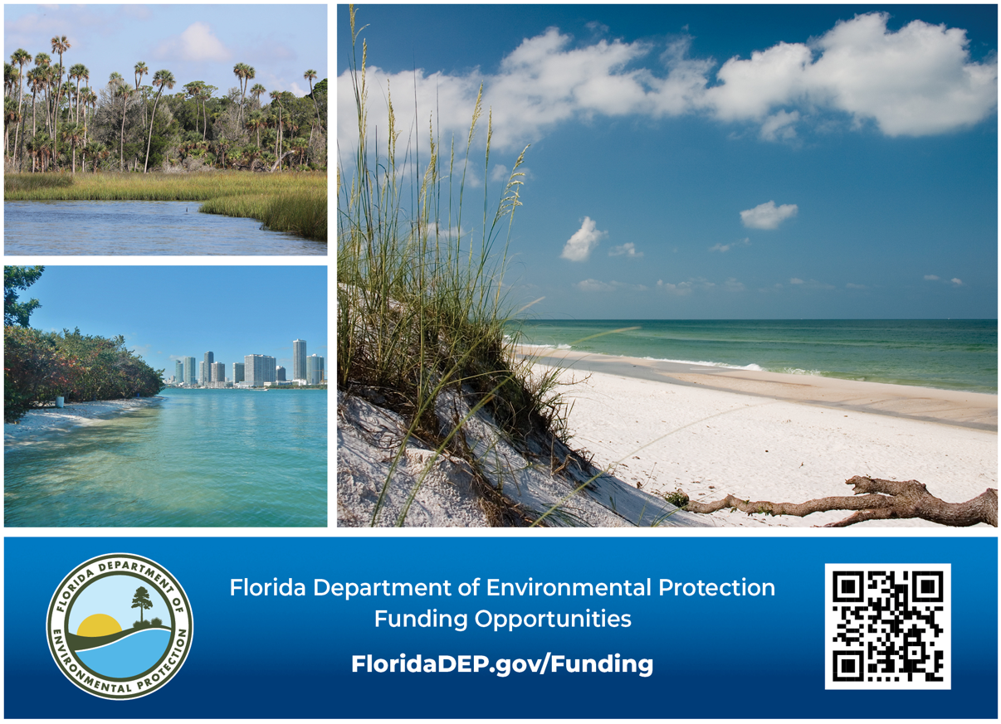
RESOURCES
FUNDING OPPORTUNITIES
Notes:
DEP provides opportunities for local governments and eligible entities to submit proposal for funding to protect and restore Florida's natural resources. Open May1- June 30 2024.

Slide 38
SPRINGS BMAP UPDATES TIMELINE
Individual meetings on allocations and milestones with BMAP stakeholders.
Final wastewater and OSTDS plans due from stakeholders.
Two more public meetings on allocations, milestones and the draft BMAP document.
May- Aug. 2024
Aug.1, 2024
June- Sept. 2024
June- Dec. 2024
Dec. 2024
Technical analysis and drafting the BMAP documents.
Final Draft BMAP documents.
Statutory deadline for updated nutrient BMAPs.
July 1, 2025

Slide 39
THANK YOU
Chandler Keenan
Environmental Consultant
850-245-8555
Chandler.B.Keenan@FloridaDEP.gov
Jessica Fetgatter
Environmental Consultant
850-245-8107
Jessica.Fetgetter@FloridaDEP.gov
Lauren Campbell, Ph.D.
Environmental Administrator
850-245-8083
Lauren.Campbell@FloridaDEP.gov

