Slide 1
Agricultural Best Management Practices (BMPs)
In the Springs Coast BMAP Areas
Holly Edmond
Office of Agricultural Water Policy
August 2014

Slide 2
Agricultural Best Management Practices (BMPs)
  BMPs are practical measures that reduce the amount of fertilizers, pesticides, animal waste, and other pollutants entering our water resources
    Determined through research, field-testing, and expert review
    Designed to improve water quality while maintaining agricultural production.
  Adopted by FDACS, collection of practices in each manual is verified effective by FDEP
    BMP manuals developed in collaboration with ag industry, agencies, other stakeholders
  Must be economically and technically feasible for the producer to implement
    When funding is available, FDACS works with producers to secure cost-share for some BMPs

Slide 3
Florida Watershed Restoration Act
(section 403.067, F.S.)
Authorizes FDACS to develop BMPs for agricultural nonpoint sources to help meet Total Maximum Daily Loads (TMDLS) and otherwise protect water quality.
Implementation of FDACS BMPs, according to rule*, provides a “presumption of compliance” with state water quality standards for the pollutants addressed by the BMPs (e.g., nitrogen, phosphorus, etc.).
* FDACS rules require submittal of Notice of Intent (includes checklist of practices), implementation of applicable practices, and record keeping.

Slide 4
Agriculture’s Role in Water Quality Protection
The Legislature provided for agricultural operations to implement BMPs as the preferred means to help meet TMDLs and otherwise protect water quality.
Agricultural operations within BMAP areas, and within the Northern Everglades, have two options*:
  Enroll in and implement FDACS BMPs
  Or
  Follow an FDEP- or WMD-prescribed water quality monitoring plan at the producer’s own expense (complicated and costly)
  * Failure to do either could bring enforcement action by FDEP or the applicable WMD

Slide 5
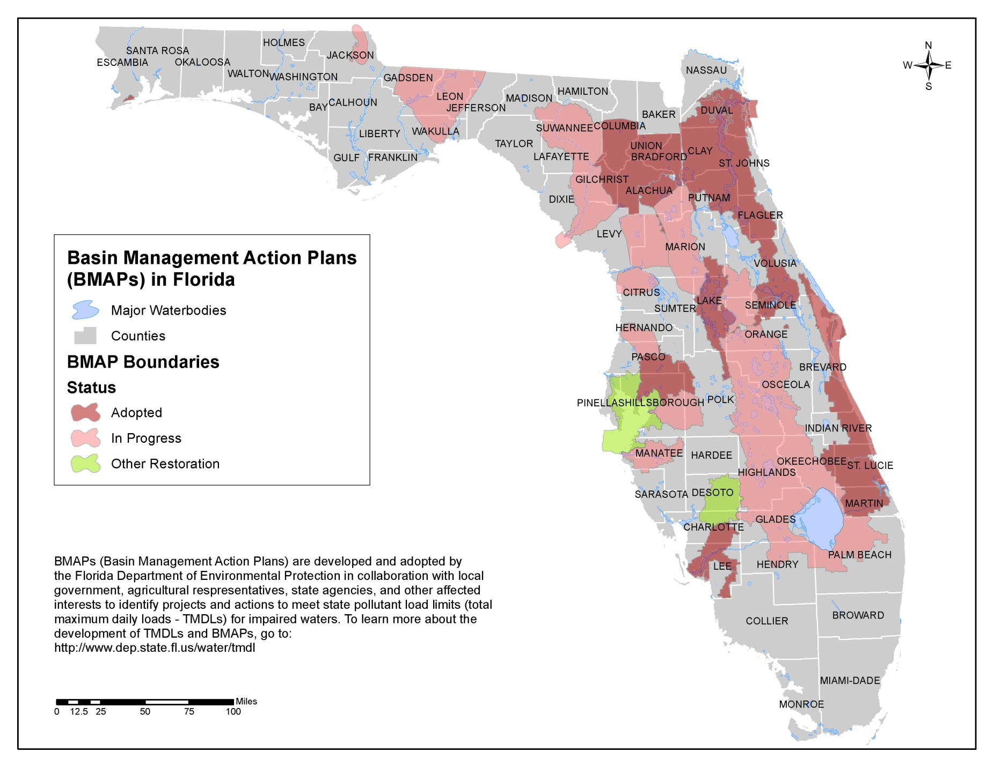

Slide 6
FDACS BMP Programs
Focus is on Commercial Agricultural Operations
Citrus: Statewide manual adopted January 2013
Vegetable/Row Crop: Adopted 2005, under revision
Nursery: Container nursery manual adopted 2006, statewide manual (includes container, field, and cut foliage) adopted June 2014
Sod: Adopted 2008
Cow/Calf: Adopted 2009
Conservation Plan Rule: Adopted 2010
Specialty Fruit/Nut: Adopted 2011
Equine: Adopted 2011
Forestry: Program under the Florida Forest Service
Aquaculture: Division of Aquaculture Certification Program

Slide 7
Benefits of Participating in FDACS BMPs
Demonstrates environmental stewardship and strengthens support for BMP approach
Some practices increase efficiencies/reduce costs
Provides presumption of compliance with state water quality standards
Protection from duplicative regulation by local government – for activities addressed by implemented BMPs
Eligibility for state-funded cost share
May satisfy some WMD permit requirements (check with your WMD)

Slide 8
Statewide BMP Enrollment
as of June 30, 2014
Statewide Non-Forestry – 4.16 million acres, including (rounded numbers):
Cow/Calf – 2.3 million acres
Row Crops – 1.04 million acres
Citrus – 581,000 acres
All other - 239,000 acres
Statewide Forestry (rounded number): 5.3 million acres

Slide 9
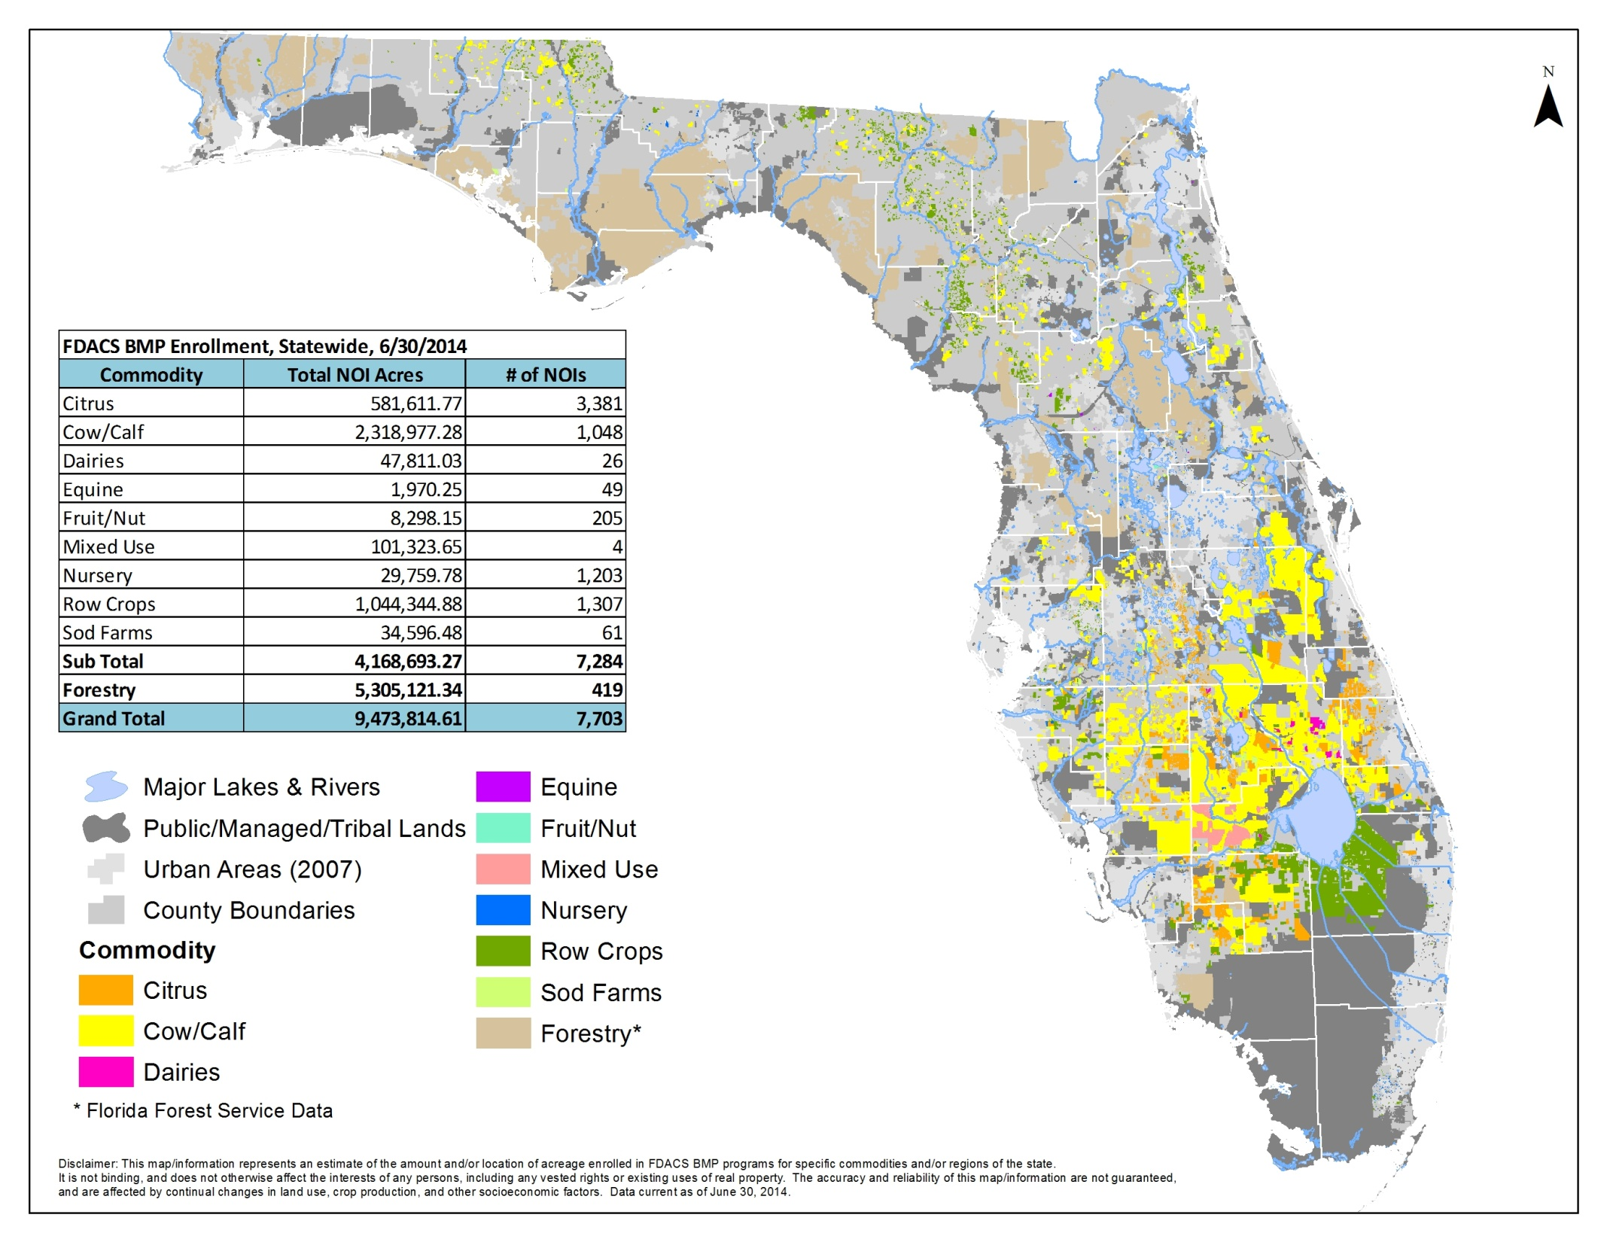

Slide 10
Agricultural Land Use in the Proposed Weeki Wachee BMAP Area
2009 SWFWMD Land Use | 2009 Acres
Cropland and Pastureland | 29,167.3
Rangeland | 3,900.6
Specialty Farms | 1,228.7
Row Crops | 118.3
Tree Crops | 1,503.6
Nurseries and Vineyards | 601.8
Feeding Operations | 206.2
Other Open Lands (Rural)* | 3,856.7
TOTAL | 40,583.2
* Land in this category may not need to be enrolled as it is possible that there is no agricultural production on the land

Slide 11
Agricultural Land Use in the Proposed Kings Bay/
Crystal River BMAP Area
2009 SWFWMD Land Use | 2009 Acres
Cropland and Pastureland | 10,436.4
Rangeland | 2,030.1
Specialty Farms | 338.5
Row Crops | 69.2
Nurseries and Vineyards | 86.2
Other Open Lands (Rural)* | 4,147.3
Tropical Fish Farms | 9.7
TOTAL | 17,117.4
* Land in this category may not need to be enrolled as it is possible that there is no agricultural production on the land

Slide 12
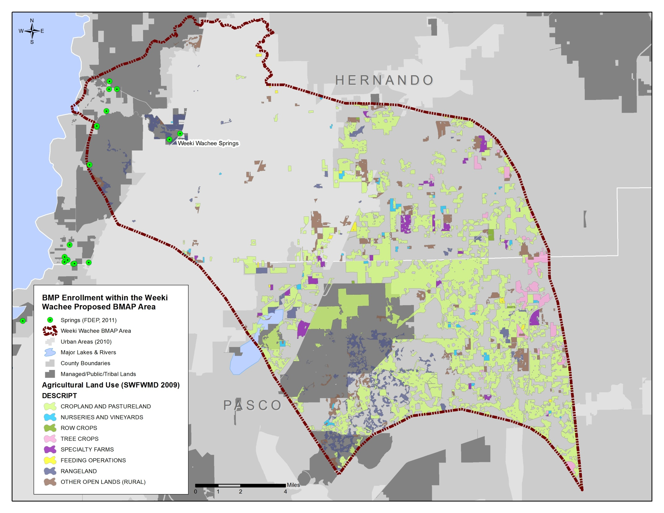
Agricultural Land Use within the Proposed Weeki Wachee BMAP

Slide 13
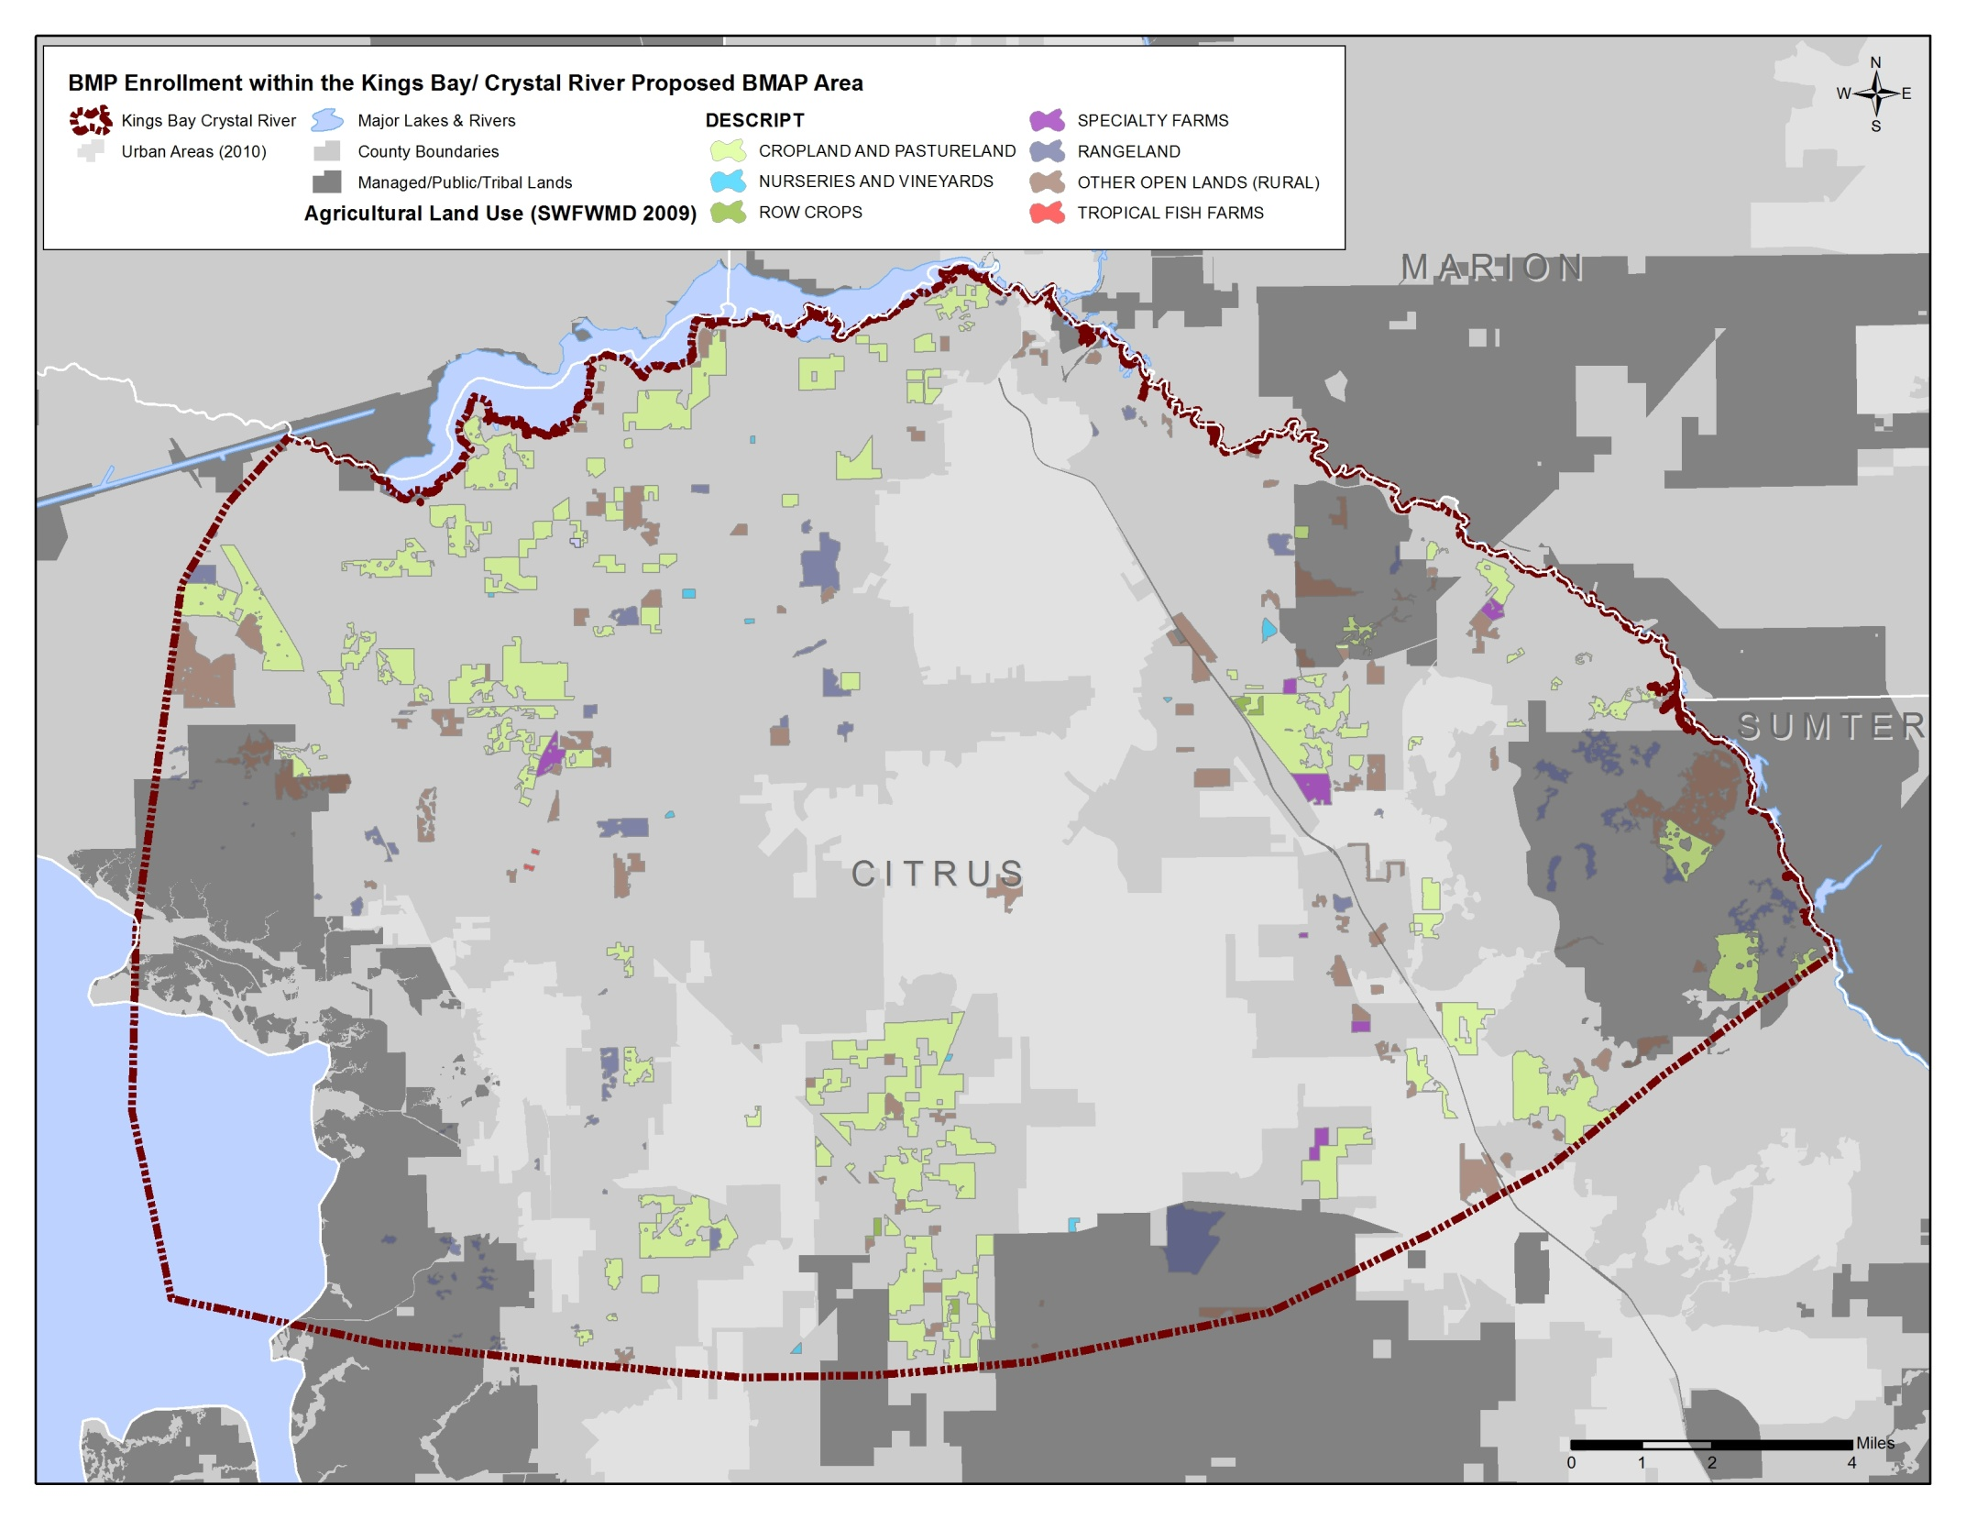
Agricultural Land Use within the Proposed Kings Bay/Crystal River BMAP

Slide 14
BMP Enrollment in Weeki Wachee Proposed BMAP Area
as of June 30, 2014
Non-Forestry Agricultural Acreage Enrolled – 8,624 acres (21% of ag land use acreage):
Cow/Calf – 8,042 acres
Nursery – 245 acres
Citrus – 238 acres
Fruit/Nut – 87 acres
Row Crops – 12 acres

Slide 15
BMP Enrollment in Kings Bay/
Crystal River Proposed BMAP Area
as of June 30, 2014
No enrollment yet – lots of opportunity!

Slide 16
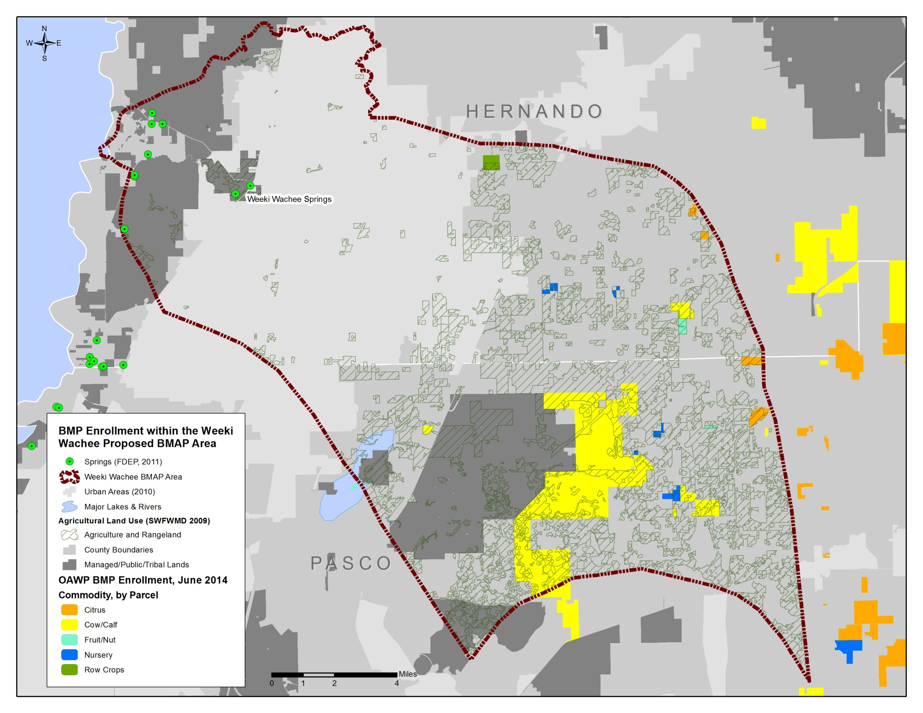

Slide 17
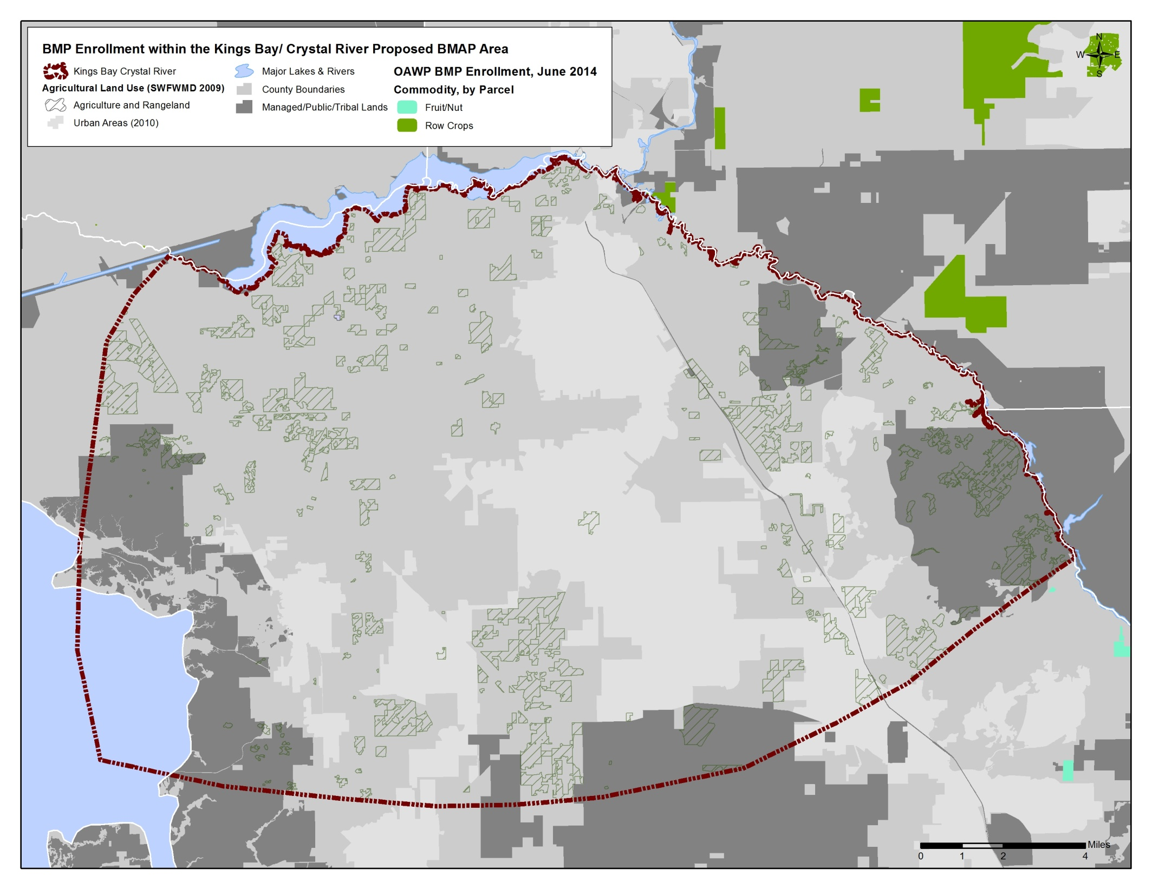

Slide 18
Types and Categories of BMPs
BMP Types:
Management BMPs - Such as nutrient and irrigation management, comprise the majority of practices and often are not readily observable. Generally affordable.
Structural BMPs - Involve the installation of structures or changes to the land. These BMPs include water control structures, fencing, and tailwater recovery systems, among others. Sometimes require cost share to be economically feasible.
Key BMP Categories:
Nutrient Management
Irrigation Management
Sedimentation and Erosion Control
Water Resources Protection

Slide 19
Key BMP Categories
  Nutrient Management - Provide necessary crop nutrients while protecting against adverse environmental effects. Soil testing, plant tissue testing to determine appropriate nutrients and rates; fertilizer application timing and placement, etc.
  Irrigation Management - Control the volume and frequency of irrigation water applied, to meet water needs of crops while conserving water resources
Sedimentation and Erosion Control - Prevent sediment loss, slow water flow, and/or trap or collect debris and sediments in runoff
Water Resources Protection (riparian, wetlands, springs, aquifers) – Minimize adverse impacts to water resources through preventative measures, such as conservation buffers, wellhead protection, and backflow prevention.

Slide 20
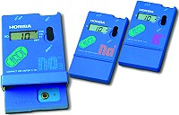
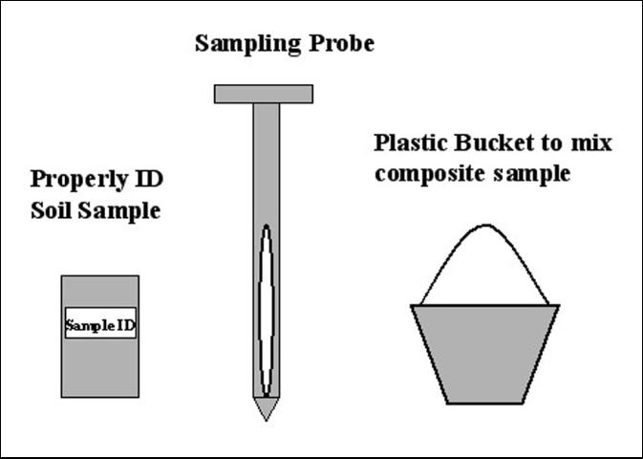
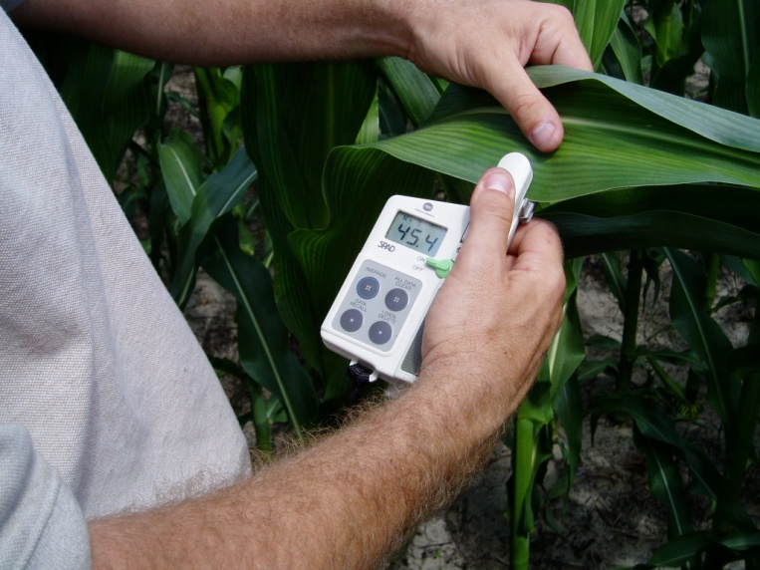
Examples of BMPs - Nutrient Management
Tissue Test Meter
Soil and pH Analysis

Slide 21
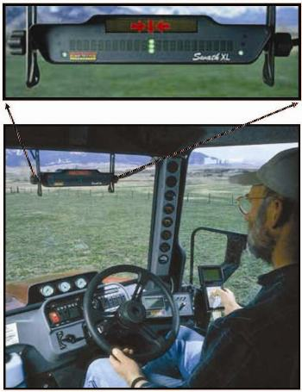
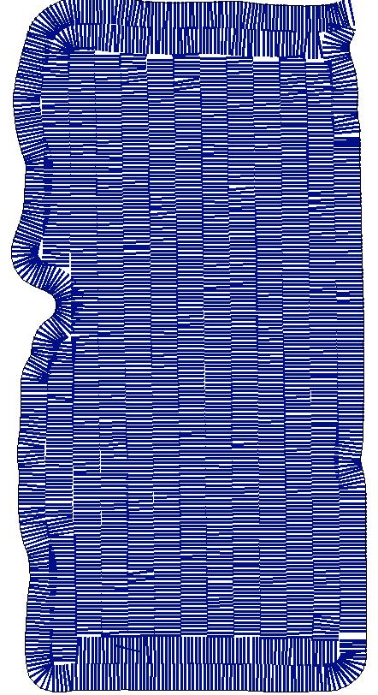
Examples of BMPs - Nutrient Management
Tractor-Mounted Navigation Equipment

Slide 22
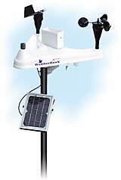
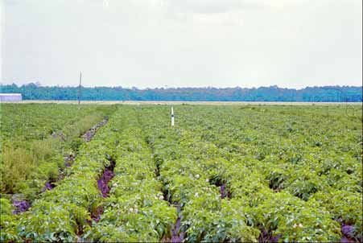
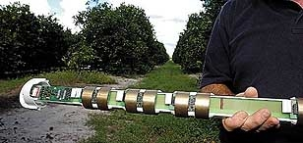
Examples of BMPs - Irrigation Management
Weather Stations
Observation Wells
Soil Moisture Monitoring

Slide 23
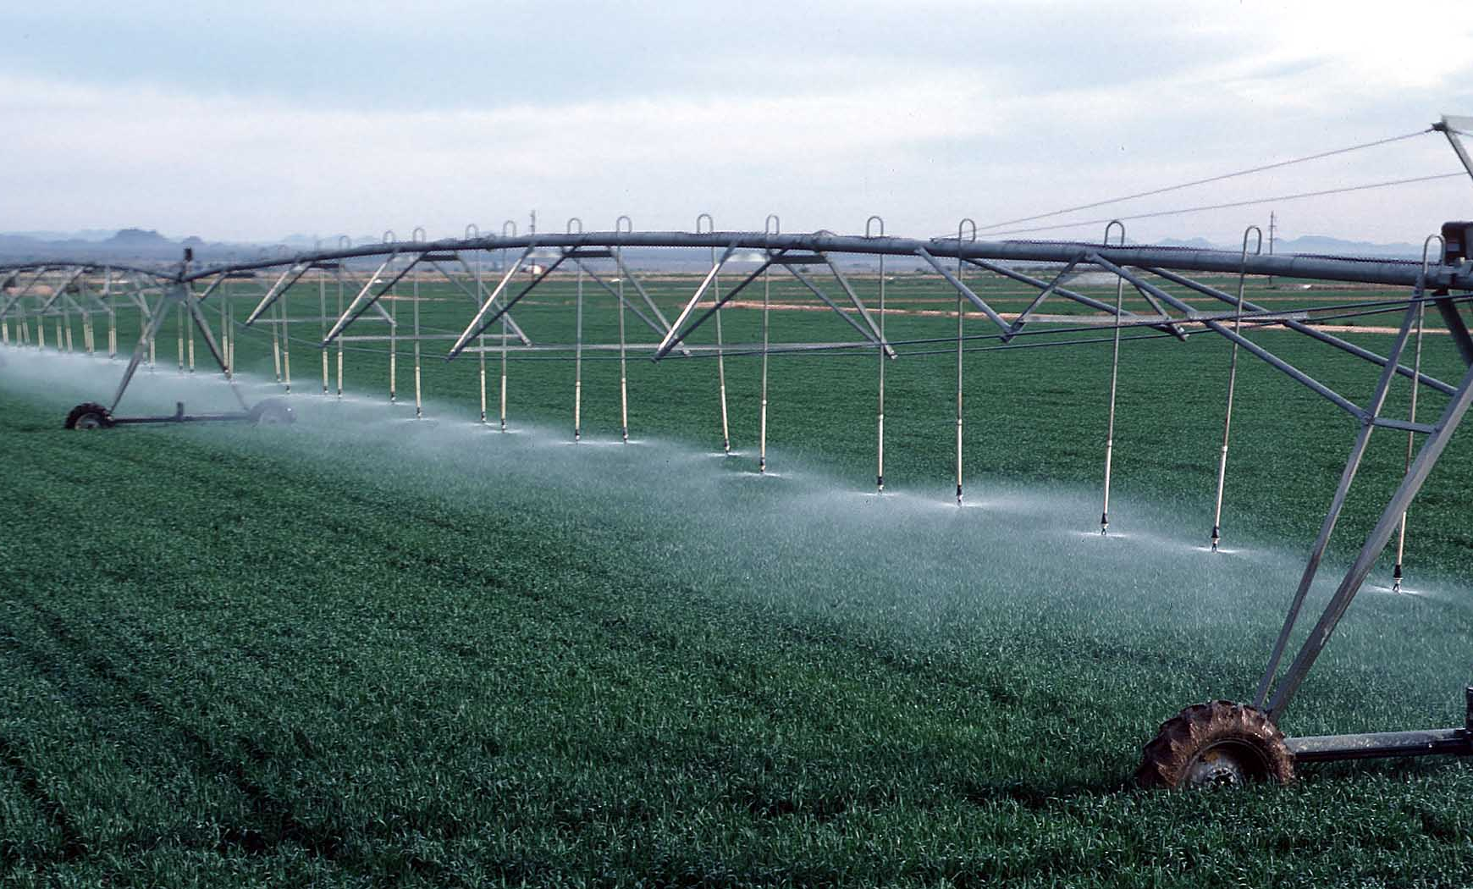
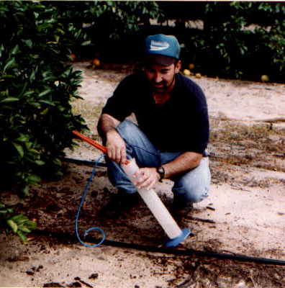
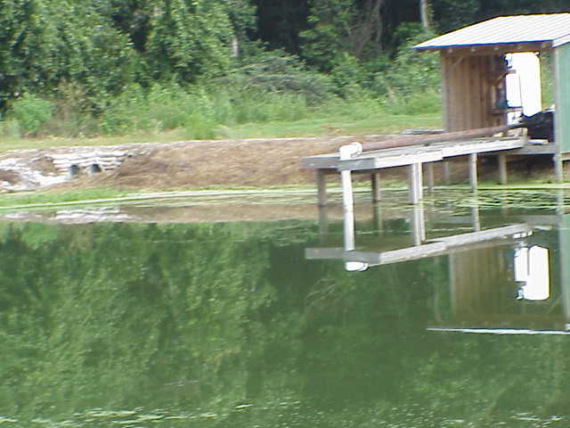
Examples of BMPs - Irrigation Management
Irrigation System Retrofits
Mobile Irrigation Labs
Tailwater Recovery

Slide 24
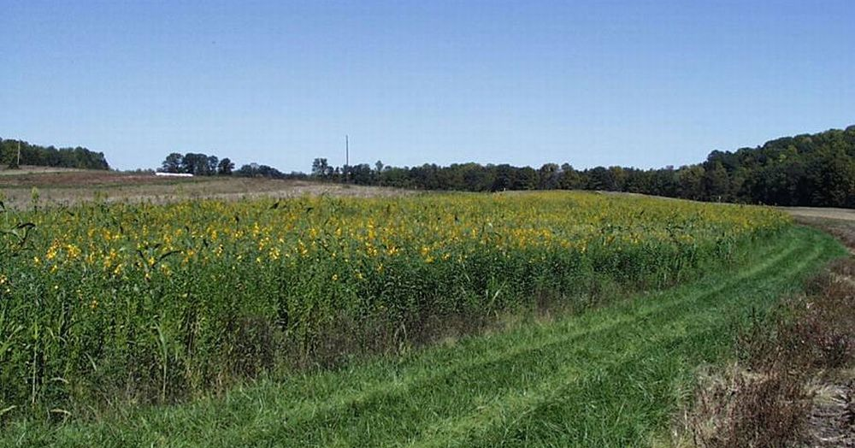
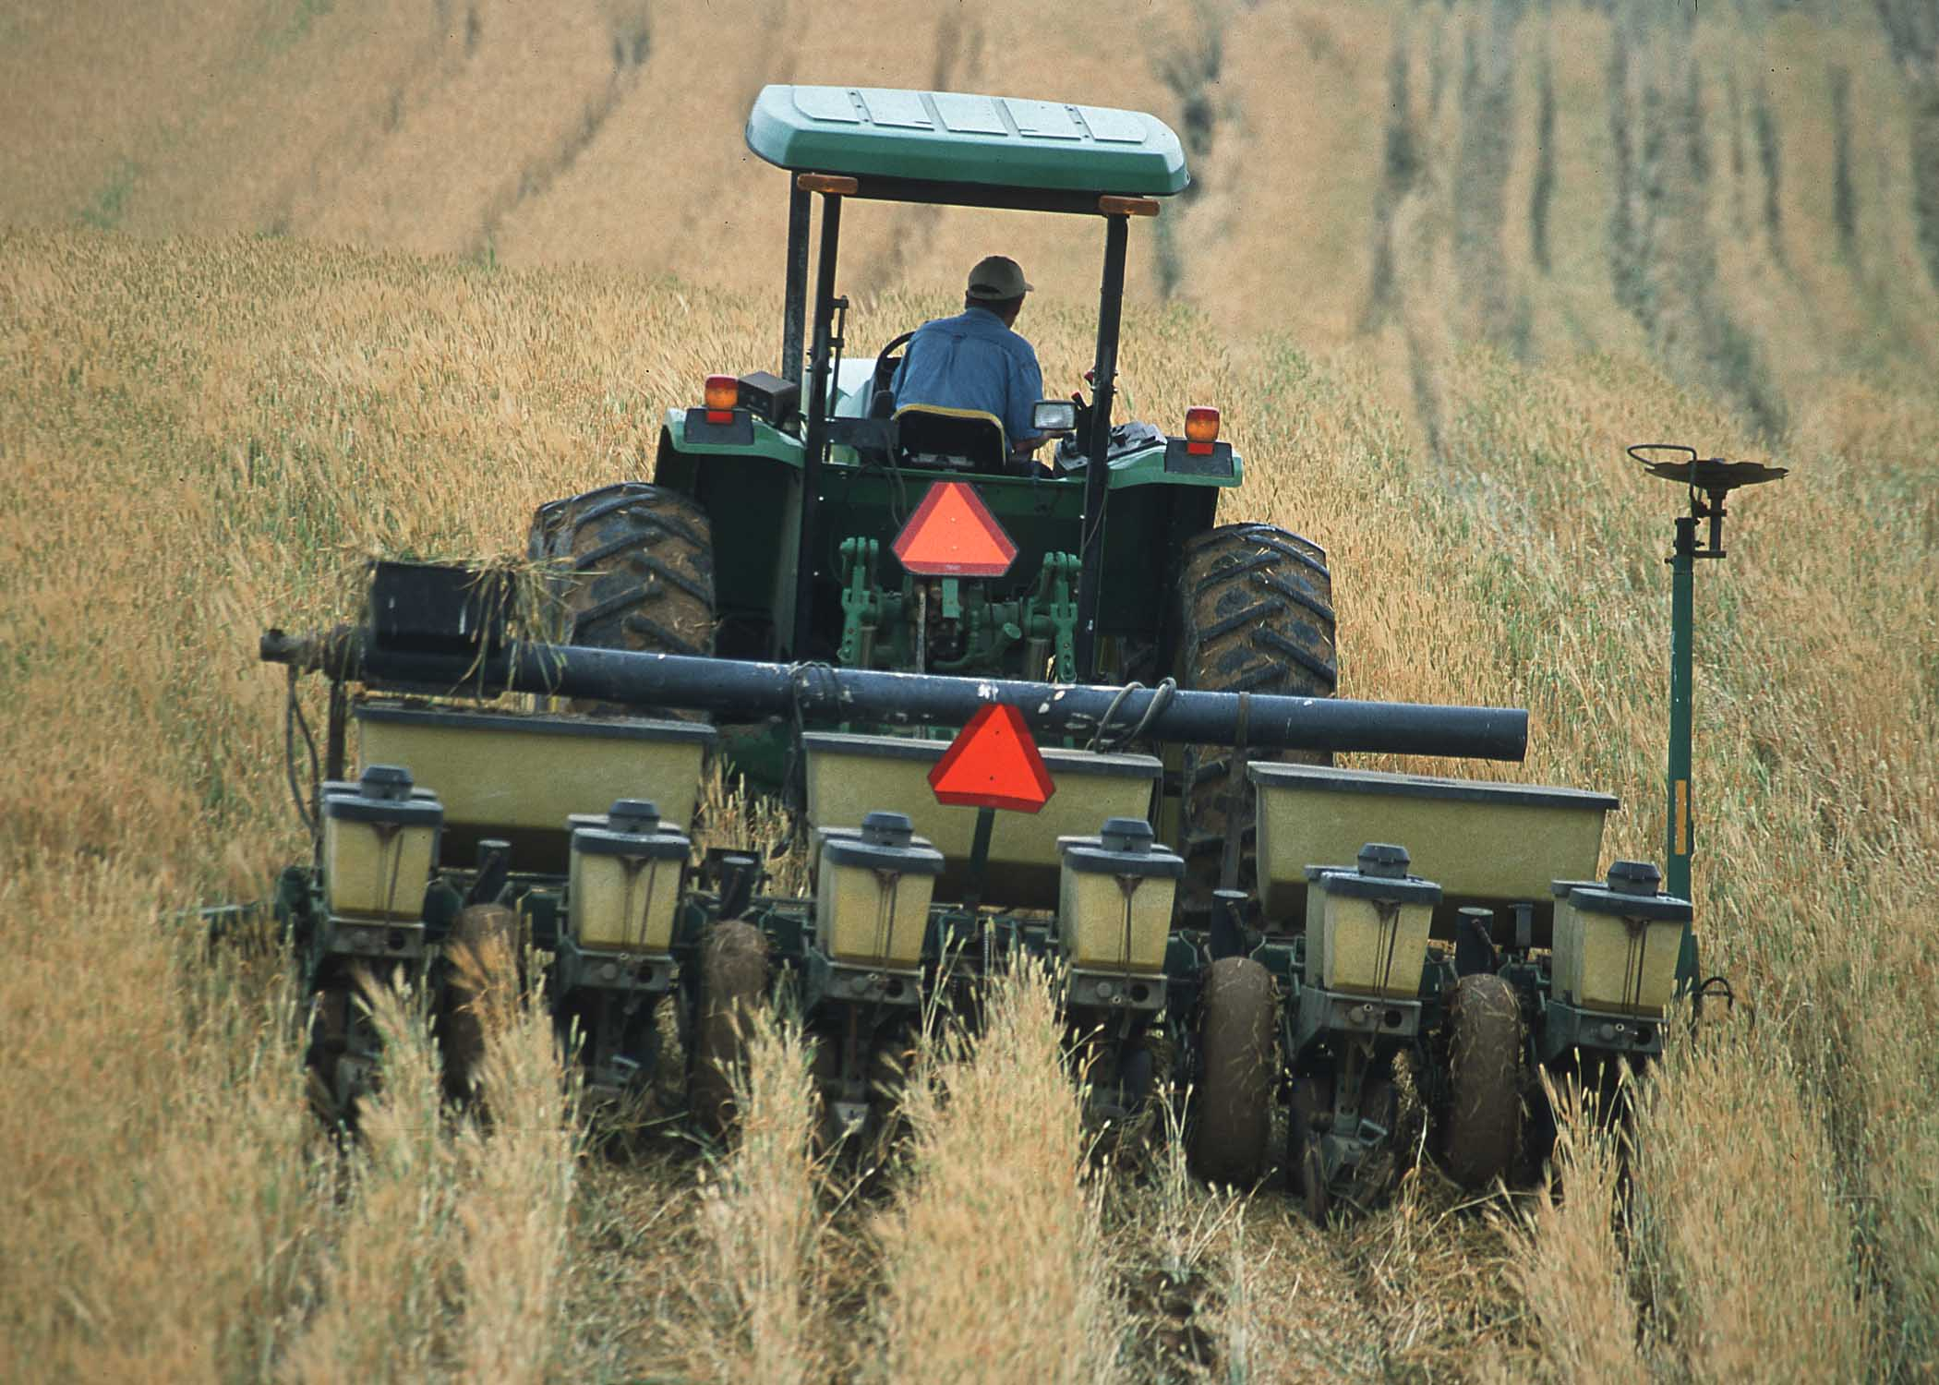
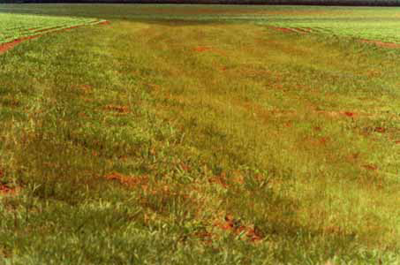
Examples of BMPs - Sedimentation/Erosion Control
Cover Crops
Conservation Tillage
Grassed Waterways/Filter Strips

Slide 25
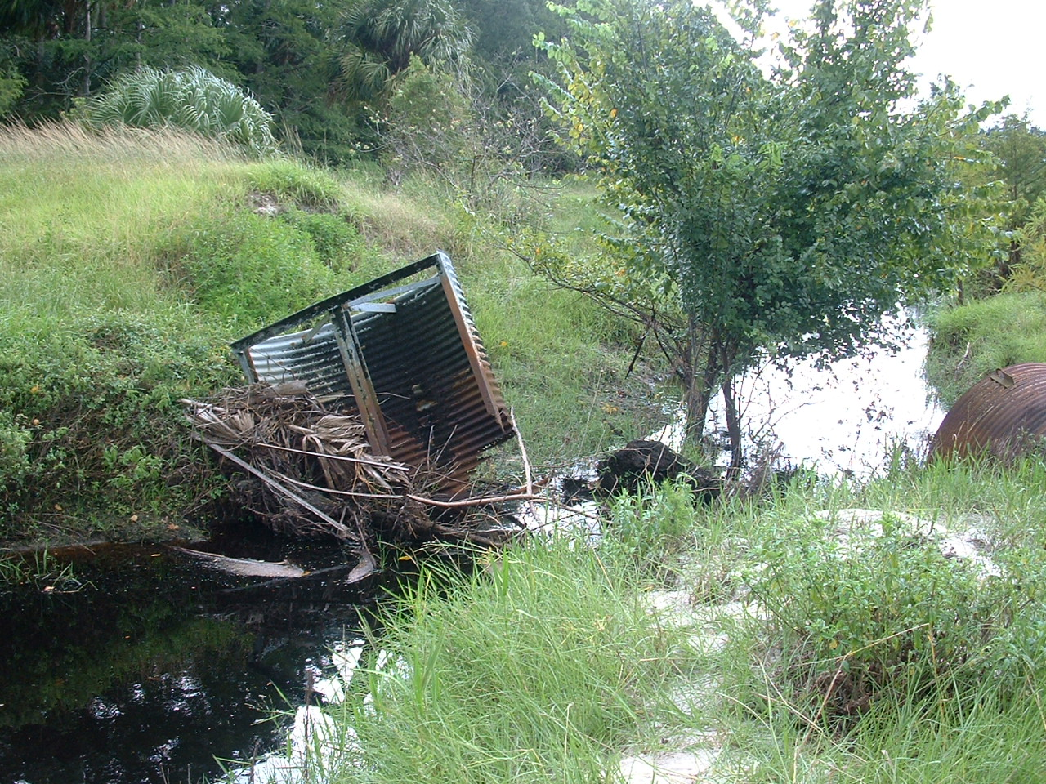
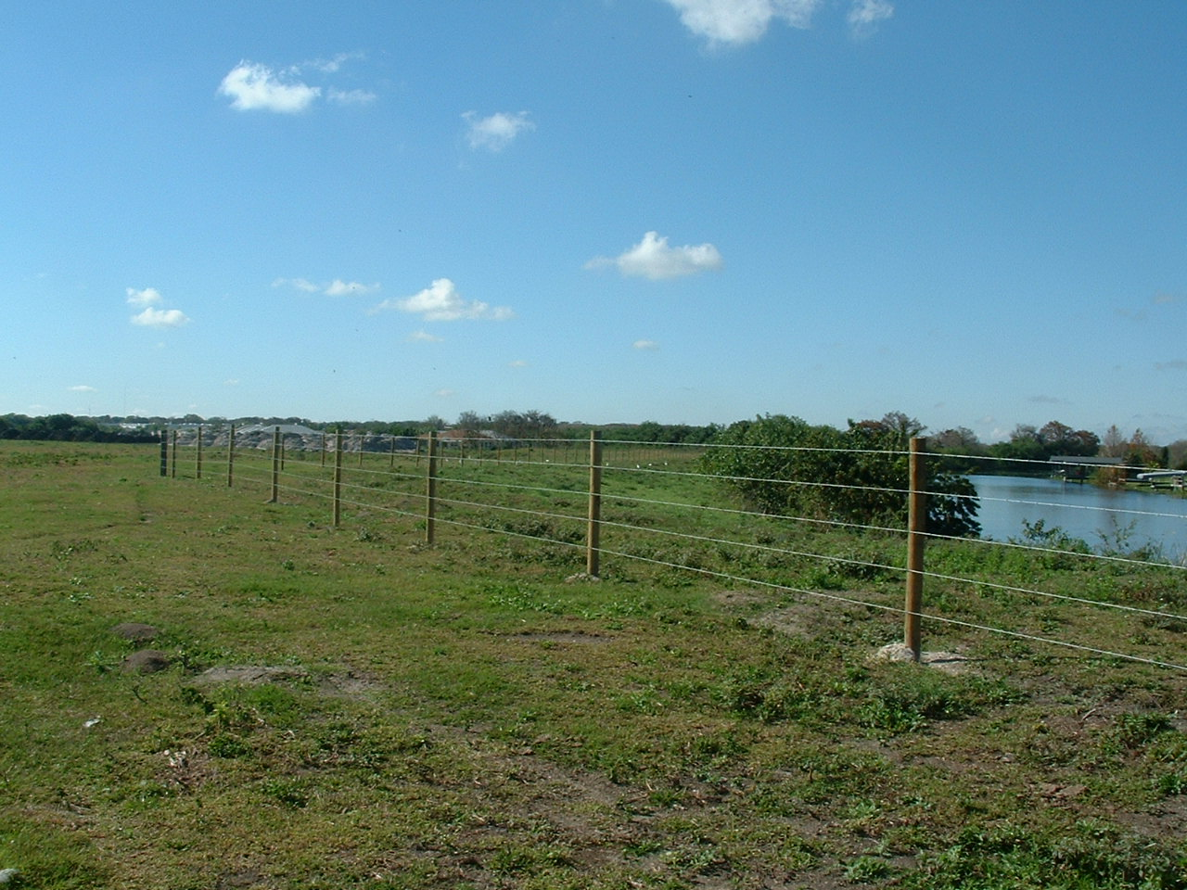
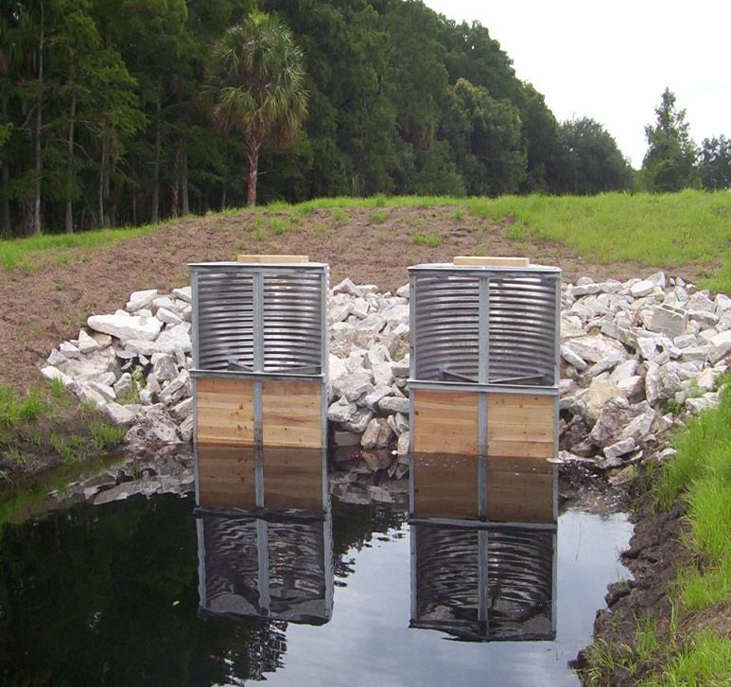
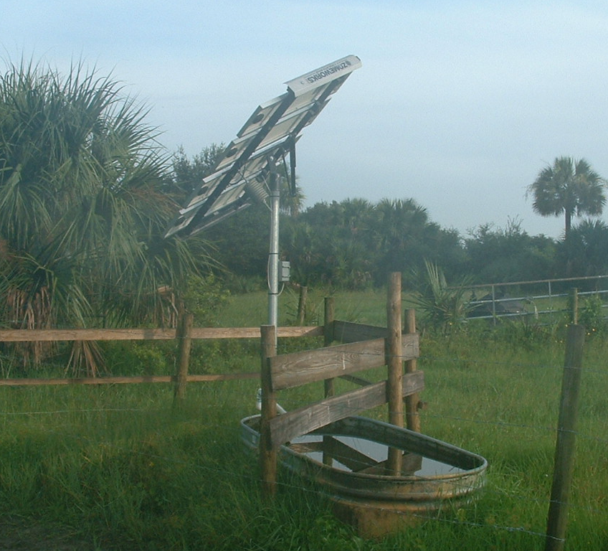
Examples of BMPs - Water Resources Protection
Replace
Water
Control
Structures
Critical
Area
Fencing
Watering Troughs

Slide 26
Participating in BMPs - How to Enroll
Schedule an on-site visit with a BMP team member, who will provide a free FDACS BMP manual and other BMP-related information.
Participate in the free assessment of your operation, to determine which BMPs apply to you.
Fill out a BMP checklist and sign the Notice of Intent (NOI) to implement the BMPs.
Keep a copy of the checklist and signed NOI in your records.
Implement and maintain the applicable BMPs and keep records as instructed in the manual, to maintain a presumption of compliance with state water quality standards.
You may request a Certificate of Enrollment in BMPs through
a BMP team member, or by contacting FDACS at (850) 617-1727 or AgBmpHelp@FreshFromFlorida.com

Slide 27
Participating in BMPs - Preparing for Enrollment
Review the relevant BMP manual before the site assessment, and jot down any questions you have about the BMPs, unfamiliar terms, or other manual contents. You can get the manuals at: http://www.FloridaAgWaterPolicy.com/ .
Be ready to confirm the tax parcel IDs of land to be enrolled in the program, to ensure the accuracy of the NOI.
Have someone available the day of the visit who is familiar with the nutrient and irrigation regimes of the operation.
During the visit, the BMP team member will discuss with you any resource concerns (impacts to wetlands, streams, sinkholes, springs, etc.), help identify what BMPs to implement, and assist with completing the BMP checklist and NOI.

Slide 28
Participating in BMPs - After Enrolling
Document through record keeping, as specified in FDACS rules and BMP manuals. This is sometimes the only way to confirm BMP implementation.
BMP records should be accurate, clear, and well-organized. You may develop your own record-keeping forms or use the ones provided in the manual.
FDACS BMP team members, soil and water conservation districts, USDA-NRCS and/or county Extension staff can assist producers with BMP implementation and record-keeping methods.
Cost share may be available for certain practices.

Slide 29
Participating in BMPs - After Enrolling
90-day follow-up
A BMP team member will check in within 90 days of enrollment to see whether there are questions or assistance is needed
BMP Implementation Assurance
  Written surveys to get producer feedback on BMP implementation –
    Helps evaluate effectiveness of programs/identify producer needs
  Some site visits conducted, scheduled at grower’s convenience
    To review key BMPs, discuss questions, provide technical assistance
    LSJR compliance process

Slide 30
Cost Share Funding
Several cost share funding programs are expected to be available in the Springs Coast BMAP areas during the next fiscal year
$250,000 within SWFWMD; all commodities, administered through Hillsborough SWCD
Statewide funding for weather stations, administered through Highlands SWCD
SWFWMD’s FARMS program; all commodities, but focus is on larger commercial operations (> 100 ac)

Slide 31
Thank You!
Holly Edmond
Office of Agricultural Water Policy – Tallahassee
(850) 617-1727
AgBMPHelp@FreshFromFlorida.com
Local Contact:
Jessica Stempien (OAWP - SWFWMD)
JessicaLea.Stempien@freshfromflorida.com
(813) 985-7481

