Slide 1

Division of Environmental Assessment and Restoration
Basin Management Action Plan Weeki Wachee Basin
Terry.hansen@dep.state.fl.us August 2014

Slide 2
CWA/TMDL Process
Restoration Plan

Slide 3
Basin Management Action Plan
The Department’s method for restoring water quality to an impaired water body.
BMAPs are adopted by FDEP through a Secretarial Order.
BMAPs are enforceable.

Slide 4
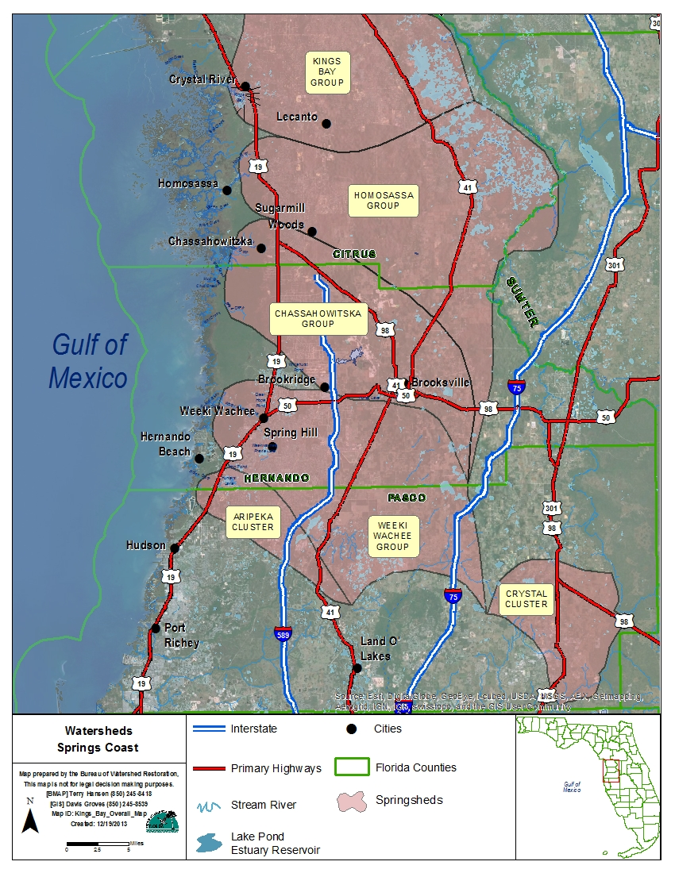
TMDLs are being completed for all the springs in the Springs Coast Area.

Slide 5
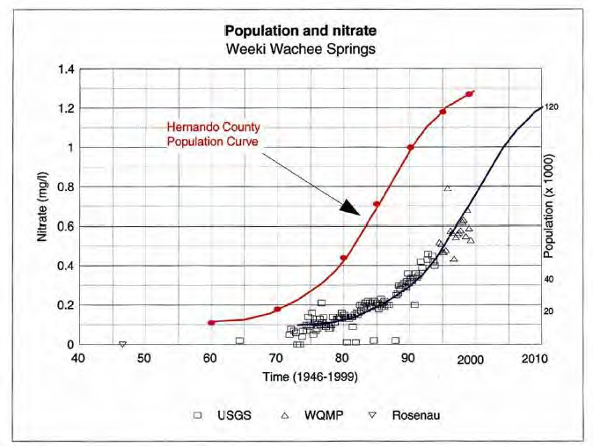

Slide 6
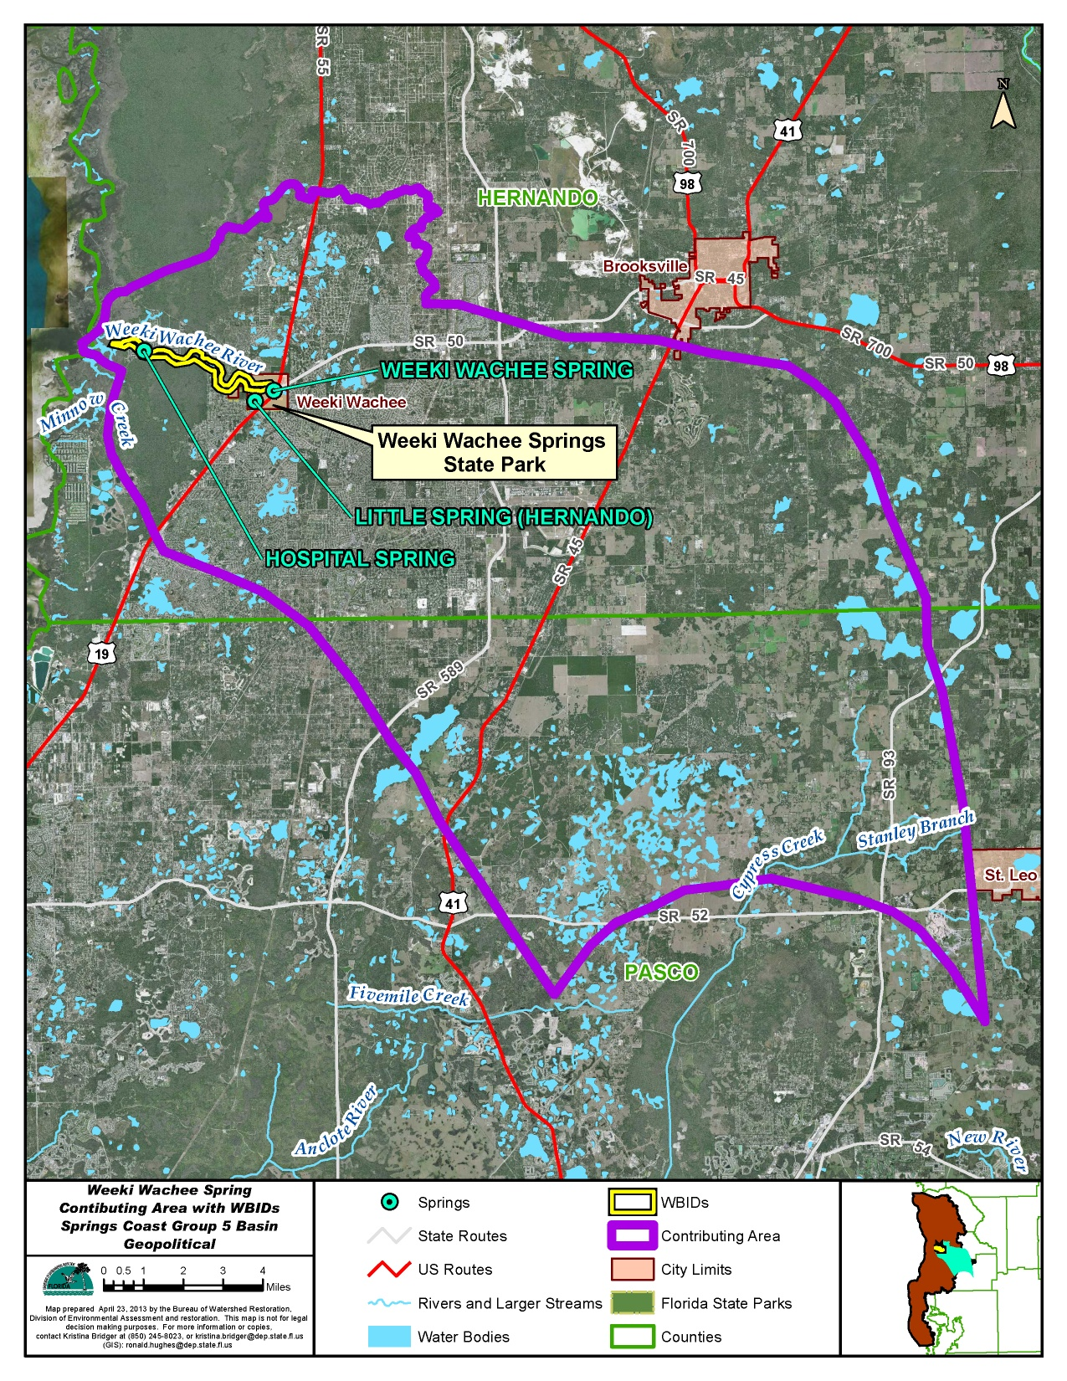
Weeki Wachee Area
Spring - WBID 1382B
TMDL 71.1% reduction to achieve 0.28mg/l nitrate as annual average
River – WBID 1382F
TMDL 77.3% reduction to achieve 0.20 mg/l nitrate as annual average

Slide 7
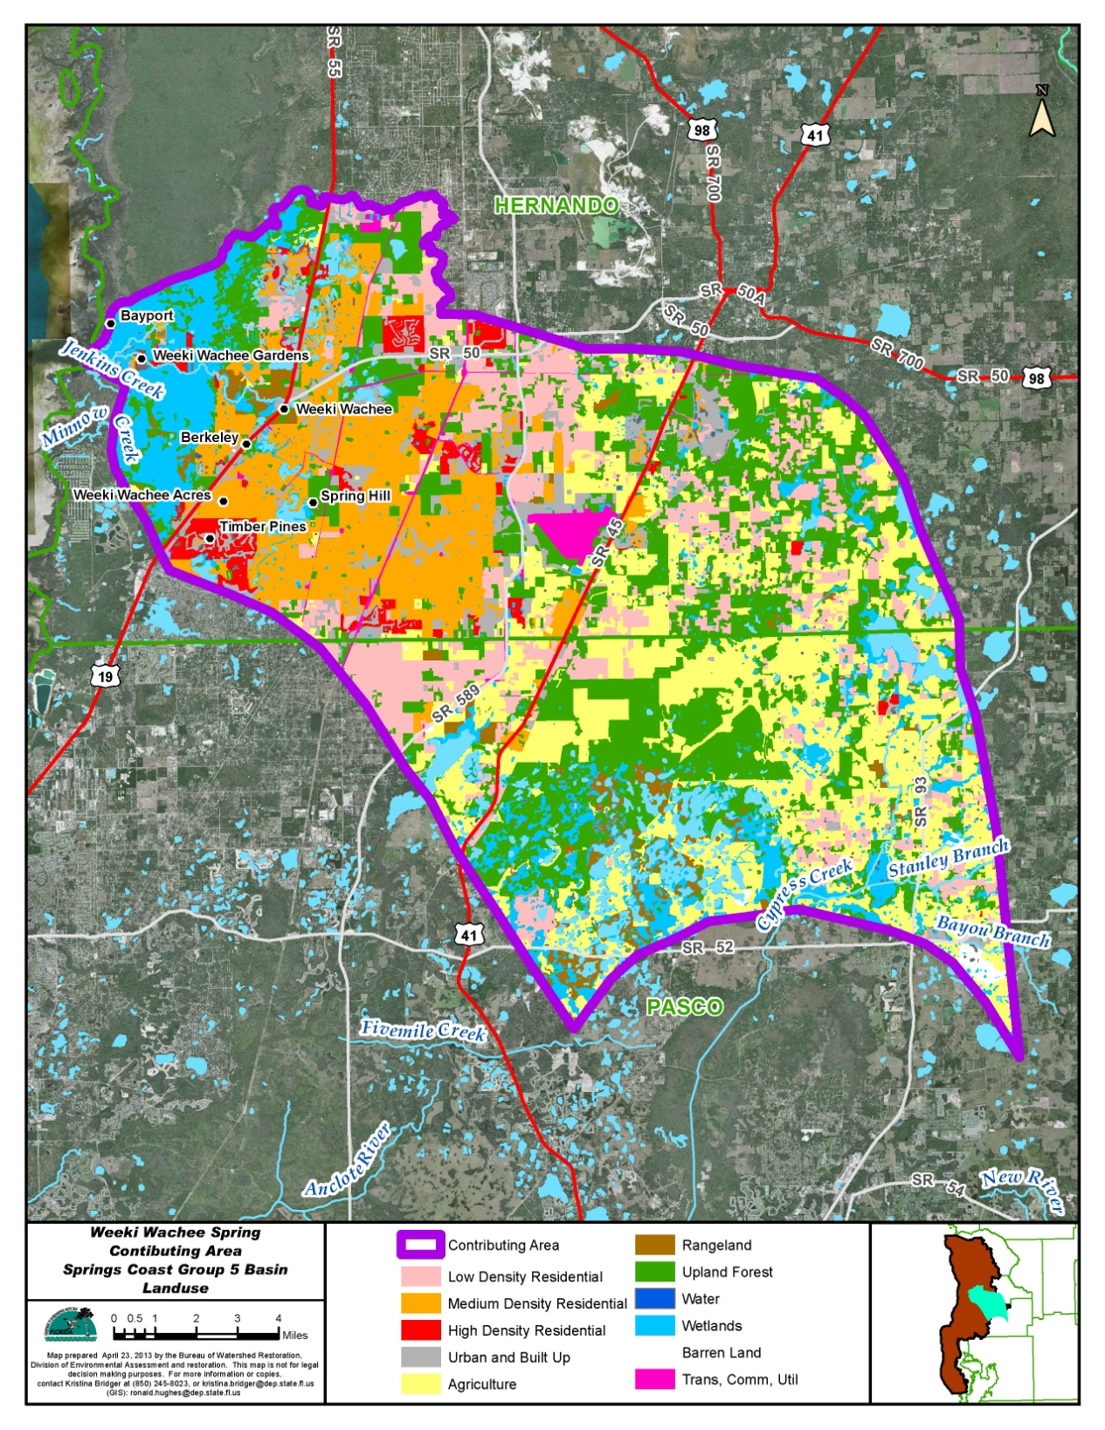
WW area land use 2009
27% residential
23% forest
23% agriculture
15% wetlands

Slide 8
Basin Management Action Plan
BMAP
Terry Hansen, P.G. terry.hansen@dep.state.fl.us
SWFWMD
Chris Anastasiou, PhD Chris.Anastasiou@swfwmd.state.fl.us
TMDLs & Springs
Richard Hicks, P.G. Richard.w.hicks@dep.state.fl.us
http://www.dep.state.fl.us/water/
www.WaterMatters.org/springs

