Slide 1
Springs Coast
Basin Management Action Plans (BMAPs)
November 16, 2016
Terry Hansen P.G., Basin Coordinator
850-245-8561
terry.hansen@dep.state.fl.us

Slide 2
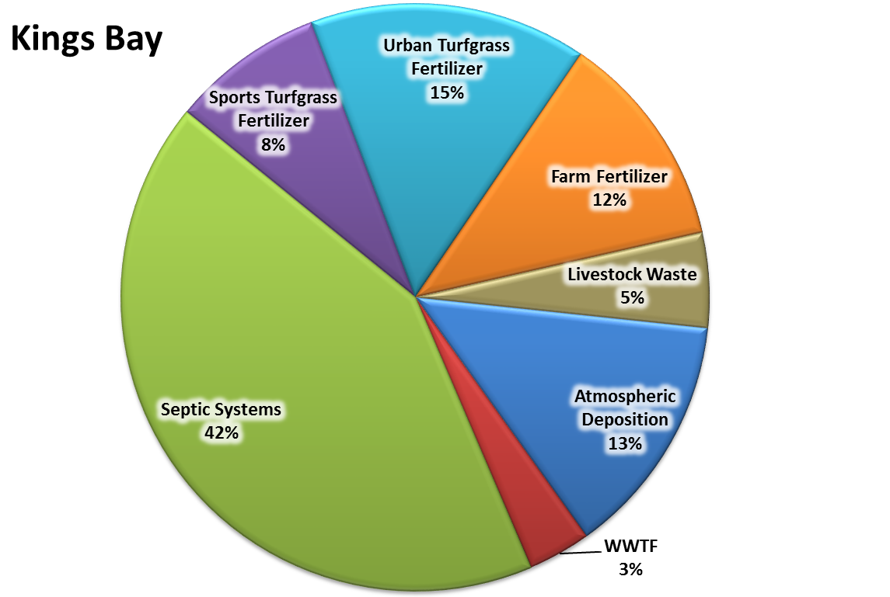
Kings Bay N Loading to Groundwater
Estimated Load to Groundwater: 592,440 lb-N/yr Estimated TMDL Load: 210,648 lb-N/yr

Slide 3
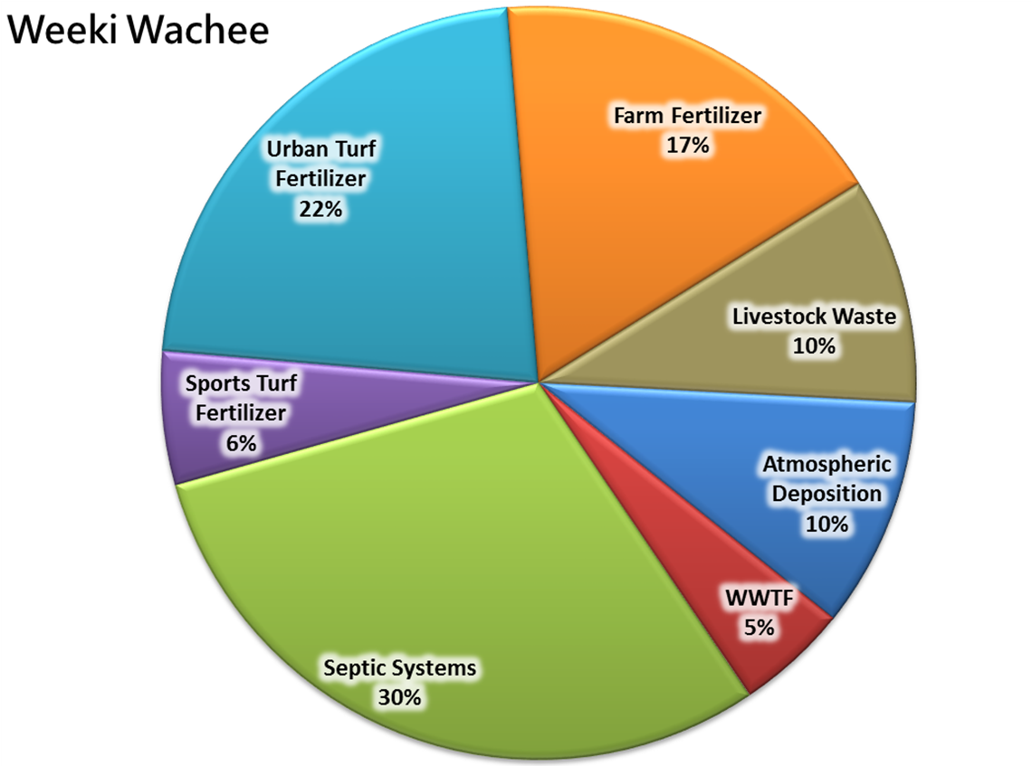
Weeki Wachee N Loading to Groundwater
Estimated Load to Groundwater: 900,000 lb-N/yr Estimated TMDL Load: 102,178 lb-N/yr

Slide 4
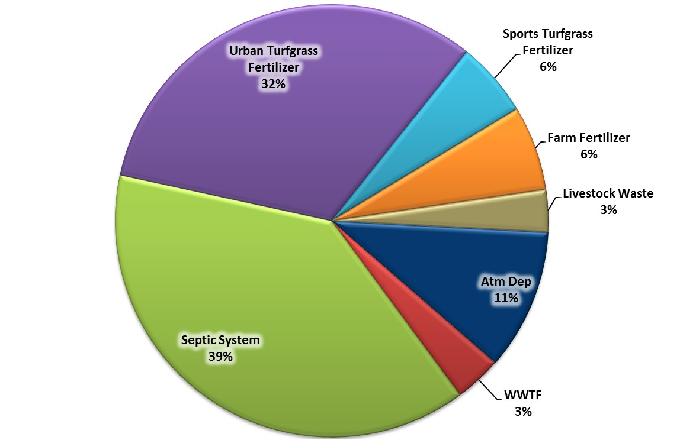
Aripeka N Loading to Groundwater
Magnolia-Aripeka
DRAFT
Estimated Load to Groundwater: 137,929 lb-N/yr Estimated TMDL Load: Unavailable

Slide 5
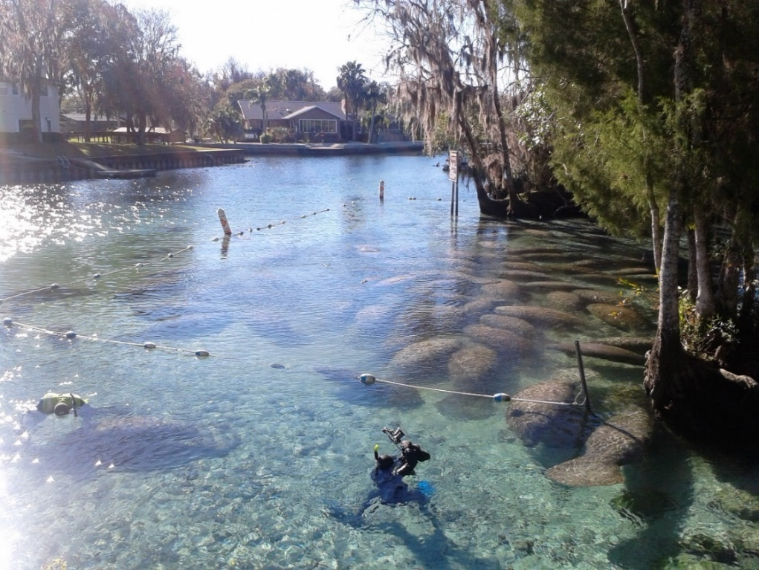
Basin Management Action Plan
Contact: Terry Hansen, P.G.
terry.hansen@dep.state.fl.us
http://www.dep.state.fl.us/water/
http://publicfiles.dep.state.fl.us/DEAR/BMAP/Springs Coast/BMAPs

