Slide 1
Weeki Wachee
Basin Management Action Plan (BMAP)
January 17, 2018
Terry Hansen P.G., Basin Coordinator
850-245-8561
terry.hansen@dep.state.fl.us

Slide 2
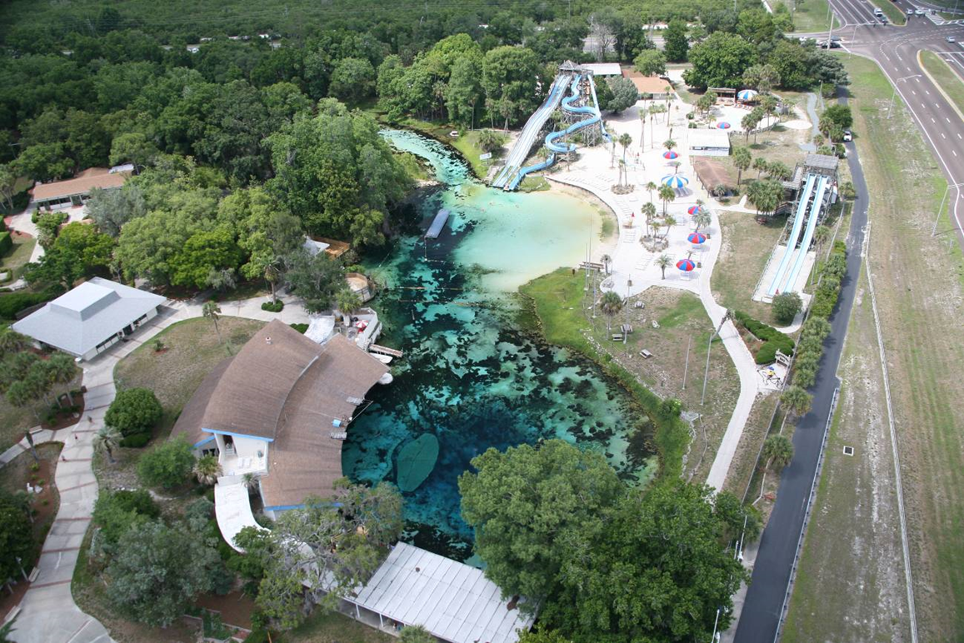
Weeki Wachee Springs State Park

Slide 3
Water Quality Framework
Collect data
Analyze and verify
List “impaired” waters
REPEAT
Monitor and report progress annually
Adapt and change – new statewide annual report
Set water quality standards
Monitor water quality
Determine pollution problems
Develop and implement restoration plans (BMAPs)
Establish restoration goals (TMDLs)
Measure success and adapt
Work with community leaders
Excessive nutrients
Bacteria, Metals, and Other Impairments
Allocate responsibilities
Identify projects
  Infrastructure
  Best Management Practices (BMPs)
Establish schedules
Identify success criteria
Gather additional data
Evaluate water quality
Adopt pollutant reduction targets

Slide 4
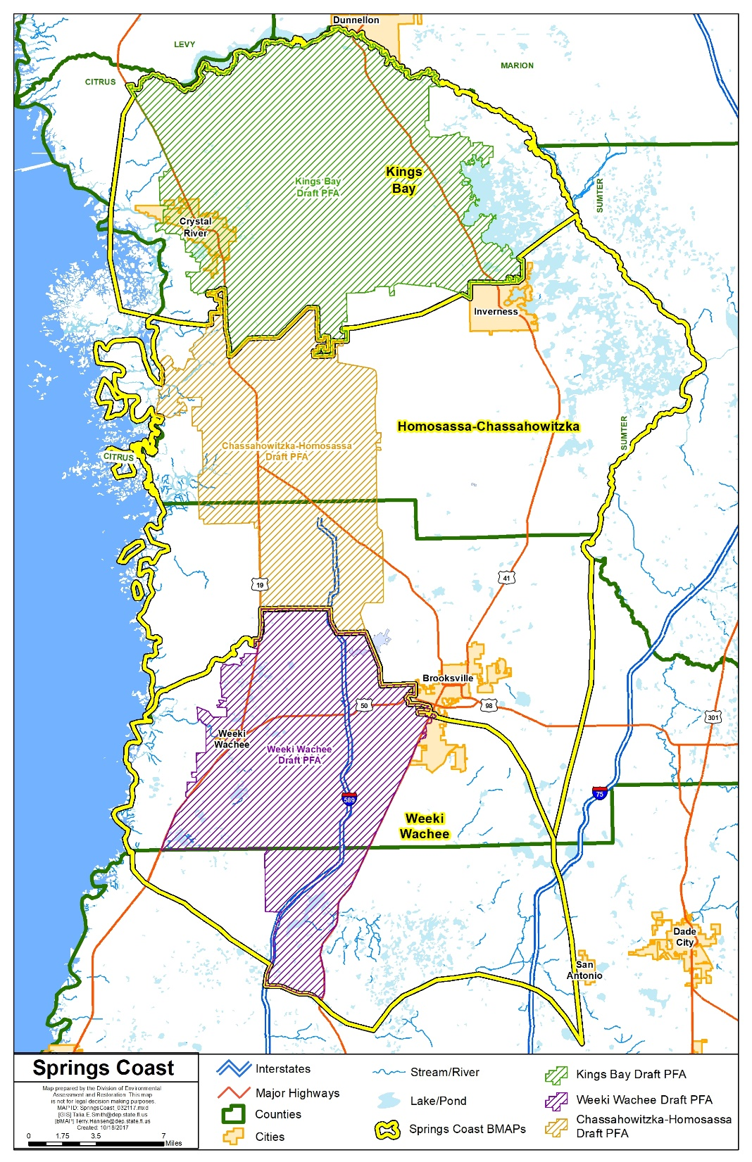
Springs Coast
BMAP Study Areas and Priority Focus Areas (PFAs)

Slide 5
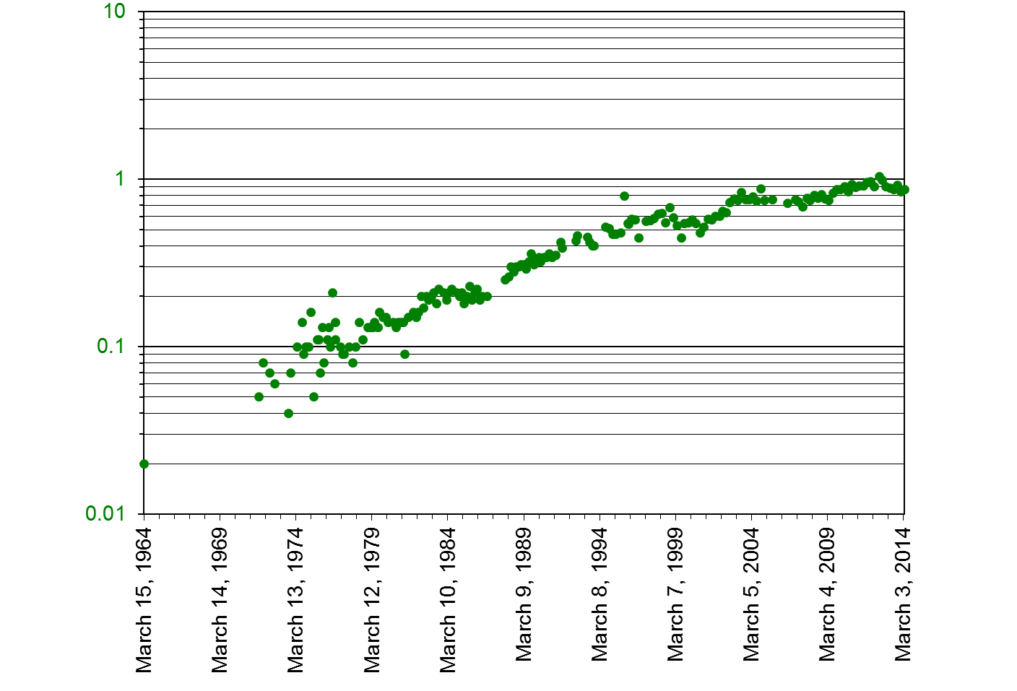
Nitrate Concentrations at Weeki Wachee Spring, 1964 to 2014
(Sources: U.S. Geological Survey [USGS] and Southwest Florida Water Management District [SWFWMD])
0.86 mg/l
nitrate + nitrite (milligrams per liter [mg/L])

Slide 6
Weeki Wachee BMAP Nitrate Total Maximum Daily Loads (TMDLs)
Waterbody or Spring Name | Waterbody Identification (WBID) Number | Parameter | Nitrate TMDL (mg/L)
Weeki Wachee Spring | 1382B | Nitrate, annual average | 0.28
Weeki Wachee River | 1382F | Nitrate, annual average | 0.28
Magnolia-Aripeka Springs Group | 1391B | Nitrate, annual average | 0.23
Wilderness-Mud-Salt Springs Group | 1382G | Nitrate, annual average | 0.23
Jenkins Creek Spring | 1389 | Nitrate, annual average | 0.23

Slide 7
Regulatory Framework
The process for preparing BMAPs is found in:
  Section 403.067, Florida Statutes (F.S.), known as the “Florida Watershed Restoration Act”
  The 2016 Florida Springs and Aquifer Protection Act lists requirements for BMAPs for Outstanding Florida Springs (OFS)
  PFA Report and Nitrogen Source Inventory Loading Tool (NSILT) developed by the Florida Department of Environmental Protection (DEP) for the Weeki Wachee Spring Group

Slide 8
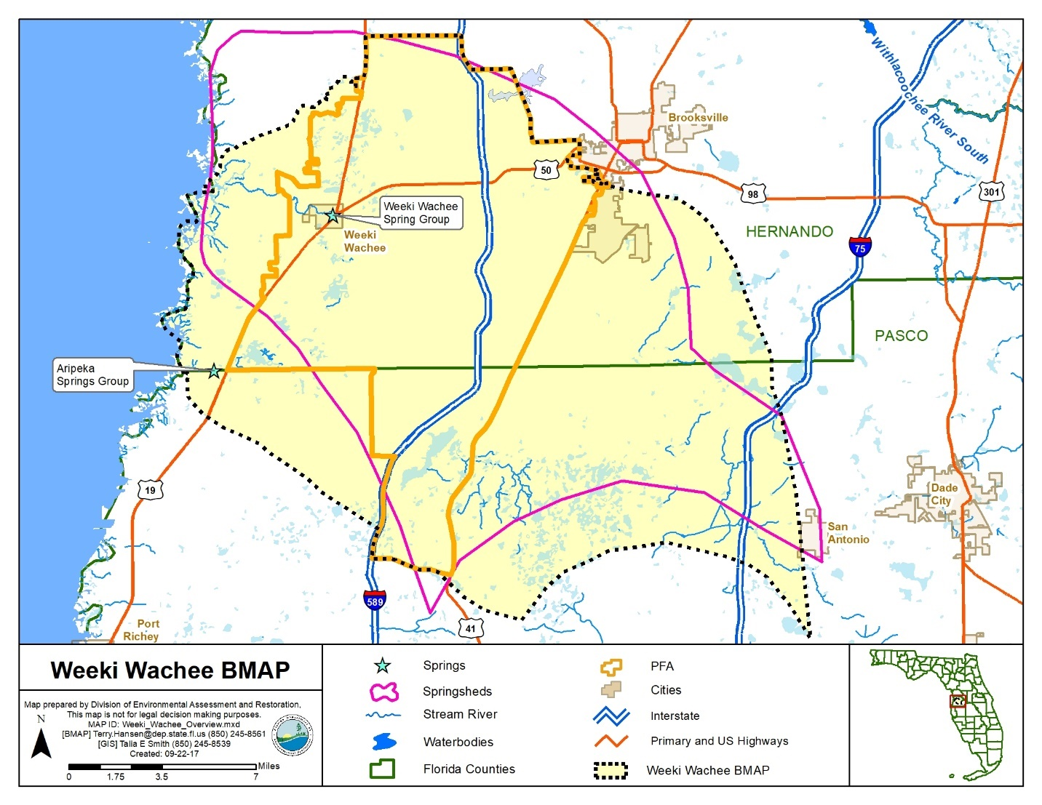

Slide 9
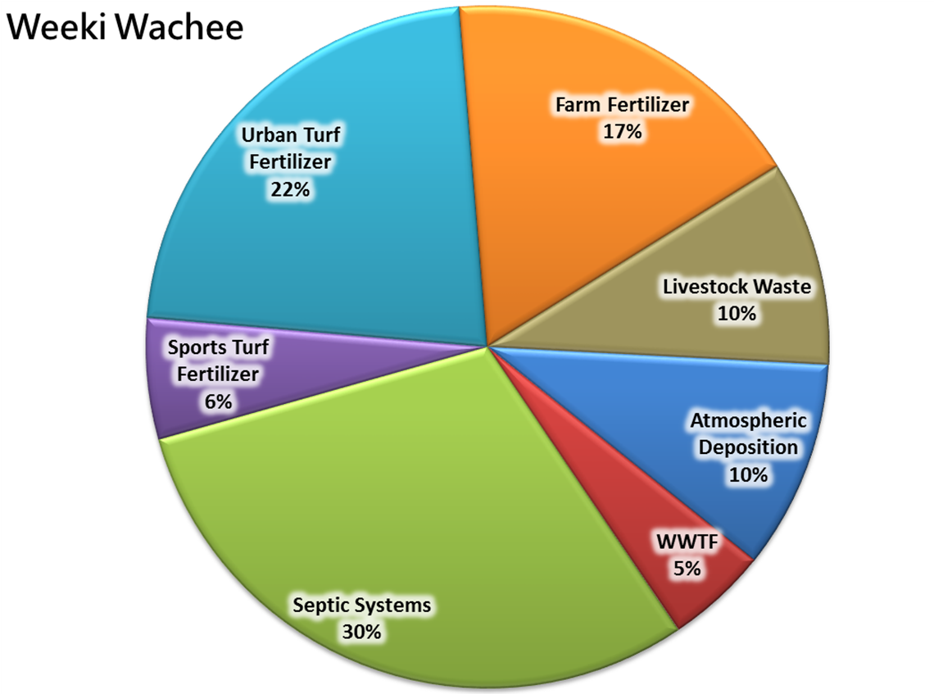
Weeki Wachee Nitrogen Loading
to Groundwater in Springshed
Estimated Load to Groundwater in Springshed: 940,144 pounds of nitrogen per year (lb-N/yr)

Slide 10
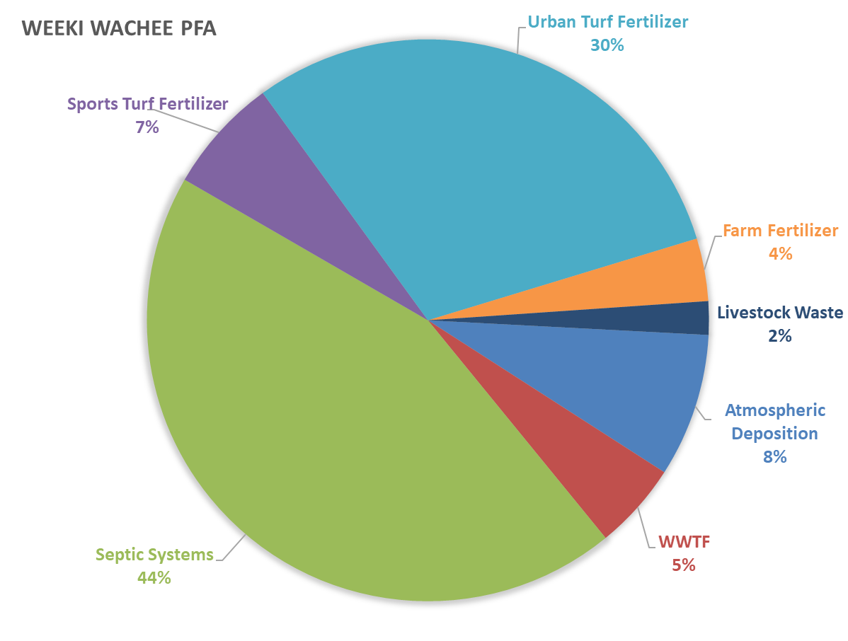
Weeki Wachee Nitrogen Loading
to Groundwater in PFA
Estimated Load to Groundwater in PFA: 654,209 lb-N/yr

Slide 11
Weeki Wachee Onsite Sewage Treatment and Disposal System (OSTDS) Remediation Plan
The Florida Springs and Aquifer Protection Act mandates that a BMAP with OSTDS contributing at least 20 % of nonpoint source load within a PFA include an OSTDS Remediation Plan (here, 44 %)
The Weeki Wachee OSTDS Remediation Plan includes:
  Public education plan
  Scientific information on effect of nutrients on springs
  Projects designed to reduce nutrient impacts from OSTDS
The OSTDS Remediation Plan is included as an appendix in the BMAP

Slide 12
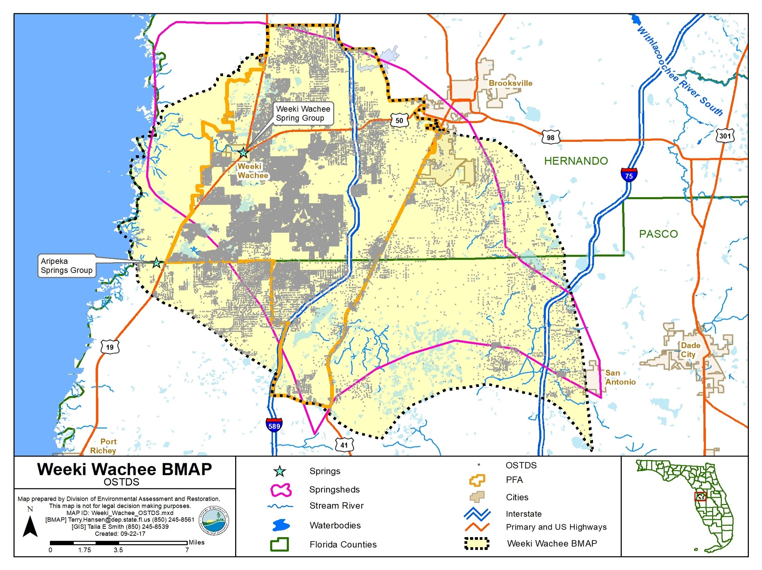

Slide 13
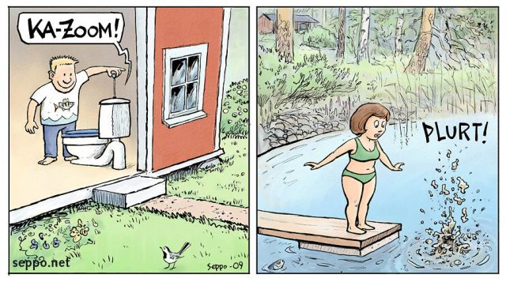
BMAP Policies – OSTDS
New OSTDS
No
Inside of PFA?
Yes
Either:
Conventional System
Enhanced System
No
Sewer
Yes*
Enhanced system
Either:
Conventional System
Enhanced System
*Must connect to sewer when available

Slide 14

TMDLs / BMAP
To achieve the TMDLs, BMAP implementation will be a 20-year process
Plan will define nitrogen reduction milestones:
  30% reduction within 5 years
  50% reduction within 10 years
  20% reduction within 15 years
  Use last 5 years to finish up and see results
Notes:
The overall load reduction targets are 30 % of the total within five years; 80 % of the total within ten years; and 100 % of the total within 15 years
The goals are aggressive for the first ten years; these aggressive goals are to ensure that the overall load reduction occurs within 20 years.
The load reduction progress will be tracked yearly and adjustments made as needed. At the five-year milestone, progress will be assessed and load reductions adjusted as necessary.

Slide 15
Nitrogen Load to Groundwater (NSILT) in Springshed
Nitrogen Source | Estimated Total Nitrogen Load to Groundwater (lb-N/yr) | Percent Contribution
OSTDS | 282,875 | 30%
Urban Turfgrass Fertilizer | 209,833 | 22%
Atmospheric Deposition | 93,208 | 10%
Farm Fertilizer | 163,935 | 17%
Sports Turfgrass Fertilizer | 53,841 | 6%
Livestock Waste | 91,347 | 10%
Wastewater Treatment Facilities | 45,105 | 5%
Total | 940,144 | 100%
Notes:
95% Avg GW conc. is 0.482 mg/L

Slide 16
Reduction to Meet the TMDLs
Required Reduction to Meet the TMDLs
Description | Nitrogen Loads (lb-N/yr) | Notes Regarding Data Used
Total Load at Spring Vents | 289,000 | Upper 95% confidence interval - nitrate data and flow data from 2000 to 2017 (94 cfs)
TMDL Load | 93,800 | TMDL target is 0.28 mg/L and using the same flow data from 2000 to 2017
Required Reduction | 195,200
cfs = cubic feet per second
mg/L = milligrams per liter
Notes:
95% Avg GW conc. is 0.482 mg/L

Slide 17
BMAP Gap Analysis
Nitrogen Source | Credits Based on Project Tables (lb-N/yr) | Description
OSTDS | 27,538 | Credits identified for stakeholder OSTDS projects (enhancement or sewer)
Urban Turf Fertilizer | 5,230 | DEP approved credits (up to 6 %) for public education activities as well as credits identified for stakeholder stormwater projects
Atmospheric Deposition | − | No reduction
Farm Fertilizer (FF) | 24,590 | 15 % BMP credit on FF load to groundwater, assuming 100 % owner-implemented BMPs on all fertilized lands
Sports Turf Fertilizer (STF) | 5,342 | 6 % BMP credit for sports fields and 10 % BMP credit for golf courses on STF load to groundwater, assuming 100 % BMP implementation on golf courses and sports fields
Livestock | 9,135 | 10% BMP credit on load to groundwater, assuming 100 % owner-implemented BMPs at all livestock facilities
Wastewater Treatment Facility (WWTF) | 33,058 | Achieved by BMAP WWTF policy (achieving 3 or 6 mg/L)
Total Credits | 158,164 | (Includes 53,272 lb-N/yr from Pasco County Restoration Project FY17/18)
Required Reduction | 195,200 | Load Remaining: 37,036

Slide 18
Options to Reduce Remaining Load
Estimated Reduction Credits for Additional OSTDS Enhancement OR Sewer
Recharge Area | BMAP Policy: OSTDS Parcels Less Than One Acre in PFAs | Credit for Enhancement (lb-N/yr) | Credit for Sewer (lb-N/yr) | OSTDS Parcels One Acre and Greater in PFAs | Credit for Enhancement (lb-N/yr)) | Credit for Sewer (lb-N/yr)
High | 29,840 | 158,152 | 229,768 | 5,847 | 30,989 | 45,022
Medium | 0 | 0 | 0 | 0 | 0 | 0
Total | 29,840 | 158,152 | 229,768 | 5,847 | 30,989 | 45,022
OSTDS That Could Be Converted to Sewer
Project # | OSTDS # | Estimated Reduction (lb-N/yr)
COB-2 | 75 | 578
COB-3 | 300 | 2,310
HC-3 | 30,000 | 231,000
Total | 30,375 | 233,888

Slide 19
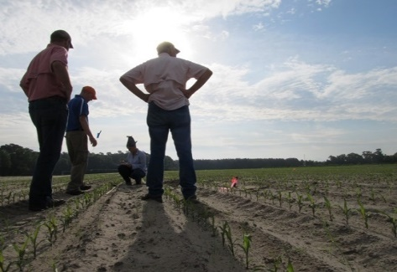
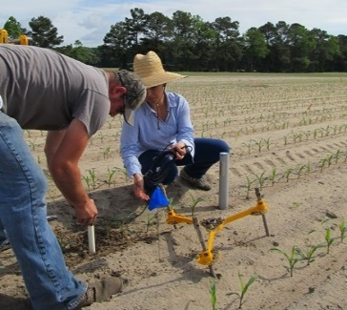
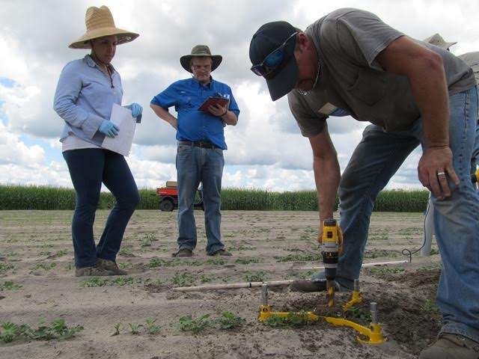
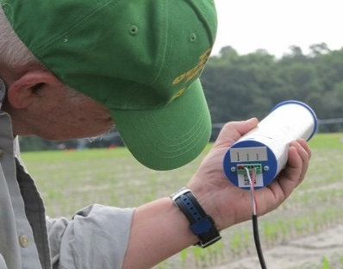
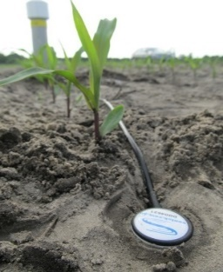
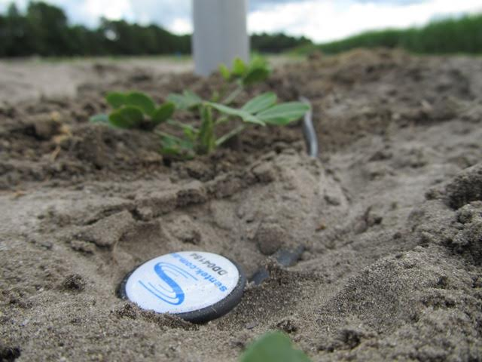
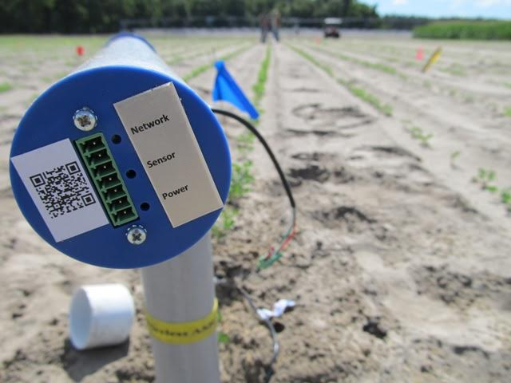
Ag Options to Reduce Remaining Load
Estimated Reduction Credits for Advanced Agricultural Practices
Action | Estimated Reduction Credit (lb-N/yr) High Recharge | Estimated Reduction Credit (lb-N/yr) Medium Recharge
Precision Irrigation | 3,129 | 1,739
Soil Moisture Probes | 41,545 | 20,773
Cover Crops | 38,394 | 21,330
Total | 83,068 | 43,842

Slide 20
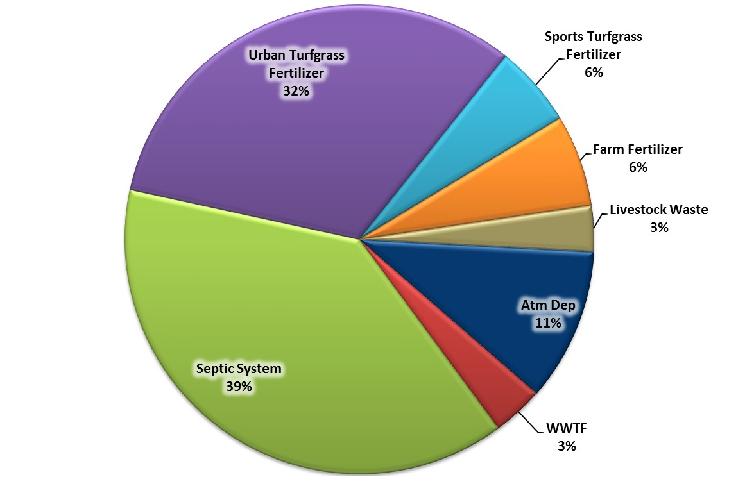
Magnolia-Aripeka Springs Nitrogen Loading
to Groundwater
Magnolia-Aripeka Springs
Spring flow is too irregular to accurately calculate TMDL load.
Estimated Load to Groundwater: 138,000 lb-N/yr

Slide 21
Suggested Magnolia-Aripeka Springs Nitrogen Reduction Guidelines by Source
Source | Estimated Portion of Total Load (%) | Estimated Total Nitrogen Load to Groundwater (lb-N/yr)
OSTDS | 39 % | 53,129
Urban Turfgrass Fertilizer | 32 % | 43,719
Atmospheric Deposition | 11 % | 14,550
Farm Fertilizer | 6 % | 8,710
Sports Turfgrass Fertilizer | 6 % | 8,710
Livestock Waste | 3 % | 4,358
WWTF | 3 % | 4,824
Totals | 100 % | 138,000
Draft April 2017

Slide 22
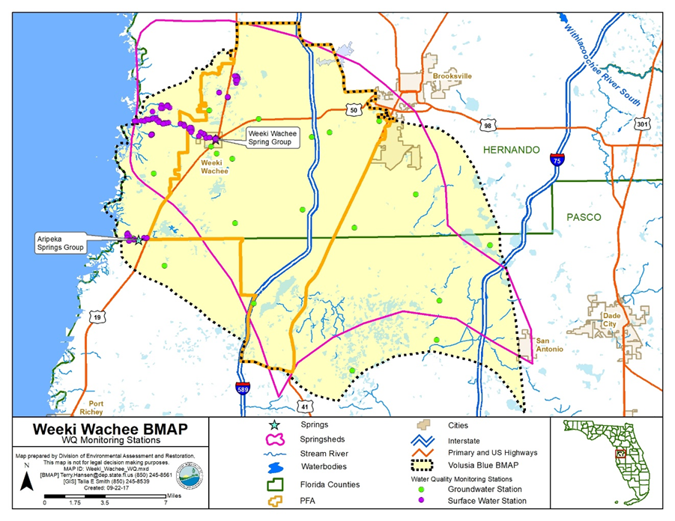
Next Steps
Comments received by January 26, 2018
BMAP adoption in February 2018
Water quality monitoring to determine improvements
Annual review of project accomplishments and adherence to schedule
Five-year revisions of BMAP and NSILT

Slide 23
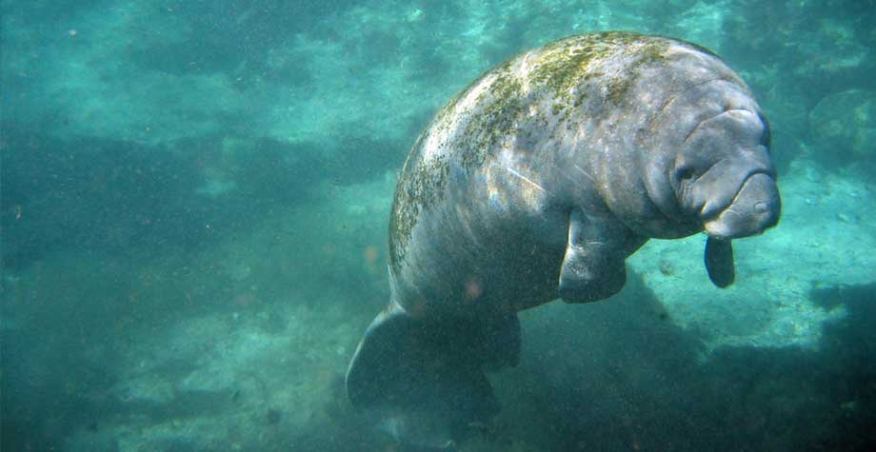
QUESTIONS??
Photo: SWFWMD

Slide 24

Basin Management Action Plan
Contact: Terry Hansen, P.G.
terry.hansen@dep.state.fl.us
http://www.dep.state.fl.us/water/
http://publicfiles.dep.state.fl.us/DEAR/BMAP/Springs Coast/BMAPs

