Slide 1

Division of Environmental Assessment and Restoration
Basin Management Action Plan Crystal River Area Springs Coast Basin
Kings Bay & Crystal River
Terry.hansen@dep.state.fl.us April 2014

Slide 2
WELCOME
Introductions
Overview SWFWMD
TMDL review FDEP
Break
BMAP process FDEP
Questions

Slide 3
CWA/TMDL Process
Restoration Plan

Slide 4
Basin Management Action Plan
The Department’s method for restoring water quality to an impaired water body.
BMAPs are adopted by FDEP through a Secretarial Order.
BMAPs are enforceable.

Slide 5
Regulatory Framework
The process for preparing BMAPs is found in:
  Section 403.067, Florida Statutes (F.S.), known as the Florida Watershed Restoration Act (FWRA).
  Spells out issues that are addressed within a BMAP.

Slide 6
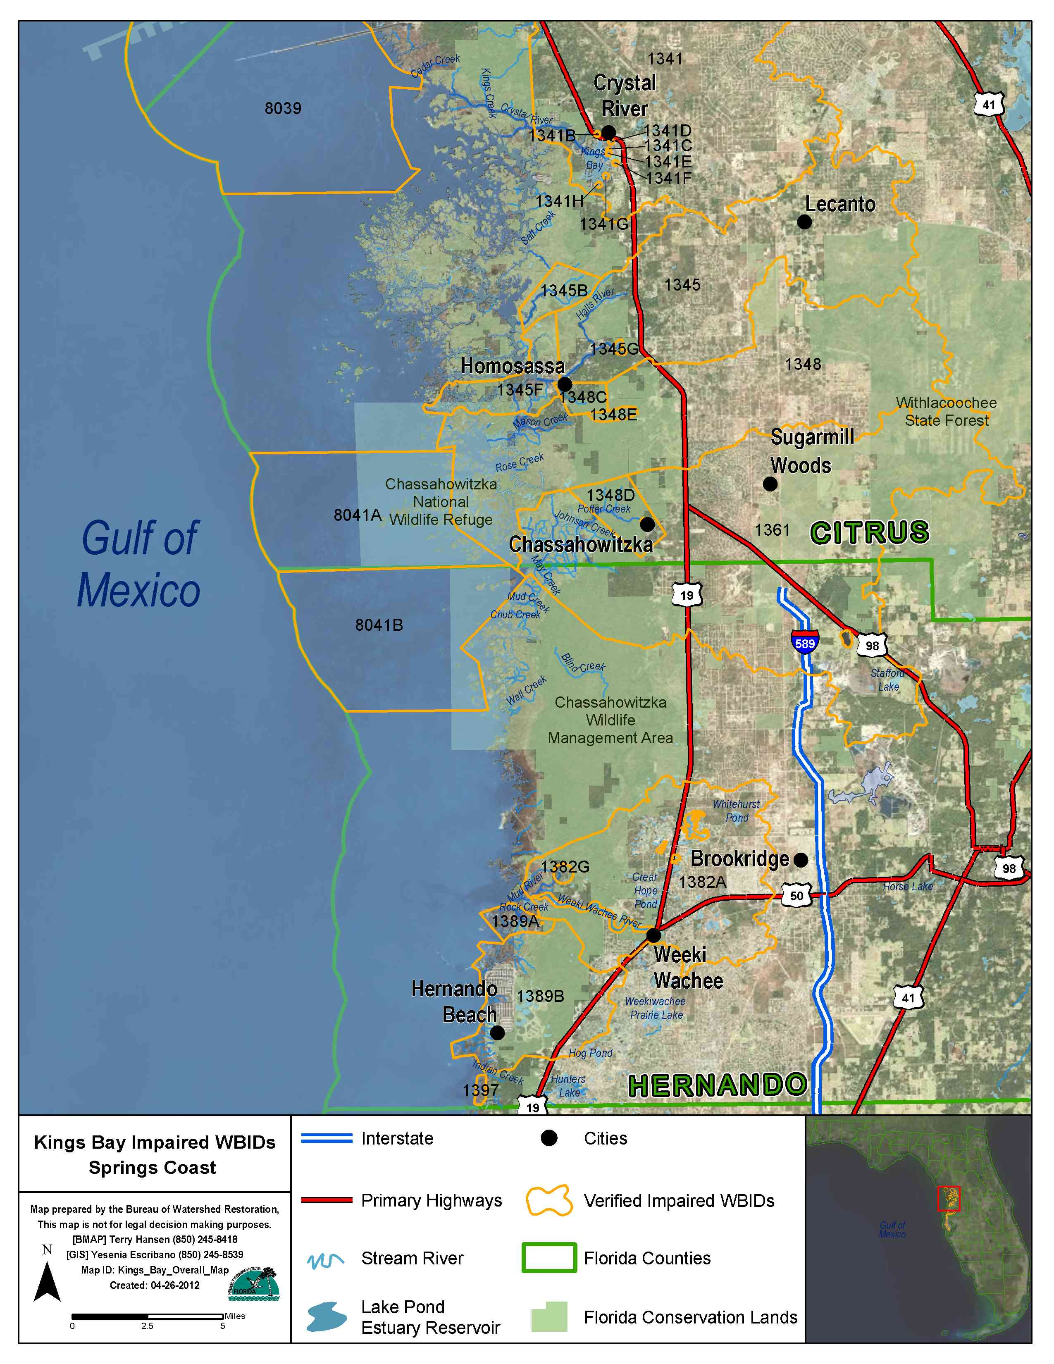
Regional Setting for Impaired WBIDs
Entire Springs Coast is having TMDLs developed

Slide 7
Kings Bay BMAP
Water Quality portion of larger more comprehensive regional restoration effort
  SWFWMD ongoing efforts
  Springs Coast Steering Committee
  Local special interest groups

Slide 8
Collaborative Efforts
Springs Coast Steering Committee Initiative
  Management Committee & Technical Committee
  Develop Spring system comprehensive plans
    Why – Background, Issues/Drivers, Goals/Targets
    What – Projects needed for system improvement
    Who – Responsible entity/group
    When – Project timeline
    How much – Cost estimates
    *Will incorporate BMAP when/as developed

Slide 9
BMAP Process
The Kings Bay BMAP will be developed collaboratively with local stakeholders.
  Through open meetings with public involvement.
  Joint decision making with local partners.
  Our local partners include Citrus County, Crystal River, SWFWMD, agriculture interests, environmental interests, community interests and others.

Slide 10
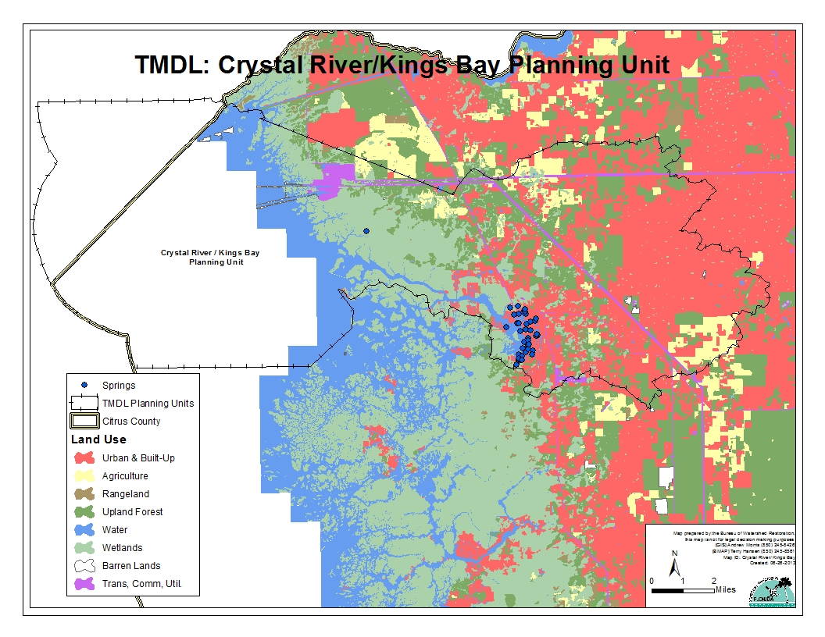

Slide 11
Key BMAP Components
TMDLs being addressed.
Defines area addressed by BMAP.
Future growth impacts.
Projects to meet the TMDL including:
  Implementation timeline;
  Commitment to project; and
  Expected water quality improvement.

Slide 12
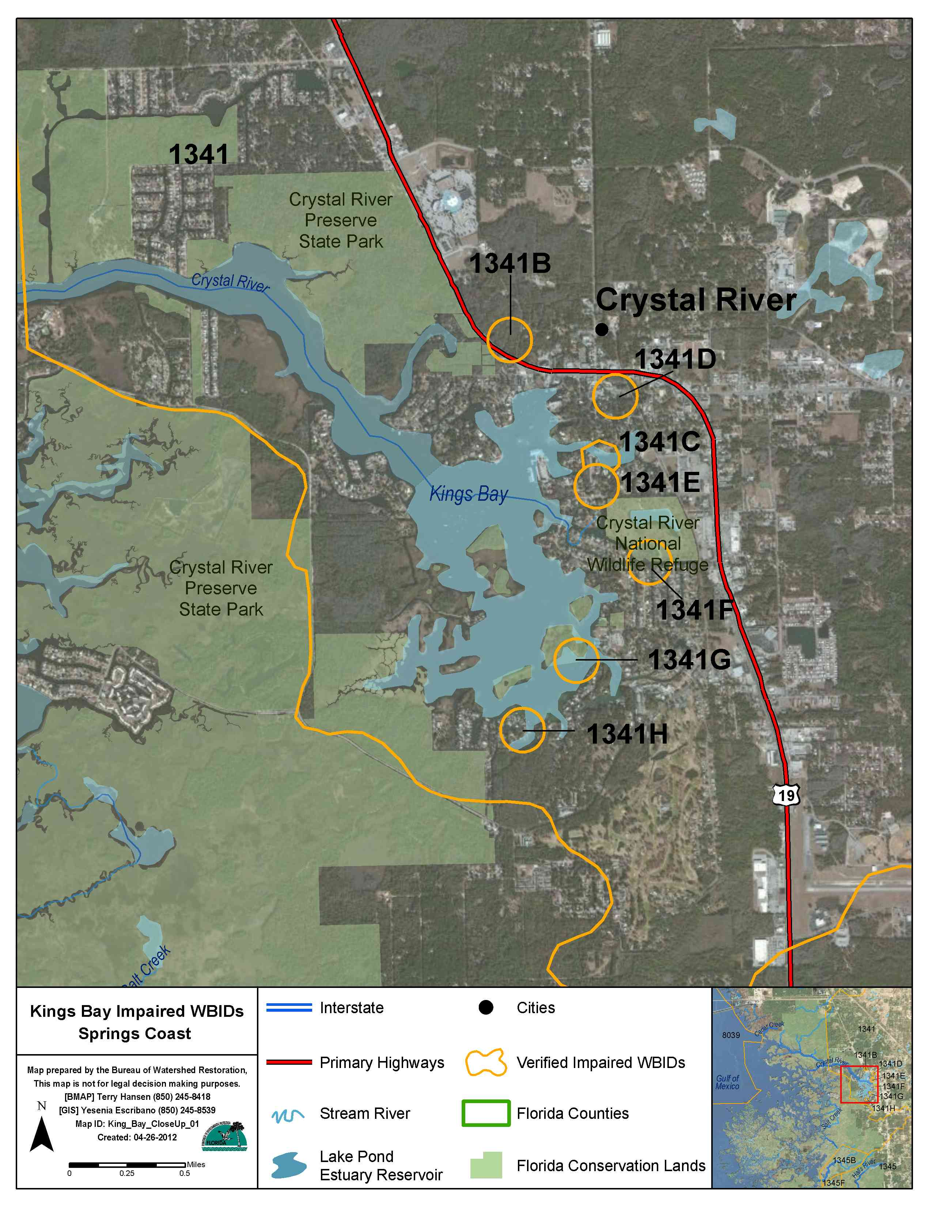
WBID | Reduction TN | Reduction P
1341 | 22% | 14% TP
1341C | 64% | 0% orthoP
1341D | 53% | 0% orthoP
1341F | 26% | 7 % orthoP
1341G | 21% | 10% orthoP
1341H | 26% | 0% orthoP

Slide 13
Key BMAP Components (cont)
Process to assess progress towards achieving the TMDL, and includes:
  Monitoring plan;
  Project reporting; and
  Periodic follow-up meetings.

Slide 14
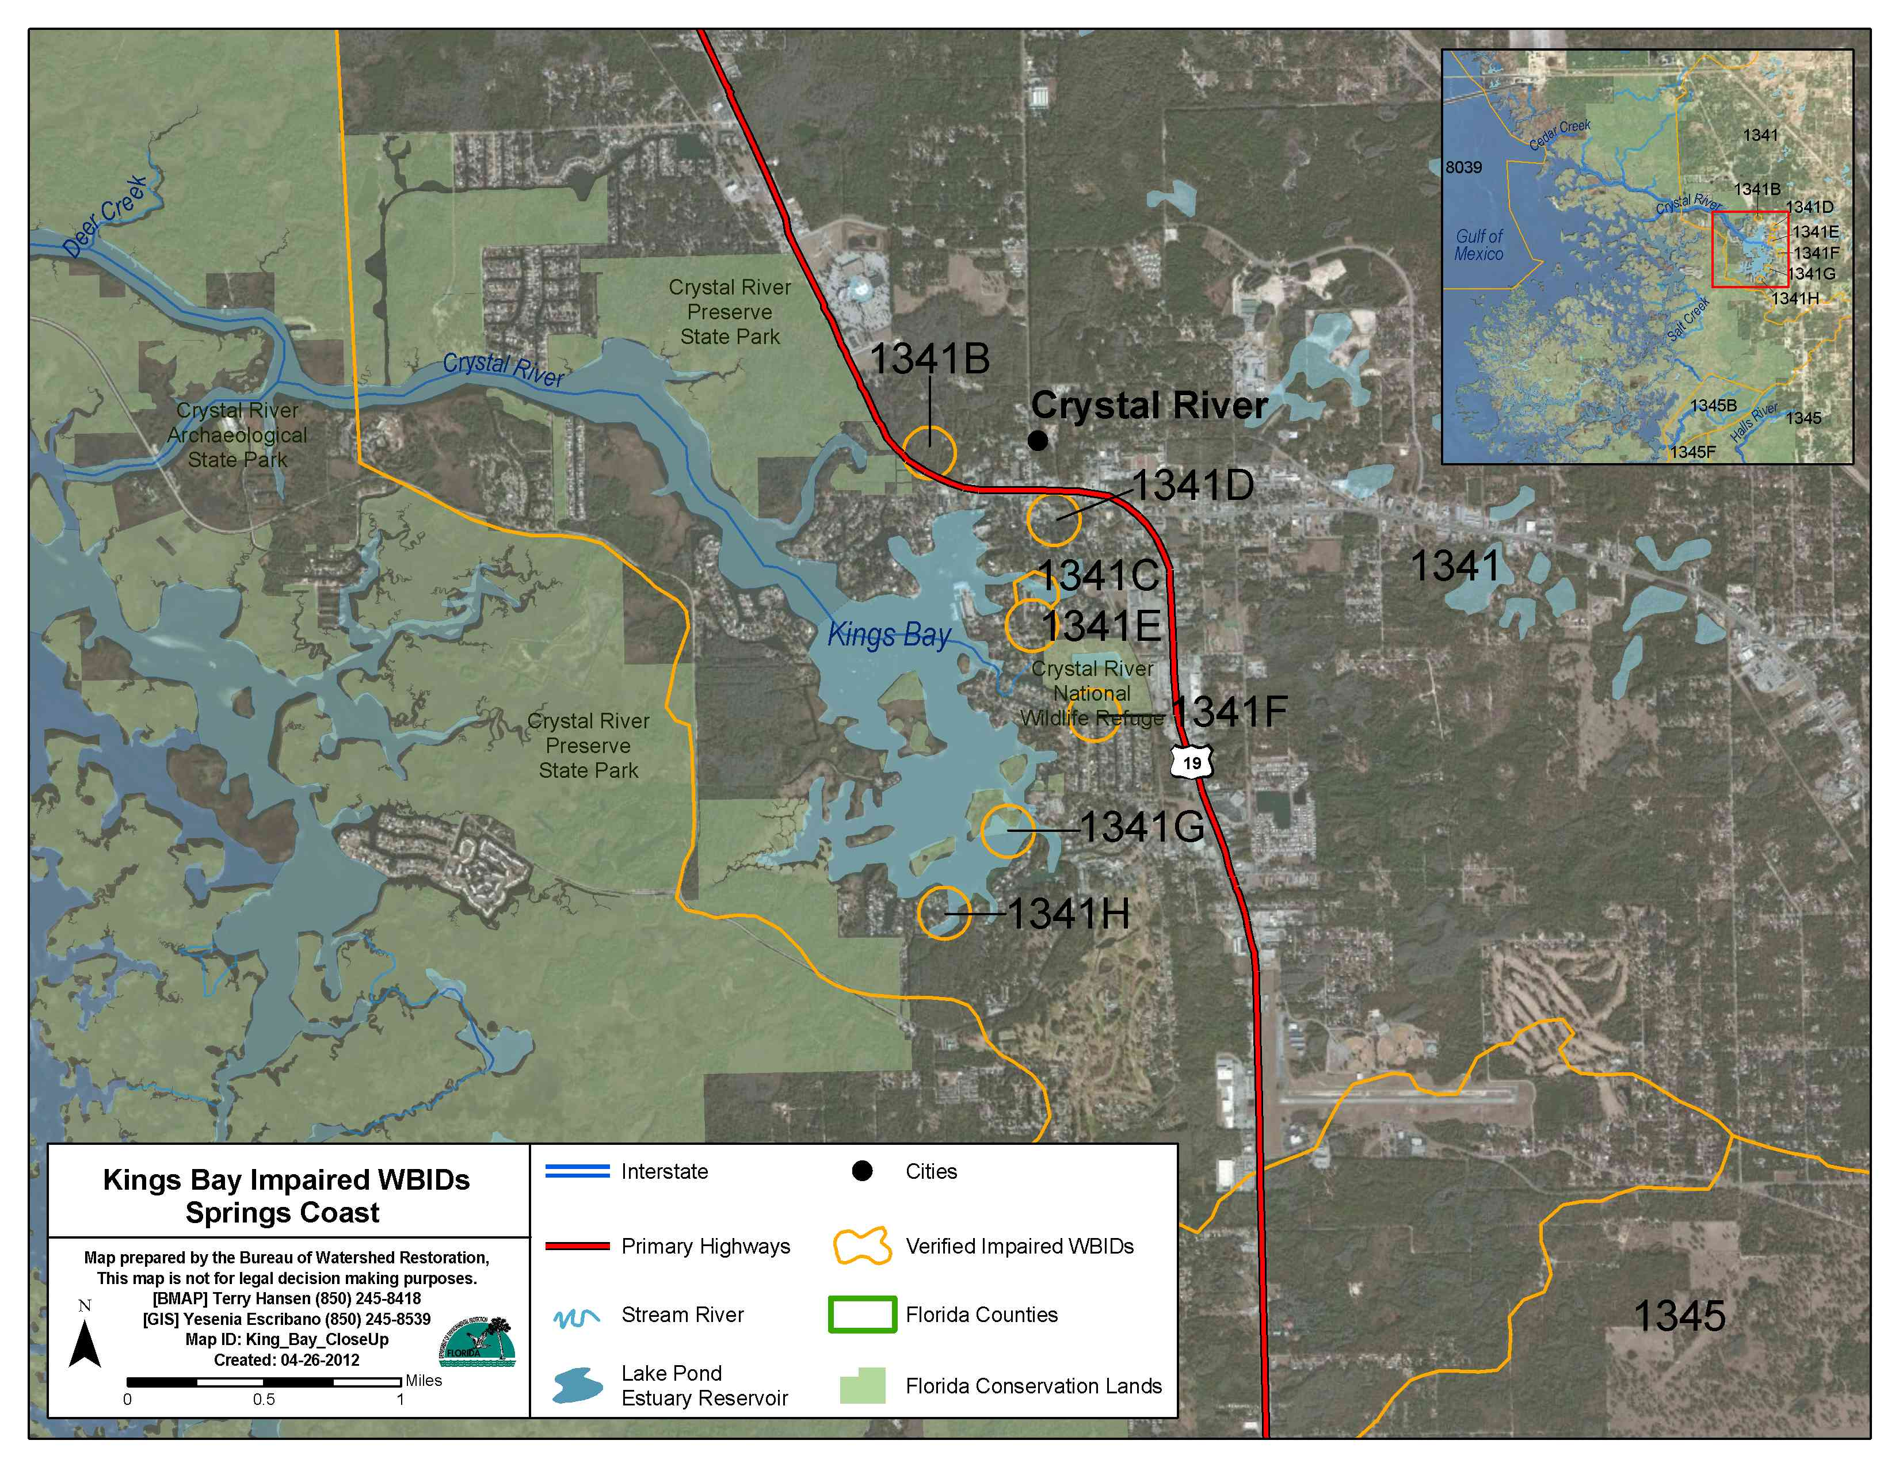

Slide 15
Ongoing Projects
SWFWMD projects in the Crystal River area.
Three Sisters Wetland Treatment Project
City of Crystal River to Progress Energy Reclaimed water Project
Hunter Springs Water Quality Stormwater Improvement Project
PROPOSED Kings Bay Stormwater Project Phase 1

Slide 16
Springs Initiative Funding
Hunters Cove Living Shoreline Project $500,000
Reclaimed Water Project $500,000
  Package plants and septic tank connections
Implement Ag BMPs in Springs Coast Basin
  Cost Share Initiative FARMS program

Slide 17
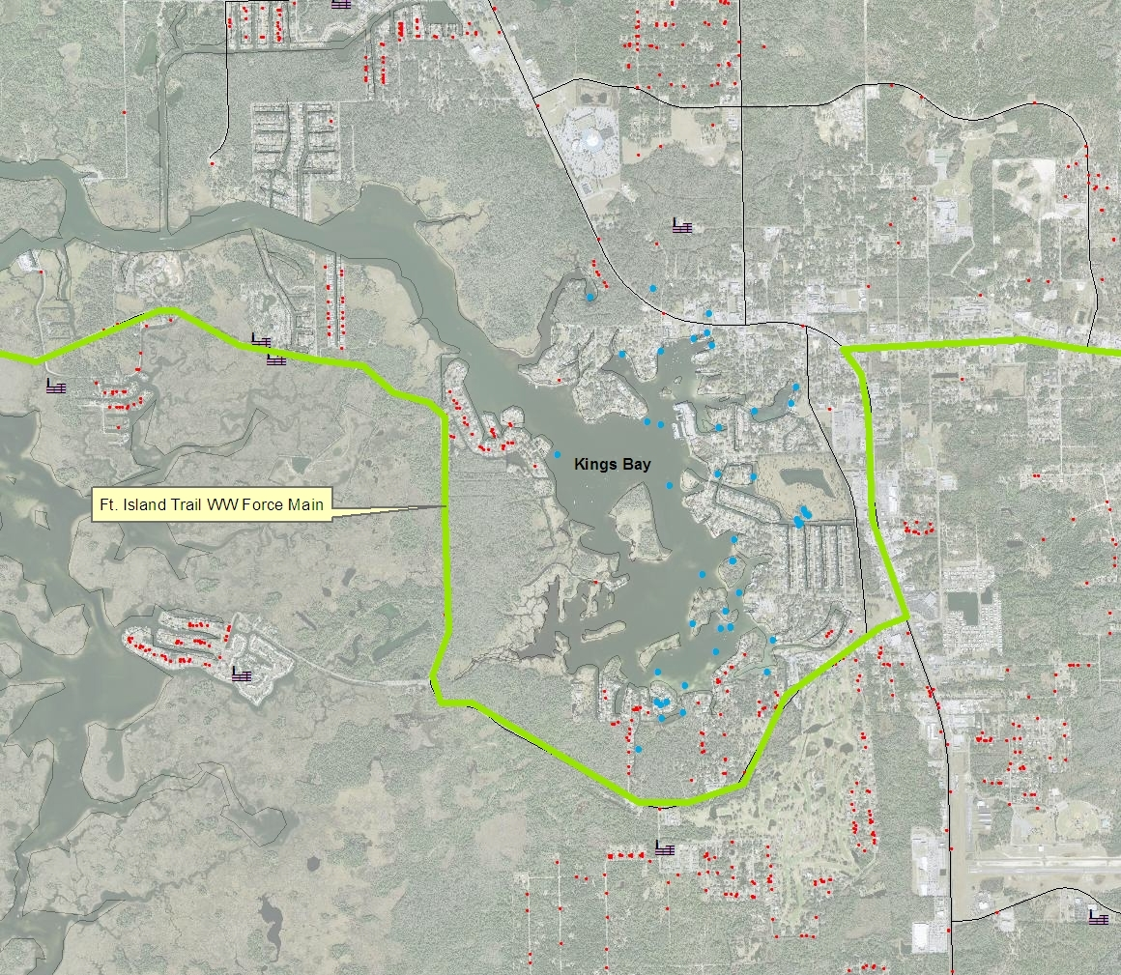

Slide 18
BMAP Area
The Kings Bay BMAP area is based on springshed and contributing area for the area
Intended to represent a logical area that takes into account current and future restoration efforts
Boundary looks at land use, natural features & man made features

Slide 19
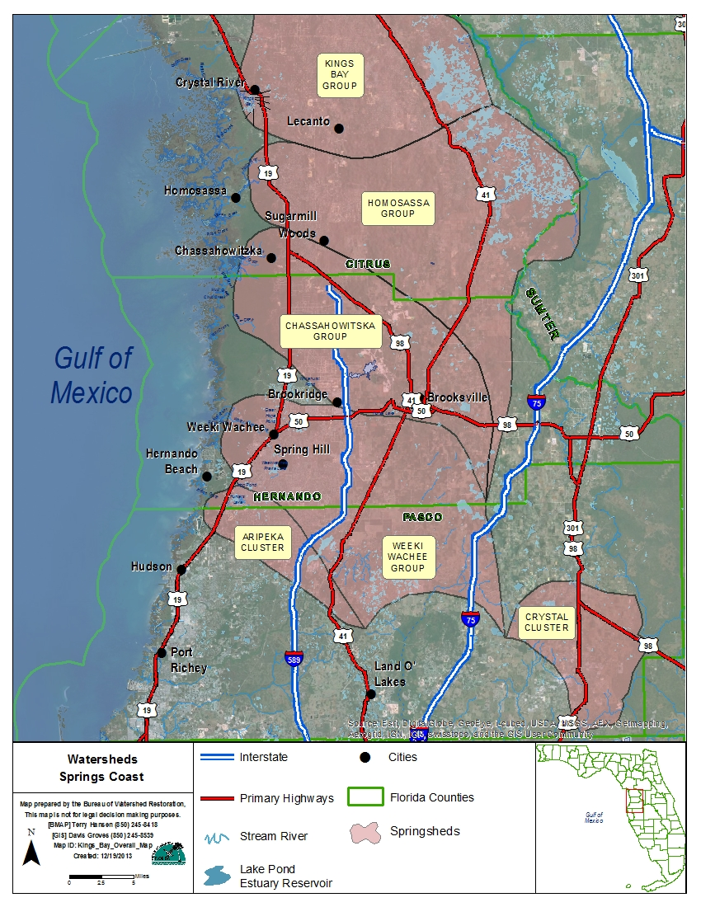

Slide 20
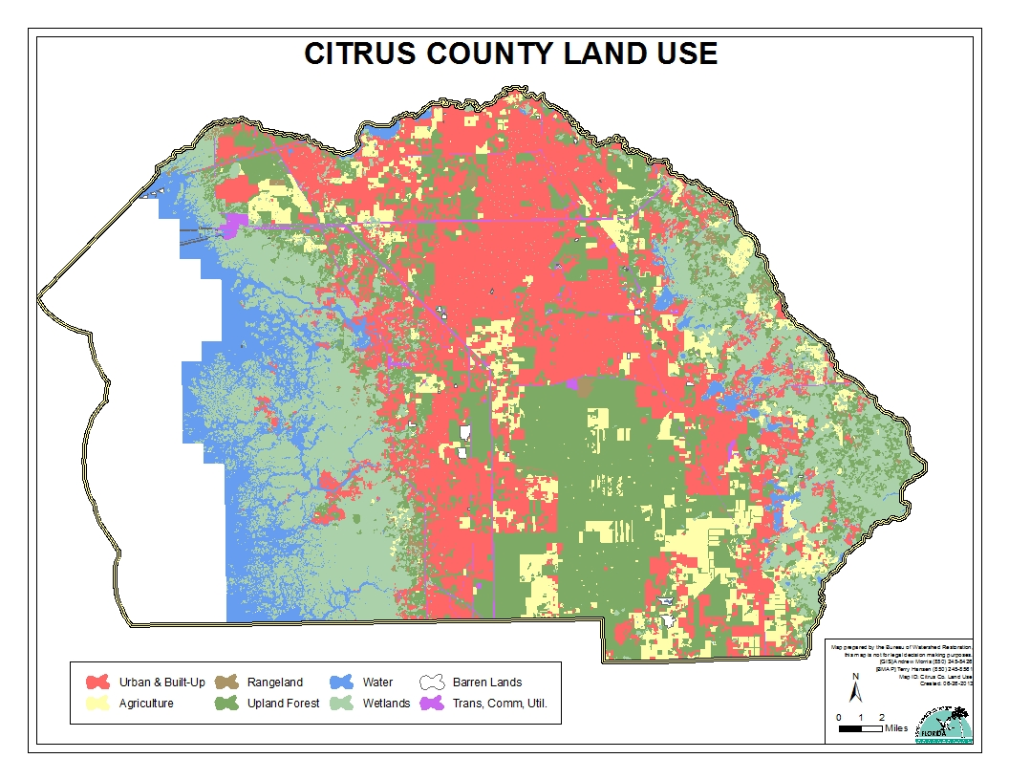
BMAP Area Land Use
33% residential
10% agricultural
29% forested
22% wetland and marsh
3% waterbodies

Slide 21
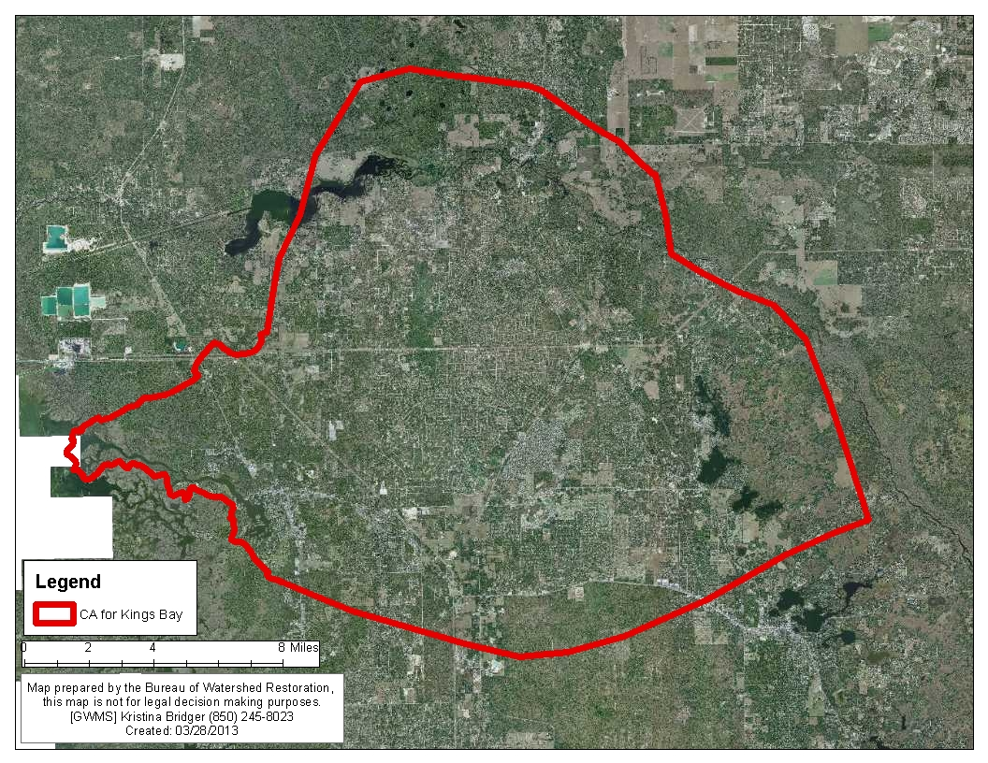

Slide 22
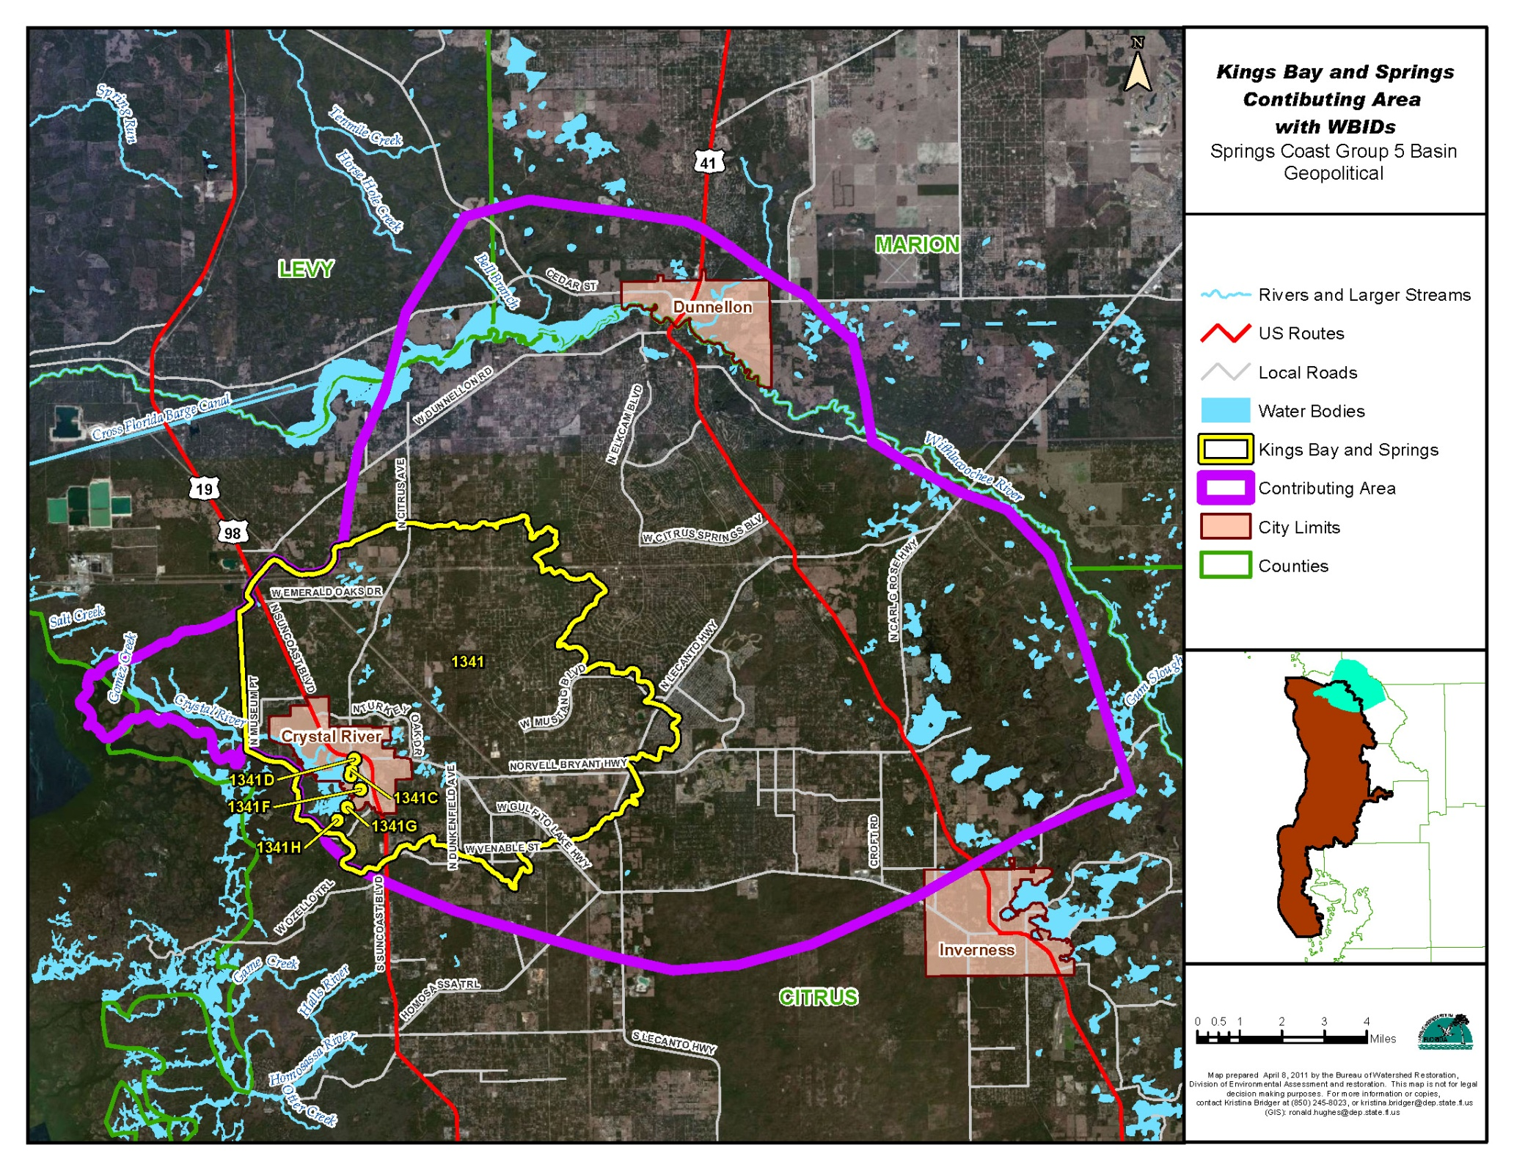

Slide 23
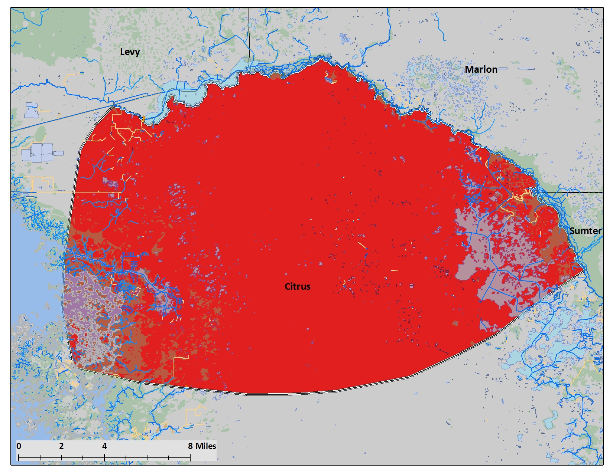

Slide 24
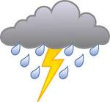



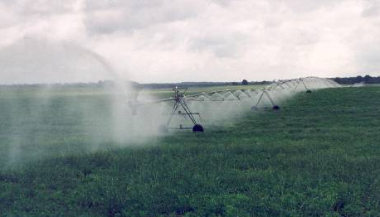


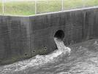
Sources of Nitrogen in BMAP area
Atmospheric Deposition
Fertilizers (cropland, pasture,
turfgrass)
Land application of treated
wastewater/ biosolids
Septic Tanks
Animal wastes
Stormwater runoff

Slide 25

Estimating Nitrogen Loads to Ground Water
A multi-step process:
Estimate the inputs of nitrogen to the land surface from the source inventory information (a work in progress).
Apply attenuation factors based on the various environmental processes that could transform the various forms of nitrogen in the subsurface (such as denitrification, nitrification of ammonia, uptake by vegetation, mineralization of organic nitrogen).
Apply an areal weighting factor that is based on the rate of recharge to ground water to get nitrogen loads to ground water.
Account for proximity of N source to spring. Fine-tune estimates after getting feedback from stakeholders.

Slide 26
Schedule
TMDL Adopted –
Intergovernmental briefings
  CCBOCC meeting April
  City of Crystal River Workshop April
Local Stakeholders meetings
  April 2014 – Intro to BMAP Process
  Late May 2014 - Nutrient Source Inventory & Legacy Loads
  June 2014 – Nutrient Reduction Strategies BMPs & Structural
  Late July 2014 – Project Collection Process

Slide 27
Questions?
Be sure to add your name and email to sign in sheet.
Please send me Interest Group Contacts
Spread the word to other interested individuals
Weeki Wachee BMAP process will begin in May
Presentations posted at: http://publicfiles.dep.state.fl.us/DEAR/BMAP/Springs Coast/BMAPs/CR_KB_BMAP/ (MONTH of meeting)

Slide 28
Basin Management Action Plan
BMAP
Terry Hansen, P.G. terry.hansen@dep.state.fl.us
SWFWMD
Chris Anastasiou, PhD Chris.Anastasiou@swfwmd.state.fl.us
TMDLs & Springs
Richard Hicks, P.G. Richard.w.hicks@dep.state.fl.us
http://www.dep.state.fl.us/water/
www.WaterMatters.org/springs

