Slide 1

Division of Environmental Assessment and Restoration
Basin Management Action Plan (BMAP)
Crystal River Area Springs Coast Basin
Kings Bay & Crystal River
Terry.hansen@dep.state.fl.us August 2014

Slide 2
Total Maximum Daily Load (TMDL) Process
Restoration Plan

Slide 3
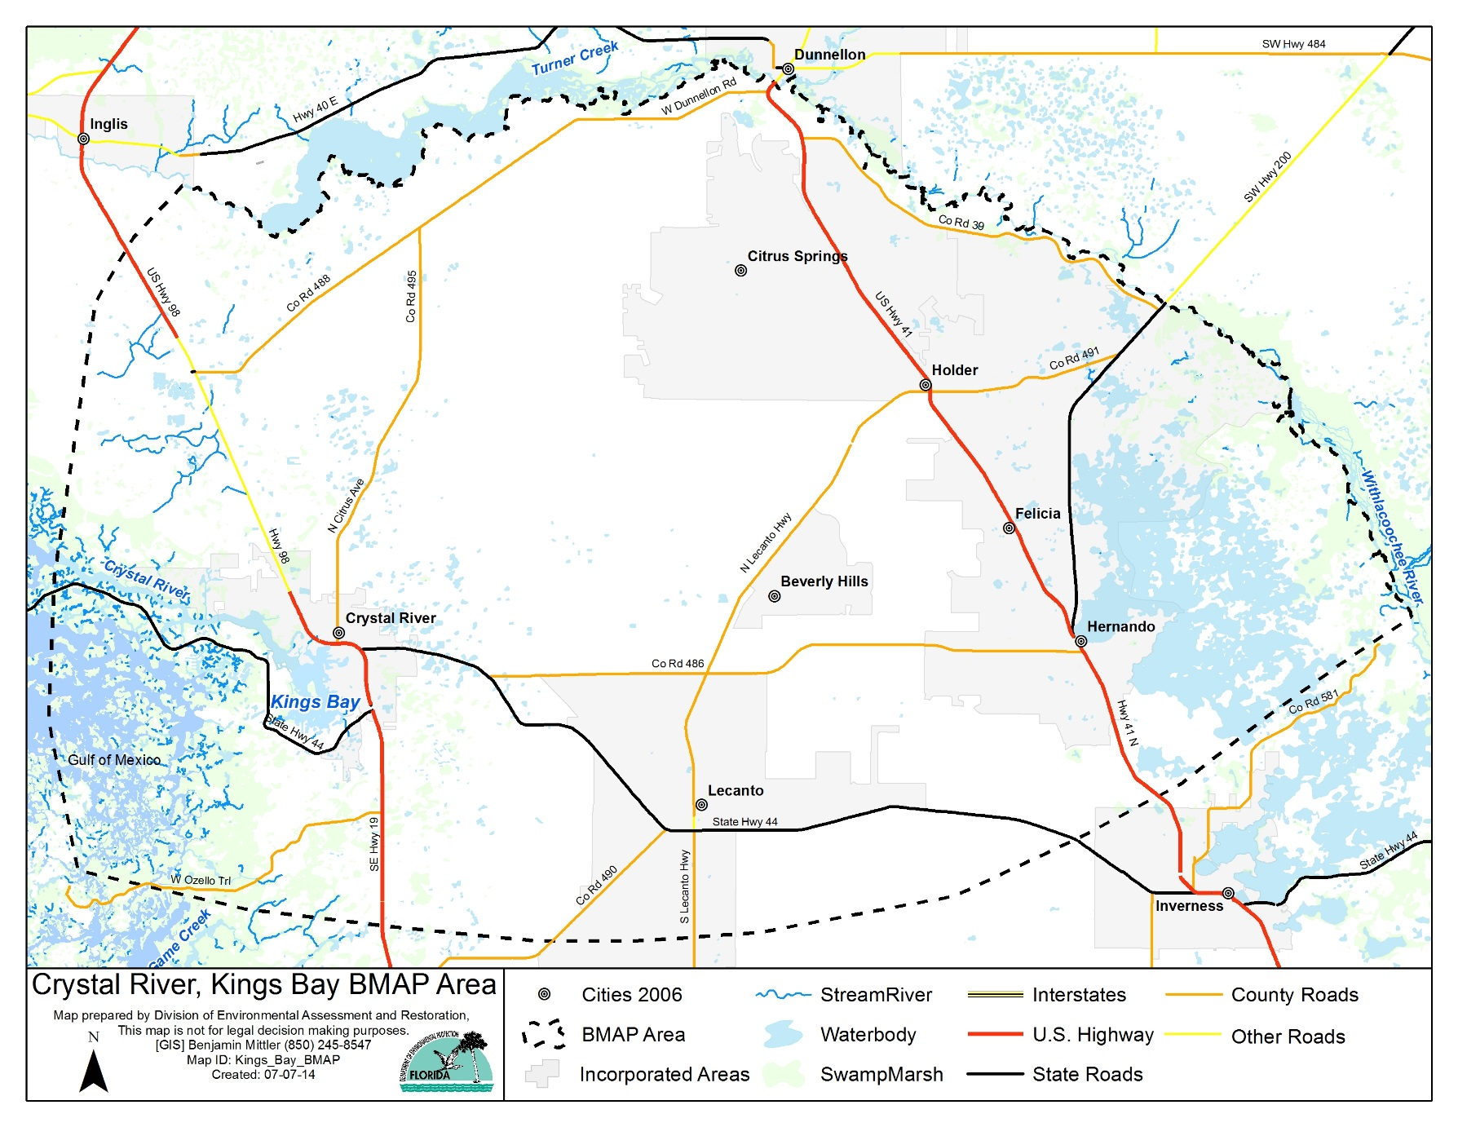
BMAP Area

Slide 4
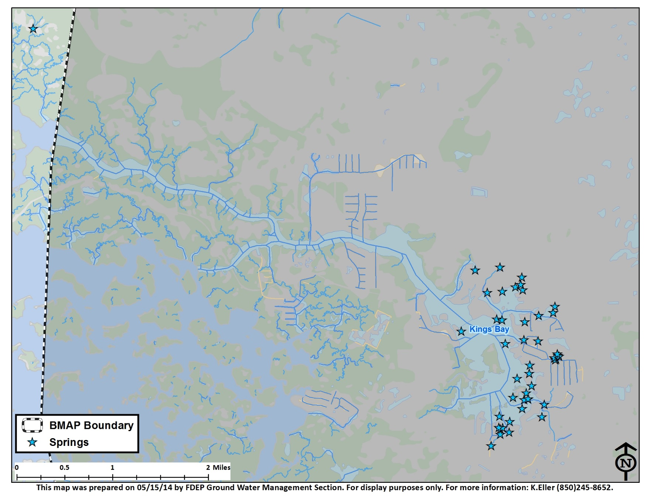
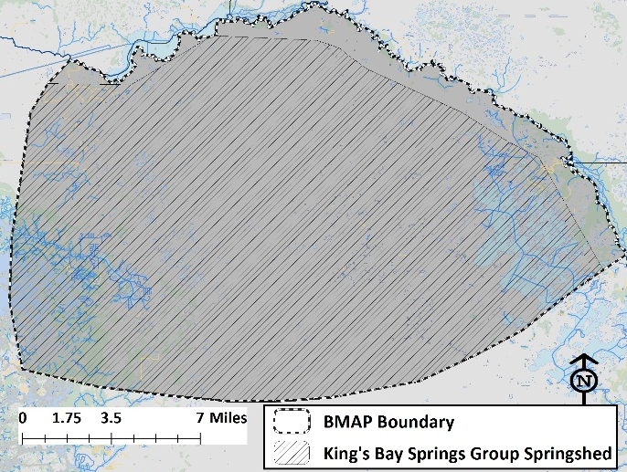
King’s Bay/Crystal River BMAP Area
BMAP area is based on the King’s Bay springs group springshed

Slide 5
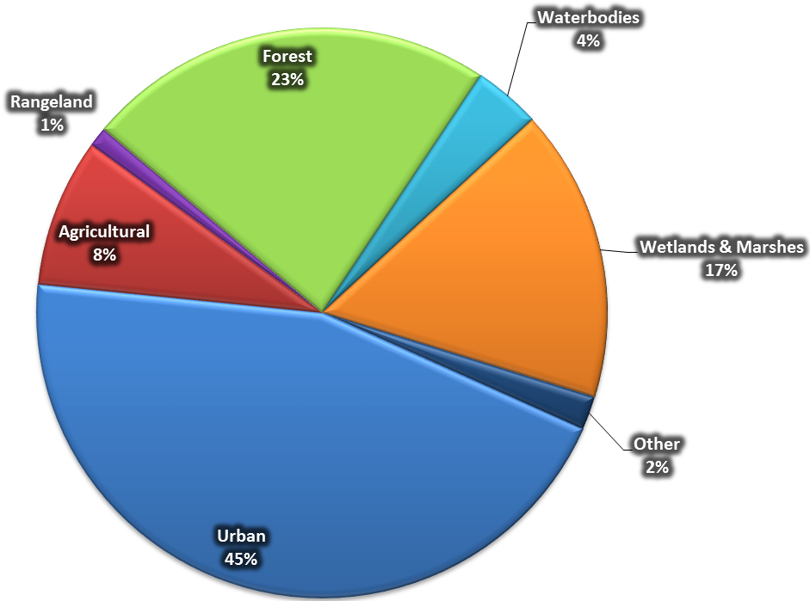
King’s Bay Land Use
Majority of inputs occur within agricultural and urban landscapes
Nitrogen sources are concentrated in 53% of the BMAP land uses

Slide 6
Document Surface Nutrient Reductions
Nutrient Source Inventory (NSI) estimates surface inputs and attenuation to estimate groundwater loading
Demonstrate initial success by identifying reductions in surface loads
Confirm success by seeing reductions in springs

Slide 7
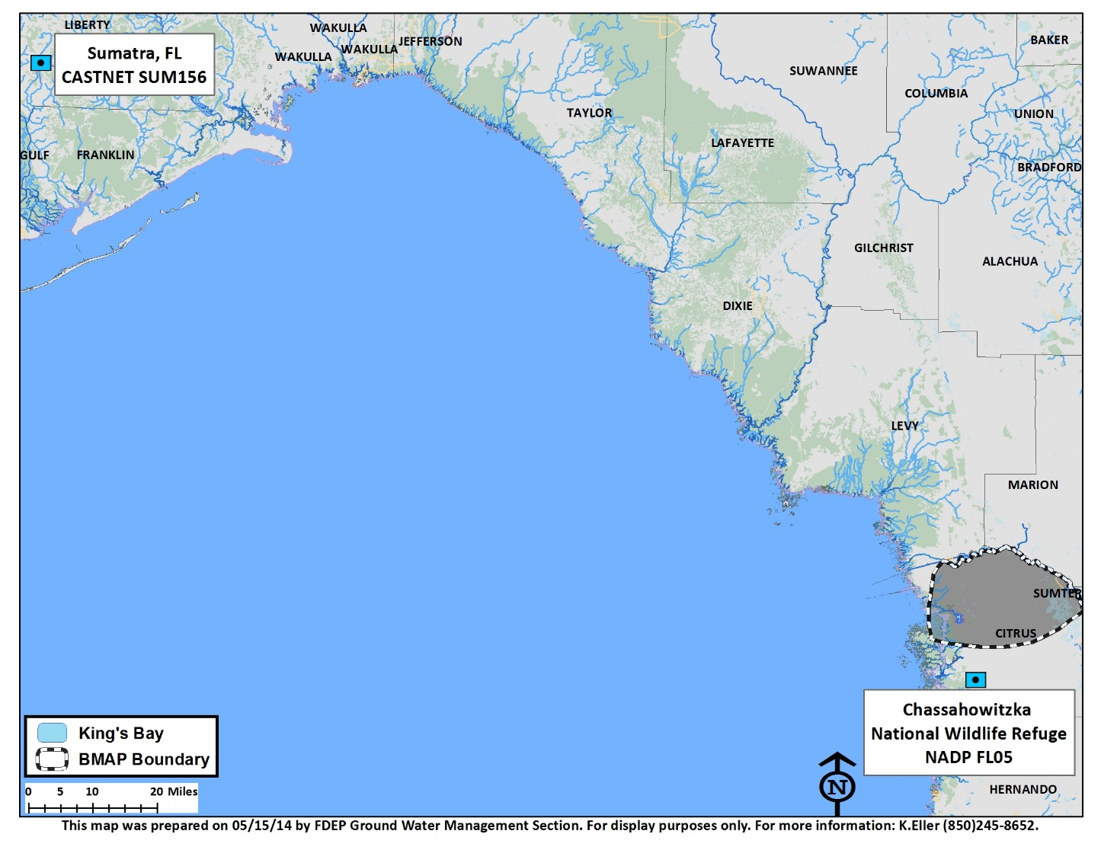
Atmospheric Deposition
National Atmospheric Deposition Program (NADP)
  Wet deposition
  Chassahowitzka National Wildlife Refuge (FL05)
Clean Air Status and Trend Network (CASTNET)
  Dry deposition
  Sumatra, FL (SUM156)
Annual Average TN deposition
  2002-2005, 2007, 2010-2011
  3.11 lbs-N/ac

Slide 8
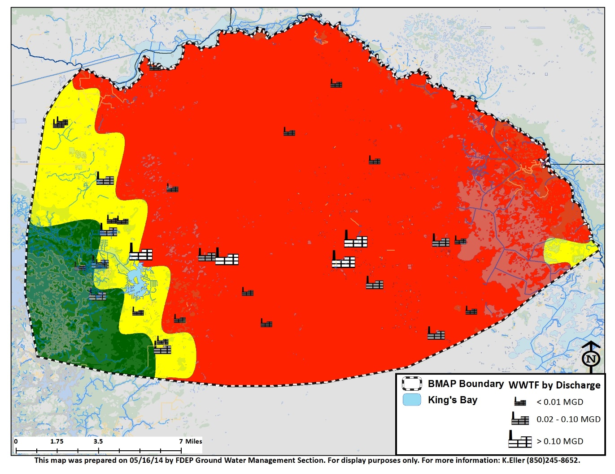
Wastewater Treatment Facilities
31 permitted facilities
  4 with discharge ≥0.1 MGD
  9 with discharge <0.1 & ≥0.01 MGD
  18 with discharge <0.01 MGD
TN effluent concentrations as reported in DMR
  NO3 used to project TN data, if necessary
  8.97 mg/L TN used if no data available
  50% design capacity if no flow data available
Recharge Area | Input to Land Surface (lbs-N)
Medium | 2,760
High | 33,753

Slide 9
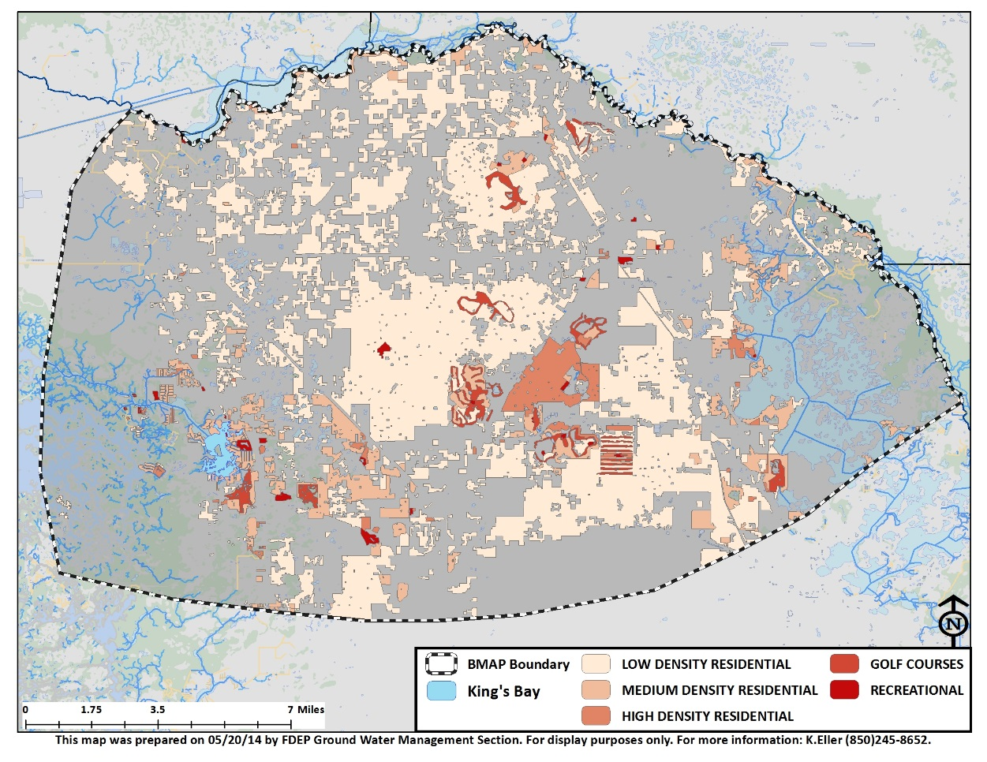
Urban Fertilizers
FL Dept of Ag Fertilizer Sales Data
  Annual data
  Total Fertilizer Sold
  Total N in Fertilizer Sold
  Total Fertilizer for Non-Farm Applications
  Full County data ONLY appropriated by land use percentages
Golf Course Exception
  150 lb-N/ac application rate
  72% of course is fertilized
Recharge Area | Input to Land Surface (lb-N)
 | Urban Fertilizers | Golf Courses
Medium | 15,079 | 21,360
High | 237,396 | 323,603

Slide 10
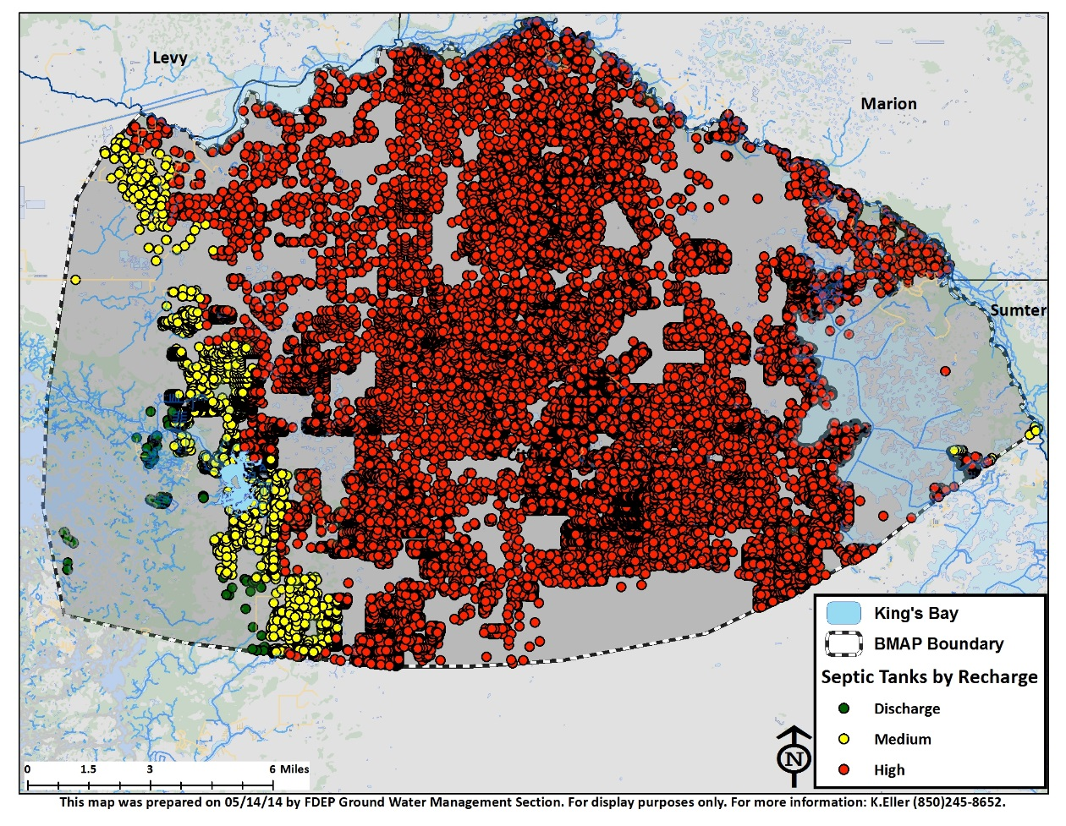
Septic Tanks
FDOH model relying on tax parcel data and sewer service areas
Calculate # of people relying on septic tanks from 2010 Census
  2.23 people per household in Citrus County
  41,504 tanks in BMAP boundary
Average annual input to septic tank = 9.92 lb-N/person (FDOH)
Recharge Area | Input to Land Surface (lb-N)
Medium | 76,268
High | 836,865

Slide 11

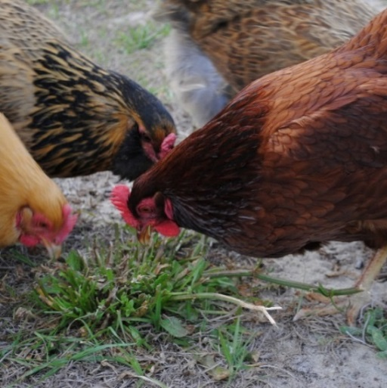


Livestock Waste
BMAP populations estimated with land use percentages
  2,201 cattle
  874 calves
  433 horses
  130 broiler chickens
  664 layer chickens
  338 goats
  73 hogs
  104 sheep
  10 turkey
Daily waste factors applied
Recharge Area | Input to Land Surface (lb-N)
Medium | 48,821
High | 312,039

Slide 12
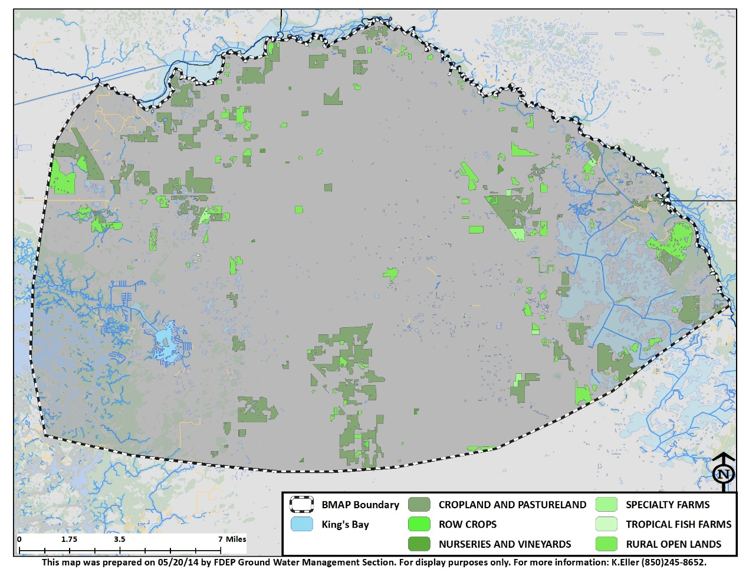
Farm Fertilizers
Property appraised land use data was compiled
Each county was evaluated individually
Land areas for specific crops were estimated
Application rates based on IFAS recommendations and farmer feedback
  25 lb-N/ac: Pastures
  80 lb-N/ac: Ornamentals
  110 lb-N/ac: Hay
  150 lb-N/ac: Orchards
Recharge Area | Input to Land Surface (lb-N)
Medium | 50,379
High | 321,132

Slide 13
Surface Loading
Document load reductions to surface
  Stormwater load reductions are accounted for in separate calculations
  Atmospheric deposition to surface is considered background loading

Slide 14
Surface Loading

Slide 15
Nutrient Reduction Solutions
Urban Fertilizer
  County & municipal ordinances
WWTP
  Permit modifications upon renewal (WWTP Initiative)
OSTDS
  Septic Tank Initiative
Agriculture (Fertilizer & Livestock Waste)
  BMPs
Golf Courses
  BMPs
Stormwater

Slide 16
WWTP Initiative
As permits are renewed for WWTP within the BMAP area:
Plants with discharge >100,000 gallons per day (GPD)
  TN <= 3.0mg/l
Plants with discharge <100,000 and >20,000 GPD
  TN <= 6.0 mg/l
Plants with discharge < 20,000 GPD
  TN,<=10.0 mg/l

Slide 17
Septic Initiative
Be prepared to utilize funding as it becomes available
Identify effective, financially feasible strategies
  Education and outreach programs
  Determine responsibilities
  ID funding sources
  Develop implementation schedule
Understand current capacity & plan for future growth

Slide 18
Agriculture
Implement BMPs
Assist FARMS and FDACS with additional projects

Slide 19
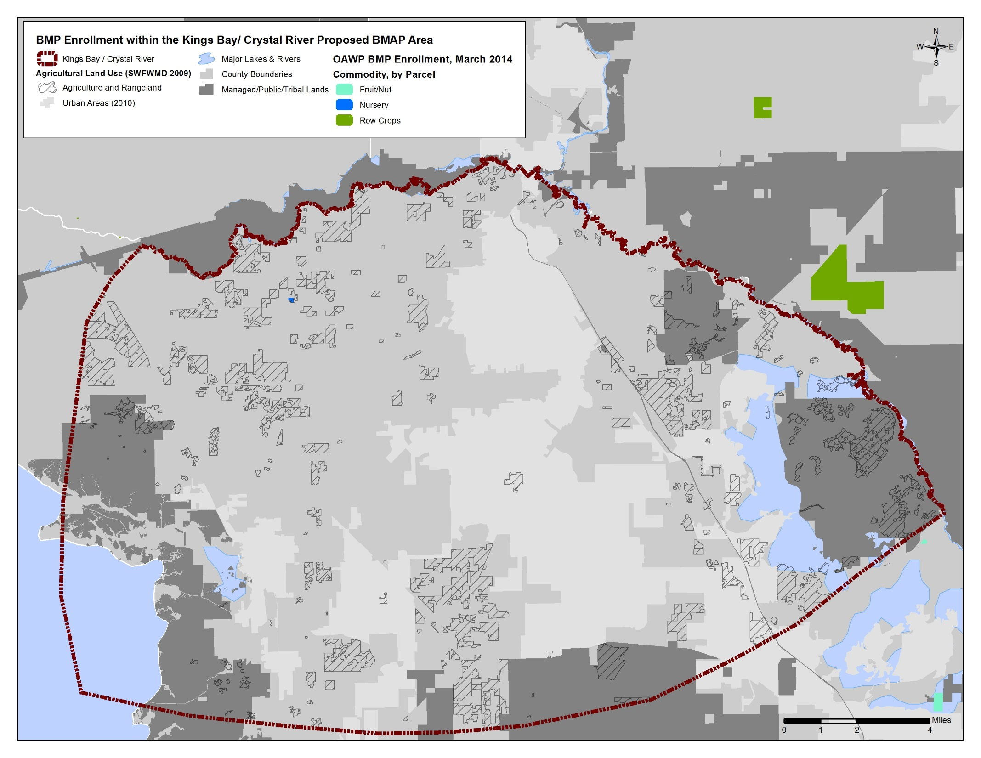

Slide 20
Golf Courses
Questionnaire for Golf Course Superintendents to fill out (PDF)
..\..\..\GOLF COURSES\Springs Coast Golf Course Questionnaire.pdf
Develop additional guidance as needed

Slide 21
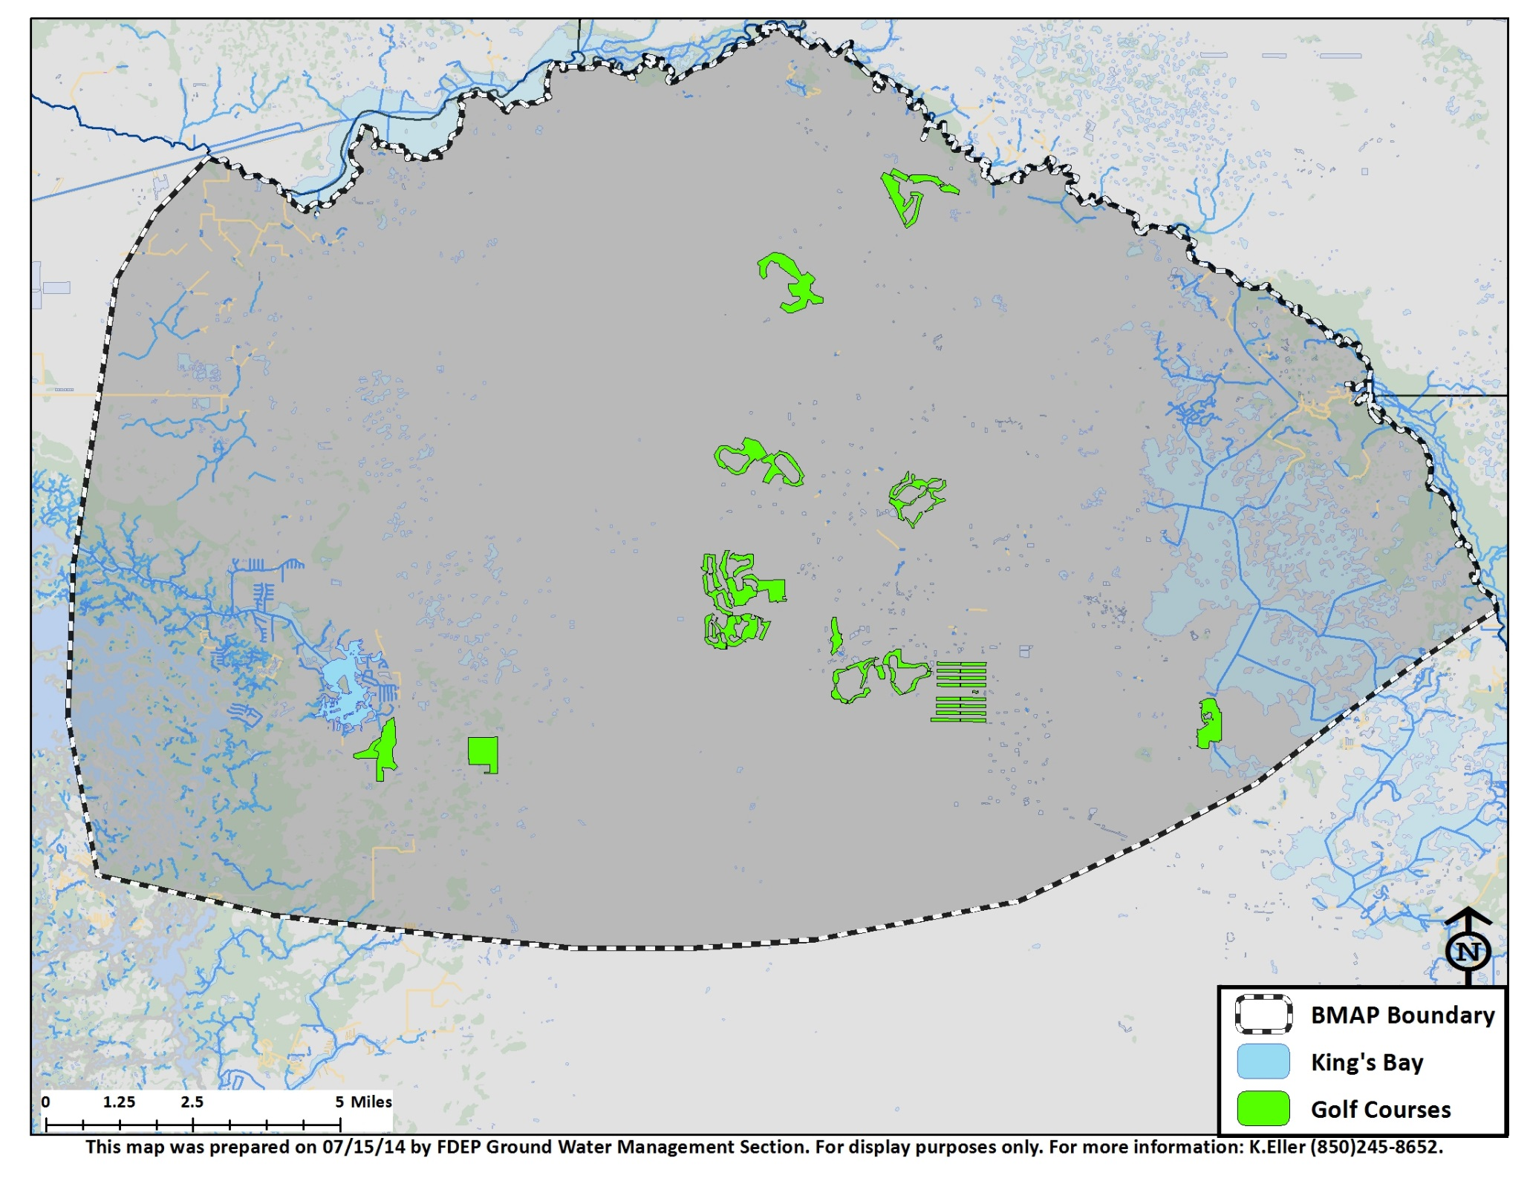

Slide 22
Stormwater
NOT included in loading to surface in springshed
Loads variable in nature and extent across basin
Utilize existing removal efficiencies for BMPs on individual project basis

Slide 23
Other Projects
SWFWMD existing and ongoing projects that may NOT fit into a source category

Slide 24
Next Steps
Collect Project Information

Slide 25
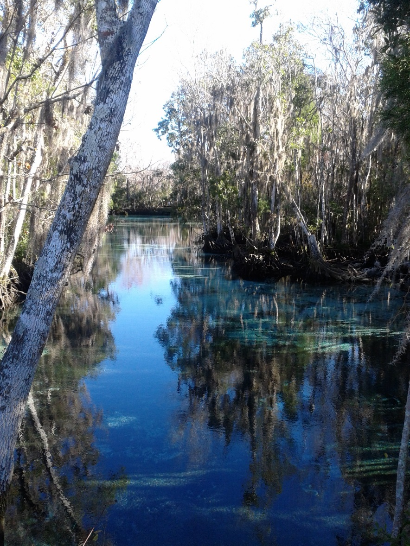
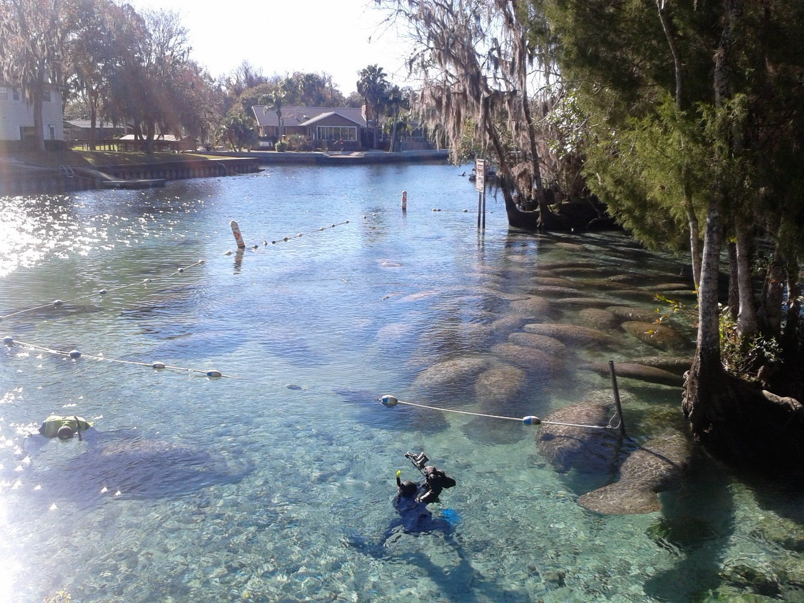
Questions??

