Slide 1
Basin Management Action Plan (BMAP)
Crystal River/Kings Bay
August 23, 2016
Terry Hansen P.G., Basin Coordinator
850-245-8561
terry.hansen@dep.state.fl.us

Slide 2
Topics
Priority focus area (PFA)
Planning projects and level of effort
  Necessary reductions
  Additional nitrogen source reduction measures
Onsite Sewage Treatment and Disposal System (OSTDS) Remediation Plan (continued)
  Science/research
  Projects
  Public education strategy

Slide 3
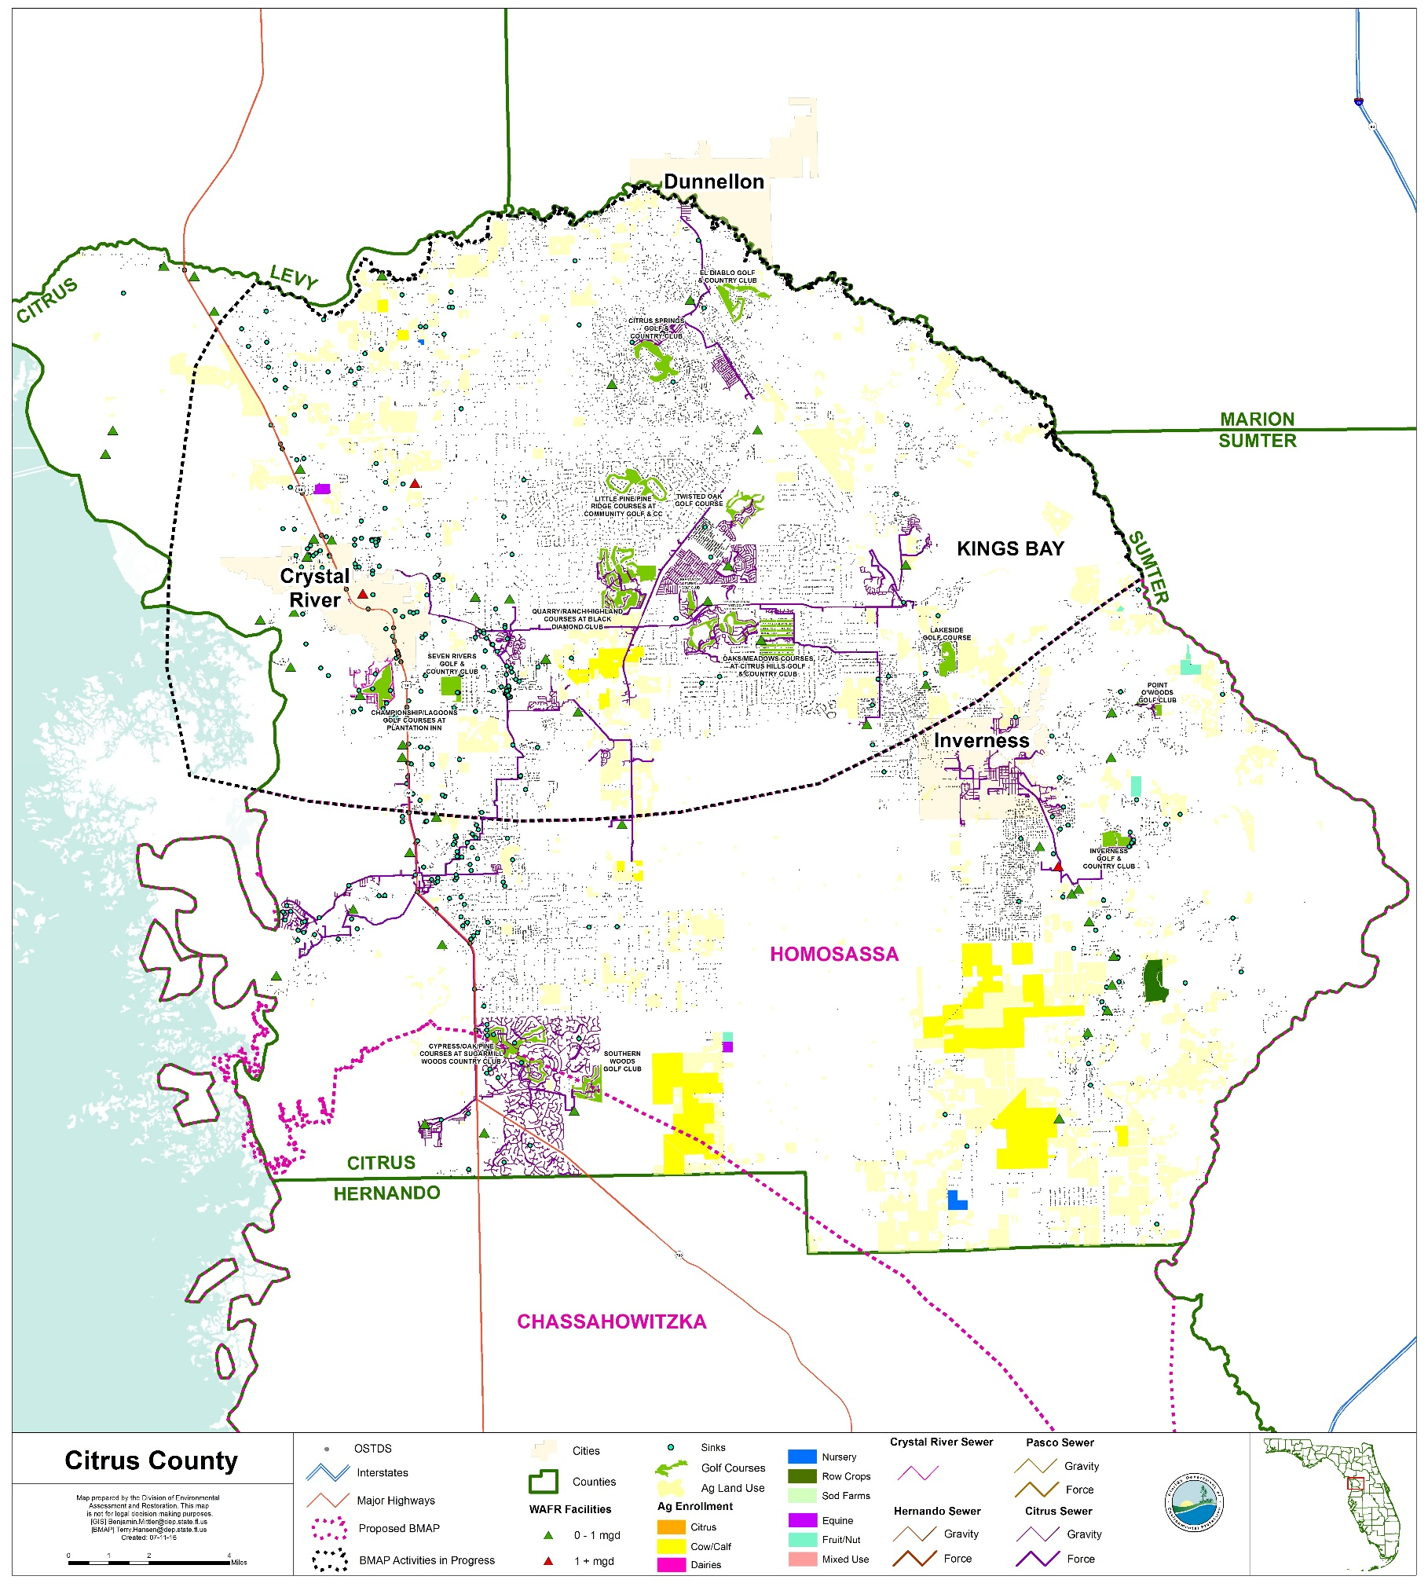

Slide 4
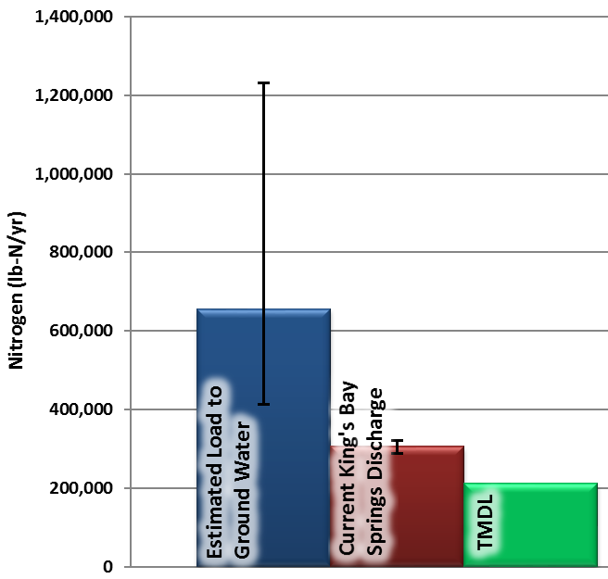
Kings Bay Discharge of Nitrogen
Current
  Discharge = 466 cubic feet per second (ft³/sec)
  TN = 0.33 milligrams per liter (mg/L)
  Load = 305,897 pounds of nitrogen per year (lbs-N/yr)
TMDL
  Using current discharge
  Nitrate = 0.23 mg/L
  Load = 210,648 lbs-N/yr
Notes:
This plot illustrates that the estimated nitrogen load to groundwater is higher than what is currently discharging from the springs. The discharge measurement was estimated for all Kings Bay springs and the listed concentration is a 2009 average from Hunter Spring, House Spring, Idiot’s Delight, Tarpon Spring and Black Spring. This may indicate that we are over-estimating the amount of nitrogen entering the subsurface within the Kings Bay BMAP area. Or, there could be considerable nitrogen storage in the subsurface, which may enter the aquifer slowly over time.
The most important thing to note is the nitrogen load discharging from the spring is higher than the target TMDL. The management practices implemented with the BMAP over time will help to improve the overall water quality of the Kings Bay springs. We are continually refining the NSILT methodology and results as new data become available. In the future, we hope to receive more detailed information about nitrogen application practices including those associated with urban fertilizer usage and storm water runoff to catchments.

Slide 5
PFA

Slide 6
PFA Requirements
  Sub-Section 373.802, Chap. 2016-1 Laws of Florida:
    Definition: Area or areas of a basin where the Floridan Aquifer is generally most vulnerable to pollutant inputs where there is a known connectivity between ground water pathways and an Outstanding Florida Spring (OFS).
Notes:
Definition: area or areas of a basin where the Floridan Aquifer is generally most vulnerable to pollutant inputs where there is a known connectivity between ground water pathways and an Outstanding Florida Spring (OFS), as determined by the department in consultation with the appropriate water management districts, and delineated in a BMAP.
Using the best data available from the water management districts and other credible sources, the department, in coordination with the water management districts, shall delineate priority focus areas for each OFS or group of springs that contains one or more OFS and is identified as impaired in accordance with s. 373.807.
PFA and is effective upon incorporation in a basin management action plan.
For ease of implementation delineation Shall use understood and identifiable boundaries such as:
Roads.
Political jurisdictions

Slide 7
PFA Requirements
  Sub-Section 373.803, Chap. 2016-1 Laws of Florida:
    To be delineated considering factors that may lead to degradation of an OFS, such as:
      Groundwater travel time to spring
      Hydrogeology
      Nutrient load to spring
      Additional factors
        Soil types
        Pollutant sources
      Identifiable boundaries

Slide 8
PFA Determination
  Establish groundwater contributing area (CA) for the spring.
  Identify regions within the CA where greatest recharge occurs.
  Identify regions within the CA where Floridan Aquifer is most vulnerable.
  Consider nitrogen loading and travel time.
  Consider groundwater travel time.
  Identify regions within CA to exclude or include based on land use and potential occurrence of pollutant sources.
  Create PFA boundary that corresponds with identifiable boundaries.

Slide 9
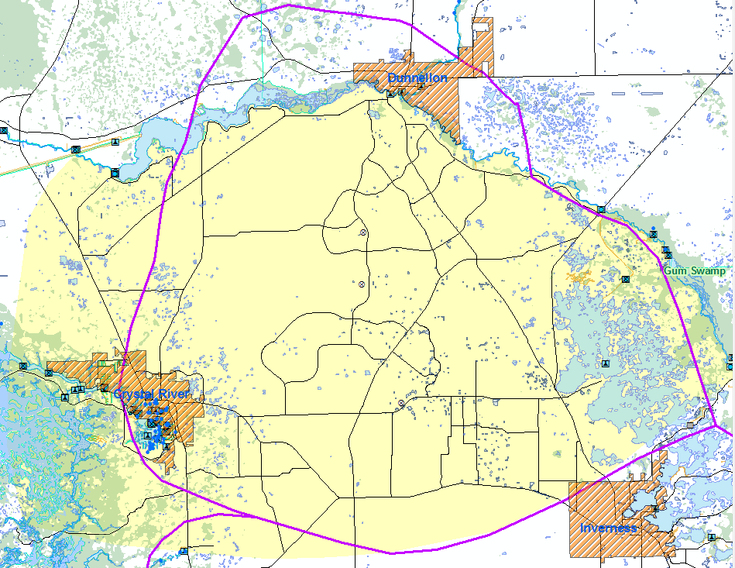

Slide 10
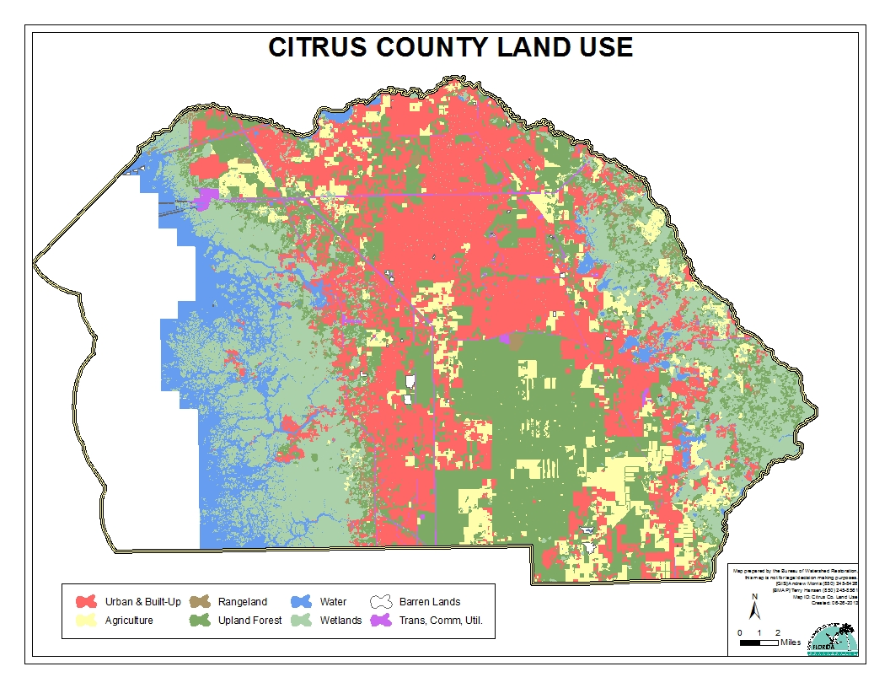

Slide 11
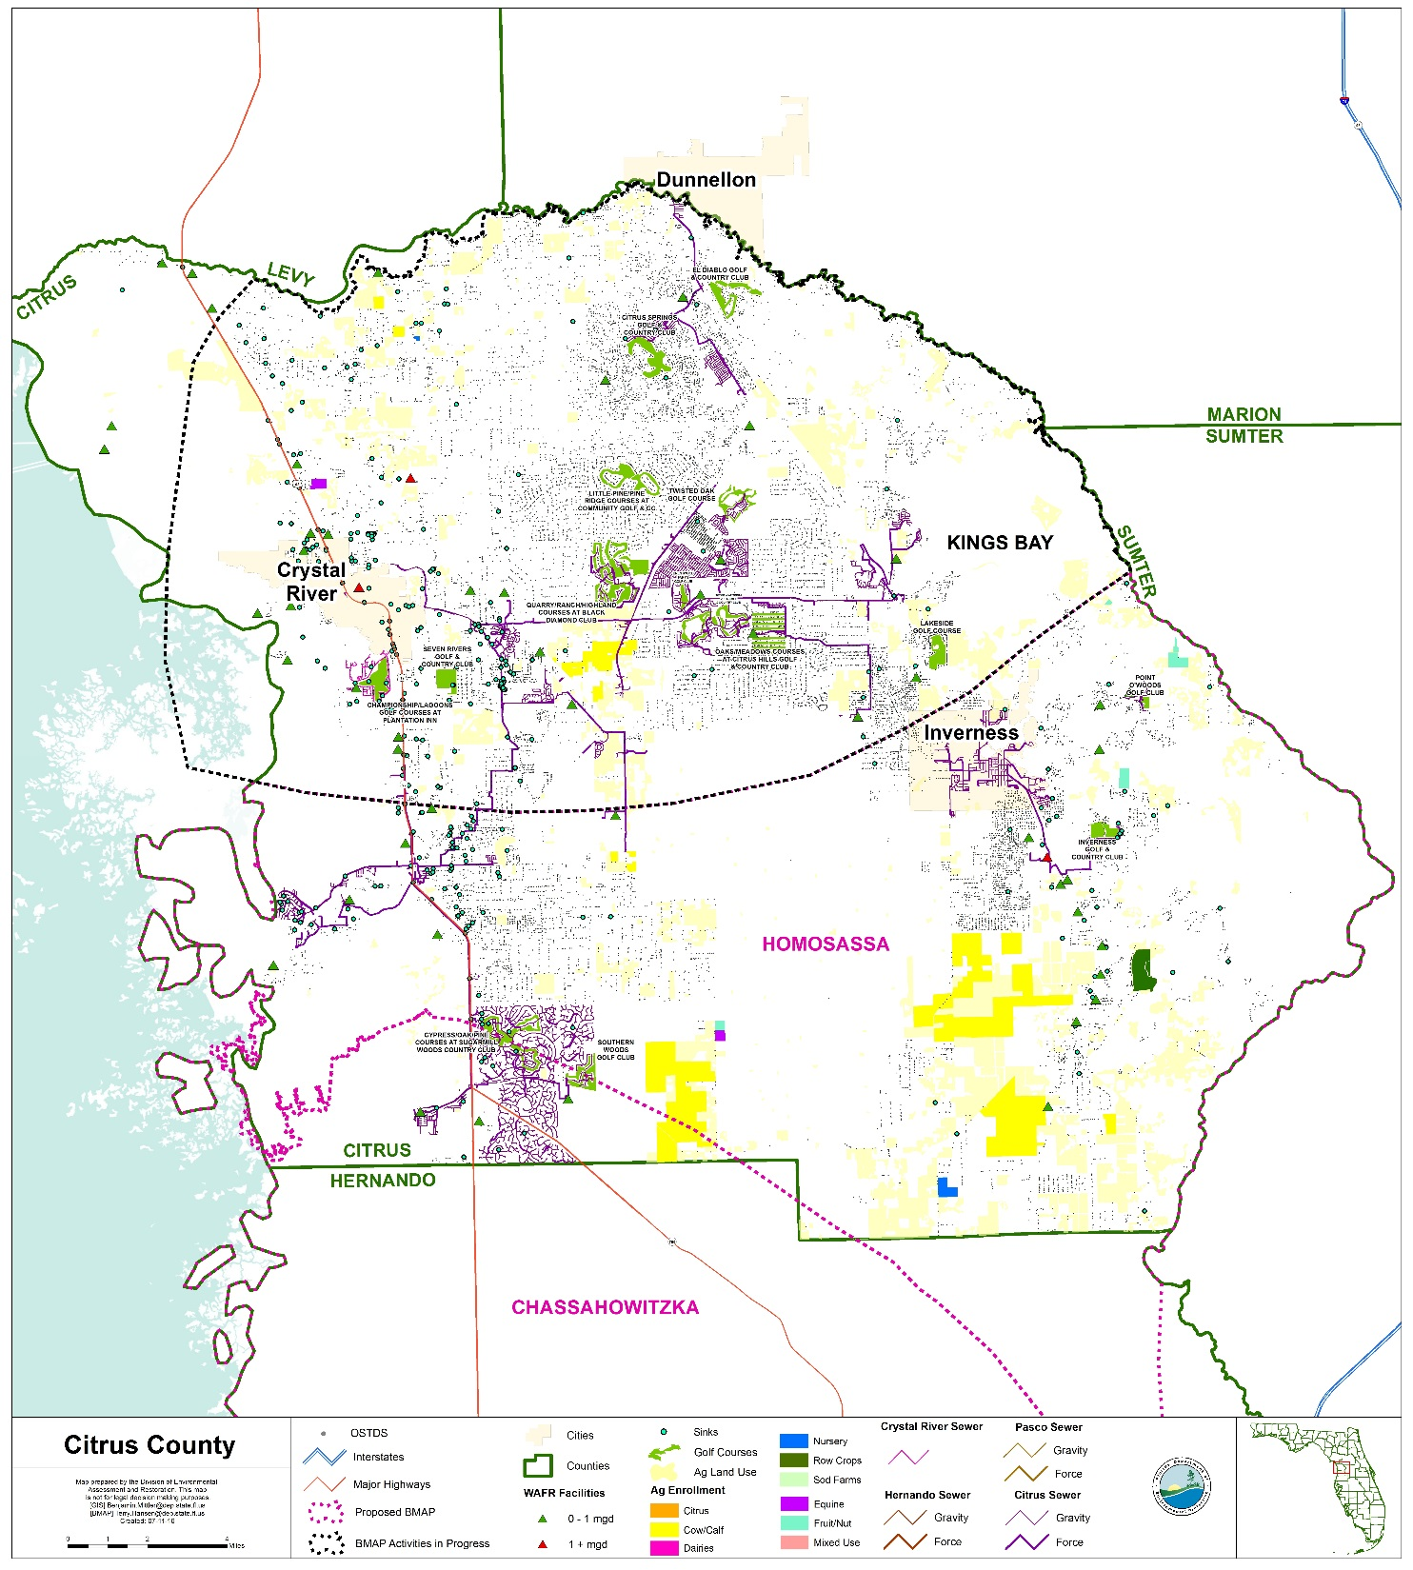
PFA Determination-
Septic System Locations

Slide 12
PFA Determination
  Questions on PFA Process?

Slide 13
Planning Projects and Level of Effort

Slide 14
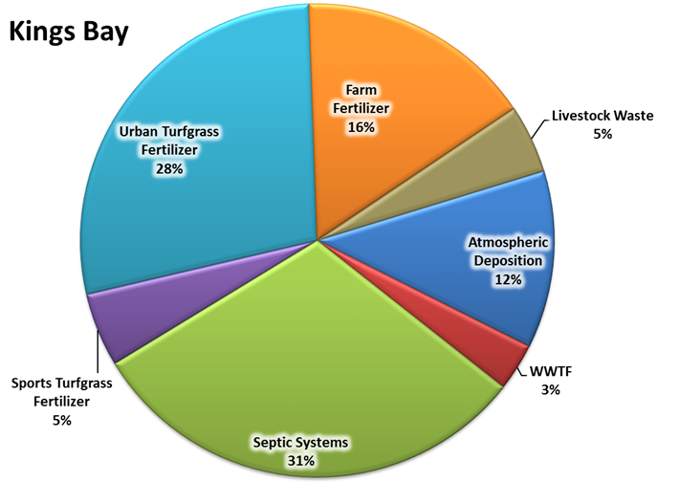
Nitrogen Source Reduction
NSILT Load to Groundwater
655,616 lb-N/yr

Slide 15
Nitrogen Source Reduction Strategy
Source | % of total TN load (655,616) | Total estimated pounds/year TN to be reduced
Septic Systems | 31 | 203,241
Urban Turfgrass Fertilizer | 28 | 183,573
Sports Turfgrass Fertilizer | 5 | 32,781
Farm Fertilizer | 16 | 104,899
Livestock Waste | 5 | 32,781
WWTF | 3 | 19,669
Atmospheric Deposition | 12 | 78,674
Load Reduction Targets:
  5 years − 30% of total
  10 years − Additional 50% (80% total)
  15 years − Remaining 20% (100% total)

Slide 16
Nitrogen Source Reduction Strategy
Propose to set atmospheric deposition reductions aside and focus on controllable load reductions.
Next step, provide reduction amounts to each entity and to agriculture.
Yearly - Track load reduction progress and make adjustments as needed.
At 5-year milestone:
  Assess progress.
  Adjust load reductions as necessary.
  Determine if atmospheric deposition reductions should be assigned.
Monitor existing groundwater and springs sampling locations.

Slide 17
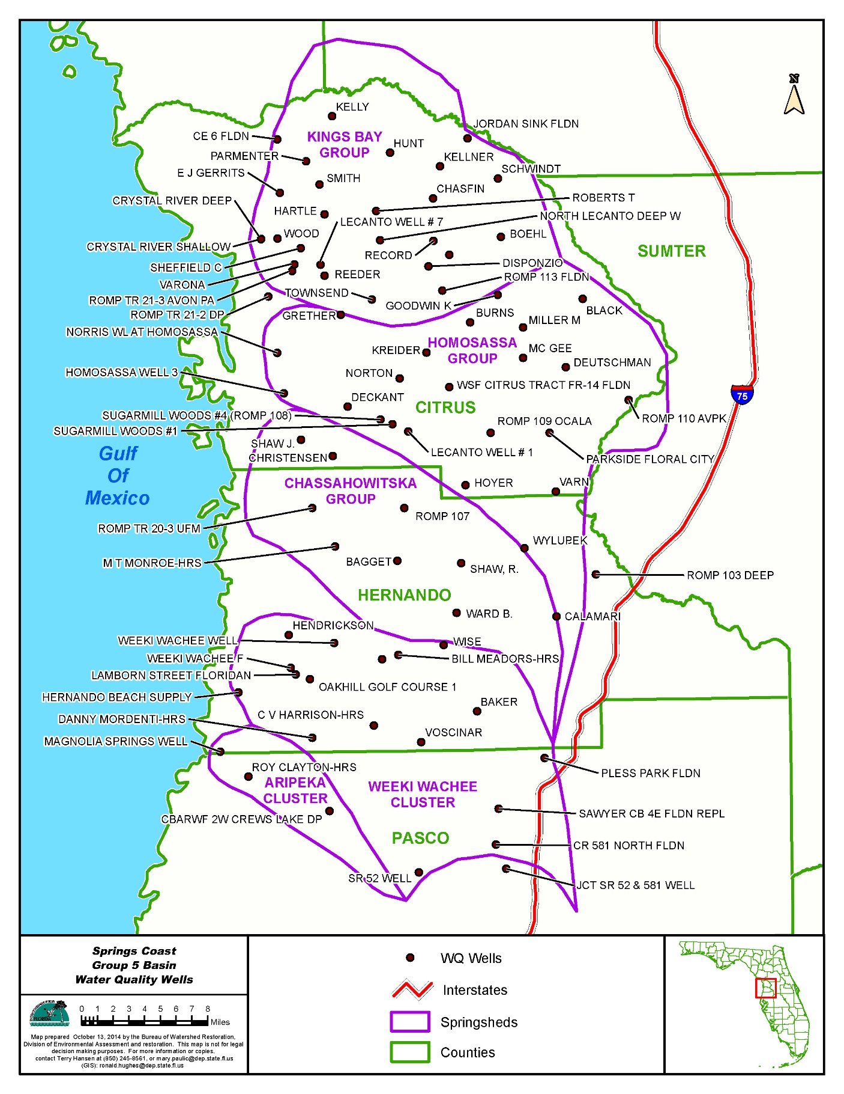

Slide 18
Source Categories & Solutions?
Ideas for urban turfgrass fertilizer (183,573 lbs/yr reduction):
  Ordinances
  Enforcement
  Education
  Fertilizer sales bans
  New types of fertilizer
Ideas for sports turfgrass fertilizer (32,781 lbs/yr reduction):
  Municipal and school sports fields
    Application program for field managers

Slide 19
Springs Coast Ordinances, Comp Plans & Land Development Codes
Local Government | Topic
 | Fertilizer Ordinance | Reclaimed Water Ordinance | Stormwater Utility Ordinance (sets up funding) | Septic Systems/Wastewater
 |  |  |  | Inspections | Require mandatory connections to central sewer
Brooksville | No ordinance or comp plan policies | No ordinance; few comp plan policies |  |  | X
Citrus County | X* | No specific ordinance, but comp plan policies | X |  | X
Crystal River | No ordinance, but city does ban the residential and commercial use and sale of fast release fertilizer | No ordinance; few comp plan policies |  |  | X
Hernando Co. | X | X | X
Pasco County | X | X | X |  | X
*Citrus County's fertilizer ordinance has detailed citation and financial penalty text not common to the DEP model ordinance.

Slide 20

Source Categories & Solutions?
October 18, 2016 − Joint meeting for Crystal River/Kings Bay and Weeki Wachee stakeholders at SWFWMD headquarters in Brooksville.
Nanette O’Hara, Public Outreach Coordinator, Tampa Bay Estuary Program.
  Education efforts and successes.

Slide 21
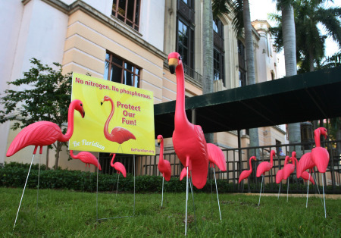
Source Categories & Solutions?
Questions on Source Categories and Solutions?

Slide 22
Onsite Sewage Treatment and Disposal System (OSTDS) Remediation Plan (continued)
Science/research
Projects
Public education strategy

Slide 23
OSTDS Remediation Plan
Recap of 2016-1 Requirements
Collect and evaluate credible scientific information on the effect of nutrients, particularly forms of nitrogen, on springs and springs systems.
Develop a public education plan to provide area residents with reliable, understandable information about onsite sewage treatment and disposal systems and springs.

Slide 24
OSTDS Remediation Plan
Recap of 2016-1 Requirements (continued)
Include options for repair, upgrade, replacement, drainfield modification, addition of effective nitrogen reducing features, connection to a central sewerage system or group of systems within a PFA (if OSTDS are 20% or more of the total nitrogen source – in Crystal River/Kings Bay OSTDS are 31% of the nitrogen sources).
Priority ranking of the projects to assist with funding.

Slide 25



OSTDS Remediation Plan
Nitrogen Reduction Options
for Onsite Wastewater
93%
70%
30%
Conventional systems
Lined drainfield & existing advanced technologies
Nitrogen reducing systems

Slide 26
Science-Related Actions–
2015 Crystal River/Kings Bay SWIM Plan
Management Action | Lead Entity
Monitoring and Research
Improve our understanding of the ecological responses to nutrient enrichment and reductions | FDEP/SWFWMD/ Universities
Maintain and expand water quality monitoring programs | SWFWMD/FDEP
Report annual status and trends | SWFWMD
Evaluate new and emerging technologies | SWFWMD
Septic Tank Systems
Research and develop advanced septic tank systems | FDOH/FDEP/UF-IFAS

Slide 27
Science & OSTDS Related
2015 SWIM Plan Projects
Ongoing Projects | Lead Entity
Quarterly Springs Water Quality Monitoring | SWFWMD
Stream Water Quality Monitoring | SWFWMD
Upper Floridan Aquifer Nutrient Monitoring | SWFWMD
Springs Initiative Monitoring | SWFWMD
Evaluation of Nitrogen Leaching from Reclaimed Water Applied to Lawns, Spray Fields, and RIBs | SWFWMD
Project COAST | SWFWMD
Florida Onsite Sewage Nitrogen Reduction | FDOH
Developing Tools for Surface Nutrient Loading Attributable to Reclaimed Water | WateReuse / Water Management Districts / FDEP
USGS Ground Water Data Collection | USGS / SWFWMD
USGS Surface Water Data Collection | USGS / SWFWMD

Slide 28
Science & OSTDS Related
2015 SWIM Plan Projects
Proposed Projects | Lead Entity
Nutrient Hot Spot Loading Identification | FDEP / SWFWMD
Groundwater Quality Monitoring for BMAP Assessment | FDEP / SWFWMD

Slide 29
Science Strategy
SWIM Plan Item: Research and develop advanced septic tank systems
Are there other OSTDS-related science questions we haven’t covered?
  Are there other data needed to identify potential project areas?
  Are there specific questions about the ground water system we would like to answer?
  Are there specific questions about project effectiveness we would like to answer?

Slide 30
Project Strategy
Overall reductions needed:
  By source category.
  By entity or group.
Calculating project credits:
  OSTDS improvements.
  Efforts in other source categories.
Sharing additional information.

Slide 31
Septic Field Enhancements
Project topics to contemplate for a future meeting:
Septic Field Enhancements
Florida Department of Health
  Are there site conditions/limitations that should be considered for installation of field enhancements?
  What site conditions affect the cost estimates (up or down)?
All
  Do we have the information we need to evaluate site conditions for field enhancements?
  Do we have the information we need to estimate costs of field enhancements?

Slide 32
Public Education
Recap of Public Education Recommendations:
Target Audiences
Policy makers – local, regional, and state
Residents in Citrus, Hernando, and Pasco Counties
Utilities and public works managers
Schools; bottom-up curriculum; kids to adults
Camps (emphasize connection to springs)
Septic tank contractors
Business community (through the chambers of commerce)
Civic groups
Homeowner associations
Builders/realtors/developers

Slide 33
Public Education
Recap of Public Education Recommendations:
Messaging
Conventional septic systems provide minimal nitrogen treatment; enhancement is needed
Convey costs of doing nothing
Convey costs on a monthly basis rather than an overall lump sum
We are all a part of the problem and all are part of the solution
People need to understand water and wastewater – where it comes from and where it goes
Keep messaging simple and focused
The watershed is large
Case studies (cost/benefit)
TV commercials

Slide 34
Public Education
Recap of Public Education Recommendations:
Existing Materials/Resources
Public service announcements
  Florida Department of Health
  Florida Onsite Wastewater Association
  Citrus County
SWFWMD springs education webpage
City of Tallahassee’s TAPP (Think About Personal Pollution) Campaign
Tampa Bay Estuary’s “Be Floridian” campaign
UF-IFAS new outreach program to homeowners
U.S. EPA “Septic Sam” in the SepticSmart outreach toolkit
Social media
Door-to-door

Slide 35
Public Education
Stakeholder Public Education Priorities
Recommended Target Audiences
Brooksville | Crystal River | Citrus County
Schools – Bottom-up Curriculum – Kids to Adults | Utilities | Builders / Realtors / Developers / Business Community
Residents in Citrus, Hernando, and Pasco Counties |  | Septic System Contractors
Policymakers – Local, Regional, and State
Recommended Messaging
Brooksville | Crystal River | Citrus County
TV commercials | Keep the messaging simple | Convey cost of doing nothing
People need to understand water- where it comes from and where it goes |  | Conventional septic system provides minimal nitrogen treatment; septic system enhancement is needed
We are all part of the problem and all part of the solution. Show the negative and positive contributions by people. For example, the duck campaign used by the City of Tallahassee in its TAPP (Think About Personal Pollution) program.
Recommended Materials / Resources
Brooksville | Crystal River | Citrus County
Florida Department of Health's public service announcements on septic systems
City of Tallahassee's TAPP program | Crystal River social media | Florida Onsite Wastewater Association's public service announcements on septic systems
Brooksville website | Citrus County public service announcements | Southwest Florida Water Management District's springs education webpage

Slide 36
Basin Management Action Plan
Next Meeting: Thursday, September 29, 2016
Proposed Topics:
Site considerations/field enhancements for OSTDS
Approaches to load reduction calculations
Potential efforts/reductions in other source categories

Slide 37
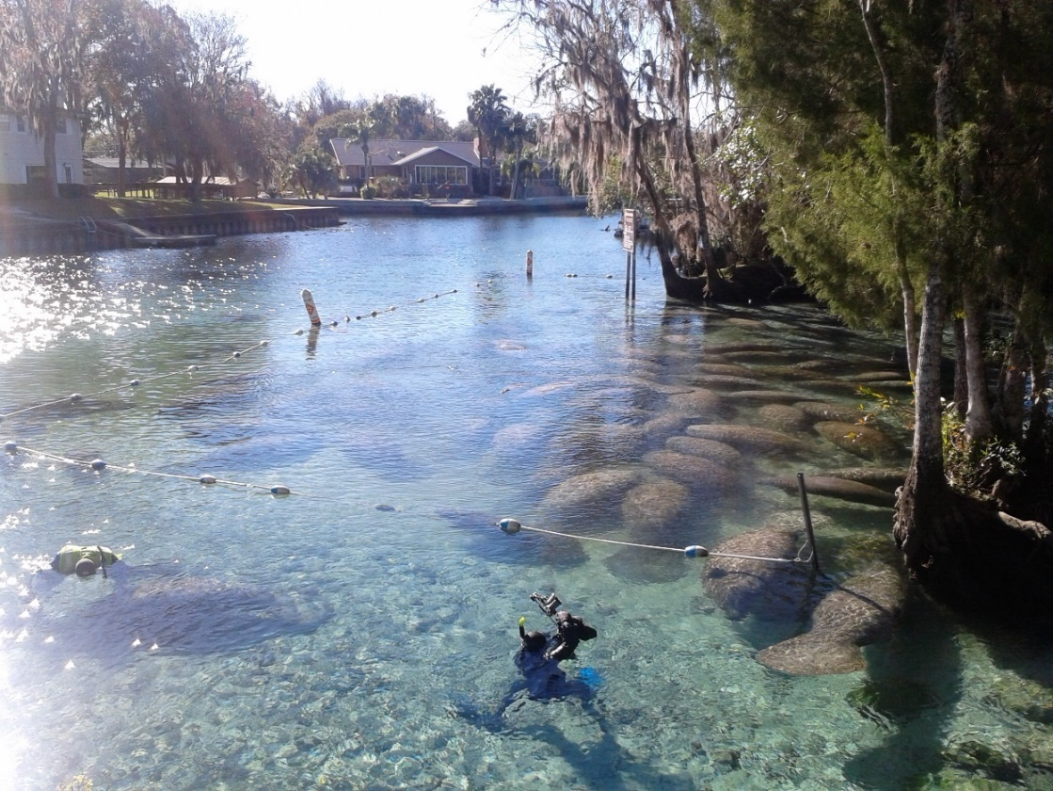
Basin Management Action Plan
Contact: Terry Hansen, P.G. terry.hansen@dep.state.fl.us
http://www.dep.state.fl.us/water/
http://publicfiles.dep.state.fl.us/DEAR/BMAP/Springs Coast/BMAPs/CR_KB_BMAP/

