Slide 1
Springs Coast
Basin Management Action Plans (BMAPs)
April 6, 2017
Terry Hansen P.G., Basin Coordinator
850-245-8561
terry.hansen@dep.state.fl.us

Slide 2
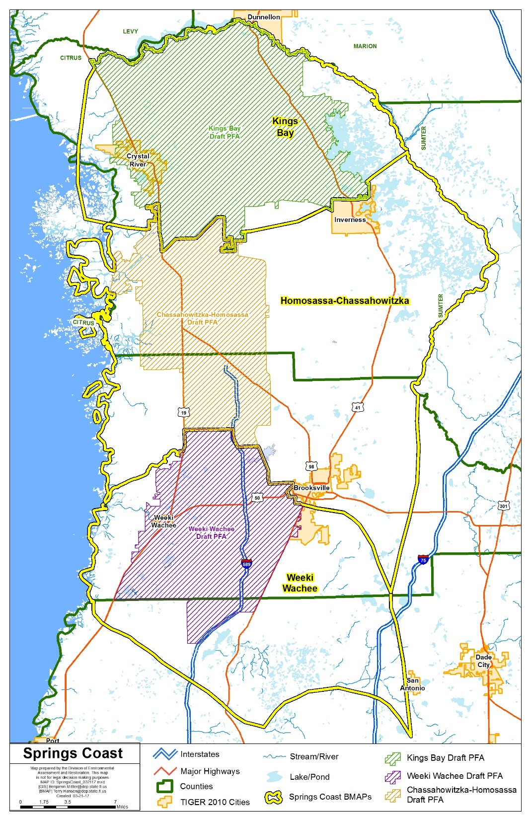
Springs Coast
BMAP Study Areas and Priority Focus Areas

Slide 3
Pollutant Source Reduction Obligations of Stakeholders

Slide 4
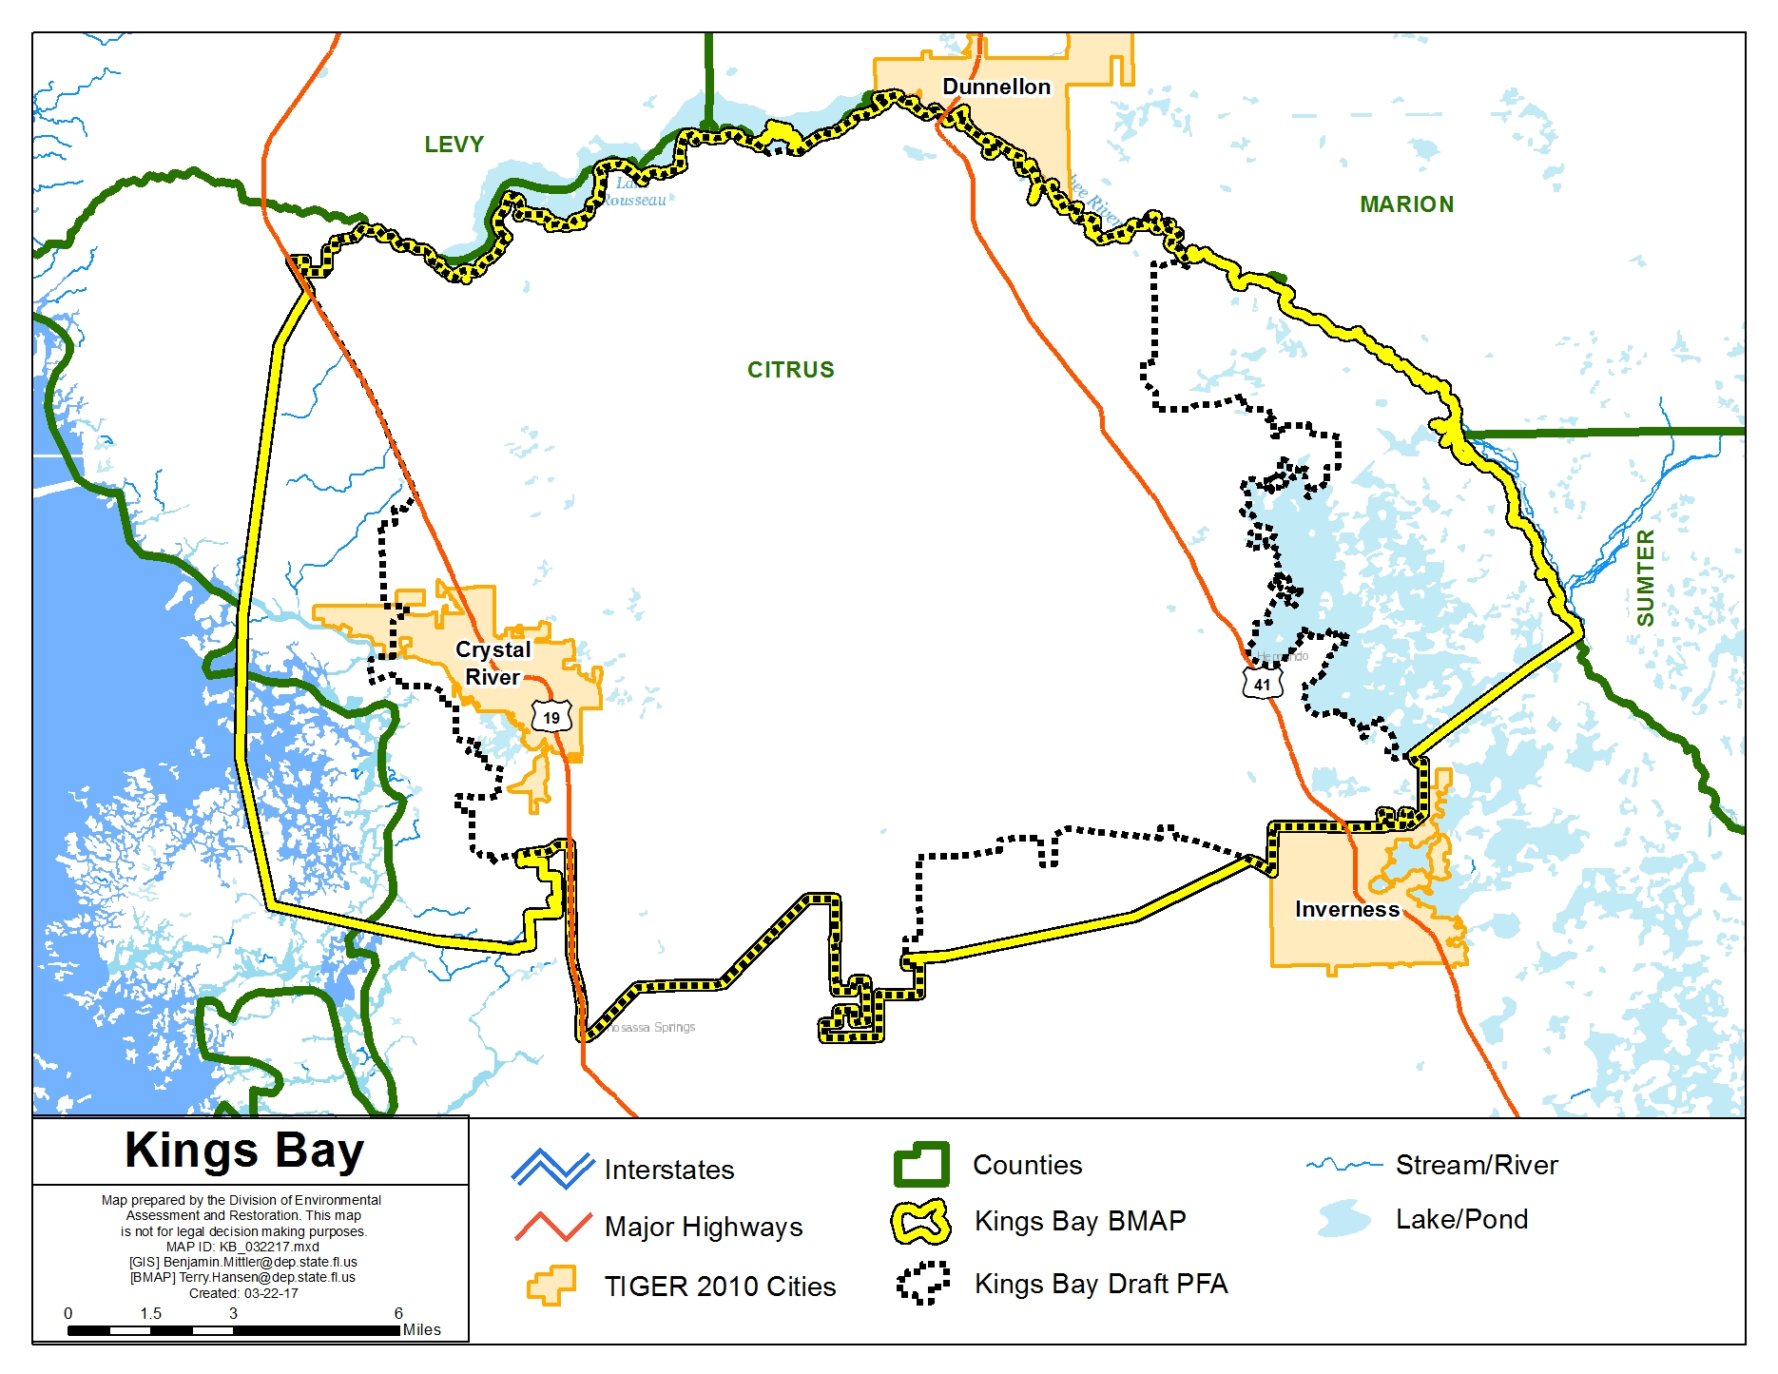

Slide 5
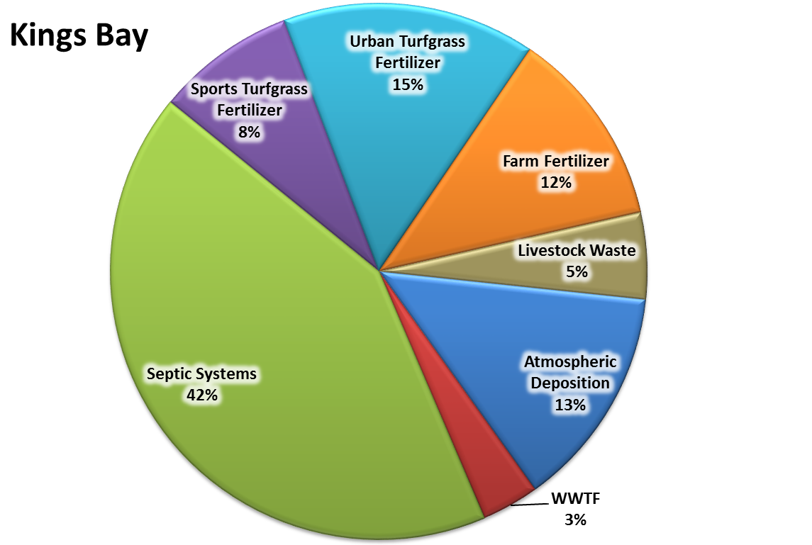
Kings Bay Nitrogen Loading to Groundwater
Estimated Load to Groundwater: 600,000 lbs-N/yr Estimated TMDL Load: 200,000 lbs-N/yr

Slide 6
CR/KB Nitrogen Reductions by Source
Source | Estimated Portion of Total Load (%) | Estimated Total Nitrogen Load to Groundwater (pounds of Nitrogen per year [lbs-N/yr]) | Estimated Load Reduction (lbs-N/yr) [Groundwater Load – TMDL Load (x) %]
Septic systems | 42 % | 252,000 | 168,000
Urban turfgrass fertilizer | 15 % | 91,500 | 60,000
Atmospheric deposition | 13 % | 81,000 | 56,000
Farm fertilizer | 12 % | 71,500 | 48,000
Sports turfgrass fertilizer | 8 % | 50,500 | 32,000
Livestock waste | 5 % | 31,500 | 20,000
WWTF | 4 % | 22,000 | 16,000
Totals | 100 % | 600,000 | 400,000
Draft April 2017

Slide 7
CR/KB Reduction Obligations by Entity by Source (lbs-N/yr)
Source | Citrus County | Crystal River | Agricultural Producers | Golf Courses | Total Nitrogen Reduction
Septic systems | 167,586 | 414 |  |  | 168,000
Urban turfgrass fertilizer | 59,201 | 799 |  |  | 60,000
Atmospheric deposition | * | * | * | * | 56,000
Farm fertilizer |  |  | 48,000 |  | 48,000
Sports turfgrass fertilizer | 1,301 |  |  | 30,699 | 32,000
Livestock waste |  |  | 20,000 |  | 20,000
WWTF | ** | ** | ** | ** | 16,000
Totals | 228,088 | 1,213 | 68,000 | 30,699 | 400,000
*Atmospheric deposition is an uncontrollable load, but will likely be reduced through stormwater treatment and WWTF uptake.
**WWTF owners/operators in the BMAP study area are 100 % responsible for achieving the appropriate source reductions based on their facility loads, with consideration for attenuation and locations in the high, medium, or low recharge areas.
Draft April 2017

Slide 8
CR/KB Reductions by Source Category by Milestone
Entity | 5-Year Milestone (30 % of Total) (lbs-N/yr) | 10-Year Milestone (50 % of Total) (lbs-N/yr) | 15-Year Milestone (20 % of Total) (lbs-N/yr) | Total Nitrogen Reduction (100 %) (lbs-N/yr)
Septic systems | 50,400 | 84,000 | 33,600 | 168,000
Urban turfgrass fertilizer | 18,000 | 30,000 | 12,000 | 60,000
Atmospheric deposition* | 16,800 | 28,000 | 11,200 | 56,000
Farm fertilizer | 14,400 | 24,000 | 9,600 | 48,000
Sports turfgrass fertilizer | 9,600 | 16,000 | 6,400 | 32,000
Livestock waste | 6,000 | 10,000 | 4,000 | 20,000
WWTF** | 4,800 | 8,000 | 3,200 | 16,000
Totals | 120,000 | 200,000 | 80,000 | 400,000
*Atmospheric deposition is an uncontrollable load, but will likely be reduced through stormwater treatment and WWTF uptake.
**WWTF owners/operators in the BMAP study area are 100 % responsible for achieving the appropriate source reductions based on their facility loads, with consideration for attenuation and locations in the high, medium, or low recharge areas.
Draft April 2017

Slide 9
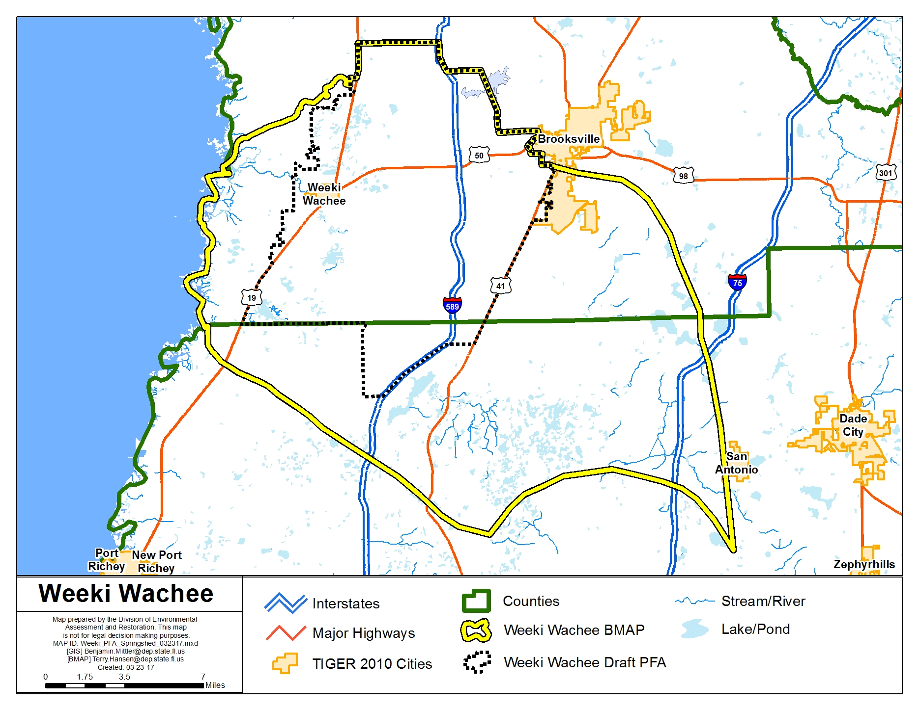

Slide 10
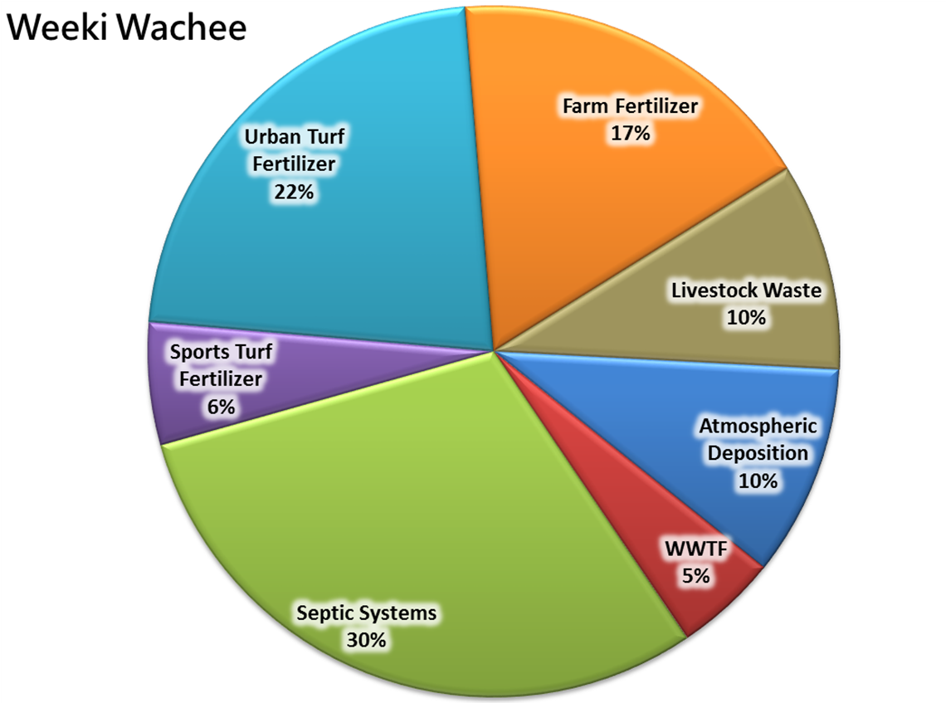
Weeki Wachee (WW) Nitrogen Loading
to Groundwater
Estimated Load to Groundwater: 940,000 lbs-N/yr Estimated TMDL Load: 103,000 lbs-N/yr

Slide 11
WW Nitrogen Reductions by Source
Source | Estimated Portion of Total Load (%) | Estimated Total Nitrogen Load to Groundwater (lbs-N/yr) | Estimated Load Reduction (lbs-N/yr) [Groundwater Load – TMDL Load (x) %]
Septic systems | 30 % | 282,875 | 251,100
Urban turfgrass fertilizer | 22 % | 209,689 | 184,140
Farm fertilizer | 17 % | 163,935 | 142,290
Atmospheric deposition | 10 % | 93,208 | 83,700
Livestock waste | 10 % | 91,347 | 83,700
Sports turfgrass fertilizer | 6 % | 53,841 | 50,220
WWTF | 5 % | 45,105 | 41,850
Totals | 100 % | 940,000 | 837,000
Draft April 2017

Slide 12
WW Reduction Obligations by Entity by Source (lbs-N/yr)
Source | Hernando County | Pasco County | Brooksville | Agricultural Producers | Golf Courses | Total Nitrogen Reduction
Septic systems | 220,215 | 29,881 | 1,004 |  |  | 251,100
Urban turfgrass fertilizer | 165,542 | 17,309 | 1,289 |  |  | 184,140
Atmospheric deposition | * | * | * | * | * | 83,700
Farm fertilizer |  |  |  | 142,290 |  | 142,290
Sports turfgrass fertilizer | 2,511 |  |  |  | 47,407 | 50,220
Livestock waste |  |  |  | 83,770 |  | 83,700
WWTF | ** | ** | ** | ** | ** | 41,850
Totals | 388,268 | 47,190 | 2,293 | 225,990 | 47,709 | 837,000
*Atmospheric deposition is an uncontrollable load, but will likely be reduced through stormwater treatment and WWTF uptake.
**WWTF owners/operators in the BMAP study area are 100 % responsible for achieving the appropriate source reductions based on their facility loads, with consideration for attenuation and locations in the high, medium, or low recharge areas.
Draft April 2017

Slide 13
WW Reductions by Source Category by Milestone
Entity | 5-Year Milestone (30 % of Total) (lbs-N/yr) | 10-Year Milestone (50 % of Total) (lbs-N/yr) | 15-Year Milestone (20 % of Total) (lbs-N/yr) | Total Nitrogen Reduction (100 %) (lbs-N/yr)
Septic systems | 75,330 | 125,550 | 50,220 | 251,100
Urban turfgrass fertilizer | 55,242 | 92,070 | 36,828 | 184,140
Atmospheric deposition* | 25,110 | 41,850 | 16,740 | 83,700
Farm fertilizer | 42,687 | 71,145 | 28,458 | 142,290
Sports turfgrass fertilizer | 15,066 | 25,110 | 10,044 | 50,220
Livestock waste | 25,110 | 41,850 | 16,740 | 83,700
WWTF** | 12,555 | 20,925 | 8,370 | 41,850
Totals | 251,100 | 418,500 | 167,400 | 837,000
*Atmospheric deposition is an uncontrollable load, but will likely be reduced through stormwater treatment and WWTF uptake.
**WWTF owners/operators in the BMAP study area are 100 % responsible for achieving the appropriate source reductions based on their facility loads, with consideration for attenuation and locations in the high, medium, or low recharge areas.
Draft April 2017

Slide 14
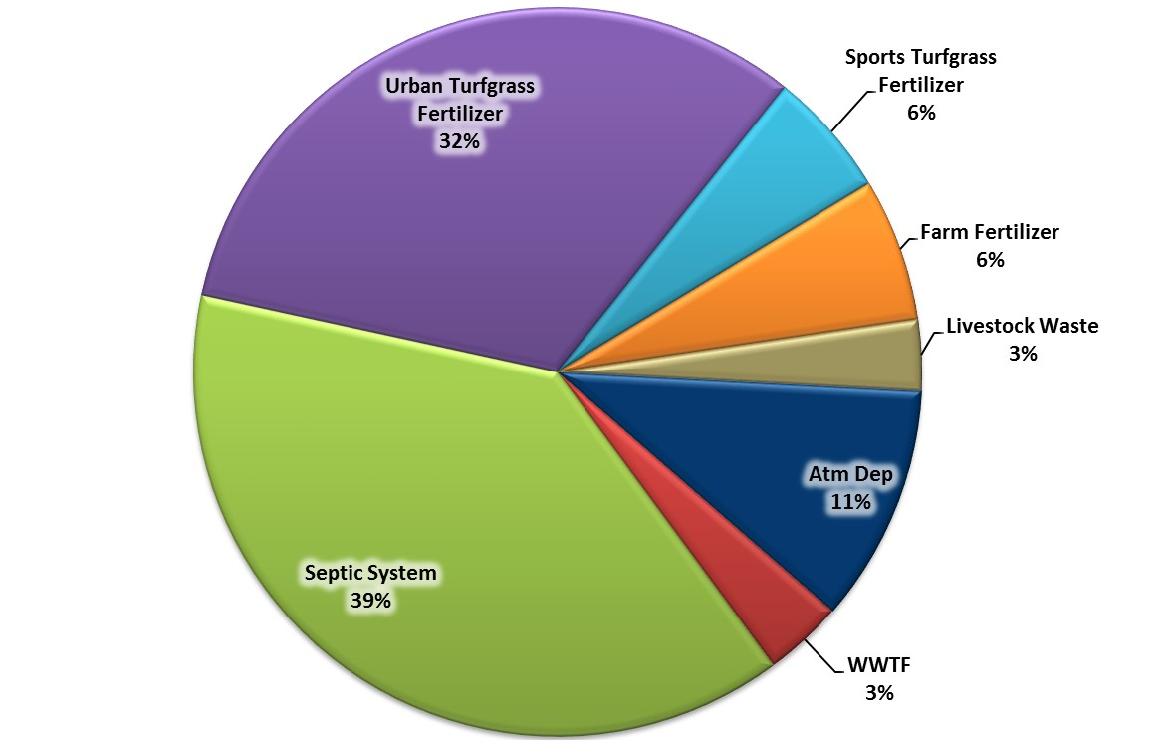
Magnolia-Aripeka Springs Nitrogen Loading
to Groundwater
Magnolia-Aripeka Springs
Spring flow is too irregular to accurately calculate TMDL load.
Estimated Load to Groundwater: 138,000 lbs-N/yr

Slide 15
Suggested Magnolia-Aripeka Springs Nitrogen Reduction Guidelines by Source
Source | Estimated Portion of Total Load (%) | Estimated Total Nitrogen Load to Groundwater (lbs-N/yr)
Septic systems | 39 % | 53,129
Urban turfgrass fertilizer | 32 % | 43,719
Atmospheric deposition | 11 % | 14,550
Farm Fertilizer | 6 % | 8,710
Sports turfgrass fertilizer | 6 % | 8,710
Livestock Waste | 3 % | 4,358
WWTF | 3 % | 4,824
Totals | 100 % | 138,000
Draft April 2017

Slide 16
Suggested Magnolia-Aripeka Springs Reduction Obligations by Entity by Source (lbs-N/yr)
Source | Hernando County | Pasco County | Agricultural Producers | Golf Courses | Total Nitrogen Reduction
Septic systems | 21,783 | 31,346 |  |  | 53,129
Urban turfgrass fertilizer | 13,553 | 30,166 |  |  | 43,719
Atmospheric deposition | * | * | * | * | 14,550
Farm fertilizer |  |  | 8,710 |  | 8,710
Sports turfgrass fertilizer |  | 1,568 |  | 7,142 | 8,710
Livestock waste |  |  | 4,358 |  | 4,358
WWTF | ** | ** | ** | ** | 4,824
Totals | 35,336 | 63,080 | 13,068 | 7,142 | 138,000
*Atmospheric deposition is an uncontrollable load, but will likely be reduced through stormwater treatment and WWTF uptake.
**WWTF owners/operators in the BMAP study area are 100 % responsible for achieving the appropriate source reductions based on their facility loads, with consideration for attenuation and locations in the high, medium, or low recharge areas.
Draft April 2017

Slide 17
Suggested Magnolia-Aripeka Reductions by Source Category by Milestone
Entity | 5-Year Milestone (30 % of Total) (lbs-N/yr) | 10-Year Milestone (50 % of Total) (lbs-N/yr) | 15-Year Milestone (20 % of Total) (lbs-N/yr) | Total Nitrogen Reduction (100 %) (lbs-N/yr)
Septic systems | 15,939 | 26,565 | 10,626 | 53,129
Urban turfgrass fertilizer | 13,116 | 21,860 | 8,744 | 43,719
Atmospheric deposition* | 4,365 | 7,275 | 2,910 | 14,550
Farm fertilizer | 2,613 | 4,355 | 1,742 | 8,710
Sports turfgrass fertilizer | 2,613 | 4,355 | 1,742 | 8,710
Livestock waste | 1,307 | 2,179 | 872 | 4,358
WWTF** | 1,447 | 2,412 | 965 | 4,824
Totals | 41,400 | 69,000 | 27,600 | 138,000
*Atmospheric deposition is an uncontrollable load, but will likely be reduced through stormwater treatment and WWTF uptake.
**WWTF owners/operators in the BMAP study area are 100 % responsible for achieving the appropriate source reductions based on their facility loads, with consideration for attenuation and locations in the high, medium, or low recharge areas.
Draft April 2017

Slide 18
Stakeholder Projects –
Source Reduction and Education
(Handouts)

Slide 19
Remaining BMAP
Schedule

Slide 20
Remaining Schedule
April 11, 2017 – Deadline for stakeholders to submit project edits or comments.
April 19, 2017 – Deadline for Terry to route draft BMAP for internal DEP review.
May 31, 2017 – Release draft BMAP to stakeholders for review.
June 2017 – BMAP public meeting with stakeholders prior to DEP adoption.

Slide 21
Nitrogen Source Inventory Loading Tool (NSILT)
Revisions

Slide 22

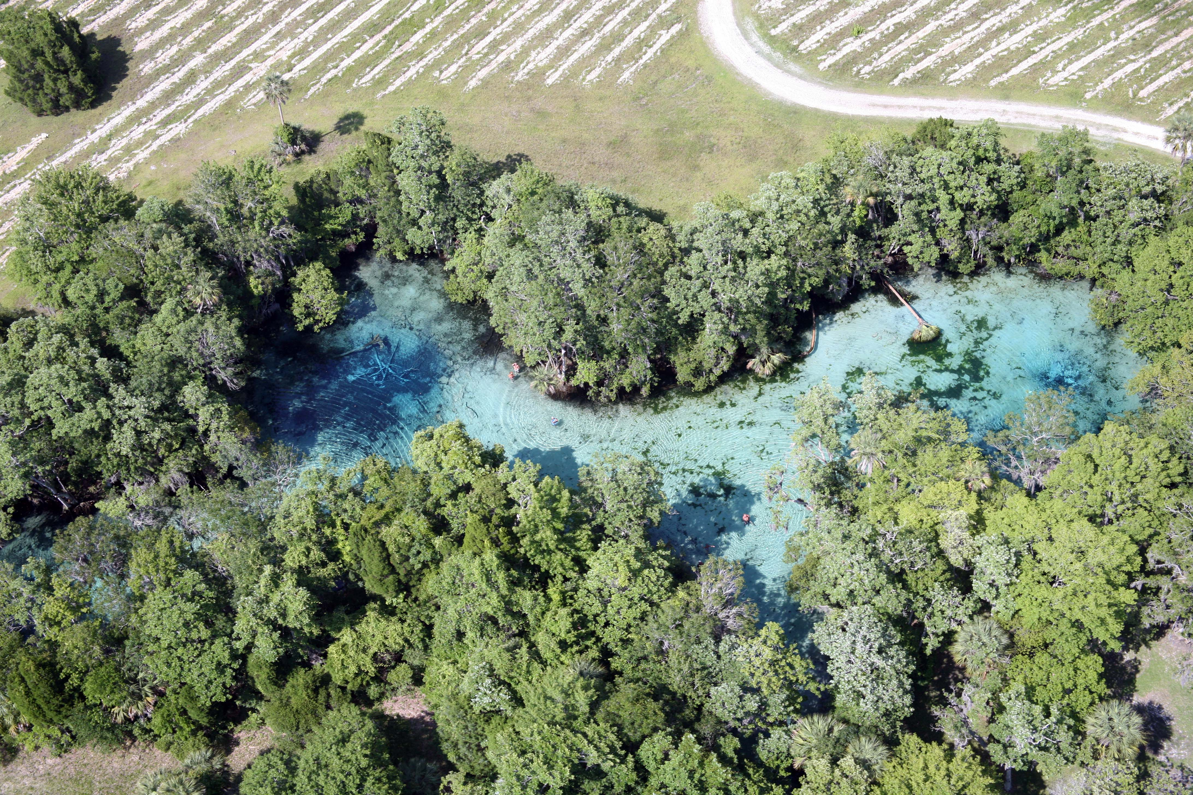

Division of Environmental Assessment and Restoration
5 Year Updates
Nitrogen Source Inventory and Loading Tool (NSILT) for
Springs Coast BMAP areas
Celeste Lyon
Groundwater Management Section
April 6, 2017
Celeste.Lyon@dep.state.fl.us

Slide 23
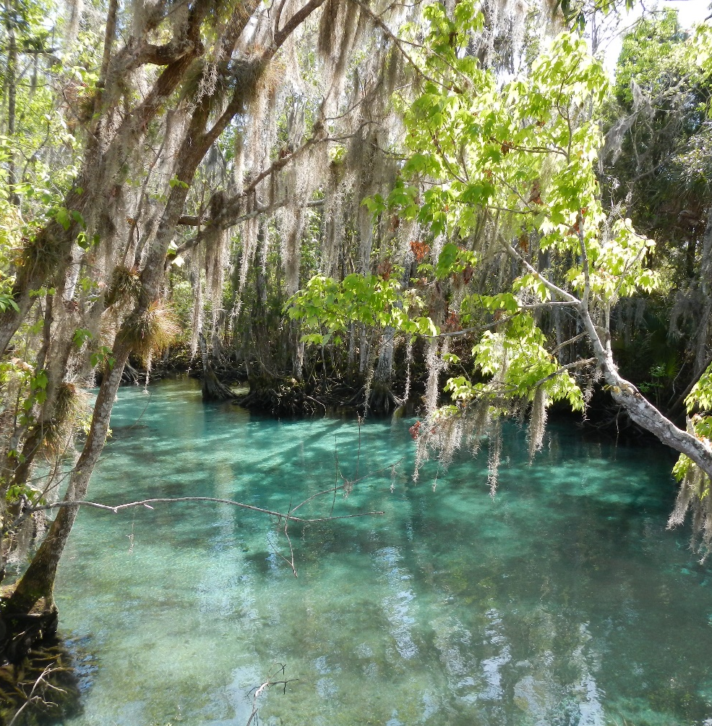
NSILT
Estimate N loading to groundwater within BMAP areas.
Identify sources for which reductions in N loading could achieve restoration of impaired waters.
Customize for individual spring basins.
Notes:
The Nitrogen Source Inventory and Loading Tool (NSILT) was developed to identify and quantify the major sources contributing nitrogen to ground water in the Kings Bay BMAP area. The NSILT is a GIS- and spreadsheet-based tool that provides spatial estimates of the relative contribution of nitrogen from various sources, and takes into consideration the transport pathways and processes affecting the various forms of nitrogen as they move from the land surface through soil and geologic strata into the Floridan aquifer.
The NSILT is used as an ESTIMATE of nitrogen loading and is updated as new sources of data become available.

Slide 24
NSILT 5-Year Updates
Use 25 % of total acreage from PA classified grazing lands instead of 100 %.
  Consistent methodology throughout Springs Coast.
Update acreages for agricultural land use.
Correct any errors in Excel.
Incorporate FDOH data for updated OSTDS inventory.
Notes:
We currently are aware of several items that will be addressed and updated accordingly in 5 years.
We cannot update the NSILT every time new information is provided, which is why we set the 5-10-15 yr benchmarks. This allows us to start with an estimate and move along with the process, but account for changes at appropriate time intervals.

Slide 25
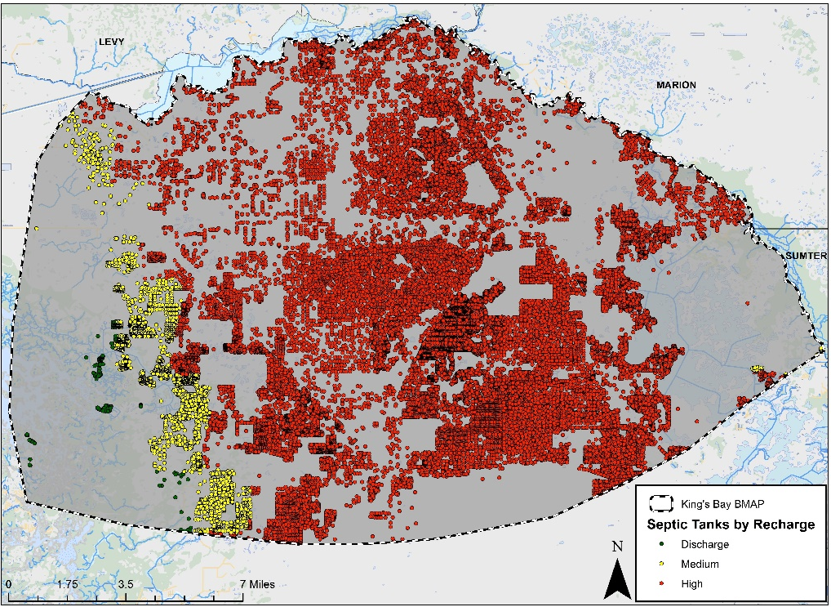
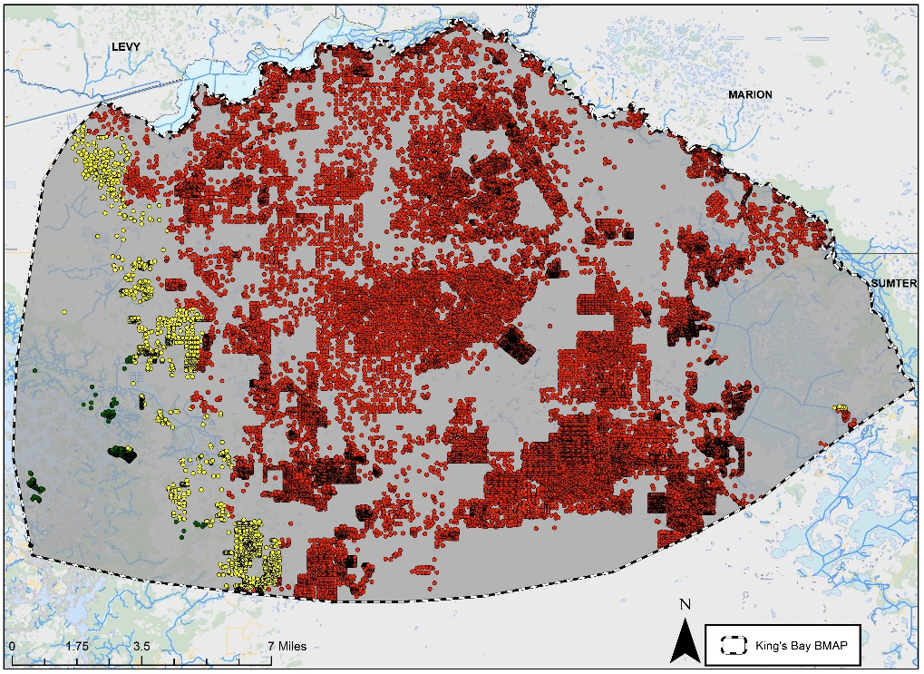
Example of Updates
Hall and Clancy Model: 32,913 septic systems
FLWMI: 28,573 septic systems
Notes:
We are constantly fine tuning our methods with each NSILT that is created. The goal is to use a uniform methodology for the Springs Coast NSILTs as they become updated.
Here is an example of one of the updates that will be incorporated. When the Kings Bay NSILT was created, the FDOH Florida Water Management Inventory had not been published. The Hall and Clancy Model was used to estimate the number of septic tanks in the area. Using this new data will provide us with a more accurate OSTDS count.
Another example is updating land use. DEP is working with FDACS to establish a single land coverage to use for agricultural acreage estimations. Future land use (i.e urban growth, etc) will also be incorporated when the NSILT is updated at the 5 year mark.

Slide 26
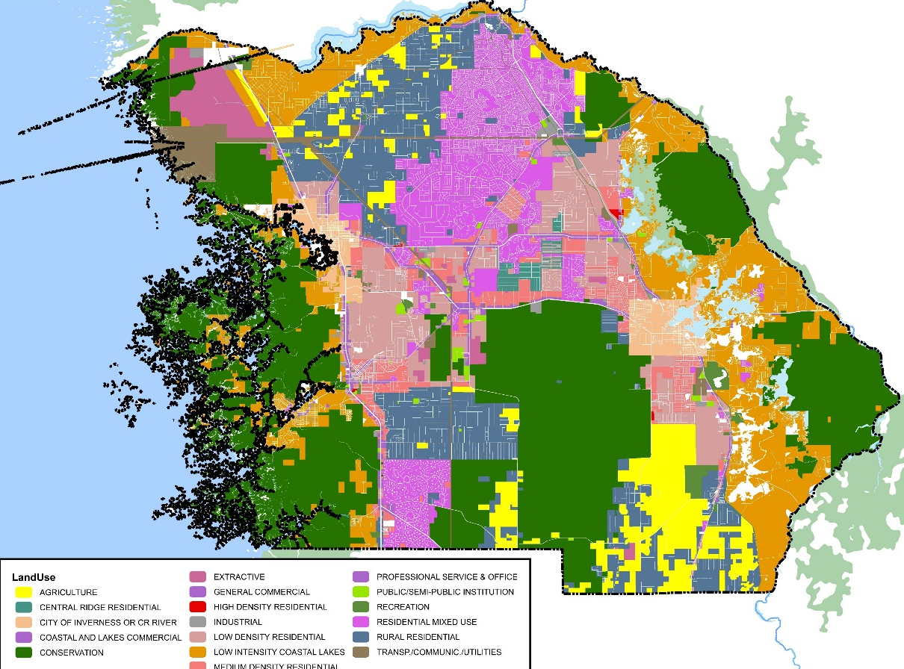
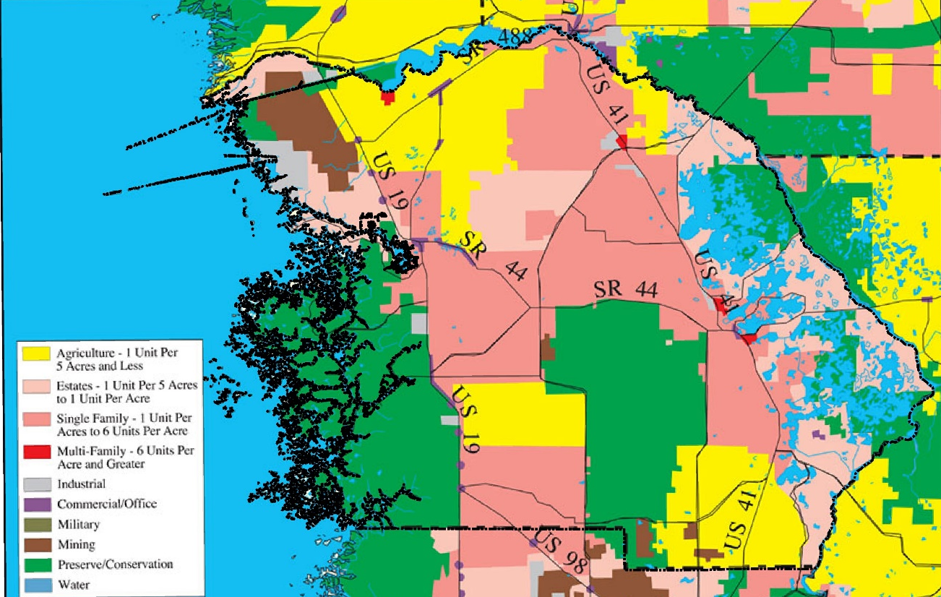






Future Land Use
Acreage likely to receive fertilizer estimated from PA data and property values.
  Residential
  Nonresidential
Impervious surfaces estimated based on zoning laws.
Agricultural acreage receiving fertilizer estimated from PA and WMD land use.
  Single land use coverage is being developed for agricultural estimations.
Crops produced may change based on climate, land use, demand, etc.
Notes:
County zoning laws may change as land use changes.
Urban growth will alter the fertilizable acreage used to estimate the urban fertilizer N inputs.
Some Ag lands may shift from pasture to silviculture, or crop coverage may change.

Slide 27
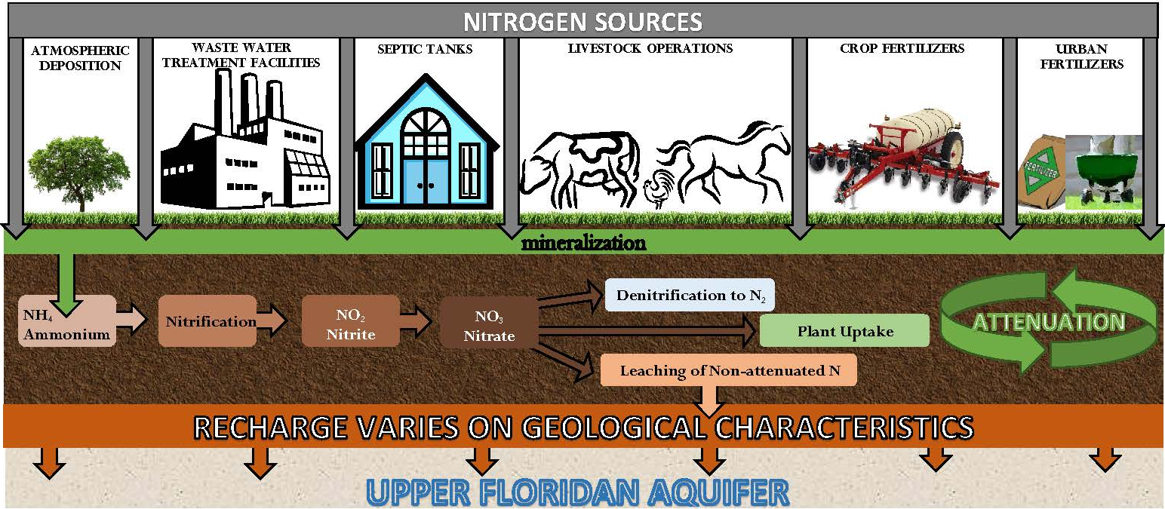
Biochemical Attenuation Factors
Represent the percentage of N removed and therefore not available for leaching to groundwater.
Based on factors used in similar past studies and found in relevant literature.
Loading Category | N Attenuation Factor
Atmospheric Deposition | 90%
Septic Systems | 50%
WWTF-RIB | 25%
WWTF-Sprayfield | 60%
WWTF-Reuse | 75%
Urban Turfgrass Fertilizers | 70%
Sports Turfgrass Fertilizers | 70%
Farm Fertilizers | 80%
Livestock | 90%
Notes:
Already we have seen a change in attenuation factors since the King’s Bay NSILT was first presented. We will continue to use the best data and literature as it becomes available to assign attenuation factors.
It is important to note that we are continuously researching these topics in order to provide the most current and relevant estimations at the time of each benchmark update.

Slide 28

QUESTIONS??
Division of Environmental Assessment and Restoration
Ground Water Management Section
Celeste.Lyon@dep.state.fl.us

Slide 29
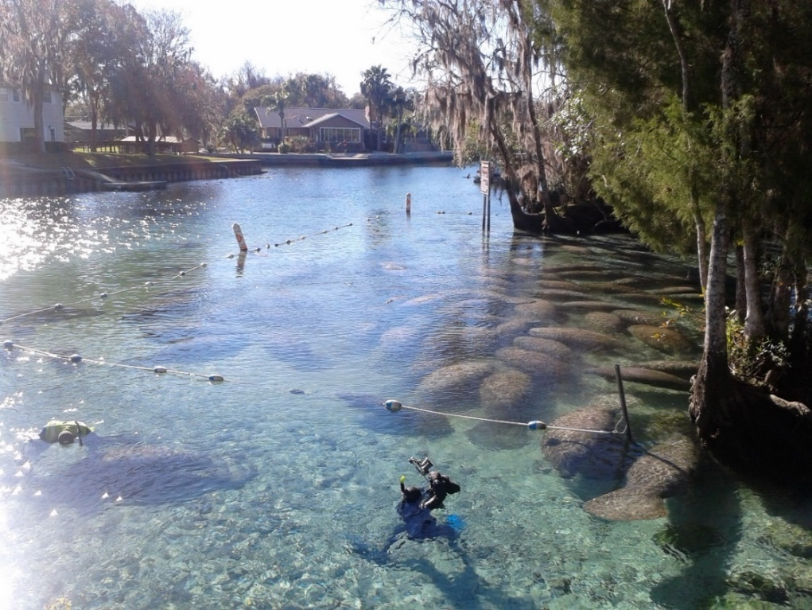
Basin Management Action Plan
Contact: Terry Hansen, P.G.
terry.hansen@dep.state.fl.us
http://www.dep.state.fl.us/water/
http://publicfiles.dep.state.fl.us/DEAR/BMAP/Springs Coast/BMAPs

