Slide 1
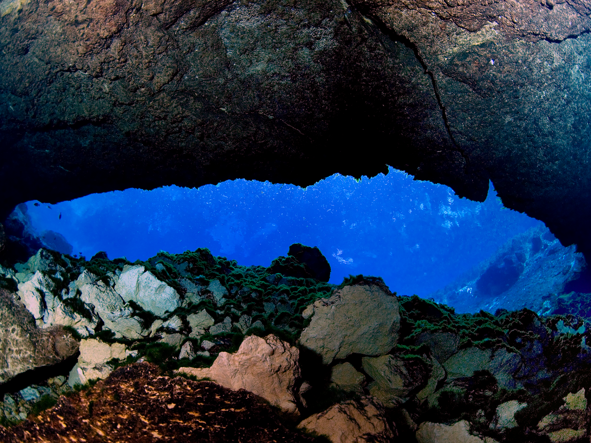
St. Johns River Water Management District
Setting Benthic Algal Abundance Targets to Protect Spring-Run Stream Ecosystems
Or; How much algae is too much algae?
Robert A. Mattson, CEP, CSE
Environmental Scientist V
Bureau of Water Resources

Slide 2
Setting Algal Abundance Targets in Lakes
Well-established in lake management
  Florida Numeric Nutrient Criteria (Chapt. 62-302.531, FAC): 20 µg/L Chlorophyll a (6 µg/L for clear, softwater lakes)
  Lower St. Johns River: an “algal bloom event” defined by Chlorophyll a > 40 µg/L
  Florida Lakes**:
    <10 µg/L – water appears clear
    10-20 µg/L – water light green color
    40 µg/L – water dark green; a visible algal bloom
    250 µg/L – “pea soup” green; fish kill level
** - Williams et al. 1985 IN: Fla. Aquatic Habitat and Fishery Resources

Slide 3
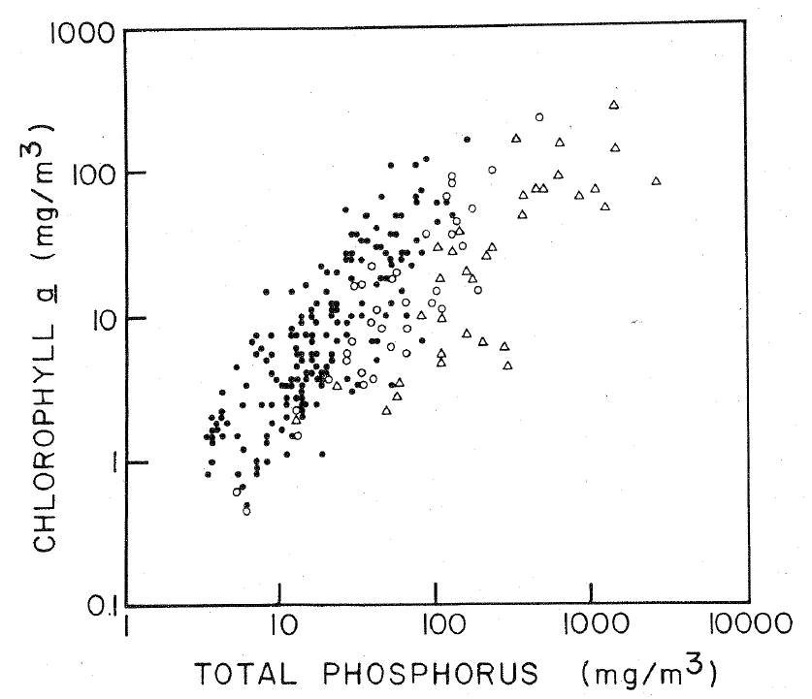
Phosphorus vs. Chl. a in Lakes
Canfield 1983

Slide 4
Stream Algae
Attached algae:
  Epiphytic on macrophytes
  Periphyton on other hard surfaces (rock, wood, etc.)
  Epipelic on sediment
  Includes filamentous taxa that may form algal “mats”

Slide 5
Stream Algae and Nutrients
More nutrient-rich streams (both N and P) generally support higher benthic algal standing crop/cover
Quantitative relationships not as straightforward as in lakes due to flow of water

Slide 6
Spring Nitrate Trends

Slide 7
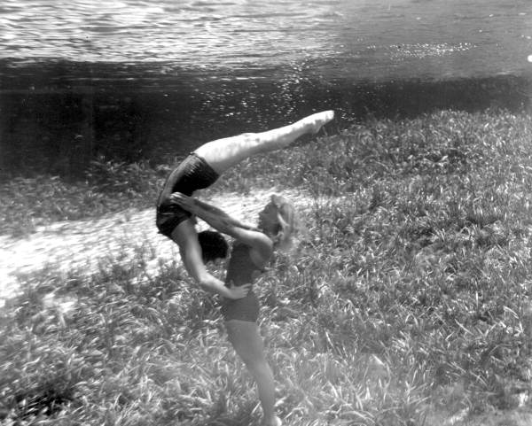

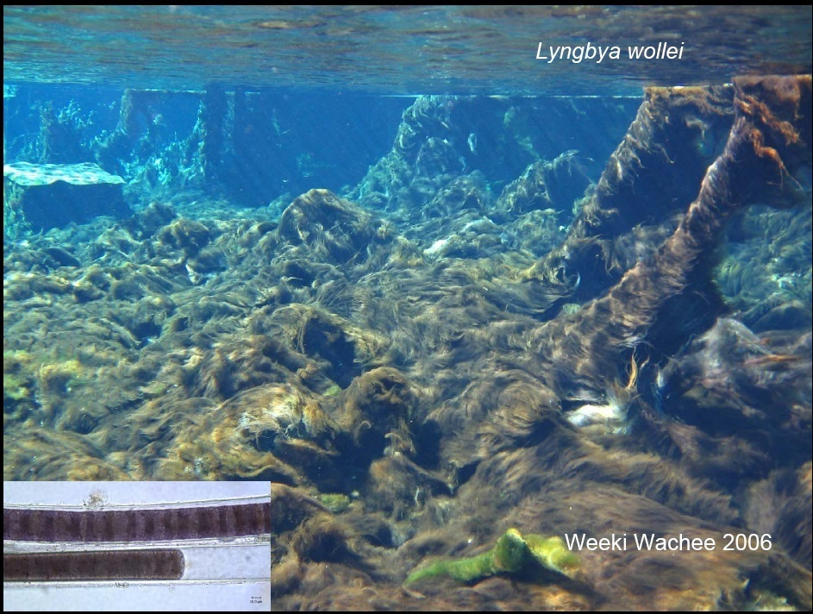
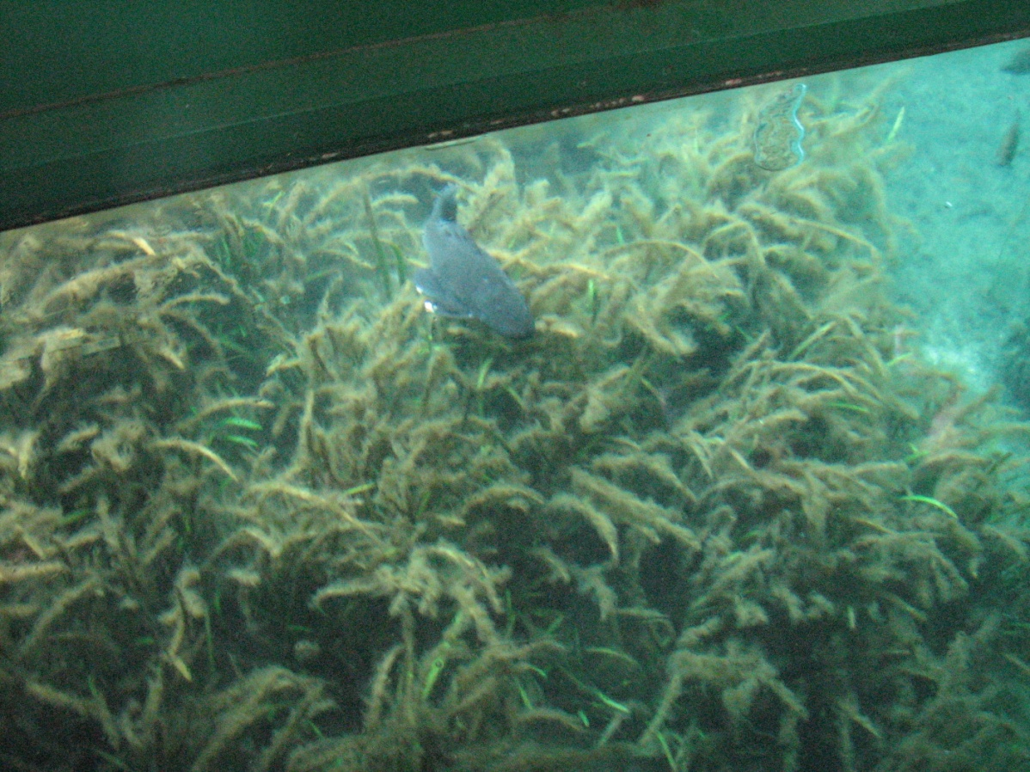
The Issue in Spring-Run Streams
Changes in Plant Communities
Weeki Wachee 1951
Silver Springs 1950s
Photo by Bruce Mozert
Source: Fla. State Archives
Weeki Wachee 2006
Silver Springs 2010
SJRWMD
A. Pinowska, Michigan State Univ.

Slide 8
Objectives
St. Johns River Water Management District
Review stream literature for proposed benthic algal target criteria
Evaluate these benthic algal abundance targets proposed by other investigators
Consider applicability to Florida streams and spring-run streams
Implications?

Slide 9
Factors to Consider
St. Johns River Water Management District
Aesthetics – “it doesn’t look appealing or nice” (algal mats, odor)
Recreation – anglers slipping on rocks; canoeing through floating algal mats; allergic reactions of swimmers
Water supply – algal mats breaking free and clogging water intakes
Ecological – effects on stream flora/fauna and their habitats

Slide 10
Factors to Consider
St. Johns River Water Management District
Ecological – effects on stream flora/fauna and their habitats:
  Epiphytic growth affecting macrophytes
  “Algal smothering” – mats disrupting habitat
  Water quality effects (reduced DO)
  Food quality (diatoms vs. cyanobacteria)
  Toxin production (filamentous cyanobacteria)

Slide 11
Factors to Consider
St. Johns River Water Management District
Algal species composition; Diatoms vs. Cyanobacteria and Chlorophyta (green algae)
  Latter two tend to be regarded as the “nuisance” taxa; filamentous taxa forming extensive benthic or floating mats
Mean/median or maximum algal abundance
Abundance measure (cover, Chl a, or Dry Weight (DW)/Ash-Free Dry Weight (AFDW)
  Chl a and DW/AFDW typically expressed as per unit area

Slide 12
Literature Review
St. Johns River Water Management District
Horner, R.R., E.B. Welch and R.B. Veenstra. 1983. Development of nuisance periphytic algae in laboratory streams in relation to enrichment and velocity. IN: R.G. Wetzel (ed), Periphyton of Freshwater Ecosystems.
  Studies in 16 natural streams (including some spring-fed systems) and 9 artificial streams
  Maximum abundance as Chl a: 5.9-73,000 mg/m²
Algal abundance of <100 mg Chl a/m² rarely associated with elevated nutrients; >150 mg Chl a/m² only occurred under enriched conditions (elevated N or P or both)

Slide 13
Temperate Stream Study
St. Johns River Water Management District
Welch, E.B., J.M. Jacoby, R.R. Horner and M.R. Seeley. 1988. Nuisance biomass levels of periphytic algae in streams. Hydrobiologia 157.
  Focus on filamentous macroalgal mat proliferation
  Six streams in WA state; 10 other northwestern US streams and 6 streams in Sweden
  Stony, rocky bottom
  Unshaded stream channel locations
Algal abundance of 100-150 mg Chl a/m² and >20% cover associated with aesthetic and recreational interference; no effect on DO or macroinvertebrate community

Slide 14
Florida Spring-Run Streams
2015 SJRWMD Study
14 streams sampled
Conducted once in Spring and once in Fall
Not all streams supported macroalgal mats; some dominated by macrophytes w/ epiphytes
Most streams with mats exceeded 20% cover

Slide 15
Florida Spring-Run Streams
2015 SJRWMD Study
14 streams sampled
Conducted once in Spring and once in Fall
Not all streams supported macroalgal mats; some dominated by macrophytes w/ epiphytes
Some streams with mats exceeded the lower threshold of 100 mg/m² Chlorophyll a
~100 mg/m²
~100 mg/m²

Slide 16
St. Johns River Water Management District
Additional Literature Review
Biggs, B.J.F. 1996. Patterns in benthic algae in streams. IN: R.J. Stevenson, M.L. Bothwell, and R.L. Lowe (eds.), Algal Ecology. Freshwater Benthic Ecosystems.
  Reviewed the Welch et al. and Horner et al. work, his own work in 400+ New Zealand streams, and a literature review done in Canadian streams
  <40% maximum seasonal cover
  <50 mg/m² Chl a to protect recreational uses
  <100 mg/m² Chl a to protect other aquatic life
  <40 g/m² AFDW

Slide 17
St. Johns River Water Management District
2015 Spring-Run Stream Survey
Macroalgae data
Red = exceeds Biggs’ criteria
 | Max Cover (%) Spring/Fall | Max Chlorophyll a (mg/m²) Spring/Fall | Max AFDW (g/m²) Spring/Fall
Alexander Springs Creek | 78 / 60 | 1,509 / 400.0 | 262.5 / 65.6
Blue Spring Run (Volusia) | 85 / 90 | 58.2 / 55.2 | 62.5 / 46.9
Gum Slough | --/ 85 | --/ 145.2 | --/ 39.1
Manatee Spring Run | 100 / 100 | 94.4 / 226.4 | 27.5 / 21.4
Rainbow River | 89 / 15 | 890 / 250.2 | 118.8 /35.27
Rock Springs Run | 2.5 /-- | 145 /-- | 56.3 /--
Silver Glen Spring Run | 98 /-- | 1,127 /-- | 262.5 /--
Wakulla River | 99 / 55 | 168.2 / 1,008.1 | 22.5 / 332.8
Weeki Wachee River | 30 / 45 | 323.7 / 1,123 | 181.3 / 131.3
  <40% maximum seasonal cover
<100 mg/m² Chl a to protect other aquatic life
<40 g/m² AFDW

Slide 18
All Algae
(Epiphytes and macroalgae)
* - incomplete monitoring year
*
*
*
*

Slide 19
All Algae
(Epiphytes and macroalgae)

Slide 20
Epiphytic Algae on Macrophytes
Intercept/capture incident light that reaches the macrophyte leaves:
  Reduced photosynthetic rate
  Reduced primary production
  Affect leaf chlorophyll levels
Interfere with absorption of carbon or nutrients
Promote bacterial growth which may cause physical leaf damage

Slide 21
Epiphytic Algae in the Chassahowitzka River
St. Johns River Water Management District
Guan, J., C.A. Jacoby, and T.K. Frazer. 2020. Light attenuation by periphyton on Vallisneria americana. Ecol. Indicators 116.
Guan, J., C.A. Jacoby, and T.K. Frazer. 2020. In situ assessment of the effects of periphyton on the growth of Vallisneria americana. Ecol. Indicators 119.

Slide 22
Guan et al. Epiphyte Studies in Chassahowitzka River
St. Johns River Water Management District
Growth of Vallisneria was measurably affected when epiphytes intercepted 74-83% of the incident light
  Sunny/Open channel: 4.0-5.3 mg DW/cm² (= 14.0-17.5 g AFDW/m²)
  Shaded channel: 0.4-0.8 mg DW/cm² (= 1.4-2.8 g AFDW/m²)

Slide 23
Florida Spring-Run Streams
2015 SJRWMD Study
14 streams sampled
Conducted once in Spring and once in Fall
For streams dominated by macrophytes w/ epiphytes
Some streams exceeded the upper threshold (14-17.5 g/m² AFDW); many exceeded the lower threshold (1.4-2.8 g/m² AFDW)
Upper threshold
Lower threshold

Slide 24
Epiphytic Algae
St. Johns River Water Management District
Upper threshold
Lower threshold
Stevenson
SJRWMD/GreenWater Labs
SJRWMD/Amec

Slide 25
Epiphytic Algae
St. Johns River Water Management District
Upper threshold
Lower threshold
Stevenson
SJRWMD/GreenWater Labs
SJRWMD/Amec

Slide 26
Epiphytic Algae on Potamogeton crispus
(Laboratory study)
St. Johns River Water Management District
Chen, C., D. Yin, B. Yu and H. Zhu. 2007. Effect of epiphytic algae on photosynthetic function of Potamogeton crispus. J. Freshwater Ecol 22(3)
  Eutrophic (0.75 mg/L NO₃-N; 0.10 mg/L PO₄-P): saw a maximum of 73.1 mg Chl a / m²
  Hypereutrophic (7.5 mg/L NO₃-N; 1.00 mg/L PO₄-P): saw a maximum of 91 mg Chl a / m²

Slide 27
Florida Spring-Run Streams
2015 SJRWMD Study
14 streams sampled
Conducted once in Spring and once in Fall
For streams dominated by macrophytes w/ epiphytes
Mean Chl a densities all below the lower (eutrophic) maximum burden of 73.1 mg Chl a/m²

Slide 28
St. Johns River Water Management District
2015 Spring-Run Stream Survey
Epiphytic algae data
Red = exceeds Chen et al. criteria
 | Max Chlorophyll a (mg/m²) Spring/Fall
Alexander Springs Creek | 27.91 / 25.0
Gum Slough | 87.7 / 17.8
Ichetucknee River | 23.3 / 20.0
Juniper Creek | 12.8 / 3.6
Rainbow River | 60.1 / 18.3
Rock Springs Run | 15.2 / 12.7
Silver River | 27.6 / 9.6
Silver Glen Spring Run | 28.5 / 8.1
Wacissa River | 14.5 / 36.8
Wakulla River | 77.5 / 14.7
Weeki Wachee River | 5.7 / 13.4
Wekiva River | 11.9 / 28.9
<73.1 mg/m² Chl a (effect on macrophyte physiology)

Slide 29
Epiphytic Algae
St. Johns River Water Management District
Stevenson
SJRWMD/GreenWater Labs
SJRWMD/Amec

Slide 30
Epiphytic Algae
St. Johns River Water Management District
Stevenson
SJRWMD/GreenWater Labs
SJRWMD/Amec

Slide 31
St. Johns River Water Management District
Effects on Benthic Macroinvertebrates
Mattson, R.A. 2009. Relationships Between Benthic Algae and Benthic Macroinvertebrate Communities in Florida Spring-Run Streams. SJRWMD Professional Paper SJ2009-PP1.
  Literature review and analysis of existing data; with higher algal abundance:
    Increased invertebrate taxa richness and abundance
    Decreased invert diversity and eveness; increased % dominance
    Possible changes in FFG
  Changes in species composition; loss of sensitive taxa with increased abundance of “nuisance” algal taxa
Similar effects seen by Camp et al. (2014) in Homosassa and Chass Rivers

Slide 32
Algal Community Composition
(FDEP Bioassessment Data)
Pearson r = - 0.202; P = 0.015
Mattson, R. A. 2009 SJRWMD Professional Paper SJ2009-PP1

Slide 33
St. Johns River Water Management District
Global Changes in Streams
Hudon, C., M. De Sève and A. Cattaneo. 2014. Increasing occurrence of the benthic filamentous cyanobacterium Lyngbya wollei: A symptom of freshwater ecosystem degradation. Freshwater Science 33(2)
  In streams worldwide, “nuisance” blooms of the filamentous cyanobacterium L. wollei appear to be on the increase
Chen, C., D. Yin, B. Yu and H. Zhu. 2007. Effect of epiphytic algae on photosynthetic function of Potamogeton crispus. J. Freshwater Ecol 22(3)
  Proliferation of epiphytic algal growth on macrophytes also appears to be an increasing global issue

Slide 34
St. Johns River Water Management District
Conclusions
Many Florida spring-run streams exceed macroalgal criteria proposed in the stream literature; some exceed epiphytic algal thresholds
May or may not be applicable to Florida streams (spring-run or in general): EPA does use these for general guidance
Benthic algal proliferation in streams (both macroalgal mats and epiphytic cover on macrophytes) appears to be increasing globally
Further development of quantitative targets/ criteria appears warranted

Slide 35
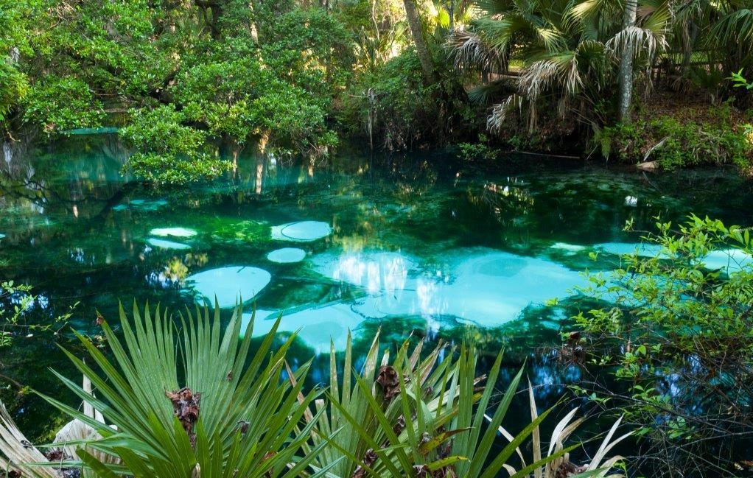
rmattson@sjrwmd.com
Thank you
www.sjrwmd.com/springs

