Slide 1
Stream Nutrient Criteria Development Using Periphyton: Florida Efforts
Nia Wellendorf
Water Quality Standards Program
FDEP Division of Environmental Assessment
and Restoration

Slide 2
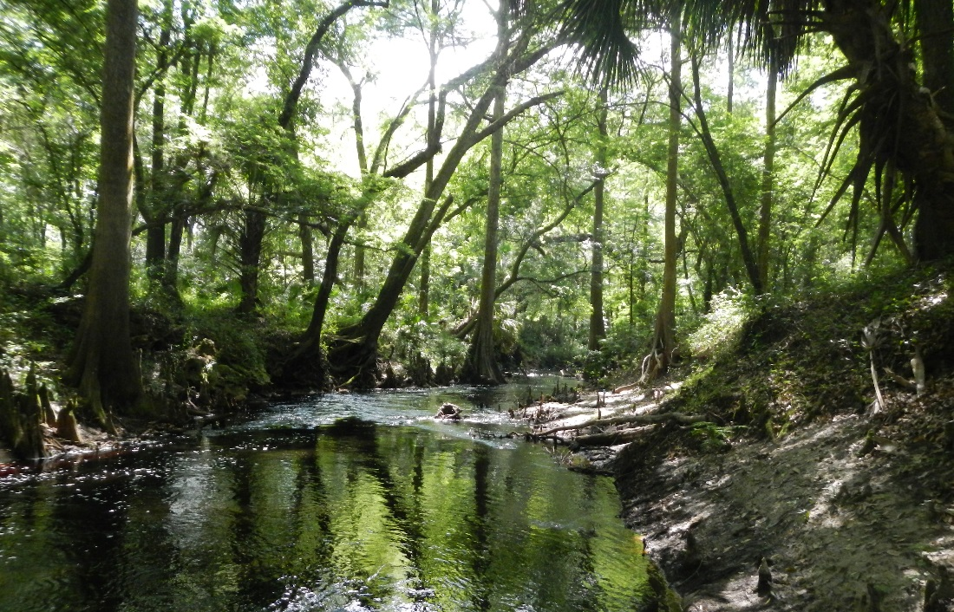
Outline
History of Methods Used
Numeric Nutrient Criteria (NNC) Studies
Ultimate Use of Periphyton for NNC

Slide 3
Florida Periphyton Efforts
Applications of periphyton studies
  Point source studies
  Ambient aquatic health assessment
  Numeric nutrient criteria development
Challenges
  Rocky substrate rare
  Wide range of natural conditions

Slide 4
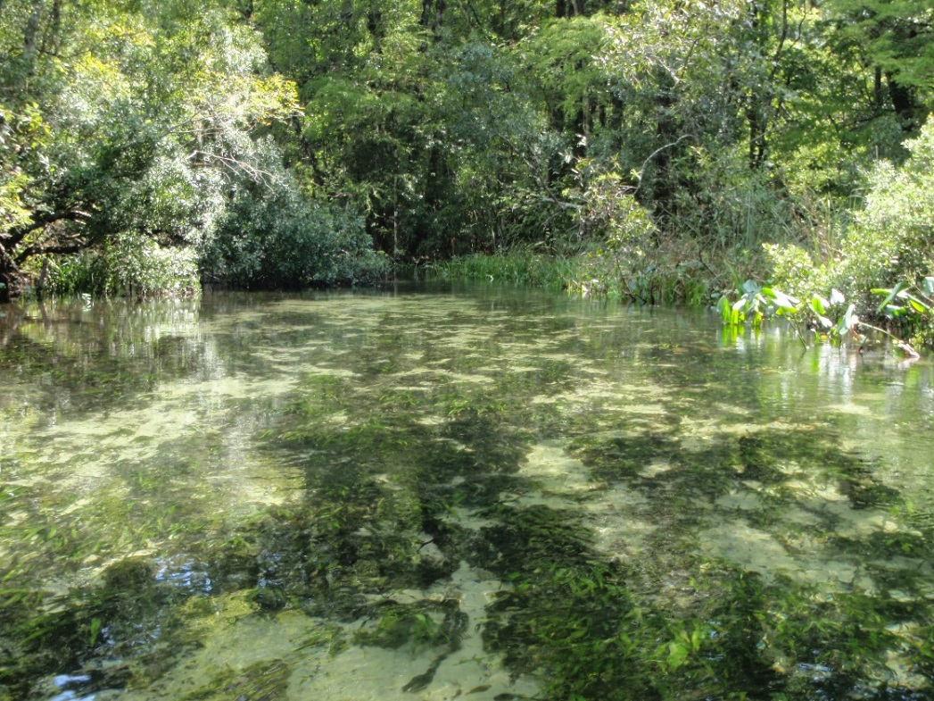
History of Sampling Methods
1981-2003 Periphytometers
~ 2004-2010 – Natural Substrate Collection
~ 2006-Present – Rapid Periphyton Survey (RPS)

Slide 5
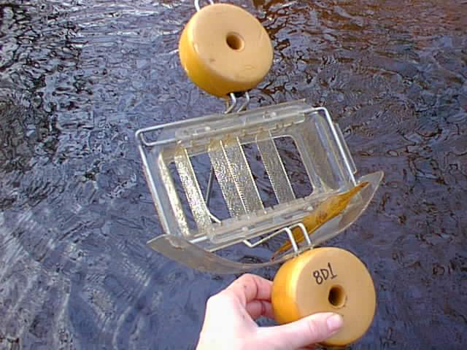
Periphytometers
Point source and other studies
Deployed 28 days (typically)
Harvest all algae, conduct ID and chlorophyll a analyses
Reduced use due to concerns about grazing and algal sloughing

Slide 6
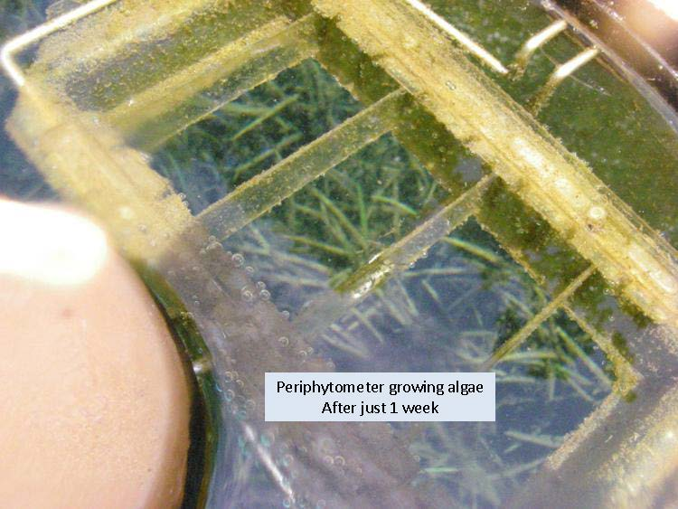
Periphytometers
Pros
  Quantitative
  Standardized across sites
Cons
  Requires revisits
  Loss and theft
  Loss due to grazing and overgrowth

Slide 7
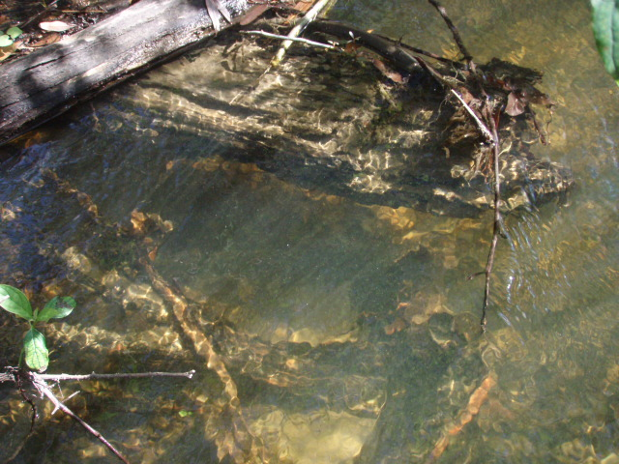
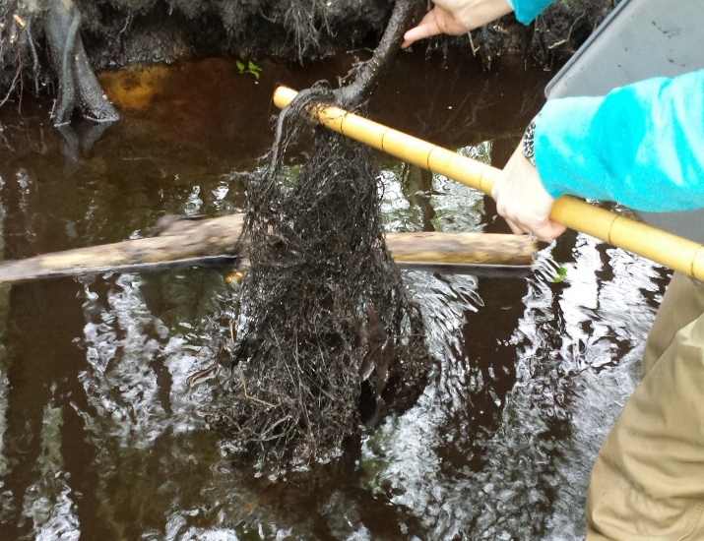
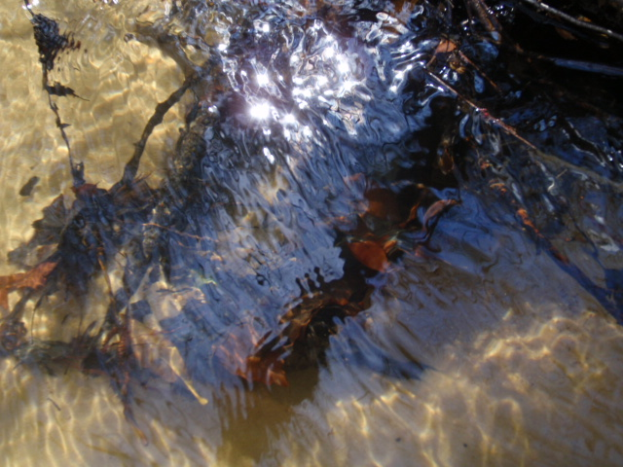
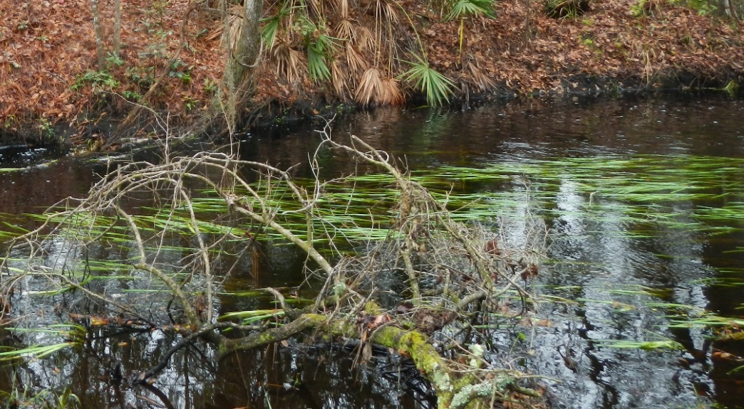
Natural Substrates

Slide 8
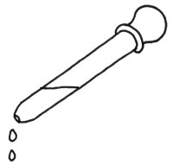
Natural Substrates
Leaf pack
Snag
4 mL from each aliquot into final container
Root
Agitate representative fragment of plant, leaf, snag, root, or rock within 100 ml of site water.
Transfer 4 ml of slurry to sample bottle.
Repeat 10 times with a mix of substrates present.
100 mL
fill line
to rub substrate

Slide 9
Natural Substrates
Pros
  Same day collection
  Reflects in-stream communities
  Takes into account grazing pressure
Cons
  Labor intensive lab work (“Dirty samples”)
  Initial efforts at algal community index were unsuccessful

Slide 10
Rapid Periphyton Survey adapted from Stevenson method
100
90
80
70
60
50
40
30
20
10
0
100 m
Length of unit = 100 m.
Width is adjusted by system.
9 observations every 10 m
99 observation points total.
Canopy measurement at mid-point

Slide 11
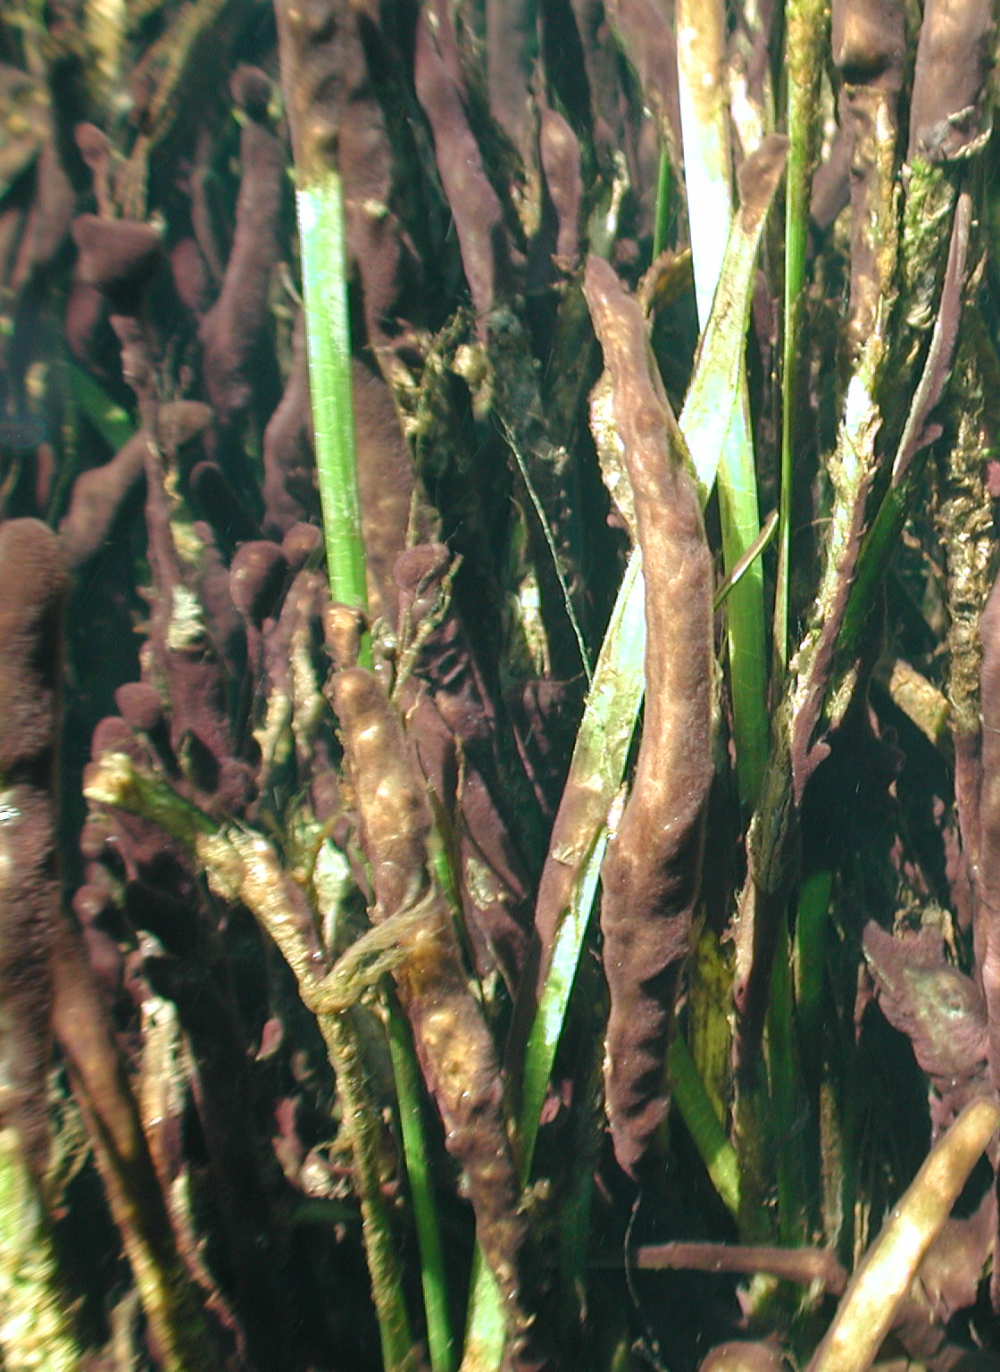
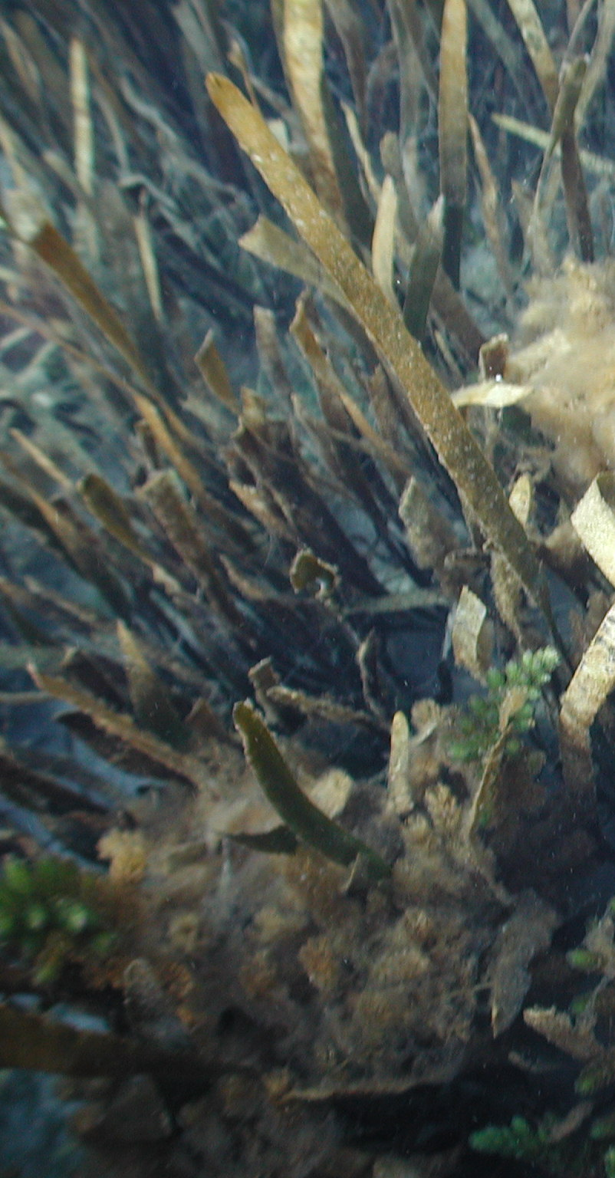
Mid-high rank RPS
Low rank for RPS

Slide 12
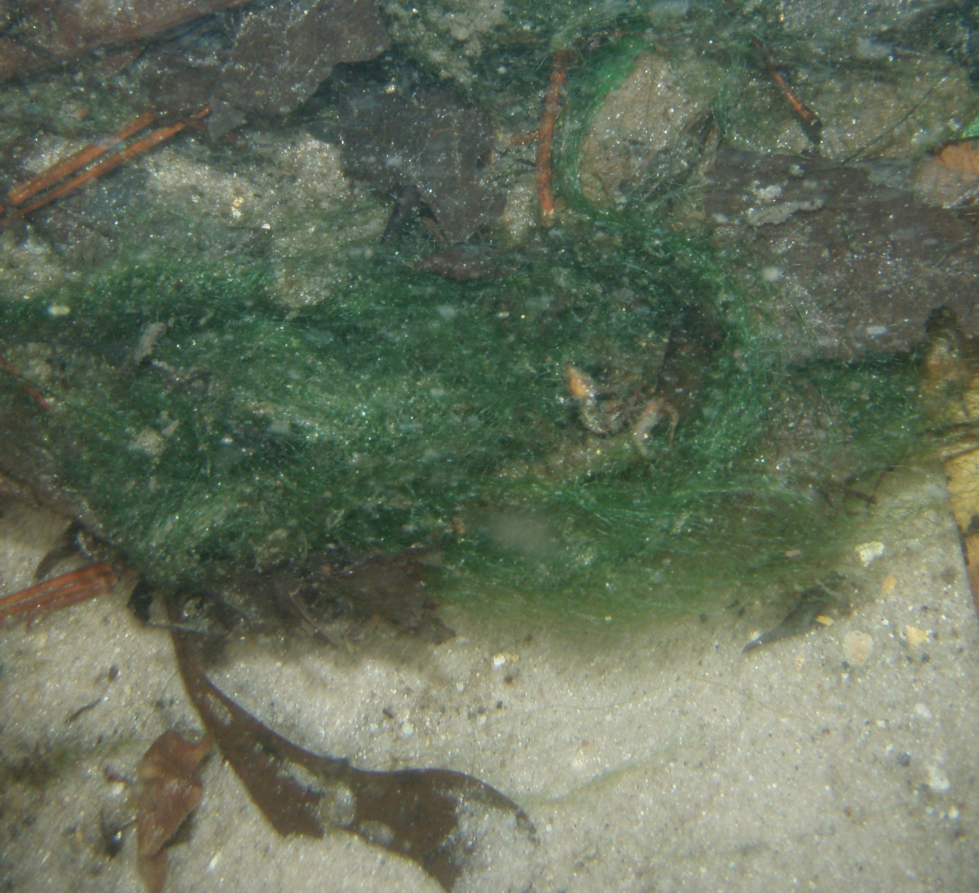
Rapid Periphyton Survey
Pros
  Rapid
  Very little lab work
  Directly addresses the question of nuisance conditions
  Somewhat quantitative
Cons
  Does not provide community level or biomass information

Slide 13
Approaches for NNC Development
Goal was to find statistically and biologically significant relationships between algal condition and nutrient concentrations.
  Stream Diatom Index
  Rapid Periphyton Survey
  Periphytometer Studies (non-DEP)
  Lab and Field studies focused on Springs

Slide 14
Stream Diatom Index (SDI)
Multimetric index developed with Natural Substrate data
Diatom metrics that changed along human disturbance gradient
Metrics more strongly correlated with pH than with any other water quality variable
Index scores poorly related to nutrients, even when analyses accounted for effects of pH

Slide 15
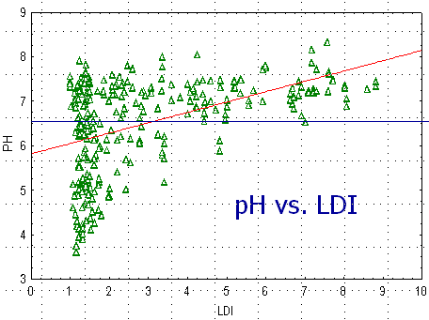
pH vs. Landscape Development Intensity (LDI)
LDI and pH are strongly related for Stream Diatom Index development sites. The blue line indicated pH of 6.5, at which sites were divided for SDI development.

Slide 16
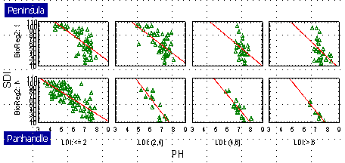
Stream Diatom Index (SDI)
There are strong relationships between the Stream Diatom Index and pH throughout various categories of human disturbance.

Slide 17
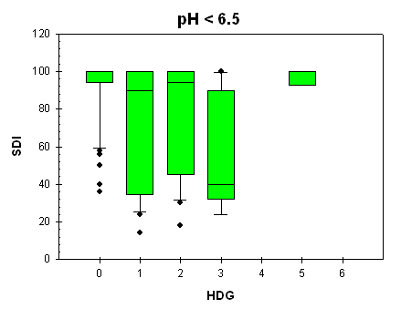
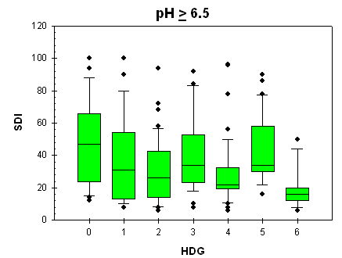
Stream Diatom Index
Relationship between the Stream Diatom Index and the Human Disturbance Gradient in low pH sites (< 6.5 SU) and high pH sites (≥ 6.5 SU). Note lack of strong association.

Slide 18
Stream Diatom Index
Peninsula
  Nearly all metrics most strongly related to pH
  Quantile regression used to estimate effects due to measured variable while accounting for effects of unmeasured variables (limiting factor analysis)
  More strongly related to TN than TP
Panhandle
  Many metrics strongly correlated with TP
  Change point analysis conducted for Panhandle, but change points were very weak

Slide 19
SDI Pass/Fail vs. TP
SDI passing or failing not related to TP concentrations. For all regions, mean TN and TP concentrations not consistently higher at sites that failed the SDI.

Slide 20
Approaches for NNC Development
Stream Diatom Index
Rapid Periphyton Survey
  RPS data analyzed by EPA- and DEP-contracted statisticians
  Tried to account for color, canopy
Periphytometer Studies
Lab and Field studies focused on Springs

Slide 21
Conclusions from RPS analyses
  Algal thickness positively correlated with conductivity, pH, nitrate
  Algal thickness negatively correlated with canopy cover, color, TKN (organic N + NH4) (color and TKN very highly correlated with each other)
  No relationship with TP
  The only nutrient variable that is significantly correlated with algal thickness is NO ₂₊₃ concentrations. However, this correlation is also strongly masked by the correlation between color and algal thickness; in other words, colored streams have both lower NO₂₊₃ concentrations and algal thickness.

Slide 22
RPS Results
Periphyton and phytonplankton algal biomass in different colored streams. Different letters on top of each box indicate significant differences. (from Lei Zheng memo, May 2009)
Notes:
Lei Zheng classified streams into three color categories: color <= 40 as clear streams, 40~100 as intermediate streams, and >100 as colored streams. I also selected transects with less than 40% canopy cover and averaged algal thickness in the remaining transects as the mean algal thickness in each stream reach (Figure 5). Since the shaded stream segments are most likely light limited, excluding these light limited stream segments would hopefully strengthen the signal of the expected response of algal abundance along an increasing nutrient concentration gradient.

Slide 23
RPS Conclusions
Clear streams:
  Algal thickness in clear streams are correlated with TN concentrations only; not with other nutrient variables; multiple variable interactions are possible;
  Multiple logistic regression analysis was used explore the potential interactions among predictors, TN and TP, and NOx and TP models turned out to be significant;
  Contour plots may be able to help delineate nutrient criteria, however, the impairment threshold and the probability of allowable impairment will have to be determined by management.
Colored streams:
  Periphyton thickness became increasingly limited by light, the correlations with nutrients are very weak; water column Chl a became the dominant algal biomass.
  Planktonic algal biomass (Chl a) was correlated with TN and TKN concentrations;
  Dissolved oxygen in the water column was negatively associated with water column Chl a concentrations.
  SCI was also negatively correlated with Chl a in the water.

Slide 24
Approaches for NNC Development
Stream Diatom Index
Rapid Periphyton Survey
Lab and Field studies focused on Springs
Periphytometer Studies

Slide 25
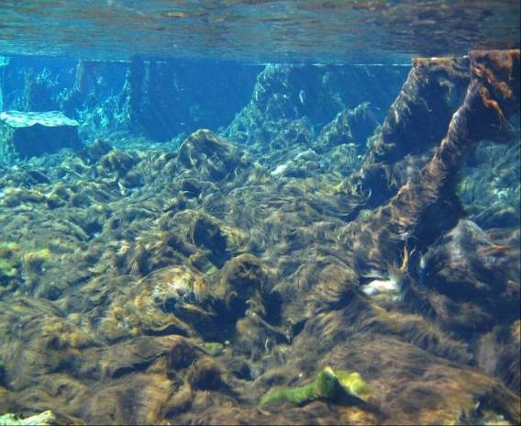
Springs Studies
Weeki Wachee, 1950s;
Nitrate < 0.1 mg/L, Eel grass
Weeki Wachee, 2001:
Nitrate ~ 0.7 mg/L, Lyngbya mats

Slide 26
Springs Studies
Field study of 60 Florida Springs, using RPS and predominant periphyton taxonomic identification
  Vaucheria response threshold of 0.454 mg/L NO₃
Lab and microcosm studies on growth of Lyngbya wollei and Vaucheria spp., the most common springs periphyton taxa
  Lyngbya wollei growth controlled at 0.300 mg/L NO₃
  Nitrate+nitrite was primary factor causing elevated growth at levels above 0.230 to 0.263 mg/L
  Studies by Stevenson, Pinowska, and others

Slide 27
Approaches for NNC Development
Stream Diatom Index
Rapid Periphyton Survey
Lab and Field studies focused on Springs
Periphytometer Studies
  Suwannee river basin study of 13 sites within three rivers 1990-1998, conducted by Suwannee River Water Management District
  Inputs from springs and point sources created a nutrient gradient, along which algal cell density and biomass increased

Slide 28
Suwannee Periphytometer Change Point Analysis
Change Point at 0.441 mg/L Nitrate-nitrite, R2 = 0.62
Field study by the SRWMD, statistical analysis by Dr. Niu
Notes:
Study with floating periphytometers on Suwannee, Santa Fe, and Withlacoochee Rivers

Slide 29
Suwannee Periphytometer Study
Lower 95% Confidence Interval = 0.326 mg/L
Change point: 0.441
Notes:
Regression based on 12 stations on Suwannee

Slide 30
Nitrate-nitrite Criteria
Lab studies demonstrated nitrate-nitrite was primary factor causing elevated growth at levels above 0.230 to 0.263 mg/L
  But don’t know growth level resulting in impairment
Independent field studies showed imbalances occur at 0.441 to 0.454 mg/L nitrate-nitrate
  But need to set criterion below these levels to prevent imbalance from occurring
Criteria set at 0.35 mg/L for spring boils (this is the only cause-effect stream criterion)

Slide 31
General Stream Criteria
Did not find causal relationship between TP or TN and biological response (algae or inverts)
Plan B: Reference-based Criteria (TP and TN)
  Based on presumed protection of in-stream biology and minimal disturbance, not threshold of impairment.
  Nutrient regime associated with minimally disturbed sites, which are characterized healthy biological communities, is inherently protective of the “healthy, well balanced” designated use

Slide 32
Reference Site Approach
FDEP used extensive, multi-step selection process to demonstrate minimally disturbed conditions (very small amounts human disturbance)
  Landscape Development Intensity Index (LDI) as initial screening
  Review of Planning and Verified TMDL Lists
  Screen against springs nitrate threshold (eliminate far field groundwater effects)
  BPJ Input from District Biologists
  Examination of recent aerial photos
  Field Verification, including watershed assessment and application of BPJ
  Demonstration that sites support valued ecologic attributes (healthy SCI and minimal algae growth)

Slide 33
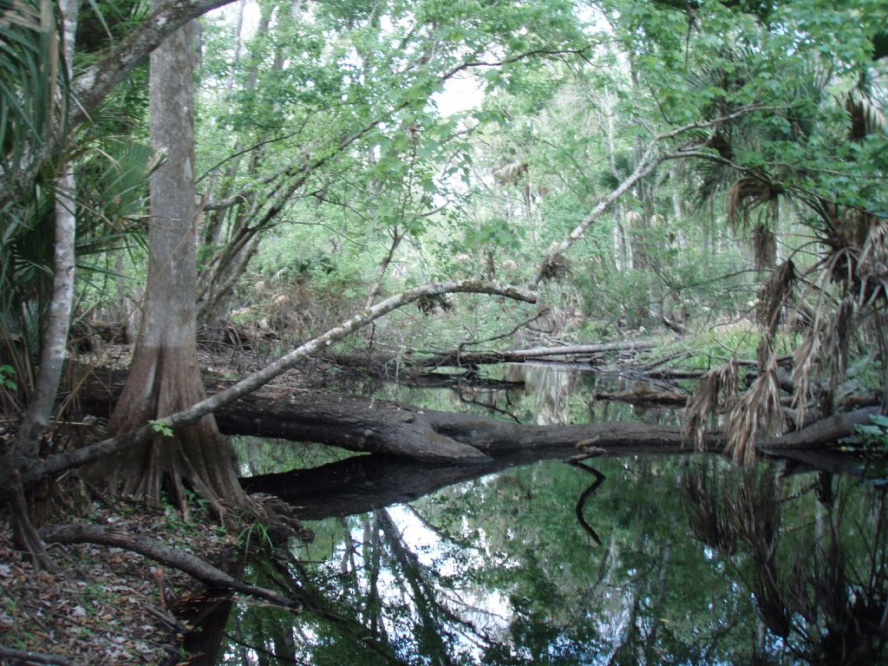
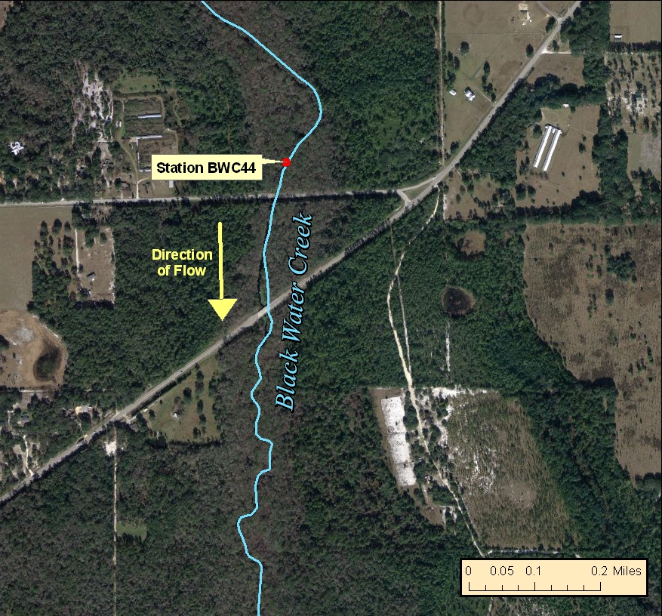
Reference Site Documentation
Assembled documentation of site visit photos, aerial photos, LDI, biological and water quality data gathered for each site.

Slide 34
Reference Site Approach
Florida conducted a rigorous reference site verification, including watershed assessment and biological confirmation.
Biological data shows the 90th percentile fully supports aquatic life, therefore, minimal chance of Type II error.
  Healthy SCI scores
  Minimal algal growth
75th percentile generally inappropriate due to high Type I error
  25% of documented healthy sites would “fail.”
  Due to limited number of reference sites there, Bone Valley is an exception to this, where 75th percentile is proposed due to more uncertainty associated with small sample size.

Slide 35
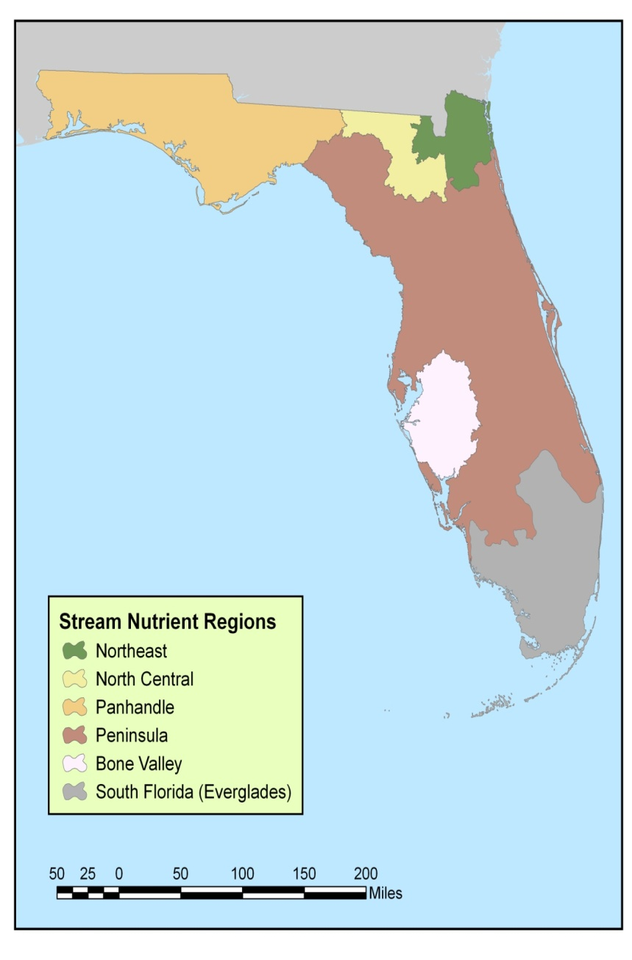
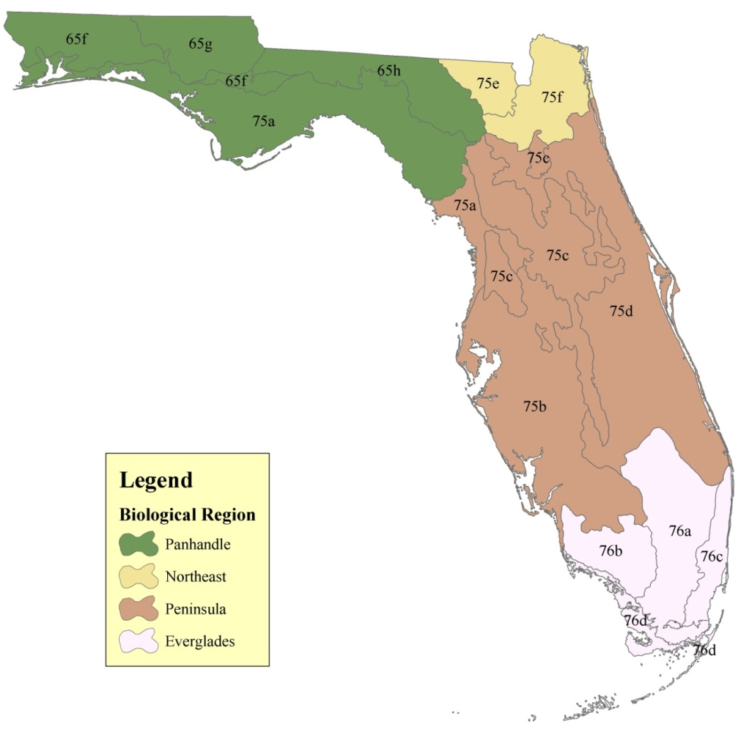
Stream Bioregions
Ecoregions served as starting point for nutrient regions
Criteria set at 90th %ile within each region
35

Slide 36
RPS in Stream Criteria
Rapid periphyton survey (RPS) used in conjunction with TN and TP limits to determine achievement of NNC, based on reference site expectations
Algal thickness >6 mm judged to be nuisance condition (ranks 4-6)
For streams with healthy SCI scores, 90% of sites have < 25% of 99 points with RPS ranks 4-6
Therefore, if ranks 4-6 comprise < 25% of points for two temporally independent samples, DEP concludes that there is not an imbalance of flora

Slide 37
Conclusions
Florida has tried many methods and analyses to link periphyton community quality with nutrient concentrations, but has thus far been unsuccessful.
Currently using reference approach.
Next steps – better refine stream categories based on expected pH and revisit past efforts.

Slide 38
Additional Information
Stream Diatom Index development document: http://www.dep.state.fl.us/water/bioassess/pubs.htm
NNC documents: http://www.dep.state.fl.us/water/wqssp/nutrients/index.htm
DEP Sampling SOPs: http://www.dep.state.fl.us/water/sas/sop/sops.htm
  See FS 7000 sections for algal sampling SOPs

Slide 40
EXTRA SLIDES

Slide 41
SDI and Metric Correlations:
Peninsula and Panhandle
PENINSULA WEAVER REGION
= Pr < 0.05 | Response Variable
Order of Response | PollSens | PollTol | %Tol low DO | % Oligosap | VD TSI | TP Sens Dia | TIN Sens Dia | TP Sens Wet | TIN Sens Wet
1 | pH | pH | pH | pH | pH | CondL | pH | Long | TNL
2 |  | Long | Long | Long | Long | pH | CondL | ColorL | CondL
3 |  |  | TNL | TNL | TNL | TPL | TNL | pH | pH
4 |  |  | ColorL | TPL |  | TINL |  | TNL
5 | ` |  |  |  |  |  |  | Lat
Adjusted r²= | 0.05 | 0.04 | 0.14 | 0.10 | 0.30 | 0.25 | 0.28 | 0.07 | 0.05
PANHANDLE WEAVER REGION
= Pr < 0.05
Order of Response | PollSens | PollTol | %Tol low DO | % Oligosap | VD TSI | TP Sens Dia | TIN Sens Dia | TP Sens Wet | TIN Sens Wet
1 | Long | pH | TPL | TPL | TPL | TPL | TPL | Lat | pH
2 | ColorL | TPL | CondL | pH | CondL | CondL | CondL | pH | Lat
3 | CondL |  | ColorL | ColorL | Lat | ColorL | ColorL | TPL | TNL
4 |  |  | pH | CondL |  | TNL |  |  | TINL
5 |  |  | TNL
Adjusted r²= | 0.10 | 0.25 | 0.51 | 0.53 | 0.41 | 0.27 | 0.30 | 0.08 | 0.11
Peninsula: Nearly all metrics most strongly related to pH
Panhandle: Many metrics strongly correlated with TP
Change point analysis conducted for Panhandle, but change points were very weak

Slide 42
Quantile Regression for SDI and metrics: Peninsula
Quantile regression used to estimate effects due to measured variable while accounting for effects of unmeasured variables (limiting factor analysis)
More strongly related to TN than TP

Slide 43
Quantile Regression for SDI and metrics: Panhandle
SDI more strongly related to TP than TN

Slide 44
SDI Pass/Fail vs. Nutrient Concentrations

Slide 45
RPS Results
Figure 2. Factors potentially contributing to algal biomass. The smooth curves are the locally weighted smoothing lines. The vertical lines are the change points (solid lines) and their confidence intervals (dashed lines). (from Lei Zheng memo May 2009)

Slide 46
Clear
(<40)
Intermediate
(40-100 PCU)
Colored
(>100)
TP
NO_{x}
TN
Notes:
The relationships between nutrients and periphyton thickness were much stronger in clear streams (Figure 6a1~a3) than in colored streams (Figure 6c1~c3), indicated by the stronger Spearman correlations as well as Loess regression in the clear streams. The main relationships observed were between nitrogen parameters and benthic algal thickness. The effect of phosphorus seems to be negligible in all stream types. Nutrients do not seem to play a critical role in algal biomass accumulation, based on the increased color and potentially stronger light limitation.

Slide 47
Application of Stream Criteria
All streams eligible for site specific criteria based on protection of aquatic life use using biological health assessments
Protection of Downstream Waters from excess loading still required

