Slide 1
Common Macroalgae in Florida Springs
Cyanophyta:
Lyngbya majuscula
Oscillatoria sp.*
Rhodophyta:
Polysiphonia subtilisima
Caloglossa sp.
Campsopogon sp.*
Audionella sp.
Xanthophyceae:
Vaucheria sp.
Chlorophyta:
Spirogyra sp.*
Cladophora cf glomerata
Rhizoclonium hieroglyphicum
Dichotomosiphon sp.*
Hydrodiction sp.*
Enteromorpha sp.
Chaetomorpha sp.

Slide 2
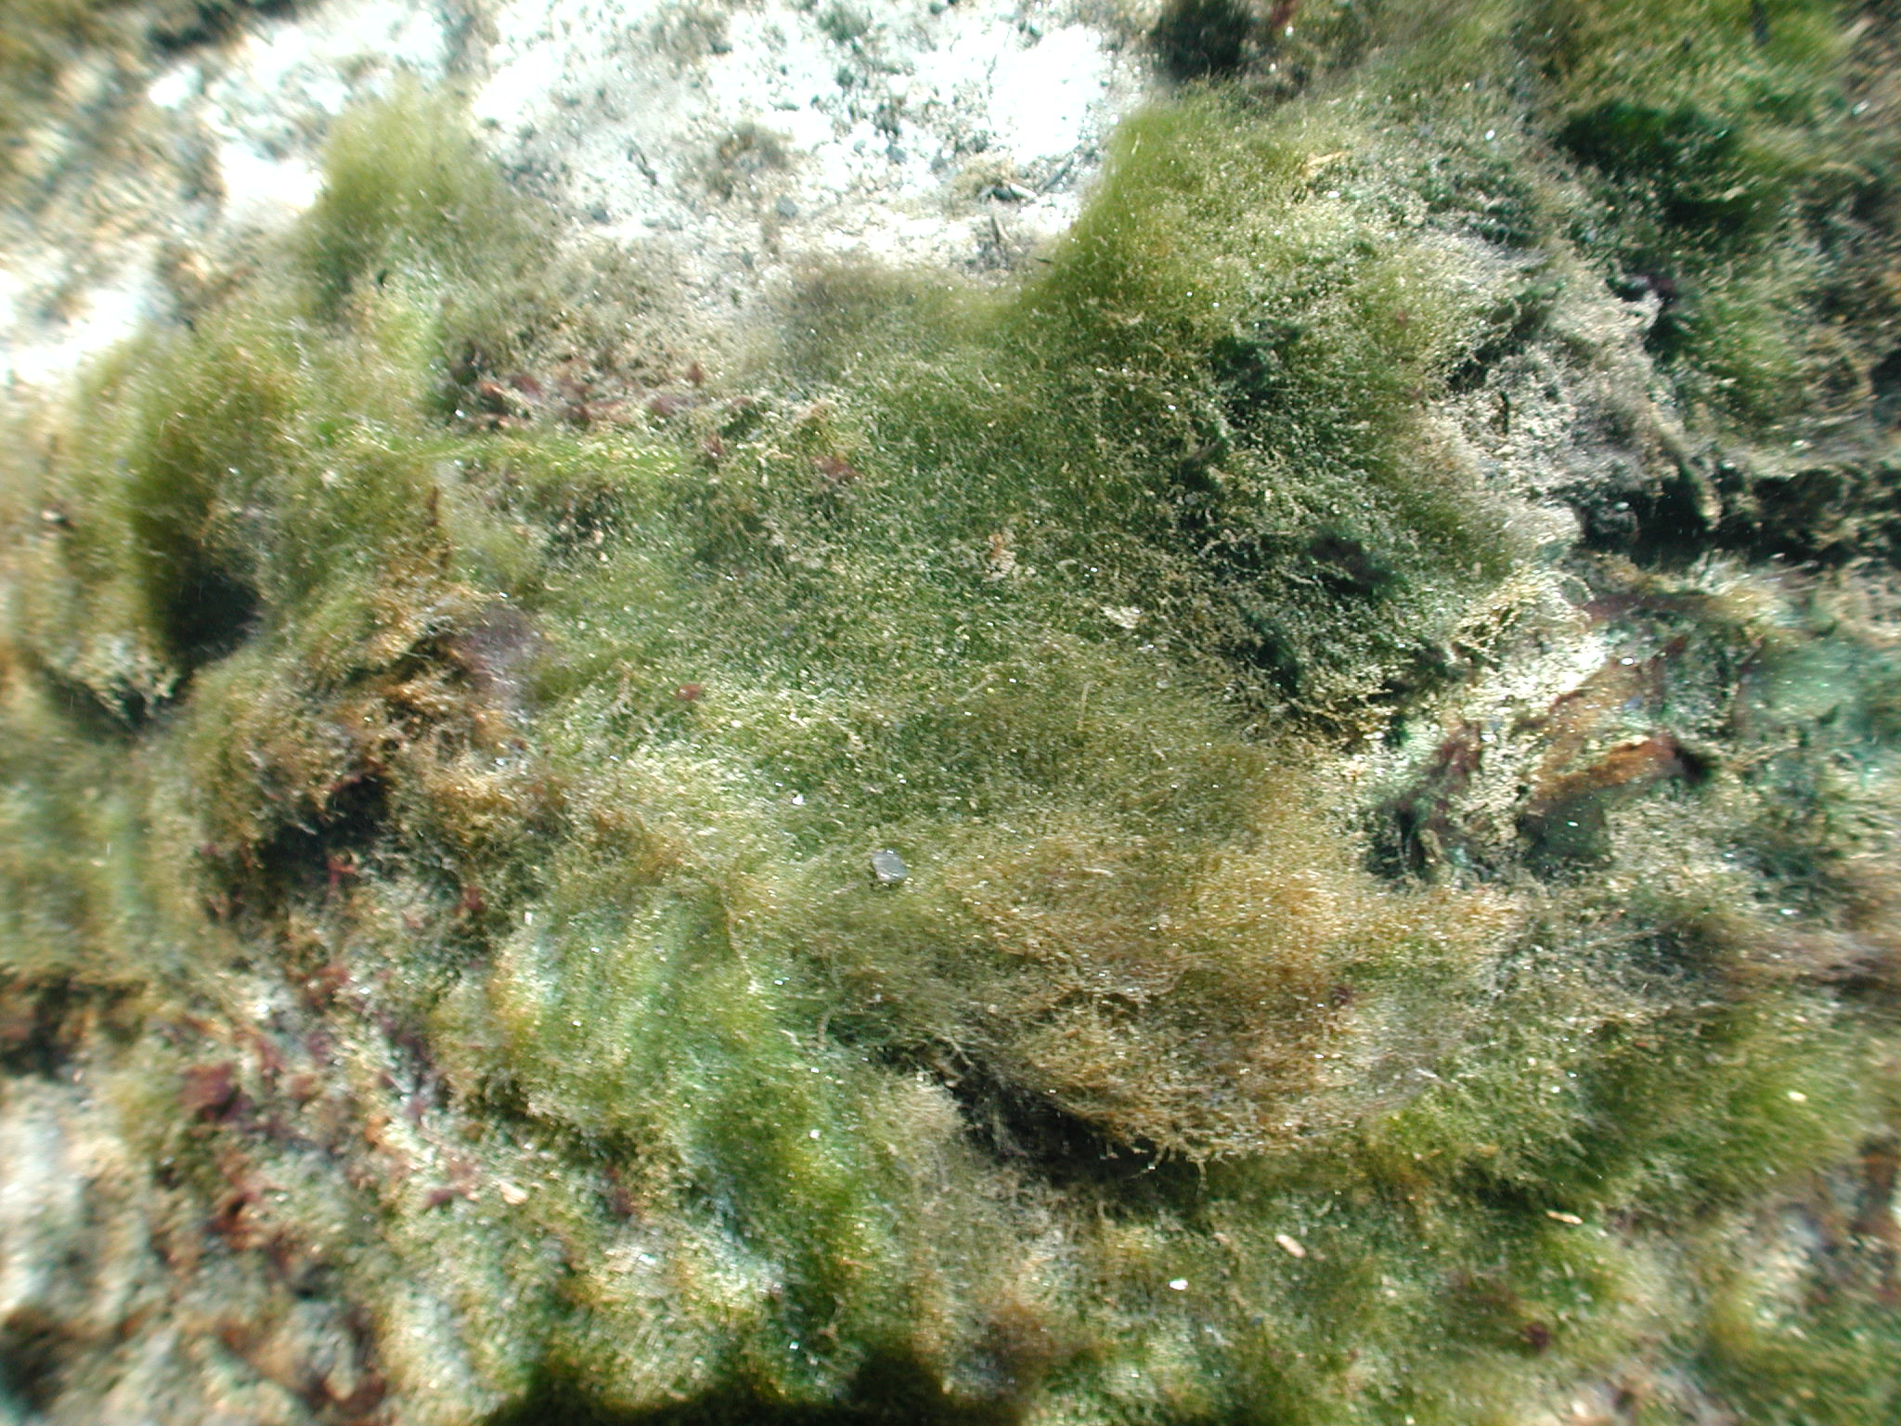
Vaucheria sp.

Slide 3
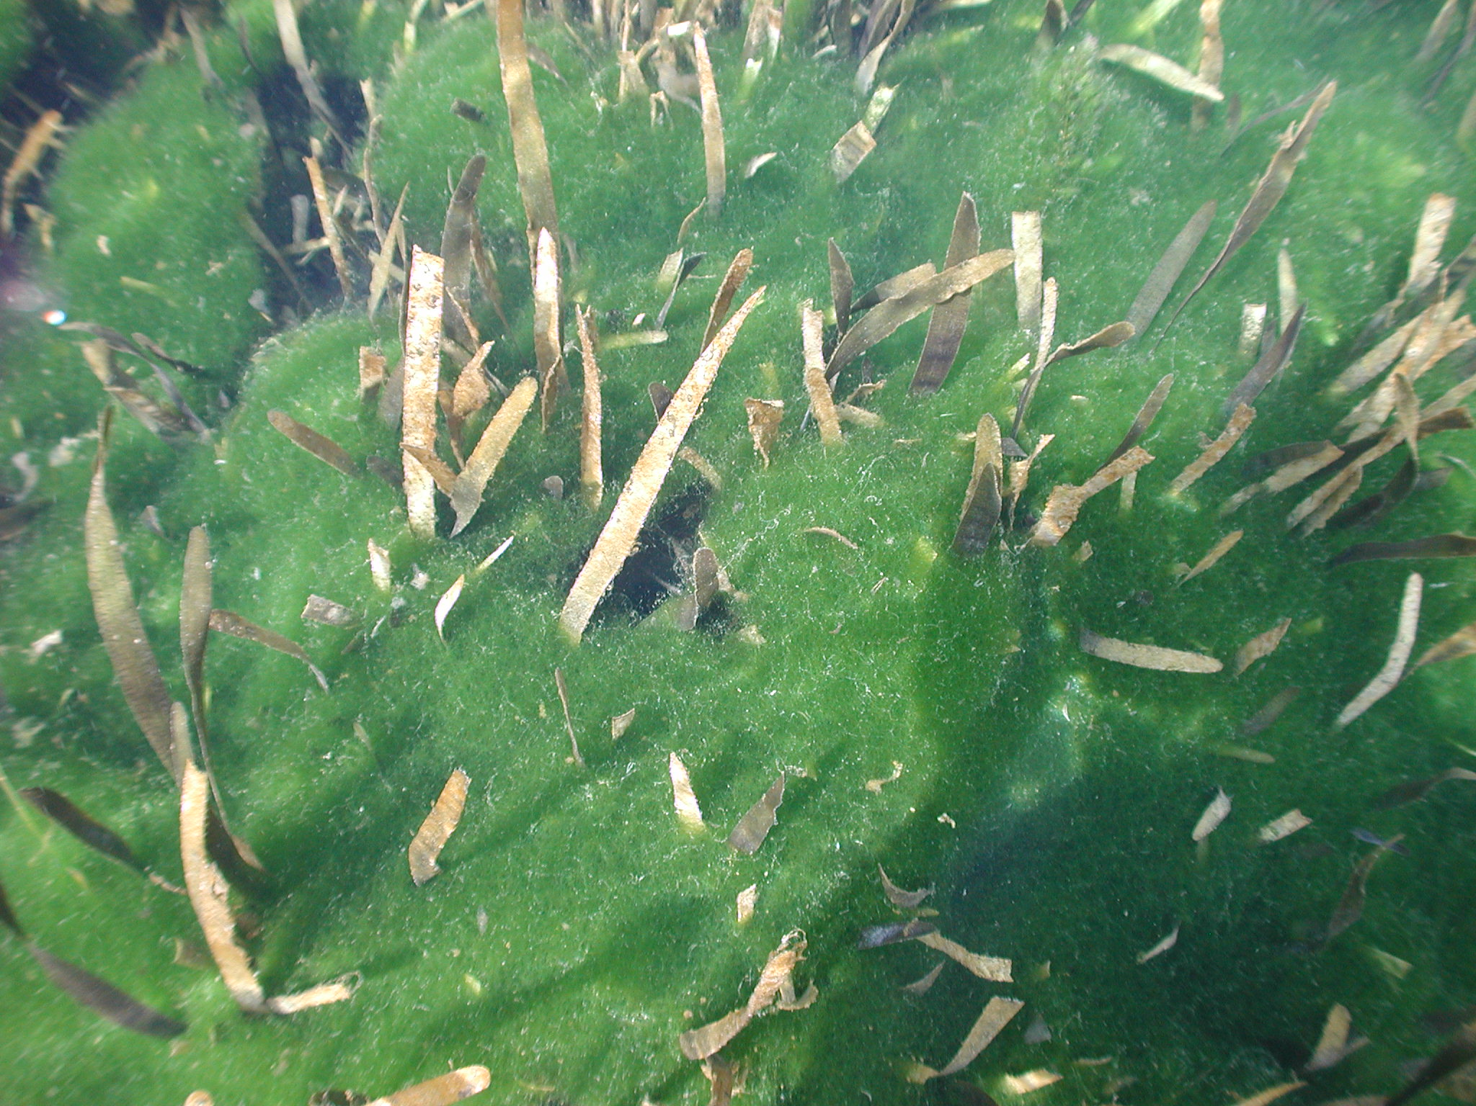
Spirogyra sp.

Slide 4
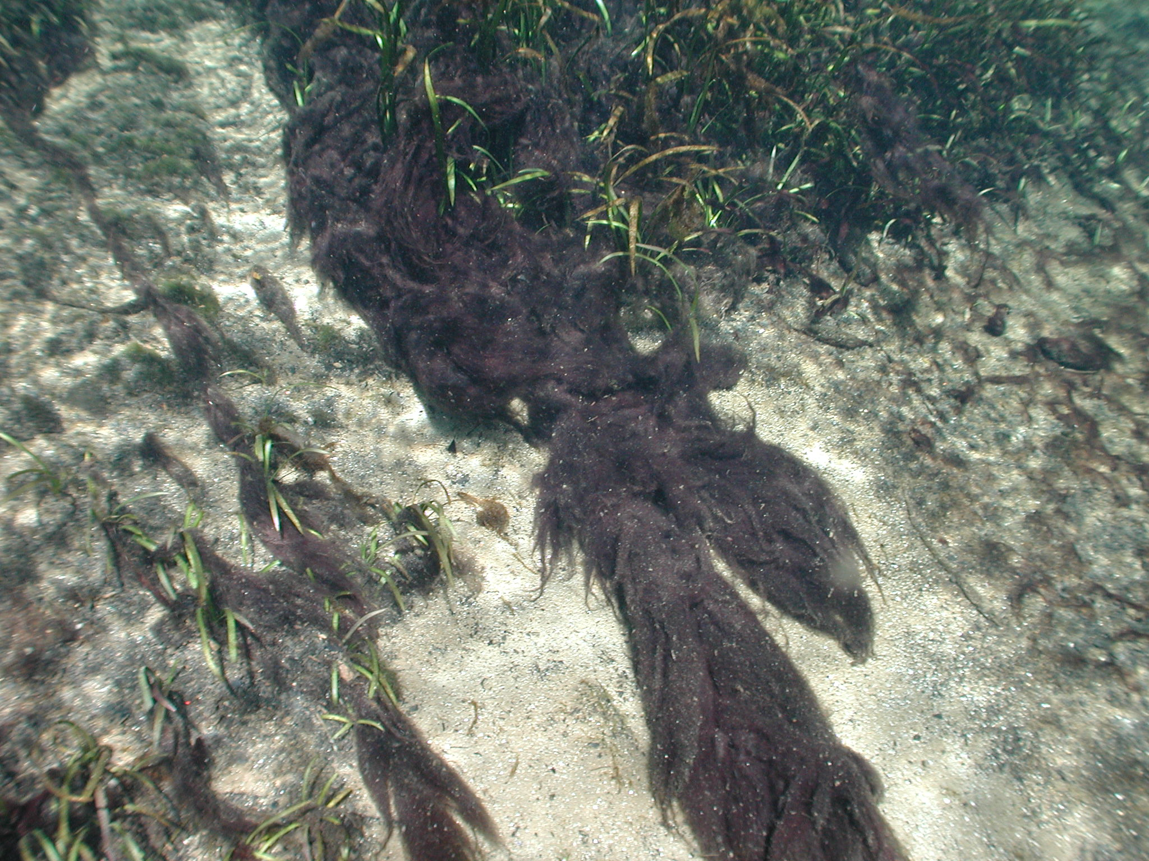
Lyngbya majuscula

Slide 5
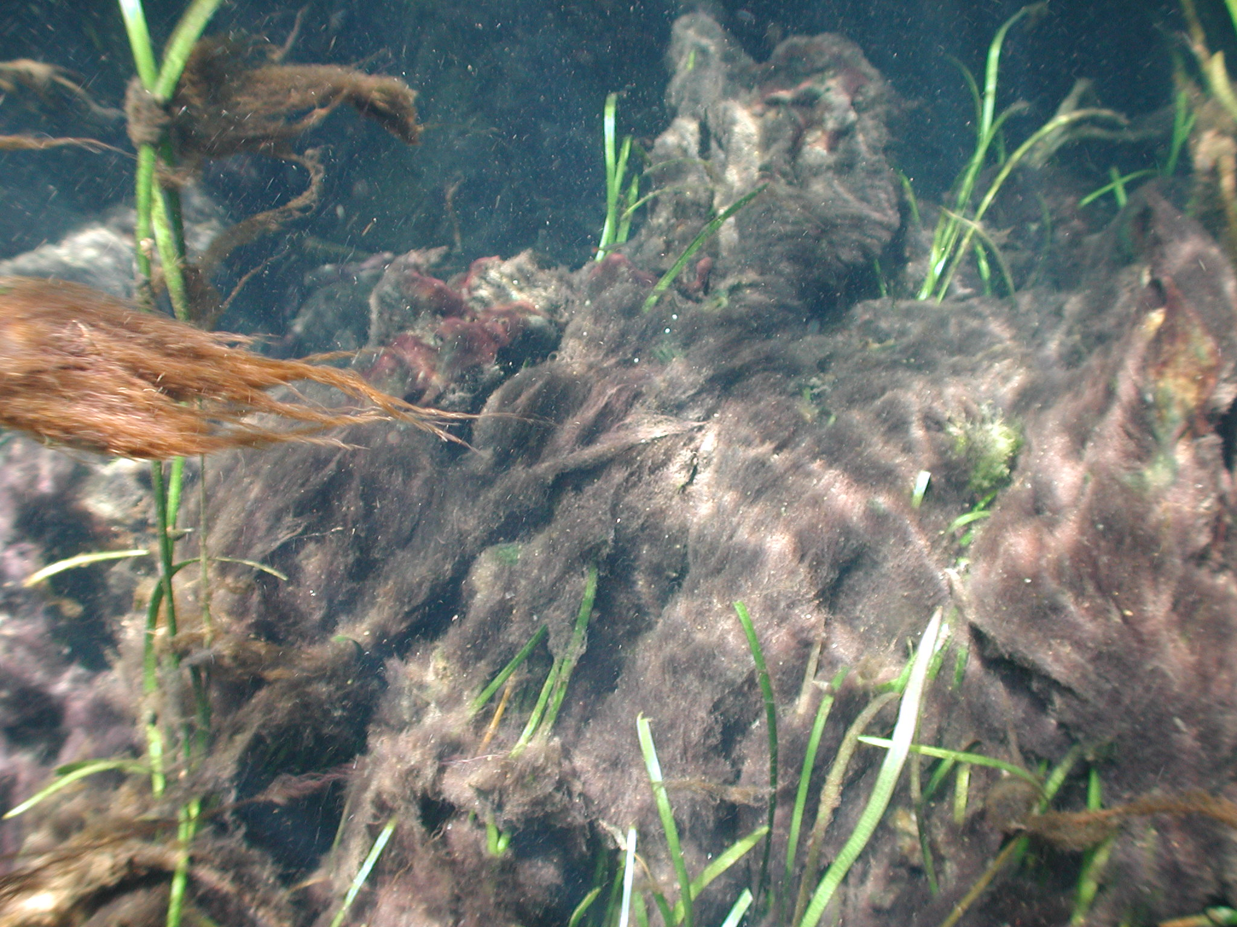
Lyngbya majuscula

Slide 6
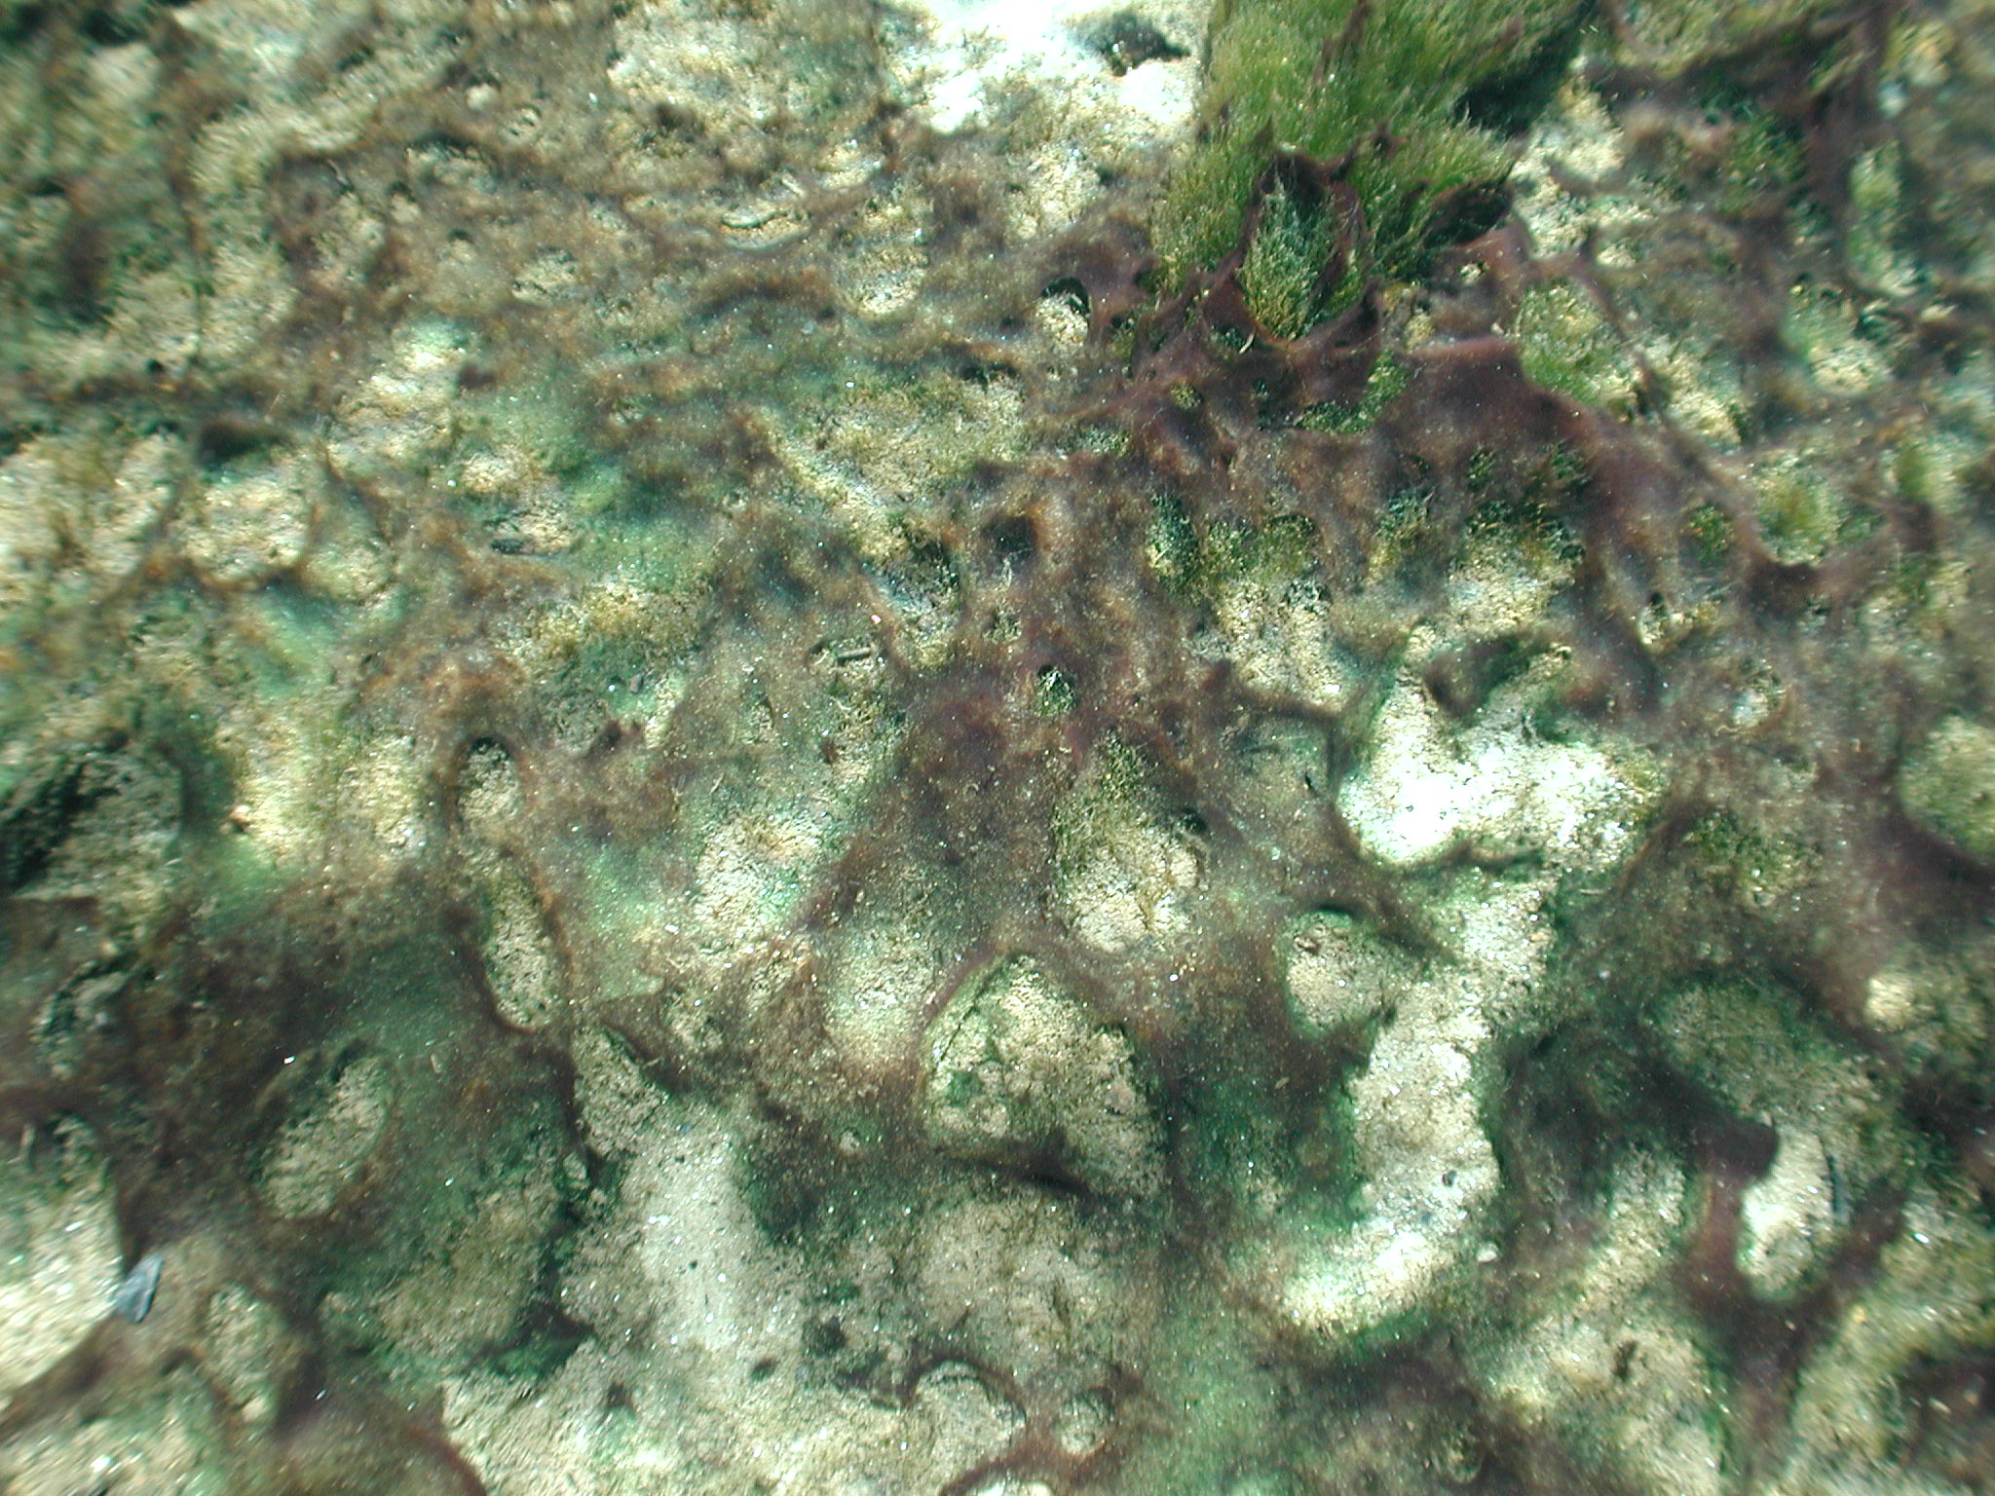
Oscillatoria sp.

