Slide 1



New Fertilizer Ordinance / Education & Septic Upgrade Incentive Program Update
Orange County - Emily Lawson

Slide 2

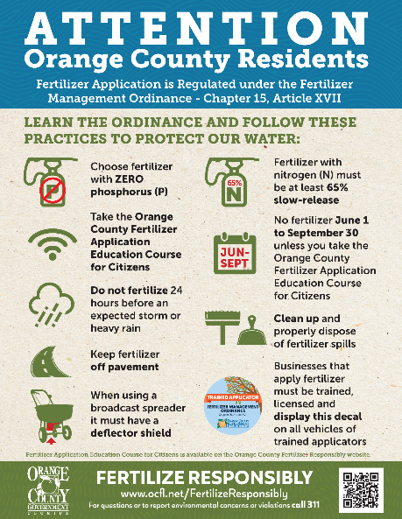
My Yard, My Springs Campaign
Education Grant – through September 30, 2021
Grant funded marketing firm (Marketing for Change) development of campaign materials and marketing strategy to be implemented by Orange County:
            MyYardMySprings.org Website
            Social Media
            Retail
            Billboards
            Yard-Springs Connection Infographic and Animation
            All source files
            Social Media Ads: (specific zip codes) Growth Marketing
            Summer and Fall 2021
            Public Service Announcements (PSAs): were created from Yard-Springs Animation/theme (Channels 6 and 9) and aired Summer 2021 – also on YouTube and Orange TV
Notes:
Website (everything points here with MyYardMySprings.org and QR Codes)
Social Media (plan, images, videos, text)
Retail (springshed poster, seasonal tear-off reminder cards, images/textures for posters describing ordinance)
Billboards (seasonal themed messaging) and signage
Yard-Springs Connection Infographic and Animation
All source files were provided for future modification by graphics/Orange TV/vendors – also easily shared with other stakeholders

Slide 3


My Yard, My Springs Campaign
Education Materials

Slide 4
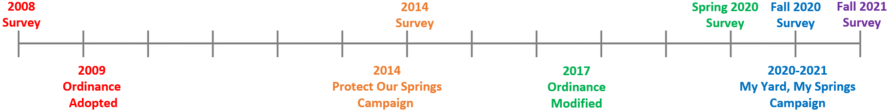
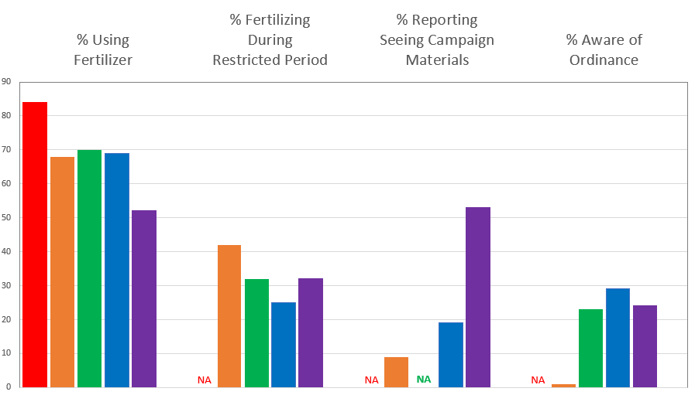
Campaign
Metrics: Surveys
Surveys
Ordinance
& Campaign
Milestones
Timeline
Results
Legend
2008 Survey
2014 Survey
Spring 2020 Survey
Fall 2020 Survey
Fall 2021 Survey
Notes:
Respondents specifically commented on PSAs
BCC Meeting attendees also commented on billboard and recommended multilingual/cultural approach

Slide 5
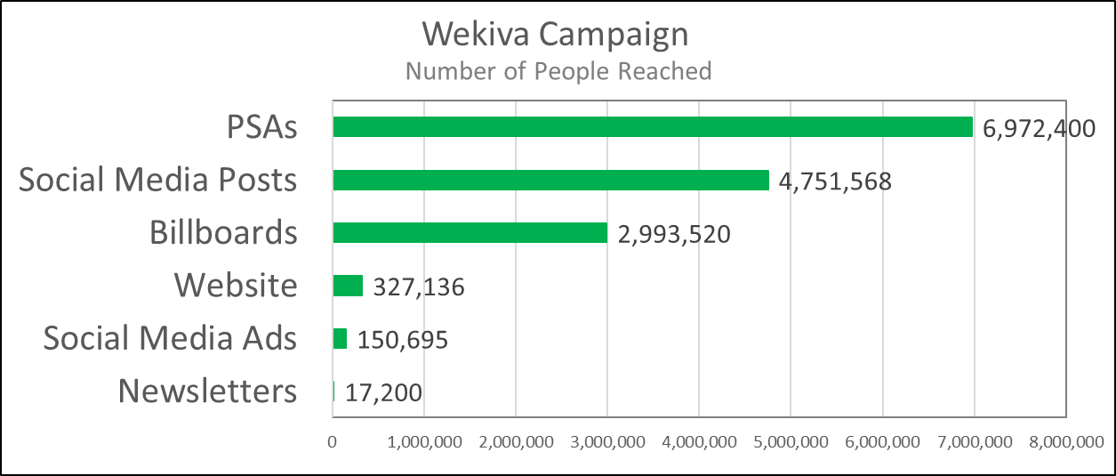
Campaign
Metrics: Reach
Estimated Number of People Reached
Notes:
Focus: PSAs, social media, and billboards
Consider: radio and multilingual materials
Continue: taking advantage of low-hanging fruit (newsletters, banners

Slide 6
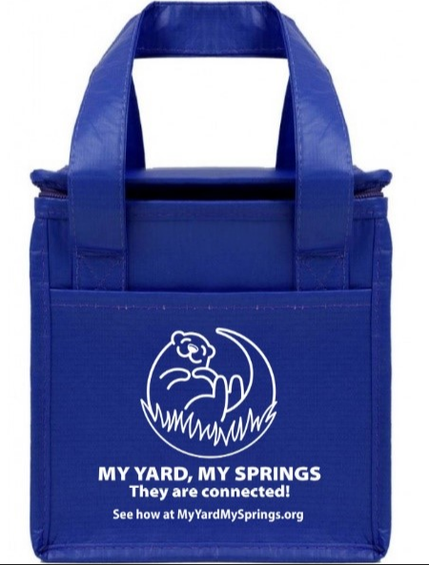
My Yard, My Springs Campaign
Partners
Orange County Environmental Protection Division was the lead,
but we had help!
            Partners: reviewed, hosted and distributed material
            Contact: direct and deliver materials to them
            Issues: Storage and tracking were potential issues,
            no problems
            Orange County Utilities
            Commissioners
            Orange County Library System
            Wekiva State Park
            Hope CommUnity Center
            IDEAS for Us
            Friends of the Wekiva
            Local Municipalities
            Orange County Parks
            Neighborhood Services
            University of South Florida
            Orange TV
            Orange County Communications

Slide 7
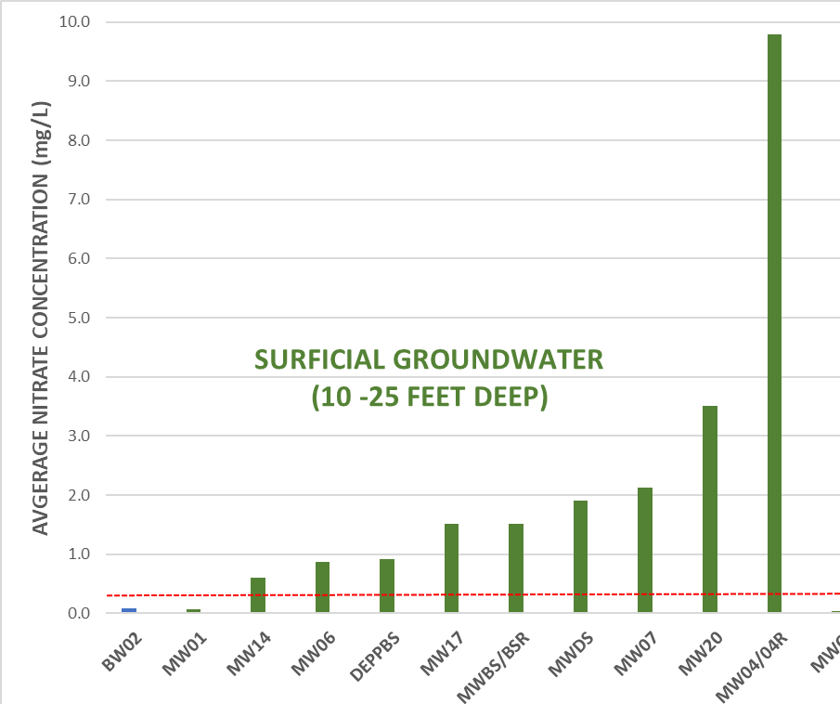
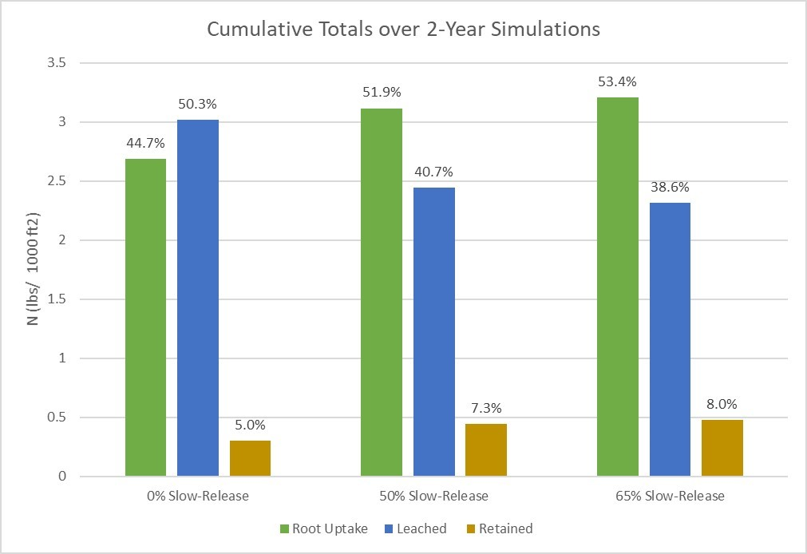
New Ordinance
Science First
2017 Ordinance Update: BCC requested scientific studies to inform potential future changes
              confirmed fertilizer is a major source of nitrate in springshed groundwater
              – monitoring well concentration data
              – isotope data
              USDA Hydrus model supports increasing percentage of slow-release nitrogen to reduce leaching
              Increasing trend in nutrient impairments countywide
              Orange County required to remove pollutants from impaired waters
              Removing pollutants is more costly than preventing them from entering our waters
0% SRN 50% SRN 65% SRN
BLUE BAR IS LEACHED TO GROUNDWATER

Slide 8
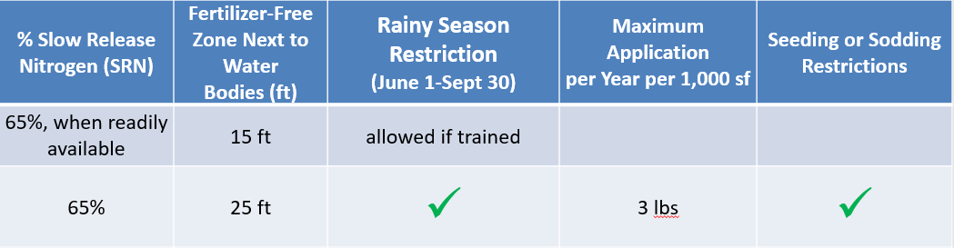
New Ordinance
Summary
Effective Date: June 1, 2022
New training requirements: institutional applicators and golf courses
2017
*New*
Current

Slide 9
New Ordinance
Communication and Implementation
Scientific studies: 2017 through 2021
Code update meetings: March 2021 through February 2022
Stakeholder Involvement
            Stakeholder List: Ordinance (2009) and Ordinance Update (2017) and continue to update
            Reach out via email to provide drafts and invites to stakeholder meetings
            Email specific to fertilizer materials
            Hold public stakeholder meetings
            Meetings with stakeholders that requested (virtual and in person): Agricultural Advisory Board, Massey Services, Scotts, IFAS, Sustainability Advisory Board, Environmental Protection Committee
Updating this ordinance was an expensive and time-consuming process
Orange County now has one of the most stringent fertilizer ordinances in the state - ideas for supporting BMAP credits?
Notes:
Ag Advisory Board
Sierra Club
Friends of Wekiva
Audubon & Orange Audubon
Massey Services
TruGreen
OC Public Schools
Sunniland
Scotts
Florida Turf Grass Association
Dr. Jacks
Zen Outdoor Living
National Park Services
Florida Environmental Research and Education Foundation
Florida Golf Course Superintendents
FFL Advisory Committee
FNGLA
Cities within Orange County
Town of Windermere
Water Control Districts
Commissioners
Lowes
Home Depot
Ace
WalMart
OC Utilities
OC Fire Rescue
OC Convention Center
OC Public Works
OC Facilities
OC Capital Projects
OC Planning
OC Zoning
OC Corrections
OC Parks
OC Neighborhoods
OC Code Compliance
OC EPD
OC Sustainability Office
IFAS
Seminole County
Carol King Landscape
Environmental Pest & Lawn
Quality First Lawn-Shrub Care
LuvaLawn
Landscape Maintenance Professionals
Brightview
Green Armour Services
DesignScapes
AmeriScapes Landscape
LawnDoctor
Signature Landscape Contractors
Veteranscape
Miller Enviro Care
Bugsy Malone Pest Control Inc
Advance Tech Pest Management Services Inc
Accurate Pest Control
Lawn Worx, ProScape
Hurst Lawn & Ornamental
Falcon Termite & Pest Control
Land Technologies
Lewis Cobb Pest Control
LandCare Orlando
AlwaysGreen
Greater Outdoors Lawn Care
Helping Hand Lawn care
P&L Lawn Maintenance
Prostaff Pest Control
Nature Conservancy
Nelson’s Nursery
Friends of Lake Apopka
Surfrider Foundation
Sweetwater golf and Country Club
Ventura Country Club
Winter Pines Golf Club
Isleworth country Club
Forest Lake Golf Club
Eagle Creek Golf Club
North Shore Golf Club

Slide 10
New Ordinance
Education
Institutional applicators and golf courses: new training requirements
Commercial applicators and Retail: Postcards, flyers, letters, posters with changes and important ordinance elements
Merge Fertilize Responsibly and My Yard, My Springs campaigns: new materials, but applicable countywide (lakes, rivers, and springs)
Website: information, FAQs, videos, NEW fertilizer calculator
www.ocfl.net/FertilizeResponsibly
Local municipality websites: providing updated information

Slide 11
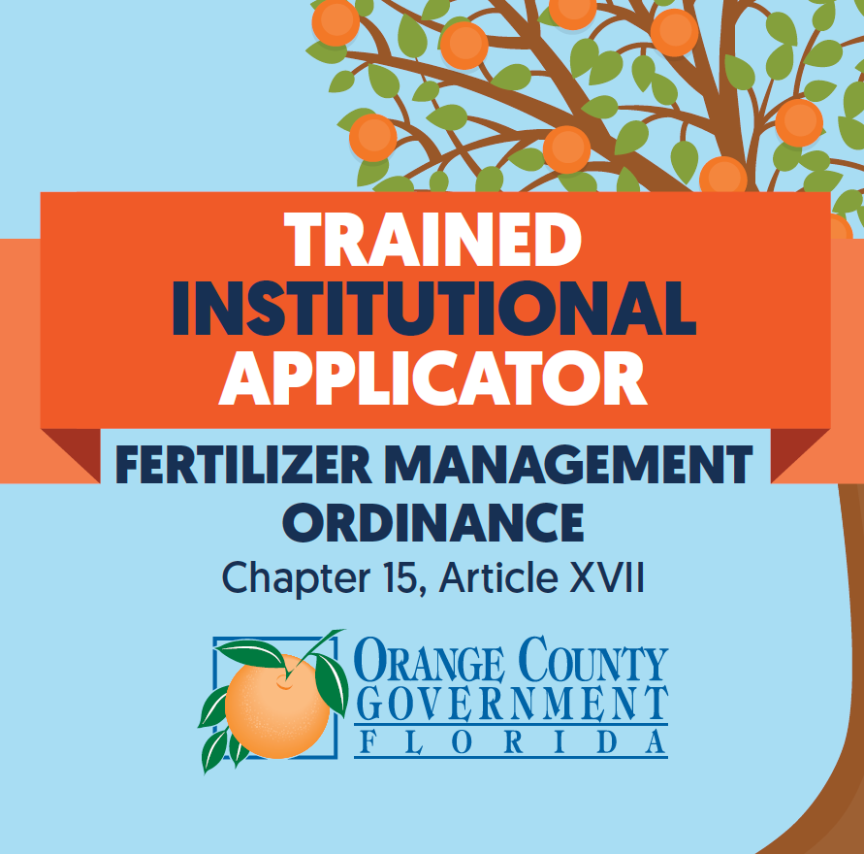
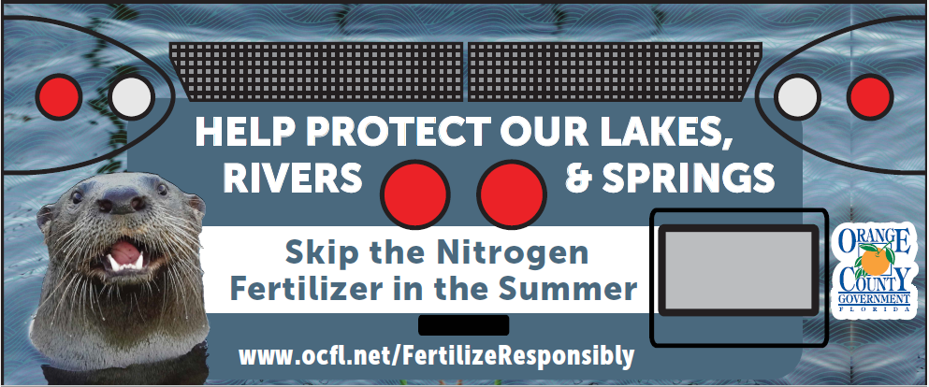


New Ordinance
Education
Institutional Applicator Decals
Post Cards - Seasonal
Bus Wraps
Email Title Block
Messages

Slide 12
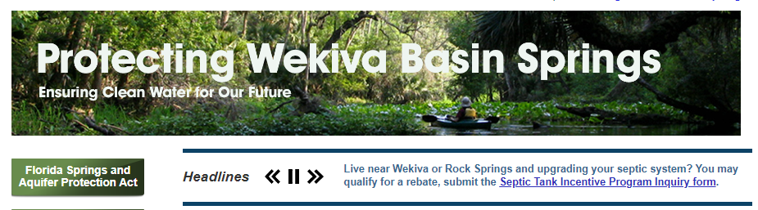
Septic Upgrade Incentive Program
Springs Grant
Grant is specific to Priority Focus Area within Wekiwa and Rock Springs BMAP Area
Headline banner on OC Springs website links to simple inquiry form – emails Neighborhood Services contact for address-based screening
              Address in Orange County Utilities service area
              Address not included in 5-year Utilities sewering plan
Long form application (6 pages) provided if screening passes

Slide 13
Septic Upgrade Incentive Program
Science and Regulatory
Regulatory
Wekiwa and Rock Springs BMAP
– require septic upgrade or sewering
– not currently enforcing septic upgrades for repair permits (January 4, 2024)
Nutrient BMAPs
– requiring Wastewater and OSTDS Plans
– septic upgrades not efficient phosphorus reducers, may only be feasible for nitrogen BMAPs
Vulnerability Study
Similar to Aquifer Vulnerability Assessments in Florida (FAVA) and Wekiva (WAVA)
What areas of Orange County are vulnerable to pollution from septic systems
Where should we perform wastewater feasibility studies
Notes:
FDEP FLORIDA GEOLOGICAL SURVEY

Slide 14
Septic Upgrade Incentive Program
Partners
Local Department of Health has been very helpful
              list of systems upgraded to advanced nitrogen treatment systems within the grant timeframe - we could reach out directly
              where are systems failing
Orange County Neighborhood Services: helping implement the application process
Orange County Utilities: providing information from the Wastewater Feasibility Study
areas to avoid (planned for sewer in the next 5 years)
areas to target
Other counties – working with homeowners or installers? Local DOH?

Slide 15
Septic Upgrade Incentive Program
Challenges
Residential Issues
              Skeptical
              Financial
              Timing
              Knowledge
Regulatory – Without regulatory driver to upgrade for repair permits, residents choose not to upgrade, stick with lower cost conventional system
Negative publicity – some advanced treatment technologies have been criticized
Utilities Wastewater Feasibility Study incomplete – unable to broadly advertise, don’t want to compete with other initiatives or confuse residents
Notes:
Residential Issues
Skeptical – believe the offer is a scam
Financial – Reimbursement is an issue for lower income residents
Timing – Need to reach resident during decision process
Knowledge – Residents are unfamiliar with advanced treatment technologies and some have been intimidated by information needed for application
Knowledge – upgraded systems are more $$ and technical, we don’t want system failure due to lack of maintenance

Slide 16
Summary
My Yard, My Springs Campaign: People remember what they see on TV
Fertilizer Ordinance:
Engage stakeholders for stronger ordinance and greater support
Target education of new requirements
Septic Upgrade Incentive Program: without a regulatory driver, residents are not utilizing the program so far
Resources for Septic:
regulation requiring septic upgrades
infographic of technologies (3 options)
funding that is available County-wide
FDEP plan for upgrade regulation and funding
Notes:
Resources for Septic:
regulation requiring septic upgrades
easy to understand infographic of technologies (3 options)
funding that is available County-wide (outside springs OFS) – esp with OSTDS plans required for all BMAPs (also applies to fertilizer)
FDEP plan for upgrade regulation and funding (some residents can’t afford, need at least the delta funded)

Slide 17
Thank You!
Emily Lawson
Emily.Lawson@ocfl.net
321-689-7576
Orange County
Environmental Protection Division

