Slide 1
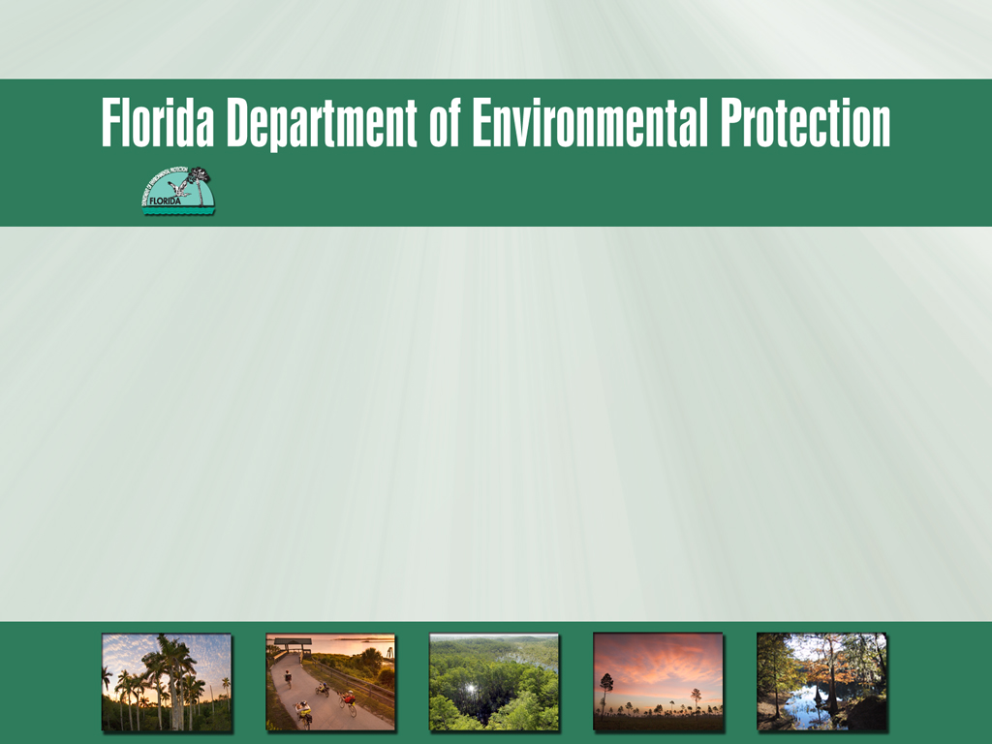
St. Lucie River and Estuary Basin Management Action Plan (BMAP) Monitoring Plan
December 12, 2012

Slide 2
Presentation Overview
Overview of need for monitoring plan.
Review of monitoring plan development process.
Identification of monitoring plan objectives.
Review of existing/historic monitoring in watershed.
Discussion of sampling parameters and frequency.
Discussion of additional monitoring needs.

Slide 3
Overview of Need for Monitoring Plan

Slide 4
Why do we need a monitoring plan?
Subparagraph 403.067(7)(a)5:
  “The basin management action plan must include milestones for implementation and water quality improvement, & an associated water quality monitoring component sufficient to evaluate whether reasonable progress in pollutant load reductions is being achieved over time.”

Slide 5
Why do we need a monitoring plan? (Continued)
373.4595(4)(b)(3) St. Lucie River Watershed Research and Water Quality Monitoring Program:
  “The district, in cooperation with the other coordinating agencies and local governments, shall establish a St. Lucie River Watershed Research and Water Quality Monitoring Program that builds upon the district’s existing research program & that is sufficient to carry out, comply with, or assess the plans, programs, and other responsibilities created by this subsection.”

Slide 6
Review of Monitoring Plan Development Process

Slide 7
What are some important considerations for the monitoring plan?
TMDL parameter(s) addressed in the BMAP;
Goals and objectives for monitoring to determine success of the BMAP;
Core and supplemental parameters that should be assessed related to the impairment;
Important assumptions made in TMDL development;
Specific allocations to sources (where applicable);
Existing stations; and
Responsible entities.

Slide 8
Monitoring Plan Development Process
Step 1: Establish objectives.
Step 2: Identify existing and historic monitoring in the basin.
Step 3: Discuss sampling parameters and frequency.
Step 4: Identify monitoring and research needs associated with the BMAP.
Step 5: Develop monitoring plan document.
Notes:
Step 2: Compile historic and current monitoring locations for discussions.
Discuss which stations are key to the BMAP monitoring network.
Identify where gaps occur.

Slide 9
Identification of Monitoring Plan Objectives

Slide 10
Monitoring Plan Objectives
Example Primary Objective
  Track trends in total nitrogen (TN) and total phosphorus (TP) loads in major canals and tributaries in the basin.
Example Secondary Objectives
  Measure reductions in watershed loadings of the total maximum daily load (TMDL) target pollutant(s).
  Measure effectiveness of individual or collective projects in reaching TMDL target-pollutant loadings.

Slide 11
Review of Existing/Historical Monitoring in Watershed

Slide 12
Existing Water Quality Monitoring
Organization | Type | Number of Stations | Location | Frequency | Period | Analyte
SFWMD/ Water Quality Monitoring – North | Water quality | 5 grab | SLE & watershed district | Monthly | 1982–present | Nutrients, Physical, Other
 |  |  | Structures | Quarterly |  | Nutrients, Physical, Other
 |  |  |  |  |  | Nutrients
 |  | 5 auto-sampler |  | Weekly
 | Flow | 5 auto-sampler |  | Weekly |  | --
SFWMD / SE | Water quality | 13 grab | SLE | Monthly | 1991–present | Nutrients, Physical
SFWMD: Salinity Monitoring | Salinity | -- | SLE | 15 minutes | 1997–present | Physical, DO at some sites (HR-1)
St. Lucie County Public Works Department Works Department | Water quality | 2 auto-sampler composite time | North Fork tributary | Tri-weekly | 2008–present | TP, total nitrogen (TN), biochemical oxygen demand, field parameters
 |  | 2 grab
Notes:
-Taken from Attachment D: St. Lucie River Watershed & St. Lucie Estuary Monitoring Efforts from Appendix 10-1: St. Lucie River Watershed Protection Plan Update
-As of June 2011
-E-mail request sent to stakeholders on September 4, 2012

Slide 13
Existing Water Quality Monitoring (Continued)
Organization | Type | Number of Stations | Location | Frequency | Period | Analyte
SFWMD / St. Lucie Synoptic Monitoring |  | 12 grab | C-23/C-24 | Event-driven | 2010–present | Nutrients
 |  |  | sub-watershed
SFWMD / Lake Okeechobee Inflows & Outflows |  | 1 (S-308C) grab | C-44 and Lake | Biweekly | 1973–present | Nutrients, Physical
 |  |  | Okeechobee
 |  |  | S-308 lock | Quarterly |  | Tot-Fe

Slide 14
Existing Aquatic Program Monitoring
Organization | Number of Stations | Location | Frequency | Period | Analyte
Seagrass Mapping & Monitoring | 80+ | Transect locations represent all segments of the lagoon | Semiannually | 1994–present | Species composition, epiphytes, coverage, abundance, drift algae, light extinction, salinity, temperature, DO
Seagrass Mapping & Monitoring | Lagoon-wide maps | Entire lagoon including SLE upstream to Roosevelt Bridge (US 1) | Every 2–5 years | 1986–present | Seagrass distribution & density
Seagrass Mapping & Monitoring | 10 | Southern Indian River Lagoon | Bi-monthly | 2008–present | Seagrass canopy height seagrass percent cover, macroalgae percent cover, spatial distribution of seagrass species, physical parameters.
 |  |  | (3 sites near SLE are monitored monthly)
CERP Oyster Monitoring & Mapping: FWC | 9 | SLE | Semiannually | 2005–present | Oyster spat recruitment, oyster condition, reproductive, & disease monitoring. Water quality (salinity, temperature, pH, DO, Secchi depth) is monitored monthly. Juvenile growth & mortality were measured in 2005–2007 & added into the 2011 monitoring plan.

Slide 15
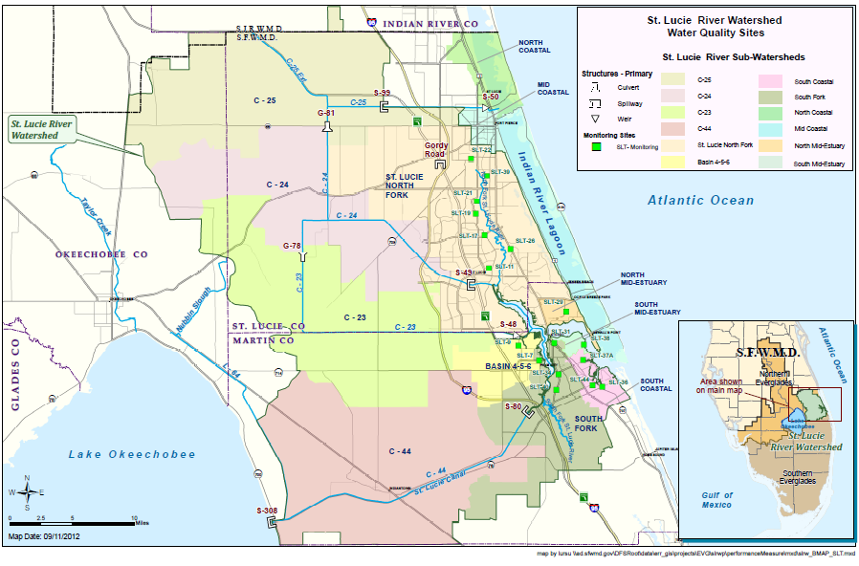
South Florida Water Management District (SFWMD) Source Control Water Quality Monitoring

Slide 16
SFWMD Source Control Water Quality Monitoring
# | Site | Watershed (Other entity) | Sub-watershed | Auto sampler | Grab¹ | Flow
 | S50² | IRL | C25 |  | Weekly | Yes
1 | SLT09⁷ | SLRW | Basin 4-5-6 |  | Biweekly⁴
2 | SLT07⁷ | SLRW | Basin 4-5-6 |  | Biweekly⁴
3 | S48 | SLRW | C23 | TP³, TKN | Weekly | Yes
4 | S49 | SLRW | C24 | TP³, TKN | Weekly | Yes
5 | G81 | SLRW | C24 |  | Biweekly⁴ | Yes
6 | GORDY | SLRW | North Fork St. Lucie River | TP³, TKN | Weekly | Yes
7 | SLT11 | SLRW | North Fork St. Lucie River |  | Biweekly⁴
8 | SLT17 | SLRW | North Fork St. Lucie River |  | Biweekly⁴
9 | SLT19 | SLRW | North Fork St. Lucie River |  | Biweekly⁴
10 | SLT21 | SLRW | North Fork St. Lucie River |  | Biweekly⁴
11 | SLT22 | SLRW | North Fork St. Lucie River |  | Biweekly⁴

Slide 17
SFWMD Source Control Water Quality Monitoring (CONTINUED)
# | Site | Watershed (Other entity) | Sub-watershed | Auto sampler | Grab¹ | Flow
12 | SLT22A | SLRW | North Fork St. Lucie River |  | Biweekly^{4,8}
13 | SLT39 | SLRW | North Fork St. Lucie River |  | Biweekly⁴
14 | SLT29 | SLRW | North Mid-Estuary |  | Biweekly⁴
15 | SLT26 | SLRW | North Fork St. Lucie River |  | Biweekly⁴
16 | SLT37A | SLRW | South Coastal |  | Biweekly⁴
17 | SLT36⁷ | SLRW | South Coastal |  | Biweekly⁴
18 | SLT31 | SLRW | South Fork St. Lucie River |  | Biweekly⁴
19 | SLT34A | SLRW | South Fork St. Lucie River |  | Biweekly⁴
20 | SLT40 | SLRW | South Fork St. Lucie River |  | Biweekly⁴
21 | SLT40A | SLRW | South Fork St. Lucie River |  | Biweekly^{4,5}

Slide 18
SFWMD Source Control Water Quality Monitoring (CONTINUED)
# | Site | Watershed (Other entity) | Sub-watershed | Auto sampler | Grab¹ | Flow
22 | SLT38 | SLRW | South Mid-estuary |  | Biweekly⁴
23 | SLT38A | SLRW | South Mid-estuary |  | Biweekly^{4,6}
24 | S80 | SLRW & LOW | C-44 | TP³, TKN | Weekly | Yes
25 | S308 | SLRW & LOW (COE) | C-44 |  | Weekly | Yes

Slide 19
SFWMD Source Control Rainfall Monitoring
# | Station | C-44 | Basin 4 | Basin 5 | Basin 6 | C-23 | C-24 | C-25 | North Fork | South Coastal | South Fork | North Mid Estuary | South Mid Estuary
1 | BLUEGOOS_R | √ |  |  |  | √ | √
2 | COW CREE_R |  |  |  |  | √ | √ | √
3 | FT PIERC_R |  |  |  |  |  |  | √ | √
4 | FTP FS_R |  |  |  |  |  | √ | √ | √
5 | MOBLEY_R |  |  |  |  |  | √ | √
6 | OPAL_R |  |  |  |  | √ | √
7 | PAHOKEE1_R | √
8 | ROCK K_R |  |  |  |  |  |  | √
9 | S135_R | √
10 | S49_R |  |  |  |  | √ | √ |  | √
11 | S80_R | √ | √ | √ | √ |  |  |  |  | √ | √ |  | √
12 | S97_R | √ | √ | √ | √ | √ |  |  | √ |  | √ | √ | √
13 | VERO TOW_R |  |  |  |  |  |  | √

Slide 20
Historical Water Quality Monitoring
Organization | Type | Number of Stations | Location | Frequency | Period | Analyte
SFWMD / SE Releases | Water quality | 7 grab | SLE | Sampled on request | 1991–2009 | Chla, chlorophyll 2 , color, pheophytin, TSS, turbidity, DO, Physical, depth at sites SE02, SE03, HR1, SE06, SE08B, IRL11B, IRL17
SFWMD / St. Lucie Tributary Monitoring Network | Water quality | 19 grab | SLE tributaries including North Fork, South Fork, Bessey Creek, and Danforth Creek basins | Biweekly when water is flowing | 2001–2011 | Chla, chlorophyll b, pheophytin, O-PO₄, TKN, T-PO₄, TSS, turbidity, NH₄, NOx, DO, Physical.
 |  |  |  | Monthly |  | Includes all biweekly parameters plus Ca, Mg, Tot-As, Tot-Cu, Tot-Cr
 | Flow and rainfall | 12 flow |  | Continuous
 |  | 8 rainfall
Notes:
-Taken from Attachment D: St. Lucie River Watershed & St. Lucie Estuary Monitoring Efforts from Appendix 10-1: St. Lucie River Watershed Protection Plan Update
-As of June 2011
-E-mail request sent to stakeholders on September 4, 2012

Slide 21
Historical Water Quality Monitoring (Continued)
Organization | Type | Number of Stations | Location | Frequency | Period | Analyte
Blue-green Algae Interagency Coordination Committee | Chlorophyll | As required by the Blue-Green Algae Interagency Coordination Committee | SLE when | As required by the Blue-Green Algae Interagency | 2005–2006 | Chla
 |  |  | Blue-green algae is present | Coordination Committee
SFWMD / Allapattah Complex Restoration Area (ACRA) | Water quality | 6 grab | Watershed | Biweekly (2 sites) | 2003–2010 | NH₄, NOx, TKN, T-PO₄, DO, specific conductance, temperature, pH
 |  |  | (Allapattah | Monthly |  | Includes all biweekly parameters plus SO₄
 |  | 2 auto-sampler | Restoration | Weekly |  | T-PO₄ at sites ACRA1, ACRA2
 | Fish | 4 fish | Area) | Quarterly (4 sites) |  | Total mercury and organochlorine pesticide compounds in mosquitofish at sites ACRA1, ACRA1B, ACRA7, and ACRA8
 |  |  |  | Annually (2 sites) |  | Mercury and organochlorine compounds in large bodied fish [e.g., largemouth bass (Micropterus salmoides), bluegill (Lepomis macrochirus)] at sites ACRA1, ACRA1B
Notes:
-Taken from Attachment D: St. Lucie River Watershed & St. Lucie Estuary Monitoring Efforts from Appendix 10-1: St. Lucie River Watershed Protection Plan Update
-As of June 2011
-E-mail request sent to stakeholders on September 4, 2012

Slide 22
Historical Aquatic Program Monitoring
Organization | Number of Stations | Location | Frequency | Analyte | Summary
American Recovery & Reinvestment Act (ARRA) Project Oyster Monitoring & Mapping: FFWCC and Mapping: Florida Fish and Wildlife Conservation Commission (FWC) | 2 natural sites | SLE | summer 2009 – | Oyster spat recruitment, oyster condition, reproduction, &disease monitoring. Water quality (salinity, temperature, pH, DO, Secchi depth) is monitored monthly. | Adult oysters are sampled twice per year from replicate stations within the SLE establishing an oyster baseline. Oyster monitoring includes reproduction, recruitment, & disease patterns.
 | 4 restoration reefs |  | summer 2011

Slide 23
Stakeholder Comments
Jason Bessey:
  St. Lucie County Health Department has discontinued the bacteria testing program, first line pg. App 10-1-3.
David Brigida:
  The North Fork should be monitored at the junction of the C-24, Mud Cove, and the St. Lucie River. This is where the waters come together.
  The monitoring of the C-23 and C-24 canals should not be event driven, that would be too late but should be monitored and reported at least monthly.
Dianne Hughes:
  Martin County is no longer performing water quality monitoring at the two STAs as identified in the St. Lucie River Watershed Protection Plan. This was project specific monitoring to determine the performance efficiency of the stormwater treatment facilities. Martin County is not conducting any other monitoring that would be beneficial regionally to the BMAP effort.

Slide 24
Discussion of Sampling Parameters & Frequency

Slide 25
Possible Parameters and Frequencies
Core Parameters | Supplemental Parameters
TP | Total Suspended Solids/Turbidity
Orthophosphate as P | Alkalinity
Nitrate/Nitrite as Nitrogen (N)
N, Ammonia
Total Kjeldahl Nitrogen (TKN)
Dissolved Oxygen (DO)
pH
Temperature
Specific Conductance
Frequency (Depending on parameter):
Monthly
Biweekly

Slide 26
Discussion of Additional Monitoring Needs

Slide 27
Additional Monitoring/Research Needs
What are the monitoring needs that should be included in the BMAP monitoring plan?
What about research needs?
  E.g., nutrient flux study, further hotspot analysis

Slide 28
Action Items/Contact Information
Send monitoring ideas to Katie Hallas by Wednesday, January 16, 2013.
Katie Hallas
  Basin Coordinator
  Florida Department of Environmental Protection
  E-mail: Katie.Hallas@dep.state.fl.us
  Phone: 850-245-8432

Slide 29

Questions

