Slide 1
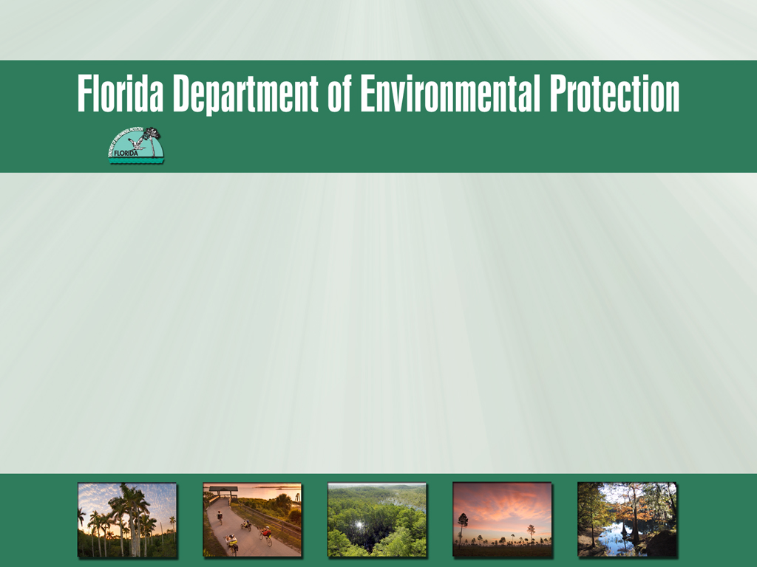
Project Credit Calculations
St. Lucie River & Estuary BMAP Meeting
November 29, 2012

Slide 2
Project Collection Process
To achieve the total nitrogen (TN) and total phosphorus (TP) reductions, each responsible stakeholder will provide projects and programs that reduce nutrient loads.
Projects will be collected in two steps:
  Completed projects since January 1, 2000; and
  Additional planned efforts to meet the balance of the required reductions.

Slide 3
Project Requirements
Credit is only applied to projects that have treatment above and beyond any permitted requirements.
All projects must treat nutrients (TN, TP, or both).
All projects must be within the St. Lucie River Watershed.
The Geographic Information System (GIS) files for the watershed boundaries are located on the FTP site.

Slide 4
Types of Projects
Standard stormwater treatment best management practices (BMPs) include:
  Retention BMPs;
  Wet detention ponds;
  Treatment trains;
  Dry detention;
  Baffle boxes (1st generation);
  Nutrient (2nd generation) baffle boxes;
  Swales;
  Alum injection;
  Stormwater reuse;
  Stormceptor devices;
  Continuous deflective separation (CDS) units;
  Street sweeping;
  Catch basin inserts/inlet filters; &
  Septic tank phase out.

Slide 5
Types of Projects, continued
Provisional BMPs include:
  Public education and outreach efforts;
  Floating islands/ managed aquatic plant systems (MAPS);
  Muck removal/restoration dredging;
  Aquatic vegetation harvesting; and
  Water control structures.

Slide 6
Retention BMPs
The efficiency for retention BMPs depends on whether the BMP is on-line or off-line and the inches of retention provided.
Credit will be assigned for TN and TP as follows:
  Off-line Retention 0.25” treatment volume – 40%
  Off-line Retention 0.50” treatment volume – 62%
  Off-line Retention 0.75” treatment volume – 75%
  Off-line Retention 1.00” treatment volume – 84%
  On-line Retention 0.25” treatment volume – 30%
  On-line Retention 0.50” treatment volume – 52%
  On-line Retention 0.75” treatment volume – 65%
  On-line Retention 1.00” treatment volume – 74%

Slide 7
Wet Detention Ponds
Credit for wet detention ponds will be based on the mean annual residence time of the pond.
The residence time will be used in the equations in Figures 13.2 & 13.3 of the Draft Stormwater Treatment Applicant’s Handbook.
This Handbook can be accessed at: http://publicfiles.dep.state.fl.us/dwrm/stormwater/stormwater_rule_development/docs/ah_rule_draft_031710.pdf .

Slide 8
TN Removal for Wet Detention Ponds
Figure 13.3 Removal Efficiency of Total Nitrogen in Wet Detention Ponds as a Function of Residence Time

Slide 9
TP Removal for Wet Detention Ponds
Figure 13.2 Removal Efficiency of Total Phosphorus in Wet Detention Ponds as a Function of Residence Time

Slide 10
Street Sweeping & Catch Basins
In May 2011, the Florida Stormwater Association (FSA) released a report that quantifies nutrient loads associated with source control and maintenance practices.
The report includes concentrations of TN and TP per kilogram of dry weight of material collected.
This information was determined using data collected by municipal separate storm sewer systems (MS4s) across the state of Florida.

Slide 11
Street Sweeping & Catch Basins, continued
FSA developed a spreadsheet to estimate the TN and TP reductions associated with street sweeping, catch basin clean out, and other BMPs clean out.
Data on the dry weight or volume of material collected annually are input to the spreadsheet to determine the credit.
This spreadsheet is posted to the FTP site at: http://publicfiles.dep.state.fl.us/DEAR/BMAP/StLucie/Project Collection Information.

Slide 12
Septic Tank Phase Out
FDEP contracted with Florida State University (FSU) to create a septic tank model called ArcNLET.
ArcNLET is a tool for estimating the concentration and loading of nitrate from an area served by septic tanks to nearby surface waters.
ArcNLET was developed using laboratory measurements and field observations and uses ArcGIS as its software platform.
ArcNLET is publicly available at http://people.sc.fsu.edu/~mye/ArcNLET/index.html.

Slide 13
Septic Tank Phase Out, continued
The model uses information on septic tank locations, soil type, and surface waters to estimate loading.
A GIS layer showing the location of tanks that have been/will be phased out is needed to determine credit.
FDEP has FSU under contract to provide support to St. Lucie BMAP entities interested in using this model.

Slide 14
Other Standard BMPs
Standard BMPs | TP % Reduction | TN % Reduction
BMP treatment trains using a combination of BMPs | Use BMP Treatment Train (TT) equation: BMP TT Efficiency = Eff₁ +((1-Eff₁)*Eff₂) | Use BMP Treatment Train (TT) equation: BMP TT Efficiency = Eff₁ +((1-Eff₁)*Eff₂)
Dry detention | 10 | 10
Baffle box | 2.3 | 0.5
Nutrient baffle box (2nd generation) | 15.5 | 19.05
Grass swales with swale blocks or raised culverts | Use on-line retention BMP values | Use on-line retention BMPs values
Grass swales without swale blocks or raised culverts | 50% of value for grass swales with swale blocks or raised culverts | 50% of value for grass swales with swale blocks or raised culverts
Alum injection | 90 | 50
Stormwater reuse | Estimate amount water not discharged annually because used for irrigation. | Estimate amount water not discharged annually because used for irrigation.
Stormceptor | 13 | 2
CDS units | 10 | Not applicable

Slide 15
Provisional BMPs
Florida-specific studies are currently being conducted to determine the efficiencies for these types of BMPs.
The credit assigned for these BMPs will be for this first iteration of the BMAP and could change in future BMAP iterations based on new information.
Floating islands, or managed aquatic plant systems (MAPS), will receive a 20% reduction credit for TN and TP as part of a treatment train.
  At least 5% of the pond must be covered with floating islands, and the plants must be harvested annually to receive this credit.

Slide 16
Public Education Activities
Up to a 6% credit from the TN and TP anthropogenic baseline loads for:
  Participation in Florida Yards and Neighborhoods (FYN);
  Local ordinances for fertilizer, irrigation, landscaping, and pet waste management;
  Public service announcements (PSAs);
  Informational pamphlets and presentations;
  Websites; and
  Illicit discharge program and call-in number.

Slide 17
Public Education Credit
A form has been provided for details on the educational activities.
Credit will be calculated as follows:
  When all six types of activities are conducted, entities receive the full 6% reduction credit.
  PSAs, websites, brochures, and an illicit connection program are a 1% reduction credit.
  Only FYN is a 3% reduction credit.
  All four ordinances is a 2% reduction credit.
  Other combinations are analyzed on a case-by-case basis for credit.

Slide 18
Muck Removal
FDEP is in the process of developing a guidance document, which details the requirements to receive muck removal project credit.
The muck deposit average minimum thickness should be 30 centimeters, muck must be removed to the natural substrate, and the material must be stored away from surface waters.
Credit is calculated by multiplying the area of muck removed by the difference in the nutrient flux rate of the muck and natural substrate.
  Information on flux rates in the St. Lucie River Watershed will be needed.
Adequate source controls must also be in place in the St. Lucie River Watershed to limit future accumulation of muck after dredging.

Slide 19
Aquatic Vegetation Harvesting
FDEP is in the process of developing a guidance document, which details the requirements to receive credit for aquatic vegetation harvesting.
Credit is assigned based on the type of vegetation removed, the nutrient content for that type of plant, amount of plant material removed, and the percent dry weight of material collected.
Stakeholders, who harvest aquatic vegetation, will determine an annual average TN and TP load removal, to be included in the BMAP as credit.

Slide 20
Water Control Structures
Credit is assigned for structures, such as tilting weir gates, which allow water to flow over the top of the structure while holding back any sediment.
Based on available information, FDEP determined that a 5% TN reduction could be assigned.
  No reductions in TP were found.
Better data can be provided to determine credit.

Slide 21
Project Credit Calculated to Date
For projects submitted to date, credit was calculated by FDEP.
  Spreadsheets with each entity’s projects and credits are posted on the FTP site at: http://publicfiles.dep.state.fl.us/DEAR/BMAP/StLucie/Project Credit Calculations
Each entity’s project sheet includes multiple tabs:
  Summary with all projects and associated credit;
  Wet pond calculations (if needed);
  Retention BMP calculations (if needed); and
  Model information for each project area.

Slide 22
Project Spreadsheet
For stakeholders, who have not yet submitted projects or have additional projects, a project spreadsheet was provided.
The spreadsheet must be completed to the extent possible for each project.
Projects that are part of a treatment train should be noted in the appropriate columns.
For permitted projects, permit numbers must be provided.

Slide 23
Project Spreadsheet, continued
The area treated by each project is needed for the structural BMPs.
The map can be submitted as a GIS file, Computer Aided Design (CAD) file, Google Maps file, or PDF.
The map file name must correlate to the project spreadsheet.

Slide 24
Timeline for Project Submittals
Any additional completed projects or missing project information is due to FDEP by December 14, 2012.
Updated project calculations will be discussed at the January 2013 meeting.

Slide 25
Contacts
Questions about project collection sheets and supporting project files:
  Katie Hallas, Katie.Hallas@dep.state.fl.us or
  850-245-8432.
  Marcy Policastro, mpolicastro@wildwoodconsulting.net or 904-829-0394.
Send completed spreadsheets and maps to Katie Hallas and Marcy Policastro

Slide 26

Questions
Notes:
Added a graphic.

