Slide 1
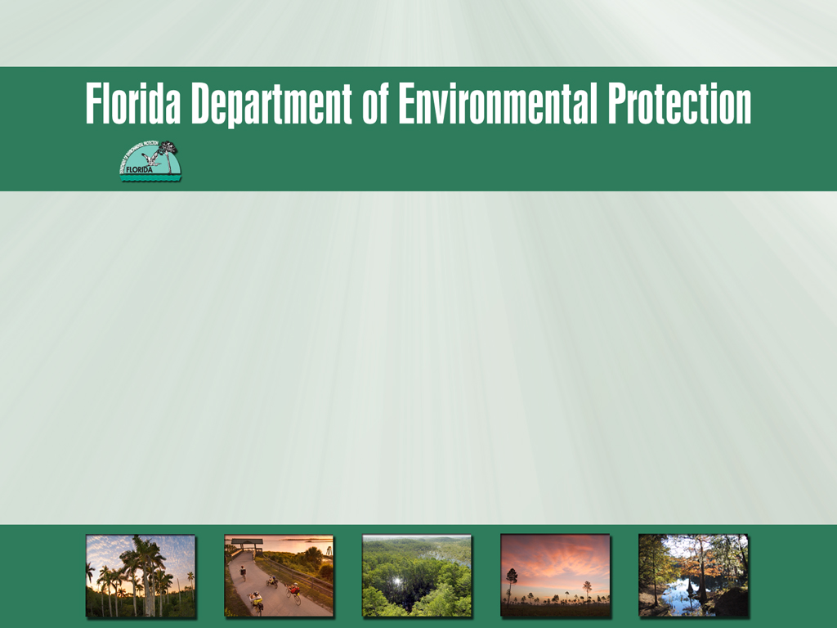
St. Lucie River and Estuary Basin Management Action Plan (BMAP) Monitoring Plan
November 29, 2012

Slide 2
Why do we need a monitoring plan?
Subparagraph 403.067(7)(a)5:
  “The basin management action plan must include milestones for implementation and water quality improvement, & an associated water quality monitoring component sufficient to evaluate whether reasonable progress in pollutant load reductions is being achieved over time.”

Slide 3
Why do we need a monitoring plan? (Continued)
373.4595(4)(b)(3) St. Lucie River Watershed Research and Water Quality Monitoring Program:
  “The district, in cooperation with the other coordinating agencies and local governments, shall establish a St. Lucie River Watershed Research and Water Quality Monitoring Program that builds upon the district’s existing research program & that is sufficient to carry out, comply with, or assess the plans, programs, and other responsibilities created by this subsection.”

Slide 4
Existing Monitoring Inventory
Notes:
-Taken from Attachment D: St. Lucie River Watershed & St. Lucie Estuary Monitoring Efforts from Appendix 10-1: St. Lucie River Watershed Protection Plan Update
-As of June 2011
-E-mail request sent to stakeholders on September 4, 2012

Slide 5
Existing Monitoring Inventory

Slide 6
Existing Monitoring Inventory

Slide 7
Information Needed
Review table & provide comments to Florida Department of Environmental Protection (FDEP) by Tuesday, December 4th.
Monitoring meeting on Wednesday, December 12th
  Discussion Items:
    Existing monitoring
    Future monitoring
    Maps
    Monitoring objectives

Slide 8
Contact Information
Katie Hallas
  Basin Coordinator
  Florida Department of Environmental Protection
  E-mail: Katie.Hallas@dep.state.fl.us
  Phone: 850-245-8432

Slide 9

Questions

