Slide 1
Terry Pride, Holly Edmond, Vanessa Bessey
February 13, 2013
Agriculture
and the
St. Lucie BMAP

Slide 2
Best Management Practices (BMPs)
Agricultural BMPs
  Most effective and practicable means for improving water quality
    Determined through research, field-testing, and expert review
  Adopted by FDACS, verified effective by DEP
  Must be economically and technically feasible for the producer to implement
    When funding is available, FDACS works with producers to provide cost-share for some BMPs

Slide 3
Agriculture’s Role in BMAPs
Commercial agricultural operations within BMAP areas have two options:
  Enroll in and implement FDACS BMPs
  Follow a FDEP- or WMD-prescribed water quality monitoring plan at their own expense
  Failure to do either could result in enforcement action by FDEP or the applicable WMD

Slide 4
Typical Agricultural BMPs
Nutrient Management
  Practices designed provide necessary crop nutrients while protecting against adverse environmental effects
    Soil testing, plant tissue testing to determine appropriate rates; fertilizer application timing and placement
Irrigation Management
  Control the volume and frequency of irrigation water applied to crops, to meet water needs of crops while conserving water resources

Slide 5
Agricultural Acres
Loading calculations based on SFWMD land use/land cover from 2004
Agricultural acres include all 2000 codes and 3300 (mixed rangeland)
  285,234 acres (~55% of basin in 2004)

Slide 6
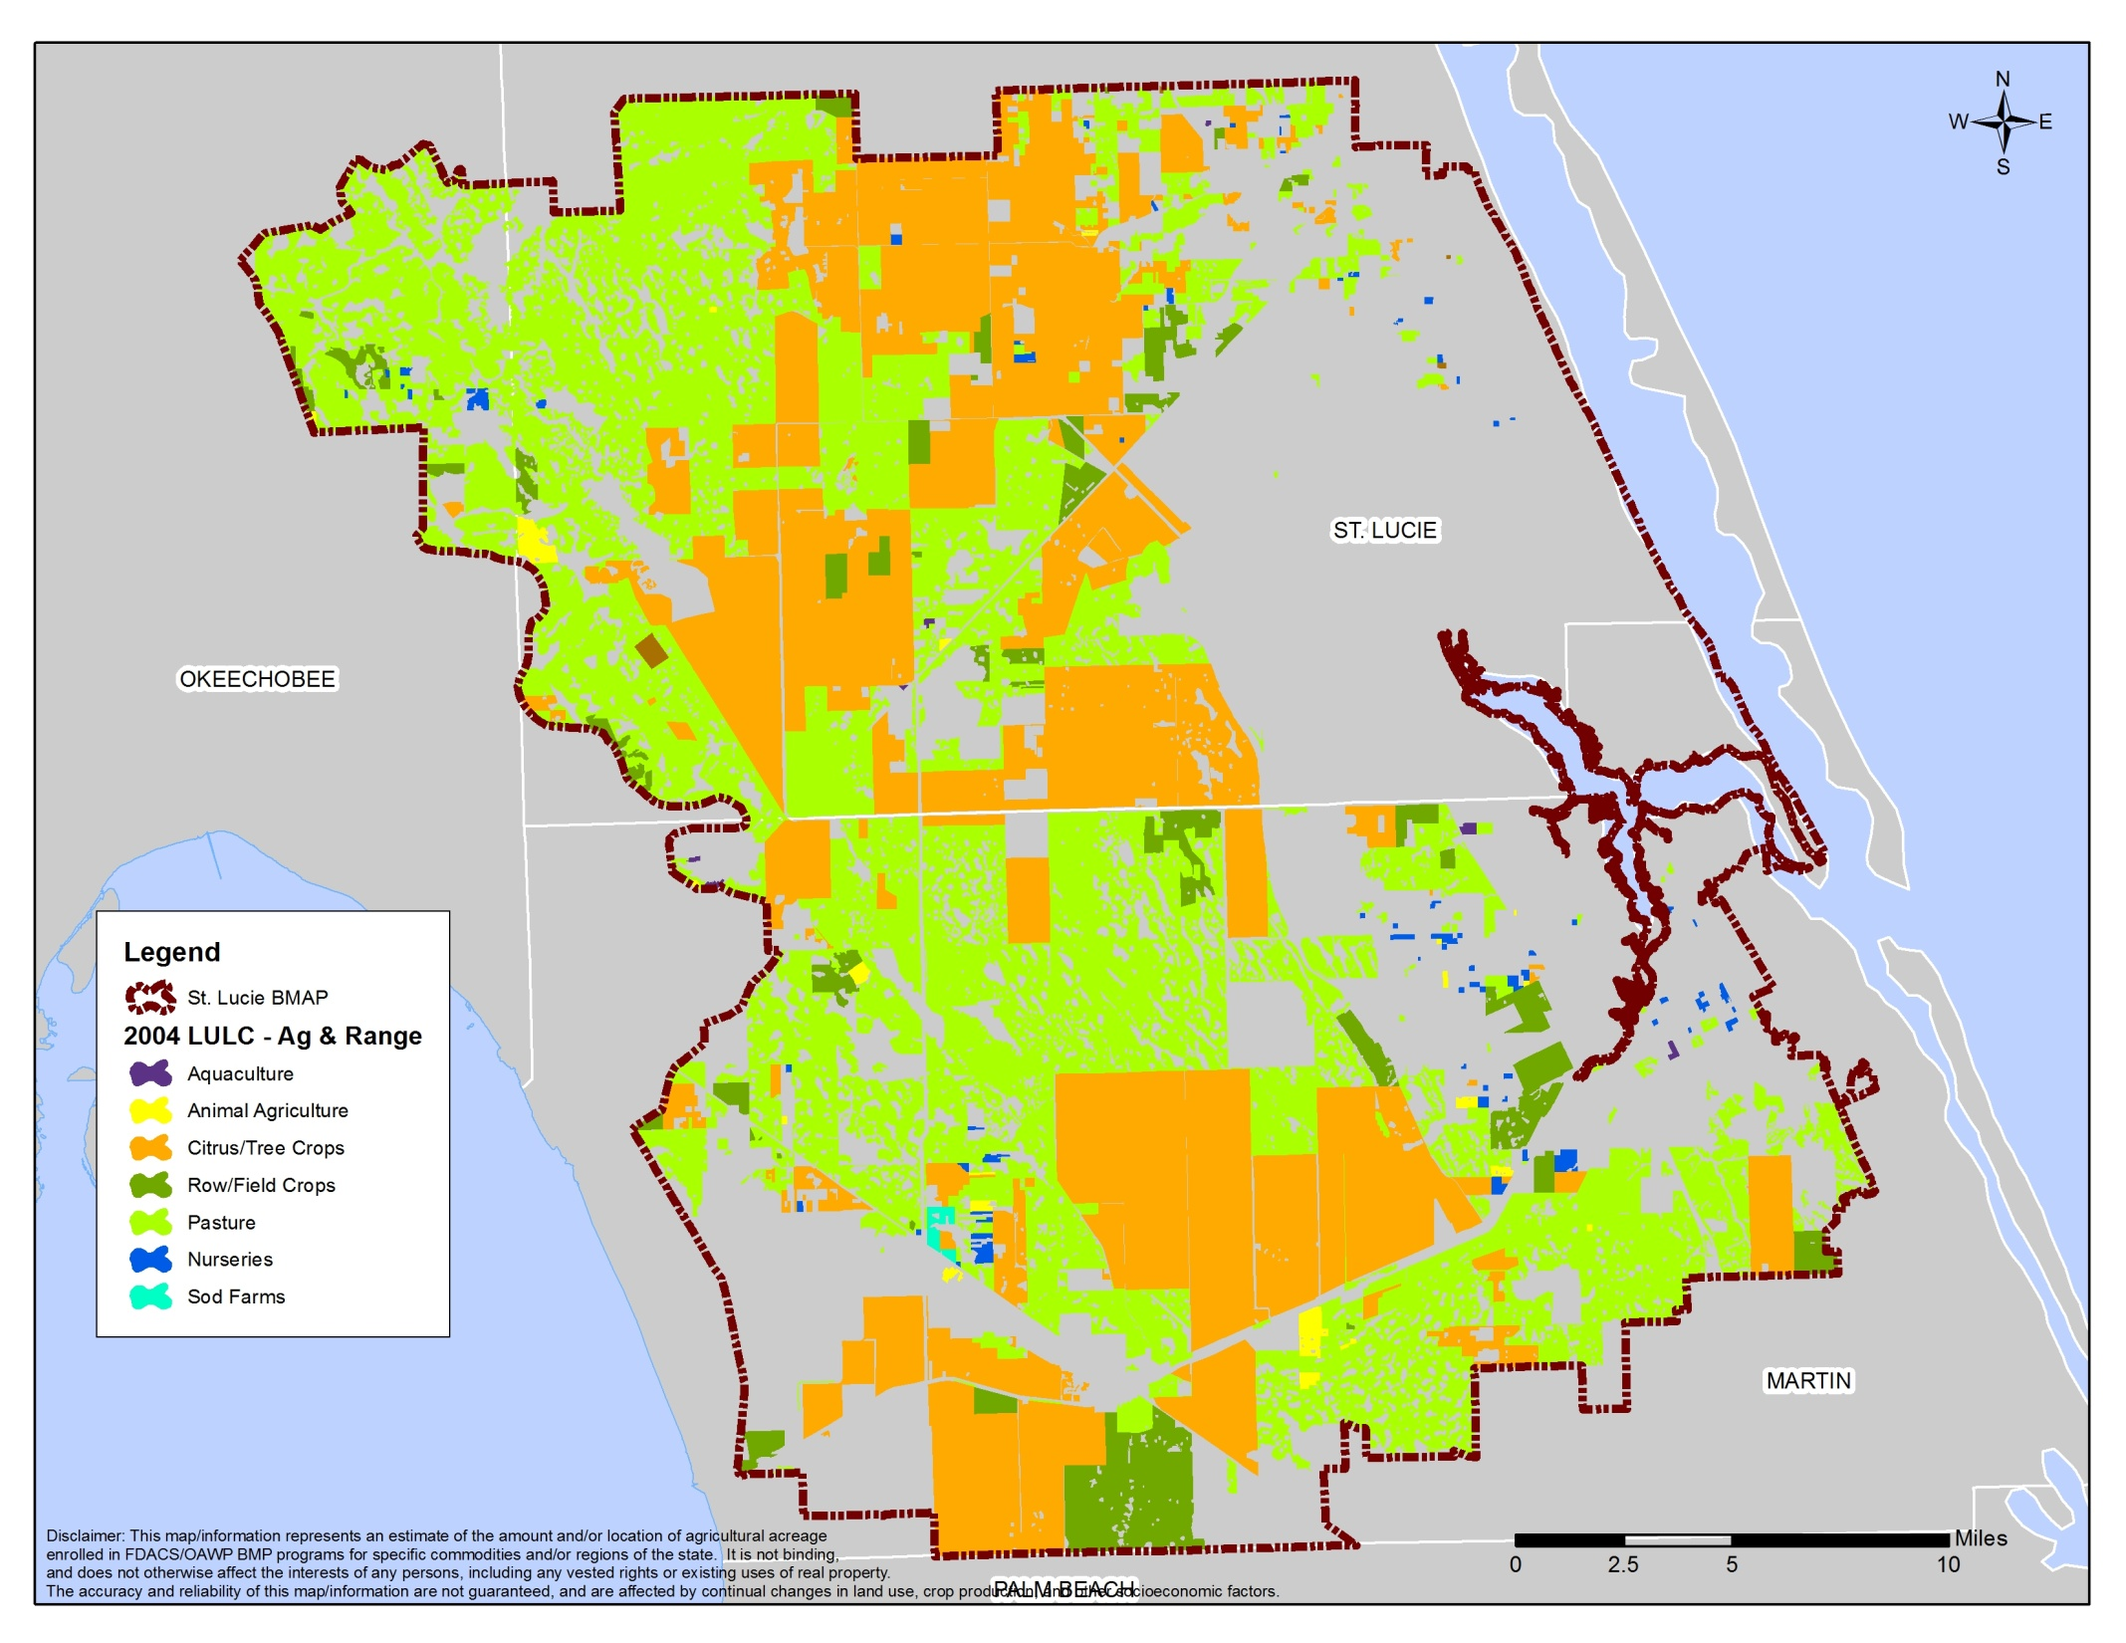

Slide 7
Agricultural Acres
Significant land use changes since 2004
  GIS staff identified changes using current aerial imagery
  Approximately 3,500 acres of urban conversion, 235 acres of commodity changes, and almost 49,000 acres of abandoned/out of production agriculture

Slide 8
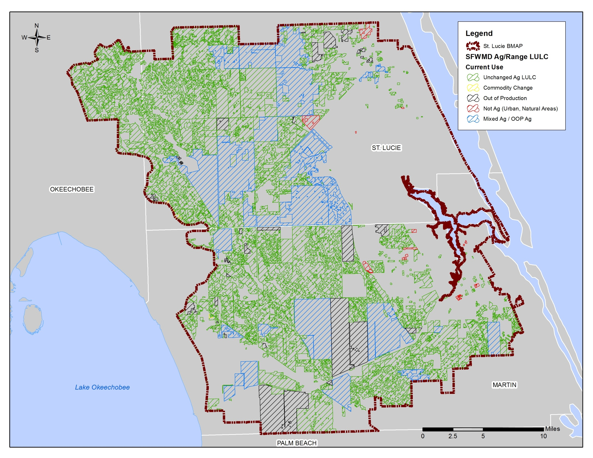

Slide 9
Load Reduction Estimates – Land Use Changes
DACS worked with DEP to develop estimates for load reduction credits associated with land use changes
  Out of production and commodity changes: 144,858.6 lbs/yr TN; 46,706.9 lbs/yr TP
  Urban conversion: 26,917.8 lbs/yr TN; 7,484.2 lbs/yr TP
  Total land use change credit: 171,776.4 lbs/yr TN; 54,191.1 lbs/yr TP

Slide 10
Load Reduction Estimates – Land Use Changes
DACS also helped DEP estimate load reduction credits for agricultural acreage changes within the WCDs
  North St Lucie: 46,460.3 lbs/yr TN; 14,652.7 lbs/yr TP
  Hobe St. Luce: 7,000 lbs/yr TN; 2,258.8 lbs/yr TP
  Troup Indiantown: acreage adjustments all occurred within the C44 (separate credit)
  Pal Mar: de minimus

Slide 11
Current BMP Enrollment
150,797 acres currently enrolled basin-wide
  52,726 acres of citrus
  1,797 acres of container nurseries
  92,032 acres of cow/calf
  2,987 acres of row/field crops

Slide 12
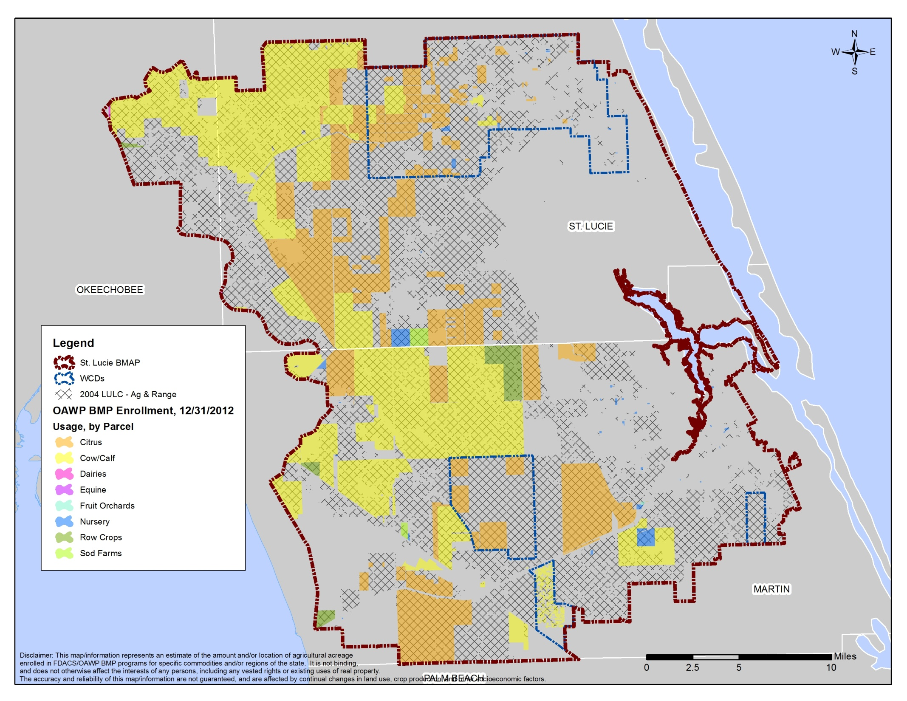

Slide 13
Load Reduction Estimates – Best Management Practices
DACS used ranges from a 2008 SWET report on nutrient loading rates/reductions associated with BMP implementation to estimate ag BMP load reductions
  Based on 90% enrollment, DACS estimates a total TN reduction of 197,217.6 lbs/yr
  Total TP reduction of 40,442.0 lbs/yr

Slide 14
Load Reduction Estimates – Best Management Practices
Within WCDs, based on 90% enrollment
  North St. Lucie: 16,979.9 lbs/yr TN; 3,513.4 lbs/yr
  TP
  Troup Indiantown: 1,856.3 lbs/yr TN; 445.8 lbs/yr TP
  Pal Mar: 962.2 lbs/yr TN; 91.7 lbs/yr TP
  Hobe St. Lucie: 191.0 lbs/yr TN; 29.5 lbs/yr TP

Slide 15
Total Agricultural Load Reduction Estimates
Estimated Loads | TN (lbs/yr) | TP (lbs/yr)
Total Agricultural Required Reduction | 812,924 | 307,059
30% of Required Reductions | 243,277 | 92,117
Estimated Load Reductions via BMPs (90% target enrollment) | 197,217 | 40,442
Reductions from Land Use Changes | 171,776 | 54,191
Total Estimated Load Reductions | 368,992 | 94,633
Remaining Load Reductions Needed for Phase 1 of BMAP | -125,715 (credit) | -2,515 (credit)

Slide 16
Addressing Ag Loadings
DACS will work with remaining agricultural operations to increase BMP enrollment/implementation.
DACS will continue to be the lead on agricultural BMPs, and will consult with the water control districts regarding ag lands w/in their boundaries.
Other ag-related programs and projects are under way in the St. Lucie Watershed.

Slide 17
Questions?
For more information on BMP programs:
www.floridaagwaterpolicy.com

Slide 18
Vanessa Bessey
863-462-5725
Terry Pride, Holly Edmond
850-617-1700
AgBMPHelp@FreshFromFlorida.com

