Slide 1

Allocation Process
St. Lucie River and Estuary Basin Management Action Plan (BMAP)
January 16, 2013

Slide 2
Overview
Allocation process steps
Updated allocations and required reductions
Required reductions for the first BMAP iteration
Project calculations
Additional projects collection

Slide 3
Allocation Process Steps

Slide 4
Allocation Process Steps
The Geographic Information Systems (GIS) base map was used to clip the areas associated with each entity.
  Land uses, soil types, event mean concentrations (EMCs), runoff coefficients (ROCs), rainfall.
The base map was updated with 2004 land uses.
Each entity’s area was clipped from the base map.
  Used jurisdictional boundaries provided.
Each entity’s area was then erased from the base map.

Slide 5
Allocation Process Steps, continued
The clipping was done sequentially as follows:
  Natural lands;
  Water control districts (WCDs) and other special districts;
  Agriculture;
  Roads (Florida Department of Transportation [FDOT] and Turnpike);
  Community development districts (CDDs) each to its own boundary;
  Municipalities each to its own municipal separate storm sewer system (MS4) boundary;
  Florida Power & Light (FPL) pond;
  Non-MS4s; and
  Remaining area assigned to each county.
Notes:
Natural lands - land cover codes 3000 (upland nonforested; not including 3300), 4000 (upland forests), 5000 (water), and 6000 (wetlands)
Agriculture – land cover codes 2000 (agriculture) and 3300 (rangeland)

Slide 6
Resulting Files
Agriculture
Copper Creek CDD
FDOT District 4
Fort Pierce MS4
FPL Pond
Hobe St. Lucie Conservancy District
Martin County MS4
Natural Lands
North St. Lucie River WCD
Okeechobee County MS4
Pal Mar WCD
Port St. Lucie MS4
Port St. Lucie Non-MS4
Sewall’s Point MS4
St. Lucie County MS4
St. Lucie County Non-MS4
Stuart MS4
Tradition CDD
Troup-Indiantown WCD
Turnpike
Verano CDD

Slide 7
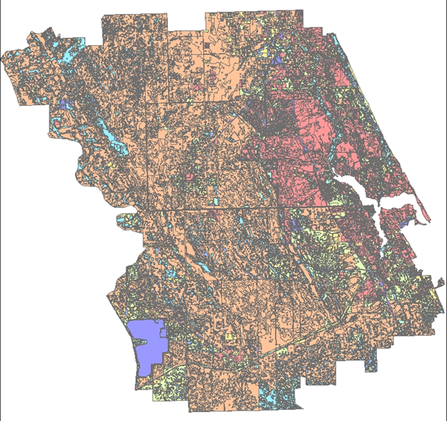
Base Map – 2004 Land Cover

Slide 8
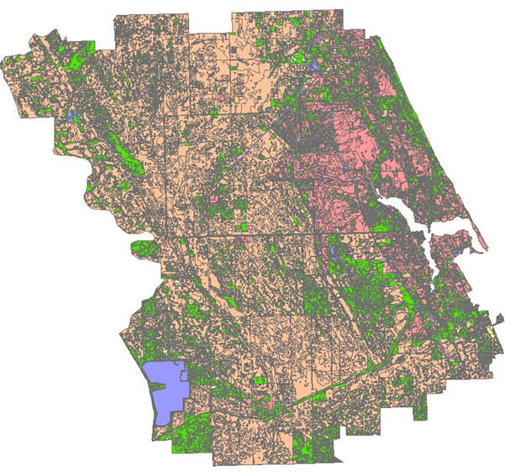
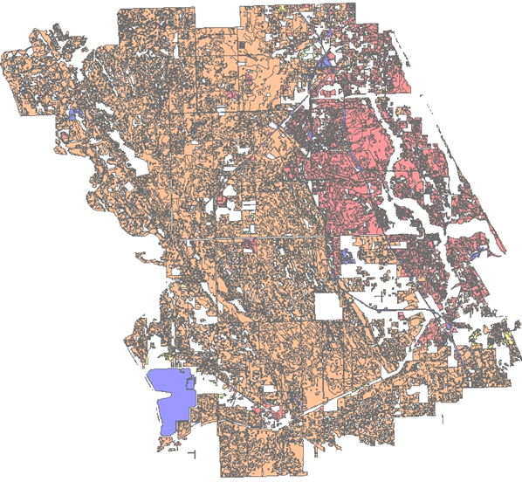
Base Map Minus Natural Lands
Notes:
On left, natural lands shown in green. On right, natural lands clipped out and saved as own file and then erased from base map.

Slide 9
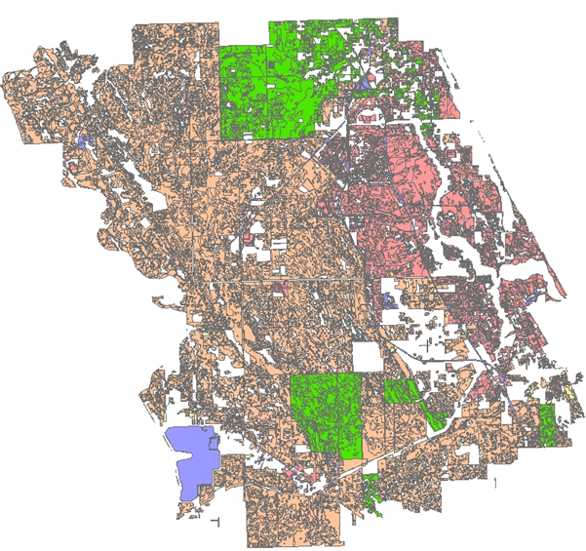
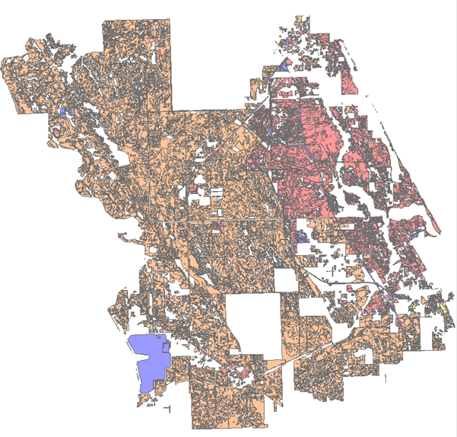
Base Map Minus Special Districts
Notes:
On left, special districts shown in green. On right, special districts clipped and erased from base map and saved as own file for each district.

Slide 10
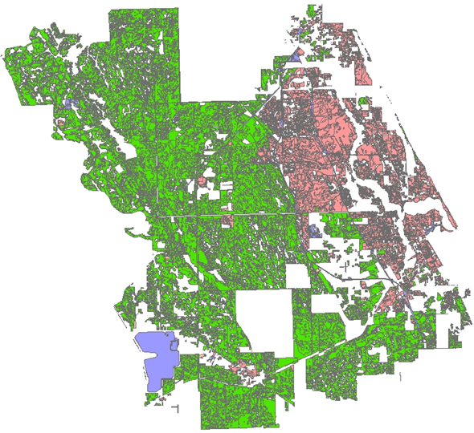
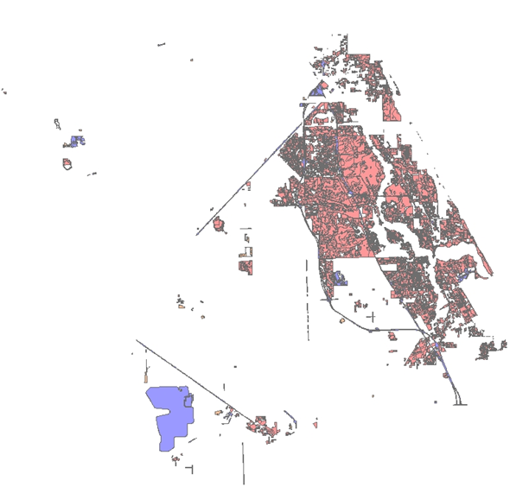
Base Map Minus Agriculture
Notes:
On left, agriculture areas highlighted in green. On right, base map with the agricultural areas clipped and erased.

Slide 11
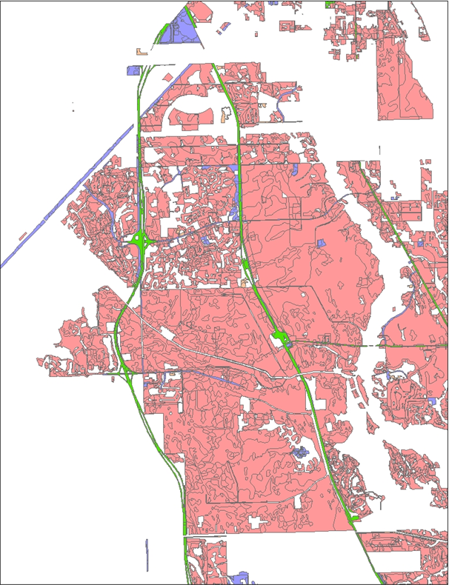
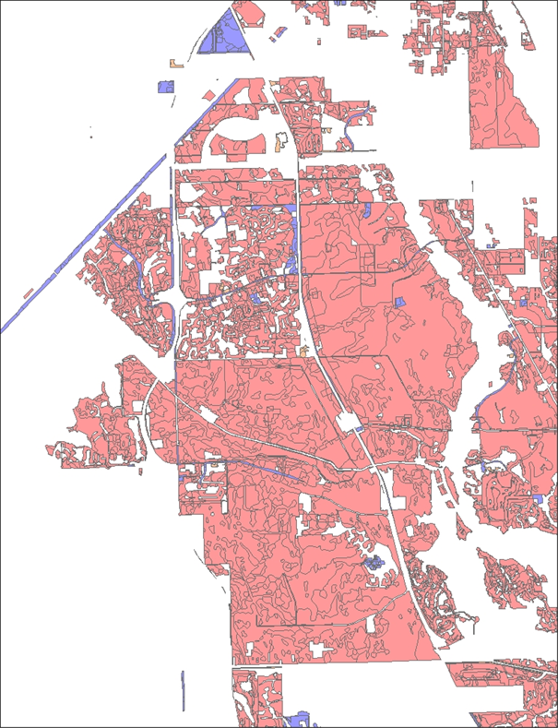
Base Map Minus Roads
Notes:
On left, roads (both FDOT D4 and Turnpike) in green. On right, base map with roads clipped and erased.

Slide 12
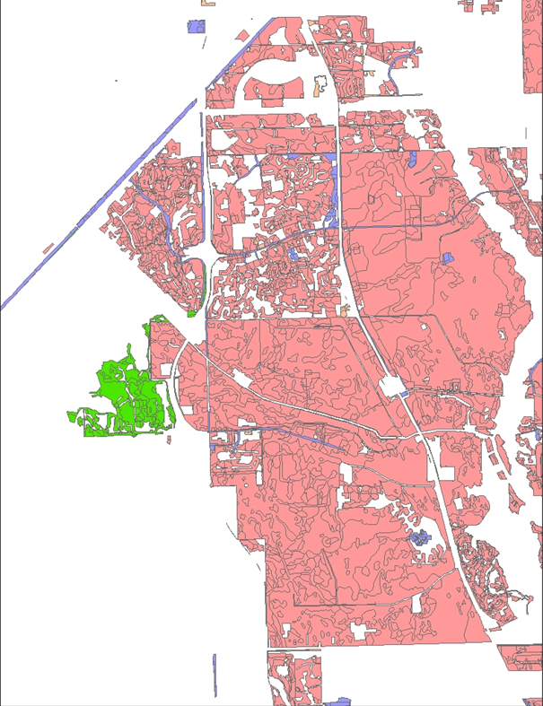
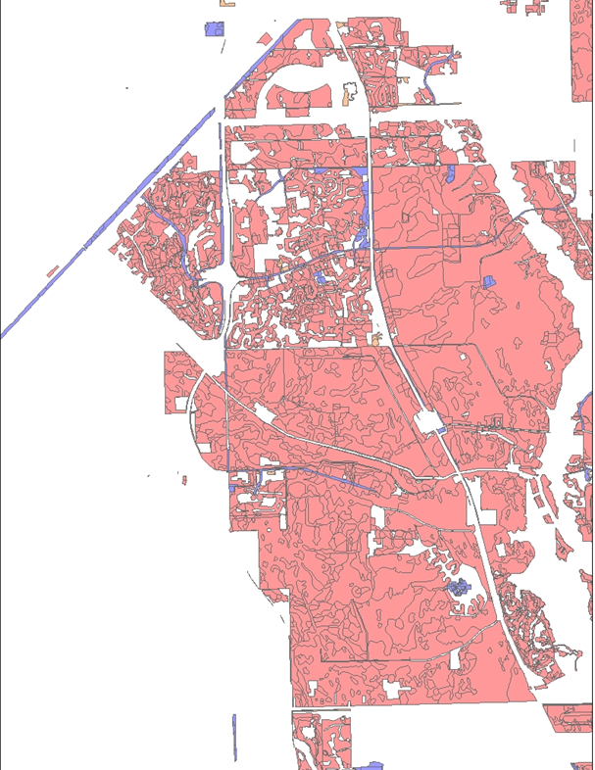
Base Map Minus CDDs
Notes:
On left, CDDs in green. On right, base map with CDDs clipped and erased.

Slide 13
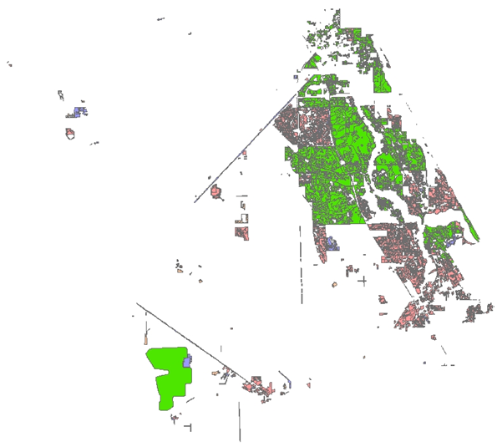
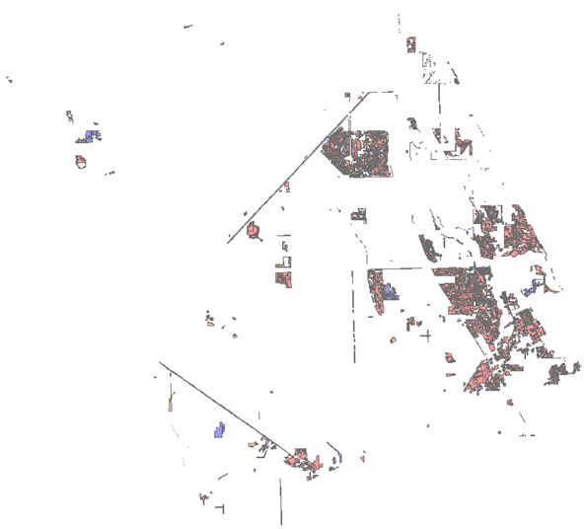
Base Map Minus MS4s and FPL Pond
Notes:
On left, MS4s and FPL pond in green. On right, base map with MS4s and FPL pond clipped and erased. FPL pond load and acreage set aside - not part of allocations (same as what was done before).

Slide 14
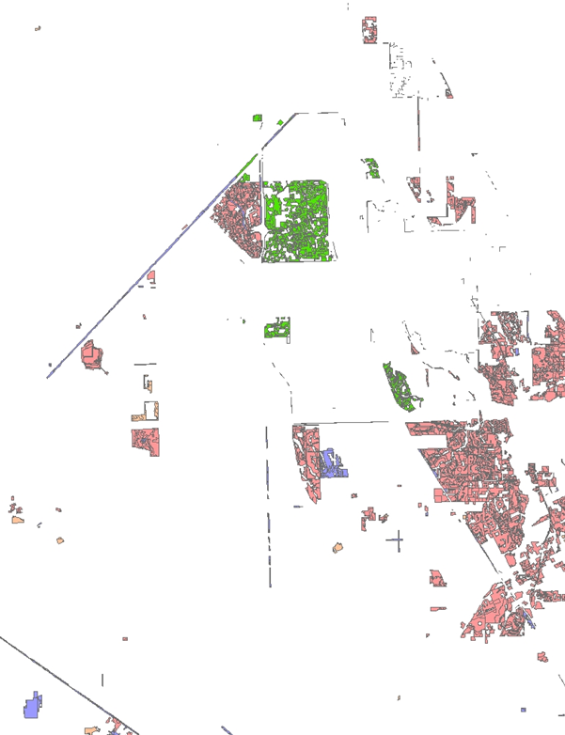
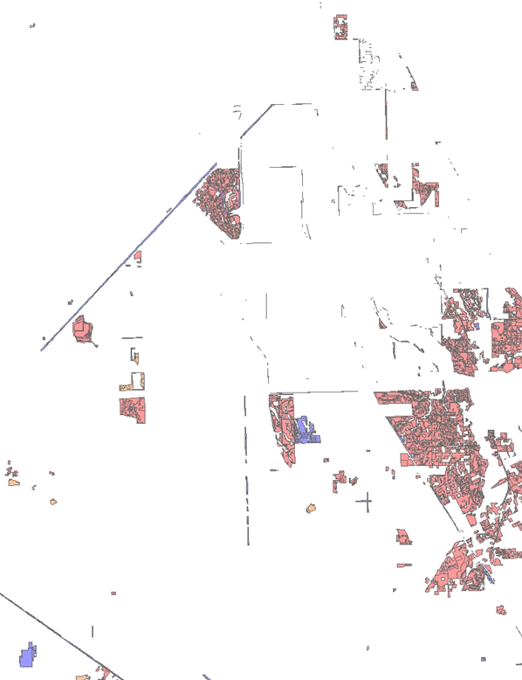
Base Map Minus non-MS4s
Notes:
On left, non-MS4 (Port St. Lucie) in green. On right, base map with non-MS4 clipped and erased.

Slide 15
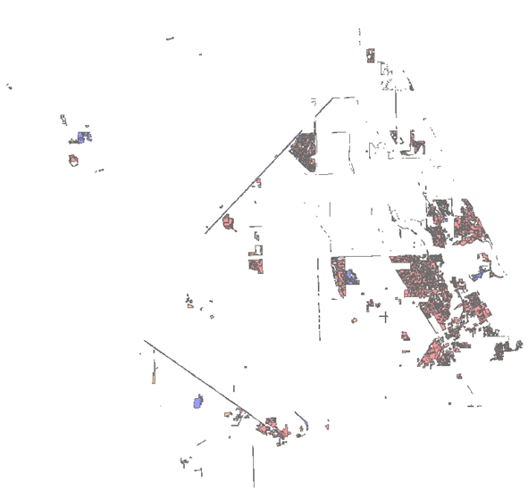
Base Map – Remaining Counties
Notes:
Remainder to counties based on boundaries. Martin County – MS4; St. Lucie County – non-MS4; Okeechobee County – MS4

Slide 16

Questions on the Processing Steps?

Slide 17
Updated Allocations and Required Reductions

Slide 18
Allocation Model Contents
Table of Contents-Lists model’s contents. (NEW)
Conformance-Lists the EMC land use definition & ROC land use definition to the land use type.
EMCs-Includes table of EMCs.
ROCs-Includes table of ROCs.
Summary-Summarizes area and loading by sub-watershed to calculate total nitrogen (TN) and total phosphorus (TP) target loads per acre and compares with St. Lucie River Watershed Protection Plan (SLRWPP).
Target Loads per Acre-Calculates target loads per acre. (NEW)
Calcs Juris-Calculates starting load for each entity using land use and basin-specific data.

Slide 19
Allocation Model Contents, continued
Juris N Red-Calculates the starting load, allocation, and required TN reductions by entity.
Juris P Red-Calculates the starting load, allocation, and required TP reductions by entity.
Starting Loads-Shows starting loads, which are also contained in Juris N Red and Juris P Red tabs. (NEW)
de Minimus-Shows calculation of de minimus entities. (NEW)
Allocations-Shows the allocations and possible options for percent reductions for first five-year iteration of BMAP. (NEW)

Slide 20
Calculating Starting Loads
Using the model factors associated with each land use type and each sub-watershed, TN and TP starting loads for each entity were calculated.

Slide 21
TN Starting Loads
Entity | Basins 4 5 6 (lbs/yr) | C-23 (lbs/yr) | C-24 (lbs/yr) | C-44 S-153 (lbs/yr) | North Fork (lbs/yr) | South Fork (lbs/yr) | Total (lbs/yr) | Total (MT/yr)
Agriculture | 17,051 | 470,081 | 574,852 | 458,432 | 24,355 | 126,080 | 1,670,852 | 757.89
Copper Creek CDD | - | - | 14 | - | - | - | 14 | 0.01
FDOT District 4 | 952 | 1,510 | 950 | 1,537 | 4,277 | 3,649 | 12,874 | 5.84
Fort Pierce MS4 | - | - | - | - | 17,041 | - | 17,041 | 7.73
FPL Pond | - | - | - | 53,623 | - | - | 53,623 | 24.32
Hobe St Lucie Conservancy District | - | - | - | 17,482 | - | 10,819 | 28,301 | 12.84
Martin County MS4 | 26,394 | 5,947 | - | 10,775 | 19,806 | 40,423 | 103,345 | 46.88
Natural Lands | 15,128 | 14,991 | 24,792 | 65,287 | 43,326 | 26,980 | 190,503 | 86.41
North St. Lucie River WCD | - | - | 37,251 | - | 160,152 | - | 197,404 | 89.54
Okeechobee Co MS4 | - | 3,184 | 121 | - | - | - | 3,305 | 1.50
Pal Mar WCD | - | - | - | 8,834 | - | 22 | 8,856 | 4.02
Port St. Lucie MS4 | - | 396 | 8,217 | - | 127,998 | - | 136,611 | 61.97
Port St. Lucie Non-MS4 | - | 1,119 | 58 | - | 18,693 | - | 19,871 | 9.01
Sewall’s Point MS4 | - | - | - | - | 1,771 | - | 1,771 | 0.80
St Lucie County MS4 | - | - | - | - | 18,114 | - | 18,114 | 8.22
St Lucie Co Non-MS4 | - | 1,594 | 16,757 | - | 5,409 | - | 23,761 | 10.78
Stuart MS4 | - | - | - | - | 1,614 | 12,384 | 13,998 | 6.35
Tradition CDD | - | 1 | 7,057 | - | 31 |  | 7,089 | 3.22
Troup-Indiantown WCD | - | - | - | 81,331 | - | - | 81,331 | 36.89
Turnpike | 789 | 51 | - | - | 2,651 | 1,286 | 4,776 | 2.17
Verano CDD | - | - | 257 | - | - | - | 257 | 0.12
Total | 60,313 | 498,874 | 670,326 | 697,302 | 445,238 | 221,642 | 2,593,693 | 1,066
Notes:
-Southern Grove is no longer included in the model as a separate entity. FDEP had several meetings with Southern Grove and with the City of Port St. Lucie. Southern Grove is a DRI, so it will not receive a separate allocation. Instead, its allocation is now part of Port St. Lucie’s non-MS4 allocation.

Slide 22
TP Starting Loads
Entity | Basins 4 5 6 (lbs/yr) | C-23 (lbs/yr) | C-24 (lbs/yr) | C-44 S-153 (lbs/yr) | North Fork (lbs/yr) | South Fork (lbs/yr) | Total (lbs/yr) | Total (MT/yr)
Agriculture | 3,920 | 150,255 | 136,471 | 87,337 | 5,988 | 26,869 | 410,840 | 186.35
Copper Creek CDD | - | - | 3 | - | - | - | 3 | 0.00
FDOT District 4 | 200 | 464 | 226 | 229 | 818 | 659 | 2,596 | 1.18
Fort Pierce MS4 | - | - | - | - | 3,879 | - | 3,879 | 1.76
FPL Pond | - | - | - | 8,361 | - | - | 8,361 | 3.79
Hobe St Lucie Conservancy District | - | - | - | 3,515 | - | 2,563 | 6,078 | 2.76
Martin County MS4 | 5,930 | 2,250 | - | 1,871 | 4,339 | 8,419 | 22,809 | 10.35
Natural Lands | 3,383 | 19,795 | 11,341 | 3,525 | 9,639 | 5,054 | 52,737 | 23.92
North St. Lucie River WCD | - | - | 9,063 | - | 36,821 | - | 45,884 | 20.81
Okeechobee Co MS4 | - | 937 | 38 | - | - | - | 974 | 0.44
Pal Mar WCD | - | - | - | 1,318 | - | 4 | 1,322 | 0.60
Port St. Lucie MS4 | - | 139 | 2,193 | - | 28,271 | - | 30,602 | 13.88
Port St. Lucie Non-MS4 | - | 379 | 13 | - | 4,021 | - | 4,413 | 2.00
Sewall’s Point MS4 | - | - | - | - | 384 | - | 384 | 0.17
St Lucie County MS4 | - | - | - | - | 4,127 | - | 4,127 | 1.87
St Lucie Co Non-MS4 | - | 838 | 3,961 | - | 1,273 | - | 6,072 | 2.75
Stuart MS4 | - | - | - | - | 379 | 2,727 | 3,107 | 1.41
Tradition CDD | - | - | 1,903 | - | 7 | - | 1,910 | 0.87
Troup-Indiantown WCD | - | - | - | 16,502 | - | - | 16,502 | 7.49
Turnpike | 170 | 16 | - | - | 506 | 233 | 925 | 0.42
Verano CDD | - | - | 63 | - | - | - | 63 | 0.03
Total | 13,604 | 175,073 | 165,274 | 122,658 | 100,451 | 46,528 | 623,588 | 255

Slide 23
Acres
Entity | Basins 4 5 6 | C-23 | C-24 | C-44 S-153 | North Fork | South Fork | Total
Agriculture | 2,445 | 84,744 | 63,488 | 65,937 | 3,967 | 18,176 | 238,757
Copper Creek CDD | - | - | 2 | - | - | - | 2
FDOT District 4 | 171 | 306 | 137 | 270 | 864 | 636 | 2,383
Fort Pierce MS4 | - | - | - | - | 3,706 | - | 3,706
FPL Pond | - | - | - | 6,501 | - | - | 6,501
Hobe St Lucie Conservancy District | - | - | - | 2,949 | - | 1,945 | 4,894
Martin County MS4 | 4,989 | 1,738 | - | 2,231 | 4,378 | 7,763 | 21,100
Natural Lands | 7,830 | 23,706 | 15,701 | 37,163 | 33,129 | 18,987 | 136,516
North St. Lucie River WCD | - | - | 4,028 | - | 32,491 | - | 36,519
Okeechobee Co MS4 | - | 574 | 30 | - | - | - | 604
Pal Mar WCD | - | - | - | 1,161 | - | 4 | 1,165
Port St. Lucie MS4 | - | 89 | 1,252 | - | 30,374 | - | 31,715
Port St. Lucie Non-MS4 | - | 237 | 6 | - | 3,744 | - | 3,988
Sewall’s Point MS4 | - | - | - | - | 457 | - | 457
St Lucie County MS4 | - | - | - | - | 3,995 | - | 3,995
St Lucie Co Non-MS4 | - | 763 | 2,172 | - | 1,146 | - | 4,081
Stuart MS4 | - | - | - | - | 353 | 2,386 | 2,739
Tradition CDD | - | - | 923 | - | 6 | - | 929
Troup-Indiantown WCD | - | - | - | 13,649 | - | - | 13,649
Turnpike | 147 | 10 | - | - | 528 | 226 | 912
Verano CDD | - | - | 36 | - | - | - | 36
Total | 15,582 | 112,167 | 87,777 | 129,862 | 119,139 | 50,122 | 514,649

Slide 24
Natural Lands and FPL Pond
Stakeholders are not expected to make reductions on natural lands.
The acres and loadings for the natural land uses are set aside in the allocations.
  Allocations based only on the anthropogenic (human) land uses.
The acreage and loading for the FPL pond were also set aside in the allocations.
  Additional nutrient reductions are not being required in the pond.

Slide 25
De Minimus
The starting loads were sorted for TN and TP loads from highest to lowest.
Identified entities with low enough TN and TP loads that reductions would not have a significant impact.

Slide 26
De minimus, continued
Entity | TN Starting Load (lbs/yr) | % of Total TN Starting Load
Agriculture | 1,670,852 | 71.1%
North St. Lucie River WCD | 197,404 | 8.4%
Port St. Lucie MS4 | 136,611 | 5.8%
Martin County MS4 | 103,345 | 4.4%
Troup-Indiantown WCD | 81,331 | 3.5%
Hobe St. Lucie Conservancy District | 28,301 | 1.2%
St. Lucie County Non-MS4 | 23,761 | 1.0%
Port St. Lucie Non-MS4 | 19,871 | 0.8%
St. Lucie County MS4 | 18,114 | 0.8%
Fort Pierce MS4 | 17,041 | 0.7%
Stuart MS4 | 13,998 | 0.6%
FDOT District 4 MS4 | 12,874 | 0.5%
Pal Mar WCD* | 8,856 | 0.4%
Tradition CDD* | 7,089 | 0.3%
Turnpike* | 4,776 | 0.2%
Okeechobee County* | 3,305 | 0.1%
Sewall's Point MS4* | 1,771 | 0.1%
Verano CDD* | 257 | 0.0%
Copper Creek CDD* | 14 | 0.0%
Entity | TP Starting Load (lbs/yr) | % of Total TP Starting Load
Agriculture | 410,840 | 73.0%
North St. Lucie River WCD | 45,884 | 8.2%
Port St. Lucie MS4 | 30,602 | 5.4%
Martin County MS4 | 22,809 | 4.1%
Troup-Indiantown WCD | 16,502 | 2.9%
Hobe St. Lucie Conservancy District | 6,078 | 1.1%
St. Lucie County Non-MS4 | 6,072 | 1.1%
Port St. Lucie Non-MS4 | 4,413 | 0.8%
St. Lucie County MS4 | 4,127 | 0.7%
Fort Pierce MS4 | 3,879 | 0.7%
Stuart MS4 | 3,107 | 0.6%
FDOT District 4 MS4 | 2,596 | 0.5%
Tradition CDD* | 1,910 | 0.3%
Pal Mar WCD* | 1,322 | 0.2%
Okeechobee County* | 974 | 0.2%
Turnpike* | 925 | 0.2%
Sewall's Point MS4* | 384 | 0.1%
Verano CDD* | 63 | 0.0%
Copper Creek CDD* | 3 | 0.0%
* De minimus stakeholder
Notes:
-Combined total TN loading = 1.1%
-Combined total TP loading = 1.0%

Slide 27
De Minimus, continued
De minimus entities are:
  Copper Creek CDD
  Okeechobee County
  Pal Mar WCD
  Tradition CDD
  Sewall’s Point
  Turnpike
  Verano CDD
De minimus entities are not assigned an allocation for the first BMAP iteration.
  May receive allocations in future iterations.
The loads associated with the de minimus entities were not reallocated to the other stakeholders.

Slide 28
Target Load Per Acre
Allocations to each entity were assigned using a target load per acre for both TN and TP.
Calculated by determining the percent reduction needed in each sub-watershed to achieve the target concentrations.
This percent reduction was multiplied by the current anthropogenic load per acre in each sub-watershed.
  Total anthropogenic loading for the sub-watershed from the model divided by the total anthropogenic acres in the sub-watershed.
The current anthropogenic load per acre minus the needed reduction resulted in the target load per acre for each sub-watershed.

Slide 29
TN Targets
Category | Basins 4 5 6 | C-23 | C-24 | C-44 S-153 | North Fork | South Fork
Estimated Concentration (mg/L) | 1.11 | 1.51 | 1.53 | 1.36 | 1.18 | 1.30
Target Concentration (mg/L) | 0.72 | 0.72 | 0.72 | 0.72 | 0.72 | 0.72
Reduction Required (%) | 35% | 52% | 53% | 47% | 39% | 45%
Estimated load per acre (lbs/acre) | 5.83 | 5.47 | 8.96 | 6.71 | 4.67 | 6.25
Target Load per acre (lbs/acre) | 3.77 | 2.60 | 4.21 | 3.56 | 2.85 | 3.45

Slide 30
TP Targets
Category | Basins 4 5 6 | C-23 | C-24 | C-44 S-153 | North Fork | South Fork
Estimated Concentration (mg/L) | 0.25 | 0.53 | 0.38 | 0.24 | 0.27 | 0.27
Target Concentration (mg/L) | 0.081 | 0.081 | 0.081 | 0.081 | 0.081 | 0.081
Reduction Required (%) | 68% | 85% | 79% | 66% | 70% | 70%
Estimated load per acre (lbs/acre) | 1.32 | 1.76 | 2.14 | 1.29 | 1.06 | 1.33
Target Load per acre (lbs/acre) | 0.43 | 0.27 | 0.46 | 0.44 | 0.32 | 0.39

Slide 31
Allocations
The TN and TP target load per acre was multiplied by each entity’s acreage in each subbasin to determine the allowable loading in that sub-watershed.
The sum of each entity’s allowable load in each sub-watershed is the total allocation.

Slide 32
TN Allocations
Entity | Basins 4 5 6 (lbs/yr) | C-23 (lbs/yr) | C-24 (lbs/yr) | C-44 S-153 (lbs/yr) | North Fork (lbs/yr) | South Fork (lbs/yr) | Total (lbs/yr) | Total (MT/yr)
Agriculture | 9,217 | 220,738 | 267,229 | 234,701 | 11,316 | 62,776 | 805,977 | 365.59
FDOT District 4 | 644 | 796 | 578 | 960 | 2,463 | 2,195 | 7,636 | 3.46
Fort Pierce MS4 | - | - | - | - | 10,572 | - | 10,572 | 4.80
Hobe St Lucie Conservancy District | - | - | - | 10,497 | - | 6,717 | 17,215 | 7.81
Martin County MS4 | 18,812 | 4,527 | - | 7,941 | 12,488 | 26,812 | 70,581 | 32.02
North St. Lucie River WCD | - | - | 16,953 | - | 92,674 | - | 109,627 | 49.73
Port St. Lucie MS4 | - | 231 | 5,270 | - | 86,636 | - | 92,137 | 41.79
Port St. Lucie Non-MS4 | - | 617 | 26 | - | 10,680 | - | 11,323 | 5.14
St Lucie County MS4 | - | - | - | - | 11,396 | - | 11,396 | 5.17
St Lucie Co Non-MS4 | - | 1,988 | 9,143 | - | 3,269 | - | 14,399 | 6.53
Stuart MS4 | - | - | - | - | 1,006 | 8,241 | 9,247 | 4.19
Troup-Indiantown WCD | - | - | - | 48,584 | - | - | 48,584 | 22.04
Copper Creek CDD | - | - | - | - | - | - | - | -
Okeechobee Co MS4 | - | - | - | - | - | - | - | -
Pal Mar WCD | - | - | - | - | - | - | - | -
Sewall’s Point MS4 | - | - | - | - | - | - | - | -
Tradition CDD | - | - | - | - | - | - | - | -
Turnpike | - | - | - | - | - | - | - | -
Verano CDD | - | - | - | - | - | - | - | -
Total | 28,673 | 228,898 | 299,199 | 302,684 | 242,500 | 106,741 | 1,208,694 | 548.25

Slide 33
TP Allocations
Entity | Basins 4 5 6 (lbs/yr) | C-23 (lbs/yr) | C-24 (lbs/yr) | C-44 S-153 (lbs/yr) | North Fork (lbs/yr) | South Fork (lbs/yr) | Total (lbs/yr) | Total (MT/yr)
Agriculture | 1,040 | 22,708 | 29,076 | 28,747 | 1,275 | 7,168 | 90,013 | 40.83
FDOT District 4 | 73 | 82 | 63 | 118 | 278 | 251 | 863 | 0.39
Fort Pierce MS4 | - | - | - | - | 1,191 | - | 1,191 | 0.54
Hobe St Lucie Conservancy District | - | - | - | 1,286 | - | 767 | 2,053 | 0.93
Martin County MS4 | 2,122 | 466 | - | 973 | 1,407 | 3,061 | 8,029 | 3.64
North St. Lucie River WCD | - | - | 1,845 | - | 10,441 | - | 12,286 | 5.57
Port St. Lucie MS4 | - | 24 | 573 | - | 9,761 | - | 10,358 | 4.70
Port St. Lucie Non-MS4 | - | 63 | 3 | - | 1,203 | - | 1,270 | 0.58
St Lucie County MS4 | - | - | - | - | 1,284 | - | 1,284 | 0.58
St Lucie Co Non-MS4 | - | 205 | 995 | - | 368 | - | 1,568 | 0.71
Stuart MS4 | - | - | - | - | 113 | 941 | 1,054 | 0.48
Troup-Indiantown WCD | - | - | - | 5,951 | - | - | 5,951 | 2.70
Copper Creek CDD | - | - | - | - | - | - | - | -
Okeechobee Co MS4 | - | - | - | - | - | - | - | -
Pal Mar WCD | - | - | - | - | - | - | - | -
Sewall’s Point MS4 | - | - | - | - | - | - | - | -
Tradition CDD | - | - | - | - | - | - | - | -
Turnpike | - | - | - | - | - | - | - | -
Verano CDD | - | - | - | - | - | - | - | -
Total | 3,235 | 23,547 | 32,571 | 37,074 | 27,322 | 12,187 | 135,937 | 61.65

Slide 34
Required Reductions
Difference between the total starting loads and allocations is the required reductions for each entity.

Slide 35
TN Required Reductions
Entity | Basins 4 5 6 (lbs/yr) | C-23 (lbs/yr) | C-24 (lbs/yr) | C-44 S-153 (lbs/yr) | North Fork (lbs/yr) | South Fork (lbs/yr) | Total (lbs/yr) | Total (MT/yr)
Agriculture | 7,834 | 249,344 | 307,623 | 223,731 | 13,038 | 63,305 | 864,874 | 392.30
FDOT District 4 | 308 | 713 | 372 | 576 | 1,814 | 1,454 | 5,238 | 2.38
Fort Pierce MS4 | - | - | - | - | 6,469 | - | 6,469 | 2.93
Hobe St Lucie Conservancy District | - | - | - | 6,984 | - | 4,101 | 11,086 | 5.03
Martin County MS4 | 7,581 | 1,419 | - | 2,834 | 7,318 | 13,611 | 32,763 | 14.86
North St. Lucie River WCD | - | - | 20,298 | - | 67,478 | - | 87,776 | 39.81
Port St. Lucie MS4 | - | 165 | 2,947 | - | 41,362 | - | 44,474 | 20.17
Port St. Lucie Non-MS4 | - | 502 | 32 | - | 8,013 | - | 8,547 | 3.88
St Lucie County MS4 | - | - | - | - | 6,718 | - | 6,718 | 3.05
St Lucie Co Non-MS4 | - | - | 7,615 | - | 2,141 | - | 9,756 | 4.43
Stuart MS4 | - | - | - | - | 607 | 4,143 | 4,751 | 2.15
Troup-Indiantown WCD | - | - | - | 32,747 | - | - | 32,747 | 14.85
Copper Creek CDD | - | - | - | - | - | - | - | -
Okeechobee Co MS4 | - | - | - | - | - | - | - | -
Pal Mar WCD | - | - | - | - | - | - | - | -
Sewall’s Point MS4 | - | - | - | - | - | - | - | -
Tradition CDD | - | - | - | - | - | - | - | -
Turnpike | - | - | - | - | - | - | - | -
Verano CDD | - | - | - | - | - | - | - | -
Total | 15,723 | 252,143 | 338,887 | 266,873 | 154,960 | 86,614 | 1,115,199 | 505.85

Slide 36
TP Required Reductions
Entity | Basins 4 5 6 (lbs/yr) | C-23 (lbs/yr) | C-24 (lbs/yr) | C-44 S-153 (lbs/yr) | North Fork (lbs/yr) | South Fork (lbs/yr) | Total (lbs/yr) | Total (MT/yr)
Agriculture | 2,881 | 127,548 | 107,395 | 58,590 | 4,713 | 19,701 | 320,827 | 145.52
FDOT District 4 | 128 | 382 | 163 | 111 | 540 | 408 | 1,732 | 0.79
Fort Pierce MS4 | - | - | - | - | 2,688 | - | 2,688 | 1.22
Hobe St Lucie Conservancy District | - | - | - | 2,230 | - | 1,796 | 4,025 | 1.83
Martin County MS4 | 3,808 | 1,784 | - | 898 | 2,932 | 5,357 | 14,780 | 6.70
North St. Lucie River WCD | - | - | 7,218 | - | 26,379 | - | 33,598 | 15.24
Port St. Lucie MS4 | - | 115 | 1,620 | - | 18,510 | - | 20,244 | 9.18
Port St. Lucie Non-MS4 | - | 316 | 10 | - | 2,817 | - | 3,143 | 1.43
St Lucie County MS4 | - | - | - | - | 2,843 | - | 2,843 | 1.29
St Lucie Co Non-MS4 | - | 634 | 2,966 | - | 905 | - | 4,505 | 2.04
Stuart MS4 | - | - | - | - | 266 | 1,786 | 2,052 | 0.93
Troup-Indiantown WCD | - | - | - | 10,551 | - | - | 10,551 | 4.79
Copper Creek CDD | - | - | - | - | - | - | - | -
Okeechobee Co MS4 | - | - | - | - | - | - | - | -
Pal Mar WCD | - | - | - | - | - | - | - | -
Sewall’s Point MS4 | - | - | - | - | - | - | - | -
Tradition CDD | - | - | - | - | - | - | - | -
Turnpike | - | - | - | - | - | - | - | -
Verano CDD | - | - | - | - | - | - | - | -
Total | 6,816 | 130,779 | 119,732 | 72,380 | 62,593 | 29,049 | 420,988 | 190.96

Slide 37
Questions on Updated Allocations and Required Reductions?

Slide 38
Required Reductions for the First BMAP Iteration

Slide 39
Reductions
BMAP required reductions will be phased over a 15-year period.
  Three, five-year iterations.
Allows reductions to occur while using adaptive management principles to evaluate progress towards the total maximum daily load (TMDL).
Compared required reductions to project credit.
  Agricultural reductions (agriculture and special district allocations) are being calculated and will be presented at a future meeting)
Based on reductions achieved through projects completed since January 1, 2000, the proposed reductions for this BMAP iteration are 30% of the total required reductions.

Slide 40
TN Reductions and Project Credits
Entity | TN Required Reductions (lbs/yr) | Project TN Credit (lbs/yr) | % TN Reduction Achieved
Agriculture | 864,874.0 | TBD | TBD
FDOT District 4 | 5,238.0 | 1,989.1 | 38.0%
Fort Pierce MS4 | 6,469.0 | 18,965.6 | 293.2%
Hobe St Lucie Conservancy District | 11,086.0 | 3,097.2 | 27.9%
Martin County MS4 | 32,763.0 | 12,040.1 | 36.7%
North St. Lucie River WCD | 87,776.0 | 5,759.8 | 6.6%
Port St. Lucie MS4 | 44,474.0 | 23,707.7 | 53.3%
Port St. Lucie Non-MS4 | 8,547.0 | 1,276.2 | 14.9%
St Lucie County MS4 | 6,718.0 | 3,863.0 | 57.5%
St Lucie Co Non-MS4 | 9,756.0 | 2,413.3 | 24.7%
Stuart MS4 | 4,751.0 | 3,738.5 | 78.7%
Troup-Indiantown WCD | 32,747.0 | 30,324.2 | 92.6%
Copper Creek CDD | 0.0 | 0.0 | 100.0%
Okeechobee Co MS4 | 0.0 | 0.0 | 100.0%
Pal Mar WCD | 0.0 | 0.0 | 100.0%
Sewall’s Point MS4 | 0.0 | 190.0 | 100.0%
Tradition CDD | 0.0 | 0.0 | 100.0%
Turnpike | 0.0 | 23.2 | 100.0%
Verano CDD | 0.0 | 0.0 | 100.0%

Slide 41
TP Reductions and Project Credits
Entity | TP Required Reductions (lbs/yr) | Project TP Credit (lbs/yr) | % TP Reduction Achieved
Agriculture | 320,827.0 | TBD | TBD
FDOT District 4 | 1,732.0 | 1,068.5 | 61.7%
Fort Pierce MS4 | 2,688.0 | 11,721.8 | 436.1%
Hobe St Lucie Conservancy District | 4,025.0 | 1,013.8 | 25.2%
Martin County MS4 | 14,780.0 | 4,699.0 | 31.8%
North St. Lucie River WCD | 33,598.0 | TBD | TBD
Port St. Lucie MS4 | 20,244.0 | 8,587.2 | 42.4%
Port St. Lucie Non-MS4 | 3,143.0 | 316.8 | 10.1%
St Lucie County MS4 | 2,843.0 | 1,375.7 | 48.4%
St Lucie Co Non-MS4 | 4,505.0 | 780.4 | 17.3%
Stuart MS4 | 2,052.0 | 1,530.0 | 74.6%
Troup-Indiantown WCD | 10,551.0 | 9,800.5 | 92.9%
Copper Creek CDD | 0.0 | 0.0 | 100.0%
Okeechobee Co MS4 | 0.0 | 0.0 | 100.0%
Pal Mar WCD | 0.0 | 0.0 | 100.0%
Sewall’s Point MS4 | 0.0 | 60.7 | 100.0%
Tradition CDD | 0.0 | 0.0 | 100.0%
Turnpike | 0.0 | 3.4 | 100.0%
Verano CDD | 0.0 | 0.0 | 100.0%

Slide 42
Proposed Reductions
Based on reductions achieved through projects completed since January 1, 2000, the proposed reductions for this BMAP iteration are 30% of the total required reductions.

Slide 43
Proposed TN Reductions
Entity | Total TN Reductions (lbs/yr) | 30% TN Reductions (lbs/yr) | 30% TN Reductions (MT/yr)
Agriculture | 864,874 | 259,462.29 | 117.69
FDOT District 4 | 5,238 | 1,571.48 | 0.71
Fort Pierce MS4 | 6,469 | 1,940.71 | 0.88
Hobe St Lucie Conservancy District | 11,086 | 3,325.75 | 1.51
Martin County MS4 | 32,763 | 9,829.05 | 4.46
North St. Lucie River WCD | 87,776 | 26,332.85 | 11.94
Port St. Lucie MS4 | 44,474 | 13,342.26 | 6.05
Port St. Lucie Non-MS4 | 8,547 | 2,564.12 | 1.16
St Lucie County MS4 | 6,718 | 2,015.47 | 0.91
St Lucie Co Non-MS4 | 9,756 | 2,926.69 | 1.33
Stuart MS4 | 4,751 | 1,425.15 | 0.65
Troup-Indiantown WCD | 32,747 | 9,824.03 | 4.46
Copper Creek CDD | - | - | -
Okeechobee Co MS4 | - | - | -
Pal Mar WCD | - | - | -
Sewall’s Point MS4 | - | - | -
Tradition CDD | - | - | -
Turnpike | - | - | -
Verano CDD | - | - | -
Total | 864,874 | 334,559.85 | 151.75

Slide 44
Proposed TP Reductions
Entity | Total TP Reductions (lbs/yr) | 30% TP Reductions (lbs/yr) | 30% TP Reductions (MT/yr)
Agriculture | 320,827 | 96,248.10 | 43.66
FDOT District 4 | 1,732 | 519.74 | 0.24
Fort Pierce MS4 | 2,688 | 806.37 | 0.37
Hobe St Lucie Conservancy District | 4,025 | 1,207.58 | 0.55
Martin County MS4 | 14,780 | 4,433.92 | 2.01
North St. Lucie River WCD | 33,598 | 10,079.30 | 4.57
Port St. Lucie MS4 | 20,244 | 6,073.26 | 2.75
Port St. Lucie Non-MS4 | 3,143 | 943.04 | 0.43
St Lucie County MS4 | 2,843 | 852.92 | 0.39
St Lucie Co Non-MS4 | 4,505 | 1,351.37 | 0.61
Stuart MS4 | 2,052 | 615.65 | 0.28
Troup-Indiantown WCD | 10,551 | 3,165.26 | 1.44
Copper Creek CDD | - | - | -
Okeechobee Co MS4 | - | - | -
Pal Mar WCD | - | - | -
Sewall’s Point MS4 | - | - | -
Tradition CDD | - | - | -
Turnpike | - | - | -
Verano CDD | - | - | -
Total | 420,988 | 126,296.50 | 57.29

Slide 45
Questions on the Proposed Reductions?

Slide 46
Additional Projects Collection

Slide 47
Project Calculations
Project credit calculations are on the FTP site in the “Project Credit Calculations” folder under the “January 2013” subfolder.
Stakeholders should review the current calculations and verify that the project information is correct by January 31st.

Slide 48
Additional Projects
Stakeholders that have not achieved their first BMAP iteration reductions (30% TN and 30% TP) must submit additional projects.
Project collection information is on the FTP site in the “Project Collection Information” folder.
Projects are due by February 15th.
  Submit to Katie Hallas (Katie.Hallas@dep.state.fl.us) and Marcy Policastro (mpolicastro@wildwoodconsulting.net).

Slide 49
Questions?

