Slide 1
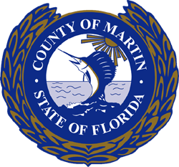
2016 BMAP Annual Meeting
Martin County Update
St Lucie River and Estuary Basin Management Action Plan (BMAP)
Annual Meeting
Martin County Engineering Department /
Ecosystem Restoration and Management Division
Greg Nolte
Project Manager
October 26, 2016

Slide 2
Current Status &
Completed Projects
Beginning of Year Status
2015 BMAP Progress Report – 34 Projects
  TN Reductions: 41,511 lbs / year *
  TP Reductions: 7,920 lbs / year *
2016 Completed Projects
Danforth Creek Hybrid Wetland Treatment Technology *
Manatee Pocket SW Prong Baffle Box
Martin County Golf Course Improvements
* Credits for Danforth Creek HWTT were included in the 2015 Progress Report and was listed as “Under Construction”. Construction was finalized and online in 2016.

Slide 3
Danforth Creek HWTT
Hybrid Wetland Treatment Technology (HWTT) is a patented alternative treatment technology that combines wetland and chemical treatment in a series of processes designed to achieve high rates of nutrient removal within a smaller spatial footprint.
Treats 2,419 acre upstream basin
Addition to and in conjunction with Danforth Creek Phase 1 Project
Project site 9.14 acre – Total project site 20.6 acres
Variable pump system – maximum capacity 25 cfs
Chemical treatment utilizes Aluminum Sulfate (Alum) and polyaluminum chloride (PAC) introduced front end of system to coagulate and precipitate nutrients
Process includes an above ground, lined Contact Pond, a Settling Pond, a Floating Aquatic Vegetation (FAV) Pond and a Submerged Aquatic Vegetation (SAV) Pond
Starting with Contact Pond, each pond will cascade from one to next via gravity through internal weirs with final discharge into Danforth Creek

Slide 4
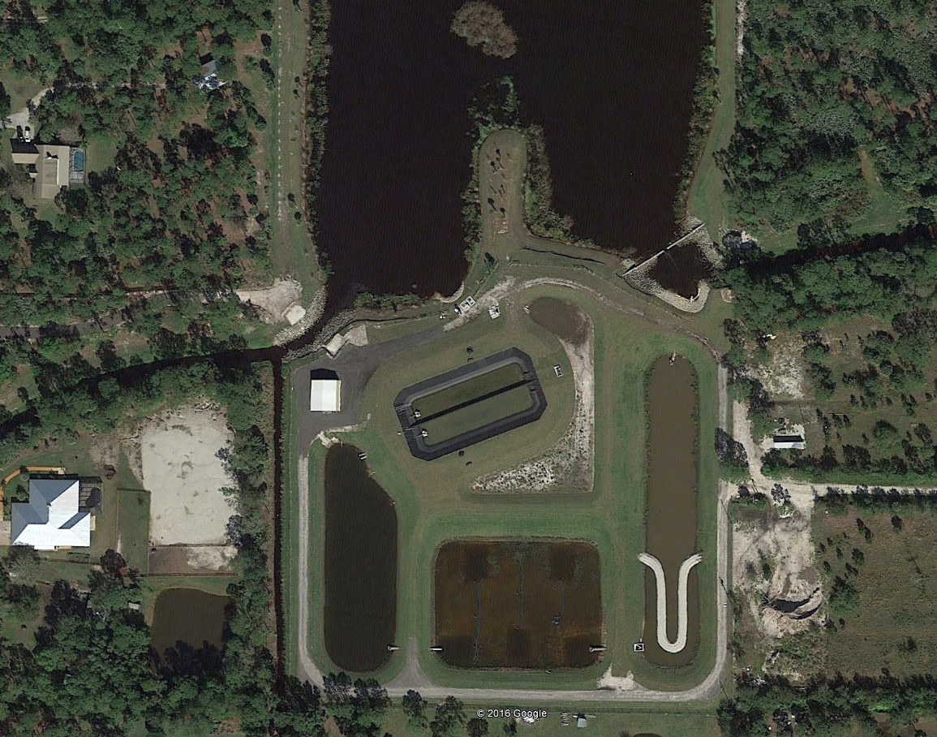
Danforth Creek HWTT
Danforth Phase 1
Pump Station
Contact Pond
Storage Building
Discharge
Danforth Creek
Settling Pond
SAV Pond
FAV Pond

Slide 5
Danforth Creek HWTT
Partnership with FDACS - $3,000,000 State Appropriations
Design / Build:
  Watershed Technologies and Federico, Lamb & Associates
Design and Permitting: Started Sep ’14, Completed Feb ‘15
Construction: Started Mar ’15, Completed Apr ’16
  Contractor: A-Shaping
  Preliminary Performance Efficiencies
    TN Reduction: ~60% Removal efficiency
    TP Reduction: ~90% Removal efficiency
    Fecal Coliform: ~90% Removal efficiency

Slide 6
SW Prong Baffle Box
Southwest Prong is one of the many tributaries to the Manatee Pocket
Located between the Salerno Creek and Manatee Creek Basins
Watershed is approximately 200 acres that includes portions of New Monrovia, Murray Middle School, Emerald Lakes and Publix’s shopping center at Cove Road and US Highway 1
Large upstream portion of basin drains via an existing 48” x 76” ERCP
Project consisted of installation of a 10’ x 16’ second generation Baffle Box in-line with existing 48” x 76” ERCP

Slide 7
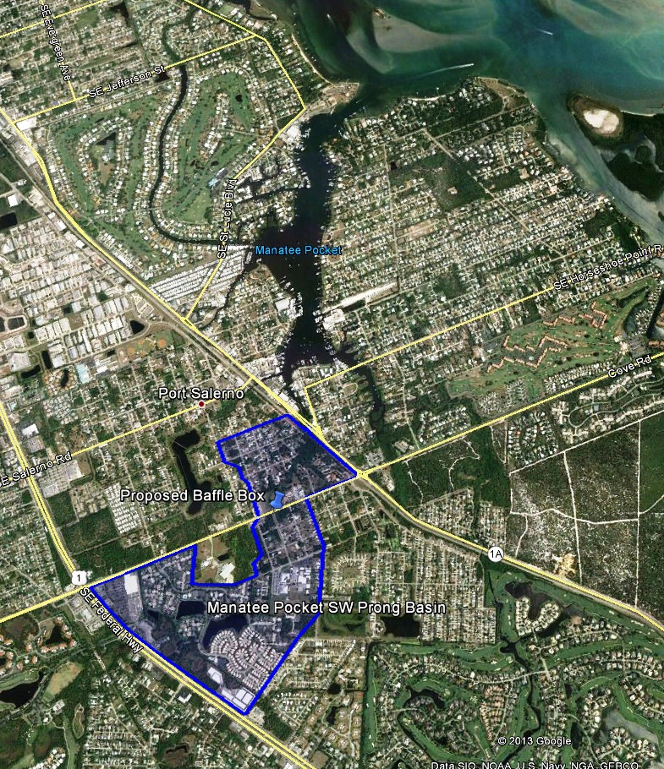
SW Prong Baffle Box
Design Team: CAPTEC & AACE
Design and Permitting:
  Feb 2015 – Jul 2015
Construction:
  Sep 2015 - Jan 2016
  Contractor: Custom Built Marine Construction (CBMC)
  Funding:
    Martin County - $132,500
    SLRIT Grant - $100,000
    Costs:
    Design & Permit: $ 50,230
    Construction: $182,270
    Total Cost: $232,500

Slide 8
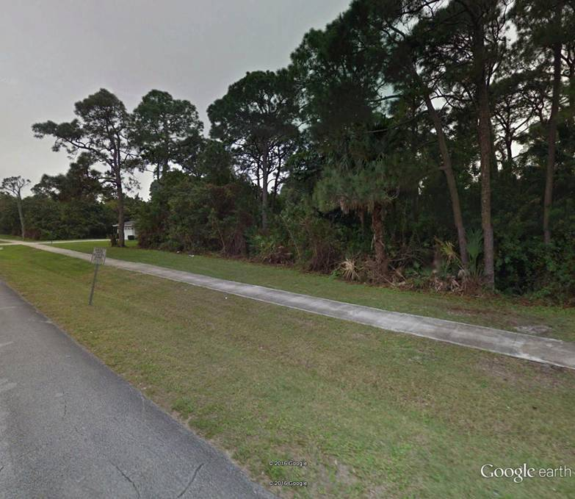
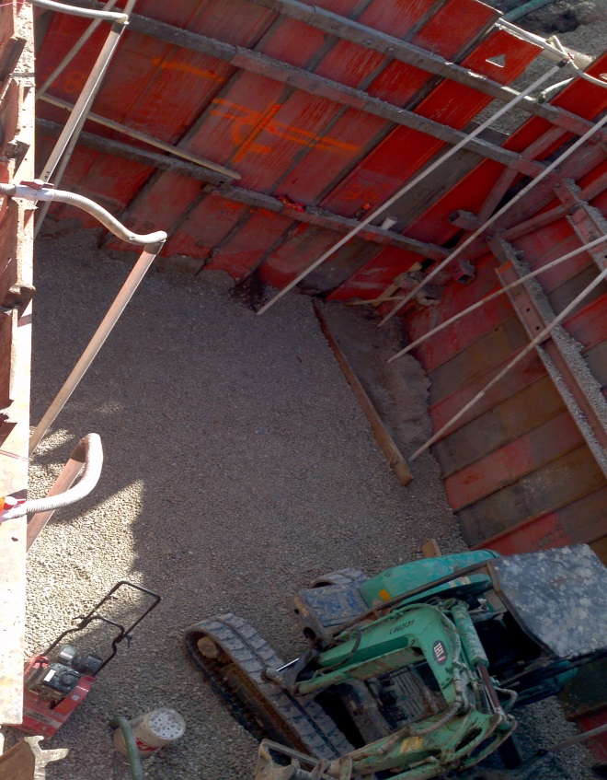
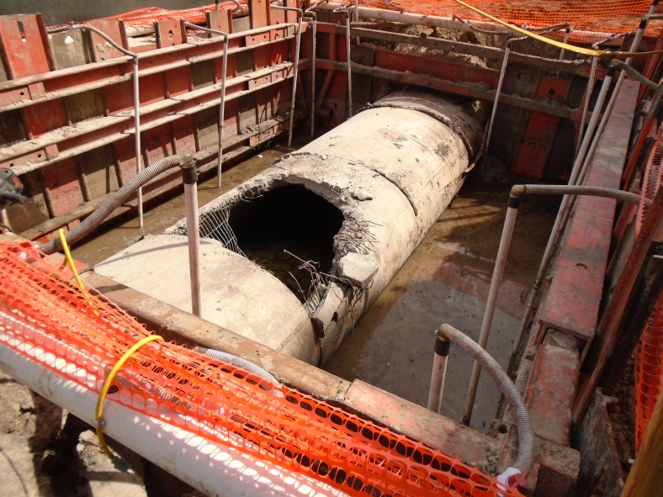
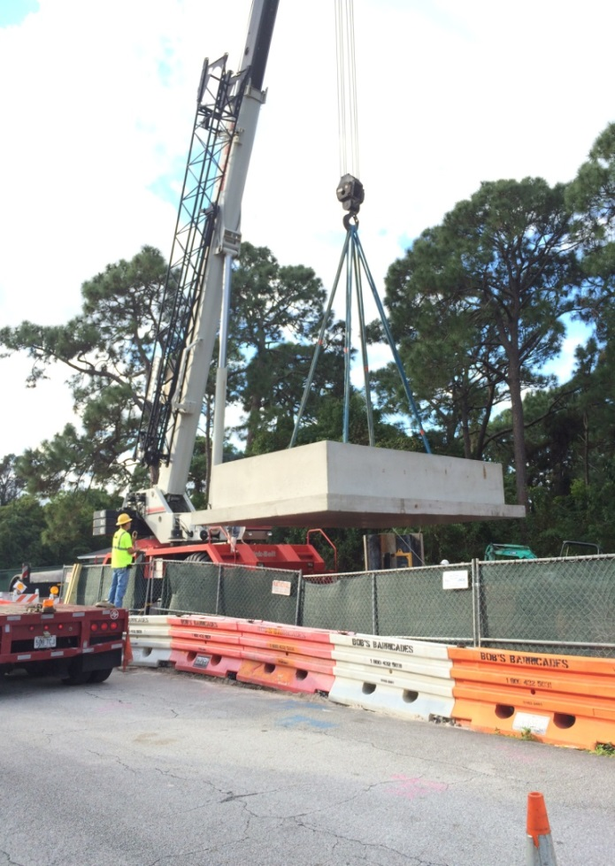
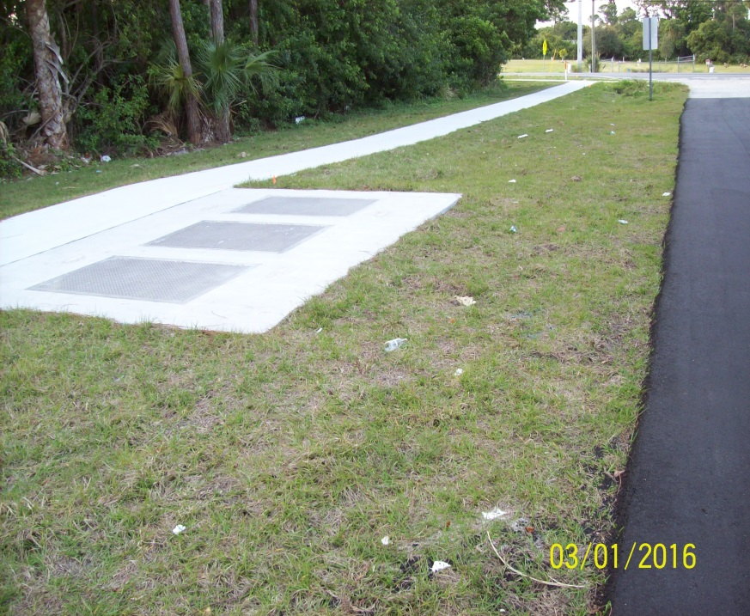
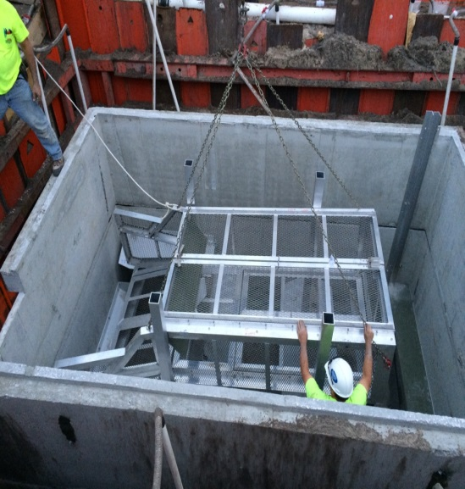
SW Prong Baffle Box

Slide 9
MC Golf Course
Water Quality Improvements
Original golf course was built prior to today’s requirements for water quality treatment; lake only provided flood protection
Watershed is approximately 234 acres of golf course
Project consisted of retrofitting three outfall culverts with weirs and improvements to outfall ditch and existing weir
Project provides 19.5 ac-ft of water quality treatment, which equates to 1” over the contributing area

Slide 10
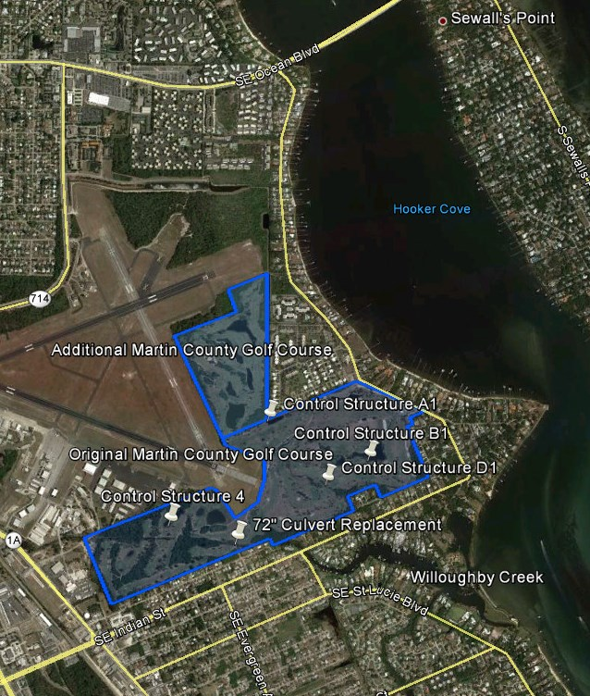
MC Golf Course
Water Quality Improvements
Design Team: CAPTEC
Design:
  Jan 2015 - Oct 2015
Construction:
  Nov 2015 - Mar 2016
  Contractor: Coastal Land Development(CLD)
  Funding:
    Martin County - $106,250
    SLRIT Grant - $ 50,000
    Costs:
    Design & Survey: $ 24,290
    Construction: $131,960
    Total Cost: $156,250

Slide 11
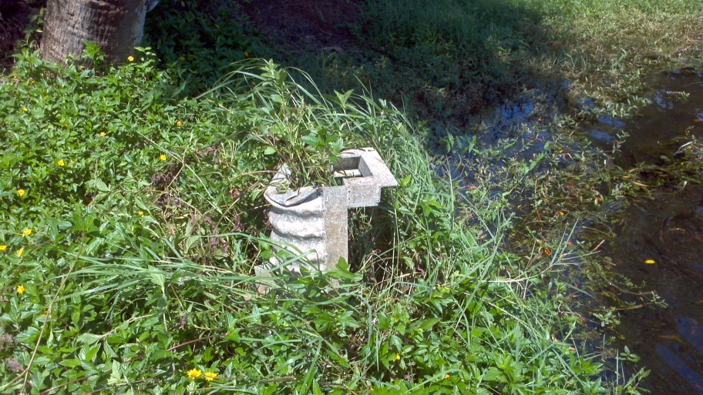
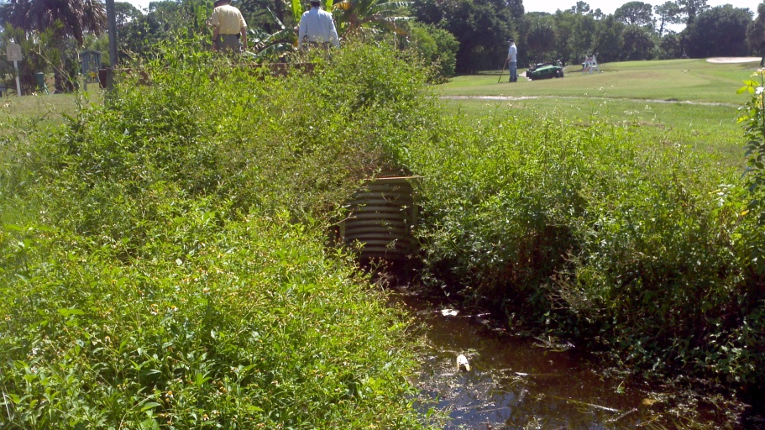
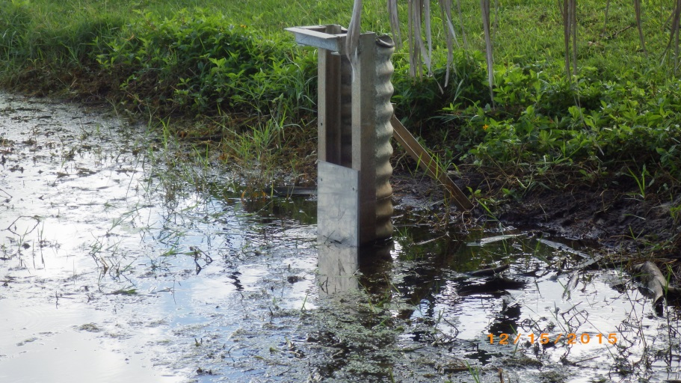
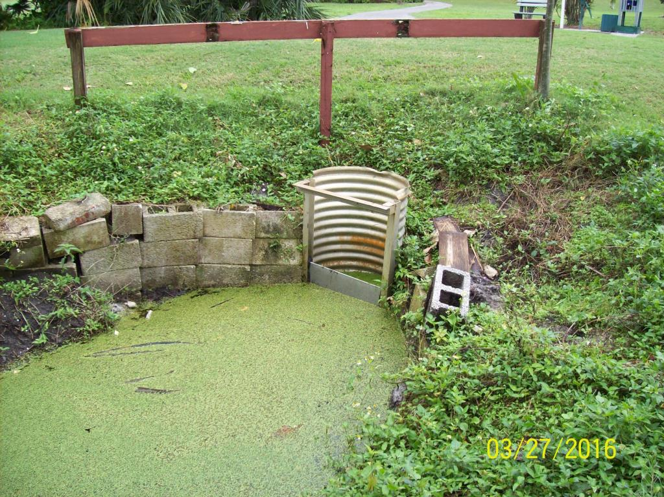
MC Golf Course
Water Quality Improvements
Before
Before
After
After

Slide 12
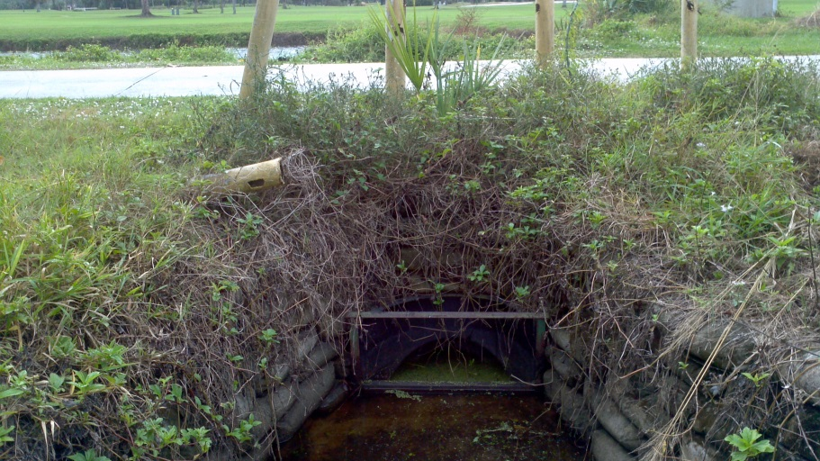
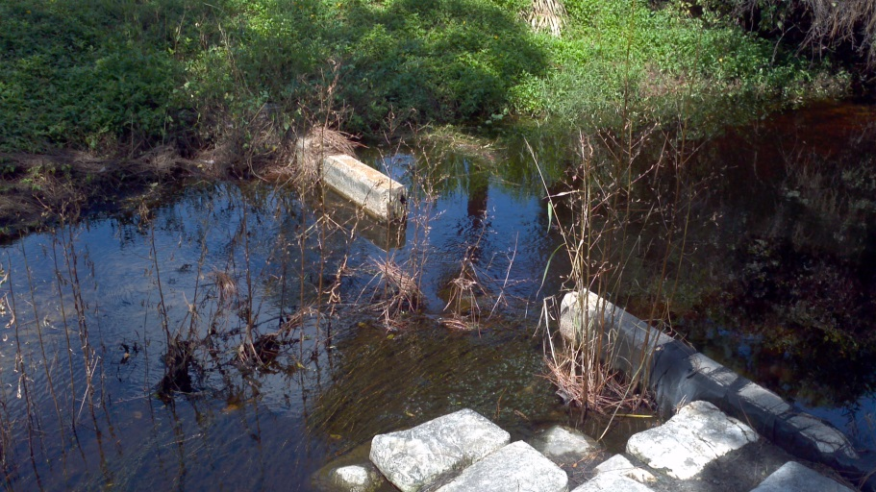
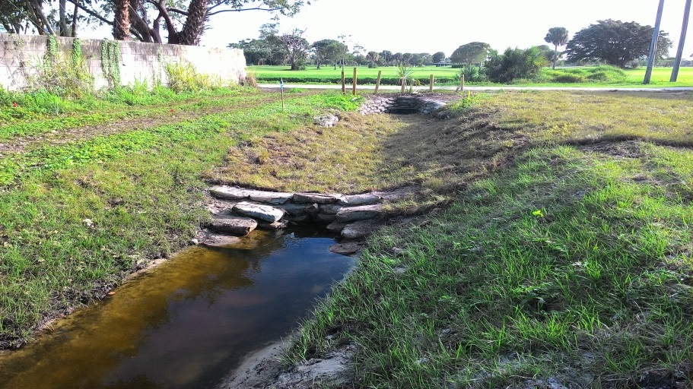
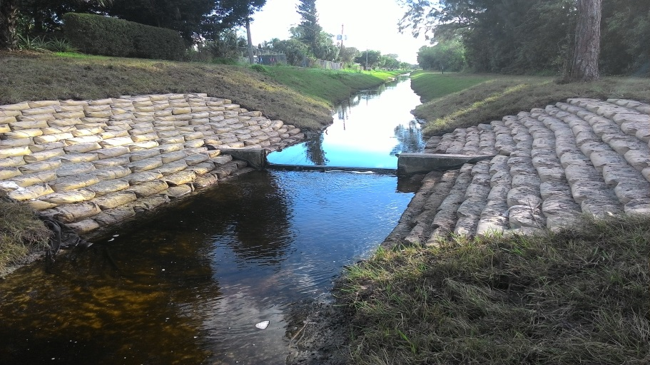
MC Golf Course
Water Quality Improvements
Before
Before
After
After

Slide 13
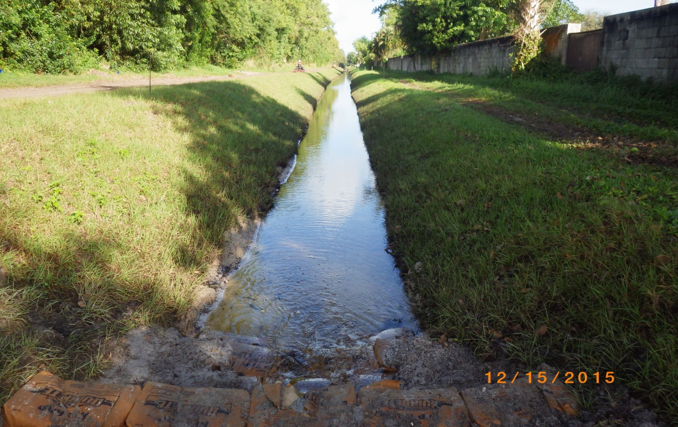
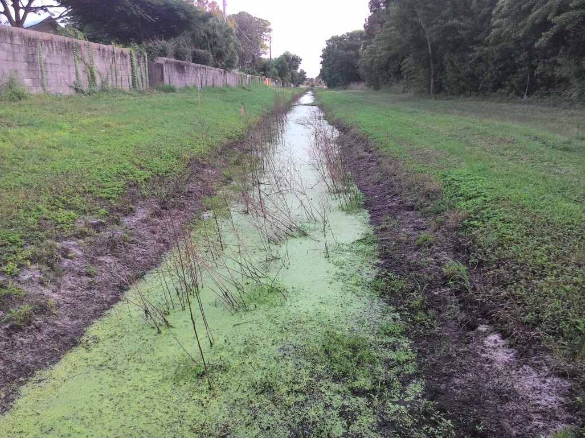
MC Golf Course
Water Quality Improvements
Before
After

Slide 14
Martin County
TMDL / BMAP Status

Slide 15
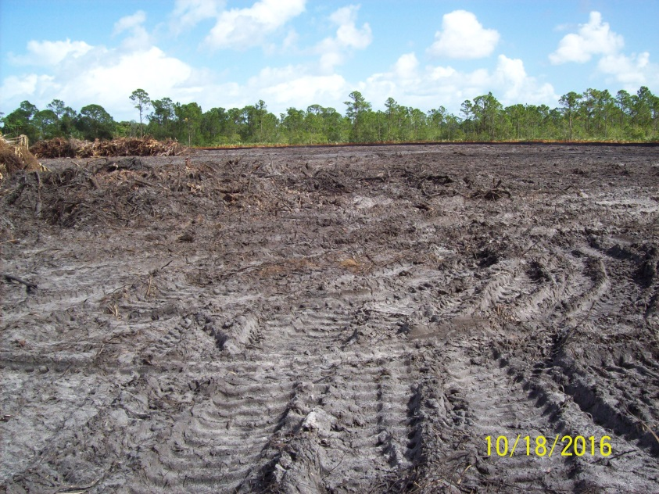
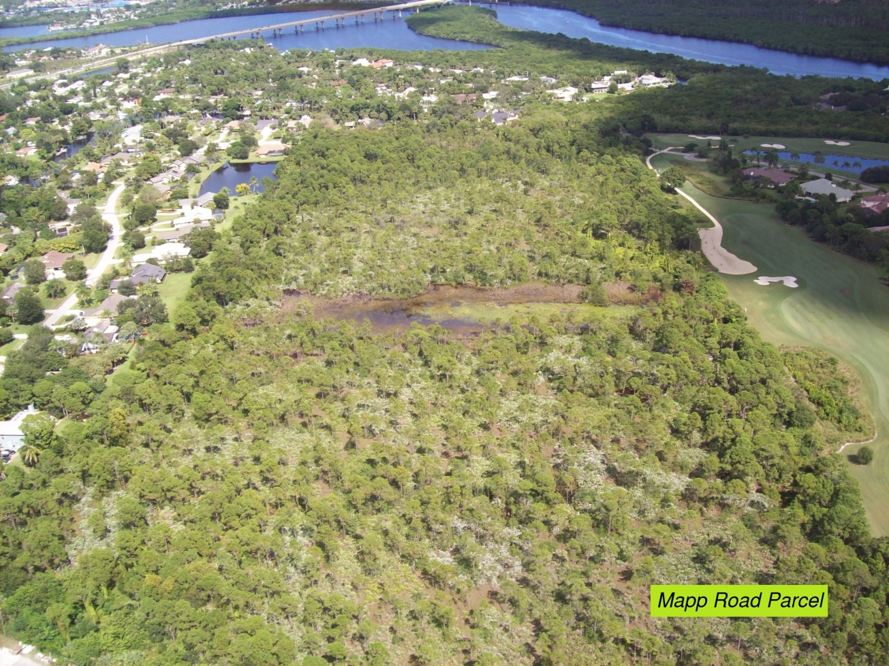
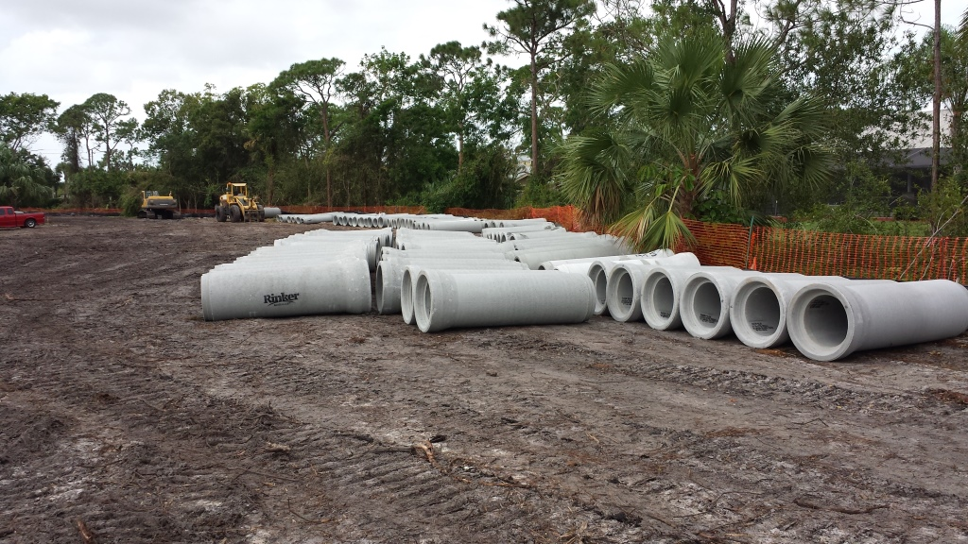
Current Projects
All American Ditch Stormwater Quality Improvement Project

Slide 16
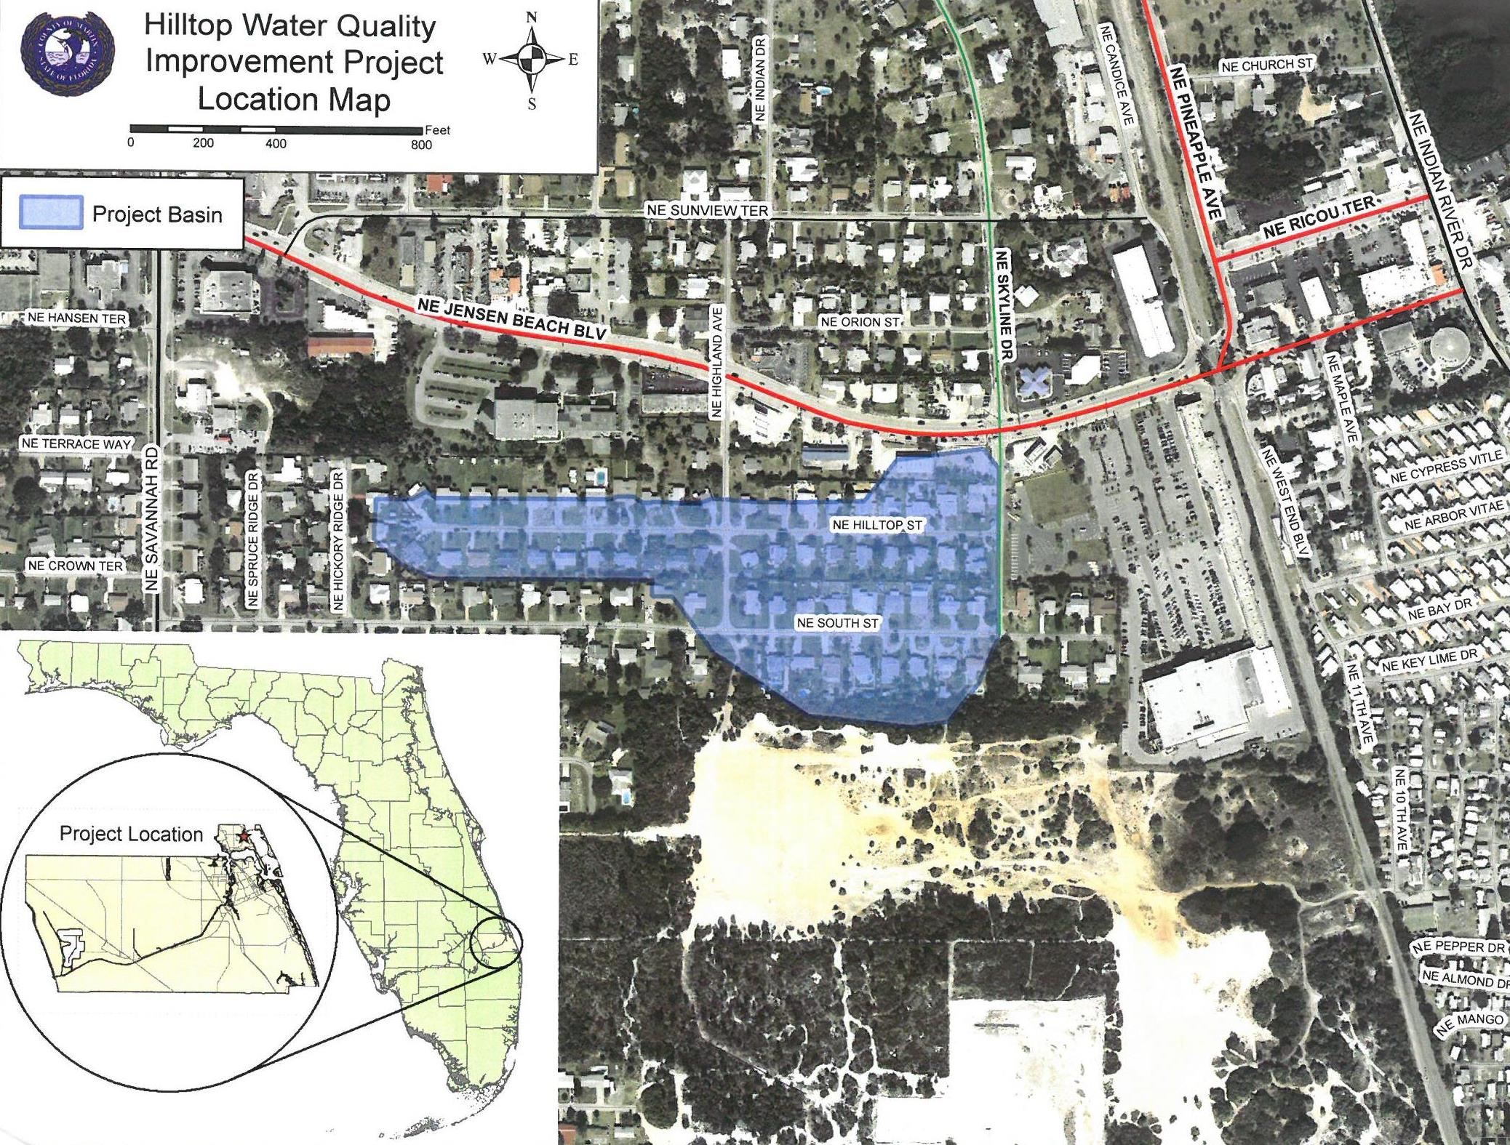
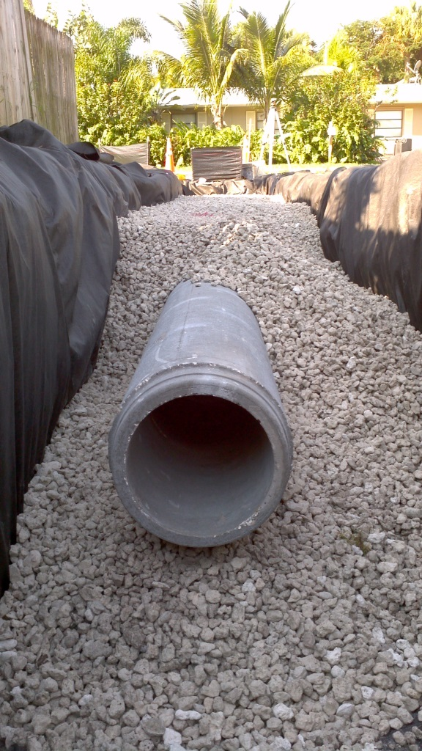
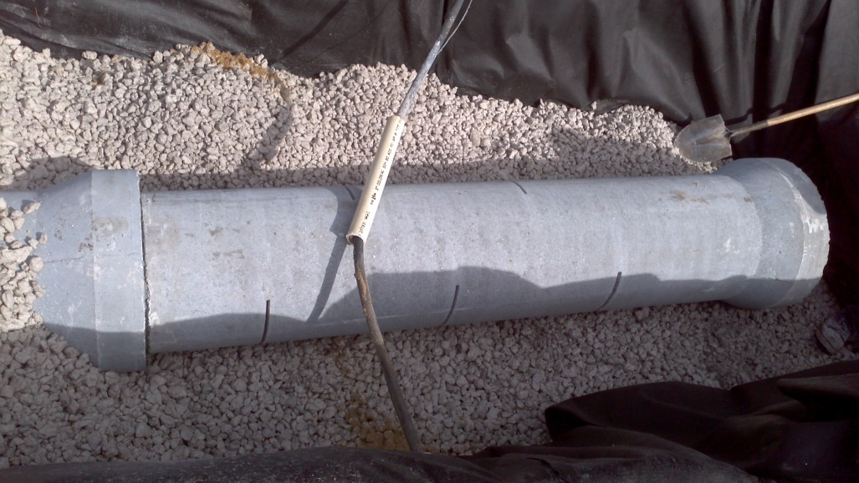
Current Projects
Hilltop Street Water Quality Improvement Project

Slide 17
Thank you!
Questions?
Martin County Engineering Department /
Ecosystem Restoration and Management Division
Greg Nolte
Project Manager

