Slide 1
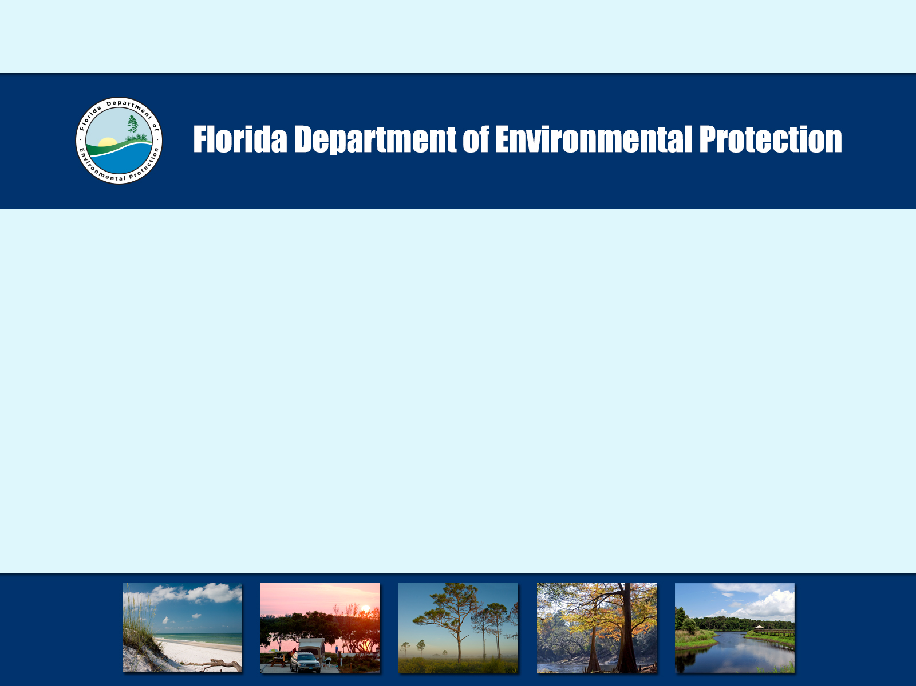
Water Quality Restoration Program
St. Lucie River and Estuary Basin Management Action Plan
3rd Annual Meeting
October 26, 2016
David Glassner
david.glassner@dep.state.fl.us

Slide 2
Meeting Agenda
Welcome and Opening Remarks
Overview of St. Lucie River and Estuary Basin Management Action Plan (BMAP) Annual Progress Report
WaSh Model Update Presentation
BMAP Monitoring Network Project Presentation
Florida Department of Agriculture and Consumer Services Presentation
Stakeholder Update Presentations
Questions/Comments
Adjourn

Slide 3
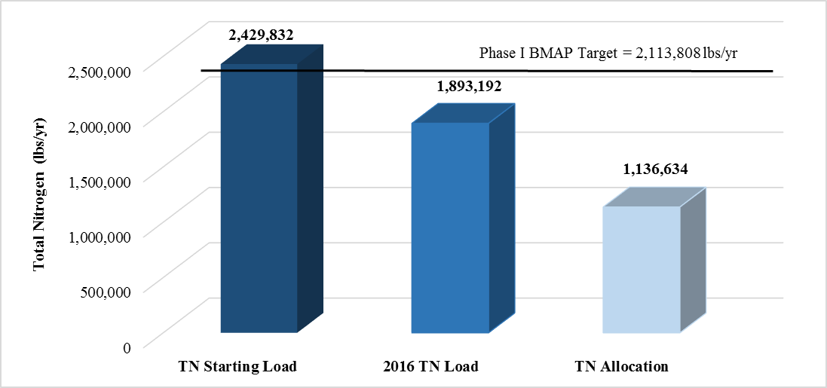
St. Lucie River and Estuary BMAP
Phase I (TN) Required Reduction
  316,024 lbs/yr
Current Estimated TN Reduction
  536,000 lbs/yr
Progress Towards the St. Lucie River and Estuary Total Nitrogen (TN) Total Maximum Daily Load (TMDL) through June 30, 2016

Slide 4
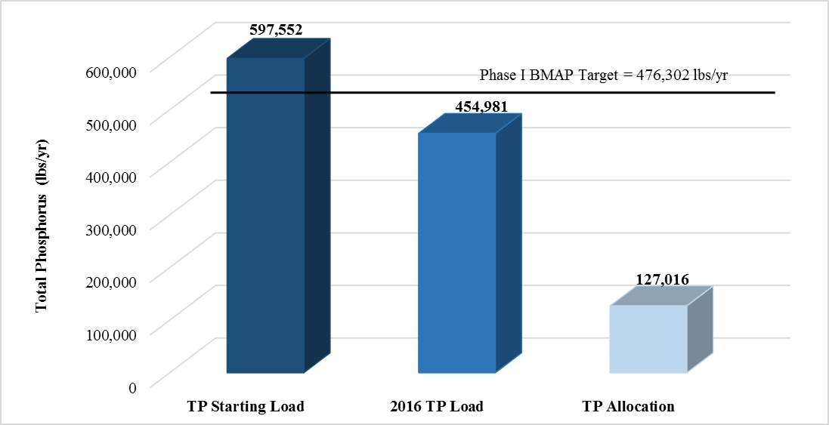
St. Lucie River and Estuary BMAP
Phase I TP Required Reduction
  121,250 lbs/yr
Current Estimated TP Reduction
  142,571 lbs/yr
Progress Towards the St. Lucie River and Estuary Total Phosphorus (TP) TMDL through June 30, 2016

Slide 5
St. Lucie River and Estuary BMAP
Yearly Calendar Average (through August 2016) TN Concentration at Roosevelt Bridge (Station SE 03)

Slide 6
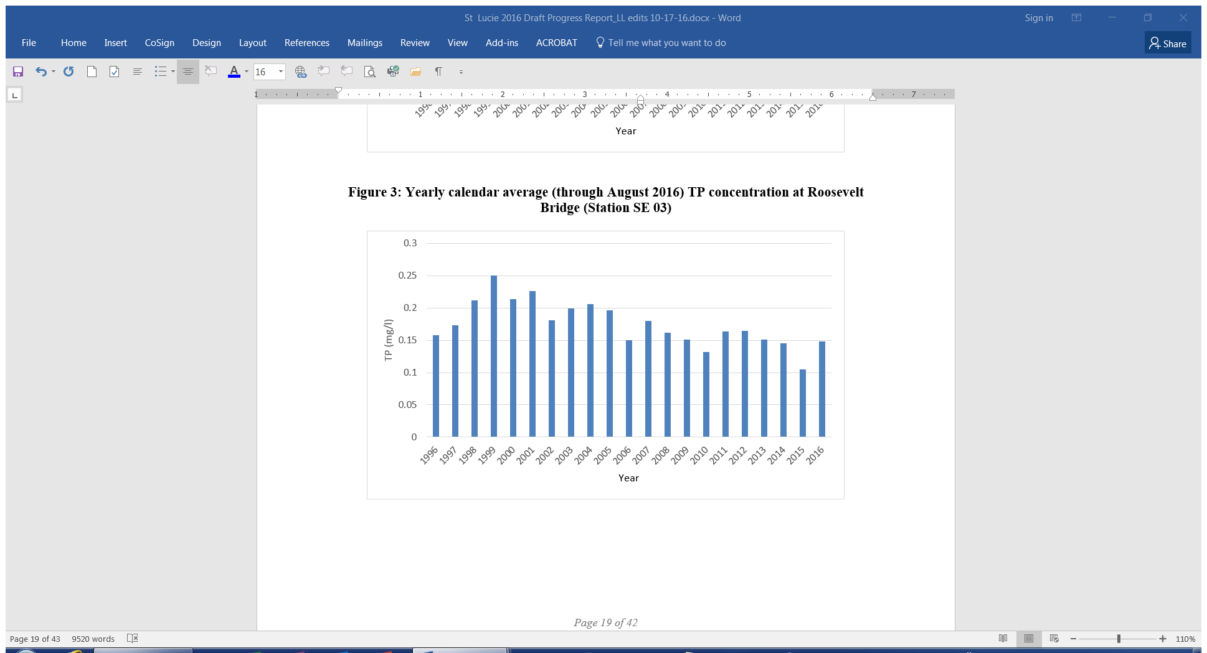
St. Lucie River and Estuary BMAP
Yearly Calendar Average (through August 2016) TP Concentration at Roosevelt Bridge (Station SE 03)

Slide 7
St. Lucie River and Estuary BMAP
Entity | Projects Listed in 2013 BMAP | Completed | Cancelled | Underway
City of Fort Pierce | 6 | 6 | - | -
City of Port St. Lucie | 26 | 25 | 1 | -
City of Stuart | 15 | 15 |  | -
FDOT | 40 | 38 | 2 | -
Hobe St. Lucie Conservancy District | 3 | 3 | - | -
Martin County | 28 | 28 | - | -
North St. Lucie River WCD | 8 | 8 | - | -
Pal Mar WCD | 1 | 1 | - | -
St. Lucie County MS4 | 8 | 8 | - | -
St. Lucie County Non-MS4 | 6 | 6 | - | -
Town of Sewall's Point | 29 | 27 | - | 2
Troup-Indiantown WCD | 2 | 2 | - | -
Turnpike Authority | 3 | 3 | - | -
Total | 179 | 174 | 3 | 2
Summary of Completed Projects Identified in the 2013 BMAP by Entity

Slide 8

WaSh Model Update
Additional Enhancements
a wash-off build-up algorithm for Event Mean Concentrations (improved representation of sub-seasonal variability)
improved irradiation function in the advanced water quality algorithm (improved representation of diurnal variations)
modification to the infiltration and the advanced water quality algorithms for reservoirs (supports simulation of Water Farms)

Slide 9
WaSh Model Update
Calibration from 2000 – through 2013
Spin-up period from 1998 to 2000
Changed Land Use between 2006/2007 to reflect large
changes during the period
Calibration included:
Flow
D.O.
Nutrients (Nitrogen & Phosphorus)
Chla

Slide 10
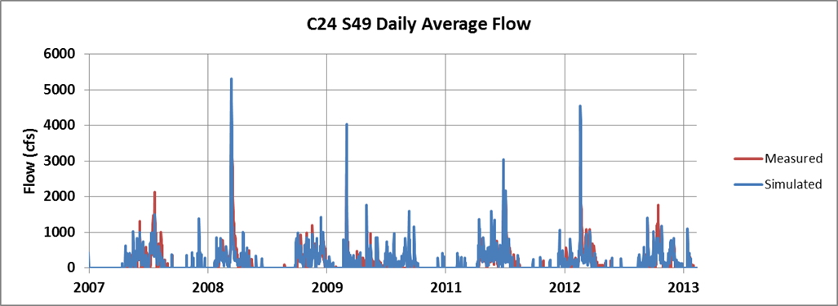
WaSh Model Update

Slide 11
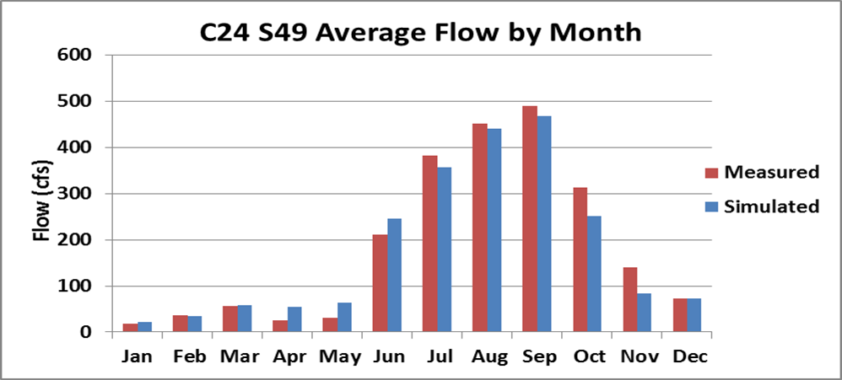
WaSh Model Update

Slide 12
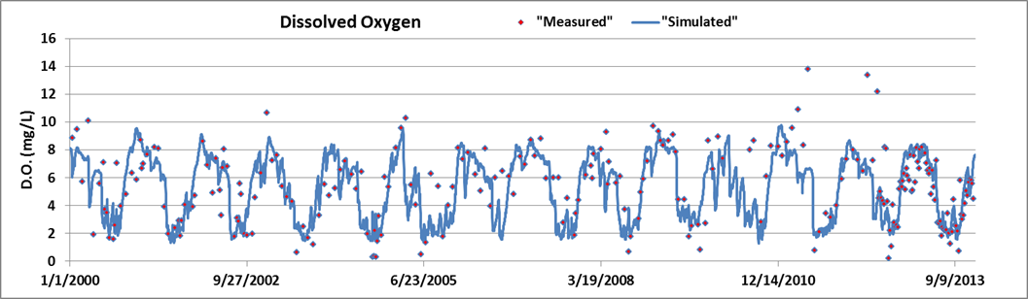
WaSh Model Update

Slide 13
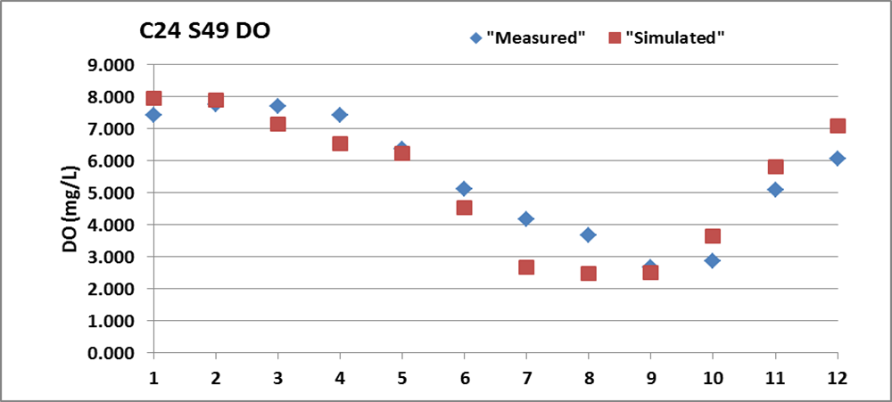
WaSh Model Update

Slide 14
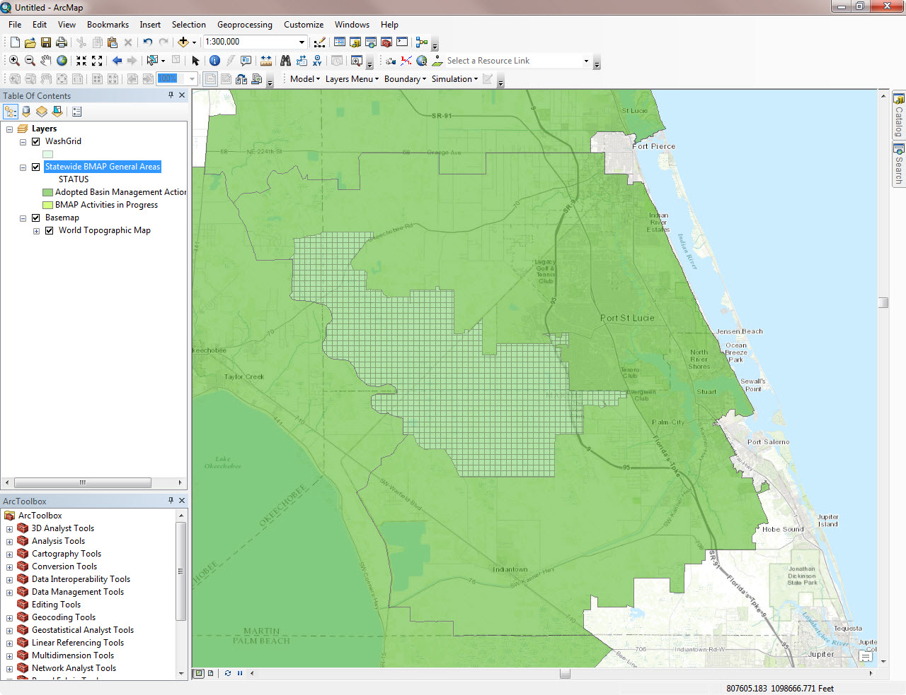
WaSh Model Update

Slide 15
New Requirements
Revisions to Section 373.4595, Florida Statutes (F.S.) during 2016 Legislative session
New requirements for Northern Everglades watersheds
  Lake Okeechobee
  Caloosahatchee
  St. Lucie
Enhanced integration of Water Management District (WMD) protection plans and BMAPs
Additional reporting
  5-year BMAP progress reports
  Annual Northern Everglades Coordinating Agencies Report
Notes:
During the 2016 Legislative session, new requirements were established for the Northern Everglades watersheds and BMAPs in general.

Slide 16
New Requirements
New elements for Northern Everglades and Estuaries Protection Program (NEEPP) BMAPs
Projects to achieve the TMDL in 20 years
5/10/15-year milestones to measure progress
5-year progress report
New elements for all new or revised BMAPs
Additional project information
Additional funding information
Notes:
All new or revised BMAPs are required to have additional project information including ranking, cost and load reduction estimates, and funding sources.
July 1, 2018 Progress Report or Phase II of BMAP

Slide 17
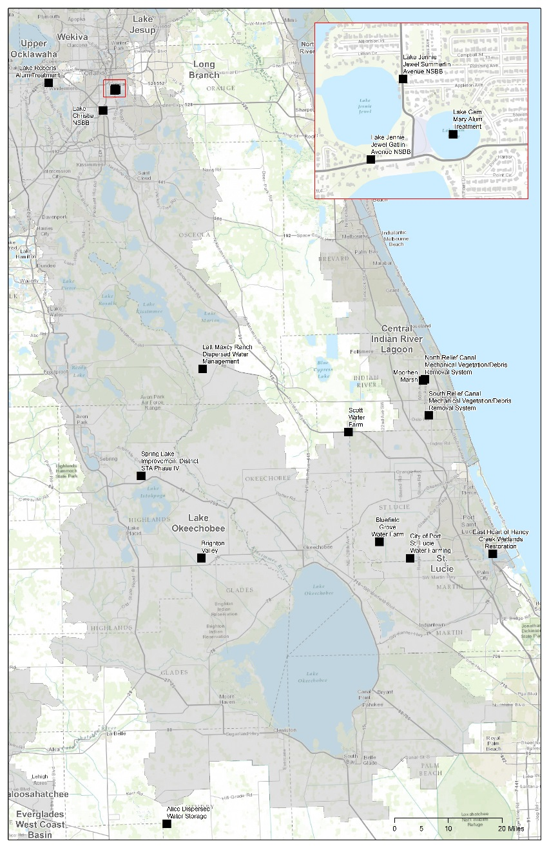
Project Information Collection
Survey January 2016 for projects in South Florida BMAPs
Contacted >1,000 stakeholders
Requested Information
  Sponsor, Partners
  Project Type
  Schedule
  Cost, Annual Operations & Management (O&M)
  Acres Treated
  Estimated TN/TP Reductions
Caulkins Water Farm
Notes:
Contacted >1,000 stakeholders in 5 south Florida BMAPs

Slide 18
Water Quality Restoration Program
St. Lucie River
Water Quality Prioritization and Data Analysis
October 26, 2016
Mary Szafraniec, PhD
Amec Foster Wheeler
Mary.Szafraniec@amecfw.com

Slide 19
Overview
BMAP Monitoring Network water quality site prioritization
Trend analysis

Slide 20
Water Quality Site Prioritization

Slide 21
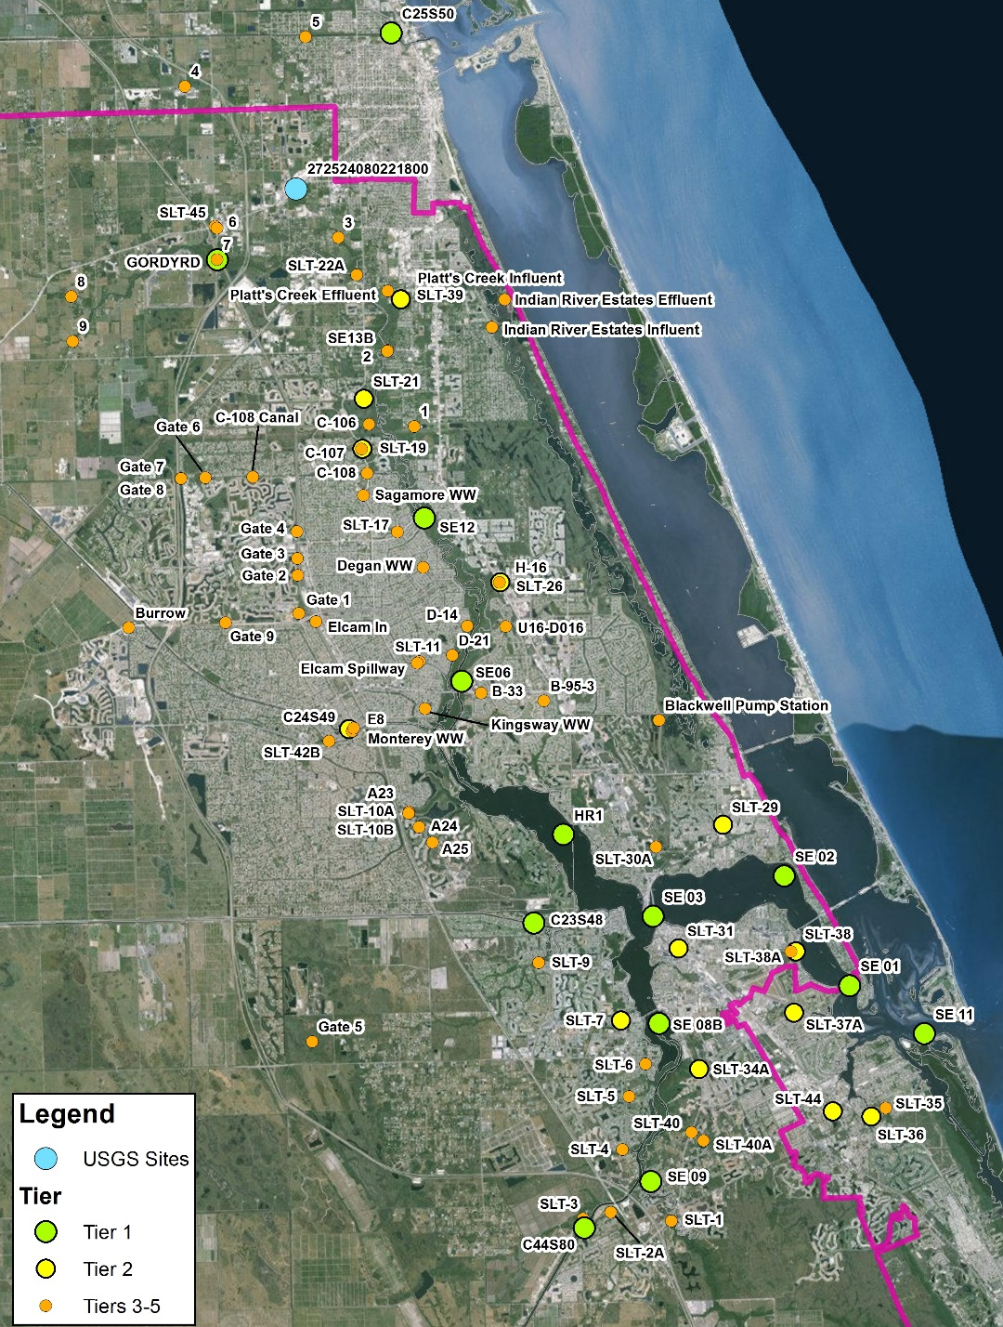
St. Lucie BMAP Monitoring Network Stations
All stations in monitoring network
Data Providers:
  North St. Lucie River WCD
  Port St. Lucie
  SFWMD
  St. Lucie County
  St. Lucie West Services District
  U.S. Geological Survey

Slide 22
Prioritization Methodology
Step 1: Database Assessment
Data Retrieval: STORET, DBHydro
Data Screening: period of record (POR), sampling frequency, and data gaps
Data Processing/Formatting: data qualifiers, replicates, coincident time step
Development of Tier Criteria Table
Development of Monitoring Station Summary Table with Tier Classification
Tier Classification list developed based on data availability, POR, sampling frequency, and data gaps

Slide 23
Tier Criteria
Tier | Criteria | Stations Used for Data Analysis
1 | - Most recent data records are from 2015 or later. | YES
 | - Five or more consecutive years of data exist going back from the time of most recent data (2015/2016).
 | - Data gaps less than 90 days in most recent consecutive five year period.
 | - Typical sampling frequency of monthly or shorter frequency.
 | - All quarters in most recent consecutive five year period have data.
2 | - Most recent data records are from 2015 or later. | YES
 | - Five or more consecutive years of data exist going back from the time of most recent data (2015/2016).
 | - Typical sampling frequency greater than monthly, and less than or equal to annually.
 | - No more than one complete quarter of missing data per year in most recent consecutive five year period.
3 | - Most recent data records are earlier than 2015. | NO
 | - Less than five consecutive years of data exist going back from the time of most recent data.
 | - More than one complete quarter of missing data exists per year in most recent consecutive five year period.
 | - Typical sampling frequency greater than monthly, less than or equal to annually.
4 | - Data assumed not ambient per site description. | NO
5 | - Data not available in STORET or DBHYDRO. | NO
Notes:
Temporary suspensions or alterations to frequencies less than one year did not affect Tier classifications.

Slide 24
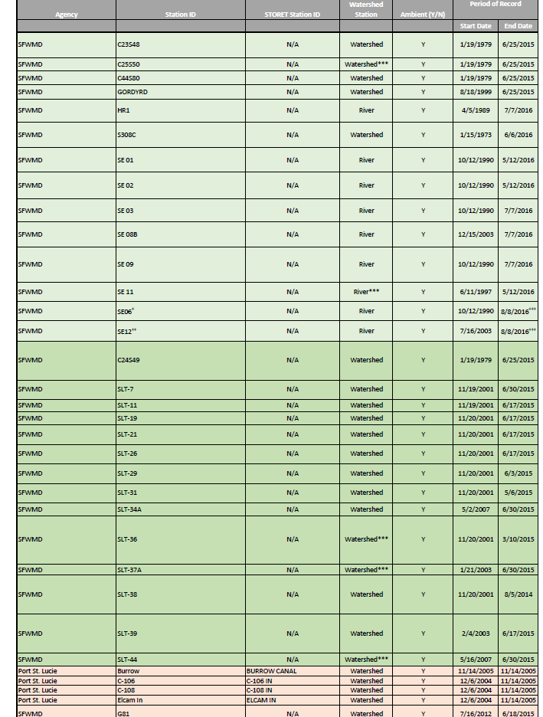
Station Summary Table
-See handout

Slide 25
Prioritization Methodology
Step 2: Data Driven Prioritization based on Statistical Analyses
Time Series Analysis
  Parameter reduction
Autocorrelation Function Analysis (ACF)
  Identify trends/periodicity in data in individual sites
Cross-correlation Analysis (CCF)
  Identify correlation between SE03 and all other stations
Principal Components Analysis (PCA)
  Identify similarity/correlations/groupings among stations
Notes:
TS analysis: To detect any obvious temporal/seasonal trends and potential outliers
ACF + CCF: we generated auto-correlation and cross-correlation graphs to identify any potential cyclic or temporal behavior within a time-series for a given parameter or to determine similarities between observed time-series at SE03 (compliance station) and other river or watershed sites. Auto-correlation graphs plot correlation values between a data point and the values observed at the same site after a certain lag time. Similarly cross-correlation graphs allow plotting correlation between a data point and the values observed at another site after a certain lag. Cross-correlation graphs are useful in identifying how water quality parameters are correlated at different lag times. Different from a linear correlation since those are usually coincident time steps or purposely lagged based on a known physical or biological process.
PCA: multivariate statistical analysis (nonparametric) method to understand the temporal and spatial variability of WQ parameters and to determine patterns and interactions across all of the stations using TN and TP as parameters. PCA (similar to cluster analysis) can be used to classify stations into groups that share similar characteristics or properties. We went a step further to optimize the results by following the PCA with a rotation called varimax, which is used to simplify the PCA results. It maximizes the sum of the variances of the squared loadings (squared correlations between variables and factors)
Future work: The cross-correlation graphs could be useful in identifying how flow patterns influence water quality parameters. For instance, a cross-correlation graph indicating a high degree of correlation between a given point and one that lags by five days might indicate a time-of-flow from adjacent site to site of interest of approximately five days. Recommend conducting flow vs. TN and TP concentrations at coincident or different sites that are hydraulically connected within reason.

Slide 26
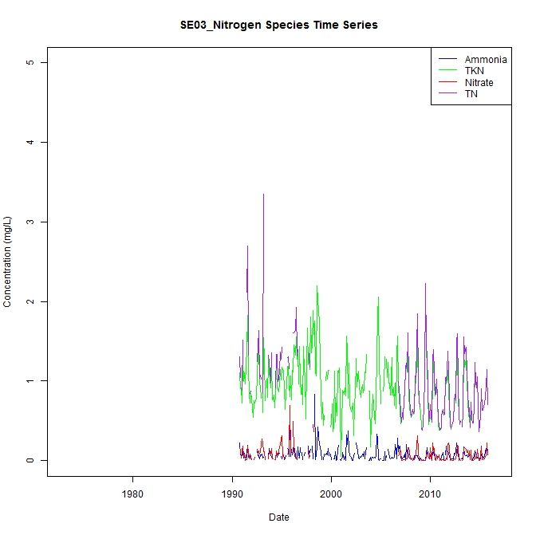
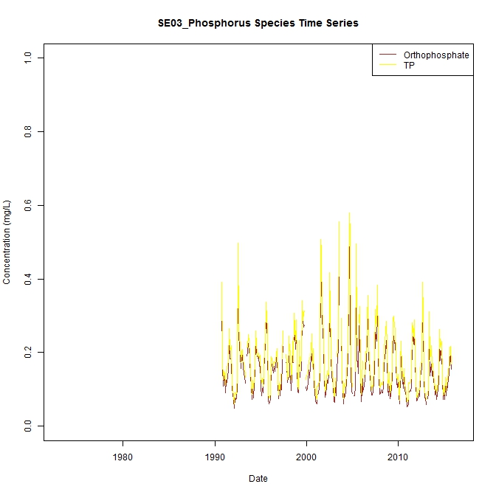
Time Series Results

Slide 27
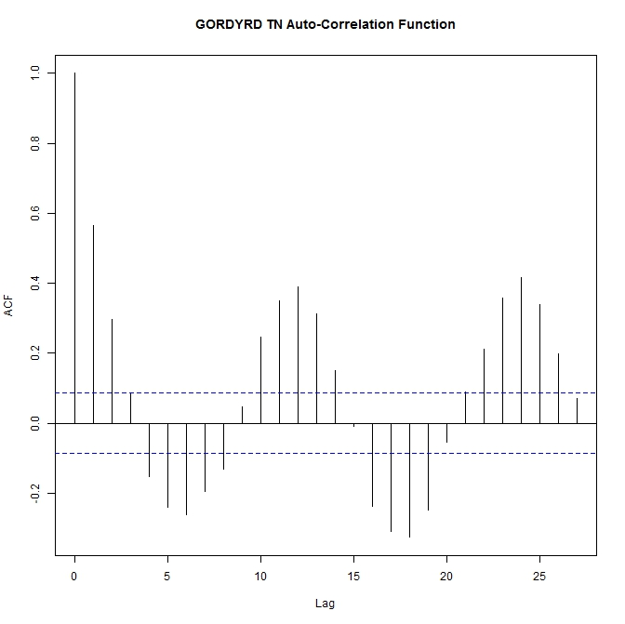
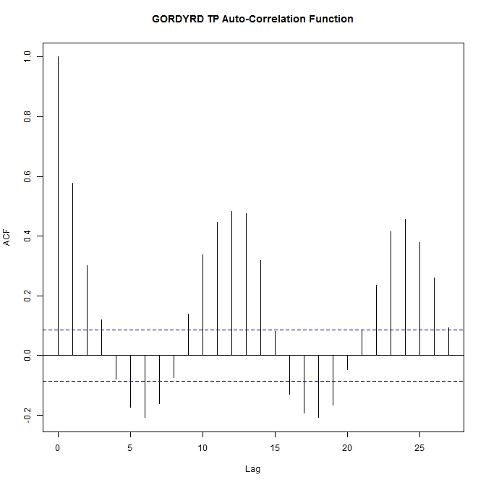
Autocorrelation Function Results
Notes:
Textbook example of seasonality at Gordy Rd.
Very strong annual seasonal pattern
Inverse relationship on a SEMI-ANNUAL trend, happens every 6 months
Positive trend today will be negative 6 months from now.
This indicates a natural cycle

Slide 28
Trend Analysis

Slide 29
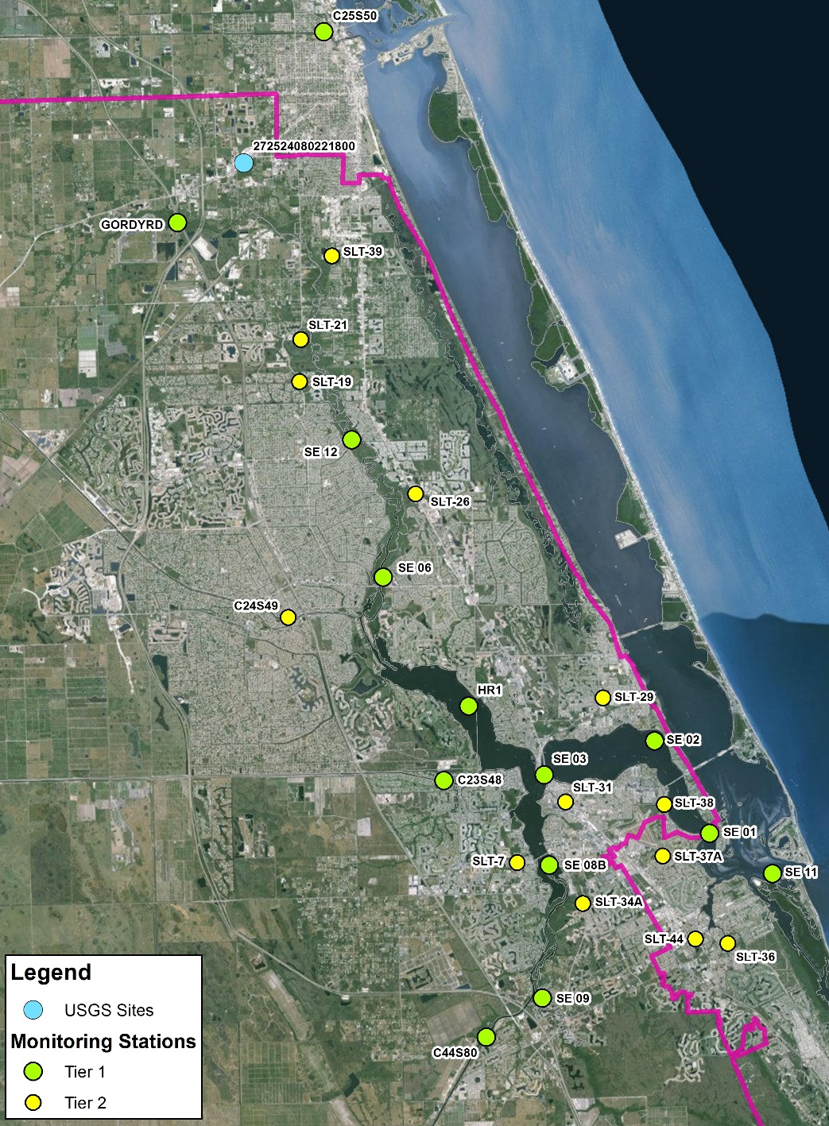
Trend Analysis Methodology
Statistical Trend Analysis
Tier I and II stations used to conduct trend analyses
Monthly mean values used in analyses for POR (1/1/2008 – 7/1/2016)
Data filtered to include surface water grab samples
Fatal flaw qualifier codes removed
  Non-detect data converted to ½*MDL

Slide 30
Trend Analysis Methodology
Statistical Trend Analysis
Monotonic trend analyses used the non-parametric Mann-Kendall test to identify trends in a statistically rigorous way
  Accounted for seasonal variability on individual sites (Seasonal Kendall test)
    Wet vs. Dry season
  Accounted for regional variability (Regional Kendall test)
    Region 1: North Fork watershed and river stations
    Region 2: South Fork watershed and river stations
    Region 3: Watershed and river stations below SE03
  Combined trend tests using both seasonal and regional Kendall tests

Slide 31
Individual Site Seasonal Kendall Trend Analysis Results
TN Seasonal Mann-Kendall Results
Station | Region | Tau | P-Value
C23S48 | 1 - N Fork | 0.060 | 0.433
C24S49 | 1 - N Fork | -0.126 | 0.109
C25S50 | 1 - N Fork | -0.059 | 0.440
GORDYRD | 1 - N Fork | -0.091 | 0.237
HR1 | 1 - N Fork | 0.027 | 0.721
SE 06 | 1 - N Fork | -0.097 | 0.185
SE12 | 1 - N Fork | -0.194 | 0.008
SLT11 | 1 - N Fork | -0.125 | 0.116
SLT19 | 1 - N Fork | -0.086 | 0.286
SLT21 | 1 - N Fork | -0.198 | 0.019
SLT26 | 1 - N Fork | -0.113 | 0.164
SLT39 | 1 - N Fork | 0.012 | 0.898
C44S80 | 2 - S Fork | -0.027 | 0.733
S308C | 2 - S Fork | -0.193 | 0.006
SE08B | 2 - S Fork | 0.043 | 0.555
SE09 | 2 - S Fork | 0.060 | 0.410
SLT31 | 2 - S Fork | 0.186 | 0.025
SLT34A | 2 - S Fork | -0.146 | 0.063
SLT7 | 2 - S Fork | -0.113 | 0.186
SE01 | 3 - Below SE03 | 0.073 | 0.324
SE02 | 3 - Below SE03 | 0.072 | 0.326
SE03 | 3 - Below SE03 | 0.025 | 0.737
SE11 | 3 - Below SE03 | 0.132 | 0.073
SLT29 | 3 - Below SE03 | -0.114 | 0.163
SLT36 | 3 - Below SE03 | -0.369 | 0.000
SLT37A | 3 - Below SE03 | -0.107 | 0.185
SLT38 | 3 - Below SE03 | -0.185 | 0.046
SLT44 | 3 - Below SE03 | -0.062 | 0.433
TP Seasonal Mann-Kendall Results
Station | Region | Tau | P-Value
C23S48 | 1 - N Fork | 0.070 | 0.364
C24S49 | 1 - N Fork | -0.001 | 0.990
C25S50 | 1 - N Fork | 0.020 | 0.794
GORDYRD | 1 - N Fork | -0.127 | 0.098
HR1 | 1 - N Fork | -0.034 | 0.644
SE 06 | 1 - N Fork | -0.165 | 0.022
SE12 | 1 - N Fork | -0.213 | 0.003
SLT11 | 1 - N Fork | 0.021 | 0.790
SLT19 | 1 - N Fork | -0.100 | 0.211
SLT21 | 1 - N Fork | -0.009 | 0.922
SLT26 | 1 - N Fork | -0.101 | 0.213
SLT39 | 1 - N Fork | -0.124 | 0.154
C44S80 | 2 - S Fork | 0.034 | 0.663
S308C | 2 - S Fork | -0.020 | 0.779
SE08B | 2 - S Fork | 0.021 | 0.774
SE09 | 2 - S Fork | 0.012 | 0.877
SLT31 | 2 - S Fork | -0.057 | 0.487
SLT34A | 2 - S Fork | -0.174 | 0.027
SLT7 | 2 - S Fork | -0.132 | 0.117
SE01 | 3 - Below SE03 | 0.057 | 0.435
SE02 | 3 - Below SE03 | 0.068 | 0.349
SE03 | 3 - Below SE03 | -0.008 | 0.911
SE11 | 3 - Below SE03 | 0.124 | 0.101
SLT29 | 3 - Below SE03 | -0.088 | 0.281
SLT36 | 3 - Below SE03 | -0.422 | 0.000
SLT37A | 3 - Below SE03 | 0.004 | 0.961
SLT38 | 3 - Below SE03 | 0.017 | 0.864
SLT44 | 3 - Below SE03 | 0.077 | 0.332
Notes:
Season Criteria
1-Wet season (June-Sept)
2- Dry season (Oct-May)
Region and Criteria
1- Sites on or contributing to the North Fork of the St. Lucie River; above SE03
2- Sites on or contributing to the South Fork of the St. Lucie River; above SE03
3- Sites on or contributing to the eastern portion of the St. Lucie River below SE03
TN: 19% 5 decreasing trends out of 26 sites; 4% 1 increasing trends out of 26 sites
TP: 15% 4 decreasing trends out of 26 sites
P-values were not corrected for serial correlation

Slide 32
Individual Site Seasonal Kendall Trend Analysis Results
Seasonal Kendall Trend Analysis
North Fork Region (1)

Slide 33
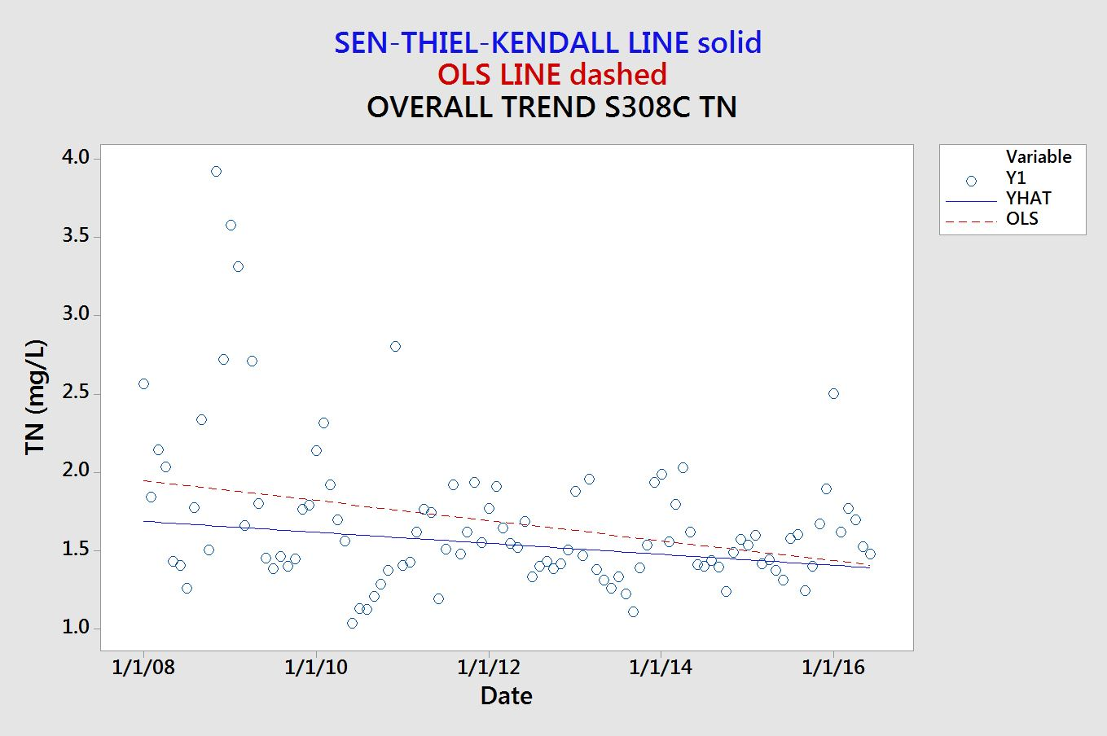
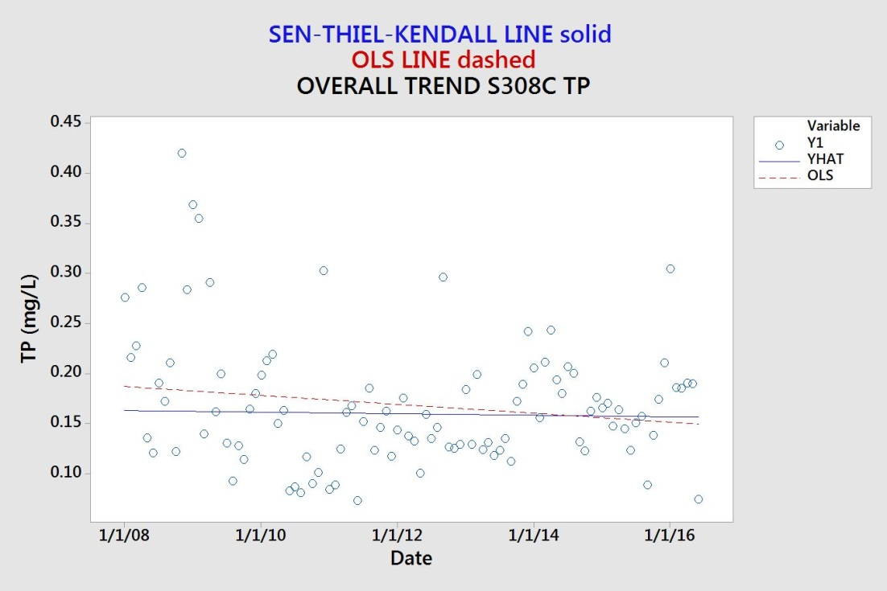
Individual Site Seasonal Kendall Trend Analysis Results
Seasonal Kendall Trend Analysis
South Fork Region (2)

Slide 34
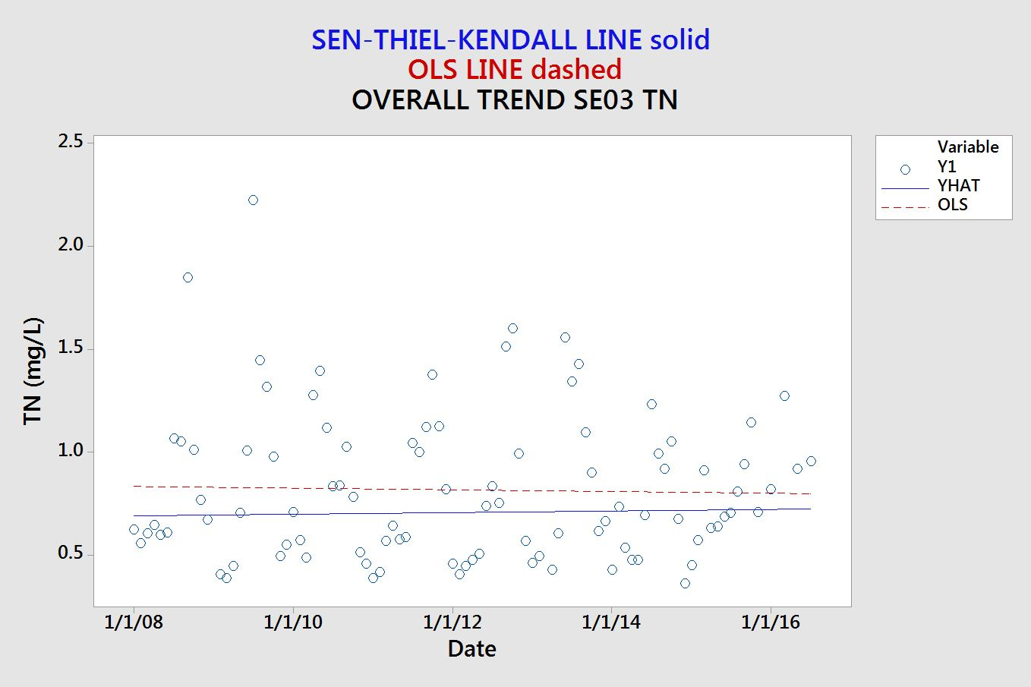
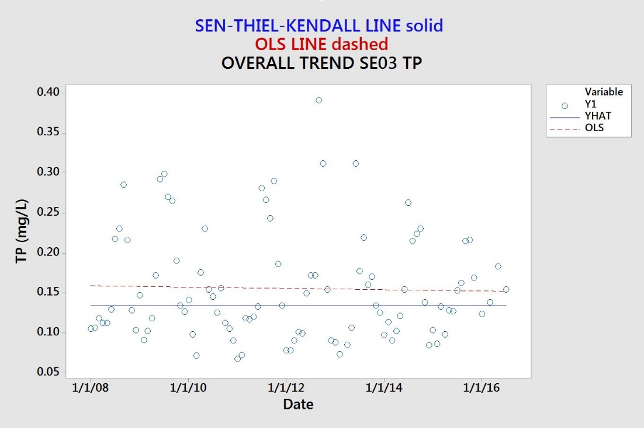
Individual Site Seasonal Kendall Trend Analysis Results
Seasonal Kendall Trend Analysis
Compliance Point (3)

Slide 35
Regional and Seasonal Trend Analysis Results
TN Regional Kendall Results
Region | Tau | P-Value
1 - N Fork | -0.061 | 0.004
2 - S Fork | -0.016 | 0.557
3 - Below SE03 | -0.017 | 0.494
TP Regional Kendall Results
Region | Tau | P-Value
1 - N Fork | -0.046 | 0.031
2 - S Fork | -0.016 | 0.557
3 - Below SE03 | 0.000 | 0.993
TN Regional & Seasonal Kendall Results |  |  |  | TP Regional & Seasonal Kendall Results
Region | Tau | P-Value |  | Region | Tau | P-Value
1 - N Fork | -0.077 | 0.001 |  | 1 - N Fork | -0.055 | 0.013
2 - S Fork | -0.031 | 0.293 |  | 2 - S Fork | -0.033 | 0.258
3 - Below SE03 | -0.016 | 0.538 |  | 3 - Below SE03 | 0.011 | 0.690
Notes:
P-values were not corrected for serial correlation
Season Criteria
1-Wet season (June-Sept)
2- Dry season (Oct-May)
Region and Criteria
1- Sites on or contributing to the North Fork of the St. Lucie River; above SE03
2- Sites on or contributing to the South Fork of the St. Lucie River; above SE03
3- Sites on or contributing to the eastern portion of the St. Lucie River below SE03

Slide 36
END OF PRESENTATION

Slide 37
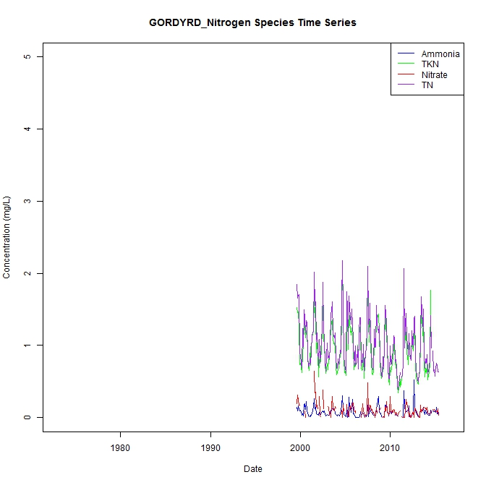
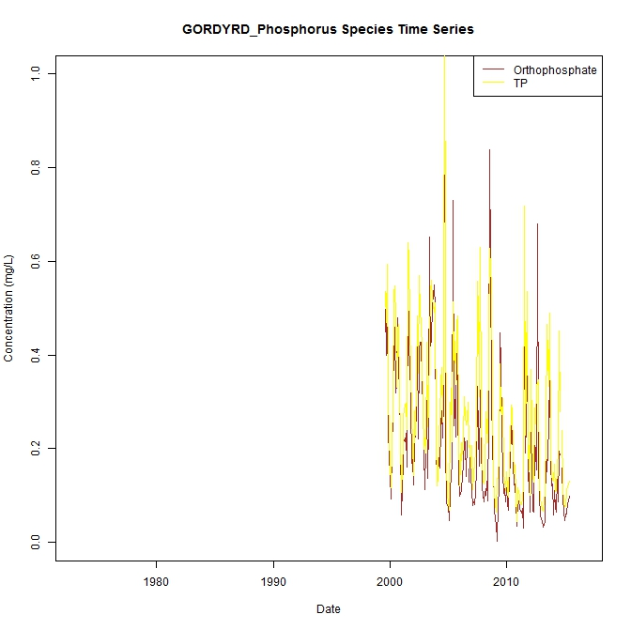
Time Series Results

Slide 38
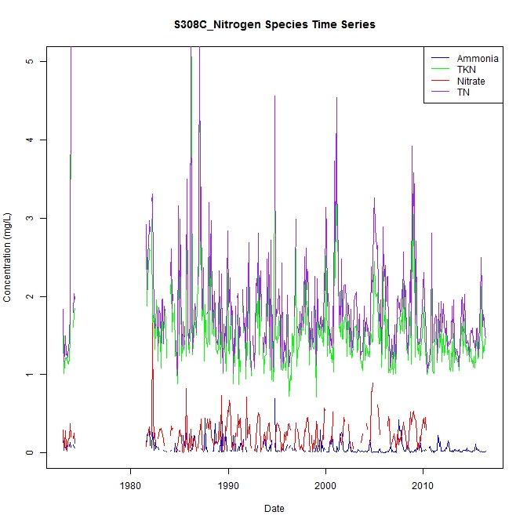
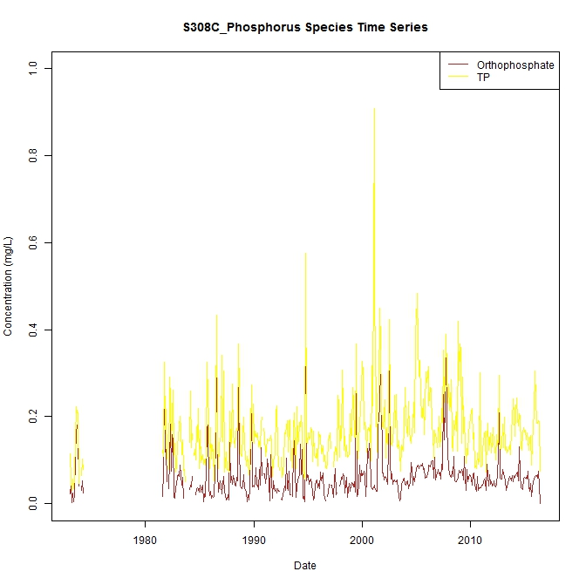
Time Series Results

Slide 39
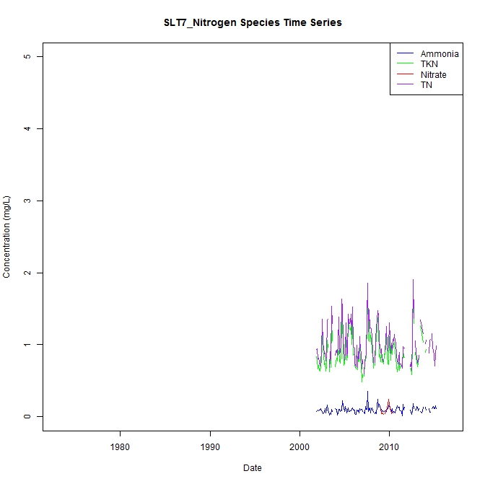
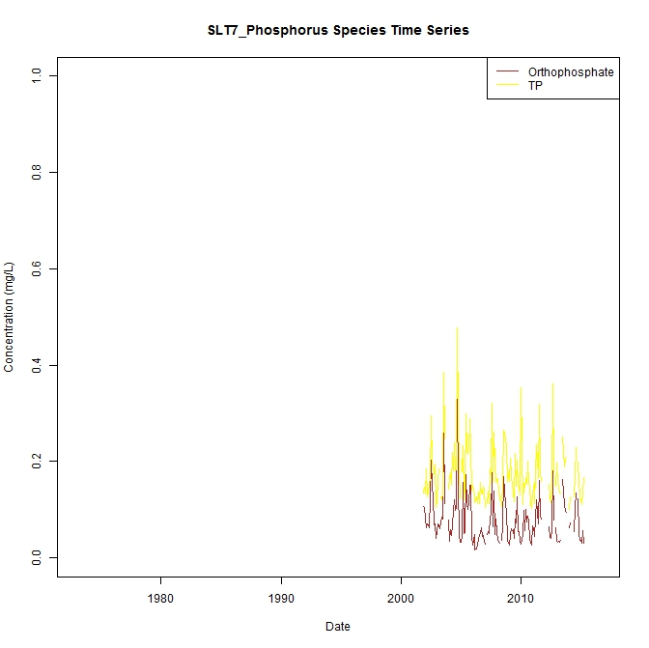
Time Series Results

Slide 40
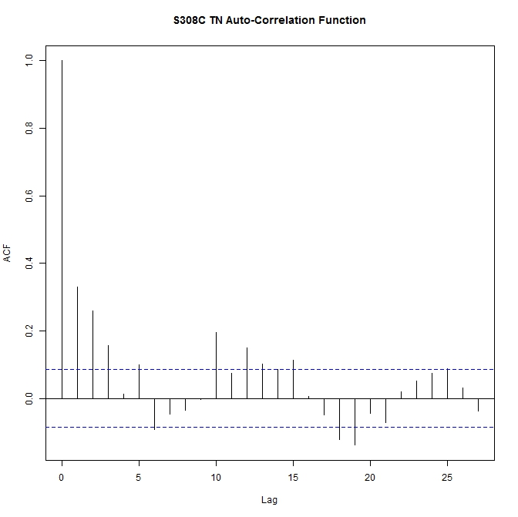
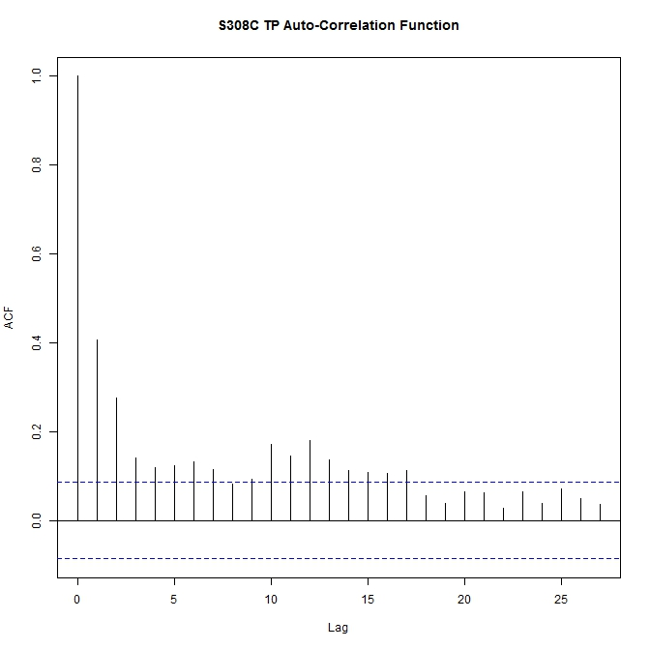
Autocorrelation Function Results
Notes:
We don’t see a strong pattern here at S308C. For TN, it could be interpreted as weak and inconsistent. But no pattern for TP.
This may be due to anthropogenic influences such as controlled discharge
There is a difference between the underlying physical processes that are controlling this data and Gordy Rd.

Slide 41
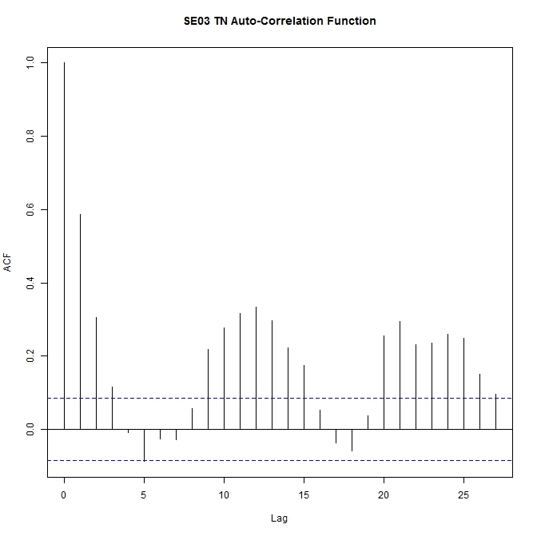
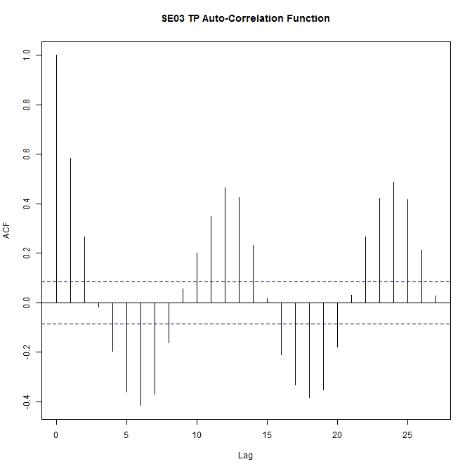
Autocorrelation Function Results
Notes:
There is an annual pattern seen here, not semi-annual as in Gordy Rd. station.
This may also be indicative of a regulated/managed system,
*I didn’t show the results for SLT44, but that site also does not have a strong correlation and no long term trend. The results indicate a mixed bag, which is a mixture of natural and regulated influences.
So there seem to be 3 extremes: natural, mixed and regulated or managed causing distinct shapes in the result output. All of this is based on the underlying biological and physical processes respective of the site.

Slide 42
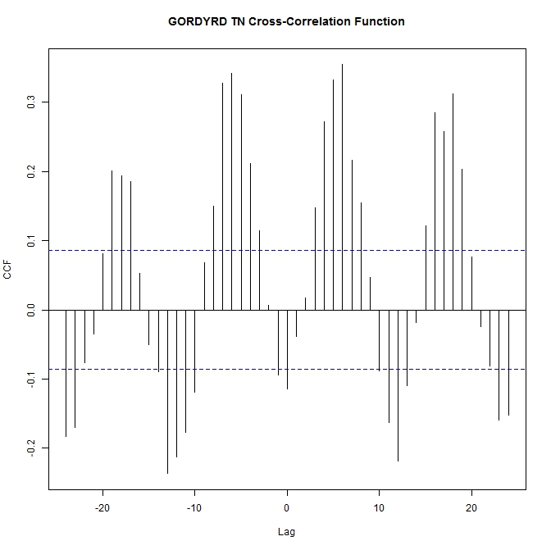
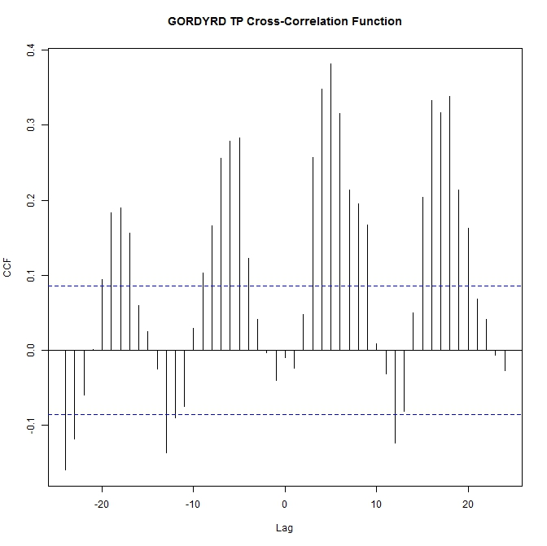
Cross-correlation Function Results

Slide 43
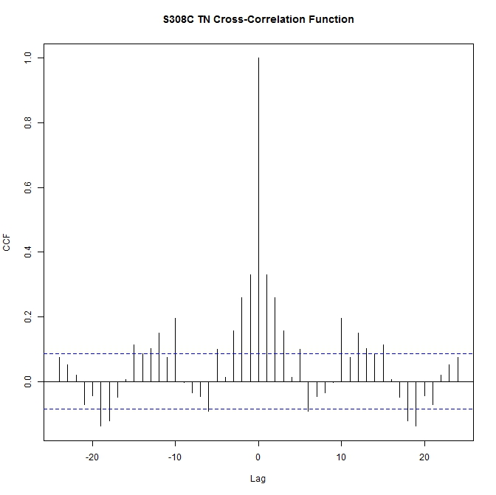
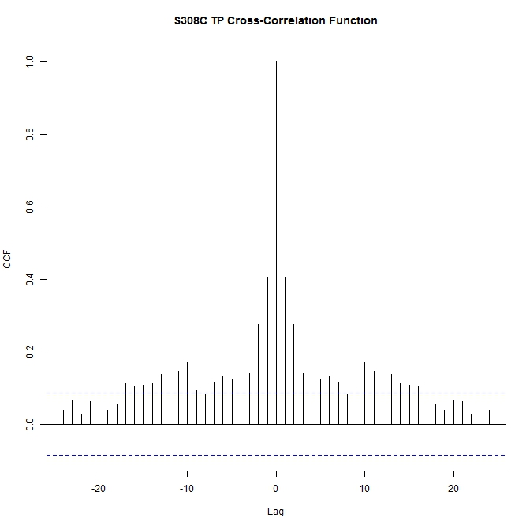
Cross-correlation Function Results

Slide 44
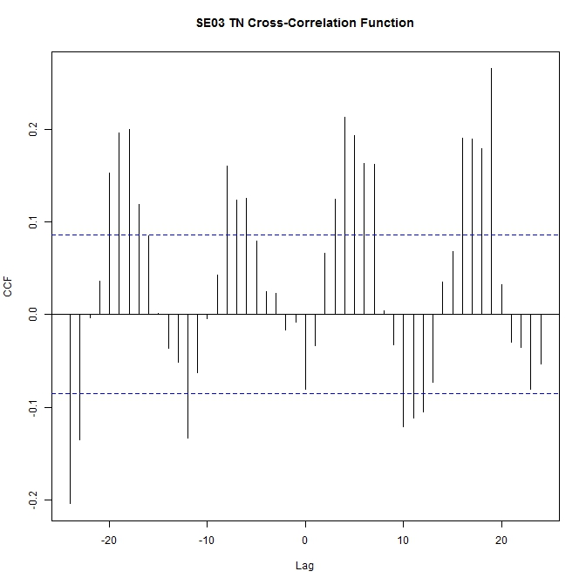
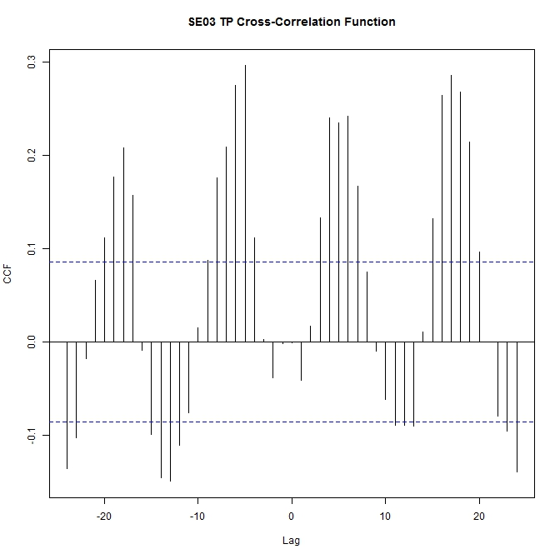
Cross-correlation Function Results

Slide 45
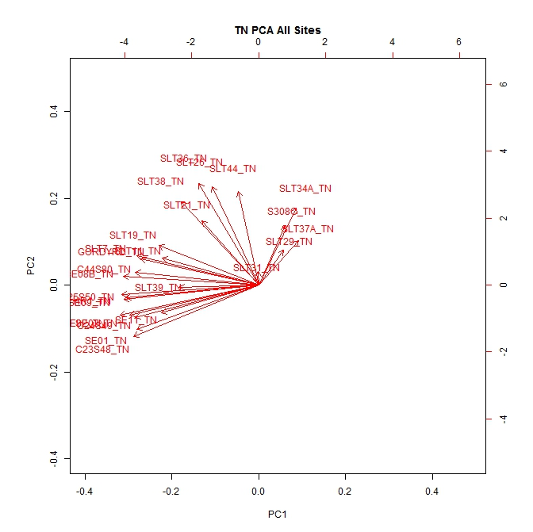
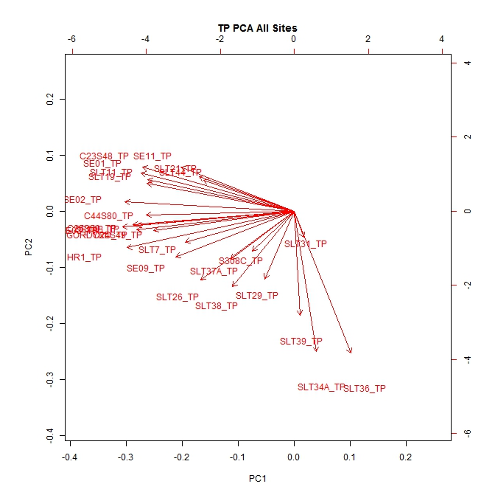
Principal Components Analysis
Notes:
PCA is a useful tool for identification of important monitoring sites and parameters. PCA is an application of an empirical approach for assessing variation and for classification of sites based on nutrient parameters. Multivaraiate stat nonparametric
Our evaluation variable for this analysis is the monitoring stations TN/TP data
What sites are responsible for data structure explaining at leas 90% of total variability of the dataset?
Could also use the method to extract parameters that are most important in assessing variation in WQ

Slide 46
Principal Components Analysis

Slide 47
Principal Components Analysis
Notes:
Deleted slides with PC and eigenvalues

Slide 48
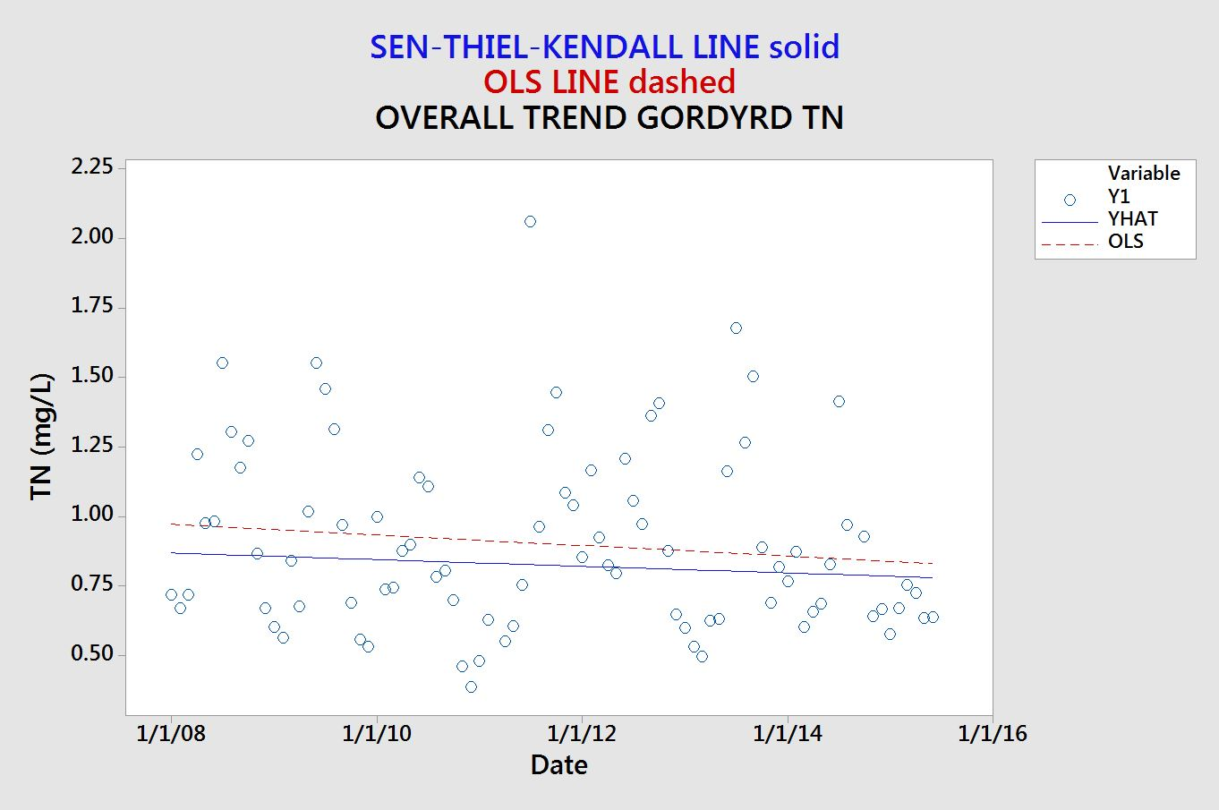
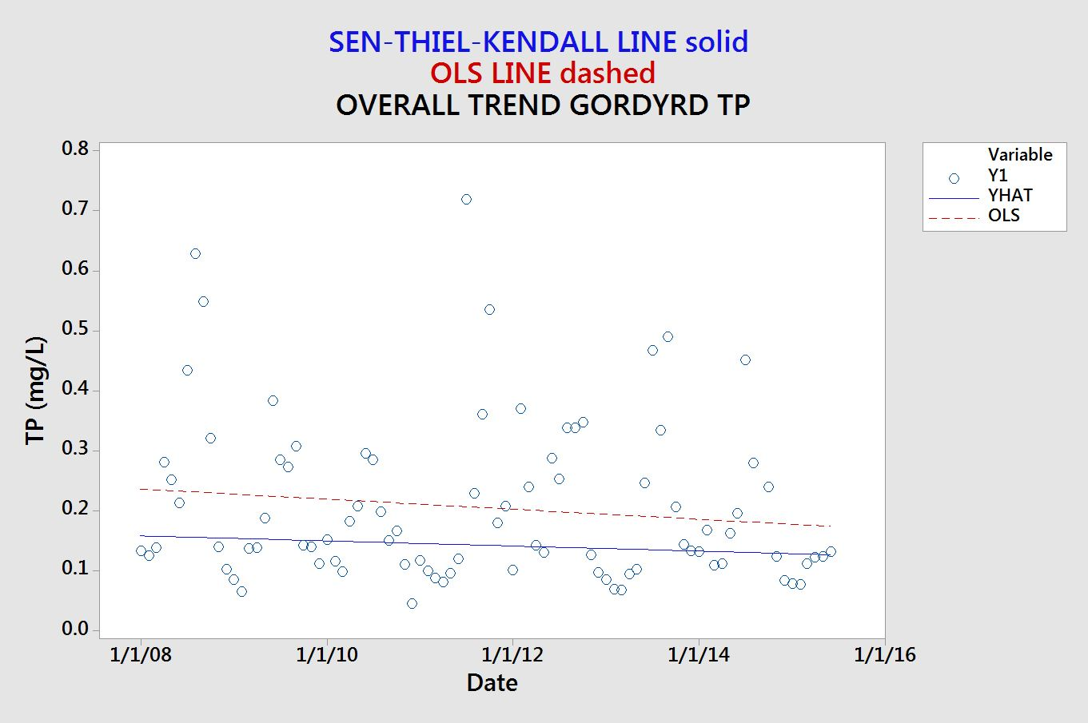
Individual Site Seasonal Kendall Trend Analysis Results
Seasonal Kendall Trend Analysis
North Fork Region (1)

