Slide 1
Water Quality Restoration Program
St. Lucie River
Water Quality Prioritization and Data Analysis
October 26, 2016
Mary Szafraniec, PhD
Amec Foster Wheeler
Mary.Szafraniec@amecfw.com

Slide 2
Overview
BMAP Monitoring Network water quality site prioritization
Trend analysis

Slide 3
Water Quality Site Prioritization

Slide 4
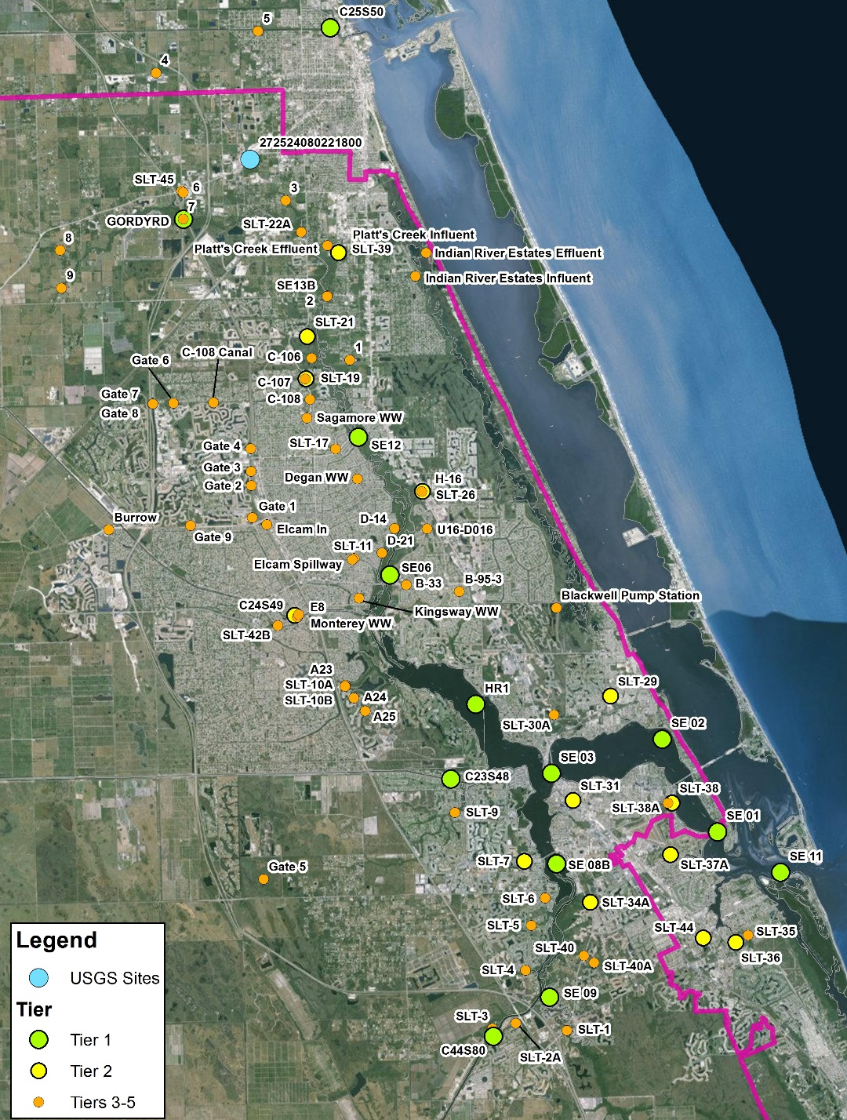
St. Lucie BMAP Monitoring Network Stations
All stations in monitoring network
Data Providers:
  North St. Lucie River WCD
  Port St. Lucie
  SFWMD
  St. Lucie County
  St. Lucie West Services District
  U.S. Geological Survey

Slide 5
Prioritization Methodology
Step 1: Database Assessment
Data Retrieval: STORET, DBHydro
Data Screening: period of record (POR), sampling frequency, and data gaps
Data Processing/Formatting: data qualifiers, replicates, coincident time step
Development of Tier Criteria Table
Development of Monitoring Station Summary Table with Tier Classification
Tier Classification list developed based on data availability, POR, sampling frequency, and data gaps

Slide 6
Tier Criteria
Tier | Criteria | Stations Used for Data Analysis
1 | - Most recent data records are from 2015 or later. | YES
 | - Five or more consecutive years of data exist going back from the time of most recent data (2015/2016).
 | - Data gaps less than 90 days in most recent consecutive five year period.
 | - Typical sampling frequency of monthly or shorter frequency.
 | - All quarters in most recent consecutive five year period have data.
2 | - Most recent data records are from 2015 or later. | YES
 | - Five or more consecutive years of data exist going back from the time of most recent data (2015/2016).
 | - Typical sampling frequency greater than monthly, and less than or equal to annually.
 | - No more than one complete quarter of missing data per year in most recent consecutive five year period.
3 | - Most recent data records are earlier than 2015. | NO
 | - Less than five consecutive years of data exist going back from the time of most recent data.
 | - More than one complete quarter of missing data exists per year in most recent consecutive five year period.
 | - Typical sampling frequency greater than monthly, less than or equal to annually.
4 | - Data assumed not ambient per site description. | NO
5 | - Data not available in STORET or DBHYDRO. | NO
Notes:
Temporary suspensions or alterations to frequencies less than one year did not affect Tier classifications.

Slide 7
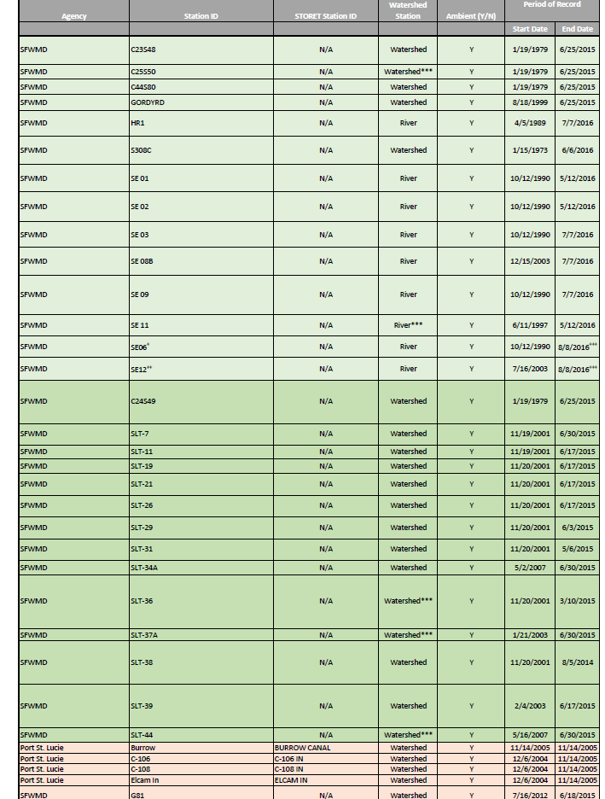
Station Summary Table
-See handout

Slide 8
Prioritization Methodology
Step 2: Data Driven Prioritization based on Statistical Analyses
Time Series Analysis
  Parameter reduction
Autocorrelation Function Analysis (ACF)
  Identify trends/periodicity in data in individual sites
Cross-correlation Analysis (CCF)
  Identify correlation between SE03 and all other stations
Principal Components Analysis (PCA)
  Identify similarity/correlations/groupings among stations
Notes:
TS analysis: To detect any obvious temporal/seasonal trends and potential outliers
ACF + CCF: we generated auto-correlation and cross-correlation graphs to identify any potential cyclic or temporal behavior within a time-series for a given parameter or to determine similarities between observed time-series at SE03 (compliance station) and other river or watershed sites. Auto-correlation graphs plot correlation values between a data point and the values observed at the same site after a certain lag time. Similarly cross-correlation graphs allow plotting correlation between a data point and the values observed at another site after a certain lag. Cross-correlation graphs are useful in identifying how water quality parameters are correlated at different lag times. Different from a linear correlation since those are usually coincident time steps or purposely lagged based on a known physical or biological process.
PCA: multivariate statistical analysis (nonparametric) method to understand the temporal and spatial variability of WQ parameters and to determine patterns and interactions across all of the stations using TN and TP as parameters. PCA (similar to cluster analysis) can be used to classify stations into groups that share similar characteristics or properties. We went a step further to optimize the results by following the PCA with a rotation called varimax, which is used to simplify the PCA results. It maximizes the sum of the variances of the squared loadings (squared correlations between variables and factors)
Future work: The cross-correlation graphs could be useful in identifying how flow patterns influence water quality parameters. For instance, a cross-correlation graph indicating a high degree of correlation between a given point and one that lags by five days might indicate a time-of-flow from adjacent site to site of interest of approximately five days. Recommend conducting flow vs. TN and TP concentrations at coincident or different sites that are hydraulically connected within reason.

Slide 9
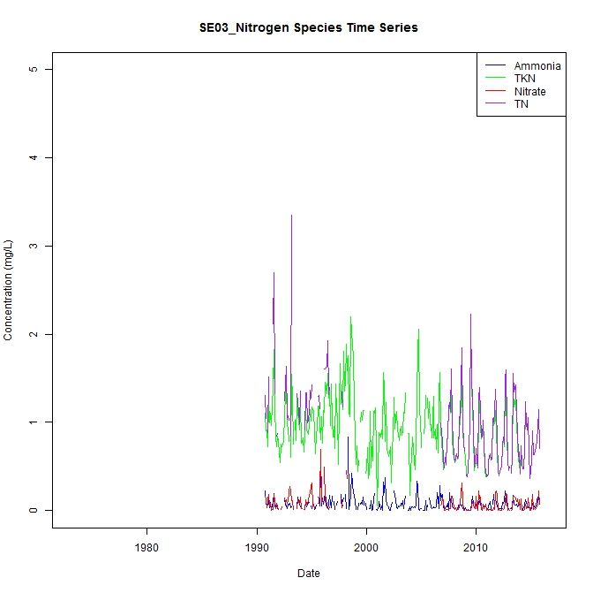
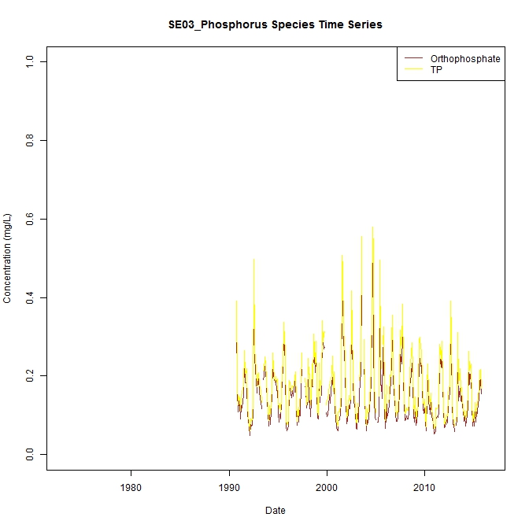
Time Series Results

Slide 10
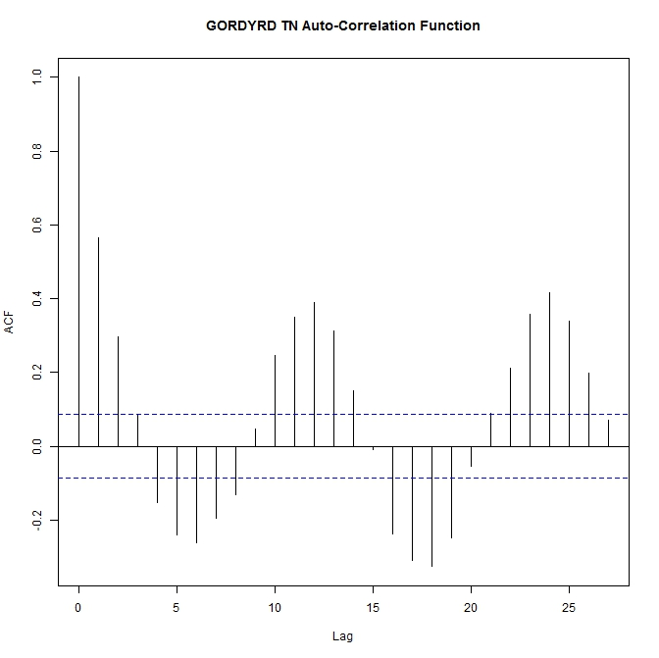
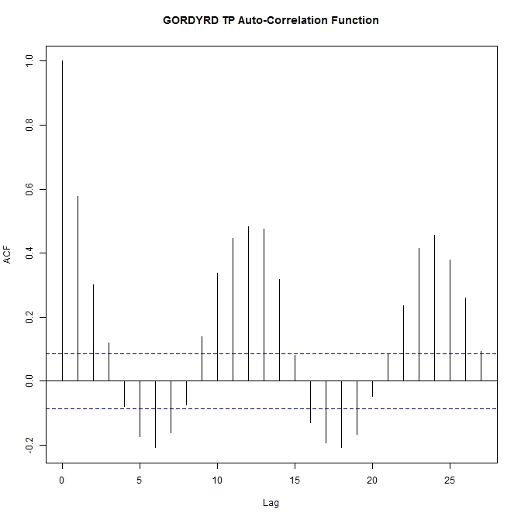
Autocorrelation Function Results
Notes:
Textbook example of seasonality at Gordy Rd.
Very strong annual seasonal pattern
Inverse relationship on a SEMI-ANNUAL trend, happens every 6 months
Positive trend today will be negative 6 months from now.
This indicates a natural cycle

Slide 11
Trend Analysis

Slide 12
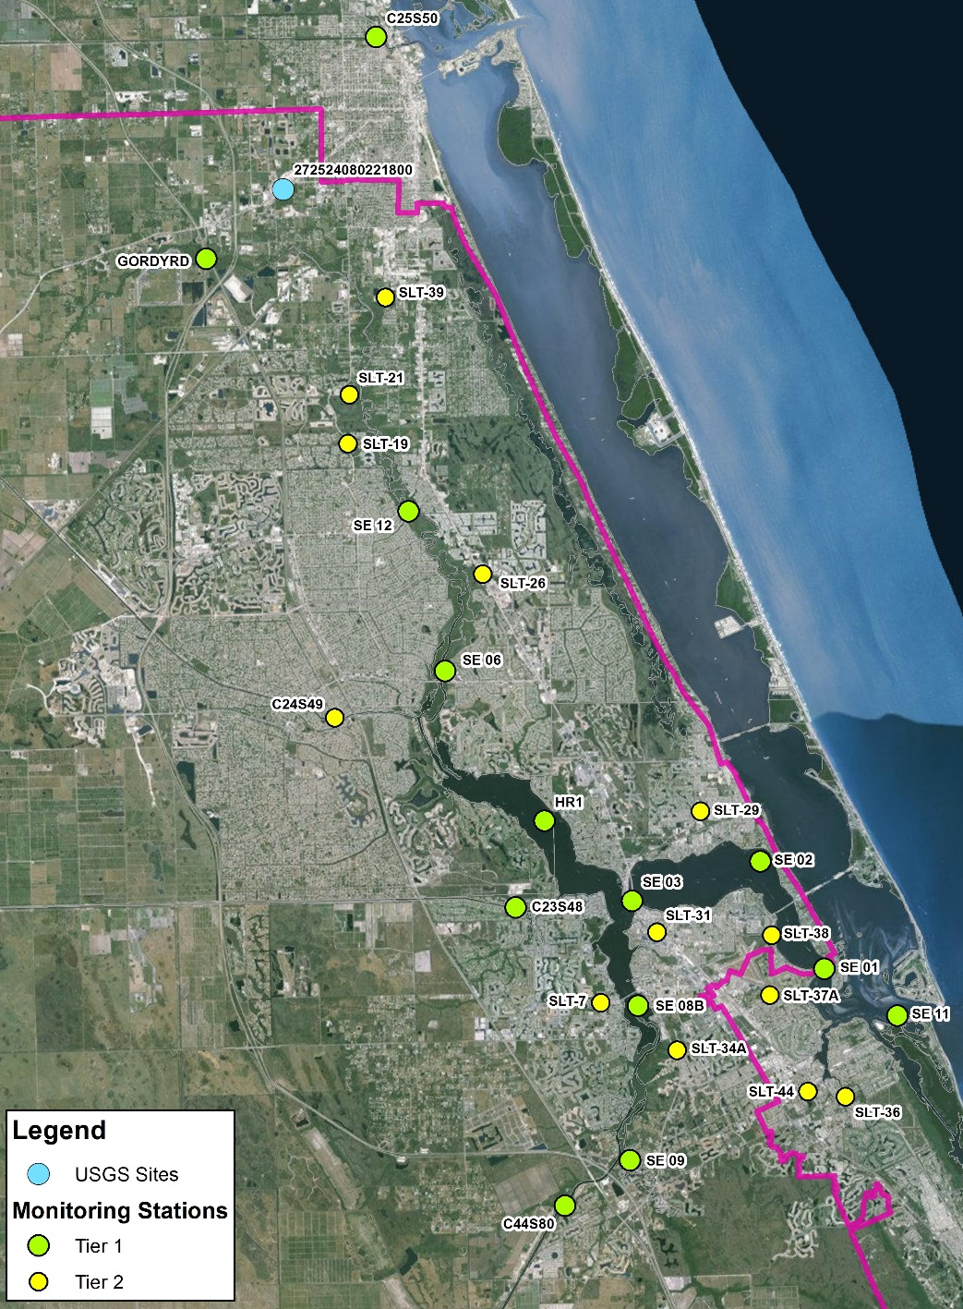
Trend Analysis Methodology
Statistical Trend Analysis
Tier I and II stations used to conduct trend analyses
Monthly mean values used in analyses for POR (1/1/2008 – 7/1/2016)
Data filtered to include surface water grab samples
Fatal flaw qualifier codes removed
  Non-detect data converted to ½*MDL

Slide 13
Trend Analysis Methodology
Statistical Trend Analysis
Monotonic trend analyses used the non-parametric Mann-Kendall test to identify trends in a statistically rigorous way
  Accounted for seasonal variability on individual sites (Seasonal Kendall test)
    Wet vs. Dry season
  Accounted for regional variability (Regional Kendall test)
    Region 1: North Fork watershed and river stations
    Region 2: South Fork watershed and river stations
    Region 3: Watershed and river stations below SE03
  Combined trend tests using both seasonal and regional Kendall tests

Slide 14
Individual Site Seasonal Kendall Trend Analysis Results
TN Seasonal Mann-Kendall Results
Station | Region | Tau | P-Value
C23S48 | 1 - N Fork | 0.060 | 0.433
C24S49 | 1 - N Fork | -0.126 | 0.109
C25S50 | 1 - N Fork | -0.059 | 0.440
GORDYRD | 1 - N Fork | -0.091 | 0.237
HR1 | 1 - N Fork | 0.027 | 0.721
SE 06 | 1 - N Fork | -0.097 | 0.185
SE12 | 1 - N Fork | -0.194 | 0.008
SLT11 | 1 - N Fork | -0.125 | 0.116
SLT19 | 1 - N Fork | -0.086 | 0.286
SLT21 | 1 - N Fork | -0.198 | 0.019
SLT26 | 1 - N Fork | -0.113 | 0.164
SLT39 | 1 - N Fork | 0.012 | 0.898
C44S80 | 2 - S Fork | -0.027 | 0.733
S308C | 2 - S Fork | -0.193 | 0.006
SE08B | 2 - S Fork | 0.043 | 0.555
SE09 | 2 - S Fork | 0.060 | 0.410
SLT31 | 2 - S Fork | 0.186 | 0.025
SLT34A | 2 - S Fork | -0.146 | 0.063
SLT7 | 2 - S Fork | -0.113 | 0.186
SE01 | 3 - Below SE03 | 0.073 | 0.324
SE02 | 3 - Below SE03 | 0.072 | 0.326
SE03 | 3 - Below SE03 | 0.025 | 0.737
SE11 | 3 - Below SE03 | 0.132 | 0.073
SLT29 | 3 - Below SE03 | -0.114 | 0.163
SLT36 | 3 - Below SE03 | -0.369 | 0.000
SLT37A | 3 - Below SE03 | -0.107 | 0.185
SLT38 | 3 - Below SE03 | -0.185 | 0.046
SLT44 | 3 - Below SE03 | -0.062 | 0.433
TP Seasonal Mann-Kendall Results
Station | Region | Tau | P-Value
C23S48 | 1 - N Fork | 0.070 | 0.364
C24S49 | 1 - N Fork | -0.001 | 0.990
C25S50 | 1 - N Fork | 0.020 | 0.794
GORDYRD | 1 - N Fork | -0.127 | 0.098
HR1 | 1 - N Fork | -0.034 | 0.644
SE 06 | 1 - N Fork | -0.165 | 0.022
SE12 | 1 - N Fork | -0.213 | 0.003
SLT11 | 1 - N Fork | 0.021 | 0.790
SLT19 | 1 - N Fork | -0.100 | 0.211
SLT21 | 1 - N Fork | -0.009 | 0.922
SLT26 | 1 - N Fork | -0.101 | 0.213
SLT39 | 1 - N Fork | -0.124 | 0.154
C44S80 | 2 - S Fork | 0.034 | 0.663
S308C | 2 - S Fork | -0.020 | 0.779
SE08B | 2 - S Fork | 0.021 | 0.774
SE09 | 2 - S Fork | 0.012 | 0.877
SLT31 | 2 - S Fork | -0.057 | 0.487
SLT34A | 2 - S Fork | -0.174 | 0.027
SLT7 | 2 - S Fork | -0.132 | 0.117
SE01 | 3 - Below SE03 | 0.057 | 0.435
SE02 | 3 - Below SE03 | 0.068 | 0.349
SE03 | 3 - Below SE03 | -0.008 | 0.911
SE11 | 3 - Below SE03 | 0.124 | 0.101
SLT29 | 3 - Below SE03 | -0.088 | 0.281
SLT36 | 3 - Below SE03 | -0.422 | 0.000
SLT37A | 3 - Below SE03 | 0.004 | 0.961
SLT38 | 3 - Below SE03 | 0.017 | 0.864
SLT44 | 3 - Below SE03 | 0.077 | 0.332
Notes:
Season Criteria
1-Wet season (June-Sept)
2- Dry season (Oct-May)
Region and Criteria
1- Sites on or contributing to the North Fork of the St. Lucie River; above SE03
2- Sites on or contributing to the South Fork of the St. Lucie River; above SE03
3- Sites on or contributing to the eastern portion of the St. Lucie River below SE03
TN: 19% 5 decreasing trends out of 26 sites; 4% 1 increasing trends out of 26 sites
TP: 15% 4 decreasing trends out of 26 sites
P-values were not corrected for serial correlation

Slide 15
Individual Site Seasonal Kendall Trend Analysis Results
Seasonal Kendall Trend Analysis
North Fork Region (1)

Slide 16
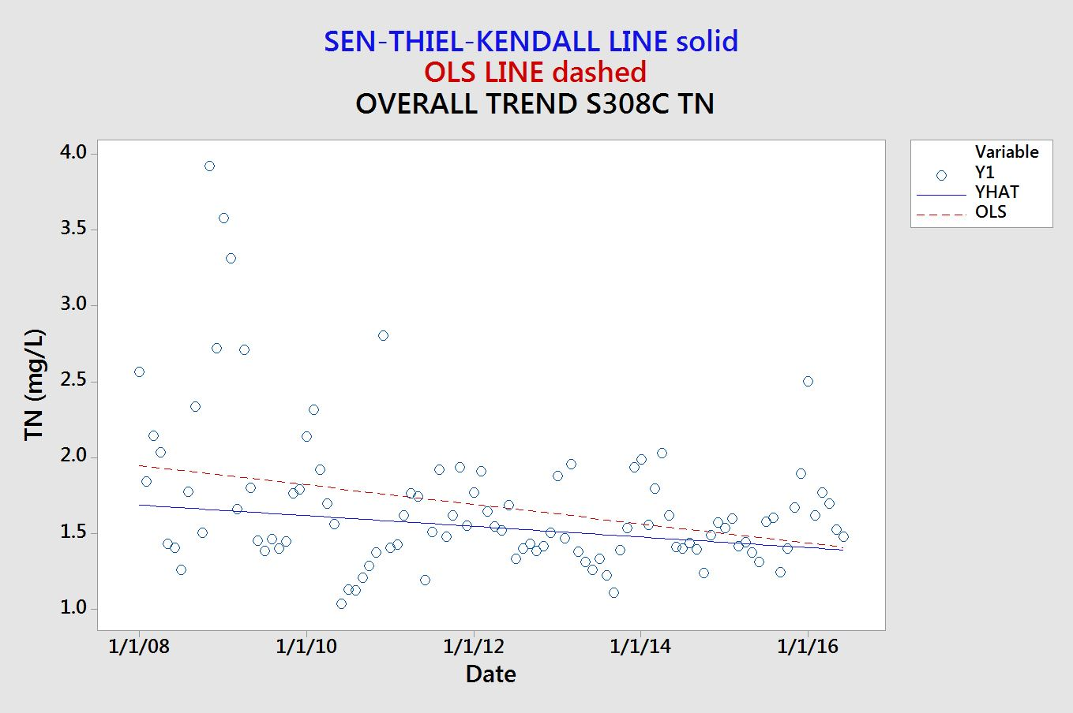
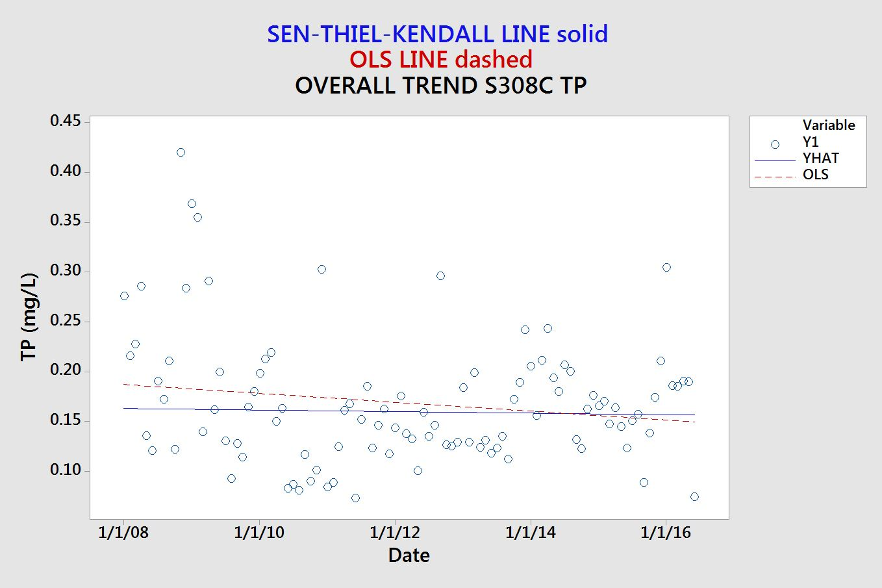
Individual Site Seasonal Kendall Trend Analysis Results
Seasonal Kendall Trend Analysis
South Fork Region (2)

Slide 17
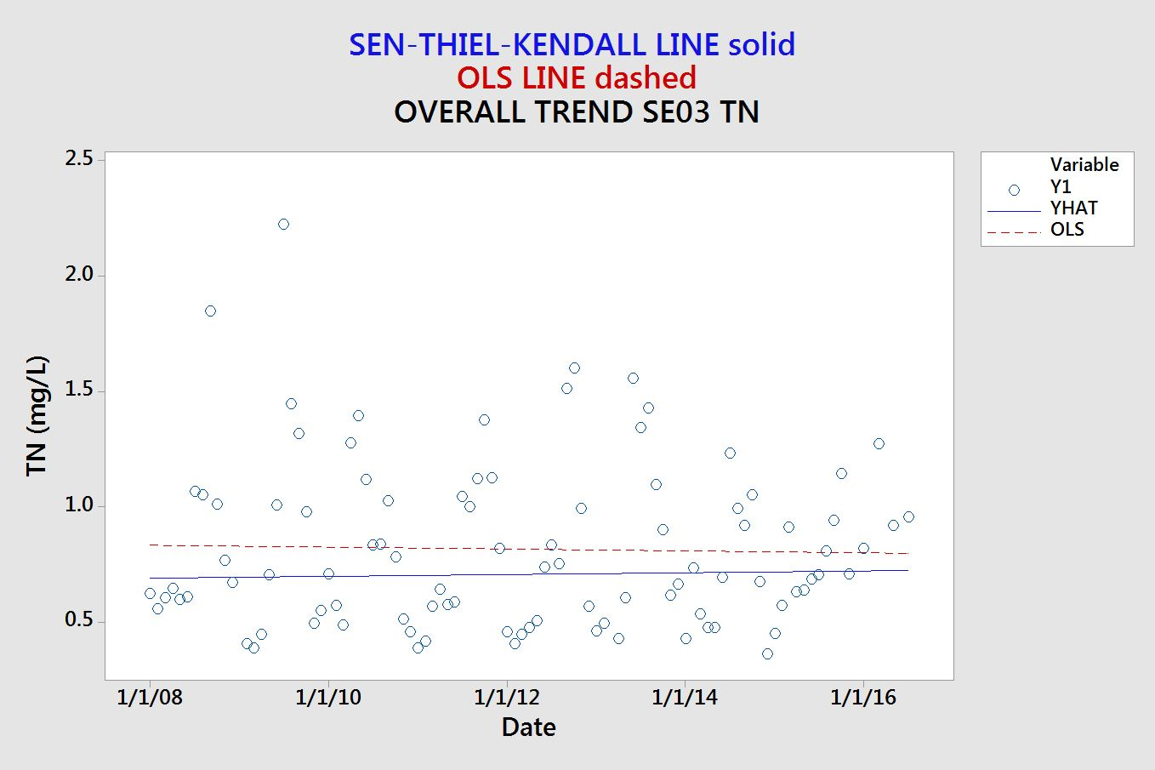
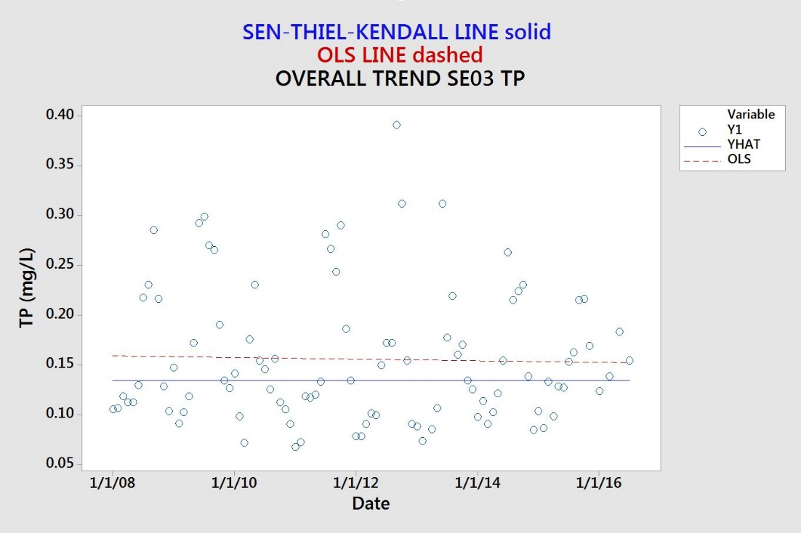
Individual Site Seasonal Kendall Trend Analysis Results
Seasonal Kendall Trend Analysis
Compliance Point (3)

Slide 18
Regional and Seasonal Trend Analysis Results
TN Regional Kendall Results
Region | Tau | P-Value
1 - N Fork | -0.061 | 0.004
2 - S Fork | -0.016 | 0.557
3 - Below SE03 | -0.017 | 0.494
TP Regional Kendall Results
Region | Tau | P-Value
1 - N Fork | -0.046 | 0.031
2 - S Fork | -0.016 | 0.557
3 - Below SE03 | 0.000 | 0.993
TN Regional & Seasonal Kendall Results |  |  |  | TP Regional & Seasonal Kendall Results
Region | Tau | P-Value |  | Region | Tau | P-Value
1 - N Fork | -0.077 | 0.001 |  | 1 - N Fork | -0.055 | 0.013
2 - S Fork | -0.031 | 0.293 |  | 2 - S Fork | -0.033 | 0.258
3 - Below SE03 | -0.016 | 0.538 |  | 3 - Below SE03 | 0.011 | 0.690
Notes:
P-values were not corrected for serial correlation
Season Criteria
1-Wet season (June-Sept)
2- Dry season (Oct-May)
Region and Criteria
1- Sites on or contributing to the North Fork of the St. Lucie River; above SE03
2- Sites on or contributing to the South Fork of the St. Lucie River; above SE03
3- Sites on or contributing to the eastern portion of the St. Lucie River below SE03

