Slide 1
DB Hydro TP Averages @ S-48 Structure
Jan-Dec 2015
    .296 mg/l (all 7-day timed composite samples, 52 samples)
Jan – Dec 2016
    .506 mg/l (all 7-day timed composite samples, 52 samples)
Jan – Aug 2017
    .280 mg/l (all 7-day timed composite samples, 34 samples, stopped in Aug)
Sept – Dec 2018
    .148 mg/l (all weekly grab sample,16 samples, Sept – Dec)
Jan – Dec 2019
    .153 mg/l (all weekly grab samples, 51 samples)
Jan – May 2020
    .208 mg/l (combo of Grab and Composites, 20 samples , w/ 4 grab samples in January, and 2 in May)

Slide 2
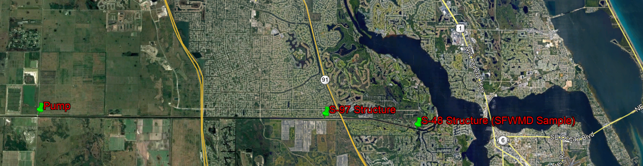
Future Load Reduction for SLR/C-23 WQP
CPSL having continuing discussions with SFWMD/FDEP about the sample results/validity/reliability from the S-48 structure/auto sampler along with the lower than normal concentrations we are seeing in the C-23 Canal.
    S-48 is 12.25 miles downstream
    The S-97 control structure is between SLR/C-23 and S-48 structure
    Auto Sampler was OOS from Aug 2017 – Feb 2020. Used Grab Sample Results at S-48, (2018-2019 all grab samples)
    Feb 2020 started using a 7-day timed composite sample, auto Sampler OOS again from May 7-21 (used grab samples)
    At times CPSL pumps into the AGI, and S-97 gates are not open
    Between weekly grab samples, S-48 timed composite sample, combined with occasional pumping into AGI when S-97 gates aren’t open, S-48 structure doesn’t appear to be a representative sample
    FDEP informed us we should start using the 5-yr SFWMD moving averages. TN-1.57mg/l, TP-.377mg/l (6/25/2020)
    More research may be needed over the years to determine the most accurate way to receive credits.

Slide 3
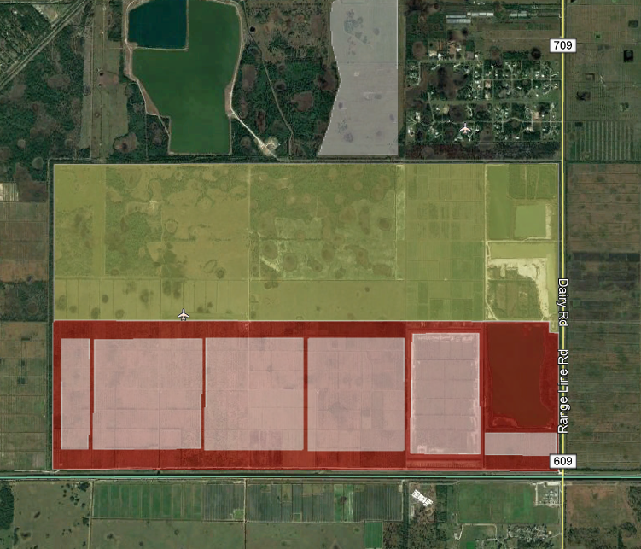
Future Load Reductions for SLR/C-23 WQP
From June 2019 to May 2020
  Pumped 786 Million Gallons onsite from C-23 Canal
    This is used to calculate load reduction numbers
  Pumped 1.385 Billion Gallons into AGI 1 (Above Ground Impoundment) (runoff from McCarty Ranch Extension and 2000 acres north of the Extension)
  The difference is 599 Million Gallons
  We have worked with the FDEP on these load reductions and on 5/7/2020 the FDEP confirmed will be receiving an estimated 24,000 lbs/yr TN and 5500 lbs/yr TP credit for storing this runoff.

