Slide 1
Suwannee River
Agriculture Update
Katie Hallas
Florida Department of Agriculture and Consumer Services (FDACS)
Office of Agricultural Water Policy
April 18, 2016

Slide 2
Presentation Overview
  Agricultural Best Management Practices (BMP) Program
  BMP Program Enrollment Update
  FDACS Cost-Share Opportunities

Slide 3
Agricultural BMP Overview
Practical measures that reduce amount of fertilizers, pesticides, and animal waste entering water resources.
BMP manuals developed in collaboration with agricultural industry, agencies, and others.
Must be economically and technically feasible for producer to implement.
Notes:
-Manuals adopted by FDACS. BMP manuals are verified by FDEP.
-When funding is available, FDACS works with producers to secure cost-share for some BMPs.
-BMPs are practical measures that are determined through research, field-testing, and expert review. They are designed to improve WQ while maintaining agricultural production.
-The VAC manual was originally adopted in 2006, and it was revised in 2015. The manual includes specific nutrient and irrigation management BMPS for plastic mulch, bare ground, sugarcane, hay/silage, and greenhouse production systems.
-The dairy manual became effective January 10, 2016. It includes a flowchart that directs producers how to achieve nutrient balance based on whether N or P is the limiting nutrient based on their geographic location in a basin & proximity to lakes &/or impaired waters.
-The poultry manual is under development.
-We have manuals for cow/calf, citrus, VAC, nurseries, equine operations, SFN, sod, and dairies.

Slide 4
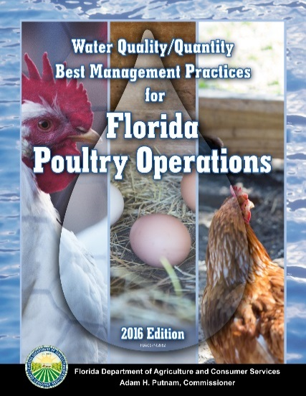
BMP Manual Update
Notes:
-Manuals adopted by FDACS. BMP manuals are verified by FDEP.
-When funding is available, FDACS works with producers to secure cost-share for some BMPs.
-BMPs are practical measures that are determined through research, field-testing, and expert review. They are designed to improve WQ while maintaining agricultural production.
-The VAC manual was originally adopted in 2006, and it was revised in 2015. The manual includes specific nutrient and irrigation management BMPS for plastic mulch, bare ground, sugarcane, hay/silage, and greenhouse production systems.
-The dairy manual became effective January 10, 2016. It includes a flowchart that directs producers how to achieve nutrient balance based on whether N or P is the limiting nutrient based on their geographic location in a basin & proximity to lakes &/or impaired waters. Growers that produce crops or livestock other than those covered by this manual should use the appropriate FDACS BMP manual. Dairies with NPDES or DEP groundwater discharge permits must follow their permit requirements. However, permitted dairies may want to use this manual for aspects of their operation that are not addressed by their permit. For very small animal operations that are below the scale intended for this manual, please see the Livestock and Poultry Environmental Stewardship program at http://www.extension.org/pages/8890/lpes-curriculum-small-farm-fact-sheets or the Maryland Small Ruminant Page at http://extension.umd.edu/sheep-goats or UF-IFAS Extension at
http://edis.ifas.ufl.edu/.
-The poultry manual is under development.

Slide 5
Statewide BMP Enrollment

Slide 6
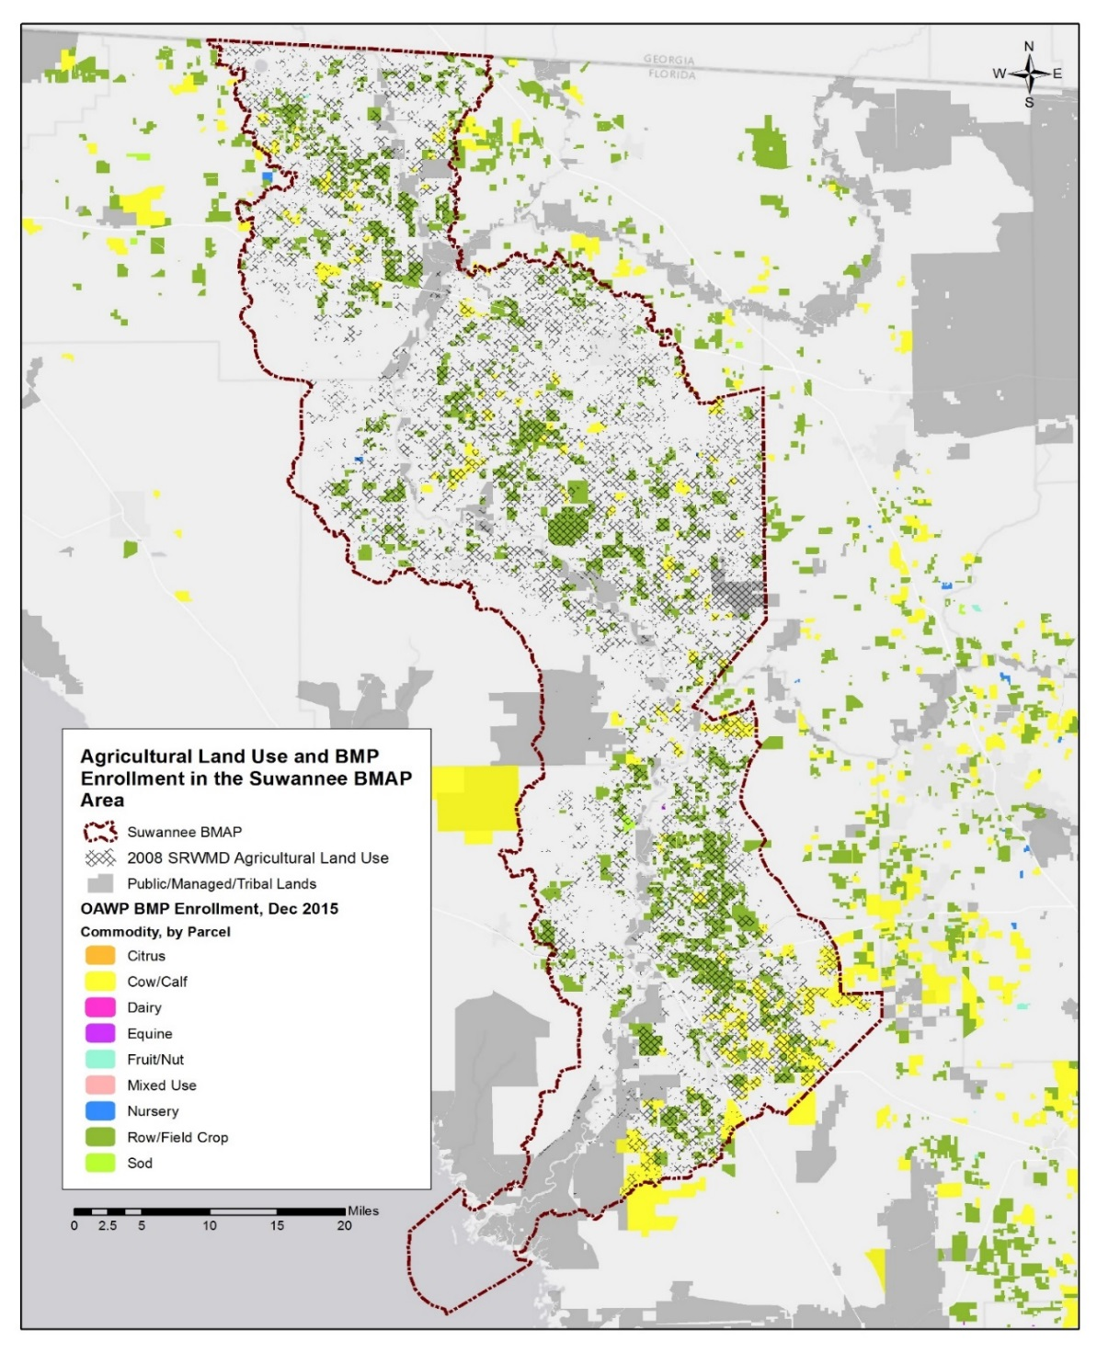
Suwannee River BMP Enrollment as of December 31, 2015

Slide 7
Suwannee River BMP Enrollment as of December 31, 2015
2008 SRWMD Land Use | 2008 Acres | Related FDACS BMP Programs | Acreage Enrolled¹ | Related NOIs
Pasture and Rangeland | 170,762.2 | Cow/Calf | 48,209.2 | 129
Row/Field/Mixed Crops | 53,328.6 | Vegetable/Agronomic Crops | 138,493.9 | 428
Hay Fields² | 94,208.4 | Vegetable/Agronomic Crops | N/A | N/A
Fallow Cropland | 3,806.1 | No enrollment needed | N/A | N/A
Citrus Groves | 39.4 | Statewide Citrus | 0.0 | N/A
Other Groves and Fruit Orchards | 1,788.8 | Specialty Fruit and Nut | 100.6 | 4
Nurseries | 3,310.4 | Statewide Nurseries | 129.7 | 3
Sod Farms | 412.3 | Sod | 187.0 | 1
Cattle Feeding Operations | 1,660.9 | Conservation Plan Rule | 0.0 | N/A
Poultry Feeding Operations | 1,713.9 | Conservation Plan Rule/Future Poultry Manual | 0.0 | N/A
Specialty Farms | 61.3 | Conservation Plan Rule | 0.0 | N/A
Horse Farms | 2,282.5 | Equine | 40.0 | 1
Dairies | 2,582.7 | Dairy | 0.0 | N/A
Other Open Lands – Rural | 5.9 | No enrollment needed | N/A | N/A
Aquaculture | 5.8 | Division of Aquaculture
Total | 335,969.2 | N/A | 187,160.5 | 566
Notes:
¹ Enrollment numbers will depend on the ability of field staff to identify and locate producers and whether producers choose to implement BMPs or monitor their water quality. Also, specific agricultural land uses and number of agricultural operations may change from year to year. Progress on enrollment, based on best available information, will be included in the BMAP annual update.
² Acreage in the hay fields category is likely an overestimate as the aerial imagery is collected in the winter when producers are growing winter forages. FDACS staff will review the most recent aerial imagery to determine if any of the acreage identified as hay fields should actually be in the row/field/mixed crop category.
We are at 55.72% enrollment.

Slide 8
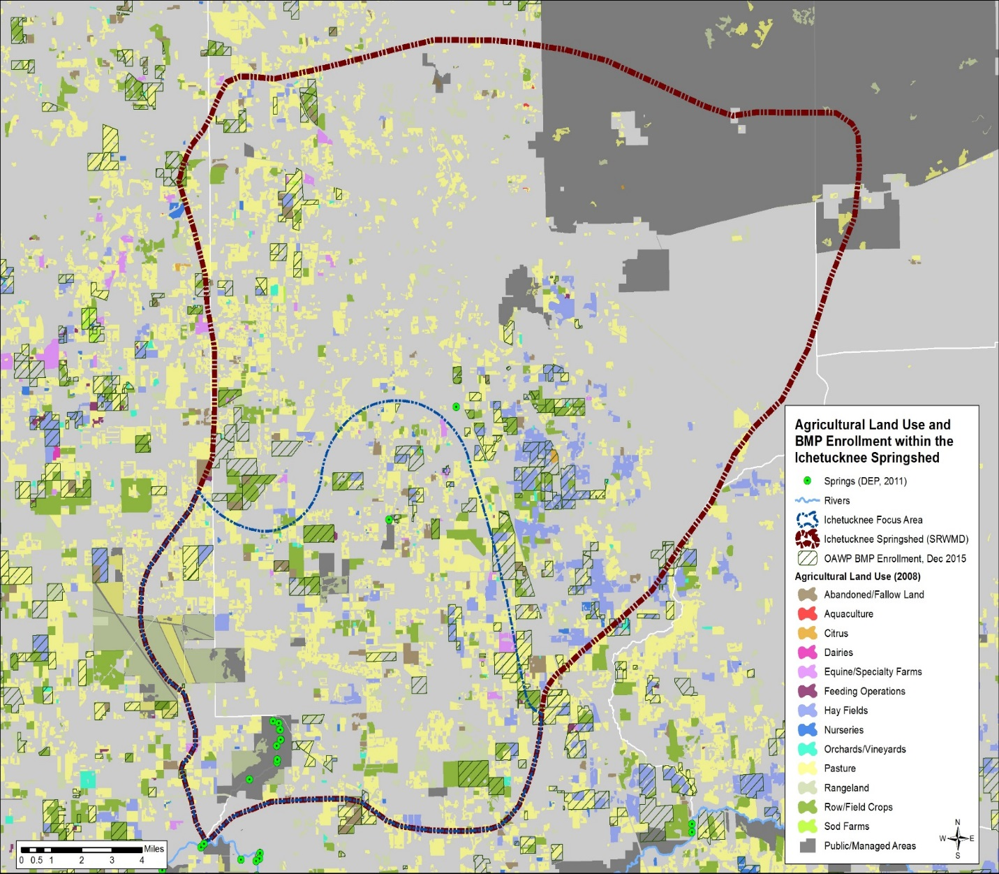
Ichetucknee Restoration Focus Area (RFA) BMP Enrollment as of December 31, 2015

Slide 9
Ichetucknee RFA BMP Enrollment as of December 31, 2015
2008 SRWMD Land Use | 2008 Acres | Related FDACS BMP Programs | Acreage Enrolled | Related NOIs
Pasture and Rangeland | 17,874.0 | Cow/Calf | 1,458.8 | 9
Row/Field/Mixed Crops | 3,915.8 | Vegetable/Agronomic Crops | 4,129.5 | 22
Hay Fields | 1,971.7 | Vegetable/Agronomic Crops | N/A | N/A
Fallow Cropland | 966.2 | No enrollment needed | N/A | N/A
Other Groves | 161.2 | Specialty Fruit and Nut | 0.0 | N/A
Nurseries | 97.1 | Statewide Nurseries | 10.0 | 1
Poultry Feeding Operations | 25.4 | Conservation Plan Rule/Future Poultry Manual | 0.0 | N/A
Horse Farms | 403.1 | Equine | 0.0 | N/A
Total | 25,414.4 | N/A | 5,598.2 | 32
Notes:
We are at 22.03% enrollment.

Slide 10
FDACS Cost-Share Opportunities
Funding available through Soil and Water Conservation Districts:
  Suwannee
  Gilchrist
  Levy
Reimbursement of 75% of equipment cost.
Contacts:
  Barton Wilder 850–688–0142
  Hugh Thomas 850–363–4574
  Joel Love 386–688–3730
  WC Hart 386–208–5091
  Ryan Lawson 386–590–1562
  Buck Carpenter 850–673–8388
  John Stubblefield 352–317–1525
  Scott Tucker 352–317–6111

Slide 11
Thank You!
Katie Hallas (Tallahassee)
Office of Agricultural Water Policy
Katie.Hallas@FreshFromFlorida.com
(850) 617-1719

