Slide 1
Suwannee River
Basin Management Action Plan
April 13, 2017
Terry Hansen P.G., Basin Coordinator
850-245-8561
terry.hansen@dep.state.fl.us

Slide 2
Suwannee River
Basin Management Action Plan (BMAP) (BMAP)
BMAP overview.
Legislative requirements (2016-1).
Nitrogen Source Inventory Loading Tool.
Loads to groundwater by source.
Schedule.

Slide 3
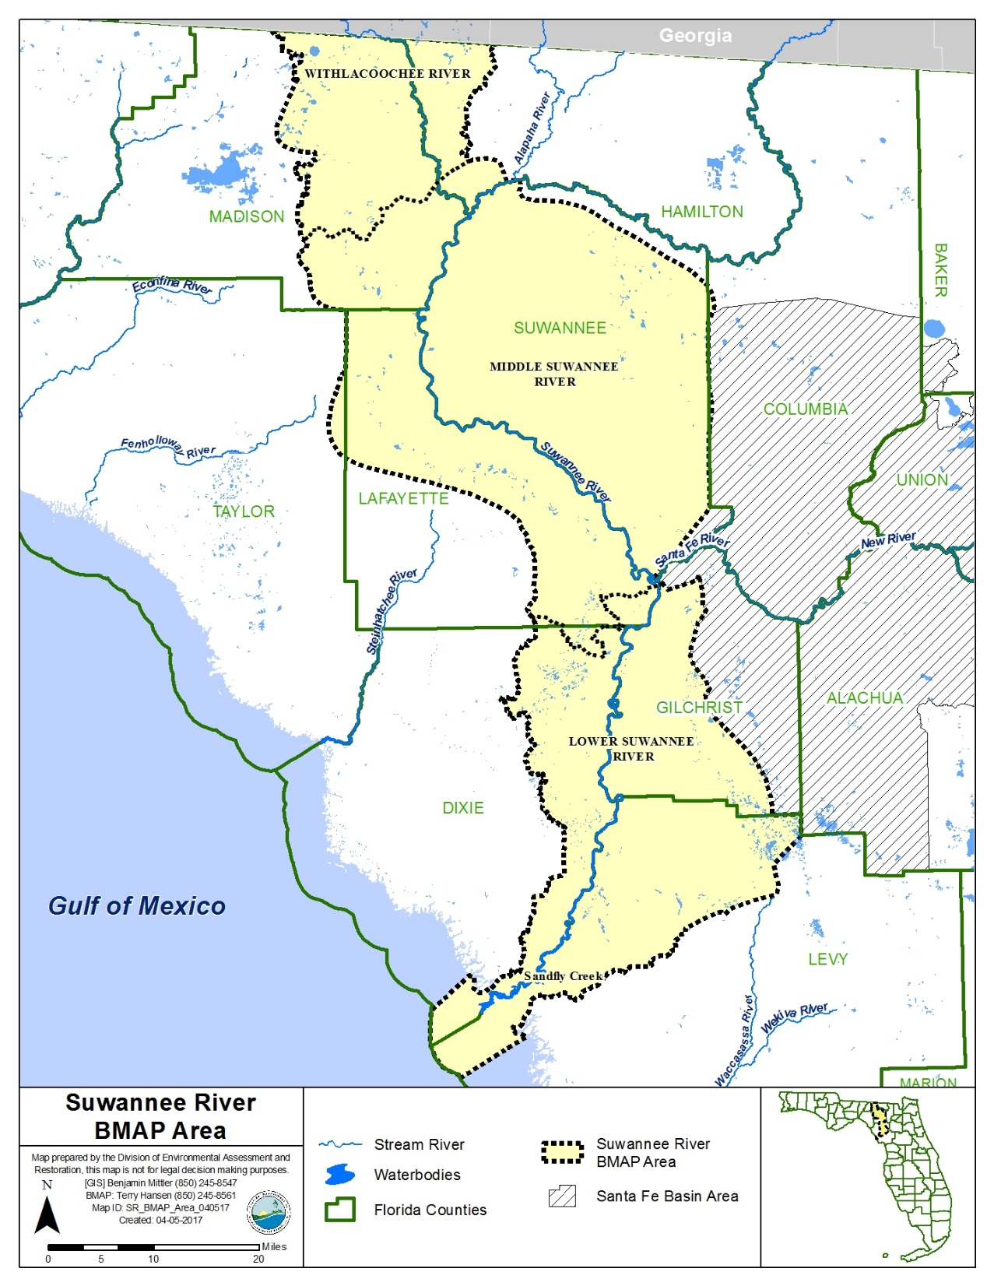
Suwannee River BMAP Area
Withlacoochee River: 41 springs
13, 1St and 2nd magnitude springs
OFS* - Madison Blue
Middle Suwannee River: 103 springs
32, 1st and 2nd magnitude springs
OFS* - Falmouth, Lafayette Blue, Peacock, and Troy
Lower Suwannee River: 31 Springs
17, 1st and 2nd magnitude springs
OFS* – Fanning and Manatee
*OFS = Outstanding Florida Spring

Slide 4
Water Quality Framework
Collect data.
Analyze and verify.
List “impaired” waters.
REPEAT
Monitor and report progress annually.
Adapt and change.
Set water quality standards
Monitor water quality
Determine pollution problems
Develop and implement restoration plans (BMAPs)
Establish restoration goals (TMDLs)
Measure success and adapt
Work with community leaders
Excessive nutrients
Bacteria
Mercury
Allocate responsibilities.
Identify projects.
  Infrastructure
  Best Management Practices (BMPs)
Establish schedules.
Identify success criteria.
Gather additional data.
Model water quality.
Adopt pollutant reduction targets.

Slide 5

BMAP
Florida Department of Environmental Protection’s (DEP’s) method for restoring water quality to an impaired water body.
BMAPs are adopted by DEP through a Secretarial Order.
BMAPs are enforceable.
BMAPs are reviewed annually and updated every five years.

Slide 6
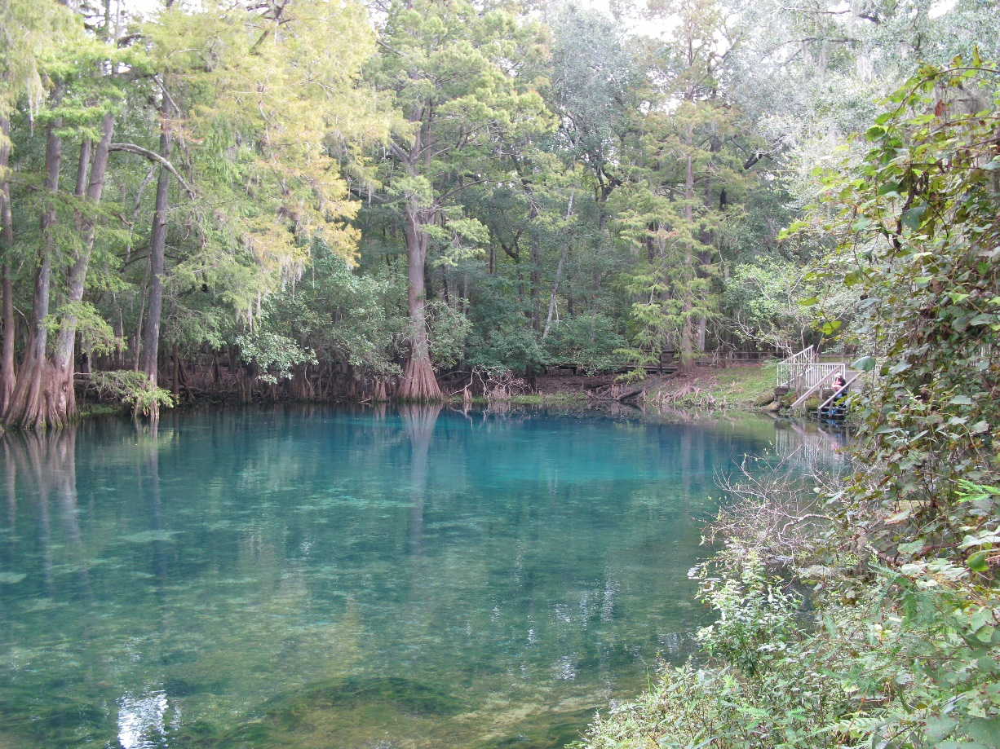
Regulatory Framework
The process for preparing BMAPs is found in:
  Section 403.067, Florida Statutes (F.S.), known as the Florida Watershed Restoration Act.
  Spells out issues that are addressed within a BMAP.

Slide 7
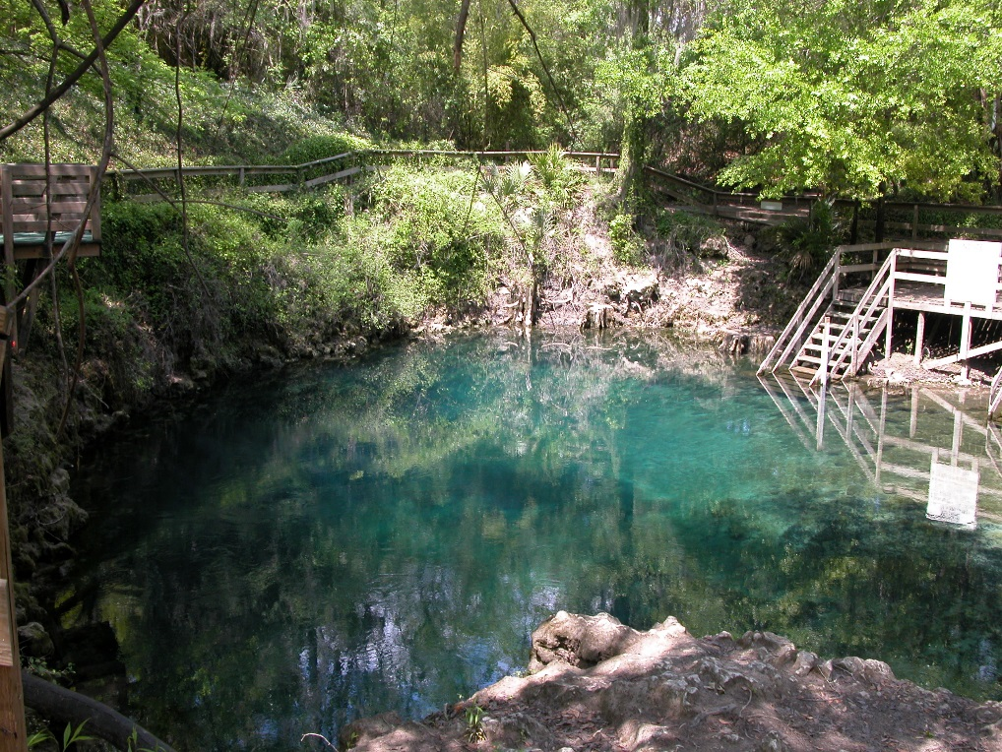
Florida Springs and Aquifer Protection Act (2016-1)
The 2016 Florida Springs and Aquifer Protection Act lists requirements for BMAPs for Outstanding Florida Springs (OFS):
  BMAPs must be adopted within two years after initiation and must include detailed project, financial and water quality benefits information; five-year incremental milestones; and implementation plan designed with a target to achieve the TMDL* no more than 20 years after adoption (373.807(1)(b), F.S.).
*TMDL = Total Maximum Daily Load

Slide 8
Florida Springs and Aquifer Protection Act (2016-1)
  Specifically the project list for the BMAP area must be:
    Prioritized.
    Include a planning level cost estimate and completion date.
    Identify funding sources.
    Identify point and nonpoint sources.
    Implementation plan with TMDL achievement less than or equal to 20 years.
    5-, 10- and 15-year schedules for planning and funding.

Slide 9
Florida Springs and Aquifer Protection Act (2016-1)
  Specifically requires:
    Identification of point sources and nonpoint source categories with estimated load allocations (NSILT).
    Fertilizer ordinance for all local governments.
    Agricultural BMPs.
  Delineate within the priority focus area (PFA):
    List of projects.
    Create an onsite sewage treatment and disposal system (OSTDS) Remediation Plan if OSTDS loads are greater than or equal to 20 % of nitrogen load, or determined to be needed by DEP.
  Prohibits within a PFA:
    Wastewater treatment facilities greater than 100,000 gallons per day (GPD), UNLESS advanced wastewater treatment (AWT) is used.
    New OSTDS on less than one-acre lots.
    Ban on land application of biosolids.
    Hazardous waste facilities.

Slide 10
PFA Requirements
  Sub-Section 373.802, F.S.:
    Definition: Area or areas of a basin where the Floridan Aquifer is generally most vulnerable to pollutant inputs where there is a known connectivity between groundwater pathways and an Outstanding Florida Spring (OFS).
  Sub-Section 373.803, F.S.:
    Delineation considers factors that may lead to degradation of an OFS, such as:
        Groundwater travel time to the spring
        Hydrogeology
        Nutrient load, etc.
Notes:
Definition: area or areas of a basin where the Floridan Aquifer is generally most vulnerable to pollutant inputs where there is a known connectivity between ground water pathways and an Outstanding Florida Spring (OFS), as determined by the department in consultation with the appropriate water management districts, and delineated in a BMAP.
Using the best data available from the water management districts and other credible sources, the department, in coordination with the water management districts, shall delineate priority focus areas for each OFS or group of springs that contains one or more OFS and is identified as impaired in accordance with s. 373.807.
PFA and is effective upon incorporation in a basin management action plan.
For ease of implementation delineation Shall use understood and identifiable boundaries such as:
Roads.
Political jurisdictions

Slide 11
Suwannee Basin PFAs
  PFAs delineated for OFS:
    Withlacoochee River (Madison Blue)
    Middle Suwannee River (Falmouth, Lafayette Blue, Peacock, and Troy)
    Lower Suwannee River (Fanning and Manatee)
Notes:
Definition: area or areas of a basin where the Floridan Aquifer is generally most vulnerable to pollutant inputs where there is a known connectivity between ground water pathways and an Outstanding Florida Spring (OFS), as determined by the department in consultation with the appropriate water management districts, and delineated in a BMAP.
Using the best data available from the water management districts and other credible sources, the department, in coordination with the water management districts, shall delineate priority focus areas for each OFS or group of springs that contains one or more OFS and is identified as impaired in accordance with s. 373.807.
PFA and is effective upon incorporation in a basin management action plan.
For ease of implementation delineation Shall use understood and identifiable boundaries such as:
Roads.
Political jurisdictions

Slide 12
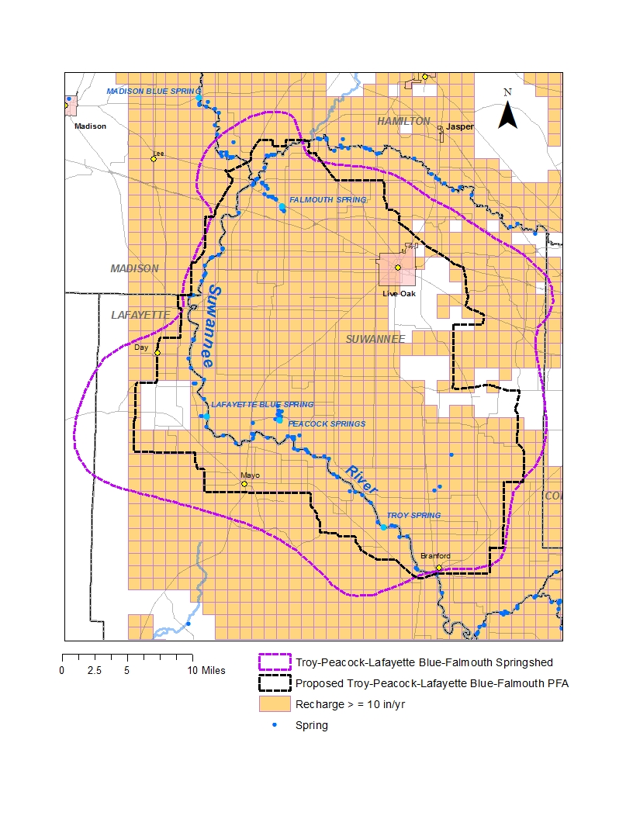
PFA Process
Middle Suwannee River
Recharge

Slide 13
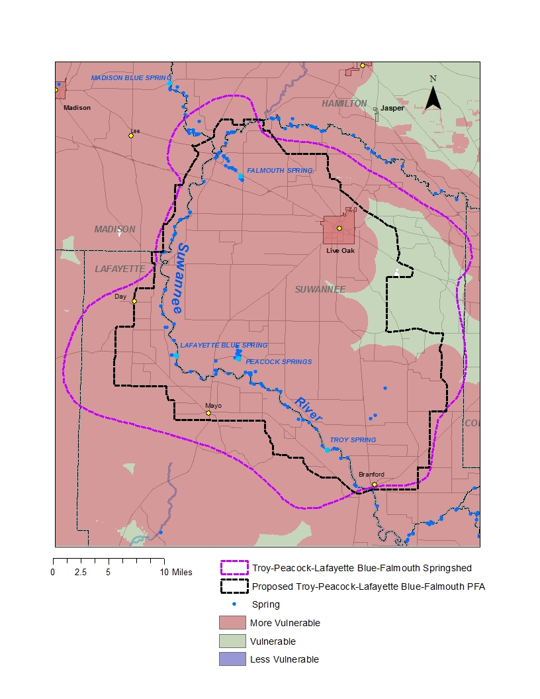
PFA Process
Middle Suwannee River
Vulnerability

Slide 14
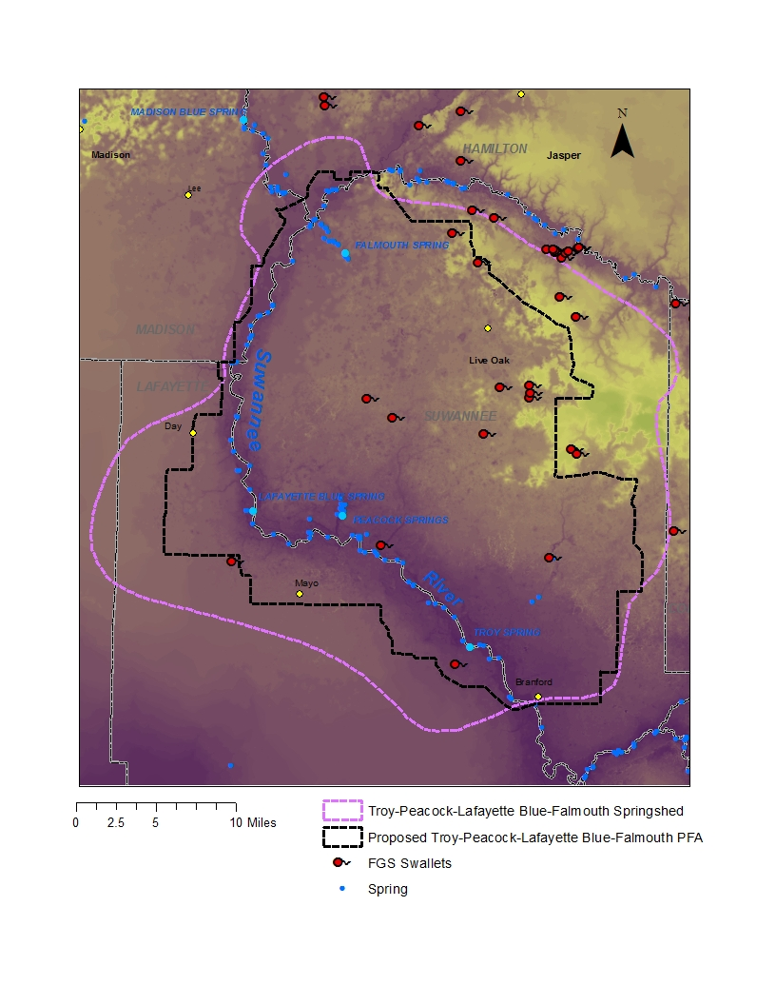
PFA Process
Middle Suwannee River
Stream to Sink Features

Slide 15
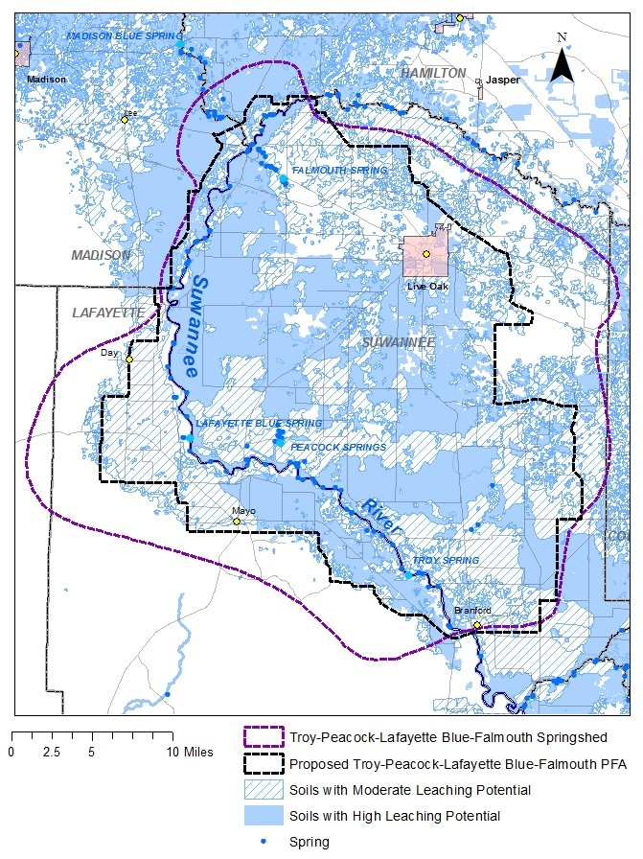
PFA Process
Middle Suwannee River
Soils

Slide 16
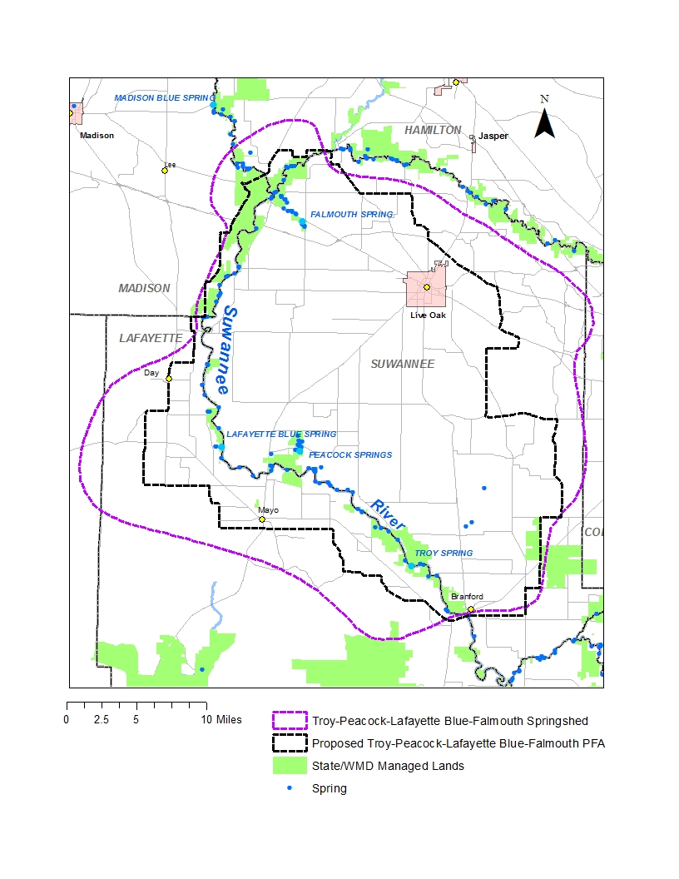
PFA Process
Middle Suwannee River
State Lands

Slide 17
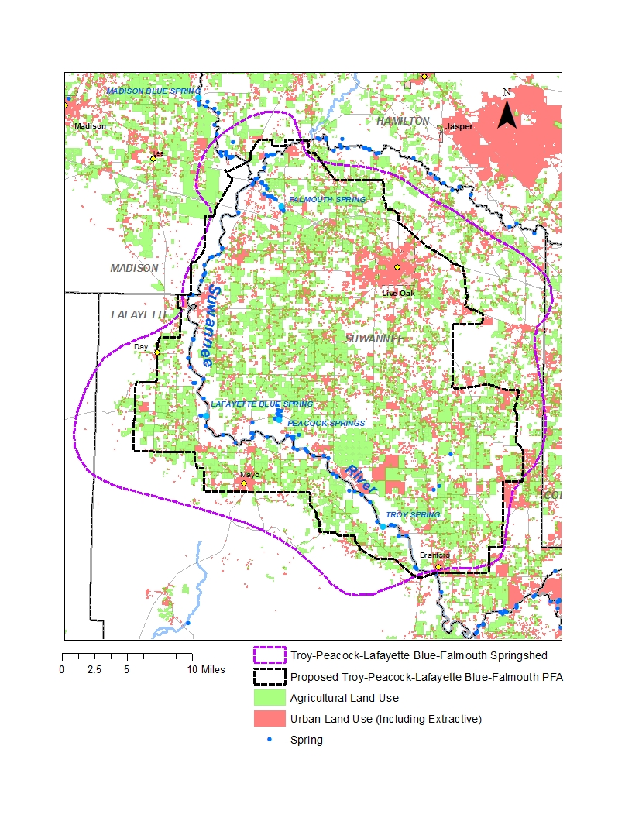
PFA Process
Middle Suwannee River
Land Use

Slide 18
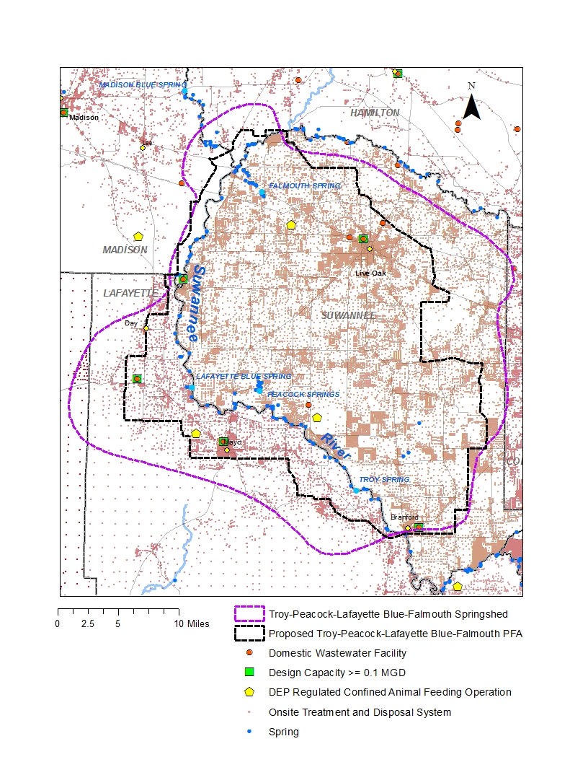
PFA Process
Middle Suwannee River
Wastewater and Animal Feeding Operations

Slide 19
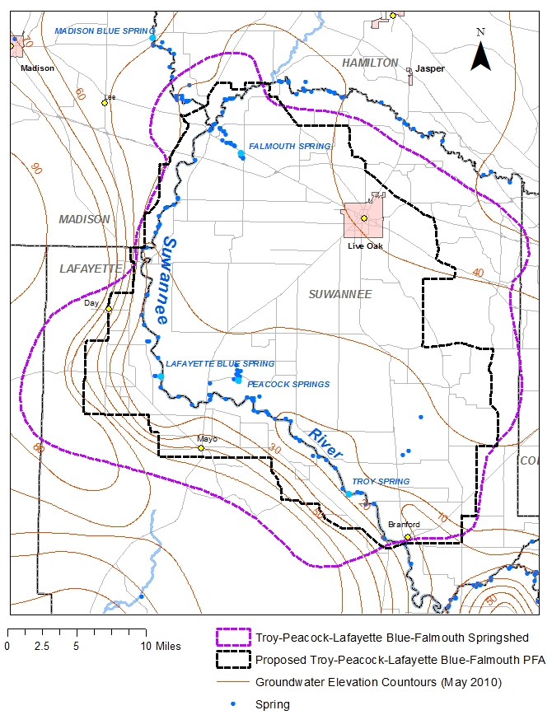
PFA Process
Middle Suwannee River
Elevation Contours

Slide 20
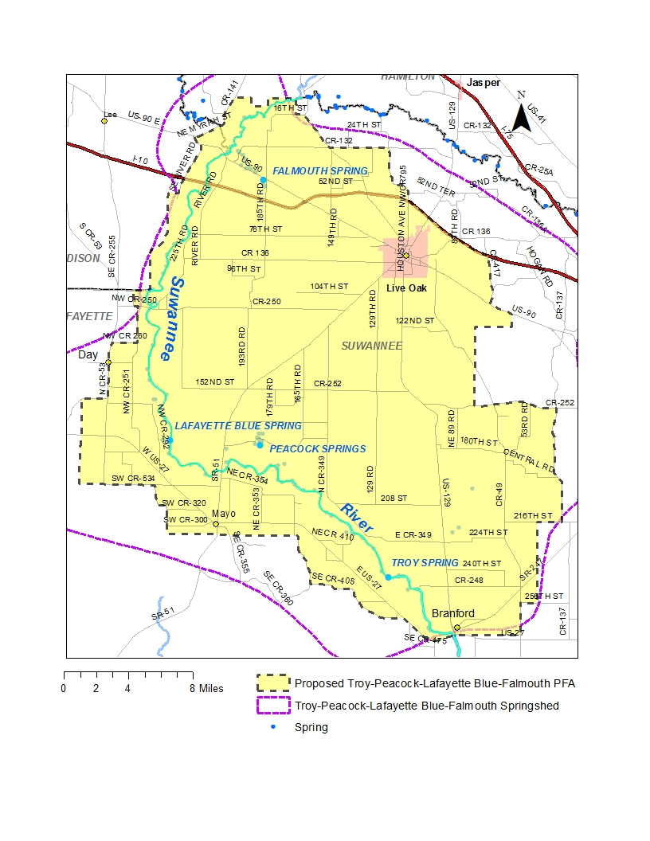
PFA Process
Middle Suwannee River
Boundaries

Slide 21
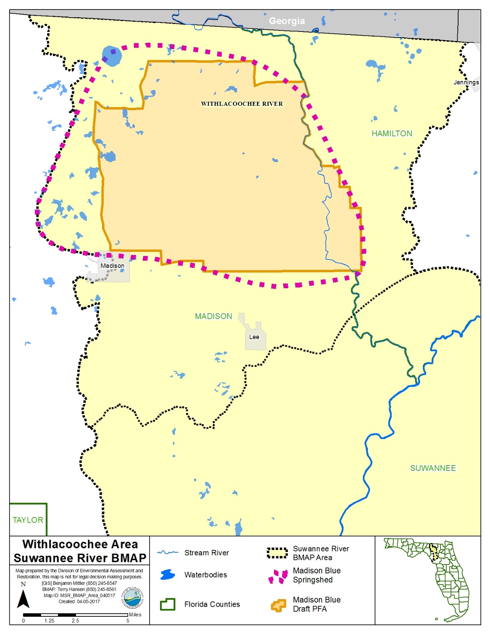
PFA
Withlacoochee River PFA
(Madison Blue OFS)

Slide 22
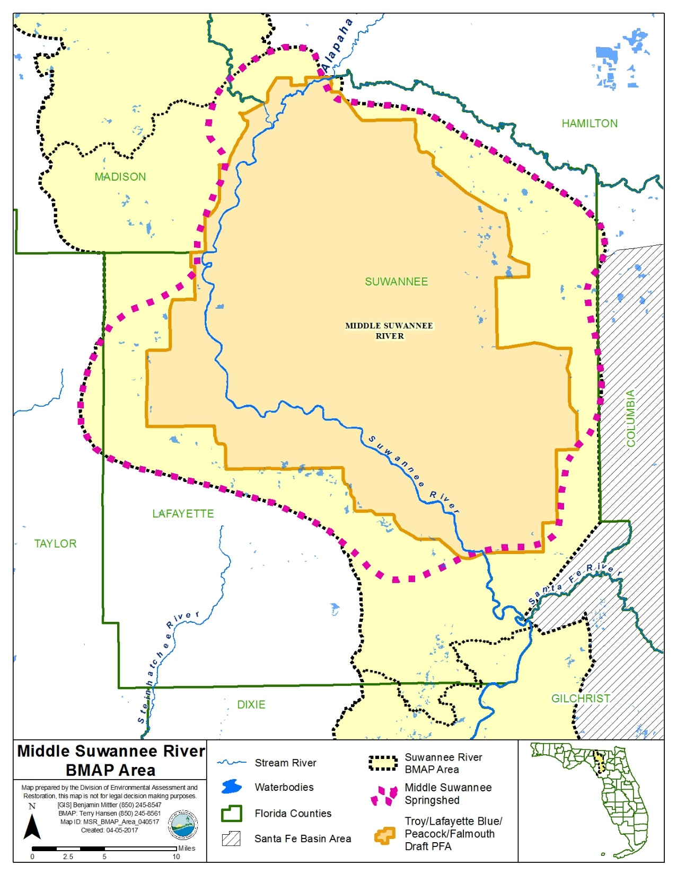
PFA
Middle Suwannee River PFA
(Falmouth, Lafayette Blue, Peacock, and Troy OFS)

Slide 23
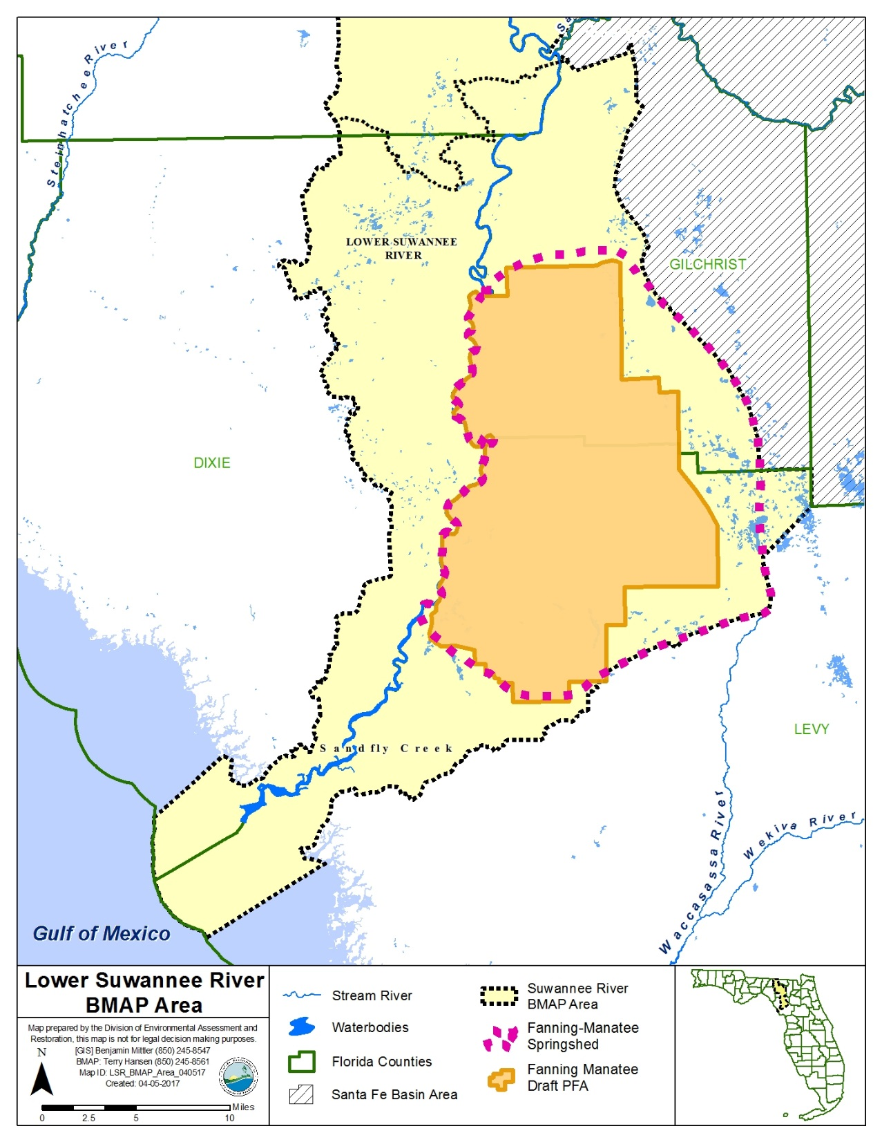
PFA
Lower Suwannee River PFA
(Fanning and Manatee OFS)

Slide 24

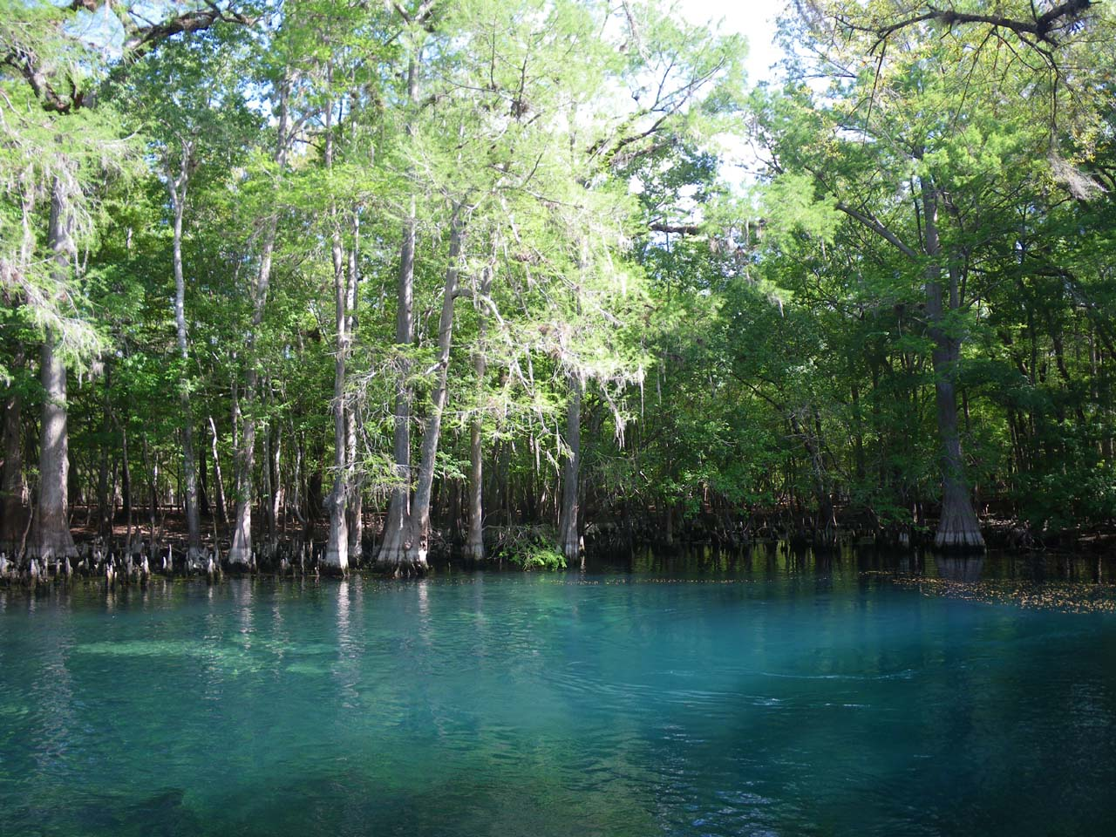

Division of Environmental Assessment and Restoration
Nitrogen Inputs:
Nitrogen Source Inventory and Loading Tool for
Outstanding Florida Springs of the Suwannee-Withlacoochee Basins
Celeste Lyon and Brian Katz, PhD
Groundwater Management Section
April 13, 2017

Slide 25
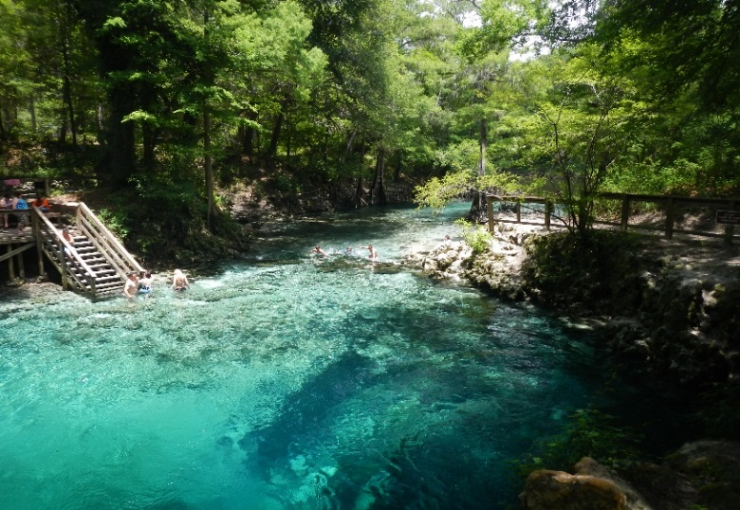
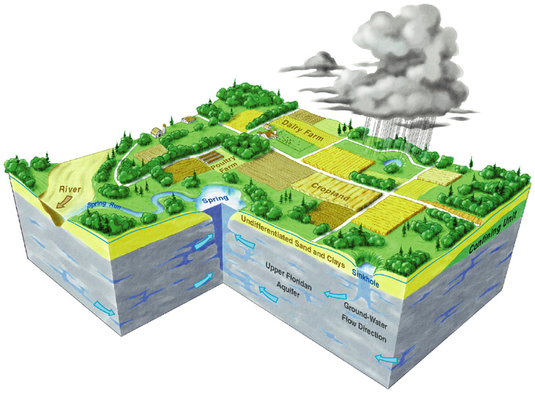
Nitrate-Impaired Spring Waters
The water quality in several Outstanding Florida Springs in the Suwannee River Basin is impaired due to elevated nitrate concentrations
Many sources contribute nitrogen in each springshed:
  atmospheric deposition
  fertilizers (farm and non-farm)
  septic tanks
  land application of wastewater
  livestock manure
Madison Blue Spring

Slide 26
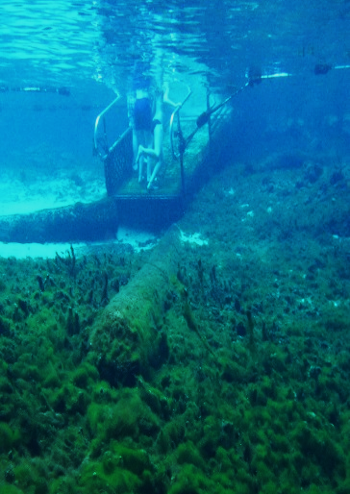
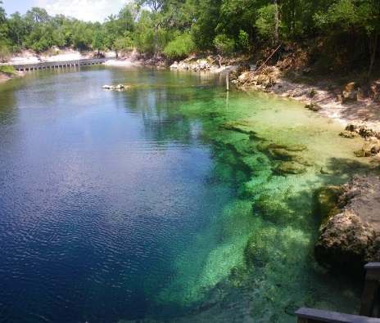
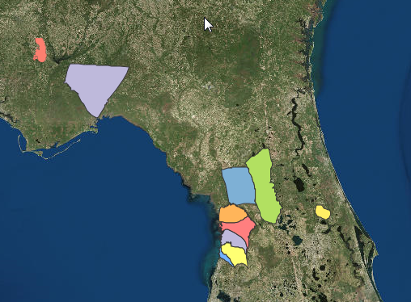
Nitrogen Source Inventory and Loading Tool
Quantifies nitrogen sources and loading to ground water, and highlights source categories where reductions in N loading could help achieve restoration of impaired waters
We customize the inventory for each spring basin or BMAP area to account for hydrogeologic and land use differences
Inventories have been completed for several BMAP areas (Wakulla, Jackson Blue, Silver, Rainbow, Volusia Blue, Springs Coast Springs
Troy Spring
Fanning Spring

Slide 27

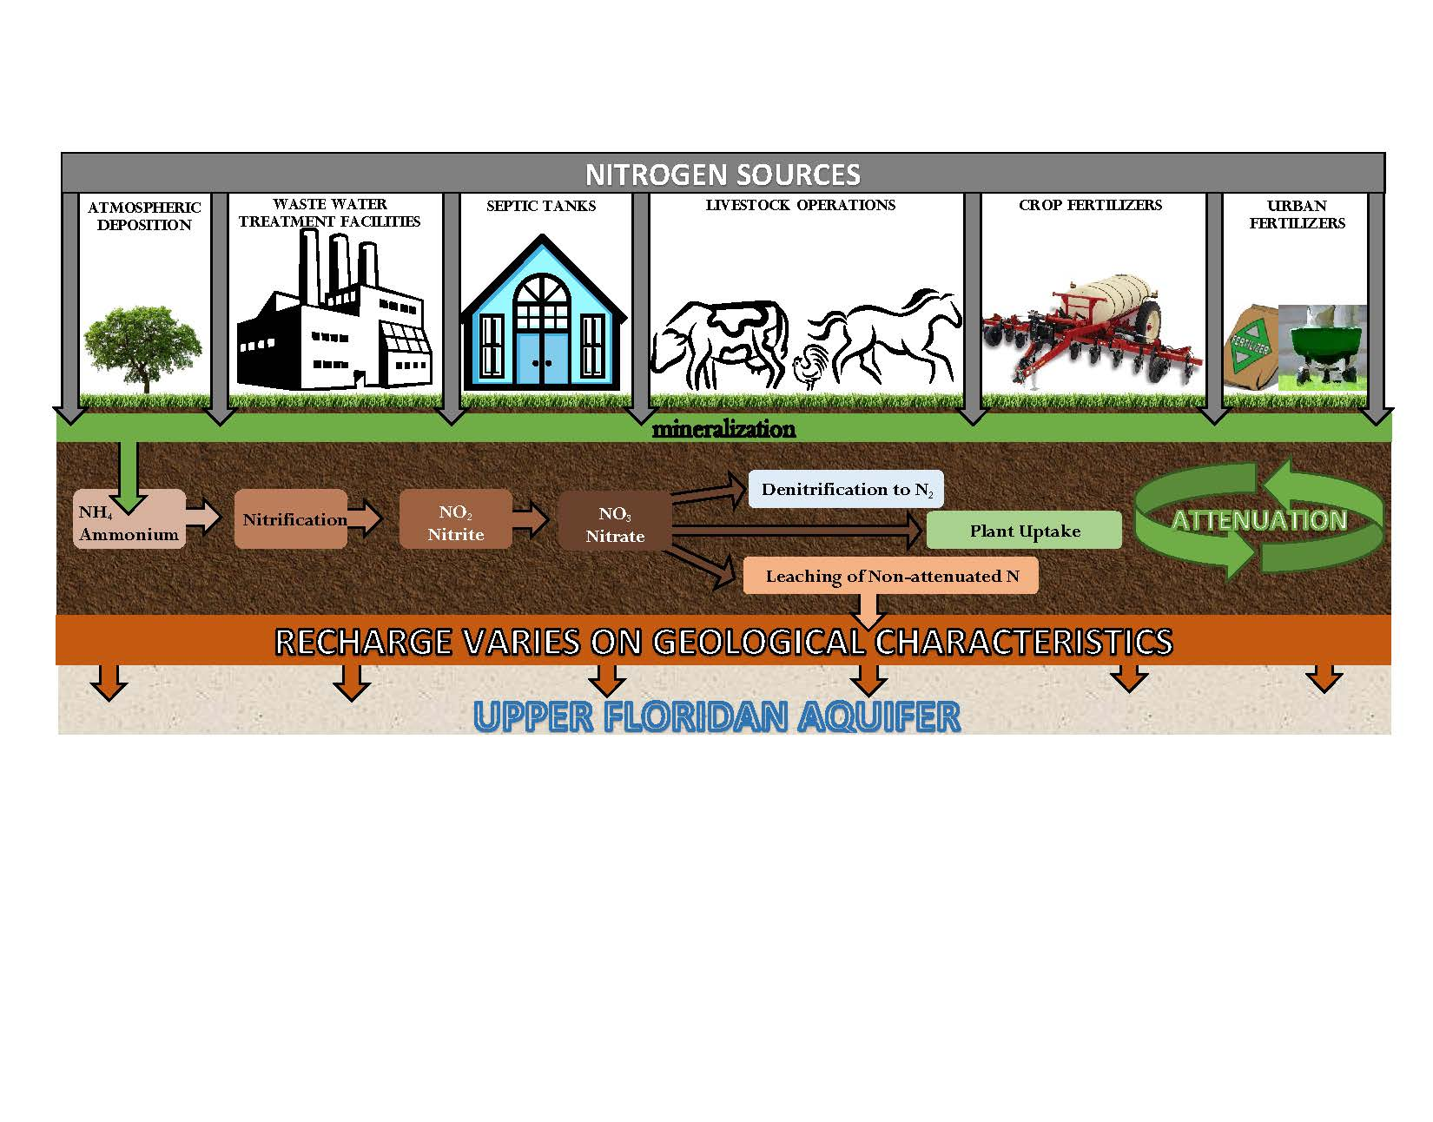
Nitrogen Cycle and Nitrogen Attenuation
LEACHING OF N TO GROUND WATER is related to many factors, such as variable soil conditions, fertilizer material, livestock type, crop types, irrigation, recharge to the aquifer.
Notes:
This cartoon describes the NSILT process. The nitrogen source categories are listed at the top; each with its own input into the environment obtained from current land use and other sources of info. The processes listed in the brown bar describe the attenuation or how different processes uptake, remove or impede the movement of N in the subsurface. We use information from published research investigations in Florida wherever available for the studied BMAP area. If local info is not available we will use published reports from other areas with similar hydrogeologic characteristics. For our estimates of N loading to groundwater, we are interested in the bar labeled “Leaching of Non-attenuated N”. This is the nitrogen which is not utilized by the environment and has the potential to reach ground water.

Slide 28
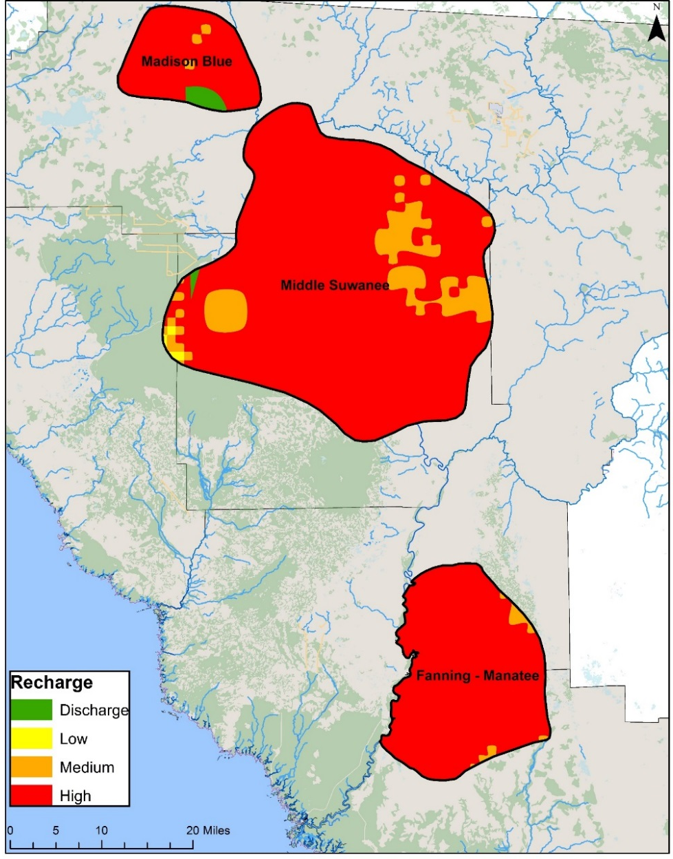
Groundwater Recharge and Nitrogen Attenuation
The amount of nitrate that is transported to the UFA in a given year is related to the rate of recharge to the aquifer (soil properties, hydrogeology, rainfall
(FGS, USGS, WMD).
  High Recharge: > 10 in/yr
  Medium Recharge: 3-10 in/yr
  Low Recharge: 0-3 in/yr
A weighting factor is assigned to recharge category to account for additional attenuation:
High, 0.9
Medium, 0.5
Low, 0.1
Notes:
Here is the BMAP area and associated recharge rates to the Upper Floridan Aquifer. As you can see, the majority of the area has high recharge with over 10 inches of water every year infiltrating to the ground water.
Recharge layer from FNAI/ Advanced Geospatial Inc. (based on FAVA layer developed by FGS) and USGS 2002 Recharge layer

Slide 29
Nitrogen Cycle and Nitrogen Attenuation
NSILT Process is on-going:
We fine-tune and revise nitrogen loading estimates to groundwater as new information becomes available, and after getting feedback from stakeholders.
Notes:
This is a cartoon describing our process. The nitrogen source categories are listed in the top; each with its own input into the environment. The processes listed in the brown bar describe the attenuation or how the environment is able to process and take up nitrogen. For our estimates, we are interested in the bar labeled “Leaching of Non-attenuated N”. This is the nitrogen which is not utilized by the environment and has the potential to reach ground water.

Slide 30

Outstanding Florida Springs
Outstanding Florida Springs in this BMAP area were aggregated into three general springshed areas to more efficiently organize information and implement restoration actions:
Madison Blue Spring (and associated springs of Withlacoochee River)
Middle Suwannee Springs combined springshed (including Troy, Peacock, Lafayette Blue, Falmouth and major second magnitude springs)
Fanning and Manatee Springs

Slide 31
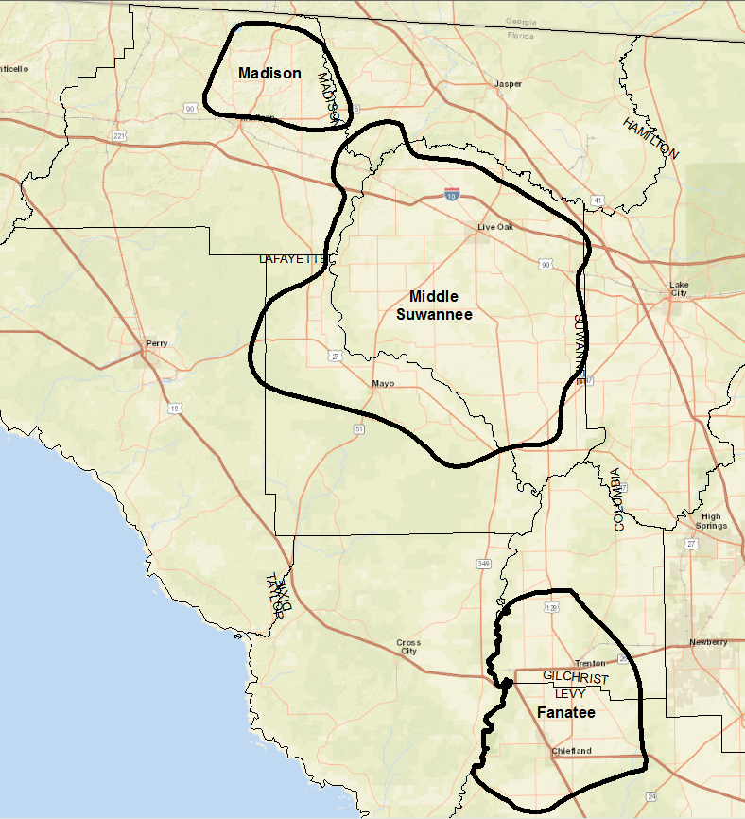
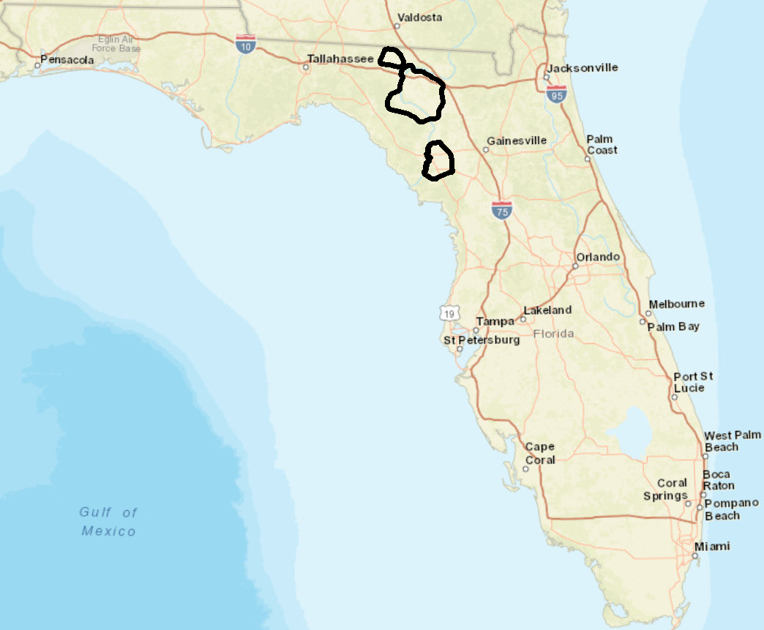
Inventories Conducted for 3 Springshed Areas
Springshed Area | County | Acres
Fanning-Manatee | Gilchrist | 80,233
Fanning-Manatee | Levy | 119,694
Madison Blue | Hamilton | 5,672
Madison Blue | Madison | 79,116
Middle Suwannee | Columbia | 1,148
Middle Suwannee | Hamilton | 11,937
Middle Suwannee | Lafayette | 134,920
Middle Suwannee | Madison | 15,171
Middle Suwannee | Suwannee | 386,144
Middle Suwannee | Taylor | 5,644
Evaluation included portions of 6 counties

Slide 32
Land Use

Slide 33
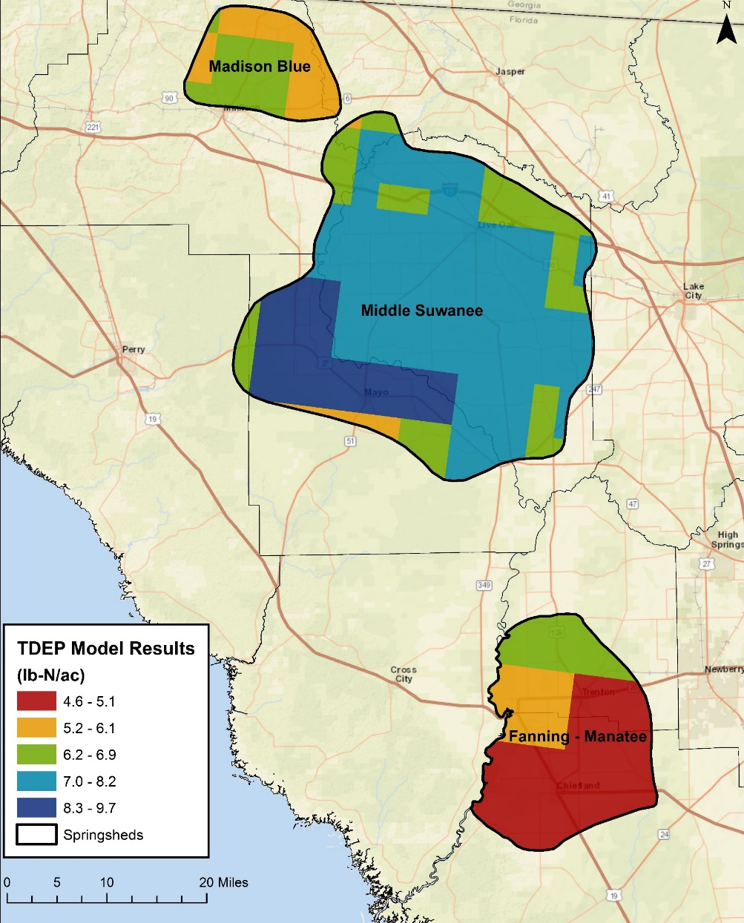
Atmospheric Deposition
TDEP model
  U.S. EPA method to estimate spatially continuous atmospheric deposition
  Nationwide total deposition model for N and S
  Estimated deposition based on monitoring stations and modeled atmospheric concentrations
  Model year is an average from 2011 to 2013
Average TN deposition
  Range 4.6 - 9.7 lb-N/ac/yr
Notes:
For atmospheric deposition, we rely on a nationwide model developed by EPA called the TDEP. This approach relies on data from monitoring stations as well as other atmospheric models. At the recommendation of the developers, the model results used included data from 2011 to 2013.

Slide 34
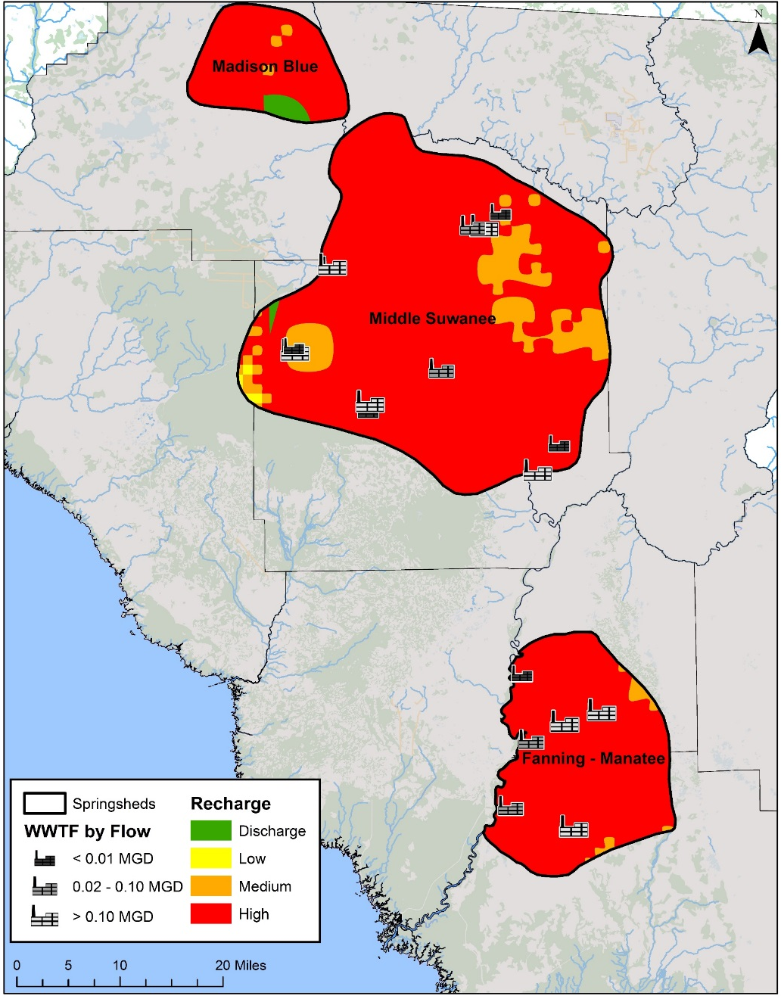
Domestic Wastewater Treatment Facilities
TN effluent concentrations as reported to DEP
NO₃ used to project TN data, if necessary
Effluent data separated based on treatment type
    RIBs, Absorption Fields
    Sprayfields
    Reuse
Notes:
Wastewater treatment facilities are required to report various nutrient and flow data as part of their permits for operating. We use this data to estimate the input from these facilities to the land surface using the total nitrogen in the effluent as well as the actual flow rate from each facility. If nitrate data is available, but not total nitrogen, then the nitrate concentrations are projected to total nitrogen based on a 2009 DEP study. The estimated input to the land surface is separated based on the type of effluent treatment: rapid infiltration basins (RIBs), absorption fields, sprayfield or reuse.

Slide 35

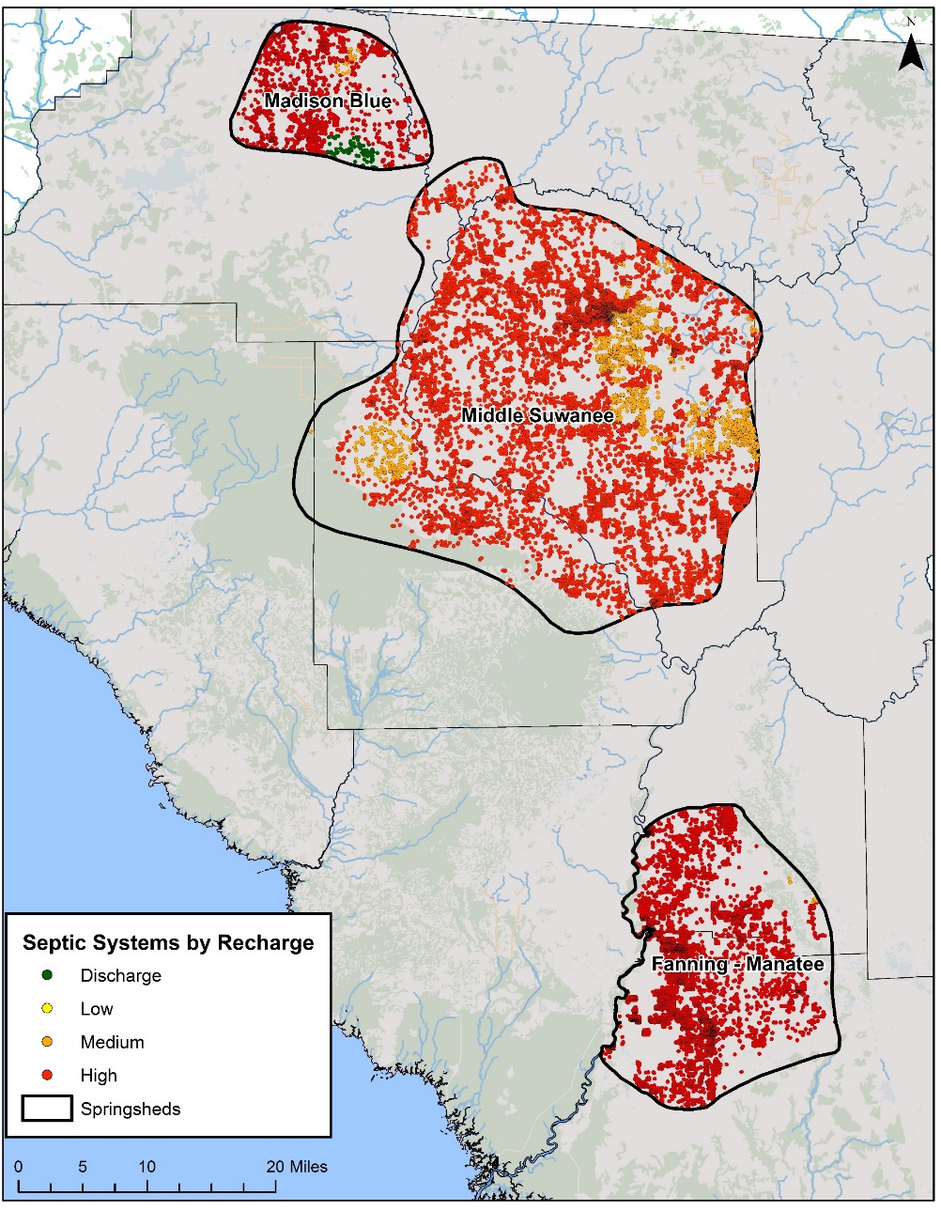
Septic Systems
Septic count taken from DOH’s Florida Water Management Inventory (FLWMI)
Accuracy of this data was verified using an aerial analysis
Calculate # of people relying on septic tanks
Average annual input to septic tank = 9.012 lb-N/person (US EPA)
Notes:
The number of septic tanks within the contributing area is taken from the DOH’s Inventory. The effective population in each county is estimated based on the number of people per occupied household (2010 US Census) and the amount of time an average person will spend at home in a given year (US Labor Statistics). This data allows us to calculate the number of people using septic tanks and apply an annual N factor per person to estimate the input to land surface.

Slide 36


Estimating Livestock Populations and Waste
Livestock | Waste Factor (lb-N/day)
Beef Cows | 0.337
Other Beef Cattle | 0.31
Chicken, broilers | 0.002
Chicken, layers | 0.003
Calves | 0.068
Equine | 0.273
Goats | 0.035
Hogs | 0.19
Sheep | 0.198
Turkeys | 0.006
Literature review provided information on common livestock animals in Florida
Animal waste factors
2012 Census of Agriculture (CoA)
# of livestock (categorized by animal)
Full county data ONLY
2016 USDA Survey
# of beef cattle
Use County-level land use information to estimate livestock population within the springsheds.
Land Use Description
Cattle Feeding Operations*
Feeding Operations*
Horse Farms
Improved Pastures*
Poultry Feeding Operations
Range Land, Herbaceous (Dry Prairie)*
Specialty Farms
Unimproved Pastures*
* Used to determine lands where beef cattle are likely to be present
Notes:
Full county livestock populations are taken from the 2012 Census of Agriculture. We use land use percentages to take the full county data and use it to estimate the populations within the contributing boundary.
Dairies, poultry, and beef operations were assessed separately because they make up a significant portion of the livestock operations in the area.
*Beef cattle land use is determined using refined categories.

Slide 37
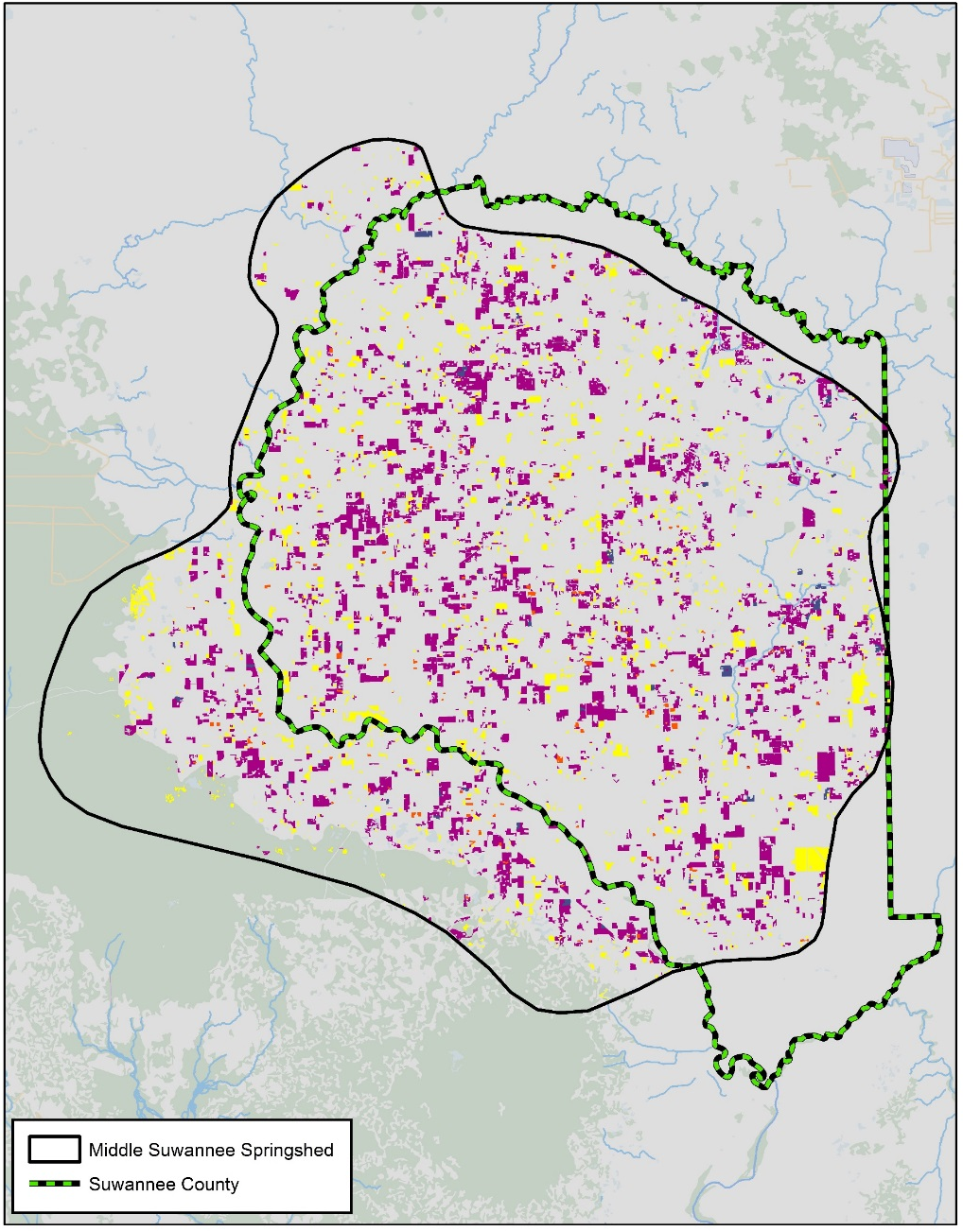
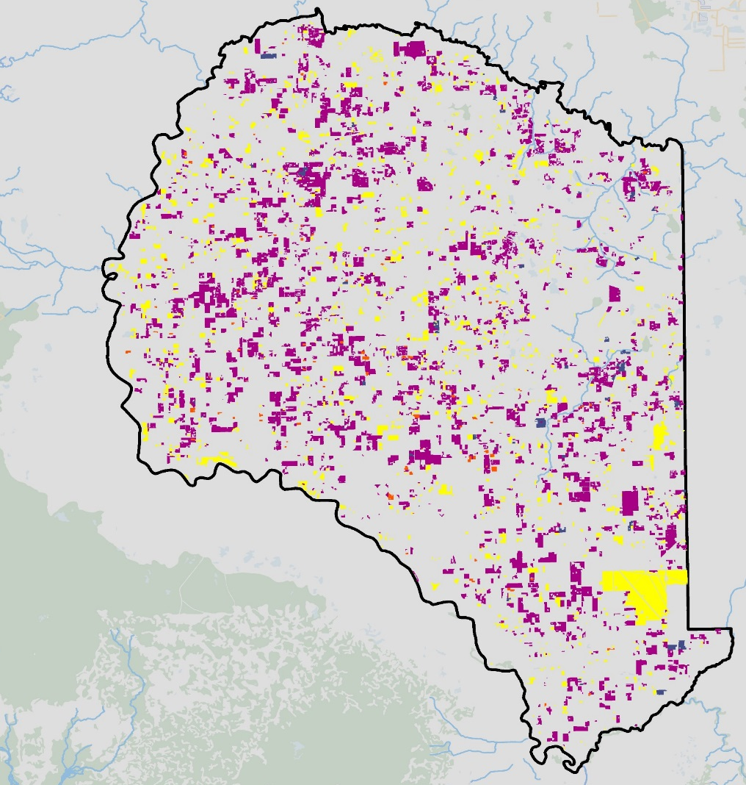
Land use Percentages: Livestock
Notes:
To calculate the land use percentages, we look at the land use for the entire county.
The land use data for Suwannee County is used as an example. The same calculations were made for the other counties
The total livestock land use acreage is a calculated for the entire county.
The same calculation is made for just the Middle Suwannee sprinsgshed which indicates that 86% of all the livestock lands in Suwannee County are also in the Springshed boundary.
76% of the Suwannee County livestock lands are within the High recharge areas of the boundary.
10% of the Suwannee County livestock lands are within the Medium recharge areas of the boundary.

Slide 38
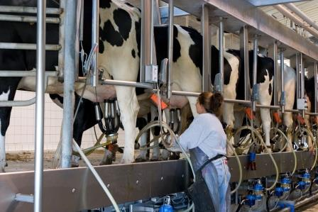
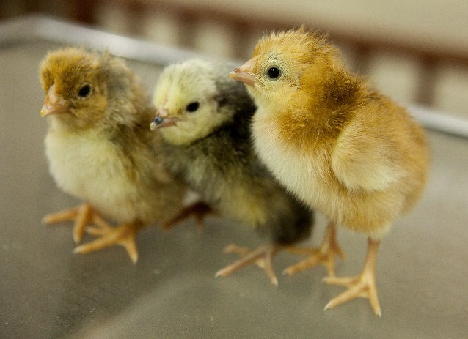

Primary Livestock Waste Contributors
Dairy Operations
Poultry Operations
Cow/Calf Operations (Beef Cattle)

Slide 39
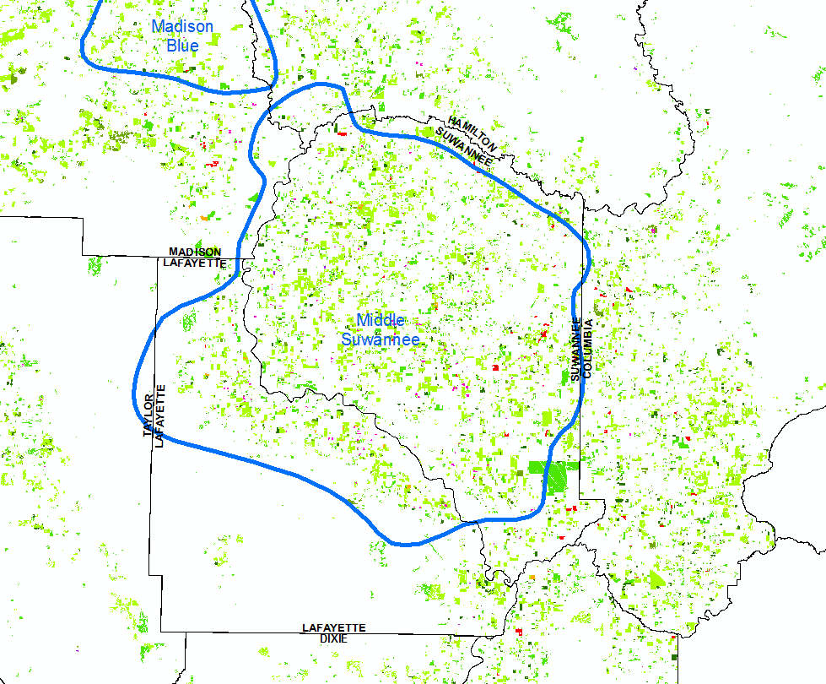
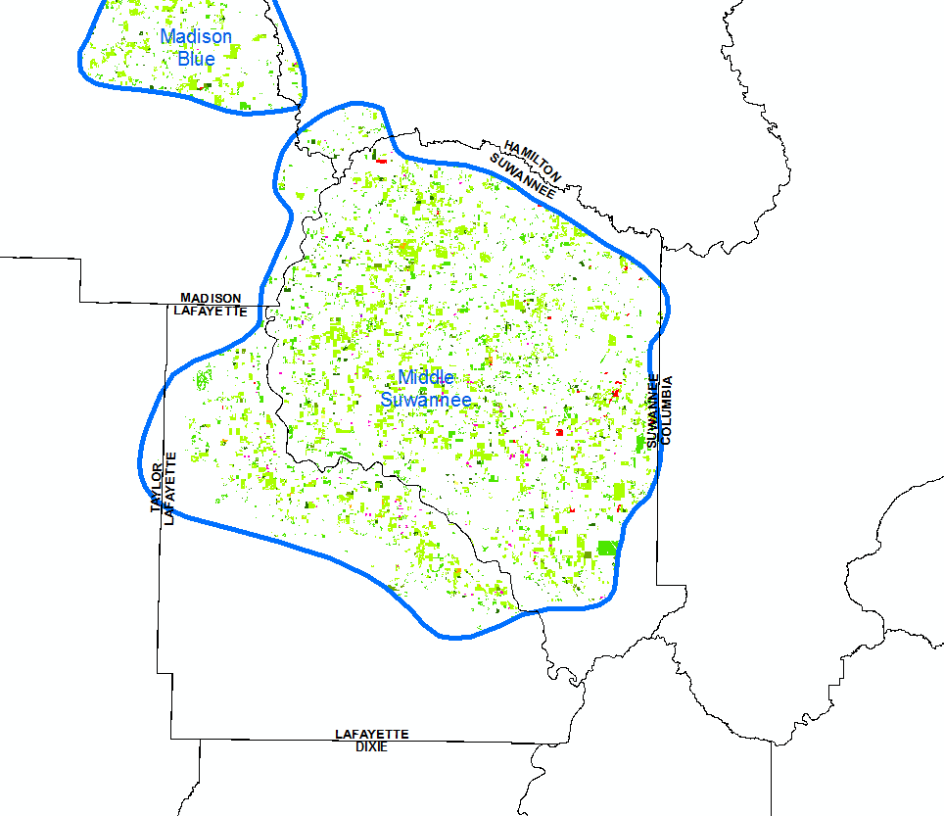
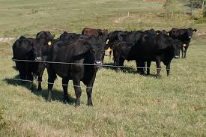
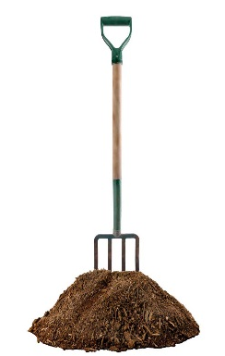
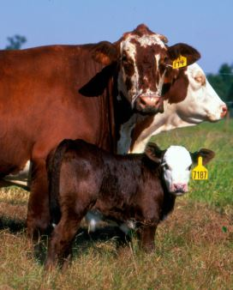
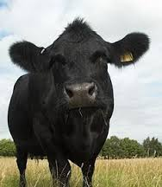
Estimating Beef Cattle (Cow/Calf) Inputs
  County livestock waste
  land use areas
  Identify percentage of livestock waste land use areas that fall within springsheds
USDA 2016 Survey County Total Cattle Population #s
Land Use Description
Cattle Feeding Operations*
Feeding Operations*
Horse Farms
Improved Pastures*
Range Land, Herbaceous (Dry Prairie)*
Specialty Farms
Unimproved Pastures*
35% of Total Beef Cattle population assumed to be calves
Subtract known Dairy population to find Beef Cattle Population #s
Apply daily N waste factors
X 365 days
Total N input from Livestock waste
Calves = Apply daily N waste factors
X 183 days
Notes:
To calculate the land use percentages, we look at the land use for the entire county. We extract the acreages of the land use categories which are likely to contain livestock animals. The total livestock land use acreage is a calculated for the entire county. The same calculation is made for just the BMAP boundary.
To calculate the total beef cattle and calf populations for the BMAP boundary, we take the total cattle number from the 2016 survey and subtract out the known dairy cattle. This gives us the total beef cattle. From there, we subtract out the beef COW population (given to us in the 2016 survey), in order to identify the remaining, assorted beef cattle. We subtract the calf number (35% of the total beef cattle population) from this remaining cattle category, to end up with the “other” beef cattle population; this includes bulls, steers, and heifers.
The land use percentage is applied to all 3 categories of beef cattle in order to estimate the populations within the BMAP boundary.

Slide 40
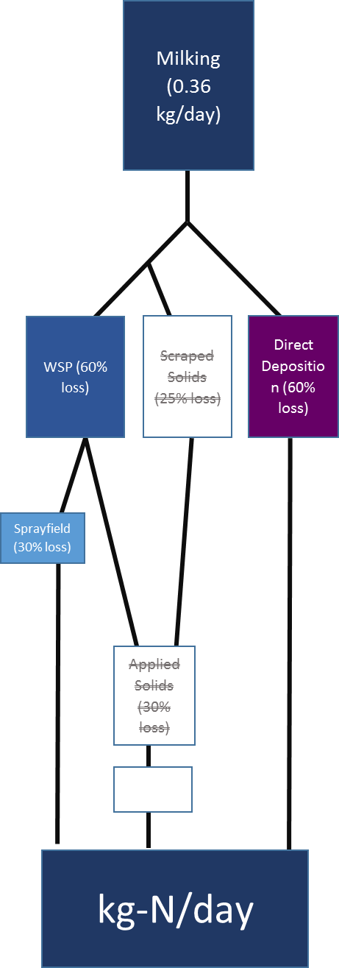
Estimating Dairy Waste Inputs
Permitted Dairy Operations
Detailed information is obtained from the DEP industrial wastewater facility permits on herd sizes, type of cows, confinement and grazing times, and waste management and disposal information
The specific waste handling process was assessed individually for each dairy because of differences in operation from site to site
Non-Permitted Dairy Operations*
Obtained herd size, confinement and waste treatment practice information from FDACS field staff and Southeast Milk
* A dairy operation containing less than 700 mature dairy cows
Notes:
The generalized methodology, seen in the flowchart, for non-permitted dairies, assumes that all small dairies direct the waste water to a waste storage pond. From there, the liquid waste is applied to a sprayfield.

Slide 41
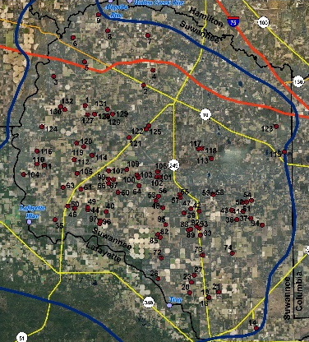
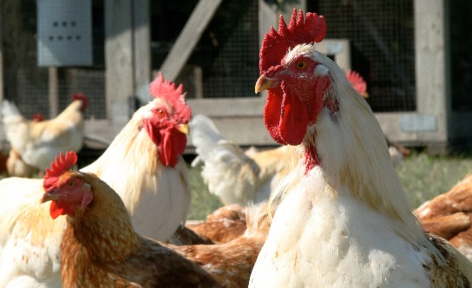




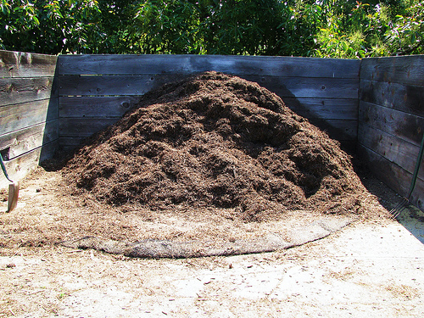
Estimating Poultry Inputs
Identification of poultry operations
Account for rotation of birds to determine average annual population
Apply Daily N Waste Factors x 365
Litter brokerage and offsite application
Volatization during storage
Total N Input from Poultry Operations
Notes:
List of likely operating farms and ownership information reviewed by FDACS, who provided operational information (annual number of birds, litter and manure management practices (composting, spreading locally, sale and transport of manure off site)
Calculating input for farms based on amount of waste generated, N loss through storage and application practices, and attenuation associated with waste disposal options
Because each site has multiple rotations of birds during a year, we assume the average time on site is about 8 weeks (0.154 year). We included this “average cycle bird factor” to calculate the annual input from broiler chickens
For all poultry operations, we accounted for nitrogen volatization during storage. We also assumed that 50% of the litter is sold to buyers outside of the BMAP boundary, therefore only 50% of the Nitrogen from the total litter is input to land surface within our area of interest.
Based on Lafayette numbers of annual birds and number of houses and the 8-week period of residence, the average house contains 18,000 birds at a given time.

Slide 42
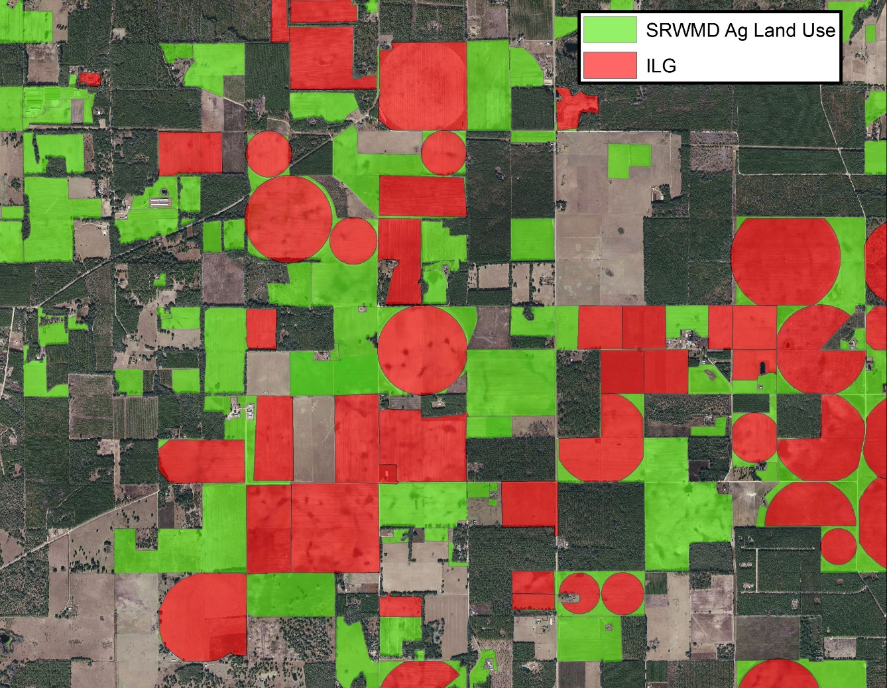


Combination of Three Agricultural Land Use Tools
to Estimate Crop Type and Acreage
Irrigated lands and crop type based on FSAID irrigated lands geodatabase (ILG).
Outside of ILG, agriculture areas based on WMD land use.
Crop fertilizer application rates were applied to the acreages identified within springsheds based on crop type.
Application rates based on UF-IFAS recommended rates as well as producer feedback.
Notes:
To identify irrigated acres we utilized FDACS Statewide Agricultural Irrigation Demand Irrigated Lands Geodatabase which is a statewide parcel-level GIS coverage that provides the estimated 2015 irrigated agricultural acreage by crop type - FSAID geodatabase includes crop irrigation and other agricultural water demand projections over the next 25 years, in five-year increments
Water Management District Land Use
USDA National Agricultural Statistics Survey CropScape 2015 Copland Data layer - is a crop-specific land cover data layer created annually for the continental United States using satellite imagery and extensive agricultural ground truth.
The National Agricultural Statistics Survey (NASS) coverage called CROPSCAPE was overlayed with the unclassified crop types in order to identify potential crop types within these areas not identified by the FSAID ILG or WMD data.
A generalized crop application rate was estimated based on the average application rates of the crops identified within the unclassified crop areas of the merged FSAID ILG WMD land use coverage
A final merged coverage was created using a combination of sources.

Slide 43






Urban Turfgrass Fertilizers
Acreage likely to receive fertilizer estimated from PA data and property values
  Residential
  Non-residential
Maximum fertilizable acreage was capped at 1 acre
Annual Application Rates based on SWFWMD study
Property values used to assess probability of fertilization
Notes:
Urban fertilizers includes fertilizer application for residential purposes, businesses, parks, etc. Golf course and sporting facility fertilizer use is estimated separately. Land areas were estimated based on property appraiser data. The amount of impervious and therefore not fertilized land area was calculated using county zoning laws, when available. The probability of fertilization was also taken into account based on property value which has been identified as an indicator of fertilizer use by socioeconomic studies. The remaining pervious surfaces are assumed to be fertilized at various rates which are derived from multiple SWFWMD studies.
For this analysis, it was assumed that the owners of properties with greater than one acre of pervious land area would regularly apply fertilizer to no more than one acre.

Slide 44

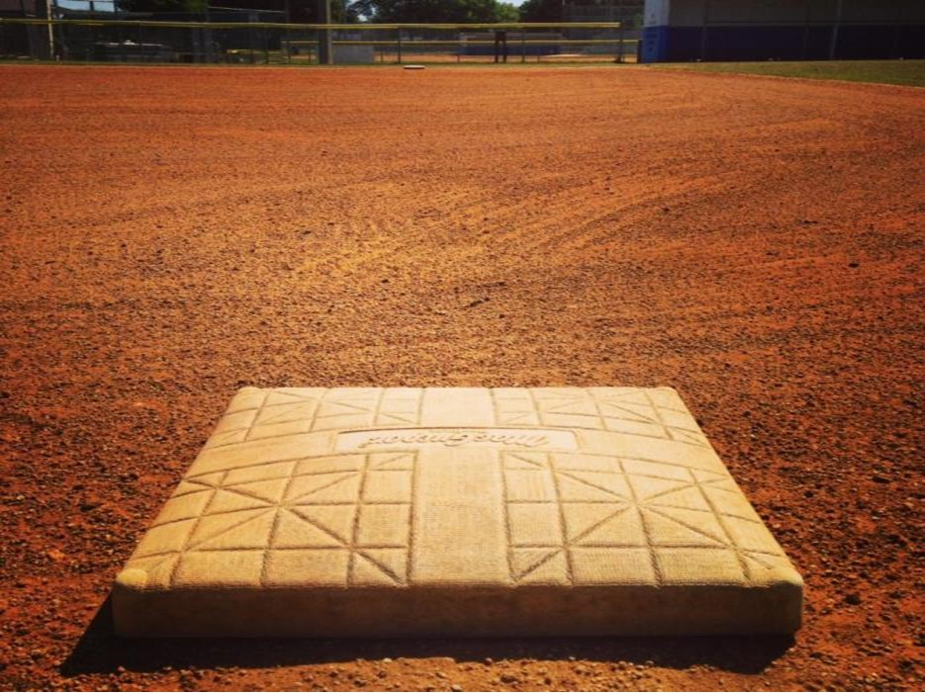
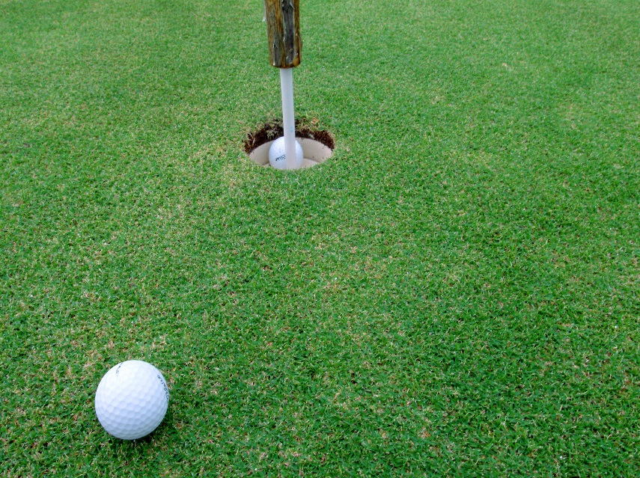
Sports Turfgrass Fertilizers
Sports fields
  Acreage estimates from aerial analysis of PA landuse data
  Application rates based on lawn service company estimates
Golf Courses
  Acreage estimated through PA landuse data
  Annual application rate = 4.5 lb-N/1,000 sq ft
Notes:
Sports turfgrass includes sporting facilities like baseball and football fields as well as golf courses. The acreage associated with sporting facilities was estimated based on an evaluation of PA landuses likely to contain these fields including schools, parks and recreational areas. The nitrogen application rate was estimated using the data for lawn service company fertilization practices (Urban Turfgrass Fertilizers slide).
Golf courses were estimated based on the acreage assessed by the PA offices. The fertilizer application rate is based on voluntary surveys completed by some of the golf course superintendents in the contributing area. For those golf courses which did not complete a survey, an average application rate of 3.24 lb-N/1,000 sq ft was estimated; an average application rate. In total, the average application rate for the contributing area is 4.5 lb-N/1,000 sq ft

Slide 45
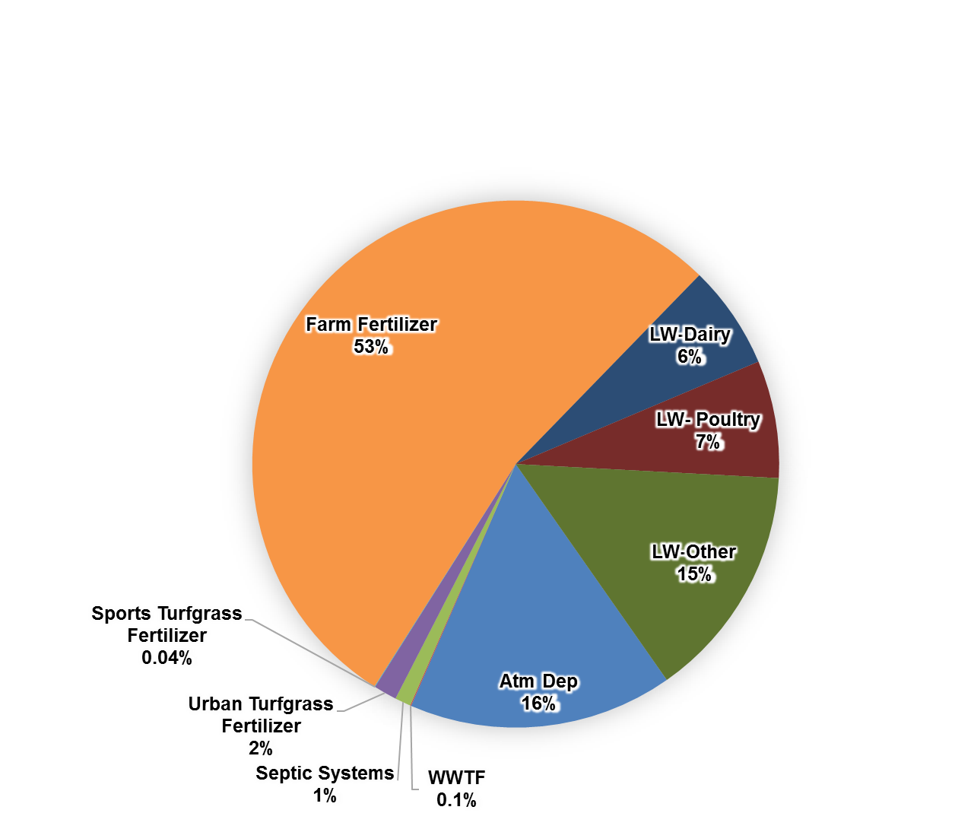
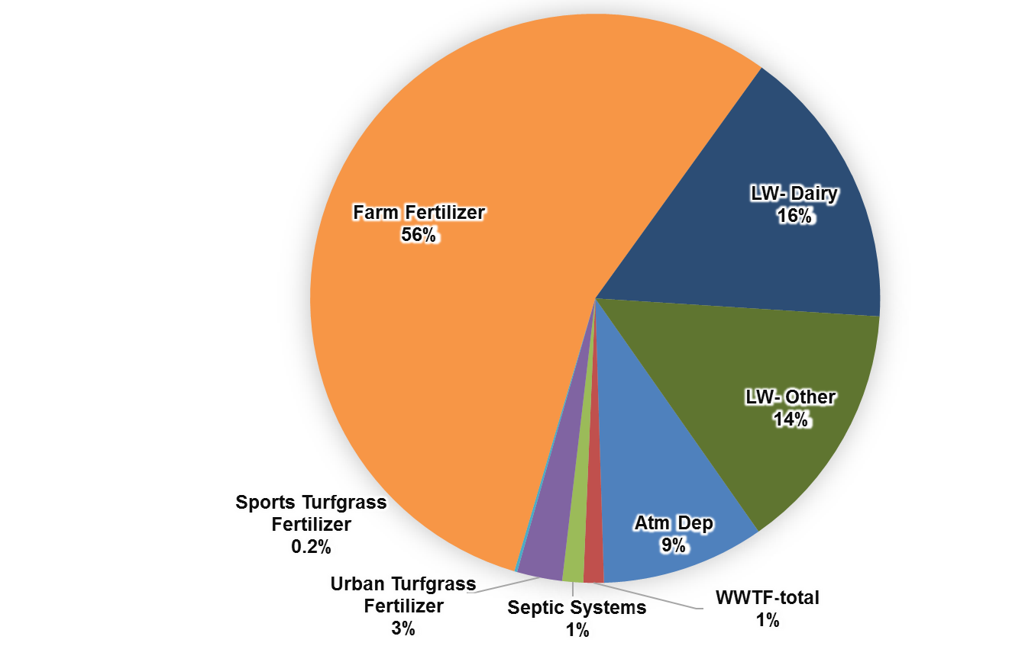
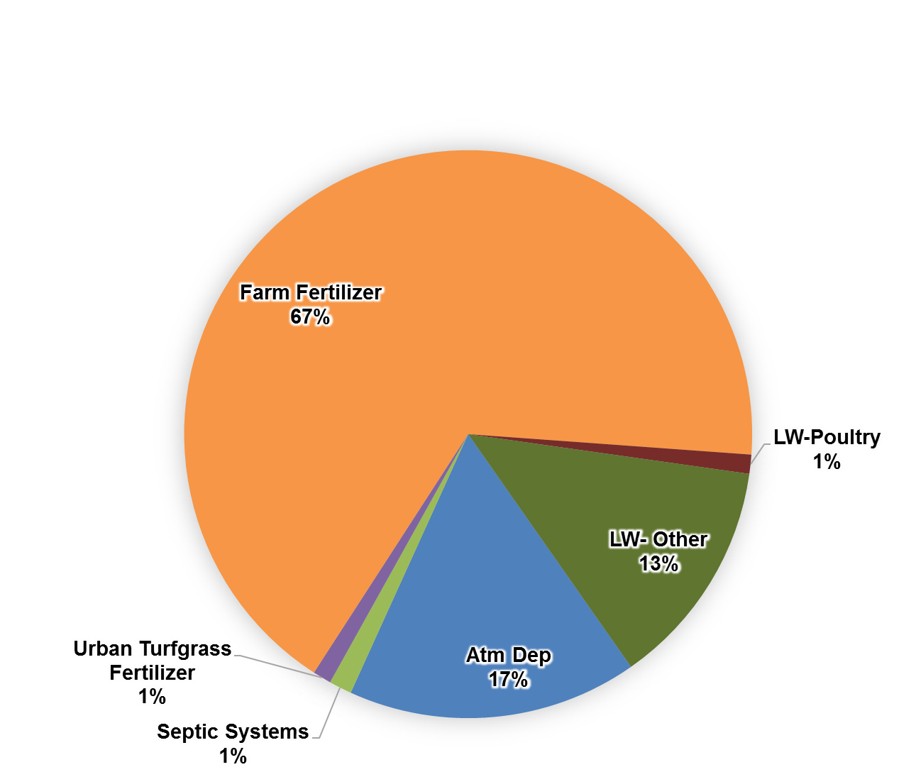
Estimates of Nitrogen Inputs
Middle Suwannee
Fanning-Manatee
Madison Blue
Notes:
WWTFs and Sports Turfgrass were not contributors of Nitrogen in this Springshed

Slide 46

Biochemical Attenuation Factors
Loading Category | N Attenuation Factor | N Leaching
Atmospheric Deposition | 90% | 10%
Septic Systems | 50% | 50%
WWTF-RIB | 25% | 75%
WWTF-Sprayfield | 60% | 40%
WWTF-Reuse | 75% | 25%
Urban Turfgrass Fertilizers | 70% | 30%
Sports Turfgrass Fertilizers | 70% | 30%
Farm Fertilizers | 80% | 20%
Livestock- Dairy | 50% | 50%
Livestock- Poultry | 90% | 10%
Livestock- Other | 90% | 10%
Represent the percentage of N removed and therefore not available for leaching to groundwater
Based on factors used in similar past studies and found in relevant literature
Notes:
After all the nitrogen input to the land surface has been estimated, attenuation factors are applied. This table lists the attenuation factors for each nitrogen source. These factors are the result of an extensive literature and peer review. There is a range for all these factors however, these values represent an average attenuation expected given Florida’s environmental conditions. These factors represent the amount of nitrogen which is taken up by the environment. For example, the 90% attenuation for atmospheric deposition means that 90% of all the nitrogen from atmospheric deposition that falls onto the land surface will be taken up by the environment and will not leach into ground water. This leaves 10% of the atmospheric nitrogen with the potential of leaching to the aquifer.

Slide 47
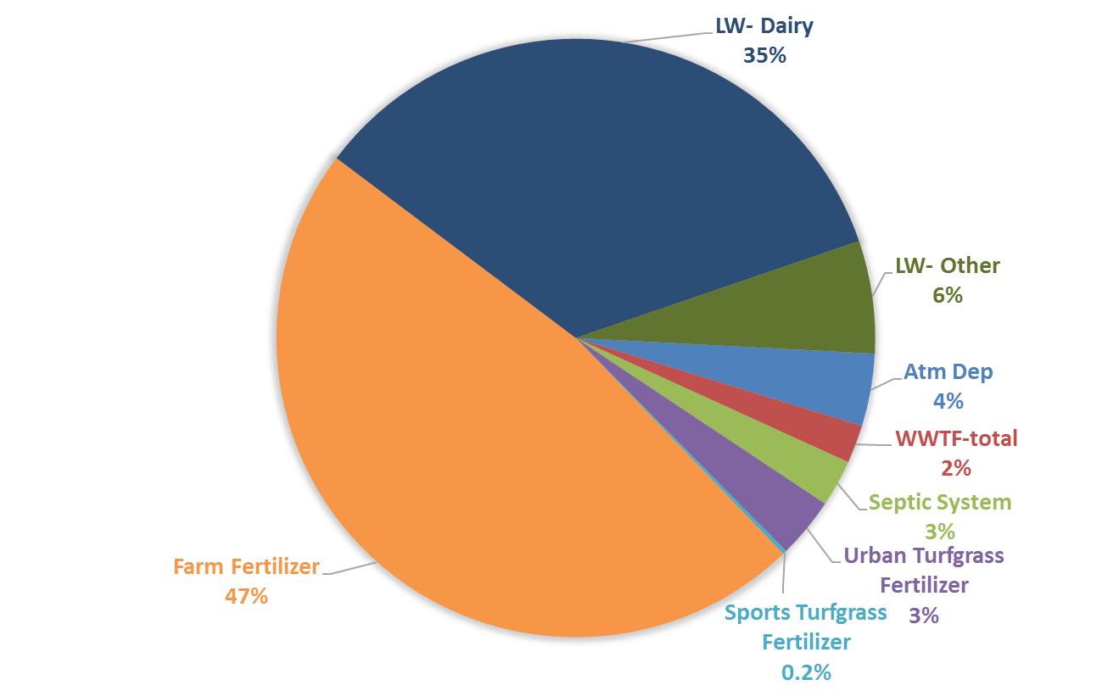
Fanning-Manatee- Nitrogen Load to Groundwater

Slide 48
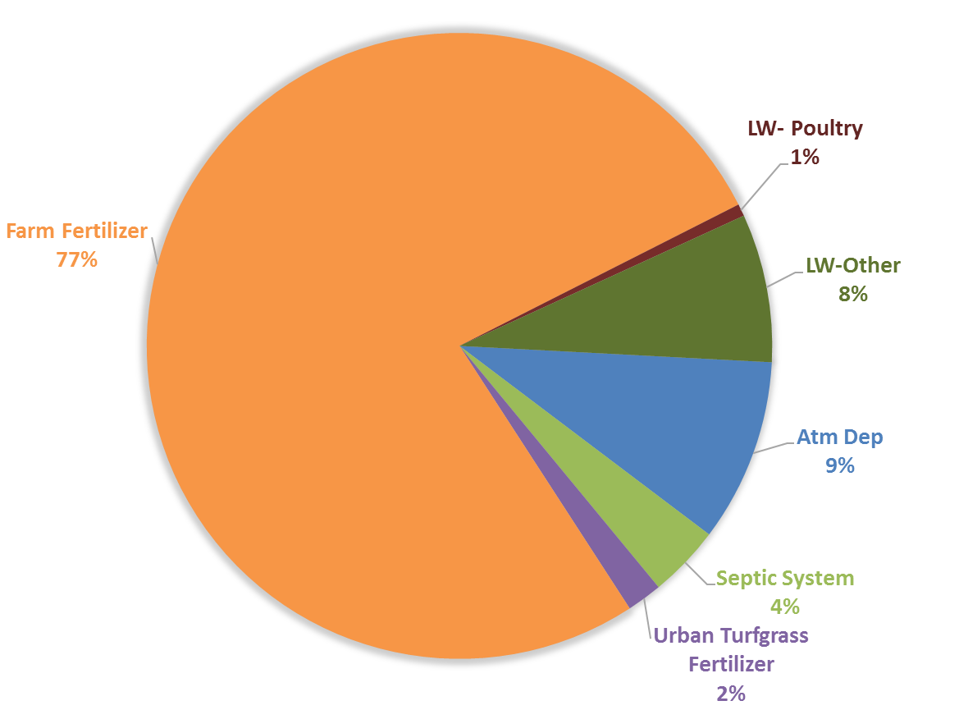
Madison Blue-Nitrogen Load to Groundwater
Notes:
WWTFs and Sports Turfgrass fields were not present in this springshed, and are therefore not included in the contributing sources.

Slide 49

Middle Suwannee- Nitrogen Load to Groundwater

Slide 50



QUESTIONS??
http://fdep.maps.arcgis.com/home/index.html
http://fdep.maps.arcgis.com/apps/MapJournal/index.html?appid=e71ecaa35bdd4caaba7a0c411691dfa7

Slide 51
Loads to Groundwater

Slide 52

Withlacoochee River Nitrogen Loading to Groundwater
Withlacoochee River

Slide 53
Withlacoochee River Nitrogen Reductions by Source
Source | Estimated Portion of Total Load (%) | Estimated Total Nitrogen Load to Groundwater (pounds of Nitrogen per year [lbs-N/yr]) | Estimated Load Reduction (lbs-N/yr) [Groundwater Load – TMDL Load (x) %]
Septic systems | 4 % | 16,833 | 14,963
Urban turfgrass fertilizer | 2 % | 8,246 | 7,481
Atmospheric deposition | 9 % | 42,745 | 33,666
Farm fertilizer | 77 % | 346,652 | 288,033
Sports turfgrass fertilizer | 0 % | - | -
Livestock waste – poultry and other | 8 % + 1 % | 36,948 | 29,926
WWTF | 0 % | - | -
Totals | 100 % | 451,424 | 374,069
TMDL = Total Maximum Daily Load
Draft April 2017

Slide 54

Middle Suwannee River Nitrogen Loading to Groundwater
Middle Suwannee River

Slide 55
Middle Suwannee River Nitrogen Reductions by Source
Source | Estimated Portion of Total Load (%) | Estimated Total Nitrogen Load to Groundwater (pounds of Nitrogen per year [lbs-N/yr]) | Estimated Load Reduction (lbs-N/yr) [Groundwater Load – TMDL Load (x) %]
Septic systems | 2 % | 108,122 | 87,971
Urban turfgrass fertilizer | 2 % | 94,053 | 77,414
Atmospheric deposition | 9 % | 362,637 | 299,101
Farm fertilizer | 57 % | 2,411,145 | 1,984,620
Sports turfgrass fertilizer | 0.1 % | 2,845 | 2,111
Livestock waste – dairy, poultry, and other | 17 % + 4 % + 9 % | 1,228,219 | 1,062,687
WWTF | 0.1 % | 5,472 | 4,926
Totals | 100 % | 4,212,493 | 3,518,830
TMDL = Total Maximum Daily Load
Draft April 2017

Slide 56

Lower Suwannee River Nitrogen Loading to Groundwater
Lower Suwannee River

Slide 57
Lower Suwannee River Nitrogen Reductions by Source (Fanning/Manatee)
Source | Estimated Portion of Total Load (%) | Estimated Total Nitrogen Load to Groundwater (pounds of Nitrogen per year [lbs-N/yr]) | Estimated Load Reduction (lbs-N/yr) [Groundwater Load – TMDL Load (x) %]
Septic systems | 3 % | 61,822 | 58,617
Urban turfgrass fertilizer | 3 % | 79,471 | 73,813
Atmospheric deposition | 4 % | 95,500 | 89,010
Farm fertilizer | 47 % | 1,156,345 | 1,076,808
Sports turfgrass fertilizer | 0.2 % | 5,104 | 4,342
Livestock waste – dairy and other | 35 % + 6 % | 884,288 | 824,974
WWTF | 2 % | 50,173 | 43,420
Totals | 100 % | 2,332,703 | 2,170,983
TMDL = Total Maximum Daily Load
Draft April 2017

Slide 58

PFA and BMAP area
Lower Suwannee PFA and BMAP Area

Slide 59
Total Suwannee River BMAP Nitrogen Reductions by Source
Source | Estimated Total Load Reduction to Groundwater Entire Suwannee River BMAP Area Millions (M) of pounds of Nitrogen
Septic systems | 0.24M
Urban turfgrass fertilizer | 0.16M
Atmospheric deposition | (0.319M)
Farm fertilizer | 4.4M
Sports turfgrass fertilizer | 0.007M
Livestock waste | 4.3M
WWTF | 0.05M
Draft April 2017
Notes:
9.48M total

Slide 60
Source Category Needs to meet 5-year Reductions
  Sports Turfgrass – Golf Courses
    Confirm rate of application for sports turfgrass facilities.
    Document relevant BMP implementation.
  Agriculture – Livestock
    Determine % reductions from BMP implementation.
    Develop and implement additional BMPs.
  Agriculture – Farm Fertilizer
    Document % reductions from BMP implementation.
    Develop and implement additional BMPs.
  Urban Turfgrass
    Document reductions.
    Develop additional measures.
  Septic Systems
    FDOH legislation to allow septic tank drain field enhancement.
    Conversion plan.
  WWTF
    Upgrade plans for facility(ies).

Slide 61

Monitoring
www.mysuwanneeriver.com
Real time water quality springs data (SUNA or EXO2) for the following sites:
  Troy.
  Fanning.
  Manatee.
  Madison Blue.
Water resources:
  SRWMD water data portal.
  Nitrate map.
  Springs dashboard.

Slide 62
Basin Management Action Plan
BMAP area.
PFAs for OFS.
BMAP area load reductions based on NSILT estimates.
5-, 10-, and 15-year milestones.
Projects to meet 5-, 10-, and 15- year milestones by source category adequate to meet TMDL in 20 yrs.
Monitoring plan.

Slide 63
Basin Management Action Plan
Schedule
  Draft BMAP for public review in May 2017.
  Public meeting in June 2017.
  Proposed BMAP adoption in July 2017.

Slide 64

Basin Management Action Plan
Contact: Terry Hansen, P.G.
terry.hansen@dep.state.fl.us
http://www.dep.state.fl.us/water/
http://publicfiles.dep.state.fl.us/DEAR/BMAP/Suwannee/DRAFT BMAP

