Slide 1
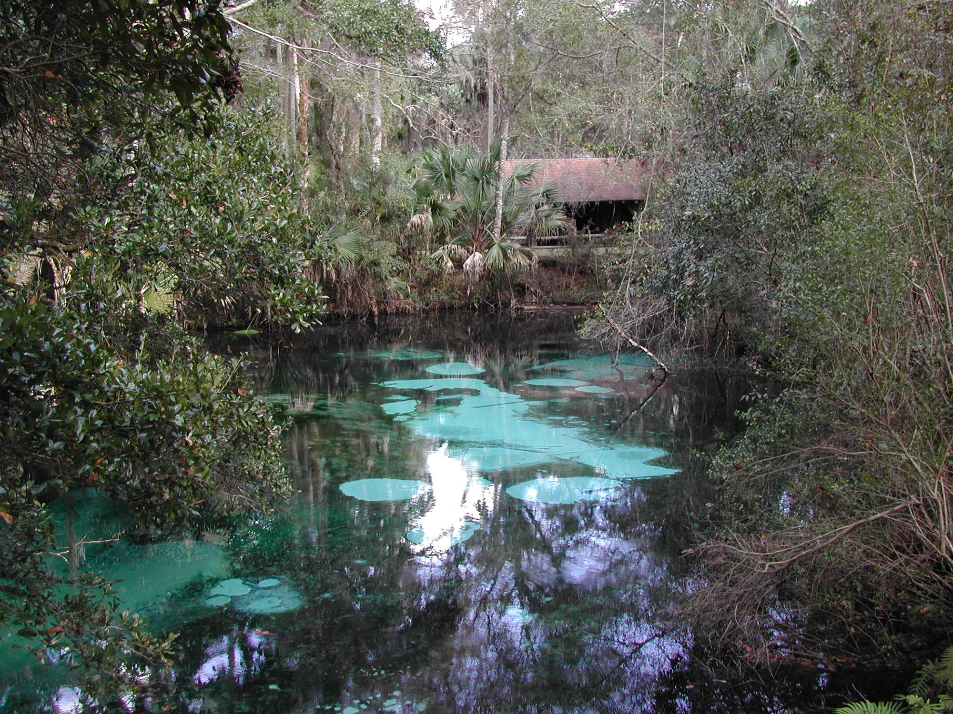

Florida’s Total Maximum Daily Load (TMDL) Program

Slide 2
Purpose of the TMDL Program
  Identify scientifically-based quantitative goals for restoration of waterbodies that do not meet State water quality standards, and implement a plan to achieve those goals.
  Local information and stakeholder involvement is the foundation of success
Notes:
Restoration of “unhealthy” waterbodies, not protection of those that are healthy (other programs such as FL Forever)

Slide 3
Basic
TMDL
Cycle

Slide 4
What is a TMDL?
Formal definition: TMDLs identify the maximum amount of a pollutant that a waterbody can receive and still meet water quality standards.
Informal definition: TMDLs set numeric water quality goals to restore the health of a lake, river, stream, spring, or estuary.

Slide 5
TMDL Development
  Specific to a waterbody and a pollutant
  Steps
  Determine “assimilative capacity”
  (i.e. maximum pollutant loading)
  Identify sources
  Calculate numeric pollutant reduction goals & allocations
  Based on best available data
  Water quality data - Land use – BMPs – etc.
Notes:
Emphasize that local information is used from the very beginning of the TMDL process.

Slide 6
TMDL Implementation
Basin Management Action Plans (BMAPs) are the primary mechanism through which TMDLs are implemented in Florida
403.067(7) F.S. provides for the implementation of TMDLs and development of Basin Management Action Plans (BMAPs)
The Department will determine the best course of action regarding TMDL implementation

Slide 7
TMDL Implementation
Implementation Options
  Considerations:
    Need for detailed allocations
    Watershed characteristics and the impairment
  Options may include:
    Direct NPDES permit modification
      TMDL requirements apply to permitted sources only
    Decision Document (no additional action)
    Local Implementation Plan
    BMAP

Slide 8
Basin Action Management Plans
BMAPs are most comprehensive approach to TMDL implementation
Collaborative process with cooperation of local stakeholders
BMAP Goals
  Reach consensus on scientific foundation of TMDL
  Determine how allocations will be calculated
  Calculate detailed allocations for each stakeholder
  Determine how and when load reductions will be accomplished

Slide 9
Benefits of a BMAP
Provides equity among stakeholders
Relies on adaptive management
Achieves documented commitments
“Safe harbor” clause for MS4 permittees and nonpoint sources upon adoption of a BMAP
Provides citizens with assurances about the future health of a waterbody by providing a restoration plan with milestones and timelines

Slide 10
What’s in a BMAP?
  Refined source identification
  Detailed allocations by entity
  Restoration projects
  Monitoring (water quality & projects)
  Commitments: funding & implementation timelines
People
Data & Information
BMAP
Projects & Funding

Slide 11
Building a BMAP
Technical Work
(refine TMDL information, detailed source identification)
Define Responsibility for Pollutant Reductions (allocations)
Integrate Other Factors
(e.g. project feasibility, funding)
Evaluate Existing and Identify New Projects
(pollutant reduction benefits, funding, & timelines)
Monitoring & Adaptive Management

Slide 12
Defined Responsibilities (Allocations)
TMDL
Same categories in every TMDL
BMAP
Varies widely among BMAPs to meet stakeholder needs & watershed characteristics
Notes:
This slide may not be necessary, depending on time limitations.

Slide 13
BMAPs & Regulatory Links
BMAPs are enforceable through:
NPDES wastewater permits
NPDES municipal stormwater (MS4) permits
Adopted BMAP

Slide 14
Reality Check – TMDL Development and Implementation is a Complicated Process
Data Acquisition and Problem Assessment
BMAP Development
Loads by entity
Required reductions
Potential projects
Project commitments
Funding commitments
Future growth considerations
Other factors
TMDL Development
Water chemistry
Ecological health
Biological resources
Pollutant loading
Source identification
Water quality restoration targets
Joint Pollutant Load Reduction Strategy
Allocation of Required Pollutant Load Reductions
Permitted/ Non-Permitted Entities
TMDLs Adopted by DEP Rule
Stakeholder Allocation Negotiation Process
Regulatory negotiations, permit renewals, BMP implementation, public education, local ordinances, etc.
New Science, Information, and Expertise
Monitoring progress and tracking project implementation
Notes:
No need to go through the details.
PURPOSE OF SLIDE – Emphasize the need for ongoing, consistent, and intense involvement by an informed City representative.

Slide 15
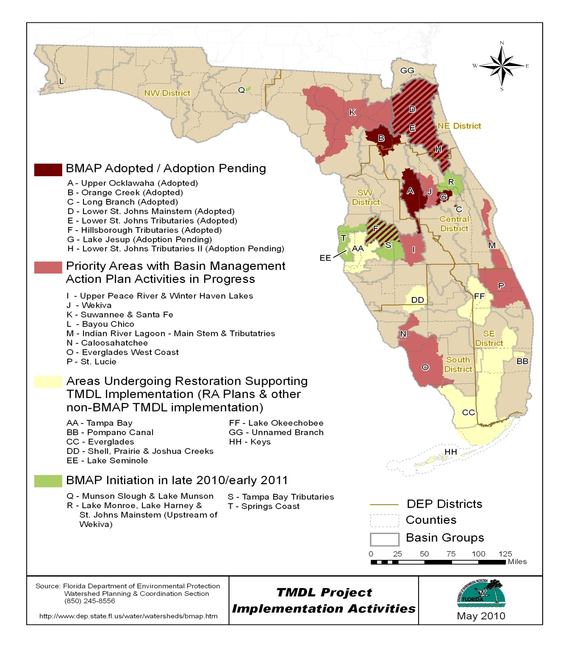
TMDL Implementation

Slide 16
Statewide Successes
Improved communication and cooperation amongst local stakeholders and state agencies
Broad application of high-quality science and local information
Clarified obligations of wastewater point source, MS4 and non-MS4 stakeholders in TMDL implementation
Enhanced transparency in DEP decision-making

Slide 17
Adopted BMAPs
Upper Ocklawaha, Nutrients
Orange Creek, Nutrients and Coliforms
Lower St. Johns Mainstem, Nutrients
Lower St. Johns Tributaries, Coliforms
Hillsborough River Tributaries, Coliforms
Lake Jesup, Nutrients

Slide 18
BMAPs in Development
  Bayou Chico
  Caloosahatchee
  Everglades West Coast
  Indian River Lagoon & Banana River Lagoon
  Santa Fe
  Suwannee
  St. Lucie
  Wekiva

Slide 19
How can SWCD help with BMAP process
Agricultural lands typically nonpoint sources.
403.067 F.S. requires BMP implementation or FDEP developed monitoring plan
FDACS/OAWP BMAP responsibility is BMPs
SWCD can provide assistance to FDACS field staff

Slide 20
Best Management Practices
“Best management practice(s)” means a practice or combination of practices determined by the coordinating agencies, based on research, field-testing, and expert review, to be the most effective and practicable on-location means, including economic and technological considerations, for improving water quality in agricultural and urban discharges.

Slide 21
FDACS-OAWP Adopted BMPs
OAWP Adopted BMPs | Rules
Ridge Citrus | 5E-1.023
Indian River Citrus | 5M-2
Peace River Citrus | 5M-5
Gulf Citrus | 5M-7
Lake Okeechobee BMPs | 5M-3
Florida Container Nurseries | 5M-6
Florida Vegetable & Ag Crops | 5M-8
Florida Sod | 5M-9
Manure Application | 5M-10
Florida Cow/Calf Operations | 5M-11

Slide 22
Example of magnitude of Effort
Santa Fe River Basin area agricultural land classification is predominant use (next slide).
Assistance is needed in:
  Implementing BMPs
  Verifying compliance
  Identifying ways to improve process
  Verifying NOI still applicable (development)

Slide 23
BMP Participation Map
NOI / CP Enrollment in the Santa Fe BMAP Basin
Commodity/Usage | # NOIs / CPs | Total Acres
Cow/Calf | 2 | 312
Dairies | 4 | 3,850
Forage Grass | 1 | 865
Nursery | 9 | 363
Poultry Feeding Operations | 1 | 37
Row Crops | 88 | 40,805
Totals: | 105 | 46,231
Notes:
Red outline is Santa Fe River basin BMAP area. Red diagonal line shows current estimated location of the potentiometric divide between SRWMD & SJRWMD. It has moved west and is indicating a loss of water resource for the SRWMD.
Ag land use by GIS indicated with existing NOIs overlain.

Slide 24
How can SWCD help with BMAP process
Property Owner identification and contact
Assistance in verifying land use from GIS coverage
Workshops on BMPs
Assistance in spreading the message to other groups
Coordinate with IFAS & WMDs

Slide 25
QUESTIONS
BMAP Questions contact
  John Abendroth WPCS section administrator
    John.abendroth@dep.state.fl.us

