Slide 1
Fecal Coliform TMDLs in my Jurisdiction
Alafia River Basin
July 7th, 2011

Slide 2
Best use of your efforts
Identify sources
Fix sources
Plan to Identify and prevent future sources
Walk the Waterbody Exercise Document
BMAP and Annual Reports
MS4 implementation

Slide 3
OVERWHELMED BY FECAL COLIFORM EXCEEDANCES?

Slide 4
EPA is aware of uncertainties using FC in South FL
“Tropical Water Quality Indicator Workshop” 2001 held by EPA and Hawaii
  Recommendations were made to EPA by experts pertaining to the efficacy of the Fecal coliform indicator in South FL and Hawaii.

Slide 5

Environmental Escherichia coli
“We find, however, that the commensal genomes encode for more functions that are important for fitness in the human gut, do not exchange genetic material with their environmental counterparts, and hence do not evolve according to the recently proposed fragmented speciation model.”
(Chengwei Luoa,b, Seth T. Walkc, David M. Gordond, Michael Feldgardene, James M. Tiedjef,
and Konstantinos T. Konstantinidisa,b,g,1”, 2011)
Notes:
“s sher eekeea”

Slide 6
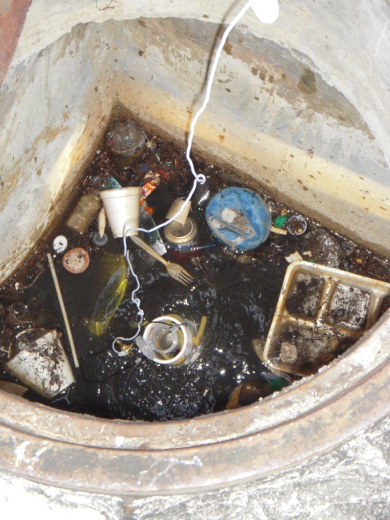
Walk the Waterbody Training
Alafia River Basin
July 7th, 2011
Photo: Miami River Commission
Version 2

Slide 7
Today’s Topics
Why Walk
Objectives
Pre Field Event Activities
Field Event
Post Event Follow Up
Additional Resources and Information

Slide 8
Why Walk the Waterbody?
There is a fecal coliform impairment or TMDL.
Good first step to determining sources (controllable and uncontrollable) and identifying easy to implement management actions.
Utilize existing programs and ongoing activities to address “low hanging fruit.”
Identify uncertainties and future options for more effective adaptive management.

Slide 9
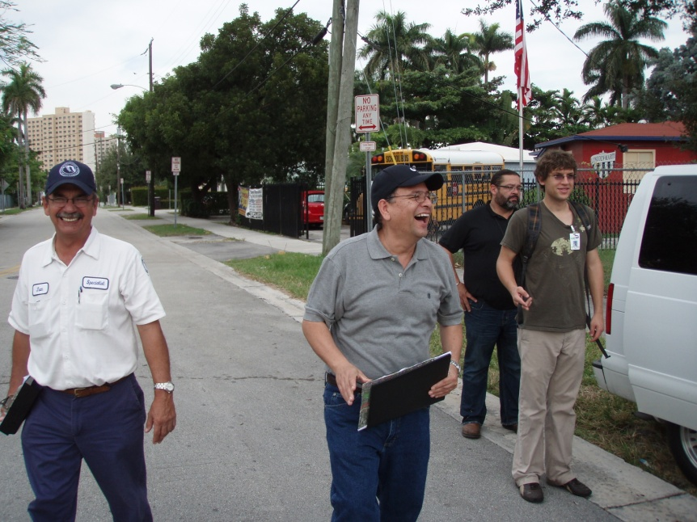
Why Walk Continued
Contributes to improved communication between and within agencies.
Increased public awareness.
Photo: Miami River Commission

Slide 10
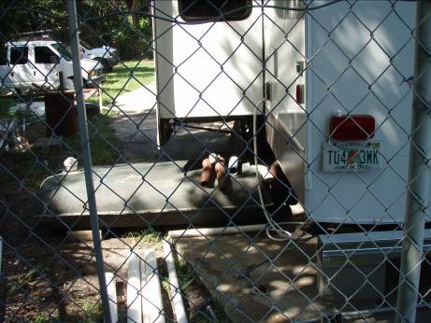
Objectives
Walking your Waterbody
Photo: PBS&J

Slide 11
Objectives of Walk the Waterbody
Categorize conditions of watershed.
  Hydrology;
  Contributing ditches and branches; and
  Flood prone areas.
Have all agencies with jurisdictional authority to collaborate simultaneously pre-event, in the field, and for post event follow up.
Notes:
Its hard for stakeholders to claim there are no problems when everyone can see them in the field

Slide 12
Objectives Continued
Implement management actions to eliminate sources and locate potential sources.
Identify sampling needs:
  Fill in knowledge gaps; and
  Identify location of suspected sources.
Establish follow-up protocol when a source is located.
Determine potential next steps.

Slide 13
A quick Reminder
Just in Case

Slide 14
Fecal Coliform & Impaired Waters Rule
IWR for determining fecal coliform bacteria impairment :
  The most probable number (MPN) or membrane filter (MF) counts per 100 ml of fecal coliform bacteria shall not exceed a monthly average of 200, nor exceed 400 in 10 percent of the samples, nor exceed 800 on any one day.
Notes:
The State surface water quality standard is all three – if we shoot for an in stream concentration of 400 – there should be no impairment – as we don’t usually have the number of samples required for determining geomean

Slide 15
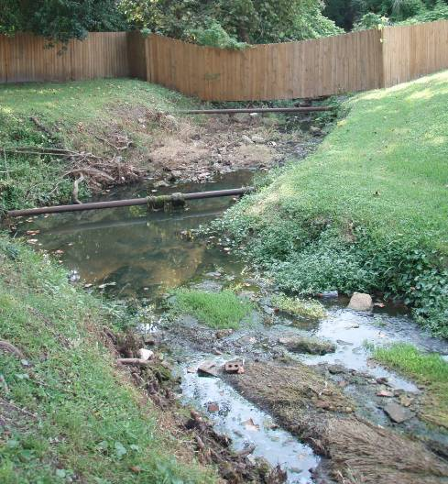
Step by Step
Planning & Execution of the Field Event
Photo: PBS&J

Slide 16
Walk the Waterbody Steps
  Lead Entity
  Stakeholder Identification
  Data Collection and Assimilation
  Maps on the Table (MOT)
  Synthesize Data from MOT
  Pre-Field Event Investigation
  Field Event

Slide 17
Identifying Stakeholders
There must be a lead agency, typically:
  MS4 permittee;
  Municipality; or
  Utility.
How to identify partner agencies:
  Characterize sources:
    MS4 co-permittees that discharge to WBID;
    Septic tanks: Department of Health;
    Wastewater utility; and
    Agriculture.
  Check TMDL.
Notes:
Additional Partner Agencies: WMD, FDEP, WCD, IFAS, HOA

Slide 18
  Data Collection and Assimilation for Maps
Collect stormwater infrastructure data:
  Inlets and outfalls
  Ponds
  Ditches
  Underground conveyance
  Best management practices (BMPs)
Gather sewer infrastructure (private & public):
  Pump stations
  Force and gravity mains
  SSO
Notes:
Sewer: ARV’s, manholes, laterals- pipe material

Slide 19
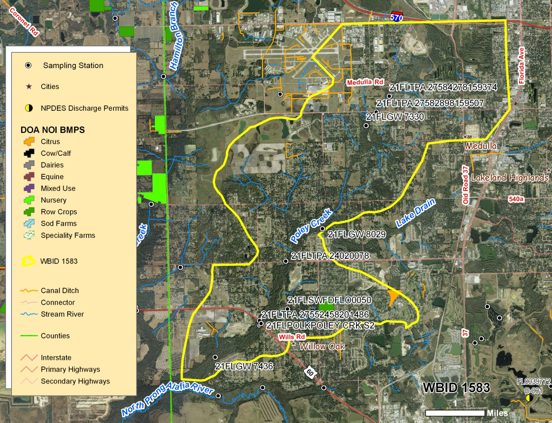
Review of the Watershed

Slide 20
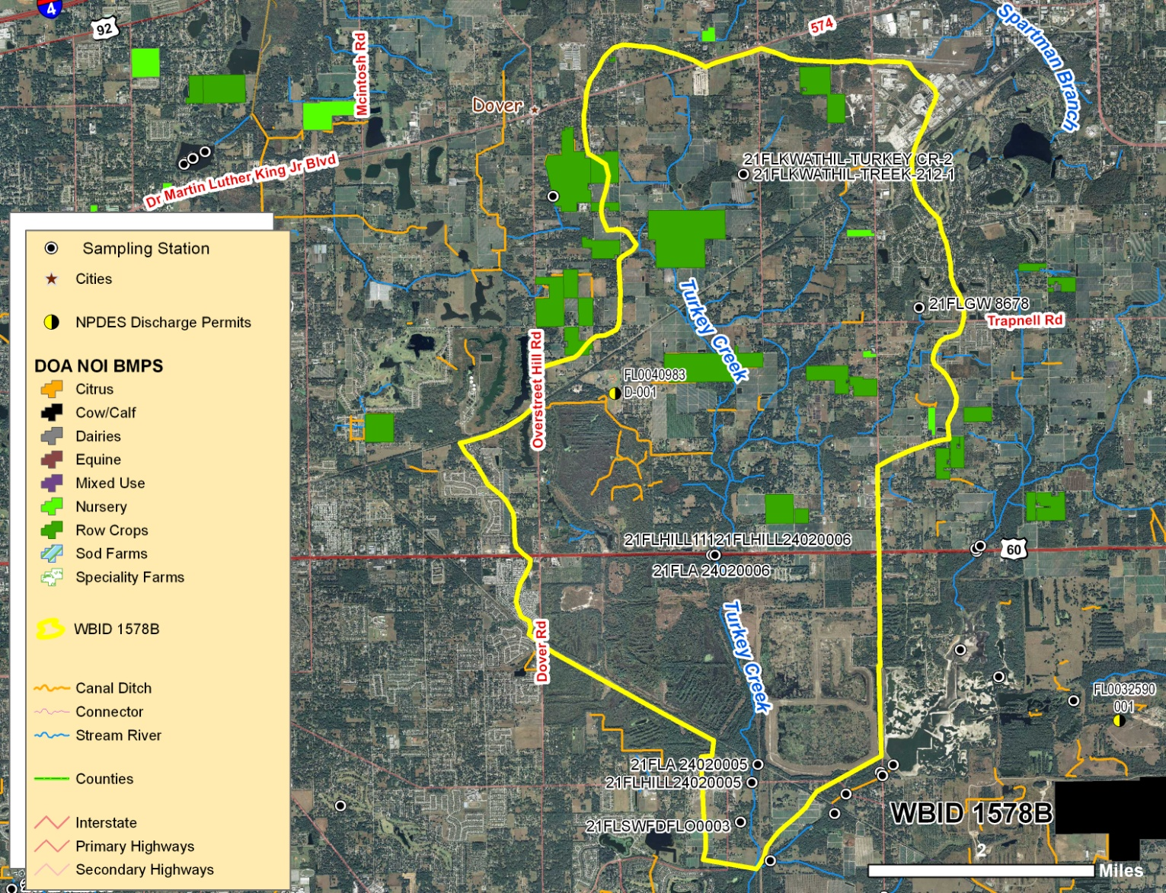
Review of the Watershed

Slide 21
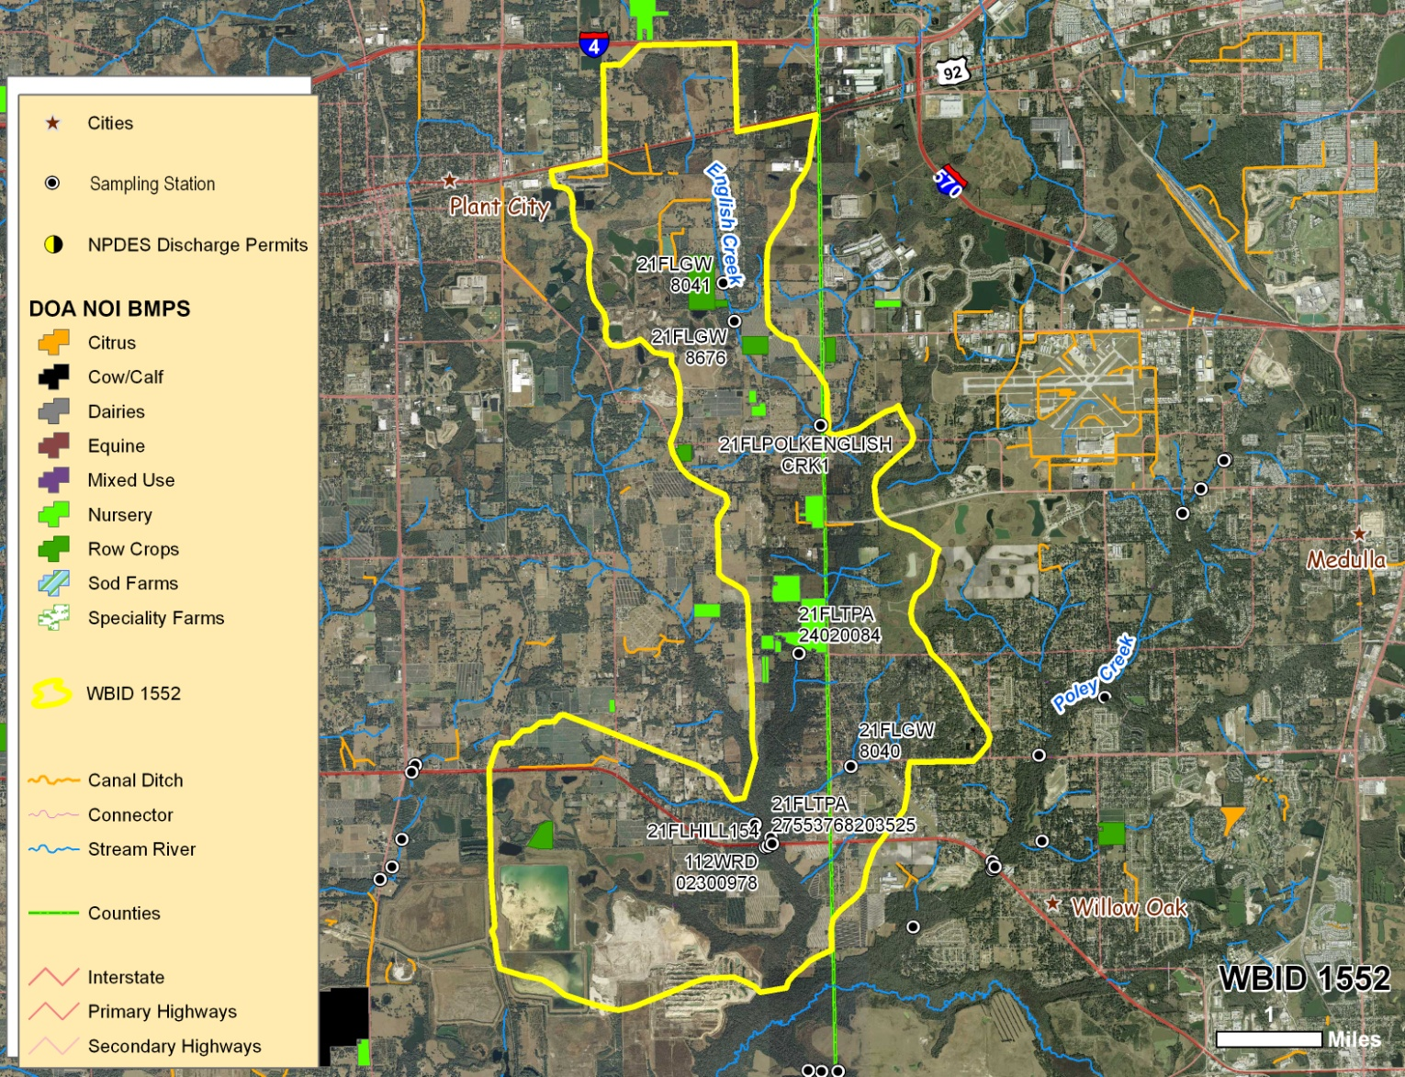
Review of the Watershed

Slide 22
  Data Collection and Assimilation
Identify septic tank locations:
  Repair permits
  Industrial permits
Locate specialty farms, kennels, or other animal operations.
Water quality sampling:
  Sampling stations
  Sampling frequency
  Sampling results

Slide 23
  Data Collection and Assimilation
Hydrology:
  Wetlands
  Streams
  Ponds
Areas of special concern:
  Landfill
  Transfer station
  Dog parks
  Homeless populations

Slide 24
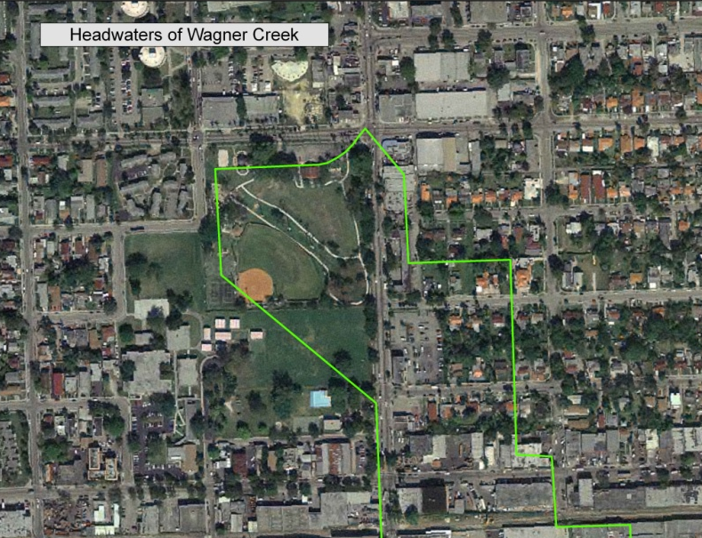
Data Collection and Assimilation
Make maps in large format and multiple copies:
  Water quality sampling locations;
  Stormwater;
  Wastewater; and
  Combined dataset.
Notes:
Note: Using the Adobe Interactive .pdf map is a huge help in MOT. Allows for information to recorded directly in the map at that location rather than trying to cross walk notes to locations identified on the map. More advanced technology requiring proficient GIS tech and software.

Slide 25
Maps on the Table
All hands on deck, a representative from each agency needs to attend.
Divide into teams, if appropriate. There should be one representative from each agency per team.
Elect a note taker.
Elect a presenter:
  Potential sources
  General information
Notes:
If there is a large group with multiple representatives; divide into teams. Generally, no more than 6 in a team- more than that is ineffective for participation

Slide 26
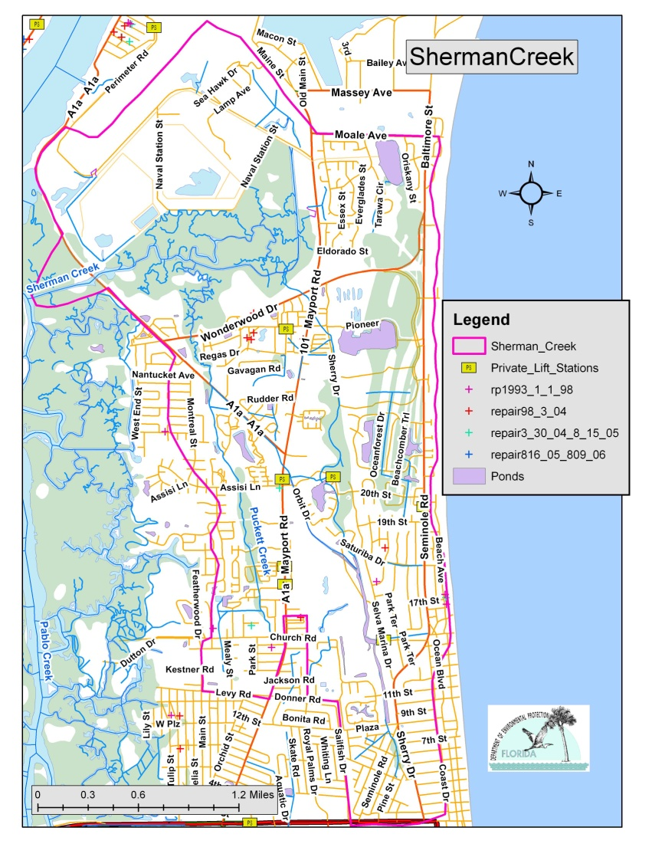
Maps on the Table Continued
Review maps as team and identify:
  Hydrology characteristics, and
  Known areas of concern.
Team members should be marking areas of concern on the maps themselves.
Notes:
We will review what we are looking for as areas of concern and potential sources in a few slides

Slide 27
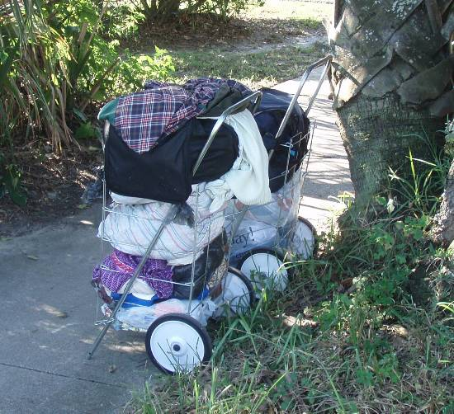
MOT Continued
Note taker should be recording the map notations.
After the team discussion, the presenter should review the teams findings to the group.
Photo: PBS&J

Slide 28
MOT Next Steps
Elect field representatives.
  Representative from each entity.
    Consider if there is more than one side of the house (stormwater vs. public works).
  Participants should have infrastructure knowledge and have access to facilities (gated stormwater ponds, pump stations, etc.).
  Sampling staff:
    Should have necessary sampling equipment, and
    Should be familiar with sampling SOP.

Slide 29
Field Planning
Spaces for field event are limited, as it is imperative all field participants ride in one vehicle.
  Yes, that means one vehicle.
  12 passenger van is recommended.
Remember you may need to coordinate with local law enforcement if you may be in areas that may have safety concerns.

Slide 30
Field Planning
Participants should plan on bringing:
  Lunch (there is no time to stop at restaurant);
  Sunscreen and bug repellent;
  Appropriate field clothing;
  Water; and
  Agency contact numbers.
Equipment for field:
  GPS;
  Camera;
  Sampling equipment, coolers, and ice;
  Large format maps.
Notes:
Note to coordinator- first thing in the morning @ meeting location determine if someone has not brought lunch- try to find a break location early am that will allow for someone to grab something before the lunch hour rush-

Slide 31
Pre-Field Day Investigation before Walking with Group
Lead agency will recon the WBID based on the MOT information, and identify:
  Field day meeting location with appropriate parking.
  Route from headwaters downstream.
  Lunch location such as a park bathrooms.
  Prioritize areas of concern.
  Access issues.
Notes:
During pre event- rule out areas that do not require the larger field day inspection: Areas with sources but not close to surface waters, etc

Slide 32
Walking the Waterbody
Designate a documentation team or teams:
  Primary note taker who coordinates GPS points, photos, and sampling locations.
  GPS – take GPS points.
  Camera – take pictures.
Imperative that the precise record (order) of GPS coordinates, photos, and notes is captured in the field.
Other participants should also be taking pictures.
Notes:
One person can’t and shouldn't handle all three, direct group, etc. Note taker should be someone who understands what needs to be recorded with a photo, GPS point , and sample (never a sample without other two pieces).

Slide 33
What kinds of observations should be noted?
In order to catalogue all potential reasons for the impairment, it’s important to look for and note
  anthropogenic potential sources
  non-anthropogenic potential sources
  conditions potentially conducive to regrowth
  permit related and unrelated O & M
  activities covered by local code
  and activites which could be addressed through public education
Notes:
One person can’t and shouldn't handle all three, direct group, etc. Note taker should be someone who understands what needs to be recorded with a photo, GPS point , and sample (never a sample without other two pieces).

Slide 34
When Walking What are we Looking For?
Flood prone areas
Evidence of pet waste
Water fowl
Chickens or other hobby animals
Ruminant populations and raccoons, etc.
Septic tanks
  Ponding
  Strong smell
  Close to surface waters
Notes:
NOTE: Just because you smell sewage at pump station or manhole does not mean there is a problem- a certain amount of odor is normal

Slide 35
Looking Continued
Wastewater
  Any infrastructure in close proximity to surface waters:
    Pump Stations:
      Alarms;
      Contact Information;
    Manholes; and
    Air release valves (ARVs).
Branches and contributing ditches.

Slide 36
Still Looking
Erosion or wash out
Dense tree canopy
Dense vegetation in stream
Stagnant water
Homeless
Animals in water:
  Horses
  Cattle
  Raccoons
Notes:
Dense Tree Canopy or Vegetation in stream can contribute to regrowth by not having UV penetration

Slide 37
It’s a lot of Looking
Stormwater
  Potential Illicit Connections
  Stormwater Drains:
    Free of debris,
    In repair, and
    Smell of sewage (cross- connections).
  Inlets:
    Free of debris, and
    Proximity to wastewater infrastructure.
  Outfalls:
    Ponds, and
    Underground conveyances.
Notes:
If inlets are blocked it could contribute to flooding conditions= failing WW and septic systems
Stormwater outfalls from underground conveyances may have high fecal numbers because of the accumulation of sediments and lack of UV penetration could equal regrowth

Slide 38
When You See a Discharge
Take a sample:
  At point, and
  Downstream and/or upstream.
If it is a serious infraction – Call it in!
  Illegal discharge
  Turbidity
  SSO
Take GPS point and pictures.
Notes:
Special Note: Don’t get bogged down in sampling a lot of ground to cover

Slide 39
When You See Potential Sources
Take pictures.
Capture area with GPS point.
Notes should indicate:
  What it is or may be.
  Who may be associated with corrective action, such as:
    County not FDOT, or
    Department of Business & Professional Regulation not local Utility.
Notes:
You get one shot and characterizing the effort after requires organized information and plenty of documentation

Slide 40
Important Sampling considerations!!!!
Remember samples must be on ice while waiting for delivery.
Samples must meet holding times (6 hours)!!
Samples must be processed in NELAP certified laboratory.
May need to make arrangements to have samples picked up for delivery to lab.
Chain of custody must still be maintained.

Slide 41
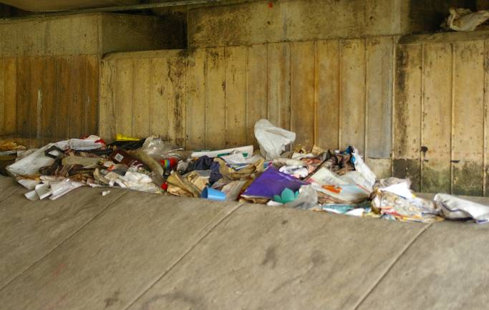
Post Event
Summary, Reporting & Follow-up
Photo: PBS&J

Slide 42
First Steps to Summarize Field Event
Post process GPS coordinates.
Create shapefile of coordinates.
Edit shapefile to include description or information about point.
Process pictures by adding labels so you can later recall what the picture was showing.
Obtain sample results from lab.

Slide 43
Hold Follow Up Meeting with Participants
Review the findings from the field:
  Pictures
  Sample results
  Follow up actions associated with jurisdictional authority:
    Actions associated with permit obligations:
      Observed SSO – Utility, or
      Potential Illicit Connection – MS4.
    Housekeeping of Existing Infrastructure:
      Broken infrastructure or in need of maintenance:
        Broken stormwater grate.
      General maintenance:
        Clogged stormwater drains.

Slide 44
Follow Up Meeting with Participants, Cont.
  Coordinated community follow up actions.
    Additional source investigations.
    Sampling:
      Increased sampling frequency (quarterly to monthly).
      New stations:
        Information gaps (only two trend stations in WBID).
        Investigate potential source - Add sampling station to help identify source location , not intended to be a fixed sampling location .
      Follow up sampling after high count.
      Specialized sampling :
        MST.
        Boron or other indicators.
    Increased maintenance.
    Other source solutions.

Slide 45
Coordinated Community Follow Up
Lead entity should host a follow up discussion to review the community follow up actions.
This meeting should prioritize actions that eliminate sources.
Agencies and partnerships of entities should volunteer for those actions that are closely related to their missions and authority.

Slide 46
Reporting
Create table of follow up actions and indicate appropriate entities for management actions.
Create mechanism to ensure all jurisdictional items are completed.
Prioritize community follow up actions:
  Identify which community follow up actions will occur near term, and
  Actions for future implementation.

Slide 47
Reporting Continued
This information should be recorded in a way that information can be provided to the Department to demonstrate:
  Identified sources;
  Completed management actions to remove sources;
  Non-human sources;
  Projects or activities to address identified source and source assessment and identification; and
  Future steps.

Slide 48
Reporting continued
A WTW reporting template is on the CD
  Implementation Guidance for the Fecal Coliform Total Daily Maximum Loads Adopted by the FDEP, and Appendices CD.

Slide 49
Additional Resources and Information
References, Case Studies

Slide 50
Additional Resources
The Department has developed a fecal coliform guidance document that is a great source of tools and information. It is posted: http://www.dep.state.fl.us/water/watersheds/bmap.htm
Contracting with consultant to obtain better information such as:
  Develop sampling program,
  MST work to identify human sources,
  Water Quality Data Analysis.

Slide 51
Approximate Time Span
A lead entity should emerge
  Requests go out for GIS info.
    Receive GIS layers, process into maps
Hold MOT meeting
Develop Field Day Route
  Assimilate MOT notes
  Pre field day trip to finalize route
Field Day
Complete follow up actions and finalize report
  1st Summary Meeting
  2nd Follow Up Meeting
Finalized Report Meeting
Continued communication between entities
1-1.5 months
1-1.5 months
2 months
Unending

Slide 52
Homework
Prioritize WBIDs according to Risk Assessment, bring back the list prioritized, and the reasons why. (last page of WTW Handout)
Page 5 of WTW Training Manual
  “Initial Steps” describes the information needed to get started. Most of this is GIS info.
  Next to the list, write down who is the keeper this info?
  Note whether it is in GIS or CAD?

Slide 53
Questions
Anita Nash
Environmental Consultant
Florida Department of Environmental Protection
850-245-8545
Anita.Nash@dep.state.fl.us
Many thanks to Amy Tracy for creating this training slide show, Version 1.

