Slide 1
Division of Environmental Assessment and Restoration
Manatee River
Basin Management Action Plan (BMAP)
Annual Meeting
April 6, 2018
Meeting materials will be posted here:
http://publicfiles.dep.state.fl.us/DEAR/BMAP/Tampa_Bay_Tributaries/manatee%20BMAP/

Slide 2
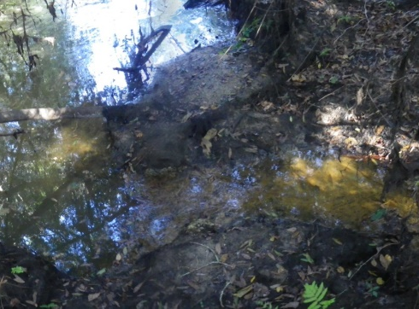

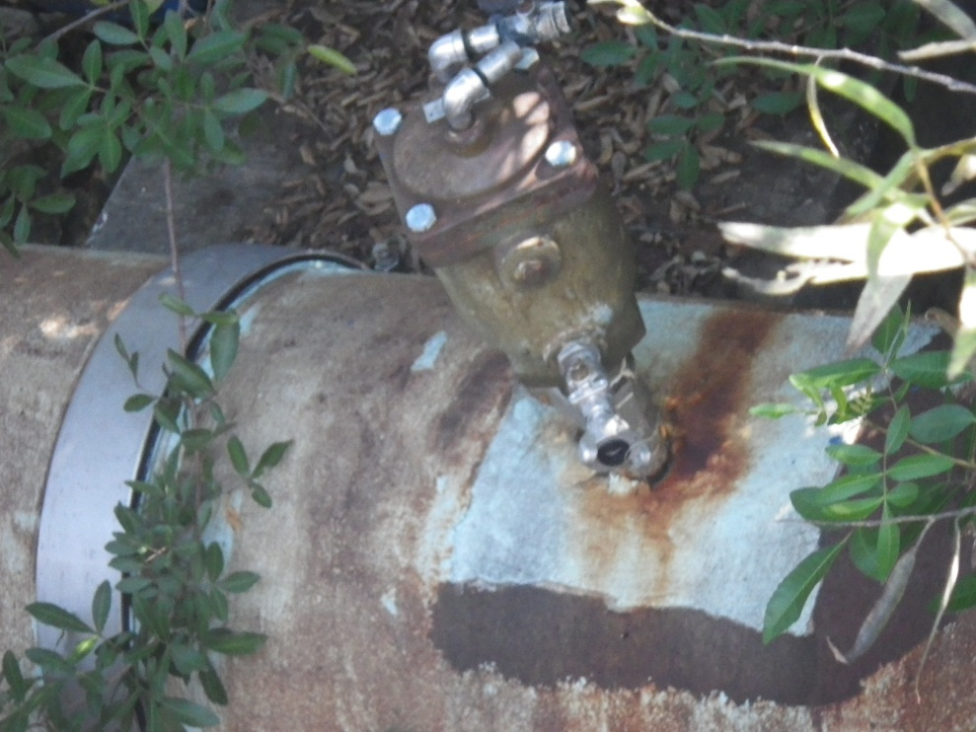
Meeting Agenda
Welcome and Introductions
BMAP Background
Project Updates
Water Quality
What’s New
Public Comments
and Wrap Up
Notes:
Photos Nash 2011
Top photo Braden Above Ward at Lake Wood Ranch Blvd.
Bottom photo Braden Above Ward at Lake Wood Ranch Blvd.
ARV, no dripping noticed. Strong smell.

Slide 3
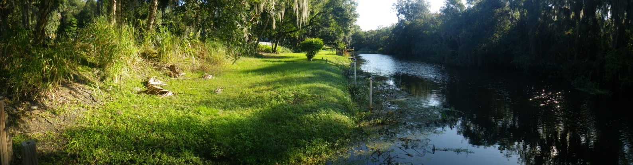

Manatee River BMAP Background
Adopted April 2014
The fourth year of the BMAP ended March 2018
The waterbodies addressed by the BMAP are Class I waters and are:
  Rattlesnake Slough
  Cedar Creek
  Nonsense Creek
  Braden River above Evers Reservoir
Notes:
Rattlesnake Slough - TN, BOD, and bacteria
Cedar Creek - bacteria
Nonsense Creek - TN, BOD, and bacteria
Braden River above Evers Reservoir - bacteria
(Image of Braden River Above Evers Reservoir Nash 2011)

Slide 4
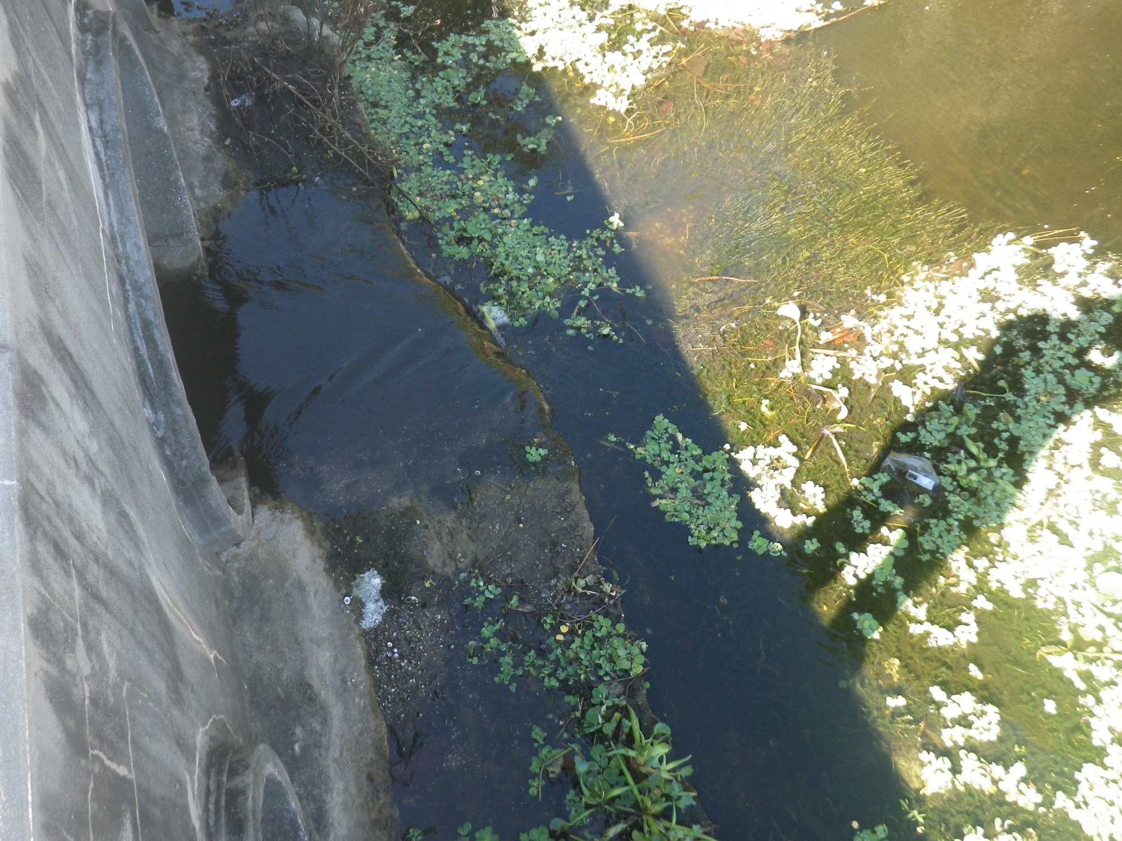
Project Updates
Florida Department of Agriculture and Consumer Services (FDACS)
Manatee County
Other Local Governments/Agencies
4
4
Notes:
(Photo Rattlesnake Slough at Whitfield, near Lockwood intersection Nash 2011)

Slide 5
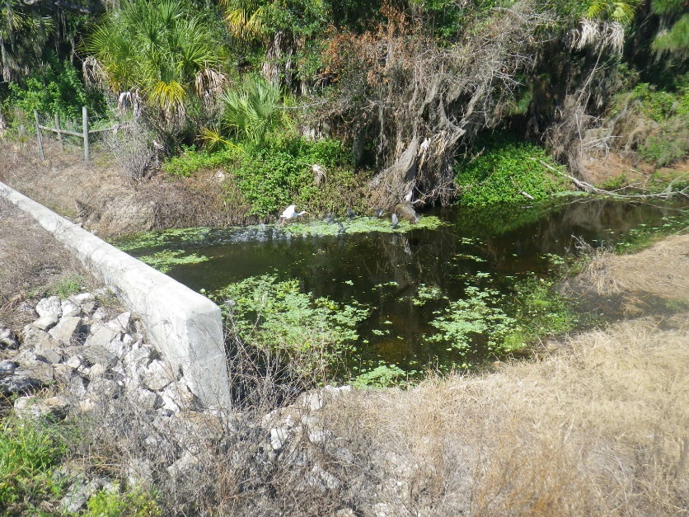
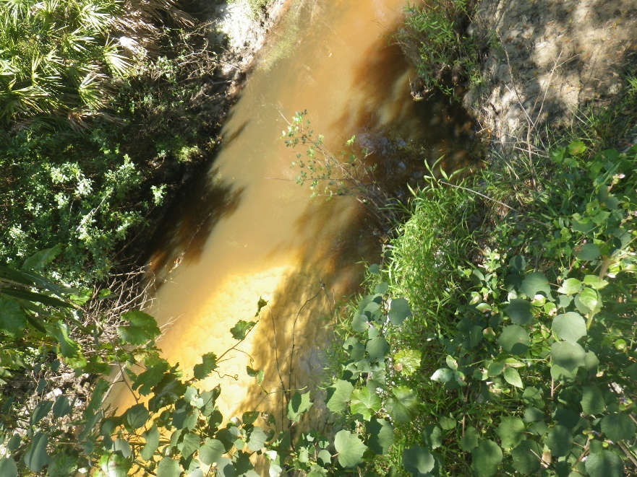
Water Quality
  Rattlesnake Slough
  Cedar Creek
  Nonsense Creek
  Braden River above Evers Reservoir
Notes:
(Images: Top is Rattle Snake Slough,
bottom is Braden River above Evers Reservoir/ Ward Lake, Nash 2011)

Slide 6








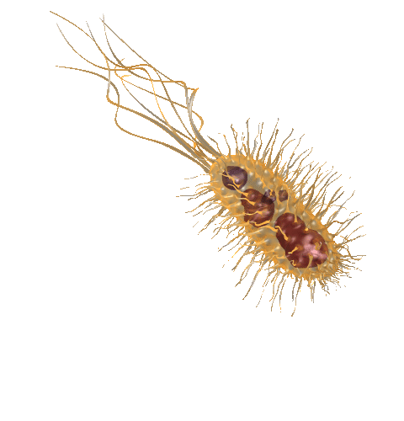








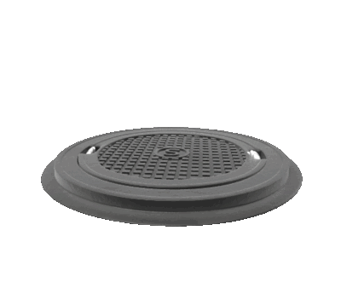



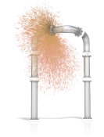
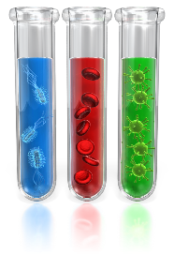





Fecal Indicator Bacteria
Restoration Tools
START
Historical Data
Collaboration Corner
Impaired
waters
Hot
Spots
Finding
New Sources
GO BACK TO START!
Sources
Of Bacteria
Field
Observations
CREATE YOUR TEXT ADD INS HERE
Source Specific Monitoring
Field Observations
Field Observations
Low Hanging Fruit

Slide 7
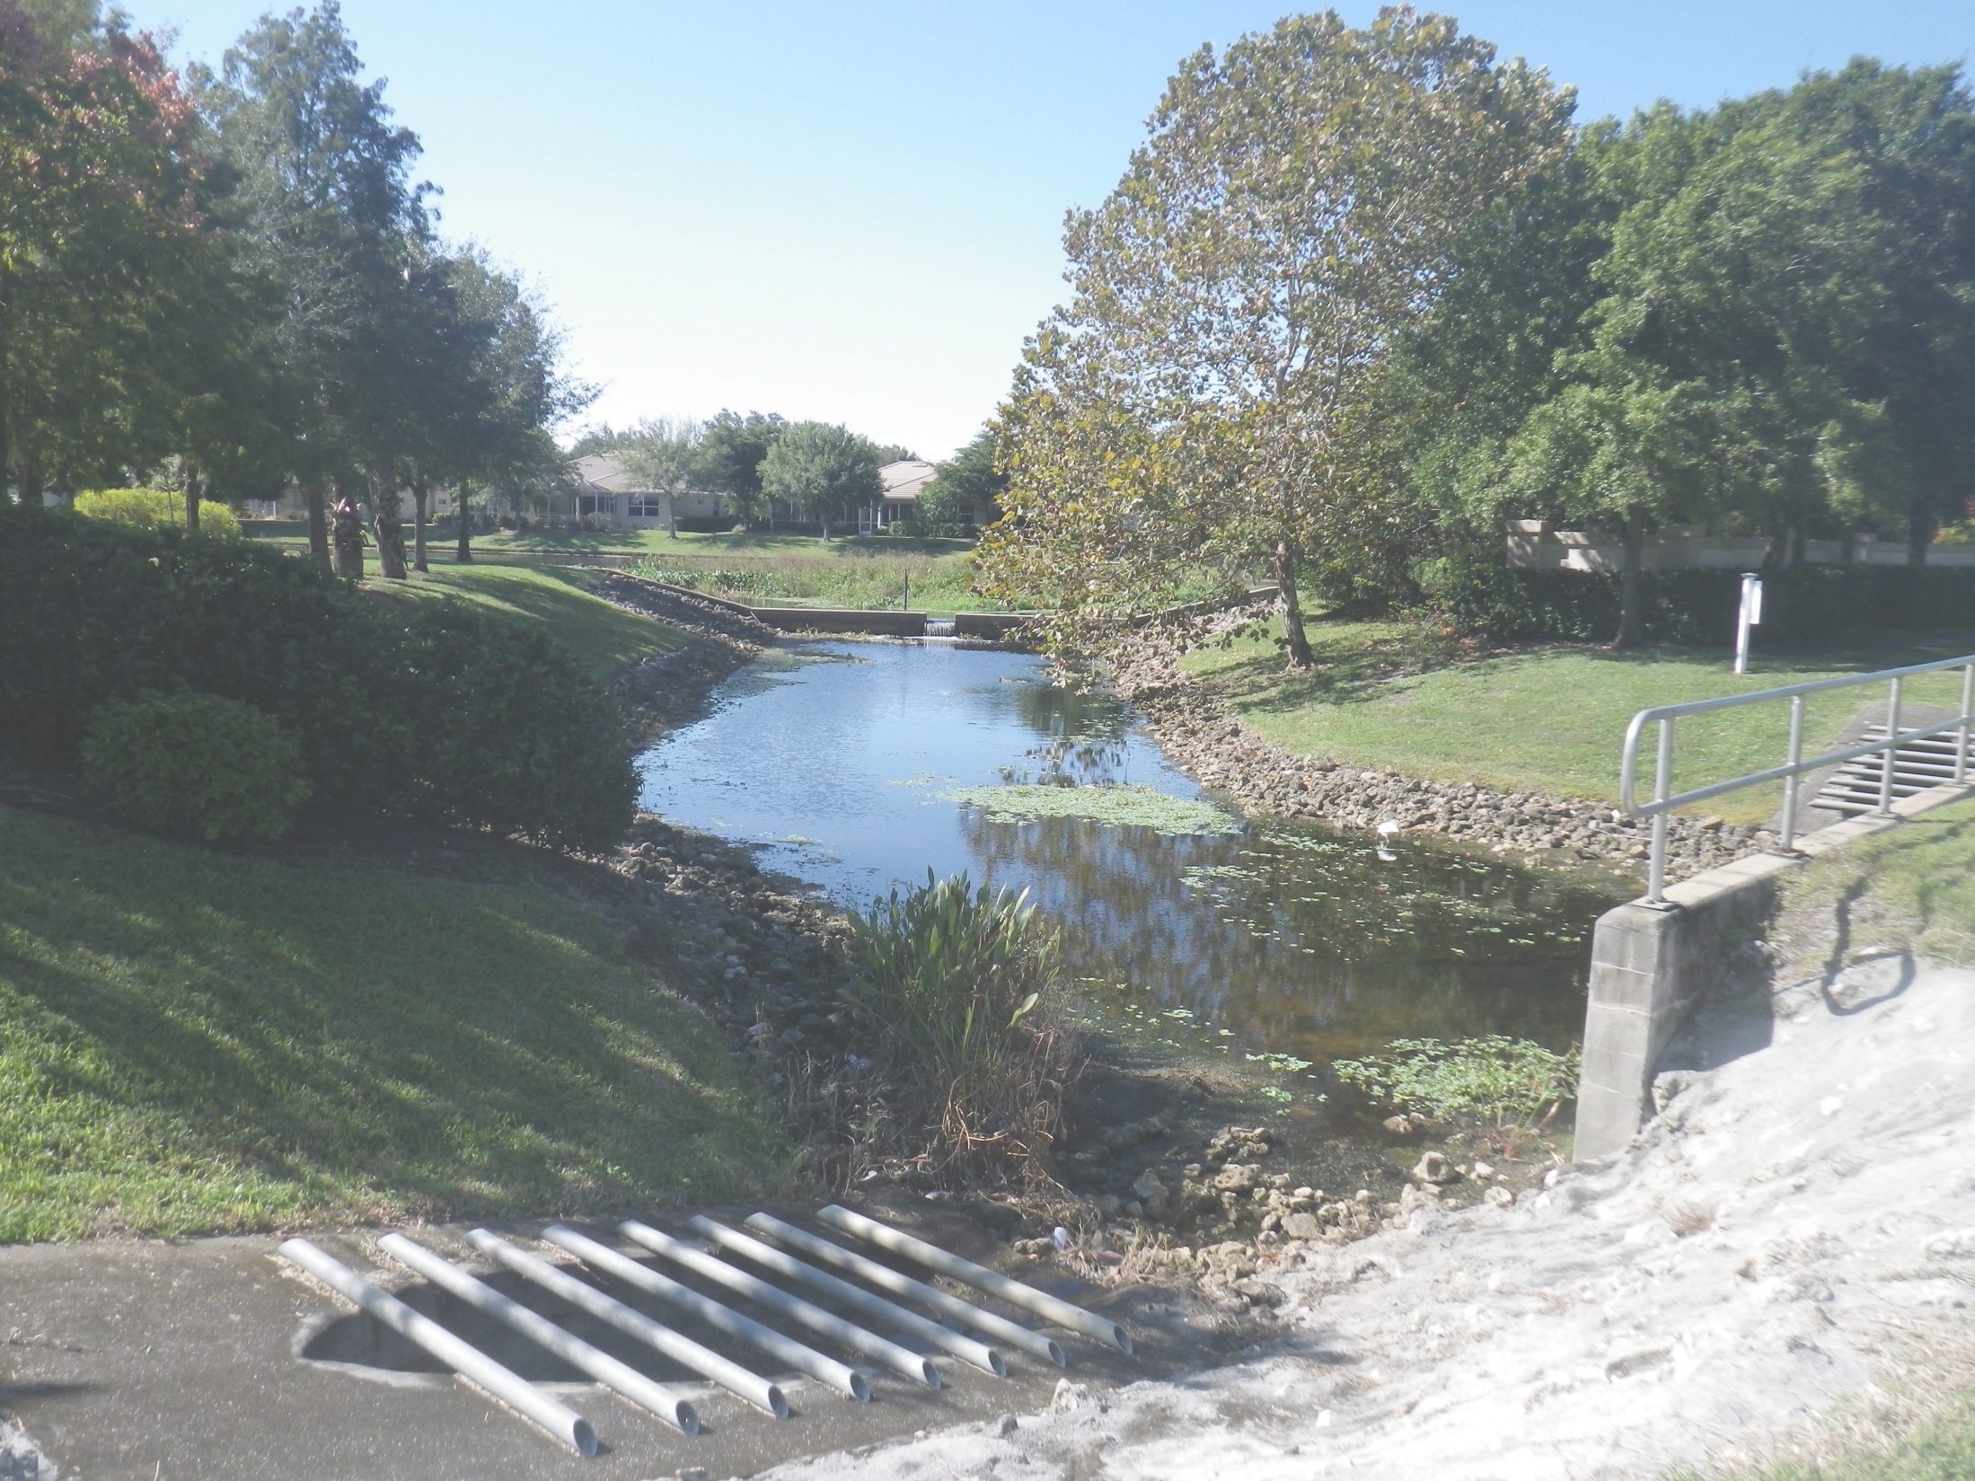

2017 Intensive Source
Identification (ID) Pilot Study
Florida Department of Environmental Protection
Division of Environmental Assessment and Restoration
Notes:
(Photo Rattlesnake Slough at Whitfield, near Lockwood intersection Nash 2011)

Slide 8



Parameters
  Escherichia coli (E. coli) - class I (fresh water) standard
  Acetaminophen - (pain reliever that indicates raw sewage)
  Sucralose - (artificial sweetener that indicates raw sewage only where records do not show reuse water or onsite sewage treatment and disposal system [OSTDS] in the contributing area)
  MST human marker HF-183 - (a segment of deoxyribonucleic acid [DNA] from bacteria most commonly found in human enteric systems)
  Propidium Monoazide (PMA) - (indicates recent discharge because it differentiates the live fraction of the Bacteroides out of the total Bacteroides detected in the sample)
EXAMPLE
EXAMPLE
Example

Slide 9
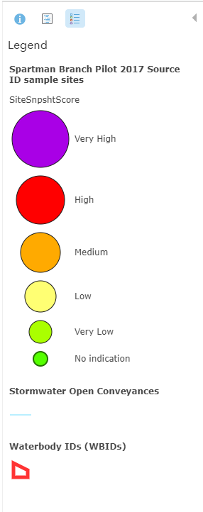

Symbology
Confidence of presence of raw sewage:
The symbols represent our level of confidence that a sample contained raw sewage, it does not represent the volume of sewage
Each station dot, in the following maps, represents a single site, during a single sampling event, and considers results from the full suite of parameters
Very High
High
Medium
Low
Very Low
No indication
Remaining trails to follow

Slide 10

Confidence of Presence of Raw Sewage in a Sample
(per analyte)
Version 2017
As detected in raw sewage
DRAFT

Slide 11
Scoring the Suite of Results
DRAFT

Slide 12
Spartman Branch
Pilot 2017 Lab Results
Spartman Branch 1561 | Site Score: Indication of raw human sewage | Station | Collection date / time | E.Coli |  |  | HF-183 Crude qPCR |  |  | HF-183 Purified qPCR |  |  | HF-183 PMA treated qPCR |  |  | Sucralose |  |  | Acetaminophen
Round |  |  |  | Result | Qualifier | Score | Result | Qualifier | Score | Result | Qualifier | Score | Result | Qualifier | Score | Result | Qualifier | Score | Result | Qualifier | Score
Round 1 | low | C | 3/21/2017 9:50 | 504 | Q | very low | 10 | T | very low | NS |  | - | NS |  | - | 0.18 |  | - | 0.01 | U | -
 | very low | A | 3/21/2017 10:15 | 279 | Q | - | 13 | T | very low | NS |  | - | NS |  | - | 0.18 |  | - | 0.01 | U | -
 | very low | A_DUP | 3/21/2017 10:20 | 132 | Q | - | 61 | T | very low | NS |  | - | NS |  | - | 0.2 |  | - | 0.01 | U | -
 | non-detect | Field Blank | 3/21/2017 10:30 | 1 | UQ | - | 71 | U | - | NS |  | - | NS |  | - | 0.01 | U | - | 0.01 | U | -
 | low | B | 3/21/2017 11:25 | 1609 | AQ | low | 24 | UJ | - | NS |  | - | NS |  | - | 0.22 |  | - | 0.01 | U | -
Round 2-C | very low | A2 | 4/10/2017 9:15 | 987 | Q | very low | 140 | UJ | - | NS |  | - | NS |  | - | 0.22 |  | - | 0.01 | U | -
 | low | C4 | 4/10/2017 9:55 | 1106 | Q | low | 580 | IJ | low | NS |  | - | NS |  | - | 0.09 |  | - | 0.01 | U | -
 | very low | C | 4/10/2017 10:25 | 10 | UQ | - | 8.5 | TJ | very low | NS |  | - | NS |  | - | 0.22 |  | - | 0.01 | U | -
 | very low | C3 | 4/10/2017 10:50 | 327 | Q | - | 27 | T | very low | NS |  | - | NS |  | - | 0.21 |  | - | 0.01 | U | -
 | low | C2 | 4/10/2017 11:20 | 426 | Q | very low | 2.6 | T | very low | NS |  | - | NS |  | - | 0.44 |  | - | 0.01 | U | -
July Wet Season Sampling Event | high | D | 7/18/2017 8:55 | 359 | Q | very low | 120 | T | very low | 1.1 | TJ | very low | 5.5 | TJ | very low | 0.13 |  | - | 0.05 |  | very high
 | non-detect | Field Blank | 7/18/2017 10:15 | 1 | UQ | - | 71 | U | - | 12 | UJ | - | 12 | UJ | - | 0.01 | U | - | 0.01 | U | -
 | high | B | 7/18/2017 10:40 | 573 | Q | very low | 140 | T | very low | 45 | IJ | low | 13 | TJ | very low | 0.25 |  | - | 0.02 | I | high
 | high | B1 | 7/18/2017 11:05 | 439 | Q | very low | 24* | UJ | - | 24 | UJ | - | 24 | UJ | - | 0.22 |  | - | 0.08 |  | very high
 | very high | C4 | 7/18/2017 11:30 | 1017 | Q | low | 30* | IJ | low | 71 | IJ | low | 205 | J | very high | 0.05 |  | - | 0.01 | I | high
 | low | C | 7/18/2017 11:50 | 148 | Q | - | 69 | T | very low | 68 | IJ | low | 21 | TJ | very low | 0.12 |  | - | 0.01 | U | -
 | low | C2 | 7/18/2017 12:30 | 439 | Q | very low | 130 | TJ | very low | 24 | TJ | very low | 32 | IJ | low | 0.11 |  | - | 0.01 | U | -
 | low | C2a | 7/18/2017 13:00 | 246 | Q | - | 30 | TJ | very low | 8.2 | TJ | very low | 12 | TJ | very low | 0.19 |  | - | 0.01 | U | -
August Persistence Check Sampling Event | low | D | 8/16/2017 10:00 | 228 |  | very low | 58* | IJ | low | 58 | IJ | low | 6.9 | TJ | very low | 0.1 |  | - | 0.01 | U | -
 | very high | C4 | 8/16/2017 10:20 | 1081 |  | low | 178* | J | medium | 182 | J | medium | 34 | IJ | low | 0.04 | I | - | 0.01 | I | high
 | low | B | 8/16/2017 10:40 | 20 |  | - | 120 | T | very low | 47 | IJ | low | 11 | TJ | very low | 0.15 |  | - | 0.01 | U | -
 | high | B1 | 8/16/2017 11:00 | 556 |  | very low | 14* | TJ | very low | 15 | TJ | very low | 8.2 | TJ | very low | 0.36 |  | - | 0.01 | I | high
 | low | C | 8/16/2017 11:20 | 233 |  | - | 76* | IJ | low | 76 | IJ | low | 31 | IJ | low | 0.14 |  | - | 0.01 | U | -
 | low | C_DUP | 8/16/2017 11:25 | 228 |  | - | 53 | T | very low | 28 | IJ | low | 9.3 | TJ | very low | 0.14 |  | - | 0.01 | U | -
 | low | C2 | 8/16/2017 11:50 | 399 |  | - | 24 | T | very low | 13 | TJ | very low | 3.1 | TJ | very low | 0.09 |  | - | 0.01 | U | -
 | low | C2a | 8/16/2017 12:10 | 144 |  | - | 28 | T | very low | 19 | IJ | low | 15 | TJ | very low | 0.13 |  | - | 0.01 | U | -
 | non-detect | WALDENLAKE | 8/16/2017 13:00 | 52 |  | - | 140 | U | - | 24 | UJ | - | 24 | UJ | - | 0.49 |  | - | 0.01 | U | -

Slide 13
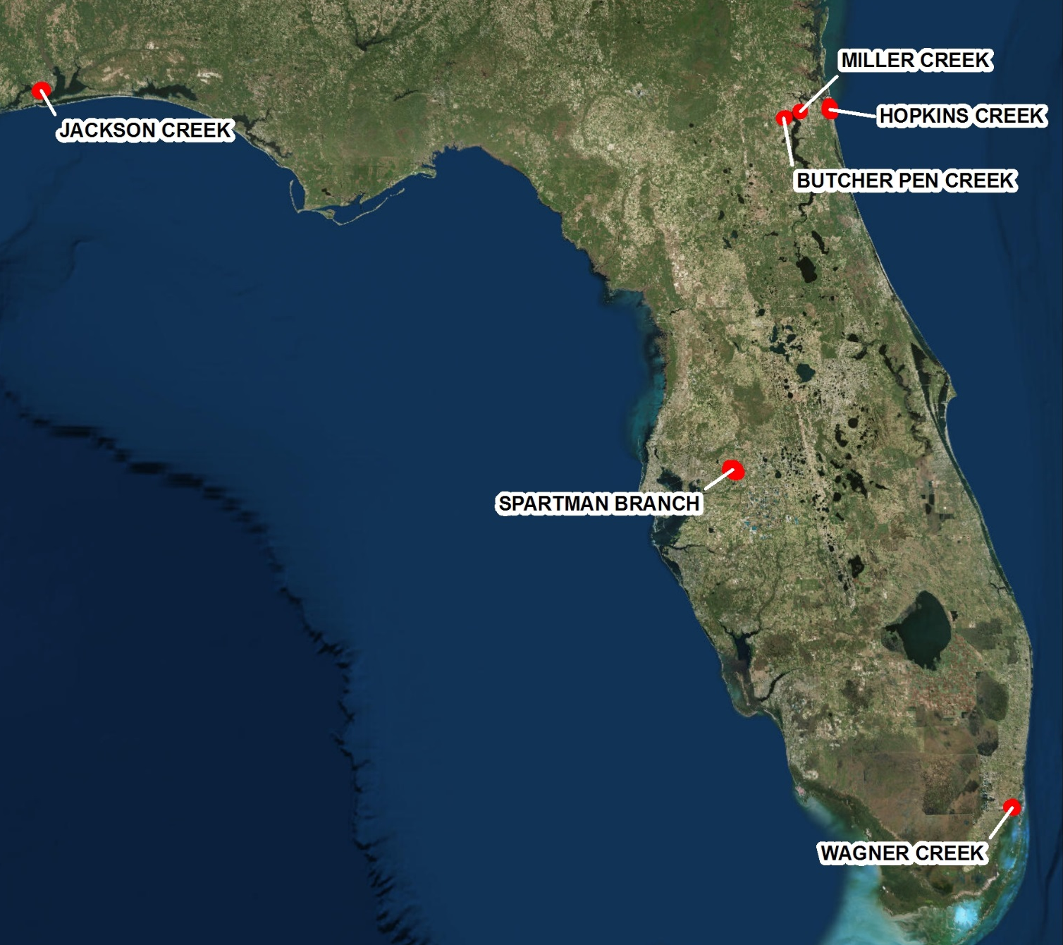

Pilot 2017 Waterbodies
Jacksonville vicinity:
  Butcher Pen Creek
  Miller Creek
  Hopkins Creek
Pensacola vicinity:
  Jackson Creek
Plant City vicinity:
  Spartman Branch
Miami:
  Wagner Creek/Seybold Canal
  Spartman Branch

Slide 14
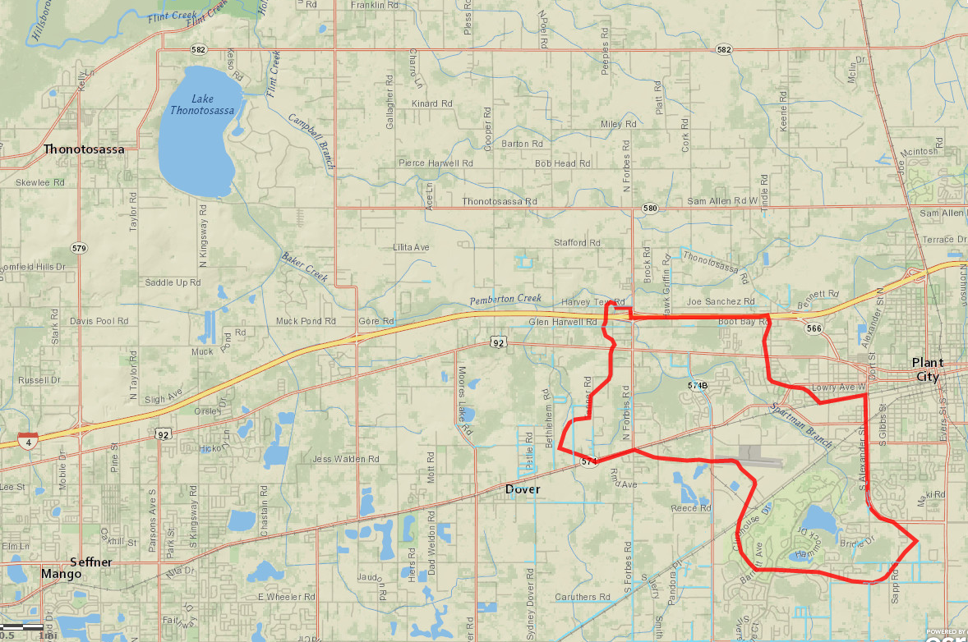


Spartman Branch WBID
Next
Flows north west to Pemberton Creek, Baker Creek, then into Lake Thonotosassa
Rural Hillsborough County
Plant City

Slide 15
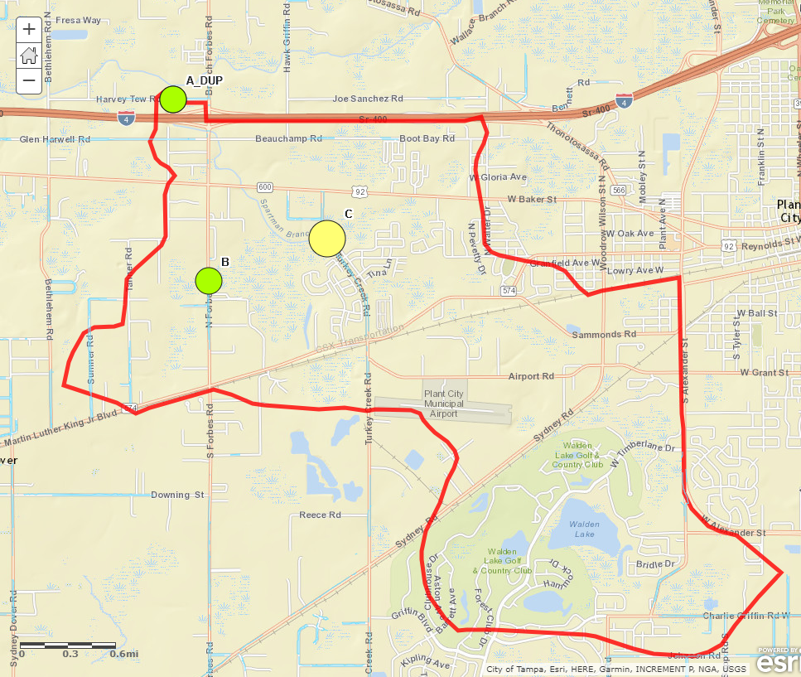
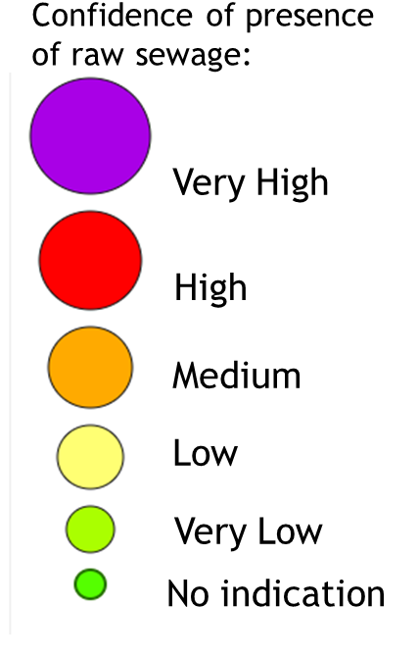
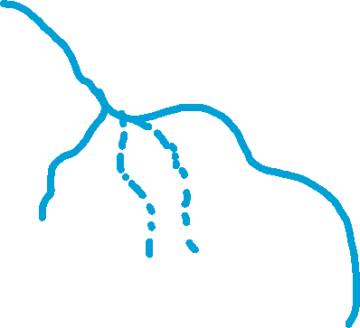
Spartman Branch
Next
Sampling Event 1 March 21

Slide 16
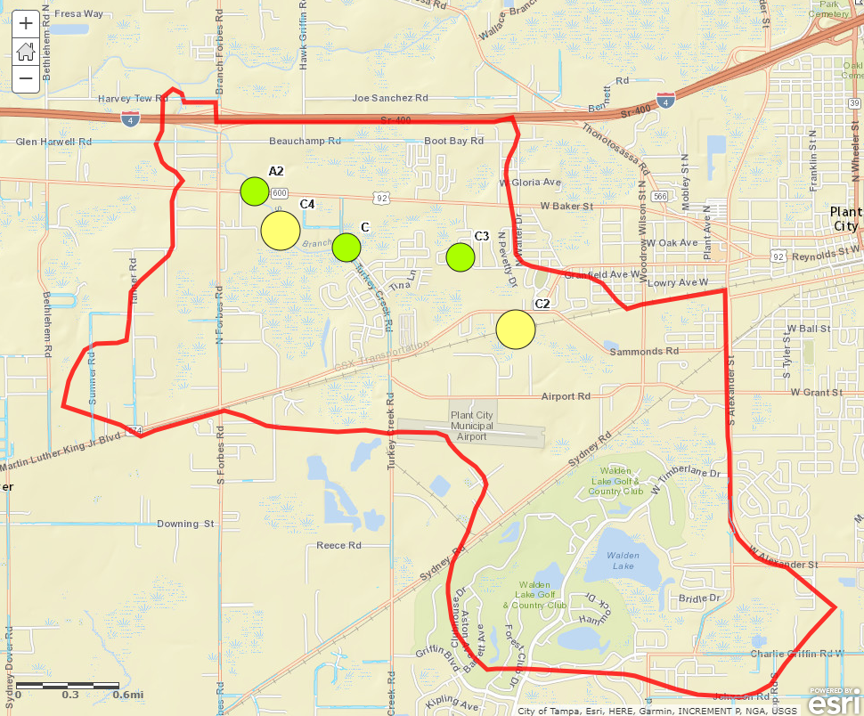
Spartman Branch
Next
Sampling Event 2
April 10
The south west tributary was dry
Shortly after, the creek went dry

Slide 17
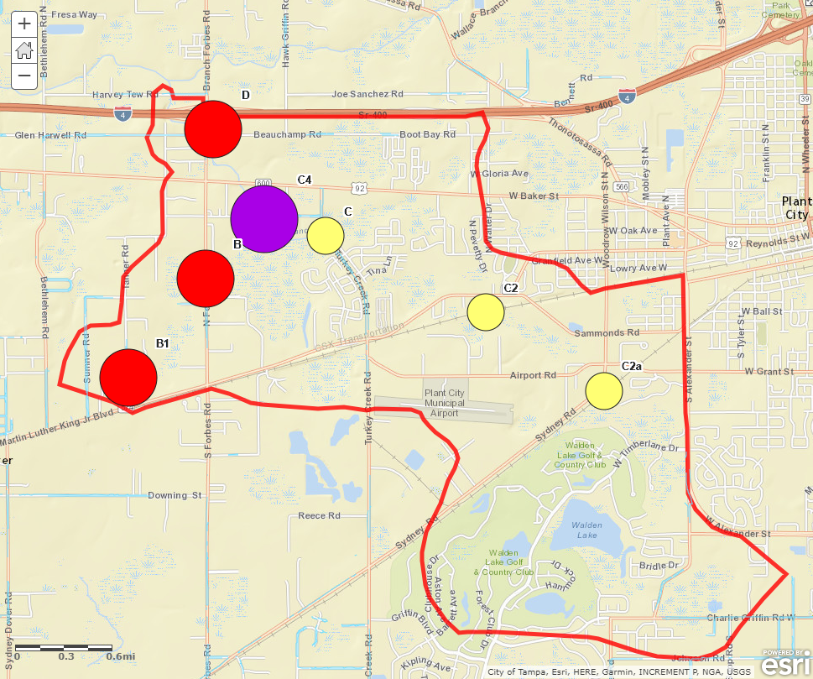
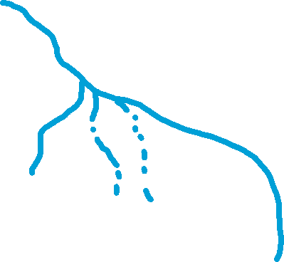
Spartman Branch
Next
Sampling Event 3
July 18
This event was after the creek began flowing again

Slide 18
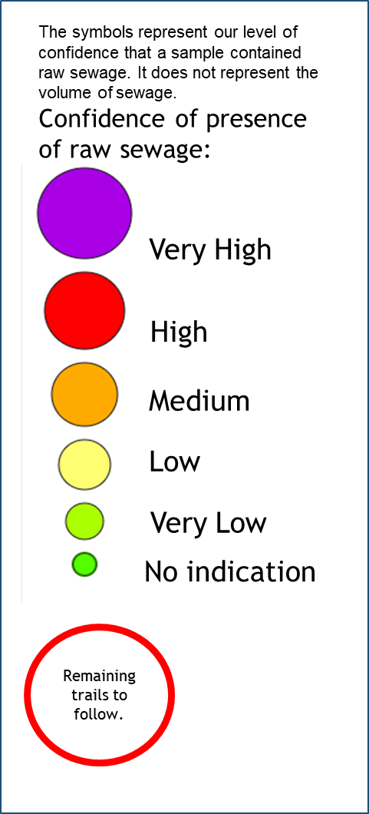
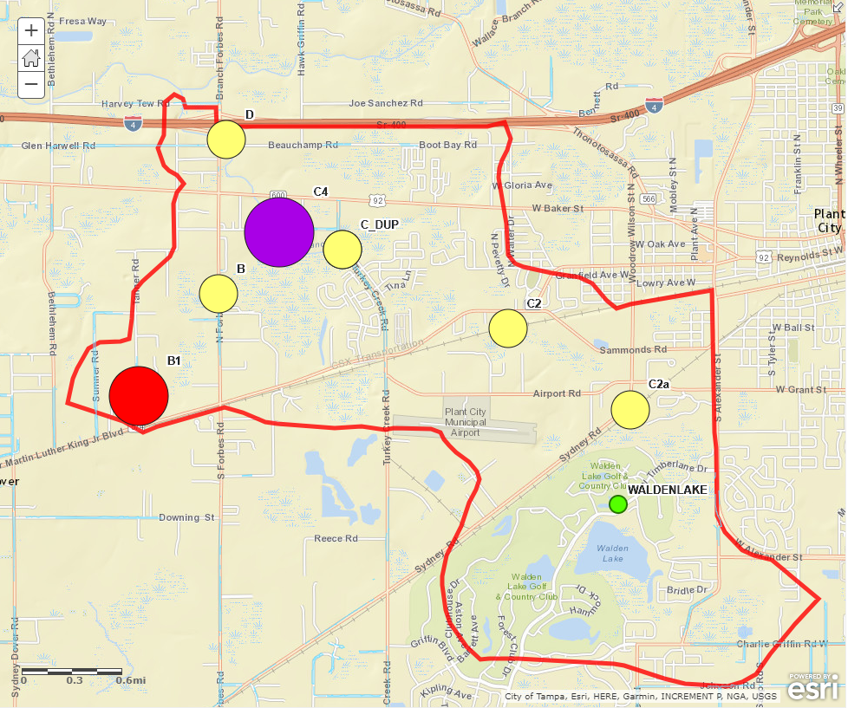
Spartman Branch
Sampling
Event 4
August 16
The last sampling event was to confirm hot spots before the conclusion of the pilot study

Slide 19
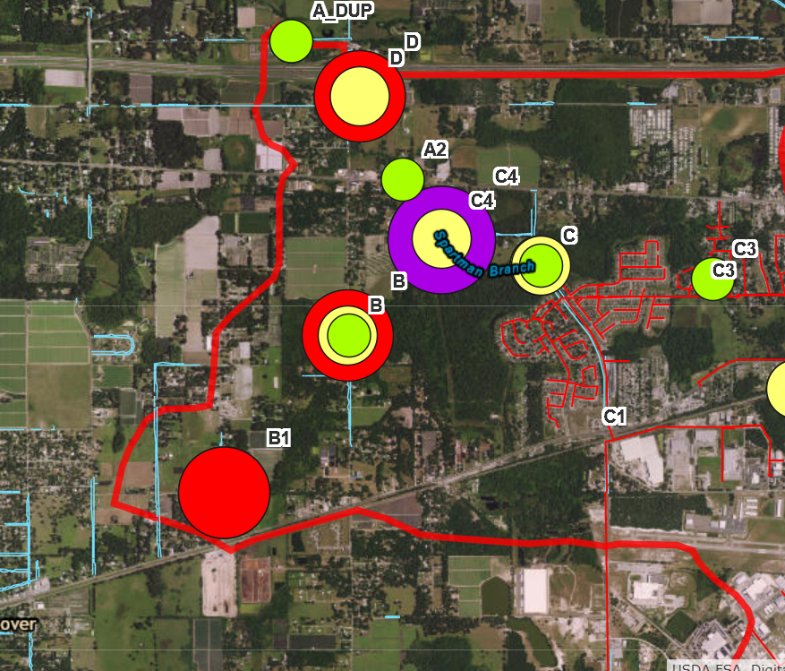
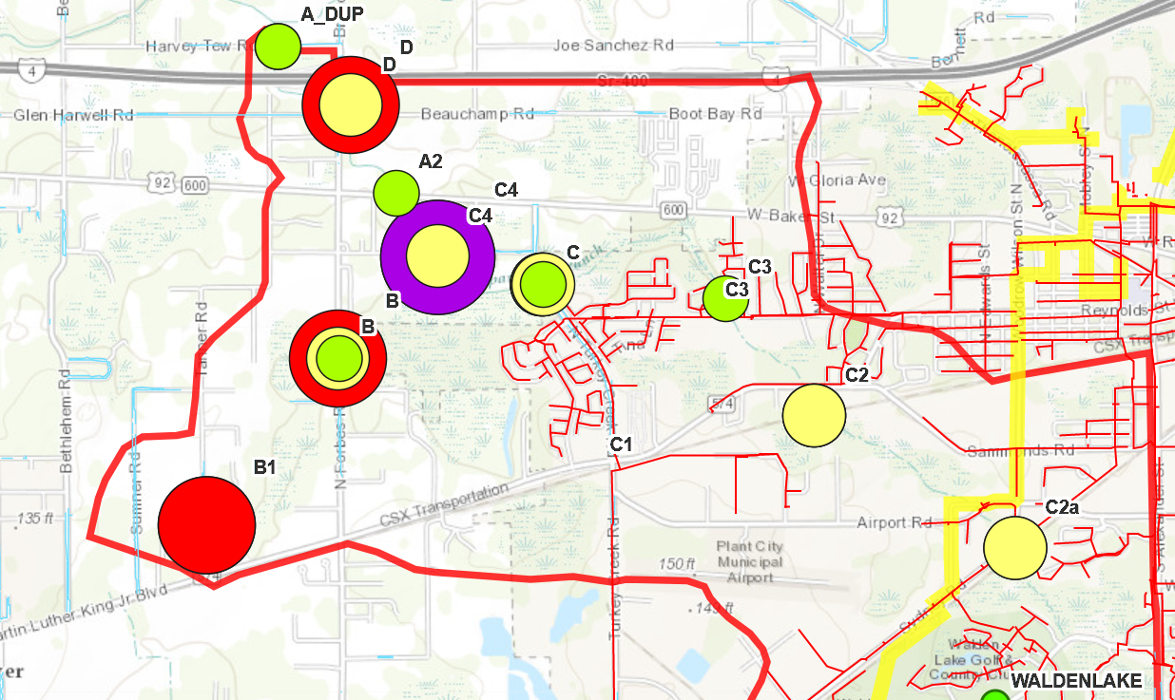
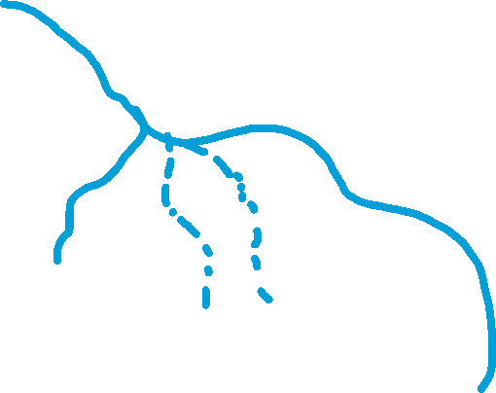

Spartman Branch
Next
All 4 pilot study sampling events

Slide 20

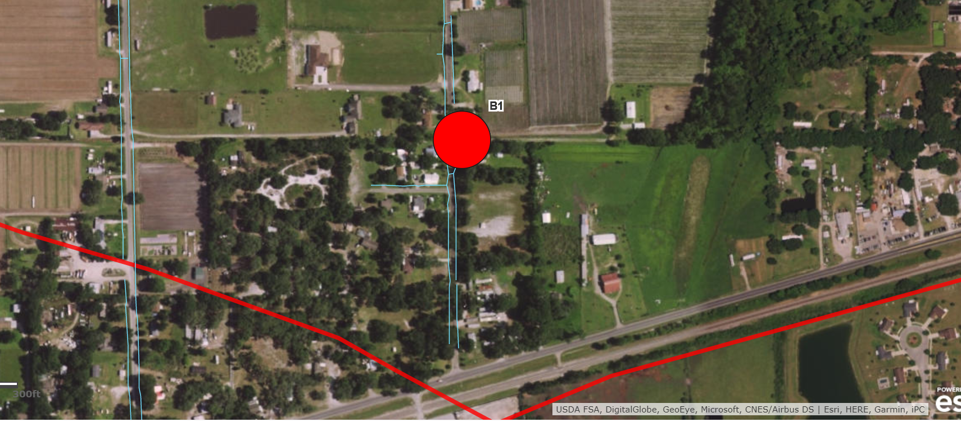


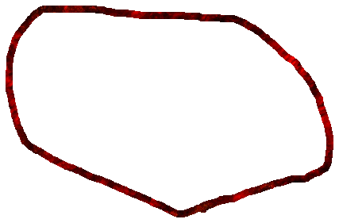
Example of a hot spot in an area serviced by OSTDS
Questions
WBID Line
Estimated Watershed Boundary

Slide 21

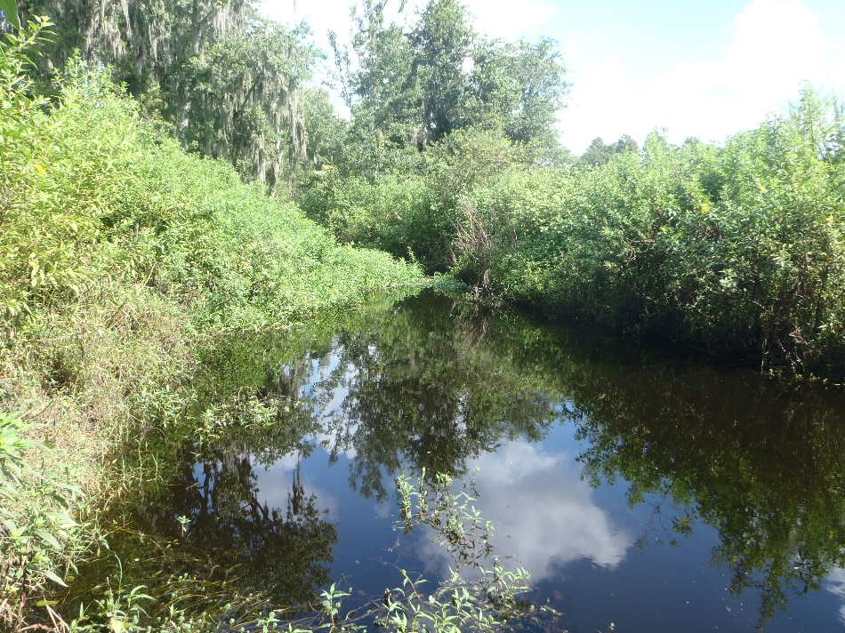

Building on the 2017 Source ID Pilot Study

Slide 22

Source Specific Data for Manatee Basin Waters
Notes:
When DEP gathers samples for Class I and III FIB assessments, source specific waste indicator samples are also being gathered in 2017 and 2018.
Moving forward, source specific indicators will be used as needed for determination of whether there are anthropogenic contributions to impaired waters.
BMAP waters are a among the DEP’s priority for identifying sources. DEP cannot create all of the source ID data so we will be looking for ways to collaborate on future monitoring of source

Slide 23


What’s New?

Slide 24

Fecal Indicator Bacteria (FIB) Impaired WBID Prioritization Tool

Slide 25
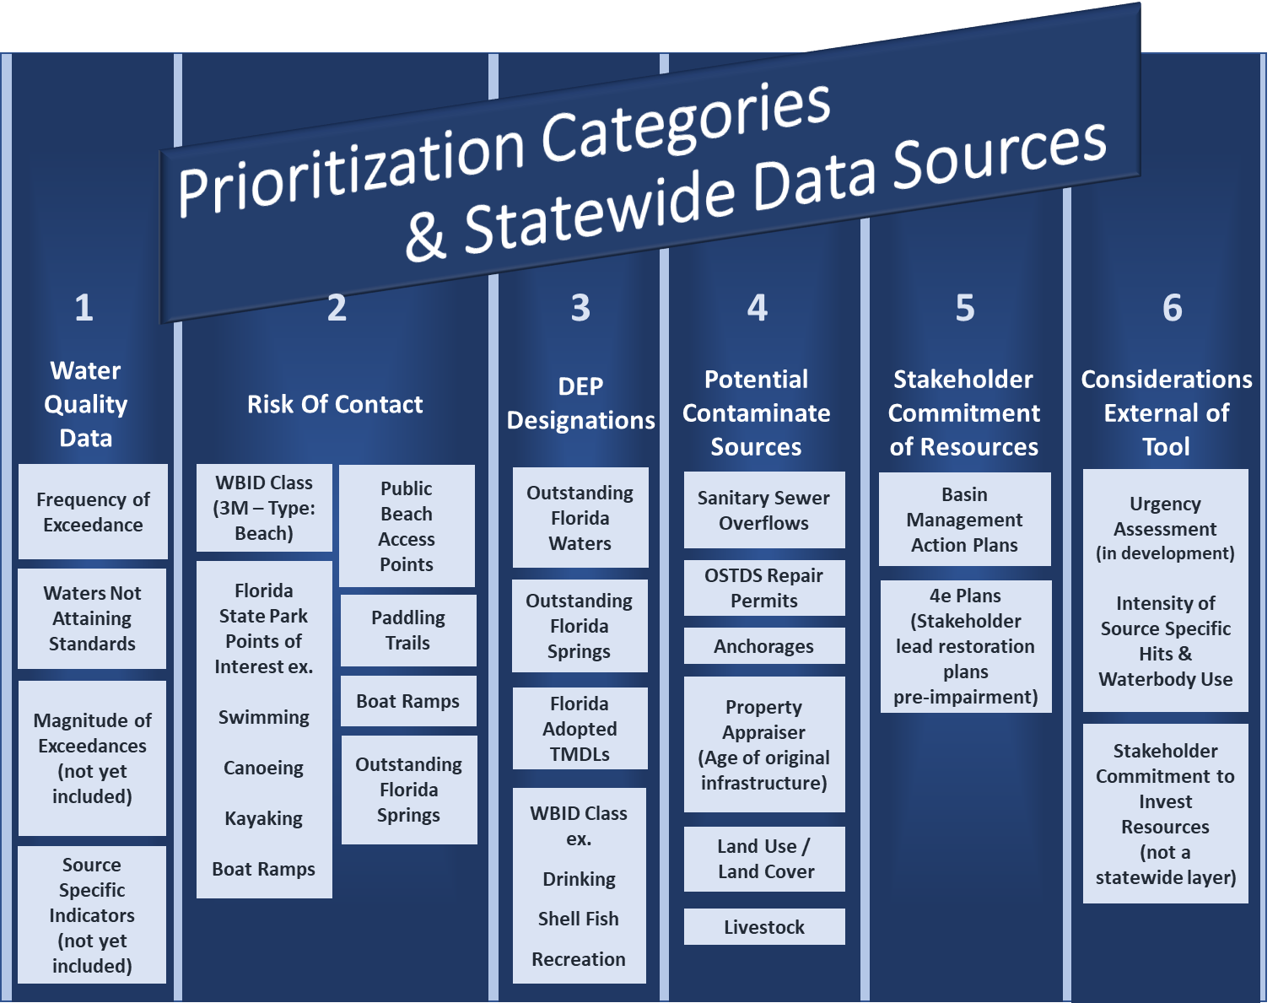

Slide 26
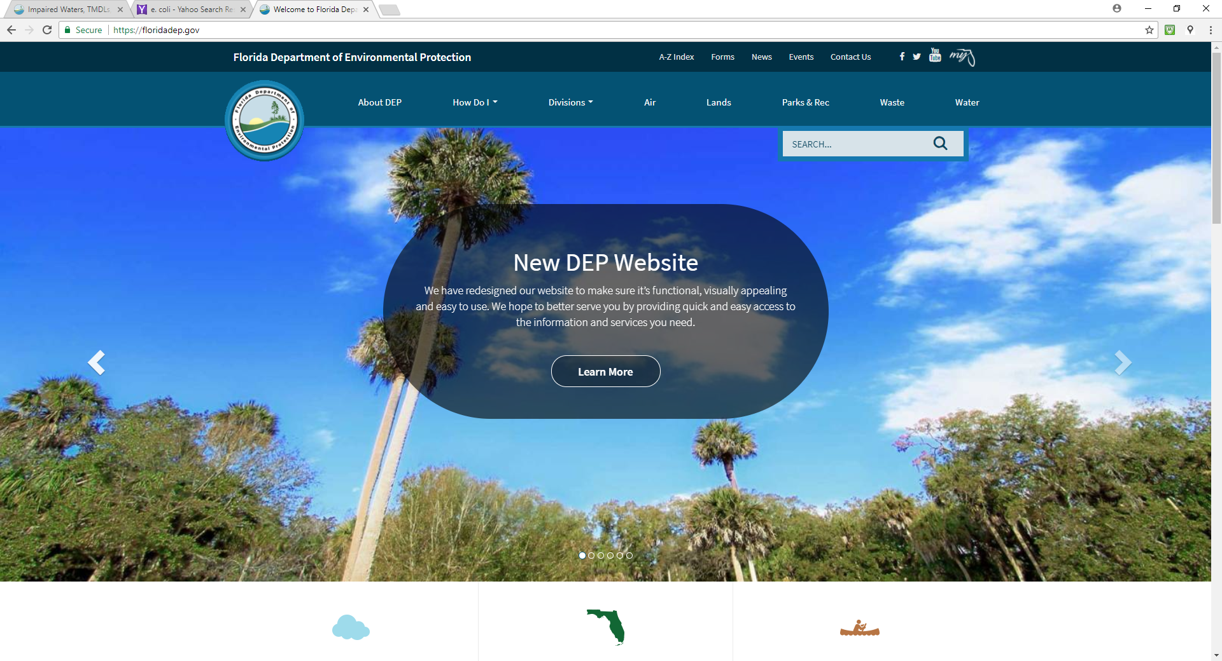
New DEP Website
https://floridadep.gov/

Slide 27
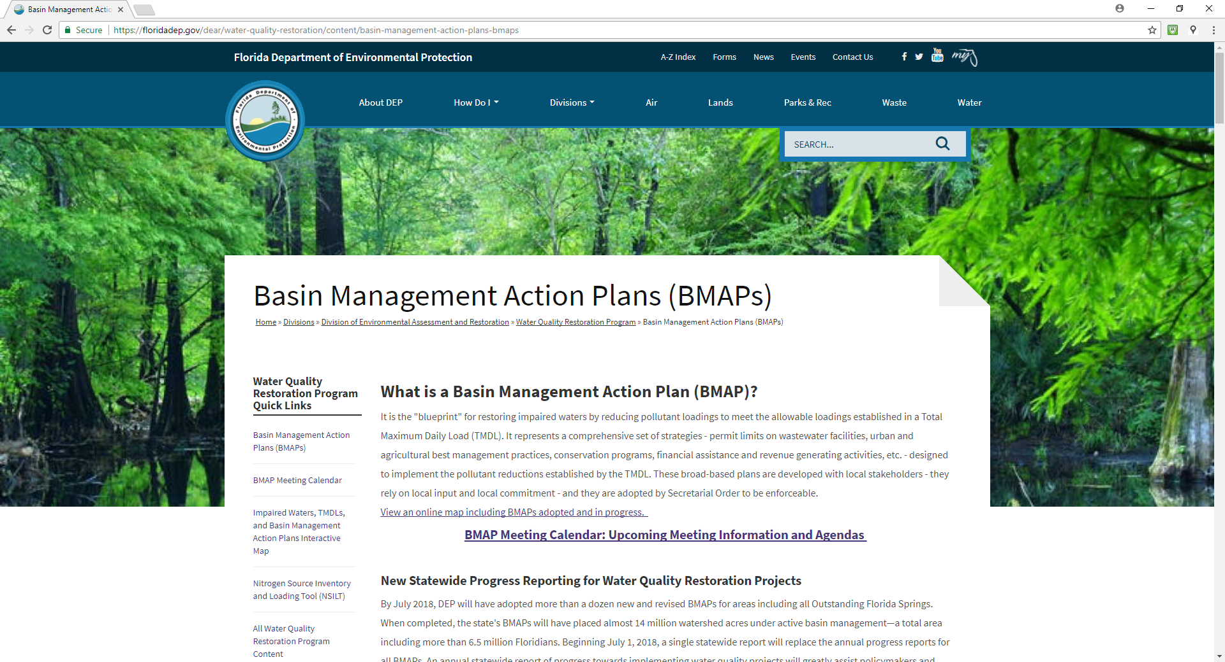
Redesigned BMAP Webpage
https://floridadep.gov/dear/water-quality-restoration/content/basin-management-action-plans-bmaps

Slide 28
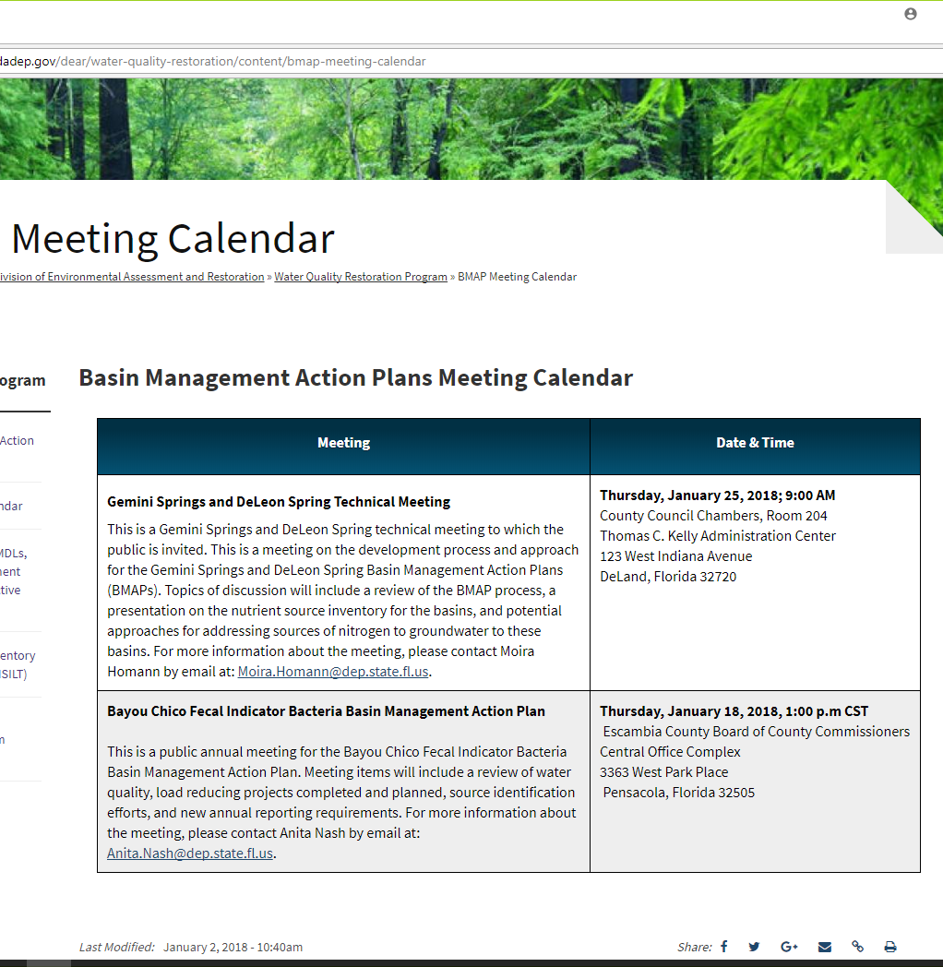
BMAP Webpage Components
BMAP Meeting Calendar
BMAP Documents
BMAP Story Maps
Water Quality Assessments, TMDLs, and BMAPs Interactive Map
Notes:
BMAP meeting calendar with upcoming meeting information and agenda

Slide 29
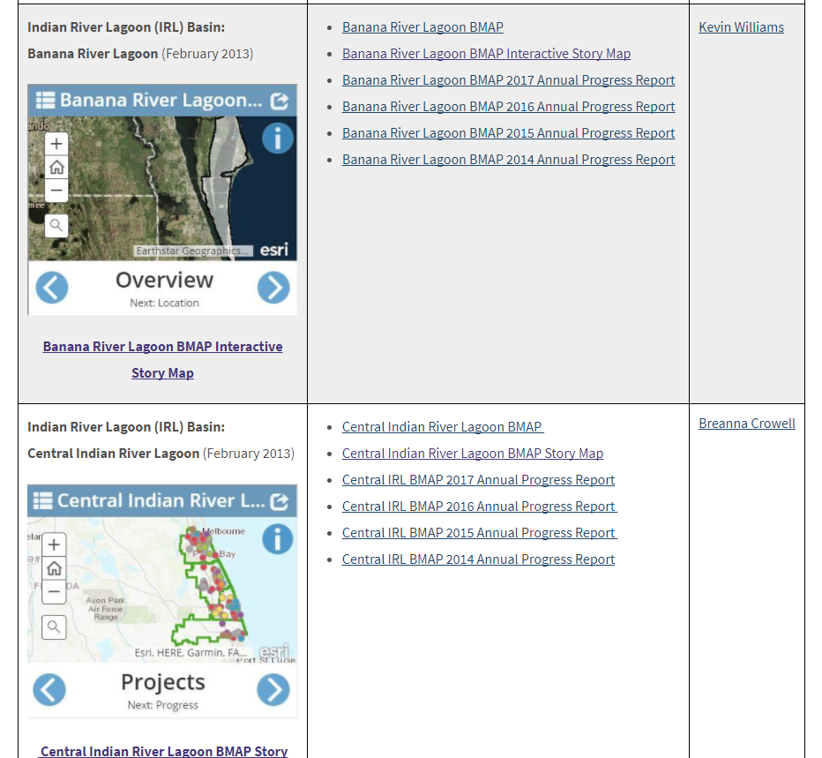
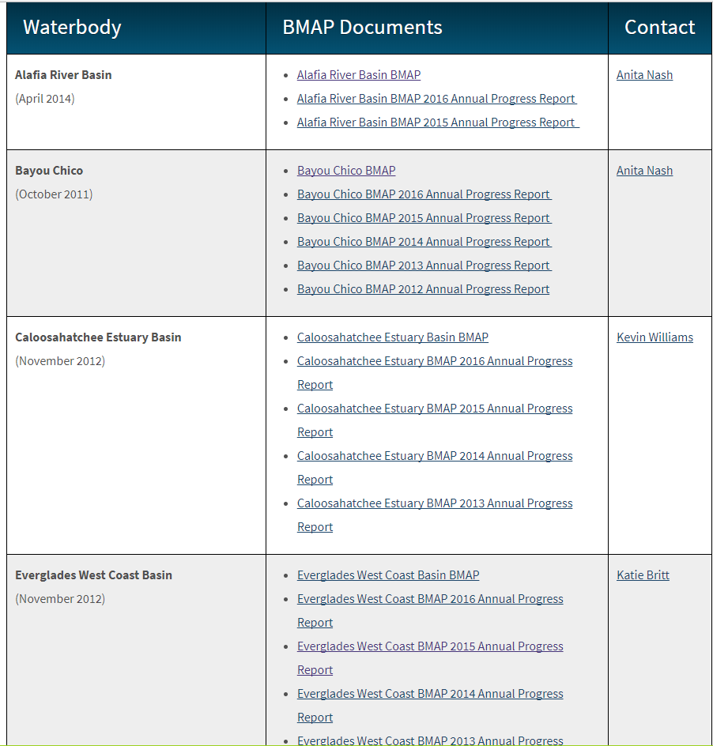
BMAP Documents and Story Maps

Slide 30
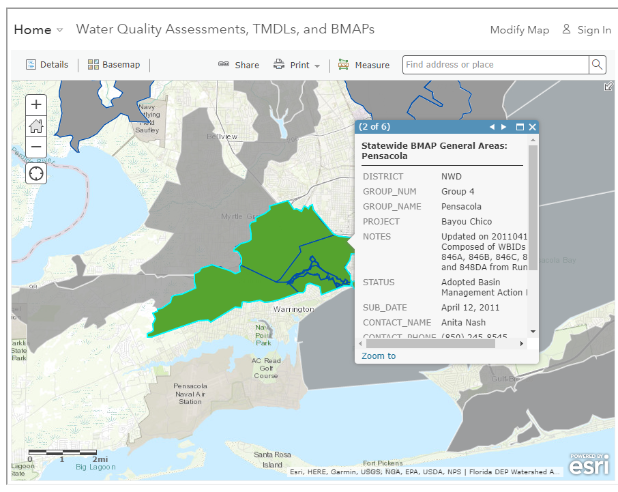
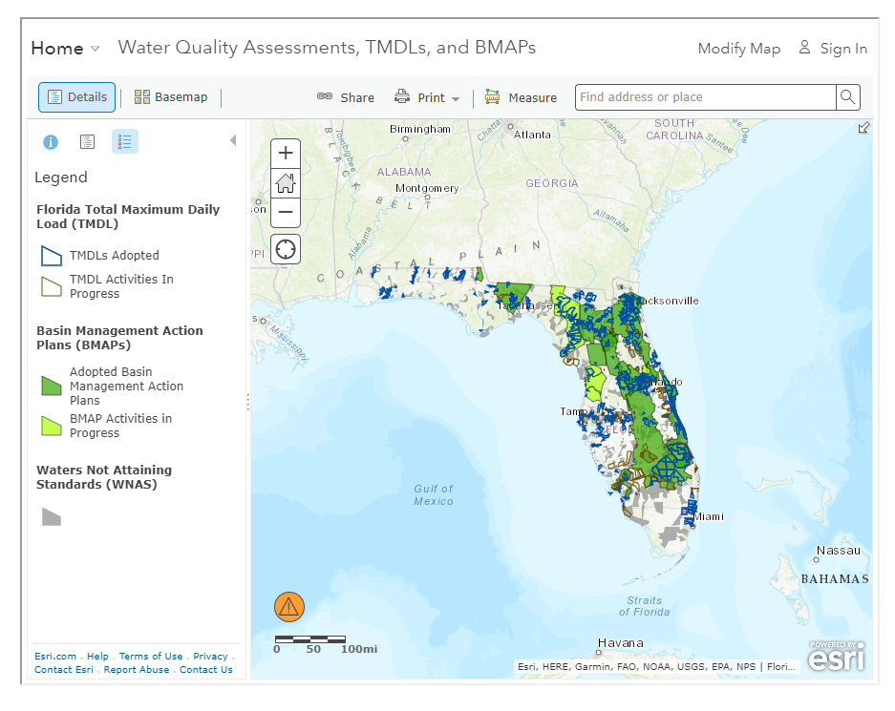
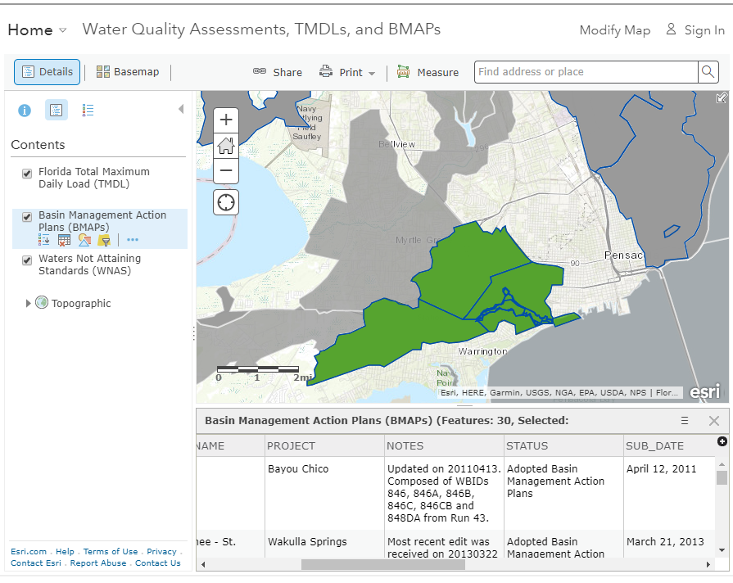
Water Quality Assessments, TMDLs, and BMAPs
Interactive Map
https://floridadep.gov/dear/water-quality-restoration/content/impaired-waters-tmdls-and-basin-management-action-plans
Displays the WBIDs that are not attaining standards, TMDLs, and BMAPs adopted and in progress

Slide 31

Watershed Information Network (WIN) and
Florida Storage and Retrieval (STORET)
WIN is live! http://prodenv.dep.state.fl.us/DearWin/public/welcomeGeneralPublic?calledBy=GENERALPUBLIC
December 2017, Florida STORET was closed to additions of new data and to corrections of existing data
DEP will accept migrations of data from Florida STORET to WIN any time after WIN comes on-line
Florida STORET will remain available for data extractions after December 2017 through STORET public access (SPA) site
  SPA: http://prodenv.dep.state.fl.us/DearSpa/public/welcome

Slide 32

WIN Contacts
Information on WIN (e.g., standards, frequently asked questions, example data templates) is provided at: https://floridadep.gov/dear/watershed-services/content/winstoret
  Denise Miller, Environmental Administrator, 850-245-8516, denise.miller@dep.state.fl.us
  Julie Zimmerman, Business Lead, 850-245-8508, julie.m.zimmerman@dep.state.fl.us
  Lisa Schwenning, Regional STORET/WIN Coordinator, 850-245-8509, lisa.schwenning@dep.state.fl.us

Slide 33


BMAP Annual Reporting
  New statewide progress report
  New requirement under Florida Statutes (F.S.) to provide an annual update to the Governor and Legislature (see Section 403.0675, F.S.)
  First report is due to the Governor and the Legislature by July 1, 2018
  DEP will submit subsequent reports by July 1st of each year

Slide 34


BMAP Annual Reporting
Annual BMAP meetings
  Manatee River BMAP meetings may be held in late spring
  Review significant source identification accomplishments
  Highlight restoration projects and management strategies
  Water quality information
Reporting period
  Project collection will be initiated November of each year
  Report will contain projects completed the previous year (January through December) for all BMAPs statewide
Notes:
Stakeholders will be able to highlight significant accomplishments and report on restoration projects and management strategies. Water quality information may also be available for discussion
DEP will request similar BMAP project information from stakeholders and coordinating agencies, but the project collection will occur at the beginning of the calendar year instead of in conjunction with the annual meetings. The new statewide report will replace individual BMAP-by-BMAP annual progress reports.
Reporting Period—The reporting periods for BMAP projects will be synced across the state. The project information collected by DEP in the beginning of the calendar year will represent implementation status as of the end of the previous calendar year (i.e., a snapshot of project status as of the prior December 31).
New Content—The statewide annual report will feature project details such as planning-level estimates of cost, schedule, financial assistance needed, and pollutant reduction to be achieved.

Slide 35
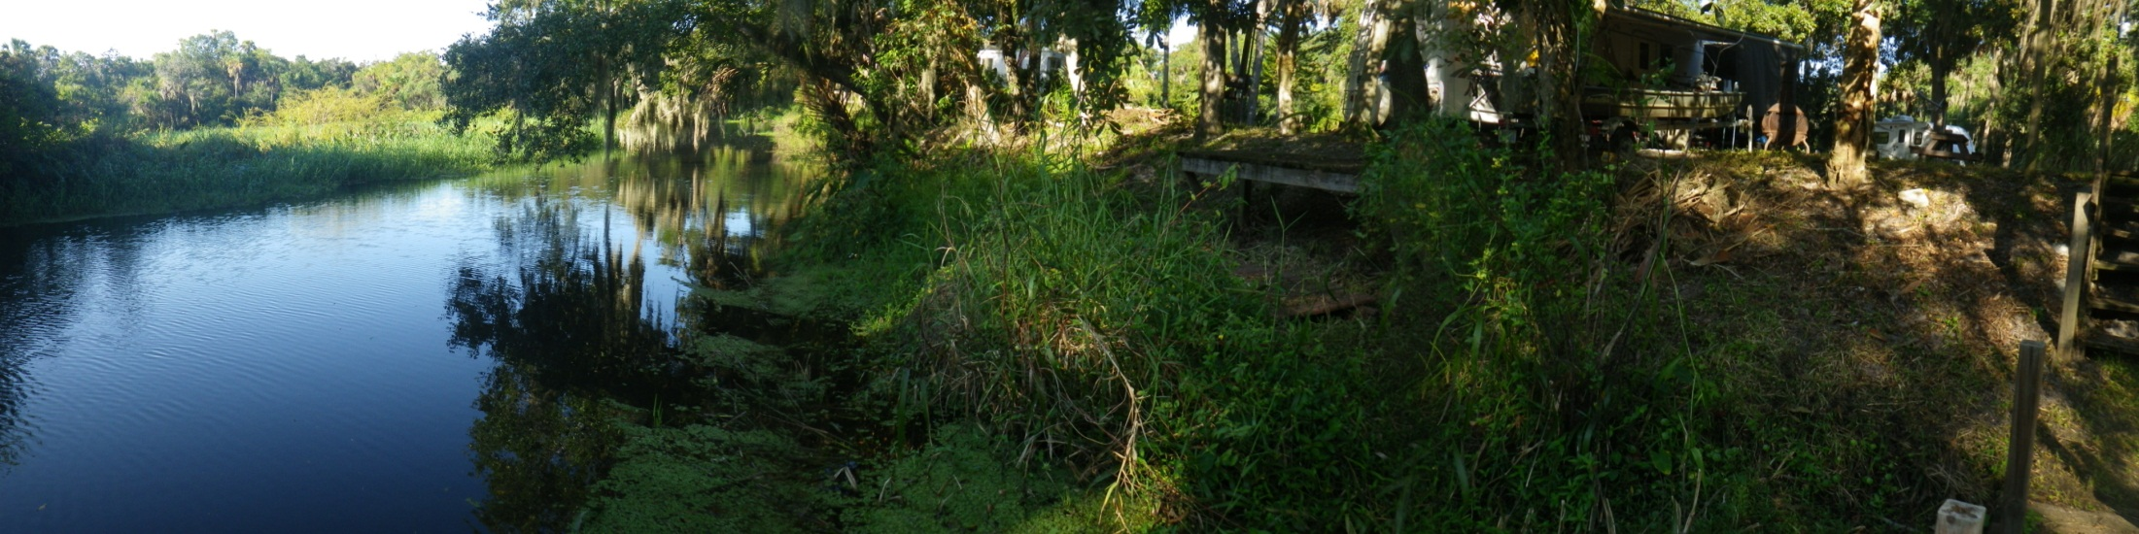

BMAP Annual Reporting
DEP will request project updates from April 2016 to December 31, 2018 via email with instructions
Will be included in the published 2019 statewide progress report
Focus will be given to source identification and elimination efforts
Notes:
Photo Braden Above Ward, Nash 2011

Slide 36
Statewide Annual Report to the Governor and Legislature
Content about projects pertinent to achieve BMAPs and Minimum Flows and Levels (MFLs)
  Water quality projects
  Water quantity projects
  Proposed priority ranking for implementation
  Load reductions (nutrient BMAPs)

Slide 37
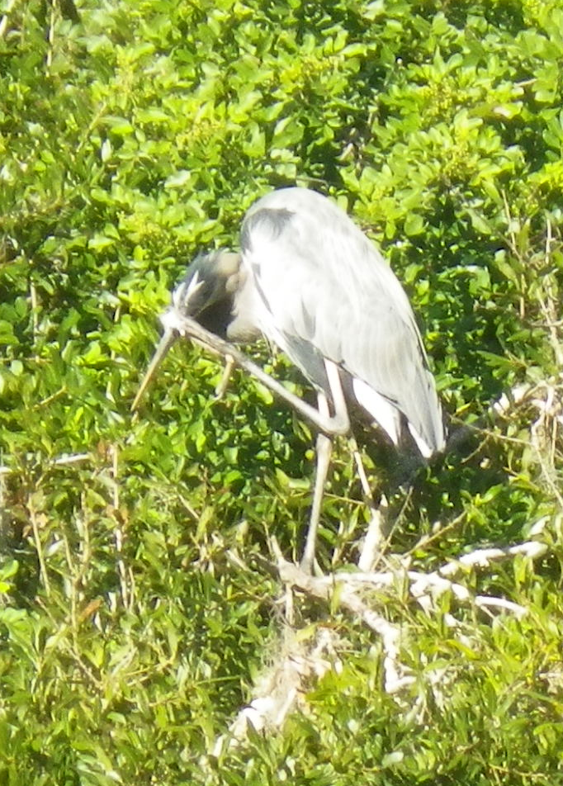
DEP Contacts
Tom Frick, Director, Division of Environmental Assessment and Restoration, Thomas.Frick@dep.state.fl.us
Kevin Coyne, Program Administrator, Water Quality Restoration Program Kevin.Coyne@dep.state.fl.us
Anita Nash, Basin Coordinator, Watershed Planning and Coordination Section, Anita.Nash@dep.state.fl.us
Notes:
Photo Braden Above Ward

Slide 38

Public Comments and Wrap Up
Meeting materials are posted to:
  http://publicfiles.dep.state.fl.us/DEAR/BMAP/Tampa_Bay_Tributaries/manatee%20BMAP/
For questions contact Anita Nash:
  Anita.Nash@dep.state.fl.us
  850-245-8545

Slide 39
The End

Slide 40





Source ID Pilot Study 2017
Progress Summary
1 source eliminated after 2nd sampling event.
7 more hot spots identified.
Followed 2 trails upstream to the
farthest extent of
city owned conveyances.
7 sampling events.
Signal traced into 6 potentially separate hot spots.
6
All 4 sites hot on first sampling event. Site B was hottest.
Flow stopped; hits in remaining pools at road crossings. 2 hot spots identified.
Hopkins
Followed 1 source trail for 4 rounds of monitoring.
Wagner
2
Jackson
Miller
2 hot tributaries identified during first round of monitoring.
Delays related to retirement of city staff and incomplete GIS inventory of stormwater conveyances incomplete.
4 hot spots identified.
Spartman Branch
Butcher Pen
All low hits on rounds 1 and 2. Creek dried up; delayed progress.
4
Sampled after rain returned,
identified 2 hot spots serviced by OSTDS.
1 source identified & eliminated
No Hits during Round 1.
2
21 hots pots remain

Slide 41
Pilot 2017 Summary Stats

