Slide 1
Upper Peace Creek Watershed
June 29, 2012
OBJECTIVES
Introductions
April 13 meeting review
Tom Frick, Bureau Chief FDEP

Slide 2
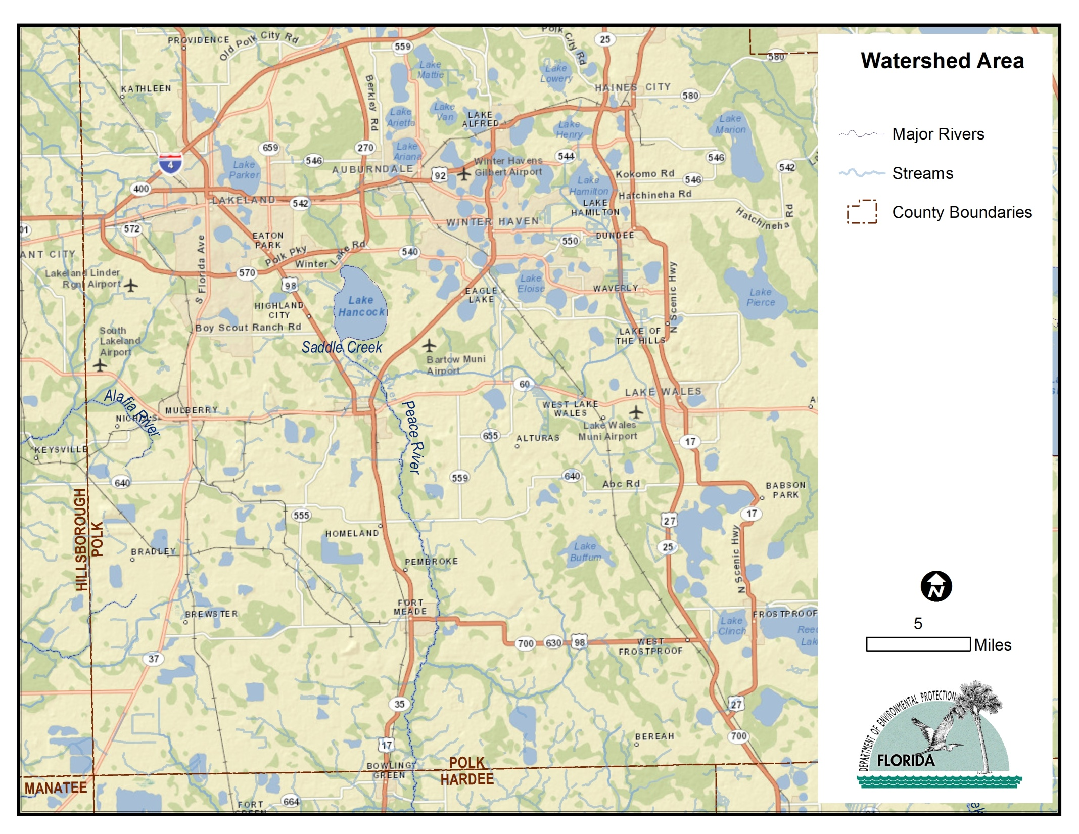

Slide 3
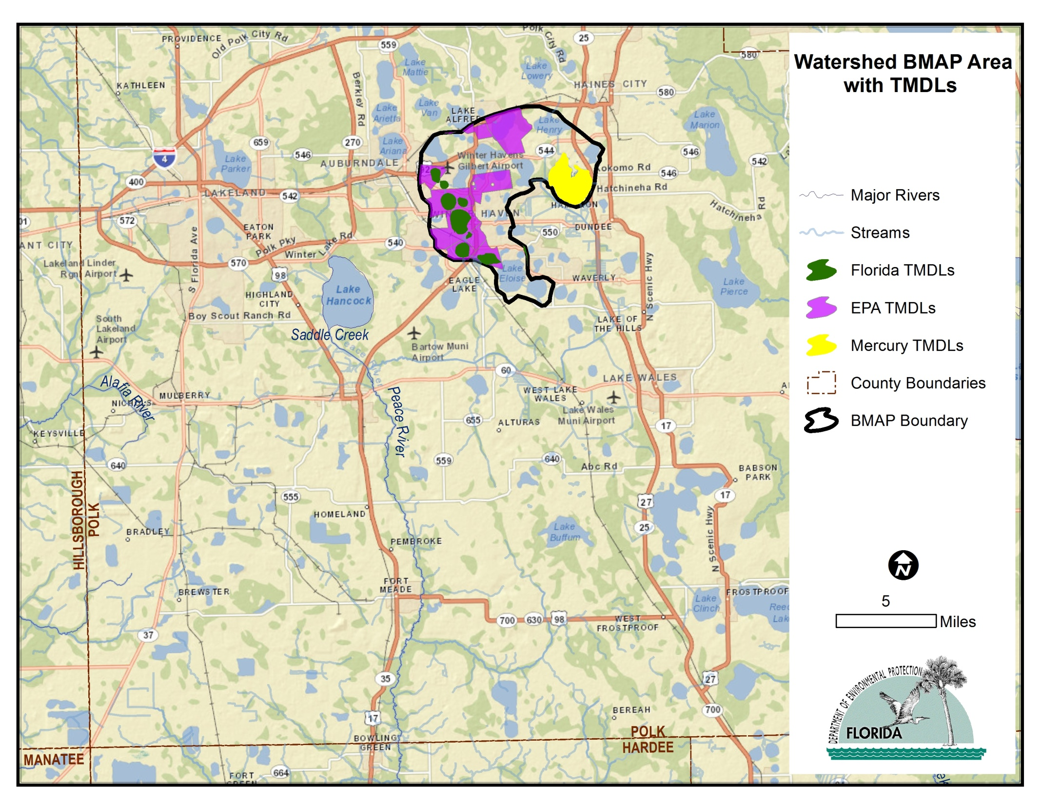

Slide 4
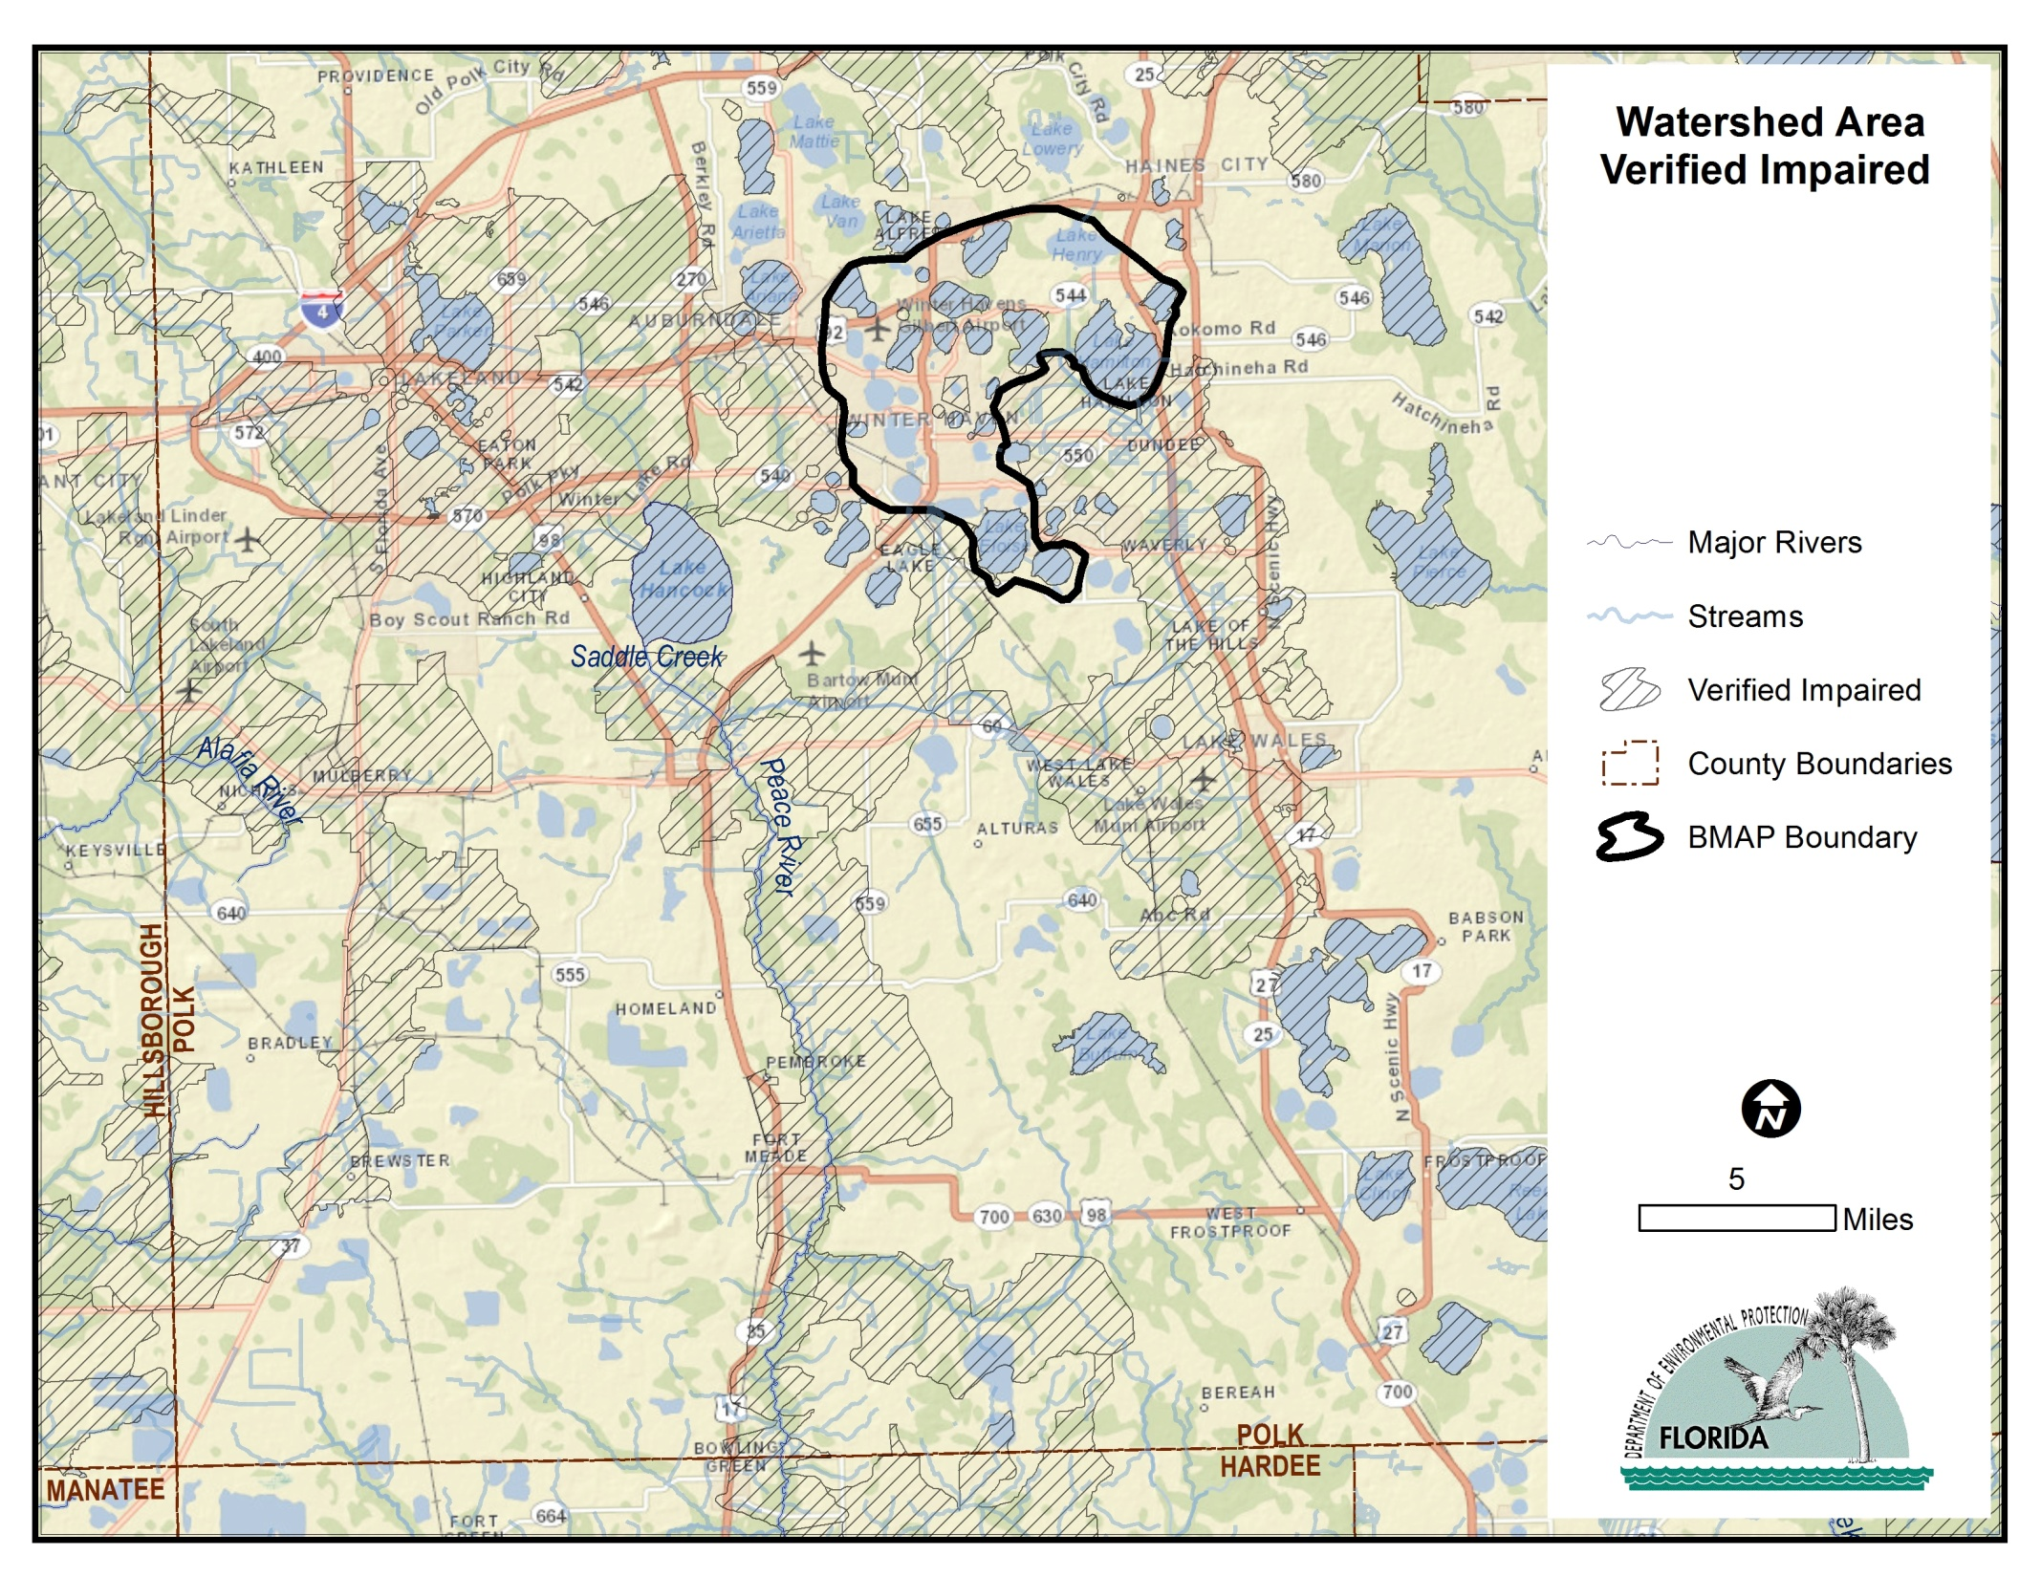

Slide 5
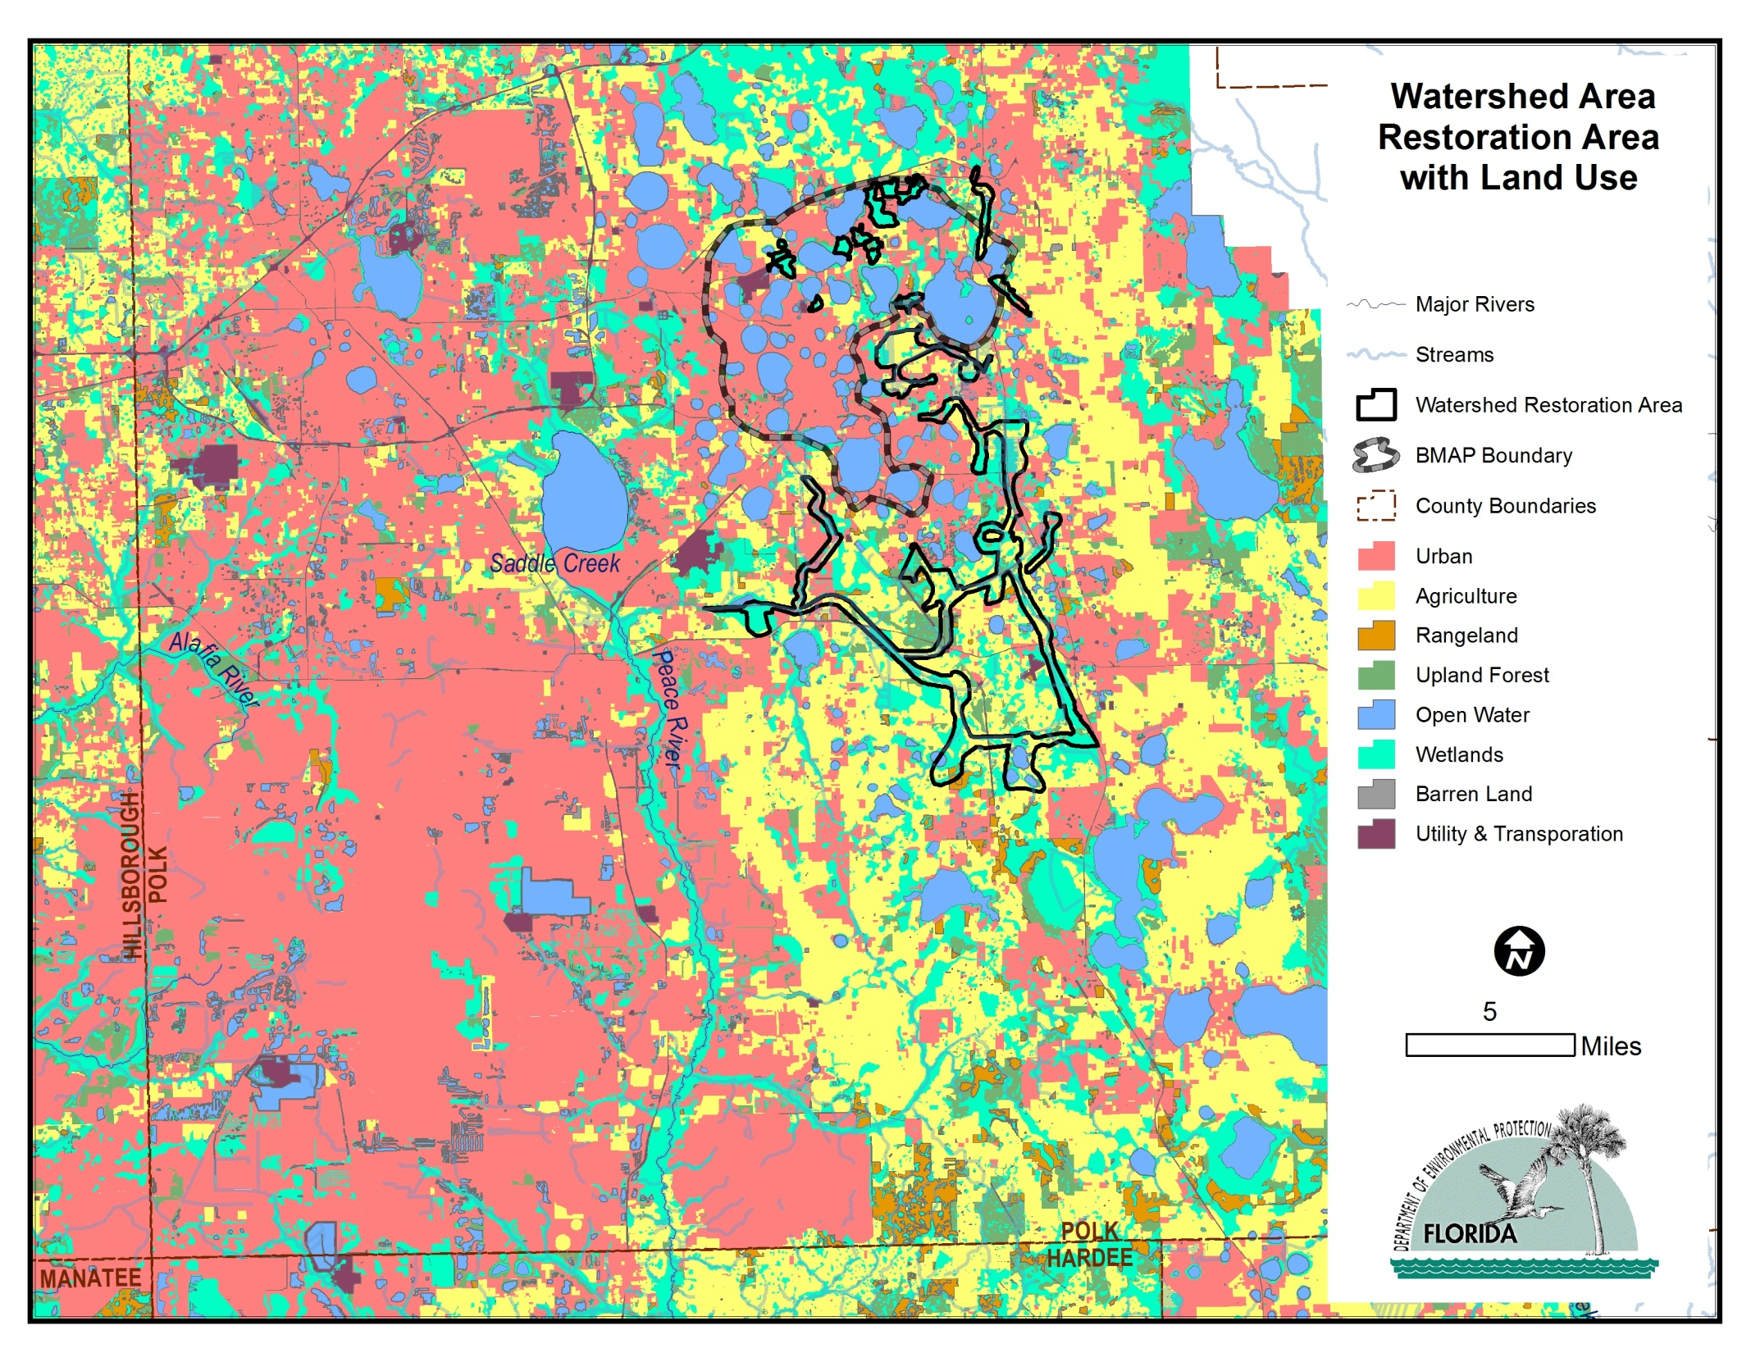

Slide 6
QUESTIONS

