Slide 1
FDEP Water Quality Guidance
Reasonable Assurance Plan (RA Plan)
Nutrient Reduction Plan
Basin Management Action Plan (BMAP)

Slide 2
Basic
TMDL
Cycle
RA Plan
Nutrient Reduction Plan

Slide 3
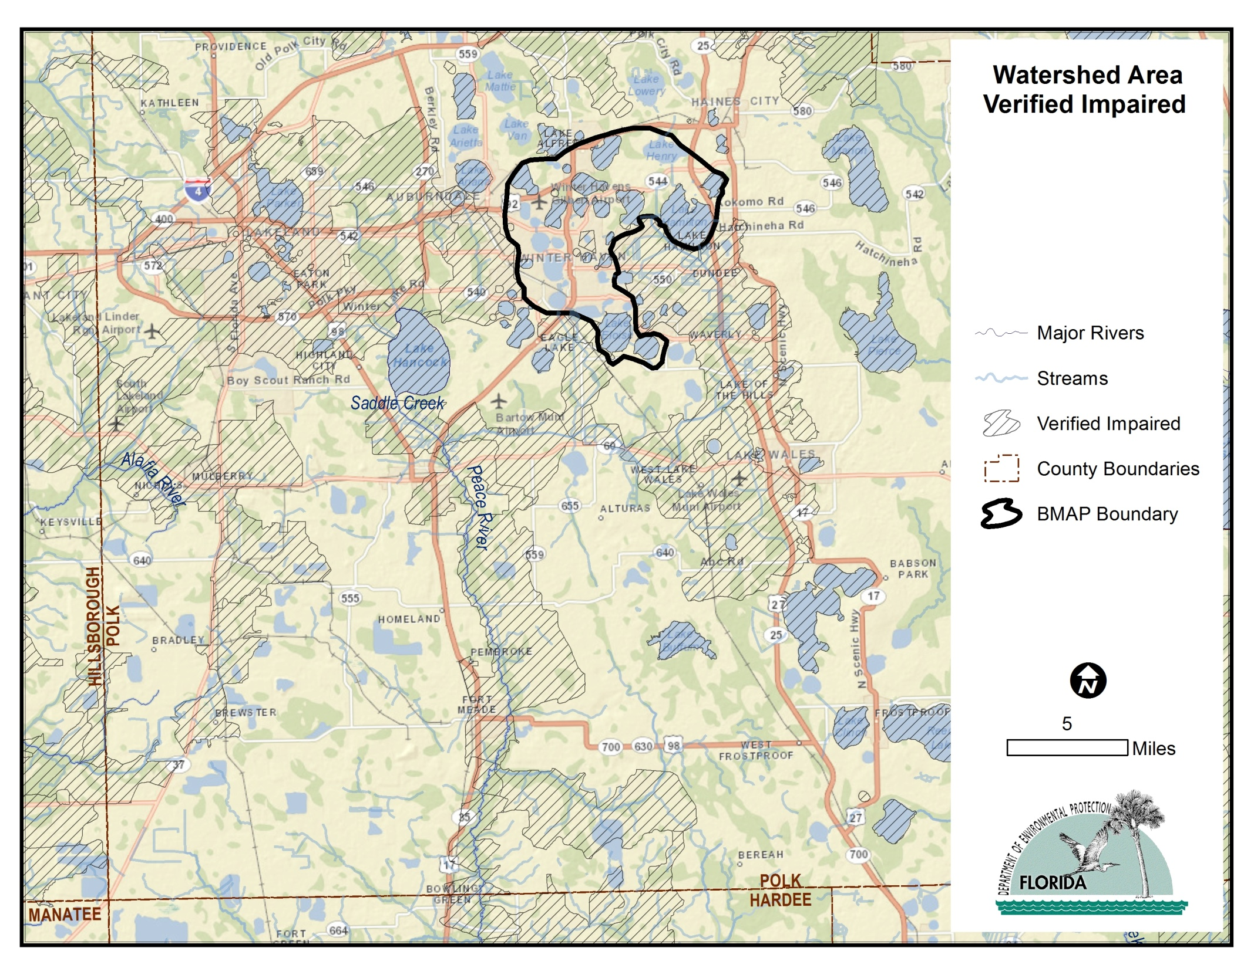

Slide 4
Reasonable Assurance (RA)
Verified Impaired (IWR)
No FDEP TMDL
Actions proposed and underway will achieve water quality standards
Adopted by FDEP Secretary
Draft Guidance: Jan. 2003 (being revised)
http://www.dep.state.fl.us/water/watersheds/docs/bmap/ReasonableAssuranceGuide.pdf
Guidance Checklist

Slide 6
Reasonable Assurance (RA)
Draft Guidance Document – Jan. 2003
  1) proposed pollution control mechanisms (typically described in watershed management or restoration plans) addressing impaired waters will result in the attainment of applicable water quality standards (designated uses) at a clearly defined point in the future, and
  2) reasonable progress towards restoration of designated uses will be made by the time the next 303(d) list of impaired waters for the basin with the impaired water is due to be submitted to the Environmental Protection Agency (EPA).

Slide 7
Reasonable Assurance (RA)
Important Reminders
RA is a written agreement, signed by both local stakeholders and at least one governmental entity
Includes
  Measurable goals
  Performance criteria
  Benchmarks
  Back-up corrective actions
  Written agreements do not need to be enforceable for non-regulated nonpoint sources.

Slide 8
Reasonable Assurance (RA)
Time Frame for Attaining Water Quality Standards
  designated uses will be met at some time in the future
Parameter Specific Nature of Demonstration
  Each parameter of concern is addressed
Water Quality-Based Targets and Aquatic Ecological Goals
  water quality based targets can take many forms, and need not be a result of a complex hydrodynamic/water quality model.

Slide 9
Reasonable Assurance (RA)
Checklist – follows guidance document
  Description of Water Body
  Description of the water quality or aquatic ecological goals
  Description of proposed management actions
  Description of monitoring and reporting procedures
  Description of proposed corrective actions

Slide 10
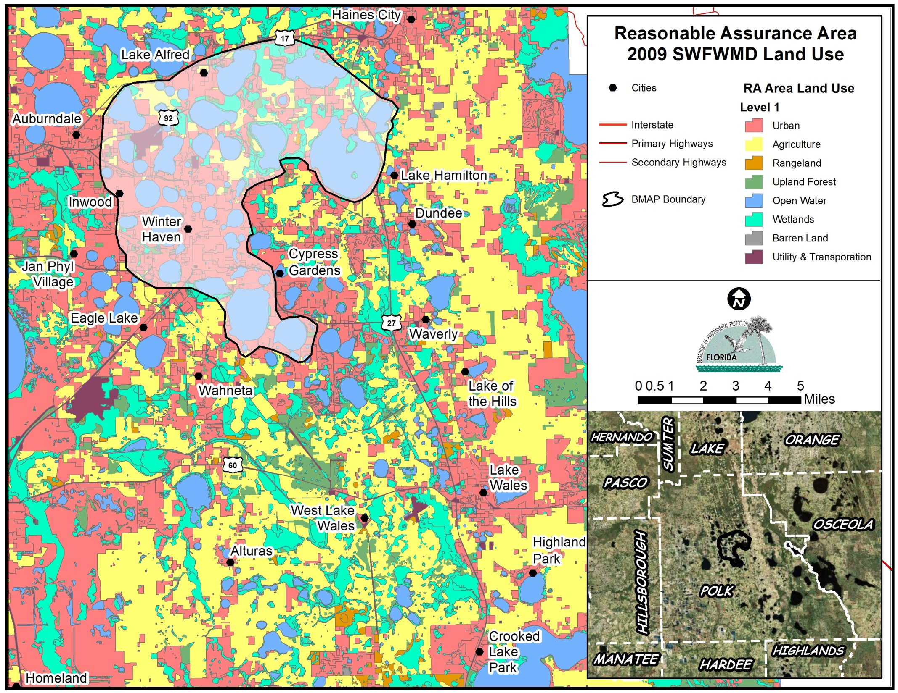

Slide 11
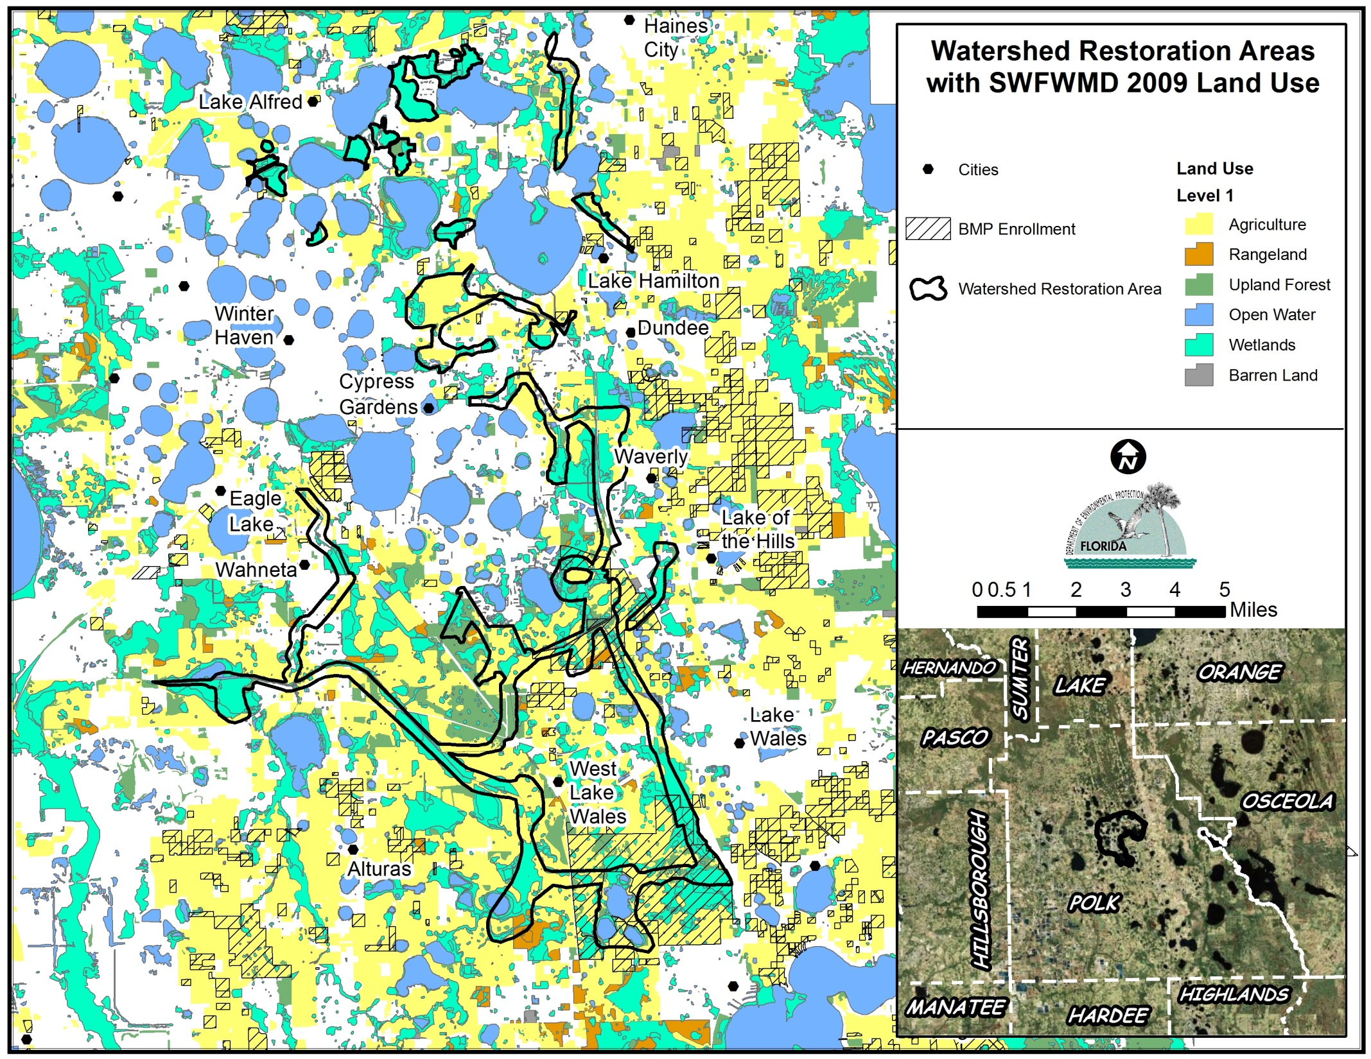

Slide 12
Reasonable Assurance (RA)
Examples: located at bottom of page http://www.dep.state.fl.us/water/watersheds/bmap.htm
  Shell, Prairie, Joshua Creek
  Lake Seminole
  Florida Keys
  Tampa Bay (USEPA)
  http://www.tbeptech.org/index.php?option=com_content&view=category&id=29:tampa-bay-nmc&Itemid=54

Slide 13
Nutrient Reduction Plan
Guidance being developed
CURRENT CONCEPT:
No water quality “targets” are set
  – Loads are not allocated
  – Not a restoration plan
  – Monitoring plan and research priorities will align specifically to the goals and objectives identified by the stakeholders to determine true future targets
  – Not a long‐term solution: stepping stone
  – Plan is not formally “adopted”

Slide 14
Purpose of Nutrient Reduction Plan
Document local efforts that achieve nutrient reductions (TN and TP)
• Provide additional time to assess the complex relationships within the waterbody(s)
• Focuses on reducing nutrient loads that can be achieved through management activities, capital improvement projects, non‐structural best management practices, and/or research activities
• Can only control what’s in your own “backyard”

Slide 15
Nutrient Reduction Plan
EXAMPLE:
  Lake Tohopekaliga

Slide 16
Basin Action Management Plans
BMAPs are most comprehensive approach to TMDL implementation
Collaborative process with cooperation of local stakeholders
BMAP Goals
  Reach consensus on scientific foundation of TMDL
  Determine how allocations will be calculated
  Calculate detailed allocations for each stakeholder
  Determine how and when load reductions will be accomplished

Slide 17
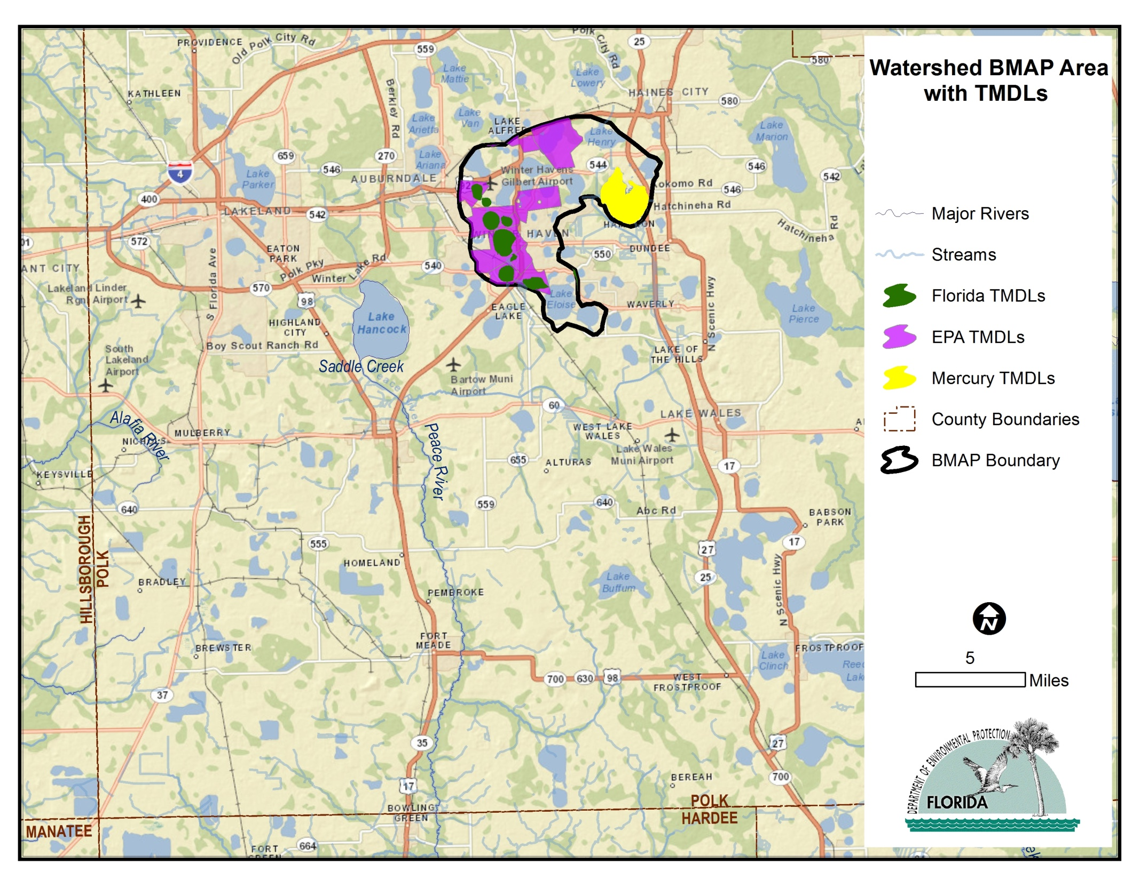

Slide 18
What’s in a BMAP?
  Refined source identification
  Detailed allocations by entity
  Restoration projects
  Monitoring (water quality & projects)
  Commitments: funding & implementation timelines

Slide 19
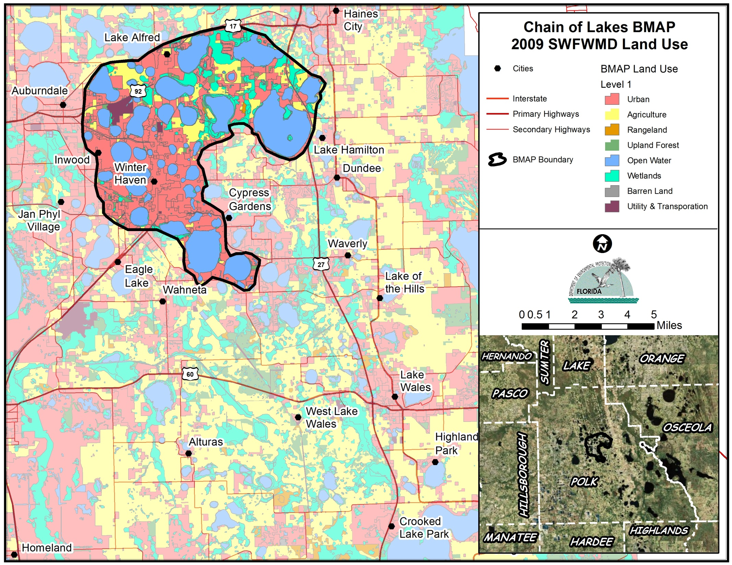

Slide 20
Benefits of a BMAP
Provides equity among stakeholders
Relies on adaptive management
Achieves documented commitments
“Safe harbor” clause for MS4 permittees and nonpoint sources upon adoption of a BMAP
Provides citizens with assurances about the future health of a waterbody by providing a restoration plan with milestones and timelines

Slide 21
BMAP and RA Plan
Present a plan to restore the waterbody(s)
  Identify Sources
  Develop nutrient reduction strategies
  Monitoring Plan
  Utilize Adaptive Management
USEPA elements of a Watershed Management Plan
  Needed for federal funding

Slide 24
QUESTIONS

