Slide 1
Winter Haven Water Quality
Management Plan –
Use of Local Equations for Setting Nutrient Targets & Value of Various Lake Management Strategies
Dave Tomasko, PhD
Emily Keenan, MS
August 13, 2009

Slide 2
Topics to discuss
Review and/or revision of TMDL targets
  The importance of endpoints on restoration activities
  Four step process
    Define “healthy” lake conditions
    Derive Chl-a target to reach that
    Derive nutrient targets to reach Chl-a target
    Develop projects to achieve nutrient targets
Determination of most beneficial project types

Slide 3
Revision of TMDL Targets – the importance of endpoints

Slide 4
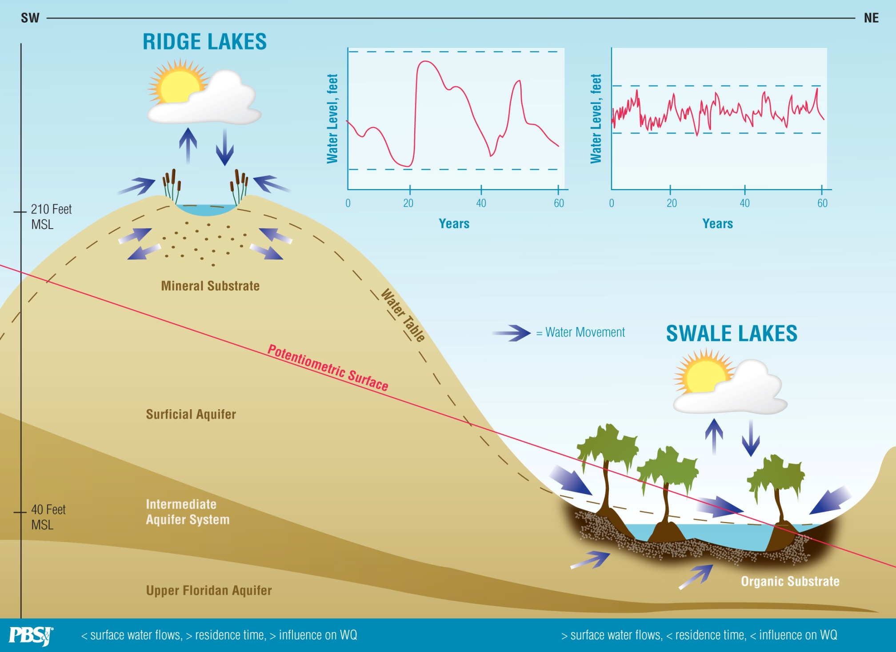
Ridge and Swale Lakes
230 Feet MSL
110 Feet MSL

Slide 5
Ridge lakes more susceptible to nutrient enrichment due to reduced levels of moderating tannins
Median values by class for 1997 to 2007

Slide 6
Locally-derived equations for target setting for TN and TP
Ridge Lakes
Swale / Valley Lakes

Slide 7
Equations from proposed numeric criteria for lakes – Underestimate for Clear Lakes (can predict, but under-predict)
Still no fit with Colored Lakes

Slide 8
Different techniques, and different Chl-a goals, result in different nutrient targets
Technique | TN | TP
TSI equations for 60 | 1.20 | 0.070
Proposed IWR equations for 20 µg / liter | 1.35 | 0.051
Locally-derived equations for 20 µg / liter | 0.93 | 0.029
Locally-derived equations for 30 µg / liter | 1.16 | 0.043
Locally derived equations for 40 µg / liter | 1.40 | 0.056

Slide 9
Why the need for a Chl-a target of
20 µg / liter?

Slide 10
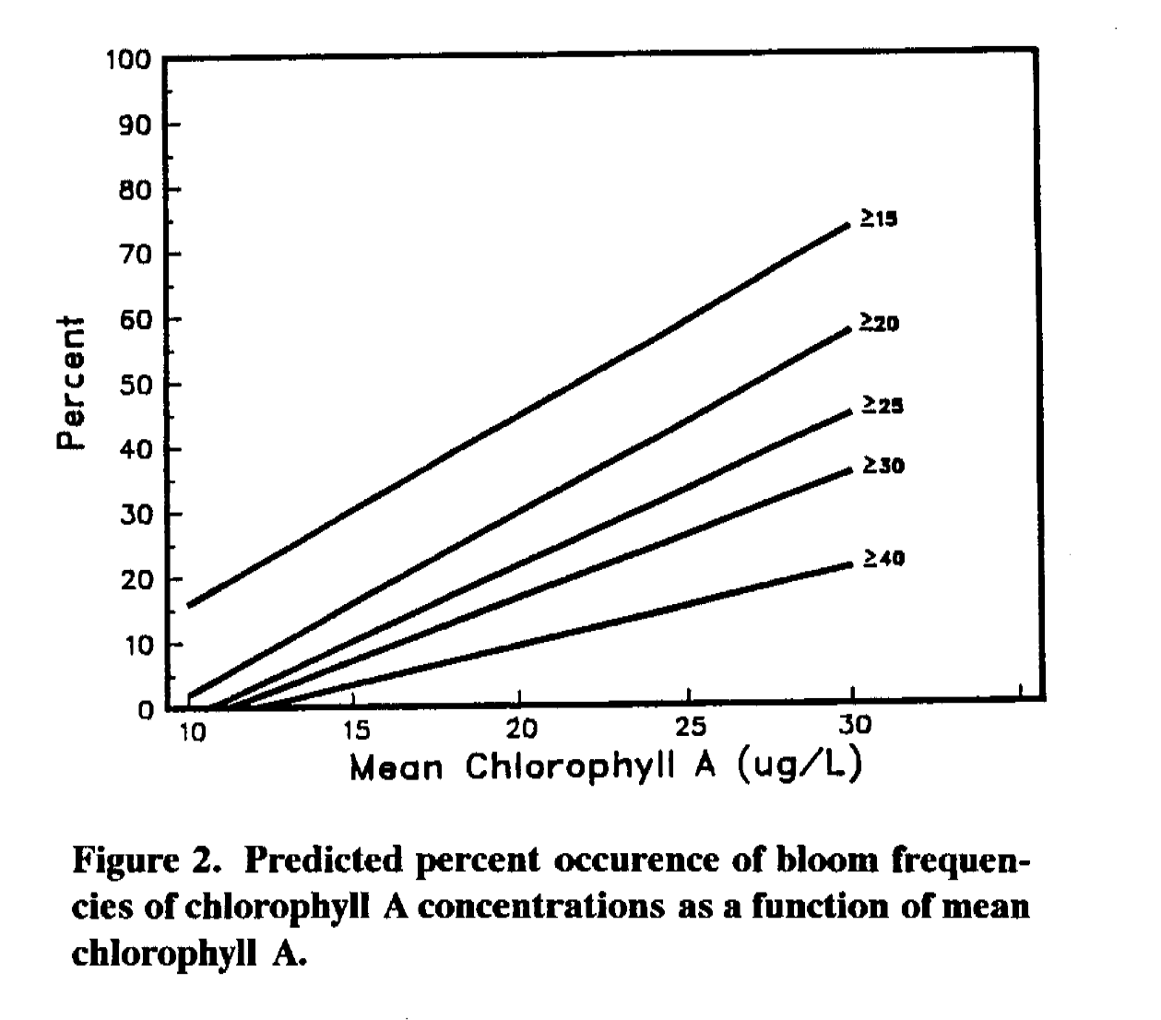
Need to protect against blooms?
Maybe (20 µg / liter keeps blooms less than 10% of time), but this data set comes from Georgia, is it relevant for WHCL?
Figure from (Raschke 1993)

Slide 11
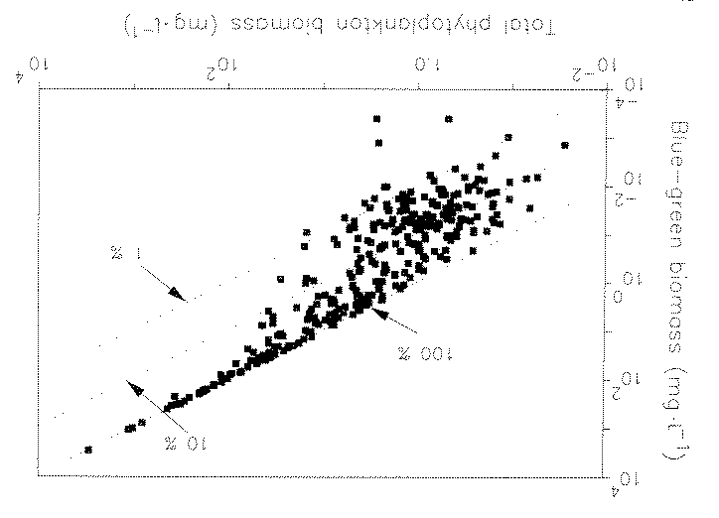
Need to protect against cyanobacteria?
  Yes, “Blue-green algal biomass was strongly correlated with (r=0.90) to total algal biomass…” (Canfield et al. 1989)
  But, “…blue-green algae became consistently dominant when total algal biomass exceeded 100 mg / liter.” (Canfield et al. 1989). But what the heck is 100 mg / liter equivalent to for Chl-a??

Slide 12
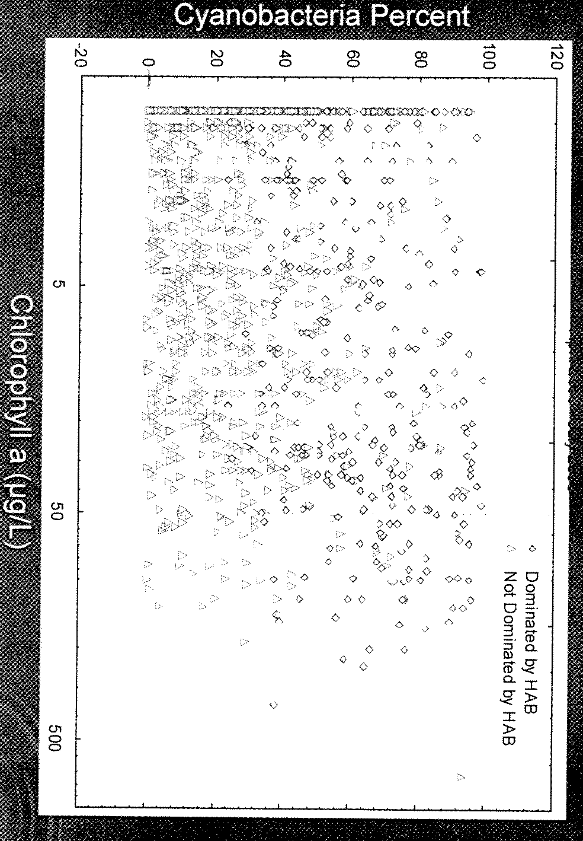
Other data show no obvious relationship between Chl-a and cyanobacteria abundance
Data from K. Weaver (2009)

Slide 13
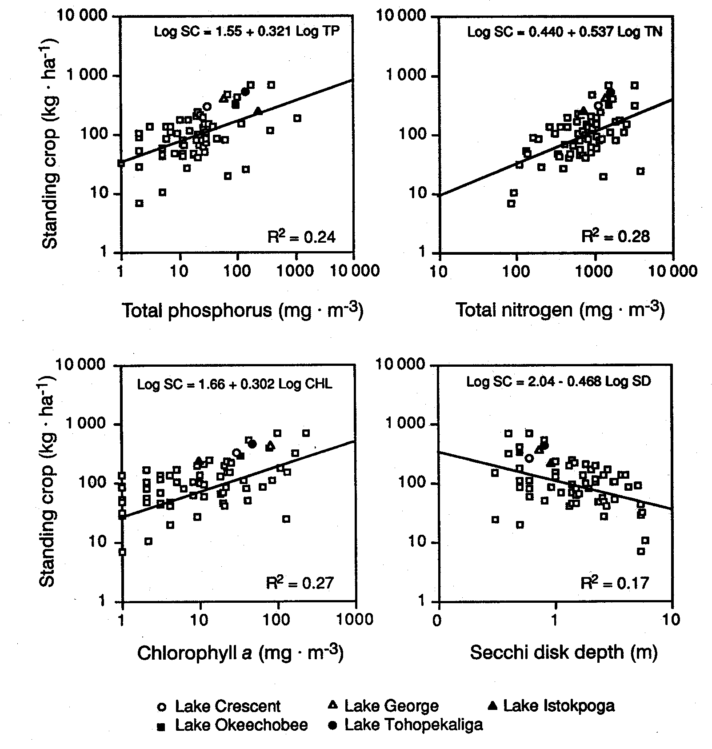
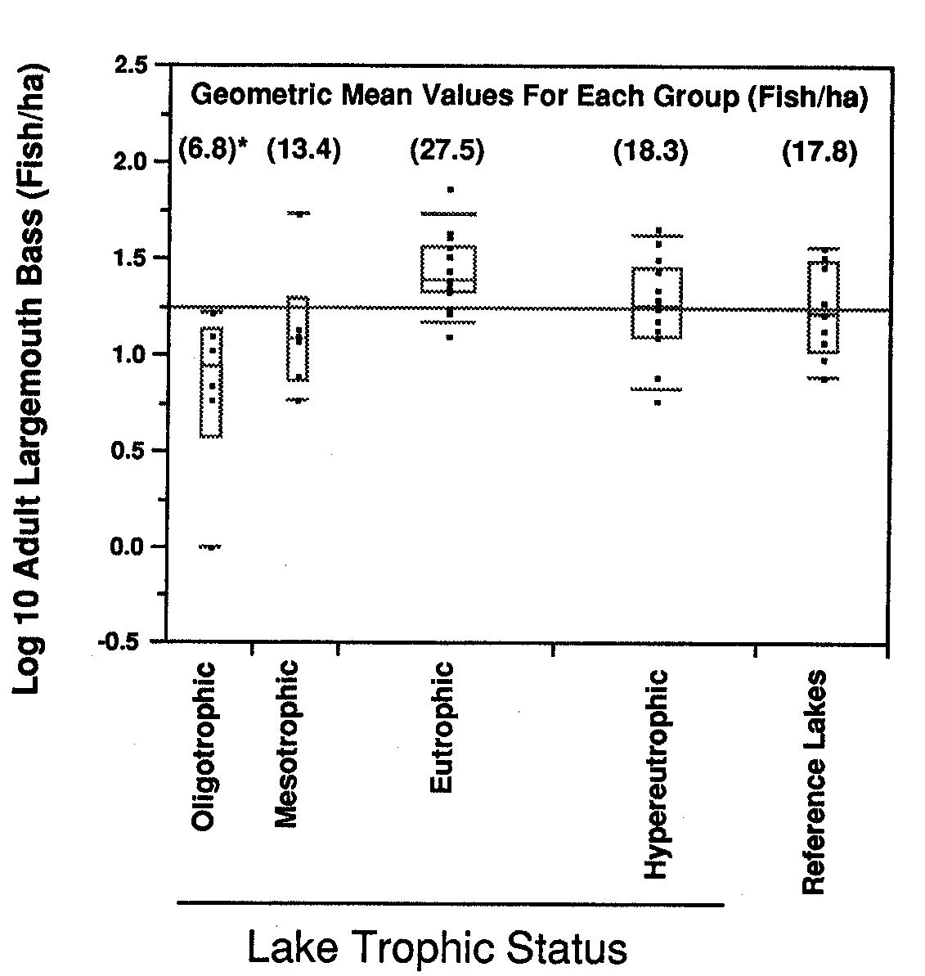
The need to protect fish abundance?
Figure from Bachmann et al. (1996)
Figure from Hoyer and Canfield (1996)

Slide 14
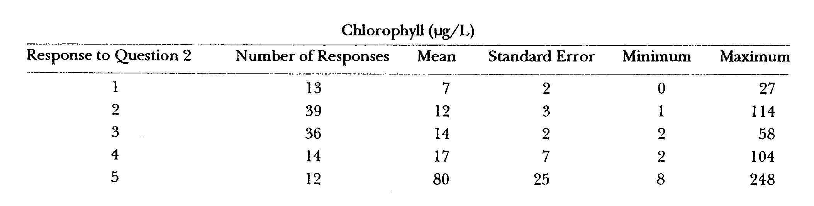
Public perception of “impairment”?
(Table from Hoyer et al., 2004)
Question posed was (to paraphrase) how suitable is the lake for recreation and aesthetics?
Response 1 – “…could not be nicer.”
Response 2 – “…excellent for swimming.”
Response 3 – “…swimming and aesthetics slightly impaired…
Response 4 – “…enjoyment…substantially reduced…”
Response 5 – “…enjoyment…nearly impossible…”

Slide 15
Public perception of lakes ranged between “excellent” to “substantially reduced” within 12 to 17 µg / liter Chl-a. Both categories are below 20 µg / liter “goal”.
Can public perception be used for guidance?

Slide 16
Water clarity?

Slide 17
Water clarity – a closer look

Slide 18
Water clarity and Chl-a
Chlorophyll-a (µg / liter) | Predicted Secchi disk depth (feet)
5 | 5.68
10 | 3.99
20 | 2.81
30 | 2.29
40 | 1.98
20 vs. 30 µg / liter Chl-a is improvement in water clarity of 6 inches
20 vs. 40 µg / liter Chl-a is improvement in water clarity of 10 inches

Slide 19
Influence of Chl-a goals on nutrient targets and water clarity
Chl-a target (µg / liter) | TN target (mg / liter) | TP target (mg / liter) | Predicted Secchi disk depth (ft)
20 | 0.93 | 0.029 | 2.81
30 | 1.16 | 0.043 | 2.29
40 | 1.40 | 0.056 | 1.98

Slide 20
Good news / Bad news
Good news-
  TSI equations didn’t match up when comparing nutrients and Chl-a – needed to change
  Proposed IWR equations can predict Chl-a (but under-predict)
  Locally-derived equations work for both TN and TP – but for Ridge-lakes only
Bad news-
  Substantial reductions (mean of 45%) in TN and TP concentrations required
  Difficult to achieve TN and TP for Chl-a of 20
  Not much difference in water clarity between Chl-a of 20 and 30 (or is that good news?)
  Not much evidence of ability to improve WQ in WHCL with “traditional” approaches (next)

Slide 21
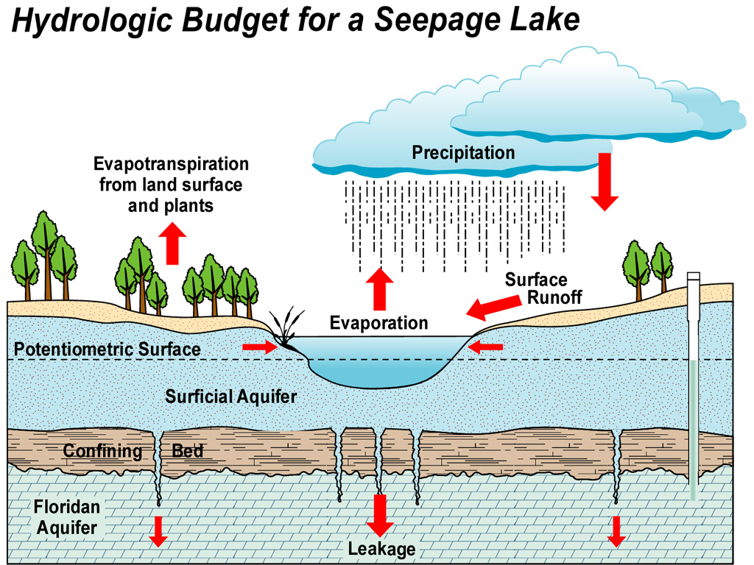
Notes:
A given aquifer has uniform water storage and transmitting properties.
Unconfined = water table
Confined = potentiometric surface
Potentiometric Surface – level to which water would rise in a well
Floridan source of most drinking water

Slide 22
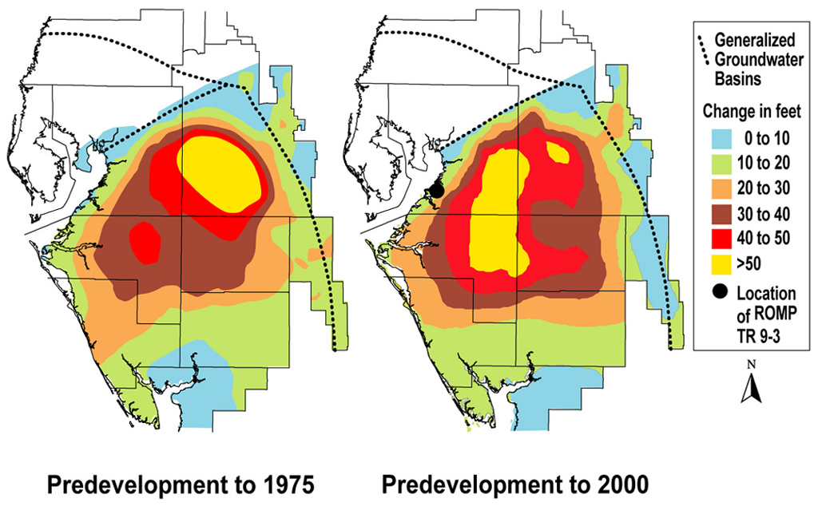
Winter Haven
Aquifer Depletion Due to Regional Withdrawals

Slide 23
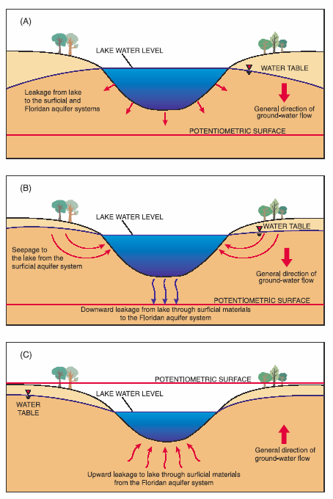
TMDLs only one “tool” we need to be using to restore lakes. Lake levels may impact water quality more than pollutant loads.

Slide 24
Measuring response to prior efforts

Slide 25
Estimated and required TP load reductions (kg TP/yr) to meet TSI goal of 60
(from Table 5.2 in FDEP TMDL report)

Slide 26
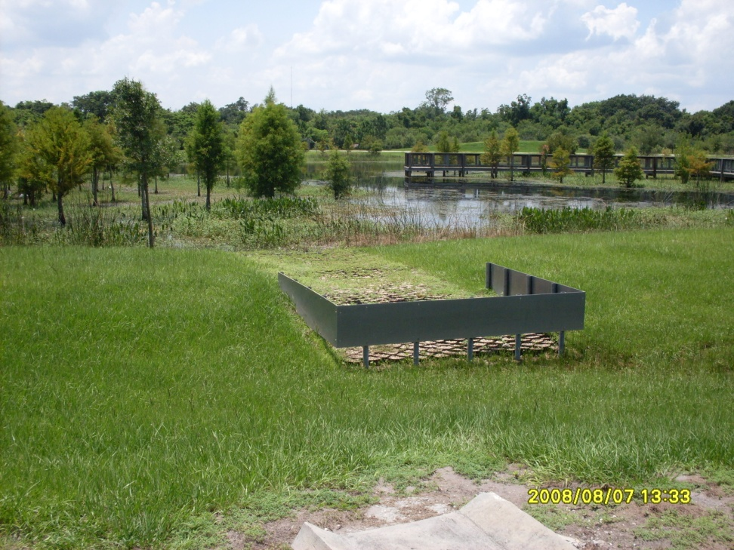
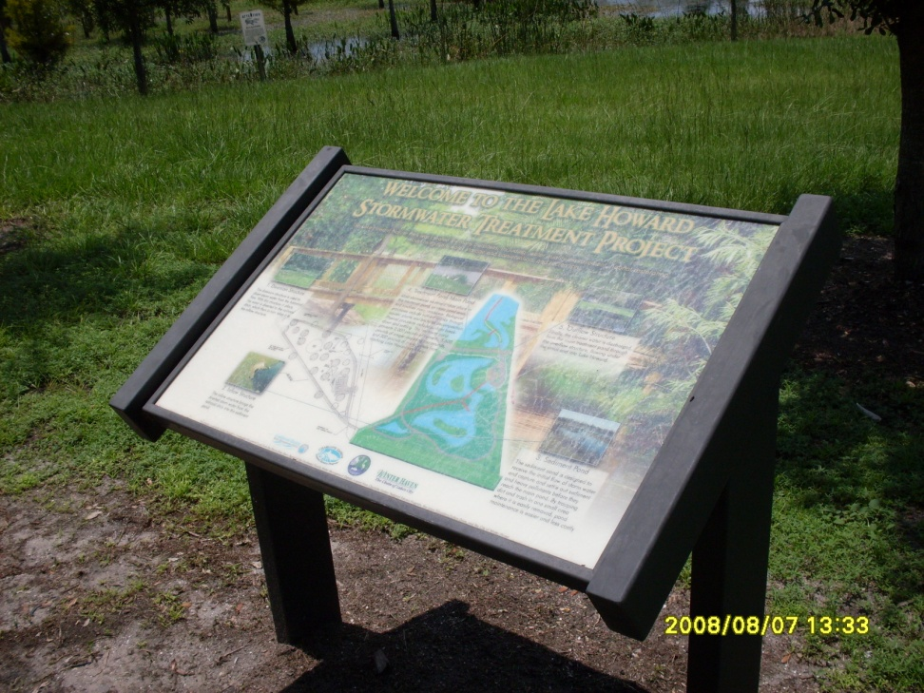
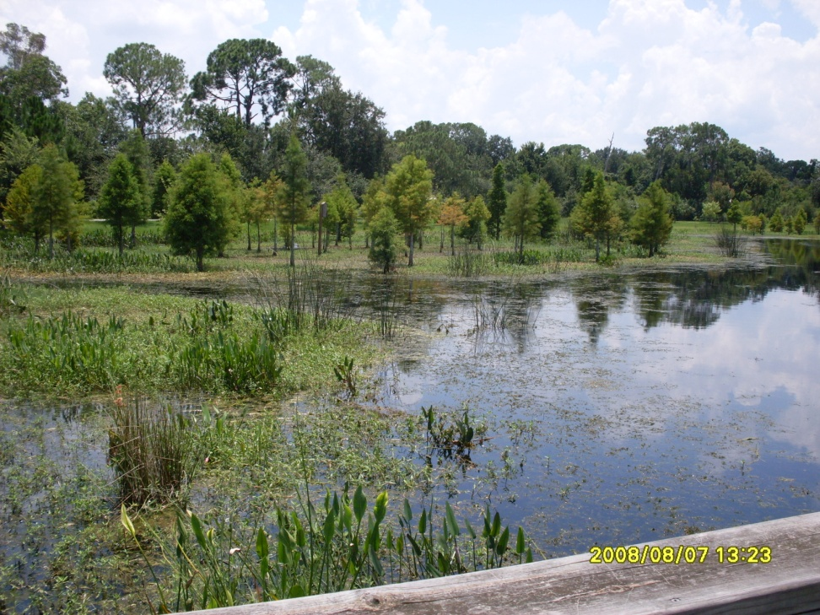
Lake Howard Stormwater Retrofit and Alum Injection
Alum Injection completed 2000
Stormwater Retrofit completed 2001

Slide 27
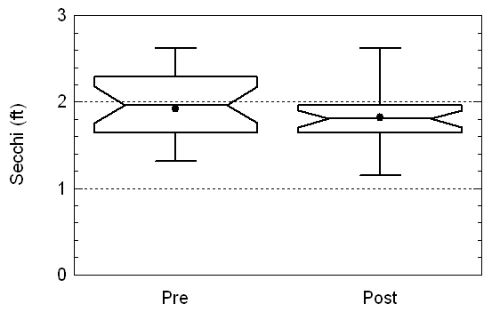
Reality Check- Lake Howard Secchi
Pre:1992-1999
Post: 2002-2009
p=0.43

Slide 28
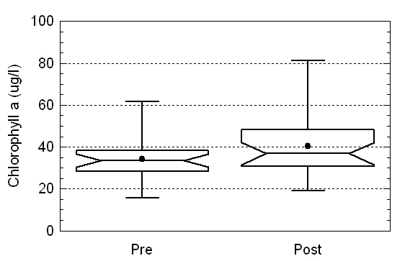
Reality Check- Lake Howard Chlorophyll a
p=0.13
TSI_{CHLA} 60 goal
Pre:1992-1999
Post: 2002-2009

Slide 29
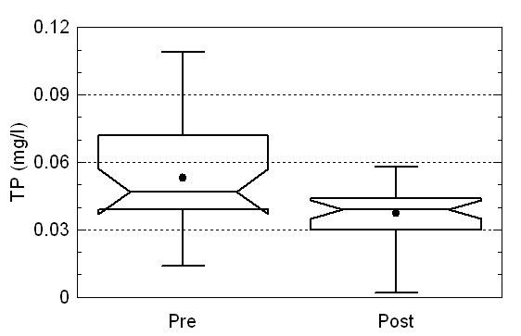
Reality Check- Lake Howard TP
p=0.013
TP target for TSI_{CHLA} 60 goal
Pre:1992-1999
Post: 2002-2009
(TSI_{TP} goal of 60 is
0.07 mg / liter)

Slide 30
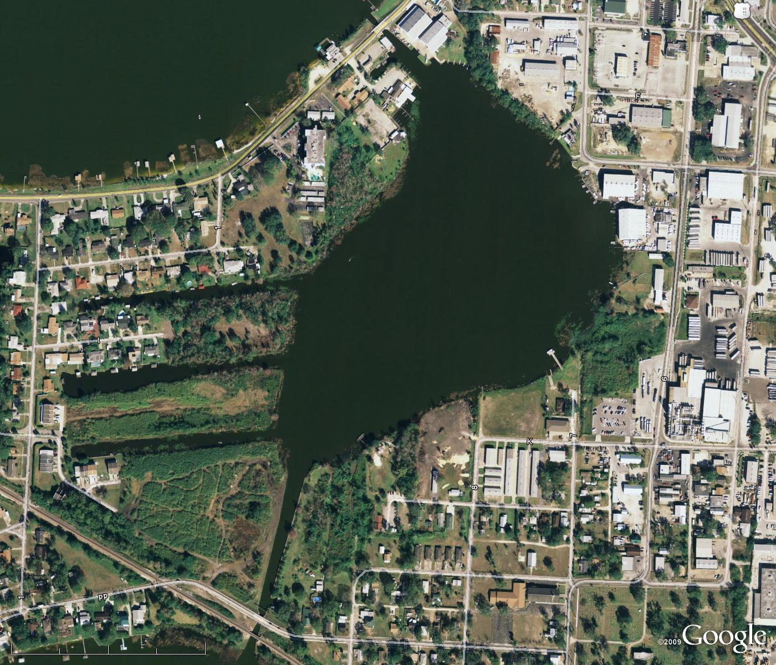
Lake May Stormwater Retrofit and Alum Injection
Completed 2005

Slide 31
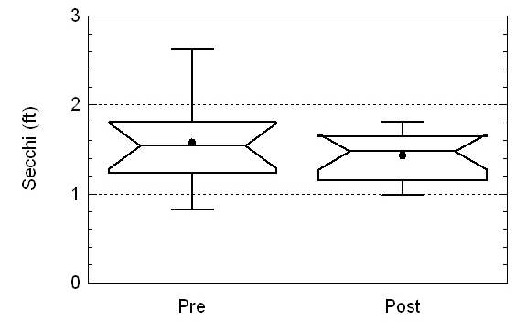
Reality Check- Lake May Secchi
Pre: 2001-2004
Post: 2006-2009
p=0.60

Slide 32
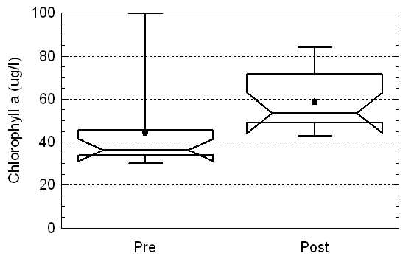
Reality Check- Lake May Chlorophyll a
TSI_{CHLA} 60 goal
Pre: 2001-2004
Post: 2006-2009
p=0.0037

Slide 33
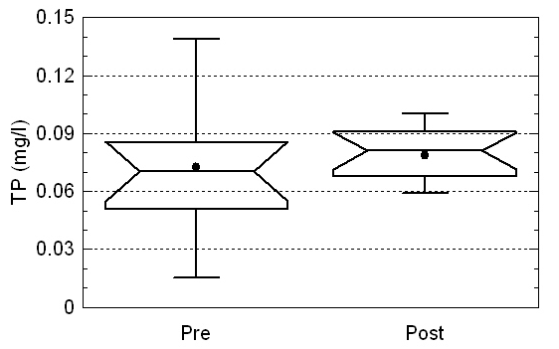
Reality Check- Lake May TP
TP target for TSI_{CHLA} 60 goal
Pre: 2001-2004
Post: 2006-2009
p=0.19

Slide 34
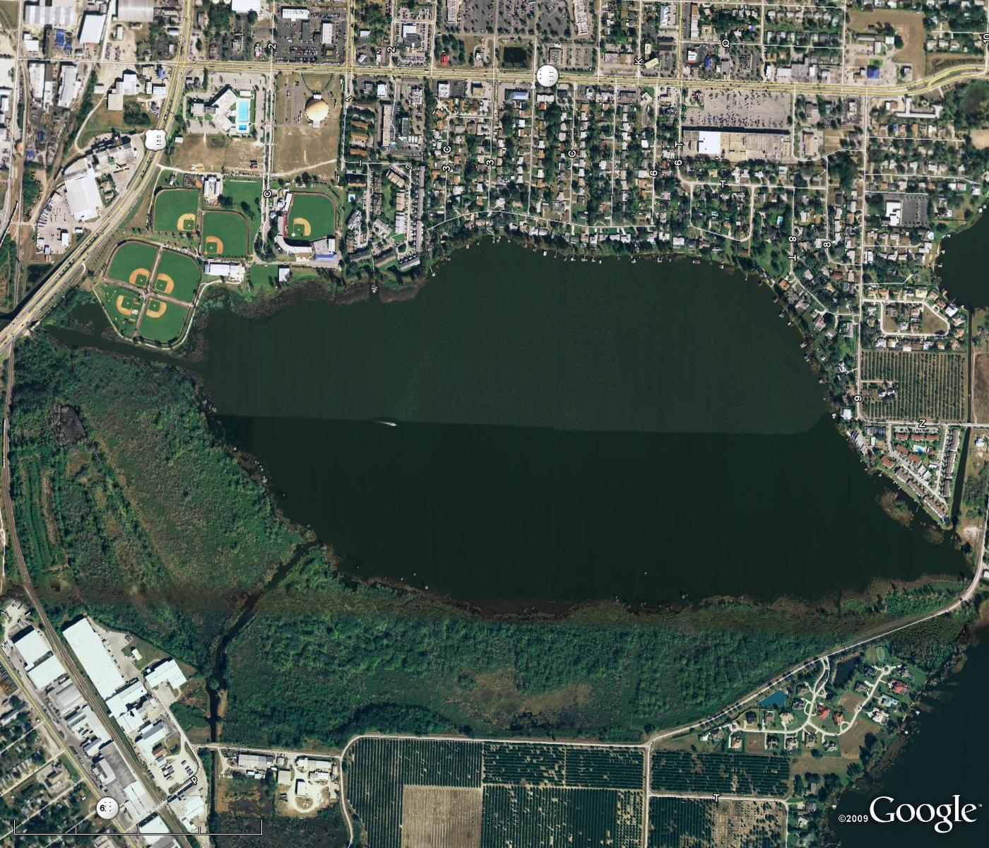
Lake Lulu Stormwater Retrofit and Alum Injection
Completed 2005

Slide 35
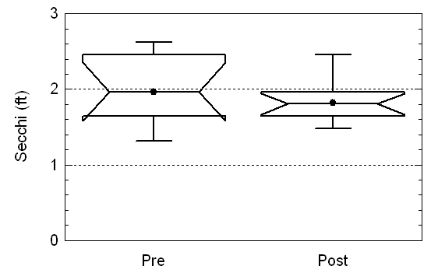
Reality Check- Lake Lulu Secchi
Pre: 2001-2004
Post: 2006-2009
p=0.40

Slide 36
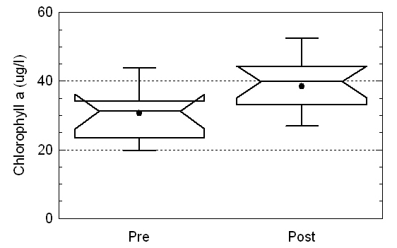
Reality Check- Lake Lulu Chlorophyll a
TSI_{CHLA} 60 goal
Pre: 2001-2004
Post: 2006-2009
p=0.023

Slide 37
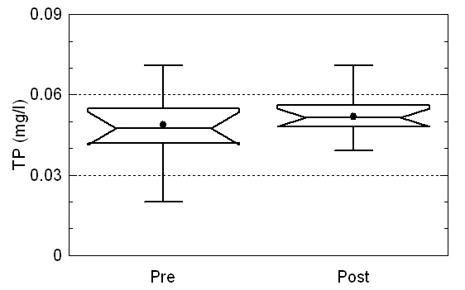
Reality Check- Lake Lulu TP
TP target for TSI_{CHLA} 60 goal
Pre: 2001-2004
Post: 2006-2009
p=0.38

Slide 38
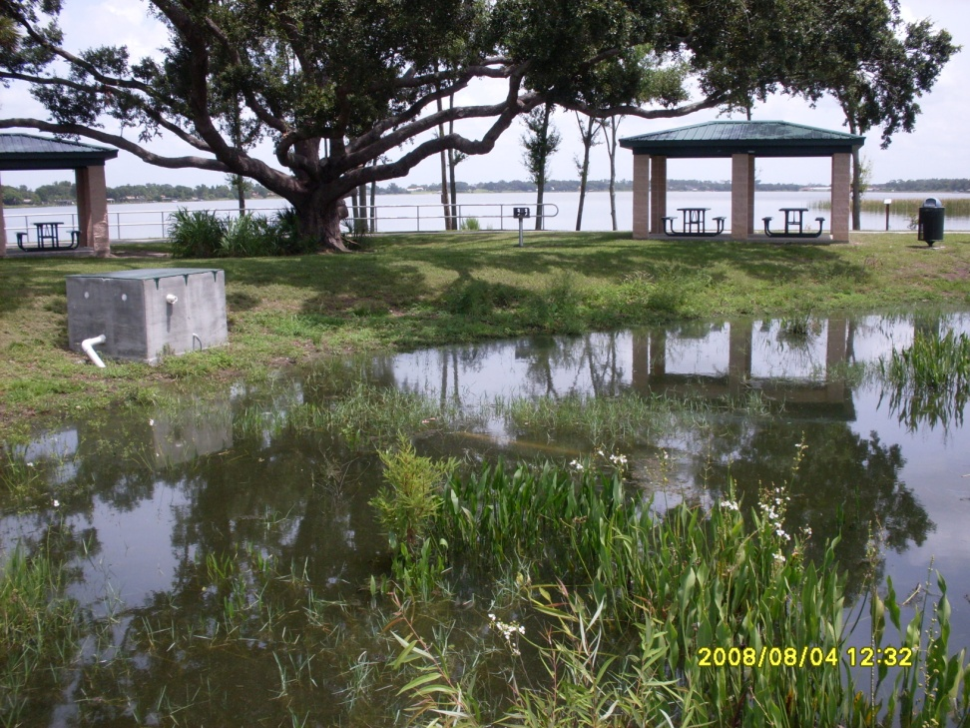
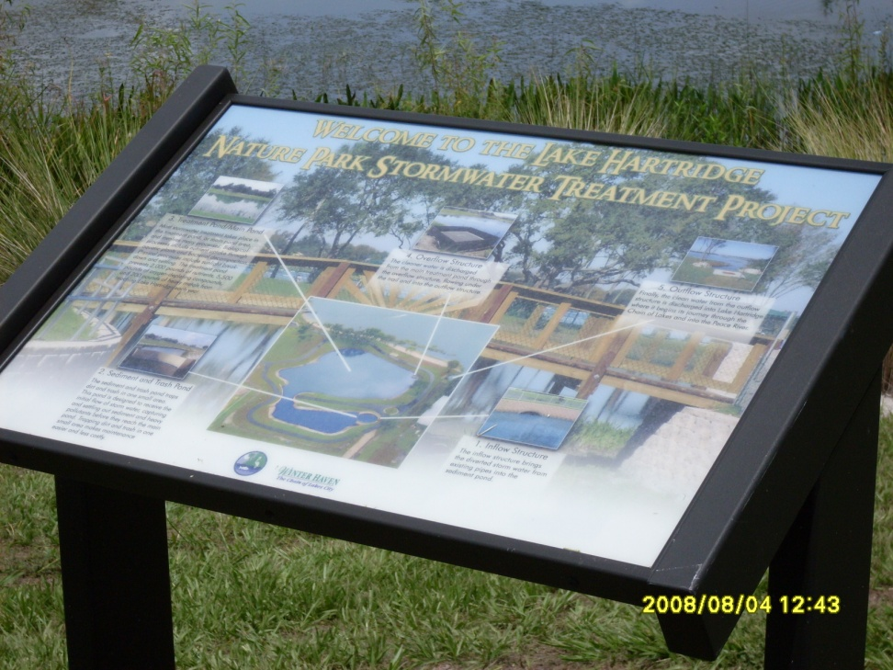
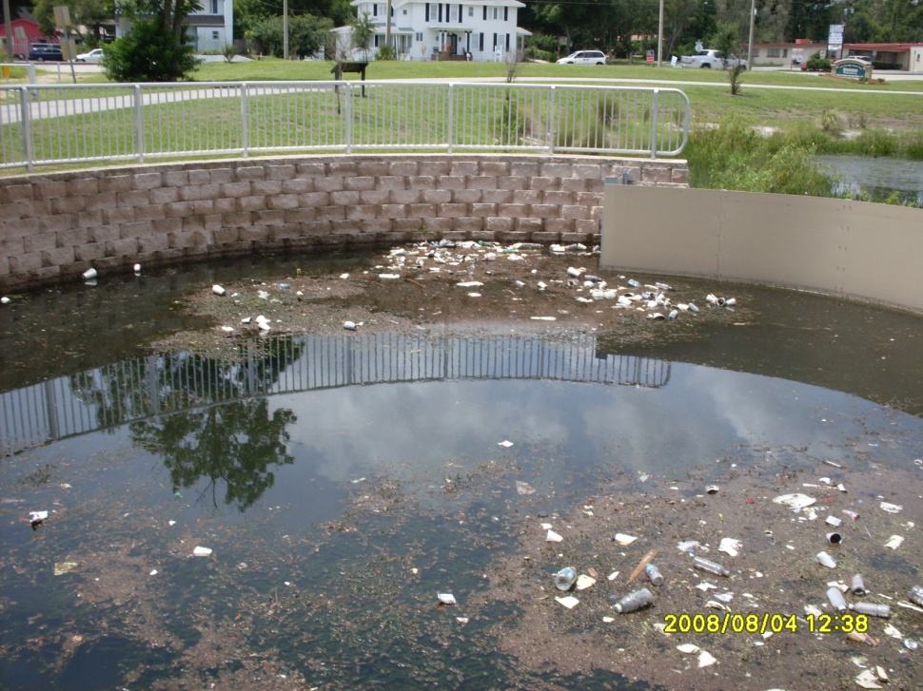
Lake Hartridge Stormwater Treatment Pond
Completed 2007
Results pending

Slide 39
Determination of most beneficial project types.
Farther back in time for many of them – use of “control” lakes to account for regional / climatic confounding factors

Slide 40
Whole Lake Alum Treatment
Lake Conine received alum treatment in 1995
Water quality improvements compared to reference lake (Lake Parker) which did not receive treatment
Median Secchi, Chlorophyll a, TN and TP concentrations compared Pre (1988-1994) and Post (1996-2009) treatment

Slide 41
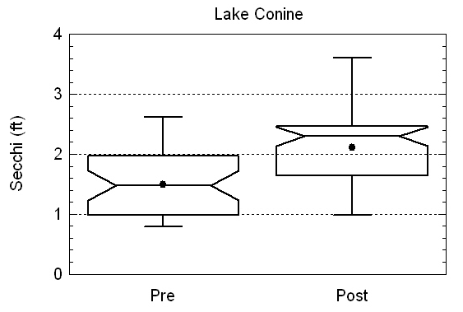
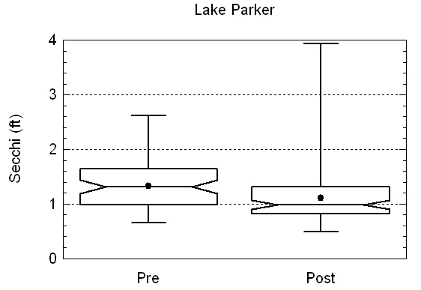
Lake Conine vs. Parker Secchi
p<0.00001
p=0.000039

Slide 42
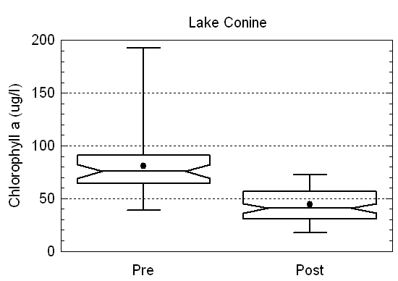
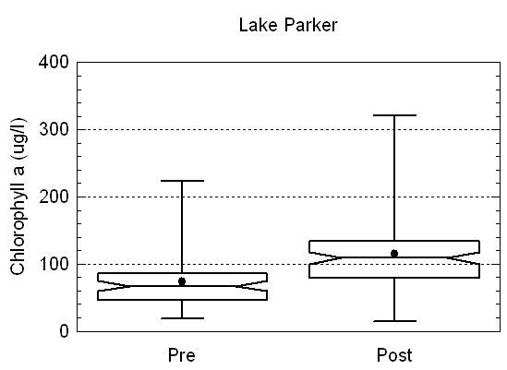
Lake Conine vs. Parker Chlorophyll a
p<0.00001
p<0.00001

Slide 43
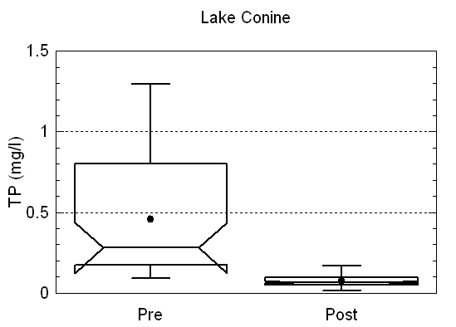
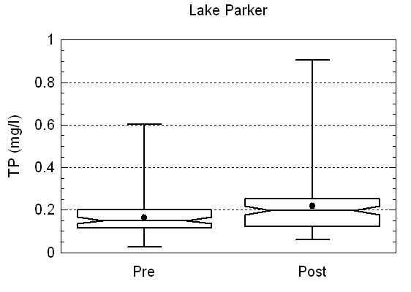
Lake Conine vs. Parker TP
p=0.0065
p<0.00001

Slide 44
Lake Dredging - Banana Lake
Banana Lake was dredged from August 1990 to August 1991
Water quality improvements compared to reference lake (Lake Parker) which did not receive treatment
Median Secchi, Chlorophyll a, TN and TP concentrations compared Pre (1985-1990) and Post (1992-2009) treatment

Slide 45
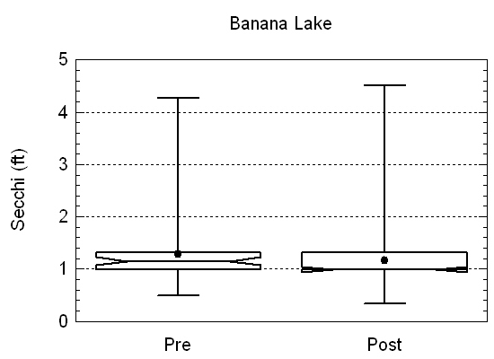
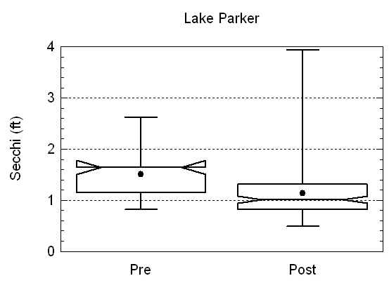
Banana Lake vs. Lake Parker Secchi
p=0.48
p=0.000012

Slide 46
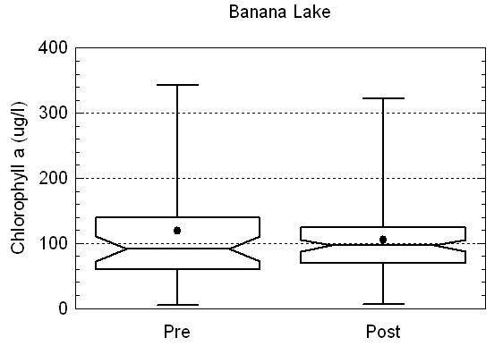
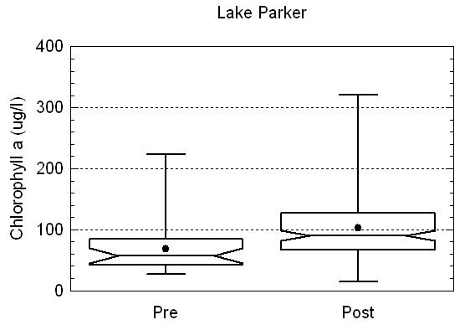
Banana Lake vs. Lake Parker Chlorophyll a
p=0.88
p=0.000057

Slide 47
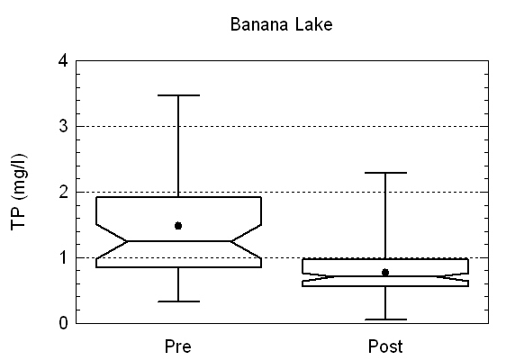
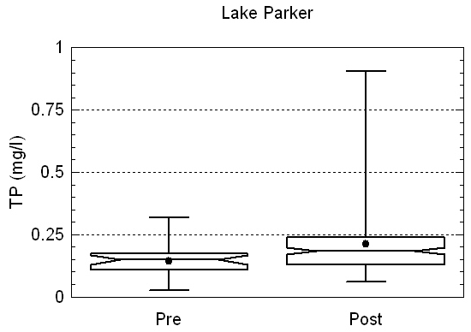
Banana Lake vs. Lake Parker TP
p=<0.0001
p=0.0028

Slide 48
Lake Dredging - Lake Maggiore
Lake Maggiore was dredged from October 2004 to October 2006
Water quality improvements compared to reference lake (Lake Seminole) which did not receive treatment
Median Secchi, Chlorophyll a, TN and TP concentrations compared Pre (1996-9/2004) and Post (11/2006-2009) treatment

Slide 49
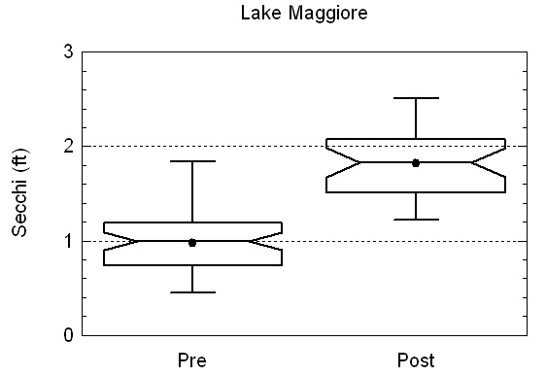
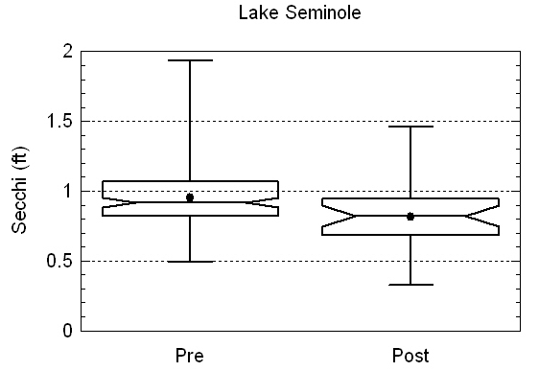
Lake Maggiore vs. Lake Seminole Secchi
p<0.00001
p=0.0079

Slide 50
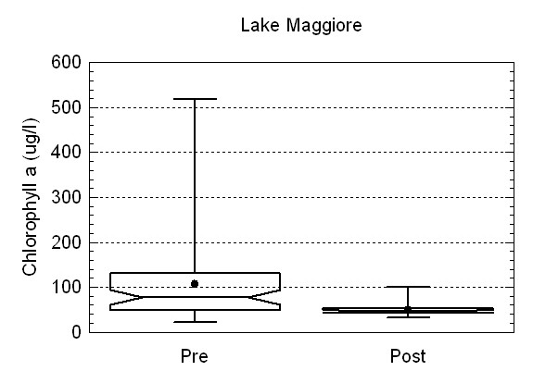
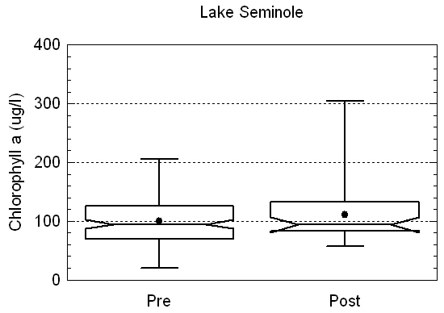
Lake Maggiore vs. Lake Seminole Chlorophyll a
p=0.00025
p=0.49

Slide 51
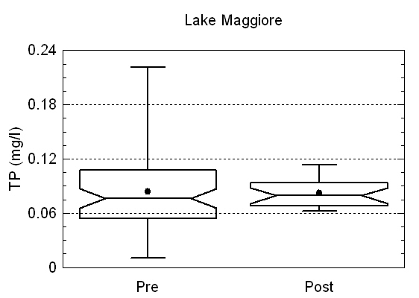
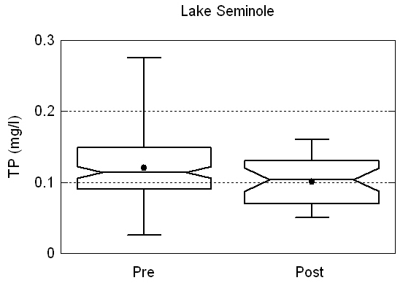
Lake Maggiore vs. Lake Seminole TP
p=0.73
p=0.04

Slide 52
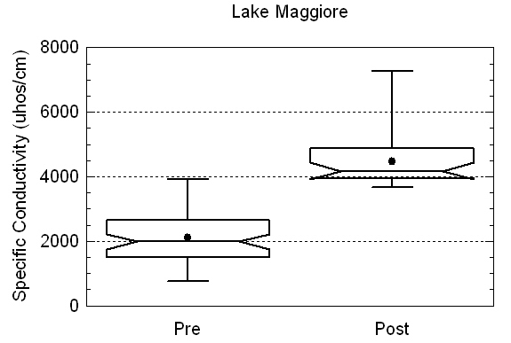
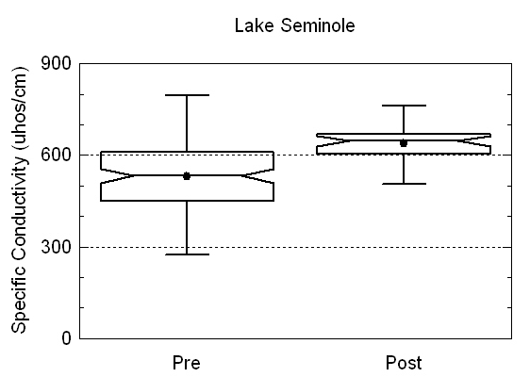
Lake Maggiore vs. Lake Seminole Specific Conductivity
ca. 2 ppt salinity
p<0.00001
p<0.00001

Slide 53
Lake Trafford
Dredged from November 2005- April 2006
Median Secchi, Chlorophyll a, TN and TP concentrations compared Pre (6/03-9/05) and Post (9/06-12/08) treatment

Slide 54
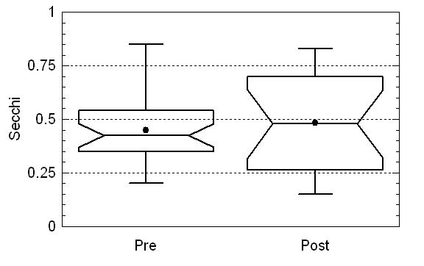
Lake Trafford Secchi
p=0.7

Slide 55
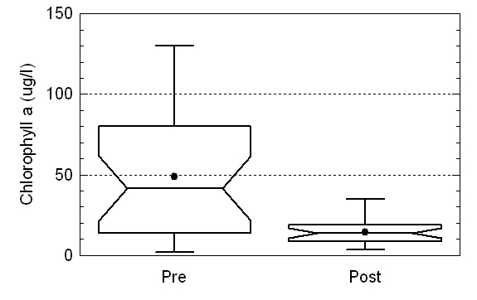
Lake Trafford Chlorophyll a
p=0.00055

Slide 56
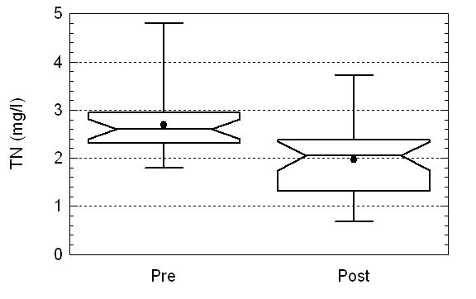
Lake Trafford TN
p=0.0003

Slide 57

Lake Trafford TP
p=0.986

Slide 58
Lake Dredging and Alum-
Lake Hollingsworth
Lake Hollingsworth was dredged from March 1997 to December 2000
Alum treatment was completed September 2003
Water quality improvements compared to reference lake (Lake Parker) which did not receive treatment
Median Secchi, Chlorophyll a, TN and TP concentrations compared Pre (1991-1996), Post Dredging (2001-8/2003) and Post (2004-2009) treatment

Slide 59


Lake Hollingsworth vs. Lake Parker Secchi
p<0.00001
p=0.49

Slide 60


Lake Hollingsworth vs. Lake Parker Chlorophyll a
p<0.00001
p=0.0016

Slide 61


Lake Hollingsworth vs. Lake Parker TP
(potential problem with data prior to 2005)
p<0.00001
p=0.53

Slide 62
What works?
Point source reductions: Haines & Conine
Stormwater retrofits / traditional TMDL approach?
  Howard, May and Lulu: no change in clarity or chlorophyll, even though all met TMDL load reduction goals
  TP levels still too high (above 0.029 mg / liter) as the cause?
  Under appreciated impacts from internal sources
Whole lake alum?
  Conine: strong evidence, and downstream benefit to Smart
  Hollingsworth: was dredging getting there anyway?
  Both with sediments as a “legacy” of permitted discharges
Sediment removal?
  Banana: no evidence of improvements in clarity or chlorophyll
    However, TSI and WQI both improved
  Hollingsworth: maybe more important than alum?
  Maggiore: unintended consequence of salinization?
  Trafford: decrease in Chl-a

Slide 63
Summation
Does WHCL have to default to 20 µg / liter Chl-a as a goal?
Can WHCL use locally-derived TN and TP targets – for whatever Chl-a target is used for management?
Will FDEP allow / fund non-traditional approaches to water quality improvement?
For Valley Lakes, tannins will be main focus of restoration projects – problem for FDEP?

Slide 64

TN and TP target development
TSI-Chl-a of 60 requires Chl-a of 20 µg / liter
Use TN and TP vs. Chl-a regressions to calculate target TN and TP values (0.93 and 0.029 mg/l, respectively)
Target TN and TP compared to 1997 to 2007 median values
Concentration reduction calculated
Since lower color (state wide median PCU of 50) need TN and TP 22 and 59 % lower than their respective TSI-60 values to get TSI-Chla values to 60

