Slide 1
Basin Action Management Plans
  Section 403.067, Florida Statutes (F.S.), aka Florida Watershed Restoration Act (FWRA).
  Allows FDEP to develop a BMAP for verified impaired waters with a TMDL
  BMAPs are developed to specifically address only the impairments stated in the TMDL

Slide 2
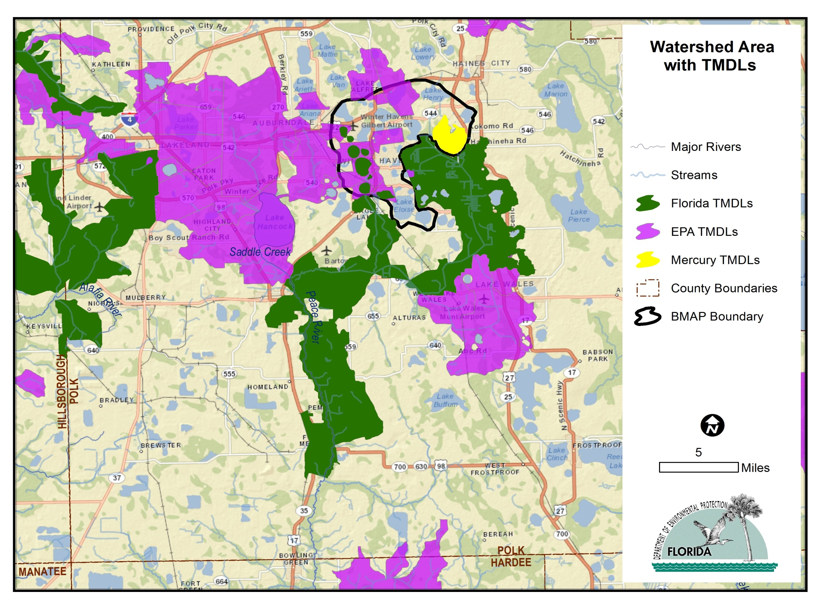

Slide 3
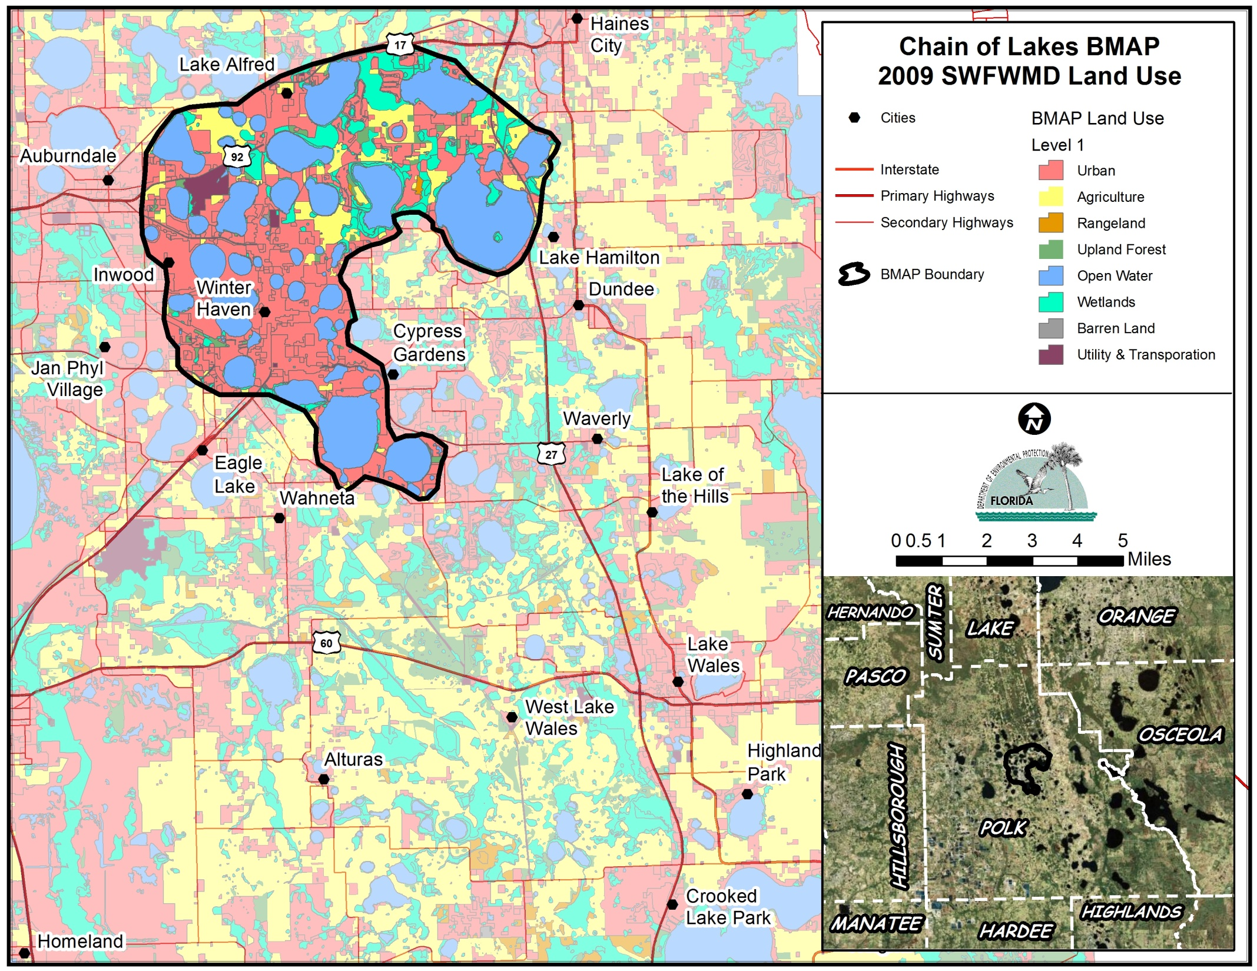

Slide 4
What’s in a BMAP?
  Refined source identification
  Detailed allocations by entity
  Restoration projects
  Monitoring (water quality & projects)
  Commitments: funding & implementation timelines

Slide 5
REMINDER
Handouts:
  403.067 F.S. requirements
  USEPA Watershed Management Plan Guidance
Questions?

