Slide 1
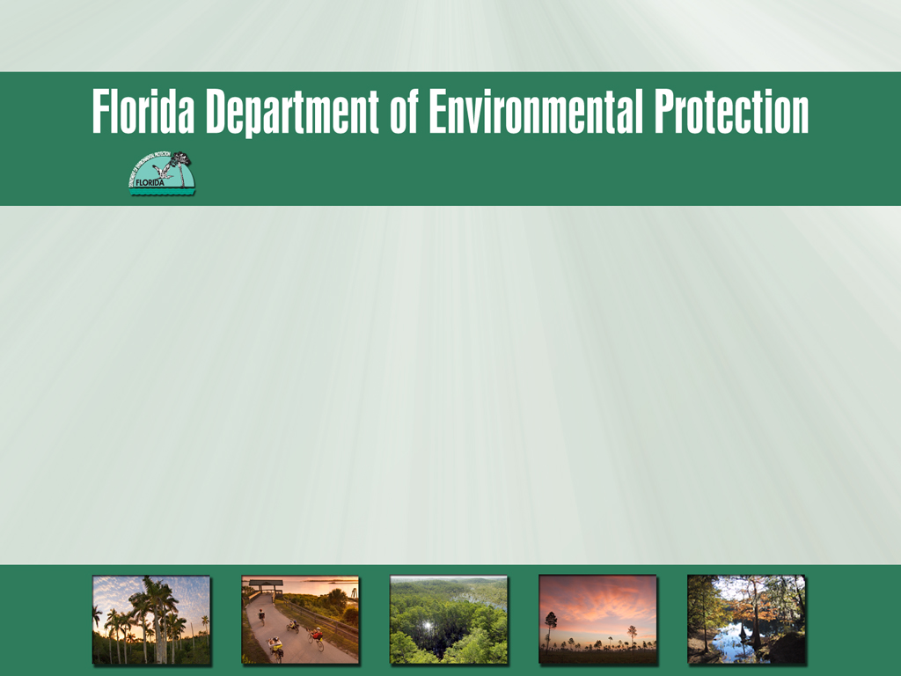
Upper Wakulla River and Wakulla Springs Draft BMAP and Review Schedule
August 21, 2014

Slide 2
Agenda
Overview of BMAP Revisions Since Previous Draft.
Review of Draft BMAP Sections.
BMAP Review Schedule.

Slide 3
Overview of BMAP Revisions Since Previous Draft

Slide 4
Revisions to OSTDS Initiative

Slide 5
On-Site Treatment and Disposal Systems (OSTDS) Initiative
Within 3 months of BMAP adoption:
  Technical meetings will be initiated;
  Purpose to identify, schedule, and implement OSTDS management strategies.
  Prioritize areas where septic tanks pose the greatest risk to water quality.
Notes:
Within three months from BMAP adoption, the Department shall conduct an initial technical meeting to present the methodology and Geographic Information Systems (GIS) data to prioritize areas where septic tanks pose the greatest risk.

Slide 6
OSTDS Initiative, continued
Identify effective, financially feasible strategies reduce OSTDS N loading.
Develop projects to reduce OSTDS contribution:
  Department of Environmental Protection.
  Florida Department of Health.
  City of Tallahassee.
  Leon County.
  Wakulla County.
  Other Parties.
Notes:
The objective of the OSTDS Initiative is to identify effective, financially feasible strategies to reduce nutrient loads from OSTDS sources.
During the first BMAP iteration, the Department, along with FDOH, the City of Tallahassee, Leon County, Wakulla County, and other parties will continue to develop nitrogen reducing projects that focus on OSTDS sources.

Slide 7
OSTDS Initiative, continued
Technical meetings objective to develop elements for inclusion in OSTDS load reduction plan.
Within 3 years BMAP adoption, the Department will develop and implement an OSTDS Plan for OSTDS load reductions.
Notes:
Priority area maps will identify affected local government jurisdictions.

Slide 8
OSTDS Initiative, continued
The OSTDS plan will:
  Provide maps of the priority areas.
  Identify wastewater treatment and collection facilities.
  Consider financial needs of providers and homeowners.
  Analyze opportunities to connect existing sewer.
  Refine the inventory and geographic distribution of septic tanks.
  Identify the nutrient reductions from septic tanks which remain necessary to achieve the TMDL.
Notes:
Priority area maps will identify affected local government jurisdictions.

Slide 9
OSTDS Initiative, continued
Stakeholders will submit additional projects and management strategies to address septic tank loads.
Special emphasis will be placed on projects:
  In process.
  Shovel-ready.
  Within priority geographical areas.
Notes:
Projects and management strategies, including implementation schedules, will be submitted within 3 years of BMAP adoption.

Slide 10
Revisions to WWTF Requirements –Reasonable Assurance Demonstration

Slide 11
WWTF Treatment Requirements
New standards for WWTFs within PFA1:
  100,000 gallons per day (gpd) or greater = final effluent annual average TN of no more than 3.0 mg/L.
  Less than 100,000 to 20,000 gpd = TN of 6.0 mg/L.
  Less than 20,000 gpd = TN of 10.0 mg/L.
--or--
Reasonable assurance the discharge is protective of the 0.35 mg/L nitrate target.
Notes:
WWTF standards apply to new and existing facilities.
100,000+: Applies to Winco Utilities WWTF.
LT 100,000 – 20,000: Applies to DISC Village WWTF and Lake Bradford Estates WWTF.
LT 20,000: Applies to Woodville Elementary School WWTF.

Slide 12
Wastewater Sufficiency, continued
If pursued, the reasonable assurance demonstration is due with the permit application or renewal.
The demonstration shall be based on:
  Monitoring data from ground water well(s).
  Site-specific information.
  Demonstrate a reasonable assurance discharge is protective of water quality with respect to 0.35 mg/L nitrate target in Floridan aquifer.
Notes:
For reasonable assurance, sampling will be based on a Department approved monitoring plan, showing the annual median value (a minimum of four quarterly samples) for nitrate to be less than or equal to 0.35 mg/L at each well.

Slide 13

Comments and Questions on Revisions

Slide 14
Review of Draft BMAP Sections

Slide 15
Chapter 1: Context, Purpose, and Scope of the Plan

Slide 16
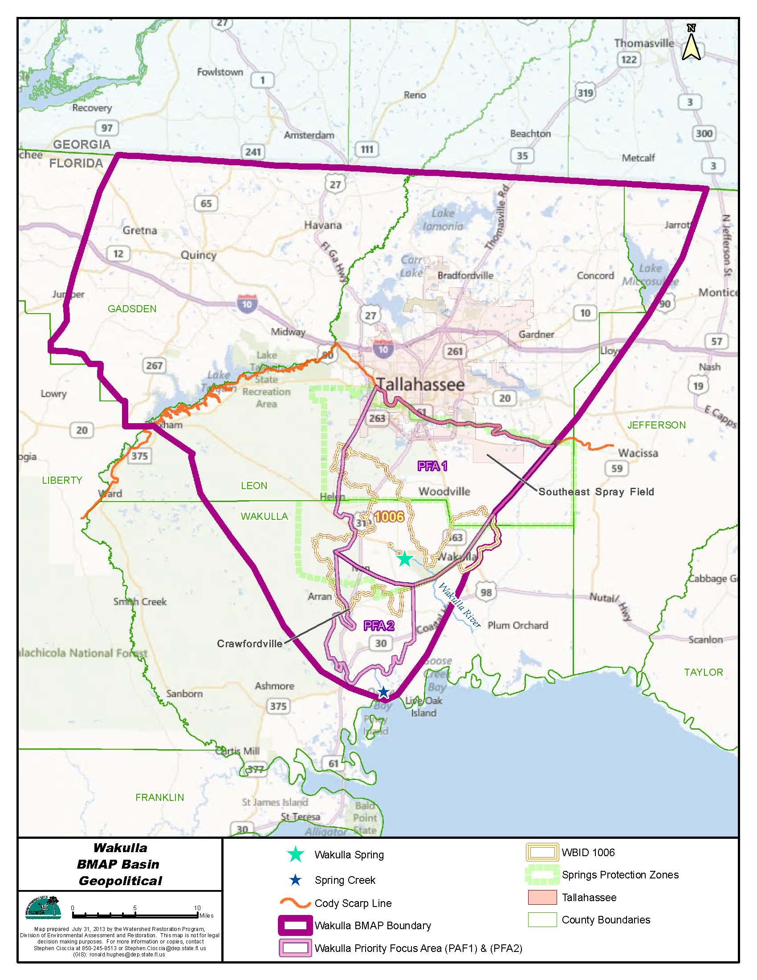
BMAP Basin
Approximately 848,445 acres.
Includes two Priority Focus Areas (PFAs):
  PFA 1.
  PFA 2.
Notes:
PFAs represent the areas where the aquifer is most vulnerable and there is a known connectivity with Wakulla Springs.

Slide 17
BMAP Approach
A sufficiency of effort evaluation rather than detailed allocations was used for the first BMAP.
The strategies from the stakeholders were compared to the sources within each PFA.
Additional details and strategies from the responsible stakeholders we collected to ensure sufficiency for the first 5-year period.
More work is needed on OSTDS sources.
Notes:
Sufficiency of effort was used given the progress in load reductions made to date and the need for further monitoring to determine to what extent additional reductions are needed.
The OSTDS Initiative is to define and promote the additional work needed on OSTDS sources.

Slide 18
OSTDS Initiative
The OSTDS Initiative was reviewed earlier in the presentation.

Slide 19
Assumptions
The following assumptions were used in the BMAP process:
  Nitrate reductions will result in improved biological communities.
  The greatest source of nitrate loading to the river is Wakulla Springs.
  The TMDL did not include the adjacent Wakulla Springs vent area and, therefore, these waters are not applicable for determining achievement of the targets.
  The BMAP focuses during first phase on reductions and management strategies within the two PFAs.
Notes:
The Wakulla Springs vent area is WBID1006X.

Slide 20
Considerations
Items were identified that could be addressed in future BMAPs:
  Water quality standards.
  Basin boundary.
  Georgia sources.
  OSTDS.
  Authority to address OSTDS.
  Lake swallets.
  Management strategy implementation.
  Increases in wastewater volume in the PFAs.

Slide 21
Future Growth
Florida Statutes require BMAPs to:
  “…identify the mechanisms by which potential future increases in pollutant loading will be addressed.”
The BMAP relies on strategies that minimize loading from future sources.
Leon County, Wakulla County, and City of Tallahassee have multiple measures in place to help control loading from future growth.
Notes:
Section 403.067(7)(a)(2), F.S., requires BMAPs to:
“…identify the mechanisms by which potential future increases in pollutant loading will be addressed.”

Slide 22
Chapter 2: Upper Wakulla River and Wakulla Springs Basin Setting

Slide 23
Land Uses
2009 land cover:
  Natural lands (84.1%).
  Urban and built-up (9.1%).
  Agriculture (6.7%).
Level 1 Land Cover Code | Land Cover Description | Acres | % Total
1000 | Urban and Built-Up | 66,045.7 | 7.8%
2000 | Agriculture | 57,105.6 | 6.7%
3000 | Upland Nonforested | 51,270.2 | 6.0%
4000 | Upland Forests | 449,521.9 | 53.0%
5000 | Water | 19,838.5 | 2.3%
6000 | Wetlands | 193,613.0 | 22.8%
7000 | Barren Land | 806.5 | 0.1%
8000 | Transportation, Communication, and Utilities | 10,255.2 | 1.2%
Total | Total | 848,456.6 | 100.0%

Slide 24
Water Quality Trends
Comparing the water quality data:
  For TMDL verified period (2000-2007).
  Using more recent data (2008-2012).
  Conclusion--Nitrate concentrations at the vent are declining.
The B-, C-, D-, and K-Tunnels show mean nitrate + nitrite concentrations above the target concentration (0.35 mg/L).
Notes:
The B-, C-, and D-Tunnels are the major contributors, and bring contributing flows from the SESF and Ames Sink.
The highest mean nitrate concentration is in B-Tunnel.

Slide 25
Biological Trends
Stream condition index (SCI) evaluations:
  2004: “Very poor.”
  2007: “Poor.”
April 2012: A rapid periphyton survey (RPS) found visible filamentous algae.

Slide 26
Chapter 3: Pollutant Sources and Anticipated Outcomes

Slide 27
WWTFs
November 2012: Tallahassee’s facility upgraded to meet advanced waste treatment (AWT) standards.
There are four, smaller WWTFs in PFA1:
  Woodville Elementary School, DISC Village, Winco Utilities, and Lake Bradford Estates.
The WWTF BMAP requirements are enforceable.
Notes:
The City of Tallahassee’s T.P. Smith Water Reclamation Facility and spray field were upgraded.
The BMAP requirements are enforceable through each facility’s permit.

Slide 28
OSTDS
Nitrate contributions from OSTDS to ground water are significant.
Based on the 2009 OSTDS coverage:
  ~3,867 septic tanks in PFA1.
  ~1,802 septic tanks in PFA2.
This source will be further addressed through the OSTDS Initiative.
Notes:
2009 OSTDS coverage is from FDOH.

Slide 29
Fertilizer and Livestock
Residential fertilizer contributes ~7% of the nitrate loading.
Local fertilizer ordinances:
  Leon County
  Wakulla County
  City of Tallahassee.
Agriculture makes up ~4% of the acreage within the PFAs.
  Mostly pasture and rangeland.
Agricultural producers: Best management practices (BMPs) or water quality monitoring are required.
Notes:
Agricultural extent is based on the 2009 land cover.

Slide 30
Stormwater – Municipal Separate Storm Sewer Systems (MS4s)
The Phase I MS4s are:
  Leon County.
  Florida Department of Transportation District 3.
  City of Tallahassee.
The Phase II MS4s (all outside the PFAs) are:
  Florida State University (FSU).
  Florida Agricultural and Mechanical University (FAMU).
  Federal Correctional Institution, Tallahassee.
Phase I and II permits include a self-implementing clause for BMAP responsibilities.

Slide 31
Stormwater – Nonpoint Sources
Nonpoint sources (all outside the PFAs) are:
  Gadsden County.
  Jefferson County.
  Wakulla County.
  City of Gretna.
  City of Midway.
  City of Quincy.
  Tallahassee Community College (TCC).
  Town of Havana.
The strategies for nonpoint sources are enforceable through the BMAP itself.

Slide 32
Chapter 4: Management Strategies within the PFAs

Slide 33
Sufficiency of Effort Evaluation
Stakeholders in the PFAs provided management strategies:
  Implemented since January 1, 2004; and
  Planned to occur during the first five-year implementation period.
Reasonable assurance that each entity has a plan to reduce nitrate concentrations.
Notes:
The management strategies provided the reasonable assurance for each entity’s plan.

Slide 34
Wastewater Sufficiency
WWTF sufficiency:
  The largest WWTF source has been addressed.
  New treatment requirements PFA1:
    Existing facilities; and
    Future facilities.
  Improvements to the sewer collection systems.
Notes:
Based on all of these management strategies, the Department determined that these strategies sufficiently address nitrate loading from the WWTFs within the PFAs for the first 5-year period.

Slide 35
Sufficiency, continued
OSTDS sufficiency:
  Current adopted and planned measures; and
  Future actions resulting from the OSTDS Initiative.
Residential fertilizer sufficiency:
  Strategies in place to reduce/remove fertilizer use.
Notes:
With the implementation of the OSTDS Initiative, OSTDS sources will be sufficiently addressed for the first iteration of the BMAP. Depending on water quality trends, additional efforts may be needed in future BMAP iterations to address OSTDS.

Slide 36
Sufficiency, continued
Agricultural fertilizer and livestock sufficiency:
  Agricultural fertilizer use has been reduced.
  All (100%) of growers are required to implement BMPs or monitor water quality.
  Florida Department of Agriculture and Consumer Services (FDACS):
    Goal--Notices of intent for BMPs on 90% of the agricultural acres.
Stormwater sufficiency
  The completed and planned strategies will sufficiently address stormwater nitrate loading.

Slide 37
Sufficiency, continued
Other strategies:
  The stakeholders also provided studies, protection measures, and source control efforts that will help improve water quality.
The BMAP includes management strategies tables for each entity in the PFAs.

Slide 38
Chapter 5: Management Strategies Outside of the PFAs

Slide 39
Strategies Outside the PFAs
The BMAP includes management strategies tables for each entity outside of the PFAs.
Notes:
Strategies are also being implemented or are planned for outside of the PFAs. These strategies will help to reduce the nitrate loading to the Upper Wakulla River and Wakulla Springs.

Slide 40
Chapter 6: Assessing Progress and Making Changes

Slide 41
Tracking Implementation
The monitoring data will be organized.
Project implementation will be tracked.
Annual progress reports will be completed.
The stakeholders will meet at least annually to review progress and plan implementation.
Notes:
The annual meetings are in addition to the OSTDS initiative meetings and efforts.

Slide 42
Water Quality and Flow Monitoring
Locations where water quality samples will be collected:
  The spring vent;
  Major conduits (B-, C-, D-, AD-, K-, and AK-tunnels);
  Recreation area boat dock; and
  The upper bridge.
Flow data will also be collected at the major conduits and Spring Creek.

Slide 43
Biological Monitoring
Biological data will be collected at two locations using:
  Rapid periphyton survey (RPS).
  Linear vegetation survey (LVS)
  Stream condition index (SCI).
  Habitat assessment (HA).

Slide 44
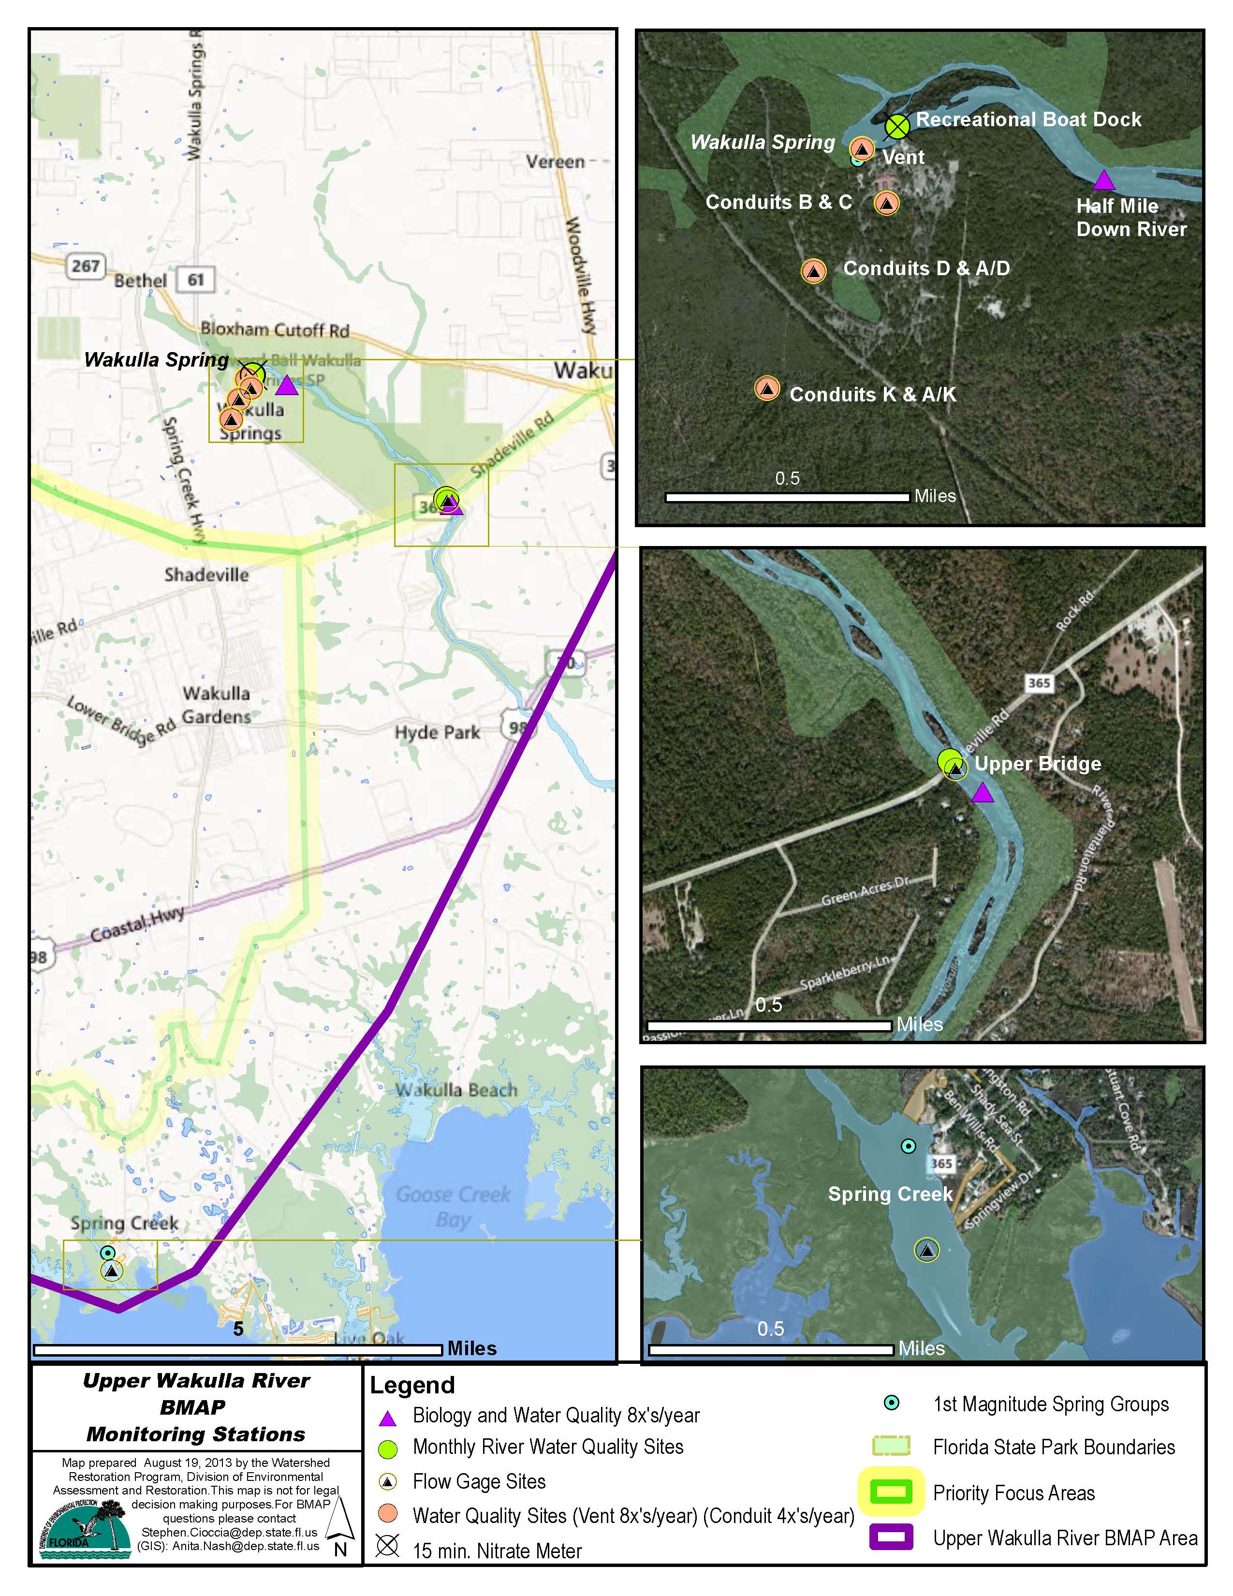

Slide 45
Research Studies
The BMAP includes the list of research items generated during BMAP development.
Notes:
During the BMAP process, the stakeholders identified several research items they would like to pursue, if funding becomes available.

Slide 46
Appendices

Slide 47
Appendices
Appendix A: TMDL Basin Rotation Schedule.
Appendix B: The Upper Wakulla River TMDL.
Appendix C: City of Tallahassee Stormwater Treatment Projects.
Appendix D: Potential Funding Sources.
Appendix E: Bibliography of Key References and Websites.

Slide 48
Comments and Questions on the BMAP

Slide 49
BMAP Review Schedule

Slide 50
BMAP Review Process
Action | Involved Parties | Date
Revised Draft BMAP for stakeholder and public review | Department | Sent – August 14, 2014
Public workshop on the BMAP | Department and Public | Today – August 21, 2014
Public comment period closes (30 days from BMAP sent to stakeholders and public) | Department | September 15, 2014
Action | Date
Brief Department management on BMAP | Early-October 2014
Brief Department Deputy Secretary on BMAP | Mid-October 2014
Brief Department Secretary on BMAP and obtain Secretarial approval | Mid-October 2014
Notify interested parties and place Florida Administrative Register (FAR) notice | Mid-October 2014
End of challenge period (21-days after notice) | Mid-November 2014
BMAP adopted and enforceable (if there are no challenges) | Mid-November 2014
Notes:
Schedule depends on availability of Secretary and FDEP upper management for briefings.

Slide 51
Questions on the Review Schedule

